Slide 1
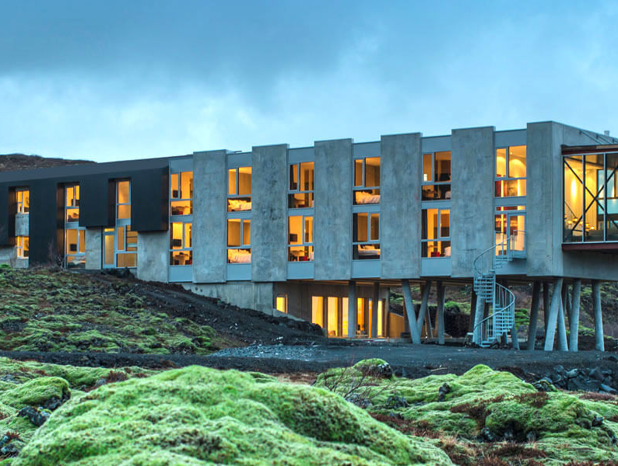
Mentoring Clinics Across Europe
Insights
Photo Credit: Sci Fi Ion Hotel, Iceland
www.epicstays.eu

Slide 2
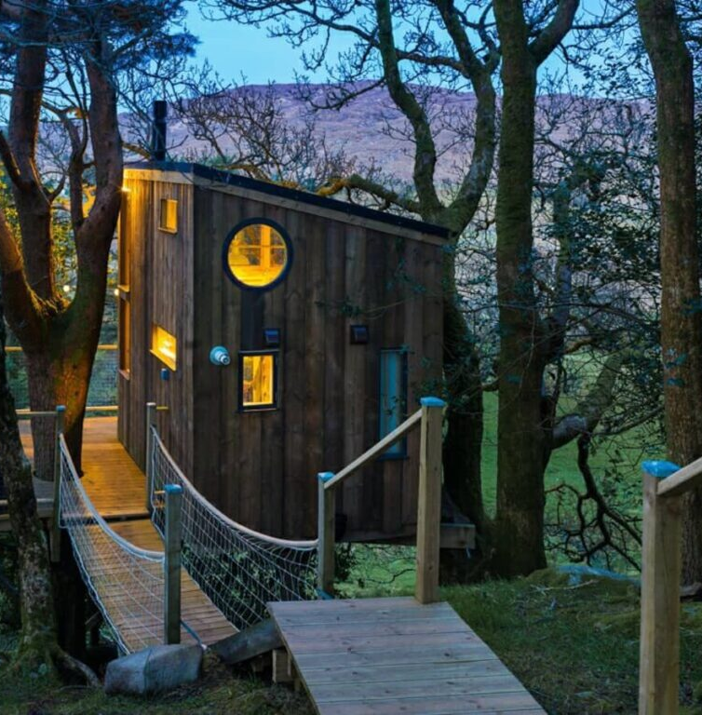
Cross-Country Patterns & Shared Learning
Despite contextual differences, several common themes emerged across all partner countries:
Experience Over Accommodation: Successful alternative stays sell identity, emotion, and story — not just beds.
Financial Clarity Is Critical: Many SMEs underestimate full costs. Mentoring improves viability awareness.
Structured Discussion Accelerates Action: The 4-part clinic format consistently led to concrete next steps.
Peer Learning Is Powerful: Entrepreneurs benefit significantly from hearing real challenges from others.
Sustainability Must Be Operational: Across all countries, sustainability must move beyond marketing into measurable practice.
Photo Credit: The Birdbox, Donegal Treehouse, Ireland

Slide 3
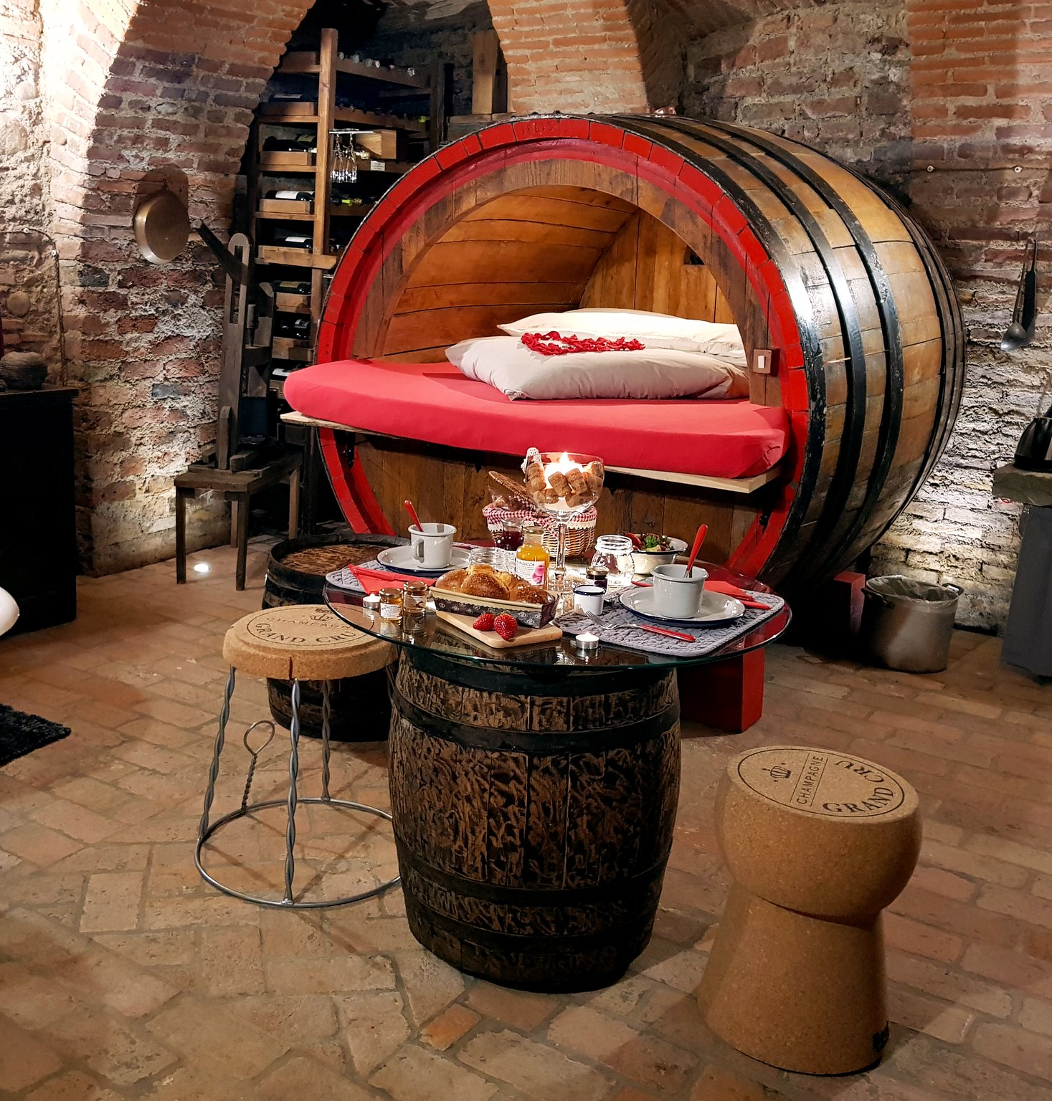
Why This Matters
The diversity of contexts — from Iceland’s dramatic landscapes to Italy’s historic buildings, the Netherlands’ structured markets, Slovenia’s green branding, and Ireland’s rural innovation — proves that the EPIC STAYS mentoring model works across tourism ecosystems.
The consistency lies in the structure.
The adaptability lies in the content.
The impact lies in the action.
“No matter the country, the turning point was the same — when accommodation stopped being the focus and experience became the product.”
Photo Credit: Cantina Al Silter, Italy

Slide 4
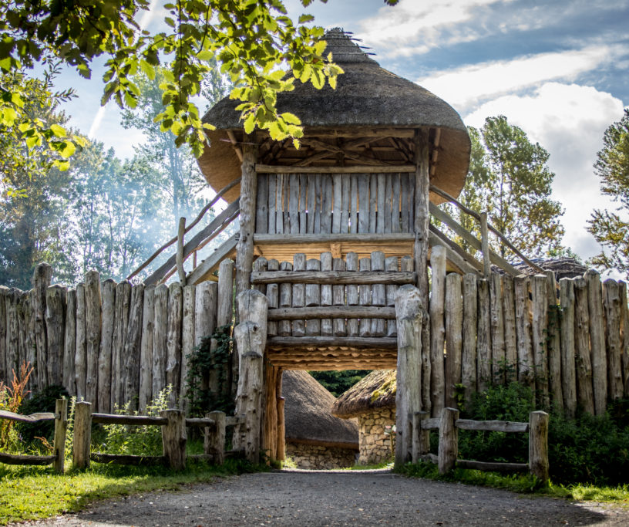
“The structure gave us clarity, but the conversations gave us courage.”
“It wasn’t just theory. Every session forced us to decide what we were actually going to do next.”
“The mentoring format worked because it balanced inspiration with accountability.”
Some of the European Wide Participants Feedback!
Photo Credit: Viking House and Settlement, Wexford, Ireland

Slide 5
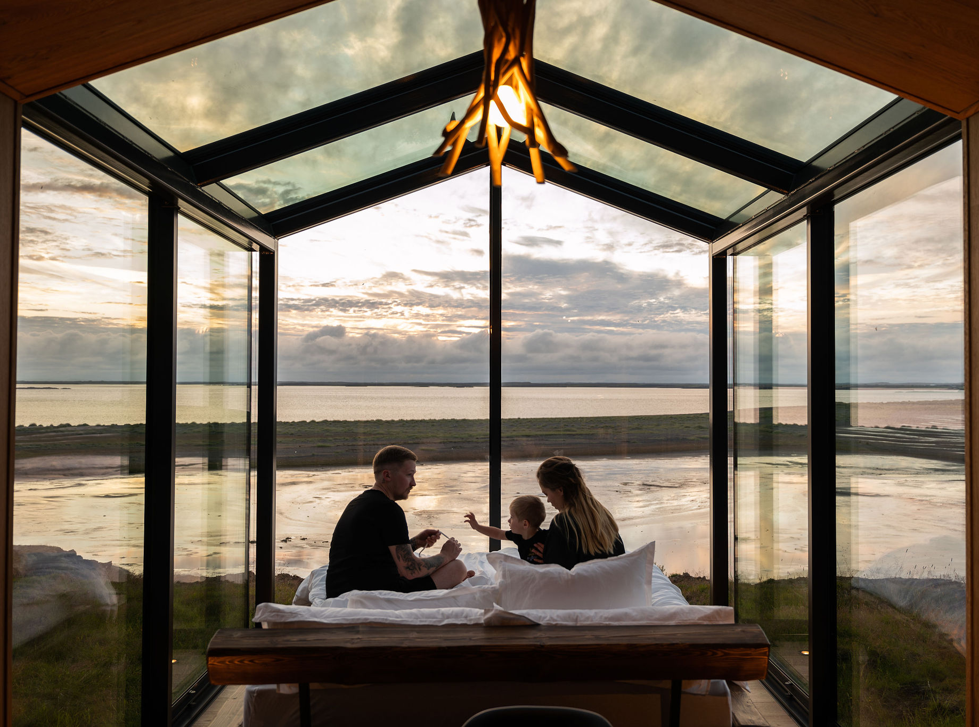

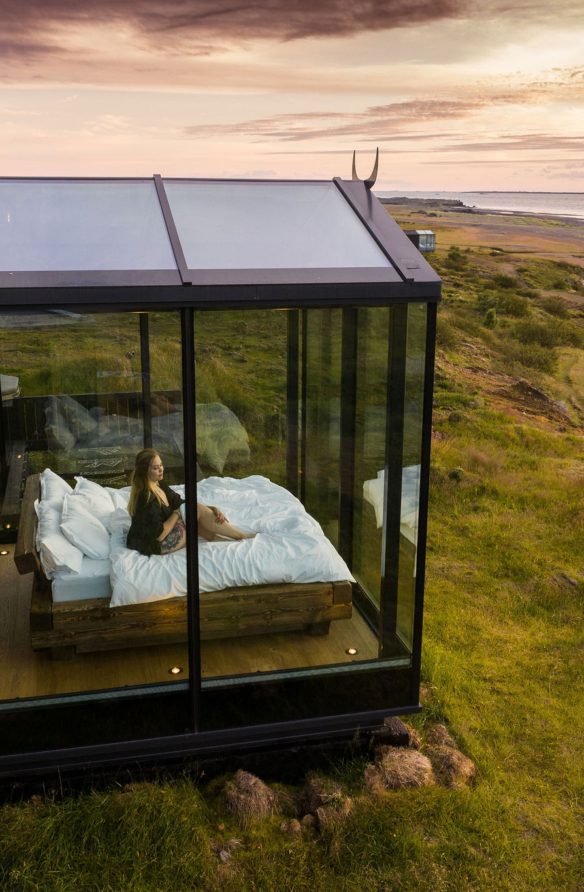
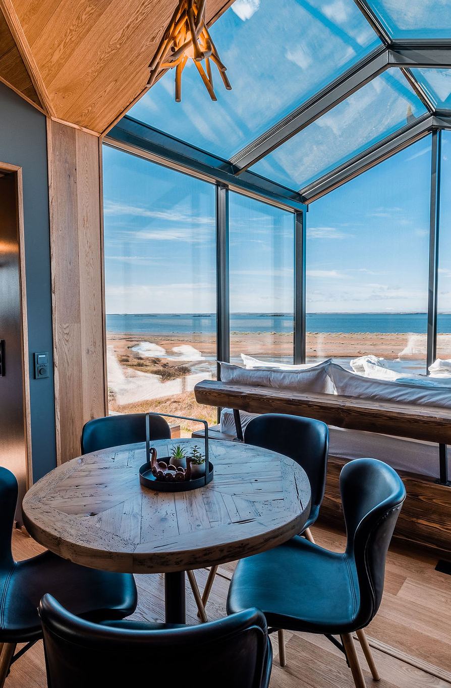
ICELAND
Photo Credit: Panoramic Glass Lodge, Iceland

Slide 6
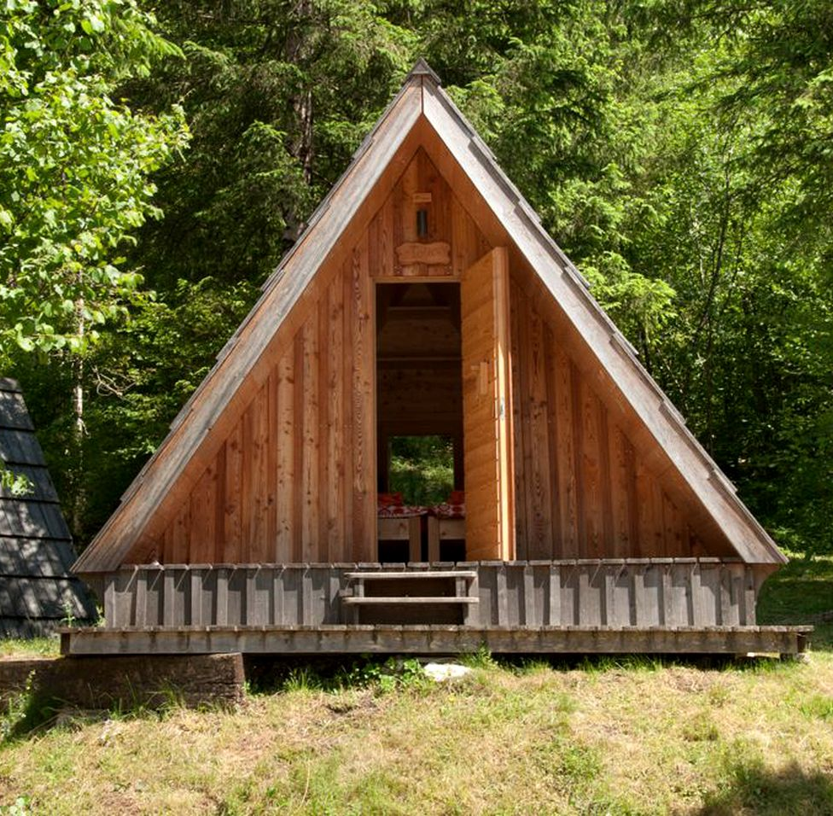
Iceland
Context
Iceland operates within a highly nature-led tourism market, with strong international visitor flows but increasing pressure around sustainability, seasonality, and differentiation.
Mentoring Clinics Insights
Mentoring Focus
Icelandic mentoring clinics placed particular emphasis on:
Moving from “scenery as product” to story-driven experience design
Strengthening emotional positioning beyond landscape photography
Managing seasonality and pricing fluctuations
Integrating sustainability meaningfully rather than superficially
Key Discussion Themes
How do you differentiate when everyone has dramatic scenery?
How can small operators maintain authenticity while meeting high visitor expectations?
How can sustainable practice be embedded operationally — not just marketed?
Outcomes
Participants refined their experiential positioning, clarified niche audiences, and explored pricing models aligned to shoulder-season demand. The clinics encouraged deeper storytelling rooted in heritage, folklore, and personal host identity.
Photo Credit: : A-Frame in Soča, Gorizia, Slovenia

Slide 7
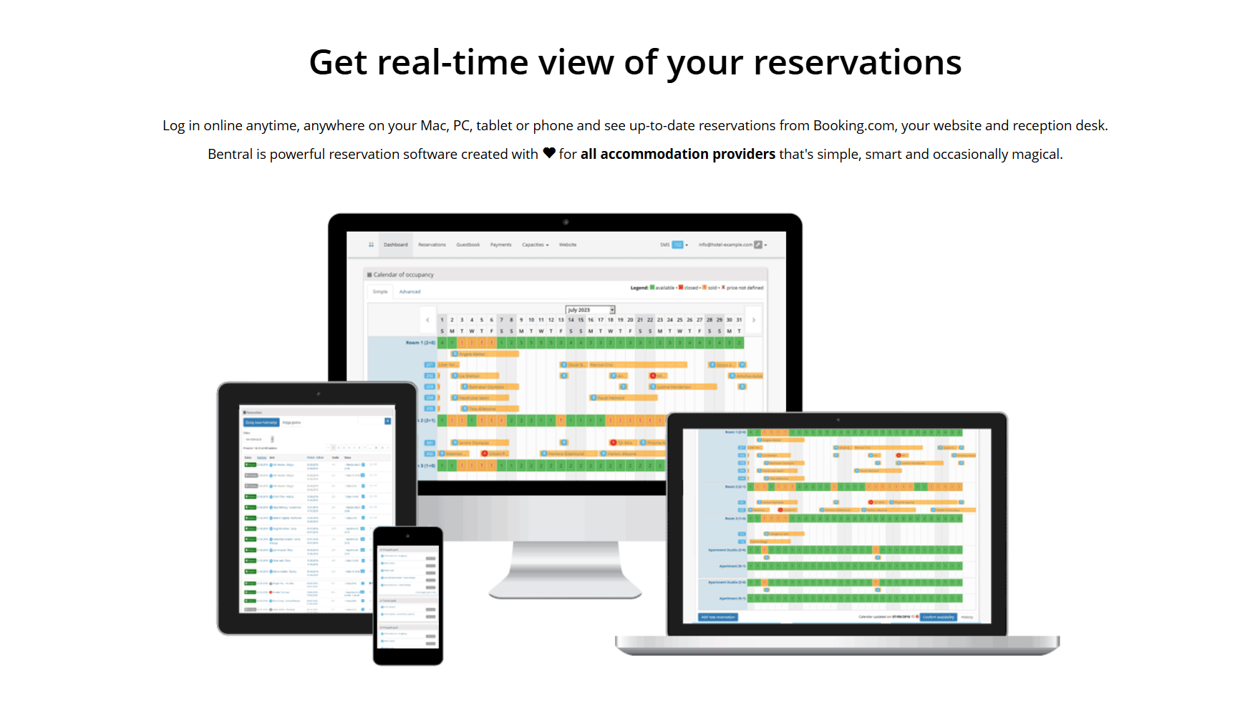
Iceland - Key Takeaway
Property Management Systems
One of the key part of running a tourism business today is Property Management Systems (PMS). Discussion from clinics pointed to this being a very valuable aspect of running a tourism accommodation business.
“Automation is very important; having a good PMS system (Property Management System) is a great value for being able to respond to guests and find out about their preferences”
Tourism businesses already using these systems explained they are using them more and more as they understand how to use them better to improve their tourism accommodation business.
Participants already using PMS systems were happy to lead discussions to help participants understand them better and their importance. Those who had not used PMS extensively said after the clinic that they planned to use the knowledge, tips and tricks learned.
Photo Credit: The Hidden Haven, Cork, Ireland

Slide 8
Iceland - Key Takeaway
Using a Sustainability Checklist
Discussions in the clinics often revolved around how you can operate more efficiently as a tourism business. The session increased learning, understanding, and knowledge on how to apply certain aspects of sustainability. Starting with a Sustainability Checklist.
The Sustainability Checklist helped participants build sustainability at the business core (solar energy, on-site organic greenhouse restaurant) and have since reported attracting global visitors at premium rates. Key mentor learnings on how to integrate sustainability into every aspect of business operations included:
Eco-Friendly Accommodations Structures: Built using natural materials, blending seamlessly with the surrounding environment.
Natural Water Features: An example provided is a resort having a swimming pond purified by aquatic plants and a stream that runs through the restaurant, enhancing the natural ambience.
On-Site Organic Garden: Another example provided where guests are encouraged to pick vegetables, herbs, and fruits from the resort's gardens, promoting a farm-to-table experience.
Energy Efficiency: The mentor explained, using the resources, how accommodations can be designed for energy efficiency, and the resort utilises renewable energy sources where possible.
Source: Slovenia Tourism – Destination Case Studies

Slide 9



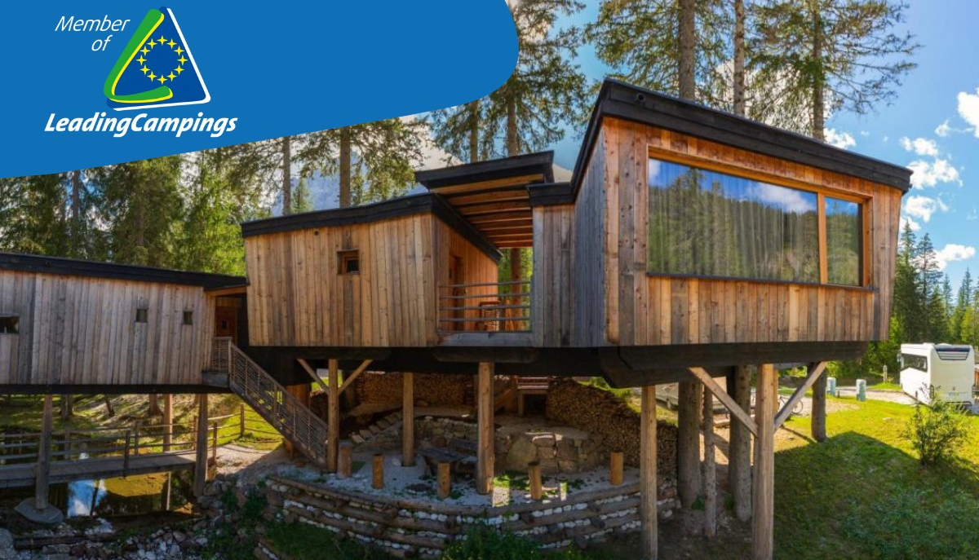
Iceland - Key Takeaway
Why Financial Management is important?
Prevent Running Out of Money: Good financial management helps you avoid cash shortages. You’ll ensure you have funds to pay bills (e.g. property upkeep, utilities) even in off-season.
Plan for Growth: It lets you plan for future needs, like buying new equipment, adding a cabin, or hiring staff as your business expands.
Build Credibility: Managing your finances effectively makes it easier to secure loans or attract investors. Lenders will see that you handle money responsibly and have a clear plan.
Photo Credit: Caravan Park Sexten, Italy

Slide 10
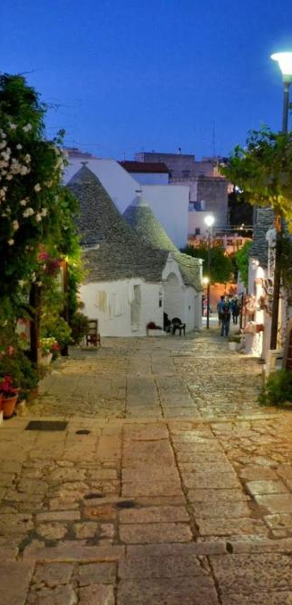
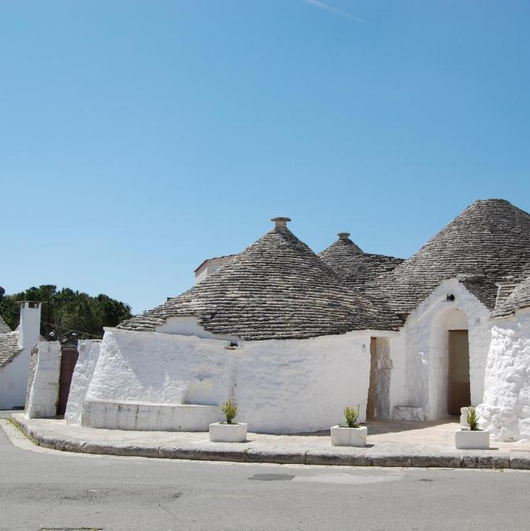

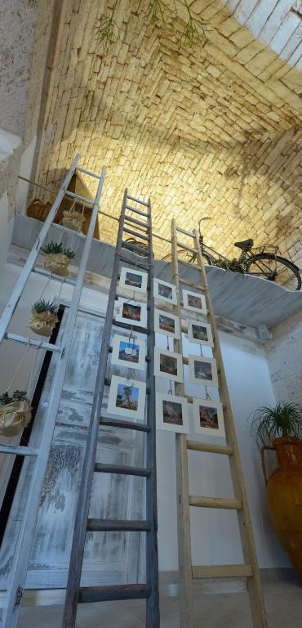
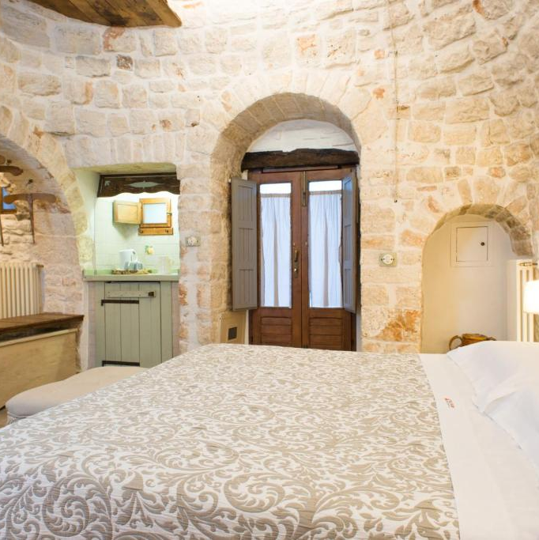
ITALY
Photo Credit: Trulli Holiday Albergo Diffuso,Italy

Slide 11
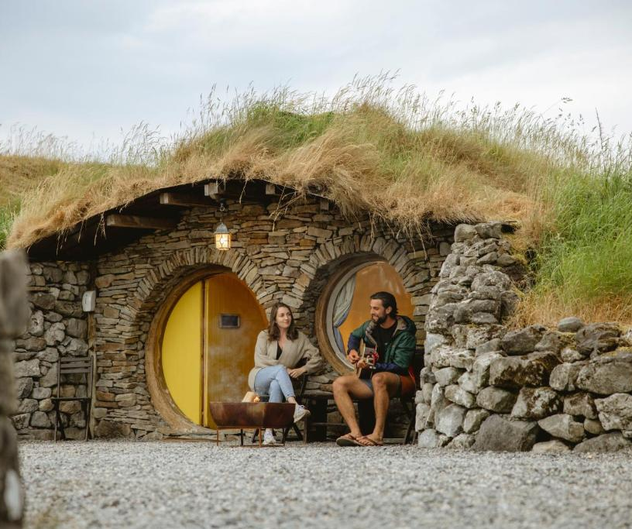
Italy
Mentoring Clinics Insights
Context
Italy’s tourism landscape is deeply rooted in heritage, architecture, gastronomy, and family-run enterprises. Many alternative accommodation businesses operate within restored historic properties.
Photo Credit: Mayo Glamping, Ireland
Mentoring Focus
Italian clinics focused strongly on:
Transforming historic assets into immersive experiences
Balancing preservation with commercial viability
Financial literacy and full-cost awareness
Pricing strategies aligned to experiential value
Key Discussion Themes
How do you monetise heritage without commodifying it?
How do you calculate true renovation and operational costs?
How do you communicate value beyond “room features”?
Outcomes
Participants developed clearer cost structures, strengthened pricing confidence, and explored ways to embed gastronomy, craft, and storytelling into guest journeys. The clinics supported greater financial clarity and experiential positioning.

Slide 12
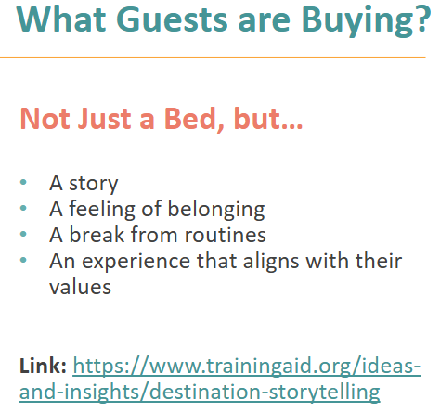
Italy – Key Takeaway
Experience Needs to Be Connected to Place
One of the key messages explored as vital to the success of Italian tourism businesses was to focus on the importance of offering unique experience-driven staying and that it needs to be connected to the characteristics of the place, the local heritage and the culture and identity of the host community.
Implementation is important and should be part of the Experience Economy and as a way of becoming “temporary local” rather than being a “tourist”. This can be done by building collaborative relationships with local farmers, artisans, and other businesses to enhance authentic guest experiences and create mutual benefits.
It was discussed there is a need to create transformative and sustainability-driven experiences.
“I’ve learned a lot about alternative accommodation and this unique type of hospitality offer which varies from territory to territory

Slide 13
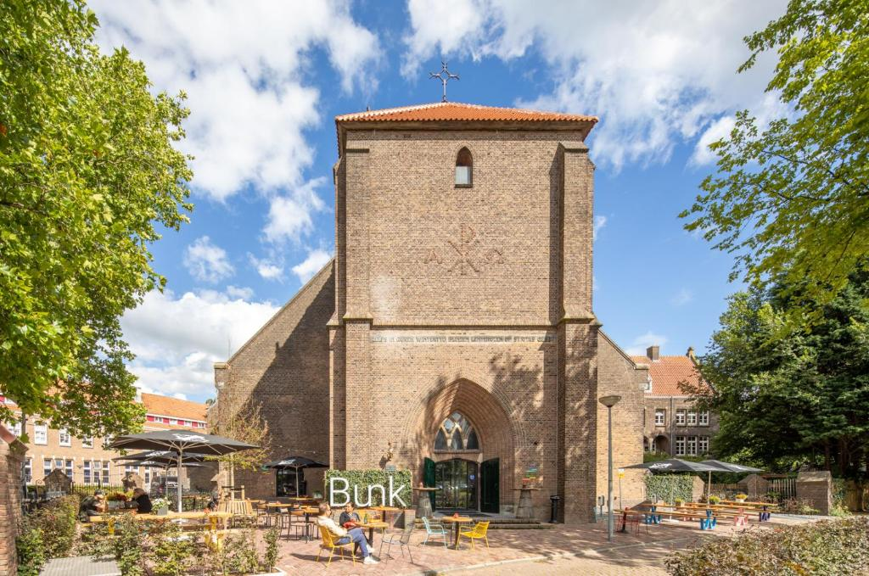
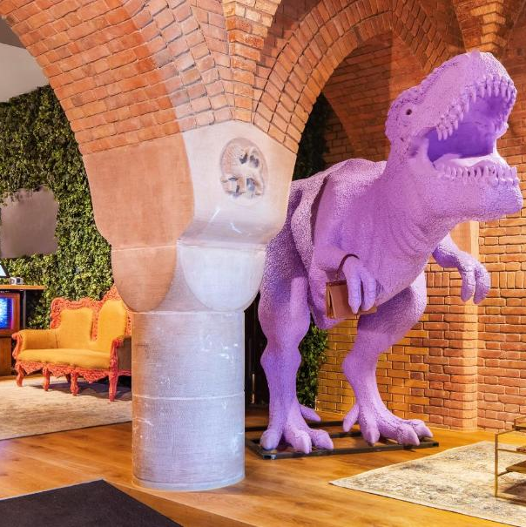

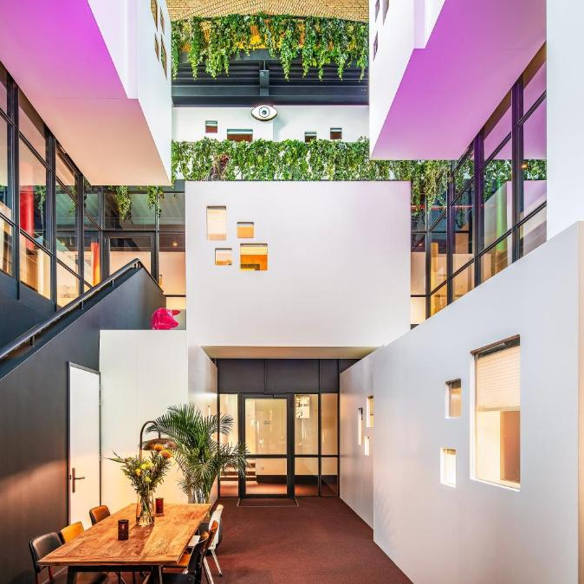
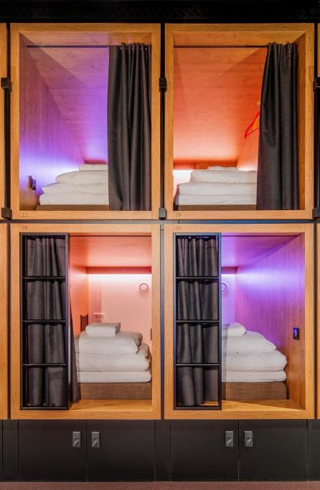
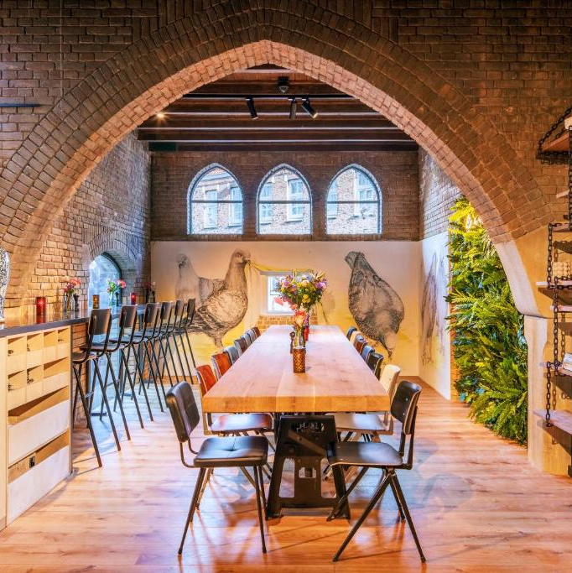
NETHERLANDS
Photo Credit: BUNK Hotel Amsterdam, Netherlands

Slide 14
Photo Credit: BUNK Hotel Amsterdam, Netherlands
02
Title
Netherlands
Mentoring Clinics Insights
Context
The Dutch tourism ecosystem includes well-developed infrastructure and digitally literate SMEs. However, competition and market clarity are critical challenges.
Mentoring Focus
The Netherlands clinics emphasised:
Structured business modelling
Strategic positioning
Digital systems and operational efficiency
Use of Pitch Deck tools and PMS platforms
Key Discussion Themes
How do you clearly define your market segment?
How can digital tools reduce administrative burden?
How do you scale responsibly?
Outcomes
Participants implemented clearer positioning strategies, improved digital management systems, and refined business planning frameworks. The clinics leaned toward structured growth and operational optimisation.

Slide 15
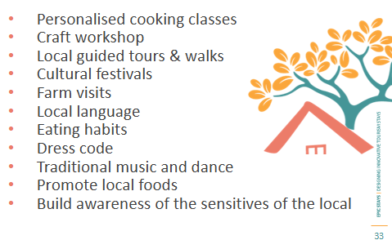
Netherlands – Key Takeaway
A Strong Brand Should Have A Good Story and Mission to Tell
In the clinics branding was highlighted as vital for business identity and reputation. Communicating brand and values need to clearly formalised for any business. For example, a tourism business that relies on nature as its selling point needs to communicate its sustainability and biodiversity efforts clearly and consistently.
“Biodiversity data is a powerful storytelling and guest-engagement tool”
The brand and communications need to focus on location, innovative use of local assets, and integration of local heritage, natural features, and community events.
Creating an emotional narrative e.g., telling the origin story of the place and business is a good place to start e.g., Why does your accommodation exist? This can show the owner´s passion for their place and this is a method that should be easy for a tourism business to implement. The focus of a rural tourism accommodation marketing and stories should not just talk about the accommodation but the place but the local culture, landscape and history.
A Genuine Experience to Gain a
Deeper Insight Into the Community

Slide 16
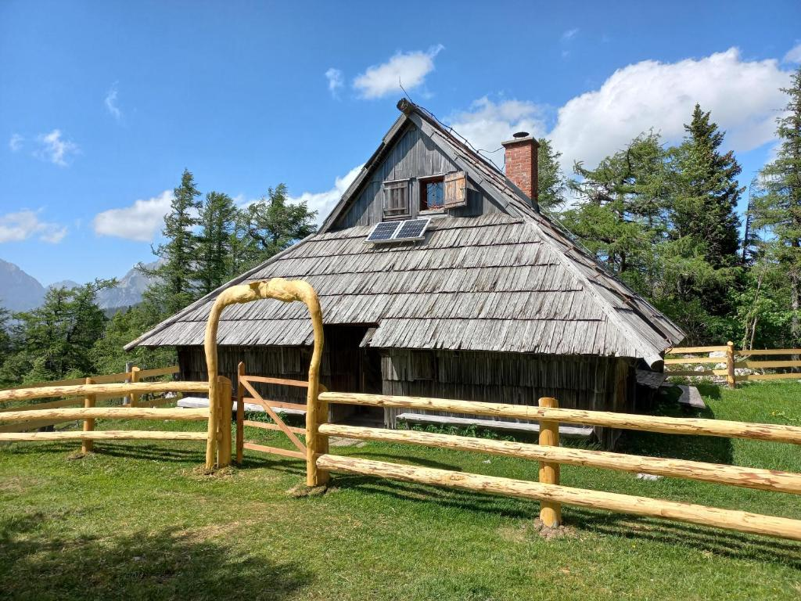

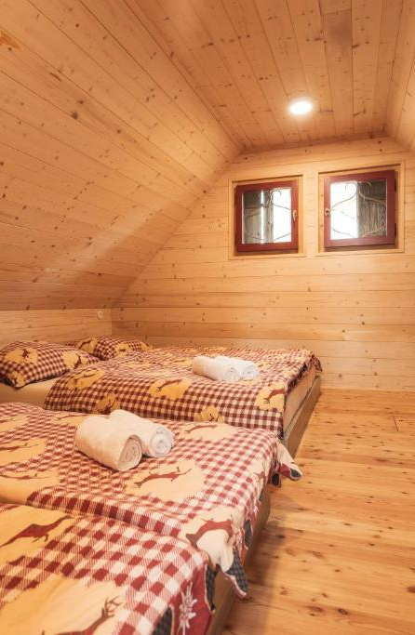
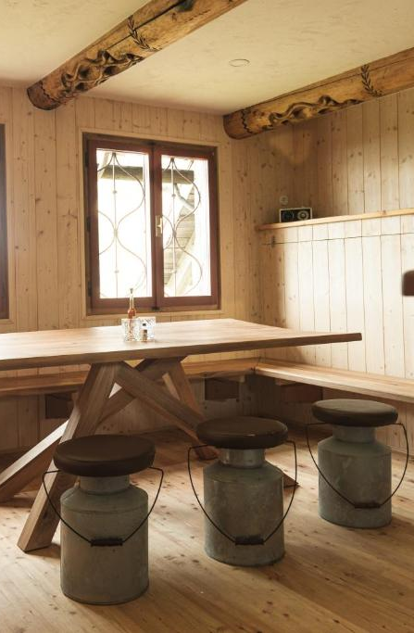
SLOVENIA
Photo Credit: Chalet Rušovc, Slovenia

Slide 17
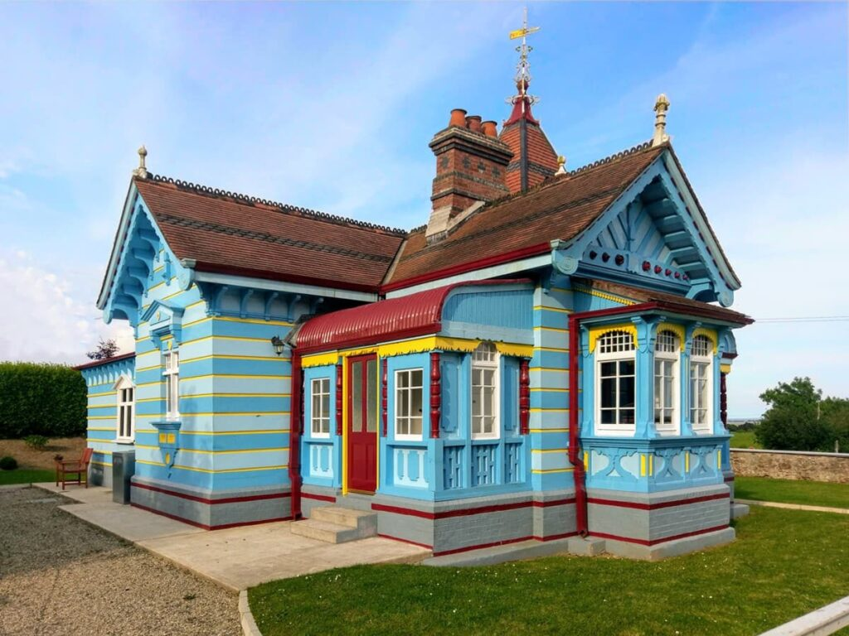
Photo Credit: The Dolls House, Wexford, Ireland
Slovenia
Mentoring Clinics Insights
Context
Slovenia has a strong sustainability brand and is internationally recognised for green tourism positioning. Many SMEs operate in rural, eco-oriented settings.
Mentoring Focus
Slovenian clinics prioritised:
Embedding sustainability in operations
Regional collaboration and cluster development
Community-based tourism integration
Strengthening local value chains
Key Discussion Themes
How can small operators collaborate rather than compete?
How do you operationalise sustainability rather than simply promote it?
How can alternative accommodation strengthen regional identity?
Outcomes
Participants explored partnership models, sustainable sourcing, and community integration strategies. The clinics reinforced Slovenia’s positioning as a green destination while strengthening SME viability.

Slide 18
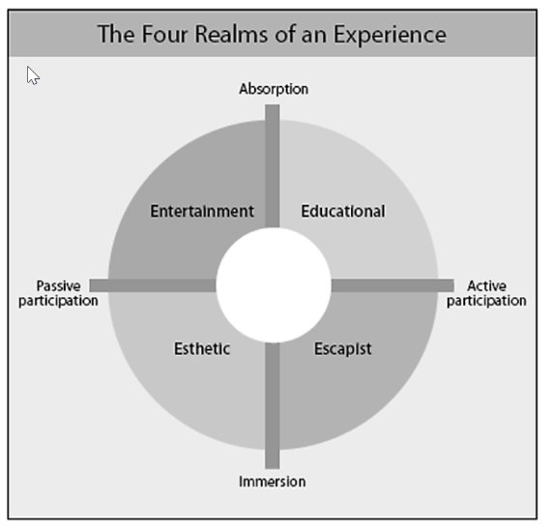
Slovenia – Key Takeaway
Guest Experience Means You Need to Know Your Guest
Part of the Slovenian mentoring clinics quickly identified that one of the key parts of running a tourism business today is knowing your guests.
That means clearly understanding your types of guests and their needs is a very important and valuable.
Understanding your location and environment is important so you can meet guest expectations. By looking at both the need of the quest and the aspects that make up your tourism business’s local environment, it becomes easier to know what type of guest you want and what aspects of your local area will attract that guest.
Define the biggest advantage of your destination – such as nature, peace, cultural element, local story, special landscape etc. - it becomes much easier to analyse what your existing product is offering and move on to implementing changes that can get you the right segment, the right type of guest.
“It is important to understand that alternative accommodation is not for everyone — and that's okay. The most successful are those who are clear about the audience they are serving. If we choose the ideal segment, we can start to tailor the product specifically for it.
The Four Realms of an Experience, p. 40
Module 2 : Market Research & Business Planning: Your Alternative Accommodation Business

Slide 19
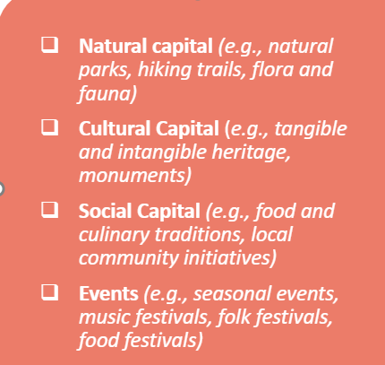
Slovenia – Key Takeaway
Guest Experience Means You Need to Know Your Guest
In the clinics, concepts important in the clinics – the how storytelling can be used as a tool. Start with mapping your territory and gathering the stories within your communities, culture and regions. This can make a tourism product get a clearer identity and make, for example, a beekeeping farm with a small accommodation stand out.
By implementing the storytelling tool and territory mapping, business owners can begin to define their place as a bee-inspired wellbeing stay. This concept work led to a:
Clear narrative used consistently across accommodation design, guest experience and marketing
Strong differentiation from generic rural apartments
Foundation for naming, visual identity and experience design
This would enhance the tourism experience and be practical to implement for this tourism business.
“The accommodation will not be positioned as “just a holiday rental” but as a bee-inspired wellbeing stay”
Mapping Your Territory And Its Offer
Module 1 (part 2) : Introduction to Alternative Tourism Accommodation: Business Planning and Spotting Opportunites

Slide 20
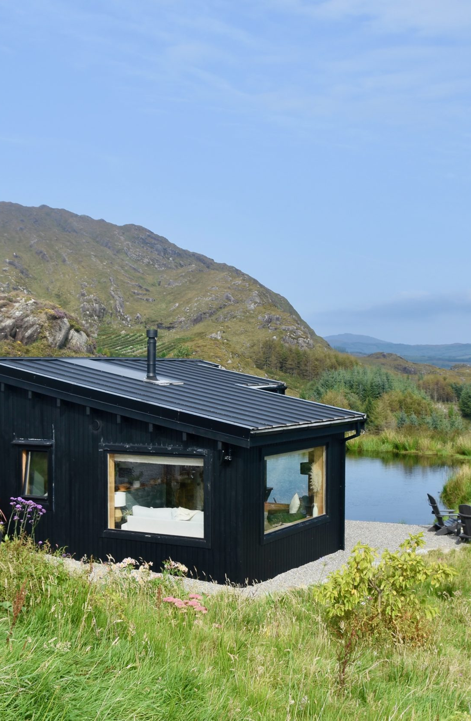
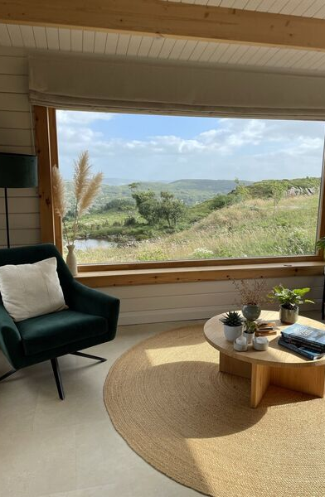

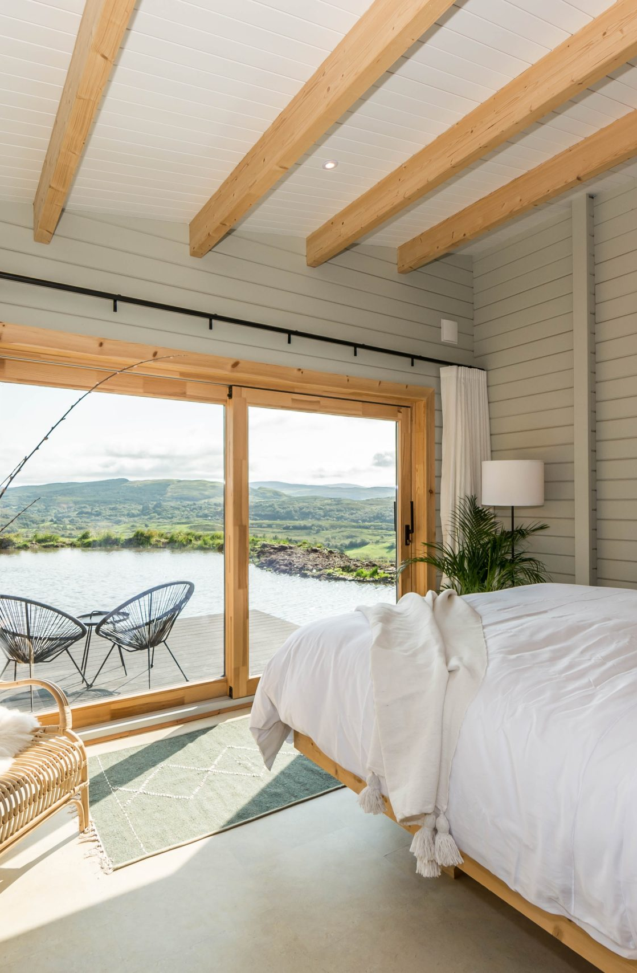
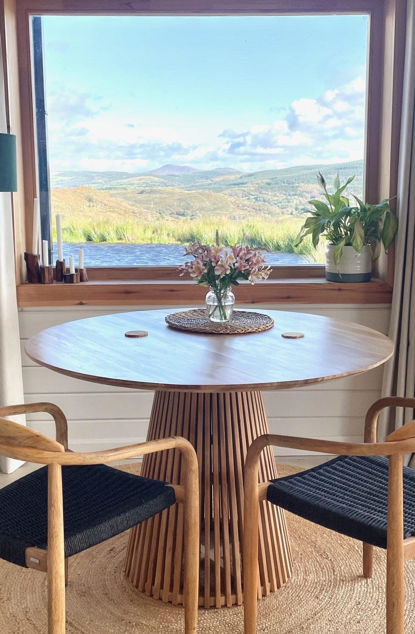
IRELAND
Photo Credit: The Hidden Haven, Cork, Ireland

Slide 21
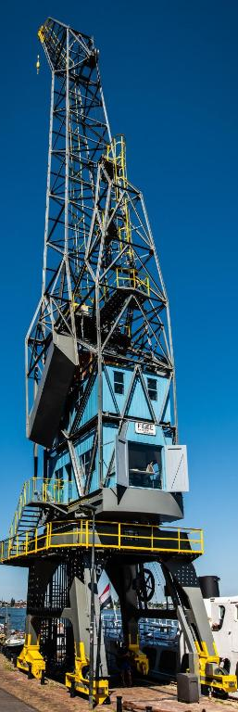
Photo Credit: Amsterdam the Crane by YAYS, Netherlands
Ireland
Context
Ireland’s rural tourism sector includes farm stays, eco-cabins, heritage B&Bs, and micro-accommodation enterprises. Planning regulations, budgeting realism, and marketing clarity are frequent challenges.
Mentoring Focus
Ireland’s clinics combined:
Real-world rural entrepreneurial experience
Structured EPIC STAYS module delivery
Practical planning guidance
Financial awareness and cost mapping
Marketing clarity and digital efficiency
Key Discussion Themes
How do I navigate planning permission?
What does my full cost structure really look like?
What is my true “WOW” factor?
How do I market without burning out?
Outcomes
Participants reported increased clarity, improved planning decisions, and greater confidence in pricing and positioning. The balance of lived experience (Lorcan) and structured frameworks (Laura) ensured both inspiration and implementation.

Slide 22
Quotes from European Participants
“We realised that the landscape alone isn’t our product — it’s the story we build around it that makes guests remember us.”
Iceland
“For the first time, I looked at my property not just as a historic building, but as an experience I needed to design and price properly.”
Italy
“I came in with ideas and left with decisions. That’s the difference mentoring made.”
“The honest conversations about planning, costs and reality were exactly what I needed.”
Ireland
“The clinic helped me simplify my business model. I stopped overcomplicating and started focusing on positioning and systems.”
Netherlands
“Sustainability became something practical, not just something we talk about in brochures.”
Slovenia
Photo Credit: The Birdbox, Donegal Treehouse, Ireland

Slide 23
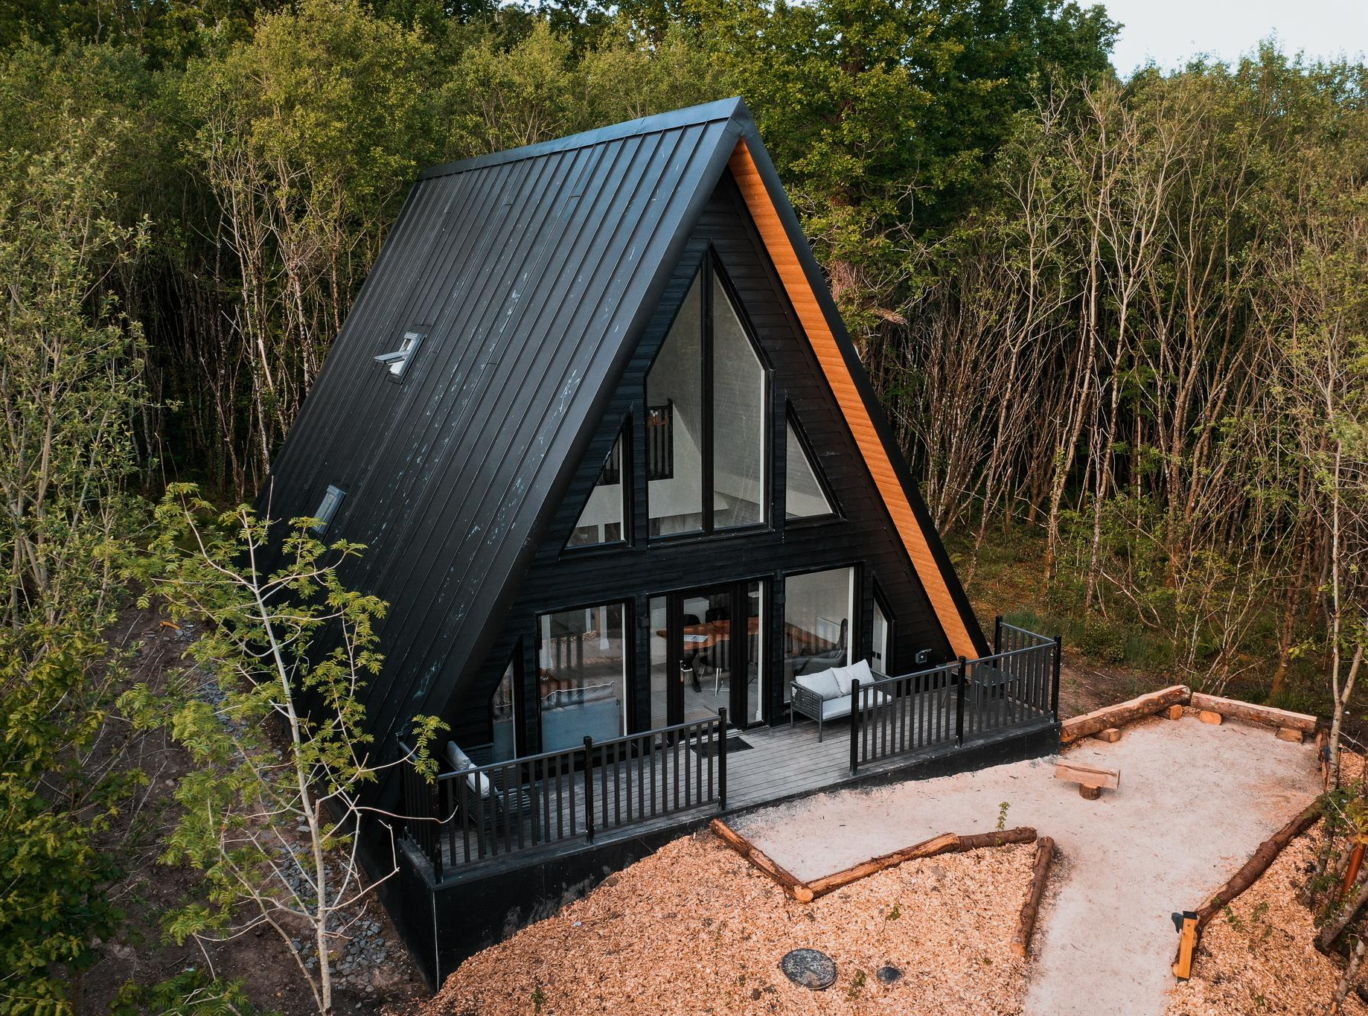
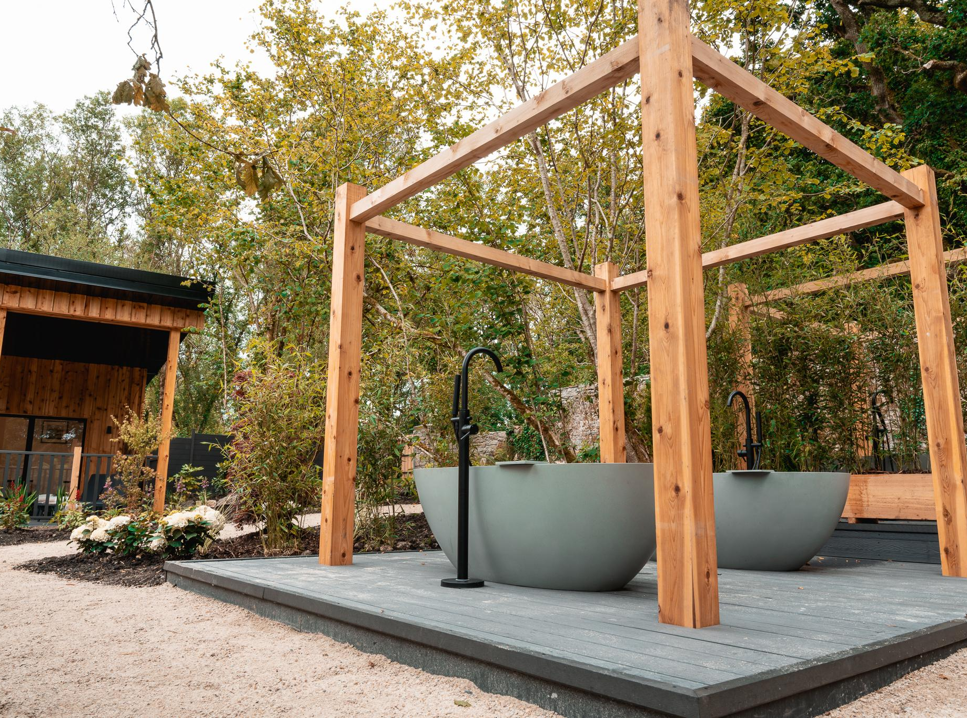
IRELAND
Photo Credit: Drumheirny Woodland, Leitrim, Ireland

Slide 24

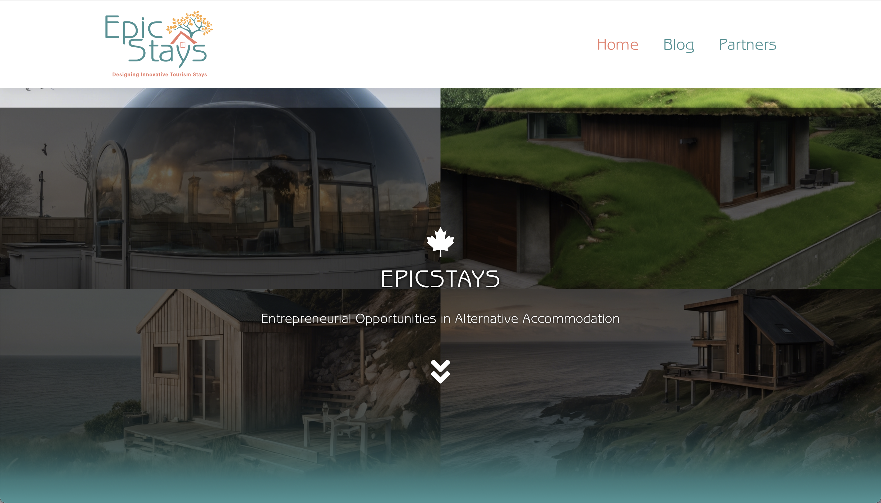

Click to type
Follow Our Journey
www.epicstays.eu

