Slide 1
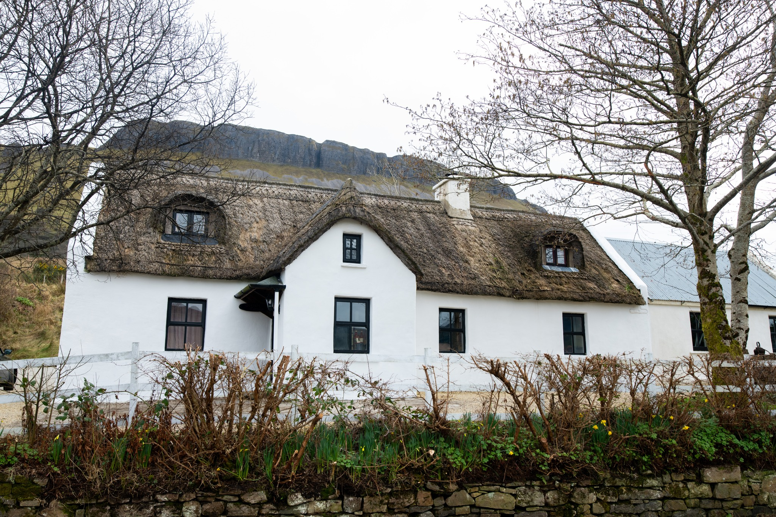
SESSION 1 (Part 1)
Intro & “Where You’re At & What You’re Actually Selling”
Photo Credit: Crusaders Cabins Kinlough
www.epicstays.eu

Slide 2
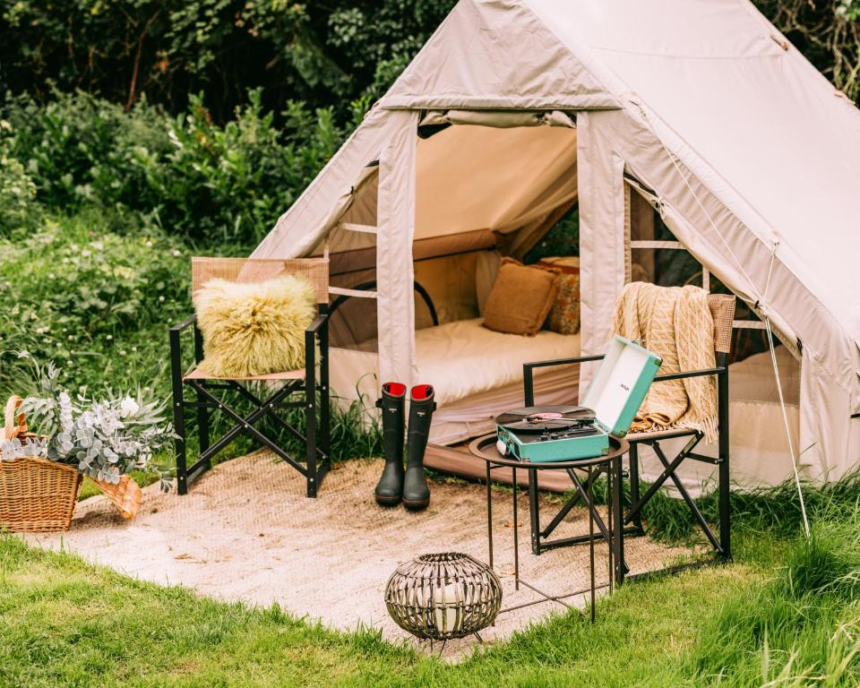
Mentoring Session 1
Intro & “Where You’re At & What You’re Actually Selling”
SESSION FOCUS: Help participants clarify their market, guest motivations, what business model they are adopting, and identify an opportunity in their region or property. The case studies help them see how others are doing it.
Fitz of Inch, Ireland
This session helps you understand the real foundation of your business: who your guest is, what they value, and what you are truly offering beyond a physical stay.
By exploring your market, your motivations, and your region’s potential, you’ll begin shaping a concept that aligns with both guest demand and your personal vision.

Slide 3
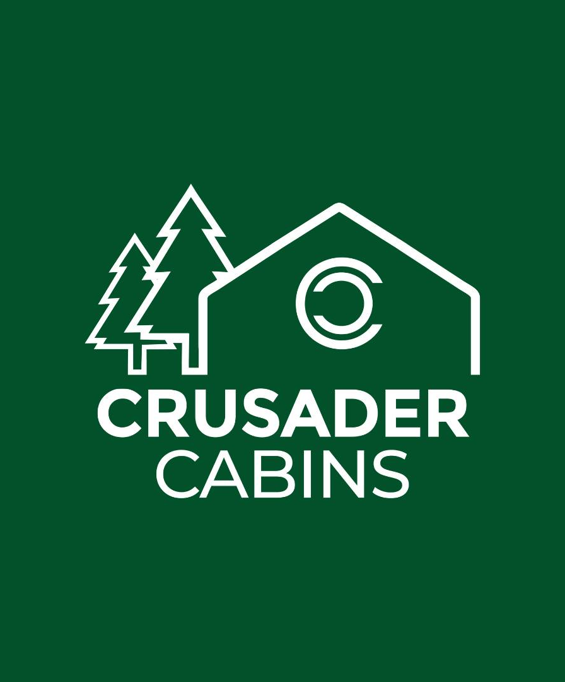
Mentoring Series (Nov/Dec 2025)
Overview
Tuesday 11 November, 6 - 7 pm
Monday 17 November, 6 - 7 pm
Monday 24 November, 6 - 7 pm
Monday 01 December, 6 - 7 pm
1
FORMAT: 4 x 60-minute live online group mentoring calls
20 mins
2
START: Introduction to concepts through module learning
3
MIDDLE: Mentoring with Lorcan followed with discussion
30 mins
4
END: Key takeaways and learnings, follow up survey
5 mins
5
NEXT SESSION: Overview and Disscuss
5 mins
www.epicstays.eu

Slide 4
Practical 1-hour mentoring sessions based on Crusader Cabins and Lorcan Kearns’ journey, the EPIC STAYS modules and case studies. Designed for Ireland while providing European insights and best practices.
EPIC STAYS
Ireland: FREE Mentoring Series (November 2025)
Overview
Format: 4 x 60-minute live online group mentoring calls
Audience: Irish existing and potential businesses and entrepreneurs thinking of launching, already building or improving alternative accommodation and place-based experiences (eco-cabins, cottages, farm stays, heritage conversions, weaving workshops, craft tourism, nature-based wellbeing stays, etc.)
Goal: Each participant receives mentoring so they can make at least one concrete step forward every single week (pricing clarity, planning path, guest experience design, marketing message, etc.)
Style: Informal, straight talk, lived experience, what works in Irish, country, rural and coastal locations

Slide 5
Week 1
Tuesday 11 November
Session 1 Structure
5 mins
Welcome, introduction, quick check-in
20 mins
Introduction to Modules: “Where You’re At & What You’re Actually Selling”
30 mins
Mentoring where Lorcan explains his experience (what he did, what went wrong, what worked)
Live Q&A, interactive discussion
5 mins
Key learnings & takeaways
5 mins
Next steps, next weeks discussion & plan
Feedback survey what worked, what want to cover next week etc
Please note all discussions are confidential.

Slide 6
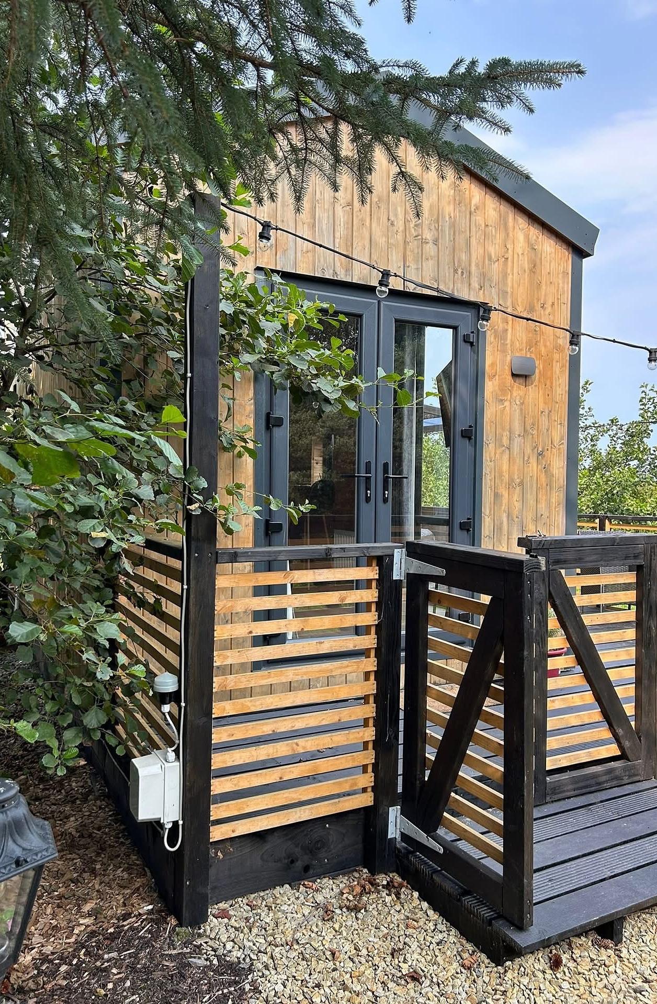
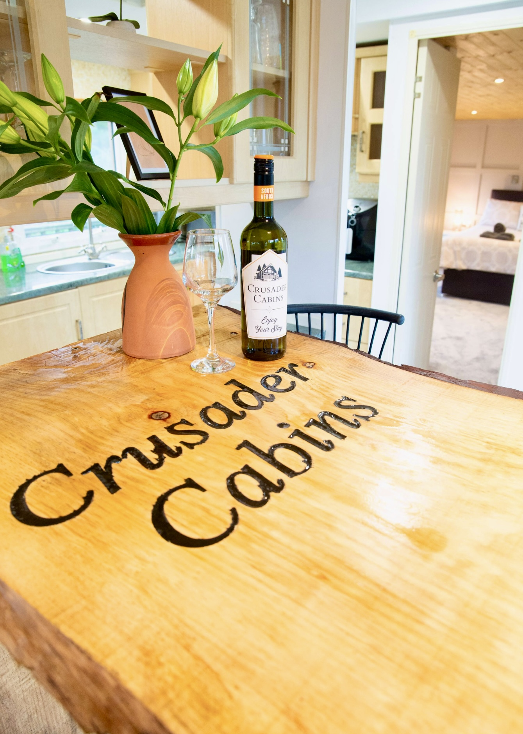
Crusader Cabins
Photo Credit: Crusader Cabins Ireland

Slide 7

Top Challenges
Roadblocks & Problems Highlighted
A chance to surface common hurdles—whether it’s choosing the right model, the correct location, working with the community, building confidence, or technical barriers.
Problems Identified
Planning & Permissions Maze
Overload & Time Constraints
Problems Identified
Building & Compliance Confusion
Logistics & Location Barriers
Staffing & Operations Pressure
Searching for Mentorship & Peer Support
Life Transitions Affecting Business
Lack of Clear Roadmap
Seasonality & Revenue Uncertainty
Marketing & Visibility Gaps

Slide 8
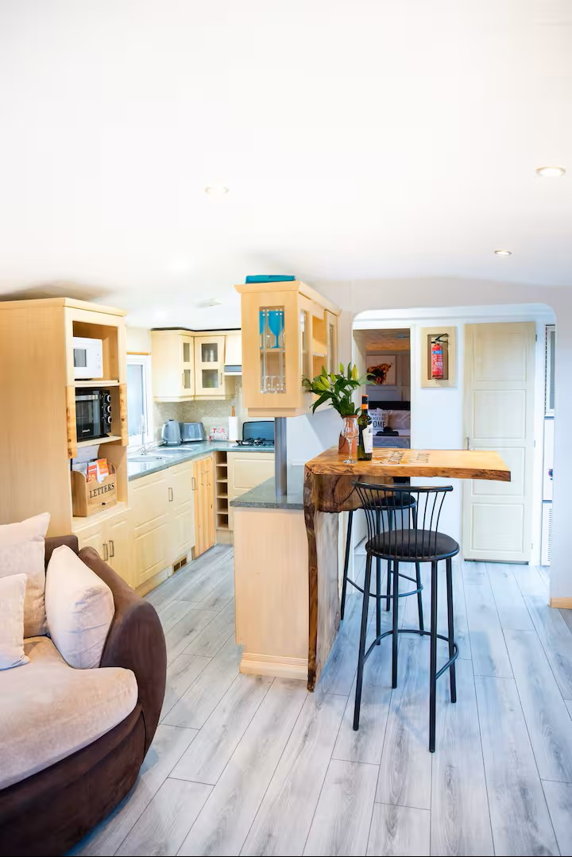
Modules Covered
Week 1 Session 1
Module 1: Introduction to Alternative Accommodation & Why It Matters Now – Changing Guest Motivations & Market Shifts
Module 2: Compare and Contrast Different Business Models of Alternative Tourism Accommodation & Spotting Opportunities.
Spotlight on European Example Case Studies
“Where You’re At & What You’re Actually Selling”
Focus
Help participants clarify their market, guest motivations, what business model they are adopting, and identify an opportunity in their region or property. The case studies help them see how others are doing it.
Photo: Crusader Cabins

Slide 9
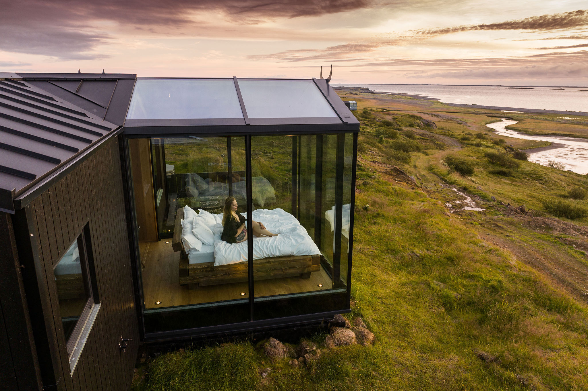
Session 1: Intro & “Where You’re At & What You’re Actually Selling”
‘Start Together’ Hybrid Conference Debrief
A brief recap of the international hybrid conference (Nov 10)
What inspired you? Think of the case studies, innovations, stories and strategies.
What were the key learnings and takeaways?
List 1 key insight from the speakers and how these could apply to Ireland.
Session Focus
Help participants clarify their market and offering – understanding who their guests are, what motivates them, which business model fits their idea, and identifying a unique opportunity in their region or property.
This session also debriefs the initial hybrid conference and uses case studies to show how others have defined their market and niche.
Panoramic Glass Lodge, Iceland

Slide 10
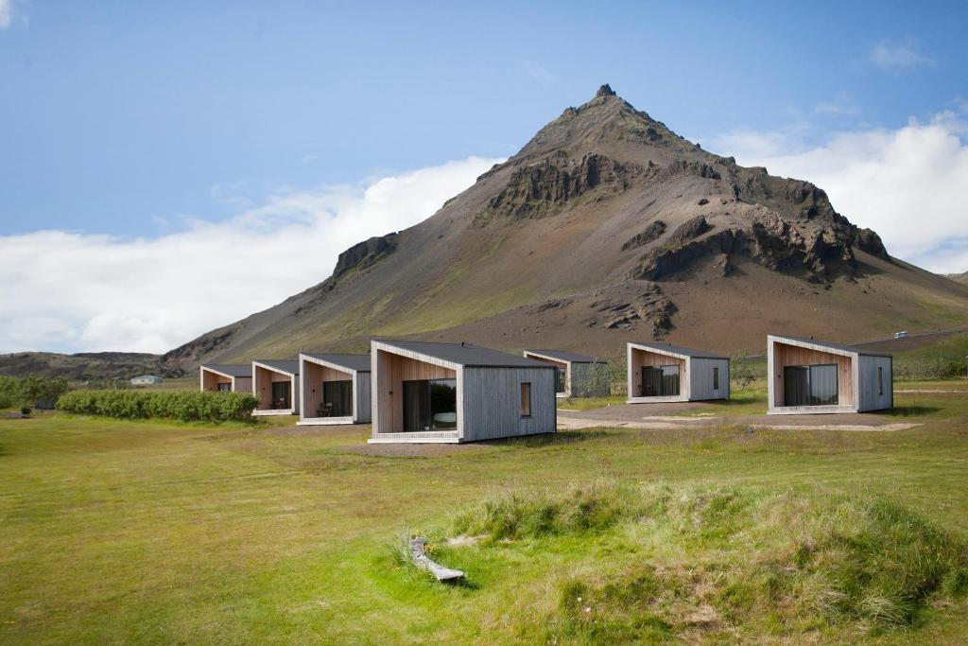
Arnarstapi Cottages, Iceland
Global Trend
Introduction to Epic Stays & Why They Matter
A Growing Global Trend
Alternative tourism accommodation is reshaping the travel landscape.
No longer are tourists or visitors content with generic, one-size-fits-all experiences.
Alternative tourism accommodations—such as eco-lodges, glamping pods, and heritage stays—offer unique experiences. Unlike traditional hotels, these spaces enable hosts to share their values and connect visitors with culture, community, and the natural world.
Today’s visitors are actively seeking meaningful stays that reflect local culture, prioritise the environment, and offer something unique to the destination.
The market is projected to grow from €216.5 billion in 2024 to over €715 billion by 2032 (Fortune Business Insights 2025 - 2032).
It aligns with global tourism trends that emphasise authenticity, environmental responsibility, immersive local engagement – trends recognised by the UNWTO, the European
Travel Commission, and national tourism bodies across Europe.
Alternative accommodation businesses are crucial to the tourism industry, providing guests with a safe, comfortable and unique place to stay. They are usually seeking accommodation that is completely different from where they live or have previously experienced.
The alternative tourism accommodation sector plays a vital role in diversifying tourism, supporting local economies, and promoting passionate, purpose-led entrepreneurship.

Slide 11
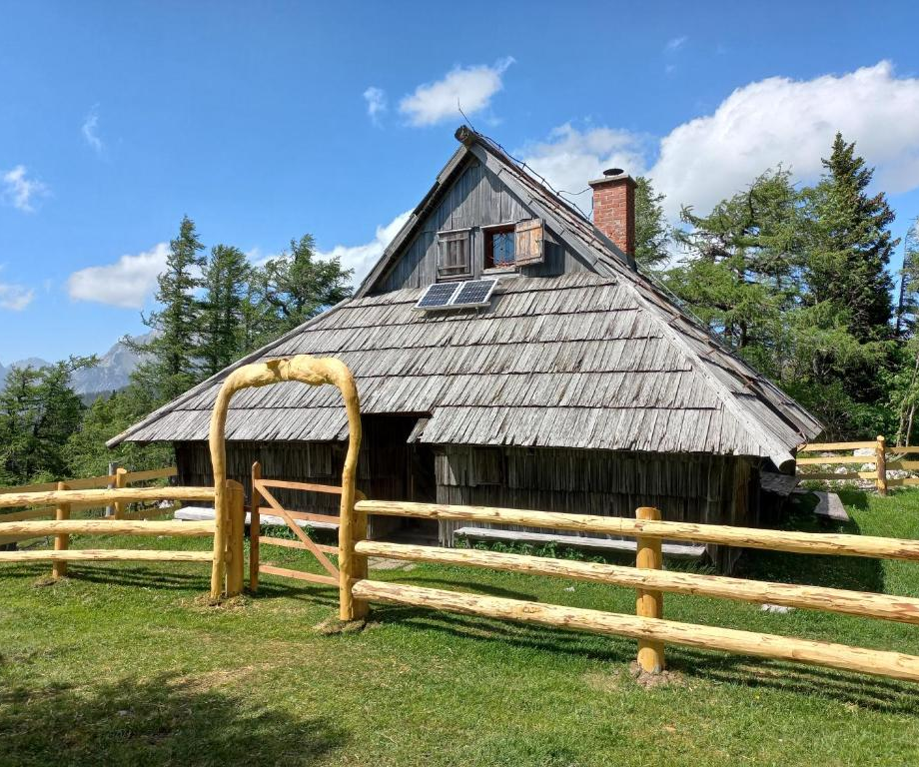
Definition
Alternative Tourism Accommodation
Alternative tourism accommodation refers to lodging options that differ from conventional hotels and resorts.
These accommodations emphasise sustainability, cultural authenticity, and unique guest experiences, often located in natural, rural, or community-based settings.
Chalet Rušovc, Slovenia
They tend to offer immersive stays and experiences shaped by local heritage, landscapes, adventure, and match the demand for ethical travel.
11
They may include:
Glamping (luxury camping)
Eco-lodges
Farm stays or agritourism
Repurposed heritage buildings
Tiny homes or cabins
Community-run guesthouses or homestays

Slide 12
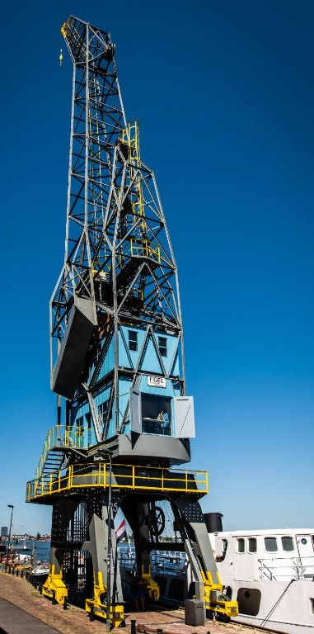
Module 1
Understanding Your Guests (Changing Motivations)
Epic Stays Guests are looking for 3 main options;
“Authenticity & Local Experience” (guests seek unique, local stays over generic hotels)
“Nature & Novelty” (interest in glamping, tiny houses, off-beat lodgings)
“Workation & Flexibility” longer stays blending work/leisure/adventure/personal development/learning.
Amsterdam the Crane by YAYS, Netherlands

Slide 13
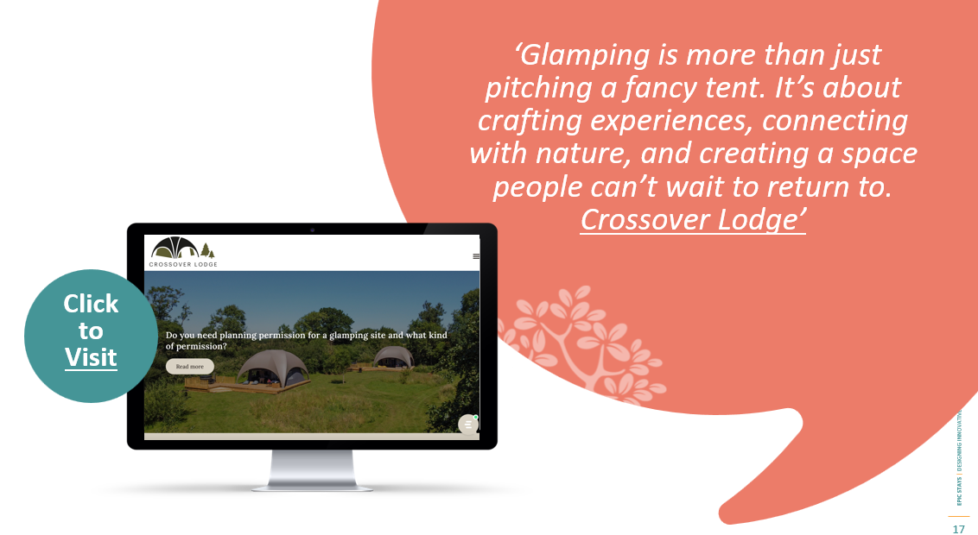
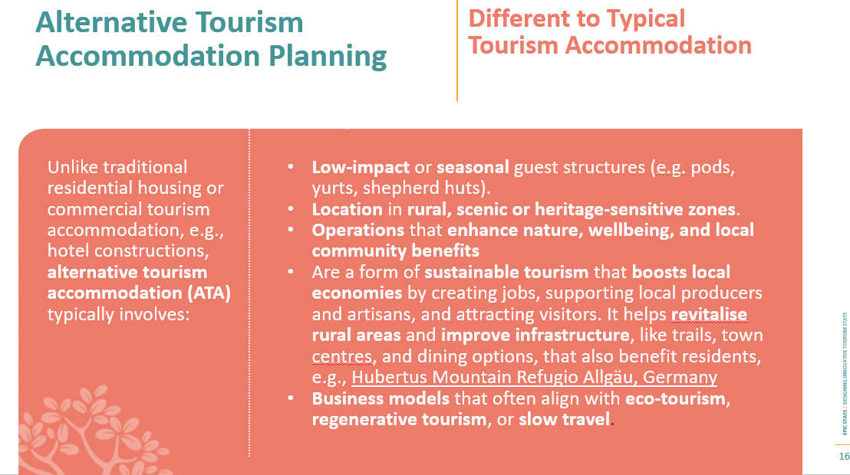

Slide 14
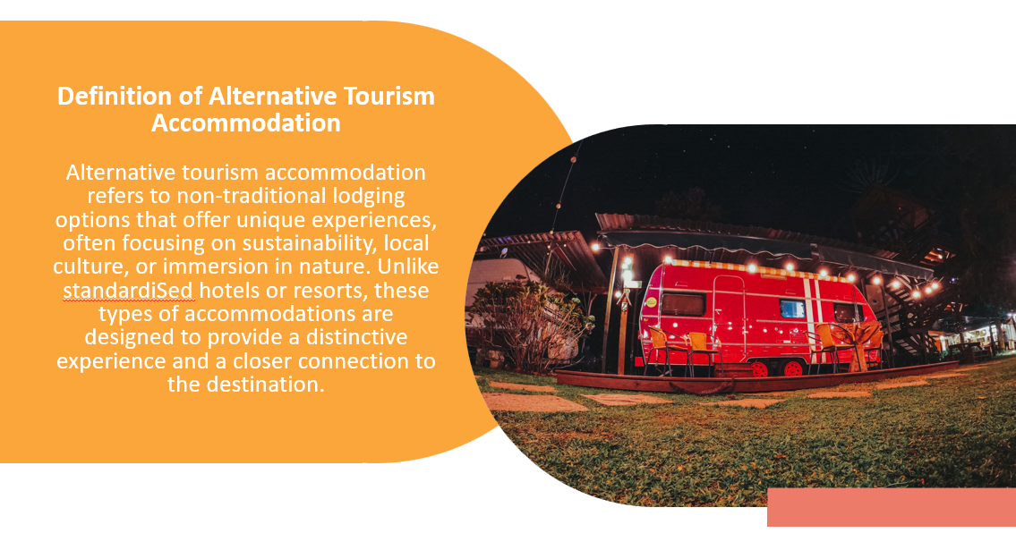
In the context of alternative tourism accommodation, a business model is:
The complete strategy that explains how your accommodation concept creates value for guests, delivers it through unique experiences, and captures income in a sustainable way.
It includes:
Who your guests are (target market)
What you offer them (value proposition – the experience, design, location, uniqueness)
How you deliver that offer (operations, channels, marketing, staffing, tech)
How you earn money (pricing, revenue streams, packages, upsells)
What makes it sustainable and viable long-term (scalability, partnerships, environmental/social factors)
In short:
A business model is not just what you build — it’s how the whole guest experience becomes a working, earning, and lasting business.

Slide 15
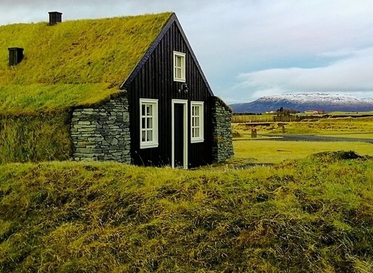
The Torfhus Retreat, Iceland
Definition
AA Business Model
What is an Alternative Accommodation Business Model?
An alternative accommodation business model describes how
a unique stay concept
creates value for guests,
delivers that experience in a memorable way,
and generates sustainable income — without operating like a traditional hotel.

Slide 16
The Alternative Accommodation Business Model is Unique.
Component | Meaning in Alternative Stays
Target Guests | Who the accommodation is designed for (couples, families, hikers, creatives, remote workers, etc.)
Value Proposition | What makes the stay different and worth paying for. The emotional and experiential “why”.
Guest Experience | The memorable moments before, during and after the stay. The story the guest goes home with.
Revenue Model | How income is earned — nightly stays, seasonal pricing, add-ons, experiences, partnerships.
Operations | How it runs day-to-day (self-check-in, cleaning, local suppliers, maintenance, systems).
Brand & Story | How the place expresses its identity and attracts the right guests.
Sustainability & Impact | How it respects place, culture, environment and supports the local economy.

Slide 17
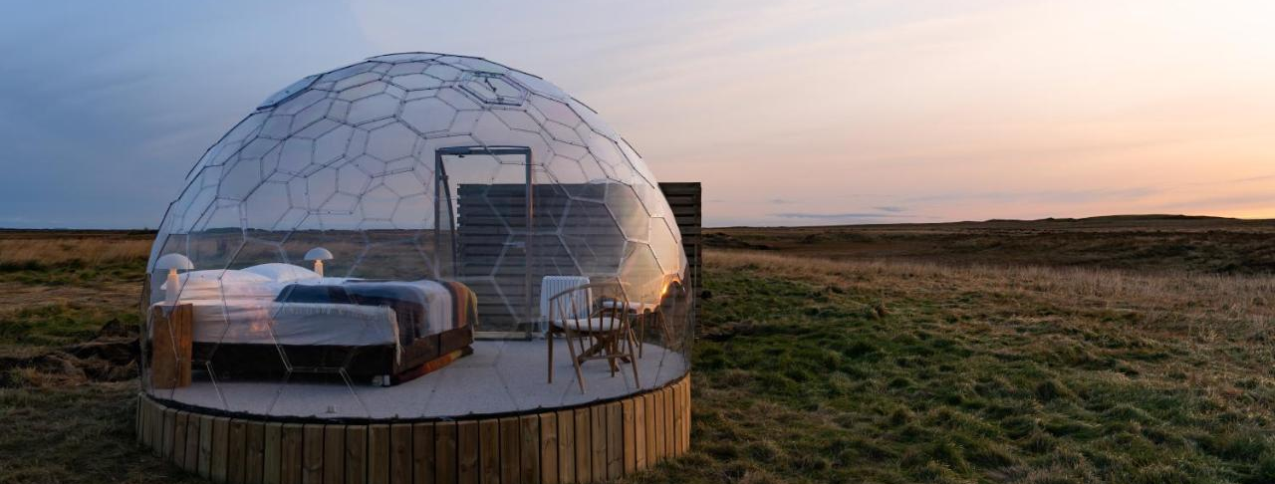
Value Proposition → Your Core Promise
Your value proposition is the essence of what your stay offers that others don’t.
You are not selling a bed. You are selling a moment, a memory, a feeling.
It describes:
What guests FEEL
What guests EXPERIENCE
Why guests CHOOSE YOU over Airbnb or hotels
Examples:
“Sleep under the stars in complete privacy”
“Live inside a restored piece of Irish history”
“A retreat for quiet minds and nature lovers”
“A family adventure cabin where memories happen outdoors”
Your value proposition should be:
Clear → Emotion-led →Memorable → Simple enough to say in one sentence.
Aurora Igloo, Iceland

Slide 18
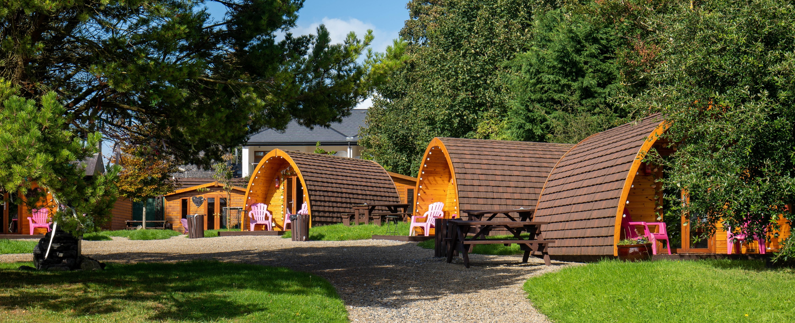
Guest Experience: Where the Magic Happens
The question to ask:
“What moment will they decide to book you, and at what moment during the stay will the guest remember for the rest of their life?”
That is the core of your guest experience strategy.
Your guest experience is:
The journey from booking → arrival → stay → departure.
The details that create an emotional connection.
The story the guest tells when they return home.
Strong guest experience focuses on:
Atmosphere (lighting, textures, scents, quietness, sound of nature)
Sense of place (local materials, local food, local stories)
Care + welcome (even in self-check stays)
Beauty and comfort balanced with simplicity
Aurora Igloo, IcelaPodumna Village, Portumna, Galway Irelandnd

Slide 19
How to Choose the Right Business Model
Step 1 — Start with Place
  What is special about your land, building, view, or story?
Step 2 — Define Your Guest
  Who is your place made for — couples, families, adventurers, creatives?
Step 3 — Match the Experience to the Guest
  Examples
  Quiet forest cabin → couples/writers
  Lakeside lodge → families/fishers / wellness seekers
  Heritage cottage → cultural travellers & slow tourism guests
Step 4 — Price for the Value You’re Creating
  Not cost-based → value-based pricing
  You price based on how rare the experience is, not on what your neighbour charges.
Step 5 — Test, Improve, Repeat
  Start small → Open → Gather guest feedback → Refine → Add layers of experience.

Slide 20
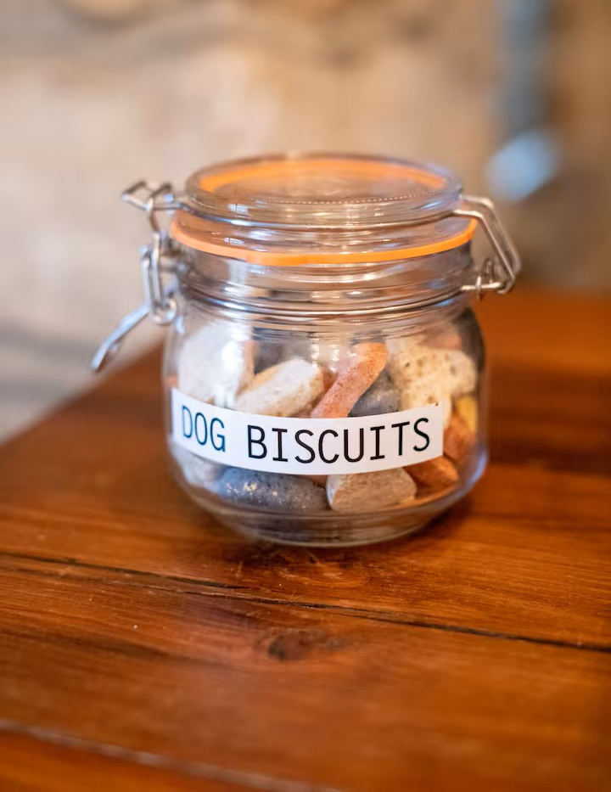
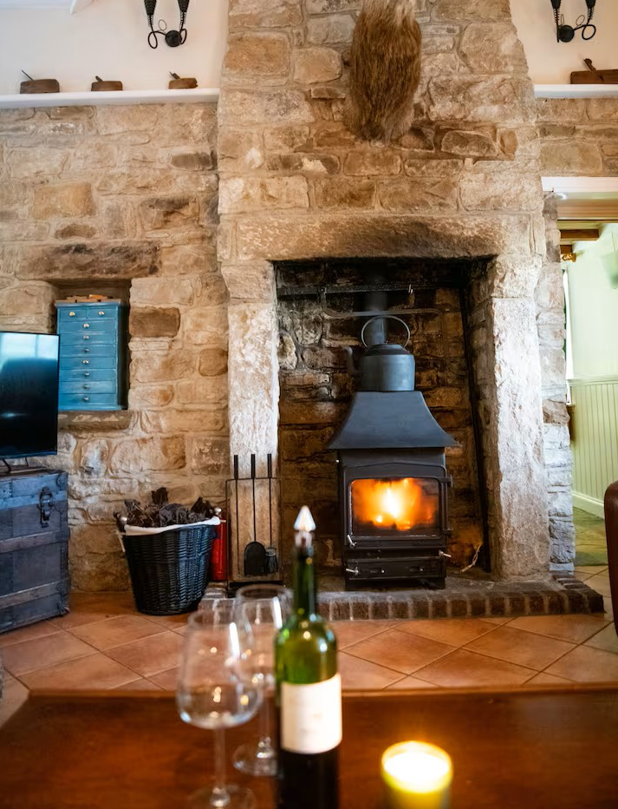
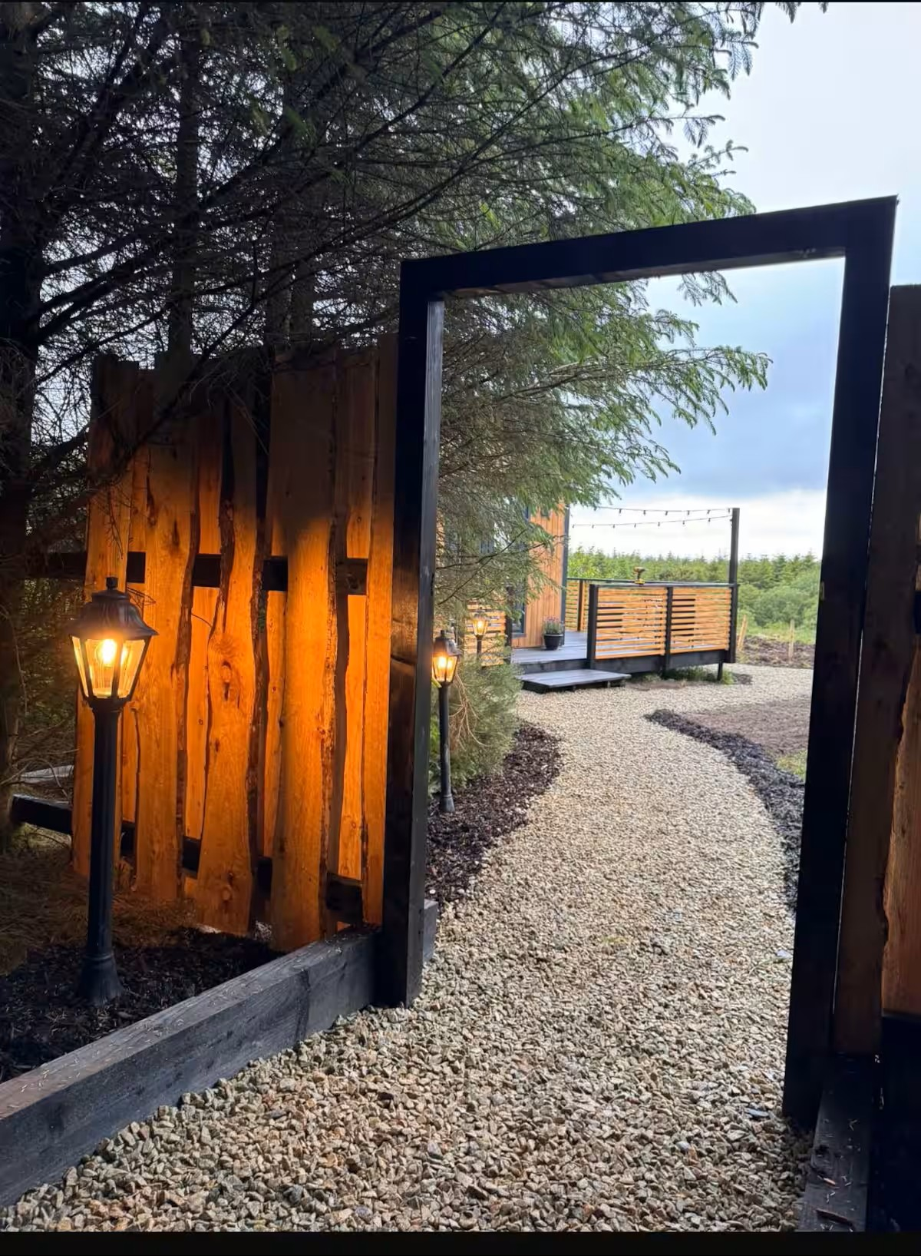
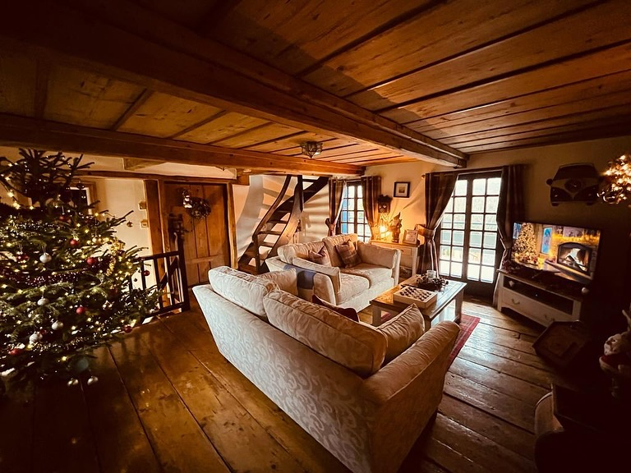
Keep Improving and Layers of Memorable Experiences
Improvement examples:
Add a wood-fired hot tub
Create a breakfast basket with local produce
Add telescope, binoculars, hammock, books of local legends
Tell the story of the place more clearly in your listing and welcome guide
Cabin Crusaders

Slide 21



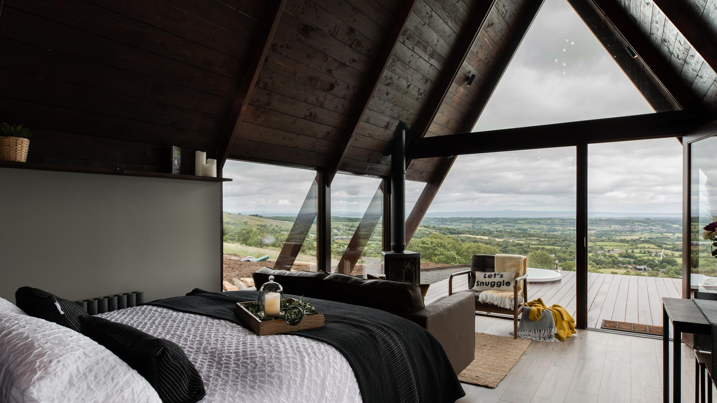
Recap In Simple Terms
Your business model decides
how you earn.
Your value proposition decides
why guests choose you.
Your guest experience decides whether they come back and tell others.
When these three align — your accommodation becomes profitable, memorable and sustainable.
Letteran Lodges, Derry, Ireland

Slide 22
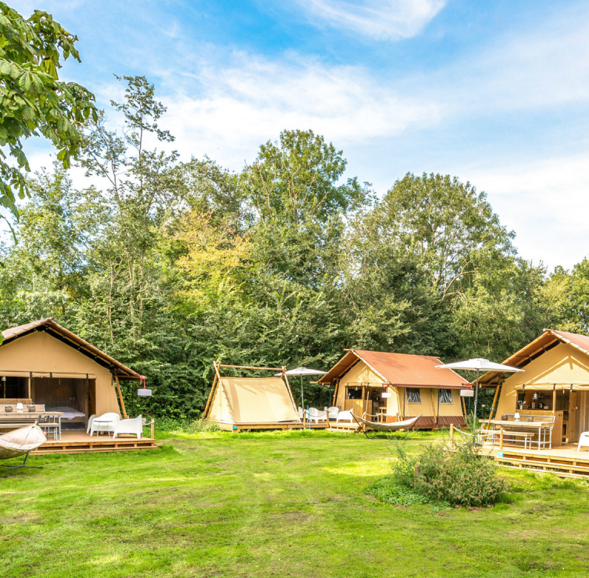
Module 2
What are you actually or really selling?
Your Business Model & Opportunity
Next we will look at the Business Model, Value Proposition and Opportunities:
Different Spaces (e.g. Bunk Hotel in Amsterdam, a tree house hotel and a community co-operative hotel)
Describe the business model and value proposition in one line
e.g., “Hybrid hostel + event space = lodging and experience for budget travelers”.
Look at “What opportunities exist in your region or property? (e.g. Unused barn? Scenic land? Local heritage story?)” so you can consider your business context.
Vrij Haven Camping, Netherlands

Slide 23
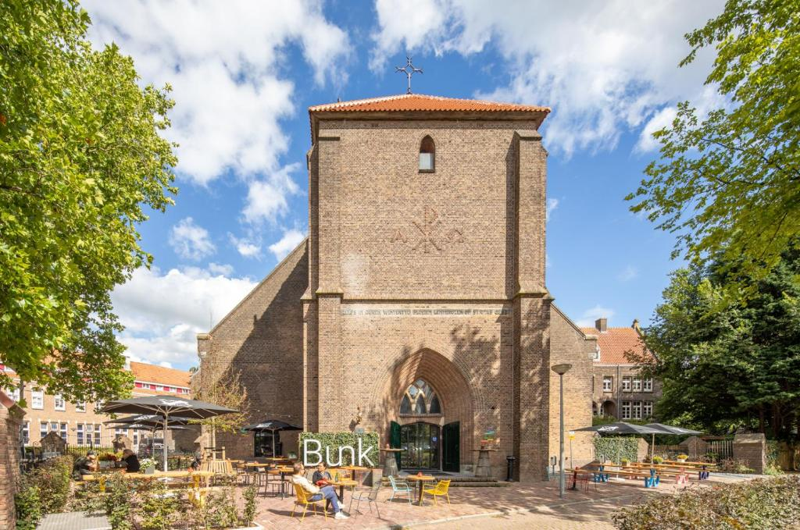
01
Bunk Hotel Netherlands
BUNK Hotels repurpose historic church buildings into hybrid spaces where capsule “pods” and compact rooms are tucked beneath lofty arches.
This innovative design reflects BUNK’s mission to blend the social vibe of a hostel with the comfort and style of a boutique hotel.

Slide 24
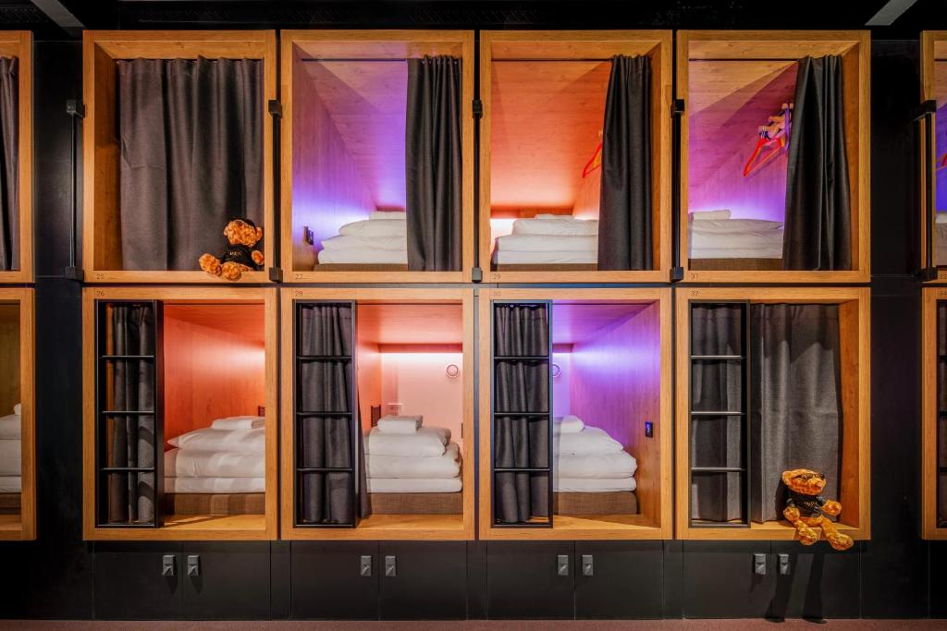
Bunk Hotel, Netherlands
Business Model Type
Hybrid Hospitality Model (Boutique Hotel + Design Hostel + Cultural Venue)
Bunk Hotel converts unused churches into design-led, affordable accommodation that merges hotel privacy with hostel community.
It offers pod-style sleeping, communal areas, live music/events, and co-working. Revenue comes from beds, food & beverage, and cultural programming.
It targets urban explorers, digital nomads, and creatives, mixing social experience with value pricing in a repurposed heritage space.
Bunk Hotel Netherlands

Slide 25
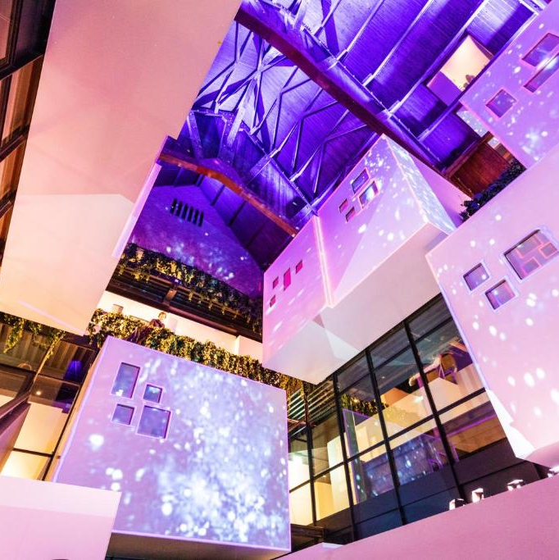
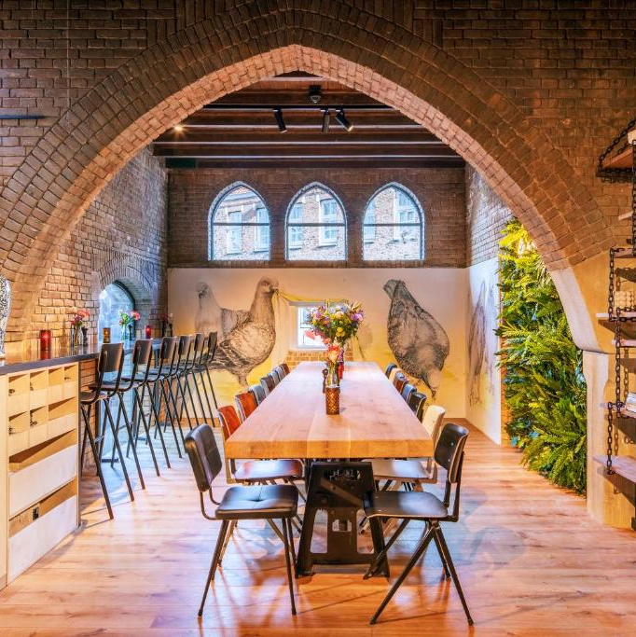
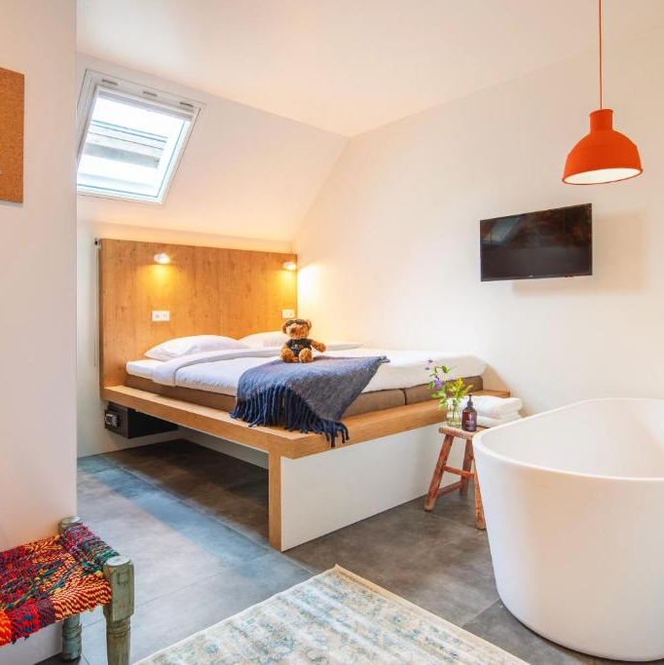
Bunk Hotel (Netherlands)
Opportunity
Spotted an opportunity in a disused church, defined a unique hybrid business model, and attracted a niche market.
They transformed a 1921 church into a hybrid hotel–hostel that doubles as a cultural hub. With affordable pods, private rooms, and vibrant communal spaces, it attracts both budget-conscious and culture-driven travellers.
Bunk Hotel, NHL

Slide 26
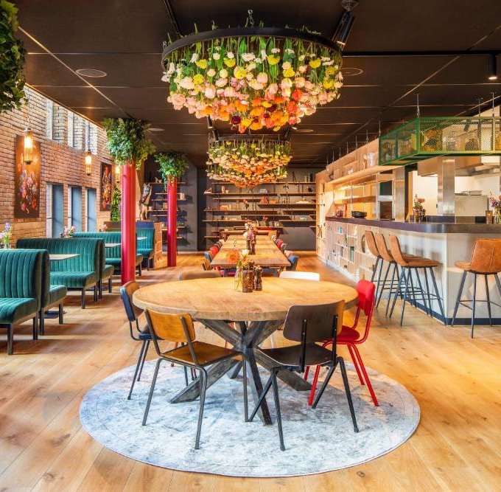
BUNK Hotels repurpose historic church buildings into hybrid spaces where capsule “pods” and compact rooms are tucked beneath lofty arches.
This innovative design reflects BUNK’s mission to blend the social vibe of a hostel with the comfort and style of a boutique hotel.
Bunk Hotel
Hybrid Hospitality Model (Boutique Hotel + Design Hostel + Cultural Venue)
Value Proposition & Target Market: BUNK is a young Dutch hotel chain (launched 2019) that bridges the gap between hostels and traditional hotels
Its core promise is to provide a “touch of luxury at an affordable price”– meaning guests get stylish, art-filled surroundings and quality amenities without the high cost.
Unique offering: By converting deconsecrated churches in Amsterdam into lodging, BUNK offers a unique stay with local character and cultural flair.
The target market skews toward young travelers and budget-conscious explorers who crave community and authenticity but also privacy and comfort. Solo travelers and couples can book futuristic sleeping pods (capsule-style bunks) for hostel-like prices, while those needing more space (including small groups or families) can opt for compact private rooms
This “for all budgets” approach is central to BUNK’s model making it attractive to backpacker-types looking to upgrade as well as conventional hotel guests looking for a quirky, social alternative.
Bunk Hotel, Netherlands

Slide 27
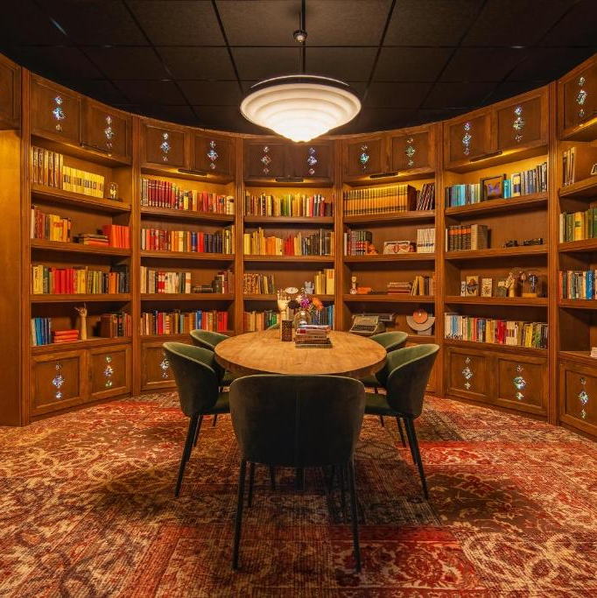
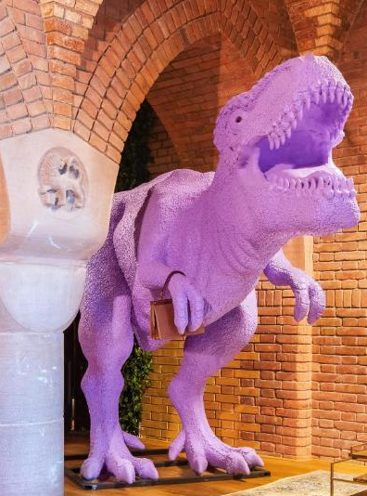
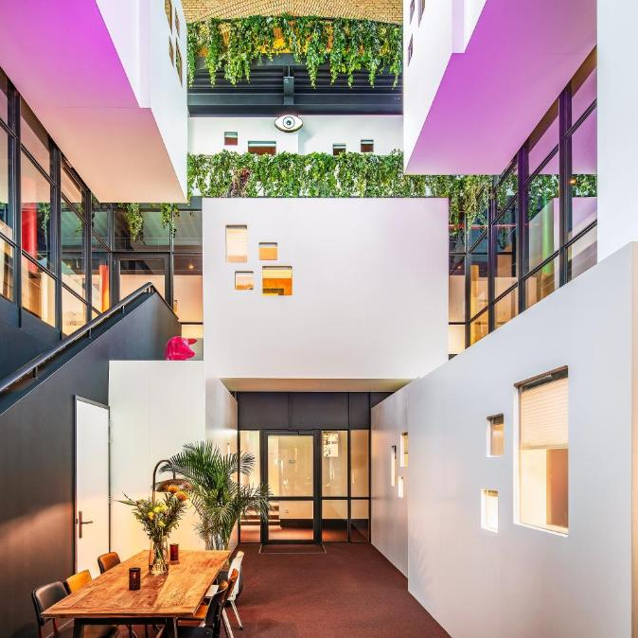
Opportunity: Reimagined a disused church as a tourism anchor, maximising space through pods, studios, and events.
Strong Brand: Positioning as a cultural hub with art, music, and podcasts embedded into its operations makes Bunk stand out in a crowded market.
Guest Experience: Guests don’t just stay overnight—they participate in cultural life through workshops, exhibitions, and live events.
Viability: Combining budget lodging with cultural programming diversifies revenue and keeps occupancy strong.
Bunk Hotel, NHL

Slide 28
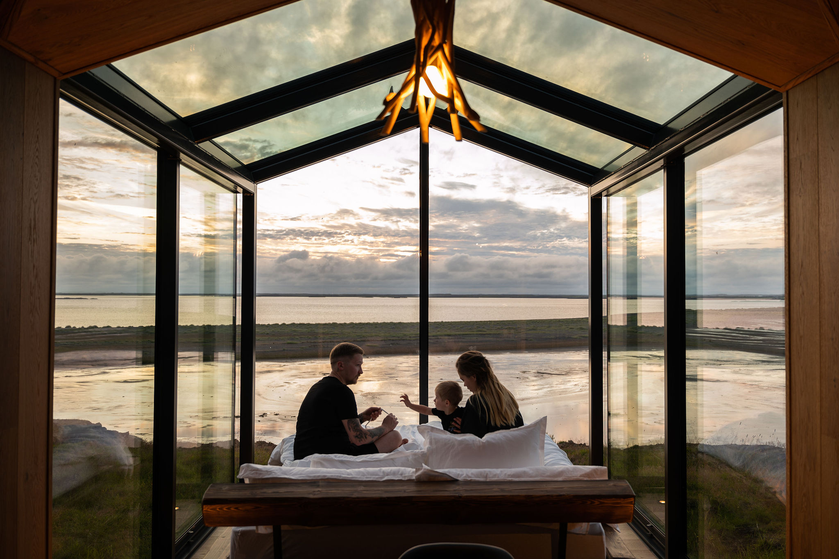
Panoramic Glass Lodge, Iceland
02
Panorama Glass Lodge offers secluded glass cabins in the wilds of Iceland, where guests can watch the northern lights or midnight sun from their bed.
This “infinite star hotel” concept delivers a once-in-a-lifetime experience blending luxury and nature.
Panoramic Glass Lodge Iceland

Slide 29
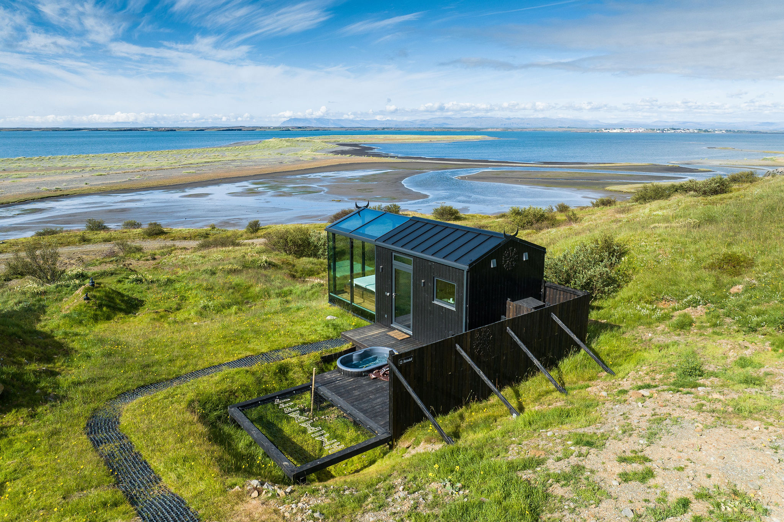
Panorama Glass Lodge, Iceland
Business Model Type
Premium Niche Eco-Glamping Model + Scenic Micro-Stay Experience
Panorama Glass Lodge operates standalone, high-end glass cabins in remote scenic locations, offering privacy, immersion in nature (aurora, midnight sun), and curated luxury experiences.
It’s designed for short-stay, high-spend travelers and built on viral appeal, scarcity marketing, and minimalist luxury.
This model focuses on low-footprint construction, premium pricing, and direct-to-consumer booking.
Panorama Glass Lodge, Iceland

Slide 30
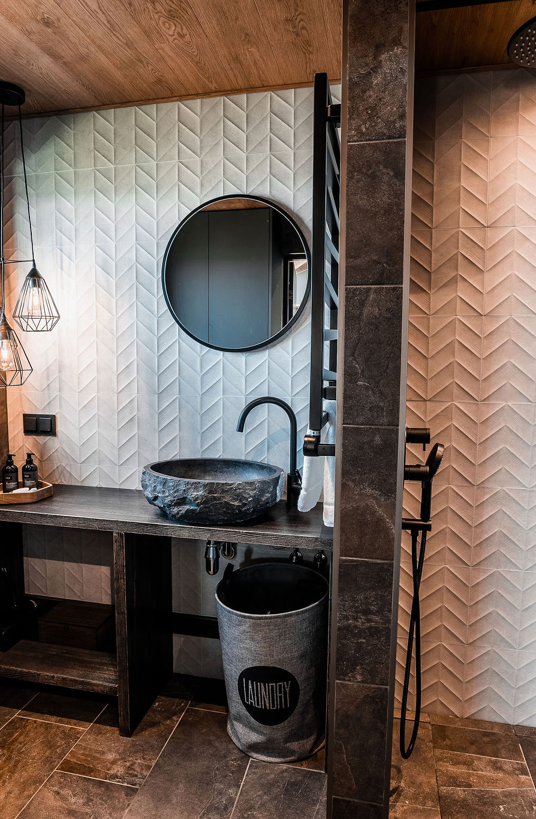
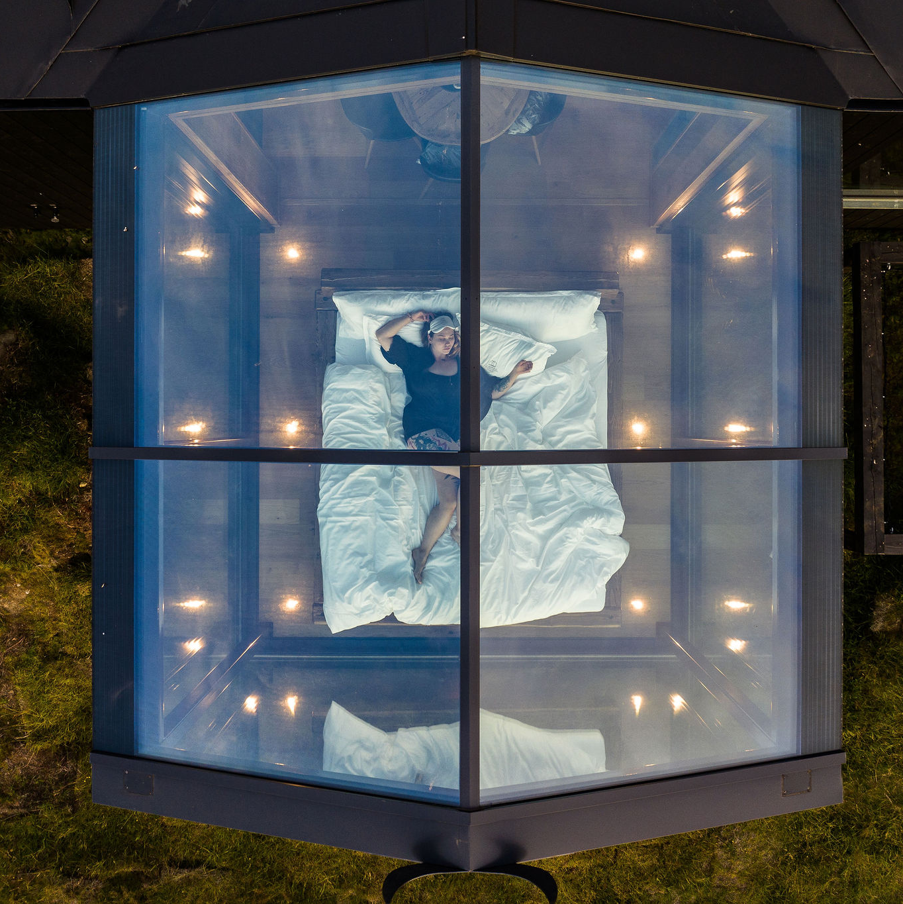
Panorama Lodge
(Iceland)
Opportunity
Strove to understand the motivation of luxury travellers and couples for “once-in-a-lifetime” nature experiences and build a business model around premium glass cabins.
Panorama Glass Lodge offers futuristic glass-roofed cabins designed to frame the Icelandic sky—aurora in winter, midnight sun in summer. Each lodge blends minimalist Viking-inspired design with privacy, hot tubs, and sustainability.
Panorama Glass Lodge, Iceland

Slide 31
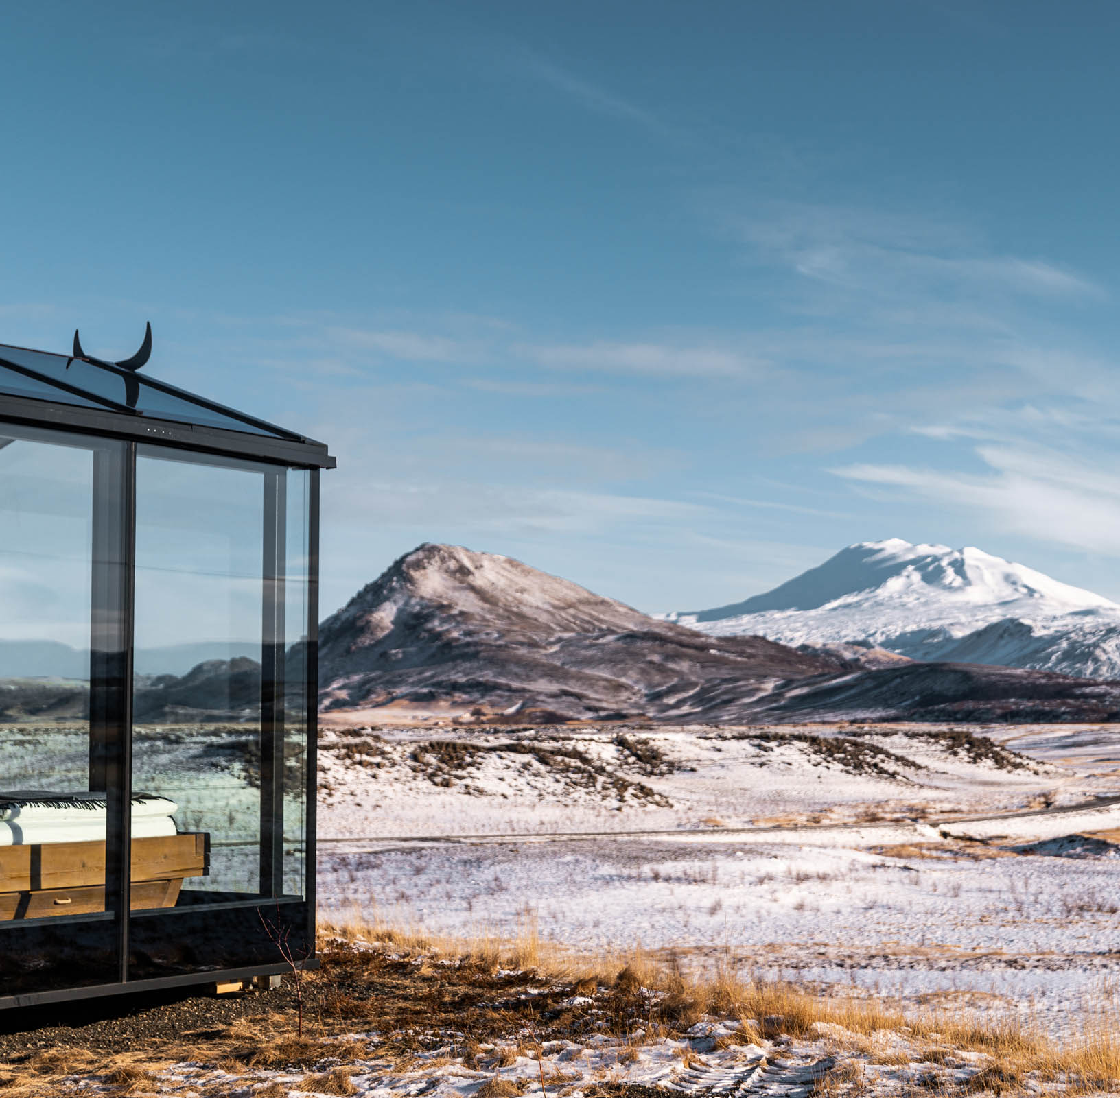
Opportunity
This was the first accommodation in Iceland where you could sleep under a glass ceiling and it remains the country’s most famous glass lodge offering.
Panorama Lodge
Premium Niche Eco-Glamping Model + Scenic Micro-Stay Experience
Value Proposition & Guest Experience: Is a family-owned glamping business that centers on an ultra-immersive nature experience with a luxury twist.
Each unit is a Scandinavian-designed glass cabin (around 23–36 m²) with floor-to-ceiling windows and a see-through glass roof, allowing guests to literally sleep under the stars (or northern lights) in comfort.
The lodges are set in remote scenic locations – currently 4 cabins in South Iceland (river and mountain views) and 3 in West Iceland (ocean views) – each deliberately placed in seclusion so guests have privacy and panoramic vistas
The target market includes honeymooners and couples seeking a romantic getaway, as well as experience-driven travelers (“bucket list” tourists) who want something extraordinary like watching the Aurora Borealis from a private hot tub.
Panorama Glass Lodge, Iceland

Slide 32
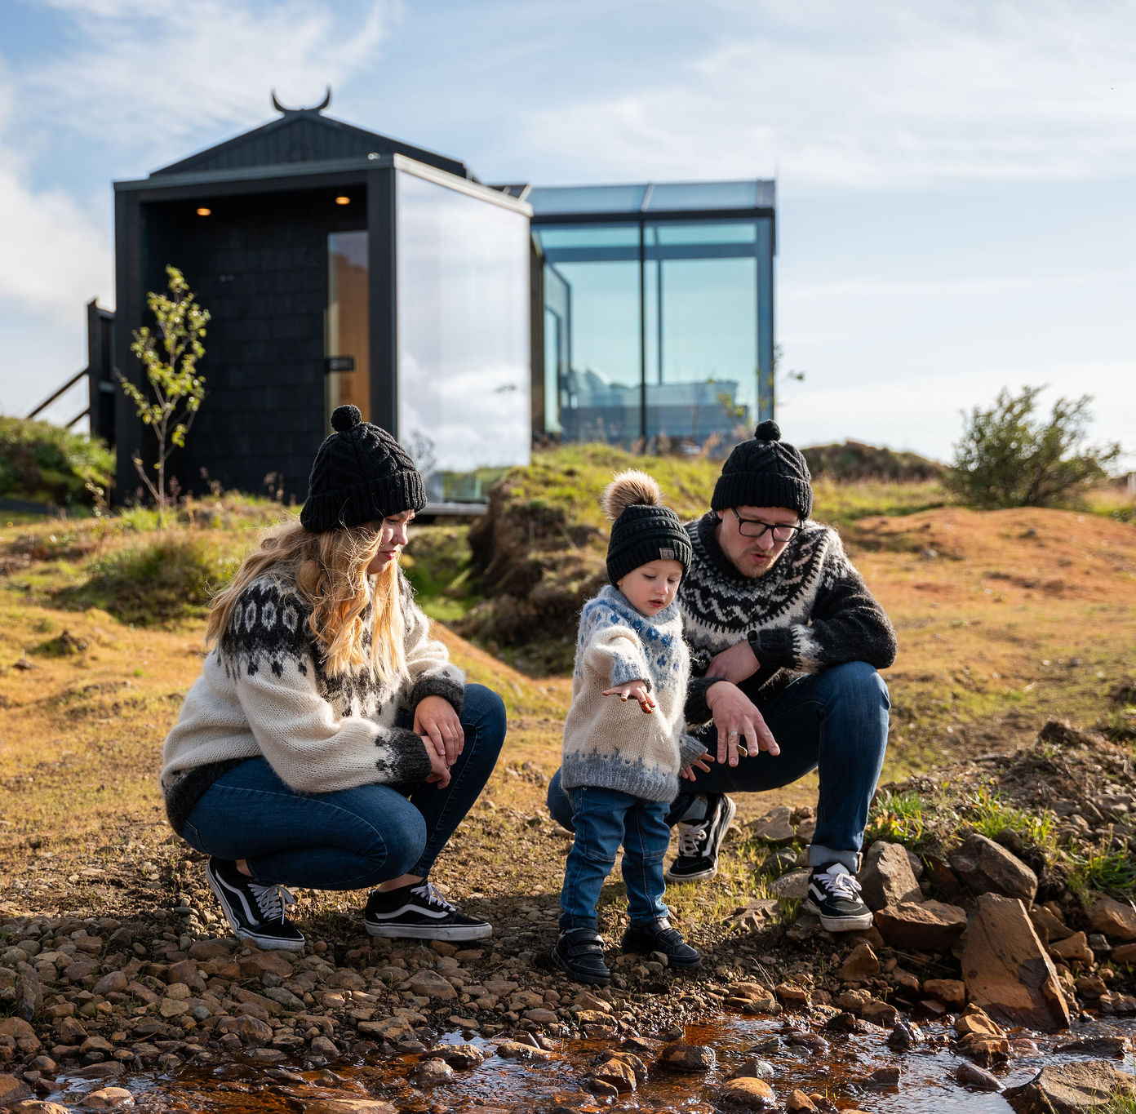
Opportunity
Saw high demand potential to cater for a new market – families.
Panorama Lodge
Premium Niche Eco-Glamping Model + Scenic Micro-Stay Experience
A larger “family lodge” for up to 5 guests exists, but the concept primarily appeals to adults on special trips.
PGL’s value proposition is encapsulated in their motto that this isn’t a typical five-star hotel, but “an infinite star” experience – guests trade conventional hotel amenities for the luxury of nature’s spectacle.
That said, the lodges still provide upscale comforts: plush king beds, a fully equipped kitchenette (with thoughtful touches like complimentary local coffee/tea and basic groceries) modern bathroom with rainshower, plus a private outdoor hot tub and deck for each cabin.
Importantly, PGL offers full privacy and self-catering independence – it is a “non-serviced” lodging with self check-in via smart locks, meaning no on-site staff or room service to intrude on the wilderness vibe.
Panorama Glass Lodge, Iceland

Slide 33
Opportunity
“luxury meets wilderness”
Panorama Lodge
Premium Niche Eco-Glamping Model + Scenic Micro-Stay Experience
This operational choice ensures that while guests enjoy hotel-level luxury in design and cleanliness, they also feel a sense of adventure and exclusivity (much like an upscale short-term rental).
The overall guest experience is one of solitude in nature without sacrificing comfort, a combination that defines its value proposition as “luxury meets wilderness”
Panorama Glass Lodge, Iceland

Slide 34
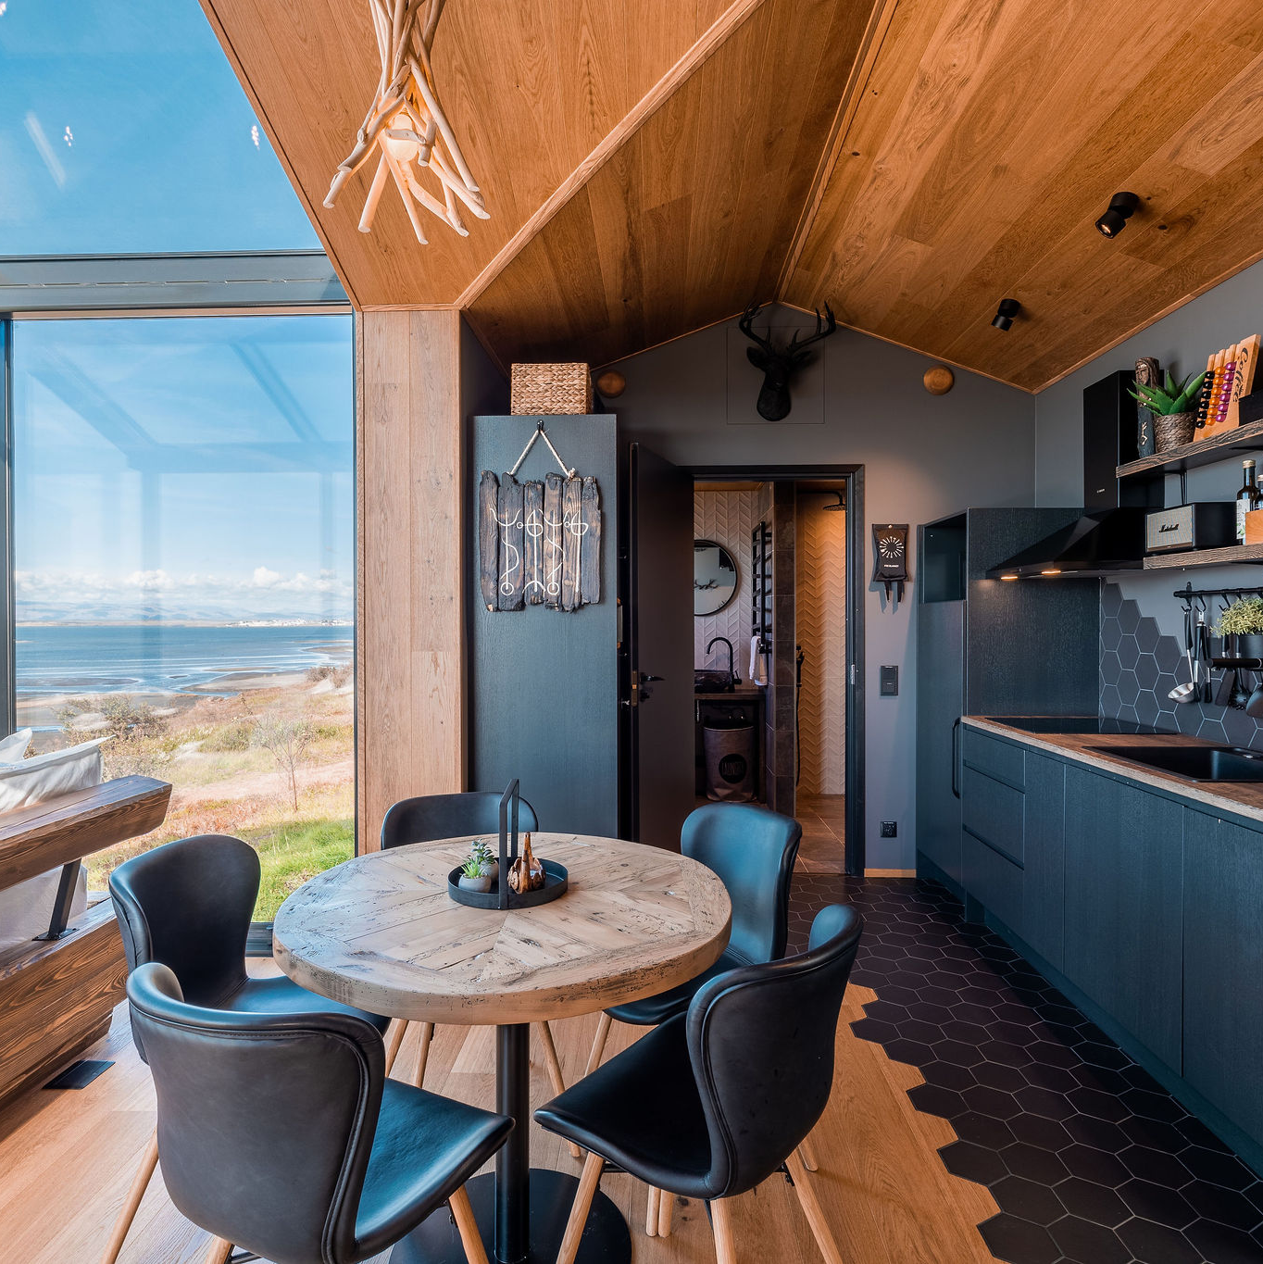
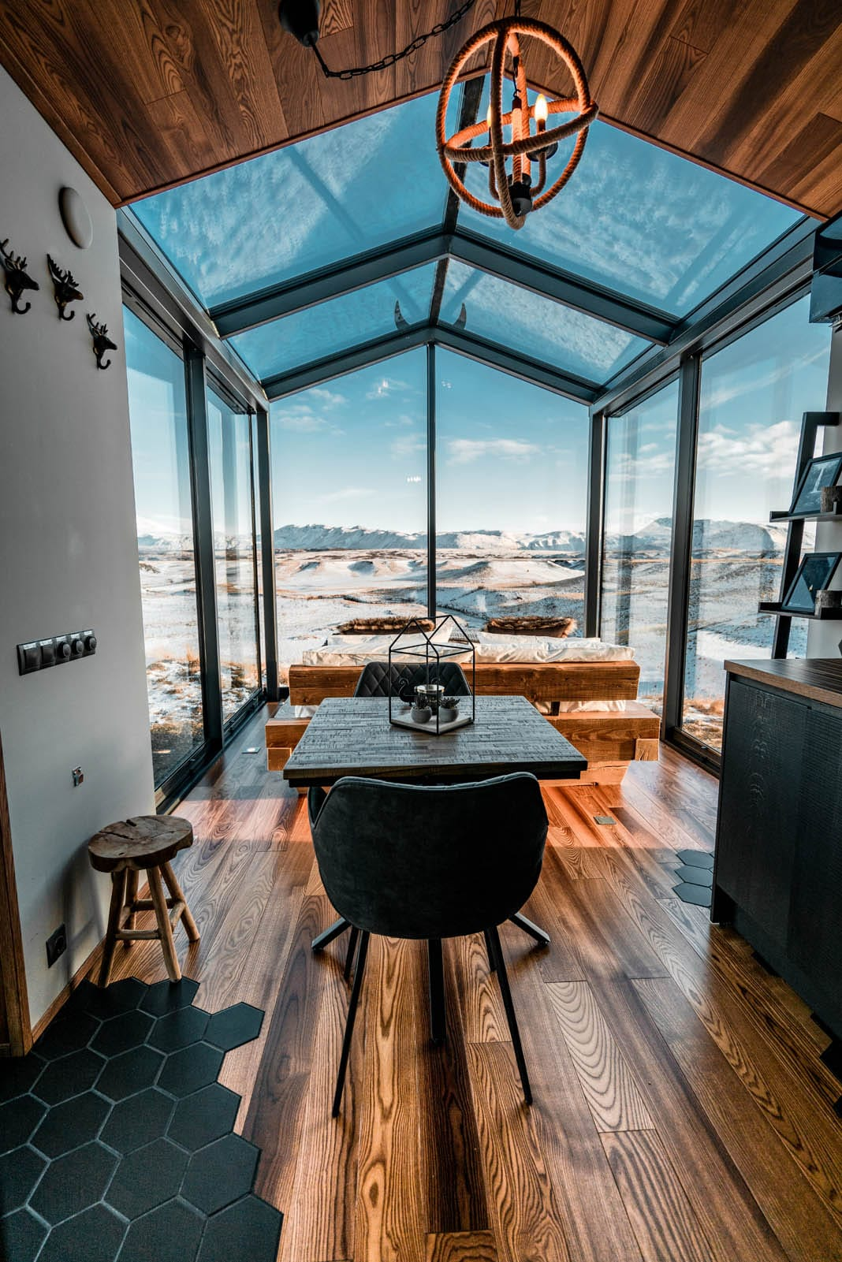
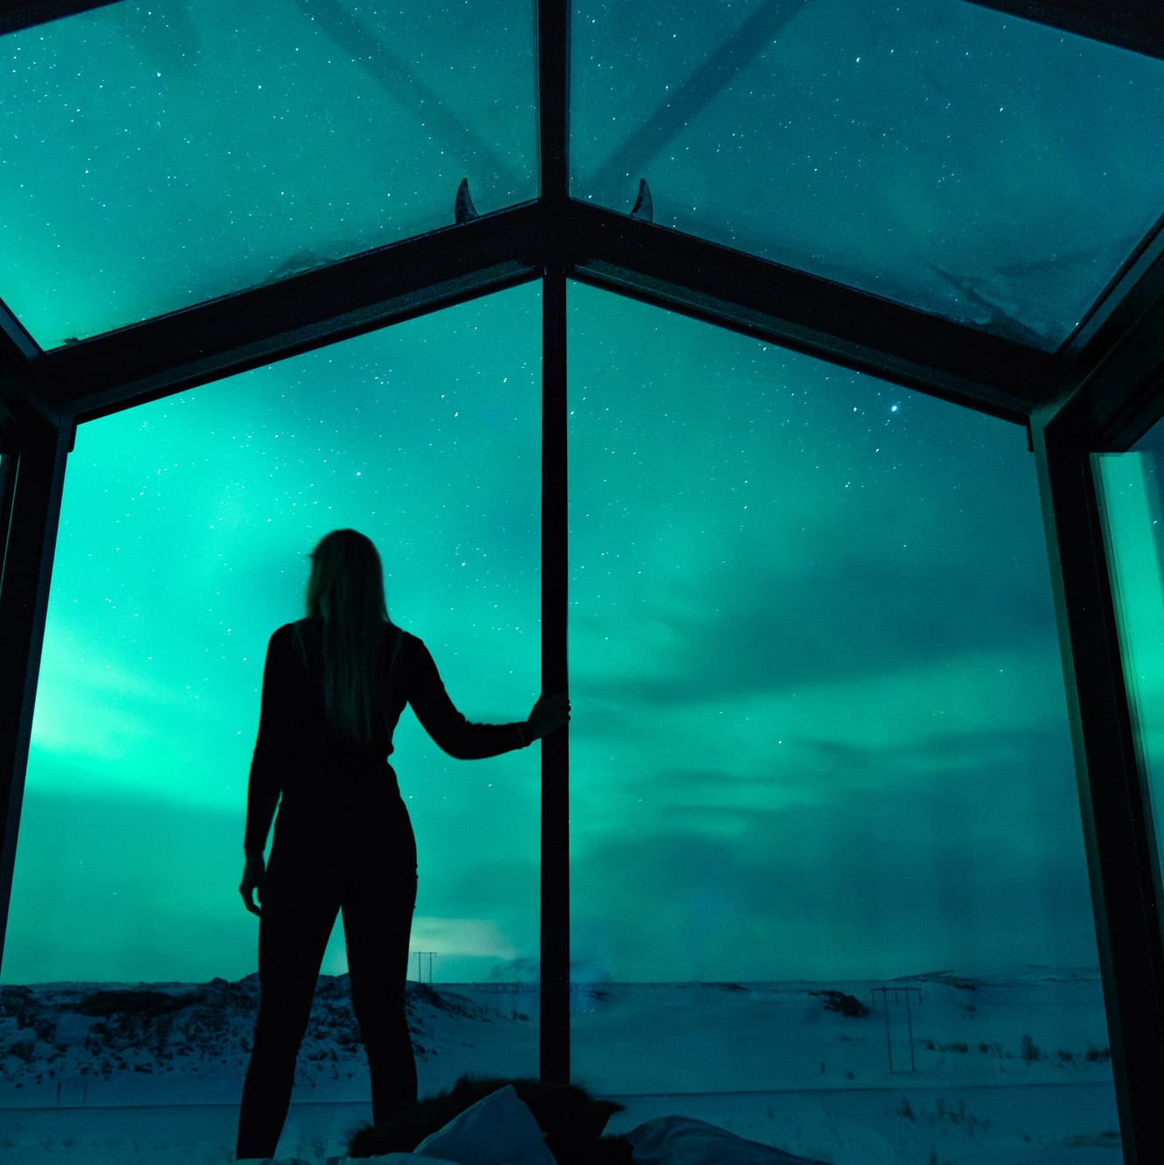
Sustainability: Screw-pile construction minimises land disturbance while glass cabins maximise exposure to nature.
Strong Brand: Clever scarcity marketing (limited booking windows) fuels demand and maintains 90%+ occupancy at premium rates.
Guest Experience: Private hot tubs, panoramic sky views, and remote locations create “once-in-a-lifetime” stays.
Viability: Premium eco-design + viral social media appeal support high nightly rates (€430–950) and profitability.
Panorama Glass Lodge, Iceland

Slide 35
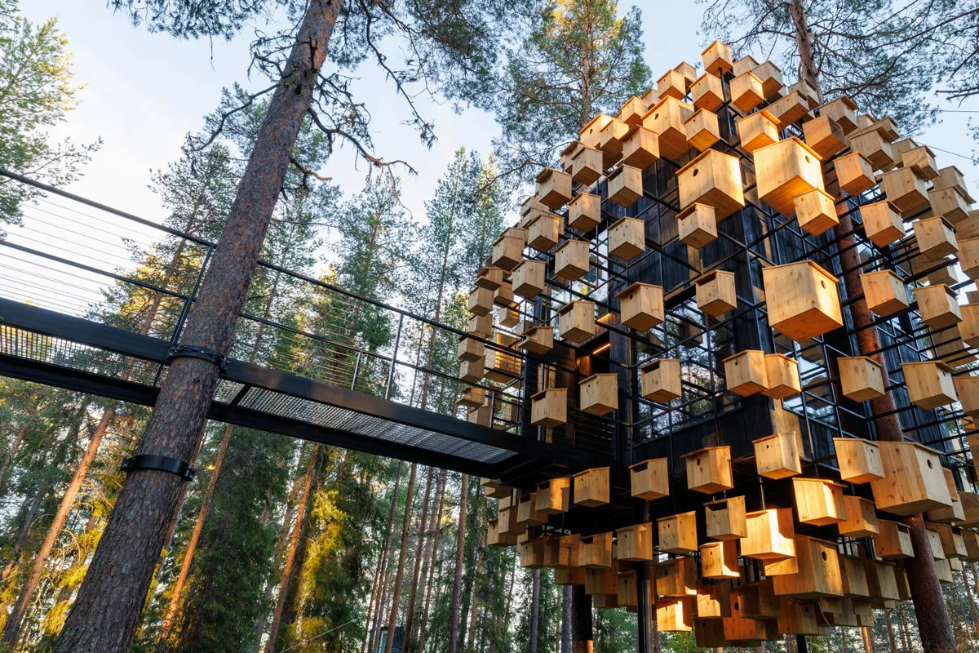
03
Tree Hotel, Sweden
Treehotel’s Biosphere tree room (opened 2022) is wrapped in 340 birdhouses to support local birdlife while immersing guests in the forest canopy.
Tree Hotel, Sweden

Slide 36
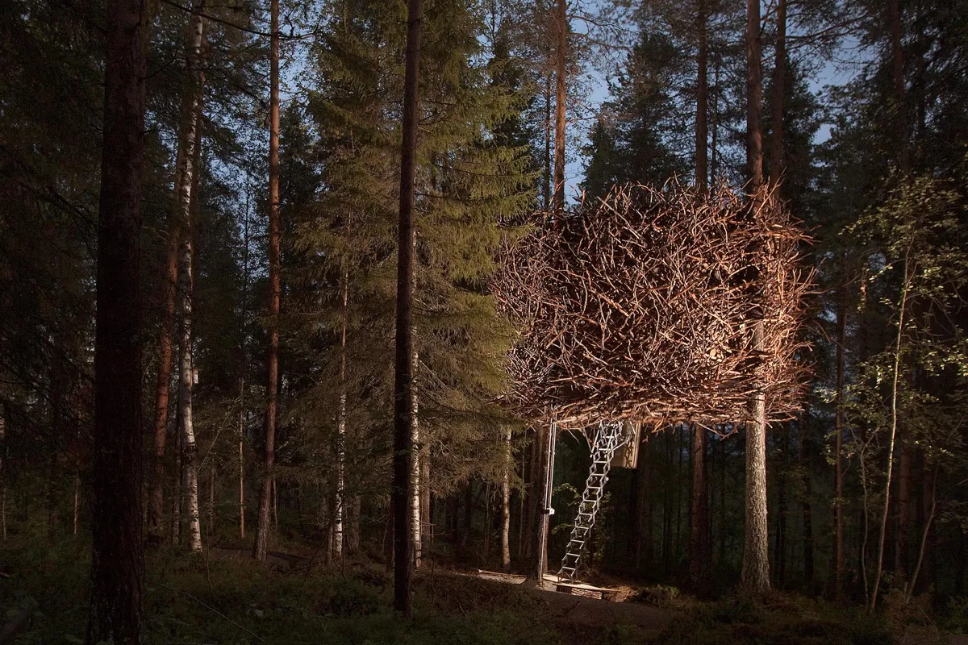
Tree Hotel
Business Model Type
Experiential Luxury Eco-Accommodation Model: Also considered a Design-Driven Boutique Hospitality Model with low-density, high-impact offerings.
Treehotel offers high-end, architect-designed tree rooms that provide once-in-a-lifetime stays in natural surroundings.
Its value lies in the experience of uniqueness, design, and nature immersion rather than standard hotel amenities. Revenue comes from premium room rates, curated local experiences, and food services.
The model relies on scarcity, storytelling, and sustainability to create demand and maintain profitability.
Tree Hotel

Slide 37
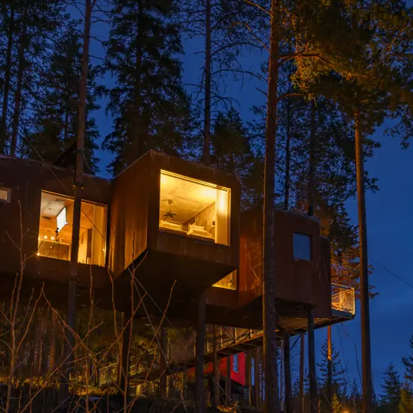
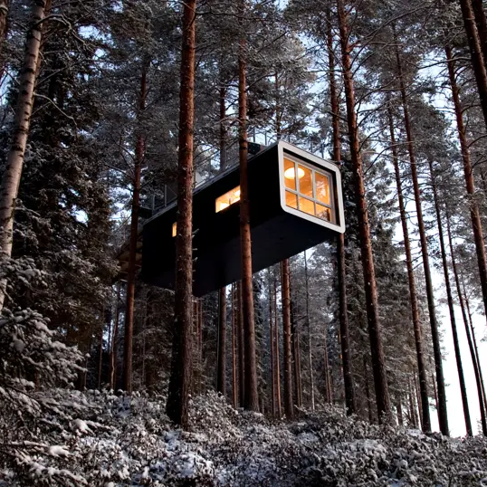
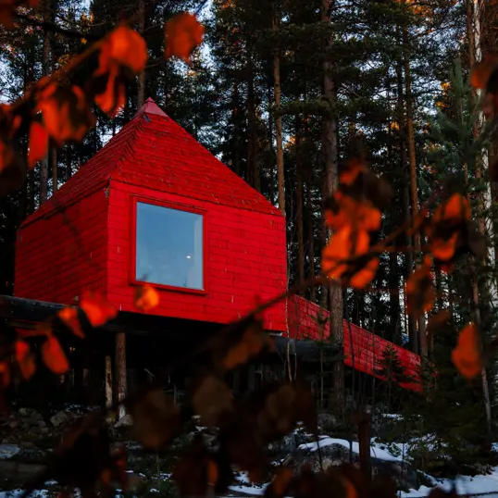
Tree Hotel
(Sweden)
Opportunity:
Treehotel is a collection of architect-designed treehouse suites suspended in the boreal forests of Swedish Lapland. Founded in 2010 in the village of Harads, it fulfills the childhood fantasy of a luxury treehouse stay high among the pines.
This innovative concept transformed a remote logging-threatened forest into a world-famous destination, attracting design-conscious travelers seeking once-in-a-lifetime experiences like the Northern Lights and midnight sun.
Tree Hotel, Sweden

Slide 38
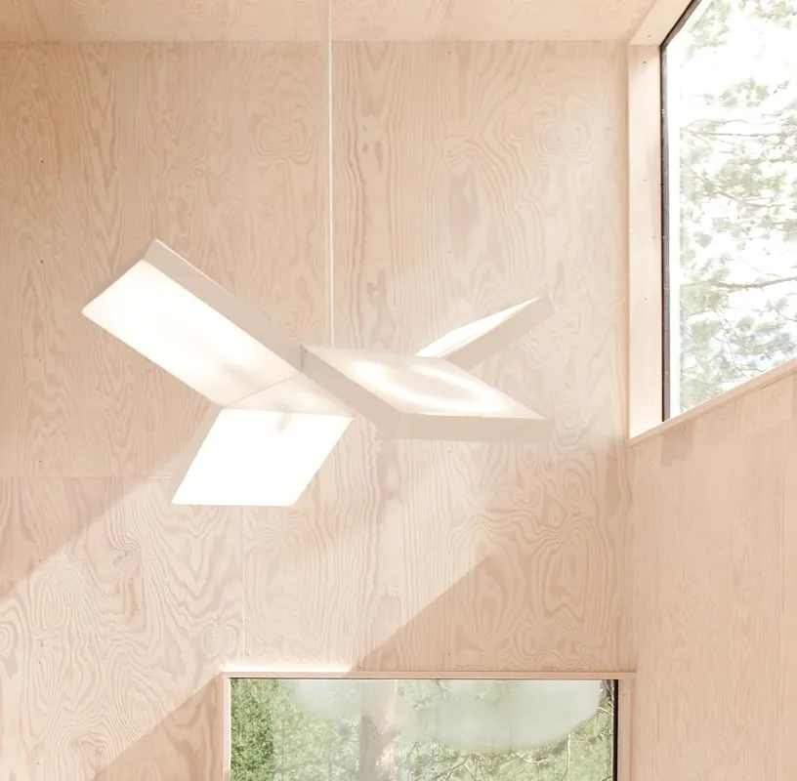
Each unique treeroom – from a mirrored cube reflecting the woods to a UFO-shaped capsule –
offers contemporary design “beyond the ordinary” and panoramic views of unspoiled nature and sustainability.
Tree Hotel
Experiential Luxury Eco-Accommodation Model
Opportunity: By leveraging spectacular nature and out-of-the-box design, Treehotel created a new tourism draw in an otherwise little-visited area – a key opportunity for regional development.
Target Market: Affluent nature and design enthusiasts from around the world form the core market.
Appeal: The resort appeals to couples (e.g. honeymoons, anniversaries) and families seeking unique adventures, as well as niche segments like architecture buffs and experience collectors.
With English-speaking staff and global media coverage, Treehotel draws international travelers (Europe, USA, Asia-Pacific) looking for Arctic Circle charm and exclusivity.
Panorama Glass Lodge, Iceland

Slide 39
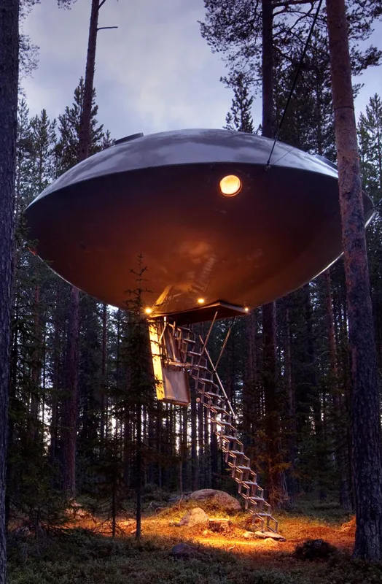
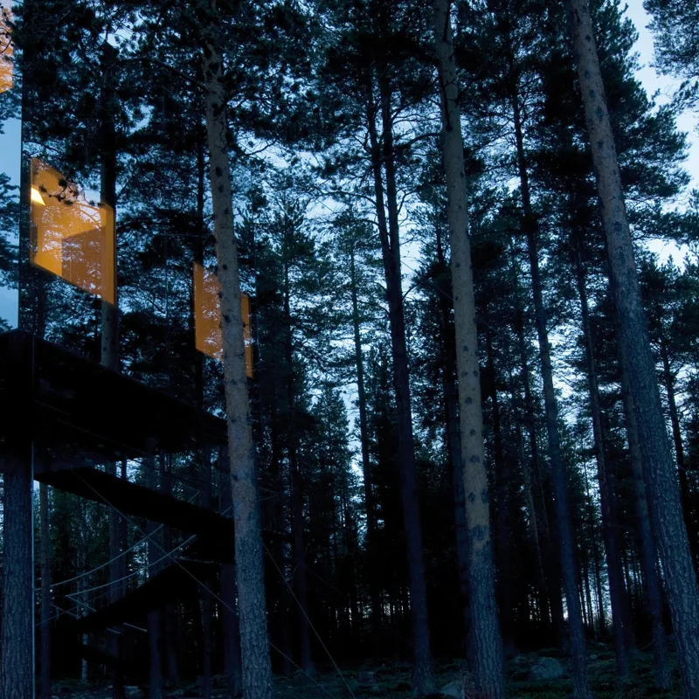
Sustainability: Treehotel’s eco-innovations (from sustainable construction to off-grid toilets) allow guests to enjoy nature with nearly zero impact.
The treehouses are built around existing trees and use renewable energy where possible, and initiatives like the Biosphere’s birdhouse façade actively support the local ecosystem.
Strong Brand: Through iconic design and storytelling, Treehotel has established a globally recognised brand for experiential luxury.
Clever marketing of scarcity (only a handful of exclusive rooms) creates buzz and desirability, keeping occupancy high at premium rates. The founders protect their brand legally, ensuring Treehotel remains one-of-a-kind – reinforcing its market differentiation and customer loyalty.
Tree Hotel, Sweden

Slide 40
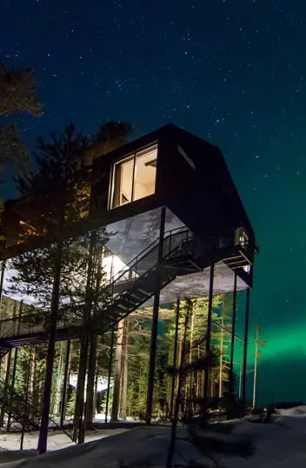
Guest Experience: Treehotel delivers an immersive, memorable guest journey – from Britta’s nostalgic guesthouse welcome to sleeping in a mirror cube under the stars.
Private saunas, outdoor hot tubs, and curated activities (midnight sun hikes, aurora sightings) cater to adventurous romantics. This focus on once-in-a-lifetime experiences, combined with warm personal hosting, leads to rave reviews and viral social media moments.
Viability & Growth: By commanding high nightly rates (€600) and offering add-ons, Treehotel achieves strong revenue per guest.
Its low-density, low-impact model keeps operating costs manageable (no large hotel infrastructure) while the constant global demand ensures profitability. The concept’s success has spurred gradual expansion (from 5 to 7 treerooms, with plans for more), demonstrating a financially viable path to growth through innovation, niche positioning, and adaptive reuse of natural space.
Tree Hotel, Sweden

Slide 41
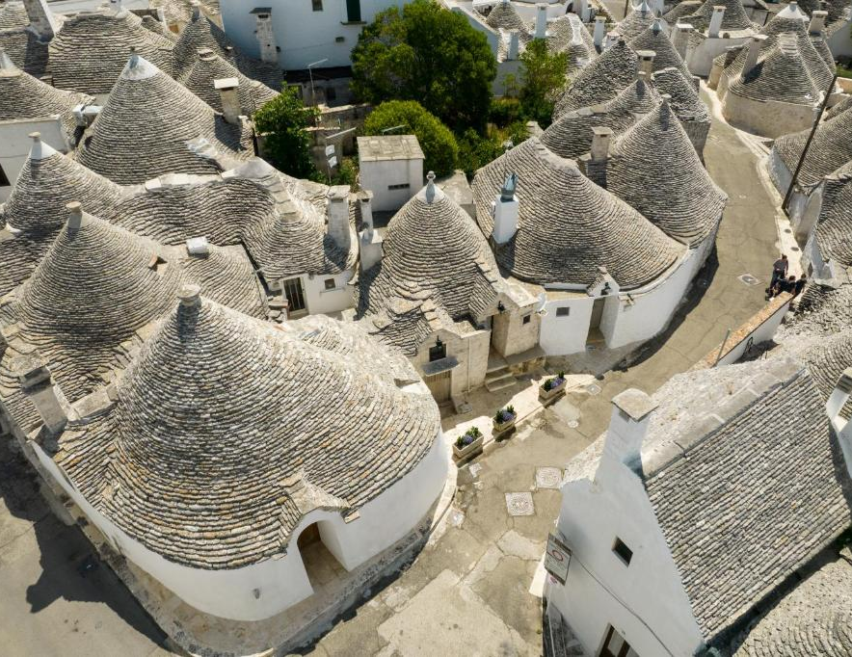
Trulli Holiday Albergo Diffuso (Italy)
04
Traditional trulli houses in Alberobello, Puglia. Trulli Holiday’s rooms are set in these historic cone-roofed dwellings, letting guests stay inside a UNESCO World Heritage site neighborhood.
Trulli Holiday Albergo Diffuso (Italy)

Slide 42

Trulli Holiday Albergo Diffuso
Business Model Type
Albergo Diffuso + Distributed Hotel Model: Also considered a sustainable heritage-based, community-integrated accommodation model.
This model distributes hospitality services across multiple renovated traditional buildings within a town (vs. one hotel structure), turning cultural heritage into a tourism asset.
Trulli Holiday restores and rents out trulli houses while providing centralised hotel-like services (check-in, breakfast, concierge). It earns revenue from accommodation, experiences, wellness services, and dining, and reinvests in the local community.
It focuses on authenticity, locality, and decentralised operations.
Trulli Holiday Albergo Diffuso (Italy)

Slide 43




Trulli Holiday Albergo Diffuso (Italy)
Opportunity:
Offers guests the chance to live in authentic trulli – the iconic whitewashed, cone-roofed stone huts of Puglia.
Instead of a single hotel building, this “widespread hotel” (albergo diffuso) spreads its rooms across dozens of historic houses throughout Alberobello’s old quarters.
Each trullo has been carefully restored and furnished in a traditional style (think rustic stone walls and antique wood furniture), but with modern comforts added.
Trulli Holiday Albergo Diffuso

Slide 44

Alberobello’s storybook setting and Trulli Holiday’s charming suites are popular for romantic getaways (reflected in a 9.7/10 rating from couples on Booking.com
Trulli Holiday Albergo Diffuso
Premium Niche Eco-Glamping Model + Scenic Micro-Stay Experience
Value Proposition & Target Market: The key opportunity here is heritage preservation as hospitality: by repurposing UNESCO-protected homes into lodging, Trulli Holiday sustains the town’s cultural architecture and offers travelers a one-of-a-kind immersion in local life.
This concept taps into rising demand for authentic, community-based travel – guests effectively “move in” among local residents, experiencing Puglian village life rather than a standard hotel.
It also revitalised the area’s economy, proving that safeguarding cultural heritage (the trulli date back centuries) can create a profitable niche in tourism.
Target Market: The target guests are experience-oriented travelers seeking culture and romance. Couples are a prime segment rating 9.7/10 on Booking.com
Trulli Holiday Albergo Diffuso

Slide 45

“magical” trullo atmosphere and friendly local service’
Trulli Holiday Albergo Diffuso
Premium Niche Eco-Glamping Model + Scenic Micro-Stay Experience
It also appeals to families (some trulli are configured with multiple beds or kitchenettes for longer stays and independent explorers from Italy and abroad who want to “live like a local.”
The staff speak multiple languages (Italian, English, French, German) and the region sees many European travelers, North Americans, and increasingly Asian tourists drawn by the UNESCO fame.
The marketing emphasizes authenticity and convenience – e.g. Trulli Holiday is often ranked #1 in Alberobello on TripAdvisor, with thousands of positive reviews praising the “magical” trullo atmosphere and friendly local service.
This word-of-mouth, along with features in travel media about Alberobello, keeps demand high year-round (not just summer).
Trulli Holiday Albergo Diffuso

Slide 46



Sustainability: No new construction, uses renewable energy features, sources local organic food, and preserves the local culture.
Strong Brand: Authentic Puglian hospitality, homemade foods, and personal local guides. Integrates with the community, sells local crafts and employs locals.
Guest Experience: Is enchanting and highly memorable. Each trullo is like a private fairy-tale cottage, yet fitted with modern luxuries (plush bedding, aircon) for comfort. Arrange a candlelit dinner, a spa treatment, or a home-cooked meal.
Viability: By tapping into a UNESCO destination with year-round appeal, it enjoys high occupancy and occupancy diversification (spread across many small units rather than one big building). Its mid-range pricing and variety of offerings attract a broad market, balancing volume and margin. Importantly, the business model has built-in resilience: distributing guests across the town mitigates over-reliance on a single site and spreads impact.
Trulli Holiday Albergo Diffuso

Slide 47

Modules Recap
Session Themes and Modules
Module | Focus | Relevance from Mentoring Session
Module 1: Ideation & Value Proposition | Understanding what you’re selling | Each participant began defining their “why” and “who for”.
Module 2: Opportunity & Feasibility | Site potential, planning, and market fit | Thomas, Bríd, and Úna discussed planning and zoning; Laura advised using SEAI and local council guidance.
Module 3: Sustainability & Community Impact | Environmental and social benefits | Emphasis on regeneration, forest trails, and community jobs.
Module 5: Guest Experience & Wow Factor | Designing memorable stays | Turf fires, storytelling, local produce, and sensory experiences highlighted.
Module 6: Financial Foundations | Pricing, planning, and revenue | Lorcan’s insights on cost-saving, lean processes, and smart reinvestment.

Slide 48



Click to type
Follow Our Journey
www.epicstays.eu

