Slide 1
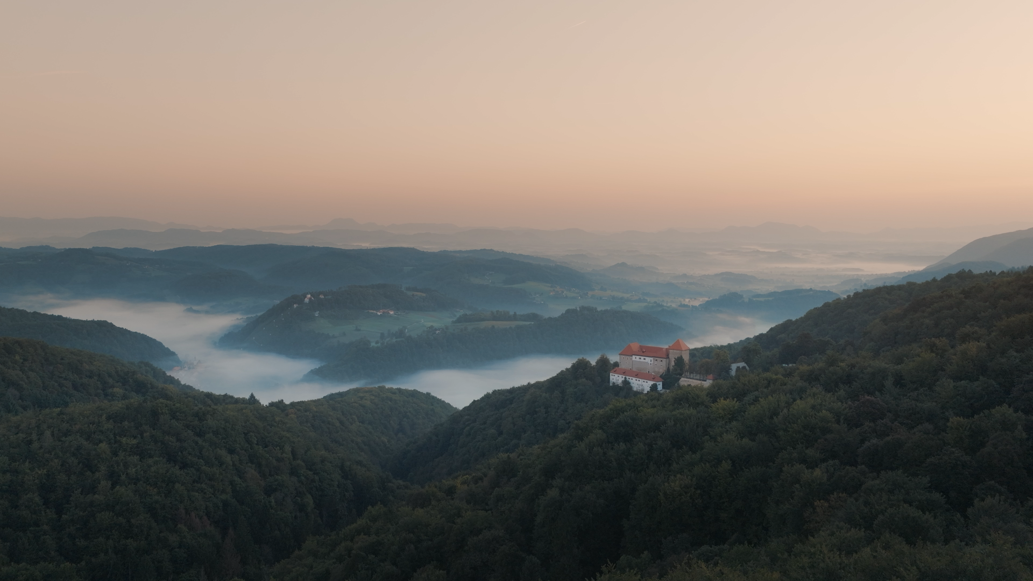

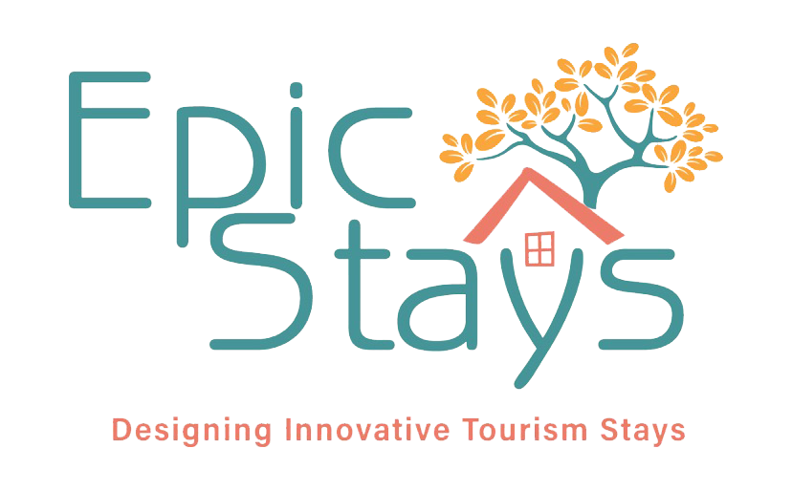

BUILDING A SUSTAINABLE FUTURE THROUGH HERITAGE AND NATURE
Tourism and development initiatives in the Kozjansko region, including Podsreda Castle
Presented by Tara Mijailović
Representative of the Kozjansko Regional Park and the Municipality of Kozje in Slovenia
Notes:
Good afternoon everyone,
First of all, I’d like to thank all the previous speakers for their inspiring and insightful presentations.
It’s truly a pleasure to hear so many different approaches to creating meaningful and alternative tourism experiences across Europe.
My name is Tara Mijajlović, and I’m here today on behalf of the Kozjansko Regional Park and the Municipality of Kozje in Slovenia.
I’m very happy to be part of this conference and to share with you the story of Podsreda Castle – a 12th-century heritage site located in the heart of Kozjansko regional park.
Podsreda Castle represents a unique example of how cultural heritage, sustainable development, and alternative accommodation can coexist in harmony.
It’s not only a monument of history – it’s a living space where visitors can experience nature, tradition, and authentic local hospitality in a truly sustainable way.

Slide 2
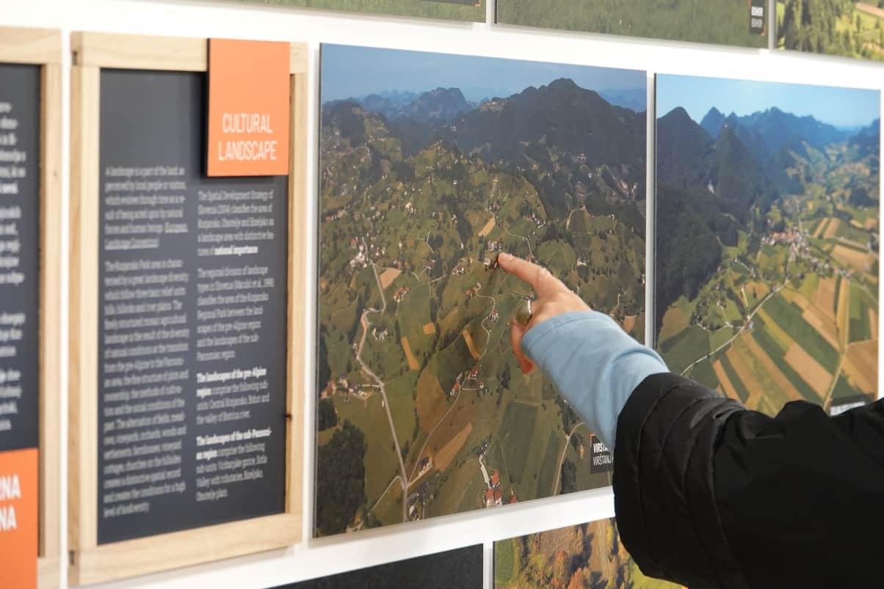
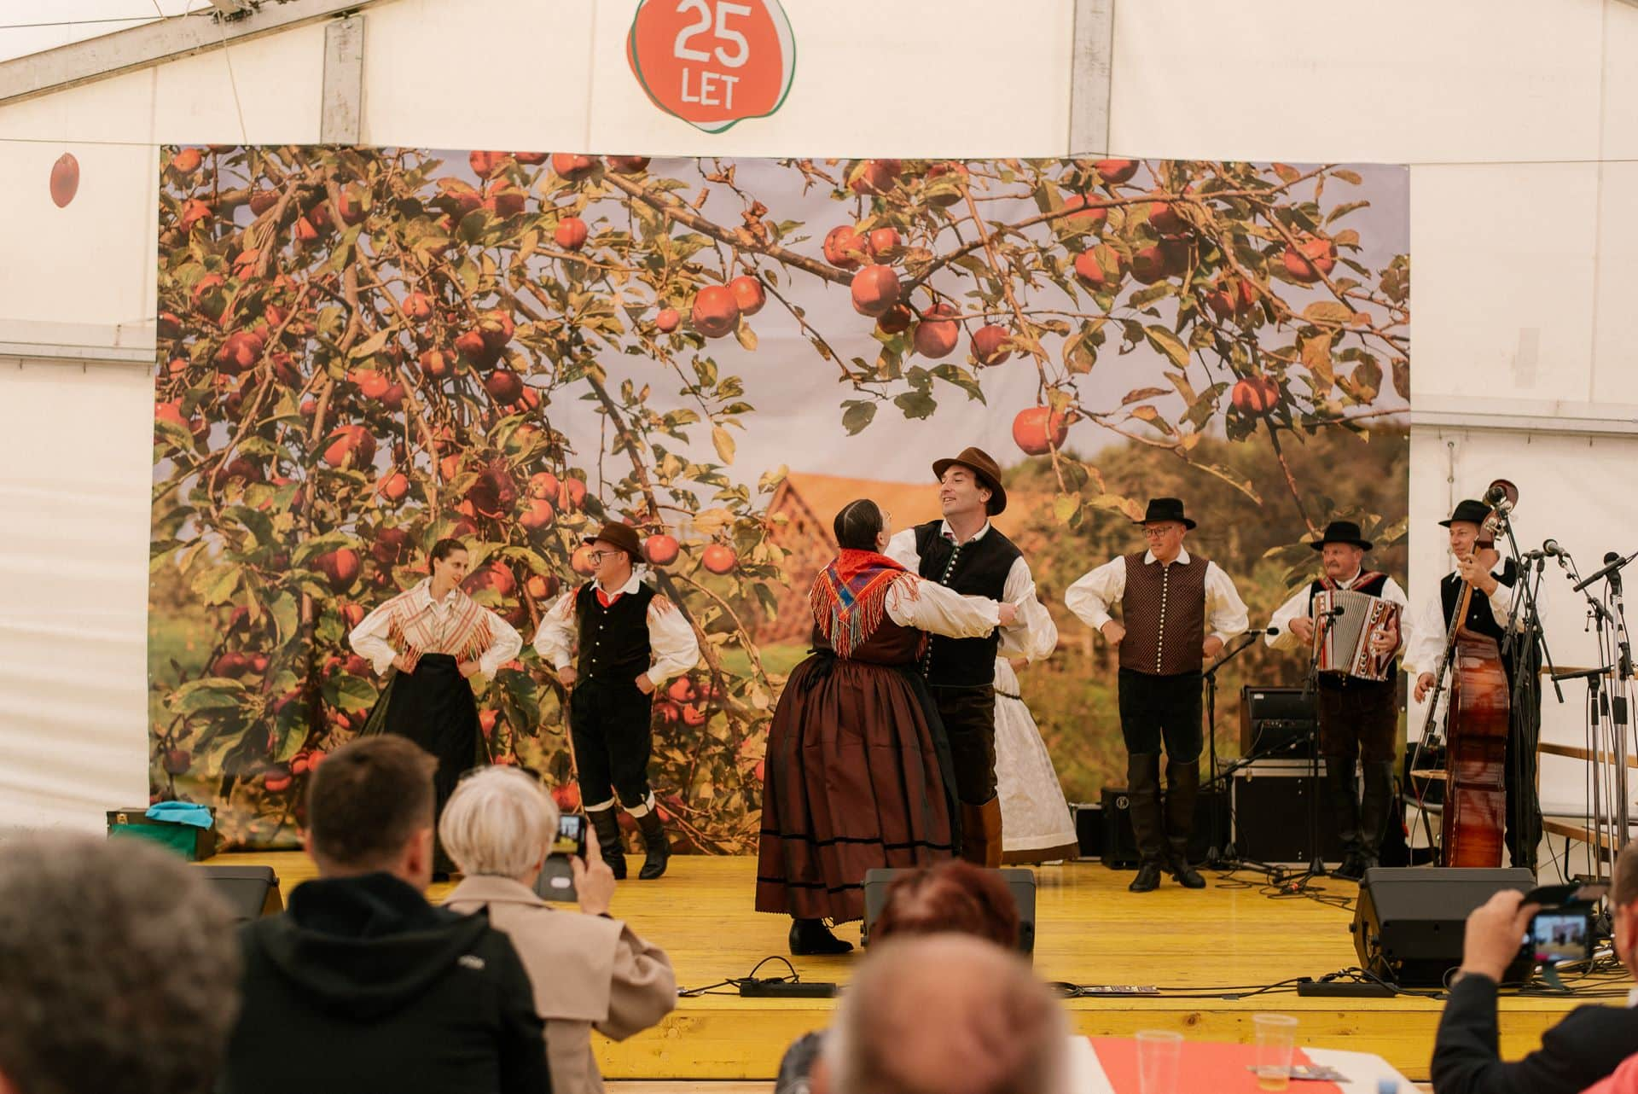
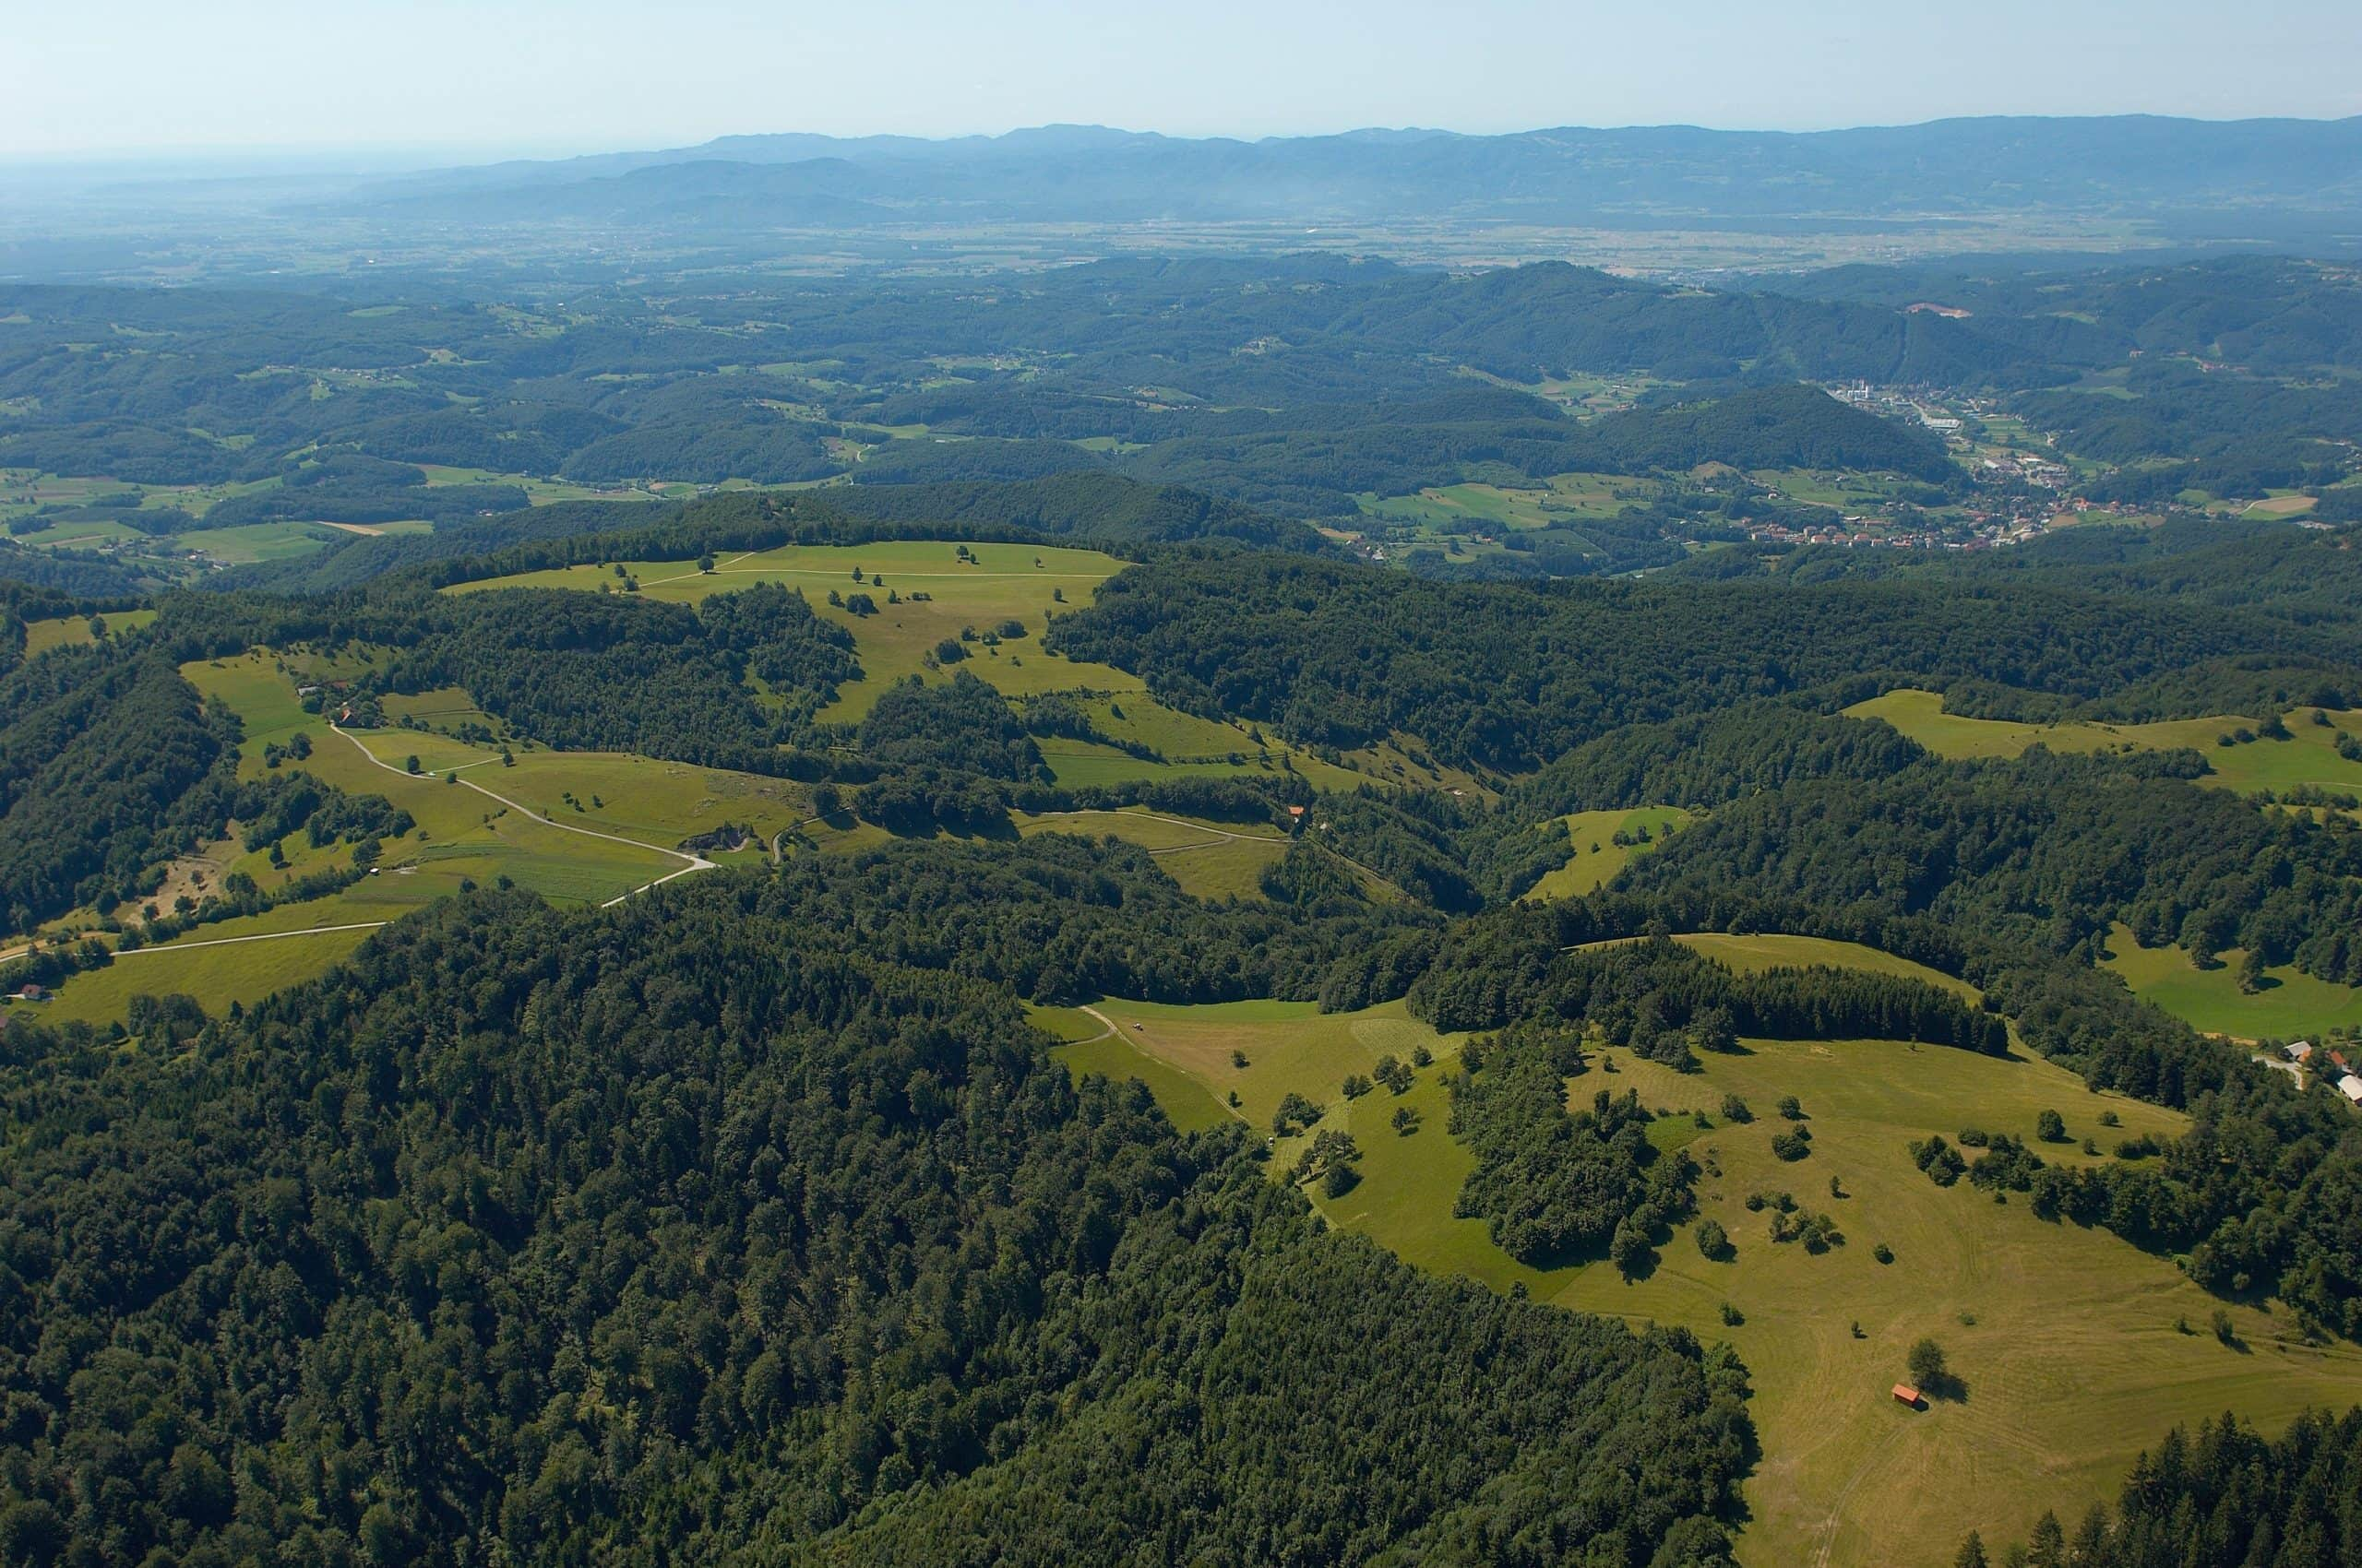
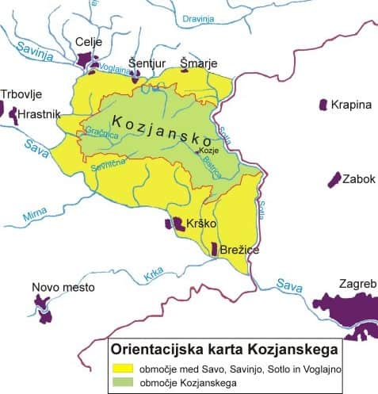
THE KOZJANSKO REGION
A Region of Harmony Between People and Nature
Notes:
THE KOZJANSKO REGION
Kozjansko lies in the eastern part of Slovenia, between the Sava River to the north and the Sotla River to the south, along the border with Croatia. The landscape is diverse and hilly, featuring numerous vineyards, orchards, and forests.
The people of Kozjansko are deeply connected to tradition. They have preserved folk songs, dances, and customs, which they proudly showcase at events such as the Kozjansko Apple Festival.
The local economy is primarily based on agriculture, fruit growing, and viticulture, while sustainable tourism is becoming increasingly important, offering opportunities for hiking, cycling, and tasting local cuisine.
Kozjansko is a region of natural beauty, rich heritage, and welcoming people — a place where tradition and nature still intertwine in perfect harmony.

Slide 3
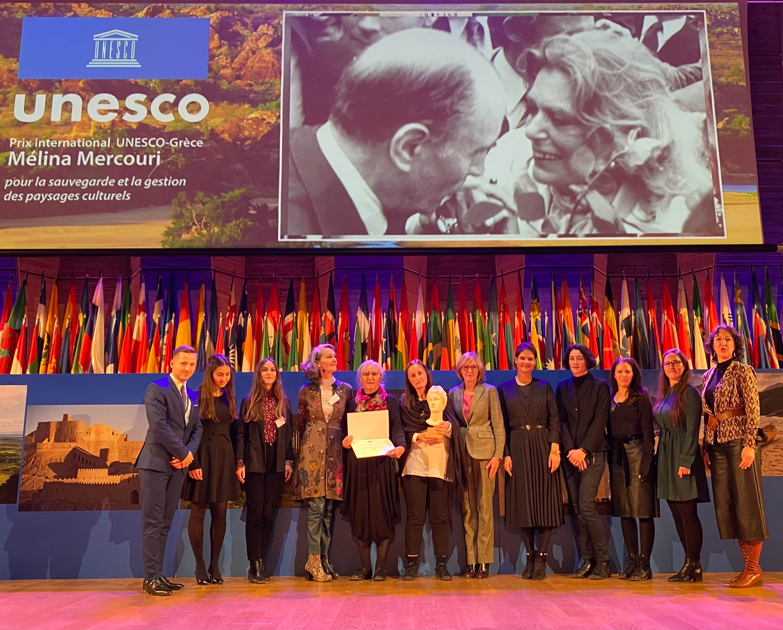
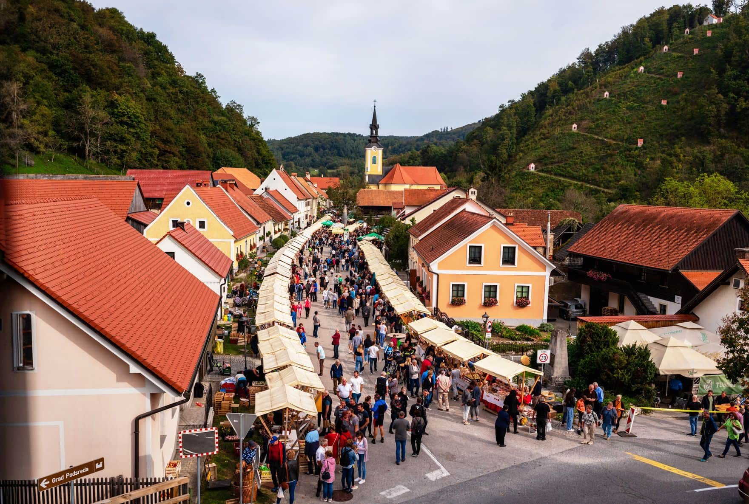
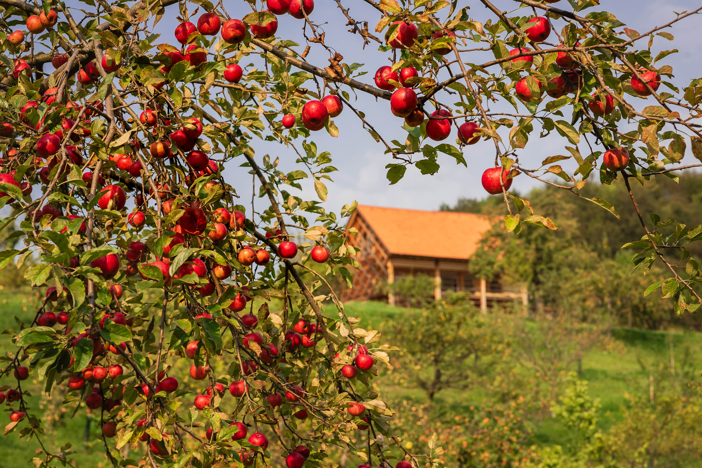
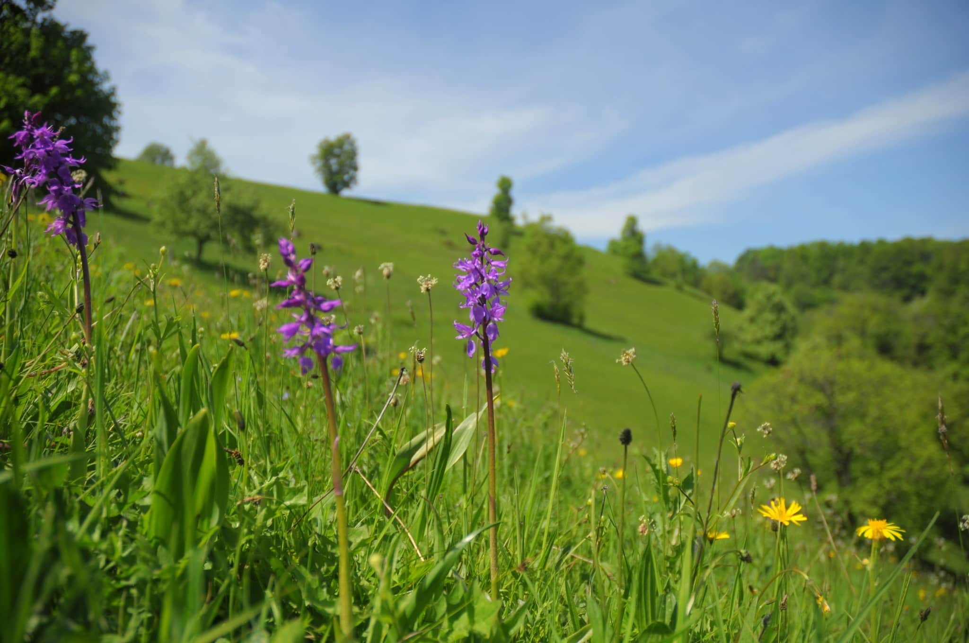
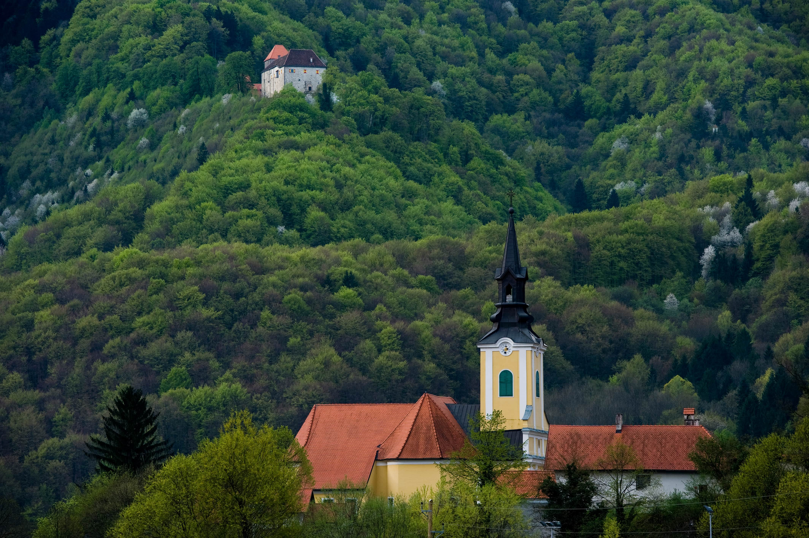
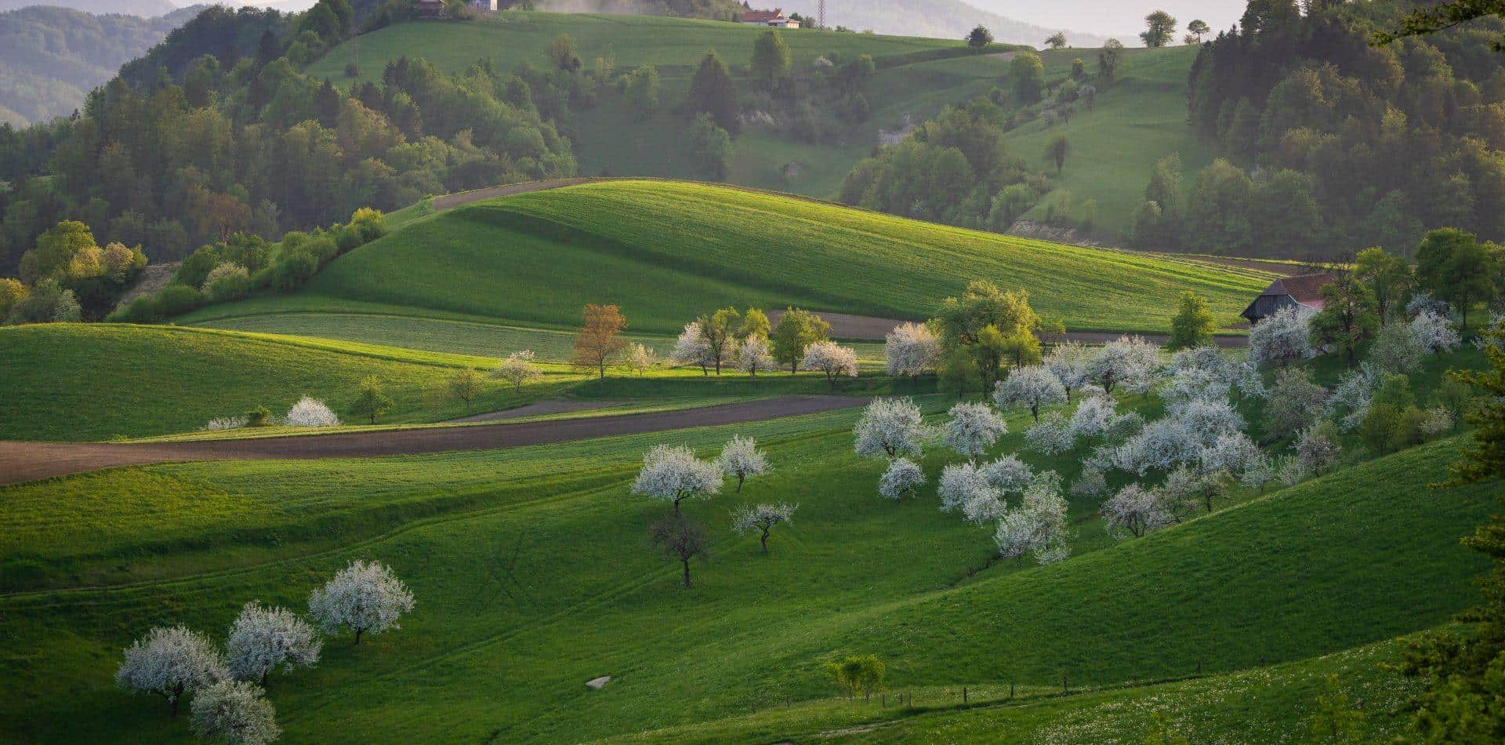
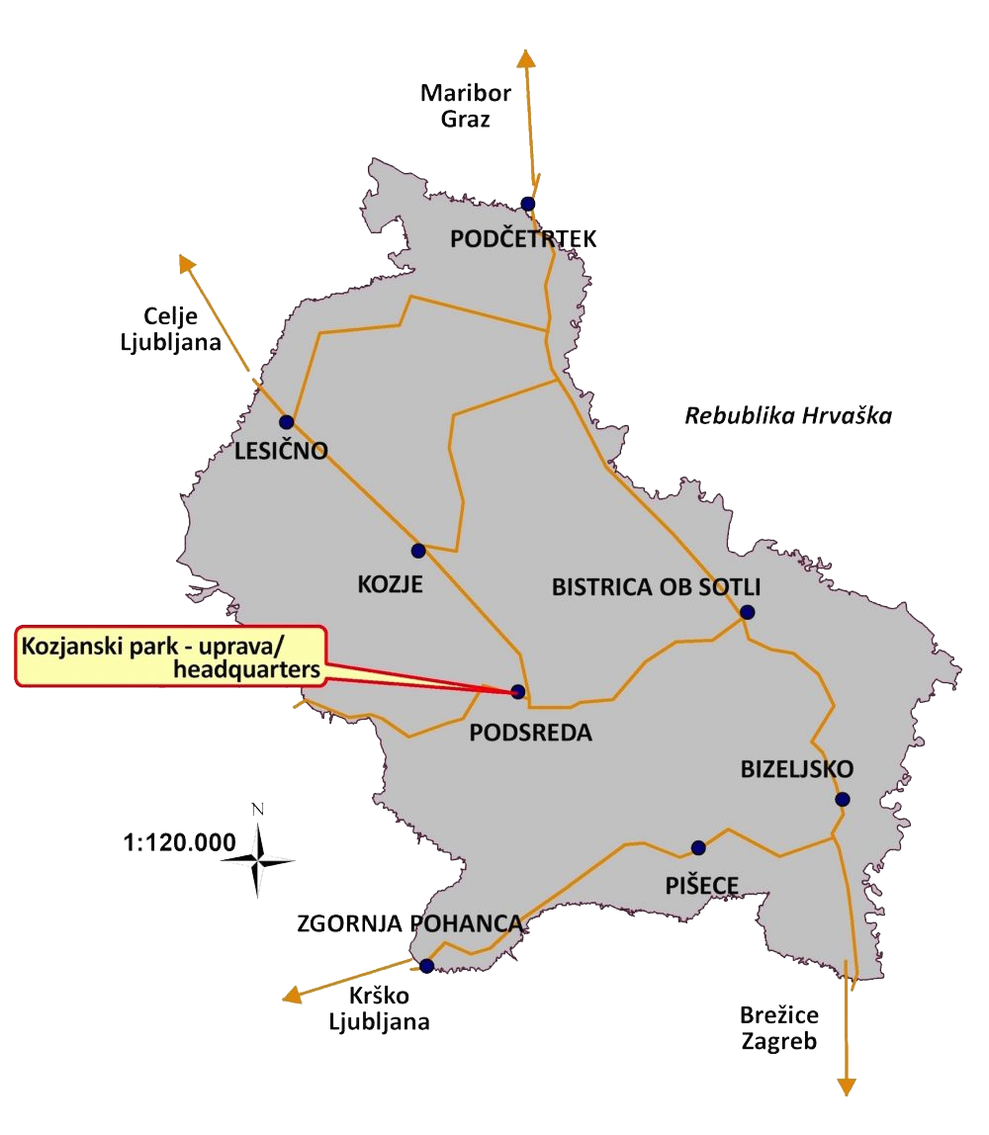
KOZANSKO REGIONAL PARK
A Protected Landscape of Nature, Heritage, and Harmony
Notes:
***
A large part of the region belongs to Kozjanski Regional Park, one of the oldest and largest regional parks in Slovenia, covering an area of 206 km².
***
Established in 1981, the park extends across five municipalities: Kozje, Bistrica ob Sotli, Podčetrtek, Brežice, and Krško.
***
Kozjanski Park is known for its preserved high-trunk meadow orchards, hilly dry grasslands, beech forests, and wet meadows along the Sotla River.
It boasts exceptional biodiversity, with much of the park included in the Natura 2000 network.
Since 2010, together with the Obsotelje area, Kozjansko has been designated as a UNESCO Biosphere Reserve.
****
In 2021, Kozjanski Park became the first in Slovenia to receive the Melina Mercouri International Prize, awarded by UNESCO for excellence in the protection and management of cultural landscapes.
*****
Thanks to its diverse terrain and rich landscape, the park is a captivating destination throughout the year —
in spring, blooming orchards and meadows invite visitors;
in summer, numerous park activities and events take place;
in autumn, the traditional Kozjansko Apple Festival brings life to the region;
and in winter, visitors can enjoy the tranquility of unspoiled nature.
The main mission of the park is the preservation of the natural and cultural heritage of this area.
****
Kozjanski Park, as a landscape of many faces, also reveals its diversity through its rich cultural heritage. Here, preserved nature intertwines with traces of human history. Archaeological sites, numerous churches, majestic castles, medieval market towns, and the heritage of everyday life all spark imagination and curiosity.

Slide 4
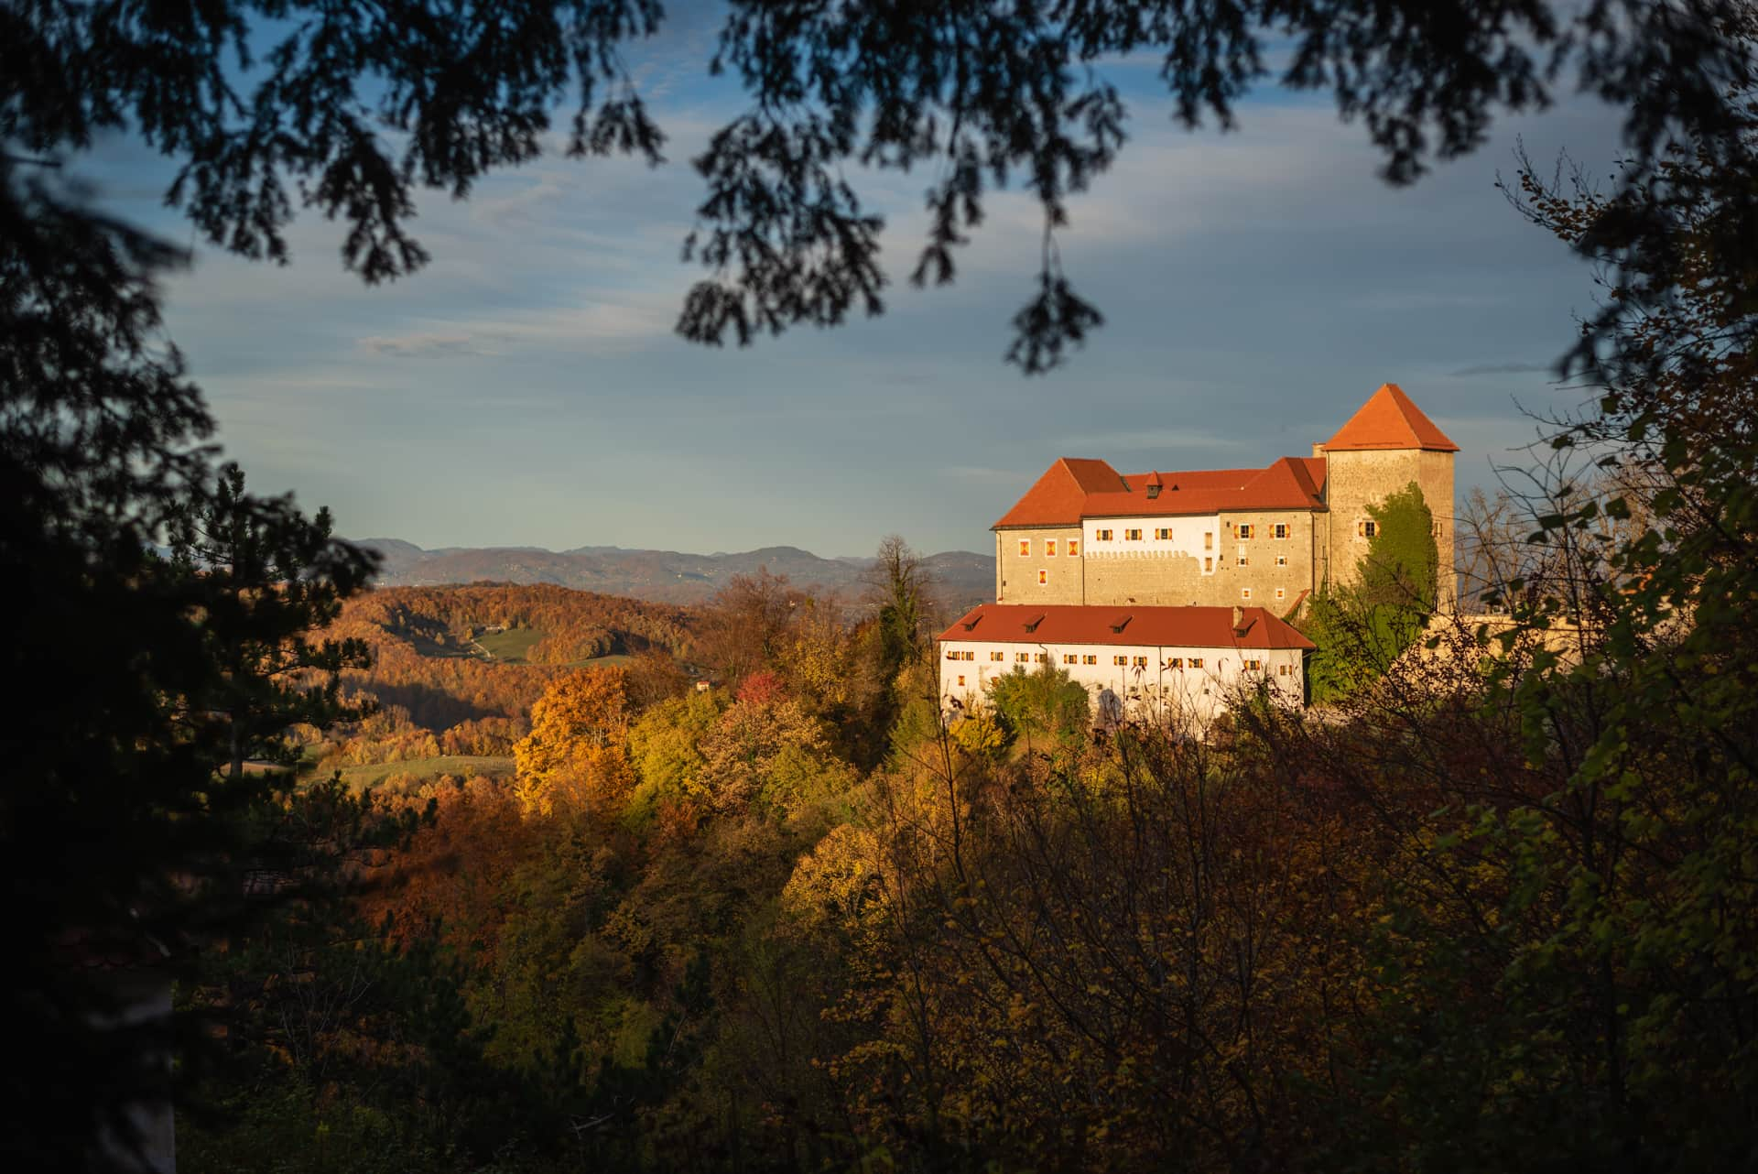
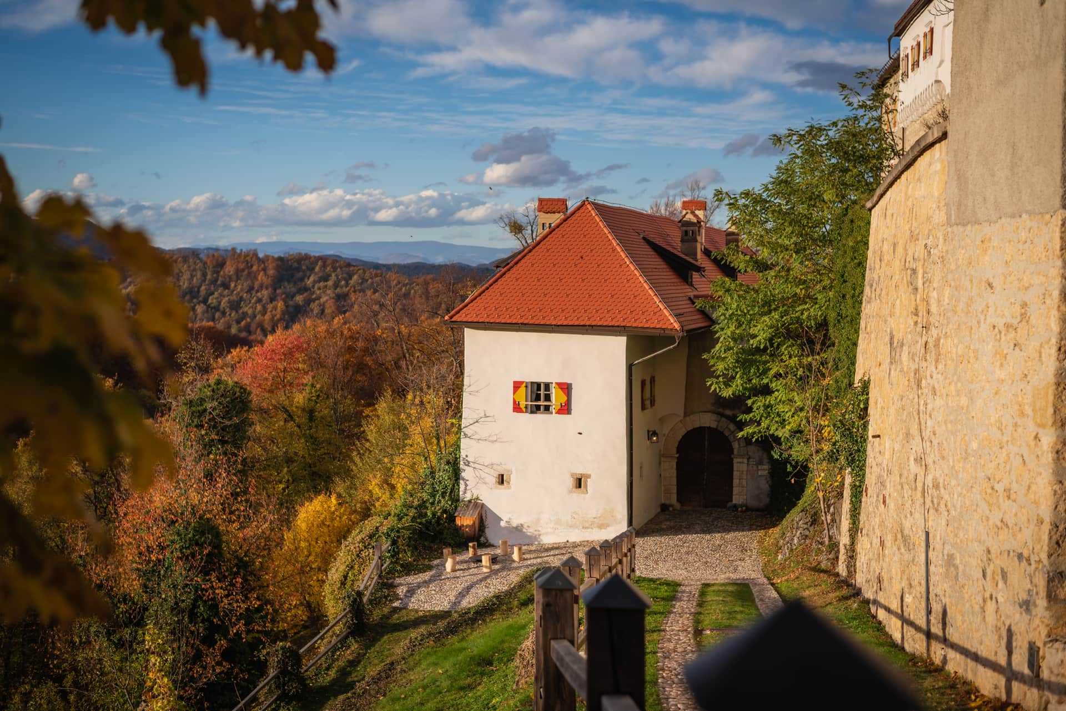
PODSREDA CASTLE
”The Most Castle-like Castle in Slovenia”
Notes:
PODSREDA CASTLE
At the very heart of Kozjanski Park stands Podsreda Castle, often called “the most castle-like castle in Slovenia.”
It sits above the medieval market town of Podsreda at an altitude of 475 metres.
Originally known as Hörberg, the castle is one of the most important examples of Romanesque architecture in the country.
Its medieval core has remained almost completely intact for centuries.
The land once belonged to Saint Emma of Gurk, Slovenia’s first saint.
Over time, the castle passed through the hands of the Bishops of Krško, the Counts of Celje, the Tattenbach and Lazarini families, and finally the Windischgrätz family.
Today, the castle is owned by the Municipality of Kozje and managed by Kozjanski Regional Park.
Since 1983, the park has ensured that this monument is not only preserved — but lives a full and dynamic life in the 21st century.

Slide 5
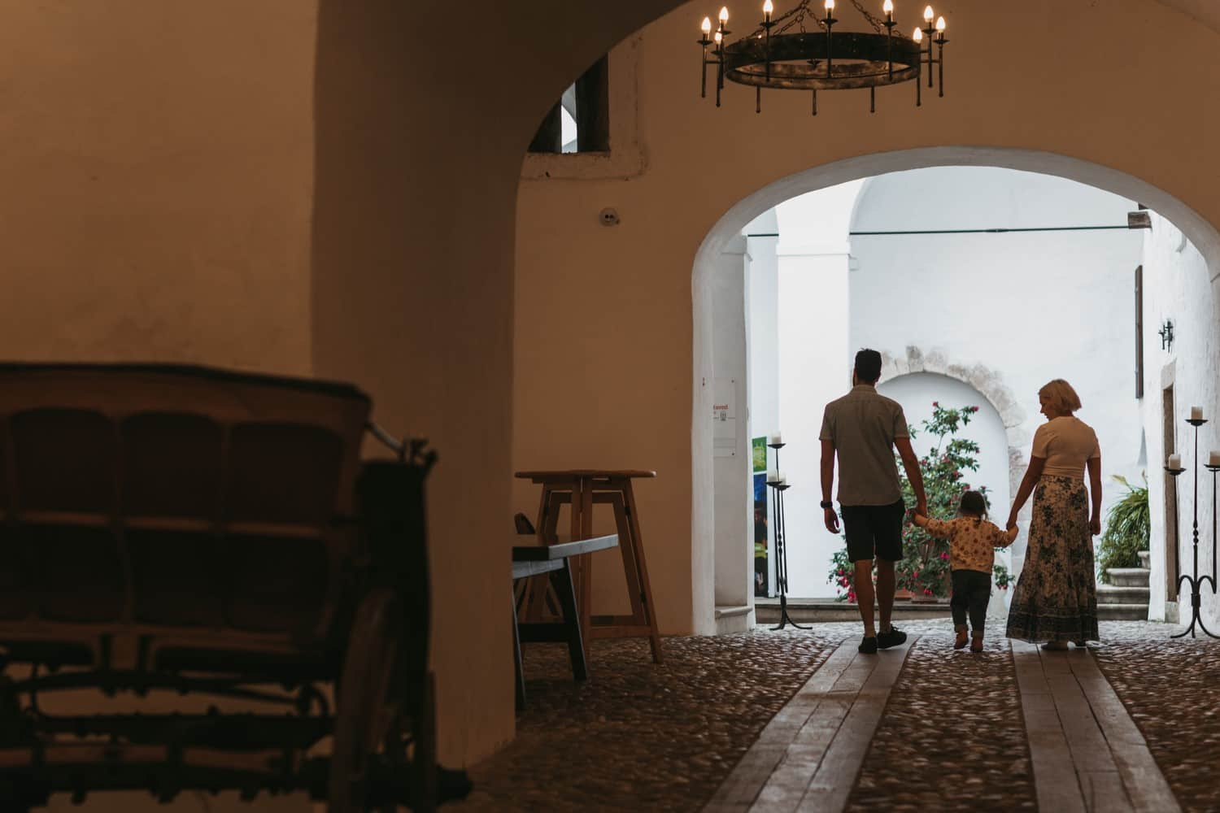
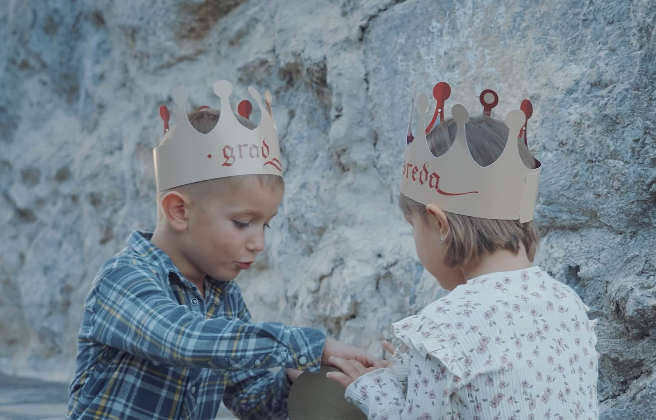
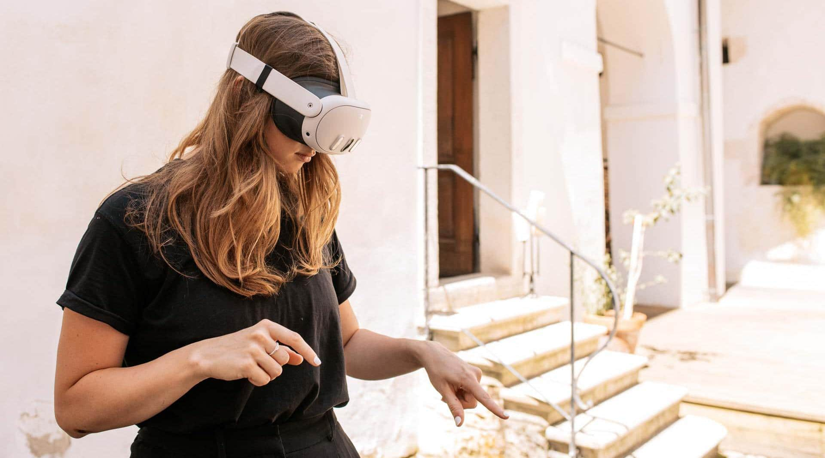
CASTLE EXPERIENCES
From Guided and Audio Tours to Treasure Hunt and Mixed Reality Experience “The Tales of Count Coldski”
Notes:
Podsreda Castle is one of the few Romanesque monuments in Slovenia that has been revived from decay over the past forty years.
It now serves as a vibrant cultural, educational, and tourist center of the Kozjanski Park.
The castle has preserved its original medieval character and charm, while offering visitors modern comfort and experiences.
Guests can explore it through audio guides or a variety of guided tours — tourist, professional, or individual.
Families can embark on an interactive adventure, taking part in the Treasure Hunt at Podsreda Castle or the Tales of Count Coldski — a unique VR and mixed-reality experience that brings medieval legends to life.

Slide 6
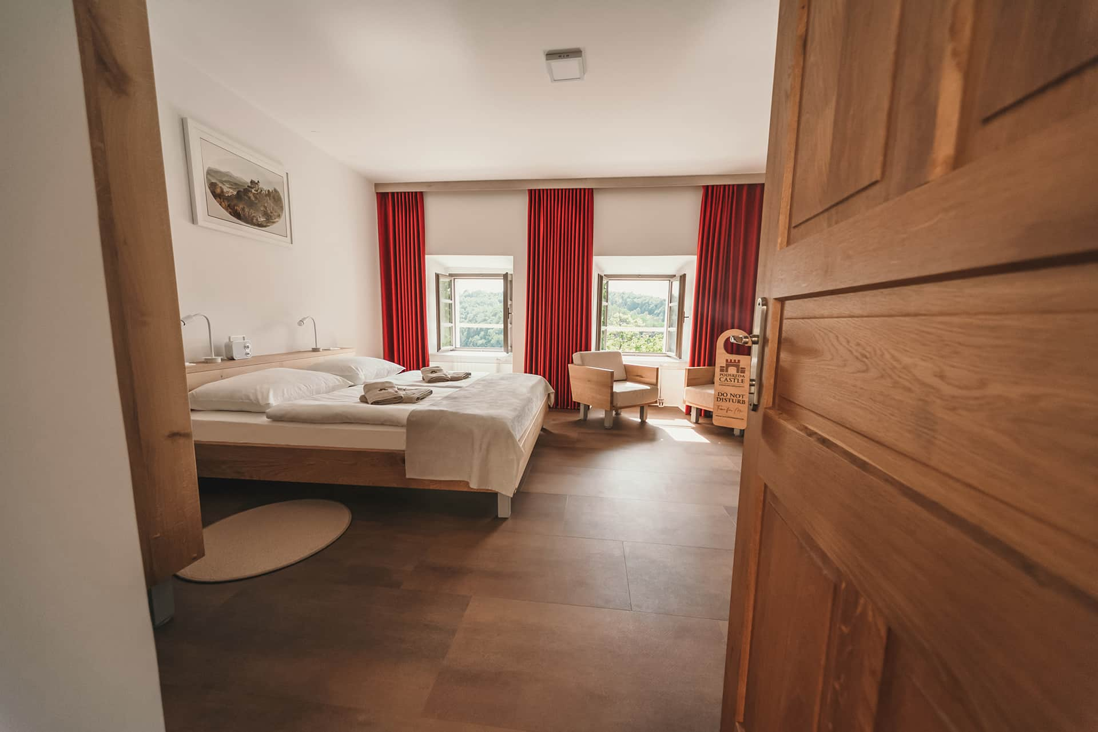
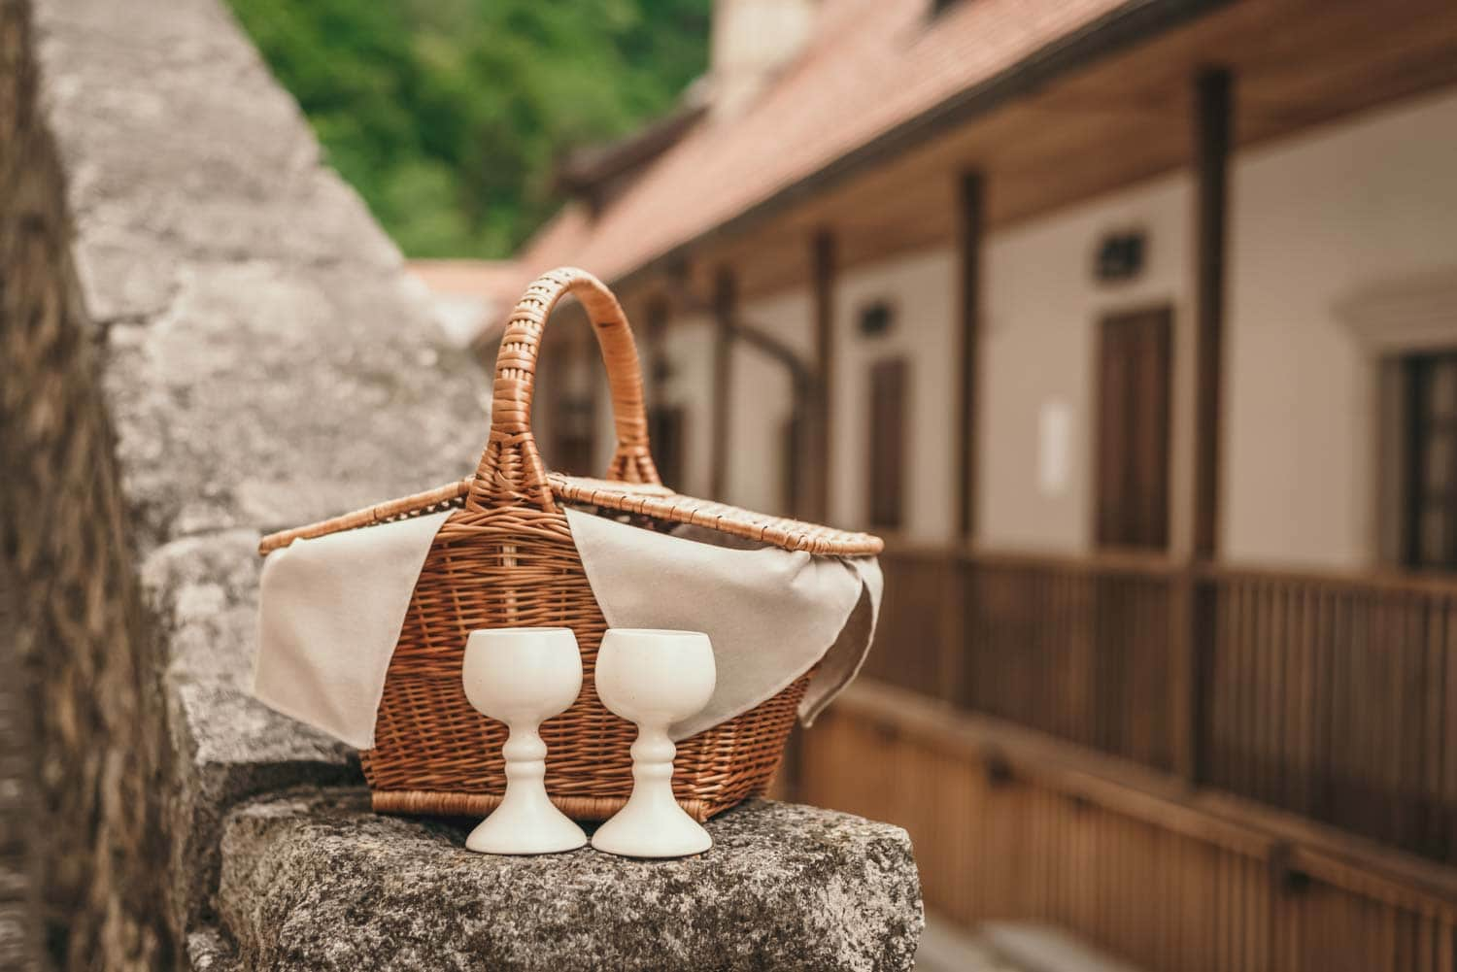
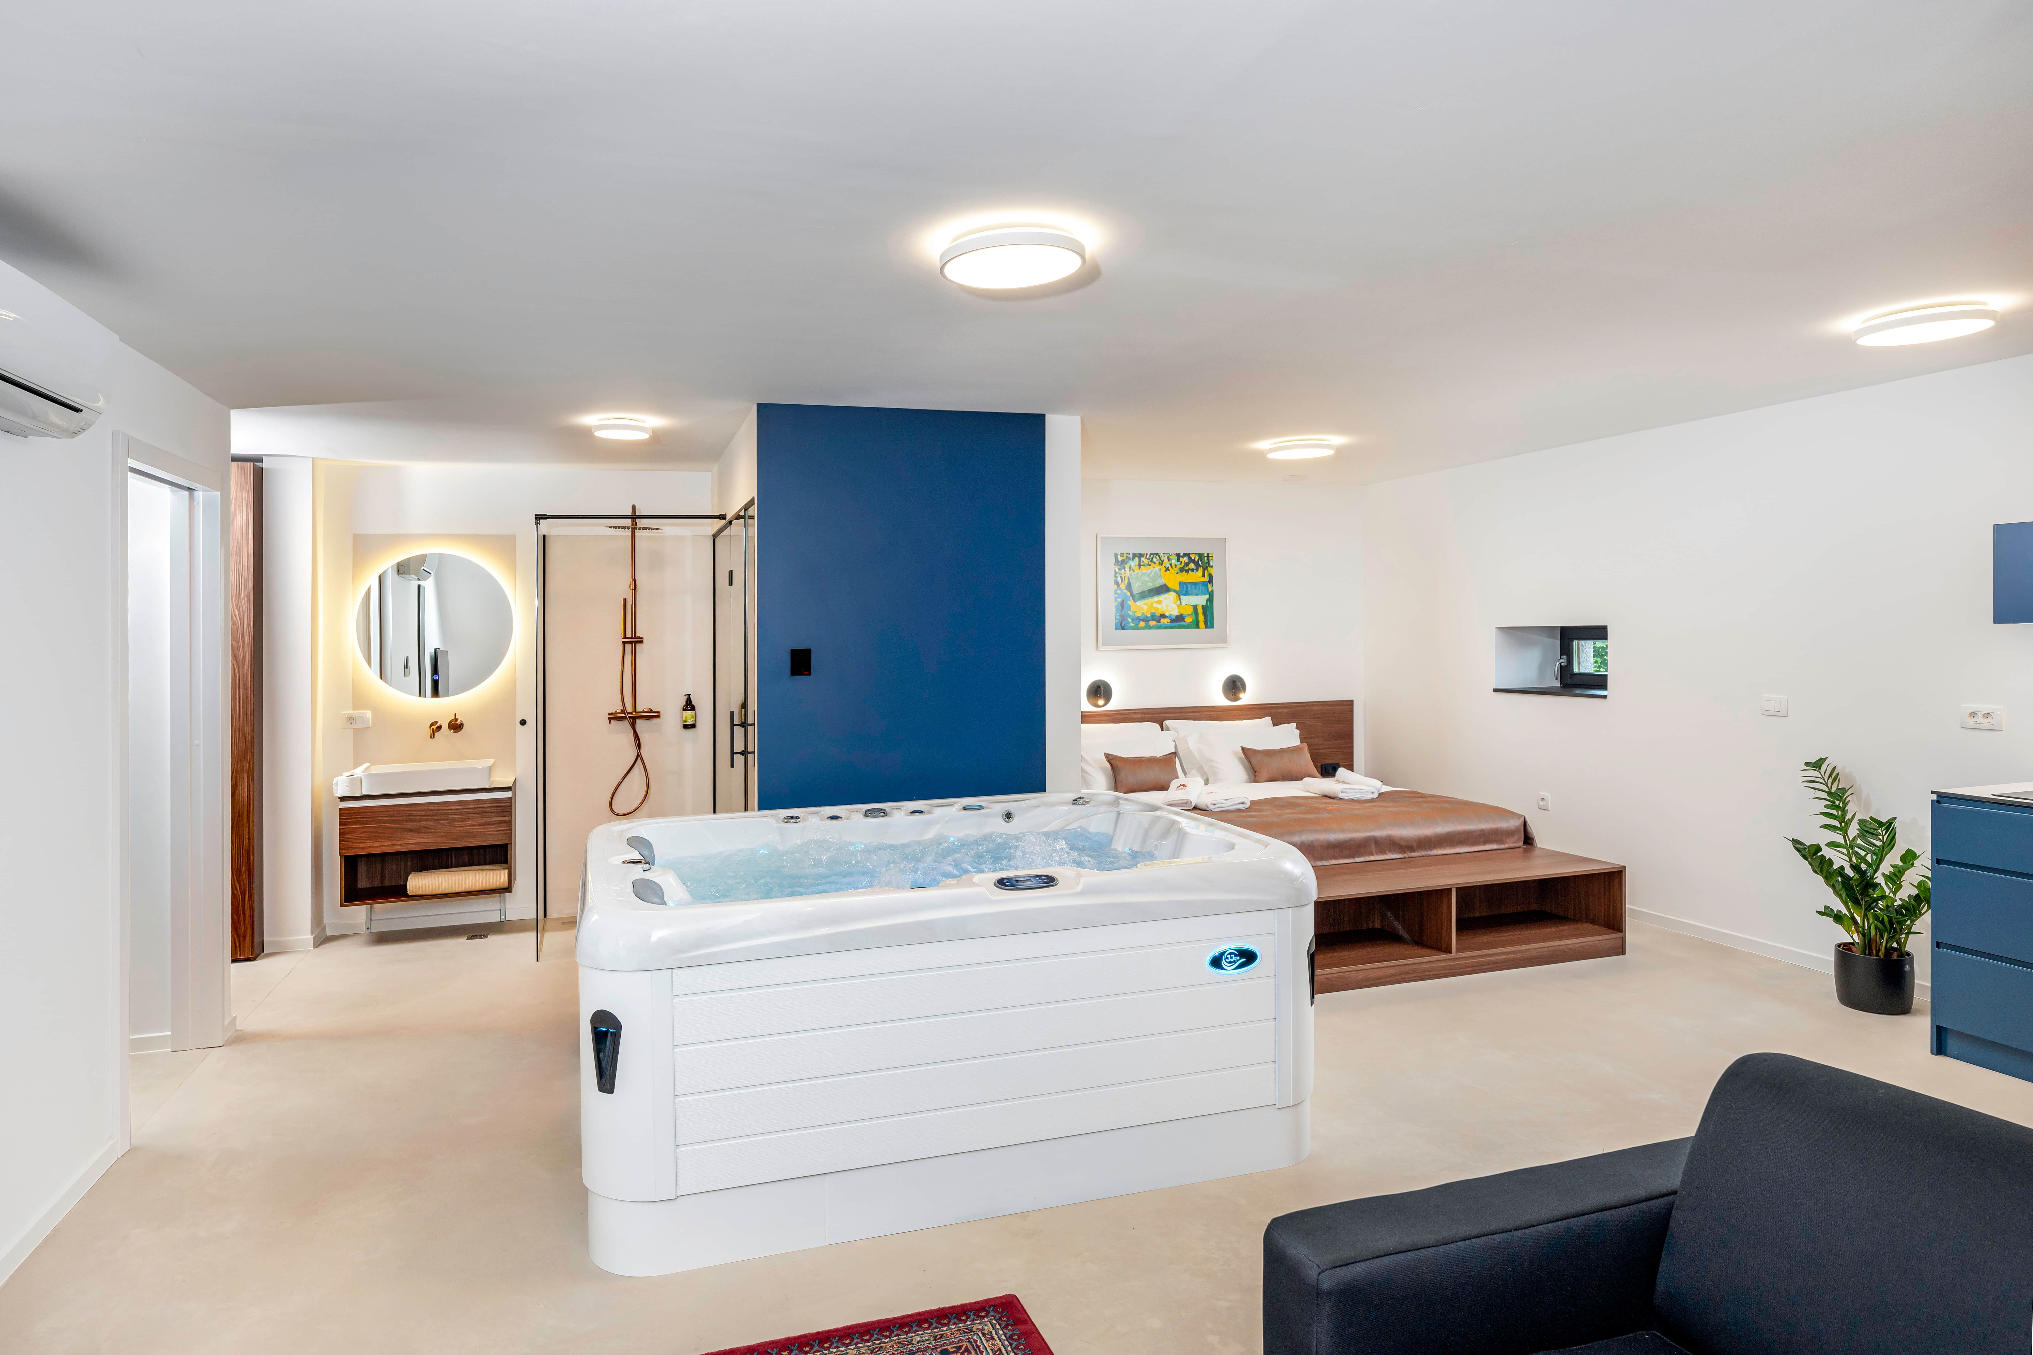
CASTLE ACCOMODATIONS AND WELLNESS
A Blend of Heritage, Comfort, and Local Flavor
Notes:
In 2020, the Municipality of Kozje, the owner of Podsreda Castle, renovated the lower section of the castle complex and created four-star “Rooms and Apartments at Podsreda Castle.”
Each room is named after one of the castle’s former owners, preserving a connection with its rich history.
Recently, three new luxury apartments were added, offering guests a private wellness experience that includes a jacuzzi and sauna.
A highlight of every stay is the Castle Breakfast Basket, filled with local delicacies and delivered daily by the organic Kukovičič Mill Farm.
This unique experience connects guests with local producers, while also supporting employment within the Kozjansko and Obsotelje Biosphere Reserve.
The newly designed Castle Wellness area, with its apple-shaped jacuzzi — symbolizing Kozjanski Park and its orchards — is available to both day visitors and overnight guests, offering a peaceful retreat within historic walls.

Slide 7
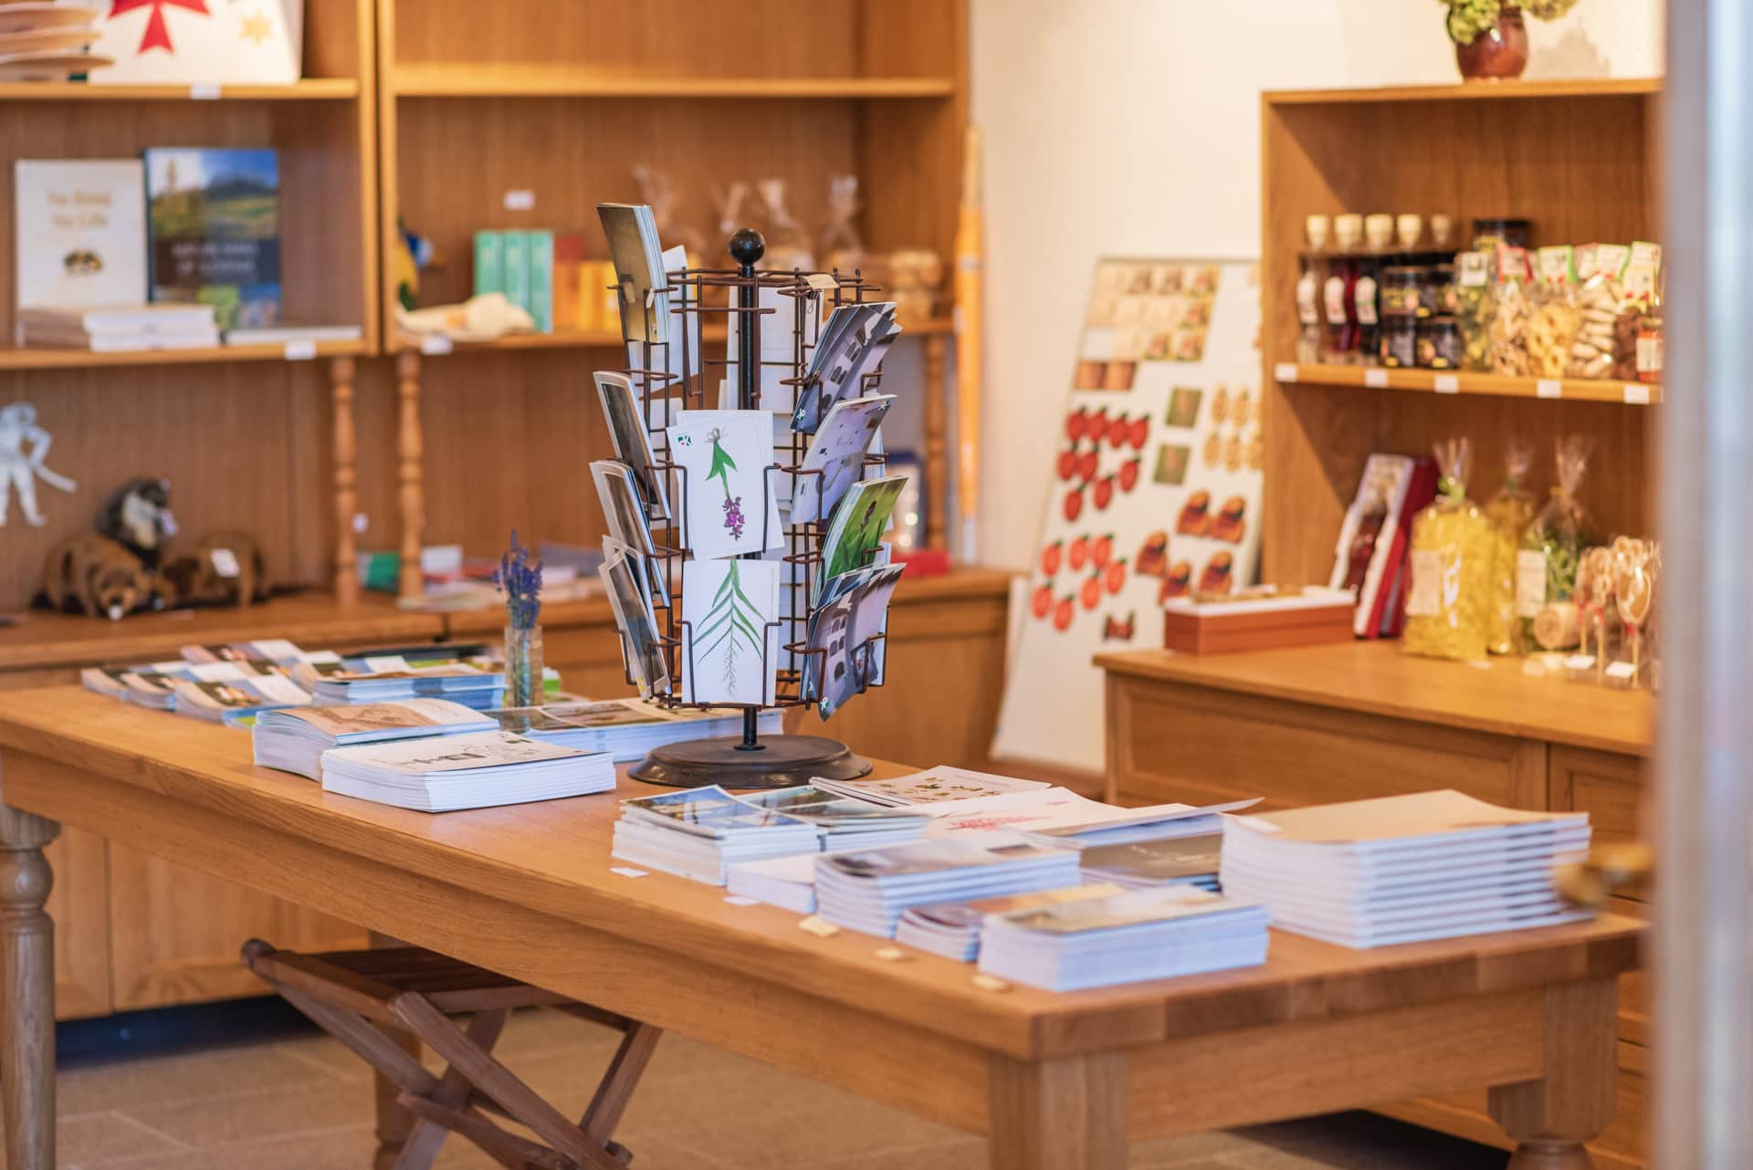
CASTLE SHOP
Supporting Local Producers and Sustainable Development
Notes:
At Kozjanski Regional Park, we believe that our story is most successful when it includes the local community.
That is why the Castle Shop features authentic products from 38 local producers from the Kozjansko and Obsotelje area.

Slide 8
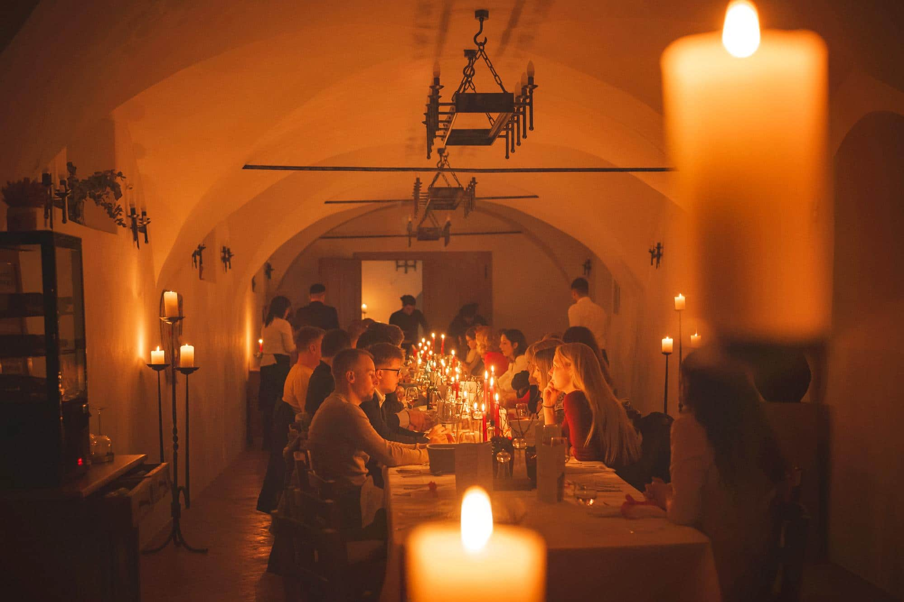
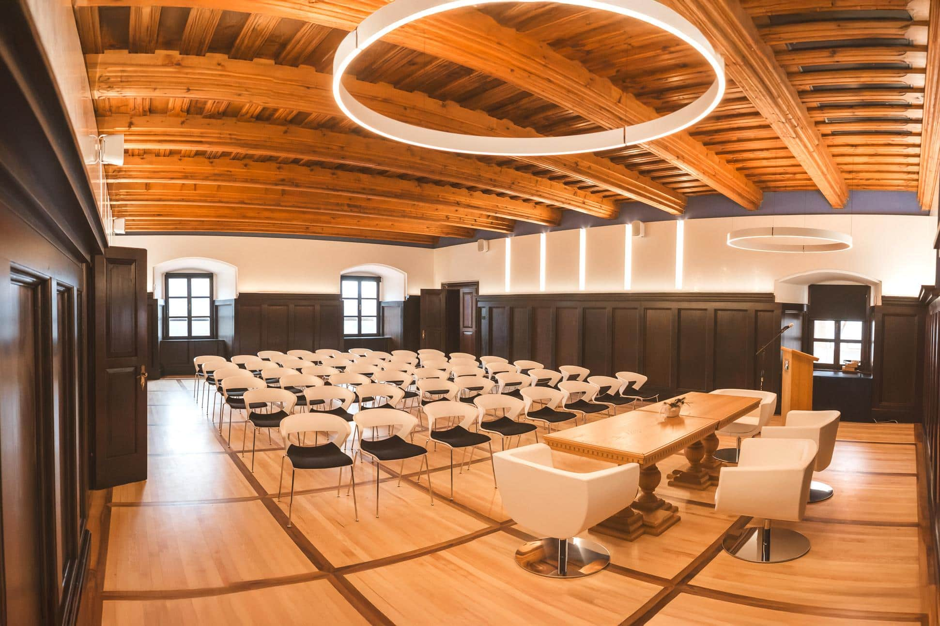
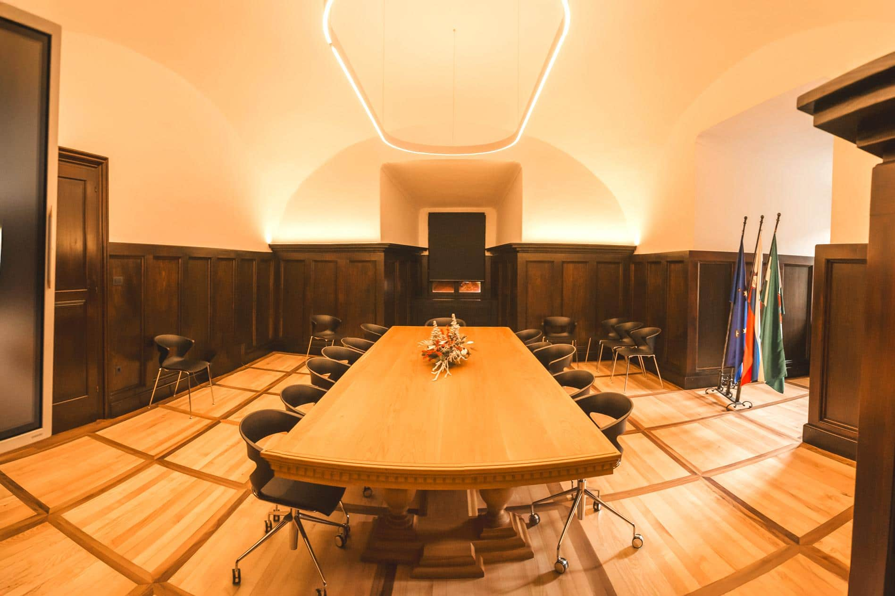
RENTAL OF THE CASTLE PREMISES
Where Business Meets Heritage
Notes:
Together, Kozjanski Park and the Municipality of Kozje continue to create unforgettable castle stories.
To expand our offer, we have recently established two newly renovated halls designed for business meetings, workshops, and cultural events.
These multifunctional spaces combine the charm of medieval architecture with modern technology, creating a unique setting for professional and social gatherings.

Slide 9
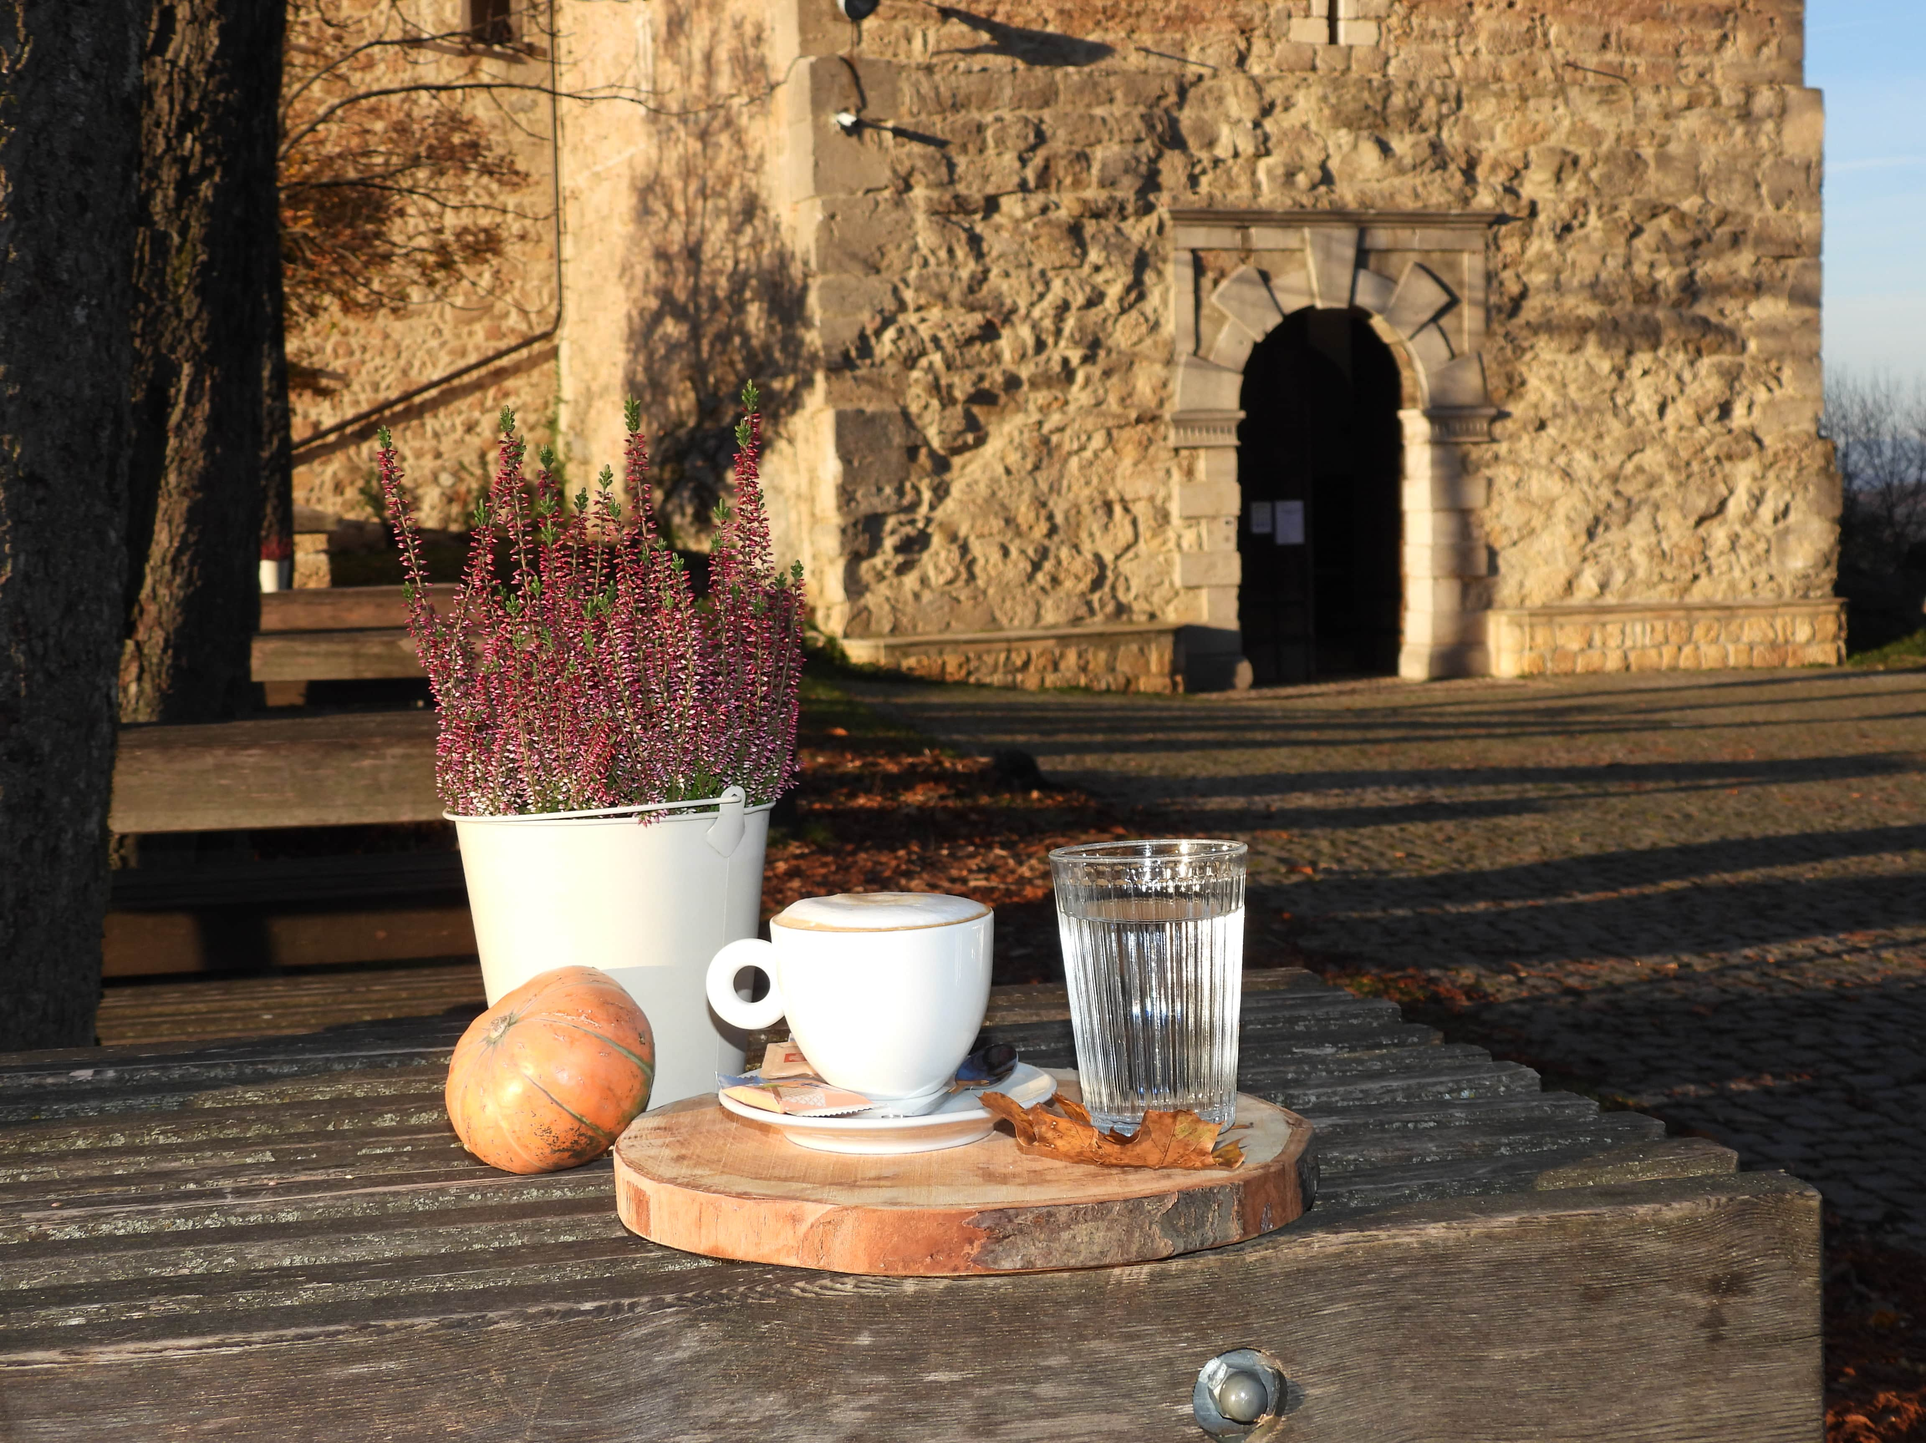
CASTLE CAFÉ
A Place to Relax and Connect
Notes:
The Castle Café has been operating for several years and has become an essential part of the castle’s visitor experience.
It offers a cozy atmosphere with views of the courtyard and surrounding nature, where guests can enjoy coffee, desserts, and local specialties.
The café has contributed significantly to the growing popularity of the castle, which now attracts over 15,000 visitors per year.

Slide 10


A GREEN COMMITMENT
Where Heritage and Sustainability Meet
THANK YOU FOR YOUR ATTENTION!
Notes:
Since 2017, Kozjanski Regional Park, the manager of Podsreda Castle, has been part of the Green Parks Network.
The castle proudly holds the Green Key, Slovenia Green Attraction, and Slovenia Green Accommodation certificates.
These achievements reflect our strong commitment to sustainable tourism, cultural preservation, and community involvement.
Our vision is to attract visitors who seek authentic, responsible, and meaningful experiences,
connecting with nature, heritage, and local life in a way that benefits both people and the environment.
As we look towards the future, our goal at Kozjansko Regional Park and Podsreda Castle is to continue developing tourism that respects both heritage and nature.
We believe that cultural monuments can have a new life — not only as preserved history, but as living, breathing spaces that connect people, nature, and local communities.
Our focus remains on authenticity, sustainability, and collaboration – values that make places like Podsreda Castle more than just destinations. They become experiences that inspire, educate, and reconnect us with what truly matters.
Thank you for your attention,
and I warmly invite you to visit us in Slovenia –
to experience the peaceful rhythm of Kozjansko,
and to discover the charm of Podsreda Castle,
where history and sustainability live in harmony.

