Slide 1
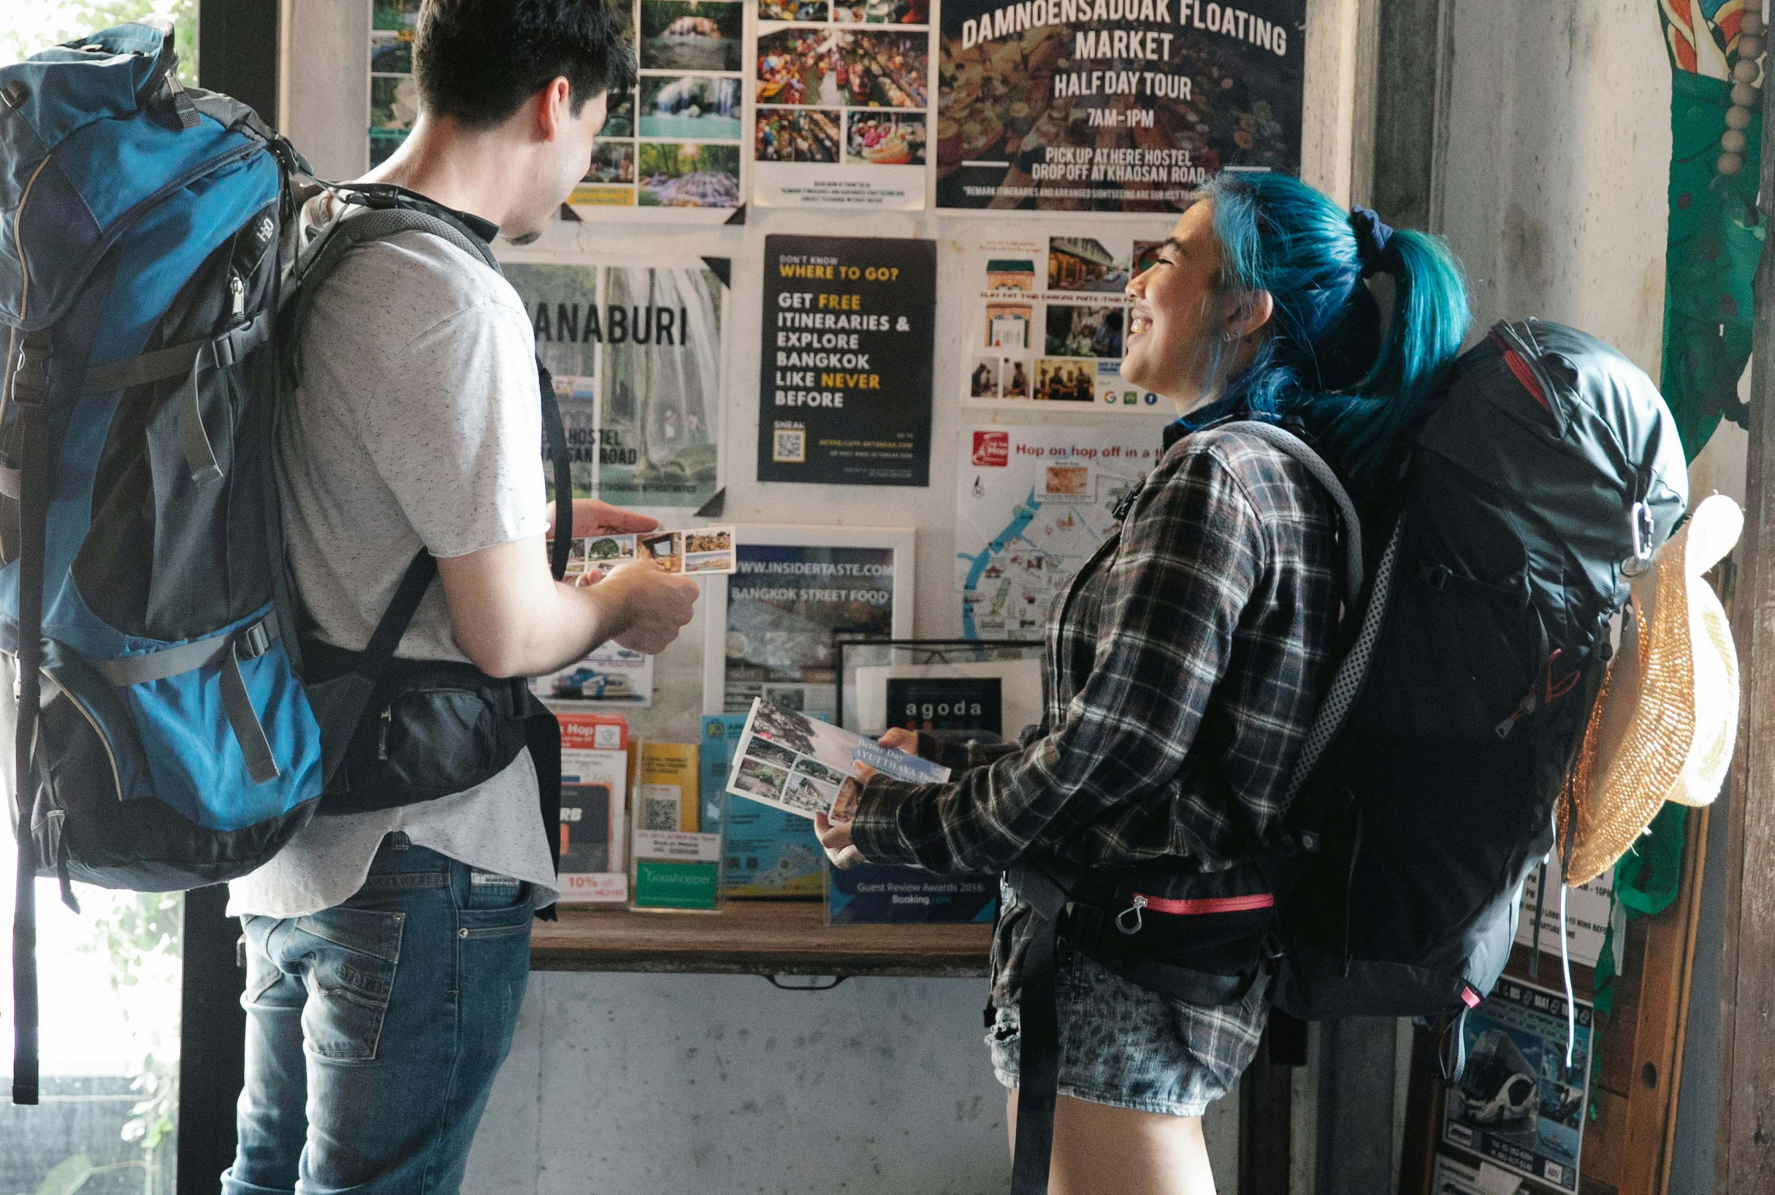

Module 5 (Part 2)
Guest Experience – Hosting with Heart, Remote Impact & Viability
www.epicstays.eu

Slide 2
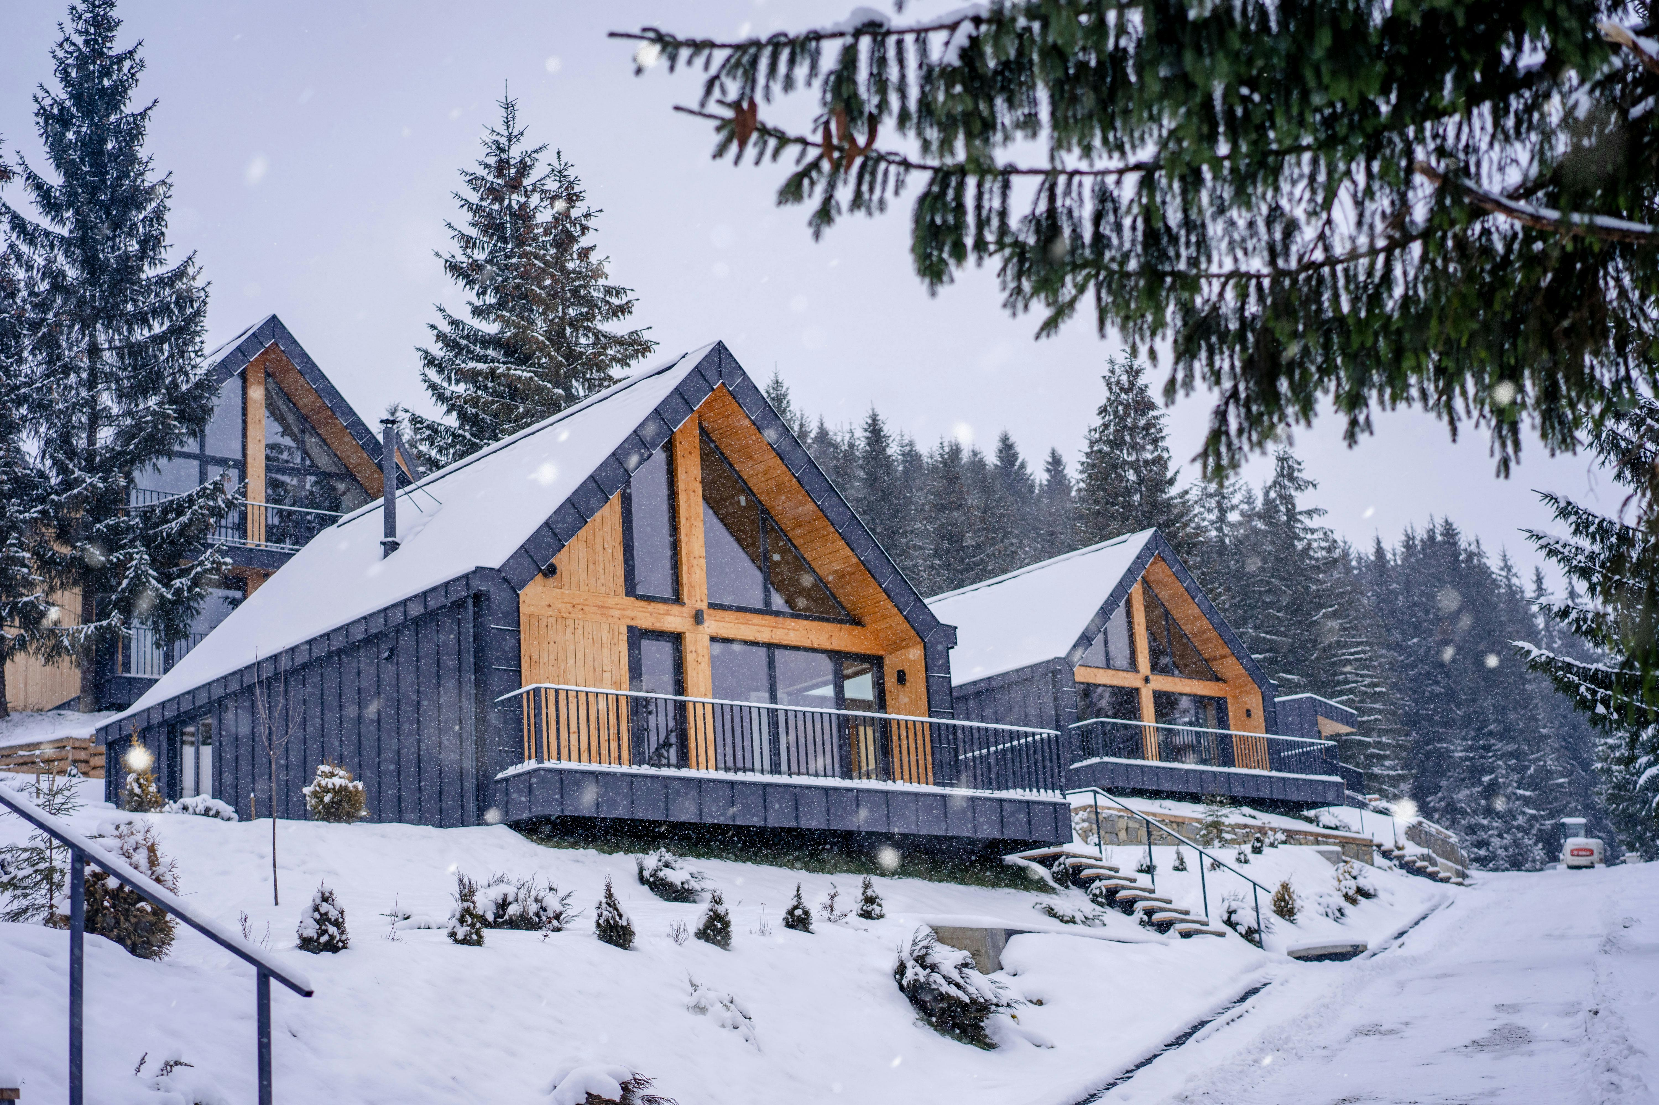
Module 5 (Part 2)
Photo Credit
Section 1
Tools & Systems for Efficient Operations
Section 3
Growing Smart – Partnerships, Upsells & Long-Term Planning

Slide 3
Module 5 Overview
01
Managing the Guest Journey – Before, During & After the Stay
This module supports learners in delivering a high-quality guest experience while ensuring the business remains manageable, efficient, and sustainable.
It focuses on the full guest journey -from first contact to follow-up - and introduces practical systems for day-to-day operations. Learners also explore ways to grow their business by adding value through local partnerships, guest offers, and long-term planning.
Learn how to give guests a great experience from booking to after their stay. Use good communication and small personal touches to make them feel welcome and want to come back.
02
Tools & Systems for Efficient Operations
Find easy and cheap tools to help you run your place without stress. Automate small tasks like check-in info and reviews so you save time but still give good service.
03
Growing Smart – Partnerships, Upsells & Long-Term Planning
Work with local businesses to offer extra services and make more money. Plan ahead so your business grows in a way that fits your goals and keeps guests happy.

Slide 4
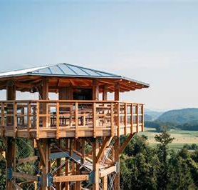
Section 1:
Managing the Guest Journey
- Before, During & After the Stay
Create a Great Guest Experience from Start to Finish.
Photo Credit:
Pomona, Rogaška Slatina, Slovenia
Section 2:
Tools & Systems for Efficient Operations
Use Simple Tools to Save Time and Stay Organized.
Learning Objectives
Section 3:
Growing Smart - Partnerships, Upsells & Long-Term Planning
Grow Your Business with Smart Moves and Local Partnerships.

Slide 5
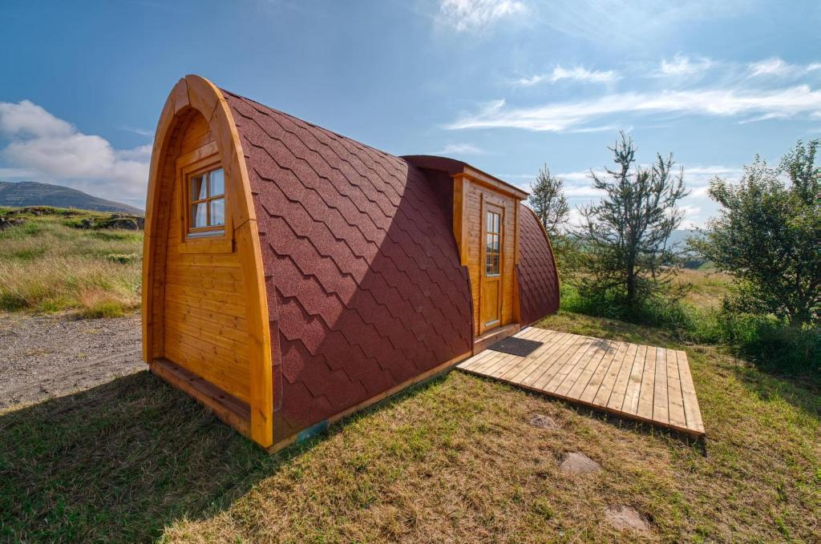
Section 2
Photo Credit: Fossatun Pods & Cottages, Iceland
Tools & Systems for Efficient Operations

Slide 6
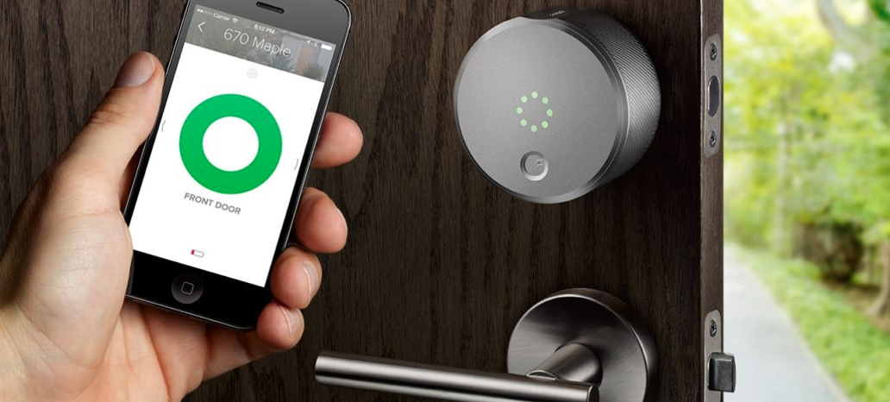
Photo Credit:
Ta fotografija avtorja Neznan avtor je licencirana pod imenom CC BY-NC-ND
Section 2
Tools & Systems for Efficient Operations
Overview:
This section helps you choose smart, simple tools to run your hosting business smoothly.
You’ll learn how to manage bookings, guest messages, calendars, and check-ins without needing a big budget or team. We focus on low-cost options that save time, reduce stress, and work well for solo hosts or small properties. You’ll also learn how to automate helpful tasks while keeping a personal touch. With the right tools, hosting becomes easier and more organized.
6

Slide 7
Introduction - Tools & Systems for Efficient Operations
Running a short-term rental doesn’t have to be complicated or expensive. With the right tools, even a single host can stay organized, respond quickly, and give guests a great experience. This section will show you how to manage bookings, calendars, and communication using simple systems. You’ll also learn how to choose tools that match your budget, location, and type of stay.
We’ll look at smart ways to automate things like check-in instructions or review requests, without losing the human touch. Plus, you’ll see how to host remotely with tools like smart locks or local contacts. Whether you're in a city or a rural area, the goal is to work smarter - not harder - and stay in control.
Source: Booking.com Partner Hub – "Delivering great guest experiences”
7

Slide 8
Choosing the Right Tools for Your Hosting Style
01
Key Learning Area
You don’t need fancy or expensive software to run a successful short-term rental. This part will help you find easy and affordable tools that fit your size and style of hosting.
The goal is to stay organized and stress-free - even if you're hosting alone or in a small, rural place.
8

Slide 9
Simple, Low-Cost Tools for Small Properties
What to do:
Tools and tips:
Start with free versions and upgrade only if needed.
Choose tools available in your language or with strong customer support
Use Google Sheets to track guest bookings, cleaning schedules, and maintenance tasks.
Rely on built-in tools from platforms like Airbnb and Booking.com (calendar, messaging, and reviews).
Try starter tools like Lodgify Free Plan, Tokeet Basic, or Smoobu’s free trial for centralizing bookings and automating messages.
Choose good Property management system (PMS)
Print or use PDFs to create a basic “host control sheet” if you don’t want to rely on digital tools 100%.
9

Slide 10


Example of Spreadsheet (Google sheets or Excel) Simple, Low-Cost Tools for Small Properties
Notes.
(Special.
Request).
New or.
Returning.
Guest.
Guest.
Name.
Cleaning.
Done.
Check-In.
Check-Out.
Guests.
Service.
Room.
Price.
June 12 2025 | June 16 2025 | Mr. Novak M. | 2 | Breakfast | Lavander app. | 120 € |  |  | New
June 14 2025 | June 16 2025 | Mrs. Fras A. | 3 (w/child) | Half-board | Chestnut Suite | 160 € |  | Earyl check-in | New
June 25 2025 | June 30 2025 | Mrs. Kokol T. | 4 (w/child) | Full board | Walnut Cottage | 250 € |  | Gluten-free diet | Returnig - they love Walnut Cottage
10

Slide 11

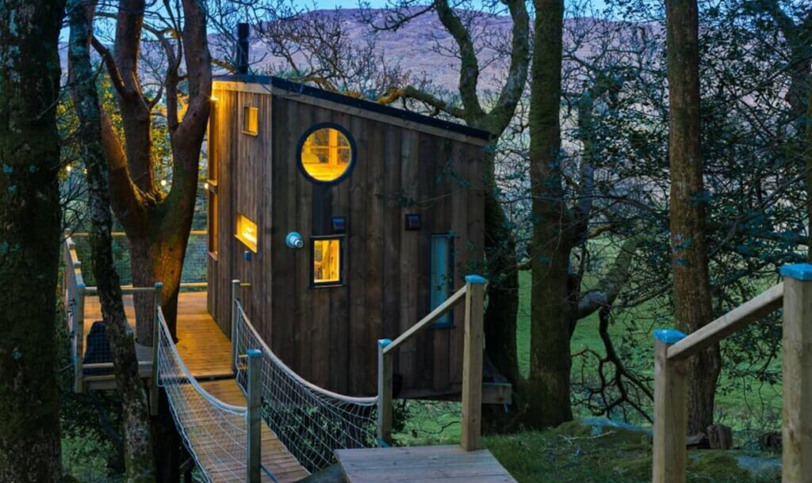
Matching Tools to Your Needs and Budget
What to do:
Tools and tips:
Review your tool use every 6 months — what’s helpful, what’s not?
Don’t be tempted by “all-in-one” software if you only need a few features.
Write down your 5 biggest admin tasks (e.g., messaging, calendar syncing).
Match each one with the simplest tool possible. For example, if you get double bookings, you need calendar sync.
Choose channel managers like Beds24 or Syncbnb if you're on more than one platform.
If you only host part-time or seasonally, stick to tools that require little maintenance.
Photo Credit: The Birdbox, Donegal Treehouse, Ireland
11

Slide 12

Practical Exercise:
Tool Planning for Your Property
Task Description:
Imagine you are hosting guests in a small apartment.
Choose three tools (e.g., PMS, messaging, calendar sync, smart lock) you would use and explain why.
Base your reasoning on simplicity, cost, and guest experience.
12

Slide 13
Automating the Tasks That Matter
02
Key Learning Area
Automation can save you time, but it only works well when it’s used in the right way. In this part, we’ll look at what to automate - like check-in info, review reminders, and short guest messages - and what to keep personal.
You’ll discover free or low-cost tools that help you reply quickly, send updates, and stay on top of things. Simple templates and basic systems like Google Sheets can go a long way.
We’ll show how to automate just enough to make your life easier without making your hosting feel robotic. The goal is to spend less time on small tasks and more time making guests feel welcome.
13

Slide 14
What to Automate (and What Not To)
What to do:
Tools and tips:
Test all automated messages — read them from the guest’s perspective.
•Keep templates stored in a doc or app for quick use (e.g., Notes, Google Docs).
Automate repetitive, low-touch tasks: booking confirmations, check-in instructions, review requests.
Avoid automating emotional or complex messages, such as responses to complaints.
Prepare templates but add personal notes when needed (e.g., “Hope you enjoy the Saturday farmers’ market!”).
14

Slide 15
Tools for Guest Messaging, Reviews, and Check-In Info
What to do:
Tools and tips:
Create a “Message Flow” timeline (e.g., Day of Booking, Day Before Arrival, Day of Departure).
For WhatsApp or SMS, always get guest consent to communicate on those channels.
Use Airbnb’s scheduled messaging or third-party tools like Hospitable, Host Tools, or Zeevou.
Create an email or WhatsApp message template with check-in steps and links to Google Maps.
Send review requests 24 hours after checkout with a friendly tone.
Photo Credit: The Birdbox, Donegal Treehouse, Ireland
15

Slide 16
Staying Personal While Saving Time
What to do:
Tools and tips:
Keep a digital note per guest in Google Keep or a spreadsheet.
Include small tokens or personal notes on arrival to complement your digital communication.
Personalize each message with the guest’s name, reason for visit (if known), or local tip.
Add a sentence at the end of templates that you update manually (e.g., “Enjoy your anniversary dinner!”).
Save guest preferences in a simple spreadsheet for future stays.
16

Slide 17
Remote Hosting Made Easy
03
Key Learning Area
You don’t have to be on-site to give guests a great experience.
This part shows how to manage your property from a distance, whether you're across town or in another country.
You’ll learn about smart locks, key safes, timers, and ways to involve local contacts when needed. We’ll explore how to keep things running smoothly even if you're not there to greet guests in person.
These tools can give you more freedom and flexibility - while still making guests feel supported. Remote hosting can be simple, safe, and personal with the right setup.
17

Slide 18
Smart Locks, Key Safes, and Local Help
What to do:
Tools and tips:
Leave clear photos in your instructions on where and how to access the key.
Test all systems before the guest arrives to ensure they work.
Install a smart lock (e.g., Nuki, Yale, or Igloohome) or mechanical key safe (e.g., Master Lock).
Use temporary access codes and change them between stays.
Arrange a backup key with a neighbor, friend, or cleaner you trust.
18

Slide 19

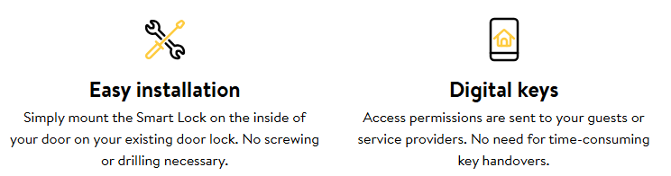
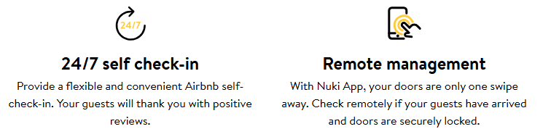
Example - Nuki Smart Lock
Smart Locks, Key Safes, and Local Help
Click to Visit
19

Slide 20
Practical Exercise: Hillview Cottage Remote Check-in Challenge
Context
Tom recently renovated a rural property called Hillview Cottage and started listing it occasionally on Airbnb. Since he lives 60 km away, he decided to install a smart lock with a mobile app for remote access. However, he did not arrange for any local support or backup access system.
Incident
A couple from Germany arrived late at night. The smart lock code Tom had set failed due to a recent software update. Unfortunately, Tom was unreachable—he was camping in a remote area with no phone signal. The guests had to sleep in their car and canceled the rest of their stay the next morning. They left a negative review, which significantly impacted the cottage’s overall rating.
20

Slide 21
Practical Exercise: Hillview Cottage Remote Check-in Challenge
Discussion & Reflection Questions
What went wrong in this situation?
What could Tom have done to prevent this problem?
How could he involve local help without increasing his costs too much?
How can a host test smart technologies before guest arrival?
Would a key safe have been a more reliable solution than a smart lock in this case?
21

Slide 22
Managing Your Property When You're Not There
What to do:
Tools and tips:
Leave physical instructions for guests in case internet fails.
Ask your cleaner or contact to check small things (e.g., heating, soap refill).
Develop the necessary standards of maintenance to achieve the required level of performance
Prepare standards for Hire a cleaner or property caretaker and give them a checklist to follow.
Use Google Docs or apps like TurnoverBnB or Properly to manage cleaning and handovers.
Keep a WhatsApp group or signal channel with your local helper for fast updates.
Photo Credit: The Birdbox, Donegal Treehouse, Ireland
22

Slide 23
Staying in Control from Anywhere
What to do:
Tools and tips:
Create a weekly routine: check calendar, confirm cleaning, and review messages once or twice a day.
•Make a backup plan (what happens if you can’t respond? Who takes over?).
Sync all bookings to a central calendar (iCal, or a channel manager).
Use apps with mobile access so you can update info on the go.
Set push notifications for new bookings, guest questions, or changes
23

Slide 24
Fill-in-the-Blank Test
Before you finish, check your knowledge from this module. In the sentences on the right, insert the words from the left-hand column.
Answers | Statements
Automated | Guests are more likely to leave a review if you send a polite ____________________ message after their stay.
Thank You | Using ______________ messages helps save time and keep communication consistent.
Communication | A Property Management System (PMS) helps hosts manage bookings, calendars, and ____________________.
24

Slide 25

Additional Reading
Guide to Top Electronic & Smart Hotel Door Lock Systems 2025
Click to Read
Comprehensive guide on choosing the right type of smart lock (Bluetooth keypad, mobile credential, RFID) and what to consider for security and convenience.
25

Slide 26

Additional Reading
Smart Hotel Technology: A Guide for Hoteliers
Click to Toolkit
Discusses how smart locks, in-room IoT sensors, and mobile controls enhance guest satisfaction, enabling personalization at scale.
26

Slide 27
Section 3
Photo Credit: Fossatun Pods & Cottages, Iceland
Growing Smart - Partnerships, Upsells & Long-Term Planning

Slide 28

NPhoto Credit:
Ta fotografija avtorja Neznan avtor je licencirana pod imenom CC BY-SA
Section 3
Growing Smart – Partnerships, Upsells & Long-Term Planning
Overview:
This section focuses on growing your hosting business in a smart, simple, and sustainable way.
You’ll learn how to partner with local businesses, offer small extras to guests, and plan for the future. We’ll explore how to increase income without adding stress, and how to grow in a way that fits your goals and values. The aim is not just to get bigger, but to grow better - with happy guests, a strong reputation, and long-term success.
28

Slide 29
Introduction - Growing Smart – Partnerships, Upsells & Long-Term Planning
Once your hosting business is running well, you may start thinking about how to grow. But growth doesn’t have to mean more work or more risk. This section will help you explore small, smart ways to improve and expand. You’ll learn how to offer guests extra services, like breakfast boxes or local tours, by working with nearby partners.
We’ll also talk about upselling - offering add-ons in a way that’s easy and helpful, not pushy. Finally, you’ll learn how to plan for long-term success: when to raise prices, how to improve your space, and how to stay focused on what matters most to you. With a little planning, you can grow your business in a way that feels right and keeps guests coming back.
Source: Booking.com Partner Hub – "Delivering great guest experiences"
29

Slide 30
Working with Local Partners
01
Key Learning Area
You don’t have to do everything on your own - local businesses can be great partners. In this part, you’ll learn how to connect with others in your area to offer guests more value.
Things like breakfast boxes, bike rentals, or guided walks can improve your guest experience and support the local economy.
We’ll show you how to choose the right partners and keep things simple and fair for both sides.
These partnerships help guests enjoy their stay more and create positive word-of-mouth. They also build strong community ties and set your property apart from others. Even small partnerships can bring big results if they’re a good fit.
30

Slide 31
Finding the Right Partners in Your Area
What to do:
Tools and tips:
Attend local farmers markets or community events to meet potential partners.
Offer them promotion in your guestbook or digital welcome pack in exchange for guest discounts.
Keep partnerships simple — even an informal arrangement works if both sides benefit.
Reach out to small local businesses like bakers, farmers, wellness providers, bike rentals, and cultural guides.
Start by asking: “What can I offer my guests that also supports my community?”
Choose reliable partners who understand guest expectations and value good service.
Focus on shared values: quality, sustainability, and hospitality.
31

Slide 32

Case Study
Finding the Right Partners in Your Area
Velika Planina (Slovenia)
Local Partnership:
Collaborates with local shepherds who bring fresh dairy to breakfast and run cheese-making workshops.
Arranges guided treks with local guides and promotes scenic hikes.
Tailors' dinner events and team-building or wedding packages through partnerships with nearby farms and providers
Click to Visit
Photo Credit: Velika Planina, Slovenia
Sources. Chalets on Velika Planina
32

Slide 33
Offering Add-On Experiences for Guests
What to do:
Tools and tips:
Include photos of the experience or products in your listing or message templates.
Keep the payment system clear: guests pay you or the partner directly.
Ask for guest feedback after they try the experience to improve the offer.
Collaborate with your partners to offer small packages: breakfast box, local hike, wine tasting, or artisan workshop.
Introduce these extras in your welcome message, printed flyer, or guest guide.
Use QR codes that link to partner menus, booking forms, or their social media.
Highlight what’s special about the offer - fresh, local, handmade, authentic.
33

Slide 34
Win-Win Collaborations That Add Value
What to do:
Tools and tips:
Revisit the collaboration regularly to adjust or refresh.
Make sure guests always know who to contact and what to expect.
Keep a list of reliable partners and update it seasonally.
Offer your partner visibility (flyers, website, guest messaging), and ask them to do the same.
Set up small referral discounts or commissions if appropriate.
Invite partners to co-create seasonal or themed offers.
Include a short story about your partners in your welcome folder - make it personal.
34

Slide 35
Simple Upselling Without the Stress
02
Key Learning Area
Upselling doesn’t have to be complicated or pushy. In this part, you’ll learn how to offer small extras that guests actually want - like early check-in, welcome baskets, or tour add-ons.
We’ll show you when and how to offer these options in a friendly and clear way. The goal is to earn a bit more while keeping the booking process smooth and simple.
You’ll also learn how to avoid overloading yourself or your guests with too many choices. Well-done upselling makes guests feel cared for and gives them more reasons to enjoy their stay. A few smart offers can boost income and improve satisfaction at the same time.
35

Slide 36
What to Offer and How to Offer It
What to do:
Tools and tips:
Think seasonal: hot tea in winter, cold drinks in summer.
Upsell things guests may forget (e.g. umbrella, travel adapter, slippers).
A small gift or add-on can become a talking point in reviews.
Create a Loyalty programme that will satisfy your customers
Offer useful, optional extras: early check-in, late check-out, welcome drinks, picnic baskets, bike rentals, or yoga mats.
Present these as guest benefits, not sales tactics - use warm, friendly wording.
Share offers before arrival (email, platform message) or in a visible place inside the accommodation.
Keep pricing clear and fair (e.g., €5 for early check-in, €10 for a local basket).
36

Slide 37

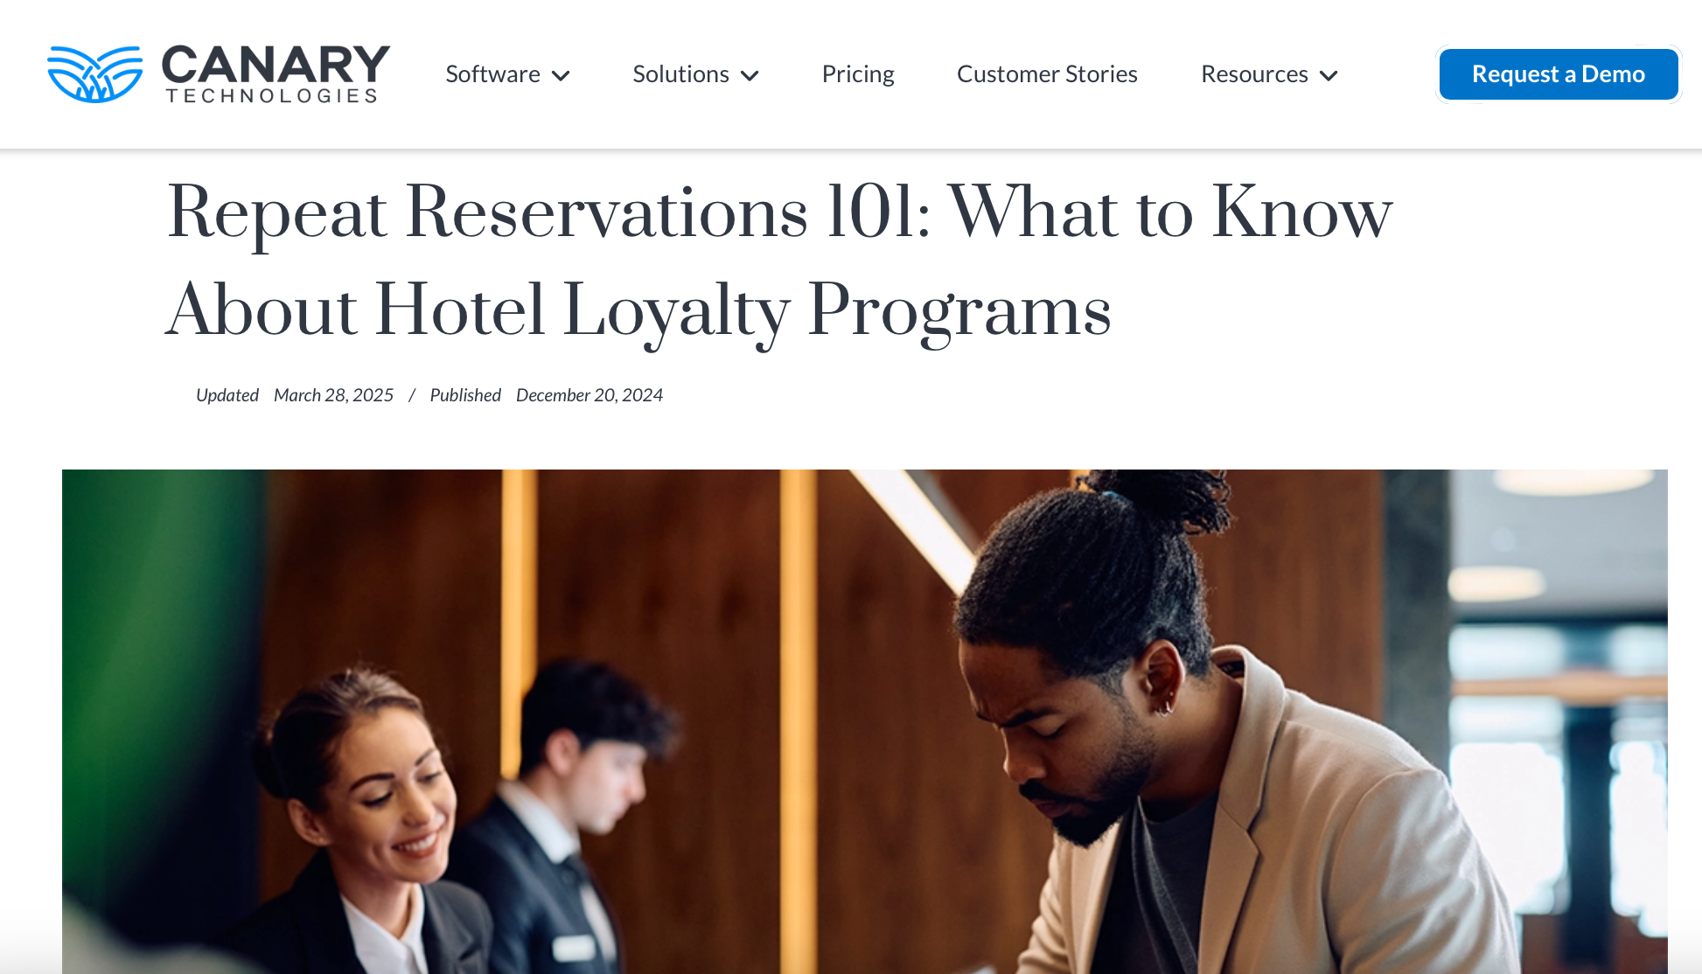
Additional Reading
Hotel Loyalty Program
Click to Read
Repeat Reservations 101: What to Know About Hotel Loyalty Programs
37

Slide 38
Keeping It Easy for You and the Guest
What to do:
Tools and tips:
Use WhatsApp or simple forms (e.g. Google Forms) if you want guests to pre-order.
Track stock levels if you offer physical items like local products or drinks.
Let your cleaner or contact help set up extras before arrival.
Keep a list or form where you track who ordered what.
Use pre-packed baskets or ready-to-offer extras that don’t need special preparation.
Include photos or a sample in your welcome area to catch their interest.
Let guests add extras themselves - no pressure or upsell speech required.
38

Slide 39
Boosting Income Without Complicating Operations
What to do:
Tools and tips:
Keep a “top 3” of best-performing upsells.
Use guest feedback to improve your offers.
Reinvest part of the upsell income into restocking or improving the service
Focus on low-effort, high-value items: ones that don’t require much time or daily involvement.
Monitor which upsells are most popular - and drop what isn’t selling.
Add optional services slowly - don’t overwhelm your setup.
Reuse ideas and offers with slight changes for holidays or events.
39

Slide 40
Planning for Sustainable Growth
03
Key Learning Area
When you're ready to grow, it's important to do it in a way that fits your goals and resources. In this part, we’ll explore ways to grow your business that feel right - like improving your space, raising prices, or adding seasonal offers.
You’ll learn how to reinvest in things that matter: comfort, quality, and guest experience. Growth doesn’t always mean getting bigger - sometimes it means getting better.
We’ll also help you think long-term, so your business stays strong and enjoyable for years to come.
Whether you want to stay small or expand, you’ll find simple steps to support your vision. Smart growth means success that lasts - for you, your guests, and your community.
40

Slide 41
Expanding Smart:
More Space or Better Rates
What to do:
Tools and tips:
Ask regular guests or trusted friends for honest feedback before making upgrades.
•Don’t expand space unless you’re ready to handle more work or hire help.
•Seasonal or weekend-only rate boosts can increase income without adding effort.
Review your space: would guests benefit more from an extra bed or better furniture?
Upgrade gradually: new linens, better lighting, or adding outdoor seating are high-impact.
Use tools like PriceLabs or Wheelhouse for dynamic pricing based on season and demand.
Increase rates only when your reviews and quality support it.
41

Slide 42
Case Study
H2Hotel: Showcases how to grow intelligently by enhancing existing space rather than expanding physically.
H2Hotel (Healdsburg, California)
The eco-focused improvements allowed the hotel to:
Charge higher rates due to its sustainable value proposition
Attract eco-conscious and design-oriented travelers
Differentiate itself from conventional urban accommodations
Maintain low operational costs through green infrastructure
Click to Visit
Photo Credit:
H2hotel, Healdsburg, California
Sources. H2HOTEL
42

Slide 43
Reinvesting in Quality and Guest Satisfaction
What to do:
Tools and tips:
Set aside a small monthly amount for upgrades or repairs.
Use reviews as a source of guidance, not just praise.
Small fixes (e.g. new shower curtain, better pillows) go a long way.
Use part of your income to maintain or upgrade your property: mattress protectors, blackout curtains, better cookware.
Focus first on cleanliness, comfort, and functionality - not decoration.
Invest in energy-saving features (LED lights, better insulation) to reduce costs and attract eco-conscious guests.
Make improvements based on what guests mention positively or negatively.
43

Slide 44
Staying True to Your Goals and Values
What to do:
Tools and tips:
Create a short “hosting mission” for yourself to stay focused.
Track what energizes or drains you about hosting.
Define your personal success: flexibility, income, guest impact, creativity, or community.
Use this vision to guide every decision - don’t follow trends that don’t match your goals.
Take time to reflect every few months: what’s working? What’s stressful?
If you grow, grow intentionally - not out of pressure or comparison.
44

Slide 45
Good Practice Examples from the Epic Stays Compendium
Property / Business | Description
A-Frame in Soča (Slovenia) | Engages local SMEs and traditional craftsmanship to support rural development.
Chalet Rušovc (Slovenia) | Connects local culture with accommodation flow to support the economy.
Firbas Farmstay (Slovenia) | Offers farm-to-table experiences and works with local agrotourism providers.
Drumhierny Woodland Hideaway (Ireland) | Combines local engagement, CSR, and staged sustainable growth.
Birdbox Treehouse (Norway) | Combines nature, eco-tourism and memorable guest experience with low footprint.
Viking House & Wicklow Lighthouse (Ireland) | Leverages local tourism networks and storytelling for growth and referrals.
45

Slide 46
Additional Reading
A Step-by-Step Guide to Hotel Upselling
Click to Read
Breaks down how to build and launch an effective upselling strategy that enhances guest experience and boosts revenue.
46

Slide 47
Additional Reading
GO RURAL Destination Development
Click to Toolkit
Covers how to develop rural tourism products around nature, culture, food, and lifestyle - emphasizes networking with local producers/stakeholders to amplify guest experience and economic impact.
47

Slide 48
Module 6 (Part 1)
Well Done
Financial Planning & Funding
Setting Up & Launching Smart
You have Completed… Module 5
Guest Experience - Hosting with Heart, Impact & Viability
Next is…

