Slide 1
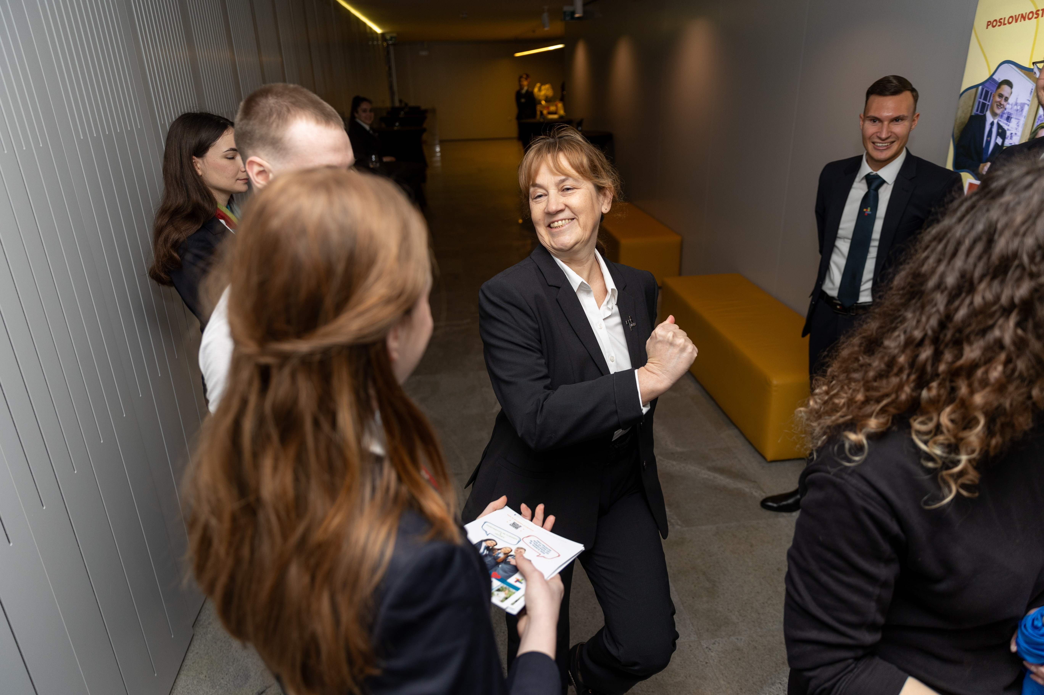

Photo Credit: VSGT Maribor, Slovenia
Module 5 (Part 1)
Guest Experience - Hosting with Heart, Remote Impact & Viability
www.epicstays.eu

Slide 2
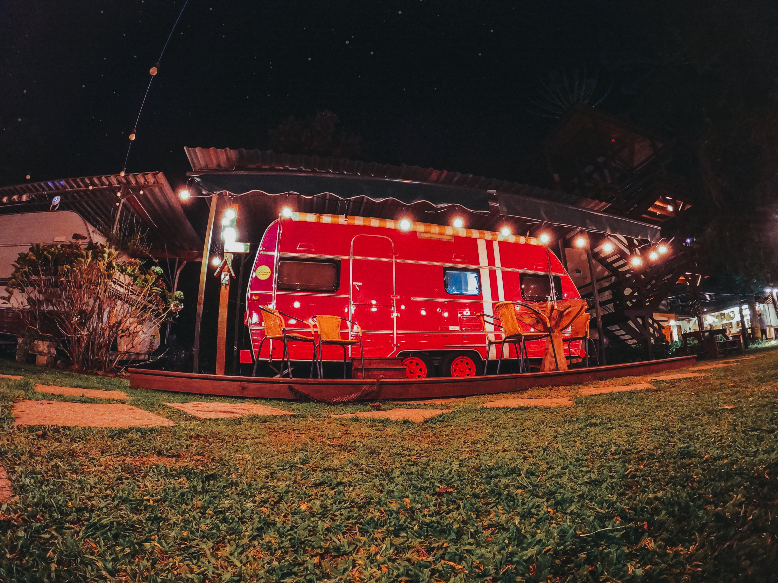
Module 5 (Part 1)
Section 1
Managing the Guest Journey - Before, During & After the Stay

Slide 3
Module 5 Overview
Learning Outcomes
01
Managing the Guest Journey – Before, During & After the Stay
This module explores how to design and deliver a guest experience that goes beyond the stay itself, ensuring visitors feel valued, cared for, and eager to return. It connects the guest journey, operational systems, and long-term growth strategies into one clear pathway for sustainable success.
The journey begins with Managing the Guest Journey – Before, During & After the Stay, where learners discover how to create positive impressions from the very first contact, provide warmth and attentiveness during the stay, and maintain relationships after departure. Through strong communication and small personal touches, hosts can build loyalty and repeat business.
Learn how to create a great guest experience from start to finish.
Map the stages of the guest journey and identify opportunities to enhance the experience.
Apply effective communication before, during, and after the stay to build trust and satisfaction.
Use personal touches to make guests feel welcome and valued.
Implement strategies that encourage guest loyalty and repeat bookings.

Slide 4
Module 5 Overview
Learning Outcomes
02
Tools & Systems for Efficient Operations
Next, the module introduces Tools & Systems for Efficient Operations, highlighting how affordable digital solutions and automation can reduce stress, save time, and ensure a consistent level of service.
Learners will see how efficient systems free them up to focus on what matters most — creating memorable guest experiences.
Use simple tools to stay organised.
Identify affordable tools that simplify day-to-day hosting tasks.
Automate routine processes such as check-in instructions, reminders, and review requests.
Organise operations efficiently to save time and reduce stress.
Balance automation with personal service to maintain a high-quality guest experience.

Slide 5
Module 5 Overview
Learning Outcomes
03
Growing Smart – Partnerships, Upsells & Long-Term Planning
Finally, learners move to Growing Smart – Partnerships, Upsells & Long-Term Planning, where they explore how to expand their business in ways that are both profitable and meaningful. By working with local businesses, offering value-added services, and planning strategically for the future, hosts can grow sustainably while contributing to their communities.
Together, these three sections show that guest experience is not just about good hospitality, but also about smart operations and forward-thinking growth, enabling alternative accommodation businesses to thrive with heart, impact, and long-term viability.
Grow your business sustainably with smart moves and local partnerships.
Collaborate with local businesses to create partnerships that add value for guests.
Design upsell opportunities that increase revenue while enhancing the guest experience.
Apply long-term planning techniques that align business growth with personal goals and community impact.

Slide 6
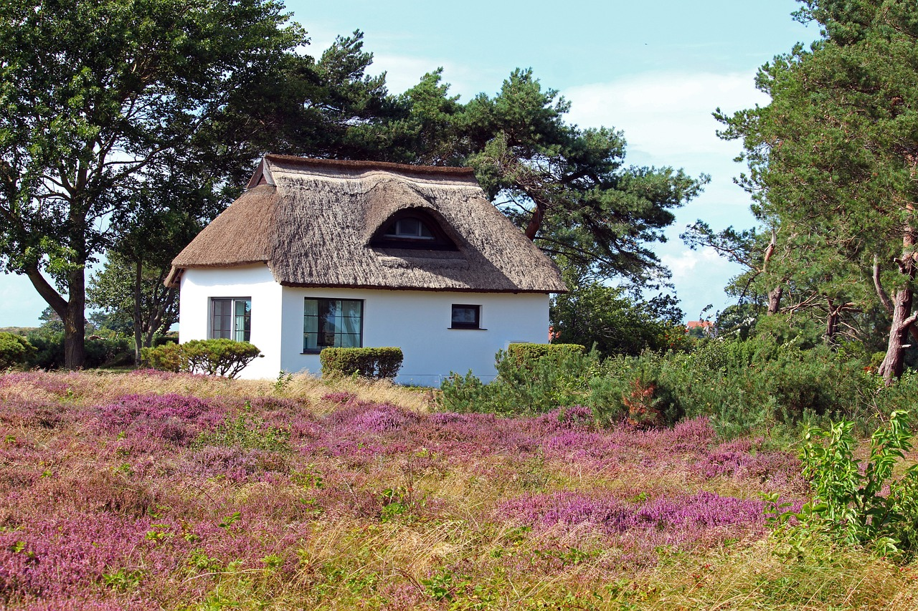
Section 1
Managing the Guest Journey - Before, During & After the Stay

Slide 7
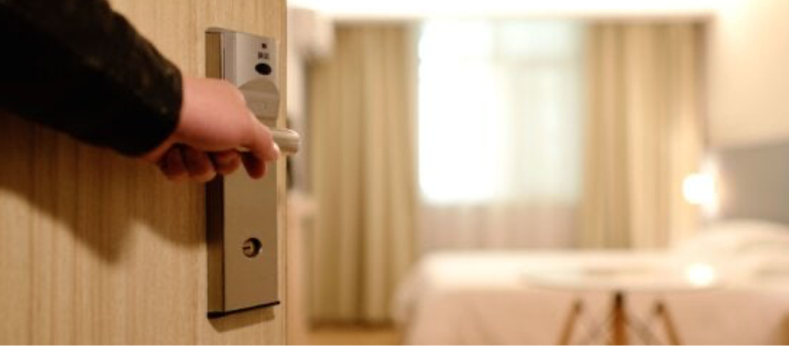
Section 1
Managing the Guest Journey – Before, During & After the Stay
Overview:
This section teaches you how to create a smooth and welcoming experience for your guests, from the moment they book until after they leave.
You'll learn how to communicate clearly, add personal touches that reflect your style and location, and handle common issues calmly and professionally. The goal is to make guests feel cared for, which helps bring more positive reviews, repeat visits, and recommendations. By focusing on each stage of the guest journey, you can build trust and create memorable stays
7

Slide 8
Introduction - Managing the Guest Journey – Before, During & After the Stay
Every guest’s experience starts from the moment they find your listing and continues even after they leave. A good guest journey is made up of small steps — booking, arrival, the stay itself, and the follow-up after they go home. At each step, you have the chance to make guests feel welcome, safe, and cared for.
In this section, you will learn how to communicate clearly, add personal touches that show your style and local area, and solve problems calmly and professionally. You will also learn easy ways to get good reviews, encourage guests to come back, and have them recommend you to others. When you manage the full guest journey well, you build trust, create great memories for your guests, and grow your business over time.
Source: Booking.com Partner Hub – "Delivering great guest experiences"
8

Slide 9
Guest Journey
Stages of Guest Journey | Inspiration and Research | Bookings | Pre-arrival Planning | Check-in | Stay | Check-out | Review and Post-stay
Motivators and Pain Points | List your guest motivators and pain points of each stage | List your guest motivators and pain points of each stage | List your guest motivators and pain points of each stage | List your guest motivators and pain points of each stage | List your guest motivators and pain points at each stage | List your guest motivators and pain points of each stage | List your guest motivators and pain points of each stage
Touchpoints | Word of mouth, social media, OTA listings, influencers | OTAs, E-mails, Customer support, Your website | Email, reminders, customer support | Ease of acces, Timely check-in, Room conditions, (hotel) staff, services | Quality of stay, toiletries, (hotel) staff, activities, Mid-stay contact | (hotel) staff, check-out services, E-mail | Social gatherings, E-mail reminders, and post-stay communication
9

Slide 10
Guest Journey
Stages of Guest Journey | Inspiration and Research | Bookings | Pre-arrival Planning | Check-in | Stay | Check-out | Review and Post-stay
Actions | Review your online rating, OTA listings, social media, and post-stay survey results | Define where to list, Evaluate your e-mail marketing strategy, and customer support ratings | Review your communication with guests and anticipate frequently asked questions | Check your reviews and see if it`s easy to access your hotel. Evaluate your communication with guests. | Run a health check on your rooms, communication, and staff. Upsell and improve your tech stack. | Review the check-out process and post-stay survey answers. | Analyze the feedback, reed and answer online review, and build a strategy to connect with guest post-stay.
10

Slide 11
Designing the Full Guest Experience
01
Key Learning Area
Being a great host means thinking about the full guest journey, not just the stay itself. Guests start forming opinions from the moment they see your listing. Clear information, friendly messages, and a smooth booking process all help make a great first impression. When they arrive, they should feel welcome and know what to expect.
During their stay, comfort and small helpful details can really stand out. After they leave, a kind follow-up message or thank you can leave a lasting impression. This full journey builds trust and makes guests more likely to come back. In this part, you will learn how to plan each step of the journey with care. You don’t need to be perfect - just consistent, friendly, and thoughtful.
A well-designed guest experience makes your place memorable and your reviews stronger.
11

Slide 12
Understanding the Guest Journey:
Before, During, and After
What to do:
Tools and tips:
Use platforms like Airbnb or Booking.com’s messaging system or other Property Management Systems to automate welcome and follow-up messages.
Create a short checklist to cover all guest journey points.
Include a mini “what to expect” timeline in the booking confirmation email.
Before the stay: Ensure your listing is clear, complete, and honest (photos, location, house rules, check-in info). Send a welcome message after booking with practical details and a warm tone.
During the stay: Make sure the space is clean, comfortable, and well-prepared. Offer a short printed or digital welcome guide with local tips and house instructions.
After the stay: Send a polite thank-you message, ask if everything went well, and kindly invite the guest to leave a review.
12

Slide 13
Before Guest Arrival: Room Reservation, Room Preparation & Pre-arrival Communication
Make the guest feel expected, welcome, and well-informed before they even arrive.
Yes No
Choose a reliable Property Management System (PMS) to help you with reservations, online check-in, etc. Review the reservation carefully.
Accept and verify the reservation (dates, room type, special requests, price); double-check the guest’s name, arrival date/time, length of stay, and room type; look for special requests (e.g., late check-in, allergy-friendly room, extra pillows); check if the guest is a returning guest or VIP — personalize service accordingly.
Assign the room based on guest preferences or requests; reserve the room in your reservation system to avoid overbooking or any other mistakes
Continued on the next slide
13

Slide 14
Make the guest feel expected, welcome, and well-informed before they even arrive.
Yes No
If possible, retrieve more guest's information with online check-in or via e-mail before the stay; address, date and place of birth, ID card details and other information that help you to make your guest's stay even more enjoyable) and to avoid unnecessary bureaucracy/situations on the day of arrival.
Send a pre-arrival message or email to the guest to provide the exact address, direction, your contact details, property policies or house rules etc. and to let them know that you are looking forward to their stay.
On the day of arrival: ensure the room is cleaned and inspected; confirm that amenities are stocked (toiletries, towels, minibar, etc.), Check that all electronics work (TV, lights, air conditioning, Wi-Fi).
Place a welcome note (with compliments) or welcome gift (if applicable). Pay attention to received guest`s information, for example: if they are already regular guests, their birthdays, lactose intolerance etc.
14

Slide 15

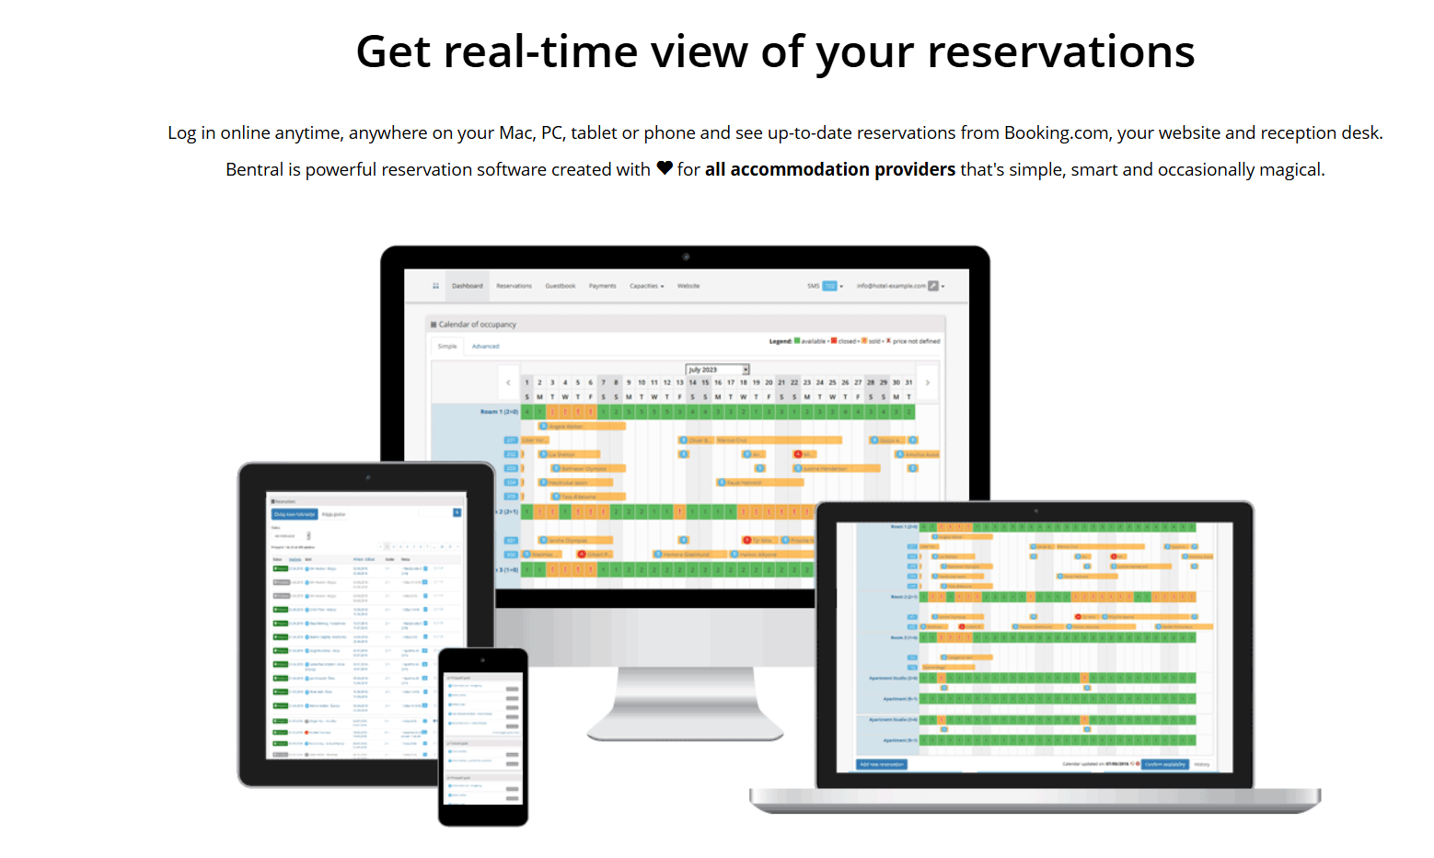
Example: PMS - Property Management System
Click to Visit
Bentral is a property management software platform designed for short-term rental hosts, property managers, and vacation rental businesses.
Key Features of Bentral:
Channel Management: Sync bookings, availability, and pricing across multiple platforms to avoid double bookings.
Booking Management: Centralized calendar and reservation system.
Guest Communication: Automated messages and guest management tools.
Payment Processing: Integration with payment gateways for easier collection.
Reporting & Analytics: Insights into booking trends, revenue, and occupancy.
Bentral website. YouTube video - Bentral
15

Slide 16

Example:
EKO kmetija Urška
Ensure your pricelist is clear and honest.
Price list - Urška tourist farm
Photo Credit: Eko Kmetija Urška Arbes

Slide 17



Dear Mr. Novak,
Thank you for choosing to stay with us at Family tourist farm. Your booking is confirmed, and we have prepared a cozy stay just for you.
Check-in: friday, June 14, from 3:00 PM
Check-out: monday, June 17, by 11:00 AM
Room: Garden view family room with balcony (half board accommodation for 3 guests)
Location and directions: Family tourist farm, Hidden road 25, 2000 Maribor, Slovenia - [Google Maps link]. Navigation will lead you directly to our front house parking place, where we will already waiting to your arrival. Please let us know your arrival time.
If you will need any furthure assistance, do not hesitate to contact us on 00386 41 000 000. We are looking forward to welcome you at our Family tourist farm! Expect homemade treats, a warm bed, and a peaceful escape.
Warm regards,
Tanja and Luka
Tel: [insert] Email: [insert] Website: [insert]
Files attached:
property policies or house rules
possibilities for additional activities at the destination, additional offers, etc.
Example: Pre-arrival Info
17

Slide 18
Understanding the Guest Journey: Checklist "During the stay"
Deliver warm, attentive, and personalized service that makes guests feel at home, safe, and cared for - not just accommodated.
Yes No
Greet your guests warmly and welcome them to your region and to your accommodation
Confirm reservation (period of stay, special requests, payment etc.) and verify ID.
Inform guest about breakfast hours and other meal if included, Wi-FI access, accommodation amenities (pool, outdoors activities, workshops, etc.), and local recommendations.
Help them without waiting to be asked as “are you planning to explore today? I’d be happy to suggest something unique!”
Make sure the information given is verified and the recommendations are credible, as this is the only way to build mutual trust, which leads to greater guest satisfaction and increases the potential for revisiting.
Continued on the next slide
18

Slide 19
Deliver warm, attentive, and personalized service that makes guests feel at home, safe, and cared for - not just accommodated.
Yes No
Offer assistance with luggage or directions to the room, ensure daily room cleaning (if applicable)
Greet guests by name when possible, respond promptly to guest requests or complaints, if a guest is alone and open to conversation, show interest in his or her well-being with simple question as “are you enjoying your stay with us? Is there anything you we can help you with?”
If the guest is celebrating a birthday, honeymoon or special event, leave a small treat or flower with handwritten note in their room as “Happy anniversary from [team and property name]. Wishing you a wonderful stay.” etc
Be present, friendly, and proactive when seeing guests in common areas, ask them about their stay and if they need any furthure assistance.
19

Slide 20
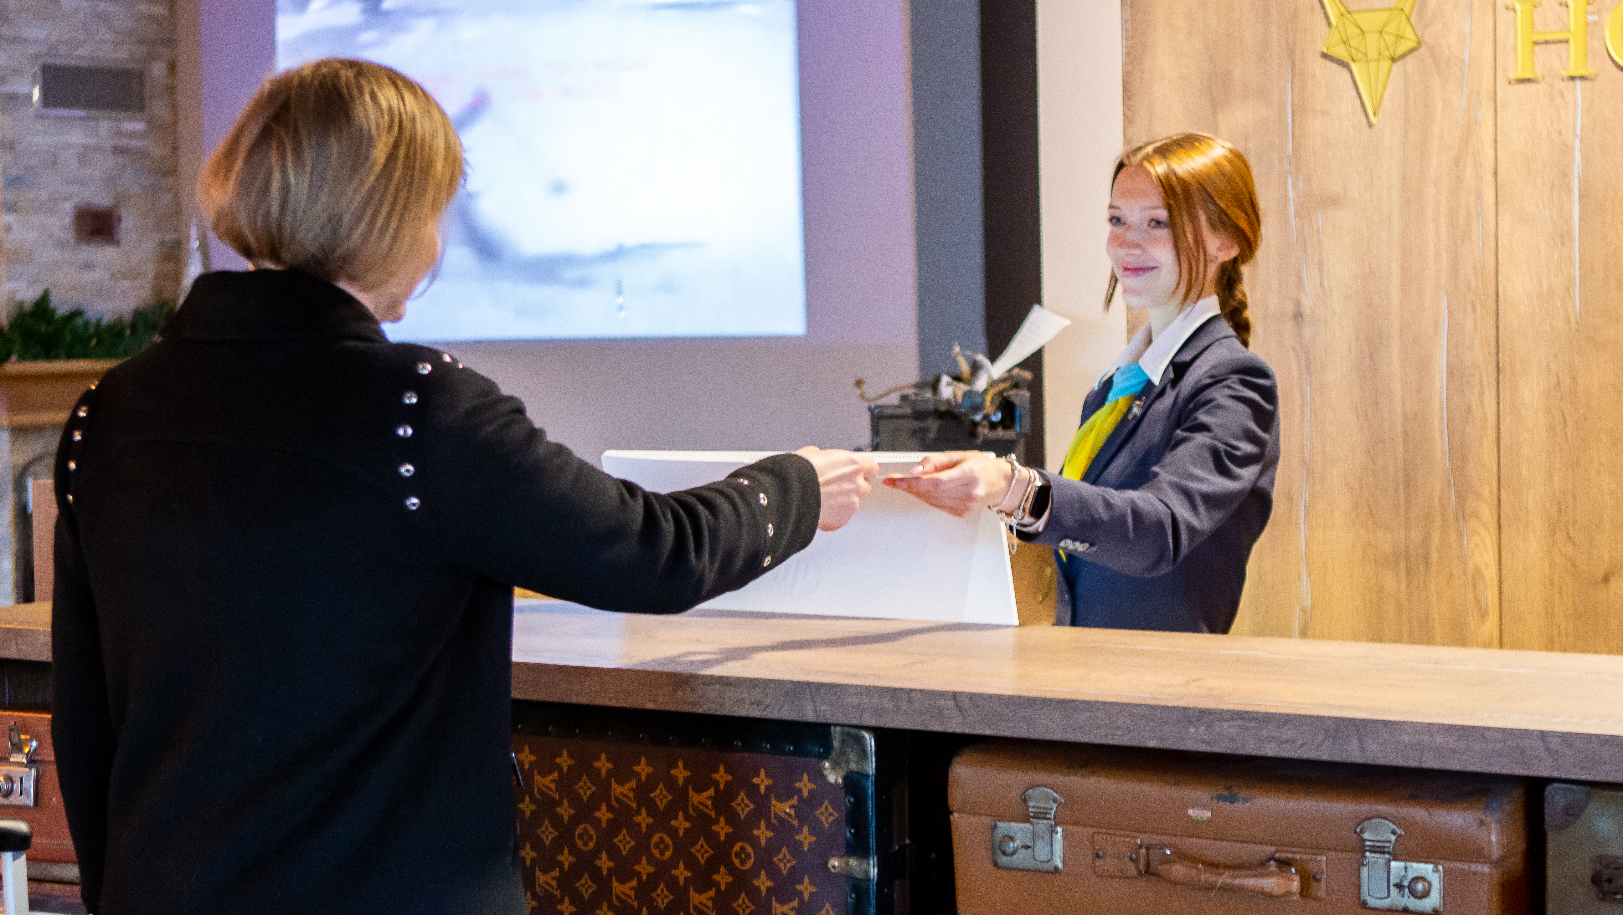
Click to Watch Video
Guest Satisfaction
Resolving Guest Issues
Description
resolving guest issues isn’t just about fixing a problem - it’s a critical opportunity to reinforce brand values, enhance loyalty, and improve overall performance. Be friendly, and proactive when seeing guests in common areas, ask them about their stay and if they need any furthure assistance.

Slide 21
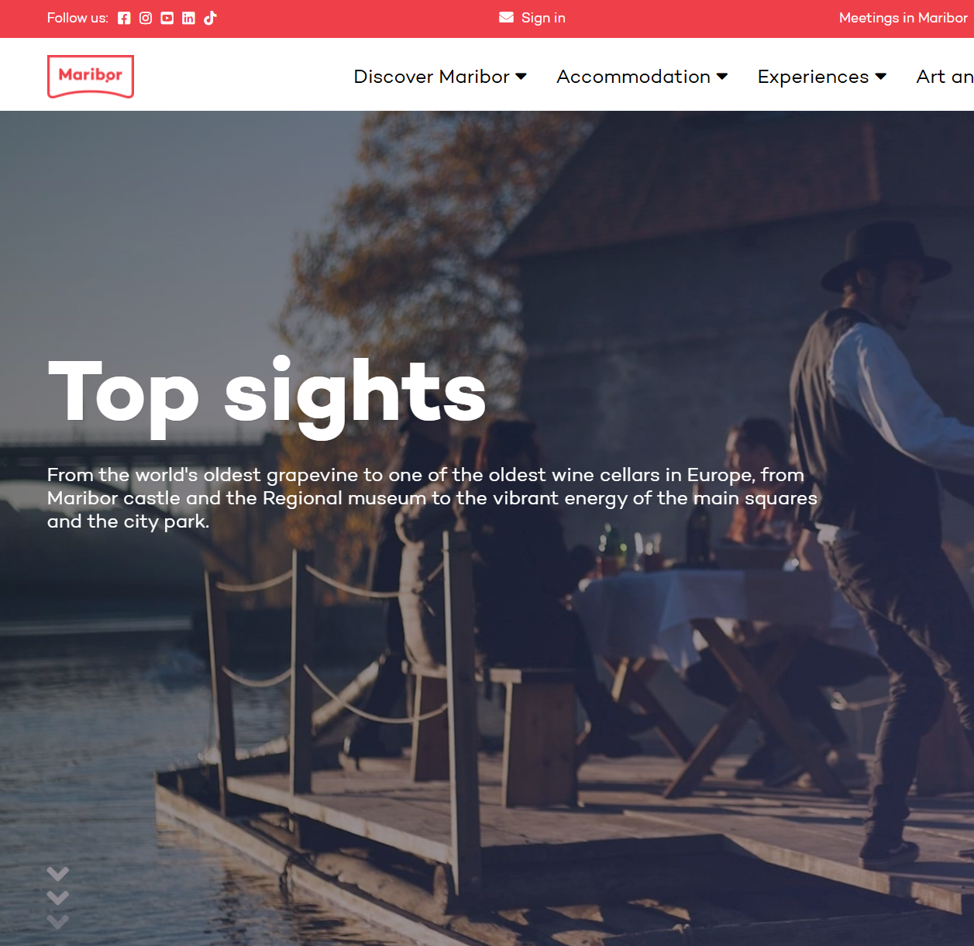
Example: Suggest Something Unique
Maribor:
From the world's oldest grapevine to one of the oldest wine cellars in Europe, from Maribor castle and the Regional museum to the vibrant energy of the main squares and the city park.
Top sights in Maribor
Photo Credit: Châteaux dans Les Arbes

Slide 22
Understanding the Guest Journey: Checklist "After the stay"
Leave guests with a warm final impression, ensure they felt cared for, and invite them to return or leave a review.
Yes No
Ask how the stay was – listen and respond professionally. Ask with genuine interest and listen closely to the response. If a guest shares any concern, respond with empathy “I’m very sorry to hear that. Thank you for letting us know. We value your feedback as it is the only way to improve our services”. Offer a small token (discount, apology note, free coffee) if appropriate.
Confirm any (extra) charges as minibar, room service etc. and provide the final invoice.
Invite the guest to leave a review or feedback “if you enjoyed your stay, we’d really appreciate a short review online - it helps others find us too.” Never pressure the guest. Keep it kind and optional.
Continued on the next slide
22

Slide 23
Understanding the Guest Journey: Checklist "After the stay"
Leave guests with a warm final impression, ensure they felt cared for, and invite them to return or leave a review.
Yes No
Offer to arrange transport or help with luggage.
Record guest notes for future stays as special occasions, likes/dislikes into the guest profile. Log any feedback or issues for continuous improvement.
Send a thank-you email or message after check-out.
23

Slide 24
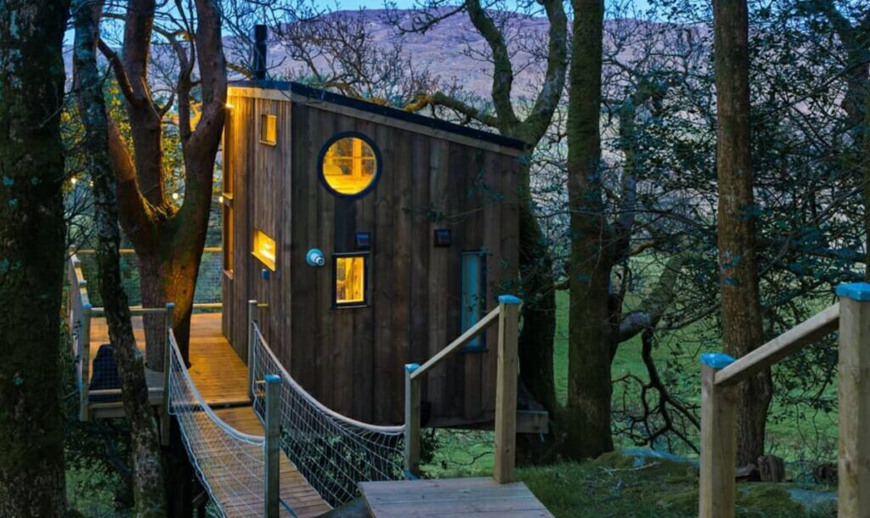
How to Make Every Step Easy and Welcoming
What to do:
Tools and tips:
Use Canva to design a printable welcome sheet with key info.
Use QR codes linked to online guides (PDF, Google Drive, or Linktree).
Keep instructions in guest language(s) if possible — Google Translate can help.
Keep check-in smooth: offer self-check-in if possible (key safe, smart lock), and send detailed instructions.
Prepare a simple, friendly welcome note or a small local snack/drink as a gesture.
Provide clear signage (e.g. Wi-Fi code, rubbish instructions, heating guide) inside the property.
Photo Credit: The Birdbox, Donegal Treehouse, Ireland
24

Slide 25
Personal Check-In
Yes No
Be ready at the agreed arrival time
Smile warmly and use the guest’s name: “Welcome, Mr. and Mrs. Novak! We’re so happy to have you.”
Make a personal check-in and retrieve more guest's information that help you to make your guest's stay even more enjoyable.
Show them around the common areas, breakfast area, garden, lounge, wellness zone, etc.
Explain any access codes, keys, or door locks clearly
Escort them to their room and show: light switches, heating/AC, Wi-Fi info, bathroom setup and any or special equipment.
Continued on the next slide
25

Slide 26
Personal Check-In
Yes No
Offer your service if anything is needed as "If you’d like extra pillows or anything at all, just let us know.” Offer a small welcome gesture in the room (as water, juice, wine, homemade or local snack) and include some seasonal touch (e.g., flowers in spring, hot tea in winter).
Provide a welcome guide if you can, include personal recommendations (your favorite café, hidden gem nearby etc).
Wish a pleasant stay and offer any furture stay as "We hope you have a comfortable and enjoyable stay. If there’s anything you need, please feel free to reach out."
26

Slide 27
Self Check-In
Ensure guests can safely, easily, and independently access your property — and feel supported even without face-to-face interaction.
Yes No
Choose a reliable Property Management System (PMS) to help you with reservations, online check-in, etc.
Clearly Communicate Check-In Instructions and send the guest step-by-step instructions at least 24 hours before arrival, also to provide the exact address, direction, your contact details, property policies or house rules etc. and to let them know that you are looking forward to their stay.
Continued on the next slide
27

Slide 28
Self Check-In
Ensure guests can safely, easily, and independently access your property — and feel supported even without face-to-face interaction.
Yes No
Include:
entry system type & location (e.g., “The black lockbox is on the left gate post”)
access code & when it becomes active (e.g., “Code 5932 works from 3 PM”)
room number and floor, wi-fi info, emergency phone number (for help on arrival), house ruls, parking options, etc.
add photos or a short video walkthrough
use the booking platform’s secure messaging system (Airbnb, Booking.com) or email
Continued on the next slide
28

Slide 29
Self Check-In
Ensure guests can safely, easily, and independently access your property — and feel supported even without face-to-face interaction.
Yes No
Test the system yourself (if code works, lockbox opens easily, doors closes and locks properly, guest can reach the property from parking, elevator, stairs etc.) and use the exact same instructions a guest will get and try checking in as if you were them
Prepare the property for a smooth arrival and leave lights on if guests may arrive after dark, place a welcome sign with guest name in the room (optional but personal) etc.
Stay available by phone, let guests know they can call, text, or message you anytime during check-in
Continued on the next slide
29

Slide 30
Self Check-In
Ensure guests can safely, easily, and independently access your property — and feel supported even without face-to-face interaction.
Yes No
Have a backup plan ready if the system fails (code not working, guest can’t find lockbox), be ready to walk them through the process by phone, offer an alternative entry method (e.g., drop a key via neighbor or lockbox), or to arrive personally as a last resort
Send a “Welcome” Message Shortly After Check-In
Security tips: change PIN codes after each stay (smart locks can automate this), never write the access code on the public property listing, make sure entry points are well-lit and clearly labelled, keep a spare key nearby in case of tech failure, but in a secure spot.
30

Slide 31
Dear Mr Marko,
we are delighted to welcome you to Family estate , Hidden road 25, 2000 Maribor, Slovenia - [Google Maps link], where we have already prepared an Apartment nr. 2 for you.
Please find your access information below:
Access to the parking lot: dial 00386 40 000 00X by using your mobile phone. Calling this number will unlock the main entrance gate. If the keypad is temporarily unresponsive, please wait a moment and try again.
Reception: there is no need to visit reception upon arrival. All formalities have been arranged in advance (payment and online check-in).
Apartment access code: 52426. This code will allow you to enter Apartment nr. 2 (ground floor).
If you will need any furthure assistance, do not hesitate to contact us on 00386 41 000 000. We are looking forward to welcome you at our Family estate!
Warm regards,
Tanja and Luka
Tel: [insert] Email: [insert] Website: [insert]
Files attached:
property policies or house rules
possibilities for additional activities at the destination, additional offers, etc.
Example: Self Check-In
31

Slide 32
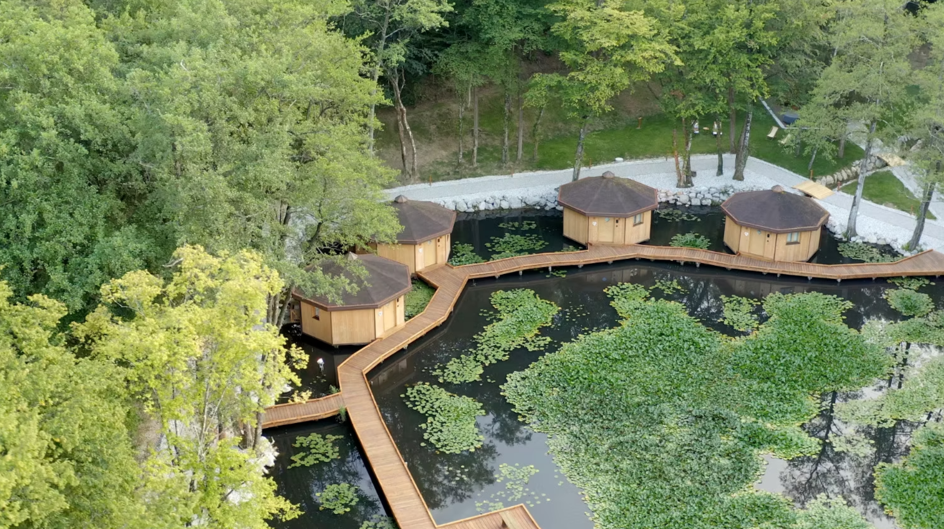
Case Study
First Floating Glamping In Slovenia
Pikol Lake Village Wine Estate, Slovenia
Information to Access
Your Apartment
Self-check-in in one of the villas using Bentral Property Management System (PMS)
in PIKOL Lake Village Wine Estate
Click to Visit
32

Slide 33
Example: Lasting Impressions
What to do:
Tools and tips:
Use message templates with space to personalize (e.g. “Hi [Name], have a great stay in Maribor – the weather looks perfect for exploring today!”).
Ask for honest feedback and act on it to show improvement.
Keep a small guestbook or feedback card on site.
Be consistent: deliver what you promise in your listing.
Show you care respond quickly to guest messages, even just to say, “I’ll check and get back to you.”
Go personal: mention their name, refer to their reason for travel if known, or offer a tailored suggestion (e.g. nearby vegan cafe if they asked about food).
33

Slide 34
Building Trust and Lasting Impressions
“Dear James, great question - I’ll double-check and get back to you within the hour.”
Quick & Caring Communication:
Sara responds to all guest messages within 1 hour. If she doesn’t have an immediate answer, she replies with:
This builds trust and reassures guests that their needs matter
34

Slide 35
Building Trust and Lasting Impressions
“Hi Lena and Marco, congratulations! I’ve left a small bottle of sparkling wine for you in the fridge. Enjoy your time in Maribor!”
Personalized Touches:
When Sara sees that a guest booked the apartment for a honeymoon, she writes:
35

Slide 36
Building Trust and Lasting Impressions
“There’s a great vegan café called ‘Rustika’ just a 5-minute walk away. I’ve marked it on the map for you.”
Personalized Touches:
For a vegan traveler who inquired about food options, she adds:
36

Slide 37
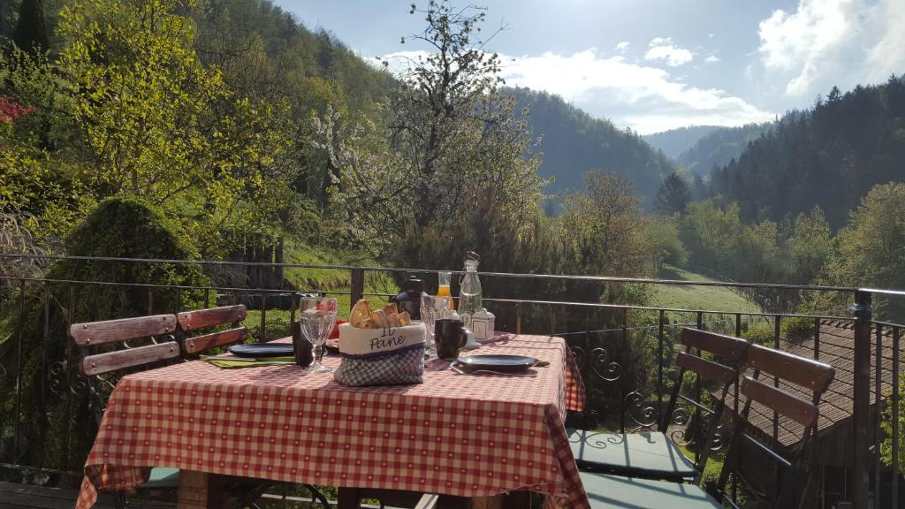
How Weiss Tourist Farm Applies It
Case Study
Weiss Tourist Farm, Slovenia
Be consistent Their website promises homemade food, authentic ambiance, and traditional décor - exactly what guests consistently receive according to reviews.
Show you care Maja and Roman are praised for their quick responses, meticulous attention to detail, and proactive assistance with local activities.
Go personal They greet guests by name, tailor breakfast creations daily, and recommend bike routes or day trips based on interests.
Tools & feedback -They encourage feedback through reviews and personal interactions. Every detail - like sauna options, room cleanliness, and responsive communications - is refined by guest input.
Click to Visit
Sources. Booking.com - Turistična kmetija Weiss
37

Slide 38
02
Setting Up Clear, Timely Communication
Key Learning Area
Good communication is one of the most important parts of hosting. You don’t need to write long emails - just give the right information at the right moment. Tools like message templates or scheduled replies can save you time.
In this part, we’ll look at tips and tools to keep communication smooth. Clear messages lead to fewer questions, better stays, and happier guests.
38

Slide 39
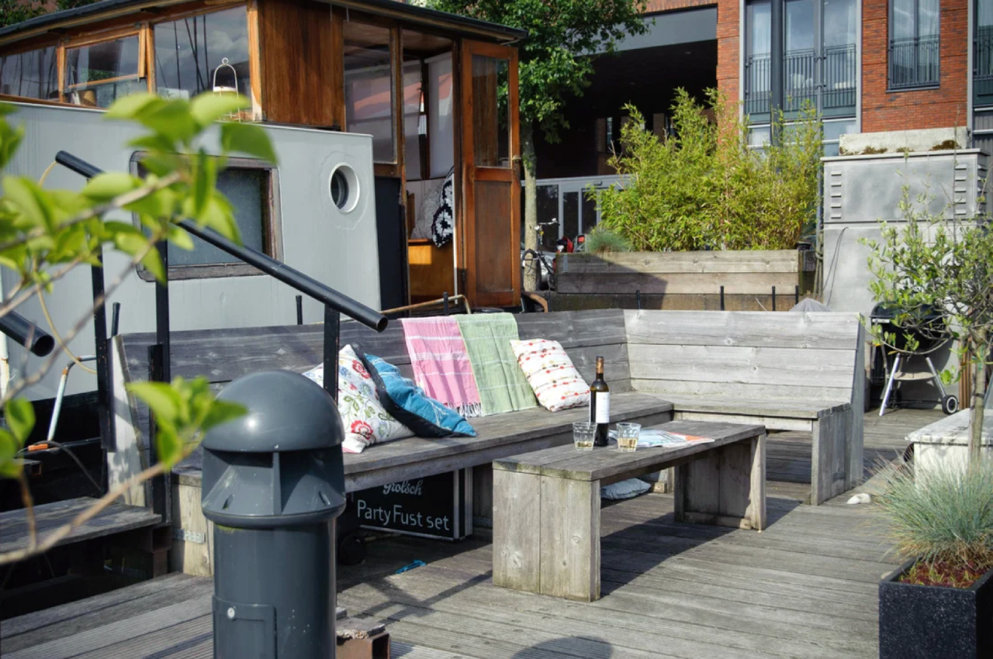
"The most important thing in communication is hearing what isn’t said." —
Peter Drucker
This quote highlights the power of digital and non-verbal cues—such as email conversations, body language, facial expressions, and tone—in effectively addressing issues and understanding questions, often more than words alone.
Photo Credit: Amsterdam, Boat, Netherlands
39

Slide 40
Booking Confirmation E-mail - Set Expectations
Before the stay:
Booking confirmed: We’ve reserved your spot - get ready for a great experience.
Check-In: [Time, e.g., 3:00 PM] - Self check-in details will be sent via email or text message.
3 Days before arrival: You’ll receive check-in instructions and any additional details.
1 Day before: A reminder with directions, parking information, and local tips.
During your stay
In - stay support: Need anything? Reach out anytime via [e-mail] or [telephone number]
Local recommendations: Explore curated guides and exclusive guest perks.
Include some of the following examples in your booking confirmation. It helps set expectations and enhance the guest experience before, during, and after their stay.
40

Slide 41
Booking Confirmation E-mail - Set Expectations
Include some of the following examples in your booking confirmation. It helps set expectations and enhance the guest experience before, during, and after their stay.
After your stay
Check-out: [Time, e.g., 11:00 AM] - Just lock up and go.
Thank you and feedback request: We’ll follow up with a short survey to hear how we did.
Loyalty perks: Returning guests receive [X]% off future stays.
41

Slide 42

Practical Exercise: Guest Journey Mapping
Task Description:
List the following actions in the correct order along the guest journey (Before the Stay, During the Stay, After the Stay). Put consecutive numbers (from 1 to 6) in the squares.
Send check-in instructions
Thank the guest for staying
Provide a welcome basket
Ask for a review
Confirm the booking
Offer local recommendations
42

Slide 43
Simple Tools to Save Time and Stay Professional
What to do:
Tools and tips:
Google Sheets: simple task tracker for messages sent.
Airbnb/Booking.com auto-replies or scheduled messages.
Use tools like Notion or Trello for storing standard texts or FAQs.
Write and save short message templates for common situations (booking, directions, house rules, check-out reminder).
Automate what makes sense: check-in instructions, thank-you notes, review requests.
Always keep tone friendly, helpful, and clear — not too formal, but not too casual.
43

Slide 44
Handling Questions and Problems Through Communication Verbal communication
What to do:
Tools and tips:
Use calming language: “Thank you for letting me know,” “I understand how that could be frustrating,” “Let’s find a solution.”
Keep records of past questions or issues to improve future info you share.
Set communication boundaries (e.g., “I usually reply between 8:00–20:00”) and include them in your guest guide.
Respond quickly - even a short “I’m looking into it now” builds trust.
Stay calm and polite if guests are upset or confused.
Ask clear follow-up questions to understand the issue fully before replying with a solution.
44

Slide 45
Handling Questions and Problems Through Communication Non-verbal communication
Positive Body Language
Maintain open posture (avoid crossed arms)
Smile naturally and make appropriate eye contact
Nod occasionally to show understanding
Gestures and Movement
Use calm, slow gestures to explain directions or demonstrate something
Avoid sudden or overly expressive movements that may confuse or alarm the guest
Facial Expressions
Keep a friendly and calm expression
Avoid frowning or looking distracted
Personal Space
Respect the guest’s comfort zone
Avoid standing too close unless necessary
Tone and Attitude
Your attitude shows through posture and facial expressions, even without words
Stay approachable and attentive
45

Slide 46
Practical Exercise: Exercise:
Build Your Host Communication Toolkit
Task Description:
You are a host of a small rural guesthouse. To stay organized and save time, you need to build a simple communication system using digital tools mentioned in the slide.
Step 1: Templates
Write three short message templates you would use in your daily operations:
Booking confirmation message
Check-in instructions
Thank-you and review request
Tip: Keep the tone friendly, helpful, and clear (not too formal, not too casual)
46

Slide 47
Practical Exercise: Exercise:
Build Your Host Communication Toolkit
Step 2: Organize Your Tools
Choose two tools from the list below and explain how you would use them to manage communication:
Tip: Keep the tone friendly, helpful, and clear (not too formal, not too casual)
Task Description:
You are a host of a small rural guesthouse. To stay organized and save time, you need to build a simple communication system using digital tools mentioned in the slide.
Tool | Example Use
Google Sheets | Tracking which guests have received which messages
Trello or Notion | Storing message templates or FAQ answers
Airbnb/Booking Auto-Replies | Scheduling review requests and check-in messages
47

Slide 48
Practical Exercise: Exercise:
Build Your Host Communication Toolkit
Task Description:
You are a host of a small rural guesthouse. To stay organized and save time, you need to build a simple communication system using digital tools mentioned in the slide.
Step 3: Reflection
Answer briefly:
What are the benefits of automating some of these tasks?
What are the risks if automation isn’t done properly?
48

Slide 49
03
Adding Personal Touches
A small personal touch can make a big difference. Guests often remember things like a handwritten note, local food tip, or cozy welcome gift. These details help show your personality and what makes your place special. They also help guests feel like they’re staying somewhere unique, not just any room. You don’t have to spend a lot of money - simple, thoughtful touches go a long way. Even using a guest’s name or recommending your favorite nearby walk can make them smile.
In this part, you’ll learn how to add these extras in a way that fits your time and budget. Personal touches can reflect your area, your values, or your style. They help guests connect with you and with the local experience. This connection is often what turns a stay into a memory.
Key Learning Area
49

Slide 50
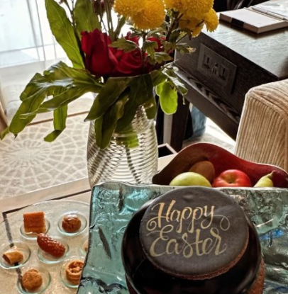
Example: Personal Touches For Holidays
In a phone conversation, a guest mentions that he and his wife are having their wedding anniversary during their holiday. Make a note of this information and find out more during your stay by making casual conversation and surprising them on the day.
If they are regular guests with whom you have already established a personal relationship, you can also follow them on social media. If you are hosting guests from another religion during their holidays, surprise them with a small gesture (such as a cake in the room) to show that you care.
Photo Credit: Gregor Jamnik

Slide 51
Why Small Details Matter to Guests
What to do:
Tools and tips:
Use recycled paper or small local postcards for notes.
Add a local phrase (e.g., “Dobrodošli!” or “Welcome to Maribor!”).
Keep a basket with small seasonal items — herbal tea, homemade jam, or dried fruit from the region.
Guests remember the feeling, not just the furniture.
A handwritten note, a local treat, or fresh flowers can make the space feel warm and welcoming.
Personal touches create emotional connection, which leads to better reviews and return visits.
Show guests they’re more than just a booking.
51

Slide 52
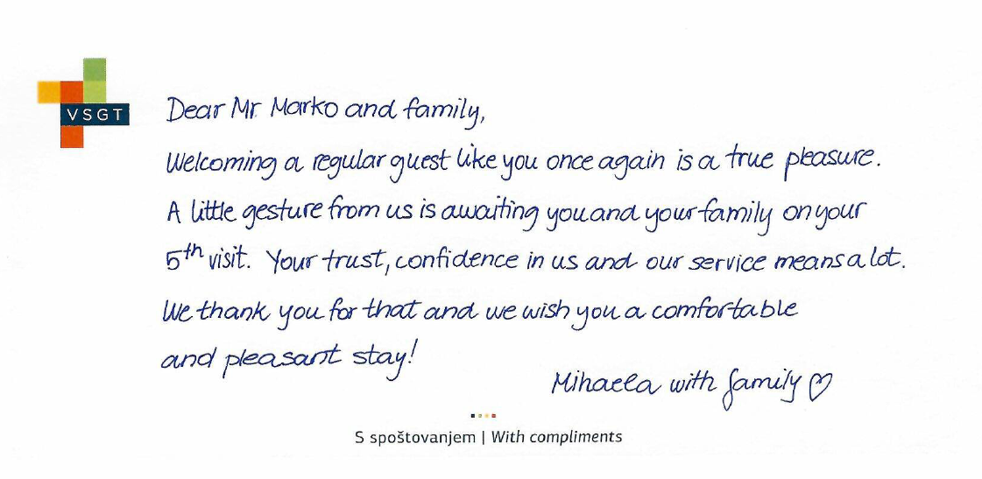
Example: With Compliments For Regular Guests
A handwritten card will further embody your sincerity and gratitude for the return visit.
Add to your dedication a thoughtfulness that comes from the heart, can be consumed or kept as a memory.
52

Slide 53
"Easy Ideas for Personal Touches That Don’t Cost Much"
What to do:
Tools and tips:
Create a simple, reusable welcome card using Canva.
QR code linking to your personal Google Map with recommendations.
Use guest message templates that include a warm welcome based on the season or holiday.
Leave a short list of your favorite nearby cafes, markets, or walks.
Use scent: light lavender sachet, fresh citrus in the kitchen, or a calming herbal blend.
Offer a reusable shopping bag or umbrella for guest use.
Celebrate special moments - ask if they’re celebrating anything and leave a note or small treat.
53

Slide 54
"Making Your Place Feel Special and Memorable"
What to do:
Tools and tips:
Keep a folder or booklet with guest stories, local events, and small surprises.
•Use a branded welcome card or printable with your hosting name/logo if you have one.
•Photos of past guests (with permission) or thank-you notes displayed in a cozy corner.
Add small items that reflect your region: local craft, plant, or historical photo.
Include a guestbook where visitors can leave comments, drawings, or travel tips.
Personalize based on who’s coming (e.g., family with kids → coloring page and crayons, business traveler → notebook and pen).
Share a short story about the space or your journey as a host.
54

Slide 55
Example: "Turn Down Service"
Turn-down-service it’s generally seen as a premium touch to enhance the sense of being cared for during a stay.
For example: take advantage of your (herb) garden and enrich your offer with Deep sleep pillow spray.
Certain scents can significantly reduce sleep onset time (how quickly you fall asleep) and improve overall sleep quality.
Lavender: reduces anxiety and promotes deeper sleep
Chamomile: lowers stress hormones and relaxes the body
Vetiver: grounds the nervous system and quiets an overactive mind
Ylang-ylang: lowers blood pressure and creates feelings of comfort
Bergamot: reduces heart rate and prepares the body for rest
55

Slide 56
04
Handling Common Guest Issues Calmly and Professionally
Key Learning Area
Sometimes things go wrong - and that’s okay. Late arrivals, lost keys, or unhappy guests are part of hosting. The key is to stay calm, be polite, and solve the problem quickly.
In this part, you’ll learn how to deal with common issues in a friendly and professional way. You’ll see that most guests just want to feel heard and respected. Even a short message or quick solution can turn things around. It’s also important to know when to say no - and how to do it kindly. You don’t need to be available 24/7, but it helps to be prepared.
This section gives you real examples and simple responses you can use. When you handle problems well, guests remember the effort - not just the issue.
56

Slide 57
"Preparing for Common Problems Before They Happen"
What to do:
Tools and tips:
Use a printed or digital FAQ with quick solutions.
Keep your phone charged and available during guest check-in periods.
Use laminated “quick help” cards in key areas (e.g. router reset instructions near the Wi-Fi box).
Identify the most common guest issues: late check-ins, Wi-Fi problems, noise, unclear appliances.
Add clear info to your guest guide, including “what to do if...” instructions.
Set up backup plans for key situations (extra keys, alternate contact, emergency numbers).
Leave basic items like a flashlight, extra batteries, or a spare charger in case of need.
57

Slide 58
"Preparing for Common Problems Before They Happen"
A young family has booked a day care during the holidays, due to the advertised variety of children's entertainment. The original babysitter has quit, and you are forced to hire a new person. But will she fulfil expectations?
Be ready for the new guests!
Invite your children or other younger family members to a trial of care and animation. Keep an eye on things to see if the new worker is suitable for the job
58

Slide 59
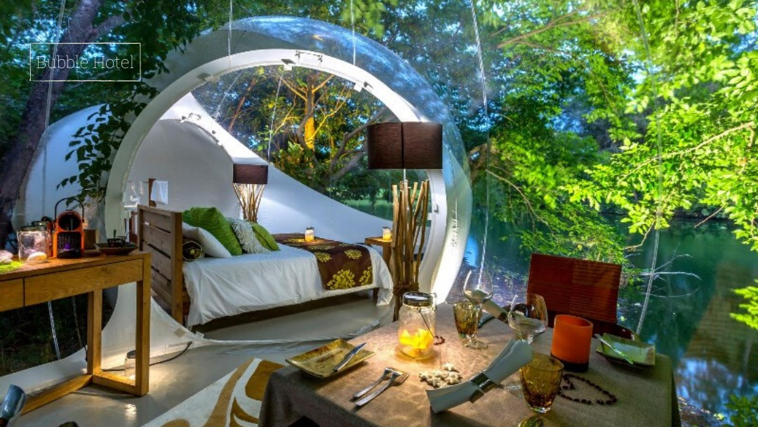
"Staying Calm and Solving Issues Quickly"
What to do:
Tools and tips:
Use calm phrases: “Thanks for letting me know,” “I understand,” “Let’s sort this out together.”
Keep a small guest support checklist for yourself.
If using platforms like Airbnb, respond via app so the communication is logged.
Respond within 10 - 30 minutes whenever possible - even if it’s just to say you’re checking.
Be polite, show empathy, and offer a clear next step.
If the guest is upset, listen first, thank them for raising the issue, and avoid blaming.
Provide a solution or clear timeline: “I’ll drop off a new kettle by 6 PM,” or “Here’s a quick fix for the heater.”
Credit: Photo Credit:
The Bubble Hotel, Iceland
59

Slide 60
“Turning Problems into Positive Experiences“
What to do:
Tools and tips:
Have pre-written messages for follow-ups after resolving an issue.
Keep a “guest care kit” ready with small tokens or notes.
Take feedback seriously and update your info or setup based on it.
After solving an issue, check in with a short message: “Hope everything is better now — let me know if you need anything else.”
Offer a small gesture if the issue was serious (e.g. local treat, small discount, late check-out).
Show appreciation for their patience: people value being heard.
Follow up after the stay to thank them again and show you care.
60

Slide 61
05
Encouraging Reviews, Return Visits & Referrals
Key Learning Area
Positive reviews are one of the best ways to grow your hosting business. Most guests are happy to leave a review - they just need a little reminder. You’ll learn when and how to ask in a natural and polite way. We’ll also talk about how to make your stay so memorable that people want to come back. Simple follow-up messages or thank-you notes can help build loyalty. You can also add small extras or offers for returning guests.
Guests who feel appreciated often tell their friends and family. That’s how word-of-mouth referrals work - and they are very powerful. This part helps you grow without spending money on ads or big marketing. Kindness, quality, and follow-up lead to stronger reviews and repeat bookings.
61

Slide 62
"Asking for Reviews the Easy Way"
What to do:
Tools and tips:
Use auto-messages on platforms like Airbnb to schedule review requests.
Save your review request template in your phone or notes app.
Include a QR code in your printed guide or check-out instructions that links directly to your review page.
Send a thank-you message within 24 hours of checkout, kindly asking for a review.
Keep your message short and warm: “It was a pleasure hosting you - I’d really appreciate it if you could leave a quick review.”
Mention that reviews help small hosts like you grow.
Avoid asking too early - wait until their experience is complete.
62

Slide 63
"Building Guest Loyalty Through Simple Actions"
What to do:
Tools and tips:
Keep a list of past guests and notes about their preferences (e.g., “loved bike tours”).
Use email or direct messaging (if allowed by the platform) to stay in touch occasionally.
Offer a “come back soon” card with a simple promo code or contact number.
Leave a personal thank-you card or follow-up email a few days after their stay.
Invite returning guests to book directly with a small discount or added bonus (e.g. free breakfast).
Mention local events or festivals they might want to return for.
Treat every guest like a potential regular - even if they’re visiting only once.
Credit: Photo Credit:
The Bubble Hotel, Iceland
63

Slide 64
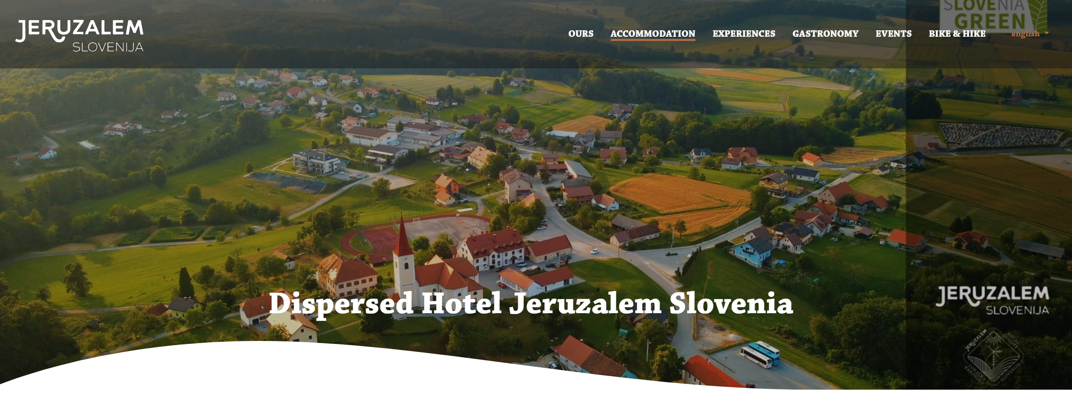
Case Study
Guest Loyalty Through Simple Actions
Dispersed hotel Jeruzalem, Slovenia
Click to Watch
A dispersed hotel in Jeruzalem, Slovenia connects various accommodation units, wine cellars, culinary spots, and local attractions under one coordinated guest experience. To fully realize the potential of this model, engaging local stakeholders is essential for creating a multiplier effect through joint promotion and shared value creation. Offer your guests credibile recommendation and improve your loyalty.
Photo Credit: Dispersed hotel Jeruzalem
64

Slide 65
"How Word-of-Mouth Can Grow Your Business"
What to do:
Tools and tips:
Create a simple “referral card” or digital thank-you with your contact and IG/Facebook info.
Feature happy guest comments or photos (with consent) on your booking profile.
Use social proof: good reviews attract more bookings and build trust faster than ads.
Encourage guests to recommend your place to friends or family.
Say something like: “If you know someone visiting Maribor, feel free to share my contact - I’d love to host them!”
Make it easy to share by offering a business card or Instagram handle.
Ask for permission to share guest photos or stories (if they post and tag you). Sharing authentic guest experiences builds trust and attracts potential guests.
65

Slide 66
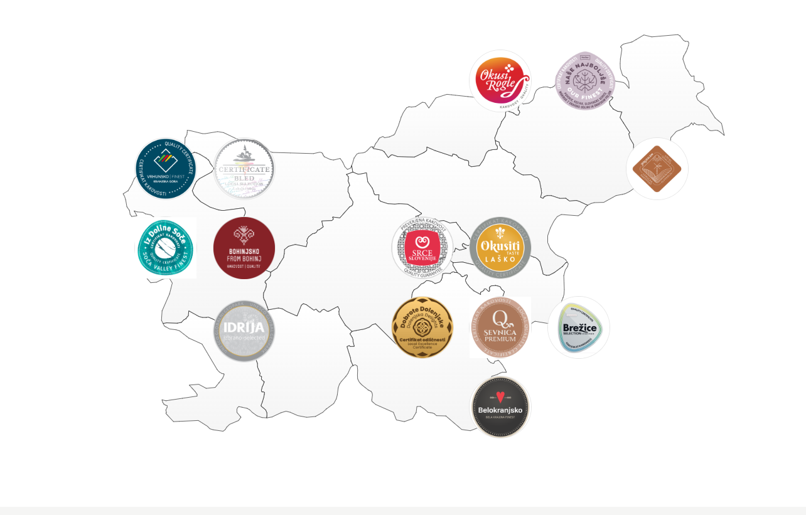
CASE STUDY: How to Work and Connect with Local Community
Photo Credit: iZVORNO SLOVENSKO
IZVORNO SLOVENSKO
Territorial collective brands represent a unique concept in the marketing and identification of local high-quality products and services. This approach not only stimulates the local economy, but also creates a strong link between the various actors of modern development in the region - from farmers, to caterers, to adventure providers. Include local certified products in your offer which increase value to your recommendation

Slide 67
Practical Exercise: Guest Experience Knowledge Test
How should you ask for a guest review?
Before check-in
During their first night
Within 24 hours after checkout
Only after receiving a complaint
Correct answer: C
67

Slide 68

Additional Reading
Hotel Guest Journey: How to Analyze (Step-by-Step)
Click to Read
A detailed guide to mapping the full guest journey—from "dreaming" to post-stay review—highlighting stages, touchpoints, and optimization strategies
68

Slide 69

Additional Reading
Hospitality In The Digital Age: Managing Quality Without Being On-Site (Forbes)
Click to Article
An opinion article exploring remote management, quality control, and how to uphold service excellence in a digital-first hospitality world.
69

Slide 70
Module 5 (Part 2)
Well Done
Section 2: Tools & Systems for Efficient Operations
Section 3: Growing Smart
- Partnerships, Upsells & Long-Term Planning
You have Completed… Module 5 (Part 1)
Section 1: Managing the Guest Journey - Before, During
& After the Stay
Next is…

