Slide 1
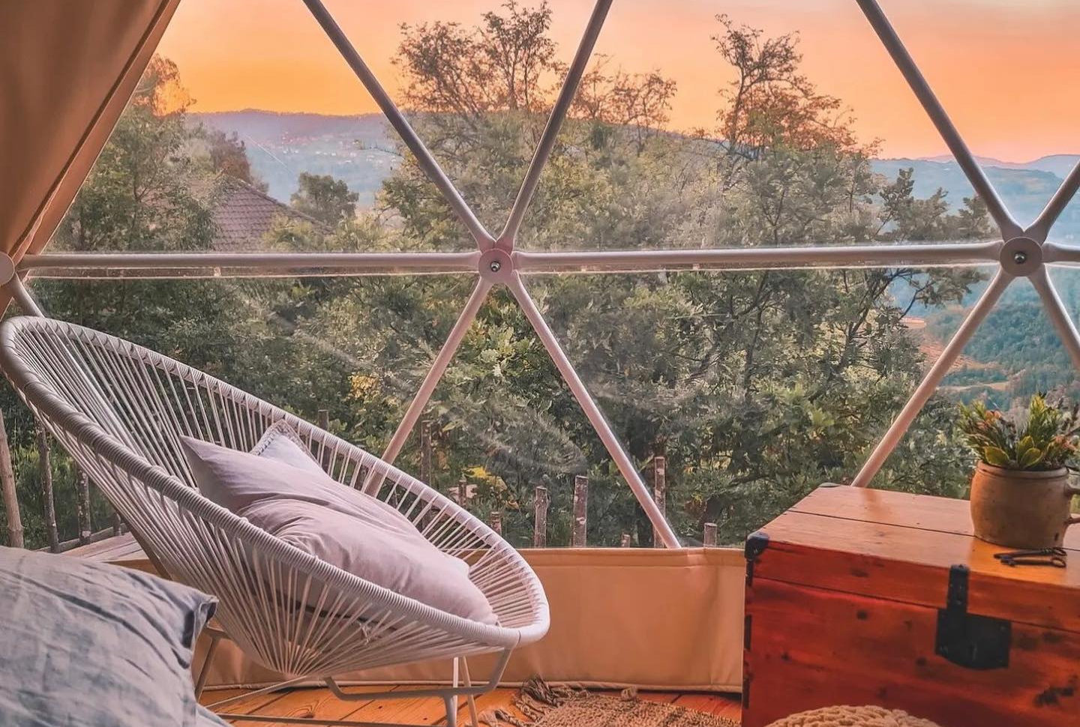

Photo Credit: Gaia's Spheres B&B, Italy
Module 3 (Part 1)
Designing Sustainable & Place-Based Accommodation
www.epicstays.eu

Slide 2
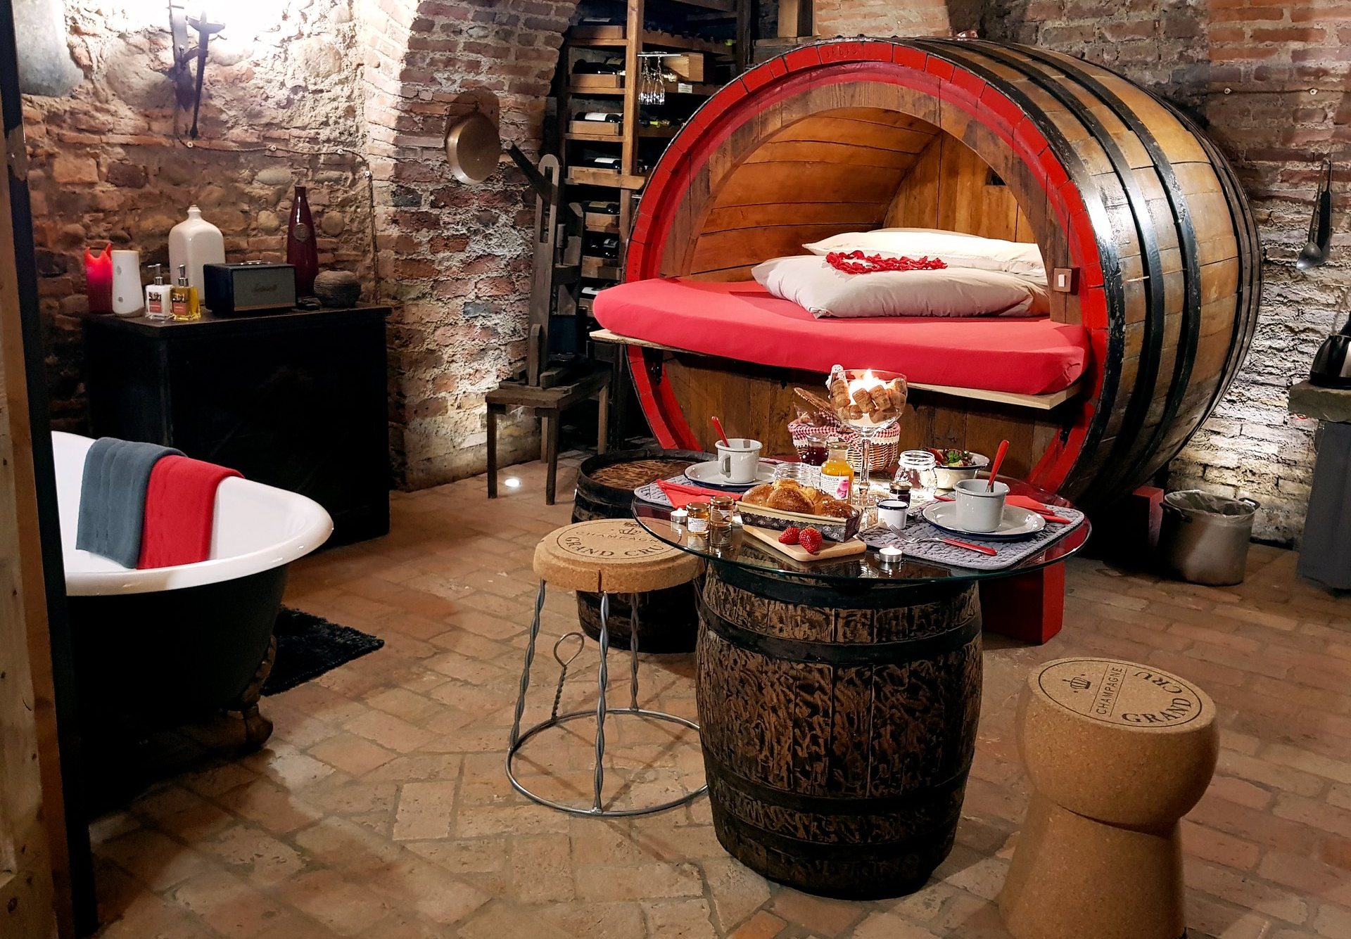
Module 3 (Part 1)
Photo Credit: Cantina Al Silter, Italy
Section 1
Smart Starts: Adapting Buildings & Using Pre-Built Units

Slide 3
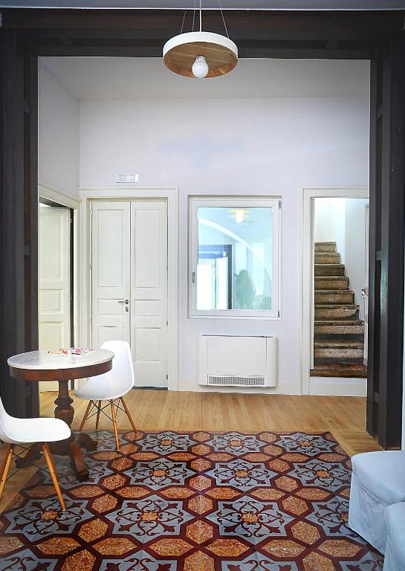
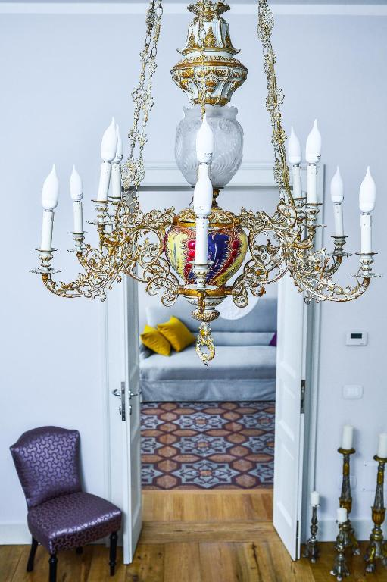
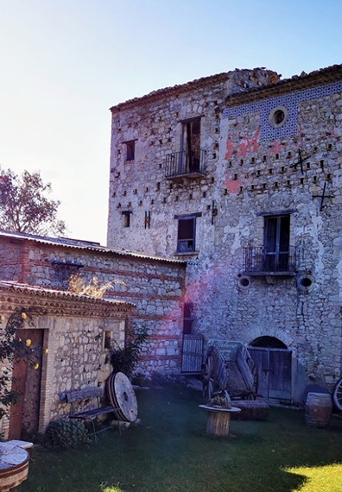
02
Photo Credit: Camera a sud, Bovino
Page 5
Photo Credit: Camera a sud, Bovino
Section 1
Smart Starts – Adapting
Buildings & Using Pre-Built Units
CONTENTS
01
03
Page 0
Page 6
Overview & Learning Objectives
Additonal Resources Section
Photo Credit: Visit Monti Dauni, Bovino

Slide 4
Learning Objectives
Module 3 Overview
01
Smart Starts: Adapting Buildings & Using Pre-Built Units
Module 3 shows how alternative accommodation can be both sustainable and deeply connected to local identity. Discover how thoughtful design, material selection, and landscape integration not only support the environment but also empower communities and preserve culture. Learn how building choices can create unique, memorable tourism experiences- especially in rural or overlooked areas.
It covers 3 Key Sections:
Smart Starts: Adapting Buildings & Using Pre-Built Units
Better Building Choices - Materials, Layout & Flexibility
Right-Sized Stays That Make a Local Impact
Learn how to unlock the potential of existing spaces by repurposing existing or rural heritage buildings and disused areas.
Explore how existing or rural heritage buildings are revitalising communities and economies.
Explore modular, flexible solutions and low-impact construction methods that preserve local charm and support sustainable tourism.
Learn how units can be adapted and reused, and how, as lightweight construction, they can preserve nature, celebrate local identity, and boost rural tourism.

Slide 5
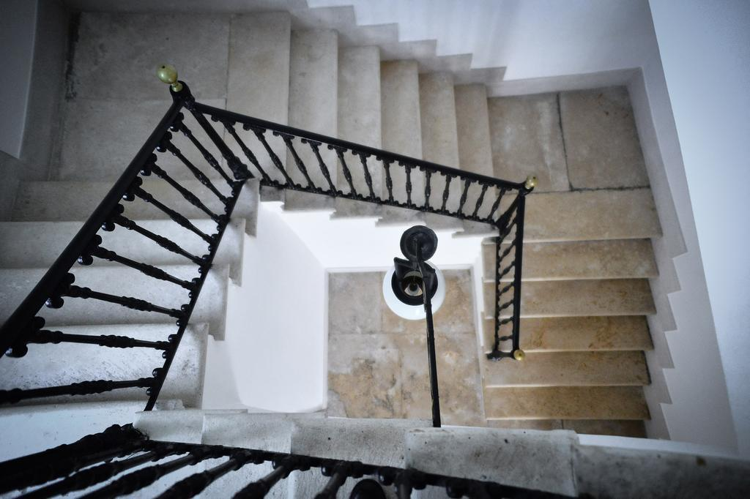
Section 1
Photo Credit: Camera a Sud, Bovino
Smart Starts – Adapting Buildings & Using Pre-Built Units

Slide 6

Photo Credit: : Meridaunia
Section 1
Smart Starts - Adapting Buildings & Using Pre-Built Units
Overview:
This section is crucial because designing accommodation in rural or underutilized areas requires creative solutions that are both context-sensitive and resource-efficient.
By repurposing existing structures -such as barns, historic homes, or disused schools -you can reduce environmental impact, preserve local heritage, and lower construction costs. Modular, transportable, and prefabricated units offer additional flexibility, enabling faster setup and adaptability to different terrains or seasonal needs. Understanding how to transform these spaces into welcoming, functional accommodations is key to unlocking the potential of overlooked areas and contributing to sustainable rural regeneration.
6

Slide 7
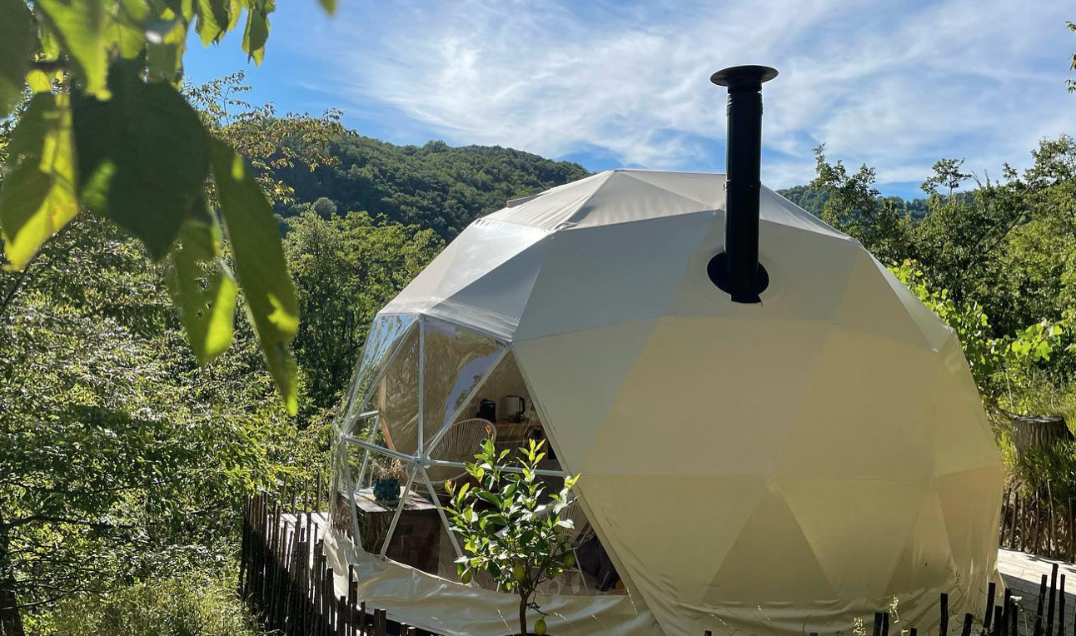
Introduction - Smart Starts – Adapting Buildings & Using Pre-Built Units
Photo credit: Gaia's Spheres B&B, Italy
Launching a sustainable and distinctive accommodation business often starts not by building from scratch, but by reimagining what already exists. Across Europe, rural villages, forgotten structures, and open landscapes hold untapped potential for tourism that is both meaningful and environmentally responsible. Whether you’re considering restoring a heritage home, transforming a disused public building, or placing modular units in underutilized land, the first step is knowing how to adapt intelligently and with purpose. This section introduces the core concepts behind “smart starts” — using existing buildings or pre-built units as the foundation of your alternative accommodation project.
Source: Dolnicar, S. (2018). Market Share and Sustainability of Alternative
Tourism Accommodation. Journal of Sustainable Tourism.
7

Slide 8
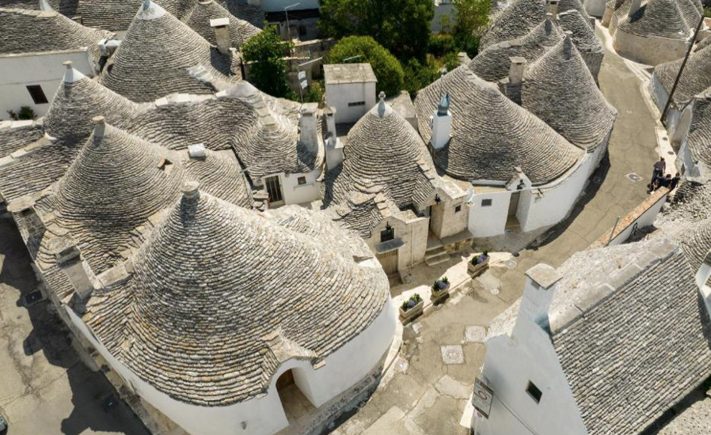
Introduction - Smart Starts – Adapting Buildings & Using Pre-Built Units
Photo credit: Trulli Holiday Albergo Diffuso ,Italy
You’ll learn how adaptive reuse preserves cultural identity while adding functionality, how pre-fabricated and transportable structures can minimize environmental impact, and how to work within the limitations of infrastructure and zoning. From historic palazzos in Italy to off-grid bubbles in Iceland, the case studies in this section demonstrate what’s possible when creativity meets practicality. By the end of this section, you’ll be able to evaluate the feasibility of reusing a space in your community, understand the unique advantages of modular solutions, and begin developing ideas that make sense for your landscape, budget, and local context.
Source: Dolnicar, S. (2018). Market Share and Sustainability of Alternative
Tourism Accommodation. Journal of Sustainable Tourism.
8

Slide 9
Section 1: 4 Key Learning Areas
01
Assessing and Repurposing Existing Buildings:
Learn how to identify underused or historic structures - such as barns, rural homes, and public buildings - with potential for tourism use. Understand how to evaluate their condition, function, and cultural value while planning adaptive reuse that respects local heritage and meets guest expectations.

Slide 10
Section 1: 4 Key Learning Areas
02
Exploring Modular and Prefabricated Solutions:
Discover how pre-built, modular, or transportable units can offer quick, cost-effective, and low-impact accommodation options. Learn where these models are most effective, what logistical considerations they involve, and how they can be adapted to rural or natural landscapes.

Slide 11
Section 1: 4 Key Learning Areas
03
Designing for Low Environmental Impact
Understand the principles of lightweight construction, minimal foundation systems, and bioclimatic adaptation. Learn how to reduce your ecological footprint while delivering comfort and quality, using appropriate materials and infrastructure-light

Slide 12
Section 1: 4 Key Learning Areas
04
Overcoming Infrastructure Challenges Creatively
Many rural areas lack water, electricity, or waste systems. This section explores creative, compliant off-grid solutions - like dry sanitation, solar energy, and rainwater harvesting-that allow alternative accommodations to operate sustainably in remote or infrastructure-poor settings.

Slide 13
01
Assessing and Repurposing Existing Buildings
Key Learning Area
Launching a unique and sustainable alternative accommodation business requires more than vision and creativity - it demands a smart use of what already exists. In rural and peri-urban areas, where resources can be limited, adapting existing buildings can offer a cost-effective, culturally sensitive, and environmentally sustainable solution.
From former schools and barns to historic homes or unused civic spaces, these structures can be transformed into compelling guest experiences.
13

Slide 14
01
Assessing and Repurposing Existing Buildings
Key Learning Area
This learning area equips you with the tools to evaluate the potential of such buildings. You’ll learn how to assess the structural and spatial suitability of underutilized assets, explore renovation options that preserve local identity, and understand how to align design choices with environmental and regulatory contexts.
By following the contents included, you'll be able to identify a building’s adaptive reuse potential, plan key structural and operational adaptations, and connect your design choices to wider sustainability and tourism development goals.
14

Slide 15
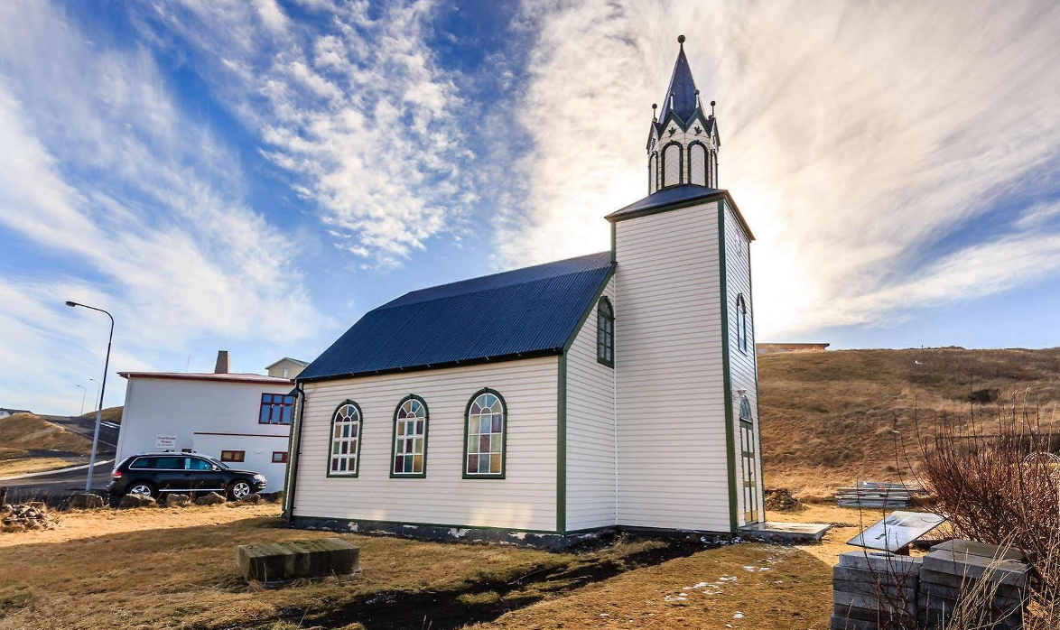
Core Contents
Why Adaptive Reuse Makes Sense
Repurposing existing buildings is not only a practical decision - it’s a powerful strategy for sustainable tourism development. In many rural areas, disused or abandoned structures such as old farmhouses, schools, or historic homes often carry deep cultural significance. Rather than letting these spaces fall further into disrepair, adaptive reuse allows entrepreneurs to breathe new life into them - preserving local identity while reducing environmental impact.
This approach significantly lowers the demand for new construction materials and minimizes land use, making it a lower-carbon alternative to building from scratch. The embodied energy already present in existing buildings - energy previously used in construction - means fewer emissions are generated in their transformation.
Photo credit: Church Blonduos, Iceland
15

Slide 16
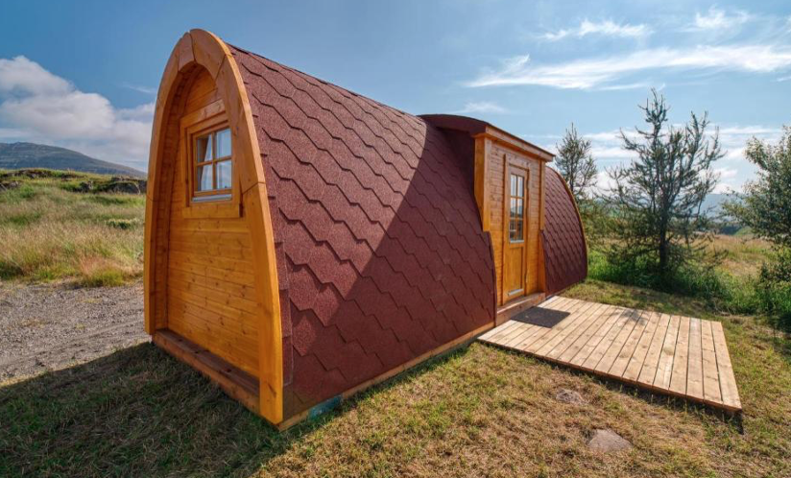
Core Contents
Why Adaptive Reuse Makes Sense
But adaptive reuse isn’t just about sustainability - it creates market value. Guests are increasingly seeking authentic, story-rich experiences. A restored 19th-century townhouse, a converted stable, or an old mill tells a unique story that connects visitors to the spirit of place. These buildings, once overlooked, can become memorable destinations that boost the local economy and encourage community pride.
By understanding the cultural, ecological, and economic advantages of adaptive reuse, you’ll be better equipped to identify promising structures in your area and envision their potential as vibrant alternative accommodations.
Photo credit:
Fossatun Pods & Cottages, Iceland
16

Slide 17
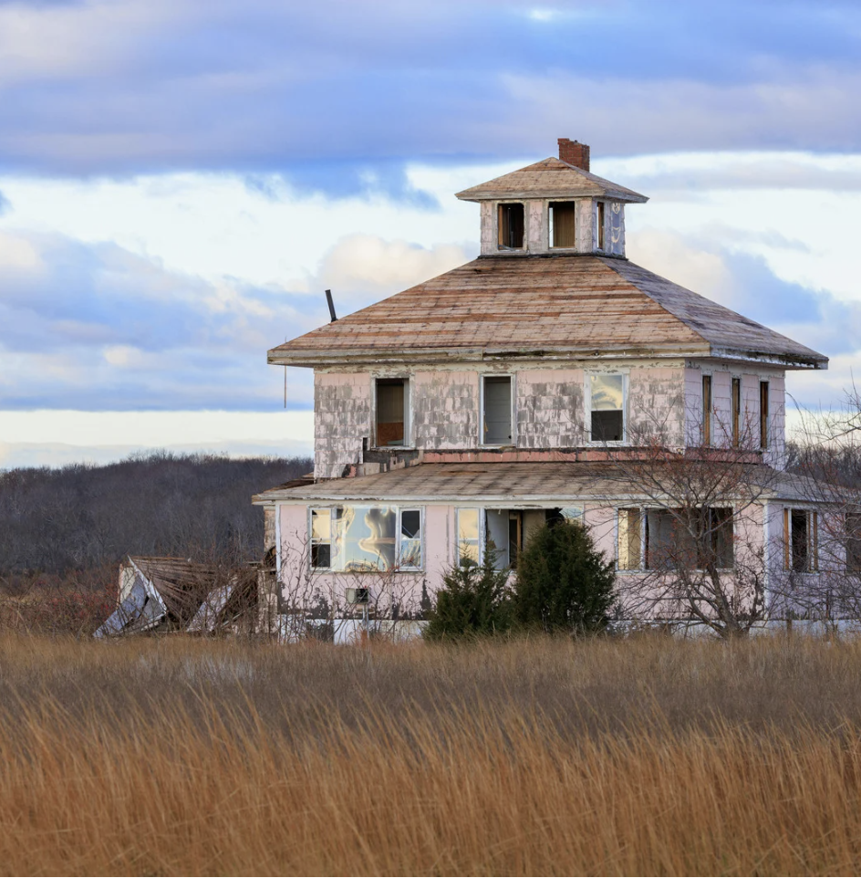
Core Contents
Initial Building Assessment
Before you can transform a vacant building into a thriving alternative accommodation, you must first assess whether the space is truly viable for repurposing.
This means going beyond aesthetics and asking the critical structural, legal, and functional questions that will determine your project's success.
Photo Credit: Meridaunia

Slide 18
Core Contents
Initial Building Assessment
A thorough feasibility assessment begins with evaluating structural integrity. Is the foundation stable? Are the walls and roof in good condition? Identifying early whether a building can be safely renovated - or if it needs significant reinforcement - will save time and unexpected costs down the line.
Next, examine access to basic utilities. Can the building be connected to essential services such as electricity, running water, and sanitation? In rural areas especially, off-grid or low-impact solutions may be required, and the cost and logistics of installing these systems should be factored into your planning.
18

Slide 19
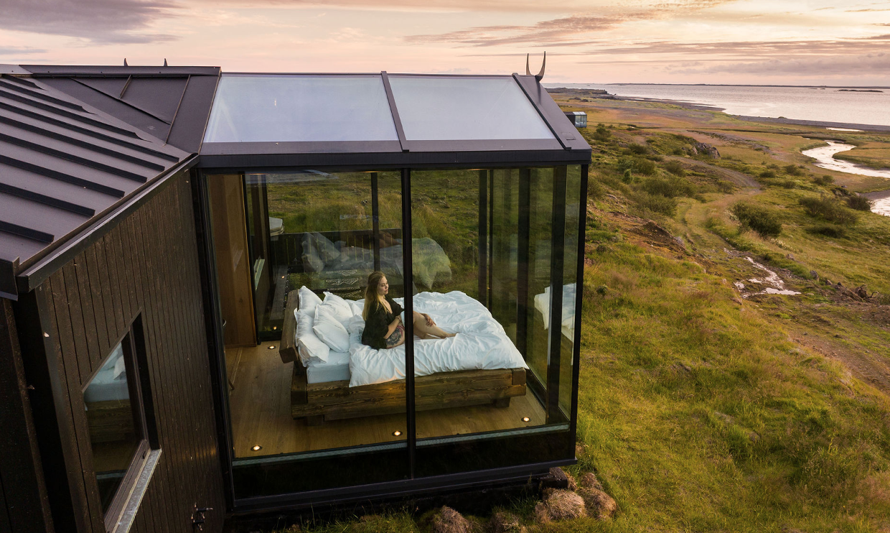
Core Contents
Photo credit:
Panoramic Glass Lodge, Iceland
Initial Building Assessment
You’ll also need to understand local zoning and building regulations. Just because a building exists doesn’t mean it’s automatically approved for tourism use. Check with local authorities to ensure the space can be legally converted into guest accommodation and understand what kinds of renovations are permitted - especially in protected or heritage zones.
19

Slide 20
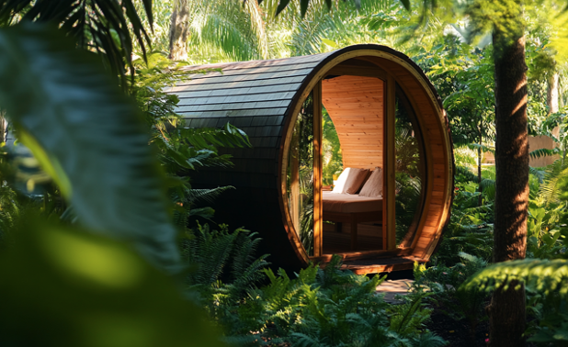
Core Contents
Initial Building Assessment
Finally, assess internal adaptability. Consider the layout: can the space be comfortably divided into private guest rooms? Is there enough room for shared kitchens, lounges, or bathrooms? Can privacy be maintained while still honoring the building’s character?
To support this process, you can use practical tools like structural audit checklists, consultations with conservation architects, and interviews with local planners. These steps will give you a clearer picture of what’s possible—and what’s worth pursuing—before investing in a full-scale renovation. A solid assessment at the beginning is the cornerstone of a successful, sustainable transformation.
20

Slide 21

Core Contents
Design for Identity and Comfort
Turning a historic structure into a welcoming guesthouse isn’t just about updating utilities or adding furniture - it’s about honoring the soul of the space. A successful adaptive reuse project thoughtfully blends modern comfort with cultural authenticity, preserving the building’s identity while making it functional and inviting for today’s travelers.
Photo Credit:

Slide 22
Core Contents
Design for Identity and Comfort
However, preserving heritage does not mean sacrificing comfort. Behind the historic charm, you’ll need to integrate essential modern amenities that ensure a pleasant stay for all guests. This includes adding energy-efficient insulation, low-impact heating systems, and accessible design features like ramps or wider doorways - especially important if you want to welcome guests of all ages and abilities.
A powerful example is Camera a Sud in Bovino, Italy. This restored 19th-century palazzo demonstrates how minimal architectural intervention, paired with maximum sensitivity, can create spaces that are both cozy and character-rich. The renovation kept the original floor plan, antique furniture, and decorative finishes intact. At the same time, it introduced environmentally responsible upgrades - such as discrete electrical rewiring and radiant heating - ensuring guest comfort without compromising historical integrity.
22

Slide 23
01
Assessing and Repurposing Existing Buildings
Key Learning Area
Adaptive reuse is a sustainable and culturally sensitive solution for tourism development, especially in rural and underutilized areas. By repurposing disused buildings—such as farmhouses, schools, or historic homes—this approach preserves local identity while reducing environmental impact, as it requires fewer raw materials and less land than new construction.
The use of existing embodied energy makes it a lower-carbon choice, aligning with broader climate goals.
23

Slide 24
01
Assessing and Repurposing Existing Buildings
Key Learning Area
Beyond sustainability, adaptive reuse creates distinctive tourism experiences. Travelers increasingly seek accommodations that tell a story and reflect the character of a place. Properties with historical or architectural significance can be transformed into economically viable destinations that support local economies and foster community pride.
In summary, adaptive reuse delivers a triple benefit: it conserves cultural heritage, lowers environmental footprints, and creates high-value, authentic guest experiences, making it a foundational strategy for developing alternative tourism accommodation.
24

Slide 25


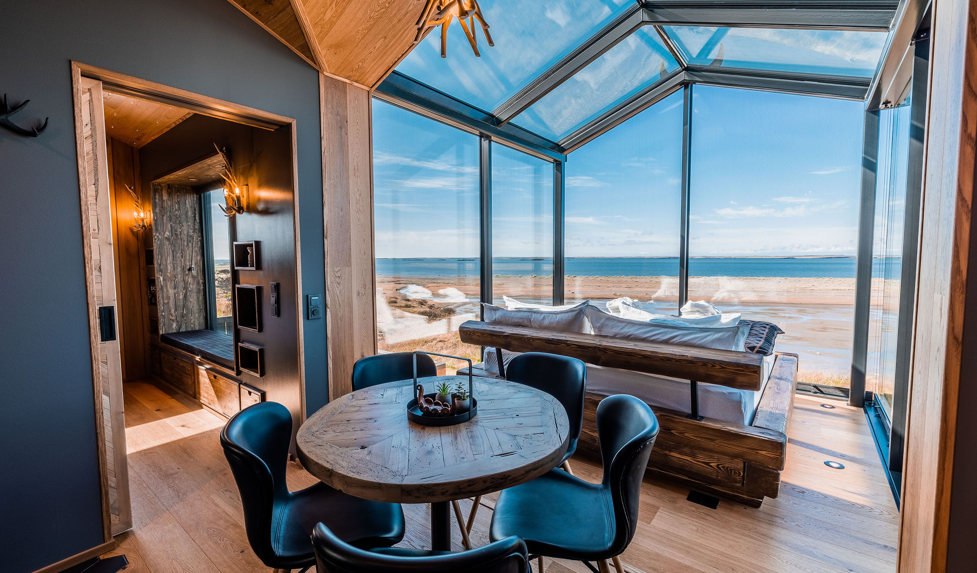
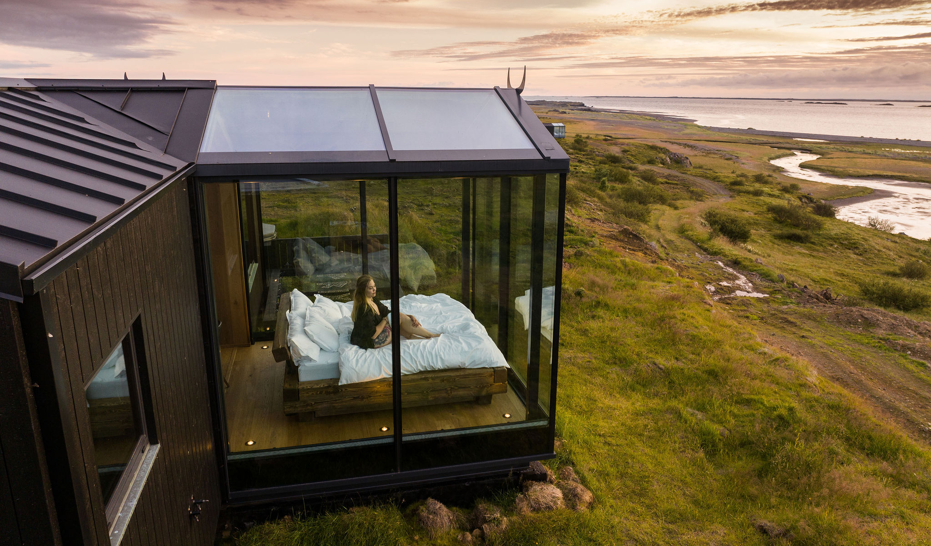
ICELAND
Photo Credit:
Panoramic Glass Lodge, Iceland
25

Slide 26
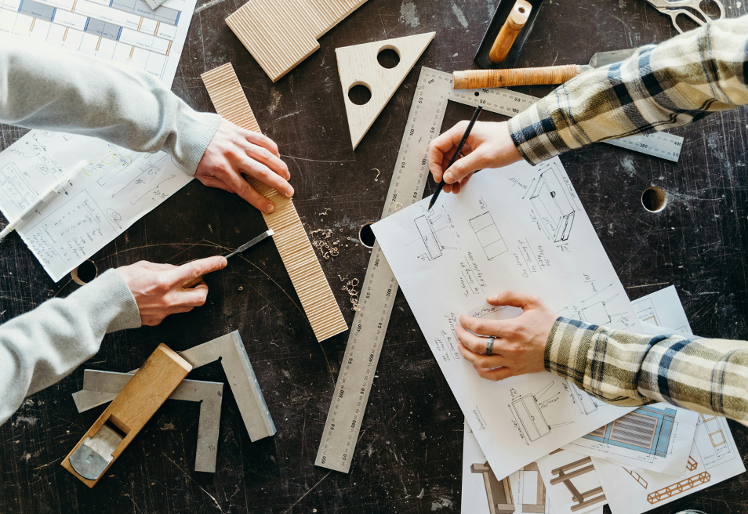
Additional Resources Section
To deepen your learning and support the practical application of this module, explore the curated selection of additional reading, exercise and digital tools provided in this section.
They are selected to help you research your market, streamline operations, enhance guest experiences, and promote your business effectively. By exploring these resources, you can strengthen your skills, increase efficiency, and ensure your accommodation offering aligns with EPIC STAYS’ values of sustainability, creativity, and community engagement.
26

Slide 27
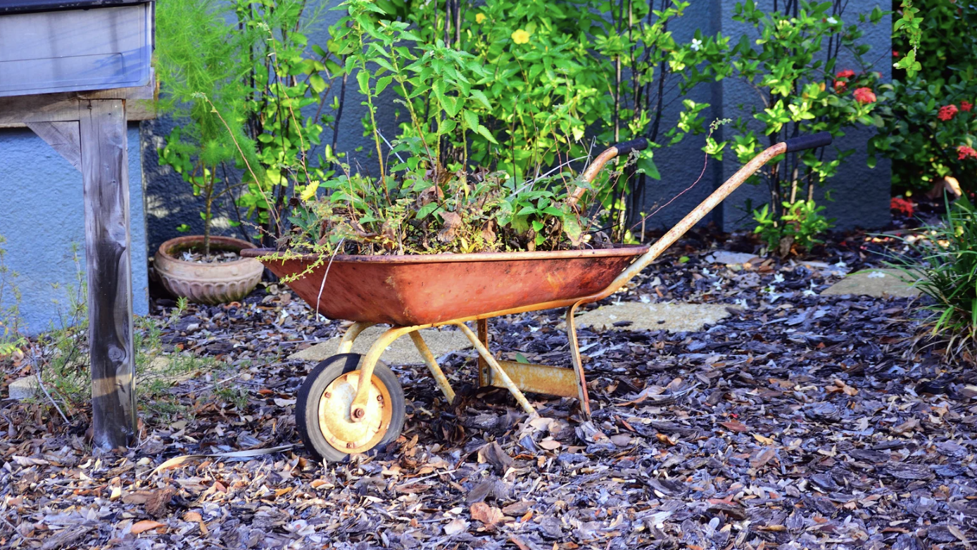
Click to Watch Video
Adaptive Reuse
and Sustainability – Defining Hospitality
Photo Credit: Meridaunia
Name:
Adaptive Reuse and Sustainability
– Defining Hospitality
Description:
This video features industry professionals discussing how adaptive reuse strategies in the hospitality sector contribute to environmental sustainability, cultural preservation, and economic revitalisation. The interview provides real-life examples of successful adaptive reuse projects and explores why this approach is becoming increasingly important in tourism and urban development.
Link: https://www.youtube.com/watch?v=ka9qWKQz-P0

Slide 28
Click to Watch Video
Adaptive Reuse
and Sustainability – Defining Hospitality
Photo Credit: Meridaunia
Name:
Adaptive Reuse and Sustainability
– Defining Hospitality
Apply to Topic 1:
Why Adaptive Reuse Makes Sense – The video supports the idea that repurposing old buildings not only saves resources but also adds storytelling and value to alternative tourism accommodations. It reinforces the concept that heritage sites can be turned into sustainable, economically viable tourism assets.
Link: https://www.youtube.com/watch?v=ka9qWKQz-P0
Name: Adaptive Reuse and Sustainability – Defining Hospitality
Description: This video features industry professionals discussing how adaptive reuse strategies in the hospitality sector contribute to environmental sustainability, cultural preservation, and economic revitalization. The interview provides real-life examples of successful adaptive reuse projects and explores why this approach is becoming increasingly important in tourism and urban development.
Apply to Topic 1: Why Adaptive Reuse Makes Sense – The video supports the idea that repurposing old buildings not only saves resources but also adds storytelling and value to alternative tourism accommodations. It reinforces the concept that heritage sites can be turned into sustainable, economically viable tourism assets.
Link: https://www.youtube.com/watch?v=ka9qWKQz-P0

Slide 29

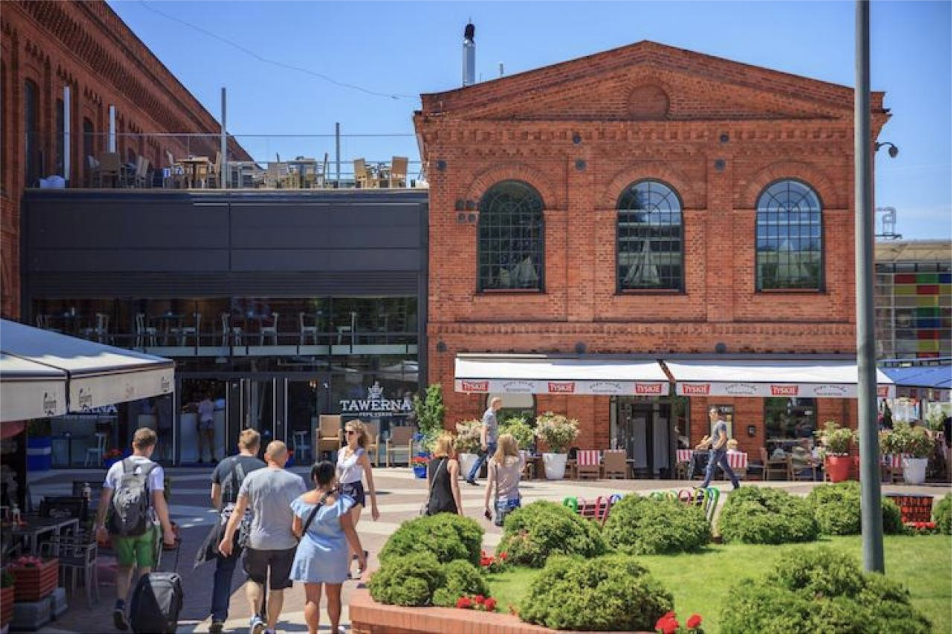
Digital Tool: HerO - Heritage and Urban Development Toolbox
Click to Download the tools
HerO supports sustainable urban development by offering resources tailored to managing and reusing historic buildings. Developed under the URBACT II Programme, it equips local authorities, planners, and project developers with tools to transform disused or underutilized heritage structures into assets for tourism, culture, and community engagement.
Evaluate Adaptive Reuse Potential
Use the toolbox’s self-assessment checklists and case studies to identify opportunities for converting abandoned buildings into alternative accommodations. Example: Evaluate a historic school or farmhouse for feasibility based on structural condition, cultural value, and economic potential.

Slide 30
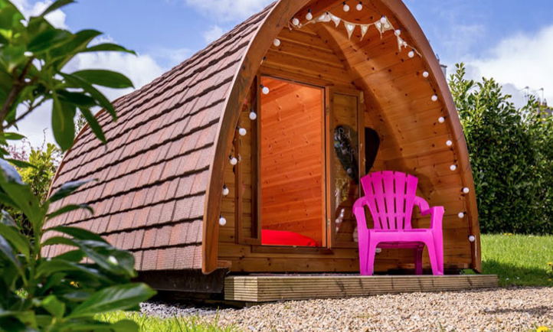
Digital Tool: HerO - Heritage and Urban Development Toolbox
Integrate Sustainability and Community Needs
Explore guidance on aligning adaptive reuse projects with wider urban sustainability goals, including social inclusion and economic revitalization.
Tip: Use the integrated planning section to align reuse projects with local community priorities and environmental commitments.
Provides Practical Resources
e.g., “Management Plan Templates” and “Good Practice Reports” offering real-world strategies from other EU cities that have successfully implemented adaptive reuse in heritage zones. Ideal for small tourism operators, DMOs, and municipalities aiming to innovate sustainably.
30

Slide 31
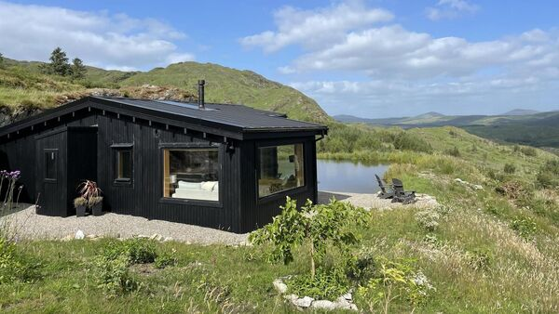
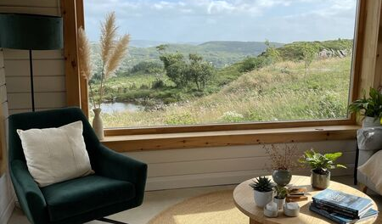

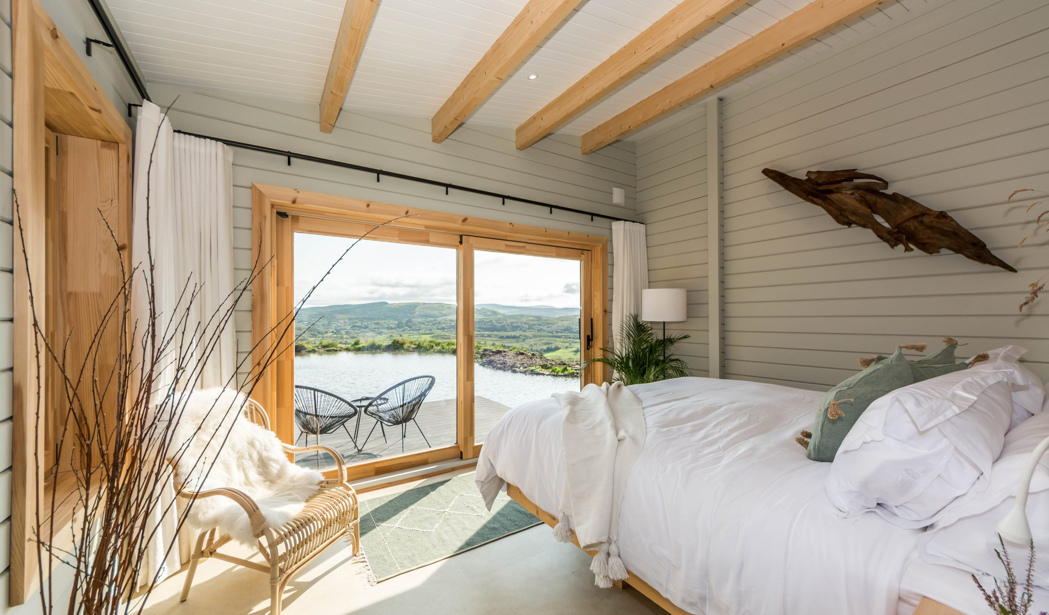
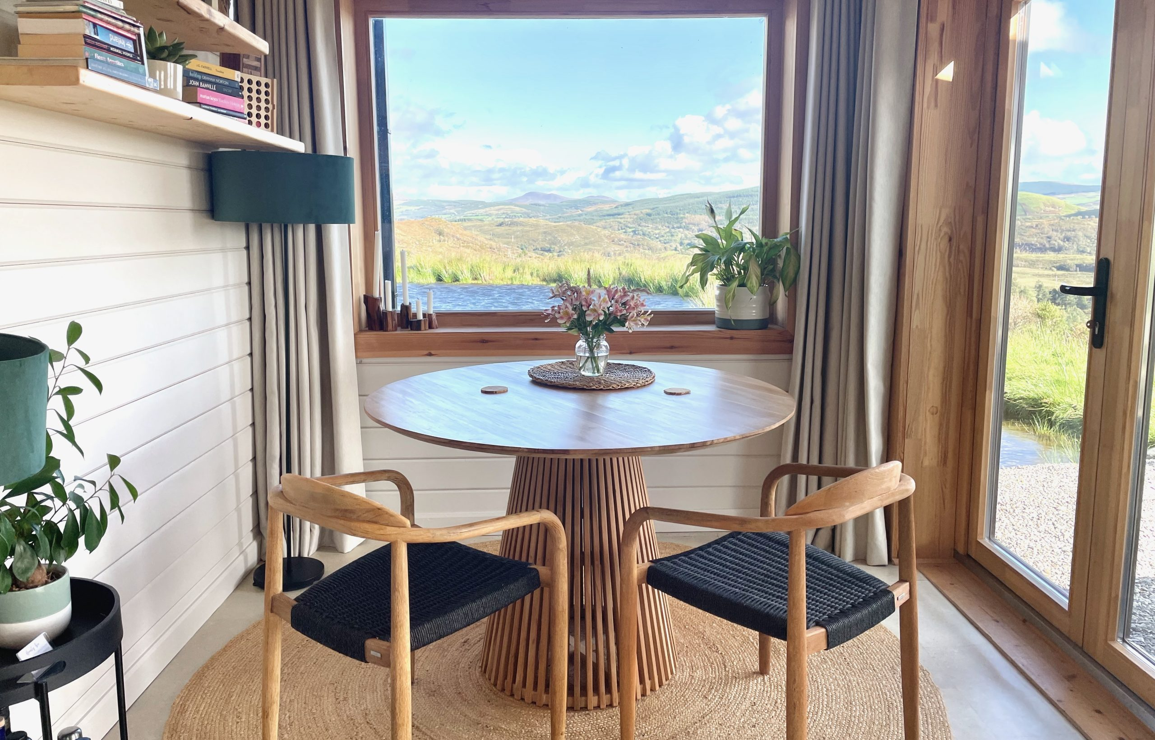
IRELAND
Photo Credit:
The Hidden Haven, Cork, Ireland
31

Slide 32

Practical Exercise: Mapping Adaptive Reuse Potential in Your Community
This exercise helps you explore the potential of repurposing an existing building for sustainable tourism. You'll assess a real or imagined structure's viability based on heritage value, structural integrity, and adaptability for guest use. By the end, you’ll understand how to turn disused spaces into meaningful, low-impact accommodation.
Step 1:
Select a Location
Choose a small town, village, or rural area familiar to you. Focus on places where tourism is emerging or where unused buildings are visible in the community fabric.
32

Slide 33
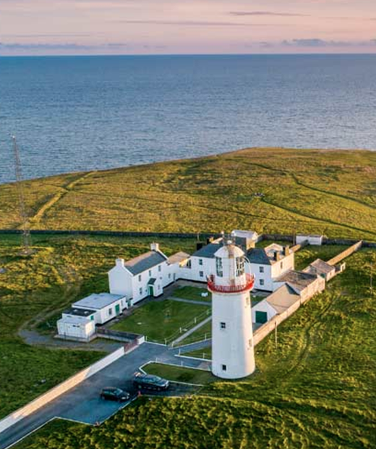
Practical Exercise: Mapping Adaptive Reuse Potential in Your Community
Step 2:
Identify 1–2 Disused Buildings
Using your own knowledge, online maps (e.g., Google Maps), or walking surveys, find one or two unused buildings that could be candidates for adaptive reuse. These might include a former school, barn, railway station, town hall, or heritage home.
Photo credit: LoopHead Lighthouse.ie
33

Slide 34
Practical Exercise: Mapping Adaptive Reuse Potential in Your Community
Step 3:
Assess Viability
Use the following criteria to create a short evaluation (1 paragraph per item):
Cultural Value: Does the building have architectural, historical, or symbolic significance for the local community?
Structural Condition: Based on observation or publicly available data, does it appear to be in usable or restorable condition?
Access to Infrastructure: Is the location accessible by road? Are there basic utilities nearby (electricity, water)?
Tourism Context: Is the building close to any existing or potential tourist attractions (e.g., hiking trails, heritage sites, cultural events)?
Zoning & Permits (if known): Is the area suitable or already zoned for tourism/hospitality use?
34

Slide 35
Practical Exercise: Mapping Adaptive Reuse Potential in Your Community
Step 4:
Assess Viability
Draw or describe how the space could be transformed into alternative accommodation. Include 3–5 features that would preserve the identity of the building while making it functional (e.g., maintaining stone walls, converting classrooms into suites, adding a communal kitchen in a former hall).
Reflection
In a short paragraph, reflect on what excites you most about adaptive reuse and what challenges might arise in making this vision a reality.
35

Slide 36
Additional Reading
Name | Description
Adaptive Reuse: Preserving Our Past, Building Our Future Department of the Environment and Energy, Australian Government | This government-issued guide explores the environmental and economic benefits of adaptive reuse, offering frameworks for evaluating heritage buildings for new uses. While Australia-focused, the methodology is highly transferable to European rural contexts. Why it’s relevant: Offers detailed strategies for integrating sustainability with cultural heritage in tourism development. https://www.dcceew.gov.au/parks-heritage/heritage/publications/adaptive-reuse
The Circular Construction Guide: Adaptive Reuse in Practice Ellen MacArthur Foundation & Arup | This resource outlines how adaptive reuse contributes to circular economy goals. It provides practical examples, materials inventories, and decision trees for transforming existing structures with minimal impact. Why it’s relevant: Deepens understanding of how reuse reduces material consumption and supports climate action in tourism. https://ellenmacarthurfoundation.org
36

Slide 37
Additional Reading
Name | Description
Rethinking Heritage Tourism in Rural Europe European Network for Rural Development (ENRD | This policy brief presents innovative rural tourism practices using heritage buildings across EU countries. It emphasizes community-led models and the revitalization of disused assets to stimulate local economies. Why it’s relevant: Anchors adaptive reuse in the real-world context of rural tourism, directly supporting EPIC STAYS goals. https://enrd.ec.europa.eu
37

Slide 38
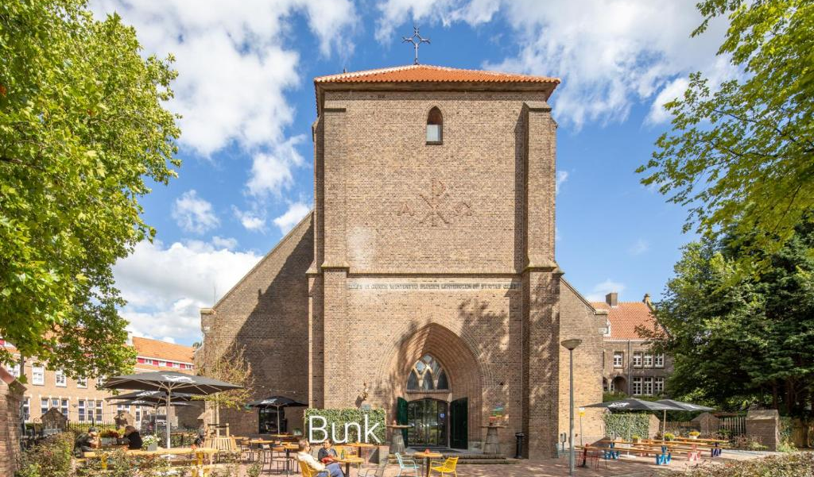
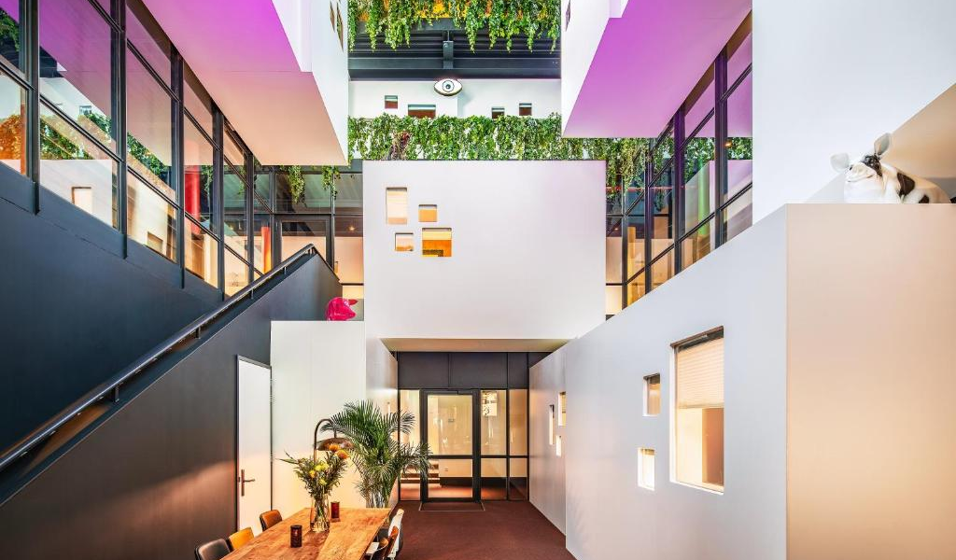

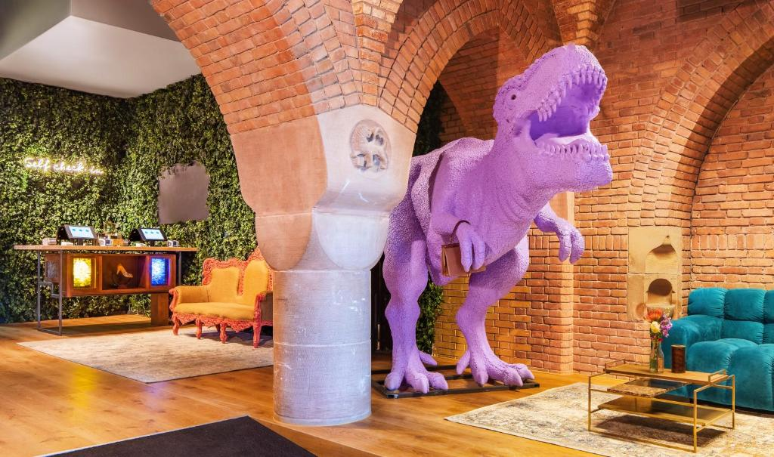
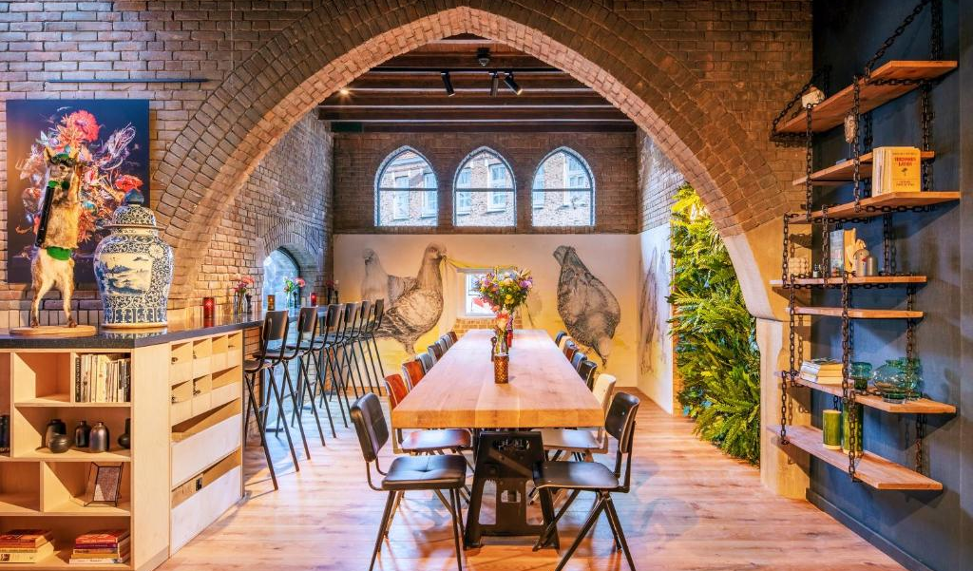
NETHERLANDS
Photo Credit:
BUNK Hotel Amsterdam, Netherlands
38

Slide 39
Well Done
Module 3 (Part 2)
Section 2: Better Building Choices: Materials, Layout & Flexibility
You have Completed… Module 3 (Part 1)
Section 1: Smart Starts: Adapting Buildings & Using Pre-Built Units
Next is…

