Slide 1
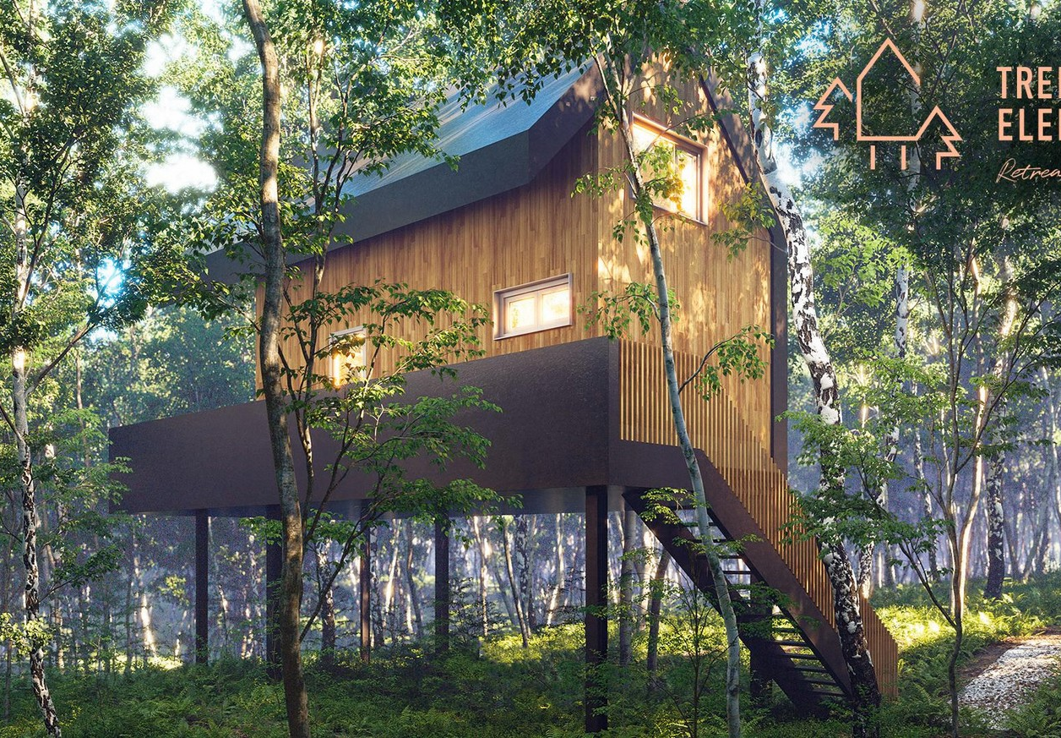
Case Study
https://www.kickstarter.com/projects/tree-elements/treehouses
Tree Elements Eco-kind Retreat, Croatia
Kickstarter Crowdfunding Example

Slide 2
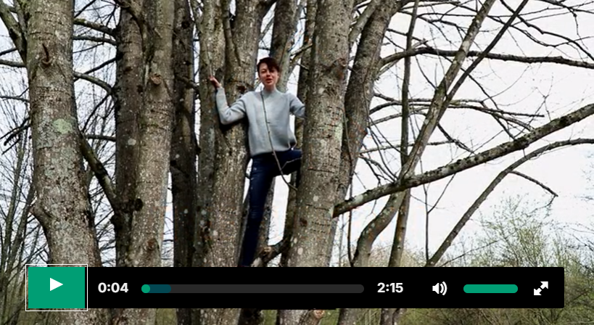
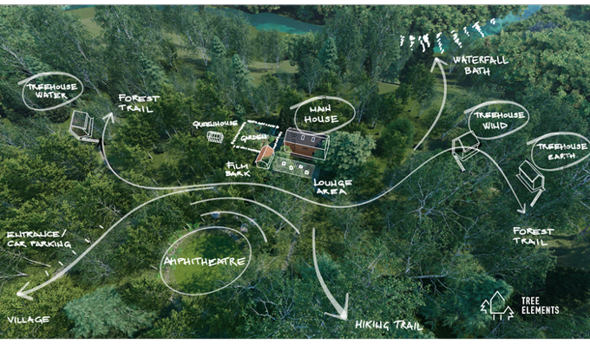


Case Study: Tree Elements eco-kind retreat (Kickstarter)
Tree Elements Kickstarter Crowdfunding. Plant trees in your sleep! We are on a mission to build an environmentally and socially conscious retreat with treehouses like no other. Secluded within the pristine forests of Rastoke, Croatia, Tree Elements greets travellers and shelter-seekers with equal respect. The funds received will go directly into the exterior, such as landscaping (such a vast area), yoga amphitheater, glass greenhouse, wooden deck for communal space, a library for the main house, chicken coop, and domestic animals, planting the organic garden and irrigation system, wood workshop with all the tools, lights all around the property, wooden paths…..and planting more trees!
EPIC STAYS is licensed
under CC BY-SA 4.0
https://www.kickstarter.com/projects/tree-elements/treehouses
Funded by the European Union. Views and opinions expressed are however those of the author(s) only and do not necessarily reflect those of the European Union or the European Education and Culture Executive Agency (EACEA). Neither the European Union nor EACEA can be held responsible for them.

Slide 3


8
Crowd Funding & Community
Objective
Crowdfunding and Community: Iceland has a vibrant local community and also a supportive international fanbase (people who love Iceland). Some projects have been crowdfunded by appealing to those groups. For instance, using platforms like Karolina Fund (an Icelandic crowdfunding site for creative projects) or even Kickstarter to invite Iceland enthusiasts worldwide to support an eco-friendly retreat in the Icelandic nature (with rewards like stays once built).
Tourism Distribution: Though smaller in scale, Iceland’s funding landscape prizes projects that help distribute tourists more evenly and do so sustainably. If your alternative accommodation is outside the heavily-travelled areas and promotes year-round tourism, emphasise that in funding applications – it aligns well with Iceland’s policy goals. See crowdfunding example on the next slide.
Recommended Reading
Landsbankinn: Growth seeking balance – economic analysis oof tourism in Iceland
Icelandic Financial Institutions
Icelandic small businesses to get €21 million European financing boost

