Slide 1
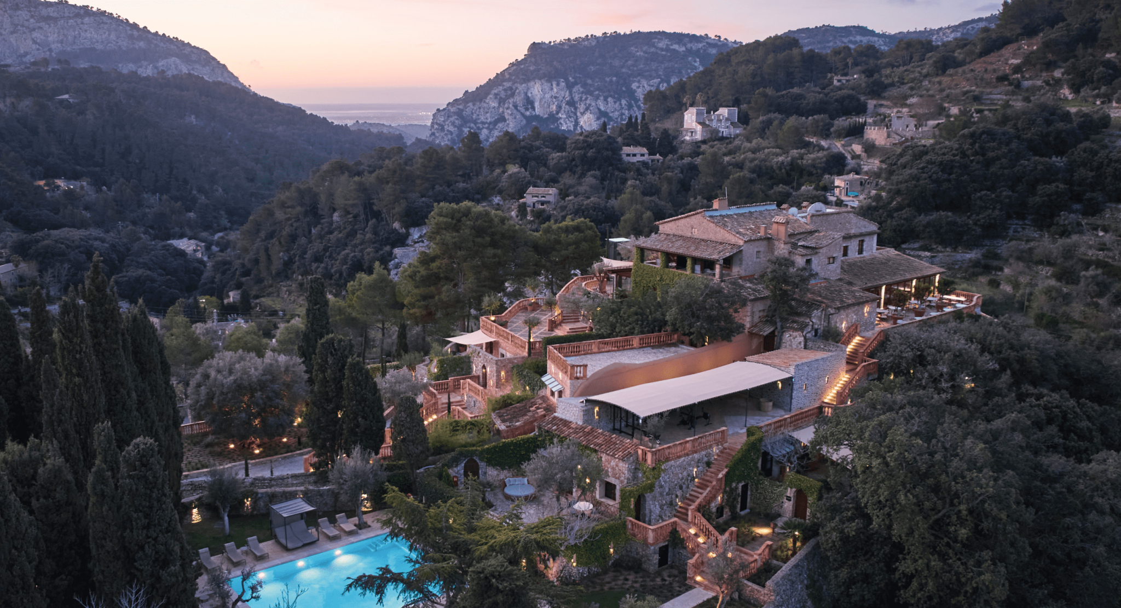

https://www.valldemossahotel.com/en/ Photo
Accommodation Type:
Natural Accommodation Sanctuary
We are a home. We are history and art. We are avant-garde. Our rooms merge tradition and design in open and inviting spaces. Here, you’ll find furniture by Le Corbusier and works by Antonia Ferrer among hundreds of olive trees. We promise to exceed all your senses’ expectations.
Welcome to this healing space in communion with nature, where body and soul are an inseparable unit.
Case Study
With the aim of improving your health and longevity, we have created the integrative program “Valldemossa Longevity”.
Valledemossa (Natural Sanctuary), Mallorca, Spain
Website: https://www.valldemossahotel.com/en/
1

Slide 2
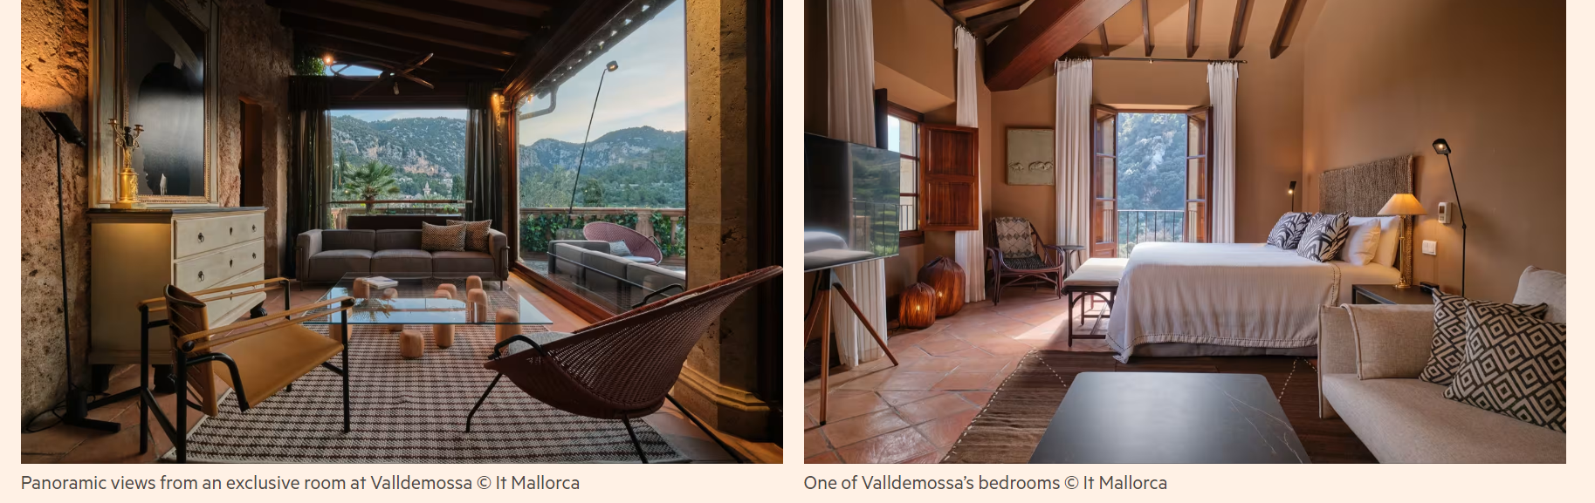
Case Study: Valledemossa (Natural Sanctuary), Mallorca, Spain
Images Financial Times
Valldemossa is located in the UNESCO-listed Serra de Tramuntana, a mountainous area in Mallorca. Any accommodation or infrastructure developed here must follow strict regulations on land use, biodiversity protection, and landscape preservation. A rambling restored 16th-century farmhouse with ecological vegetable gardens, surrounded by 20 hectares of oak forests and carob orchards.

Slide 3


Case Study: Valledemossa (Natural Sanctuary), Mallorca, Spain
Impressive living rooms and bedrooms recreate the French aesthetic of the 1950s with original furniture by Charlotte Perriand, Le Corbusier, and Miguel Milá. It has 12 suites and three villas, which share outdoor and indoor pools and a garden. The design is warm, rustic understatement using local stone and wood, and traditional Mallorcan architecture to minimise visual and environmental impact. This example supports planning for harmony with natural environments. https://www.valldemossahotel.com/
From Tokyo To Lima: Passion for local produce and the fusion of cultures. A unique culinary experience that fuses the flavours of Japan and Peru with fresh, seasonal produce from small farmers and artisans in Mallorca.
Unique Soul Enriching Natural Sanctuary Experiences: With the goal of improving your health and longevity in mind, we created the integrative “Valldemossa Longevity” program, inspired by Traditional Chinese Medicine and the Western wisdom of lymphatic drainage.
EPIC STAYS is licensed
under CC BY-SA 4.0
Funded by the European Union. Views and opinions expressed are however those of the author(s) only and do not necessarily reflect those of the European Union or the European Education and Culture Executive Agency (EACEA). Neither the European Union nor EACEA can be held responsible for them.

