Slide 1
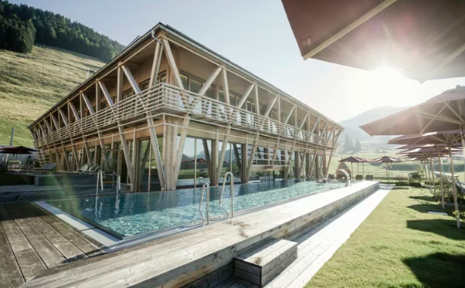

https://www.hotel-hubertus.de
Accommodation Type:
Change Maker Hotels – these are the visionaries and pioneers of sustainable hospitality in Germany, Austria, and South Tyrol.
The hotels and their owners offer vacation solutions for people who are increasingly concerned about the climate, nature, and people while travelling, and who want to travel sustainably and mindfully.
Case Study
Hubertus Mountain Refugio Allgäu, Germany
Sustainability
GIVE. AND TAKE. That's the guiding principle of our thinking up here in the mountains. Because only in a harmonious community can everyone benefit.
1

Slide 2
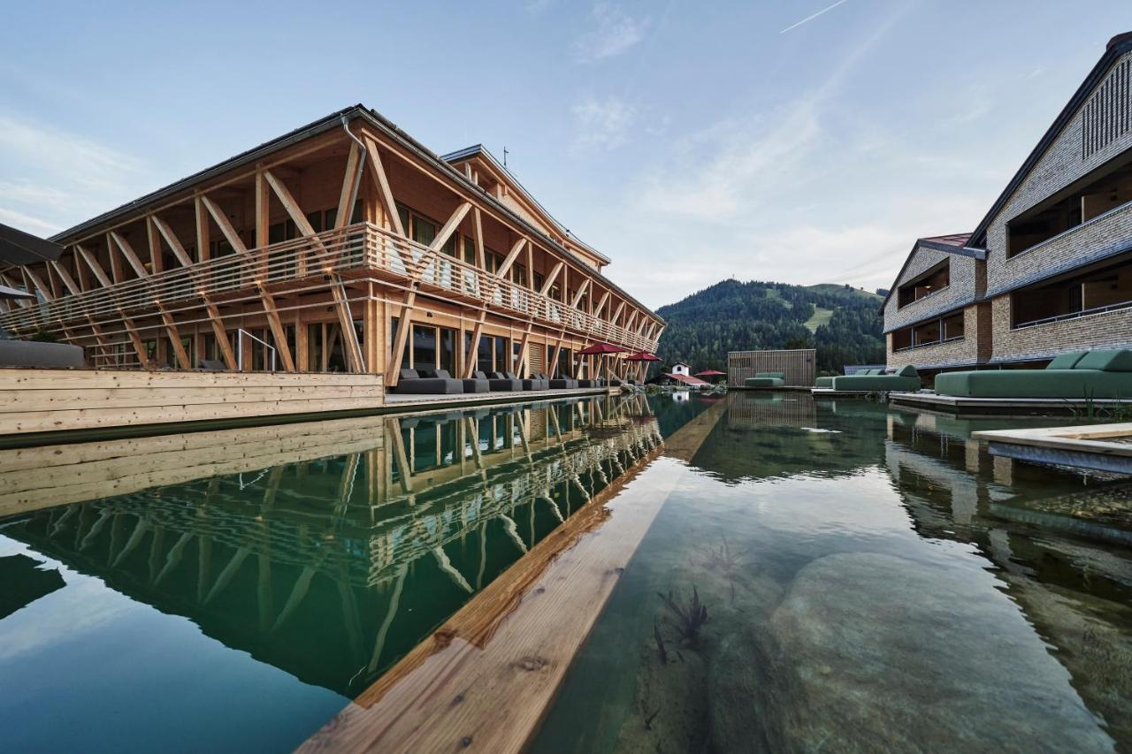


Case Study: Hubertus Mountain Refugio Allgäu, Germany
Revitalising Local Economy & Increasing Destination Attractiveness
Hubertus Mountain Refugio Allgäu, Germany, has not only contributed to the attractiveness of the region for tourists but also revitalised the rural economy.
More than 70% of the employees live within two kilometres of the hotel. The presence of the hotel supports the local economy and contributes to the vitality of the village. The town lives mainly from tourism.
It is of existential importance to the community of Balderschwang. The family-run HUBERTUS extends its experiences to the local economy, offering guests the opportunity to experience the Allgäu village, nature, whether hiking, mountaineering, or winter sports.
Website https://www.hotel-hubertus.de/
EPIC STAYS is licensed
under CC BY-SA 4.0
Funded by the European Union. Views and opinions expressed are however those of the author(s) only and do not necessarily reflect those of the European Union or the European Education and Culture Executive Agency (EACEA). Neither the European Union nor EACEA can be held responsible for them.

