Slide 1

Finlough Bubble Domes, Fermanagh, Ireland
Module 8 (Part 1)
Making It Viable – Introduction to Financial Management & Business Model Budgeting

Slide 2
Module 8 (Part 1) Overview
Learning Outcomes
Making It Viable - Laying the Financial Foundations for a Viable Accommodation Business
Financial success in alternative tourism accommodation doesn’t happen by chance—it’s built through informed planning, smart pricing, and sustainable practices.
This module introduces the core principles of financial management to help you build a resilient and profitable business, whether you’re just starting out or strengthening an existing venture.
Understand the role and importance of financial management in tourism accommodation businesses.
Define your accommodation business model in financial terms, aligned with your values, site, and market.
Recognise the difference between various ownership structures and what each means for funding and operations.

Slide 3

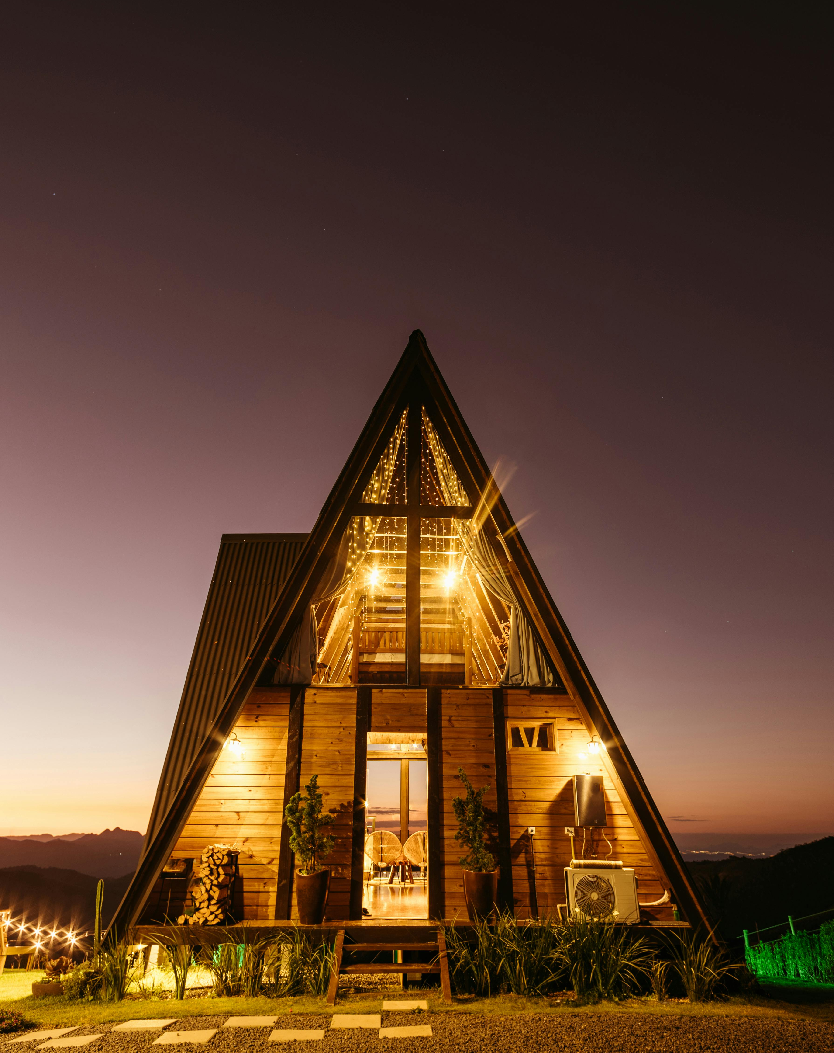
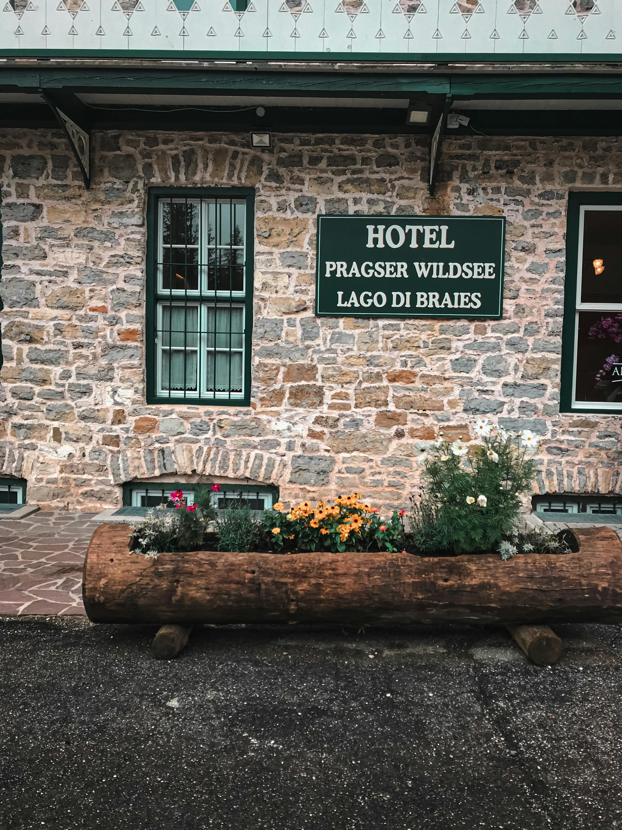
Module 8 Laying the Financial Foundations for a Viable Accommodation Business
Section 2 P26
Select Your Business Model & Budgeting
CONTENTS
03
Section 1
Section 3 P36
Introduction to Financial Management & Viability
Know Your Revenue Sources
(24 Slides)

Slide 4

Photo Credit: :
Module 8
Making It Viable – Pricing, Planning & Long-Term Financial Health
Overview: Financial success in alternative tourism accommodation doesn’t happen by chance—it’s built on informed planning, smart pricing, and long-term sustainability. This module guides you through the key pillars of financial management, from choosing the right business model and understanding your costs, to pricing strategically, tracking performance, and planning for seasonal changes and future risks. Whether you're just starting out or refining an existing business, these 11 sections will help you build a financially viable, resilient, and values-aligned accommodation offer.
4

Slide 5
Section 1 – 3 Laying the Financial Foundations for a Viable Accommodation Business
Every successful alternative accommodation business—whether it’s a glamping pod or eco-retreat —requires more than just a good location or creative design. It needs a solid financial foundation. These first three sections guide you through the essentials of financial thinking: understanding the role of financial management, selecting a model that aligns with your goals and means, and identifying all potential revenue sources. By building clarity around how your business is structured and where your income will come from, you’ll be better prepared to plan strategically, price confidently, and adapt to future challenges. This is your roadmap to understanding what’s viable, sustainable, and profitable from the start.
Section 1: Introduction to Financial Management & Viability
What does financial management mean for my alternative tourism accommodation business? Why is it so important?
Objective: To build a foundational understanding of how financial management supports sustainable, informed business decisions.
The final section will cover how to ensure viability and financial sustainability.

Slide 6
Section 1 – 3 Laying the Financial Foundations for a Viable Accommodation Business
Section 2: Select Your Business Model
What type of business or alternative accommodation model is right for me, and how do I plan for it financially?
Objective: To identify and define the accommodation business model that fits your values, site, budget, and market.
Section 3: Know Your Revenue Sources
Where does your income come from, and are you fully aware of all potential revenue streams, beyond just room bookings?
Objective: Revenue & Capacity Foundation (What you earn and what’s possible). To map out all sources of income (primary and secondary) to get a full picture of potential earnings and business opportunities.

Slide 7

Section 1
Introduction to Financial Management & Viability
What does financial management mean for my alternative tourism accommodation business? Why is it so important?
Objective: To build a foundational understanding of how financial management supports sustainable, informed business decisions. The final section will cover how to ensure viability and financial sustainability.
7

Slide 8
Introduction to Financial Management & Viability
To introduce first-time entrepreneurs to the basics of business finance in the context of alternative accommodations.
Before you dive into pricing, forecasting, or budgeting, you need to understand the core concepts of financial management. This section gives an overview of financial viability in the context of running a tourism accommodation business. We explore the essential role financial management plays in business success and introduce the key concepts and tools you’ll use throughout the rest of this guide.
01
Introduction to Financial Management and Viability
02
The Role of Financial Management
Why financial management is central to running a viable business e.g., costs, revenue and risk outcomes.
03
Key Financial Concepts
Introduction to essential terms and metrics such as financial strategy, budgeting and cash flow.
04
Four Key Elements of Financial Management
Explore planning, budgeting, managing cash flow and financial analysis.
05
Financial Planning vs. Forecasting
Understand the difference between planning and predicting and how they work together.

Slide 9
1
Introduction to Financial Management & Viability
Embarking on your journey to launch a unique and sustainable accommodation business—whether it’s a rural glamping site, a repurposed heritage building, or pop-up eco-units—can be an exciting and fulfilling venture.
But transforming that vision into a viable, long-term business requires a solid understanding of the financial realities behind the scenes. This is where Financial Management and Viability practices, key principles, applications and tools come in. This section will guide you through each consideration and provide opportunities to maximise revenue and profit, helping you on your way.
Proper financial management and budgeting will enable you to make informed decisions, avoid unexpected expenses, and plan for future growth. Having the proper financial knowledge helps you manage your resources effectively and set realistic expectations, ultimately increasing your chances of long-term success and healthy viability in the competitive alternative tourism accommodation market.

Slide 10
Financial Management
Introduction to Financial Management & Viability
We begin by explaining what financial viability means for small alternative accommodations and why sound financial management is critical before diving into specifics.
This section sets the stage, highlighting that running a unique stay (be it a yurt, treehouse, or cottage) is not just about offering great experiences – it also requires careful financial planning to succeed.
For example, a glamping business needs solid financial planning to be profitable and sustainable, beyond just providing a luxury tent experience.
Learn key concepts (profit, cash flow, break-even) in simple terms and stress that all types of properties (glamping domes, cabins, eco-lodges, etc.) benefit from the same financial fundamentals. This section connects to the next by pointing out that the first step in financial planning is to create a budget.
Setting the Stage for Viability
Financial Planning Essentials For Glamping Site Operators

Slide 11

"In business, financial management is not just about numbers; it's about making the right decisions to ensure sustainability and growth."
Warren Buffett

Slide 12
2
The Role of Financial Management
Alternative Tourism Accommodation
Financial management is the backbone of any successful business. It involves controlling and planning the money in your business.
In simple terms, it’s making sure you have enough money to run your operations and grow. For an EPIC STAYS alternative tourism business (like unique B&Bs, eco-lodges, or glamping sites), good financial management is crucial to survive seasonal ups and downs and fund improvements. It means avoiding surprises where possible!

Slide 13
The Role of Financial Management
Alternative Tourism Accommodation
Example: Imagine your glamping site has a busy summer and a slow winter. With proper financial management, you’d set aside some of the summer profits to cover winter expenses.
This way, you avoid surprises, such as suddenly not having money for maintenance in January.
In fact, creating and sticking to a budget is one of the most effective ways to take control of your finances and avoid unexpected expenses. By knowing exactly how much you’re going to spend and when, you won’t be shocked by a low bank balance unexpectedly. Effective financial management provides you with that peace of mind.
Avoid Surprises With These Financial Planning Tips

Slide 14



Why Financial Management is important?
Prevent Running Out of Money: Good financial management helps you avoid cash shortages. You’ll ensure you have funds to pay bills (e.g. property upkeep, utilities) even in off-season.
Plan for Growth: It lets you plan for future needs, like buying new equipment, adding a cabin, or hiring staff as your business expands.
Build Credibility: Managing your finances effectively makes it easier to secure loans or attract investors. Lenders will see that you handle money responsibly and have a clear plan.

Slide 15
3
Key Financial Concepts and Terms Explained
Capital Expenses
Breakdown and forecast capital costs, e.g., land purchase or lease, building, refurbishing, construction and renovation, permits, to scaling up additional units.
Ongoing Operational Costs
Plan for operational costs and expenses such as utilities, permits, maintenance, insurance, cleaning, amenities, guest services and digital platforms.
Seasonal Budget
Create a seasonal budget that realistically factors in fluctuations in bookings and prepares you for low season and long-term sustainability goals.
Pricing Strategy
Set competitive yet sustainable pricing models that reflects your perceived guest value, cost coverage, profit margin, competitor analysis, perceived costs, and market demand—while also preparing for low-season income dips.
Fixed Vs Variable Costs
Breaking down and track fixed vs. variable costs—so you can make smart adjustments without compromising guest experience.

Slide 16
Revenue
The money your business earns from sales (in our case, mainly cabin rental fees).
Profit
Revenue minus expenses. If positive, you’re making money (net profit); if negative, it’s a loss.
Break Even Point
The level of sales (or occupancy) at which revenue equals expenses, so profit is zero. Below this, you lose money; above it, you make money.
Margin
Usually refers to profit margin – profit as a percentage of revenue. High margin means you keep a large portion of each euro of revenue as profit.
Contingency
Extra allowance for unexpected costs or deviations in plan.
ROI Return on Investment
A measure of what you get back relative to what you put in.

Slide 17
Key Financial Metrics for Glamping Business
Key Metric | Description | Significance | Optimisation Tips
Occupancy Rates | Percentage of booked units or rooms. | Shows how often you fill your rooms or units and the potential revenue | Run promotions in quiet months; enhance guest experience
Average Nightly Rates | Income per booked unit/room per night | Measures how well you're pricing | Adjust rates/prices based on seasons and demand
Seasonality Impact | Changes in bookings throughout the year/seasons | Helps you plan for stable income | Provide off-season deals or offer themed events
Customer Acquisition Costs | What it costs you to get a new guest | Shows how well your marketing is doing | Use referrals, improve online presence/social media and SEO optimisation
Customer Lifetime Value | Total revenue from one guest over time | Tells you how valuable or profitable repeat guests are | Provide exceptional service, loyalty programs, personalised marketing

Slide 18

Key Financial Concepts: Financial Strategy
Before we dive deeper, let’s clarify a few key concepts in simple terms, with examples relevant to an alternative accommodation business:
Financial Strategy: This is your plan for managing money to achieve your business goals. It involves deciding how to spend, save, and invest your funds wisely over time.
For example, your strategy might be to save 20% of your monthly rental income from cottages to fund the construction of a new treehouse next year. Your financial strategy guides such decisions, enabling you to grow your business sustainably.

Slide 19
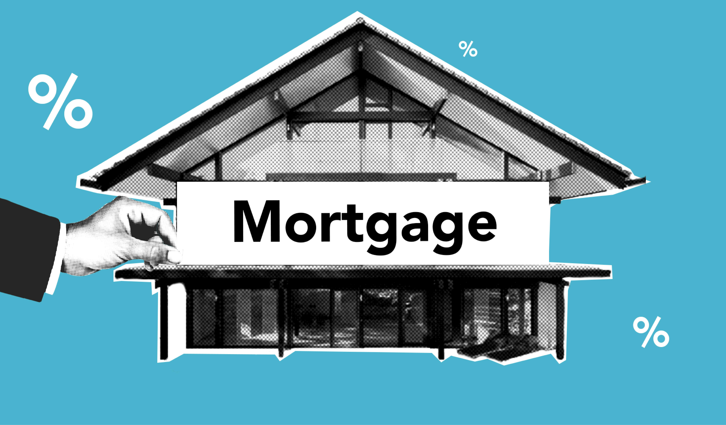
Key Financial Concepts: Budgeting
Budgeting: Budgeting is the process of planning your income and expenses over a period (typically monthly or annually). It’s basically a financial plan that shows where your money will come from and how you’ll use it. Budgeting ensures you don’t spend more than you earn.
For instance, you might create a monthly budget for your farm guest house that estimates €5,000 in income from guests and €4,000 in expenses (rent, salaries, cleaning supplies, etc.), leaving a €1,000 surplus. This helps you decide if you can afford new linens or should save that €1,000 for future renovations.

Slide 20

Key Financial Concepts: Cash Flow
Cash Flow: Cash flow refers to money moving in and out of your business. “Cash inflow” refers to money coming in (for example, guest payments, tour fees), and “cash outflow” refers to money going out (bills, wages, loans).
Positive cash flow means more cash is coming in than going out, which is needed to pay obligations on time.
In an ATA context, you need a steady cash inflow from bookings to cover costs such as utilities, cleaning, and platform fees. Even if your business is profitable on paper, poor cash flow management (like too much money tied up in unpaid bookings or assets) can cause trouble.
In fact, studies show as many as 82% of businesses close due to cash flow issues, meaning a business can be profitable yet still fail if it can’t manage its cash effectively.
Can a Profitable Business Fail Because of Cash Flow Problems?

Slide 21

4
Four Key Elements of Financial Management
Financial management generally involves four key elements that work together to keep your business financially healthy:
1
Planning
Setting financial goals and figuring out how to achieve them. This is the big-picture roadmap.
Example
You plan to increase revenue by 15% next year by adding two new rental yurts – that’s a financial goal with a plan behind it.
2
Budgeting
Allocating resources (income and expenses) according to your plan. This is where you create a detailed budget to ensure your spending aligns with your goals.
Example
Based on your plan to add yurts, you budget the costs of construction and estimate additional income from their rental, adjusting other expenses to maintain profit.

Slide 22
3
Monitoring
Tracking your financial performance against your plan and budget. You regularly check reports and actual results to see if you’re on track.
Example
Each month you compare actual occupancy and revenue of your cottages against the budgeted figures. If revenue is lower than planned, you investigate why (maybe a slow month or marketing needed).
4
Reporting
Generating financial reports that provide insights into your business’s financial health, ensuring transparency and accountability. Good reporting means keeping accurate records and producing statements like income statements or cash flow reports that summarise how you’re doing.
Example
You prepare a quarterly report showing revenue, expenses, and cash flow for your B&B. This report helps you (and any stakeholders) understand if the business is healthy or if adjustments are needed.
Note: These elements feed into each other. Planning sets goals, budgeting puts the plan into action, monitoring tells you if the plan is working, and reporting gives you the data to make informed decisions.

Slide 23
5
Financial Planning vs. Forecasting
Financial planning and financial forecasting are related but distinct concepts:
“Forecasting is the art of saying what will happen and then explaining why it didn’t.” – Anonymous
Financial Planning: Is about setting the roadmap to achieve your business goals. It’s proactive and goal-oriented. When you do financial planning, you define what you want to achieve (say, open a second location in two years) and outline the steps and financial resources needed to get there. It’s like planning a road trip – you decide your destination and the route.
Financial Forecasting: Is about predicting future financial outcomes based on historical data and trends. It’s an estimate of what will likely happen financially in the future. Forecasts project things like revenue, expenses, and cash flow for upcoming periods. Using the road trip analogy, forecasting is like checking the weather and traffic ahead to predict how your journey might go.

Slide 24
Financial Planning vs. Forecasting
How do they work together?
Planning sets your goals (the “what” and “how”), while forecasting informs you about expected conditions (the “what if”). Together, they guide decision-making.
For example, your financial plan might be to increase off-season occupancy by 20% through local marketing.
A forecast might use last year’s data to predict that, even with marketing, off-season revenue will likely be €8,000 per month instead of €6,000.
If the forecast shows a shortfall in cash, you can adjust your plan (maybe secure a short-term loan or cut some costs) before the slow season hits.

Slide 25
Financial Planning vs. Forecasting
How do they work together?
In short, financial planning gives you a strategy, and forecasting gives you an educated guess of future finances. This helps you prepare for uncertainties and seize opportunities.
A good forecast lets you anticipate cash flow needs, allocate resources efficiently, and plan for growth, rather than reacting on the fly when things happen.

Slide 26

Section 2
Select Your Business Model
What type of business or alternative accommodation model is right for me, and how do I plan financially for it?
Objective: To identify and define the accommodation business model that fits your values, site, budget, and market.
26

Slide 27
Select Your Business Model
To align your financial strategy with a business model that is operationally and financially realistic.
Before calculating costs or setting prices, you must understand what kind of accommodation business you're building. Different models—such as glamping, eco-lodges, tiny homes, or heritage stays—come with distinct cost structures, regulations, customer types, and income opportunities. This section helps you explore these models and decide which one fits your vision, land, and goals.
06
Understanding Alternative Accommodation Models
Introduction and detailed information available in Module 1 Section 3 and Module 6 Section 3
07
Introduction to Start-Up Costs and Initial Budgeting
Overview of estimated start-up costs based on your chosen model. More detail on this in Module 6 Section 2).

Slide 28
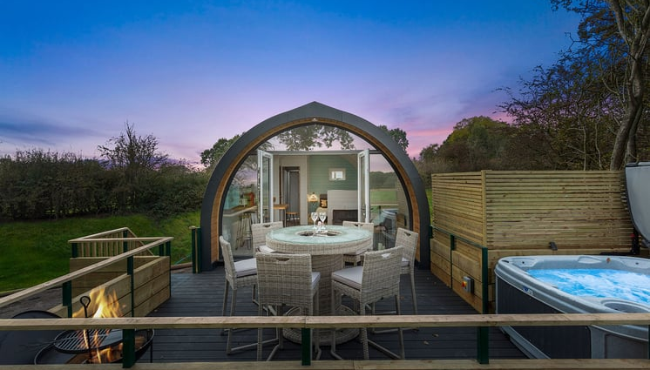
6
Understanding Alternative Accommodation Models
First, you need to understand what the Alternative Accommodation Model is and decide which one you are going to invest in. Different alternative tourism accommodations have varying cost structures and operational considerations. Understanding your specific model will help tailor your financial plan. Common types of rural glamping accommodations include:
Bell Tents, Yurts, and Safari Tents
Glamping Pods and Shepherd’s Huts
Refurbished Barns or Farm Buildings
Pop-up Units (Tiny Homes, Containers)
For more options and information, see Module 1 Section 3 and Module 7 Part 1
Decide on your ATA Business Model

Slide 29
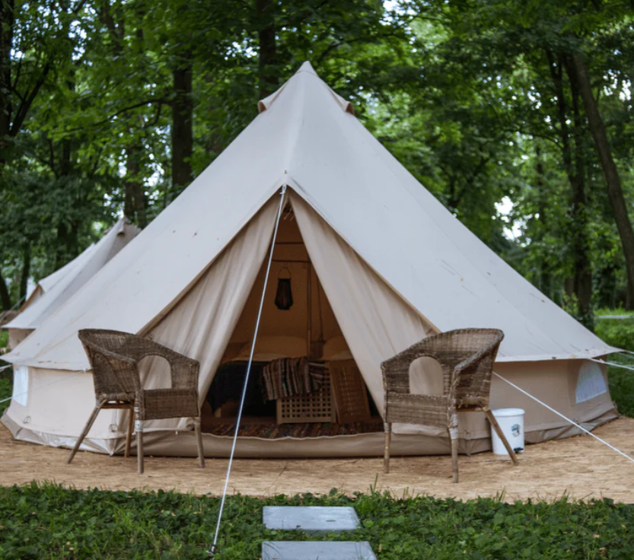
Bell Tents, Yurts, and Safari Tents:
Typically canvas-based structures.
They are relatively low-cost (a basic bell tent can cost around €1,000) but often seasonal (not ideal in cold weather).
A furnished safari tent might range from €15,000 to €20,000 each. They usually require separate bathroom facilities on-site.
Read How to Set Up A Glamping Business and Starting a Glamping Business: The Ultimate Guide

Slide 30

Glamping Pods and Shepherd’s Huts:
Solid-wall structures (wooden pods, tiny cabins, huts) that offer more weather protection.
High-quality pods/huts provide year-round comfort (insulation, heating) but come at higher cost (e.g. a high-end shepherd’s hut can cost €35–€50k each, and a 1-bed micro-lodge cabin €80k).
Their durability and comfort can attract higher nightly rates and better off-season occupancy.

Slide 31
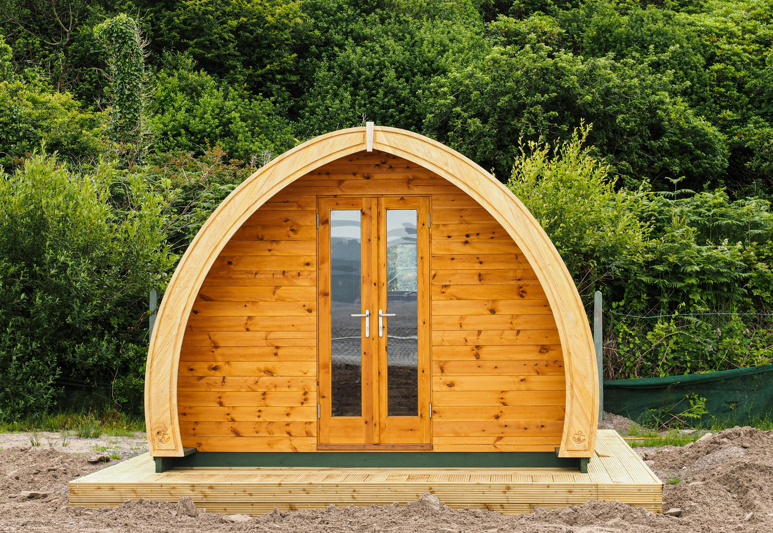
Refurbished Barns or Farm Buildings:
Converting existing structures can save on building new units, but you’ll invest in renovations (insulation, plumbing, décor).
Costs vary widely based on the building’s condition.
These often-become year-round accommodations if well insulated (similar to small cottages or B&B rooms).
  Pop-up Units (Tiny Homes, Containers):
  Portable or semi-permanent tiny houses or converted containers. Mid-range costs (a basic timber pod might be €16k) and moderate weather resilience.
  They offer flexibility (you can relocate or remove them) and can be made stylish to charge premium prices.

Slide 32

The capital investment needed tends to be highest for the accommodation units themselves.
If you already own land, the glamping units are the major expense, ranging from under € 10,000 for simple tents to over € 40,000 for high-end huts.
Also plan for infrastructure (water, power, roads) – for example, installing utilities for a small 4-unit site might cost €50–€100k depending on existing services.
Tip
Start a Glamping Business in 2025
Choosing Your Glamping Units
How to Set Up A Glamping Business
Starting a Glamping Business: The Ultimate Guide

Slide 33

7
When budgeting startup costs, list everything needed to go from an empty field to an operational glamping site. Module 6 Section 1 goes into this in more detail. Draft a hypothetical startup budget for your alternative accommodation site (in euros).
Costs vary, so do your homework! In reality, costs vary by country, location and project scale.
Example: A one 4-pod glamping site in Ireland had a total startup cost of €180k (including pods and all setup), whereas a small DIY tent-based setup could start under €50k.
Always get local quotes for groundworks and check if there are grants or supports for rural tourism. (See Module 7 for more information on funds and grants).
Start Up Costs & Initial Budgeting
Location & Scale Greatly Impact Costs

Slide 34
7
Planning & Legal Fees: Don’t forget permitting costs (planning permission, inspections, licenses). These can be a few thousand euros and should be included in the startup budget.
Example: In Ireland and much of the EU, using land for short-term accommodations typically requires a change of use permission and possibly a tourist accommodation license.
Infrastructure Setup: Setting up utilities is often a significant cost. Running water, electricity, wastewater/septic systems, and access roads or parking can collectively cost tens of thousands.
If your site is remote or off-grid, budget for alternatives (such as solar panels or boreholes) and factor those into upfront costs.
Start Up Costs & Initial Budgeting
Location & Scale Greatly Impact Costs

Slide 35

Initial Operating Cash: It’s wise to reserve some startup capital for the first few months of operations (for any unexpected expenses or simply to cover costs until revenue picks up).
Budget Tip: Use a simple spreadsheet to list all expected startup expenses. and use a contingency formula (e.g. 10% of total costs) to account for overruns.
This ensures you have a realistic view of the cash needed before opening day.
An example start-up budget for a 4-unit glamping is covered in the next slide. It is based on Irish price estimates.
Start Up Costs & Budget
Don’t Overlook Initial Fees, Costs & Early Expenses

Slide 36
Startup Costs & Initial Budgeting
Glamping 4 Pods (Ireland 2025)
Category | Description | Minimum Cost (€) | Maximum Cost (€)
Land Purchase | Buying suitable land for tourism use (zoning, access, drainage). | €50,000 | €120,000
Groundworks & Infrastructure | Includes clearance, levelling, drainage, access road, gravel pads for pods. | €20,000 | €35,000
Foundations for 4 Pods | Concrete pads or ground screws, depends on pod weight. | €6,000 | €10,000
Utility & Internet Connections | Electricity - lighting, Signage & Site Cabling (low-voltage)broadband (e.g. Starlink or fibre) setup. Depends on distance to grid; includes trenching and safety systems. | €5,000 | €10,000
Water Connection & Plumbing Infrastructure | Includes mains connection or well, water storage, and pipework. | €4,000 | €8,000
Septic System | Septic tank or small-scale treatment plant; required per regulations. | €10,000 | €18,000
Continued to next slide:

Slide 37
Category | Description | Minimum Cost (€) | Maximum Cost (€)
Solar Power | Optional off-grid setup with panels, inverter, and battery bank. | €12,000 | €25,000
Permits / Planning Advice | Planning application fees, ecological surveys, consultant support. | €3,000 | €8,000
Parking Access | Gravel bays, turning areas, road surfacing, lighting for 4 pods. | €4,000 | €8,000
Website / Booking System | Domain, hosting, calendar syncing, payment systems (Lodgify/Wix). | €1,200 | €3,500
Insurance | Public liability, fire, contents and business interruption coverage. | €1,500 | €3,000
Marketing & Branding | Launch campaign, logo, signs, photography, social media setup. | €2,000 | €5,000
Contingency Fund | Recommended 10–15% budget for delays or unforeseen costs. | €10,000 | €20,000
Total | Estimated overall cost range for full glamping setup. | €128,700 | €273,500
Use the Crossover Lodge ROI Calculator to calculate your ROI.
How To Start, Set Up, And Build A Profitable Glamping Business

Slide 38
Financial Mechanics
Sections 3 to 7
Understanding the financial mechanics behind your accommodation business is essential for making informed decisions and building long-term sustainability.
Sections 3 to 7 helps entrepreneurs and hosts uncover the “why” behind their numbers—not just to survive, but to thrive.
Whether you're running a glamping site, farmstay, eco-lodge, or short-term rental, this part of the module provides the tools to confidently set prices, calculate breakeven points, and create pricing strategies that align with your goals and guest value.
Through five key learning blocks, you'll break down the core financial pillars of your business: revenue sources, cost structures, cost per night, breakeven analysis, and profit strategies. By the end of this module, you’ll understand how to:
Identify where your money comes from.
Know exactly what it costs to host a guest.
Avoid underpricing by calculating your true nightly costs.
Set meaningful pricing based on break-even analysis and desired profit.
Choose a pricing model that reflects your values and business stage.

Slide 39
Financial Logic & Planning for Accommodation Businesses Planning
Section | Section | Why It Comes Here
3 | Revenue & Capacity Foundation | You start with calculating what you earn You must know what you're earning (primary and secondary income sources) and how many nights you can sell.
4 | Cost Structure | Figure out what you spend Without knowing your fixed and variable costs, you can't set prices or calculate profit.
5 | Know Your Cost Per Night | Calculate what each night must cover Helps establish your minimum charge to break even. You calculate the cost per night by dividing total costs by expected nights sold.
6 | Break-Even Analysis & Occupancy & Revenue Planning | Determine your financial survival point & forecast occupancy & revenue potential Tells you how to stop losing money. Once costs are known, calculate how many bookings are needed to break even. Ensure achievable pricing with realistic bookings targets and occupancy rate % goals.
7 | Profit & Pricing Strategies | Then choose a pricing strategy aligned with your goals With all the above in place, you can confidently set pricing and set profit targets

Slide 40

Well Done
Module 8 (Part 2)
Understanding Your Revenue & Letting Capacity
You have Completed… Module 8 (Part 1)
Laying the Financial Foundations for a Viable Accommodation Business
Next is…

