Slide 1

Mauritiuskerk B&B
What it’s like to run a B&B in a former church
Bonnie van der Velde - 10.11.2025
www.mauritiuskerk.nl
Notes:
Introduce myself
My name is Bonnie van der Velde, I am the owner of the St.M. B&B, next to running the B&B my family and I also live in the church.
Small introduction about the church and the B&B
2 rooms in the tower of the church
We live in the back of the building
Nice garden surrounding the church and no, there is no graveyard :)

Slide 2
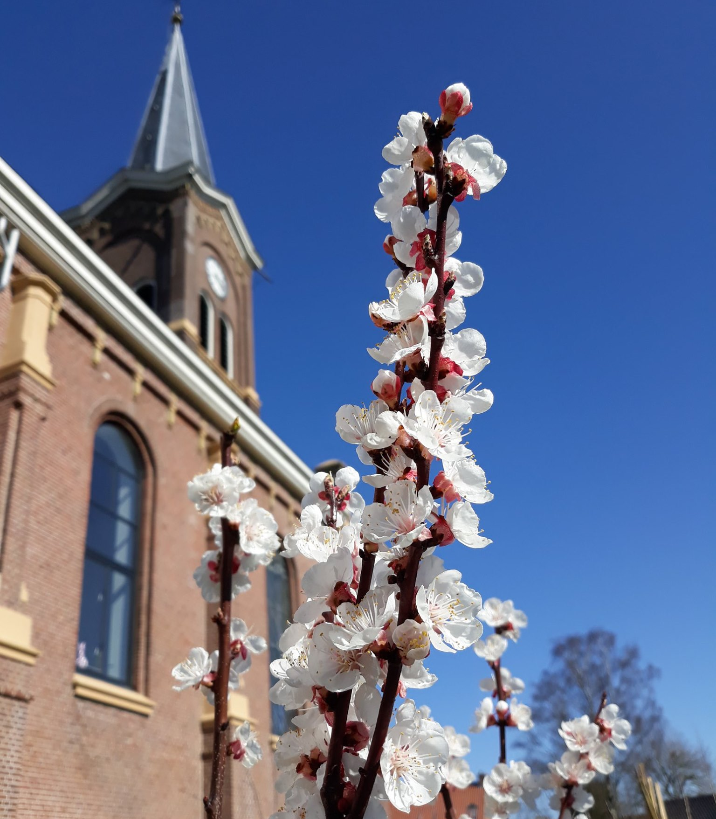
Mauritiuschurch
Our story
2019 return to the Netherlands after 20 years abroad
Bought a church with the idea to promote Friesland as a destination for the Russian and Chinese market
Covid and War - new focus
Notes:
Met my husband in Russia where we lived and worked for 15 years, followed by 5 years in China. Because we wanted to be closer to family we decided to return to the Netherlands in 2019. We came across this project and it immediately appealed to us. It was quite a big step, from Beijing to a tiny village in the Netherlands.
Initial idea was to promote the northern part of the Netherlands as a destination for the Russian and Chinese market - with our church being the centre of exploration.
During the renovation and building works already change of plan had to take place due to covid (loss of Chinese market), followed by the war initiated by Russia. Luckily we could receive guests during covid due to the fact we have a separate entrance for the guests and the room has all necessary facilities (fully equipped kitchen)
The Dutch became our main target group, actually it was a nice way of getting to know our own country and culture again. Nowadays we also receive guests from the neighboring countries: Germany, Belgium. The main reason for people to stay with us is rest.

Slide 3
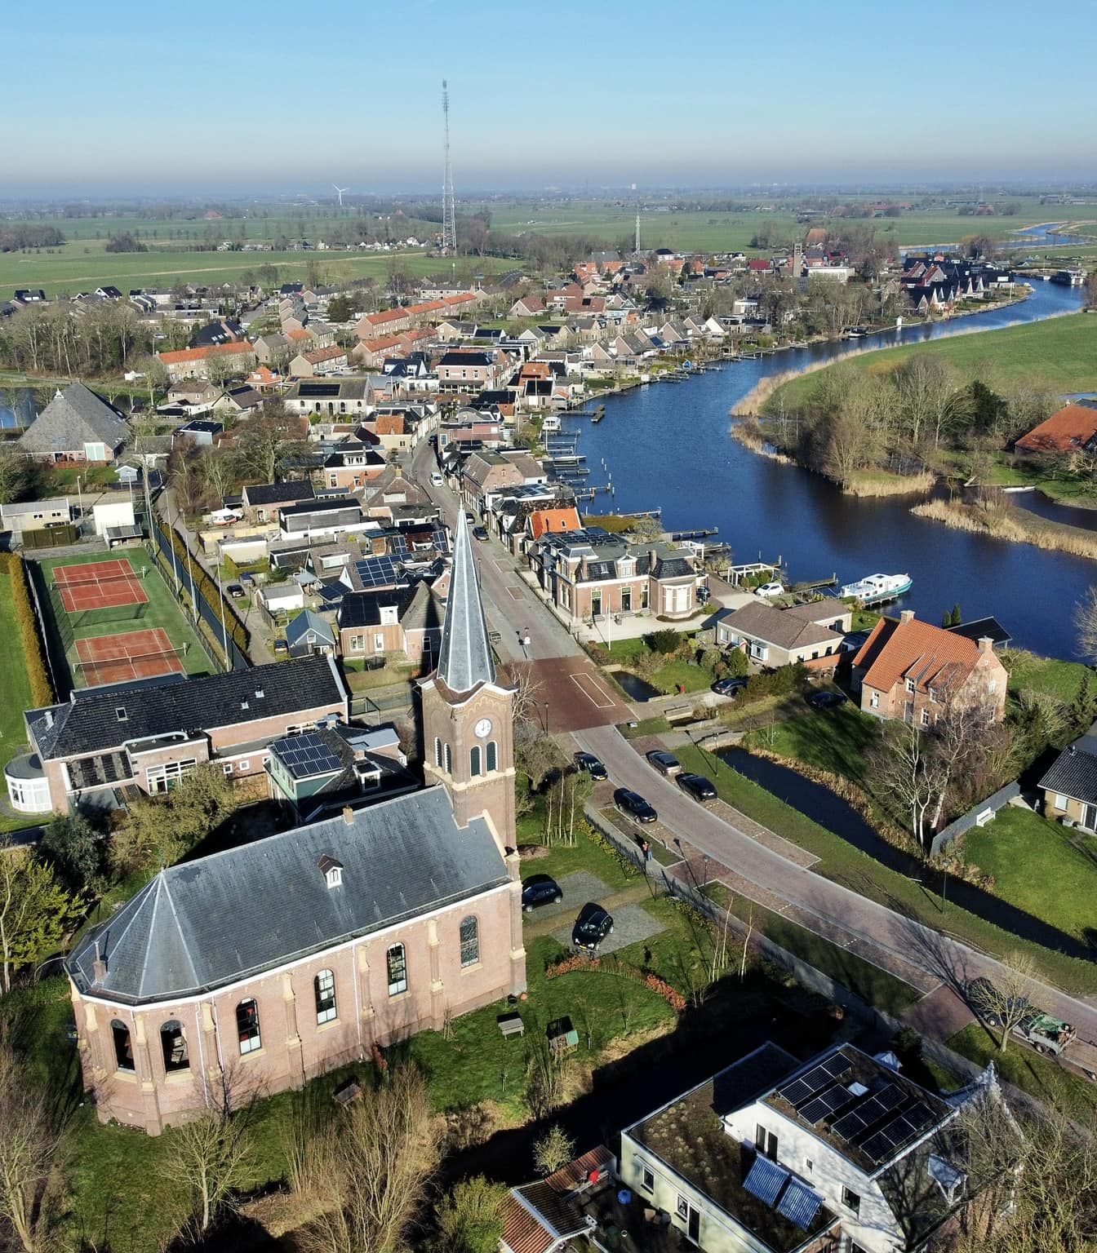
Location
Running a B&B in a small village
The Village
The church
Community involvement
Notes:
Jirnsum is a small village of about 1300 inhabitants, it has a school, a cafe/restaurant and many companies involved in water sports. There are no shops, the nearest shop is within 4km reach. We do have a community garden where we buy our vegetables, eggs and dairy products (all local).
If we wouldn’t have bought the church it is very likely it would have been demolished which is really a shame since it is such a dominating building within the village. The church is from XXXX and therefore does not carry the status of a protected building. Nevertheless, it carries a lot of history for many of the people living in the village and its surroundings: weddings, funerals, baptizing. For example, the grandfather of our neighbor used to be the sexton of the church, our neighbour always joined his grandfather as a child and knows the building better then we do.
After it was repurposed the building is now registered as an ordinary house with the municipality, which means we are only allowed to have two 2 rooms for B&B activities.
We knew from the start we had a large responsibility to the community:
bell rings every 30minutes, it is maintained by a volunteer from the village. If for some reason it doesn’t ring for sure somebody will remind us that it needs to be checked!
Easter egg hunting schools in the garden
Festive Christmas walk: singing in the hallway
Wedding ceremony
Enthousiasts who want to see the bell and the clockwork
Co-operation with the other entrepreneurs in tourism.

Slide 4
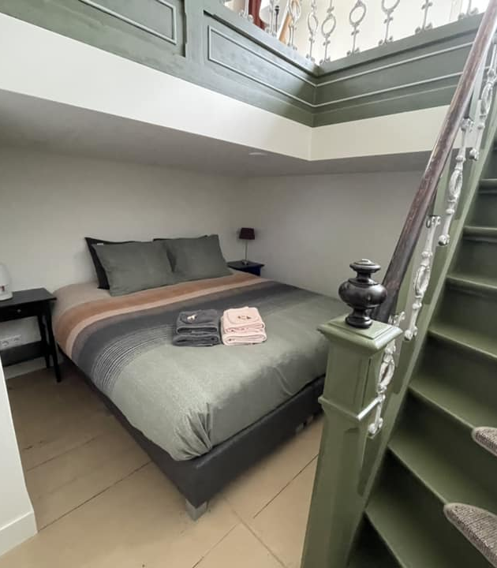
Our guests
Look for a special location, rest and local experience
Boating, cycling, walking
Cannot sleep because of the silence :)
Notes:
Mainly 60 plus people looking for rest
No TV’s in the rooms
Stay in the area but also make longer day trips (to the islands)
Very central location and easy to reach.
Average stay 3-5 days
Our guests find it quite unique that we also live in the church, we always show them our house and the bell tower and tell about the history of the building.

Slide 5
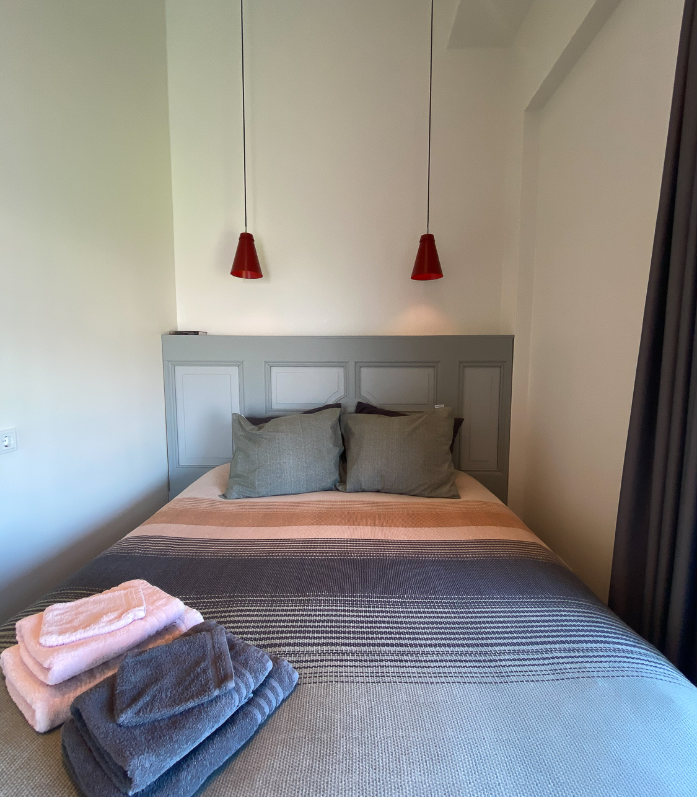
Sustainability
Where possible material re-used
Local food
Energy aware
Challenges
Notes:
When we started in 2019 knowledge about sustainability was different from now, e.g. in building less opportunities and less knowledge. If we asked a contractor about the sustainability of the material the reply was not for us, we don’t do that.
lamps re-used, old door as the headboard of the bed.
In the B&B we kept the church elements intact if possible (not all is possible due to isolation etc.)
Food from the community garden: eggs, yoghurt, meat from the local butcher but also fruit from our own garden. I like to bake so I tend to bake with the fruit from our own garden, make jam etc.
Improved the flora and fauna ion the garden
Challenges: maintenance (you need people who understand the building, like the roof) and implementation of sustainable measures (e.g. solar panels on the roof) but also sustainability (need a good plan)
The province pays a lot of attention to local and regional initiatives for a circulair economy: networking, trainings etc.

Slide 6
Thank you
Questions?
Notes:
Small introduction to our project, thank you!

