Slide 1
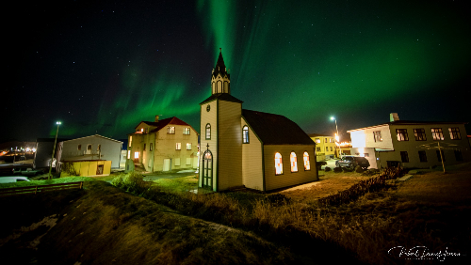
Epic stay in Hótel Blöndós
Notes:
Hello everyone and thank you for the invitation and thank you for listening. My name is Anna Birna Þorsteinsdóttir and I am the assistant manager at Hótel Blönduós and a farmer.

Slide 2
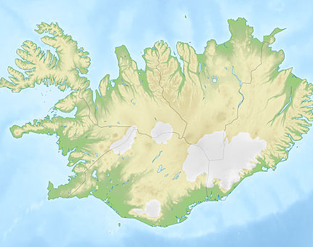
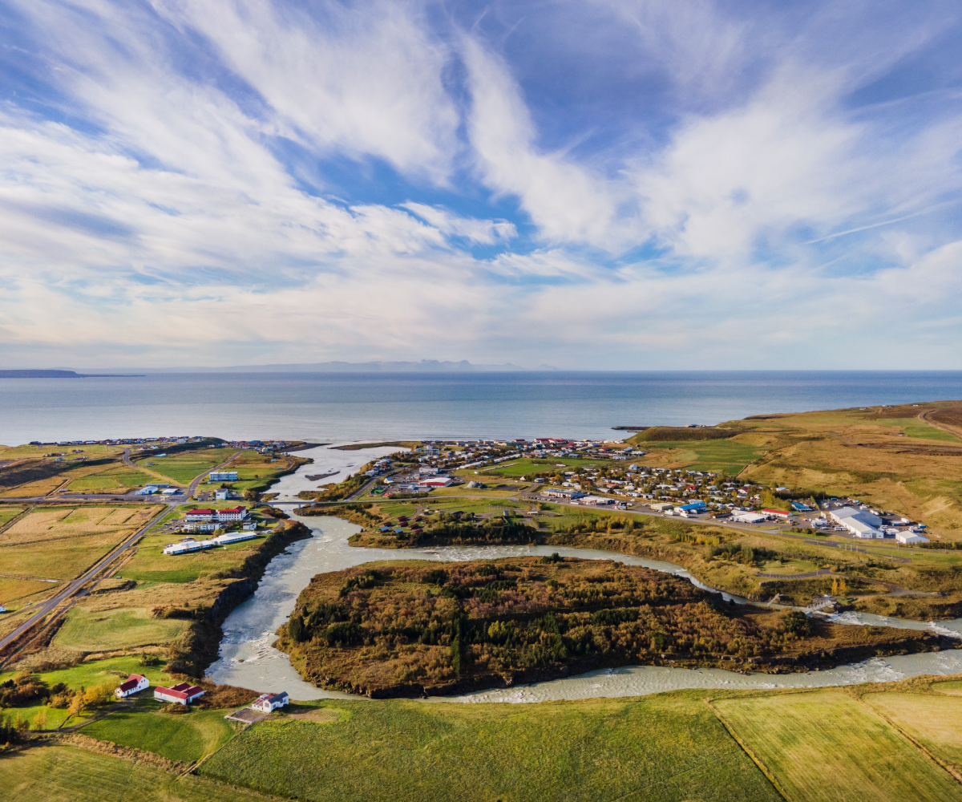
Blönduós
Over 800 people
This Photo by Unknown Author is licensed under CC BY-SA
Notes:
Blönduós is in Northwest of Iceland,
The glacier- and salmon river Blanda runs through the town. On one side is the old town, with Hótel Blönduós and some of the oldest building in town. And on the other side we have younger town where there is more population, school and supermarket and ect.
In the middel of the river is an island, called Hrútey. The island can be reached by a footbridge that crosses the river from the mainland.

Slide 3
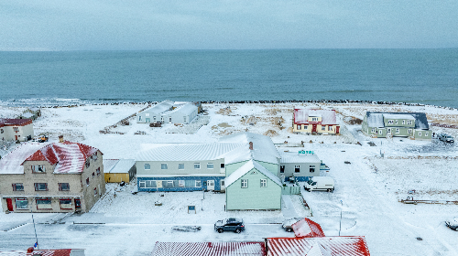
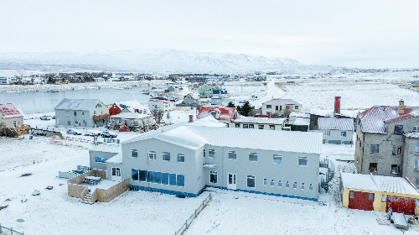
Hótel Blönduós 2025
5 buildings, Hotel, Church, Pétursborg and an in the AA house
+ 1 bakery as an event hall
Notes:
Today Hótel Blönduós run 5 buildings.
The Hotel ….. That you can see hear (front and back)
The old church
Pétursborg
AA house
and a old bakery that we use as an event hall.
The main building have 19 rooms, 17 dbl/twin/family rooms and 2 sgl room. In total we are offering 27 accommodations in 4 buildings.

Slide 4
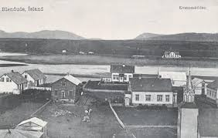
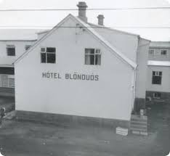
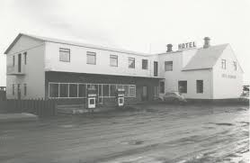
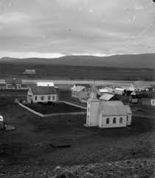
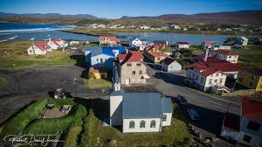
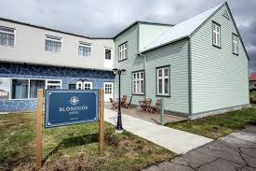
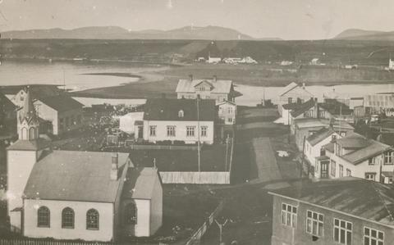
From the beginning to the present day
The oldest part of the Hótel is the sheriff's house from 1900
The hotel has been built in line with society
Notes:
Here are some pictures from the beginning of the settlement of Blönduós.
The oldest part of the hotel in the Sheriff´s house, that was built 1900, and have strong connection to the surrounding environment, locals and culture. Over the years, the house has had many different roles but has always grown in step with the community.
Since I took over as assistant hotel manager, many locals have approached me and told me stories about their connection to the house. Even asked me to remember to water the flowers, one guest told me that his mother was born in one of the rooms in the old house and many lady's have told me that Hótel Blönduós was there first plays worked. Which shows me how much the local people care about this building and the strong connection they have to it.
4

Slide 5
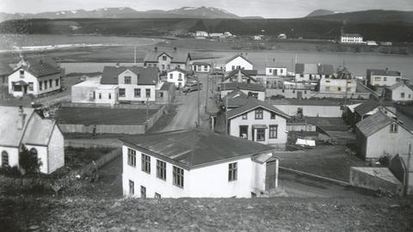
Hótel Blönduós 1943
Notes:
In the middle of this picture, you can see how the sheriff's house has slowly been given new extensions. Today the hotel bar and lounge is in this extension. And in on the top floor at the sheriff´s house we have now 3 rooms ( 1 dbl and 2 family rooms).

Slide 6
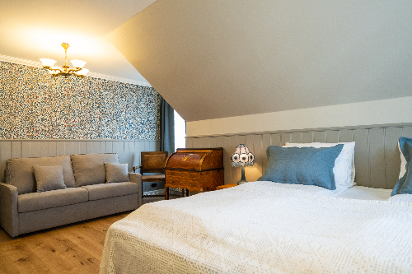
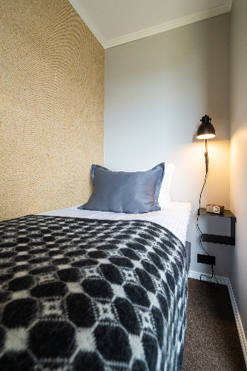
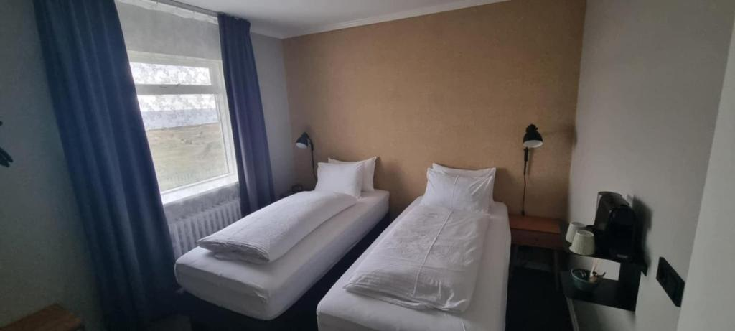
Rooms dbl, twin,sgl... Sea view or town view.
Notes:
We offer different kinds of accommodations, and no room is the same, but each room has its own identity.
Dbl, twin, sgl, family room, triple room and rooms for guests with disabilities.
In every room we have coffee machine, private bathrooms and WiFi.
BUT We don´t have TV in the rooms except in Pétursborg.
6

Slide 7
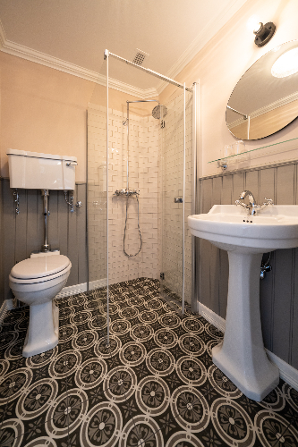
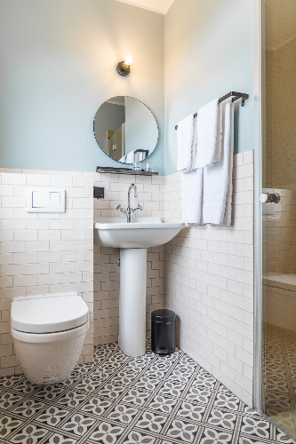
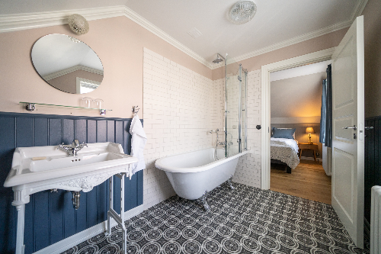
Every room with private bathroom, no room the same.
Notes:
None of the rooms looks the same, and only two of them have bathtubs and the rest of them have shower.
Except for the church, there is also a bathtub.

Slide 8
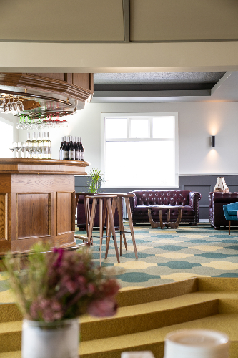
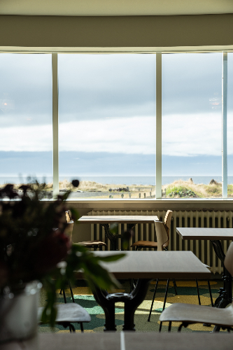
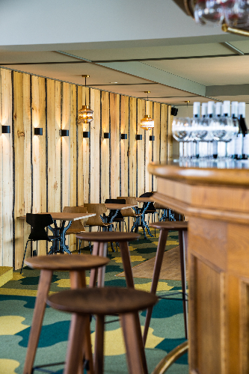
Sýslumaðurinn – Restaurant
Notes:
In the Hótel we have a restaurant that is named Sýslumaðurinn (in english The Shereff) max 80 people at the time in a la carte. The restaurant have magnificent view of the fjord and in good weather you can see the mountains in the west fjords and the Vatnssnes peninsula. Our menu have lamb meat from the farmers around the area, fish off the day (usually cod), as well as other dishes in the form of appetizers, main courses and desserts. In the old town you can see a lot of rhubarb, and this summer we offered white chocolate mousse with rhubarb sorbet.
8

Slide 9
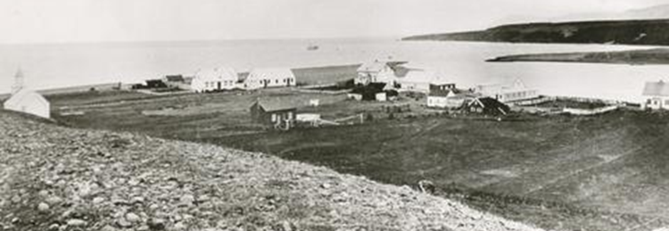
Both the Church and Pétursborg have already been built.
Blönduós year 1898
Notes:
The church was build in the fall 1894 and consecrated in 1895. After it has served the community for almost a 100 years it was deconsecrated in 2007. Today the old church is part of accomadation in Hótel Blönduós.
9

Slide 10
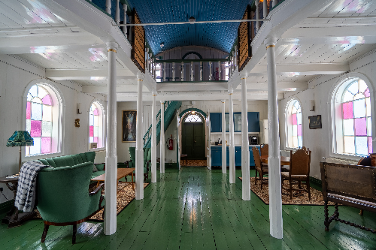
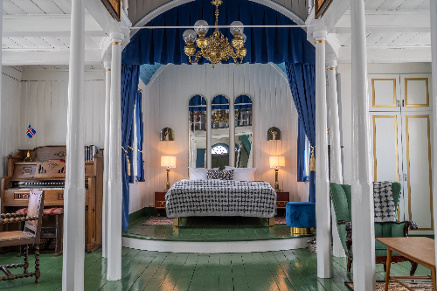
The old Church
Build 1895 – Desecrated 2007
Hotel accommodation from 2023
1895-2025
Notes:
Today, The Old Church can accommodate max 4 guests together. We have one dbl bed, that is on the old altar and in 2 sgl beds that is on the second floor where the bathroom is also located.

Slide 11
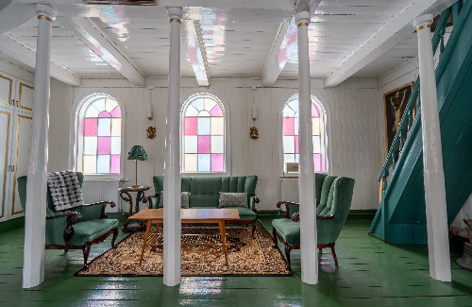
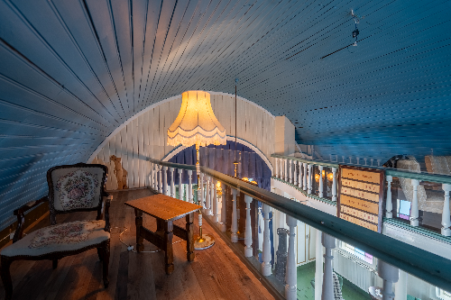
Dbl bed on the altar, living room and kitchen
Notes:
On the ground floor is living room, kitchenette, and double bed on the altar. On the second floor is the bathroom and 2 single beds.
11

Slide 12
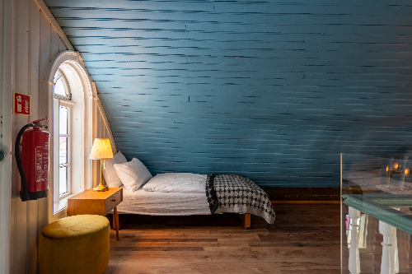
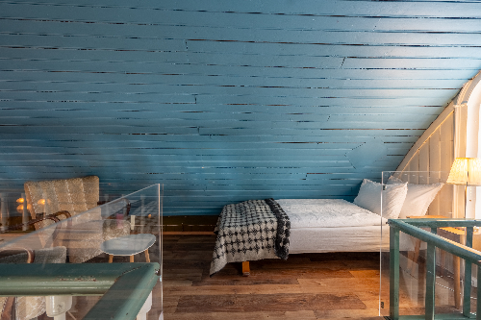
Two sgl beds on the top floor where the bathroom is.
Notes:
The two sgl beds are on opposite sides on the second floor. In the beginning we listed the church as a suite but most of our guests was not happy after there stay. We decided to change the name into: The old Church. Now the look of the church, the sound of the wood in the old floor has become charming. Everyone that stays there are blown away of the feeling and the peaceful atmosphere they are experience.

Slide 13
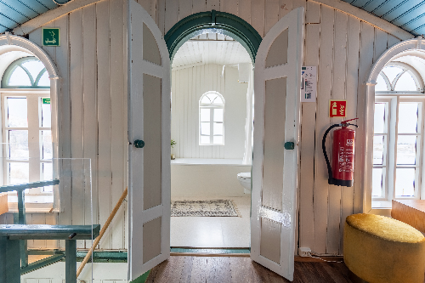
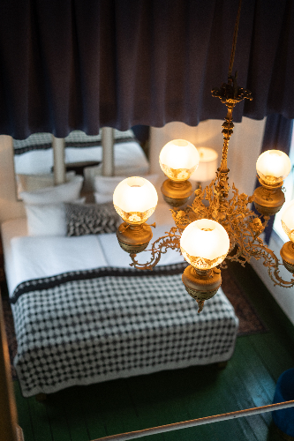
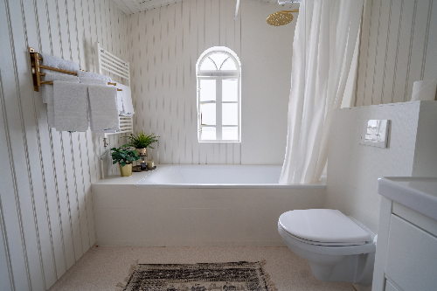
The chandelier came from Reykjavík Cathedral in 1910
Notes:
The chandelier was obtained from the Reykjavík Cathedral in 1910. The bathroom have beautiful ocean view.
13

Slide 14
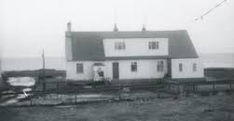
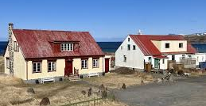
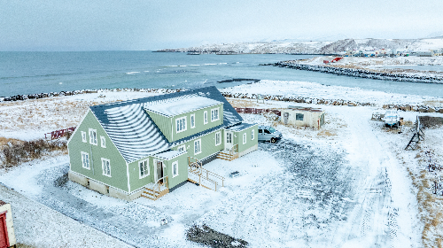
Pétursborg 1878
Warehouse/shop 1878
Apartment building 4-5 families
2024 - Five apartments with balconies towards the sea, private bathrooms, kitchen facilities and private parking spaces.
Notes:
Heimildir: https://husaskraning.minjastofnun.is/Husakonnun_178.pdf
Pétursborg was build in 1878 as a warehouse and a shop.
It´s next role was few apartments for 4 -5 families.
Today the house is a five luxury apartments for guests that stay in Hótel Blönduós.
14

Slide 15
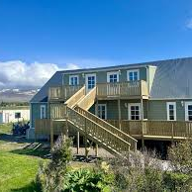
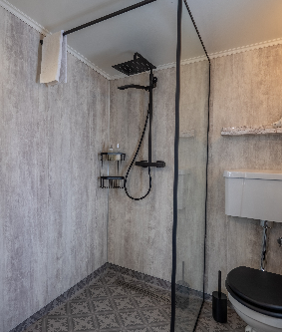
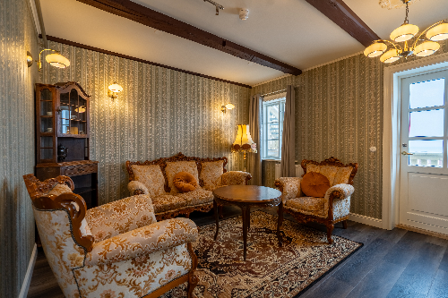
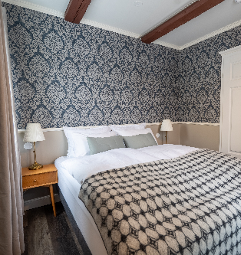
Pétursborg 2024
5 apartments
Three on the ground floor
Two on the top floor
All of them with ocean view
Privat parking place
All of them with kitchenette
Notes:
5 apartments
Three on the ground floor
Two on the top floor
All of them with ocean view
Privat parking place
All of them with kitchenette
One apartment have 2 rooms (sgl and dbl)
One can accommodate 5 guests and one can accommodate 5 guests, because in those apartments we have sofa beds.

Slide 16
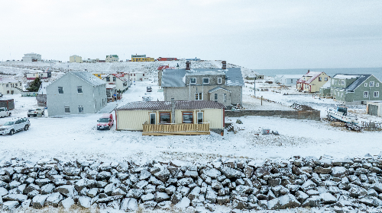
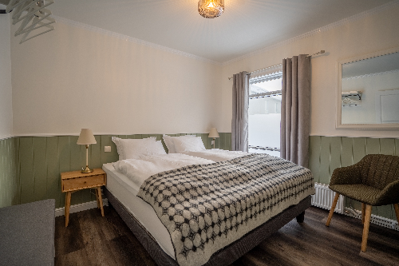
The AA house 2025.
Was built a a shop in 1934
Notes:
The last building is the AA house. Built in 1934 as a small shop with a street –facing window and entrance
Extended in 1944 to the west and slightly modified
Around 1960, Blonduós town bought the building and in 1999 the major give the AA organization to have the meetings there.
And today the house, still hold the name AA house and offer 2 dbl rooms for guests.
The hotel owner also slightly modified the house and made two large windows facing the river Blanda and the ocean.
16

Slide 17
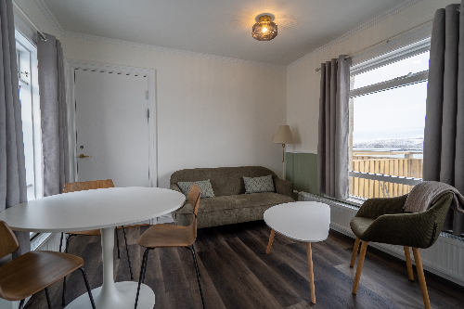
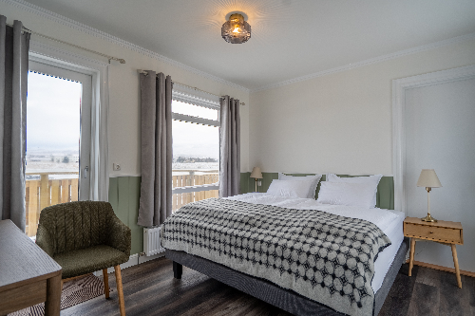
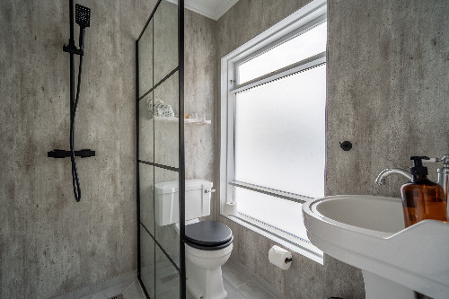
AA húsið = Two rooms with door between
Notes:
The 2 double bedrooms, have a door between them and on is slidle bigger than the otherone with a small livingroom and kitchenet. There is a door between those rooms make this accomadation perfict for a grp of friends or family.
17

Slide 18
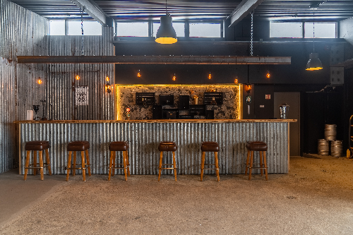
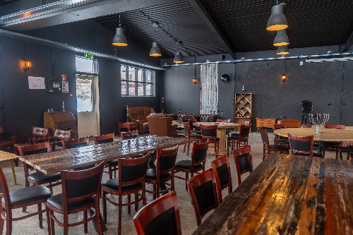
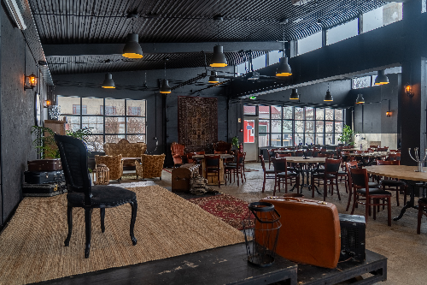
Krúttið – Event hall
Take 200 guests
Notes:
Krúttið used to be a bakery but is now it is an event hall for the Hótel Blönduós. Like all the above buildings, Krúttið has strong ties to the locals and there are several events that have become established in the summer schedule with the locals.
Like The Rhubarb Festival and the Knitting Festival.
18

Slide 19
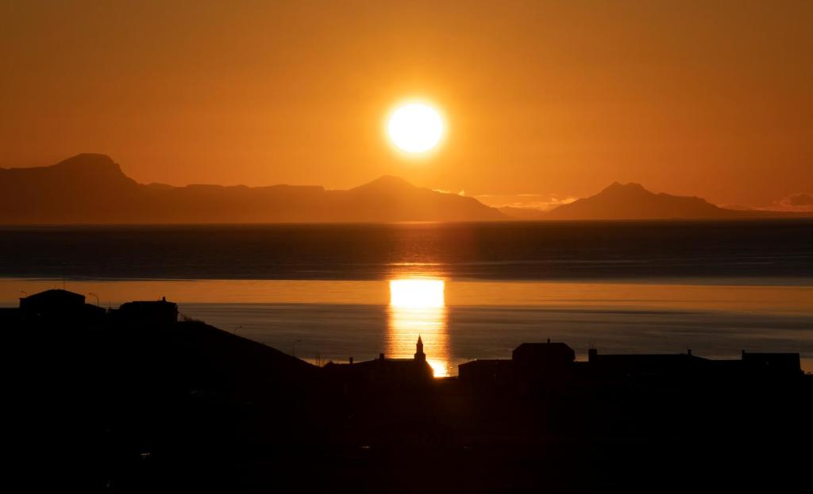
Thank you for listening
Website: https://hotelblonduos.is/
Notes:
Thank you for listening and remember you're always welcome to visit Hótel Blönduós.
19

