Slide 1
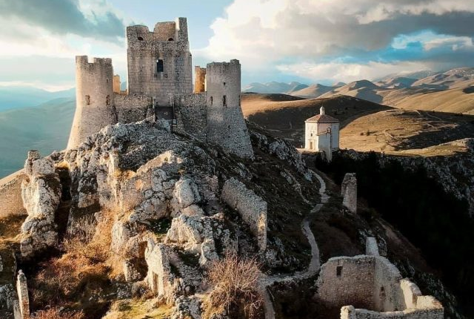
Rocca Calascio Castle, Italy
Module 8 (Part 2)
Understanding Your Revenue & Booking Capacity

Slide 2
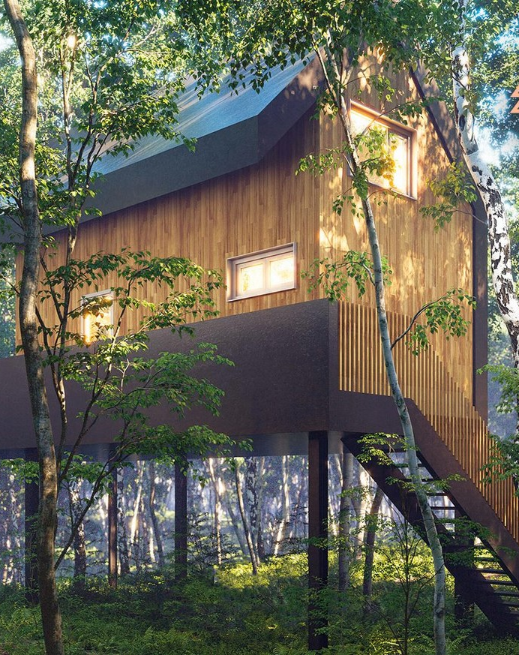
Module 8 Laying the Financial Foundations for a Viable Accommodation Business
CONTENTS
Section 3
Understanding Your Revenue & Booking Capacity
Photo Credit: Teapot Lane, Leitrim, Ireland
Photo Credit:

Slide 3
Module 8 Laying the Financial Foundations for a Viable Accommodation Business
Section 3: Know Your Revenue Sources
Where does your income come from, and are you fully aware of all potential revenue streams, beyond just room bookings?
Objective: Revenue & Capacity Foundation (What you earn and what’s possible).
To map out all sources of income (primary and secondary) to get a full picture of potential earnings and business opportunities.

Slide 4

Section 3
Know Your Revenue Sources
Revenue & Capacity Foundation (What you earn and what’s possible)
To map out all sources of income (primary and secondary) to get a full picture of potential earnings and business opportunities.
Where does your income come from, and are you fully aware of all potential revenue streams - beyond just room bookings?

Slide 5
Financial Logic & Planning for Accommodation Businesses Planning
Section | Section | Why It Comes Here
3 | Revenue & Capacity Foundation | You start by calculating what you earn or all your income You must know what you're earning (primary and secondary income sources) and how many nights you can sell.
4 | Cost Structure | Figure out what you spend Without knowing your fixed and variable costs, you can't set prices or calculate profit.
5 | Know Your Cost Per Night | Calculate what each night must cover Helps establish your minimum charge to break even. You calculate the cost per night by dividing total costs by expected nights sold.
6 | Break-Even Analysis | Determine your financial survival point Tells you how to stop losing money. Once costs are known, calculate how many bookings are needed to break even.
7 | Occupancy & Revenue Planning | Forecast occupancy and revenue potential Essential to ensure your pricing is achievable with realistic bookings. You will do this by calculating break-even data, realistic booking targets, and occupancy rate % goals.
8 | Profit & Pricing Strategies | Then choose a pricing strategy aligned with your goals With all the above in place, you can confidently set pricing and set profit targets

Slide 6
Know Your Revenue Sources
To identify and list all current and potential revenue streams your business can generate. This lays the foundation for realistic forecasting, pricing, profitability, and growth decisions.
Revenue is the lifeblood of your business. While most income may come from accommodation bookings, successful businesses explore and leverage secondary sources of income—such as meal services, workshops, equipment rental, guided tours, or spa add-ons. Identifying both core and additional revenue streams helps you diversify your business model and increase financial resilience, especially in off-peak seasons.
08
Know Your Revenue Sources
Identify and calculate your primary (e.g., bookings) and secondary income (e.g., tours, packages)
09
Determine Your Available Nights
Know how many nights per year you can rent your space.

Slide 7
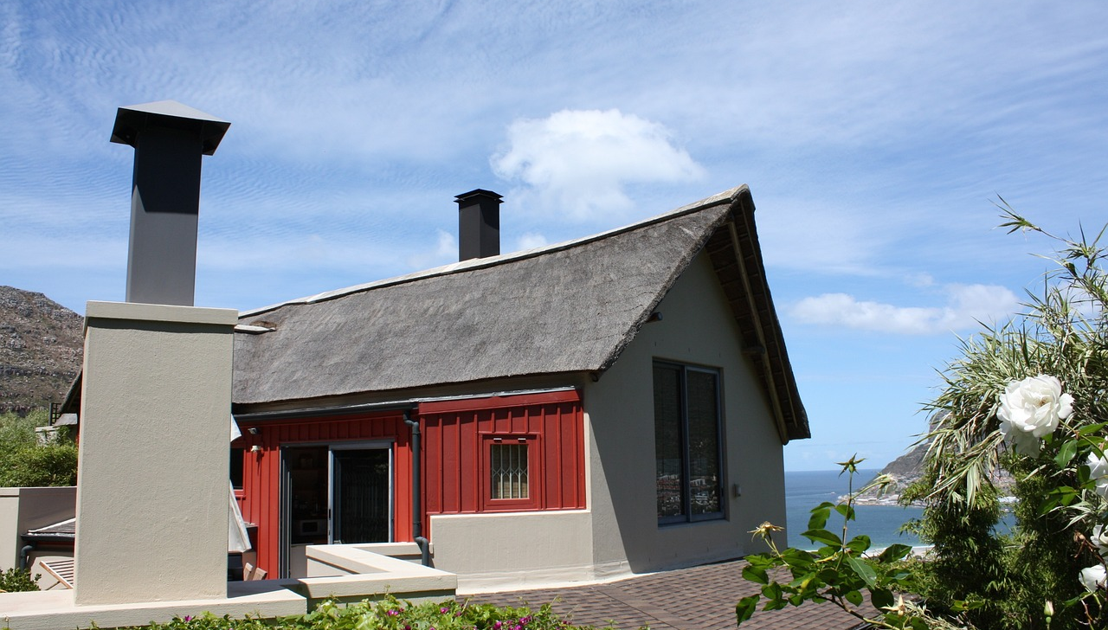
Understanding Your Income and Costs
8
Guiding Question: “Will my accommodation business be profitable, and what are my expected expenses versus income this year?”
The purpose of this section is to compile all your expected income and costs in one place, to see if your accommodation business will make money or burn money.
In a real-world context, this is like looking at your bank balance at year’s end: did you earn more than you spent?
The objective is to ensure you haven’t overlooked any costs or expenses and to determine if you need to adjust your plan (increase revenue or cut costs) to achieve a profit.
Know Your Revenue Sources
Introduction to Revenue & Costs

Slide 8
Understanding Your Income and Costs
8
Guiding Question: “Will my accommodation business be profitable, and what are my expected expenses versus income this year?”
Know Your Revenue Sources
By the end of this section, you’ll have a clear picture of your projected net profit, which is crucial for judging the viability of your business and is something any potential investor or lender will want to see.
Later on, after completing your calculations, you will be completing your Income Statement.
Introduction to Revenue & Costs

Slide 9
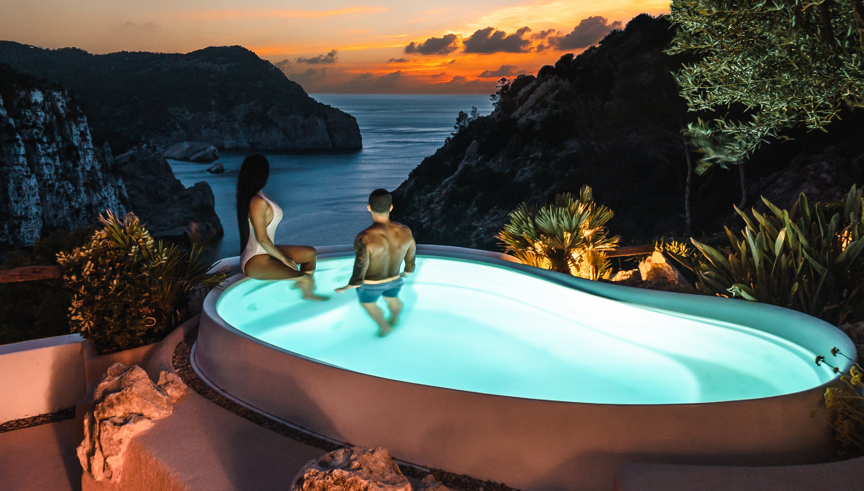
Detail All Your Sources of Income
Begin by detailing all sources of income for your business.
For most accommodation businesses, the primary revenue will be room/nightly charges (lodging fees).
However, include any other income sources you plan to have:
For example, food & beverage (if you serve breakfast or have a restaurant), extra services (airport pickup fees, tours, etc.), or ancillary fees (cleaning fees, equipment rentals, etc.).
Know Your Revenue Sources
List Your Revenue Sources
Break-Even Analysis: Formula and Calculation

Slide 10
Detail All Your Sources of Income
Example: Revenue might include €50,000 from room bookings (as per your seasonal forecast), plus €5,000 from add-ons like breakfast sales and local tours, for a total revenue of €55,000.
Writing these down establishes the income side of the equation. Tip: It’s usually better to be slightly conservative in estimates – better to be pleasantly surprised with more income than expected than the opposite.
Know Your Revenue Sources
List Your Revenue Sources
Break-Even Analysis: Formula and Calculation

Slide 11

Start with Your Primary Revenue
Primary Revenue (Core Accommodation Income)
What it is: Your core income from nightly, weekly, or long-stay guest bookings.
Nightly/weekly stays
Longer-term bookings (e.g. month-long retreats)
Group bookings (family reunions, wedding guests)
Event hosting (retreats, workshops, small weddings)
Examples: €120/night glamping pod, €300 for a 3-night eco-retreat stay.
Know Your Revenue Sources
Primary Revenue

Slide 12
Start with Your Primary Revenue
Integration:
Offer seasonal packages (e.g., Summer Stargazer Weekend, Autumn Wellness Escape).
Use value-based pricing tiered pricing: base rate + upgrades (like hot tub access). (discussed later)
Value: Predictable income stream and foundation of your business.
Know Your Revenue Sources
Primary Revenue

Slide 13
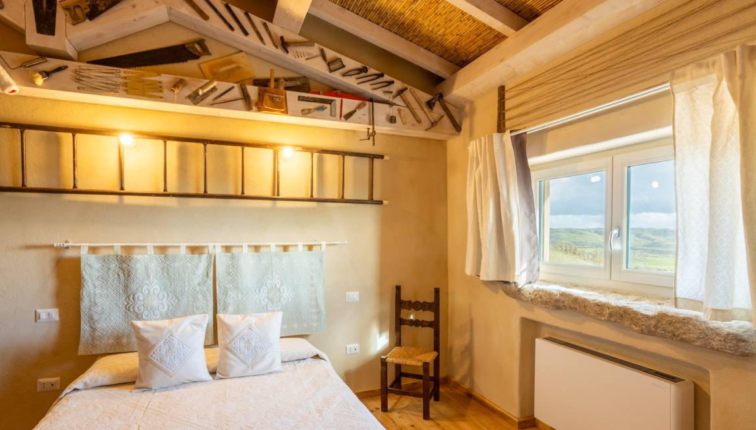
Next Calculate Your Secondary Revenue
While nightly bookings form the backbone of most accommodation businesses, your true potential for growth and financial resilience lies in secondary income streams.
These are the added services, experiences, and extras that guests are often willing—and excited—to pay for, such as breakfast hampers, guided hikes, craft workshops, or access to a hot tub.
Secondary income is not just about making more money—it’s about creating value and deepening guest connection.
Know Your Revenue Sources
Secondary Revenue
(Add-On Services & Experiences)

Slide 14
Next Calculate Your Secondary Revenue
These offerings enhance the overall guest experience, increase your average spend per booking, and help you differentiate yourself in a competitive market.
Whether it's the convenience of a cooked meal, the delight of a stargazing kit, or the memory of a local craft workshop, these additions transform a standard stay into a unique, shareable, and memorable experience.
Know Your Revenue Sources
Secondary Revenue
(Add-On Services & Experiences)

Slide 15
Next Calculate Your Secondary Revenue
Next are multiple secondary revenues (add-on services and experiences) you can use to align with your unique offering, location, and guest profile. These will help you maximise earnings while enhancing the guest experience. They also help support local partners, extend your brand identity, and cushion your business against seasonal dips in bookings.
Secondary Revenue (Add-On Services & Experiences)
Examples, Integration and How They Add Real Value
Digital & Passive Income Streams | Convenience Services
Affiliate bookings (local tours, spas, restaurants) Patreon support for educational or eco-content Virtual tours or retreat livestream access Online courses related to sustainability or hospitality | Early check-in / late check-out fees Luggage storage or transfer services Paid parking (if limited space) Pet-friendly fees or dog-sitting Airport/train station pickups

Slide 16



Digital & Passive Income (Real Value Integration)
Affiliate Bookings or Commissions: 10% commission for every guest who books a local kayaking tour. Link to third-party experiences or set up cross-promotion. Value: Earn from recommendations you already make.
Online Courses or Guides: €10 downloadable “Eco-Hosting 101” or “Hidden Hikes of Leitrim”. Offer as an upsell at booking or post-stay email follow-up.
Value: Generates passive income and extends your brand digitally.
Virtual Retreat Access: €15 livestream yoga session or online journaling circle. Use Zoom or Teachable to deliver paid online experiences.
Value: Opens access to global audiences and off-season earnings.

Slide 17



Guest Services & Practical Add-ons (Real Value Integration)
Early Check-In / Late Check-Out: €15 for early check-in from 1:00 PM; €20 for late checkout until 1:00 PM. Offer during low-demand days; automate via booking platforms. Value: Easy passive income and guest convenience.
Pet-Friendly Fees or Dog-Sitting: €25 pet stay surcharge or €10/hour dog sitting. Provide beds, bowls, and clear house rules.
Value: Opens your property to a wider audience of pet owners.
Transport Services: €40 return from the local station; €15 luggage transfer to the next stay. Offer with local drivers or through your own vehicle.
Value: Adds value in rural or hard-to-access destinations.

Slide 18
Secondary Revenue (Add-On Services & Experiences)
Examples, Integration and How They Add Real Value
Food & Drink | Wellbeing & Wellness | Outdoor Experiences
Breakfast (continental, full Irish, plant-based) Welcome hampers (local produce, wine, snacks) BBQ packs or picnic lunches Evening meals or home-cooked dinners (on request) Coffee or smoothie bar Wine, gin or craft beer tastings (especially local) | Private hot tub or sauna use (paid access per stay) Yoga or meditation classes (on-site or virtual) Forest bathing or guided mindfulness walks Massage or spa therapist partnerships Wellness retreat packages | Guided hikes or nature tours Bike, kayak, or surfboard rentals Foraging walks or wild swimming experiences Stargazing kits or telescope rental Campfire experience kits (wood, marshmallows, blankets)

Slide 19
Food and Drink Add-ons (Real Value Integration)
Breakfast Options: €10 continental breakfast basket with pastries, fruit, juice; €15 cooked breakfast. Offer a “breakfast basket” guests can pre-order when booking or request onsite. Value: Easy upsell that enhances guest comfort and supports local food producers.
Welcome Hampers: €25 locally sourced cheese and wine basket. Add a checkbox to your booking form or offer it as an upsell via email before check-in. Value: Increases booking value and supports local food artisans.
On-Demand Evening Meals: €20 for homemade vegetarian stew with soda bread. Collaborate with a local cook or prepare simple meals in advance. Value: Ideal for remote accommodations with no nearby restaurants.

Slide 20



Wellness and Wellbeing Experiences (Real Value Integration)
Private Hot Tub/Sauna Use: €25 for a 1-hour private hot tub session. Have bookable time slots, a smart lock or an outdoor privacy curtain setup.
Value: Elevates luxury and appeals to couples or wellness travellers.
Yoga or Meditation Classes: €15 per person for a morning yoga session led by a local instructor. Host sessions on a lawn, deck, or indoor space; include in retreat packages. Value: Supports health-focused guests and attracts wellness-seekers.
Forest Bathing or Mindful Walks: €10 guided silent walk-through local woodland. Add to Airbnb Experiences or create your own website booking link. Value: Enhances nature immersion and mental health value of the stay.

Slide 21



Outdoor & Adventure Activities (Real Value Integration)
Guided Hikes, Nature or Mythology Walks: €20 guided local hike; €25 for “Legends of the Landscape” storytelling walk. Offer on specific days or through partnership with local eco-guides. Value: Adds value to the rural or nature-based location.
Bicycle, Kayak, Paddleboard or Surfboard Rental: €15/day bike hire; €30/day surfboard hire. Store equipment onsite or refer to a local outdoor shop for commission. Value: Attracts active travellers and families, encourages longer stays.
Campfire Kits or Stargazing Packs: €15 stargazing pack with binoculars, blanket, thermos & star map. Market as a romantic or family experience; prepare kits in advance. Value: Turns a night under the stars into a curated, memorable moment.

Slide 22
Secondary Revenue (Add-On Services & Experiences)
Examples, Integration and How They Add Real Value
Creative Experiences | Eco & Farm Tourism | Retail & Merchandise
Craft workshops (e.g. pottery, basket weaving) Cooking or baking lessons (e.g. sourdough, boxty) Art or photography classes using the local landscape Writing or journaling retreat services | Animal feeding or farm tours (family-friendly) Gardening or permaculture experiences Bee-keeping or honey-tasting sessions Organic vegetable/egg box sales | Local crafts, art, or souvenirs for sale Eco-toiletries or refill station products Home-branded items (e.g. mugs, tote bags, robes) Digital guides or travel eBooks

Slide 23



Creative & Cultural Workshops (Real Value Integration)
Craft Classes (Pottery, Candle Making, Art): €35 for a 2-hour pottery session with a local artist. Run weekly sessions in a shared barn or repurposed space. Value: Showcases local talent and attracts guests interested in creativity and slow travel.
Cooking Lessons (Local Dishes, Foraging, Baking): €40 sourdough masterclass; €30 Irish boxty-making class. Offer workshops during quieter days or partner with a local chef. Value: Celebrates local food heritage and adds authentic flavour to the stay.
Photography Walks or Writing Retreats: €20 guided photo tour of local landscape. List as an experience, ideal for solo travellers or mid-week guests. Value: Encourages reflection, mindfulness, and connection to place.

Slide 24



Farm & Nature-Based Experiences (Real Value Integration)
Animal Encounters or Feeding Sessions: €5 child-friendly goat feeding session or mini farm tour. Safe fencing, clear schedule, and optional booking through your site. Value: Enhances family-friendliness and authenticity.
Eco-Garden Tours or Harvest Experiences: €10 guided garden tour or “pick your own veggies” session. Use raised beds or polytunnels; invite guests to harvest for their meal.
Value: Connects guests to sustainability and the land.
Bee-Keeping or Honey Sampling: €15 bee education tour + honey tasting. Create safety protocols, provide suits or observation windows.
Value: Offers a rare, educational eco-tourism experience.

Slide 25



Onsite Retail & Merchandise (Real Value Integration)
Local Artisan Goods: Handmade soaps (€6), woven baskets (€20), or ceramics (€35). Set up a small retail display in a common area or an online shop link. Value: Supports local makers and gives guests a tangible memory.
Branded Souvenirs: “Wild Atlantic Hideaway” mugs (€12) or canvas totes (€10). Sell through self-checkout or QR-code payment system.
Value: Builds brand recognition and repeat bookings.
Eco-Toiletry Refills: €8 refill of eco shampoo, conditioner, or sunscreen. Use a refill station in the shared area or cottage bathroom.
Value: Encourages sustainability and appeals to conscious travellers.

Slide 26
9
Determine Your Available Nights
(Capacity for Bookings)
Determine Available Nights
Now, consider how many nights you have available to sell in a year. There are 365 days, but will your rooms be available all 365?
Perhaps you close for maintenance, or you reserve some days for personal use if it’s a family vacation home, or maybe you simply know there won’t be demand year-round.
Calculating this “capacity” sets a ceiling on the number of bookable nights.
Capacity for Bookings

Slide 27
Determine Your Available Nights
(Capacity for Bookings)
Determine Available Nights
Example: If you plan to operate year-round with no closures, that’s 365 nights available.
If, instead, you decide to close for one month off-season (say 30 days) and also anticipate about 15 days of various maintenance or personal block-offs, then the available nights are 365 – 45 = 320 nights in a year.
In a hotel context, if you have multiple rooms, you’d multiply by the number of rooms (e.g., one room × 320 nights = 320 room-nights; if 5 rooms, then 5 × 320 = 1,600 room-nights available).
The number of available nights is useful for putting your break-even target into perspective: is it even feasible to book that many nights? It also feeds into occupancy calculations next. Essentially, this is your inventory of nights you can sell under ideal conditions.
Capacity for Bookings

Slide 28
Available Number of Nights
Example. Determine your available Nights per Year. Assume you operate all year, 365 nights. (You can adjust this if you're open seasonally, e.g., 300 nights, 250, etc.)
Available Nights = Total Nights in a Year – Owner Blocked Nights – Maintenance Days – Seasonal Closures
This number is essential for calculating realistic occupancy rates. It helps you project maximum revenue and understand operational limits. You'll use this figure in break-even analysis and revenue planning.
Total Nights in a Year | 365
Owner Use (e.g. holidays, personal stays) | 30
Scheduled Maintenance Days (e.g. deep clean, repairs) | 10
Off-Season Closures (e.g. closed Jan–Feb) | 45
Available Nights | 365 – 30 – 10 – 45 = 280 nights

Slide 29
Sample Revenue Table (Calculate Primary and Secondary)
Revenue Type | Description | Rate / Unit | Available Nights or Units | Expected Occupancy / Sales | Estimated Monthly Revenue (€) | Estimated Annual Revenue (€)
Primary Revenue Sources
Nightly Rental Rate | Main guest booking income | €140/night | 365 nights | 50% (183 nights) | €2,562 | €25,620
Cleaning Fee (per booking) | Flat fee added to each guest booking | €30/booking | 183 bookings | 100% | €457 | €5,490
Secondary Revenue Sources
Breakfast Add-On | Optional guest upgrade | €12/person | 183 bookings x 2 guests | 30% uptake (110 sales) | €132 | €1,320
Equipment Rental (e.g. bikes) | Daily guest rental | €15/day | 100 days | 20% uptake (20 rentals) | €25 | €300
Local Tour Booking Commission | Commission from referrals | €20/tour | 10 bookings/month | 10% uptake (12 tours/month) | €240 | €2,880

Slide 30

Exercise Revenue Table (Calculate Primary and Secondary)
Revenue Type | Description | Rate / Unit | Available Nights or Units | Expected Occupancy / Sales | Estimated Monthly Revenue (€) | Estimated Annual Revenue (€)
Primary Revenue Sources
Nightly Rental Rate | Main guest booking income | €[insert figure] /night | [insert figure] nights | [insert figure] % ([insert figure] nights) | €[insert figure] | €[insert figure]
Cleaning Fee (per booking) | Flat fee added to each guest booking | €[insert figure] /booking | [insert figure] bookings | [insert figure] % | €[insert figure] | €[insert figure]
Secondary Revenue Sources
Breakfast Add-On | Optional guest upgrade | €[insert figure] /person | [insert figure] bookings x [insert figure] guests | [insert figure] % uptake (110 sales) | €[insert figure] | €[insert figure]
Equipment Rental (e.g. bikes) | Daily guest rental | €[insert figure] /day | [insert figure] days | [insert figure] % uptake ([insert figure] rentals) | €[insert figure] | €[insert figure]
Local Tour Booking Commission | Commission from referrals | €[insert figure] /tour | [insert figure] bookings/month | [insert figure] % uptake ([insert figure] tours/month) | €[insert figure] | €[insert figure]

Slide 31
Sample Revenue Table (Total Primary & Secondary Revenue)
Revenue Source | Type | Unit Price (€) | Units/Nights Sold | Total (€) | Total Revenue
Nightly Guest Stay | Primary | €150 | 180 nights | €27,000
Extra Guest Fee | Primary | €25 | 40 extra guests | €1,000 | Primary €28,000
Pet Fee | Secondary | €20 | 15 bookings | €300
Firewood Package | Secondary | €10 | 50 packages | €500
Hot Tub Use Fee | Secondary | €15 | 80 bookings | €1,200
Breakfast Add-On | Secondary | €12 | 60 guests | €720
Local Tour Commissions | Secondary | €30 | 10 referrals | €300
Gift Shop Sales | Secondary | €20 | 25 purchases | €500 | Secondary €31,520
Total Revenue |  |  |  |  | €31,520

Slide 32
Exercise: Revenue Table (Total Primary & Secondary Revenue)
Revenue Source | Type | Unit Price (€) | Units/Nights Sold | Total (€) | Total Revenue
Nightly Guest Stay | Primary | €[insert figure] | [insert figure] nights | €[insert figure]
Extra Guest Fee | Primary | €[insert figure] | [insert figure] extra guests | €[insert figure] | Primary €[insert figure]
Pet Fee | Secondary | €[insert figure] | [insert figure] bookings | €[insert figure]
Firewood Package | Secondary | €[insert figure] | [insert figure] packages | €[insert figure]
Hot Tub Use Fee | Secondary | €[insert figure] | [insert figure] bookings | €[insert figure]
Breakfast Add-On | Secondary | €[insert figure] | [insert figure] guests | €[insert figure]
Local Tour Commissions | Secondary | €[insert figure] | [insert figure] referrals | €[insert figure]
Gift Shop Sales | Secondary | €[insert figure] | [insert figure] purchases | €[insert figure] | Secondary €[insert figure]
Total Revenue |  |  |  |  | €[insert figure]

Slide 33

Well Done
Module 8 (Part 2)
Understanding Your Costs, Pricing, and Break-Even Point
You have Completed… Module 8 (Part 1)
Understanding Your Revenue & Booking Capacity
Next is…

