Slide 1

Module 7 (Part 2)
Find the Funds That Fit – Funding & Finance Options
Financial Planning & Funding
Slovenia
www.epicstays.eu

Slide 2

Module 7 (Part 2) Overview
Learning Outcomes
Country-Specific Funding Opportunities
Find the Funds That Fit – Funding & Finance Options. Part 2 of module explores tailored funding opportunities for alternative tourism accommodation across Ireland, Slovenia, Iceland, Italy, and the Netherlands. This section focuses on Slovenia. Learn how to identify, compare, and assess funding streams that best fit your business model and goals. The focus is on aligning with key priorities such as regeneration, low-carbon growth, and community value. By the end, you’ll be able to evaluate eligibility, navigate national and EU schemes, and choose the right funding pathways for sustainable tourism success.
Explore Slovenia’s main funding sources e.g., grants, microloans, and co-financing from national to regional schemes.
Understand the role of the Slovenia Green Scheme and how eco-certification and sustainability standards influence funding eligibility.
Recognise opportunities for support such as ecolabel co-funding, environmental upgrade loans, and rural LEADER grants for projects like glamping or eco-lodges.
Evaluate how aligning with Slovenia’s priorities—eco-certification, local authenticity, traditional culture enhances project success.

Slide 3
06
Slovenia’s Funding Options
For Alternative Tourism Accommodation
Slovenia is a well-known leader in green tourism, offering diverse funding for alternative accommodations, such as eco-lodges and glamping. Entrepreneurs can access grants, microloans, and co-financing through national and regional schemes, including the Slovenian Enterprise Fund, SPIRIT Slovenia, and rural development programs. Innovative, sustainable projects are especially encouraged, making it an ideal environment for launching or growing purpose-driven tourism businesses.

Slide 4
Introduction: Slovenia’s Funding Priorities
Green and clean tourism, certified standards and sustainability, environmental stewardship, local authenticity and local partnerships.
Slovenia positions itself as a green boutique tourism destination, and its funding reflects that ambition. The government’s support is deeply tied to its Slovenia Green Scheme, which encourages tourism businesses to meet certification standards and embed sustainability into their core operations.
Financial support includes co-funding for ecolabel certification, soft loans and grants for environmental upgrades through EKO Sklad, and rural LEADER funding for diversified accommodation projects, such as glamping, eco-lodges, or digital storytelling experiences.

Slide 5
Introduction: Slovenia’s Funding Priorities
Green and clean tourism, certified standards and sustainability, environmental stewardship, local authenticity and local partnerships.
To attract funding, businesses must align with Slovenia’s strong emphasis on eco-certification, local authenticity, and environmental stewardship. Projects that use natural materials, promote traditional Slovenian culture, or integrate water and energy conservation systems tend to perform well. Partnerships with local craftspeople, farms, or conservation organisations are also beneficial.
To stand out, your accommodation concept should go beyond being "eco-friendly"—it should show measurable impacts (e.g. water reuse, energy savings, low-carbon mobility) and contribute meaningfully to Slovenia’s sustainable tourism identity.

Slide 6



1
Government Not-for Profit Funding
Slovene Enterprise Fund (SEF) –
Podjetniški Sklad
Slovenia may be small, but it’s a leader in green tourism and offers various funding avenues:.
Objective: The Slovene Enterprise Fund (SEF), known locally as Podjetniški Sklad, is a key institution supporting startups and SMEs in Slovenia. It offers various financial instruments, including grants, seed loans, microloans, co-financing and guarantees, to promote innovation and entrepreneurship, as well as innovative tourism ventures.
Ideal for tourism startups that are innovative (e.g., eco-tourism start-ups, innovative accommodation or digital innovation in tourism). See streams of funding:
P2 Grant 2025: Offers up to €72,000 in non-repayable funds for young innovative companies to develop and launch products.

Slide 7

Government Not-for Profit Funding
Slovene Enterprise Fund (SEF) – Podjetniški Sklad
Microloans (P7, P7R, P7OR): Provide favourable loans for smaller investments and working capital.
Guarantee Schemes (P1 plus): Facilitates easier access to bank loans with interest rate subsidies.
Example
Access the P2 grant of €54k for innovative tourism accommodation startups that are tech-oriented or have digital alignment. These often feature low interest and grace periods.

Slide 8

Government Not-for Profit Funding
Slovene Enterprise Fund (SEF) – Podjetniški Sklad
The P2 could be used for an innovative startup developing a high-tech eco-resort, and P1 Plus for scaling operations. Even if your glamping business is not a “startup” in the traditional sense, if you have an innovative angle (such as eco-tech or a digital platform), you might consider trying.
Look for calls such as P2 (Startup Grant for Innovative Companies) or P7 (Microloans), among others. They also provide vouchers for services such as digital marketing, which a tourism startup could utilise.
Recommended Reading
Republic of Slovenia SPOT Slovenia Business Point
Start Up Slovenia
Slovenian Enterprise Fund Advice and Support.
Slovene Enterprise Fund

Slide 9


2
Ministry of Economy, Tourism and Sport
Co-Financing for Accommodation Quality
Objective: Ministry of Economy, Tourism and Sport: The Ministry oversees tourism development, including legislative changes and investment incentives. It focuses on enhancing accommodation quality and promoting sustainable tourism projects. They release razpisi (calls) for tourism development – for example, grants for raising accommodation quality or for digital marketing.
Co-Financing for Accommodation Quality: In 2024, the Ministry announced a call for proposals to co-finance investments aimed at improving the quality of tourist accommodation facilities, including renovations and the construction of new facilities, as well as upgrades to existing products, with an allocation of over €10 million. There are 44 ongoing projects. Through these initiatives, a total of €58 million will be provided for investments in accommodation capacity. New Sustainable Tourism Project Plan calls are due to be launched for sustainable tourism projects in 2025.

Slide 10


3
Ministry of Economy, Tourism and Sport
Co-Financing for Accommodation Quality
Objective: Promotion of Sustainable Tourism Practices: The Slovenian Tourist Board (STB promotes Slovenia as a tourist destination and supports innovative tourism projects. It offers awards and recognition to service providers for creative and sustainable tourism initiatives. It manages tourism initiatives, policies, or programs aimed at encouraging environmentally, socially, and economically responsible tourism.
For Alternative Tourism Accommodations (ATAs), this promotion can offer significant advantages, including support, visibility, and access to funding. If your ATA (e.g., glamping site, eco-retreat, cultural homestay), you qualify for national and EU dedicated co-funded support and awards, such as:
Snovalec Innovation Awards. Provides seed funding and promotion for innovative tourism ideas, up to €5,000, for new concepts. The Snovalec Award supports the realisation of creative and innovative ideas in tourism. It provides financial, promotional, and professional support to help you bring your innovative tourism idea to life.

Slide 11
Eko Sklad is Slovenia's Environmental Public Fund, promoting environmental protection by offering financial incentives, including soft loans and grants, for various environmental investments. Eco-fund offering loans, grants and subsidies for efficiency improvements, renewable energy installations, and sustainable construction.
Example: The fund has supported the energy renovation of old buildings, thereby enhancing energy efficiency and promoting environmental sustainability. Apply for LEADER or Rural Development grants for rural or nature-integrated tourism co-funding
Podjetniški Sklad (SEF) provides startup grants and microloans for SMEs and eco-businesses.
Green Scheme of Slovenian Tourism (ZSST). The GSST is a national certification program promoting sustainable tourism. It provides tools and professional assistance for developing destinations and tourism businesses, including accommodation, to assess and improve their sustainability performance.
Recommended Reading
Slovenia Tourism Strategy 2022-2028
Welcome to Slovenian Tourist Board Business Sites
SEJALEC – Innovation Winners 2024

Slide 12

4
SPIRIT Slovenia
Business Development Agency
Objective: SPIRIT Slovenia is the public agency that promotes entrepreneurship, internationalisation, foreign investment and technology. Offers assistance in entering foreign markets and connecting with investors. Since 2023, it has also been involved in tourism promotion. In 2024, SPIRIT paid out €30 million in incentives to businesses.
It provides comprehensive support to businesses, including financial incentives, strategic guidance, and assistance in expanding into foreign markets.
Example: An eco-resort aiming to attract international tourists could utilise SPIRIT's services for market expansion. It runs programs and publishes razpisi for tourism (especially from the Recovery Plan funds).
Check their business portal or news section for ‘calls’ such as digital transformation in tourism, etc. They also often have a list of all current incentives on offer across ministries.

Slide 13
5
Slovenian Regional Development Fund (SRDF)
Slovenski regionalno razvojni sklad (SRRS)
Objective: Slovenian Regional Development Fund (SRDF) – Slovenski regionalno razvojni sklad (SRRS)
The SRDF provides financial incentives for enterprises and municipalities, with a focus on balanced regional development, particularly in border areas with problems. The Slovenski regionalno razvojni sklad (SRRS) – Slovenia’s Regional Development Fund – often issues razpisi for tourism investment, particularly in less developed areas. In 2023-24, SRRS had a razpis for tourism in border regions with co-financing for accommodation projects up to €1.8 million. Funding schemes:
Grants and Loans: In 2025, €49.3 million is allocated for enterprises, including €3.3 million in grants and €46 million in repayable financial incentives.
Tourism Infrastructure: Supports the construction of public tourist infrastructure in border problem areas.

Slide 14
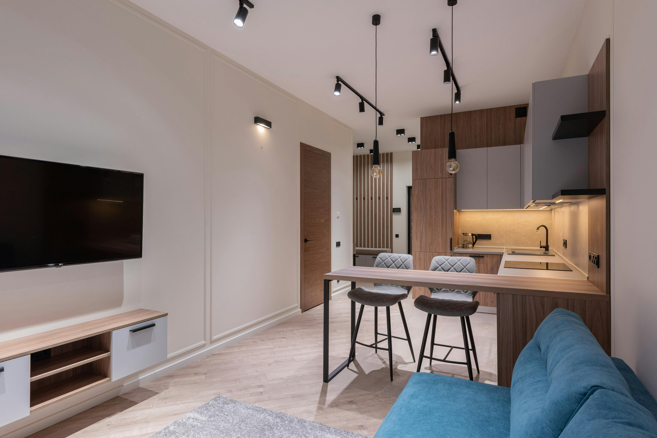
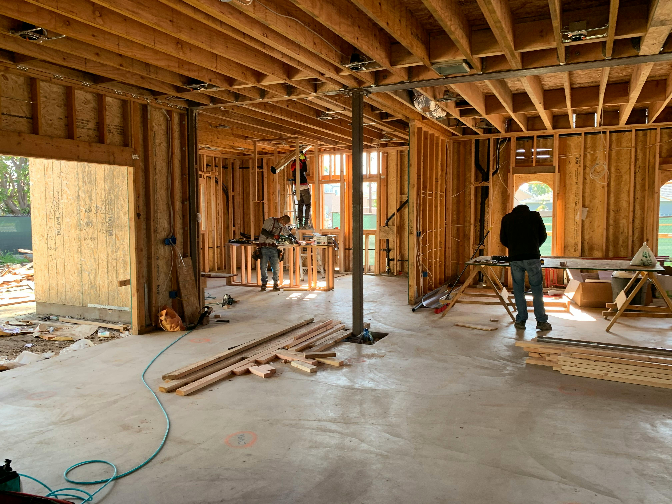
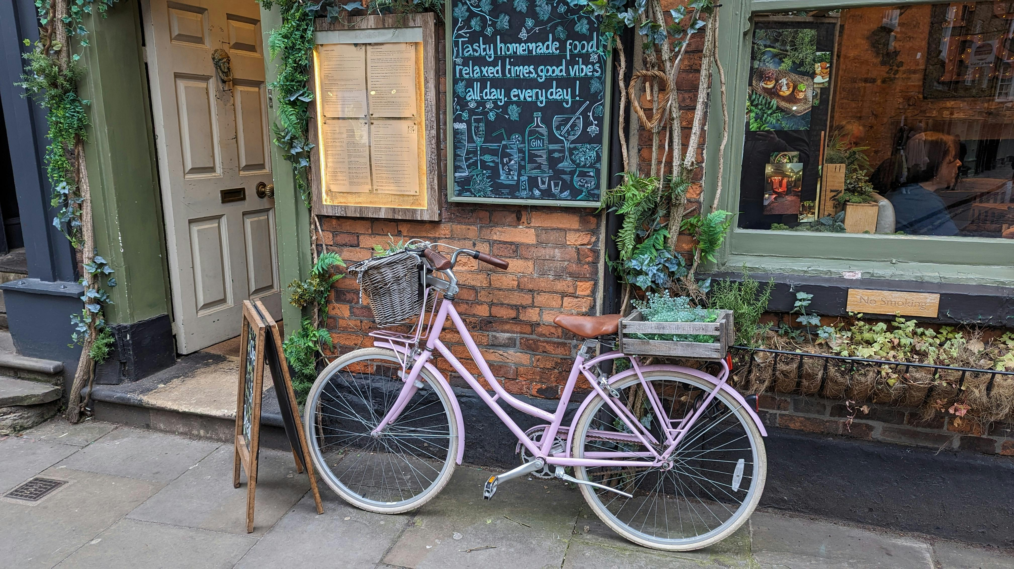
Slovenian Regional Development Fund (SRDF)
Slovenski regionalno razvojni sklad (SRRS)
Example
A glamping site in a border region seeking to enhance its facilities could apply for co-financing through SRDF.
Recommended Reading
SSRS & SSRDF Planned calls for proposals in the field of regional development in 2024 and 2025
Public tender for the complete renovation or construction of new tourist accommodation facilities

Slide 15
6
Rural Development Program (PRP) & CLLD
Objective: The Rural Development Program (PRP) & CLLD is managed by the Ministry of Agriculture, Forestry and Food (MKGP). Additionally, CLLD (Community-Led Local Development) is similar to the previous tool. A bottom-up approach is used in rural areas to implement small-scale, locally focused projects. This is Slovenia’s national implementation of the EU’s Common Agricultural Policy (CAP) to support rural development. It is Co-funded by the European Agricultural Fund for Rural Development (EAFRD).
Main Focus: Agricultural modernisation, sustainable land management, rural economy diversification—including farm tourism and eco-accommodation. Suitable for farmers, rural entrepreneurs, or communities.
Funding: PRP has a specific Measure 6.4 (Support for investments in non-agricultural activities) that provides funds for farmers converting part of their land into small-scale tourist accommodation (e.g. glamping pods, agro-tourism stays).

Slide 16

PRP Funding: Grants can be up to €70,000 with 50% co-financing. Often accessed through SPOT or KGZS advisory centres. Information on these can be found on the Ministry of Agriculture’s website or through Local Action Groups. Slovenia’s Local Action Groups (LAS) under CLLD might have calls that overlap with tourism, culture, heritage – check the LAS for your area.
Note to Clarify: PRP is more top-down, strategic, and national in scope. CLLD is a bottom-up, community-led, and project-focused initiative.
Rural Development Programme PRP (Program razvoja podeželja) (Measure 6.4) is managed by the Ministry of Agriculture. Up to €70,000 (50%) supporting farmers, farm stays, rural B&Bs, glamping
CLLD is part of the PRP, and LEADER/CLLD is a sub-program of the Rural Development Programme (PRP). CLLD/LEADER is a Local Action Group (LAS) for local development. From €10,000–€50,000 (up to 80%) for renovating village tourism, co-ops, and local trails. Suitable for NGOs, small businesses, and communities

Slide 17

LEADER/CLLD – Community-Led Local Development
Objective: LEADER (CLLD) is known as Community-Led Local Development (CLLD) and is implemented through Local Action Groups (LAGs). LAS are covering various rural areas. It supports local and rural development, as well as community-led initiatives.
It is a sub-program of the Rural Development Programme (PRP).In Slovenia, LEADER funds projects in farming and tourism. Look for suitable tourism themes. Projects can receive grants ranging from €5,000 to €200,000, with co-financing rates up to 75%.
Example A cooperative in a small village could get CLLD support to restore old barns into green guest rooms, combined with local culinary tourism.
Tip: Contact your regional LAS coordinator – they can inform you if a call is open and provide guidance on the application process.
Slovenia’s simplified community-led local development
ELARD – European LEADER Association for Rural Development
Discover the LEADER LAGs active in Slovenia

Slide 18

7
State-owned, Non-commercial Development Bank
SID Bank (Slovenska izvozna in razvojna banka)
Objective: SID Bank (Slovenska izvozna in razvojna banka) is a state-owned, non-commercial development bank, not a profit-driven commercial bank. It plays a strategic role in financing projects that strengthen the national economy. SID Bank is not a tourism-specific fund, but it funds projects that align with national development priorities, including:
Sustainable tourism infrastructure
Eco-friendly infrastructure, renovations or construction
Green energy integration (e.g., solar panels, heat pumps)
Digitalisation and modernisation of accommodation facilities
Tourism and SME growth
It provides low-interest or subsidised loans, guarantees, and financial instruments that private banks don’t usually offer, making it especially helpful for startups, eco-projects, and development in rural areas.

Slide 19

SID Bank (Slovenia’s development bank) have guarantee schemes and microloans. For example, the Slovenian Credit Guarantee Scheme can secure part of an SME loan, making banks more willing to lend.
Example: A glamping resort or eco-retreat expanding its services (e.g., building new energy-efficient lodges or adding a zero-waste restaurant) could apply to SID Bank for long-term investment loans at lower rates than traditional commercial loans.
Strategic Focus on Green Transition, Innovation Strategy and Sustainable Tourism Goals. Ideal for environmentally responsible businesses, locally rooted (e.g. family-run accommodations, farm stays) or expanding or modernising sustainably
Financial Supports include;
Investment Loans: For purchasing land, buildings, equipment, or constructing new sustainable facilities.
Development Guarantees: Reduce risk when borrowing from commercial banks.

Slide 20
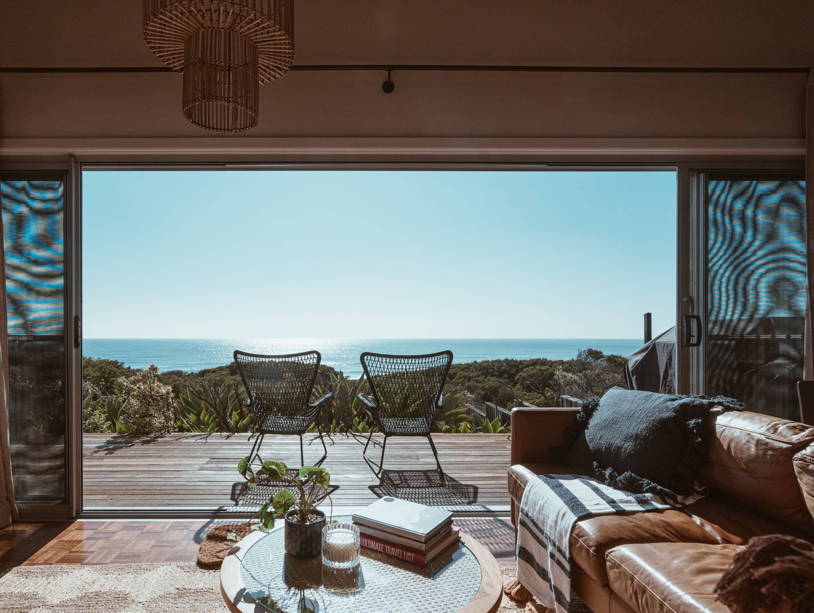
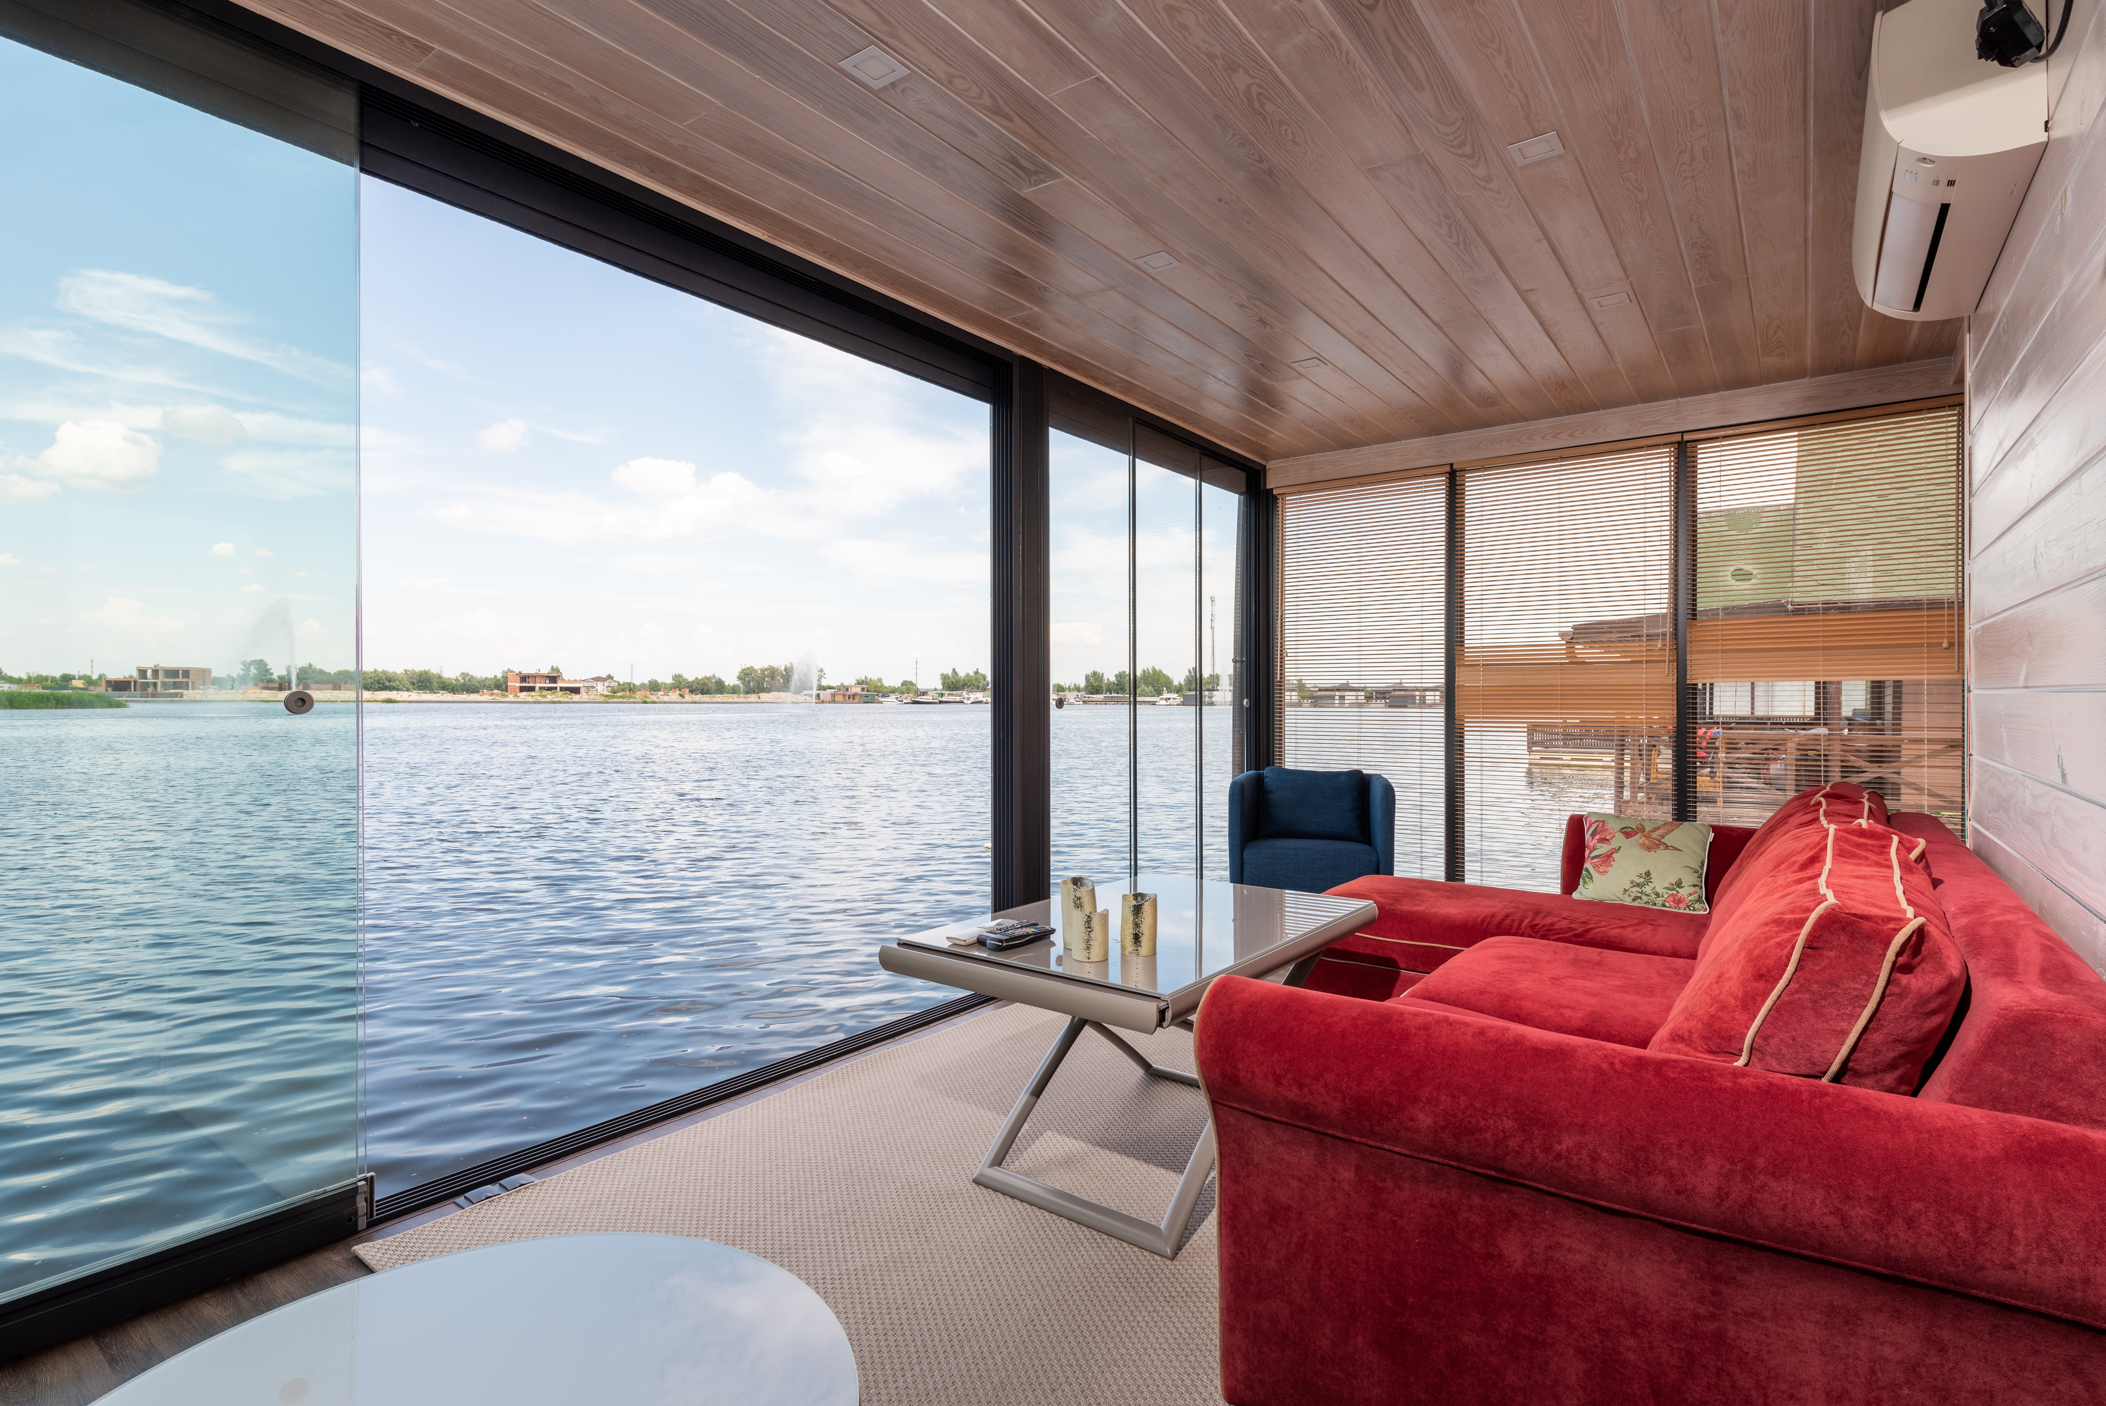
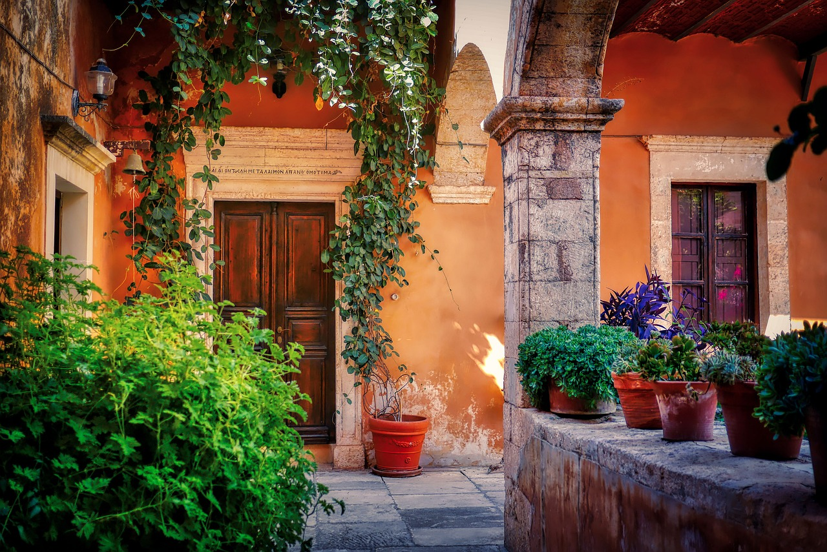
Co-financing: SID Bank can partner with other institutions or EU-backed schemes to fund larger tourism or innovation projects.
Current financing and lending schemes available to companies in Slovenia through SID banka.

Slide 21

Green Funding for Rural Alternative Tourism Accommodation

Slide 22
Green Funding for Rural Alternative Tourism Accommodation
Thinking of going green with your rural tourism business? Whether you're running a glamping site, eco-lodge, or farm stay, countries like Ireland, Slovenia, Iceland, the Netherlands, and Italy all offer green grants and loans to help small tourism businesses become more sustainable.
You can obtain funding for upgrades such as solar panels, insulation, heat pumps, or even eco-certifications.
For example, Ireland’s SEAI offers grants for energy upgrades, Slovenia’s Eco Fund supports green renovations, and Italy has a €500 million fund to make tourism more sustainable. In Iceland, rural guesthouses can apply for regional development or innovation funds, while the Netherlands offers generous tax breaks and subsidies for energy-efficient improvements.
Going green isn’t just good for the planet — it also cuts your energy bills, boosts your reputation with eco-conscious guests, and future-proofs your business. And best of all? Many of these schemes are tailored for small, rural tourism accommodations just like yours.
Let’s explore what’s out there and how you can tap into these great opportunities!

Slide 23

Green Grants and Funding
Slovenia’s government has launched major green tourism grants. In January 2025, the Tourism Ministry announced a €15.2 million call (PNRR/Recovery & Resilience funding) for new or fully renovated rural accommodations – hotels, guesthouses, B&Bs, tourist farms, camps, and glamping – under strict environmental criteria. Grants cover a substantial share of costs (10–60%, up to 70% under the EU’s “de minimis” policy). Only “highly sustainable” projects qualify.
Green Scheme of Slovenian Tourism (GSST): (Eco Label Program) is the national certification program for sustainable accommodation providers. It is not a large-scale infrastructure fund. It aims to support the “Slovenia Green” label, enhance visibility, and increase grant eligibility.
1

Slide 24
Helps tourism businesses align with sustainability standards. It is a co-funding measure that covers certification costs (e.g., audits, label acquisition) and is required for eligibility in the major grants mentioned below. Example: A forest lodge earns GSST status and becomes eligible for additional local promotional support.
2025 RRP Main Grant Call for Energy-Efficient Tourism Projects
To unlock major infrastructure and building grants below, applicants must first participate in the Slovenia Green scheme and meet high environmental building standards— essentially making certification a gateway condition for funding eligibility.
Projects must allocate at least 50% of their budget to energy-efficiency upgrades (e.g., insulation, solar, geothermal heating, rainwater harvesting, etc.). Grants can cover building and equipment costs, solar panels, and eco-label fees.
2

Slide 25
Example: Applicants (SMEs with at least two staff ) can receive up to
€1.1 million for renovation projects
€1.8 million in support for new-build eco-lodgings and construction (given a four or 5-star sustainable label).
Thus, Slovenian rural lodgings can get large co‑funding for green investments.
Eco Fund – Slovenian Environmental Public Fund (Eko Sklad) is Slovenia’s national financial mechanism for promoting energy efficiency and environmental sustainability.
It supports households, businesses, and tourism entrepreneurs in implementing green infrastructure upgrades.
It is especially relevant for rural and eco-tourism accommodations, particularly in terms of environmental impact.
3

Slide 26
Funding: Low-interest “soft” loans with favourable repayment terms (typically under 2% interest) or partial grants covering 20%–50% of total eligible project costs.
The exact co-financing rate depends on:
Type of applicant (business, SME, NGO, etc.)
Environmental performance of the investment
Location (rural/remote areas may receive higher support)
Eligibility: Funding can be used for new build projects or upgrades to existing tourist accommodations. Funding is available for energy-efficient building renovations and installations, including:
Heat pumps (air-to-water, ground-source) for low-emission heating and cooling
Solar panels (photovoltaic systems) for electricity or hot water

Slide 27
Green roofs or facades for insulation, biodiversity, and stormwater control
Wastewater treatment systems and rainwater harvesting for reuse
Energy storage systems (e.g., batteries linked to solar panels)
Example: A glamping site in rural Slovenia wants to become entirely off-grid and eco-certified. They apply to the Eco Fund for a soft loan to install:
Solar panel installation for energy independence
A rainwater harvesting system connected to eco showers and toilets
A constructed wetland for natural greywater treatment
→ The business receives a soft loan covering 70% of upfront costs and a 30% grant on specific eco-technology elements, significantly reducing their long-term utility costs and carbon footprint.

Slide 28
For maximum funding and to access additional tourism-specific grants, applicants should also:
Join the Slovenia Green Scheme
Get their site certified under EU Ecolabel or similar schemes
Show alignment with Slovenia’s National Energy and Climate Plan (NECP) and Green Transition goals

Slide 29
Resources & Supports
Slovenian Regional Development Fund (SRDF)
Advice and Support
Advice & Support: There are regional development centres (RRA – regionalni razvojni agenciji) in each part of Slovenia. They can help and support you with tourism programs and can advise on financing. For instance, a region might have a loan guarantee scheme or a contest for startup ideas. Support Network: Engaging with them can plug you into the local support network. Examples of Good Practices
The Slovenian Tourist Board (STO) focuses on marketing, but it also has a business portal that offers research and occasionally co-marketing opportunities for providers (e.g., it might co-fund participation in trade shows or inclusion in promotions). On a regional level, contact your Local Tourist Association or regional tourism office – they sometimes partner in projects and can support grant applications with letters of support or data.
Tourism Advice and Support

Slide 30
Resources & Supports
Permits and Regulations: A resource to be aware of is the SPOT portal, which provides guidance on procedures. For example, it can guide you on how to register a lodging activity (Gostinstvo-Turizem sector) and what certifications you might need (like category classification for accommodations).
Permits and Regulations Portal
Slovenia’s Playbook to Level the Playing Field
Remember: In Slovenia, personal relationships and a good reputation go a long way. Engage with the community, tourism boards, and even other glamping operators (Slovenia has many eco-resorts – network with them through associations or Facebook groups). They might share tips on which bank or program helped them get started.
Slovenia’s Playbook to Level the Playing Field

Slide 31
Well Done
Module 7 (Part 3)
Investment, Grant Applications & Pitching Your Idea
You have Completed… Module 7 (Part 2)
Find the Funds That Fit
Slovenia
Next is…

