Slide 1
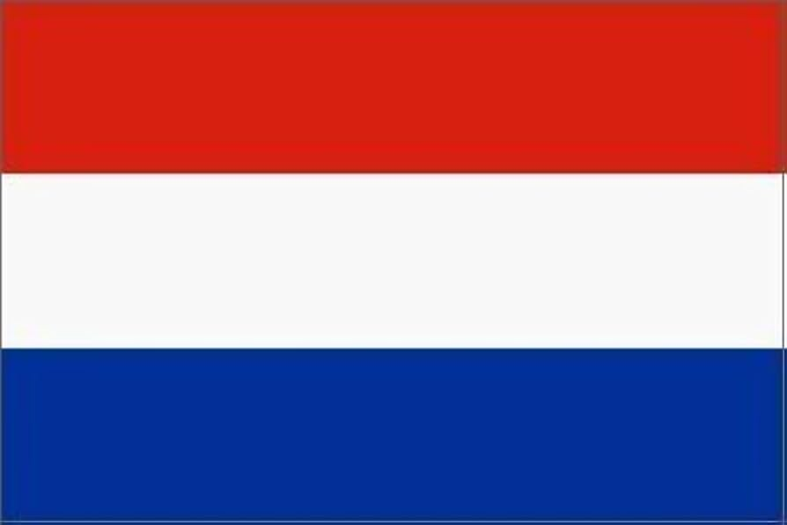
Module 7 (Part 2)
Find the Funds That Fit – Funding & Finance Options
Financial Planning & Funding
Netherlands
www.epicstays.eu

Slide 2

Module 7 (Part 2) Overview
Learning Outcomes
Country-Specific Funding Opportunities
Find the Funds That Fit – Funding & Finance Options. Part 2 of module explores tailored funding opportunities for alternative tourism accommodation across Ireland, Slovenia, Iceland, Italy, and the Netherlands. This section focuses on Netherlands. Learn how to identify, compare, and assess funding streams that best fit your business model and goals. The focus is on aligning with key priorities such as regeneration, low-carbon growth, and community value. By the end, you’ll be able to evaluate eligibility, navigate national and EU schemes, and choose the right funding pathways for sustainable tourism success.
Identify Dutch main funding opportunities for sustainable and low-carbon accommodation, including national tax incentives (MIA/Vamil, EIA, ISDE) and provincial funds.
Recognise how projects can benefit from renewable energy adoption, sustainability upgrades, and digital tools.
Understand eligibility for EU structural funds (e.g., ERDF via OPZuid) and regional innovation loans.
Demonstrate how to align proposals with Dutch priorities—environmental efficiency and smart infrastructure.
Strengthen funding applications using strategies specific to the Netherlands.

Slide 3

04
Netherland’s Funding Options
For Alternative Tourism Accommodation
The Dutch government supports alternative tourism accommodation by funding projects that promote sustainable and low-carbon experiences. These projects can include glamping, dorm-style accommodation, and eco-lodges. The goal is to encourage tourism in less-visited areas and to promote a more environmentally responsible approach to travel.

Slide 4
Introduction: Netherland’s Funding Priorities
Clean energy adoption, sustainability and innovation, high tourism quality standards, environmental efficiency and smart infrastructure.
The Netherlands focuses heavily on clean energy adoption, sustainability innovation, and high tourism quality standards. Businesses can access national tax incentive schemes like MIA/Vamil, Energy Investment Allowance (EIA), and the ISDE grant to offset the cost of green technology such as solar panels, heat pumps, and insulation.
Additionally, provincial funds like Zeeland’s Leisure Economy Fund offer loans for innovation and sustainability in local tourism. Larger, innovative projects may also qualify for EU structural funds such as ERDF through programmes like OPZuid.

Slide 5
Introduction: Netherland’s Funding Priorities
To align successfully with Dutch funding, businesses must show a commitment to environmental efficiency, smart infrastructure, and innovation. Glamping sites or heritage accommodations that install renewable systems and digital visitor tools (e.g., booking apps, energy dashboards) are particularly strong candidates.
Funders in the Netherlands appreciate data, so be specific about your sustainability metrics and energy savings. Emphasise how your project will reduce emissions, improve the visitor experience, and support regional tourism dispersal.
Partnering with local municipalities or innovation hubs also strengthens your case.

Slide 6
Qredits, Impact Driven Banks & BMKB Scheme
The Netherlands offers a variety of support mechanisms tailored to small entrepreneurs and sustainable tourism. Below are the key mechanisms available and how they help alternative accommodation ventures, such as glamping, eco-lodges, or repurposed rural spaces.
1
2
Qredits
Impact Driven Banks
Qredits is a non-profit lender for entrepreneurs. Designed for small startups that may not qualify for bank credit.
Qredits is the premier microfinance institution in the Netherlands, offering business loans ranging from €5,000 to €250,000. Offers microcredit loans for up to €50,000 for start-up costs, renovations, or eco-accommodation development. Qredits also provides mentoring and has a startup academy.
The European Investment Fund (EIF) and impact-driven banks, such as ING and Rabobank, participate in the government’s SME loan guarantee BMKB Schemes. This helps SMEs that lack collateral and are unable to obtain bank loans by securing 75% of the loan amount, with the extension until June 2027. It’s not profit-driven, so the emphasis is on enabling entrepreneurship rather than maximising returns. Compare interest rates and terms.

Slide 7



3
LEADER/GLB Management Consultancy
Objective: LEADER/GLB Management Consultancy finance community-led projects (often 50% co-financing). These grants can cover trails, visitor facilities, on-site renewable energy, habitat restoration, or cultural installations that attract tourists.
For instance, a “Natuur Educatie Tuin” project in Leudal (Limburg) recently won LEADER support (55% funding) for a nature-learning garden.
LEADER & Provincial Grants: Rural areas in NL qualify for LEADER as part of the POP3/POP4 rural development program. Each province has its own LEADER calls.
LEADERS in Friesland or Zeeland can offer 50% grants of up to around € 100,000 for projects that boost the rural economy – tourism and recreation are often priority themes. Check your province’s “Netwerk Platteland” website for open calls.

Slide 8



LEADER/GLB Management Consultancy
Example: Zeeland’s 2024–25 LEADER-uitvoering scheme offers a total of €4 million, with grants ranging from €30,000 to €200,000 (minimum 40% own funding). Projects must align with the area’s development strategy (e.g., sustainable tourism, biodiversity). Explore Provincie Zeeland, which fosters regional economic development, growth, and innovation.
Examples: Friesland’s LEADER program (via SNN) funds rural initiatives in NW/SE/SW Friesland with grants of €50,000–€125,000.
In Drenthe, there are two streams: an EU-LEADER project (€15,000–€125,000 at 50%) and a provincial micro-LEADER project (small projects, €5,000–€25,000 at 50%).

Slide 9



Examples:
Gelderland has several LEADER zones (Achterhoek, Veluwe, etc) with subsidy rates of 50% (typical grants €15k–€80k).
Limburg’s LEADER Zuid-Limburg call (open 19 Mar 2024–3 Jan 2028) covers areas like Heuvelland; it subsidizes up to 55% (projects €20k–€250k, max €137.5k normally, up to €200k for cross-boundary projects).
Eligibility: You typically must operate in a rural area within a Local Action Group (LAG) territory and form part of a community-driven project. Many grants require some local partner involvement or multi-village impact. Consult your province’s LAG early.
Recommended Reading
LEADER Projects in Zeeland
LEADER Drenthe
LEADER Fryslân and https://www.fryslan.frl/fy/leader

Slide 10
LEADER/GLB Management Consultancy
Tip for Application & Process: Contact the regional LAG to pitch your idea and check fit. Prepare a project plan, a detailed budget, and a financing plan. Applications are submitted via the RVO online portal (log in with eHerkenning for businesses or DigiD for individuals). Note seasonal deadlines: e.g., Zeeland LAG reviews applications on fixed dates (e.g., 31 May, 30 September, etc.). Use official templates (RVO provides project plan and budget formats).
Beyond LEADER, some provinces or municipalities have their own stimulus funds for tourism or sustainability (contact your Gemeente (Municipality) or Provincie economic affairs department).
*Note BMKB Scheme: Allows SMEs to secure financing even when they lack sufficient collateral. It is designed to support companies with a continuity perspective, meaning they have a reasonable chance of remaining in business, but may lack strong securities for a loan.

Slide 11
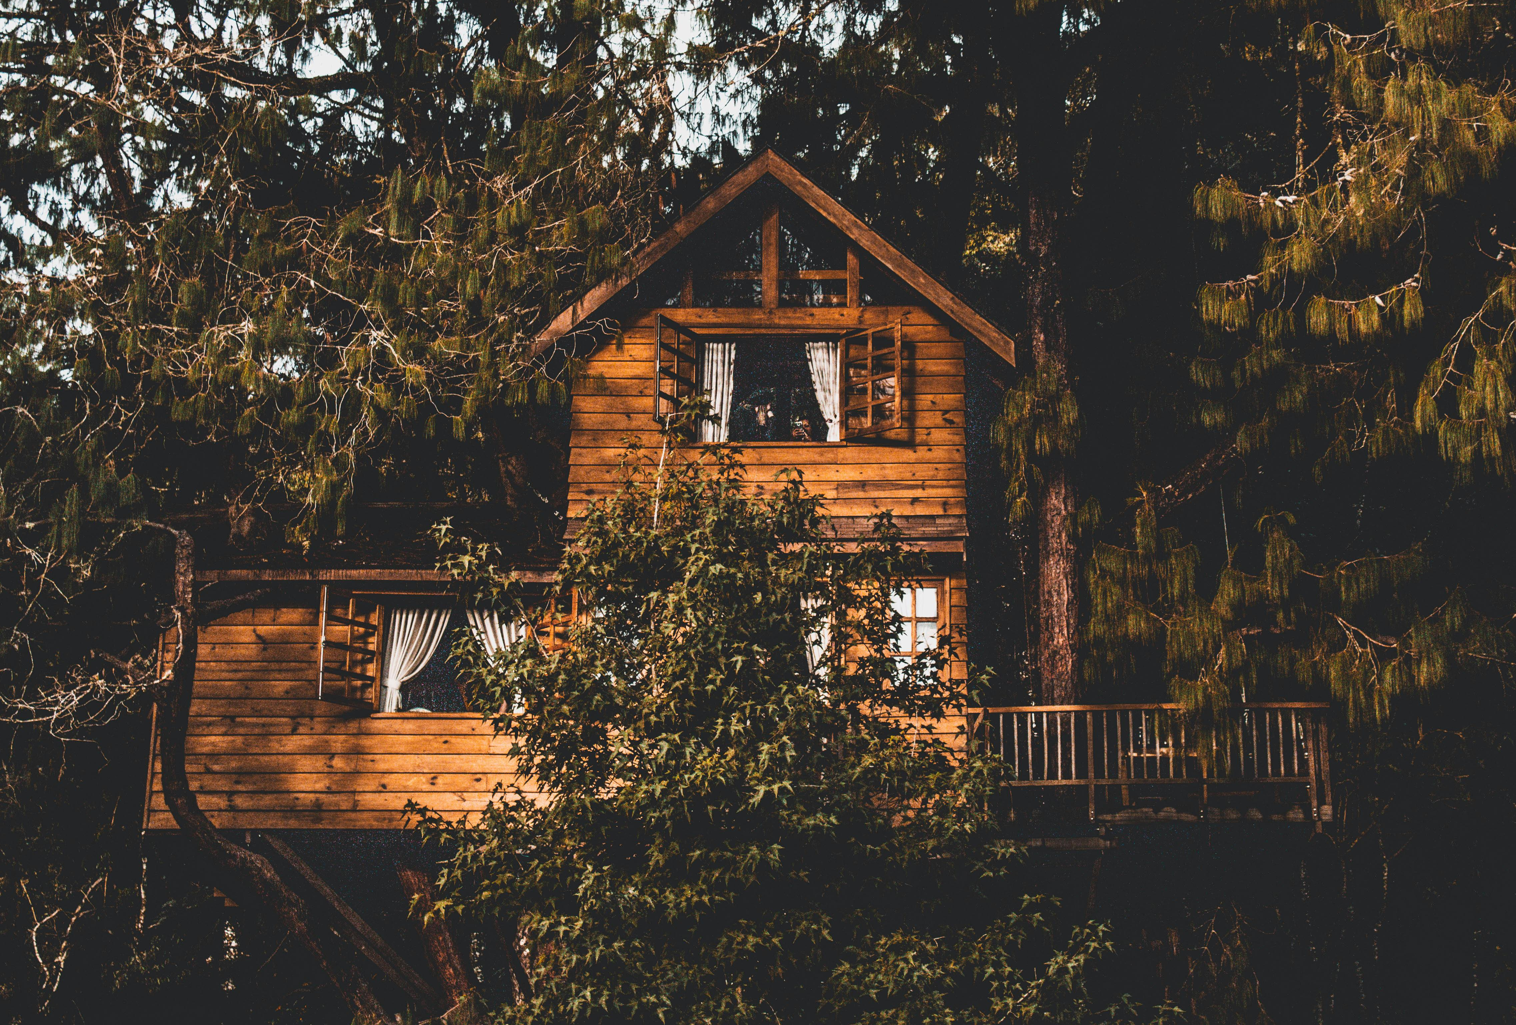
4
The Netherlands’ Recovery and Resilience Plan
Objective: The Netherlands’ Recovery and Resilience Plan, since 2022, has supported sustainable tourism, green transition, and economic resilience projects. 55% of the plan will support climate objectives, and 26% of the plan will foster the digital transition.
Recommended Reading
LEADER Implementation Projects Zeeland
Provinsje Fryslan Recreation and Tourism Incentive Program
Dutch tax changes toward sustainability: an overview
Funds for tourism SMES to improve the sustainability and digitalization of accommodation facilities

Slide 12


5
Tourism Specific Programs
Objective: Tourism Specific Programs: Many provinces offer tourism-specific funds, which are often regional. These boost local competitiveness (new attractions, better marketing, training). Programs vary, but funding is often similar (e.g., matching grants of up to low five figures). Typically aimed at existing tourism enterprises or local governments. May require a minimum size or partnership with a municipality. Check provincial sites.
Examples:
Friesland runs a “Stimulering Recreatie en Toerisme” program to improve tourist facilities.
Noord-Holland had a “Revitalisering verblijfsector” scheme: 50% subsidy (max €12.5k) for advice or planning on park quality and sustainability. The complex must have at least 40 pitches or cottages. Such grants cover feasibility studies, sustainability plans or minor upgrades.
Tip: Keep an eye on RVO’s subsidy database or sites like Ondernemersplein for updates.

Slide 13
6
Private Financing & Industry Support
Objective: Start-ups and tech-driven ventures have extra resources. Innovation grants allow you to prototype or explore new ideas without incurring significant risk.
For example, a tiny-house startup could use a voucher to test a booking app, then an innovatiebijdrage to build a prototype, sharing costs with partners.
Example: EFRO (European Regional) vouchers 2021 – 2027 fund R&D in Groningen/Drenthe/Friesland. Entrepreneurs can receive a 35% subsidy (or 45% if they are a cooperative) for developing new products or software.
Example: This has been used for new reservation platforms or eco-friendly construction methods.
Recommended Reading
Website EFRO grant period 2021-2027

Slide 14
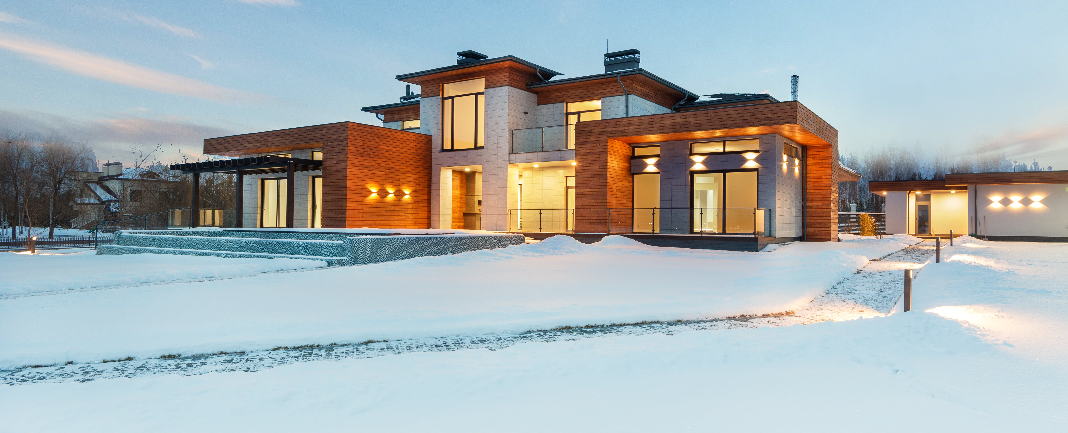


Private Financing & Industry Support
Tip: Successful projects often mix funds. For instance, a glamping site might combine a 30% RIF grant with a bank loan (possibly backed by a confederatie guarantee) and some owner equity.
Keep a clear business plan and account for matching funds. Engage with your local LAG or economic development office early.
Finally, highlight your sustainability angle: many funds favour energy efficiency, nature conservation, or community benefit.

Slide 15

Green Funding for Rural Alternative Tourism Accommodation

Slide 16
Green Funding for Rural Alternative Tourism Accommodation
Thinking of going green with your rural tourism business? Whether you're running a glamping site, eco-lodge, or farm stay, countries like Ireland, Slovenia, Iceland, the Netherlands, and Italy all offer green grants and loans to help small tourism businesses become more sustainable.
You can get funding for upgrades like solar panels, insulation, heat pumps, or even eco-certifications.
For example, Ireland’s SEAI offers grants for energy upgrades, Slovenia’s Eco Fund supports green renovations, and Italy has a €500 million fund to make tourism more sustainable. In Iceland, rural guesthouses can apply for regional development or innovation funds, while the Netherlands offers generous tax breaks and subsidies for energy-efficient improvements.
Going green isn’t just good for the planet — it also cuts your energy bills, boosts your reputation with eco-conscious guests, and future-proofs your business. And best of all? Many of these schemes are tailored for small, rural tourism accommodations just like yours.
Let’s explore what’s out there and how you can tap into these great opportunities!

Slide 17

Green Grants and Funding (Netherlands)
1
ISDE Grant – Sustainable Energy Investment Subsidy:
Helps businesses install renewable energy systems, such as Solar water heaters, heat pumps and biomass boilers. They apply to ISDE for a grant covering up to 30–40% of the installation costs.
Suitable for Alternative Tourism Accommodations:
SMEs, including farm B&Bs, small hotels, and glamping sites.
Note: You must apply before purchase or installation.
Example: A rural eco-lodge installs heat pumps and solar water heating to reduce gas use. More info & how to apply:
Official Application Portal (RVO)

Slide 18
2
Environmental Investment Allowance (MIA) & VAMIL
Provides Tax benefits for green investments, such as thermal insulation, solar panels, green roofs and sustainable construction methods. For more environmentally impactful upgrades, like composting toilets and water recycling.
Example: A sustainable retreat installs a greywater system and natural building materials.
MIA lets you deduct up to 45% of eligible investments from taxable profits.
Vamil lets you depreciate 75% of the investment at a time of your choice.
Example: An eco-B&B owner upgrades to sustainable timber construction and installs solar panels. They combine ISDE with MIA/Vamil to reduce taxable income and accelerate cost recovery.
Recommended Reading
Investment subsidy for sustainable energy and energy conservation (ISDE) 2025

Slide 19
3
Province-Level Sustainability and Tourism Grants
Supports low-interest loans for sustainable innovation in tourism, energy transition projects, and quality improvement in recreational facilities. Loan size: €50,000 – €750,000
Example: Zeeland – Leisure Economy Fund (Fonds Vrijetijdseconomie)
A nature-based retreat in Zeeland installs an off-grid solar system and accessible eco-cabins. They receive a €150,000 soft loan to co-finance the project.
Funding database overview (Fondswervingonline)
Other Regional Funds:
Flevoland: Grants for leisure and sustainability pilot projects
Flevoland Provincial Subsidies
North Holland: Co-funding eco-tourism initiatives and regional innovation, Noord-Holland Subsidies

Slide 20
4
Energy Investment Allowance (EIA)
The EIA is a tax deduction scheme that allows businesses to deduct 40% of qualifying green investments from their taxable profit. It’s designed to encourage investment in energy-saving technologies and sustainable construction. You can claim EIA for items on the approved energy list.
These include solar panels, heat pumps, insulation systems, energy-saving lighting and energy-efficient HVAC systems.
ATAs can apply, including SMEs, nature-based lodges, rural B&Bs, eco-friendly glamping operators and hotels undergoing green renovation.
Example: A nature lodge invests €20,000 in roof insulation and solar panels. Using the EIA, they deduct €8,000 from their taxable profit (40%).

Slide 21
5
OPZuid EFRO + Regional Funding (e.g., Zeeland example)
As part of the European Regional Development Fund (ERDF), the OPZuid programme supports innovative, sustainable, and low-carbon business investments. Regional authorities, such as the Province of Zeeland, often offer co-financing, which significantly enhances the budget for green upgrades. For tourism and leisure companies in the southern Netherlands (OPZuid region), particularly rural or nature-based accommodations that seek deep energy upgrades or innovative projects. This is a strong model for high-ambition green upgrades, particularly for businesses seeking to transition to off-grid or zero-emission operations. Example: Ons Buiten & Camping Olmenveld received:
€971,611 from EFRO (OPZuid)
€416,404 in co-financing from Zeeland
Use the money to install and upgrade heat pumps, battery storage, off-grid solar systems, and energy monitoring systems (EMS). Article with complete details (NL)

Slide 22

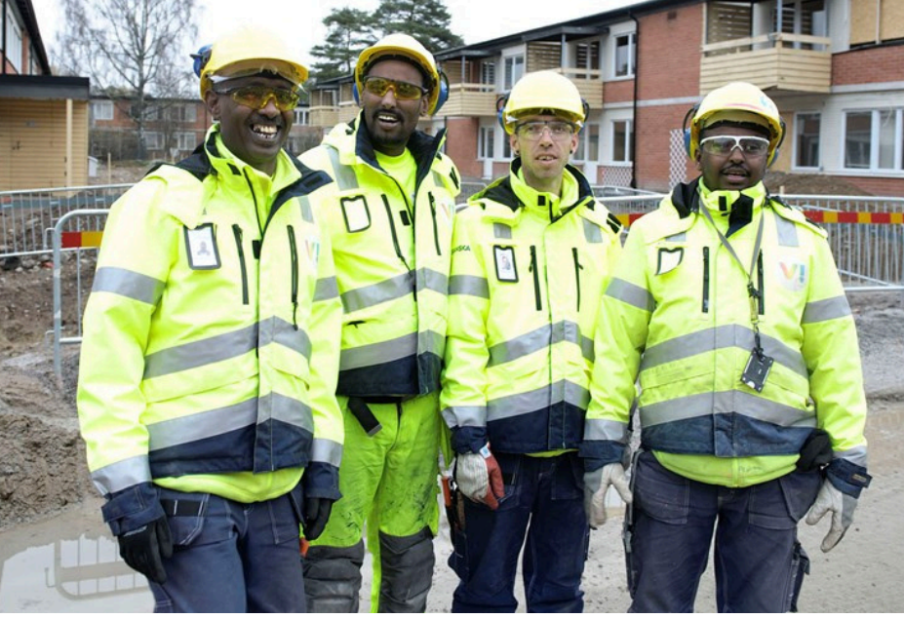
Resources & Supports
Local Enterprise Support: The Kamer van Koophandel (KVK) and the Netherlands Enterprise Agency (RVO) guide starting a business. The Kamer van Koophandel site (kvk.nl) has a section for starting a business in recreation or tourism. This is where you need to register your glamping business if you are beginning. Note: Although they may not provide direct financial assistance, they can help you identify relevant grants or programs.
Provincial and Local Programs: The Netherlands is decentralised; sometimes provinces or municipalities have funds allocated for local economic development. For example, a province might have a “Leefbaarheid” (livability) fund to support small initiatives that keep rural areas vibrant – a small glamping could qualify if pitched as enhancing the area. Check with your Gemeente (town) or province for any SME support schemes or tourism promotion grants.

Slide 23
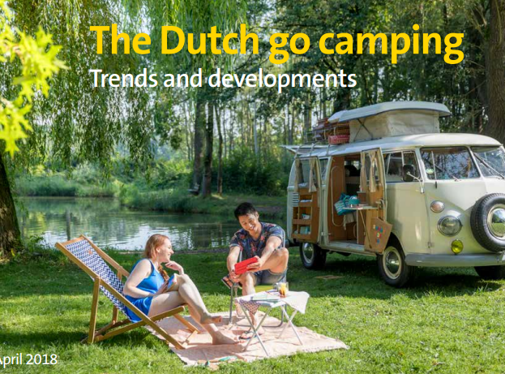
Resources & Supports
Industry Associations: The Netherlands Recreation Association (ANWB) offers various benefits and services to accommodation providers, including camping, holiday parks, and other recreational businesses. These could include industry resources, networking opportunities, and support for developing niche accommodations.
In the Netherlands, operating a glamping site generally requires a camping license or an environmental permit, and the specific requirements can vary significantly by municipality (gemeente). Sites like Ondernemersplein.nl, the government entrepreneur's portal, compile information on these licenses and other relevant regulations. For example, in the Netherlands, a camping license or environmental permit might be needed for a glamping site – each gemeente can differ.

Slide 24
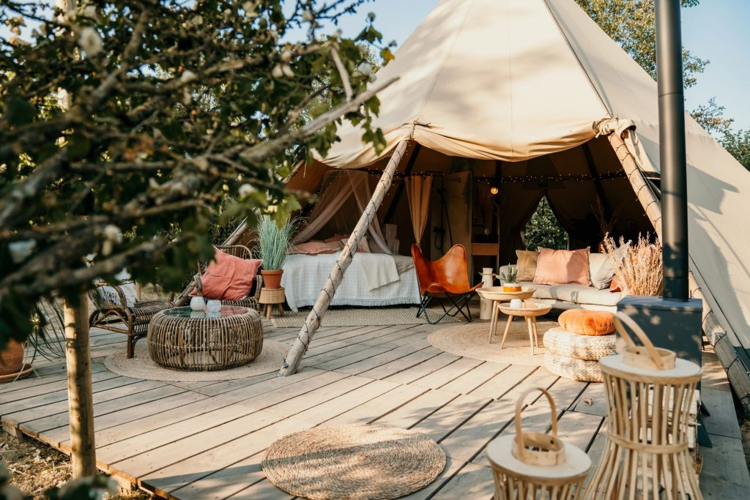
Resources & Supports
Crowdfunding in the Netherlands: The Netherlands is a country that is particularly friendly to crowdfunding. Platforms like One Planet Crowd (focused on sustainable projects) or CrowdAboutNow (for hospitality and local businesses) could be avenues to raise funds from the public.
A charming, community-oriented glamping might attract locals to invest small amounts for perks or shares. Successful Dutch campaigns often emphasise the unique experience and community benefit.
Tip: Also consider joining Dutch hospitality or glamping associations (e.g. RECRON/Hiswa). They sometimes have knowledge of grants or group schemes (like collective bargaining for insurance or energy). And they can amplify your voice when lobbying for sector support.
9x Amazing Glampings In The Netherlands from Wander-Lust.nl is a curated guide to nine unique glamping experiences across the Netherlands, offering luxurious and nature-immersive accommodations. From the luxurious Parc Buitengewoon, pop-up glamping with a festival vibe, to others combining culinary experiences or surfing.

Slide 25
Well Done
Module 7 (Part 3)
Investment, Grant Applications & Pitching Your Idea
You have Completed… Module 7 (Part 2)
Find the Funds That Fit
Netherlands
Next is…

