Slide 1



Inside the Free Resource—What You’ll Get
Upcoming Market Trends – Learn where demand is rising across Ireland and Europe, and how this shapes investment opportunities.
Costing Insights – Get a clear picture of what it takes to set up, from typical unit build costs (pods, cabins, or conversions) to infrastructure and planning fees.
Revenue Potential – See examples of average nightly rental expectations across regions, helping you plan realistic pricing strategies.
FREE Resource
﻿﻿Catalogue of Alternative Accommodation with Concepts & Costings
EPIC STAYS is licensed
under CC BY-SA 4.0
Website: https://www.savills.ie/
Funded by the European Union. Views and opinions expressed are however those of the author(s) only and do not necessarily reflect those of the European Union or the European Education and Culture Executive Agency (EACEA). Neither the European Union nor EACEA can be held responsible for them.

Slide 2
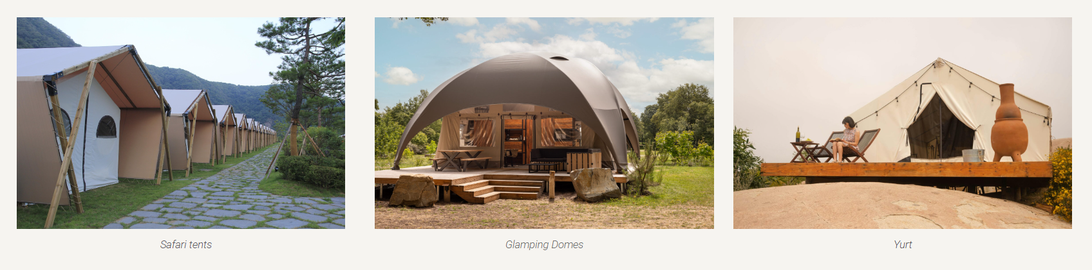
Concept And Accommodation Types
How To Start, Set Up, And Build A Profitable Glamping Business
Accommodation Type | Pros | Cons
Safari Tents | Spacious, family-friendly | Less insulated
Glamping Domes | Futuristic design, well-insulated, suitable for all audiences | Can get hot
Tiny Houses | Fully equipped, usable year-round | Smaller
Treehouses | Unique, immersive in nature | Not always accessible
Yurts | Cozy, atmospheric | Thin walls = less privacy

Slide 3
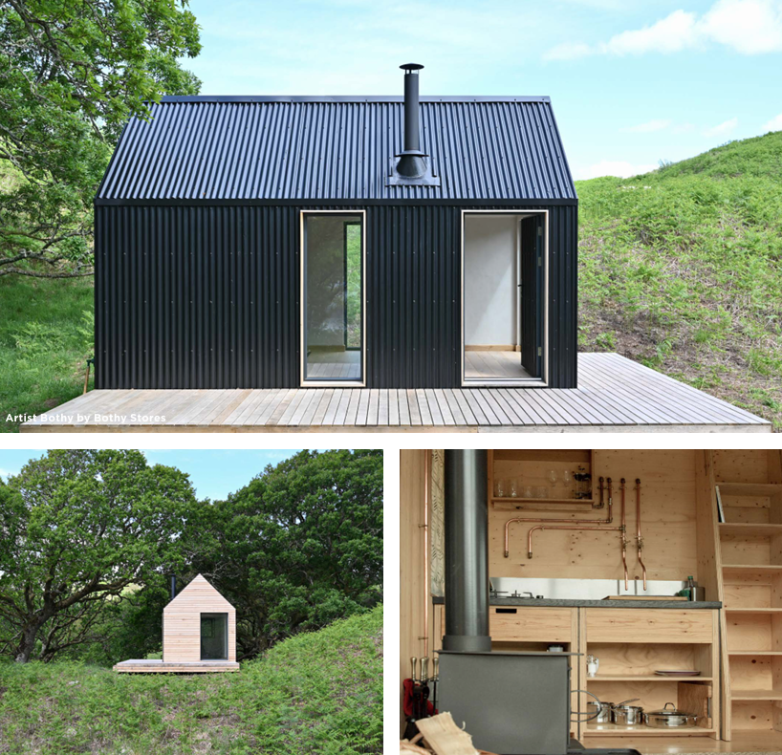
Cabins
Cabins are growing in popularity as travelers looks to reconnect with nature and escape their busy lifestyles.
Cabins can be basic through to high-end, bespoke designs.
Cabins with en-suite facilities are most popular.
With the right location, these can provide significant ROI (Return on Investment) and allow for year-round use.
Typical Unit Cost €30,000-50,000
Typical Nightly Rental €100-200
Information provided by www.savills.ie

Slide 4
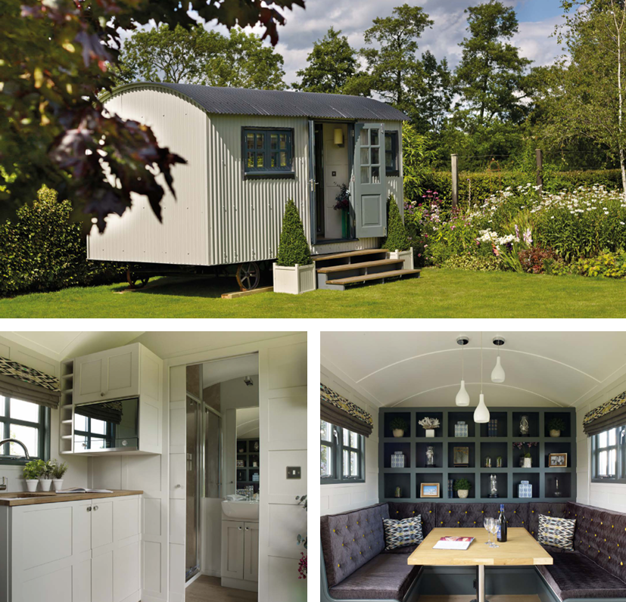
Shepard Huts
Shepherd huts are becoming increasingly popular and have had good national press recently.
ROI is good, depending on the specification, location, and rental levels.
They are more commonly used for year-round accommodation, with growing evidence of use in gardens as an office space or ‘den’.
Typical Unit Cost €18,000-50,000
Typical Nightly Rental €75-125
Information provided by www.savills.ie

Slide 5
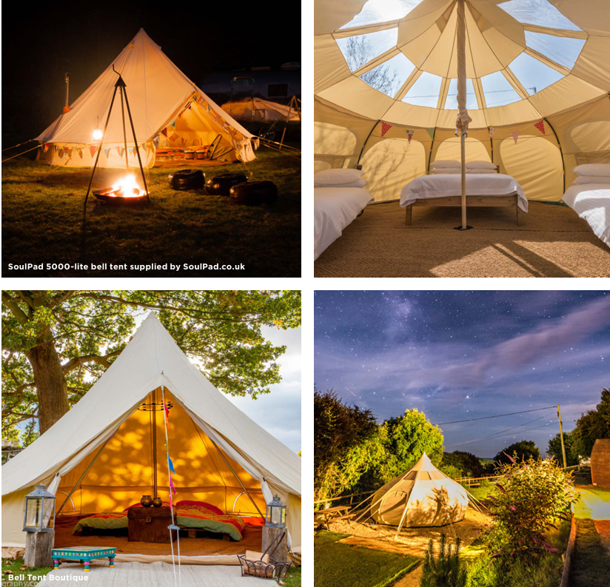
Bell Tents
A basic tent structure is usually provided as a ‘pop-up’ or height-of-summer season facility.
They provide basic facilities, although some higher-level bell tents do have furnishings to a high standard.
It is possible to provide these structures under 28-day camping rights. Check your country’s rights.
Typical Unit Cost €500-2000
Typical Nightly Rental €50-100
Information provided by www.savills.ie

Slide 6
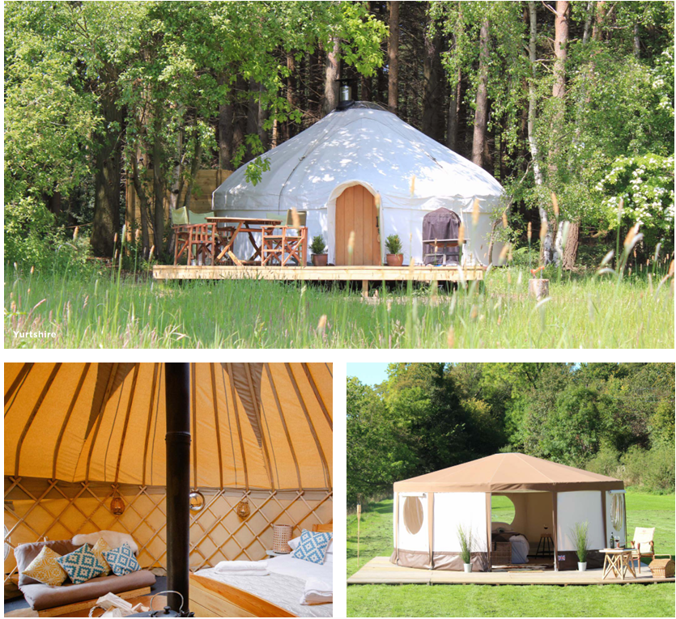
Yurts
A more robust structure than a bell tent, yurts are most suitable for high season use.
ROI is stronger depending on specification and location.
The onus is on the landowner to provide high-quality internal furnishings, including heating.
Very popular with groups of families on existing holiday parks and holiday cottage complexes
Typical Unit Cost €3,500-10,000
Typical Nightly Rental €50-150
Information provided by www.savills.ie

Slide 7
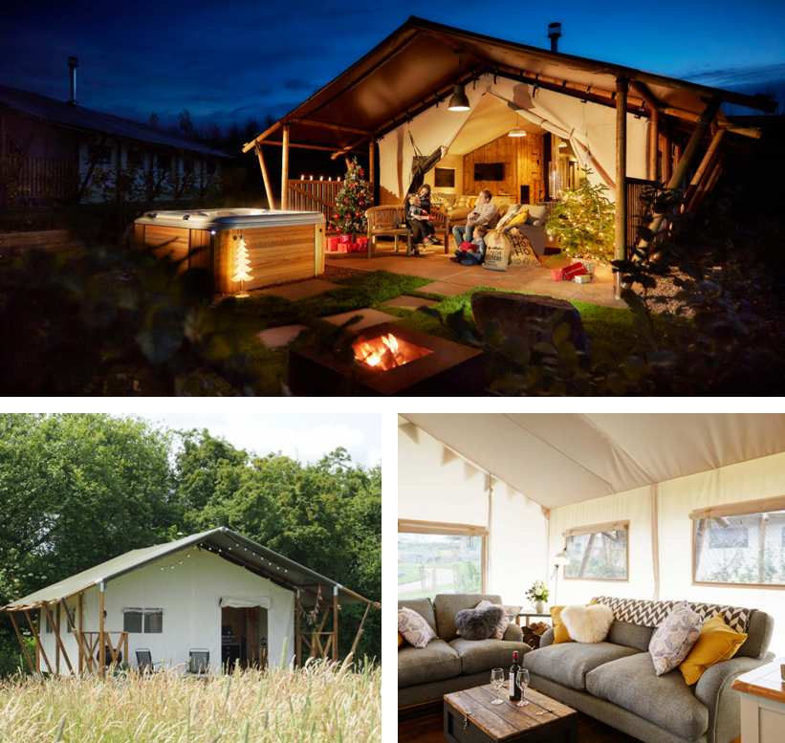
Safari Tents
Safari tents are more of a permanent structure and require a reinforced hard-standing base.
They can utilise more external space and the land owner is usually responsible for internal furnishings thereby dictating the standard of accommodation on offer.
Mainly for warmer season use.
Can deliver high occupancy rates, for short breaks when the weather suddenly improves.
Popular with families.
Typical Unit Cost €7,500-50,000
Typical Nightly Rental €125-175
Information provided by www.savills.ie

Slide 8
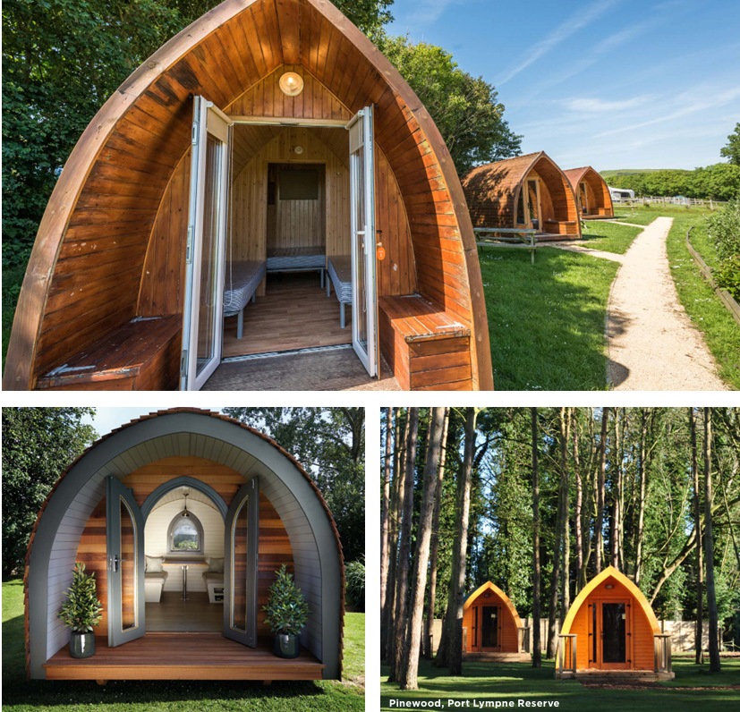
Camping Pods
Very popular on many ‘touring unit’ holiday sites as an alternative form of accommodation to complement touring caravans and tents.
Land-owners in the right locations boast of a ROI (Return on Investment) typically being at 2-3 years.
Entry-level pods can be very basic, and as with the majority of glamping products, camping pods usually require separate washroom facilities
Typical Unit Cost €6,000-15,000
Typical Nightly Rental €50-100
Information provided by www.savills.ie

Slide 9
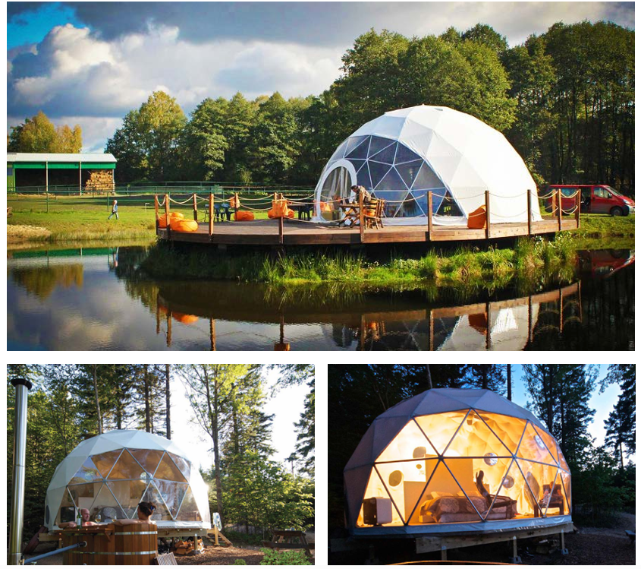
Geodesic Domes
Simple facility to construct and can be suitable for year-round use, depending on specification.
The external appearance and evening light spill can cause issues with obtaining planning permission, although manufacturers are beginning to offer a variety of more muted external colours.
Good ROI in the right location. Ideal for summer stargazing breaks.
Typical Unit Cost €6,000-15,000
Typical Nightly Rental €95-150
Information provided by www.savills.ie

Slide 10
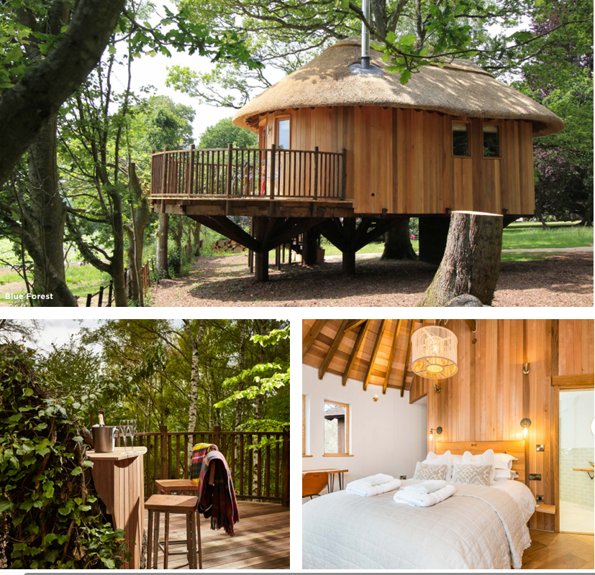
Tree Houses
Treehouses allow for imaginative, innovative designs that can be used throughout the year.
Average occupancy and nightly rates are both high for unique designs.
Very popular with couples looking for a romantic, picturesque experience
Typical Unit Cost €50,000-120,000
Typical Nightly Rental €125-250
Information provided by www.savills.ie

Slide 11
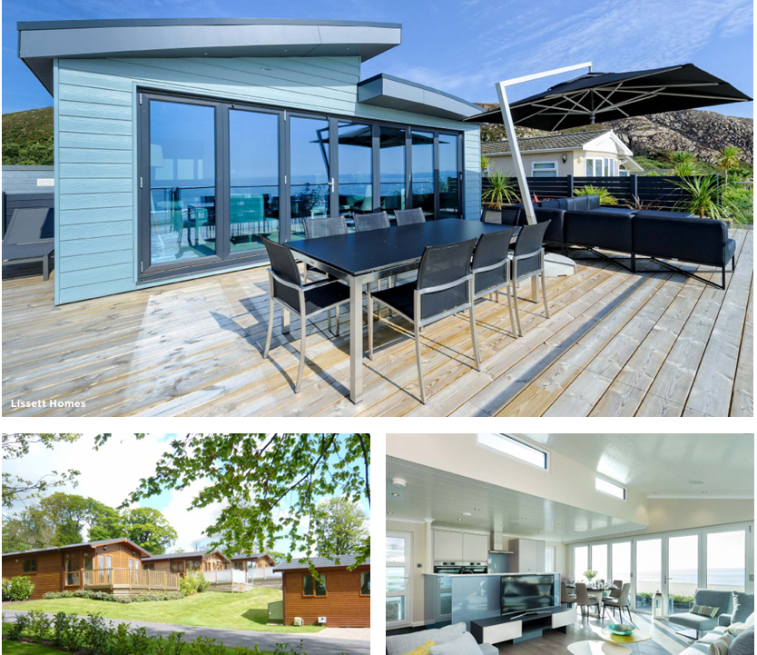
Lodges
Lodges are popular on high quality holiday parks (existing and new) and arrive on site pre-constructed and fully furnished.
They typically sleep 4-6 people and meet the legal definition of a ‘caravan’.
In the right location they can command very high ROI.
The lodges are typically sold on 25 year licence agreements, thus enabling redevelopment and additional future sales.
Typical Unit Cost €60,000-120,000
Typical Nightly Rental €200-450
Information provided by www.savills.ie

Slide 12
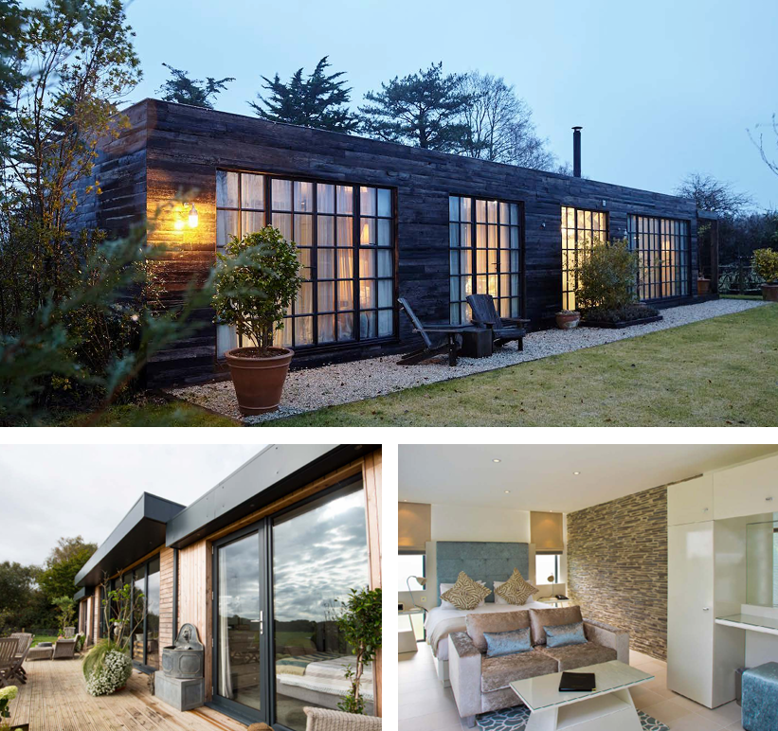
Modular Cottages
Modular holiday accommodation (and indeed modular housing) is increasing in demand due to the short on-site construction process and the factory-led design and build.
A cost-effective alternative to traditional new build holiday cottages.
Modular apartments are now commonplace as bespoke garden room accommodation at resort locations or destinations.
Typical Unit Cost €80,000-100,000
Typical Nightly Rental €125-350
Information provided by www.savills.ie

