Slide 1
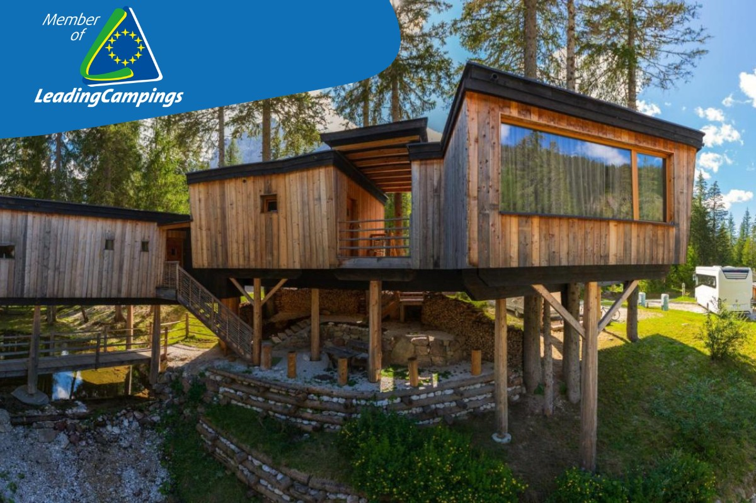

Photo Credit: Caravan Park Sexten, Italy
Module 3 (Part 3)
Designing Sustainable & Place-Based Accommodation
www.epicstays.eu

Slide 2

Module 3 (Part 3)
Photo Credit:
Il Roccolino Casa Vacanze, Italy
Section 3
Right-Sized Stays That Make a Local Impact

Slide 3
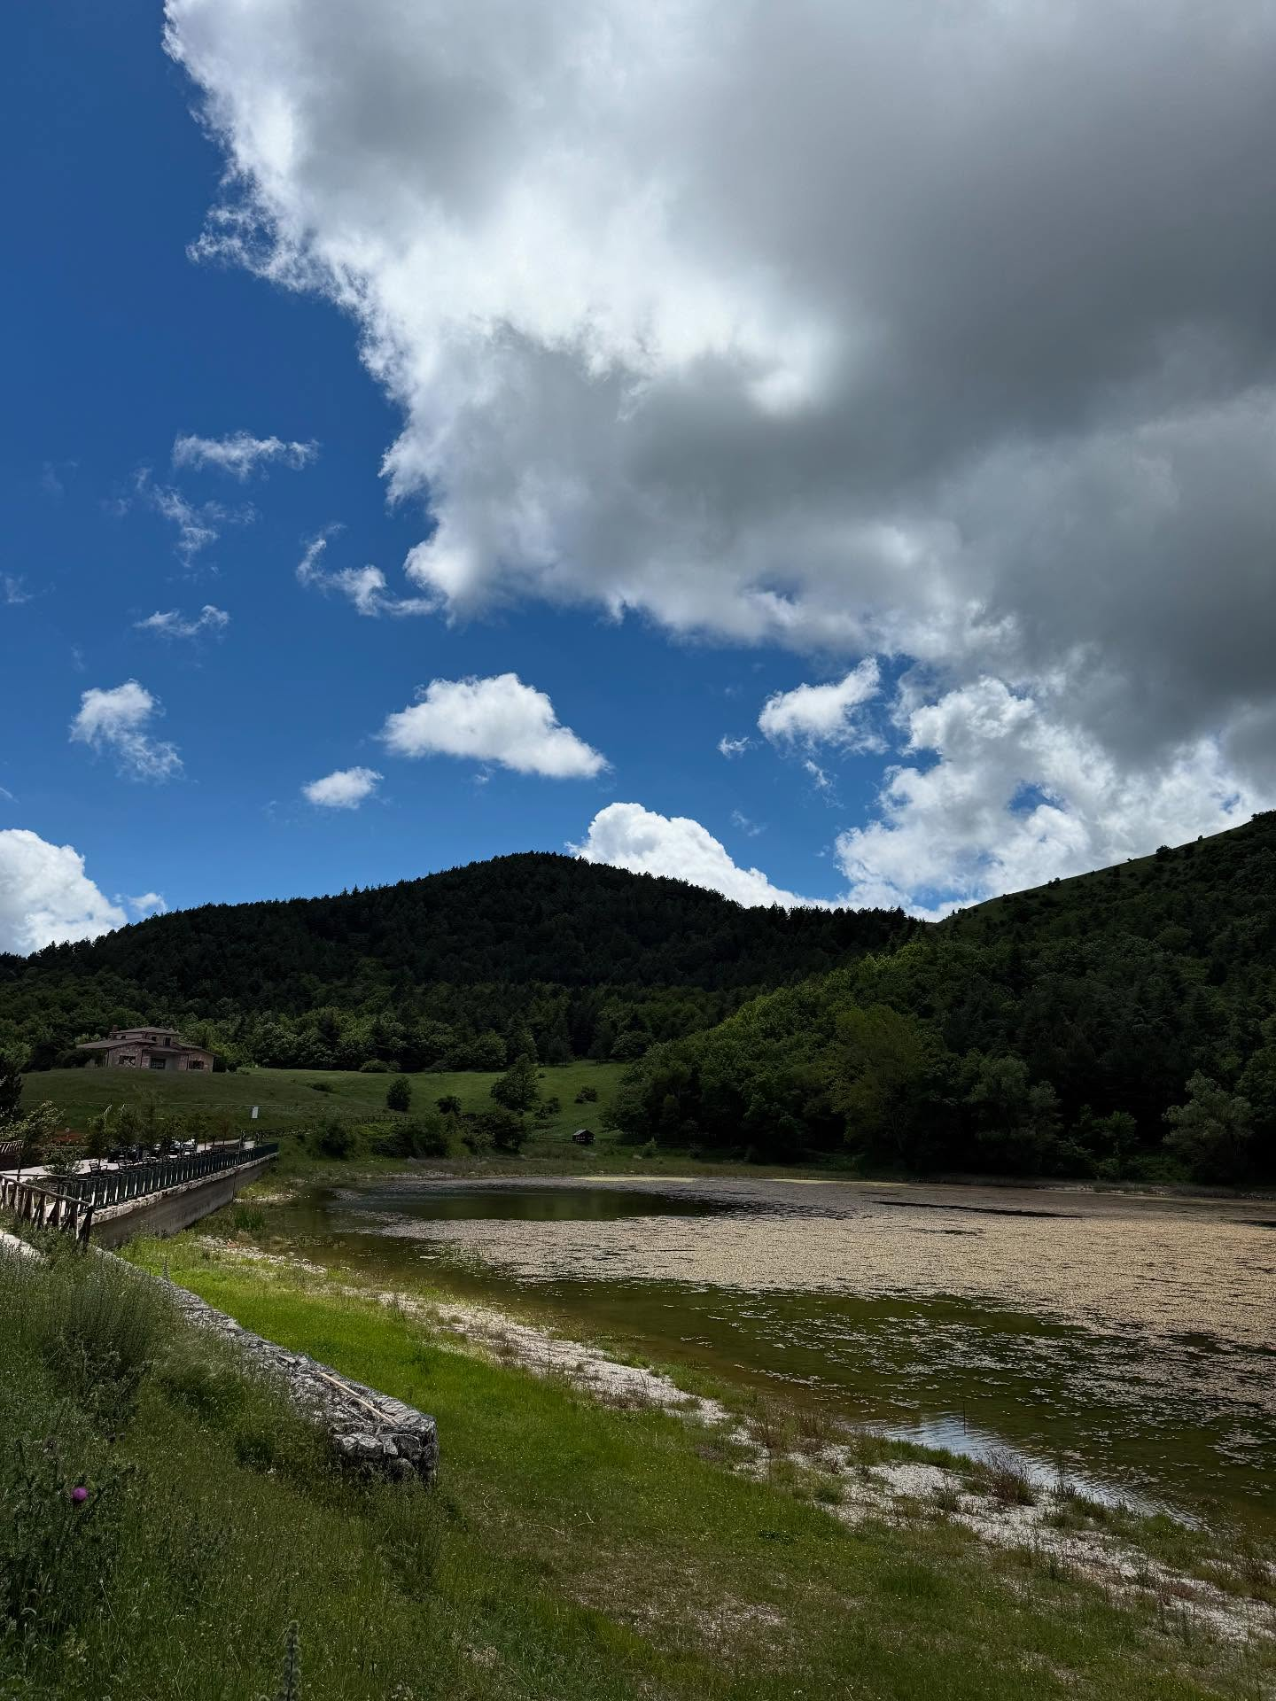
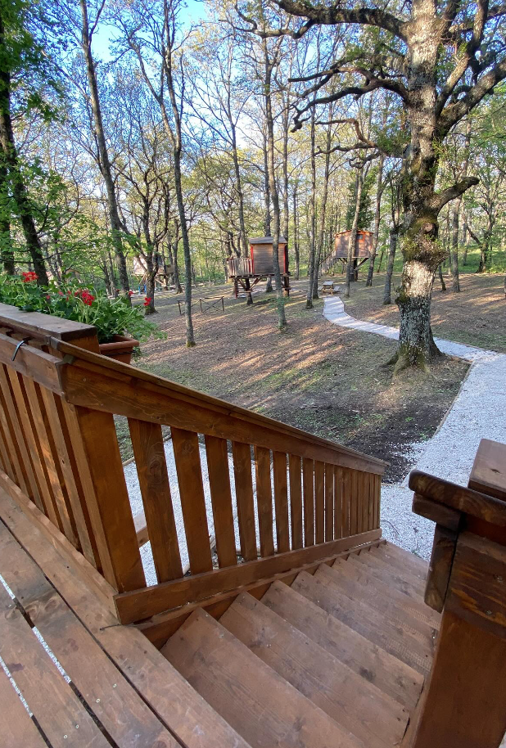
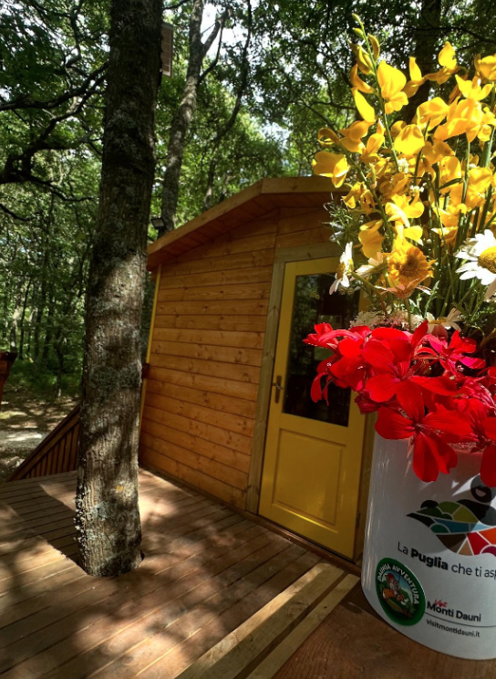
02
Photo Credit: Daunia Avventura, Biccari
Page 5
Photo Credit: Daunia Avventura, Biccari
Section 3
Right-Sized Stays That Make a Local Impact
CONTENTS
01
03
Page 4
Page 21
Module 3
Overview & Learning Objectives
Additional Resources with Practical Exercises & Additional Reading
Photo Credit: Daunia Avventura, Biccari

Slide 4
Module 3 Overview
Learning Objectives
Module 3 shows how alternative accommodation can be both sustainable and deeply connected to local identity. Discover how thoughtful design, material selection, and landscape integration not only support the environment but also empower communities and preserve culture. Learn how building choices can create unique, memorable tourism experiences- especially in rural or overlooked areas.
It covers 3 Key Sections:
Smart Starts: Adapting Buildings & Using Pre-Built Units
Better Building Choices - Materials, Layout & Flexibility
Right-Sized Stays That Make a Local Impact
03
Right-Sized Stays That Make a Local Impact
Learn how to scale your accommodation for community benefit e.g., fits local demand, respects ecological limits, and supports local economic development.
Learn what ‘right-sizing’ is so your accommodation fits local infrastructure and avoid over-tourism. For example, explore how to design for different geographies (mountain, coast, countryside) and social contexts.
Discover how small-scale models like Albergo Diffuso can support heritage, local economies, and community resilience.

Slide 5
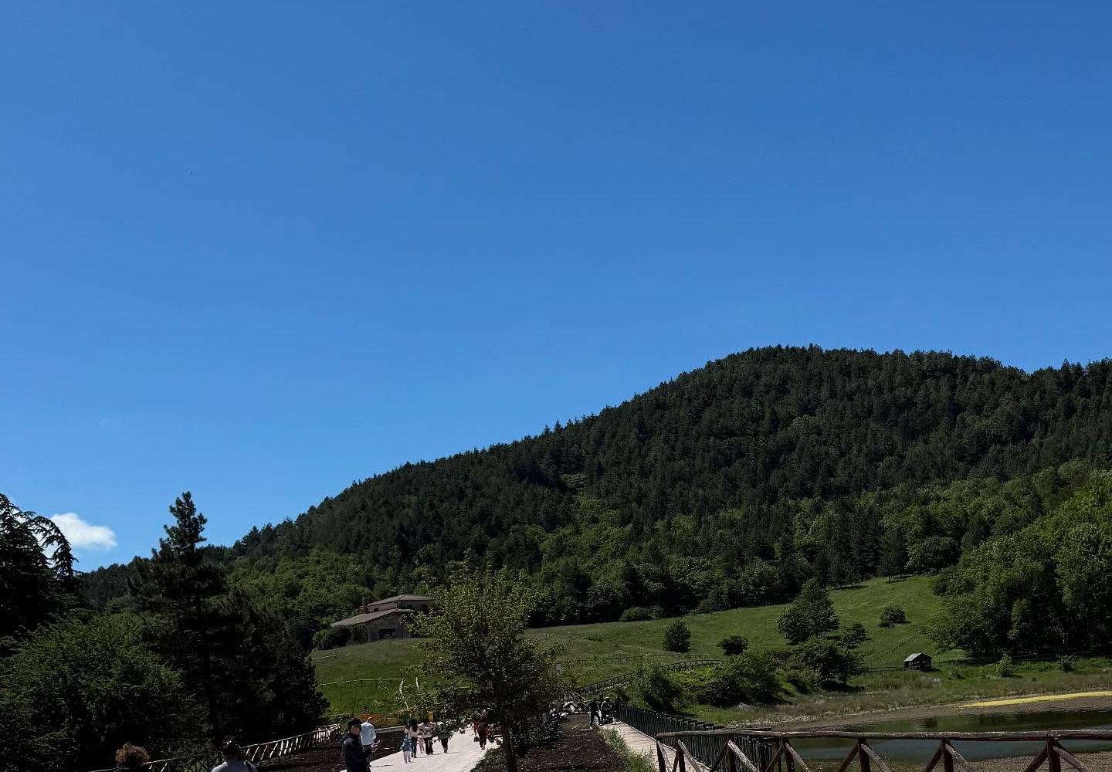
Section 3
Photo Credit: Daunia Avventura, Biccari
Right-Sized Stays That Make a Local Impact

Slide 6
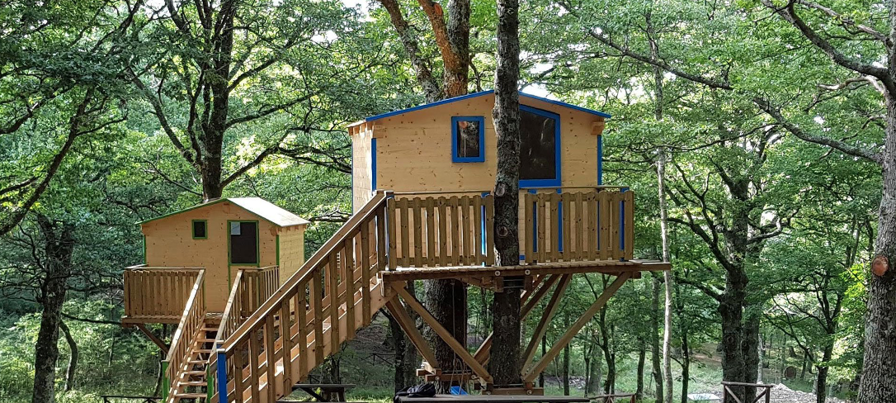
Photo Credit: : Meridaunia
Section 2
Better Building Choices - Materials, Layout & Flexibility
Overview:
This section focuses on how smart material and design choices can make alternative accommodation both sustainable and meaningful.
Using local, recycled, or eco-friendly materials reduces environmental impact while supporting local economies and cultural heritage. A flexible, climate-responsive layout ensures comfort for guests and efficient use of resources. Whether converting existing spaces or building new ones, the goal is to create accommodations that blend with the landscape, serve the community, and offer unique, authentic experiences.
6

Slide 7
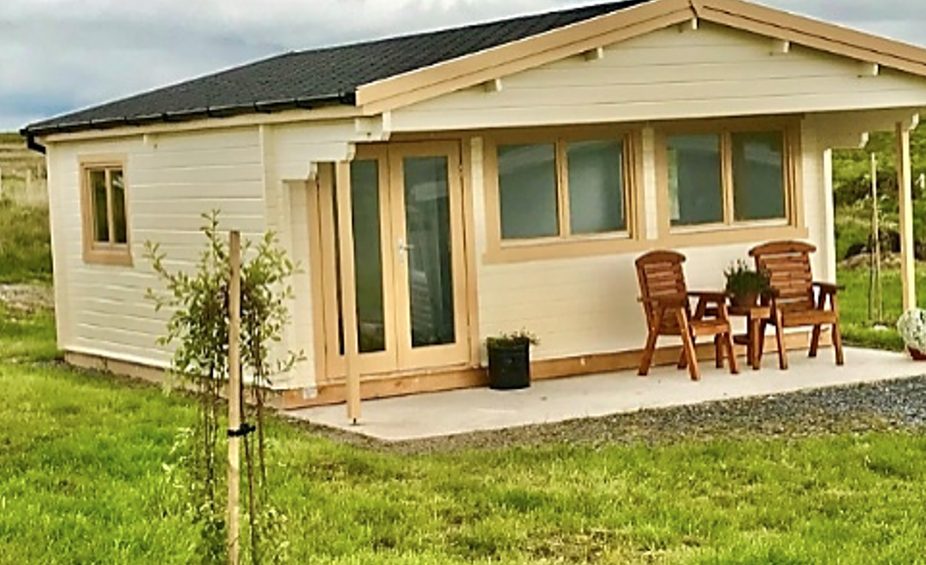
Introduction - Right-Sized Stays That Make a Local Impact
Photo Credit:
In a time when tourism can easily overwhelm the places it touches, learning to build at the right scale is more important than ever. Right-sized accommodation is not just about physical dimensions—it’s about respecting the rhythms, resources, and character of a place. Whether it’s a hillside village, a forest edge, or a small farming town, tourism should serve the local context rather than distort it.
Source: UNWTO (2021). Tourism and Rural Development.
World Tourism Organization.
https://www.unwto.org/tourism-and-rural-development
7

Slide 8
Introduction - Right-Sized Stays That Make a Local Impact
This section helps you explore how the size, type, and capacity of your alternative accommodation can be tailored to fit its environment, avoid resource strain, and enhance the community’s long-term wellbeing.
You’ll learn why “small” is often smarter—creating more resilient, flexible, and authentic hospitality experiences. From regulatory frameworks to design models like Albergo Diffuso, we’ll show how aligning your vision with the territory’s real carrying capacity leads to better outcomes for everyone—visitors, residents, and nature alike.
Source: UNWTO (2021). Tourism and Rural Development.
World Tourism Organization.
https://www.unwto.org/tourism-and-rural-development
8

Slide 9
Section 1: 4 Key Learning Areas
01
Understanding Carrying Capacity and Land Pressure:
Learn how to assess the physical, social, and environmental limits of a destination to avoid overcrowding and resource depletion. Understand why respecting carrying capacity ensures tourism remains a benefit—not a burden—for local communities.

Slide 10
Section 1: 4 Key Learning Areas
02
Aligning Design with Local Infrastructure and Services
Discover how to design accommodation that complements rather than strains existing infrastructure, such as water supply, waste management, and transportation systems - particularly in rural or remote areas with limited public services.

Slide 11
Section 1: 4 Key Learning Areas
03
Using Tourism to Support Local Economies and Value Chains:
Explore how right-sized models - such as small guesthouses, rural homestays, or scattered hotels - can strengthen local economies by sourcing from nearby farmers, artisans, and businesses, promoting inclusive and circular development.

Slide 12
Section 1: 4 Key Learning Areas
04
Regulatory Frameworks and Community-Centered Business Models:
Learn how legal tools and place-based models like Albergo Diffuso or cooperative ownership schemes enable sustainable development, preserve heritage, and embed tourism enterprises in the fabric of community life.

Slide 13
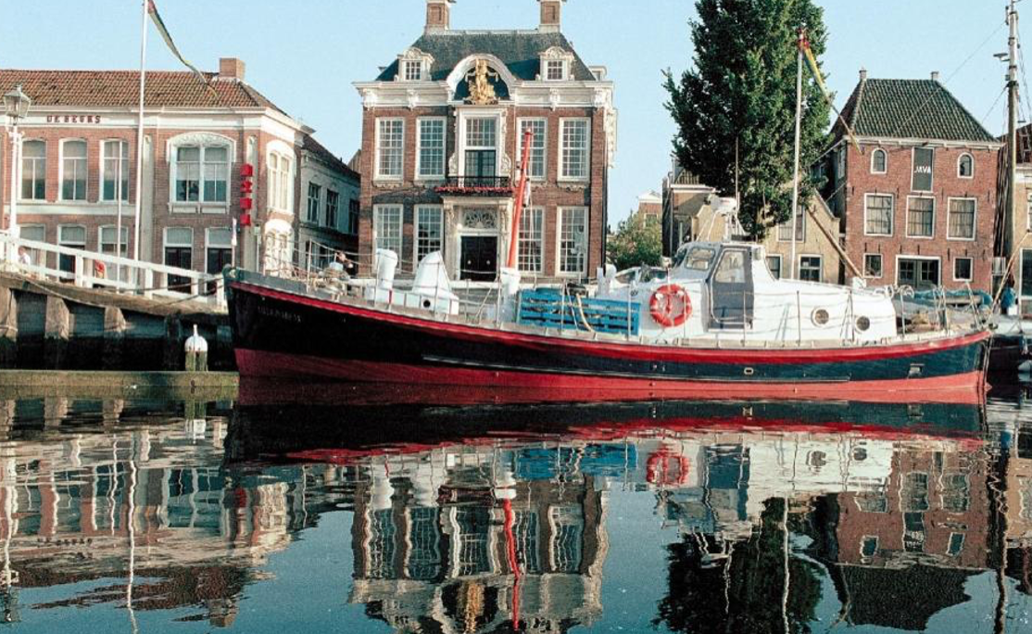
01
Understanding Carrying Capacity and Land Pressure
Key Learning Area
Designing the right size and type of tourism accommodation begins with understanding the carrying capacity of a destination. This refers to the number of visitors an area can sustainably host without damaging its environment, overwhelming local infrastructure, or compromising the well-being of its residents.
Photo credit:
Reddingsboot Harlingen Boat, Netherlands
13

Slide 14
01
Understanding Carrying Capacity and Land Pressure
Key Learning Area
In rural or ecologically sensitive areas, ignoring these limits can lead to overcrowding, land degradation, cultural disruption, and resentment among local communities. Assessing carrying capacity involves evaluating both natural resources—like water, energy, and biodiversity—and social dynamics, such as access to housing, traffic flow, and community tolerance. By aligning development with these thresholds, tourism providers can prevent long-term damage and instead support resilient, inclusive local economies. Respecting carrying capacity helps ensure that tourism remains a benefit, not a burden—preserving both the visitor experience and the quality of life for residents.
14

Slide 15
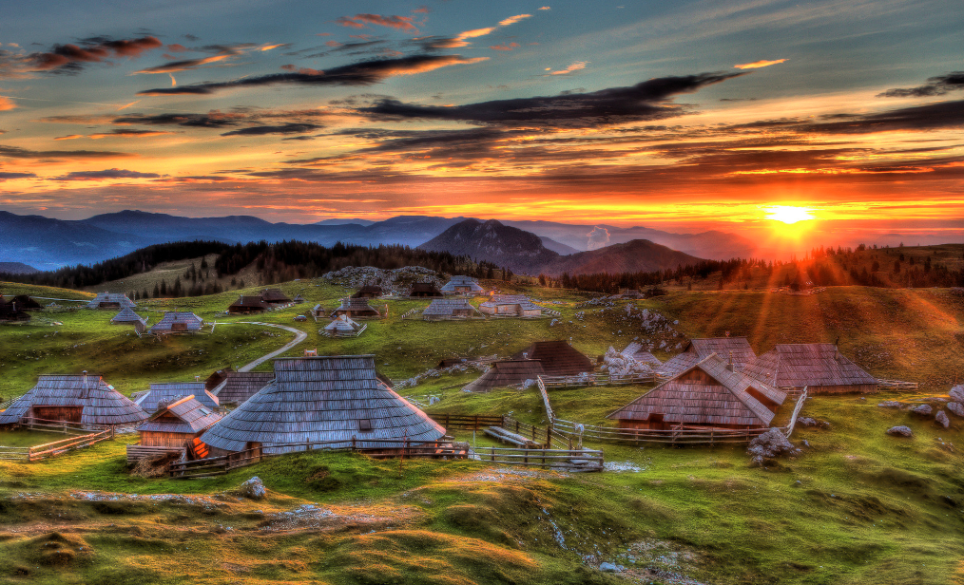
Core Contents
Photo Credit: Velika Planina, Slovenia
Defining Carrying Capacity in Tourism Contexts
Carrying capacity refers to the maximum number of visitors that a destination can accommodate without causing negative environmental, social, or cultural impacts. In the context of tourism accommodation, this means understanding how many guests the local infrastructure - roads, water systems, waste management, healthcare - can support before it becomes strained. It’s not just about numbers, but about maintaining balance between visitor experience and community well-being.
15

Slide 16
Core Contents
Physical and Environmental Indicators
Social and Cultural Sensitivities
Environmental indicators of overcapacity may include deforestation, soil erosion, water shortages, or biodiversity loss - especially in fragile ecosystems like mountain villages or coastal zones. Accommodation providers must factor in resource use (water, energy), waste output, and land coverage to avoid degrading the very landscapes that attract tourists. Sustainable design begins with respecting ecological thresholds.
Even if infrastructure can support more visitors, social carrying capacity might be lower. When tourism drives up housing prices, alters daily life, or displaces traditional practices, it causes friction. Accommodation that is too large, too disruptive, or too disconnected from local realities can generate resistance instead of support. Right-sizing your project helps preserve local identity and community acceptance.
16

Slide 17
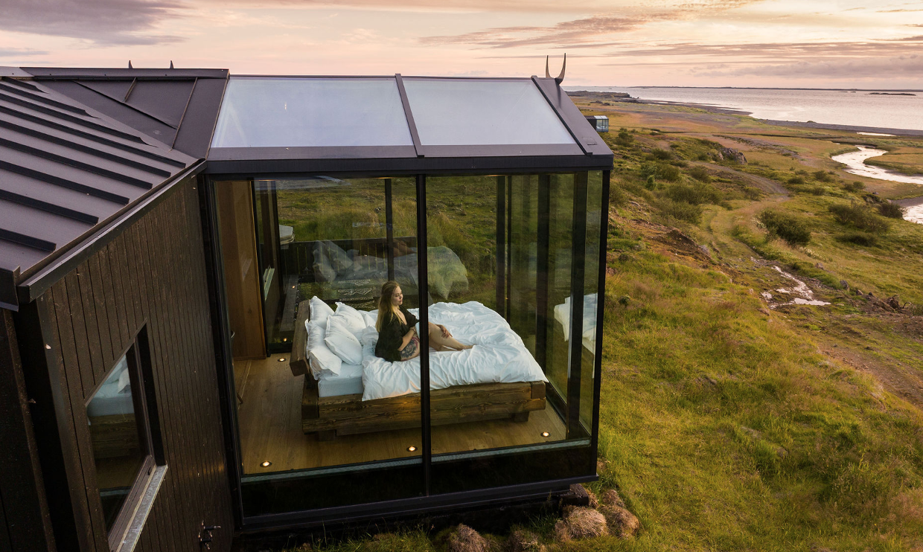
Core Contents
Photo credit:
Panoramic Glass Lodge, Iceland
Tools for Assessing Capacity and Avoiding Overload
Practical tools such as environmental impact assessments, community consultations, and seasonal occupancy data help planners understand when tourism volumes become unsustainable. Participatory planning with local stakeholders ensures that new accommodations are welcomed and grounded in shared priorities. Monitoring tools like carrying capacity checklists or tourism pressure maps can help adjust operations over time.
17

Slide 18
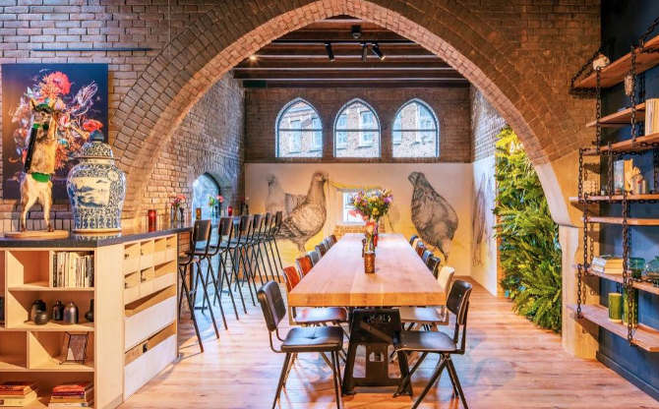
02
Aligning Design with Local Infrastructure and Services
Key Learning Area
Designing sustainable accommodation in rural or under-served areas requires careful alignment with existing infrastructure and services. Rather than overburdening limited local systems, smart design works with what’s available - ensuring feasibility, affordability, and long-term harmony with the surrounding community.
Photo credit:
BUNK Hotel AmsterPhoto Creditdam, Netherlands
18

Slide 19
02
Aligning Design with Local Infrastructure and Services
Key Learning Area
This means understanding access to water, electricity, sanitation, and waste management. In areas where these are limited or unreliable, accommodation providers can incorporate low-impact solutions such as off-grid solar systems, composting toilets, or rainwater harvesting. These choices reduce environmental pressure while increasing operational independence.
Mobility and accessibility are equally important. Guests need to reach the site safely and reliably, so considering road conditions, signage, public transport, and emergency access is key to ensuring both satisfaction and safety.
19

Slide 20
02
Aligning Design with Local Infrastructure and Services
Key Learning Area
Digital infrastructure should not be overlooked. While some guests welcome a digital break, others expect reliable internet. Assessing local connectivity early helps manage expectations and guide appropriate investments in tech solutions.
Finally, designing in sync with the surrounding service ecosystem—such as local food suppliers, artisans, and transport providers—ensures your accommodation supports rather than competes with the community. When design and infrastructure align, tourism becomes a catalyst for local resilience and regeneration.
20

Slide 21
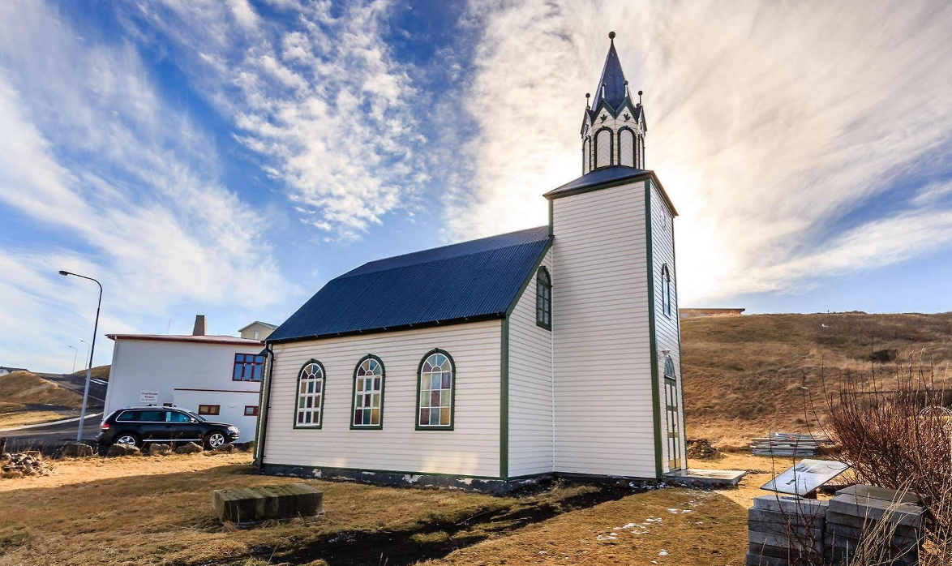
Core Contents
Assessing Basic Infrastructure Capacity
Before developing any accommodation, it’s essential to evaluate the availability and reliability of local infrastructure. This includes access to clean water, electricity, sewage systems, and waste management. In rural or remote locations, you may need to plan for independent or low-impact systems (e.g., solar panels, composting toilets, rainwater harvesting) that ensure functionality without overloading local resources.
Photo credit: Church Blonduos, Iceland
21

Slide 22
Core Contents
Ensuring Safe and Accessible Mobility
Understanding Local Digital Connectivity
Transportation infrastructure can greatly influence guest satisfaction. Check road conditions, signage, emergency access routes, and proximity to public transit. If access is limited, consider how to improve last-mile connections or provide shuttle services. This not only improves the visitor experience but ensures safety and accessibility for all users.
Reliable internet access may be limited in certain areas. Determine the bandwidth, speed, and coverage of available networks, and evaluate the need for Wi-Fi solutions that align with guest expectations. In some cases, a “digital detox” concept can be marketed positively, but it must be intentional and clearly communicated.
22

Slide 23
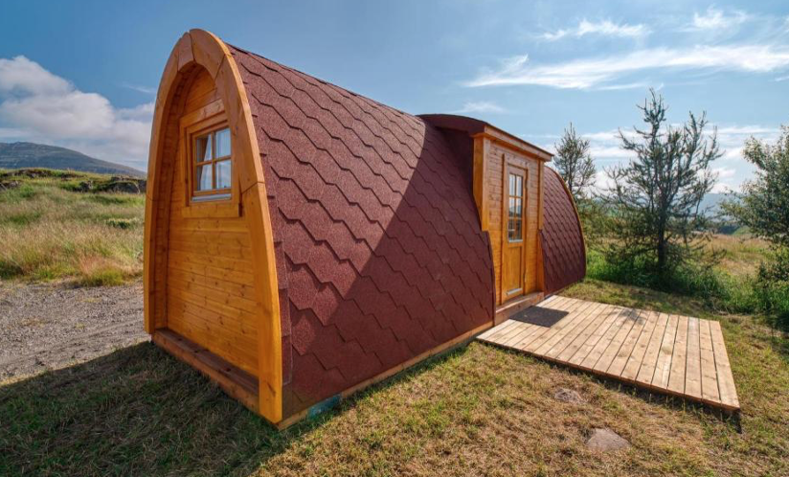
Photo credit:
Fossatun Pods & Cottages, Iceland
Core Contents
Integrating Local Service Providers
Design your business model to work alongside - not against - local services. Source supplies from nearby farms or artisans, partner with local guides, and contribute to the regional economy. This strengthens social acceptance and builds a network of collaborators that reinforces the long-term sustainability of your accommodation.
23

Slide 24

03
Using Tourism to Support Local Economies and Value Chains
Key Learning Area
Using Tourism to Support Local Economies and Value Chains means designing and managing accommodation in a way that strengthens local production, employment, and entrepreneurship. In rural or underrepresented areas, tourism can act as a powerful economic driver - if done thoughtfully. This approach involves sourcing food, furniture, textiles, and services locally, allowing nearby farmers, artisans, and micro-enterprises to benefit from increased demand.
24

Slide 25
03
Using Tourism to Support Local Economies and Value Chains
Key Learning Area
By embedding local products and traditions into the guest experience - such as serving seasonal, regional cuisine or offering guided tours by local residents - accommodation providers create a sense of authenticity while generating income for the surrounding community.
Supporting short supply chains not only reduces environmental impact through fewer transport emissions but also builds economic resilience, as more value remains within the territory. Ultimately, when tourism accommodation actively collaborates with local networks, it becomes more than a place to stay- it becomes part of the region’s development strategy.
25

Slide 26
Core Contents
Short Supply Chains
Local Collaborations and Partnerships
Understand how sourcing goods and services locally - such as food, textiles, furniture, and cleaning supplies - supports micro-enterprises and reduces environmental impact through lower transport emissions.
Learn how to build mutually beneficial relationships with farmers, artisans, cooperatives, and community groups to integrate authentic, place-based offerings into the guest experience.
26

Slide 27

Core Contents
Embedding Regional Culture into Services
Explore how culinary experiences, storytelling, and guided tours led by local residents can enrich guest stays while channeling income into the local economy.
27

Slide 28
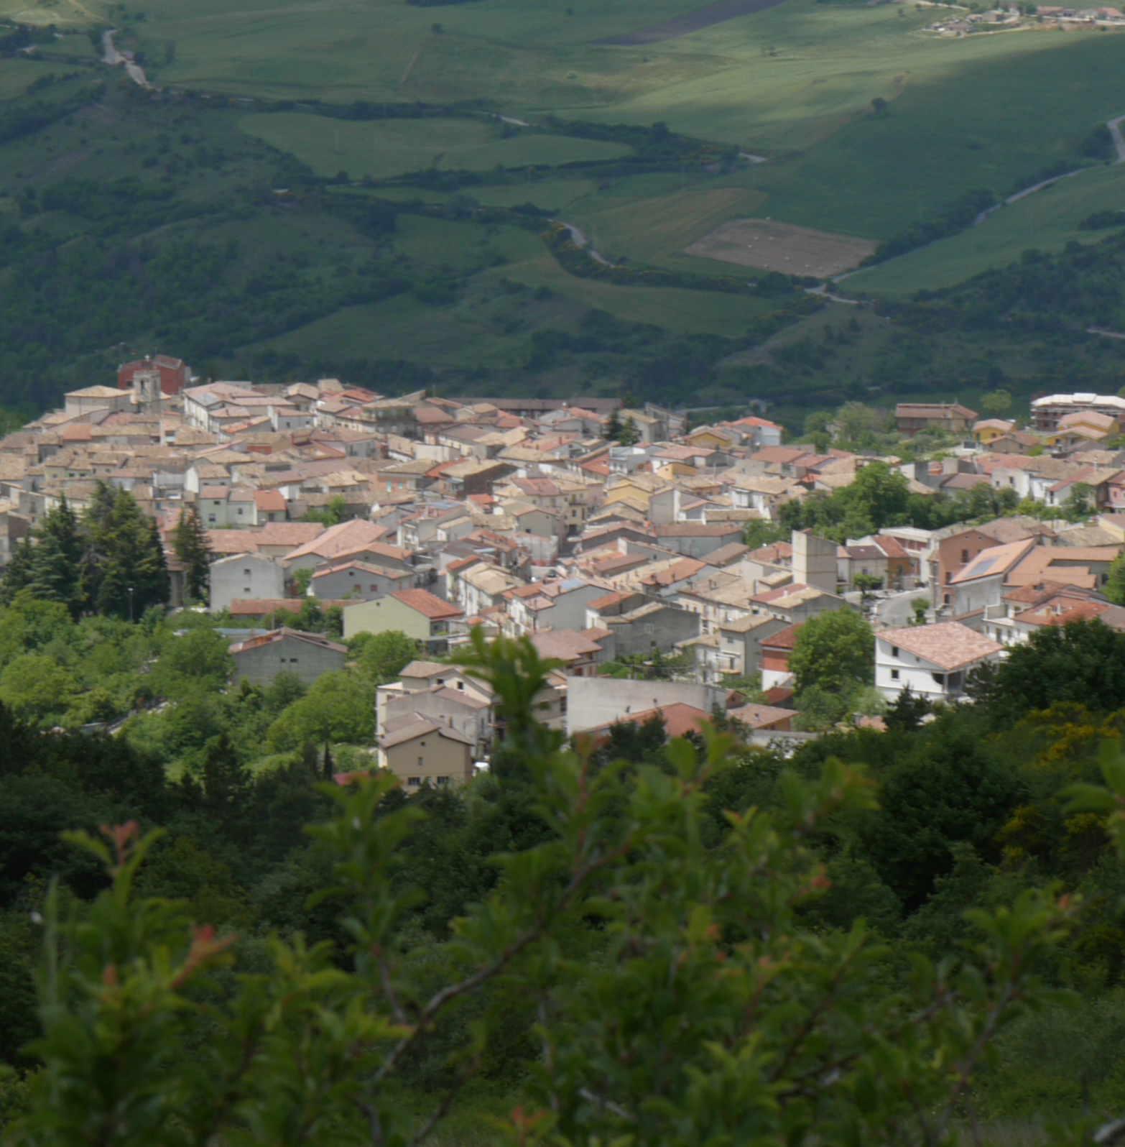
Core Contents
Tourism as Economic Multiplier
Examine how each euro spent in accommodation can circulate through the local economy when procurement, employment, and experience design are intentionally localized.
Photo Credit: Meridaunia

Slide 29
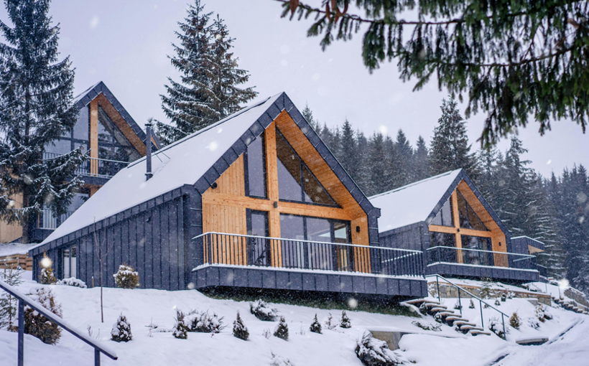
Regulatory Frameworks and Community-Centered Business Models
04
Key Learning Area
Embracing regulatory tools and locally grounded business models is essential for creating tourism accommodation that is not only sustainable but deeply rooted in community life. Understanding the legal frameworks that govern land use, building renovation, and tourism activities helps accommodation providers navigate permissions, avoid compliance issues, and align their projects with long-term territorial goals.
Models such as Albergo Diffuso - where accommodation is spread across existing buildings in a village - allow for the revitalization of underused spaces without the need for new construction, while preserving architectural heritage and fostering a strong sense of place.
29

Slide 30
04
Building for Long-Term Sustainability and Community Benefit
Key Learning Area
Community-centered ownership schemes, like cooperatives or social enterprises, offer additional pathways to integrate tourism into the local economy. These models distribute benefits more equitably and ensure that decisions about development are made with community input and local values in mind. They can also support intergenerational involvement in tourism, keeping know-how and income within the area. By combining legal awareness with inclusive ownership and governance structures, accommodation businesses can become part of a broader ecosystem of regeneration—serving as catalysts for cultural preservation, social innovation, and economic resilience.
30

Slide 31
Core Contents
Understanding Legal Frameworks for Alternative Accommodation
Before developing accommodation in rural or heritage settings, it’s essential to understand the national and local regulations that govern land use, building restoration, tourism licensing, and environmental protection. In many European regions, historic properties are protected under cultural heritage laws, which may restrict the extent of structural changes or require specific renovation techniques.
Zoning regulations may also limit the types of economic activity permitted in certain areas or impose density caps to avoid overdevelopment. Knowing how to navigate these frameworks helps project developers ensure legal compliance, minimize delays, and access public incentives that may be available for sustainable or cultural restoration. Awareness of regulatory tools also strengthens long-term planning and avoids costly retrofitting or legal disputes later in the project lifecycle.
31

Slide 32
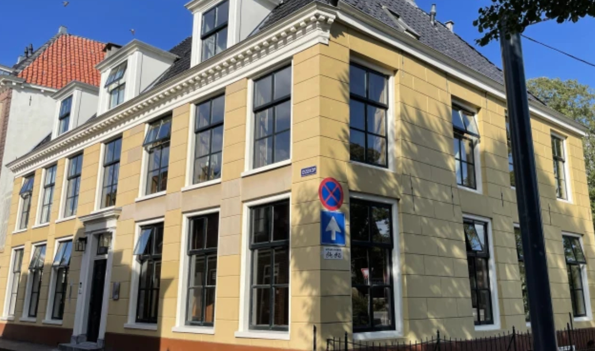
Photo credit:
De Old Signorie BB, Netherlands
Core Contents
Embedding Tourism Enterprises in Community-Based Models
Sustainable accommodation works best when it contributes to the wellbeing of the local community - not just economically, but socially and culturally. Business models like Albergo Diffuso or tourism cooperatives promote this integration by redistributing tourism activities and benefits across a broader group of residents, rather than centralizing them in a single business owner. These models encourage collaboration with local artisans, farmers, and service providers, ensuring that tourism supports existing livelihoods and traditions. In addition, when accommodations are run as cooperatives or community enterprises, local people can participate in decision-making, develop skills, and share in the financial returns. This strengthens social cohesion and gives the project legitimacy, while also aligning it with broader goals of territorial regeneration and cultural preservation.
32

Slide 33
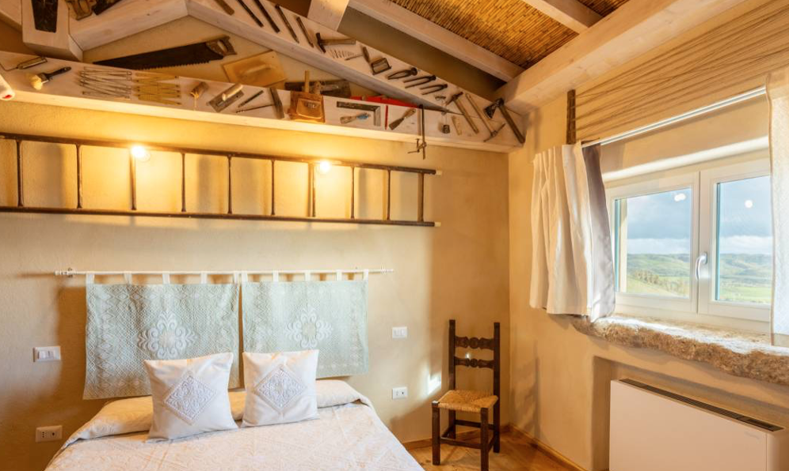
04
Right-Sized Stays That Make a Local Impact
Key Learning Area
Designing accommodation that is proportionate to its rural context is essential for achieving both environmental sustainability and local benefit. Small-scale, well-integrated lodging helps prevent overcrowding and avoids placing stress on local ecosystems, public services, or cultural landscapes. Respecting the carrying capacity of a destination ensures that tourism remains a regenerative force, rather than becoming extractive or disruptive
Source: Towards management of sustainable tourism development
in coastal destinations of the Bohai Rim: insights from a tourism carrying capacity analysis
Link: https://link.springer.com/article/10.1007/s43621-025-00951-1
33

Slide 34

04
Right-Sized Stays That Make a Local Impact
Key Learning Area
Aligning accommodation with existing infrastructure—such as access roads, water supply, waste systems, and transport—reduces the need for new developments and limits environmental impact. This thoughtful integration supports long-term viability and allows rural areas to welcome visitors without compromising daily life for residents.
Source: Sustainability of smart rural mobility and tourism:
A key performance indicators-based approach
Link: https://www.sciencedirect.com/journal/technology-in- society/vol/74/suppl/C
34

Slide 35

03
Right-Sized Stays That Make a Local Impact
Key Learning Area
Tourism can serve as a strategic tool for strengthening local economies when it is intentionally connected to existing value chains. By sourcing food from local farmers, working with craftspeople, or partnering with community-run initiatives, alternative accommodations can support livelihoods, promote cultural heritage, and build economic resilience.
Source: Local food tourism and its environmental benefits
Link: https://www.carbonclick.com/news-views/local-food-tourism-
and-its-environmental-benefits
35

Slide 36
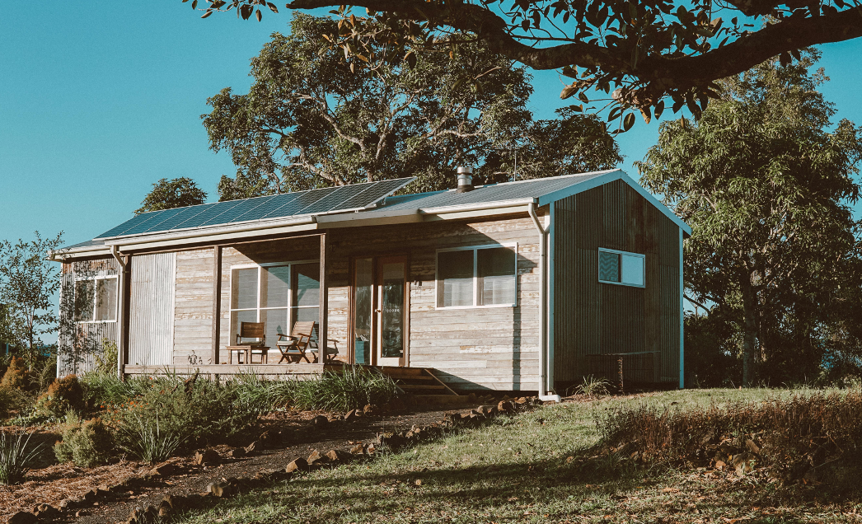
03
Right-Sized Stays That Make a Local Impact
Key Learning Area
Business models such as Albergo Diffuso or cooperative ownership schemes show how regulation and governance structures can be designed to embed tourism within the social fabric of a place. These approaches reinforce the principle that rural accommodation should not be developed in isolation, but as part of a broader vision of inclusive, place-based growth.
Source: A typical Italian phenomenon: The “albergo diffuso”
Link: https://www.sciencedirect.com/journal/tourism- management/vol/32/issue/3
36

Slide 37

Additional Resources Section
To deepen your learning and support the practical application of this module, explore the curated selection of additional reading, exercise and digital tools provided in this section. They are selected to help you research your market, streamline operations, enhance guest experiences, and promote your business effectively.
By exploring these resources, you can strengthen your skills, increase efficiency, and ensure your accommodation offering aligns with EPIC STAYS’ values of sustainability, creativity, and community engagement.
37

Slide 38
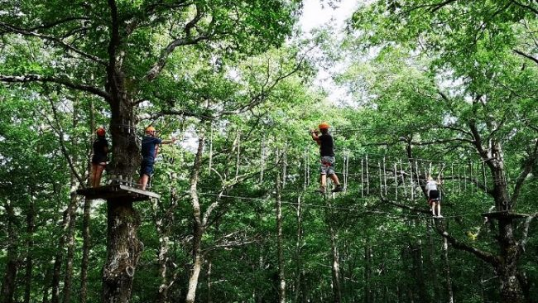
Click to Watch Video
A Secret Boutique Hotel
Name:
A Secret Boutique Hotel
Description:
This video provides a tour of a hidden medieval boutique hotel in a small Italian village, highlighting how existing historic structures have been carefully repurposed into low-scale hospitality offerings. The presentation emphasizes preservation of architectural heritage, local materials, and minimal intervention in the landscape. It underscores the hotel's harmonious fit within a rural setting, supporting tourism that respects tradition and scale.
Photo Credit: Meridaunia
38

Slide 39
Click to Watch Video
A Secret Boutique Hotel
Apply to Topic 1:
This content aligns well with Section 3: Right‑Sized Stays That Make a Local Impact. It showcases how small-scale accommodation - rooted in community, heritage, and careful design - can enhance local resilience, preserve identity, and support sustainable tourism development.
Photo Credit: Meridaunia
39

Slide 40

Digital Tool: QGIS (Quantum Geographic Information System)
Click to Download the tools
QGIS is a free, open-source geographic information system that allows users to analyze spatial data, map infrastructure, assess environmental constraints, and plan land use in a locally informed and sustainable way.
It is widely used by urban planners, architects, NGOs, and tourism developers to evaluate geographic and demographic data - making it ideal for small-scale, place-based accommodation projects.
40

Slide 41
Digital Tool: QGIS (Quantum Geographic Information System)
Click to Download the tools
NQGIS supports the planning of “right-sized” stays by helping accommodation developers assess carrying capacity, local infrastructure availability, land sensitivity, and proximity to community assets. For example, QGIS can be used to map water access, zoning regulations, or distances to public transportation and schools. This ensures that small accommodations don’t overburden rural systems and instead align with the community's spatial and service realities. It's also useful for visualizing opportunities to integrate local economies or avoid environmental conflicts.
41

Slide 42

Practical Exercise: Map the Impact: Designing a Local Tourism Value Chain
Steps:
Define Your Accommodation Concept:
Briefly describe your alternative accommodation idea: – Type of structure (e.g., cabin, guesthouse, eco-lodge);– Location (rural village, mountains, heritage site, etc.);– Capacity (e.g., 5 rooms, 3 pods)
Identify Local Stakeholders:
List at least 6 key local actors who could be involved in or benefit from your project. Think about: builders, artisans, or craftspeople, farmers, food producers, or chefs, cultural groups or local guides, transport, retail, or service providers
Objective:
To help learners explore how their accommodation idea can activate and strengthen local economic ecosystems through partnerships, sourcing, and service integration.
42

Slide 43
Practical Exercise: Map the Impact: Designing a Local Tourism Value Chain
Steps:
Map the Value Chain:
Create a simple visual map (use arrows or flowcharts) showing how materials and services flow into your project (e.g., local stone → construction; olive oil → guest breakfast), revenue, promotion, or visibility flows back to the community, guests are connected to local experiences through your accommodation
Highlight Key Partnerships:
Identify 2–3 strategic partnerships that would have the strongest community and economic impact.
43

Slide 44
Additional Reading
Name | Description
Tourism and Rural Development – A Policy Perspective UNWTO | This publication explores how tourism can be a tool for rural revitalization. It provides guidance on designing place-based tourism policies that support local economies, avoid overdevelopment, and foster community participation. https://www.unwto.org/tourism-and-rural-development
Overtourism? Understanding and Managing Urban Tourism Growth Beyond Perceptions OECD | This report analyzes how unchecked tourism impacts local infrastructure and communities. It offers tools and policy frameworks for managing tourism flows, assessing carrying capacity, and aligning services with community well-being. https://pureportal.coventry.ac.uk/en/publications/overtourism-understanding-and-managing-urban-tourism-growth-beyon
44

Slide 45
Additional Reading
Name | Description
Tourism, Degrowth and the Politics of ‘Sustainable Development Raoul V. Bianchi & Floris de Man | Published in the Journal of Sustainable Tourism, this article challenges conventional growth-oriented tourism models. It argues for right-sized tourism that prioritizes community resilience, equity, and long-term sustainability. https://doi.org/10.1080/09669582.2021.1870923
45

Slide 46

"When tourism listens to the rhythm of a place, not only does it preserve its soul - it becomes a force for regeneratio"
Photo Credit: Meridaunia
46

Slide 47
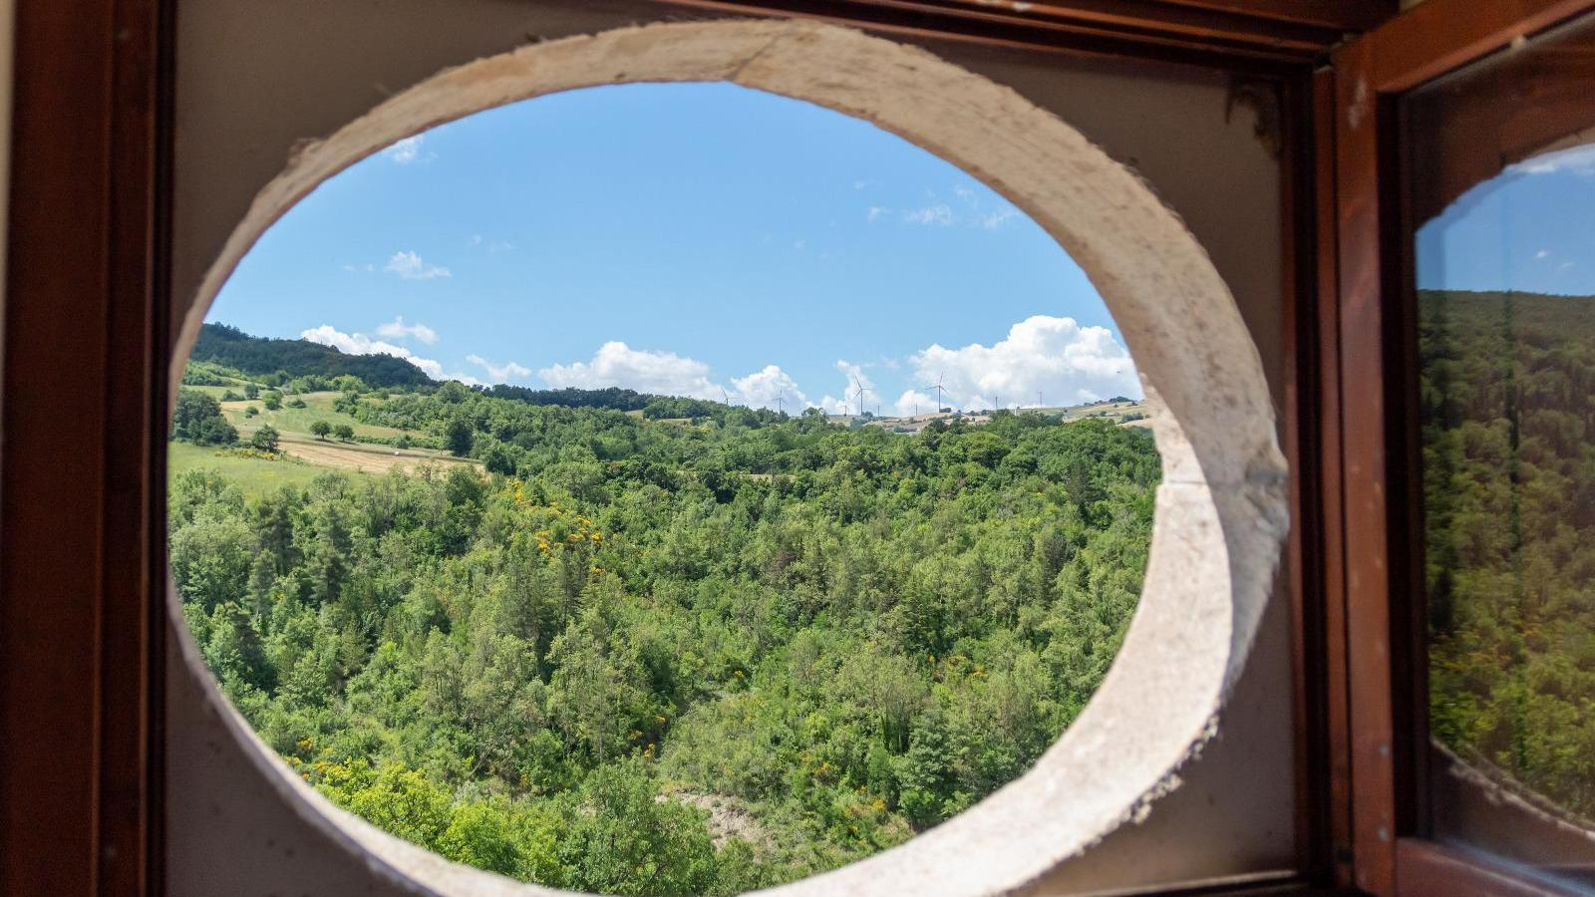



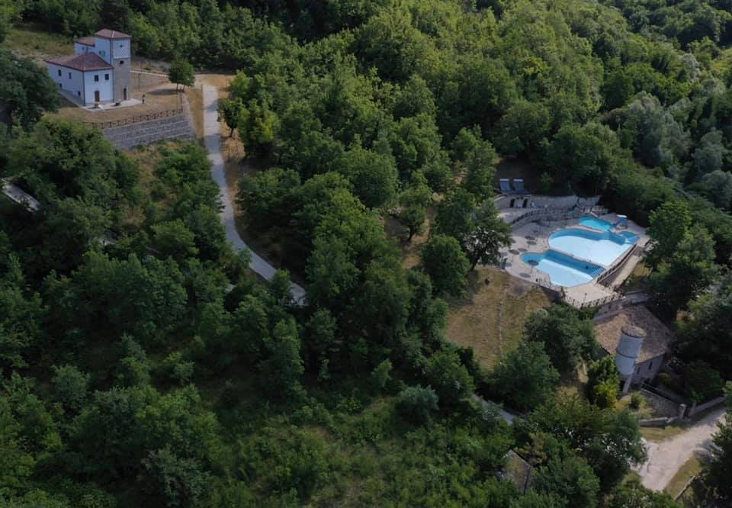
ITALY
Photo Credit: Visit Monti Dauni, Meridaunia
47

Slide 48
Well Done
Module 4
Building a Strong Brand, Storytelling & How to Get Bookings!
You have Completed… Module 3 (Part 3)
Section 3: Right-Sized Stays That Make a Local Impact
Next is…

