Slide 1


Module 2 (Part 2)
Market Research & Business Planning (Your Alternative Accommodation Business) ​
www.epicstays.eu

Slide 2

Module 2 (Part 2)
Photo Credit:
Section 3:
Building a simple, viable business plan via a Business Model Canvas
2

Slide 3
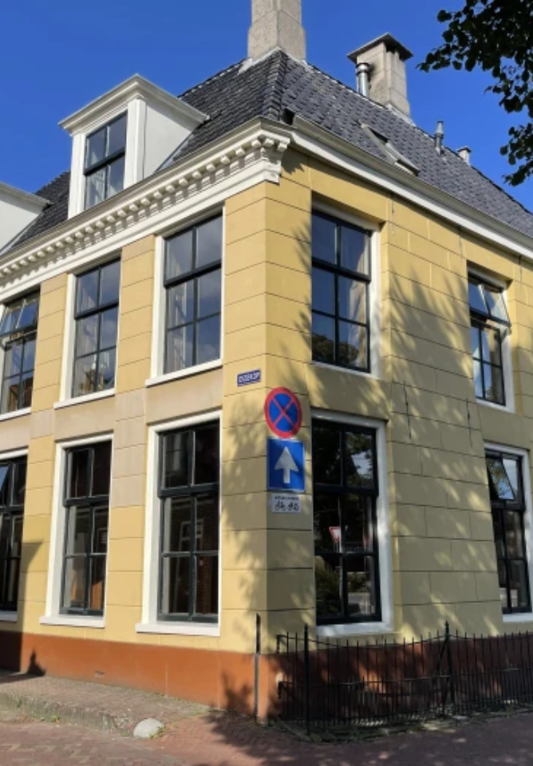
Photo Credit:
De Old Signorie BB, Netherlands
CONTENTS
06
Page 7
Section 3
Building a simple, viable business plan via a Business Model Canvas

Slide 4
Module 2 Overview
Learning Outcomes
Building a Viable Business Plan Using the Business Model Canvas (BMC)
03
The final stage Section 3 introduces the Business Model Canvas (BMC), a simple but powerful one-page planning tool. Learners will map out the essential elements of their business — from guest segments and value propositions to revenue streams, costs, partnerships, and resources. This gives them a clear and practical overview of how their accommodation concept can work in real life.
Use the Business Model Canvas (BMC) as a planning tool to organise business ideas.
Map an accommodation concept across key areas, including guest segments, value proposition, channels, revenue streams, cost structures and partnerships.
Present their business model clearly using a one-page BMC framework.
Evaluate the feasibility of your business idea based on market insights and financial projections.
Assess how different BMC components connect and influence each other to strengthen their overall business plan.

Slide 5

Section 3
Photo Credit: A-Frame in Soča, Gorizia, Slovenia
Building a Viable Business Plan Using the Business Model Canvas

Slide 6

Section 3
Building a Viable Business Plan Using the Business Model Canvas
Overview:
The BMC shows you the key factors that a business model needs to take into account and helps you obtain an overview of each of the 9 segments the make up this model. By going through this process you gain a valuable insights into your own business and its potential. In this module we focus in 5 key areas for building a viable alternative tourism accommodation business.
The Business Model Canvas (BMC) is a tool that helps you visualise your business model and further develop your business ideas.
6

Slide 7
Section 3: 3 Key Learning Areas
01
Learn How to Use The Business Model Canvas as a Simple Visual Planning Tool
02
Learn How to Map Out Your Ideas Across Key Areas
  Customer / Guest segments
  Value proposition
  Channels (how guests find your business and book)
  Revenue streams and cost structures
  Partnerships and resources

Slide 8
Section 3: 3 Key Learning Areas
03
Learn How the Business Model Canvas is a Working Plan – Flexible And Ready to Evolve Into More Detailed Versions.

Slide 9
Learn How to Use The Business Model Canvas as a Simple Visual Planning Tool
01
Key Learning Area
Why should tourism SMEs use the Business Model Canvas (BMC)?
This tool gives you a way to get a clear overview of all your business’s most important elements. By focusing on certain sections such as the customer (or guest) segments, on your value propositions (i.e. your unique value propositions) and the channels you use to reach your customer – to name a few – you get a clear and valuable overview of what your business is about and therefore how it can be improved.
By using this method, you gain clarity about your goals, your guests, and what makes your offering unique.
9

Slide 10
Learn How to Use the Business Model Canvas (BMC)
An Introduction to a Simple Visual Planning Tool
The elements this module focuses on:
Customer / Guests segments
Value propositions
Channels (how guest find your business and book a stay)
Revenue streams and cost structure
Partnerships and resources
The BMC can be set up differently based on type of businesses, as you can see from the 2 BMC visuals in the next two slides.
So how do you use the BMC? You can use a sheet of paper, different coloured Post-its and pens or use an app or software programme to draw up each of the 9 elements. You can start doing this on your own or with your team. This module focuses on specific elements and brings some of them together. Nevertheless, you can still use the 9 elements.
10

Slide 11
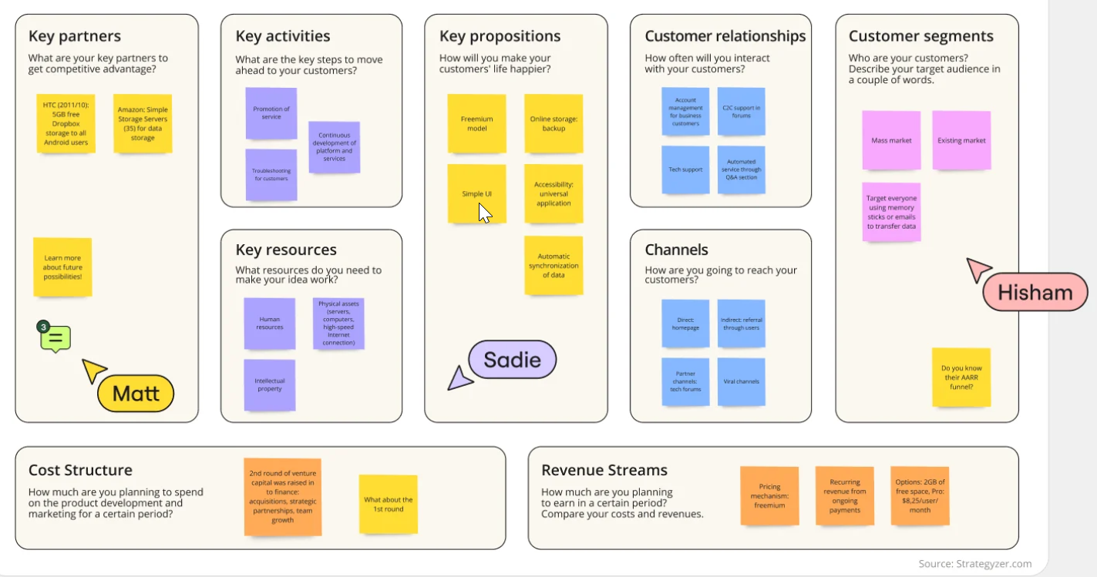
Learn How to Use the Business Model Canvas (BMC)
An Introduction to a Simple Visual Planning Tool - Miro
The 9 elements:
Key partners
Key activities
Key resources
Value or key propositions
Customer relationships
Channels
Customer segments
Cost structure
Revenue streams
Source: https://miro.com/strategic-planning/business-model-canvas-examples/
11

Slide 12
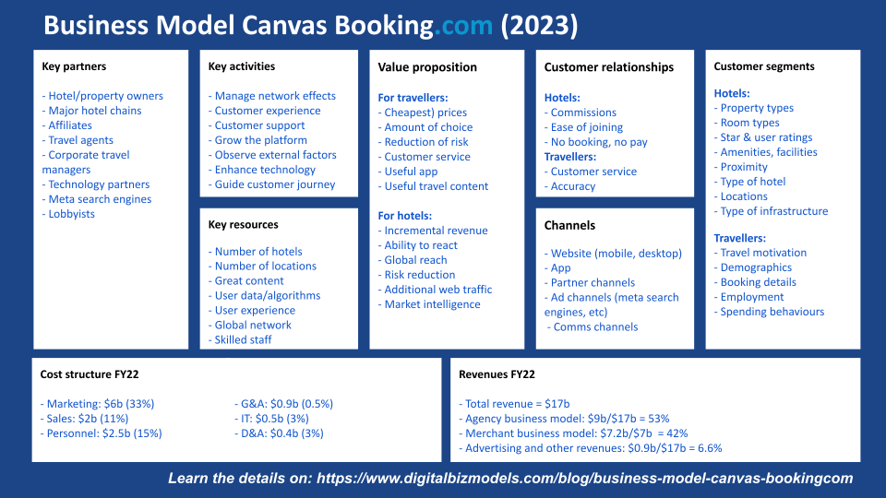
Learn How to Use the Business Model Canvas (BMC)
An Introduction to a Simple Visual Planning Tool
The 9 elements:
Value proposition
Key partners
Key activities
Key assets & resources
Customer segments
Channels
Customer relationships
Revenue
Cost structure
Source: https://www.digitalbizmodels.com/blog/business-model-canvas-bookingcom
12

Slide 13









Business Model Canvas Template (Editable)
Use the instructions below to complete each section of your business model canvas, so you can develop a comprehensive understanding of your business's operational and strategic framework.
KEY
PARTNERSHIPS
KEY
ACTIVITIES
VALUE PROPOSITIONS
CUSTOMER RELATIONSHIPS
CUSTOMER SEGMENTS
KEY
RESOURCES
CHANNELS
COST STRUCTURE
REVENUE STREAM
Source: https://www.smartsheet.com/sites/default/files/2024-04/IC-Simple-Business-Model-Canvas-Template-for-Powerpoint-Example_Powerpoint.pptx?srsltid=AfmBOop_I2pyimagKBejfl-xt8tteTukVJU7-7NT-CG1nWOo8ROqfG6t
13

Slide 14
Learn How To Map Out Your Ideas Across Key Areas
02
As you have learned from the previous key learning area the BMC tool consist of 9 elements. These 9 elements or key building blocks can be very fluid and are often connected. Nevertheless, it is advisable to work on them in a certain order. They can be split up into 2 major sections, where in areas 6-9 we look at what we need internally to deliver our value propositions in 1-5 :
Customer (Guest) Segments
Value Propositions (Unique Value Proposition)
Channels
Customer (Guest) Relationship
Revenue Streams
Key Resources
Key Activities
Key Partners
Cost
Key Learning Area
14

Slide 15

Learn How to Map Out Your Ideas Across Key Areas
Customer/Guest segments - Who Are Your Ideal Guest?
By understanding your guest segments, you can personalize your marketing efforts and create a truly unique experience. These can be:
Leisure Travelers: Are you attracting families seeking a relaxing getaway? Or adventure enthusiasts drawn to outdoor activities? Tailor your offerings accordingly. Think family game nights or partnerships with local adventure guides.
Business Professionals: Do you cater to busy executives? Offer weekday breakfast packages with grab-and-go options or in-room workspaces. Partner with local businesses to provide corporate discounts.
CUSTOMER
SEGMENTS
Segment your customers based on their needs, behaviours and other traits that affect how they value your products or services
Source: https://businessandplans.com/bed-and-breakfast-business-model-canvas-a-complete-guide/
https://www.smartsheet.com/sites/default/files/2024-04/IC-Simple-Business-Model-Canvas-Template-for- PowerpointExample_Powerpoint.pptx?srsltid=AfmBOop_I2pyimagKBejfl-xt8tteTukVJU7-7NT-CG1nWOo8ROqfG6t
15

Slide 16
Learn How to Map Out Your Ideas Across Key Areas
Customer/Guest segments - Who Are Your Ideal Guest?
By understanding your guest segments, you can personalize your marketing efforts and create a truly unique experience. These can be:
Event Attendees: Is your B&B near a popular wedding venue? Package your rooms with transportation or special amenities for the wedding party.
Special Occasions Seekers: Do you have a charming, historic property? Highlight its romantic appeal with Valentine’s Day specials or create a “staycation” package for local residents.
CUSTOMER
SEGMENTS
Segment your customers based on their needs, behaviours and other traits that affect how they value your products or services
Source: https://businessandplans.com/bed-and-breakfast-business-model-canvas-a-complete-guide/
https://www.smartsheet.com/sites/default/files/2024-04/IC-Simple-Business-Model-Canvas-Template-for- Powerpoint-Example_Powerpoint.pptx?srsltid=AfmBOop_I2pyimagKBejfl-xt8tteTukVJU7-7NT-CG1nWOo8ROqfG6t
16

Slide 17

Learn How to Map Out Your Ideas Across Key Areas
Value Propositions
You can think of value proposition as the answer to the question: What makes your accommodation stand out? Here are some ideas and examples:
Personalized Service: It is always important to strive to go the extra mile. Remember guest preferences, offer local recommendations, or provide turndown service with homemade treats.
Locally Sourced Breakfast: This is a popular trend these days. Partner with local farms for fresh ingredients and create a menu that reflects the region’s specialties. Offer dietary alternatives and cater to special requests
VALUE
PROPOSITIONS
Describe the unique benefits and solutions that your business offers your customers to solve their problems or satisfy their needs.
Source: https://businessandplans.com/bed-and-breakfast-business-model-canvas-a-complete-guide/
https://www.smartsheet.com/sites/default/files/2024-04/IC-Simple-Business-Model-Canvas-Template-for-Powerpoint-Example_Powerpoint.pptx?srsltid=AfmBOop_I2pyimagKBejfl-xt8tteTukVJU7-7NT-CG1nWOo8ROqfG6t
17

Slide 18
Learn How to Map Out Your Ideas Across Key Areas
Value Propositions
You can think of value proposition as the answer to the question: What makes your accommodation stand out? Here are some ideas and examples:
Themed Rooms: What makes your interiors unique? Do you appeal to specific interests with themed rooms, like a Parisian-inspired suite or a nautical-themed room for families?
Unique Amenities: Offer complimentary services that elevate the guest experience. Consider bicycle rentals, yoga classes, or on-site spa treatments (partner with local providers).
VALUE
PROPOSITIONS
Describe the unique benefits and solutions that your business offers your customers to solve their problems or satisfy their needs.
Source: https://businessandplans.com/bed-and-breakfast-business-model-canvas-a-complete-guide
https://www.smartsheet.com/sites/default/files/2024-04/IC-Simple-Business-Model-Canvas-Template-for-Powerpoint-Example_Powerpoint.pptx?srsltid=AfmBOop_I2pyimagKBejfl-xt8tteTukVJU7-7NT-CG1nWOo8ROqfG6t /
18

Slide 19

Learn How to Map Out Your Ideas Across Key Areas
Channels (How Guests Find Your Business and Book)
Social Media: Utilizing social media marketing is a cornerstone of any business nowadays and a bed & breakfast is no exception. Showcase your B&B’s charm with captivating photos and videos. Engage potential guests with travel tips and local recommendations. Target your social media ads based on your defined customer segments.
Online Travel Agencies (OTAs): Partner with reputable OTAs like Booking.com or Expedia to reach a wider audience. However, balance OTA exposure with your own website bookings to minimize commission fees.
CHANNELS
Identify the channels through which you engage with customers and disseminate your value proposition, such as websites, retail stores, or direct sales
Source: https://businessandplans.com/bed-and-breakfast-business-model-canvas-a-complete-guide/
https://www.smartsheet.com/sites/default/files/2024-04/IC-Simple-Business-Model-Canvas-Template-for-Powerpoint-Example_Powerpoint.pptx?srsltid=AfmBOop_I2pyimagKBejfl-xt8tteTukVJU7-7NT-CG1nWOo8ROqfG6t
19

Slide 20
Learn How to Map Out Your Ideas Across Key Areas
Channels (How Guests Find Your Business and Book)
Local Partnerships: It is a must to collaborate with tourist attractions, restaurants, or event venues. Offer joint packages or discounts to cross-promote each other’s offerings.
Email Marketing: Building an email list and sending engaging newsletters featuring special deals, seasonal events and guest testimonials can help you build and nurture a list of loyal clients and prospects.
Dedicated Website: Create a user-friendly website with high-quality photos, clear information about your offerings, and a seamless booking system.
CHANNELS
Identify the channels through which you engage with customers and disseminate your value proposition, such as websites, retail stores, or direct sales
Source: https://businessandplans.com/bed-and-breakfast-business-model-canvas-a-complete-guide/
https://www.smartsheet.com/sites/default/files/2024-04/IC-Simple-Business-Model-Canvas-Template-for-Powerpoint-Example_Powerpoint.pptx?srsltid=AfmBOop_I2pyimagKBejfl-xt8tteTukVJU7-7NT-CG1nWOo8ROqfG6t
20

Slide 21

Learn How to Map Out Your Ideas Across Key Areas
Revenue Streams: What is the Source of Your Income?
For an accommodation this typically includes:
Revenue from room bookings
Revenue from selling food and beverages
Revenue from renting the venue during weddings and other events
Other ancillary services such as guided tours, laundry services, massage or spa treatments…etc.
.
REVENUE
STREAMS
Specify how you earn revenue through each customer segment, detailing the pricing mechanism, subscription models, or sales transaction
Source: https://businessandplans.com/bed-and-breakfast-business-model-canvas-a-complete-guide/
https://www.smartsheet.com/sites/default/files/2024-04/IC-Simple-Business-Model-Canvas-Template-for-Powerpoint-Example_Powerpoint.pptx?srsltid=AfmBOop_I2pyimagKBejfl-xt8tteTukVJU7-7NT-CG1nWOo8ROqfG6t
21

Slide 22

Learn How to Map Out Your Ideas Across Key Areas
Cost Structure: What does your Cost Structure look like?
Understanding your costs allows you to maximize profitability. Here’s a simple breakdown:
Fixed Costs: These remain constant regardless of occupancy. Examples include mortgage/rent, utilities, insurance, and property taxes.
Variable Costs: These fluctuate with occupancy. Typical examples include staff salaries, food and beverage supplies, cleaning products, and amenities
COST
STRUCTURE
List the main costs involved in operation your business, distinguishing between fixed and variable costs.
Source: https://businessandplans.com/bed-and-breakfast-business-model-canvas-a-complete-guide/
https://www.smartsheet.com/sites/default/files/2024-04/IC-Simple-Business-Model-Canvas-Template-for-Powerpoint-Example_Powerpoint.pptx?srsltid=AfmBOop_I2pyimagKBejfl-xt8tteTukVJU7-7NT-CG1nWOo8ROqfG6t
22

Slide 23

Learn How to Map Out Your Ideas Across Key Areas
Key Partnerships: Who are you Going to Partner with to Succeed?
Local Businesses: Collaborate with restaurants, shops, or tour operators. Offer joint packages, discounts, or vouchers to incentivize guests to explore your offerings and those of your partners.
Travel Agencies: We highly recommend you partner with reputable travel agencies, especially those specializing in your target audience. You can also offer commission-based deals or participate in travel expos they organize.
Industry Associations: Join local or regional B&B associations. Gain access to industry resources, participate in networking events, and potentially benefit from group marketing initiatives.
KEY
PARTNERSHIPS
List your main partners, suppliers, and alliances that help you operate and reach your goals
Source: https://businessandplans.com/bed-and-breakfast-business-model-canvas-a-complete-guide/
https://www.smartsheet.com/sites/default/files/2024-04/IC-Simple-Business-Model-Canvas-Template-for-Powerpoint-Example_Powerpoint.pptx?srsltid=AfmBOop_I2pyimagKBejfl-xt8tteTukVJU7-7NT-CG1nWOo8ROqfG6t
23

Slide 24

Learn How to Map Out Your Ideas Across Key Areas
Key Resources: Assets That Your Business Needs to Grow and Thrive
The Physical Property: Maintain its charm and functionality. Consider renovations or upgrades to enhance guest experience.
Staff: Hire friendly, reliable individuals who are passionate about hospitality.
Technology Infrastructure: Invest in a booking system, a user-friendly website, and property management tools.
Financial Resources: Maintain a healthy financial plan to cover operational costs and invest in improvements.
KEY
RESOURCES
Specify the physical, intellectual, human, and financial resources your business model relies on.
Source: https://businessandplans.com/bed-and-breakfast-business-model-canvas-a-complete-guide/
https://www.smartsheet.com/sites/default/files/2024-04/IC-Simple-Business-Model-Canvas-Template-for-Powerpoint-Example_Powerpoint.pptx?srsltid=AfmBOop_I2pyimagKBejfl-xt8tteTukVJU7-7NT-CG1nWOo8ROqfG6t
24

Slide 25

Learn How to Map Out Your Ideas Across Key Areas
Key Activities: What is the Backbone of Your Operation?
Guest Management: Are you streamlining booking processes, managing check-ins and check-outs efficiently, and ensuring clear communication with guests?
Property Maintenance: Maintaining a clean and comfortable environment is crucial. Develop a regular maintenance schedule and address repairs promptly.
Marketing & Promotions: Implement your marketing strategy across various channels, track its effectiveness, and adapt accordingly.
Inventory Management: Ensure a smooth flow of supplies like toiletries, linens, and breakfast essentials.
Staff Training: It is wise to invest in staff training to ensure all team members provide exceptional guest service
KEY
ACTIVITIES
Outline the critical operational tasks, services, or production activities essential to your business model.
Source: https://businessandplans.com/bed-and-breakfast-business-model-canvas-a-complete-guide/
https://www.smartsheet.com/sites/default/files/2024-04/IC-Simple-Business-Model-Canvas-Template-for-Powerpoint-Example_Powerpoint.pptx?srsltid=AfmBOop_I2pyimagKBejfl-xt8tteTukVJU7-7NT-CG1nWOo8ROqfG6t
25

Slide 26

Learn How to Map Out Your Ideas Across Key Areas
Customer Relationships: How Will You Exceed Guest Expectations and Build Loyalty?
Pre-Arrival Communication: Successful B&Bs send personalized welcome emails with check-in details, local recommendations, and special offers. You can do the same.
Exceptional Service: Train your staff to be attentive, friendly, and knowledgeable about the area. Address guest concerns promptly and go the extra mile to resolve issues.
Loyalty Programs: These CRM tactics are proven to work by rewarding returning guests with special discounts, complimentary upgrades or exclusive experiences
CUSTOMER
RELATIONSHIPS
Detail how you interact with customers through personal assistance, or community engagement.
Source: https://businessandplans.com/bed-and-breakfast-business-model-canvas-a-complete-guide/
https://www.smartsheet.com/sites/default/files/2024-04/IC-Simple-Business-Model-Canvas-Template-for-Powerpoint-Example_Powerpoint.pptx?srsltid=AfmBOop_I2pyimagKBejfl-xt8tteTukVJU7-7NT-CG1nWOo8ROqfG6t
26

Slide 27
Business Model Canvas is a Working Plan - Flexible and Ready to Evolve Into More Detailed Versions
03
Key Learning Area
The Business Model Canva (BMC) can be used in a flexible and fluid manner in that you apply it to a certain section of your business and thus gain a more in-depth insights into the operation of your business.
The BMC gives you a clear 1-page overview of key elements in your alternative accommodation business, but sometimes it is important to go deeper and get a more in-depth understanding of how your business is working and connecting both within itself and outside. Here we give you an example of how we can take a deeper look into any of the key elements by applying the technique of storytelling. Let us start by looking at the key element of partnership and then widening our application to any of the key elements.
27

Slide 28
Business Model Canvas is a Working Plan
Flexible and Ready to Evolve Into More Detailed Versions
One of the key elements to any business is the partnerships (which we also can call networking) that you as a business build with different type of partners.
What they have in common is that they can support your business directly and indirectly, e.g. by helping provide accommodation when yours is fully booked or provide support in marketing, in staff, in food services or experiences that make your guest stay longer.
Let us take a closer look at how you can delve deeper into the key element of partnership.
28

Slide 29
Business Model Canvas is a Working Plan
Flexible and Ready to Evolve Into More Detailed Versions
We can distinguish between four different types of partnerships:
Strategic alliances between non-competitors
Coopetition: strategic partnerships between competitors
Joint ventures to develop new businesses
Buyer-supplier relationships to assure reliable supplies
Businesses use the key element of partnership to e.g. improve upon their business models, reduce risk or acquire resources.
It is therefore important for any business to analyse how and why their partnerships works. What kind of partnership works best for your business?
Source: https://cimne.com/cvdata/cntr2/spc2390/dtos/dcs/businessmodelgenerationpreview.pdf
29

Slide 30
Business Model Canvas is a Working Plan
Storytelling as a Way Of Improving Your Business Model
To go deeper into the Business Model Canvas, we need to apply certain techniques, a way of doing things. We must take into account a complex web of factors, such as competitors, technology, the legal environment, and more. We must think like designers and use tools for design techniques such as: Customer Insights, Ideation, Visual Thinking, Prototyping, Storytelling, and Scenarios.
Let us take a closer look at the technique of storytelling. This technique can be applied to many of the key elements e.g. for your value proposition, key activities, customer (guest) relationship to name a few. The storytelling Canvas includes the following 9 key steps. Each step is briefly explained so that you can then go through them with your business in mind:
Source: https://cimne.com/cvdata/cntr2/spc2390/dtos/dcs/businessmodelgenerationpreview.pdf
Source: https://brucey.com.au/resources/storytelling-canvas
30

Slide 31
Business Model Canvas is a Working Plan
The 9 key steps of storytelling Canvas. Note that step 4 is split into three parts:
SUBJECT - What is the title and subject of your story?
GOAL - What is the goal you want to achieve? Why are you telling the story? What do you want the audience to know, feel or do? Does it relate to a specific part of the customer journey?
AUDIENCE - Who is your audience? Map them as a persona and write the persona's name here. In the persona you will have captured their needs and what is most important to them. Or use the right half of the value proposition canvas. Remember if your story is not aimed at customers (e.g. you are pitching to investors, or seeking a new business partner, etc) then your audience is not your customer.
Source: https://brucey.com.au/resources/storytelling-canvas
31

Slide 32
Business Model Canvas is a Working Plan
The 9 key steps of storytelling Canvas. Note that step 4 is split into three parts:
INGREDIENTS - Try to come up with arguments that may change your audience's minds, and make sure you have a list of rational, emotional, and/or ethical points. What is your “proof”? Do you have examples or anecdotes? Find the ones that will resonate with your audience. There are different key ingredients that you can use to plot your audience's journey through the story. With your team, spend time to come up with a good number of these. Don't bother about the order yet, just try to come up with as many as you can.
Source: https://brucey.com.au/resources/storytelling-canvas
32

Slide 33
Business Model Canvas is a Working Plan
The 9 key steps of storytelling Canvas. Note that step 4 is split into three parts:
THE EMOTIONAL ROLLERCOASTER IN THREE ACTS - A good story is not a flat line; it has ups and downs. Now, it’s time to consider how you might design your own emotional roller coaster. Where is your climax moment? That is the moment you want to use to make your main point. Like most good stories, the story canvas is divided into three parts: a beginning, middle, and an end. The beginning is where you’ll set the scene. The middle is where you’ll put the meat of the story. And the end is where you’ll want to leave your audience: in a new state of mind. Divide the arguments, examples, and anecdotes. And, for good measure, insert a bit of humor over the three acts. Now have a look at the emotional roller coaster again. Did you follow your idea? Or, do you want to change it? A thing to consider while organising the pieces of your story is to accommodate different styles of listening. Cater to the rational, organised listeners first; they want to get a clear picture of what you are talking about in order to decide whether they want to listen at all. But don’t forget the others. Emotional listeners are more patient, but they do need emotion or they will get bored.
Source: https://brucey.com.au/resources/storytelling-canvas
33

Slide 34
Business Model Canvas is a Working Plan
The 9 key steps of storytelling Canvas. Note that step 4 is split into three parts:
BEFORE - In order to be meaningful, your story should change your audience in some way. Their beliefs, emotions, or knowledge should be transformed by the time you are finished. What do your audience members feel, think, know, want, etc. about the subjects in your story before they hear it? Here again you can refer to your persona, as well as the customer journey.
SET THE SCENE - Create a context (based on emotion, ethics, or facts) that helps the audience get in the mood of things. It is important to capture your audience's attention early.
MAKE YOUR POINT - What is the main message you want to come across which will help support a change of heart with the audience?
Source: https://brucey.com.au/resources/storytelling-canvas
34

Slide 35
Business Model Canvas is a working plan
The 9 key steps of storytelling Canvas. Note that step 4 is split into three parts:
CONCLUSION - How are you bringing the story to a close? What is your call to action?
AFTER - How do audience members feel, think, know, want, etc. after they hear the story? Be specific.
BLUEPRINT - Great work - you now have the blueprint of your story. That's the first step. Now get writing and go and test it with a critical audience to understand where it resonates most and where people lost interest.
Source: https://brucey.com.au/resources/storytelling-canvas
35

Slide 36
Business Model Canvas is a Working Plan
Storytelling as a Way Of Improving Your Business Model
By applying this method of storytelling to some of your key elements you can improve upon many of the key elements and get a deeper understanding about what your alternative accommodation business is all about. It can help you improve upon the tourism product, strengthen your partnerships and networking with different type of partners, stakeholders and actors within your region.
By doing this you increase the resilience of your business and make it more agile. This means it is more likely to be able to deliver the tourism experience your quests are looking for and to fulfil the promises of an alternative and sustainable accommodation business.
36

Slide 37


Digital Tool: Miro
Click to Watch Video
Build & Share Your Business Model Canvas
Drag-&-drop on a ready template - Colour-code sticky notes for Revenue, Costs, Partners & more in minutes.
Invite your team or mentor - Unlimited collaborators can comment live and move stickies on the free plan.
Export in one click - Download the canvas as PDF/PNG and drop it straight into a funding deck or e-mail pitch.
Tip: snapshot the board before and after each pivot to document your learning journey.
https://youtu.be/u_RoJ6m0iGs

Slide 38

Practical Exercise: Using the Business Model Canvas
This exercise helps you gain insights and practice by working through aspects of the Business Model Canvas (BMC)
Choose 1 element from the BMC, i.e. Channels (how guest find your business and book)
Work in a group of 2 to 4 people.
Choose an example to work from the Epic Stays EU Compendium of Good Practice in Alternative Tourism Accommodation
38

Slide 39
Practical Exercise: Using the Business Model Canvas
Go through the following checklist and map out what this business has:
Social Media
Online Travel Agencies (OTA´s)
Local Partnerships
Email Marketing
Dedicated Website
Map it on a sheet of paper or in any computer format, e.g. in powerpoint:
Describe each of the above in text and pictures
Map what on the checklist exists for this company and what does not – here you must rely on the companies website and its description in the Case-Study
Draft up what is missing and try to see how that may strengthen how guests can find that business and book.
39

Slide 40

Resources Section
Photo Credit: Images used under license from
Microsoft 365 stock library.
Additional templates for Resources, Exercises, etc

Slide 41
Business Model Canvas Template (Editable)
Use the instructions below to complete each section of your business model canvas, so you can develop a comprehensive understanding of your business's operational and strategic framework.
KEY
PARTNERSHIPS
KEY
ACTIVITIES
VALUE PROPOSITIONS
CUSTOMER RELATIONSHIPS
CUSTOMER SEGMENTS
Outline the critical operational tasks, services, or production activities essential to your business model.
Detail how you
interact with
customers through personal assistance, automated services, or community engagement.
List your main partners, suppliers, and alliances that help you operate and reach your goals.
Describe the unique benefits and solutions that your business offers your customers to solve their problems or satisfy their needs.
Segment your customers based on their needs, behaviors, and other traits that affect how they value your products or services.
KEY
RESOURCES
CHANNELS
Identify the channels through which you
engage with customers and disseminate your value proposition, such as websites, retail stores, or direct sales.
Specify the physical, intellectual, human,
and financial
resources your
business model relies on.
COST STRUCTURE
REVENUE STREAM
List the main costs involved in operating your business, distinguishing between fixed and variable costs.
Specify how you earn revenue through each customer segment, detailing the pricing mechanisms, subscription models, or sales transactions.
Source: https://www.smartsheet.com/sites/default/files/2024-04/IC-Simple-Business-Model-Canvas-Template-for-Powerpoint-Example_Powerpoint.pptx?srsltid=AfmBOop_I2pyimagKBejfl-xt8tteTukVJU7-7NT-CG1nWOo8ROqfG6t
41

Slide 42
Additional Reading, Tools & Templates
Name | Description
Business Model Generation | A handbook written by Alexander Osterwalder & Yves Pigneur, Co-created by an amazing growd of 470 practitioners from 45 countries and designed by Alan Smith, the Movement https://cimne.com/cvdata/cntr2/spc2390/dtos/dcs/businessmodelgenerationpreview.pdf
Online reading | Further reading in Wikipedia on the founder of the Business Model Canvas - https://en.wikipedia.org/wiki/Business_model_canvas
Downloadable Templates | Business Model Canvas Template https://www.smartsheet.com/sites/default/files/2024-04/IC-Simple-Business-Model-Canvas-Template-for-Powerpoint-Example_Powerpoint.pptx?srsltid=AfmBOop_I2pyimagKBejfl-xt8tteTukVJU7-7NT-CG1nWOo8ROqfG6t
42

Slide 43
Module 3 (Part 1)
Well Done
Designing Sustainable & Place-Based Accommodation
Section 1: Smart Starts: Adapting Buildings & Using Pre-Built Units
You have Completed… Module 2 (Part 3)
Section 3: Building a simple,
viable business plan via a
Business Model Canvas
Next is…

