Slide 1
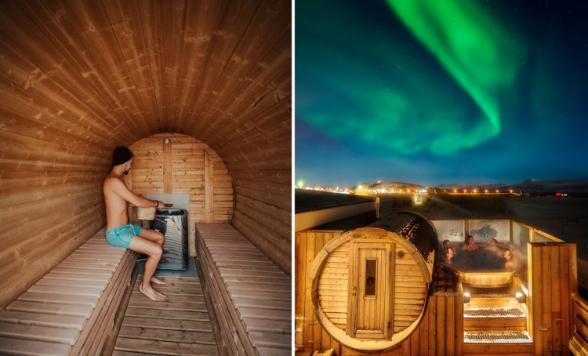

Photo Credit: Midgard Base Camp
Regenerative Concept
An abandoned South-Coast cement factory reborn as a “base-camp” hostel-plus-hub, proving how up-cycling industrial space can anchor rural tourism growth.
Signature Differentiators:
Rooftop sauna & hot-tub with views to Eyjafjallajökull volcano.
In-house adventure team curating hikes, ice-cave walks and super-jeep safaris - “locals-as-guides” authenticity.
Communal restaurant-lounge hosting live music, yoga and storytelling nights - builds a “family vibe” that review sites praise.
Case Study
Midgard Base Camp - in south of Iceland
Website: https://midgardbasecamp.is/
1

Slide 2

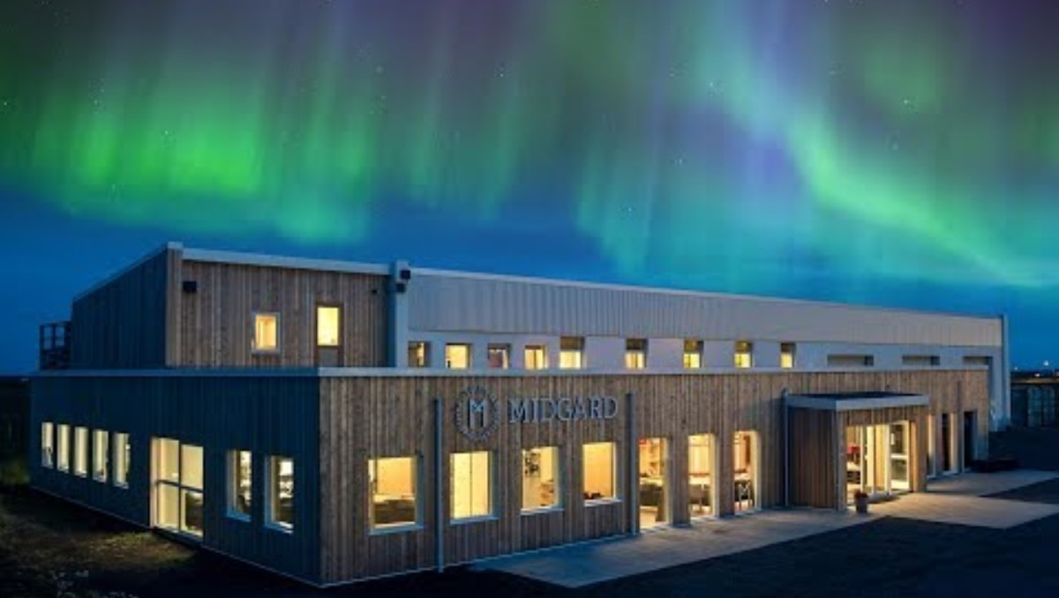
Case Study
Value for Guests:
bundled “Stay + Play” packages make trips simpler and often cheaper than booking beds, meals and tours separately, while the social design helps solo travellers find companions.
Value for Community & Planet:
Keeps spend in Hvolsvöllur via local-food sourcing and year-round jobs. Up-cycled structure, reclaimed-wood furniture and low-energy systems cut the embedded carbon.
Key take- away:
a clear, story-rich concept (industrial-site regeneration) paired with a crisp value proposition (“all-in-one adventure hub”) gives Midgard a defensible niche that resonates with its ideal guest segment - independent, experience-seeking travellers - while delivering economic, social and environmental returns.
Midgard Base Camp - in south of Iceland
2

