Slide 1
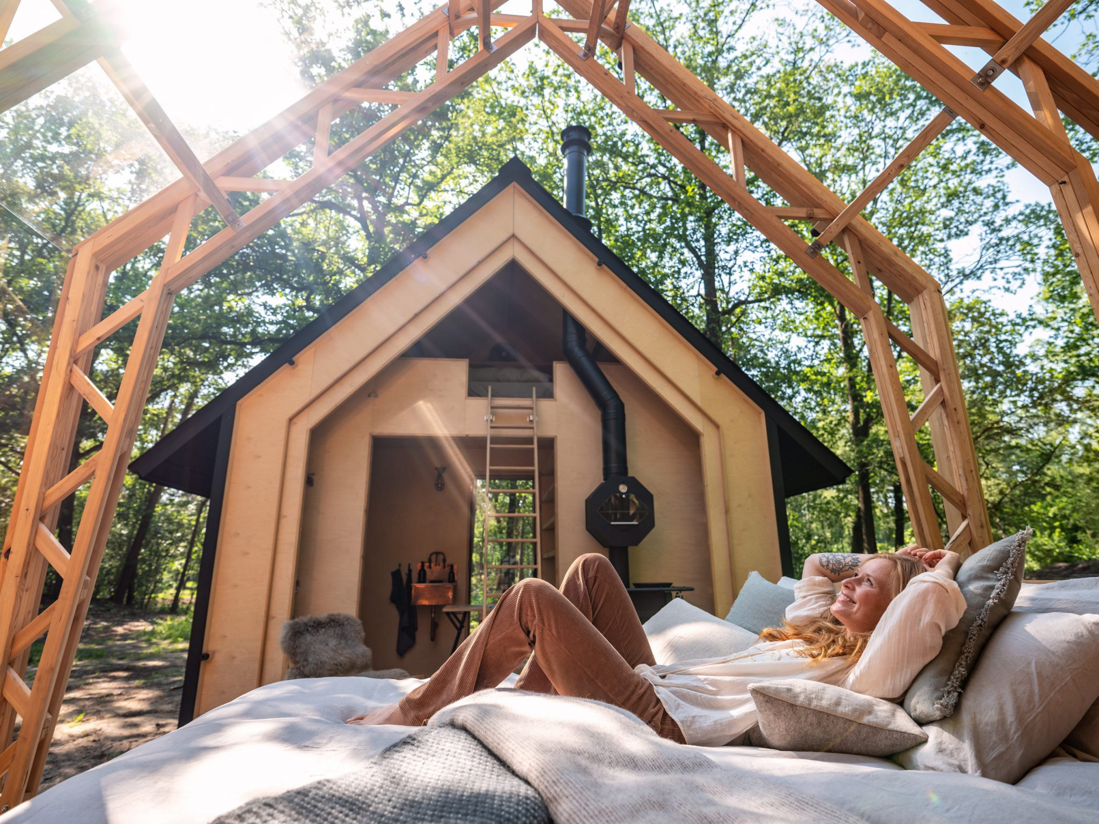
Case Study
https://www.holenberg.com/en/stay/
Holenberg, Netherlands
‘One of the best eco-friendly places to stay in Europe’

Slide 2
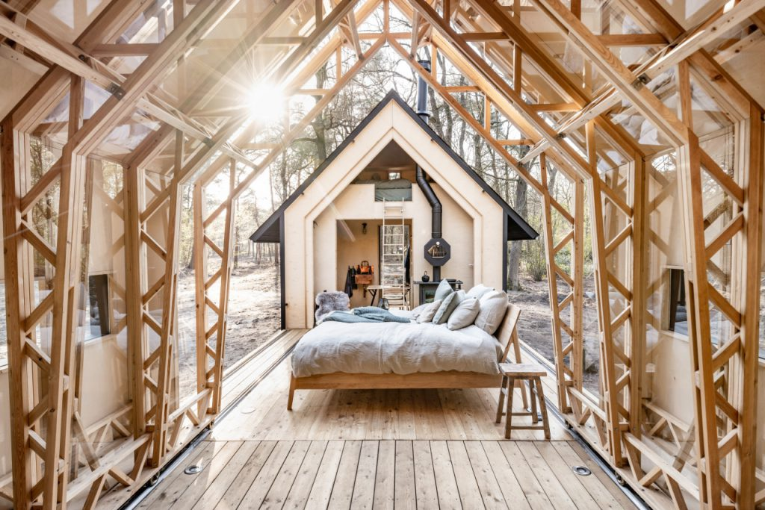
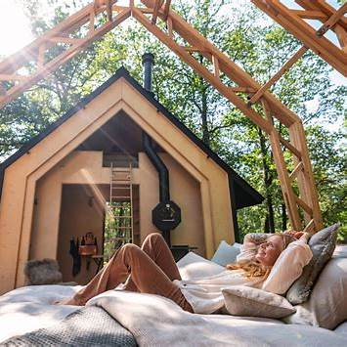
Case Study: Holenberg, NL
‘One of the best eco-friendly places to stay in Europe’
Dutch cabin resort Holenberg, NL featuring off-grid “ANNA” cabins was highlighted by The Guardian as one of Europe’s best eco-stays. Publicity like that can boost bookings and allow you to maintain strong rates year-round.
If sustainability is central to your brand, these certifications and the accompanying improvements can help justify your pricing to customers (they see it as supporting a good cause or paying for quality). Some eco-lodges find that, over time, they attract a more affluent and conscientious customer segment – guests who tend to stay longer or spend more on-site, thereby offsetting any cost increases.

Slide 3
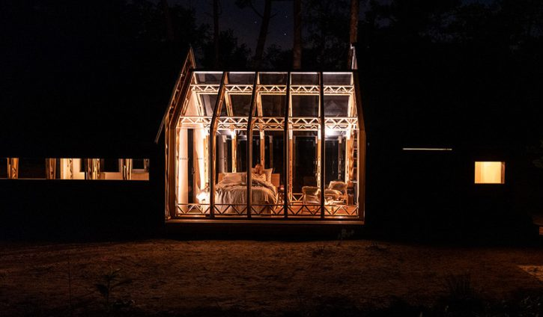
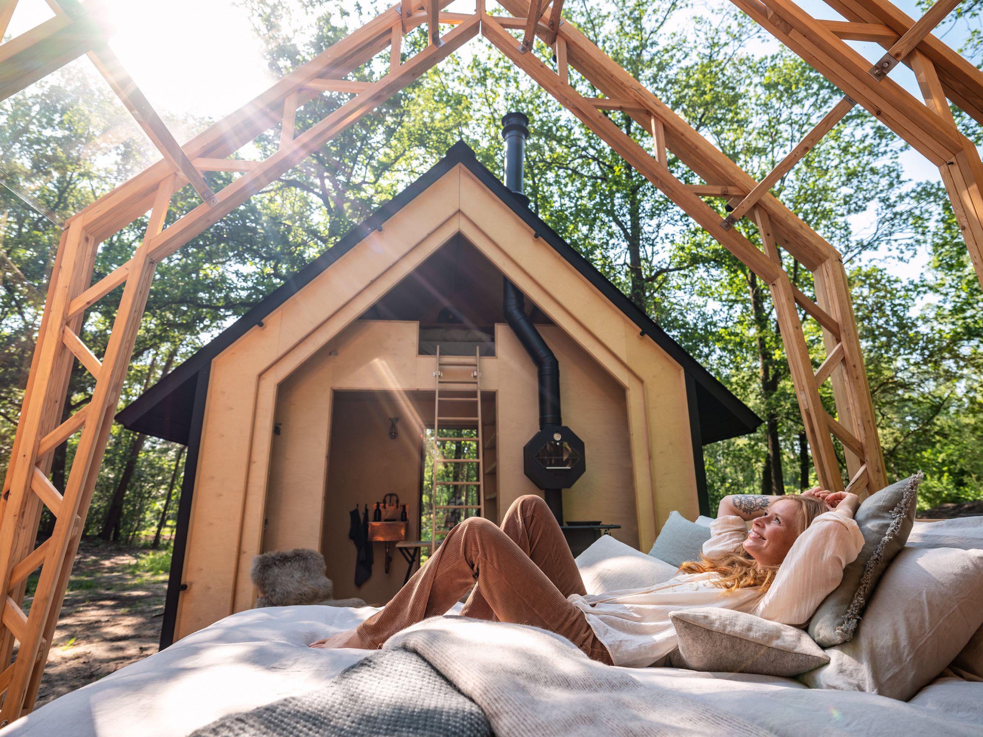


Case Study: Holenberg, NL
1. Deep connection with nature: In prime natural reserves, the cabins are designed to immerse guests in the environment.
2. Innovative, sustainable design: Built to adapt to weather and moods with a flexible layered design that reflects and respects its surroundings. Thoughtful architecture emphasises minimal environmental disruption while maximising natural comfort .
3. Strong eco‑credentials: Reduces environmental impact through off-grid energy, remote location, and a low‑impact operational ethos. It is running on minimal power and blending seamlessly with nature
read the full article in The Guardian
EPIC STAYS is licensed
under CC BY-SA 4.0
Funded by the European Union. Views and opinions expressed are however those of the author(s) only and do not necessarily reflect those of the European Union or the European Education and Culture Executive Agency (EACEA). Neither the European Union nor EACEA can be held responsible for them.

