Slide 1
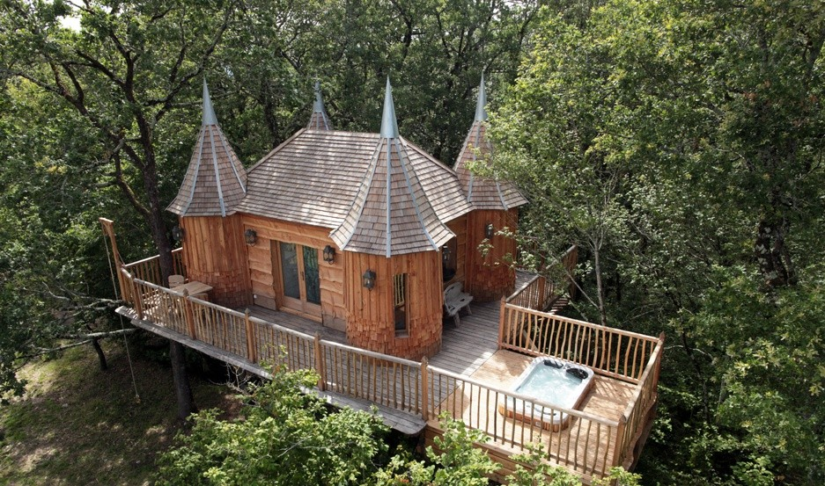
Accommodation Type: Luxury Treehouses
Start-Up Focus: High-end, eco-luxury treehouses with spa features, pool and located in a wooded park.
Ecological Impact: Each treehouse is constructed using locally sourced timber and features eco-friendly materials, emphasizing sustainability and harmony with nature. The accommodations are equipped with modern amenities, including private hot tubs, air conditioning, and Wi-Fi, offering guests a luxurious yet environmentally conscious experience.
Photo Credit: Châteaux dans Les Arbes
Case Study
Information Sources
Luxe Adventures, Tree House Castles You can Sleep In
Website: https://www.chateaux-dans-les-arbres.com/en/
Châteaux dans les Arbes (Castles in the Trees), France

Slide 2
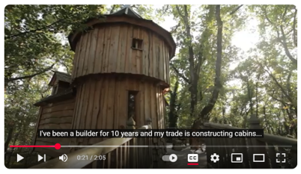
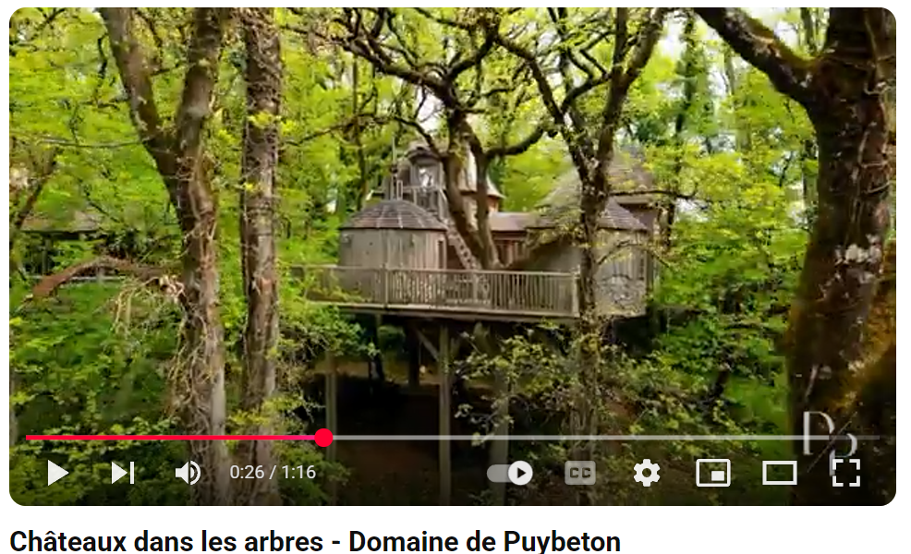
Click to See Videos
Link: https://www.youtube.com/watch?v=xlJfOzlCvIs
Click to Watch Video
Name: Rémi Becherel on Châteaux dans les Arbres
Video 1: Interview: Video 1 is an interview with Rémi Becherel, the founder, who discusses his passion for architecture and eight years of experience in building treehouses across France. He elaborates on his commitment to preserving the environment while crafting unique and luxurious spaces for guests.​
Video 2: Idea and Concept: This video showcases Chateaux dans les Arbres in all its beauty. It demonstrates Rémi's dedication and the meticulous planning that went into these treehouse designs. This piece explores the concept and design of the treehouse castles, noting their inspiration from nearby historic châteaux and the luxurious features that make for a memorable stay. (Source Uniq Hotels)
Interview with Remi Becherel
https://www.youtube.com/watch?v=kZaN-gg_KDI

Slide 3
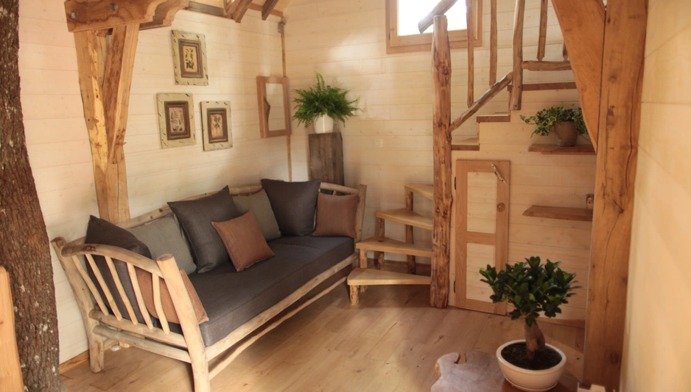
Alternative and Unique Accommodation: A collection of luxury treehouse accommodations inspired by traditional French castles. Founded by Rémi Becherel, a skilled carpenter with a passion for unique wooden structures, the project showcases his expertise in crafting intricate treehouses that blend seamlessly with the natural environment.
The Domaine de Puybeton, where these treehouses are situated, spans an 11-hectare park that was once a feudal stronghold. This historical context adds to the charm and uniqueness of the accommodations, allowing guests to immerse themselves in a setting that combines rich history with modern comfort.
Financial Journey: It is possible to start a business like this with a combination of personal investment and a bank loan. It is also common for projects of this nature to utilise grants, especially when focusing on eco-friendly construction and local craftsmanship.
Photo Credit: Châteaux dans Les Arbes
Châteaux dans les Arbes, France
Alternative Accommodation
3

Slide 4
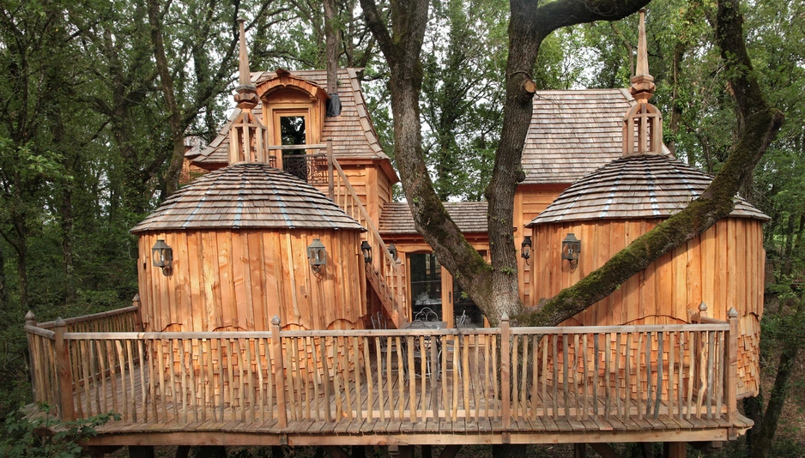
It is likely he heavily invested in eco-friendly materials, local artisan craftsmanship, and unique architectural design. In terms of business support, it is likely he worked with local tourism boards and used French government incentives for rural tourism development.
Potential Funding Sources
France, focusing on eco-tourism and sustainable development, often has access to various financial aids and grants. Here are some potential funding avenues that such projects might explore:​
ADEME (French Agency for Ecological Transition): offers financial assistance for initiatives that promote environmental sustainability, e.g., eco-friendly construction, renewable energy installations, and other green initiatives.
The Green Fund: Help local authorities and businesses improve environmental performance, adapt to climate change, and enhance living environments. They finance activities such as energy renovation of public buildings and promotion of waste sorting.
Photo Credit: Châteaux dans Les Arbes
Châteaux dans les Arbes, France
Idea & Funding Sources
4

Slide 5
Potential Funding Sources
Continued…
Regional Tourism Development Funds: Various regions in France offer grants and financial support to promote tourism and local development. For example, the Responsible & Solidarity Tourism Fund supports projects that transform tourism to be more eco-responsible and inclusive. Businesses operating in specific regions should consult local tourism authorities for available funding opportunities.
Cultural Heritage Grants: For projects involving the restoration or preservation of historical sites, cultural heritage grants are available. These grants often require the use of registered architects and adherence to specific guidelines to ensure the preservation of cultural assets. ​
ECOTOURS Project Support: The ECOTOURS Project offers financial support to Micro, Small, and Medium Enterprises (MSMEs) in France that are developing sustainable tourism products. The support is indicatively €6,650 per beneficiary, divided into three tranches, aimed at promoting eco-tourism initiatives. ​
5

Slide 6
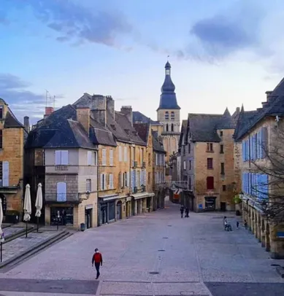
Key Takeaways
Châteaux dans les Arbres demonstrates the importance of a high-quality, sustainable offering that appeals to eco-conscious consumers, leveraging local resources and strategically managing finances. With the right mix of innovation, local collaboration, and careful financial planning, such businesses can thrive in the growing ecotourism market.
Use Eco-Friendly Materials to Attract Conscious Consumers: Eco-tourism is a booming sector. By aligning your accommodation with this movement, e.g., incorporating eco-friendly materials and green construction methods, you will reduce your environmental footprint but also attract customers who are willing to pay more for experiences that reflect their values.
Photo Credit: Châteaux dans Les Arbes

Slide 7


Key Takeaways
Investing in a Premium Experience Justifies Higher Rates: Investing in a premium, high-end, luxury experience with eco-friendly treehouses, unique architectural design, and high-quality, sustainable materials can justify higher nightly rates.
Leverage Local Artisan Craftsmanship: Partner with local artisans and businesses to offer a more authentic and sustainable product. It helps to support the local economy, minimise costs and ensure that the offering is aligned with the community and environment.
Access Government and Regional Incentives, e.g., rural tourism development programs and government incentives aimed at supporting eco-tourism and rural economic growth.
A clear Business Plan and Strategic Investment are needed to understand the scope of capital required. Thoughtful, staged investment and knowing when to use personal or borrowed funds will help manage financial risks effectively.
Creating a Unique Selling Proposition (USP) helps you differentiate your offering from competitors. Whether through unique accommodation types, exceptional sustainability practices, or bespoke experiences, a strong USP can make your business stand out.
EPIC STAYS is licensed
under CC BY-SA 4.0
Funded by the European Union. Views and opinions expressed are however those of the author(s) only and do not necessarily reflect those of the European Union or the European Education and Culture Executive Agency (EACEA). Neither the European Union nor EACEA can be held responsible for them.
7

