Slide 1
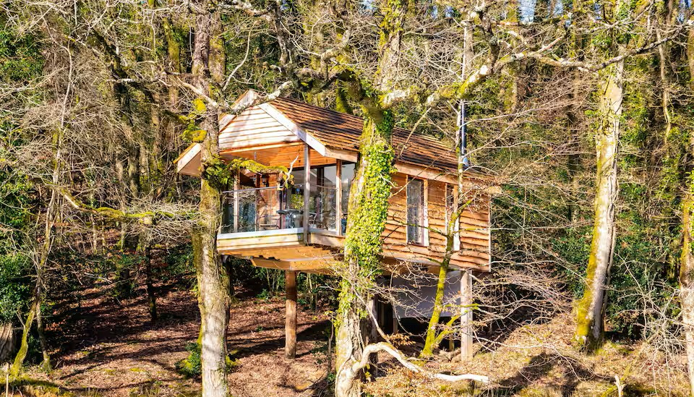

Accommodation Type:
Tree Houses above the tree-tops and above a private lake. The cosy treehouse comes with a log-burner and breathtaking views from the balcony. Completely secluded with only birds and wild deer who roam the forest as neighbours.
Uniquenesss
The Yeworthy Eco-Treehouse is an incredible off-grid retreat. Nestled in a secluded setting amongst the tree-tops above a lake, it's the perfect hideaway for couples seeking a romantic, peaceful escape.
Case Study
Treehouse in Eworthy, United Kingdom
Website: Treehouse
1

Slide 2
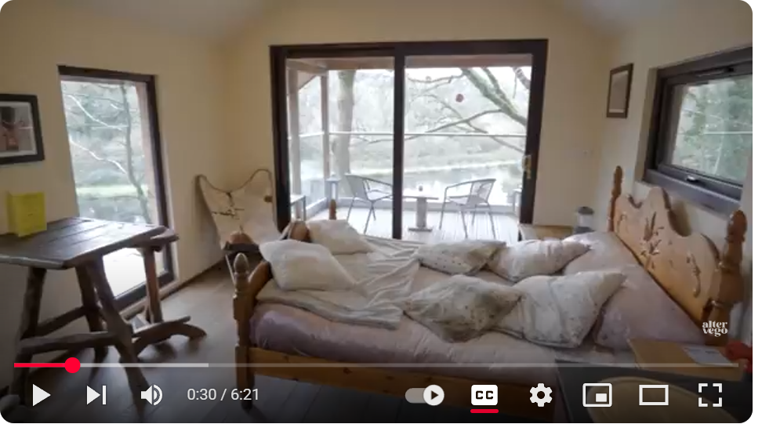
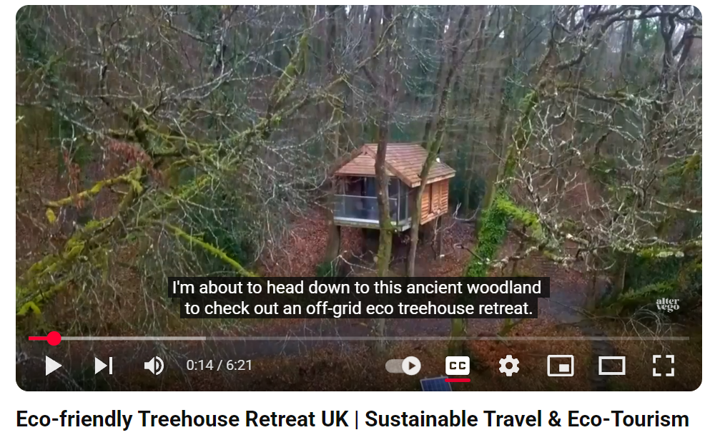


Case Study: The Yeworthy Eco-Treehouse
Off-grid Eco Treehouse Retreat
Fresh water is provided for guests from a bowser. The private, eco-friendly, sawdust toilet is in a separate structure nestled amongst the trees. Guests are met by the owners who will transport you down to the treehouse in a jeep. Guests will have access to the jeep for the duration of their stay.
The Yeworthy Treehouse is a perfect getaway for those who want to get back to nature, sleep amongst the stars and enjoy the peace and tranquillity that the setting provides.
Click To Watch
EPIC STAYS is licensed
under CC BY-SA 4.0
https://www.youtube.com/watch?v=49WRSFRq3e4
Funded by the European Union. Views and opinions expressed are however those of the author(s) only and do not necessarily reflect those of the European Union or the European Education and Culture Executive Agency (EACEA). Neither the European Union nor EACEA can be held responsible for them.
Airbnb - Finest Retreats | Yeworthy Eco-Treehouse

Slide 3
