Slide 1
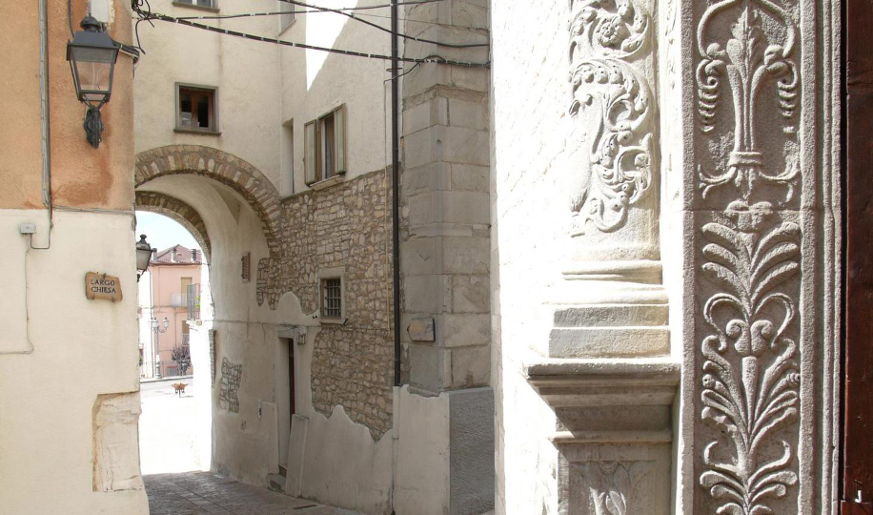

Photo Credit: Châteaux dans Les Arbes
Accommodation Type:
Restored stone guesthouse within a historic watermill complex in the village of Roseto Valfortore, offering immersive, community-rooted stays.
Start-Up Focus:
La Locanda del Mugnaio is a community-driven accommodation initiative developed by the A.RI.A. cooperative. It aims to revive the rural economy by transforming a disused local mill into a welcoming B&B, creating new livelihood opportunities through sustainable tourism.
Case Study
La Locanda del Mugnaio – Roseto Valfortore, Monti Dauni, Italy
Source https://www.borghiautenticiditalia.it/
borgo/roseto-valfortore
Website: https://www.visitmontidauni.it/roseto- valfortore/
1

Slide 2

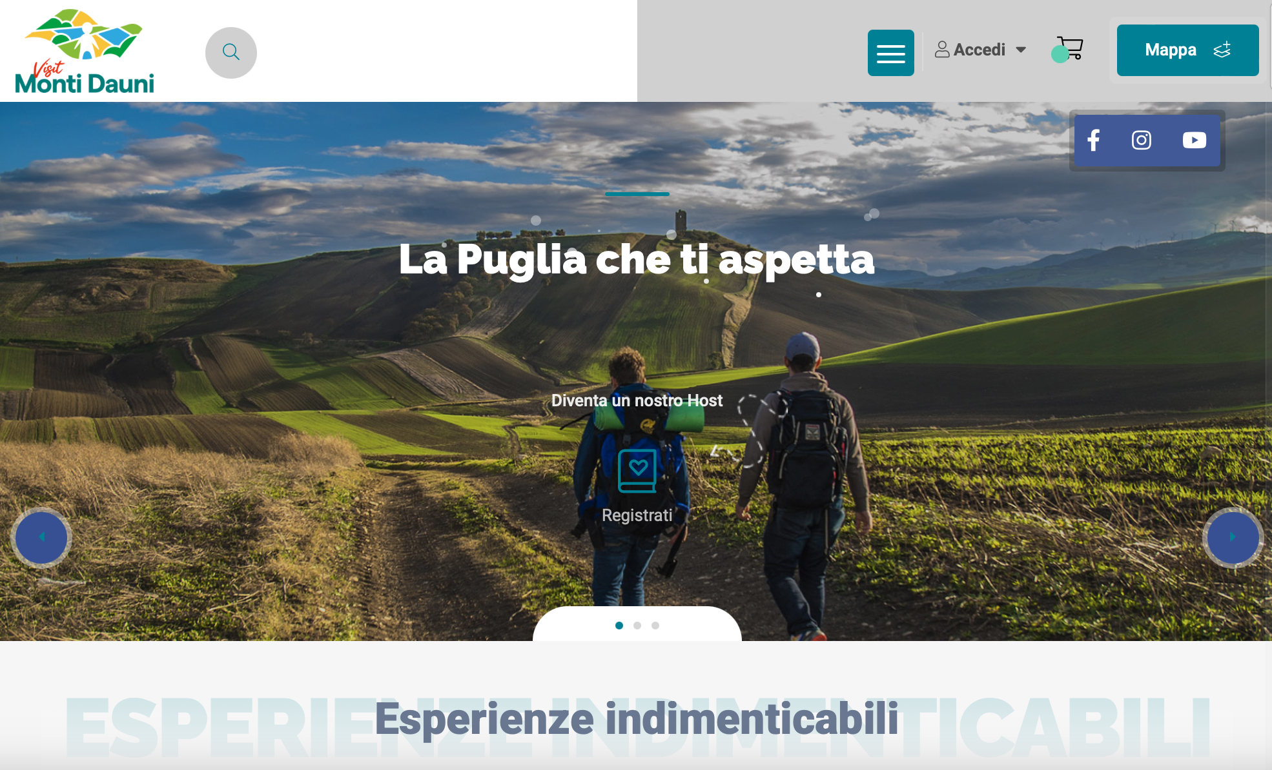
Case Study
Ecological Impact:
The guesthouse was renovated using traditional techniques and local stone, preserving the architectural integrity of the historic structure. Its location within the village reduces the need for new infrastructure, supporting a low-carbon, slow-tourism model. By sourcing food locally, promoting walking trails, and involving residents in the guest experience, the Locanda fosters ecological awareness, cultural preservation, and circular
La Locanda del Mugnaio – Roseto Valfortore, Monti Dauni, Italy
Click to Website
Source https://www.borghiautenticiditalia.it/
borgo/roseto-valfortore
Website: https://www.visitmontidauni.it/roseto- valfortore/
2

Slide 3
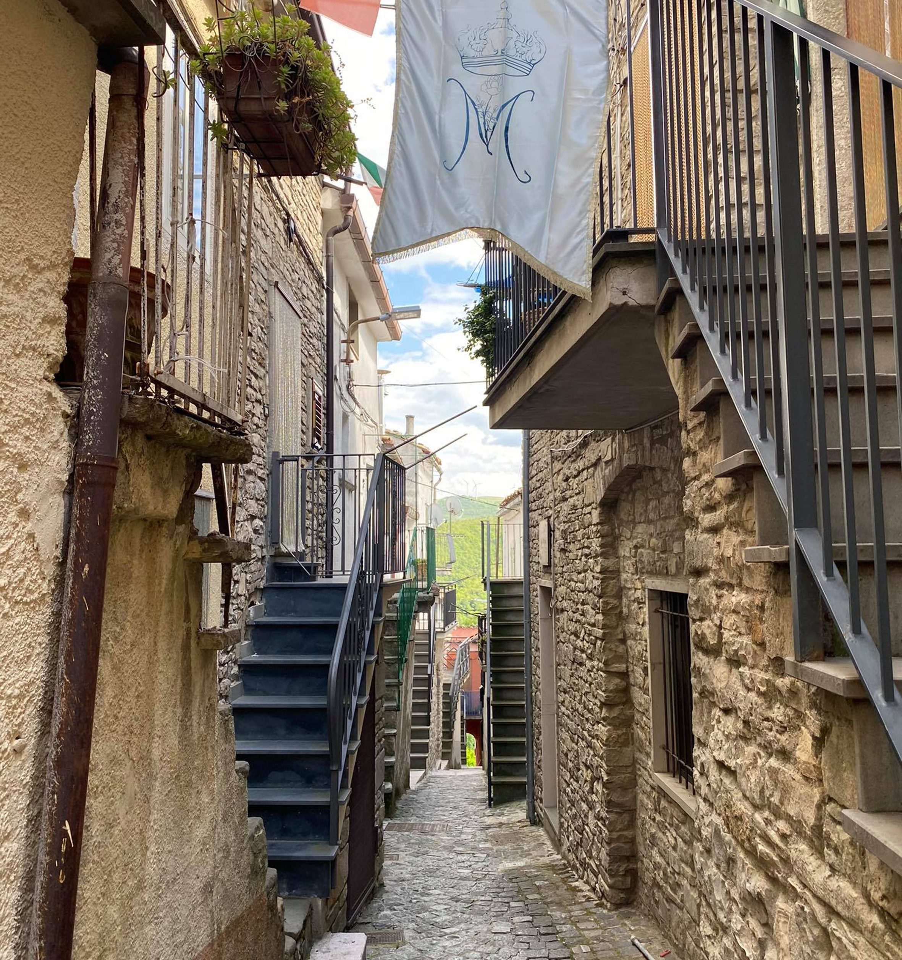
Key Takeaways
Respecting Local Scale Creates Authenticity and Balance
The Locanda del Mugnaio offers a small number of rooms, designed to match the village’s infrastructure and social rhythm. This right-sized approach avoids the strain of over-tourism, fosters genuine interactions between guests and residents, and supports the slow pace of life that defines Roseto Valfortore.
Photo Credit: Meridaunia
3

Slide 4
Key Takeaways
Regenerating Historic SpacesBuilds Cultural and Economic Value
By restoring a historic mill and repurposing it as a hospitality venue, the Locanda preserves local heritage while creating a new economic use for the space. This aligns with adaptive reuse principles and demonstrates how cultural preservation can go hand-in-hand with sustainable development.
Integrating Local Products Strengthens the Value Chain
The Locanda highlights Roseto’s agri-food identity by offering local cheese, bread, and cured meats, all sourced from nearby producers. This strengthens short supply chains, ensures income for local farmers and artisans, and gives visitors a direct taste of the territory.
Community-Centered Hospitality Enhances Resilience Locanda del Mugnaio is not just a place to stay - it is embedded in the life of the village. Its operations involve local workers, craftspeople, and storytellers, ensuring that the economic benefits of tourism are widely shared. This model exemplifies how hospitality businesses can be designed as part of a broader community ecosystem.
4

Slide 5
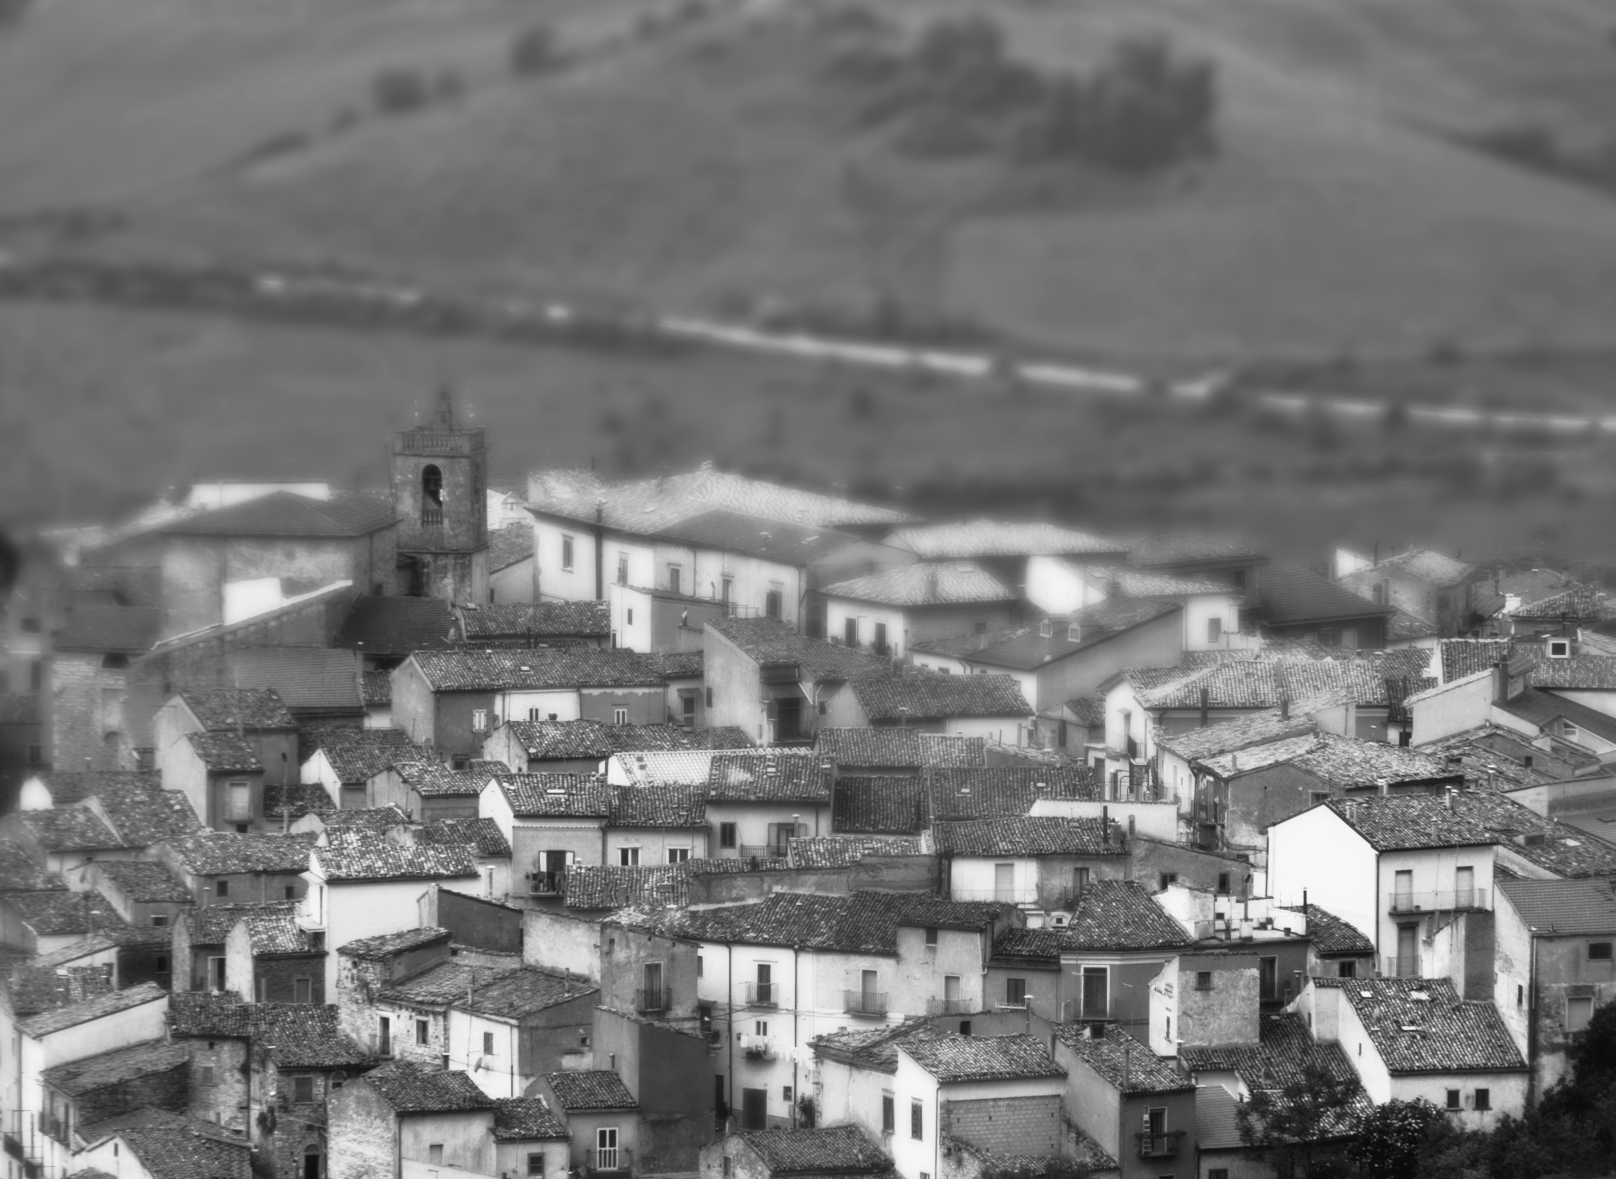
"When tourism listens to the rhythm of a place, not only does it preserve its soul—it becomes a force for regeneratio"
Photo Credit: Meridaunia
5

Slide 6
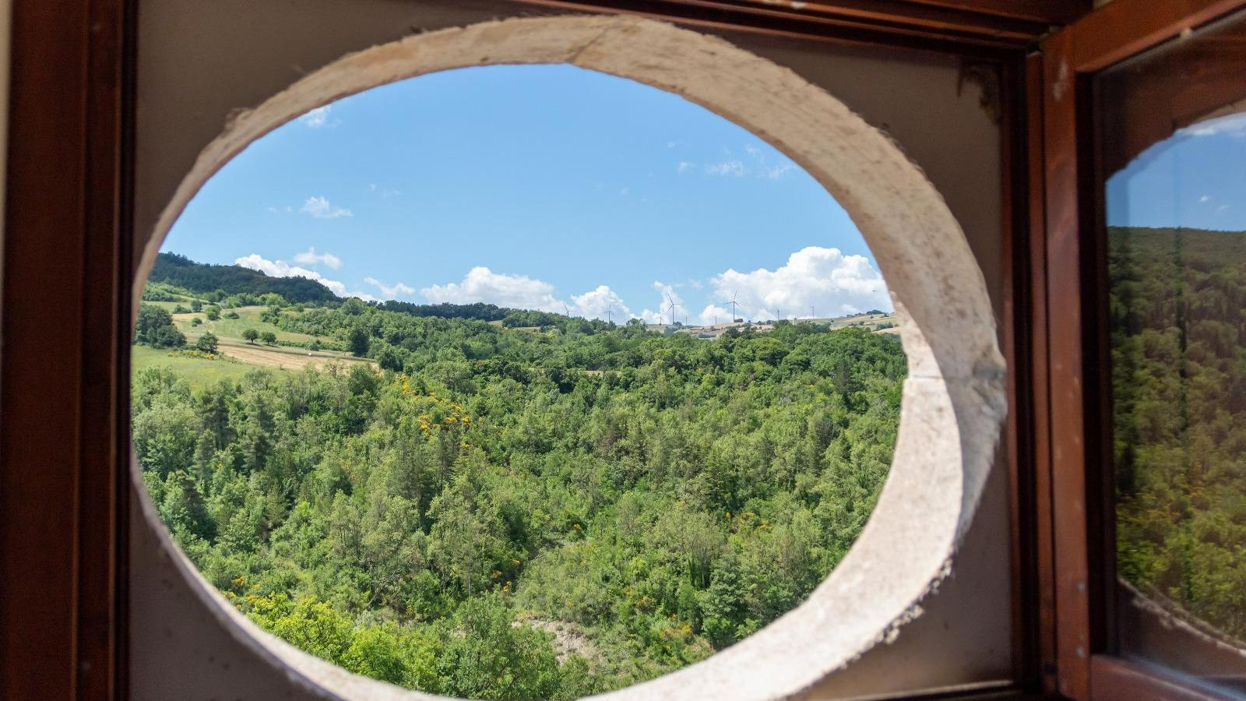


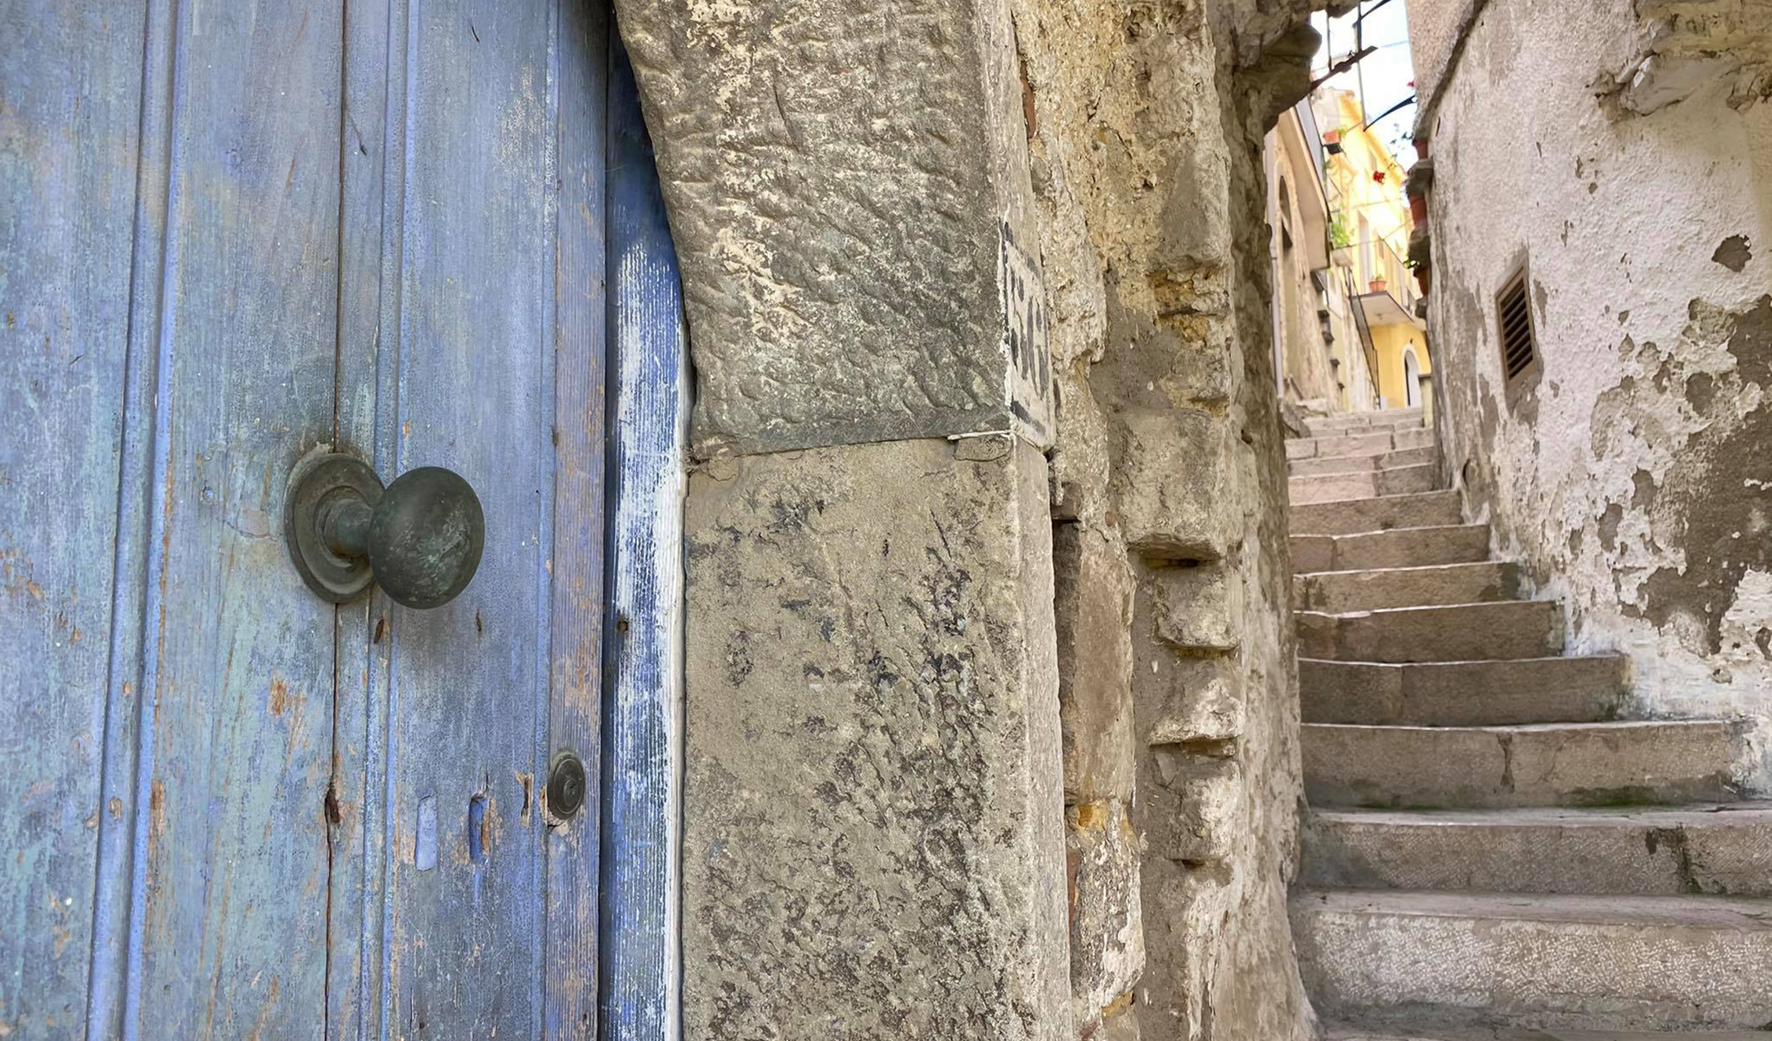
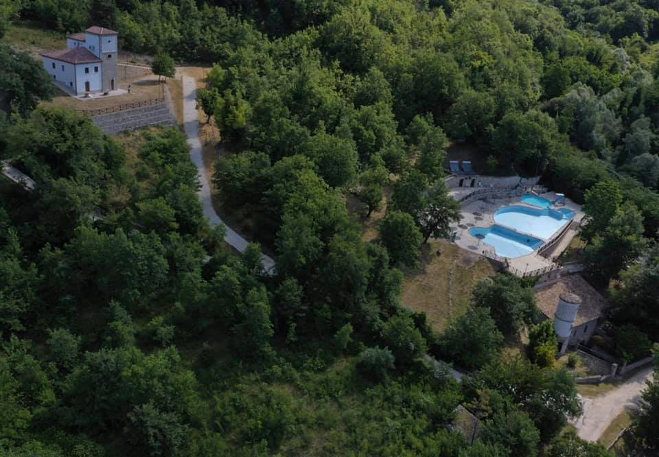
ITALY
Photo Credit: Visit Monti Dauni, Meridaunia
6

