Slide 1
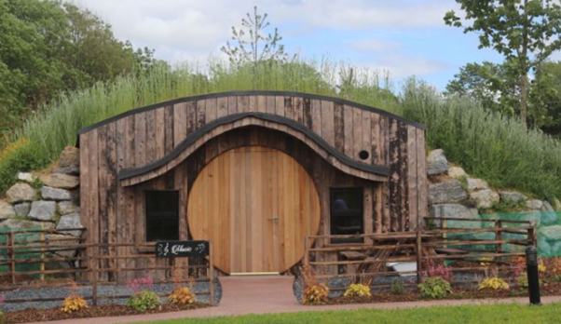
Case Study
https://www.glampingunderthestars.ie/music-house/
Emo Court Glamping, Ireland
Family Friendly Glamping on The Wild Atlantic Way

Slide 2
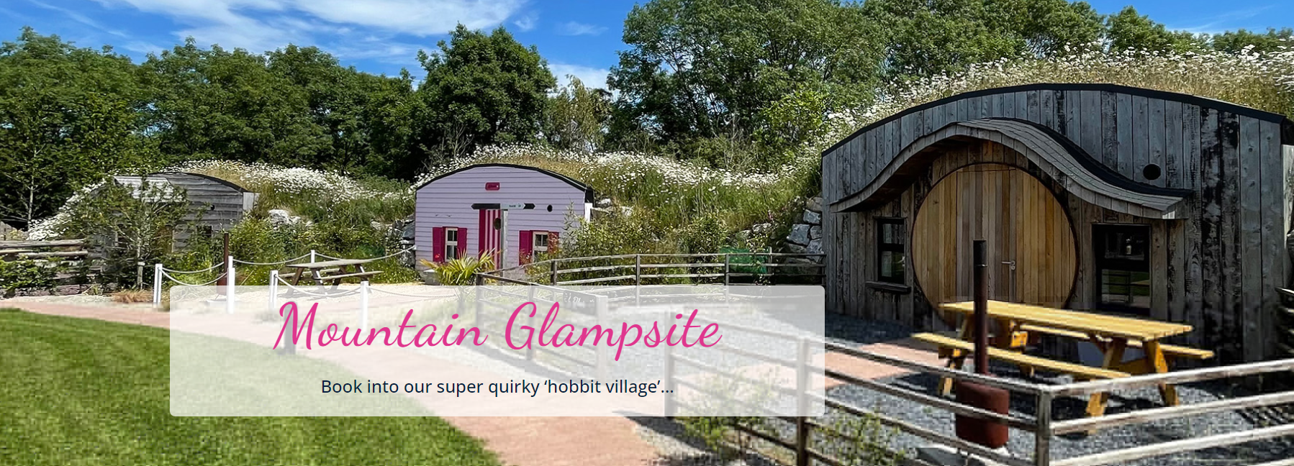

Slide 3
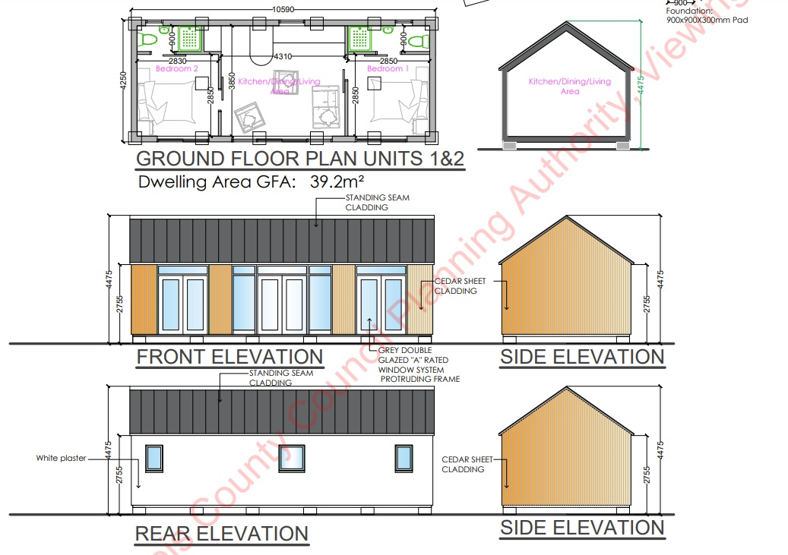
Case Study: Emo Court Glamping,
Bespoke Family Friendly Glamping on The Wild Atlantic Way
A luxury glamping site Emo Court Glamping , and a horse-drawn wagon, a glamorous camping destination in Laois have secured funding of €550,000. .
Failte Ireland Scheme: The Laois tourist destinations were among 17 tourist projects that were awarded a total of €2.9million investment under Fáilte Ireland’s Private and Community SME Scheme, which is part of the EU Just Transition Fund programme. .
Website: https://www.glampingunderthestars.ie/emo-court/
https://www.glampingunderthestars.ie/emo-court/

Slide 4
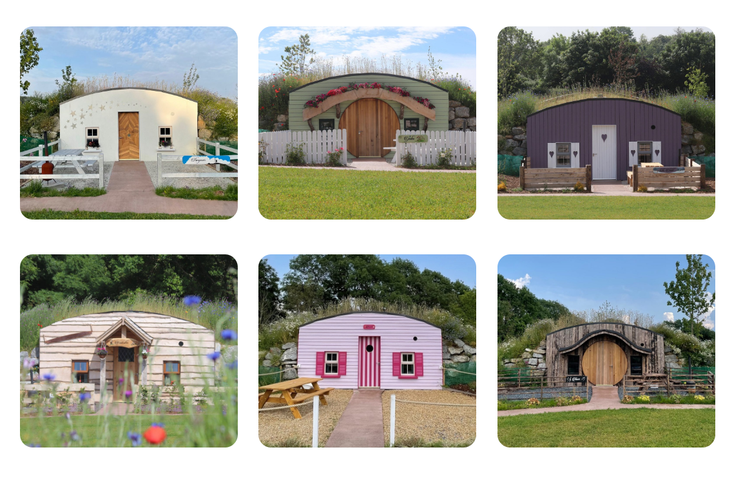

Slide 5


Case Study: Emo Court Glamping,
Bespoke Family Friendly Glamping on The Wild Atlantic Way
Outcome: Two Laois projects were selected in category two of the scheme which is aimed at the development of sustainable tourism. The largest Laois beneficiary was Emo Court Glamping, which secured a total of €300,000 for the delivery of luxury eco glamping huts, including a wheelchair accessible hut. Planning permission was granted for three standalone pod units at the Gate Lodge.
Website: https://www.glampingunderthestars.ie/emo-court/
EPIC STAYS is licensed
under CC BY-SA 4.0
Funded by the European Union. Views and opinions expressed are however those of the author(s) only and do not necessarily reflect those of the European Union or the European Education and Culture Executive Agency (EACEA). Neither the European Union nor EACEA can be held responsible for them.

Slide 6
