Slide 1
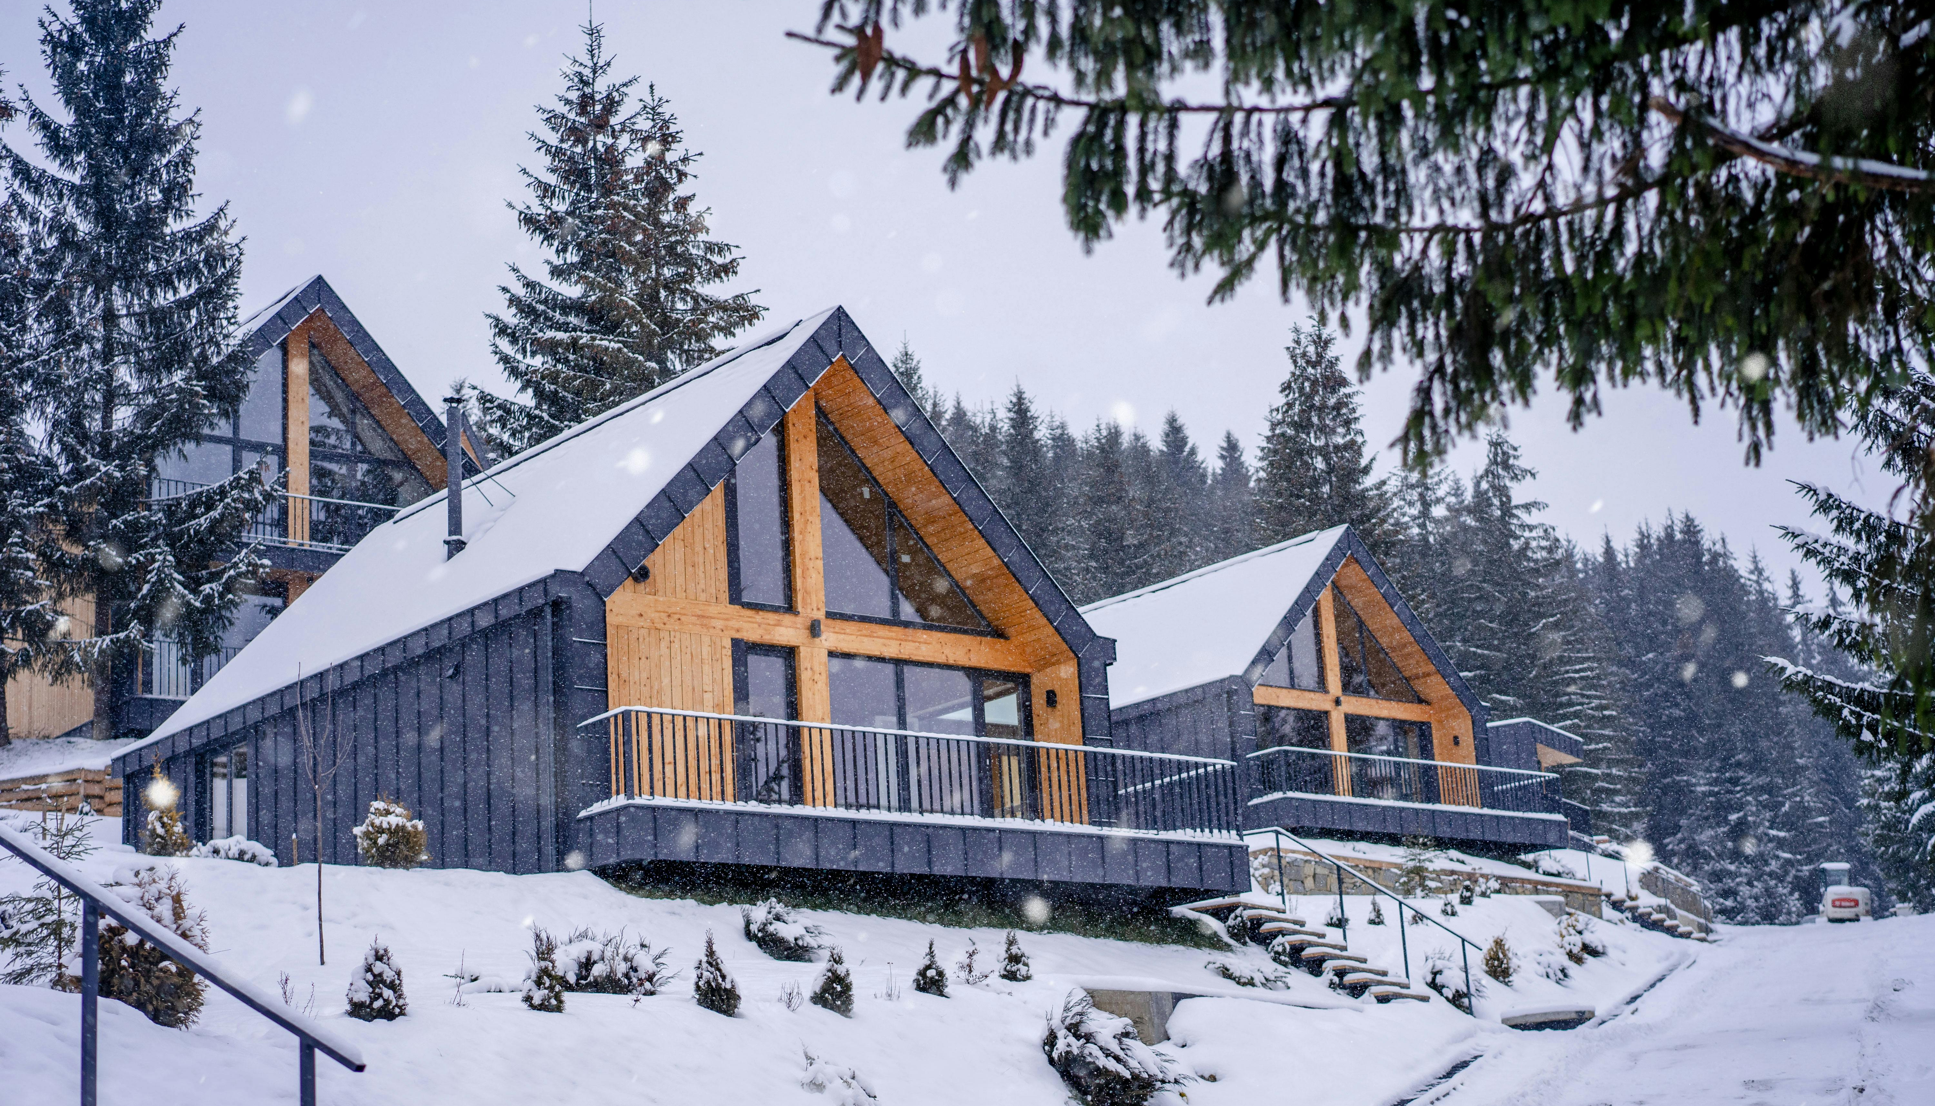


Inside the Free Resource—
We’ve created Sample Budgets for Glamping that give you a realistic picture of costs at different scales:
1 Pod or Tiny Cabin (€53,000 – €201,000) – A good way to test the market without huge investment.
2 Furnished Tents (€428,700 – €452,700) – More setup but also more income potential.
5–10 Units (€150,000 – €573,000) – A serious investment for those ready to grow into a larger business.
FREE Resource
﻿﻿Financial Planning, Budgeting & Costing
EPIC STAYS is licensed
under CC BY-SA 4.0
Funded by the European Union. Views and opinions expressed are however those of the author(s) only and do not necessarily reflect those of the European Union or the European Education and Culture Executive Agency (EACEA). Neither the European Union nor EACEA can be held responsible for them.

Slide 2
Financial Planning & Costs
Sample Budget – Glamping (1 Unit – Basic Pod or Tiny Cabin)
Item | Est Cost Range (€) | Tips
Land purchase (1-3 acres) | €10,000 – €80,000 | Prices vary by location, zoning, and access. Consider leasing first.
Planning Permission & Reports | €2,500 – €12,000 | Includes application fees, environmental assessments, and consultant fees.
Basic Pod / Tiny Cabin | €6,000 – €12,000 | Entry-level glamping pod or wooden unit. Prefab can save time/money.
Luxury Pod / Eco Modular Unit | €15,000 – €40,000 | Includes insulation, bathroom, kitchen, and heating.
Solar Power Setup | €4,000 – €10,000 | Varies by system size and battery storage.
Water & Waste Systems | €5,000 – €20,000 | Includes septic tanks, composting toilets, or reed bed systems.
Pathways, Lighting, Signage | €1,000 – €4,000 | Use gravel paths and solar lights to save costs.
Furnishings & Fit-Out (per unit) | €1,500 – €5,000 | Opt for upcycled or local second-hand where possible.
Marketing & Branding | €1,000 – €3,000 | Website, logo, social media setup, initial photography.
Insurance & Maintenance Setup | €2,000 – €5,000 | Initial setup costs for guest liability and general insurance.
Contingency | €5,000 – €10,000 | Always plan extra
Total Estimate: | €53,000 – €201,000

Slide 3

Financial Planning & Costs
Sample Budget – Glamping (2 Units – 2 Glamping Tents)
Item | Cost (€) | Notes
Land purchase | 327,000 | Excl. taxes
2 Glamping tents | 71,200 | Fully furnished
Permits/advice | 5,000–10,000 | Local costs
Insurance | 2,500 | Annual
Solar power | 8,000–15,000 | Basic setup
Septic system | 6,000–10,000 | For 2 units
Parking access | 3,000–5,000 | Gravel road
Website/booking | 1,000–2,000 | Platform setup
Contingency | 5,000–10,000 | Always plan extra
Total Estimate: | €428,700 – €452,700
Use the Crossover Lodge ROI Calculator to calculate your ROI.
How To Start, Set Up, And Build A Profitable Glamping Business

Slide 4
Financial Planning & Costs
Sample Budget – Glamping (5-10 Units – Glamping Tents)
Item | Est Cost Range (€) | Tips
Land purchase or lease (5-10 glamping units) | €50,000 – €300,000+ | Prices vary by location, zoning, and access. Consider leasing first. Leasing can lower upfront cost.
Planning Permission & Reports | €2,500 – €12,000 | Includes application fees, environmental assessments, and consultant fees.
Permits & Professional Fees | €5,000 – €20,000 | Planning permits, environmental assessments, legal and accounting fees. Varies by country regulations.
Accommodation Units | €6,000 – €45,000 | Entry-level glamping pod or wooden unit. Prefab can save time/money. E.g. 10 units × €6k–€45k each (tents, pods, cabins) including basic interiors. Scale down for fewer units.
Accommodation Units Basic Pod / Tiny Cabin | €6,000 – €12,000 | Entry-level glamping pod or wooden unit. Prefab can save time/money.
Luxury Pod / Eco Modular Unit | €15,000 – €45,000 | Includes insulation, bathroom, kitchen, and heating.
Utilities & Infrastructure | €40,000 – €150,000 | Water supply (wells/connection), electricity (grid or solar), sewage (septic or treatment)touchstay.com, Wi-Fi setup, etc.

Slide 5
Item | Est Cost Range (€) | Tips
Solar Power Setup | €4,000 – €10,000 | Varies by system size and battery storage.
Water & Waste Systems | €5,000 – €20,000 | Includes septic tanks, composting toilets, or reed bed systems.
Pathways, Lighting, Signage | €1,000 – €4,000 | Use gravel paths and solar lights to save costs.
Furnishings & Amenities | €30,000 – €100,000 | Beds, linens, furniture, décor, hot tubs or stoves, etc. Can start simple and upgrade over time.
Furnishings & Fit-Out (per unit) | €1,500 – €5,000 | Opt for upcycled or local second-hand where possible.
Marketing & Branding | €5,000 – €25,000 | Branding, website development, initial advertising. Many startups start small (basic website, logo, social media and initial photography.
Insurance & Maintenance Setup | €2,000 – €5,000 | Initial setup costs for guest liability and general insurance.
Contingency | €25,000 – €100,000 | Always plan extra. Have a Reserve plan or fund for unexpected costs (recommend 10–20% of total). Crucial in case of construction overruns or delays.
Total Estimate: | €150,000 – €573,000
Starting a glamping business: full guide
EPIC STAYS is licensed
under CC BY-SA 4.0
Funded by the European Union. Views and opinions expressed are however those of the author(s) only and do not necessarily reflect those of the European Union or the European Education and Culture Executive Agency (EACEA). Neither the European Union nor EACEA can be held responsible for them.

