Slide 1
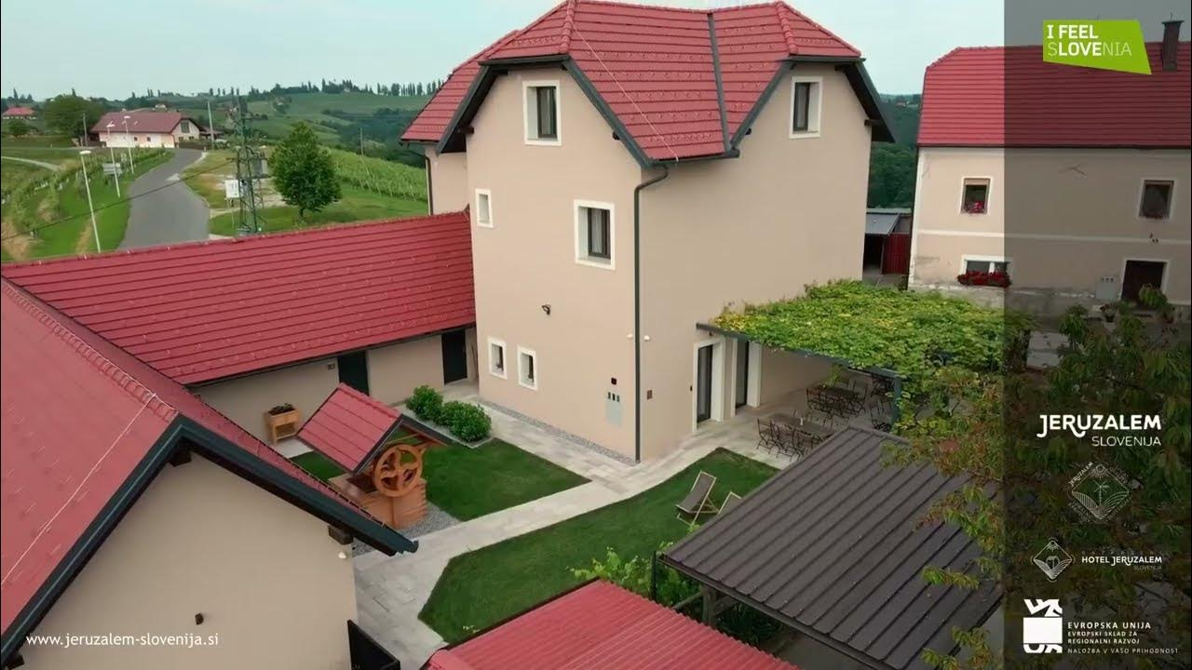

Photo Credit: Dispersed hotel Jerusalem Slovenia
Accommodation Type:
Dispersed hotel
Concept:
The Dispersed Hotel Jeruzalem represents an innovative approach to alternative accommodation that revitalises the wine-growing region of Prlekija, Slovenia. Instead of a single building, the “hotel” is spread across several carefully restored village houses and apartments, allowing visitors to experience authentic local life while enjoying the benefits of a hotel-like service structure.
Case Study
Dispersed hotel Jeruzalem, Slovenia
Website: https://www.jeruzalem-slovenija.si/en-gb/nastanitve/razprseni-hotel
1

Slide 2
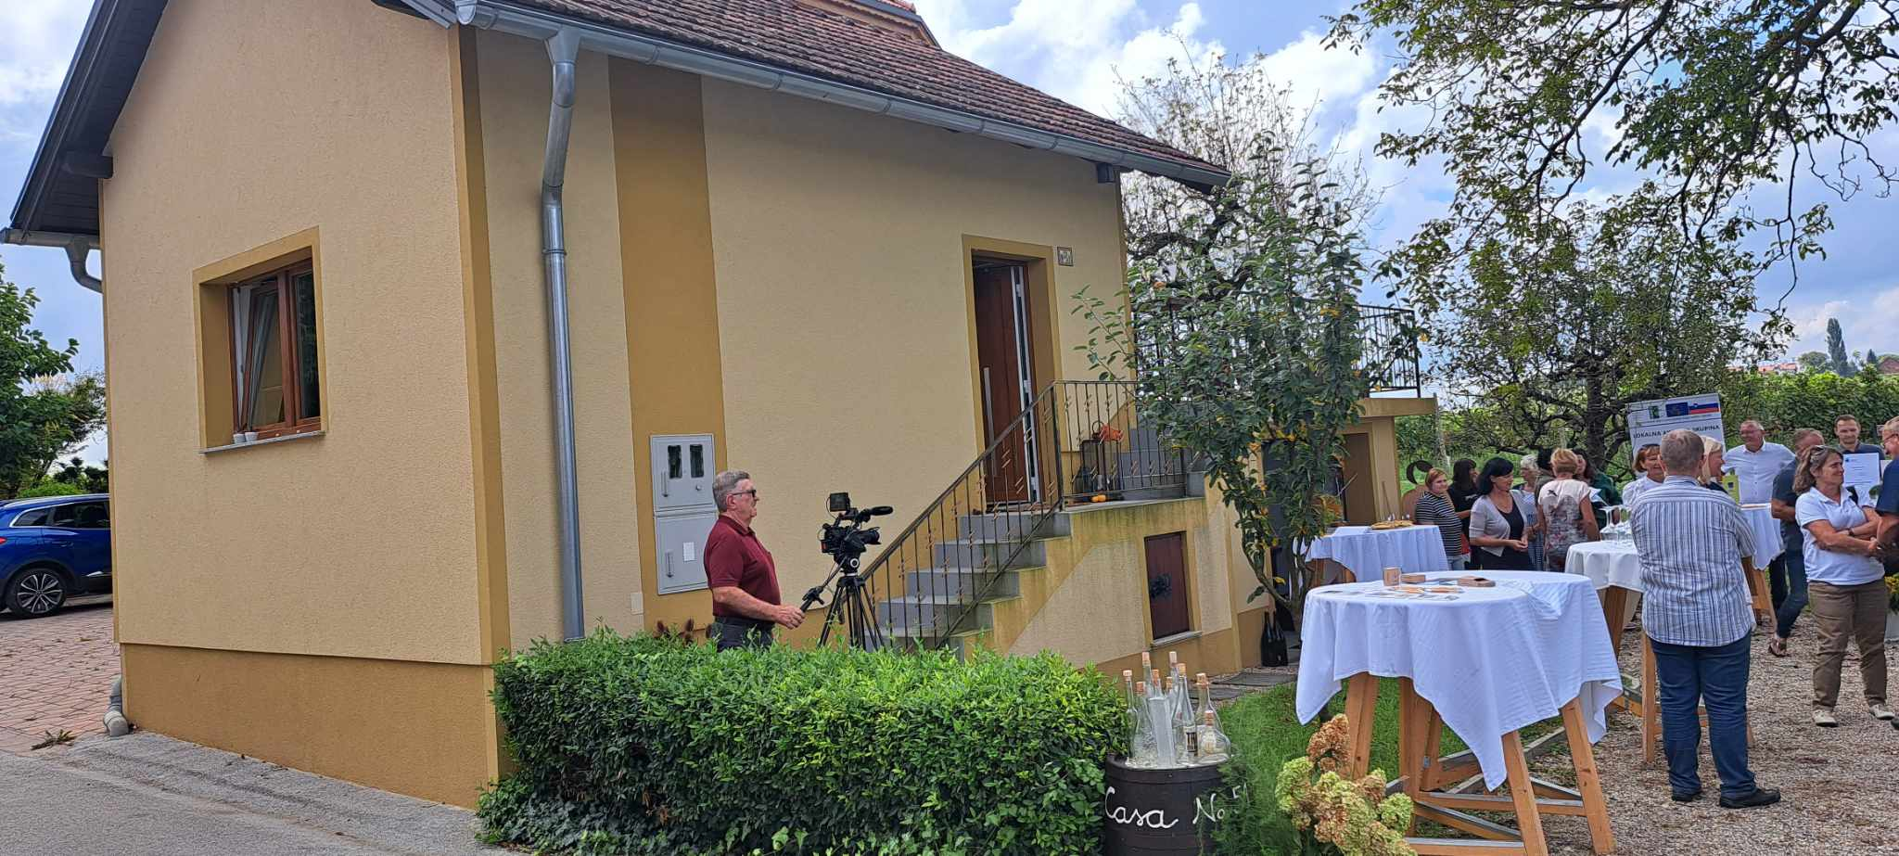
Case Study
Value Proposition:
The Jeruzalem Dispersed Hotel shows that alternative accommodation can be more than a place to sleep—it can be a living ecosystem of culture, community, and sustainability. The model is inspired by the Italian concept albergo diffuso but adapted to the Slovenian cultural and geographical context. It merges tradition with modern hospitality, offering centralised reception, guest services, and coordinated promotion, while preserving the authenticity of independent village dwellings. Guests are invited to immerse themselves in the cultural landscape of Jeruzalem’s rolling vineyards and unique heritage.
Dispersed hotel Jeruzalem, Slovenia
Website: https://www.jeruzalem-slovenija.si/en-gb/nastanitve/razprseni-hotel

