Slide 1
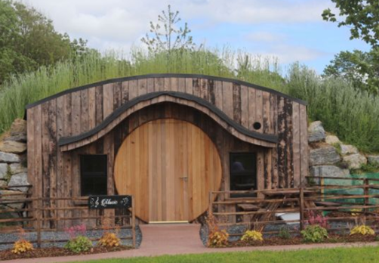
Case Study
https://www.glampingunderthestars.ie/music-house/
Glamping Under the Stars
Laois, Ireland
Low Impact, Family Friendly Glamping
Image source: https://www.glampingunderthestars.ie/

Slide 2
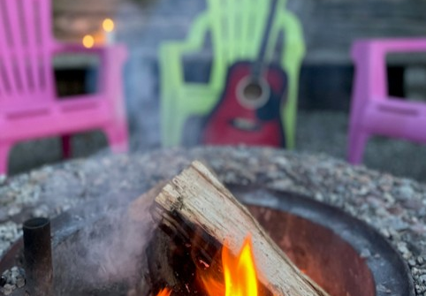
Glamping Under the Stars
A Magical Stay with a Clear Mission
This case study explores a family-operated glamping destination in rural County Laois, part of Ireland’s Ancient East, with a strong commitment to low-carbon and low-impact practices.
Glamping Under the Stars was founded with a clear mission to create magical, memorable stays while protecting and enhancing the natural environment.
Image source: https://www.glampingunderthestars.ie/

Slide 3
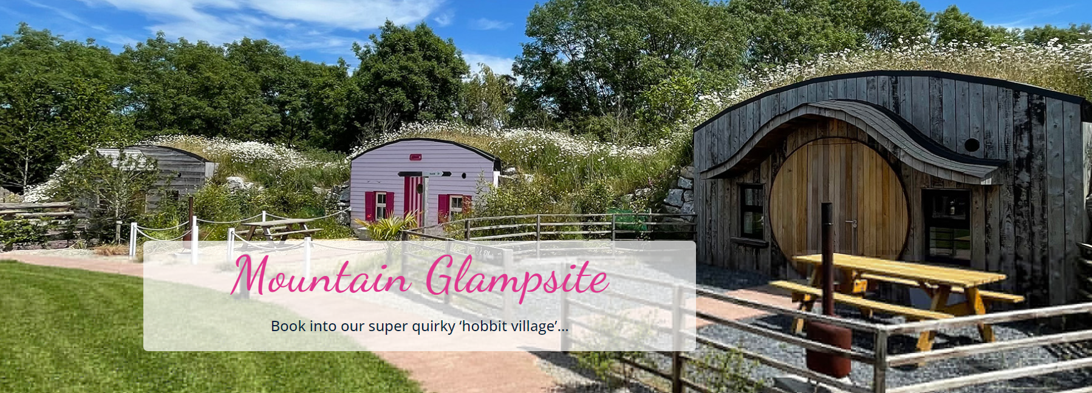


The Hobbit Village: Immersive & Sustainable Design
EPIC STAYS is licensed
under CC BY-SA 4.0
Funded by the European Union. Views and opinions expressed are however those of the author(s) only and do not necessarily reflect those of the European Union or the European Education and Culture Executive Agency (EACEA). Neither the European Union nor EACEA can be held responsible for them.

Slide 4
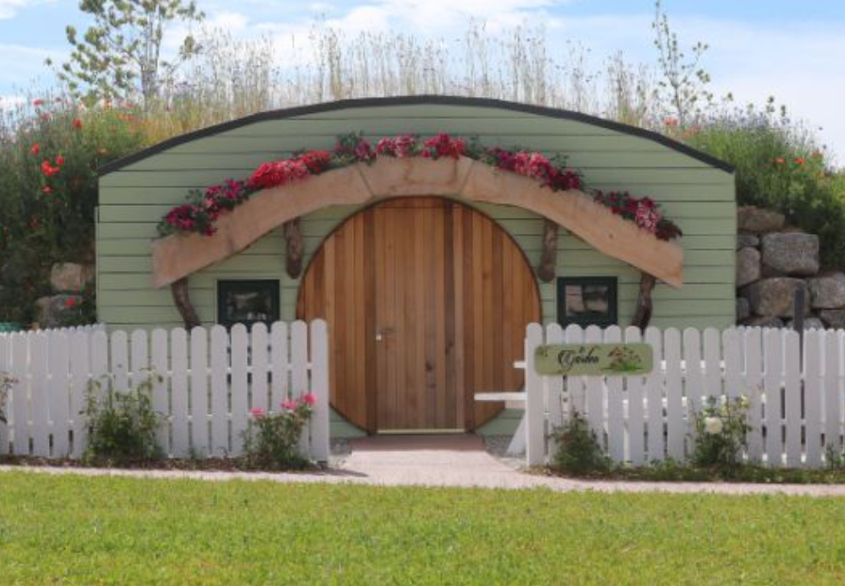
Glamping Under the Stars
Low-Impact, Family-Run Glamping
Its distinctive accommodation offering includes the “Hobbit Village,” comprising six quirky, grass-roofed units, each designed around a unique theme. Each unit offers a distinct narrative and guest experience.
These characterful hobbit houses provide an immersive guest experience that extends well beyond novelty, while showcasing sustainable design principles that align with the site’s low-impact, low carbon and environmentally responsible ethos.
Image source: https://www.glampingunderthestars.ie/

Slide 5
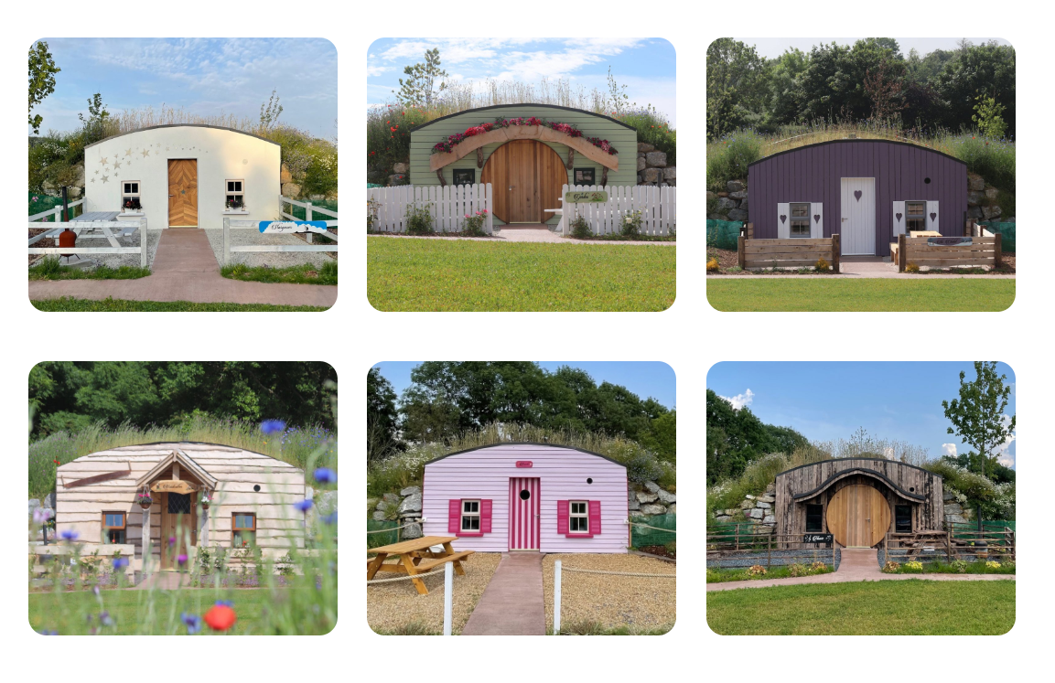
Each of these characterful accommodations features its own distinctive theme, adding to the sense of magic and escapism. Guests can choose from the Beach House, Woodcutter’s House, Music House, Stargazer’s House, Garden House, or Ski Chalet

Slide 6
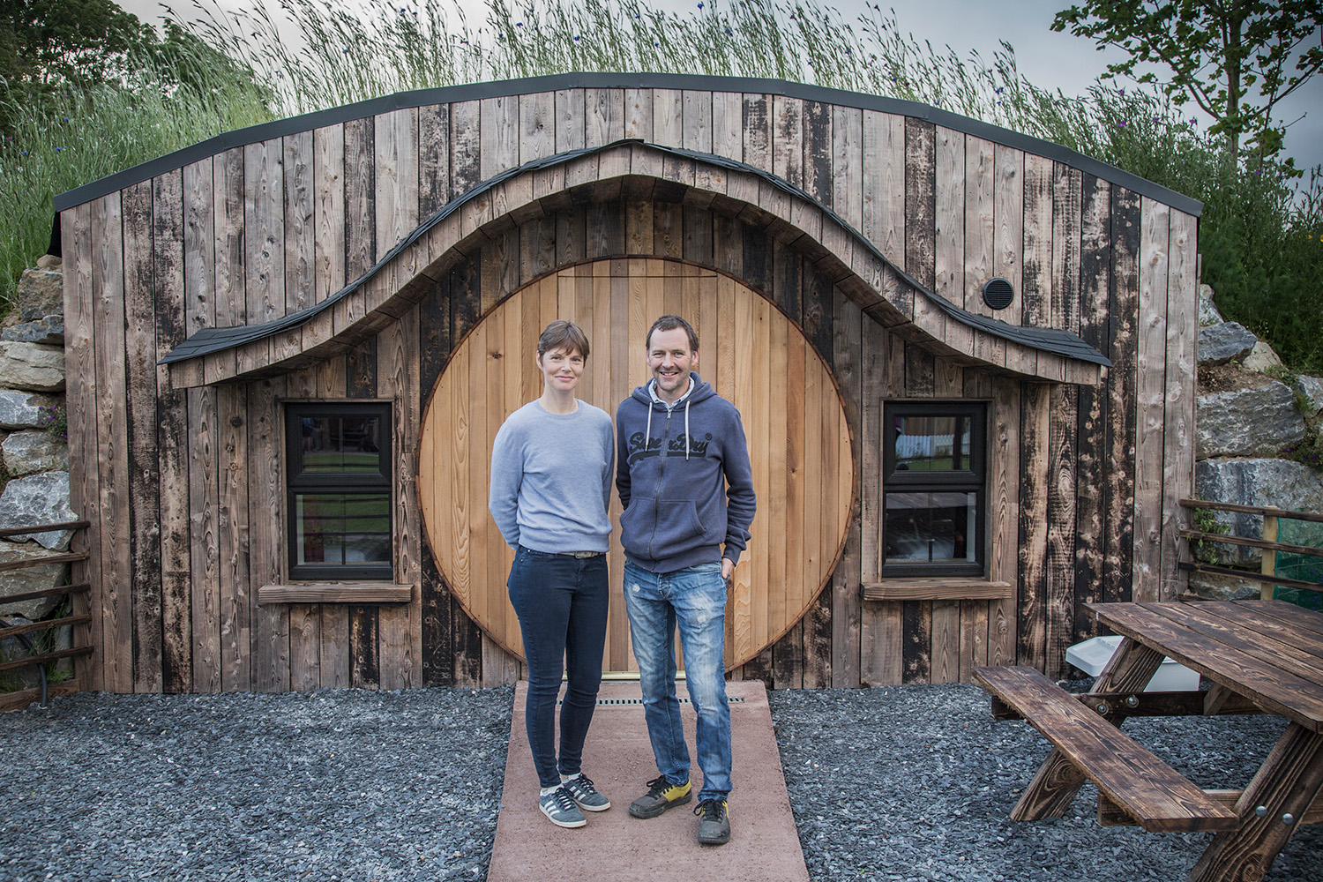
Sustainability That Works with Nature
The grass roofs on our cosy hobbit houses don’t just look enchanting - they naturally insulate the buildings, support birds and insects, and blend into the wider green landscape, creating a stunning eco-friendly hideaway.
Business Owner, Kyra Fingleton
www.glampingunderthestars.ie

Slide 7
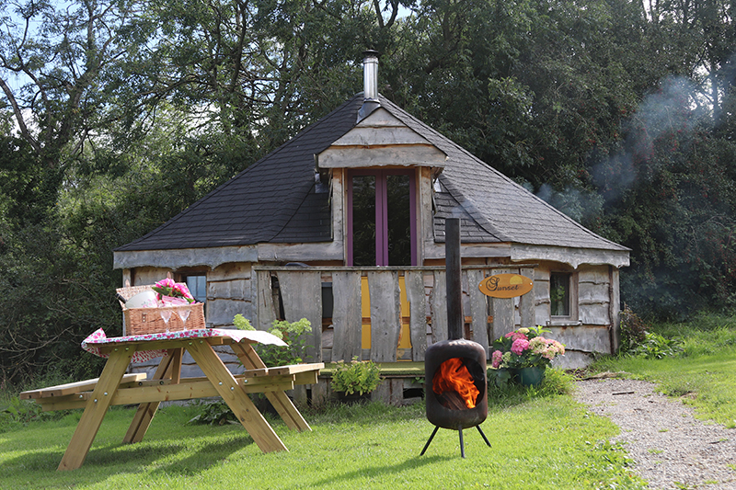
Diversification Strategy
Diversification as a Driver of Resilience
Diversification is a strategic driver for glamping under the stars reducing reliance on a single offering while extending their market reach.
Existing and proposed offerings feature low-carbon accommodation options, including wood lodges, hobbit houses, a shepherd’s hut, treehouse cabins and an accessible eco-lodge, all designed to deliver immersive outdoor experiences while upholding sustainability standards.
Image source: https://www.glampingunderthestars.ie/wood-lodges/

Slide 8
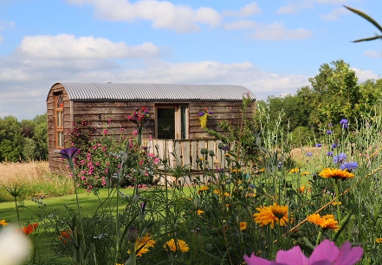
Diversification Strategy
Diversification as a Driver of Resilience
By offering distinctive, memorable experiences that differ from conventional lodging, the business attracts a broader range of visitors, enhances financial stability, improves asset utilisation and strengthens its position as an innovative, environmentally responsible destination.
Image source: Log Cabins Glamping in Co. Laois Ireland

Slide 9
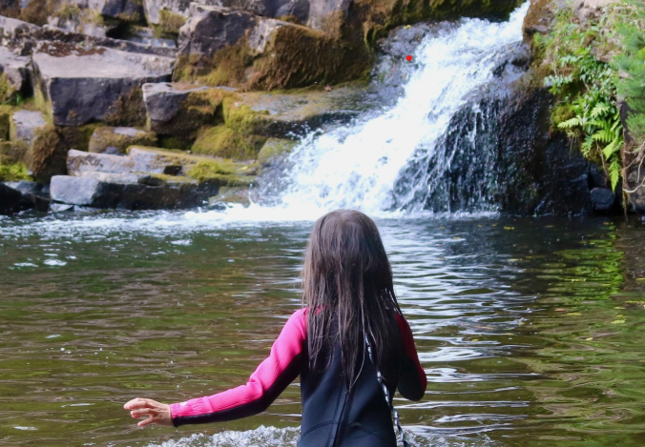
Sustainability & Biodiversity
Hands-On Actions with Real Ecological Impact
Sustainability has been embedded in the business for over a decade and places strong emphasis on protecting and enhancing local biodiversity.
Rather than relying on symbolic measures, the business implements hands-on actions that deliver real, tangible ecological benefits, including:
Pollinator-friendly planting and wildflower meadows, accommodation with living roofs and zooned wild areas.
Image source: https://www.glampingunderthestars.ie/wood-lodges/

Slide 10
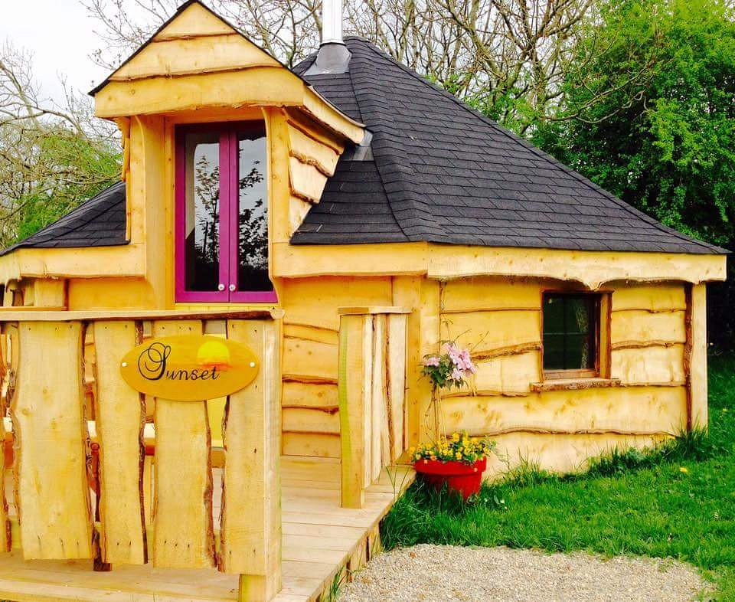
Sustainability & Biodiversity
Hands-On Actions with Real Ecological Impact
Biodiversity pond and planting of hundreds of native hardwood trees.
Protection of dark skies through low-level, sensitive lighting.
Creation of a safe habitat for a wide range of native wildlife, including insects, birds, bats, amphibians, mammals, and occasional pine martens.
Image source: Trip Advisor

Slide 11
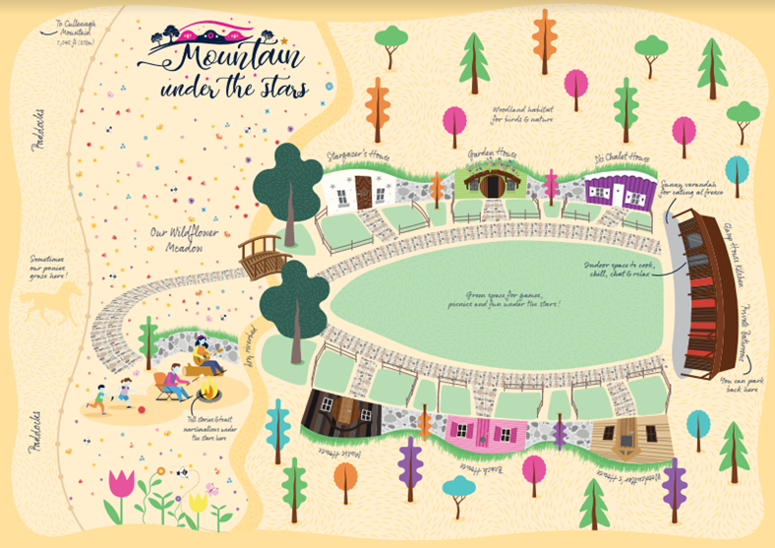
Low-Carbon Design
Designing in Harmony with Nature
Low-carbon design and infrastructure are integral to the business. Energy efficient accommodation are created using Insulated Concrete Framework (ICF).
The buildings are designed to blend naturally into the landscape and reduce environmental footprint reflecting thoughtful design and construction.
Image source: https://www.glampingunderthestars.ie/hen-party-glamping/

Slide 12
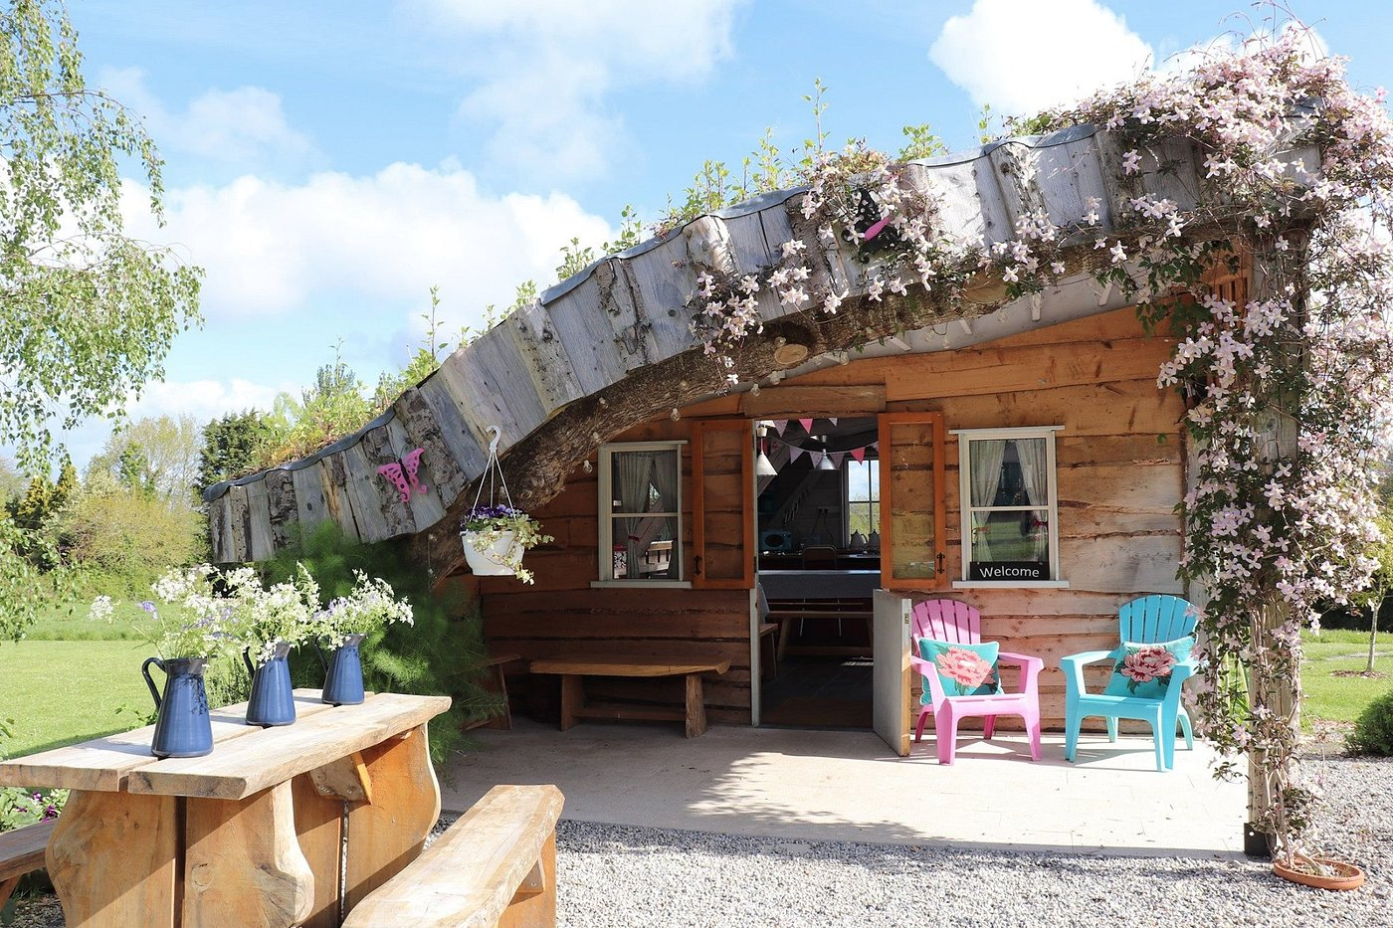
Low-Carbon Design
Building in Balance with the Natural Environment
A strong commitment to waste reduction and responsible consumption is demonstrated through waste minimisation, reduced use of single-use plastics, and composting where feasible.
This approach is further supported by encouraging guests to recycle and reuse, alongside the owners’ ongoing exploration of eco-friendly cleaning products and toiletries.
Image source: https://www.glampingunderthestars.ie/hen-party-glamping/

Slide 13
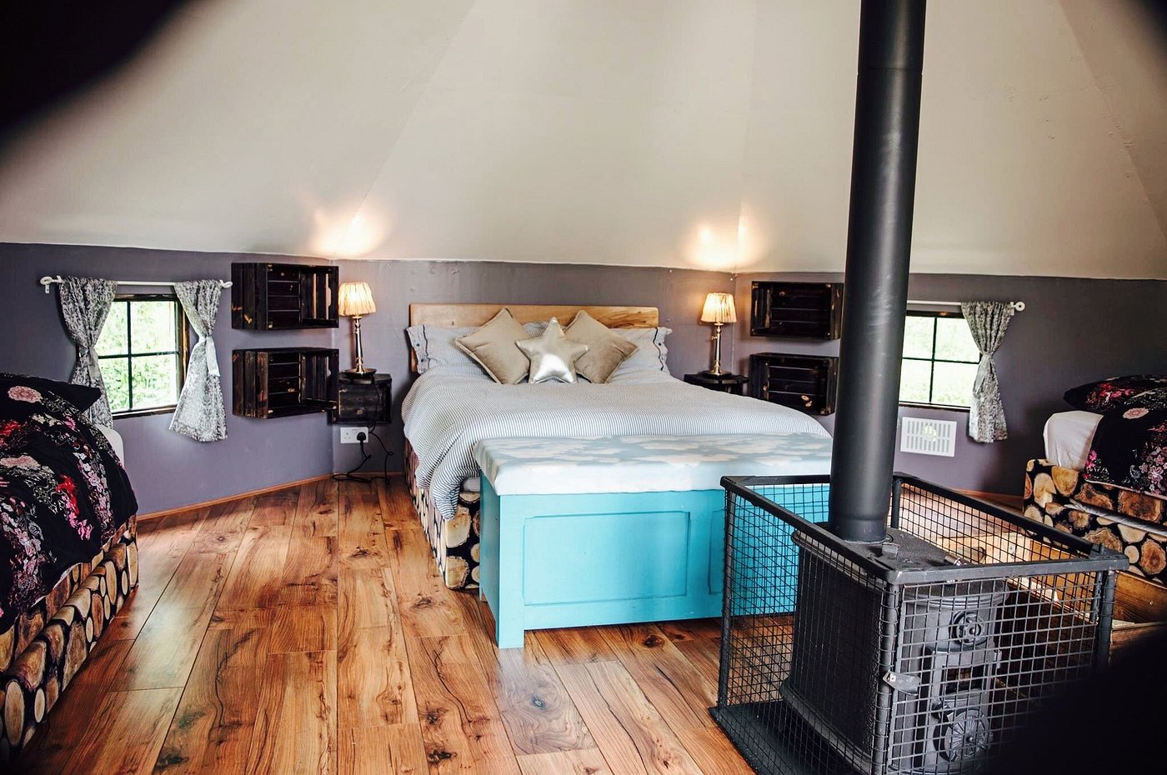
Guest Education & Engagement
Turning Guests into Environmental Stewards
Education, guest awareness, and engagement are central to the business’s sustainability approach.
Nature trails winding through wildflower meadows encourage guests to explore and connect with the landscape, while clearly presented information points help build understanding of local wildlife and ecosystems.
Image source: https://www.glampingunderthestars.ie/hen-party-glamping/

Slide 14
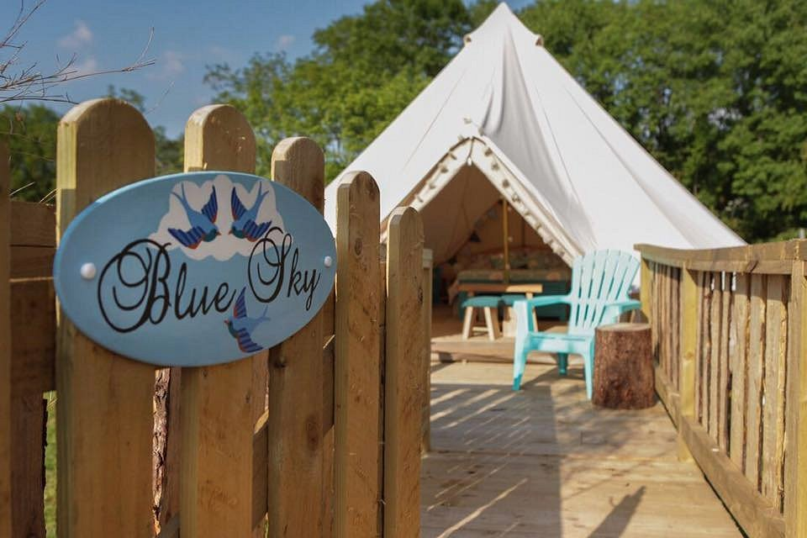
Guest Education & Engagement
Turning Guests into Environmental Stewards
This education and interpretation is further supported through planned activities such as stargazing events, foraging walks, and family-friendly biodiversity experiences.
These initiatives are designed to actively engage guests while fostering a deeper appreciation of nature and environmental stewardship.
Image source: https://www.glampingunderthestars.ie/hen-party-glamping/

Slide 15
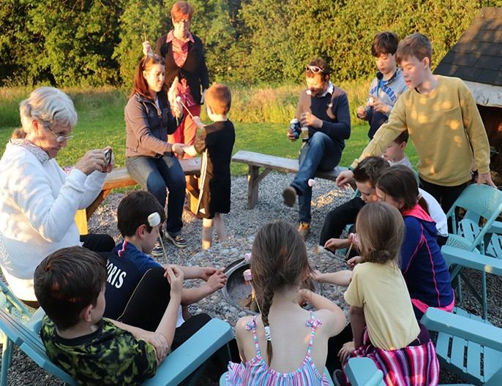
Community Collaboration
Strengthening the Local Economy
The business recognises the value of embracing community and local economic initiatives by actively fostering collaboration with local businesses, service providers, and community groups.
This approach supports a vibrant and sustainable local economy while promoting Laois as a low-impact, must-visit destination, enhancing both the region’s appeal and the business’s positive impact.
Image source https://www.glampingunderthestars.ie/hen-party-glamping/

Slide 16
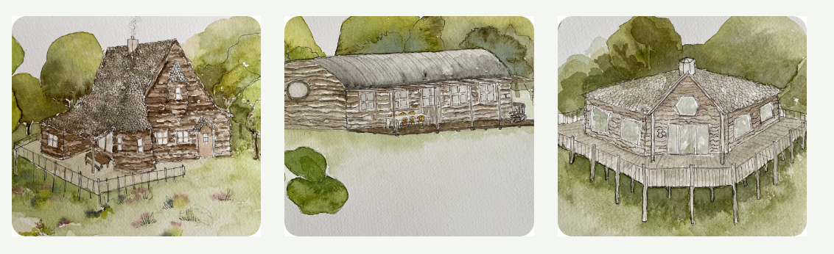
Expanding the product offering
Secured €300,000 under Fáilte Ireland’s Just Transition Fund for Treehouse Cabins & Eco Lodge.
This new accommodation offering will provide luxury, creativity, and memorable experiences. The project will deliver three innovative, low-carbon tourism options, comprising two treehouses and an eco-lodge.

Slide 17
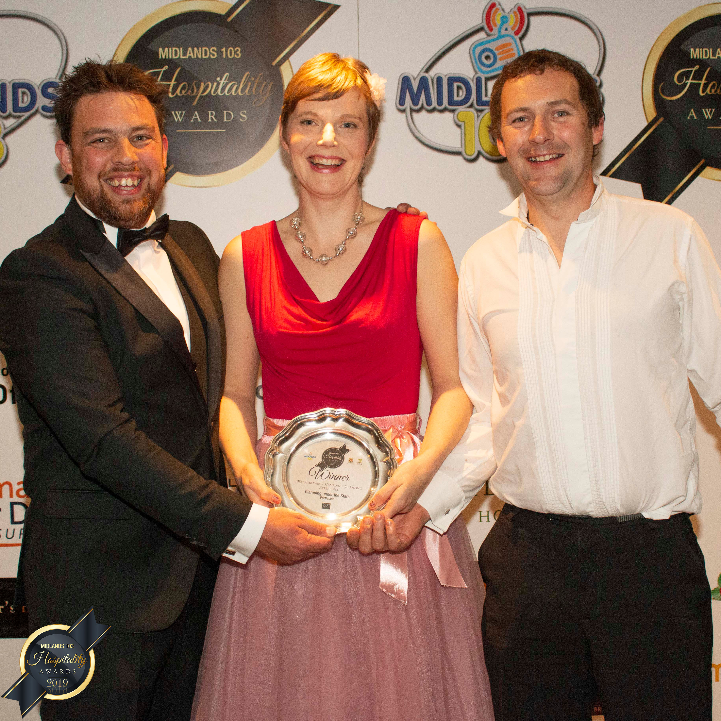
Recognised for Excellence
Celebrating Achievement
Recognised through numerous regional and national awards, including Tripadvisor Traveller’s Choice, Midlands103 Hospitality Awards; Laois Chamber and Google Digital Excellence Awards, alongside a 4-Star Failte Ireland Quality Assurance rating and among Ireland’s Fab 50 Best Places To Stay to name but a few.
They are proud members of the Sustainable Tourism Network Ireland and continue to spearhead tourism development in Laois as a Key Account for Fáilte Ireland selected for mentoring and business advisory support. They have featured in leading media such as The Sunday Times and The Irish Independent, with consistently outstanding guest reviews across Google and TripAdvisor.
Image source https://www.glampingunderthestars.ie/hen-party-glamping/

Slide 18
Looking Ahead
Future-Proofing Through Sustainability
The long-term plan for the business will concentrate on advancing sustainability while enriching visitor experiences. Plans feature:
Implementing renewable energy solutions, such as solar panels, to further reduce carbon emissions subject to resources.
Image source https://www.glampingunderthestars.ie/hen-party-glamping/

Slide 19
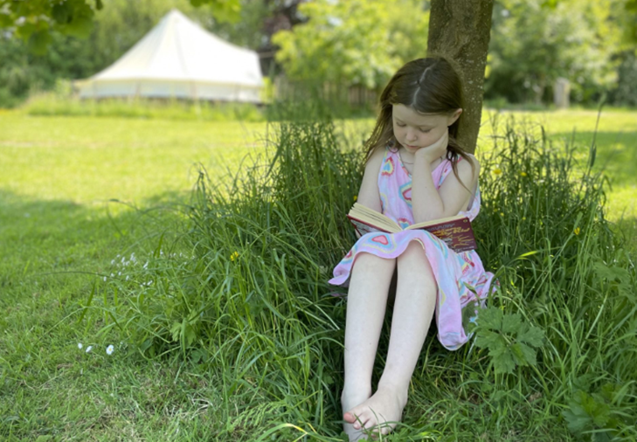
Looking Ahead
Future-Proofing Through Sustainability
Ongoing commitment and meaningful action to protect the natural environment, support the local community, and ensure a thriving, sustainable future for both the land and those who live and visit the area.
Looking forward in this way is important because it ensures that business decisions made today support long-term sustainability and resilience.
Image source Family Friendly Glamping Ireland - Short Drive from Dublin

Slide 20
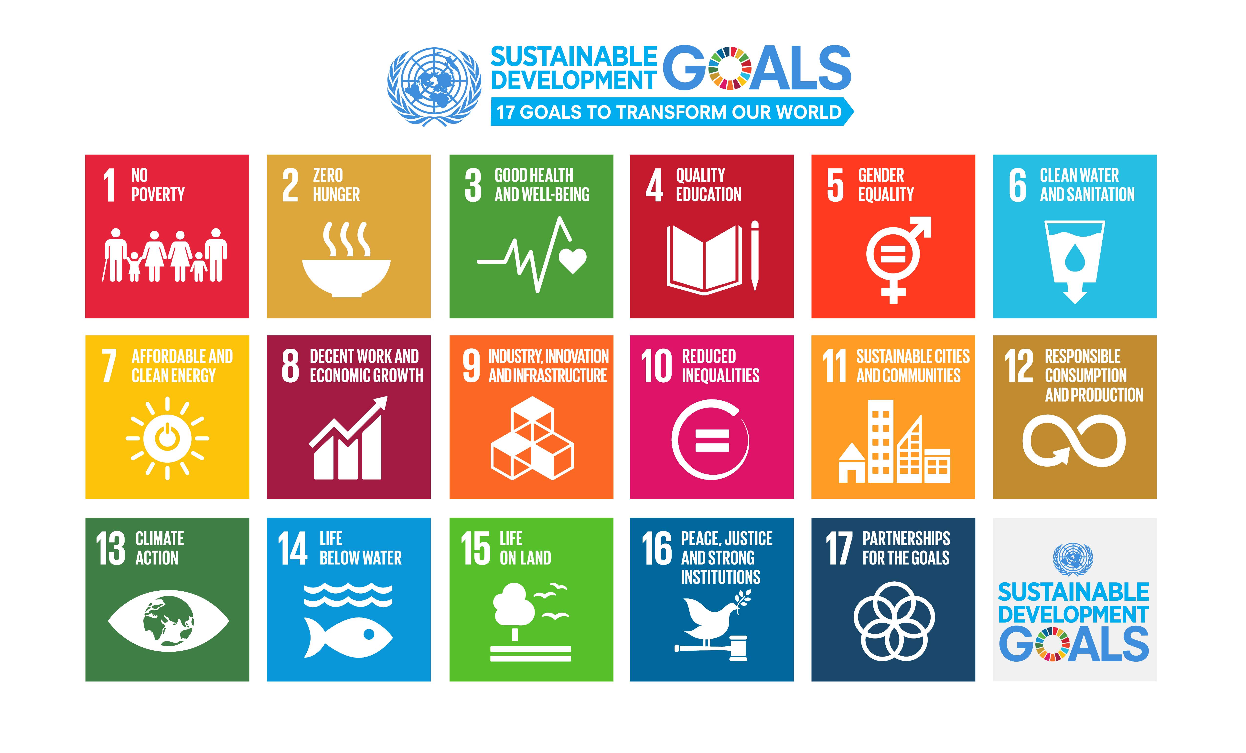
Alignment to UNSDGs
Contributing to Global Sustainability Goals
The business demonstrates strong alignment the United Nations Sustainable Development Goals. The business initiatives support:
SDG 15: Life on Land through the protection and careful management of natural habitats.
Efforts to adopt renewable energy solutions, such as solar panels, contribute to SDG 7: Affordable and Clean Energy.
By promoting low-carbon tourism, sustainable infrastructure, and community engagement, the business advances SDG 11: Sustainable Cities and Communities, fostering resilient, environmentally responsible destinations.
Image source The Sustainable Development Goals - Global Action Plan

Slide 21
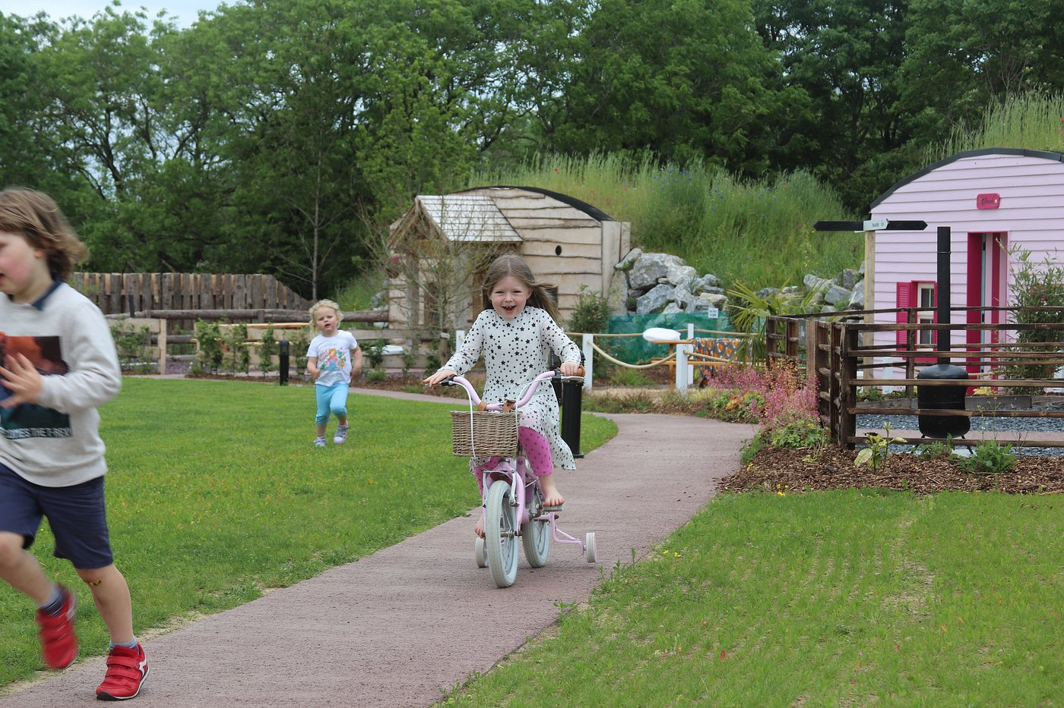
Key Strengths
Why This Model Works
Sustainability: Eco-conscious glamping in wildflower meadows, under dark skies. Showcases inclusivity, biodiversity & creative, low-impact design. Support for local community
Guest Experience: Guests stay within a beautiful biodiverse environment, while enjoying modern comforts.
Image source Trip Advisor

Slide 22
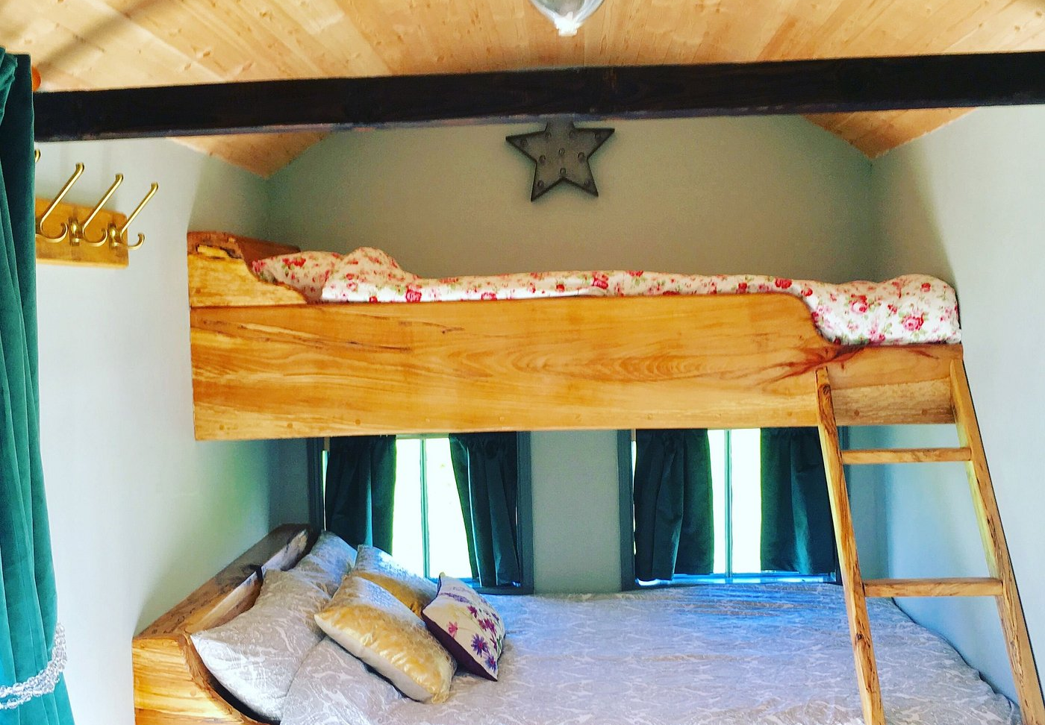
Key Strengths
Why This Model Works
Viability: Sustainable business for over a decade with a loyal and growing customer base.
Differentiation: appealing to a wide range of visitors, responding to changing consumer demands and spreading risk.
Owner-operated: facilitates a personal, hands-on approach, ensuring high-quality service and attention to detail. It fosters authentic guest experiences, quick decision-making, and a strong commitment to sustainability and community engagement.
EPIC STAYS is licensed
under CC BY-SA 4.0
Image source Family Friendly Glamping Ireland - Short Drive from Dublin
Funded by the European Union. Views and opinions expressed are however those of the author(s) only and do not necessarily reflect those of the European Union or the European Education and Culture Executive Agency (EACEA). Neither the European Union nor EACEA can be held responsible for them.

