Slide 1
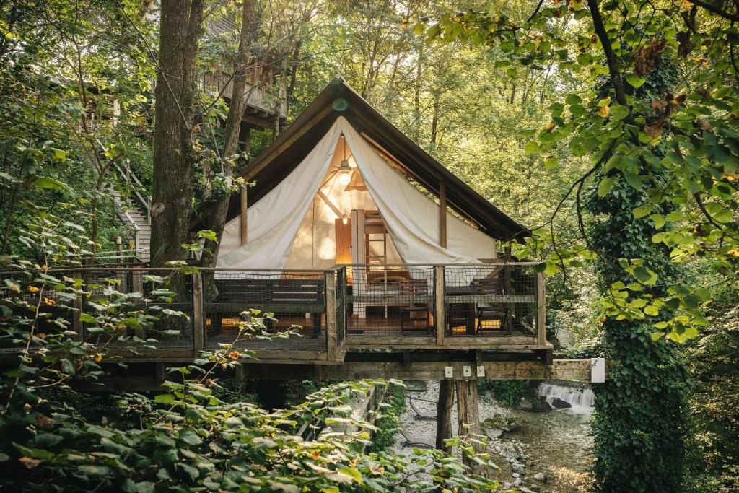
Case Study
BOOKING.COM
Garden Village Bled, Slovenia
Garden Village Among the Treetops
https://www.gardenvillagebled.com/en/

Slide 2
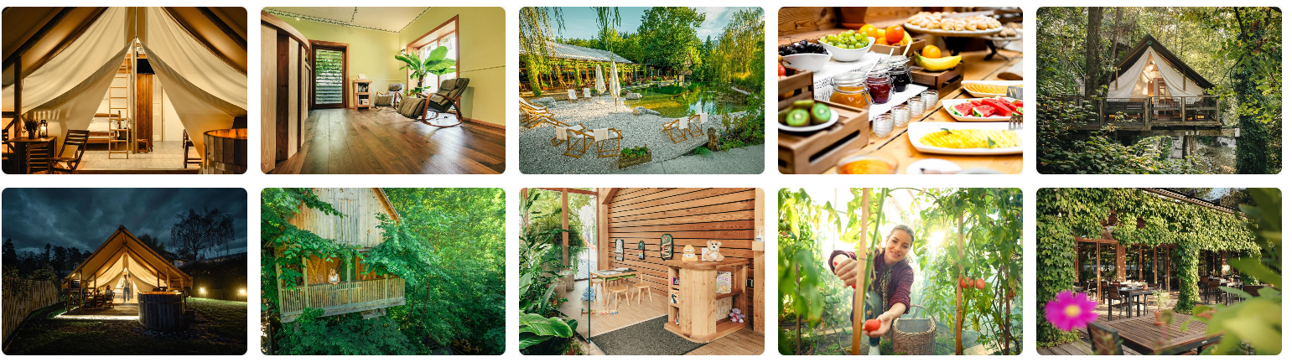
Case Study: Garden Village Bled, Slovenia
Garden Village Bled, Slovenia: A high-end glamping resort near Lake Bled known for its treehouses and glamping tents. It is a pioneering eco-resort exemplifying sustainable tourism through innovative design and environmental stewardship. Garden Village Bled, Slovenia: A high-end glamping resort near Lake Bled known for its treehouses and glamping tents. Established in June 2014 on a former plant nursery, Garden Village Bled was conceived to offer guests a luxurious yet environmentally conscious experience. The resort features unique accommodations such as treehouses, pier tents over ponds, glamping tents with private hot tubs, and deluxe apartments. Amenities include a natural swimming pond, a Finnish sauna set among the trees, and a restaurant with a stream flowing through it, where herbs grow directly on the tables Source

Slide 3
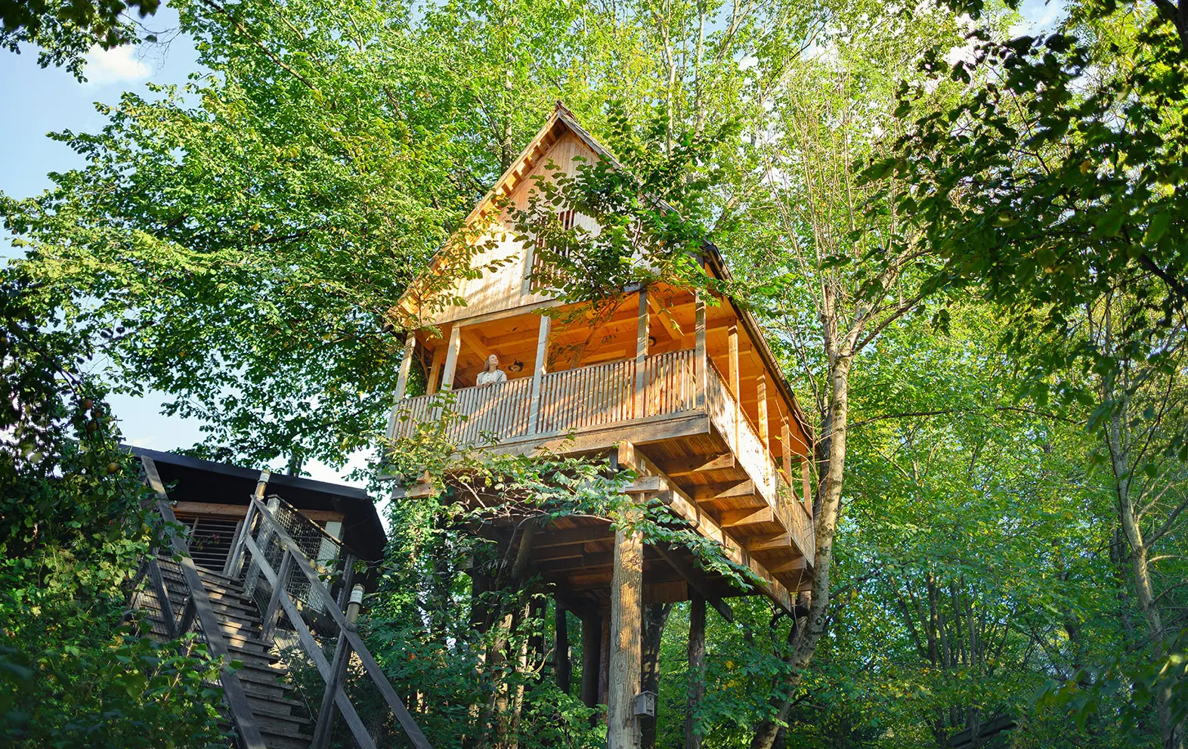
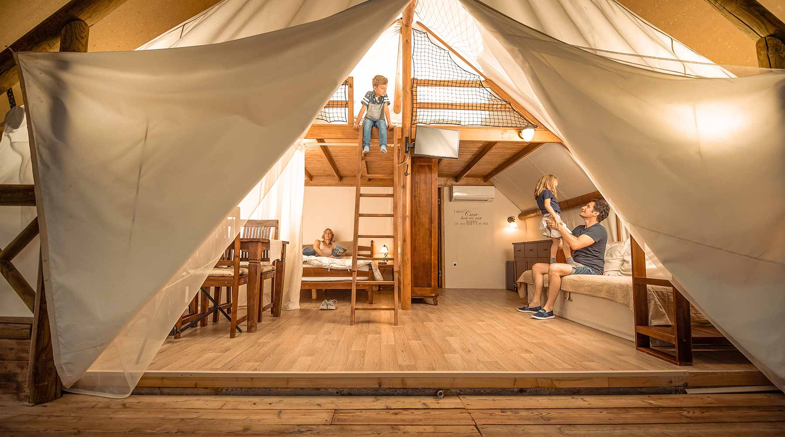
Garden Village, Accommodations:
Tree Houses: Built among the trees, fully equipped with private bathrooms. Elevated decks offer forest views and a feeling of immersion in nature
Pier Tents. Set over a natural stream and pondsWooden platforms, luxury beds, and electricity included. Guests hear the gentle sound of flowing water beneath
Glamping Tents. Spacious, safari-style tents with wooden flooring and private hot tubs. Some include en-suite bathrooms
Apartments (Luxury Suites).For guests wanting more comfort and privacy. Full kitchens, living areas, and eco-conscious interiors
Stay in the Midst of Nature: ‘Garden Village Bled is a world unlike any other. It offers five different types of accommodation – all of them among the trees, bringing you closer to the luxury of nature’
Images from Garden Village Bled, Slovenia
Case Study
Garden Village Bled, Slovenia

Slide 4
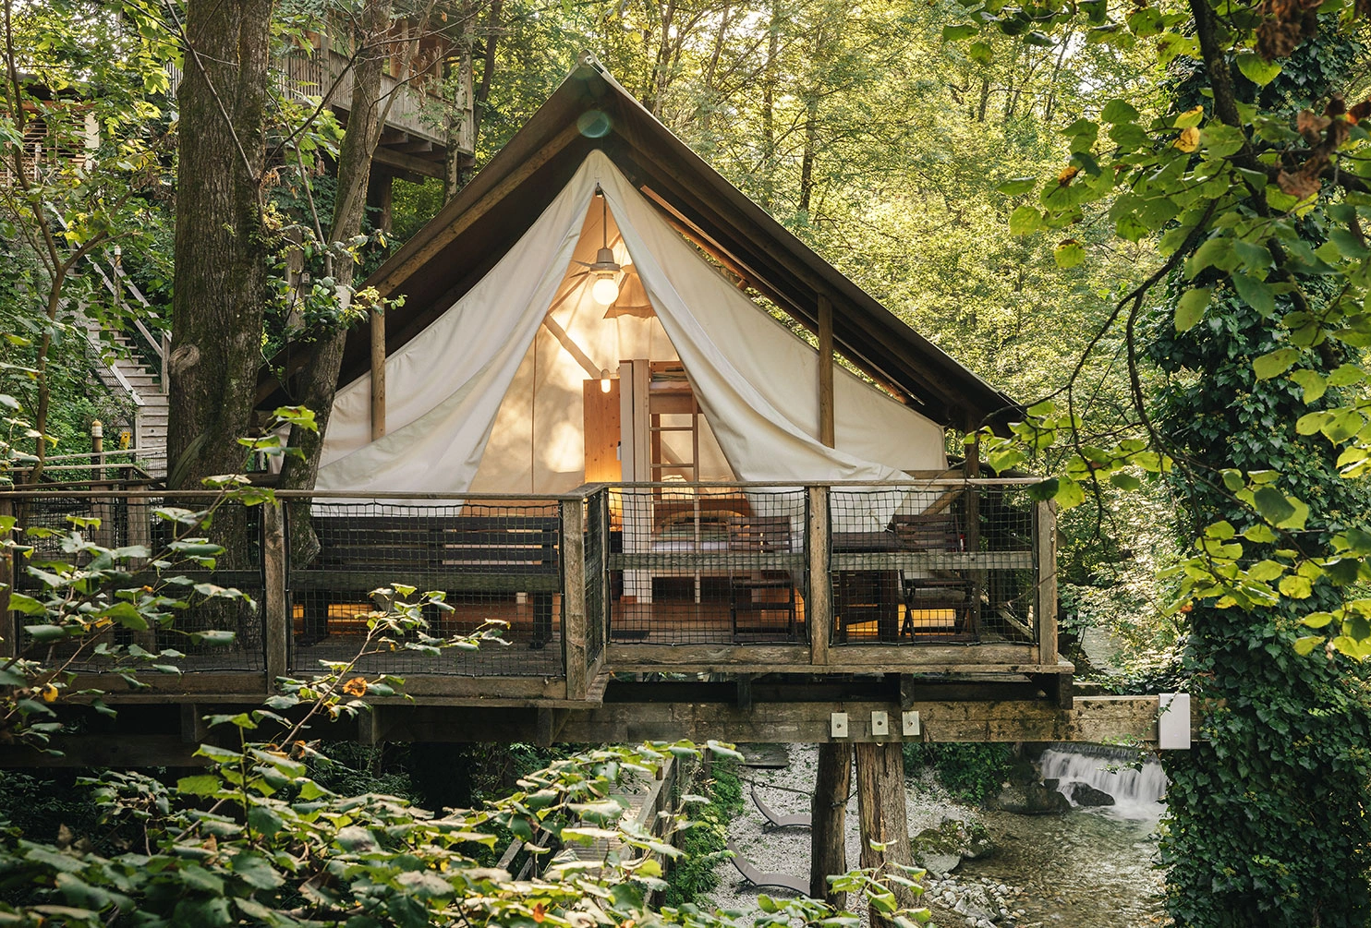
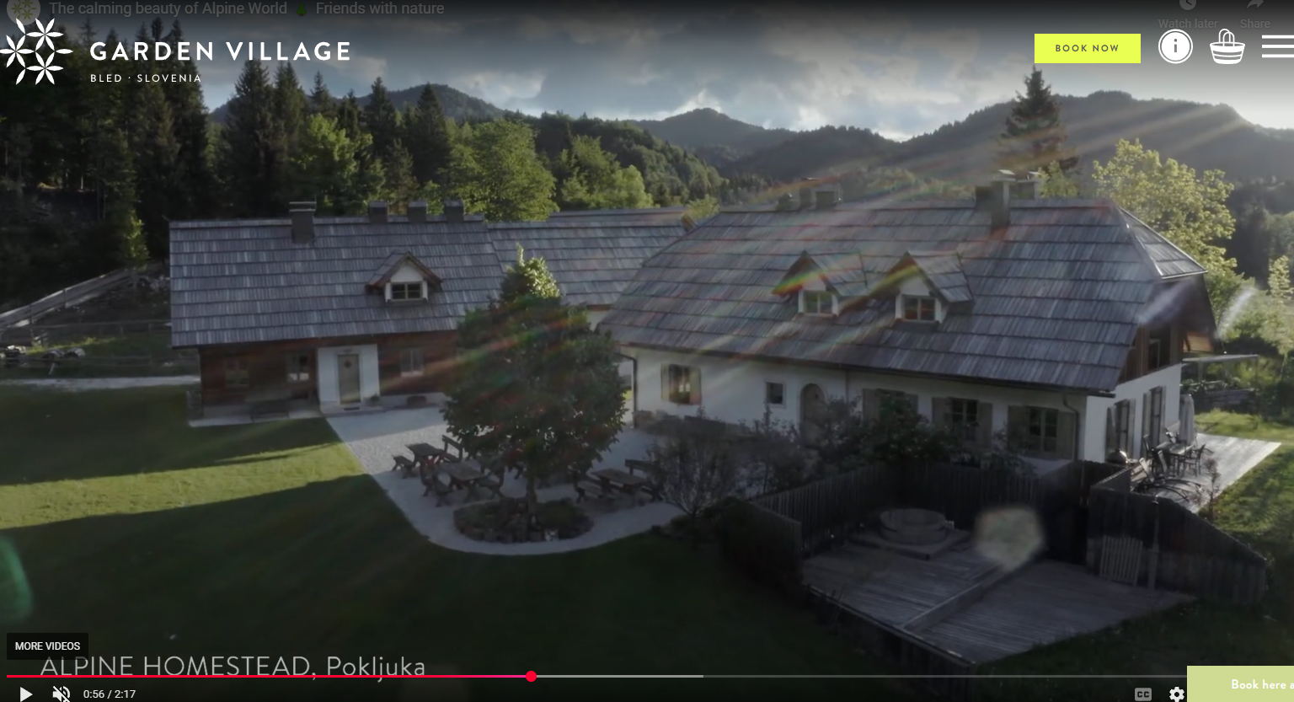
Sustainability
They built with sustainability at the core (solar energy, on-site organic greenhouse restaurant) and have been very successful in attracting global visitors at premium rates. See how they integrate sustainability into every aspect of their operations:
Eco-Friendly Accommodations: Structures are built using natural materials, blending seamlessly with the surrounding environment.
Natural Water Features: The resort includes a swimming pond purified by aquatic plants and a stream that runs through the restaurant, enhancing the natural ambience. On-Site Organic Garden: Guests are encouraged to pick vegetables, herbs, and fruits from the resort's gardens, promoting a farm-to-table experience.
Energy Efficiency: Accommodations are designed for energy efficiency, and the resort utilizes renewable energy sources where possible.
Source: Slovenia Tourism – Destination Case Studies
Images from Garden Village Bled, Slovenia
Case Study
Click to Watch Video

Slide 5
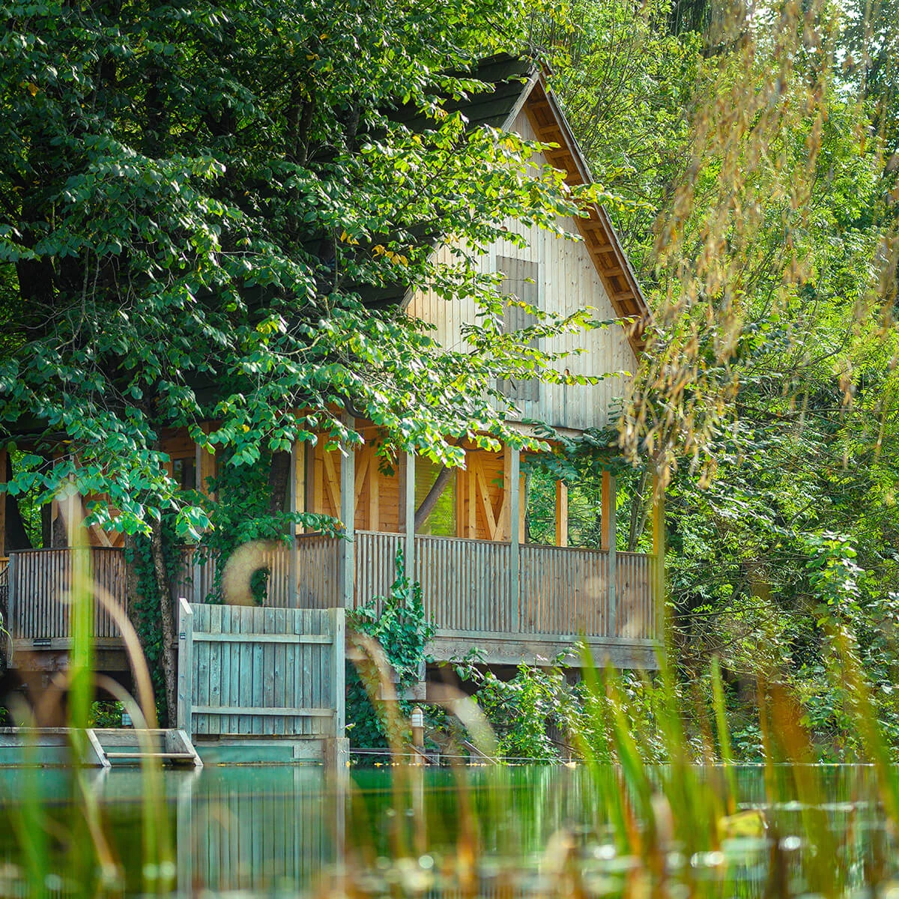


Funding and Development:
The resort was developed through a partnership between an investor with experience in tourism and the owner of the previously neglected nursery site.
While specific funding sources are not publicly detailed, the project involved collaboration with local and national stakeholders, including the municipality, tourism organisations, and the national tourism board, to gain support and necessary permissions
It’s an example of a larger private investment that also received support from Slovenia’s tourism incentives, as it was highlighted as an innovative green resort financed with backing from the Ministry of Economy/Tourism.
The takeaway: ambitious projects can seek a combination of private investors plus government support (in this case, possibly a favorable loan or subsidy via SPIRIT Slovenia) and achieve international visibility.
Images from Garden Village Bled, Slovenia
Garden Village Bled, Slovenia
EPIC STAYS is licensed
under CC BY-SA 4.0
Funded by the European Union. Views and opinions expressed are however those of the author(s) only and do not necessarily reflect those of the European Union or the European Education and Culture Executive Agency (EACEA). Neither the European Union nor EACEA can be held responsible for them.

Slide 6
