Slide 1
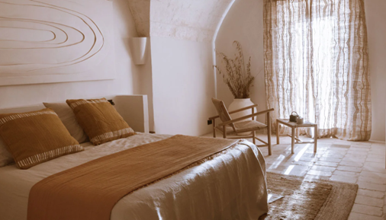
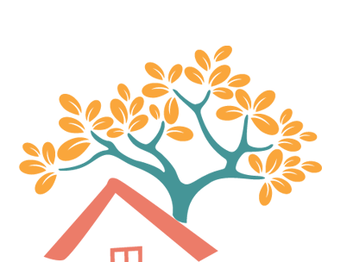
Traditional Menorcan Farmhouse
.
A lovingly restored traditional Menorcan farmhouse to an eco-hotel, designed to blend seamlessly with the breathtaking landscape.
Converted into a 14-room retreat through creative community collaboration between architects and artisans expressed through natural materials such as stone, clay, wood and textiles.
Case Study
Son Blanc, Menorca, Spain
Website Vogue: Inside Son Blanc Farmhouse, a New Eco-Retreat in Menorca
1

Slide 2
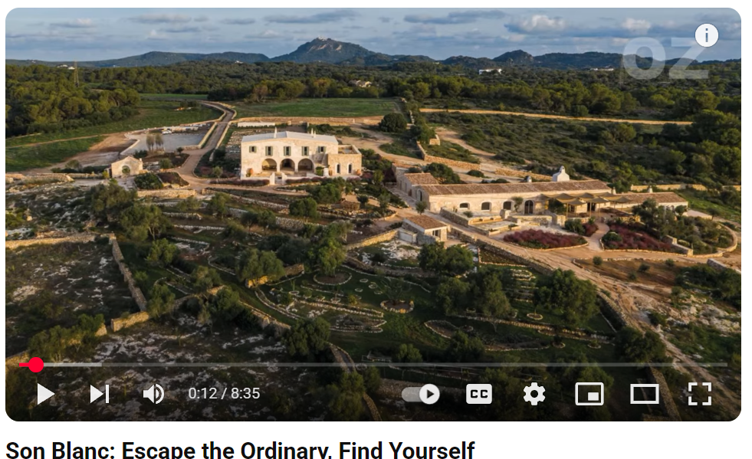


Case Study: Son Blanc, Menorca, Spain
Traditional Menorcan Farmhouse
‘We strive towards a sustainable way of life, on an audacious journey to self-sufficiency in energy, water and food, all without compromising comfort’.
Guests experience an immersive journey that combines nature, culture, and self-discovery. Delicious meals are prepared with fresh, local ingredients grown on-site using sustainable practices. Participate in unique activities, from yoga on the lawn to pottery workshops with local artisans.
The reserve is a place for exploration and communion with nature, oneself and with good company. A sensory journey to truly reconnect with what makes one feel alive and appreciate the authenticity of things.
Click To Watch
EPIC STAYS is licensed
under CC BY-SA 4.0
https://www.youtube.com/watch?v=-2ihmF1drM4
Funded by the European Union. Views and opinions expressed are however those of the author(s) only and do not necessarily reflect those of the European Union or the European Education and Culture Executive Agency (EACEA). Neither the European Union nor EACEA can be held responsible for them.
https://sonblancmenorca.com/

Slide 3
