Slide 1
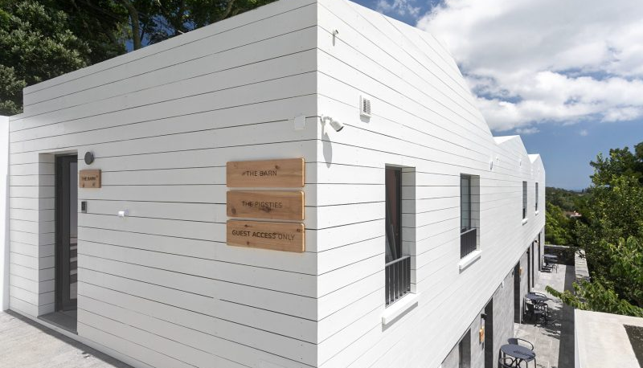

https://solarbranco.com/gallery/
Accommodation Type:
Regenerative Tourism Example
Eco Conscious Luxury
Stay With Hosts Who Share Your Values
A Leading Eco Hotel: Breathe in the clear Azorean Atlantic air as you walk through the citrus-inspired gardens. Enjoy this beautiful heritage home, built over 100 years ago, lovingly restored and brought back to life. Sleep in the big, dreamy beds. Hike, run, read. Relax. Put your phone down. Laugh out loud. Dream. Enjoy life with those around you.
Case Study
Solar Branco on São Miguel island in the Azores
Enjoy the Gin Library and Our Sushi Dining Experience
Website: https://solarbranco.com
1

Slide 2
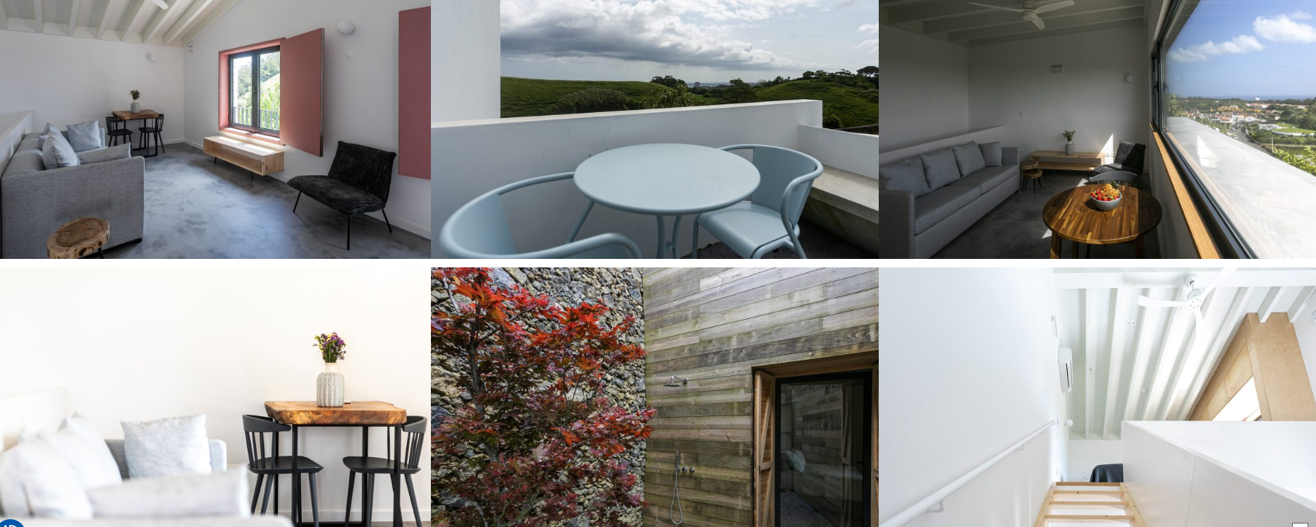

Slide 3
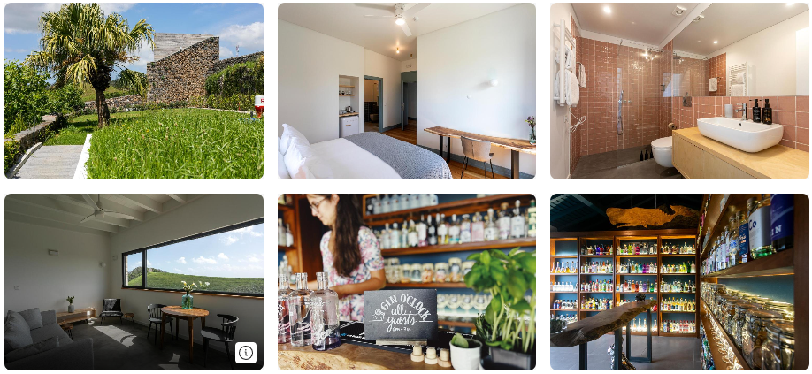
Case Study
Azores
Images from Booking.com
Solar Branco on São Miguel island in the Azores, Regenerative Tourism Example
Passionate about preserving the planet, this historic farm, built over 100 years ago, has been transformed into an eco-resort featuring local enogastronomy, architectural traditions, a renowned Gin Library with classes, and a sushi bar offering a sushi-making experience.
Its eco-sustainable initiatives include boosting biodiversity, energy tracking, banning plastics and pesticides, zero food waste, dedicated wildlife ponds for wildlife, free-range hens, and sourcing food from local vendors.

Slide 4
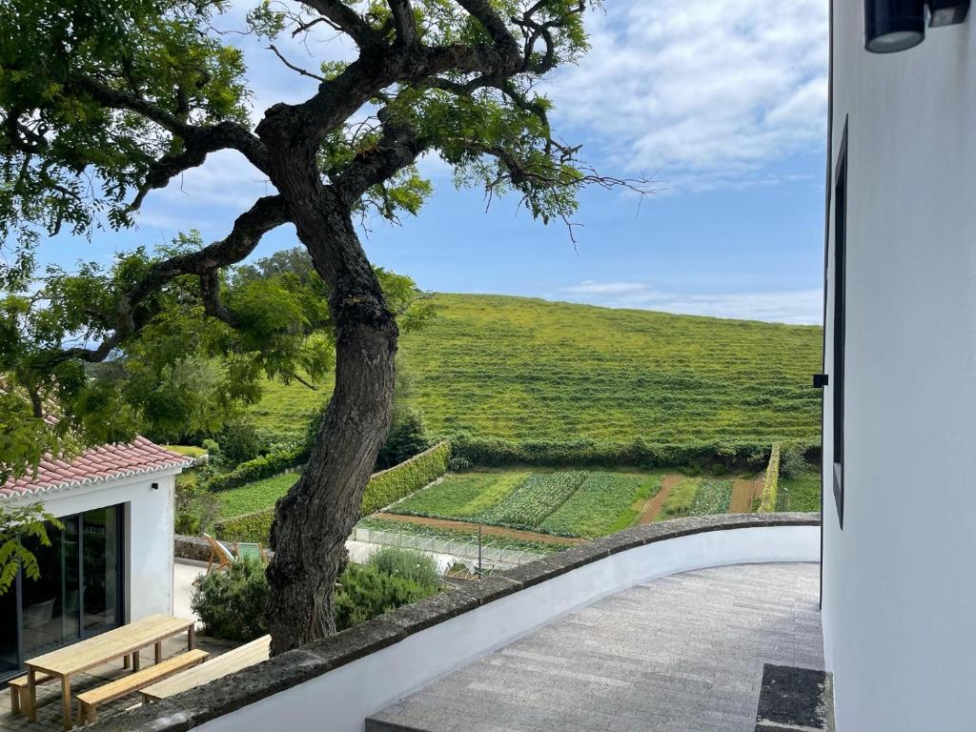
Wow Factor! Solar Branco, Sao Miguel, Azores
Eco-Building and Planning Considerations – Example ‘The Barn’
The Barn is a two-storey cottage built on the site that previously housed an old farmyard storage shed.
Building and infrastructure were planned with consideration given to the natural landscape and heritage. The exterior of the building is clad in whitewashed wood panels and volcanic stone tiles.
They used local materials and sustainable design, incorporating endemic plants for landscaping. Used local products and furnishings to complete each room.
This bedroom has 2 south-facing windows, offering views of the countryside and the ocean beyond.
The mattress is made of all-natural materials and luxury bed linen to help regulate body temperature.
The furniture includes a raw-edge wooden dining table made by a local artisan, and a sideboard made from recycled wood by a local social enterprise.

Slide 5
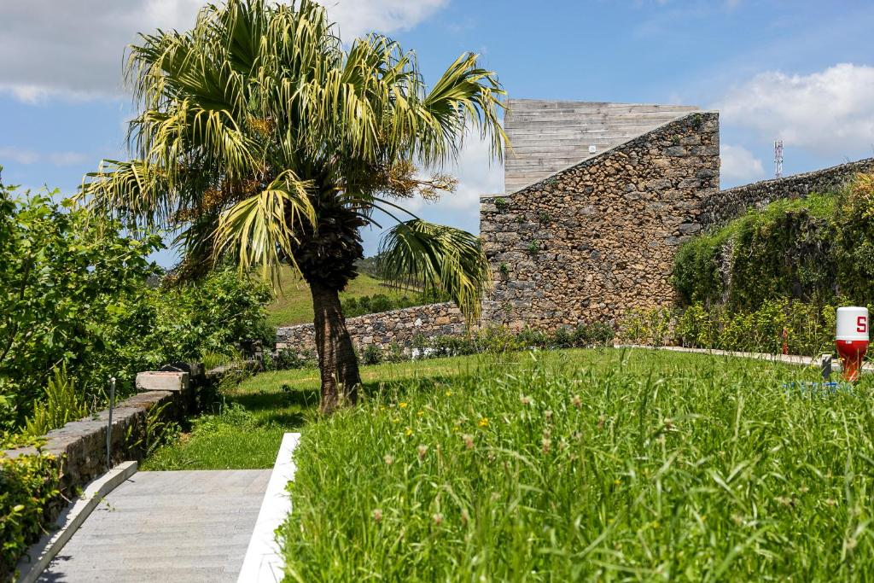
Wow Factor! Solar Branco, Sao Miguel, Azores
Eco-Building and Planning Considerations – Example ‘The Barn’
The fridge is restocked daily with complimentary local beers, soft drinks and water.
The bathroom has high-end fittings, finished with handmade Portuguese tiles in a pink tone referencing the pigs that once lived next door to The Barn.
Eco touches such as solar power, recycling, and controlled individual electricity usage.
Donations from Gin sales go to the Whales in the Azores Ocean.
Work with local entrepreneurs and guides provides an immersive, local, cultural experience.
Share information with guests on how to enjoy the Azorean island and nature in a sustainable way.

Slide 6
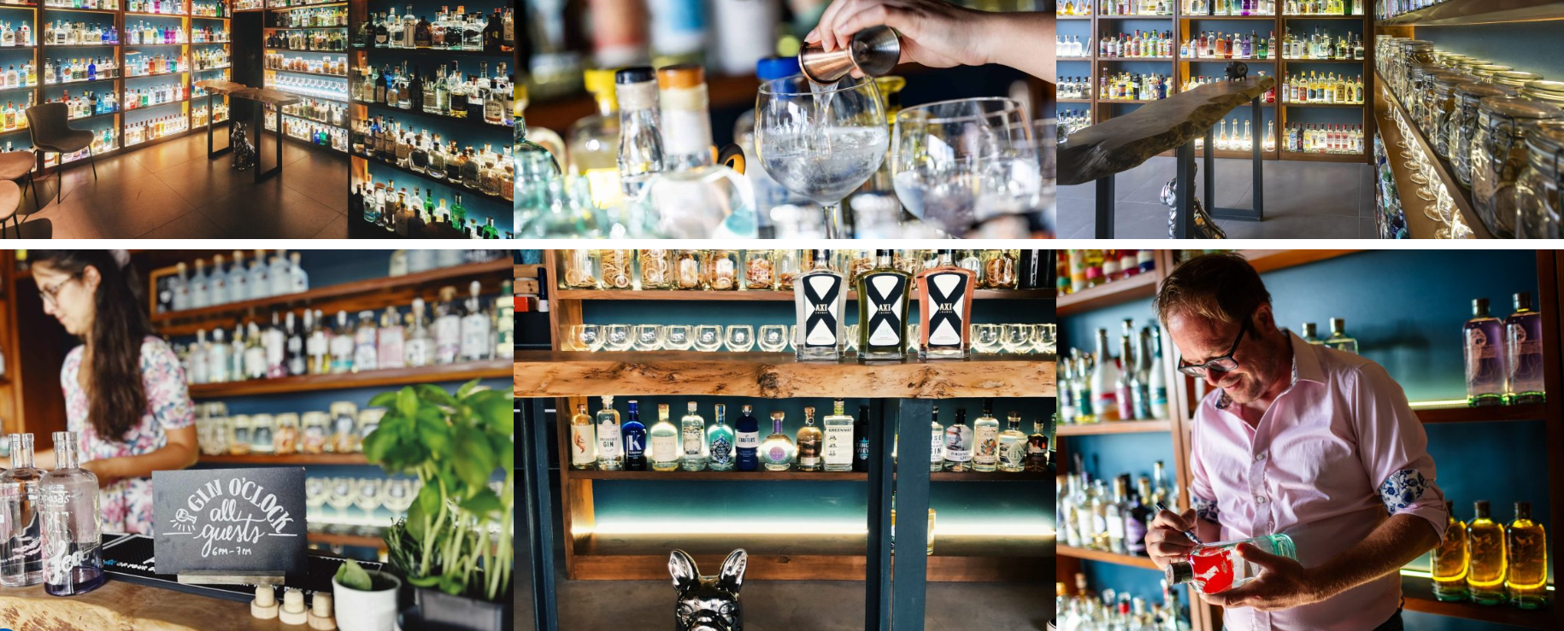

Slide 7
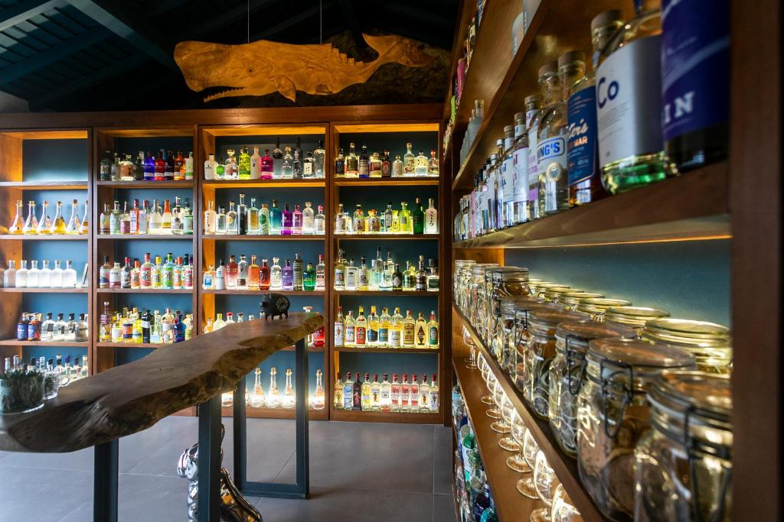
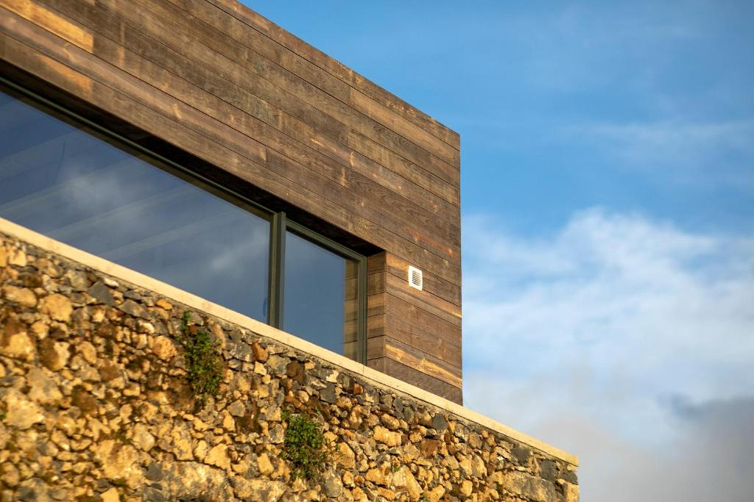
Wow Factor: countryside views, daily invite to Gin O’Clock and complimentary G&T, rain shower, king sized bed, digital guide of the island, concierge services and eco reporting from stay.
https://www.cntraveller.com/hotels/solar-branco-eco-estate

