Slide 1
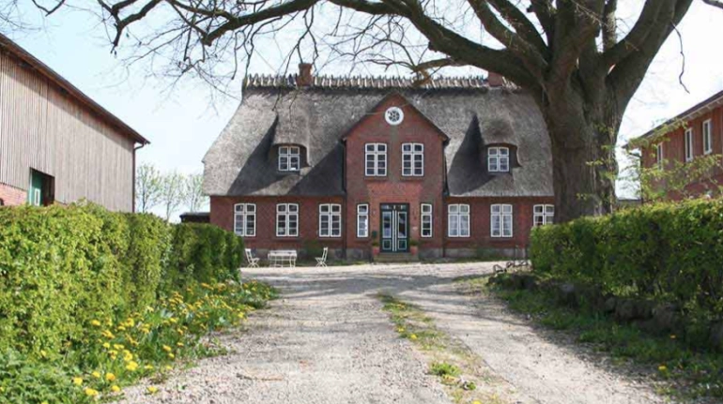

Photo Credit: Midgard Base Camp
Farm Converted into a Climate-Neutral Hotel.
The Fairhaus hotel in Germany, is one of the most climate-neutral hotels in Germany. A former farm transformed into a low-impact hotel.
Guests stay overnight in a climate-positive manner, surrounded by nature and animals. Guests help plant trees and build an eco-paradise for bees.
Case Study
Fairhaus Hotel, Germany
Website https://www.zafirohotels.com/en/son-sabater-by-zafiro/
1

Slide 2
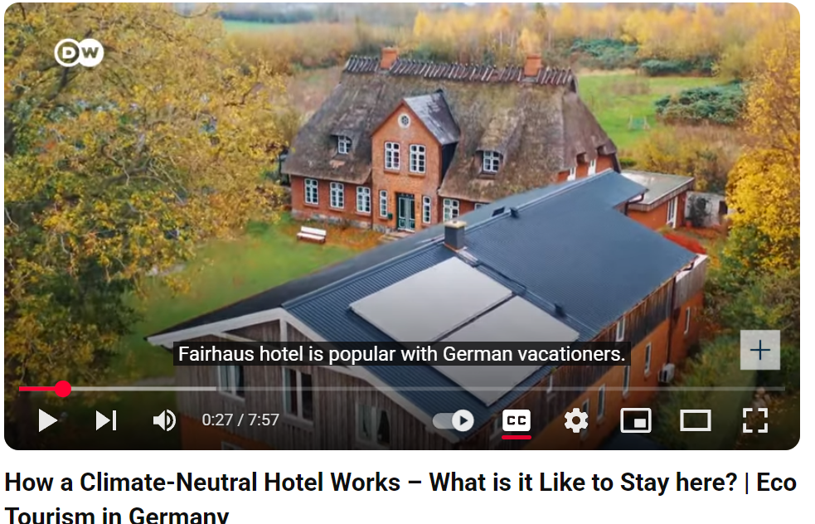


Case Study: Fairhaus Hotel, Germany
FAIRhaus on ecobnb
Our special features are our ecological concept: We are not an organic hotel, but a VIABONO-certified company, waste separation and the conservation of resources are a matter of course for us. We offer you various residential units (from rooms to holiday apartments) integrated into an ecological concept with as many circuits as possible
VIABONO-certified and CO2 footprint certified by CO2OL. They generate electricity with CHP and sun. Use the water several times and operate their own, fully biological sewage treatment plant. Constructed wetlands for wastewater treatment and have a photovoltaic system!
Click To Watch
https://www.youtube.com/watch?v=yQfKDaNonf8
Funded by the European Union. Views and opinions expressed are however those of the author(s) only and do not necessarily reflect those of the European Union or the European Education and Culture Executive Agency (EACEA). Neither the European Union nor EACEA can be held responsible for them.
EPIC STAYS is licensed
under CC BY-SA 4.0

