Slide 1
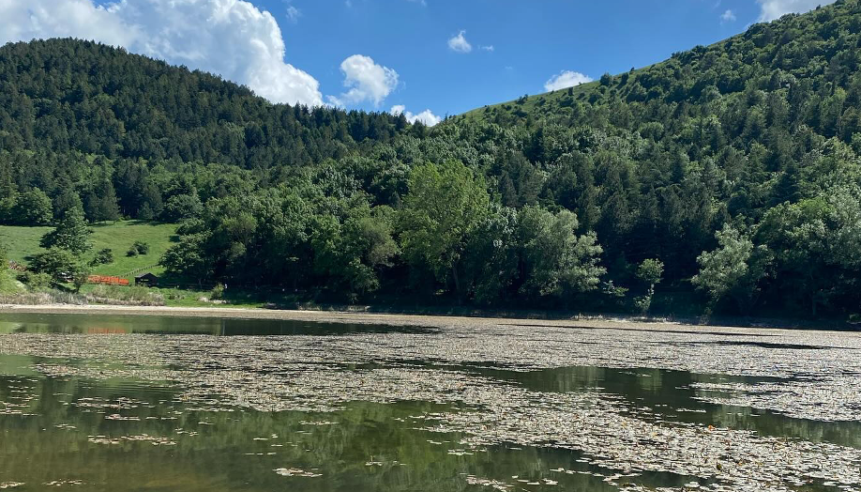

Photo Credit: Meridaunia
Accommodation Type:
Eco-friendly treehouses and lightweight wooden cabins in a natural forest setting
Start-Up Focus:
Bed&Tree offers immersive stays in Biccari’s forest using minimal-impact, lightweight construction. The project revitalizes rural land through sustainable tourism and community engagement.
Case Study
Bed&Tree – Biccari, Italy
Source https://www.iviaggidiliz.it/dormire-in-una- casa-sullalbero-in-puglia-ecco-dove/
Website: https://www.visitbiccari.com/attivita/casette- sugli-alberi-di-daunia-avventura/
1

Slide 2

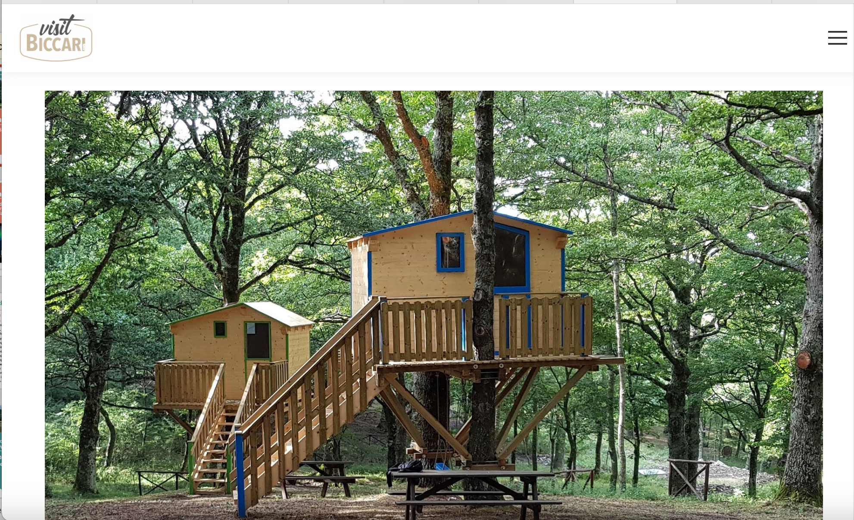
Case Study
Ecological Impact:
Treehouses are built with local wood and elevated platforms to protect the environment.
The use of dry toilets, low-energy systems, and eco-conscious design minimises resource use while promoting biodiversity and environmental education.
Bed&Tree – Biccari, Italy
Click to Website
Source https://www.iviaggidiliz.it/dormire-in-una- casa-sullalbero-in-puglia-ecco-dove/
Website: https://www.visitbiccari.com/attivita/casette- sugli-alberi-di-daunia-avventura/
2

Slide 3
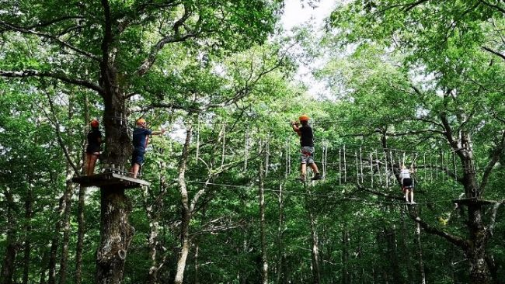
Click to Watch Video
Bed&Tree, Biccari, Italy
Video:
The reel showcases Bed&Tree, a treehouse accommodation project in the natural forest area of Biccari, in the Monti Dauni (Puglia, Italy).
The video highlights the immersive experience of staying in eco-friendly wooden cabins elevated among the trees, allowing guests to reconnect with nature while minimising environmental impact.
3

Slide 4
Click to Watch Video
Bed&Tree, Biccari, Italy
The visuals emphasize:
Simple, sustainable design using natural materials
Integration with the forest environment, offering views of Lago Pescara and the Apennines
The concept of slow tourism and outdoor hospitality, promoting local experiences
An invitation to experience the area’s beauty in a low-impact, nature-centered way
4

Slide 5
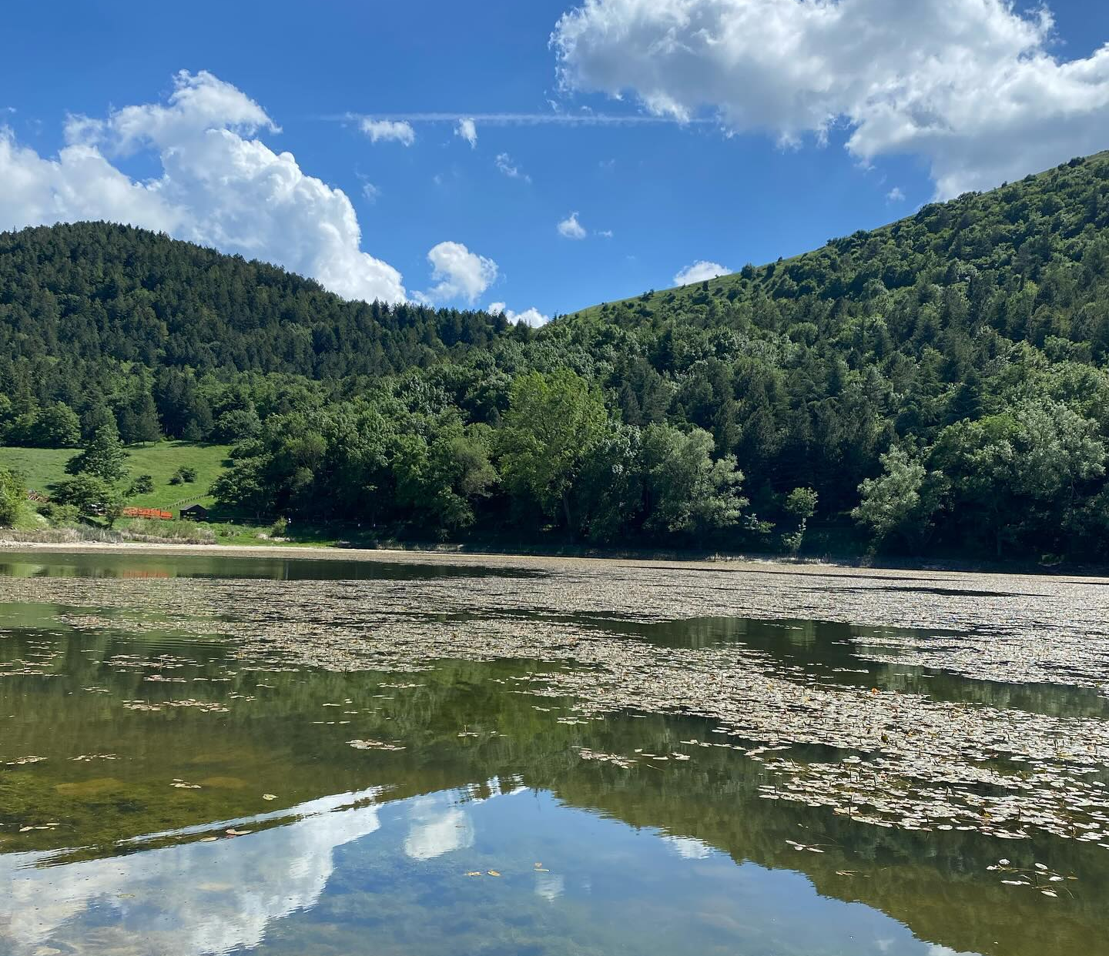


Alternative & Unique Accommodation:
Photo Credit: Meridaunia
Bed&Tree in Biccari offers an immersive eco-tourism experience through a collection of small, sustainable treehouses nestled in the Lago Pescara forest in the Monti Dauni, Puglia.
This innovative project reimagines rural hospitality by providing guests with the opportunity to sleep among the trees while maintaining full respect for the natural environment. Each treehouse is built with lightweight, locally sourced wood, ensuring minimal environmental impact and seamless integration into the forest landscape.
Bed&Tree, Biccari, Italy
EPIC STAYS is licensed
under CC BY-SA 4.0
Funded by the European Union. Views and opinions expressed are however those of the author(s) only and do not necessarily reflect those of the European Union or the European Education and Culture Executive Agency (EACEA). Neither the European Union nor EACEA can be held responsible for them.
5

Slide 6
Alternative & Unique Accommodation:
Photo Credit: Meridaunia
The concept promotes a return to simple pleasures - disconnecting from everyday stress and reconnecting with nature - while fostering slow, sustainable tourism.
Guests are invited to enjoy panoramic views, outdoor activities, and local experiences that highlight the cultural and natural richness of Biccari, creating a stay that is both memorable and environmentally responsible.
Bed&Tree, Biccari, Italy
6

Slide 7
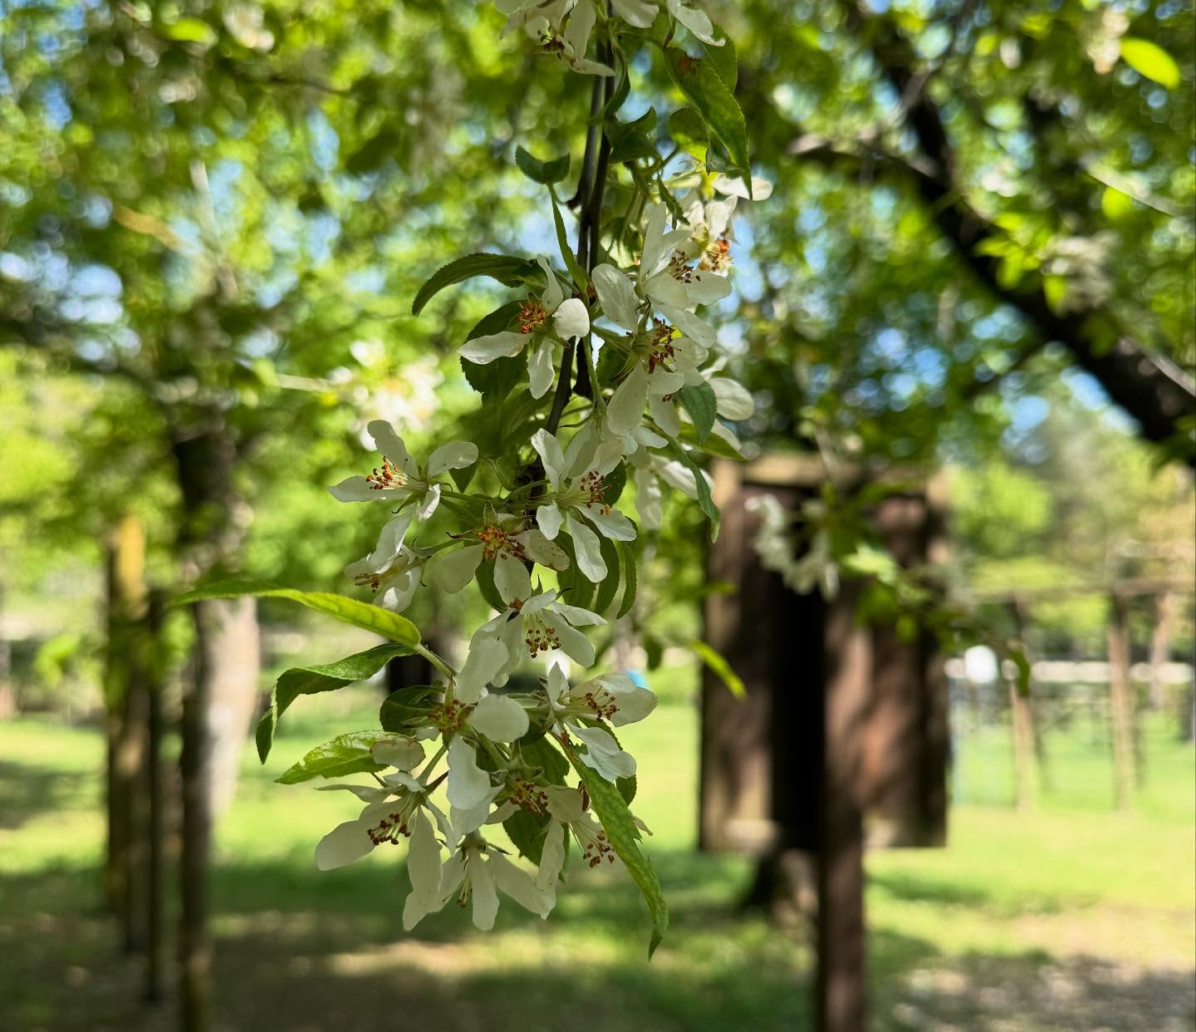
Alternative Accommodation - Financial Journey:
Photo Credit: Meridaunia
The Bed&Tree project in Biccari was made possible through a mix of public funding, local development initiatives, and community-driven investment. The primary financial support came from GAL Meridaunia, under the Puglia Rural Development Programme.
This measure focuses on fostering non-agricultural activities in rural areas, encouraging innovative tourism services, crafts, and personal care enterprises that complement traditional agriculture.
The funding covered critical start-up costs, including the construction of the treehouses, the redevelopment of the Lago Pescara didactic forest, and the installation of eco-friendly facilities such as dry toilets and minimal-impact utilities.
Bed&Tree, Biccari, Italy
7

Slide 8
Alternative Accommodation - Financial Journey:
Photo Credit: Meridaunia
The project was also supported by the Municipality of Biccari, which provided access to public forest land and facilitated administrative procedures.
By combining EU rural development funds, local governance support, and the vision of Biccari’s municipal leaders, Bed&Tree has become a model for low-cost, sustainable tourism investment that stimulates the local economy without overburdening natural resources. The financial model prioritizes long-term sustainability, with revenues from tourism reinvested into forest maintenance, educational activities, and further eco-tourism development in the area..
Bed&Tree, Biccari, Italy
8

Slide 9
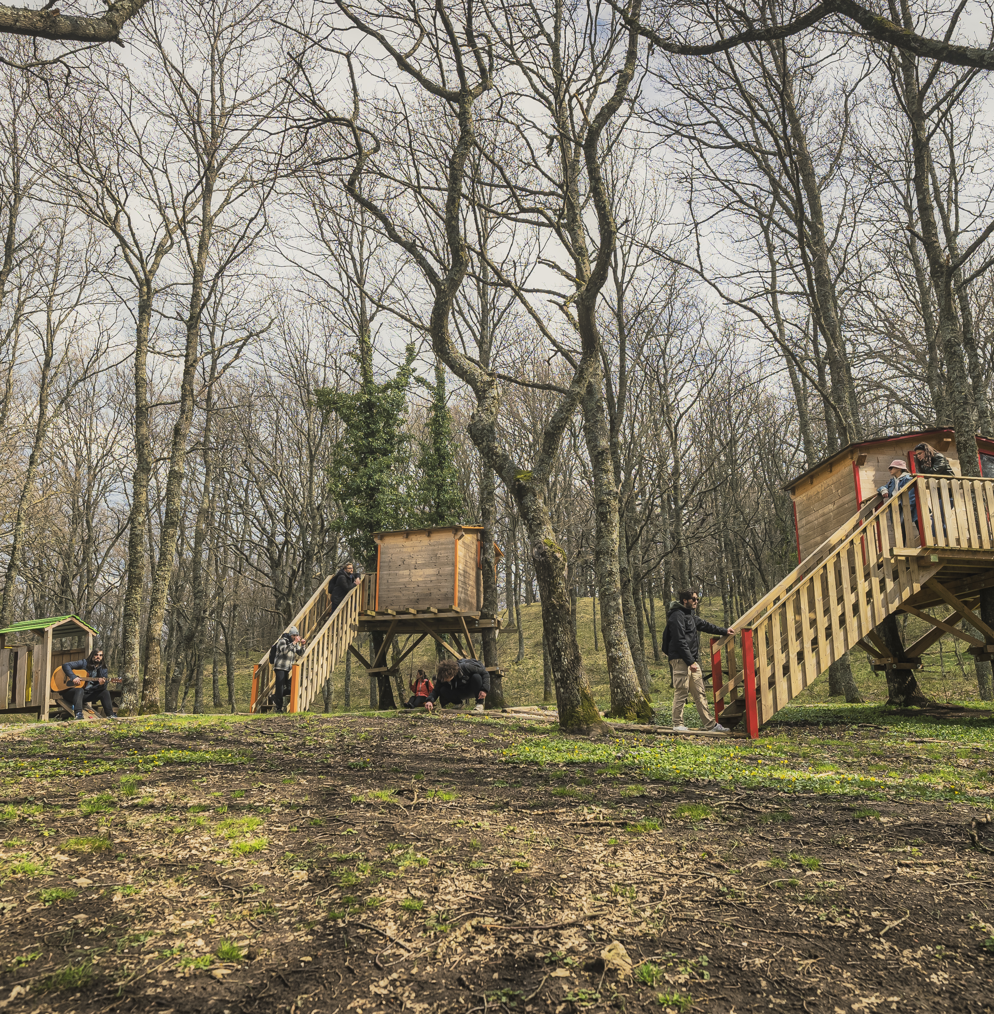
Key Takeaways
Build Light, Stay Green: Bed&Tree demonstrates how small-scale, eco-sensitive accommodations can minimize environmental impact through low-footprint construction. The treehouses are built with lightweight materials and installed using non-invasive techniques, avoiding damage to the forest ecosystem. This approach preserves biodiversity while offering a unique guest experience.
Use Local Resources and Skills: The project integrates local artisanship and materials into its design and construction. This reduces transportation emissions, supports the regional economy, and creates accommodations that reflect local identity. Involving the community also strengthens ownership and fosters long-term sustainability.
Photo Credit: Meridaunia
9

Slide 10
Key Takeaways
Design for Shared Use and Flexibility
Bed&Tree is not just about overnight stays; it serves as part of a broader multifunctional space within the Lago Pescara Didactic Forest. The area hosts educational programs, adventure tourism, and environmental awareness activities, making the accommodation part of a flexible ecosystem that benefits both visitors and residents.
Public-Private Collaboration is Key
By leveraging local development funds (GAL Meridaunia) and working closely with municipal authorities, the project showcases how public-private partnerships can deliver successful rural regeneration projects. This model allows small municipalities to attract tourism without overbuilding or compromising local heritage.
Eco-Tourism Enhances Community Resilience
Bed&Tree diversifies the local economy by creating sustainable tourism opportunities in a remote area. It generates new income streams while protecting natural and cultural assets, proving that small-scale, environmentally friendly tourism can contribute to long-term community resilience.
10

Slide 11
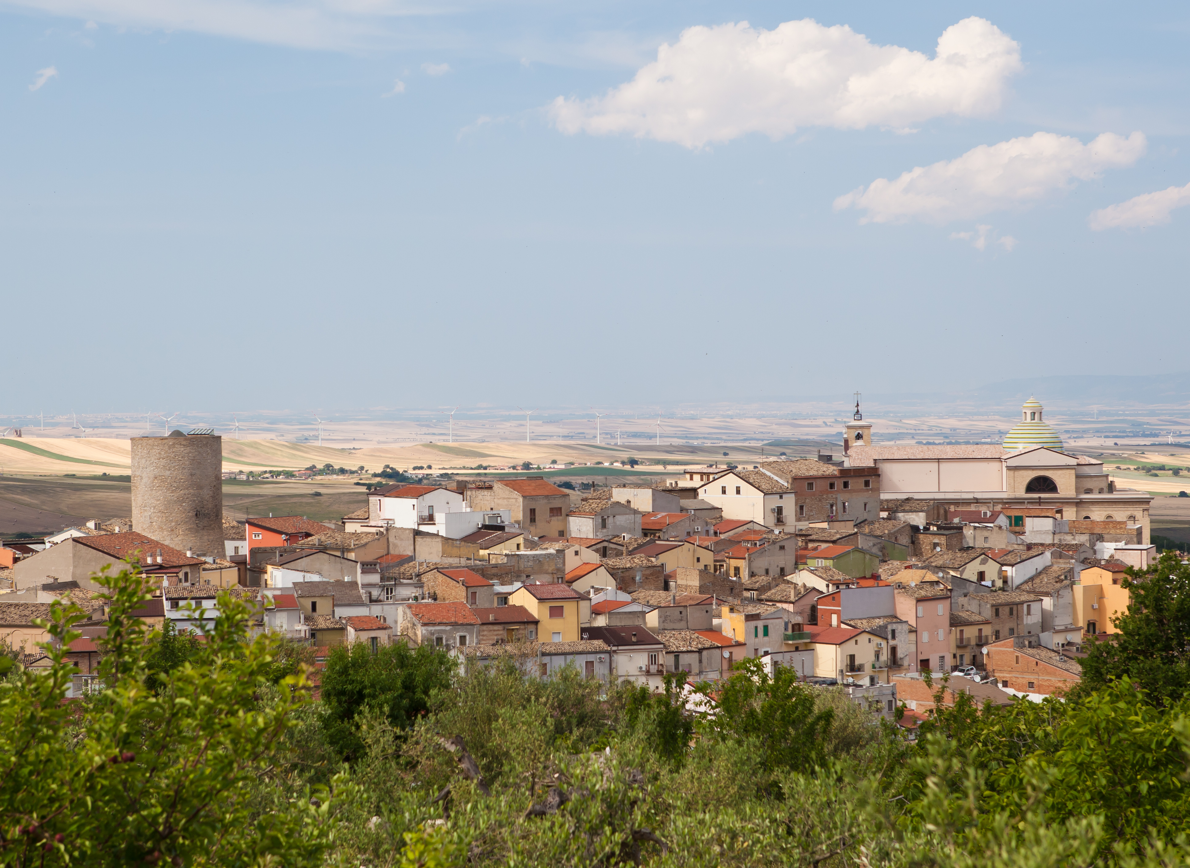
"True sustainability in tourism is not about building more—it’s about building wisely. When design respects nature and materials reflect local identity, hospitality becomes a tool for regeneration, not consumption"
Photo Credit: Meridaunia
11

