Slide 1
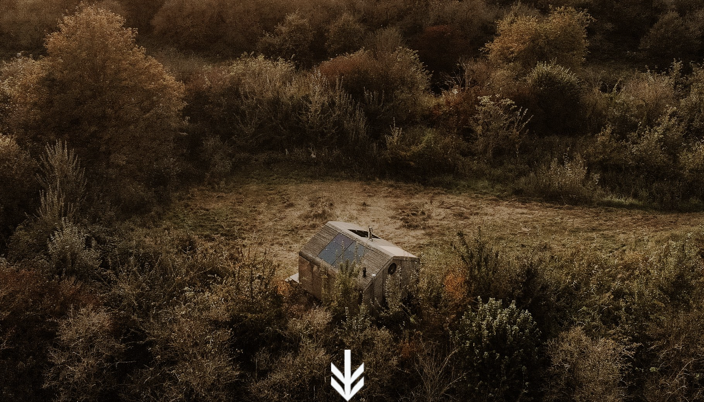


Accommodation Type: In nature off-grid cabin
Link with natural environment and hiking trails: Cabiner is a network of off-grid cabins in the most beautiful spots of Dutch nature.
Photo Credit: Cabiner
Case Study
Information Sources: Off-grid cabin in Dutch nature
Website: https://www.cabiner.com
Cabiner, Netherlands
EPIC STAYS is licensed
under CC BY-SA 4.0
Funded by the European Union. Views and opinions expressed are however those of the author(s) only and do not necessarily reflect those of the European Union or the European Education and Culture Executive Agency (EACEA). Neither the European Union nor EACEA can be held responsible for them.

Slide 2
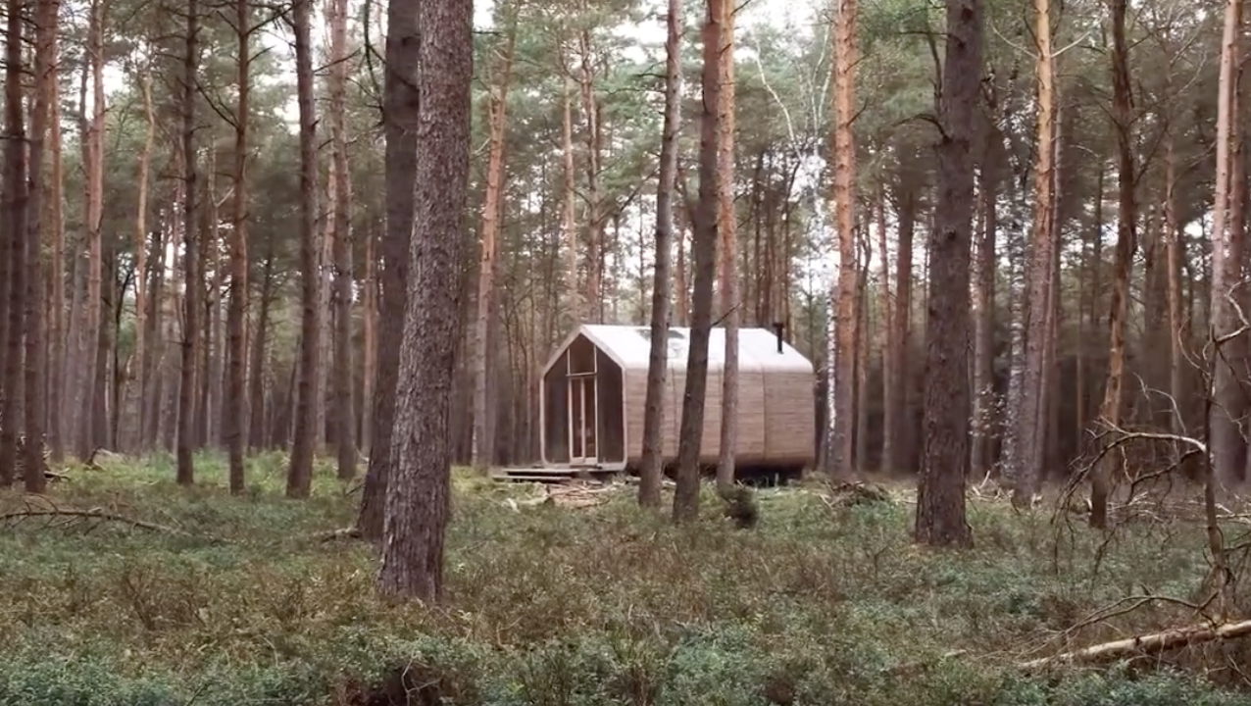
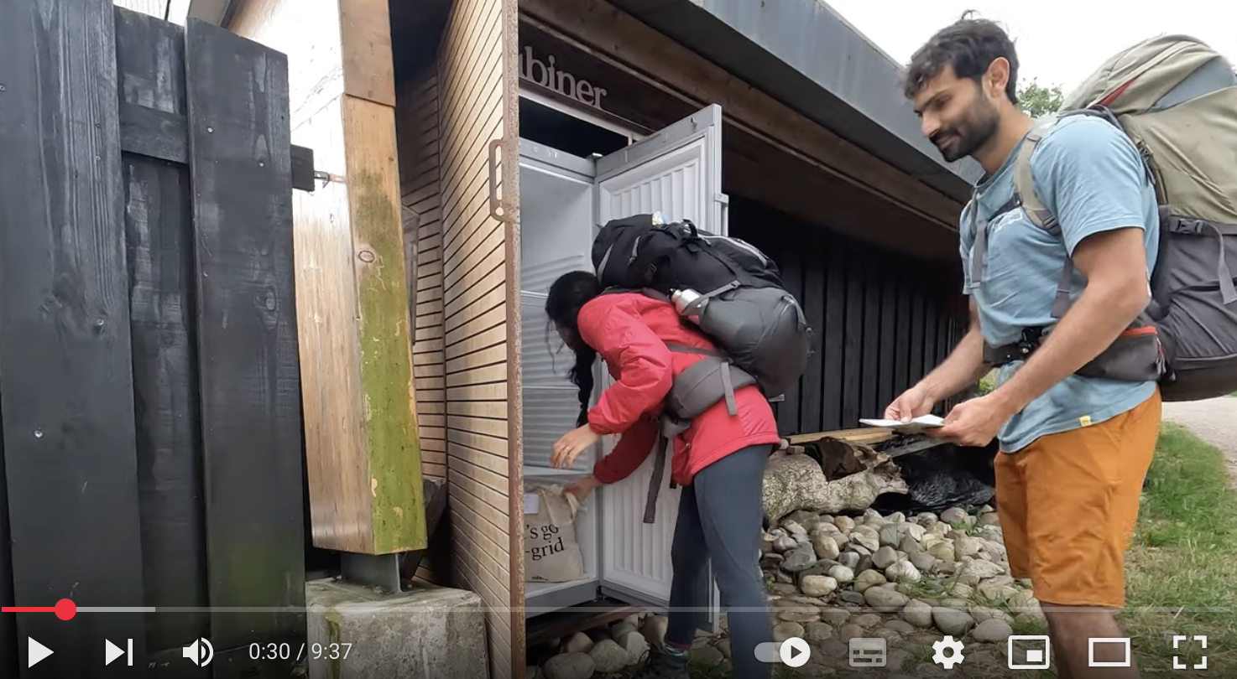
Click to See Videos
Link: https://www.youtube.com/watch?v=ZqE5xanR1sg
Click to Watch Video
Name: Cabiner
Video 1 - A Cabiner Story shows the unique experience the guests will experience by pumping their own water and chopping wood in a tiny small house off-grid in the middle of Dutch nature.
Video 2 - Traveler’s experience This video showcases the first-hand experience of a couple using a Cabiner cabin while travelling through the Netherlands. Showcasing the uniqueness of the experience and of the context can help you to promote the key features and context of your alternative accommodation.
A Cabiner story
Traveler’s experience

Slide 3
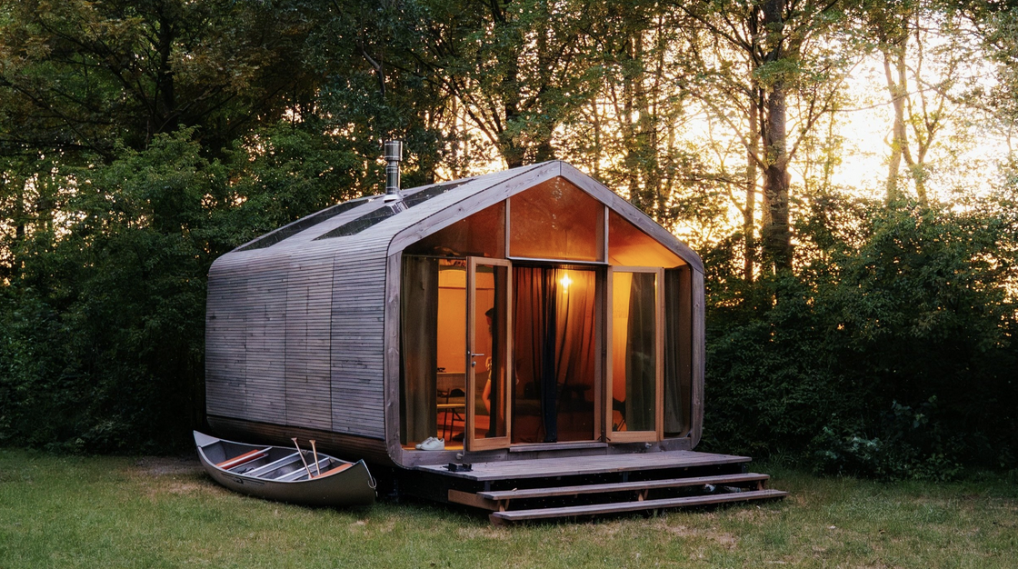
Reconnecting People with Nature: Cabiner illustrates how accommodation can become a tool for rewilding and mental restoration. By requiring guests to hike to remote cabins, it creates a slowed-down experience that enhances awareness of natural surroundings—offering a model for integrating physical activity, nature immersion, and minimalist tourism in hospitality entrepreneurship.
Sustainable Off-Grid Design: Cabiner demonstrates how sustainability and autonomy can drive innovation in hospitality. Each cabin operates off-grid with solar panels, water pumps, and composting systems. Designed to leave no trace, this approach offers valuable insights into low-impact, mobile architecture and regenerative design as emerging business opportunities in eco-conscious tourism.
Photo Credit: Cabiner (NL)
Cabiner, Netherlands
Nature-based experience
3

Slide 4
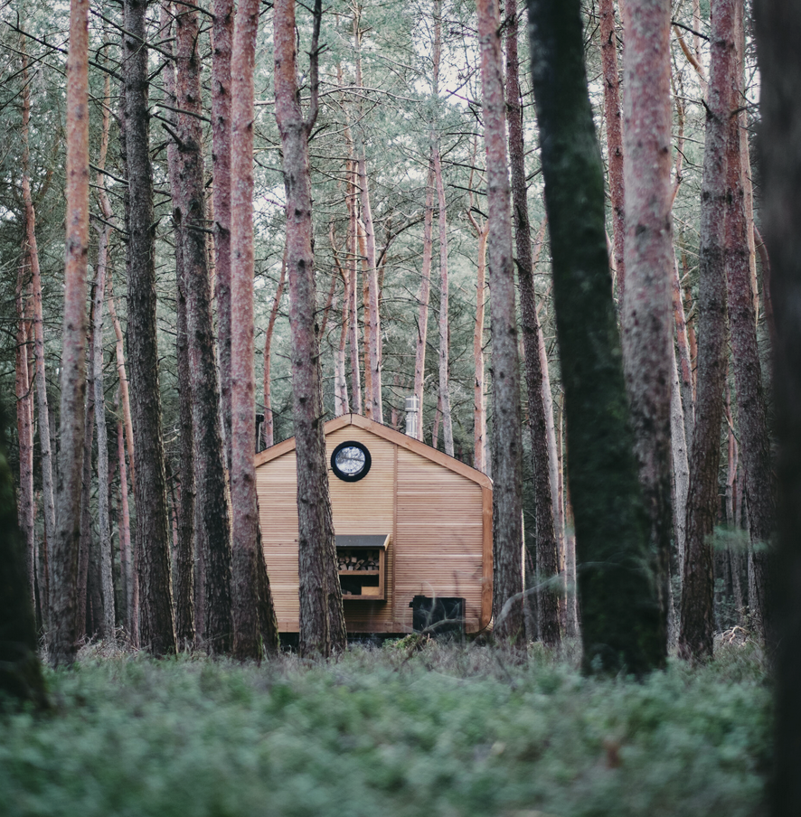
Key Takeaways
Nature as core experience: By designing accesses through hiking and/or connecting your accommodation to nature, you can turn the journey itself into an immersive, reflective part of your guest’s experience.
Sustainable innovative design: By using off-grid systems like solar power and composting toilets, you can embed sustainability into your accommodation while reducing reliance on fixed infrastructure and utilities
Unique experience: By limiting access and offering remote, minimalist stays, you can create a sense of escape and exclusivity that sets your accommodation apart from conventional options.
Photo Credit: Bunk Amsterdam

Slide 5
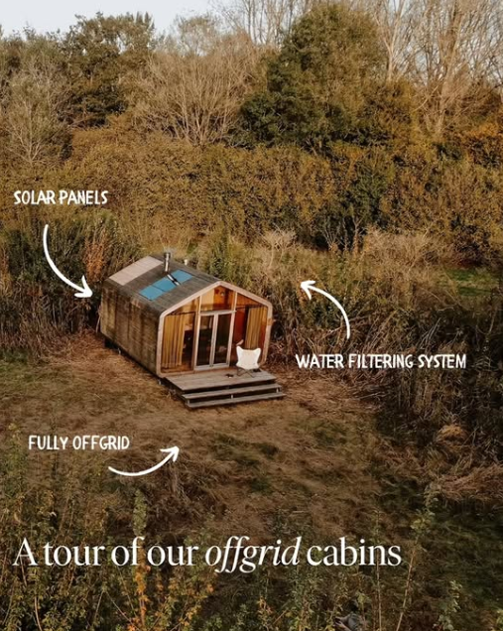
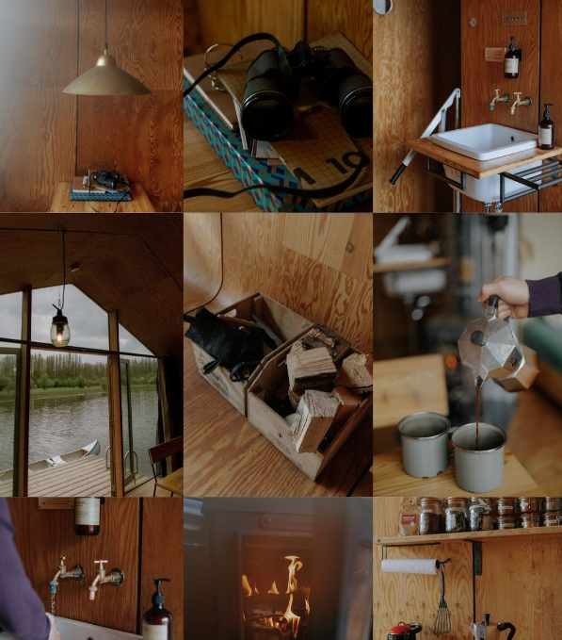
Cabiner, Netherlands
5

