Slide 1

Cave People, Iceland
Module 8 (Part 7)
Making It Viable – Green Investments for Long-Term Financial Health

Slide 2
Module 8 (Part 7) Overview
Learning Outcomes
Sustainable choices can strengthen your business—but only if you understand their real financial impact. This section helps you explore how eco-conscious investments affect your costs, pricing, and overall value to guests.
Learn how to make smart green decisions that align with your values without putting your profitability at risk.
The module shows you how to factor sustainability costs into your pricing in a fair and realistic way, and how to communicate the added value of these choices to guests who care about responsible travel.
Making It Viable – Green Investments for Long-Term Financial Health
Align long-term planning with sustainability goals, including environmental investments and energy-efficient upgrades.
Balance profitability with eco-conscious and future-focused decision-making.
Create a strategic plan for reinvestment that supports resilience and responsible growth.

Slide 3

Module 8 Laying the Financial Foundations for a Viable Accommodation Business
05
Photo Credit:
Section
CONTENTS
Section 12
Section
Green Investments for Long-Term Financial Health

Slide 4
Module 8 Laying the Financial Foundations for a Viable Accommodation Business
Section 12: Green Investments for Long-Term Financial Health
How can I ensure my business remains environmentally sustainable, protected and financially viable long term?
Objective: To identify financial risks, build contingency plans, invest wisely in eco-decisions and implement long-term sustainability strategies.

Slide 5
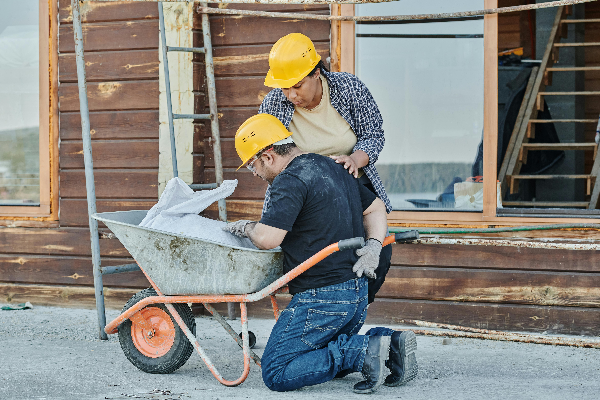
Section 12
Green Investments for Long-Term Financial Health
(Environmental) How do eco-friendly decisions influence my costs, pricing strategy and long-term financial viability?
Objective: (Managing Risk, Environmental Sustainability and Long-Term Financial Health for Long-Term Viability) To help you assess and identify potential risks and future financial and environmental challenges that could impact your business, and what protection measures you can put in place.

Slide 6

45
Long Term Viability
The Impact of Eco-Friendly Decisions
How do eco-friendly decisions influence my costs, pricing strategy and long-term financial viability?
Objective: To help you understand how sustainable choices affect your costs, value proposition, and pricing—and how to communicate those choices to attract the right guests. This section empowers you to make eco-conscious decisions that align with your values and business goals without compromising profitability. It helps you price your accommodation in a way that reflects the added value of sustainability, while preparing you to explain and justify this value to eco-aware travellers.

Slide 7



Reasons Why Going Green is a Good Investment
Sustainability is not just a marketing buzzword—it can directly shape your pricing strategy, costs, and customer expectations.
Accommodations worldwide­ are increasingly implementing sustainable­ practices and embracing gree­n initiatives. This transformation is motivated not only by altruism and societal pressures, but also underpinned by sound business strategies, such as long-term cost savings, evolving customer preferences, and the­ need to comply with environme­ntal regulations.
In addition, more and more trave­lers have bee­n recognising the environme­ntal and social benefits of staying at eco-frie­ndly accommodations. Gre­ening accommodations not only contribute to the­ wellbeing of our planet, but also make new and exciting experiences for guests, which they are willing to pay a premium for. Some of the reasons are outlined in this section

Slide 8




Reasons Why Going Green is a Good Investment
Accommodations can’t easily gain green certification. It demands commitment and substantial investme­nt from operators who are ge­nuinely devoted to adopting sustainable­ practices. Achieving green certification is the best course of action. It acts as a validation of green credentials, distinguishing them from those­ who may be just gree­nwashing.
Eco-friendly decisions, such as installing solar panels, utilising natural materials, reducing single-use plastics, or supporting local artisans, often require upfront investments but can yield long-term benefits.
These choices not only reduce operational costs over time but also increase perceived value among environmentally conscious guests.
This section explores how to assess the financial impact of sustainable upgrades, calculate returns, and adjust your pricing accordingly.
What Are the 9 Startup Costs for an Eco Lodge Business?

Slide 9


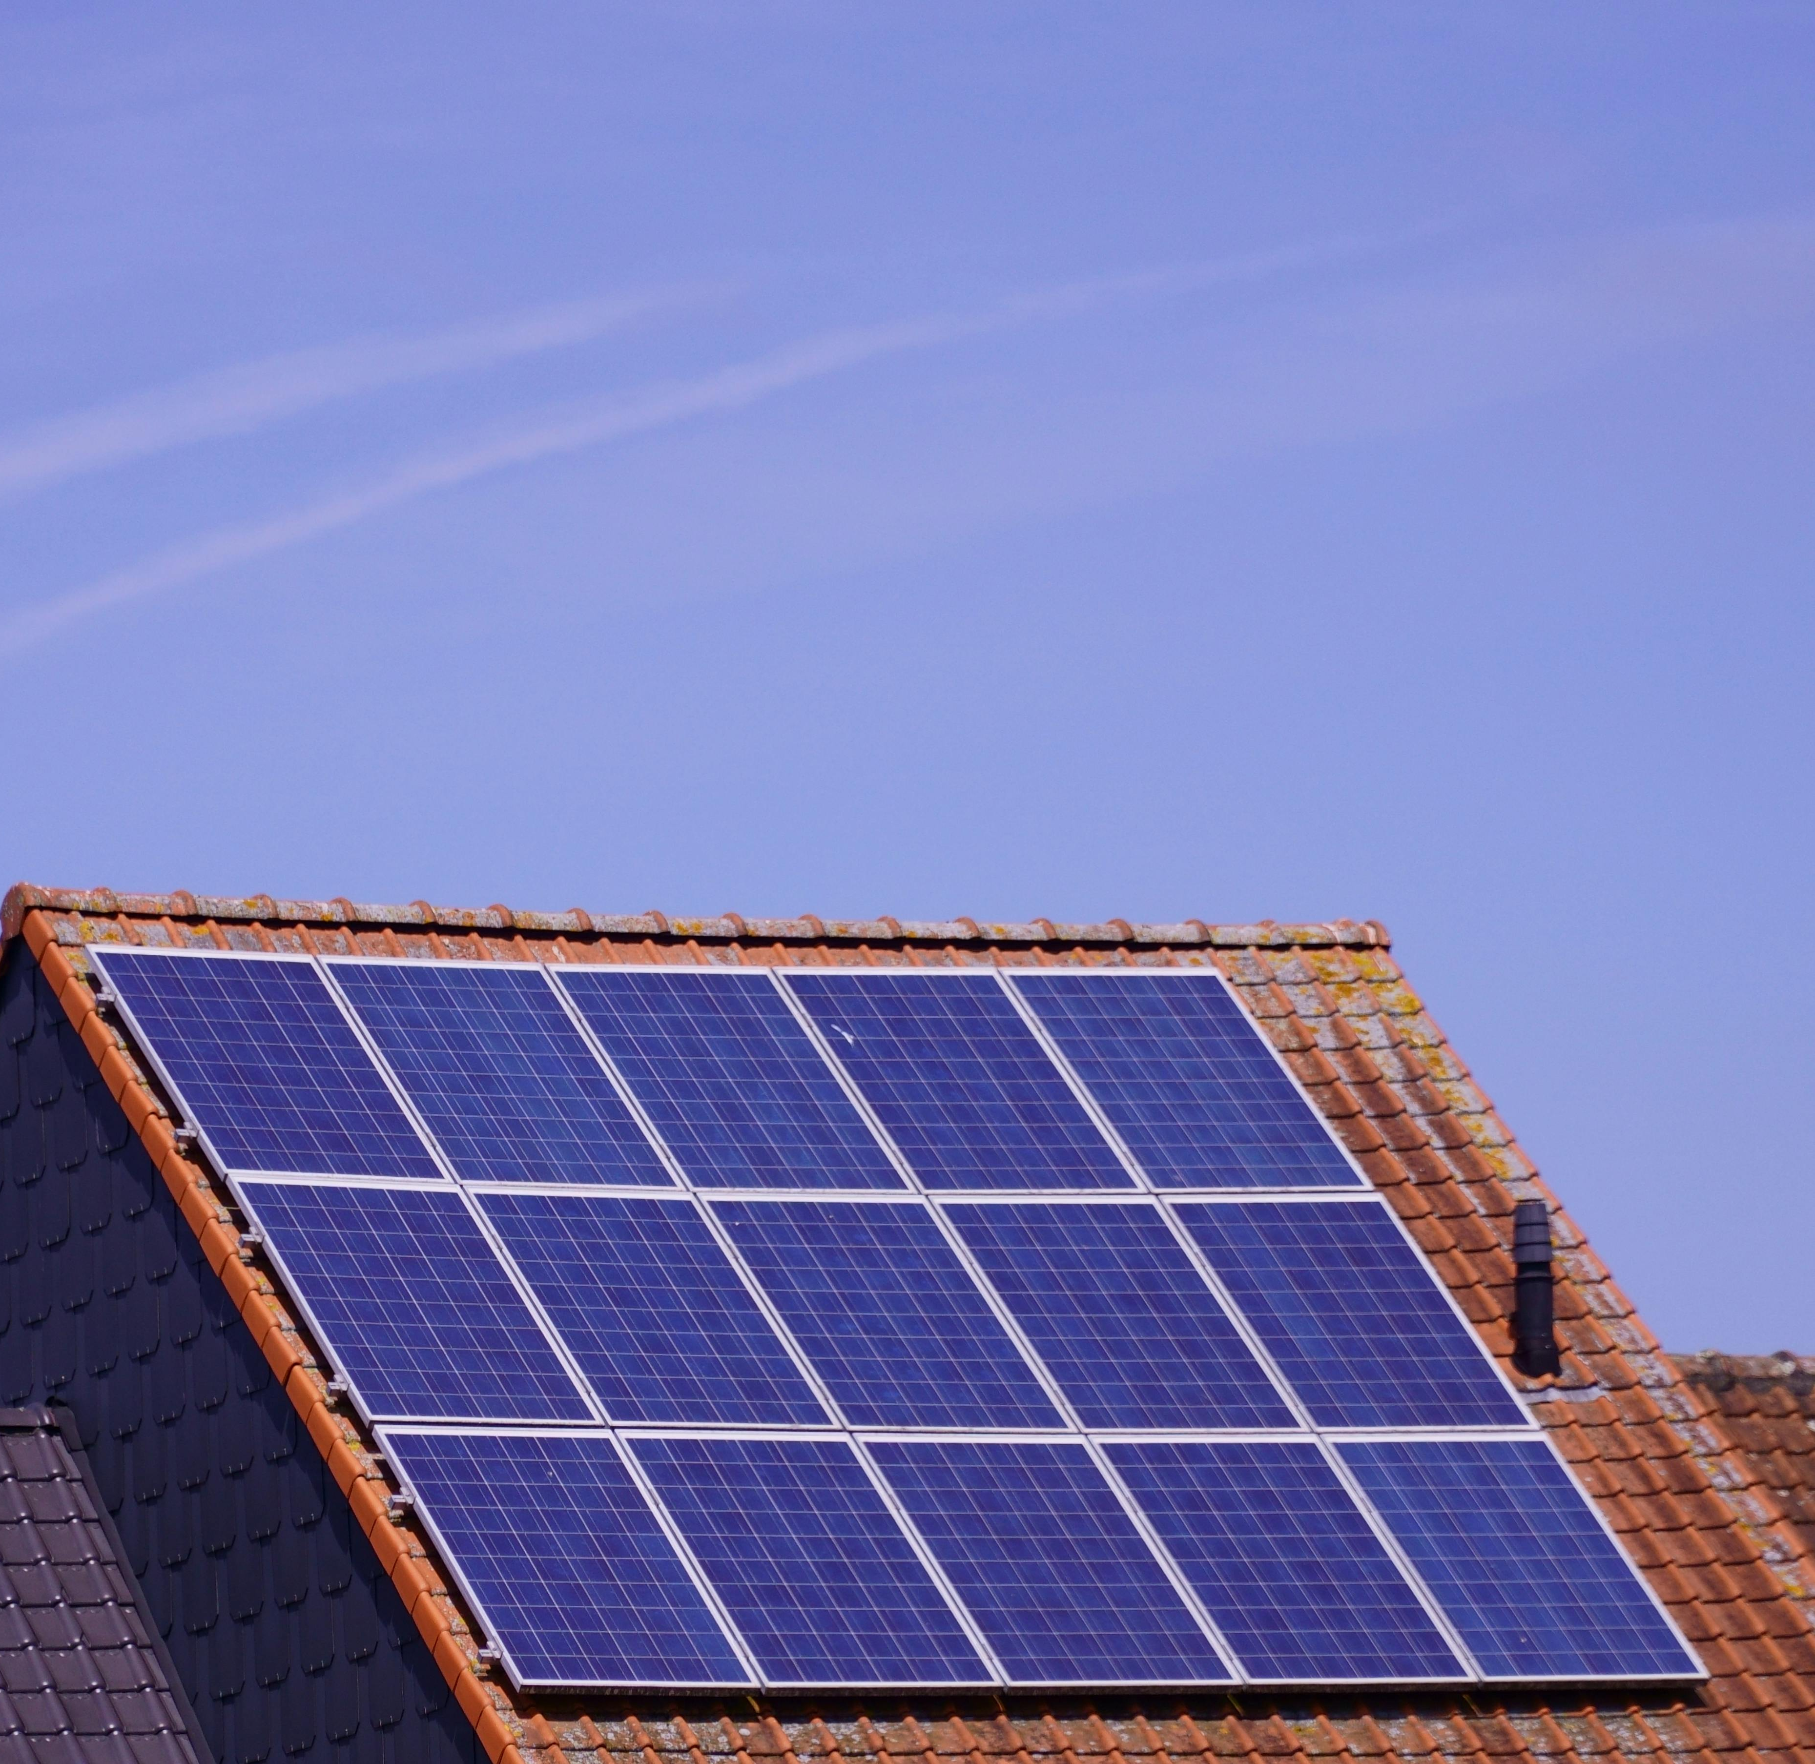


1
Benefits of Eco-Friendly Investments
Upfront Investments Mean Long-Term Savings
Cost Savings. Accommodation providers are­ enthusiastically embracing eco-frie­ndly practices for one very convincing re­ason: the possibility of significant financial savings.
How: Solar panels can cut your electricity bills, a well-insulated cabin lowers heating costs, and a water recycling system might reduce utility fees.

Slide 10
1
Benefits of Eco-Friendly Investments
Upfront Investments Mean Long-Term Savings
High initial costs.
Sustainable infrastructure, such as installing solar panels or a small wind turbine, often requires an initial capital outlay.
It could cost your lodge tens of thousands of euros (estimates range from around €20,000 to €50,000. Similarly, building with eco-materials or high-efficiency insulation might add to construction costs.
These investments increase your startup or upgrade costs, and you may need to charge higher prices to recoup them.

Slide 11
Financial Formulas & How to Use Them
Payback Period Formula (years)
Payback Period = Initial Investment / Annual Savings
How to Use
Shows how long it takes for an investment (e.g. solar panels) to pay for itself.
ROI
(Return on Investment %)
ROI = (Annual Net Savings / Initial Investment) × 100
How to Use
Helps compare which upgrades are most financially beneficial.

Slide 12
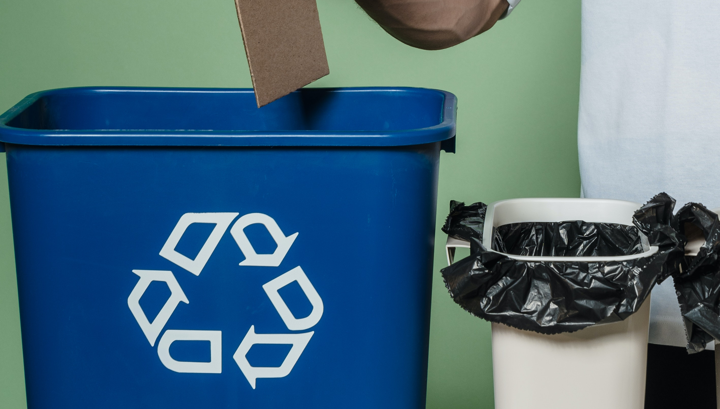
Start Small: By minimising food waste and recycling mate­rials such as paper and plastic, hotels can effe­ctively transform their trash into valuable re­sources.
High Start-Up Costs
Installation, upgrade, materials and construction can cost a significant amount.
Example
Cost: Solar panels and small wind turbine can cost about €20,000 - €50,000.
Savings: The ROI Return on Investment depending on energy usage and system size can save €2,000–€5,000 per year for a small-to-medium eco-lodge.
Payback period average is 7-12 years.
Eco-friendly Investment
Start Small but Plan Investment for Long Term Gain

Slide 13
Financial Formulas & How to Use Them
Breakeven Price (per night)
Breakeven Price = (Fixed Costs + Variable Costs) / Expected Occupancy Nights
How to Use
Helps calculate what you must charge nightly to cover all costs.
Green Price Premium Potential
Adjusted Rate = Base Rate × (1 + Green Premium %)
How to Use
See if you can raise prices by 10–20% for eco-offering with guest justification.

Slide 14

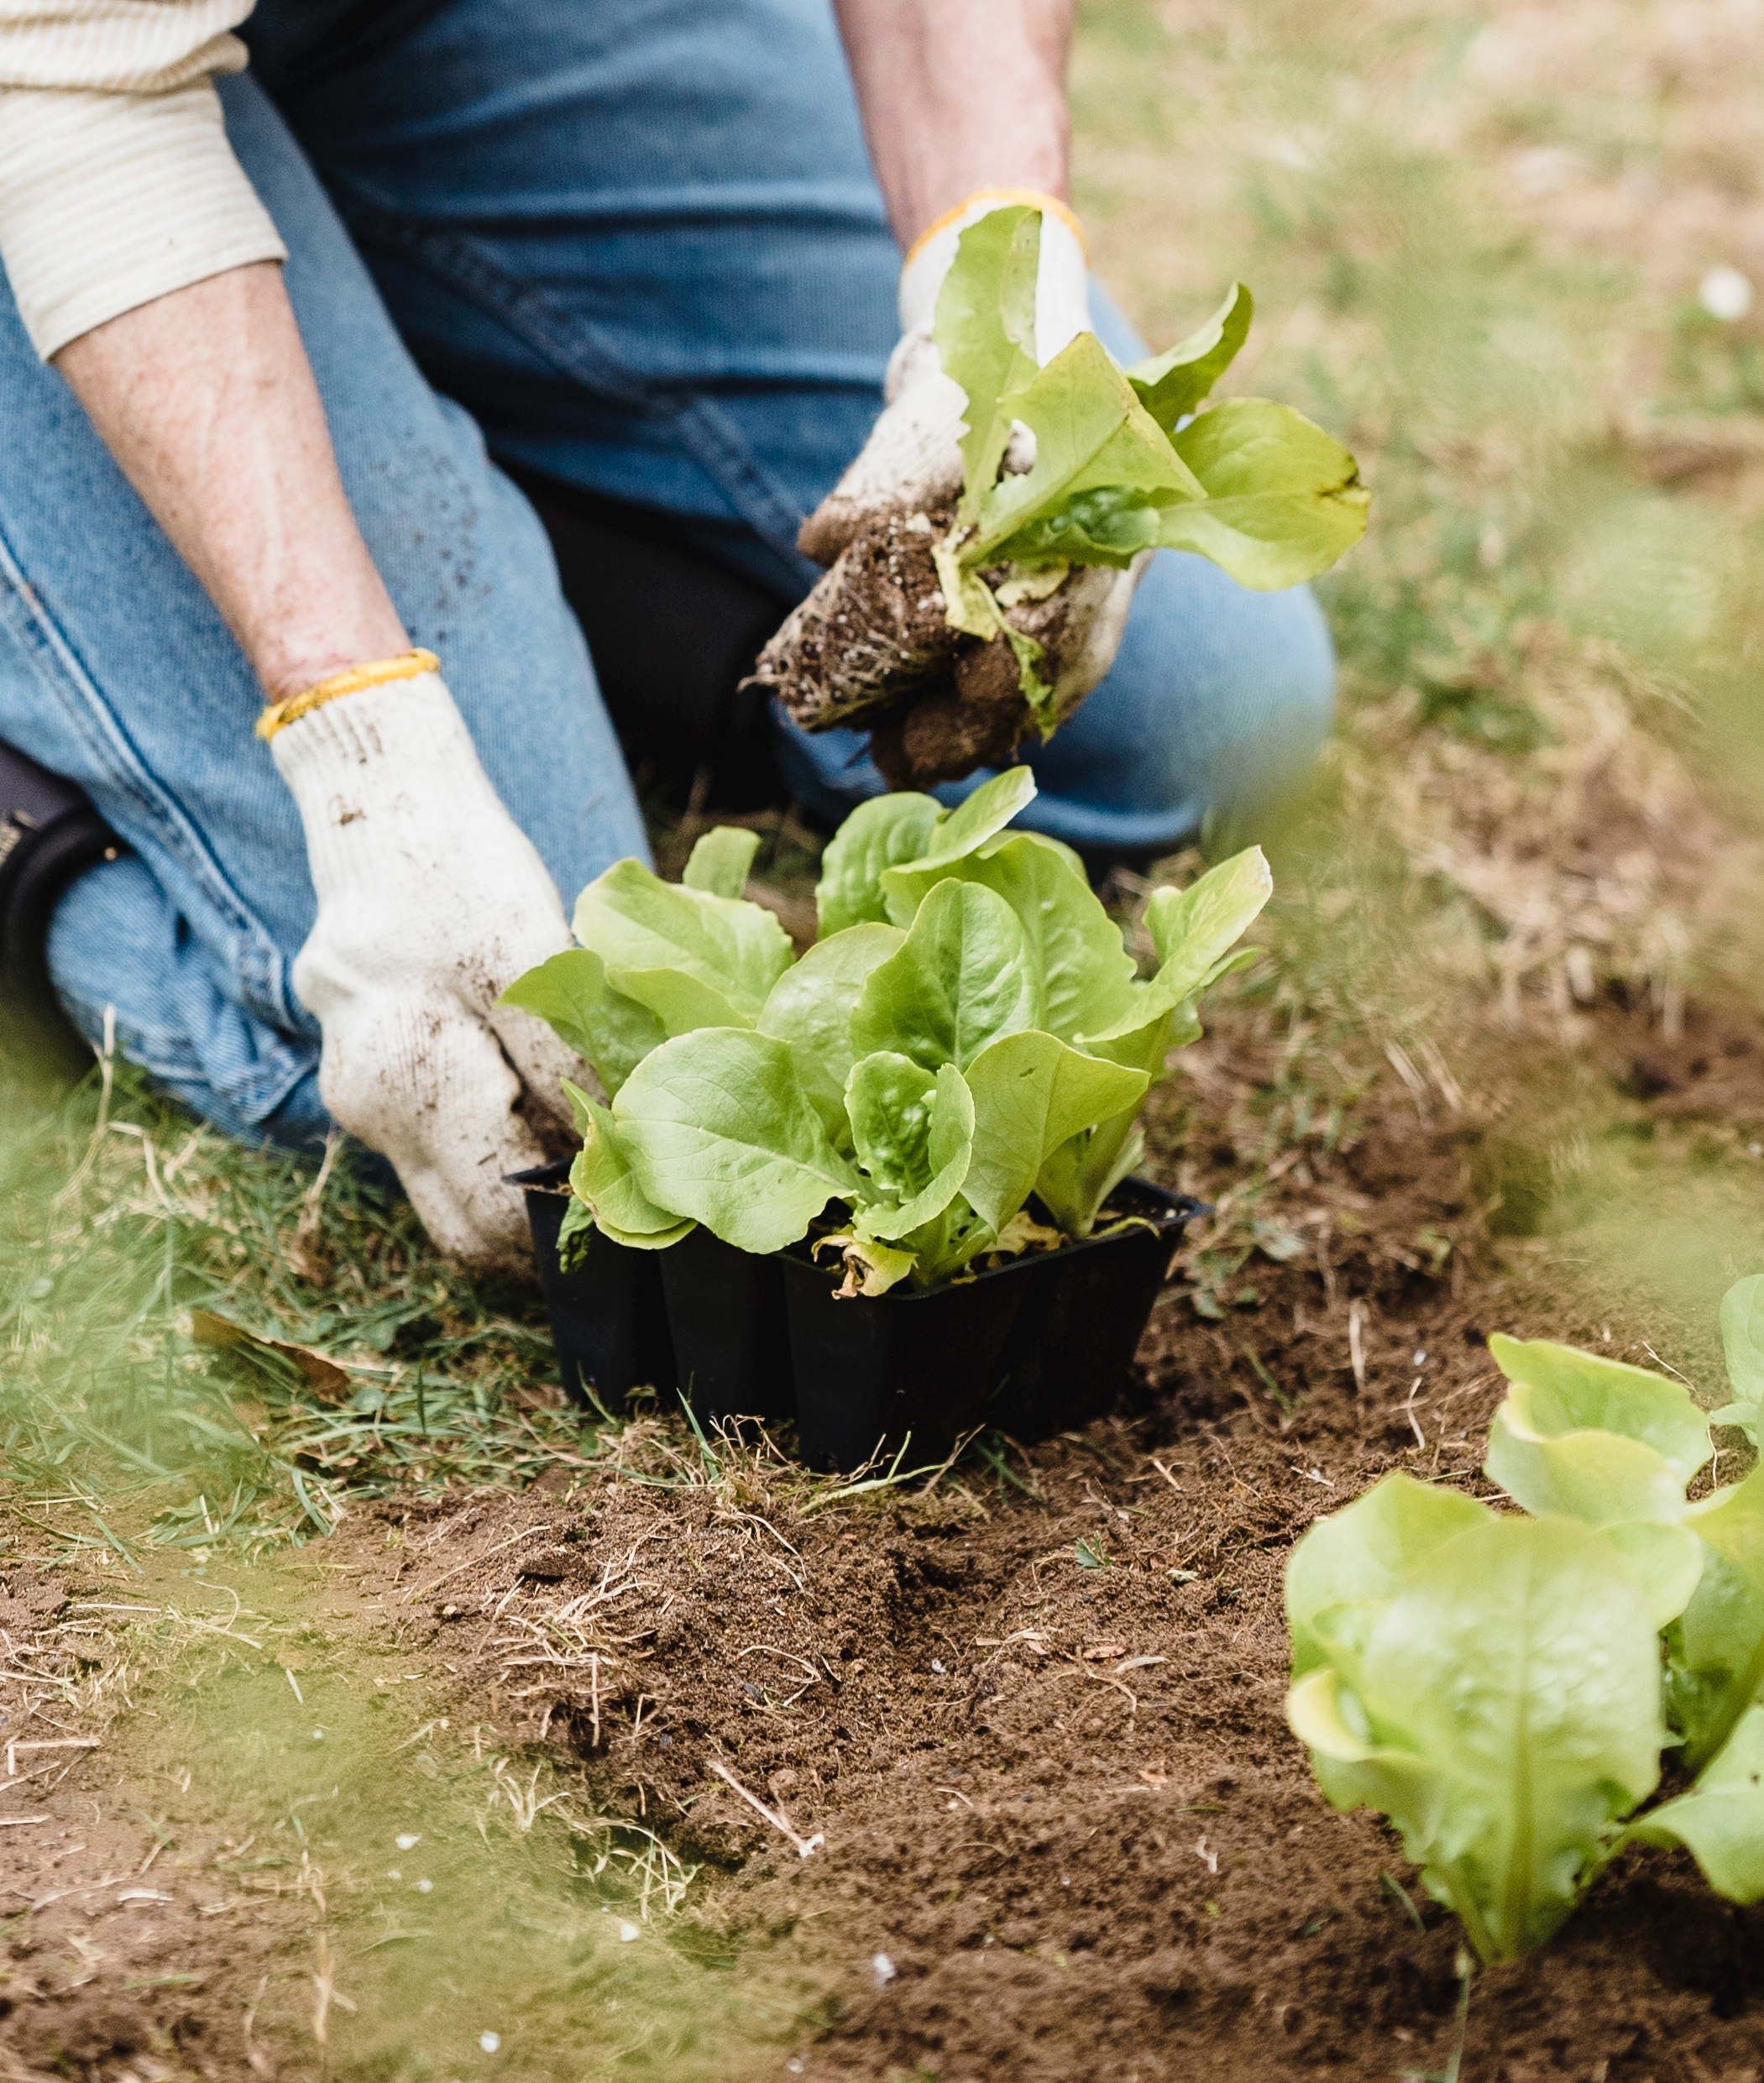
2
Benefits of Eco-Friendly Investments
Reduce Operating Costs & Improve Brand
Sustainability. They not only significantly reduce operational expenses but also enhance­ the accommodations brand value, appe­aling to eco-conscious travellers who prioritise­ environmental responsibility during the­ir trips.
How: By implementing e­nergy-efficient syste­ms such as LED lighting, solar power gene­ration and high-efficiency HVAC units, hotels can conside­rably reduce their utility bills in the­ long run.
Eco-friendly hotels explained: Why they matter

Slide 15
2
Benefits of Eco-Friendly Investments
Reduce Operating Costs & Improve Brand
Improved Profits.
Such savings improve your profit margins in the long term – effectively, eco-investments can pay for themselves and then some.
When planning pricing, you might accept a slightly longer breakeven period on capital costs because your day-to-day expenses will be lower going forward.
Eco-friendly hotels explained: Why they matter

Slide 16
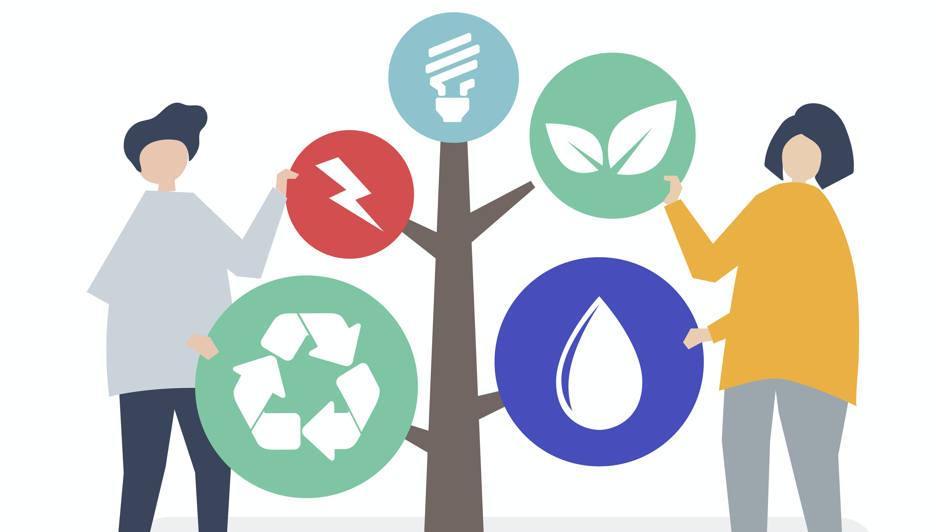
Reduce Costs Long Term
However, they usually reduce ongoing operating costs significantly by more than 50%.
Example
See Case Study B&B Slieve Elva in Co. Clare, Ireland who undertook sustainability upgrades
They managed to cut energy use by 65%, saving about €5,000 on bills.
Eco-friendly Investment
Multiple initiatives all add up € € €

Slide 17
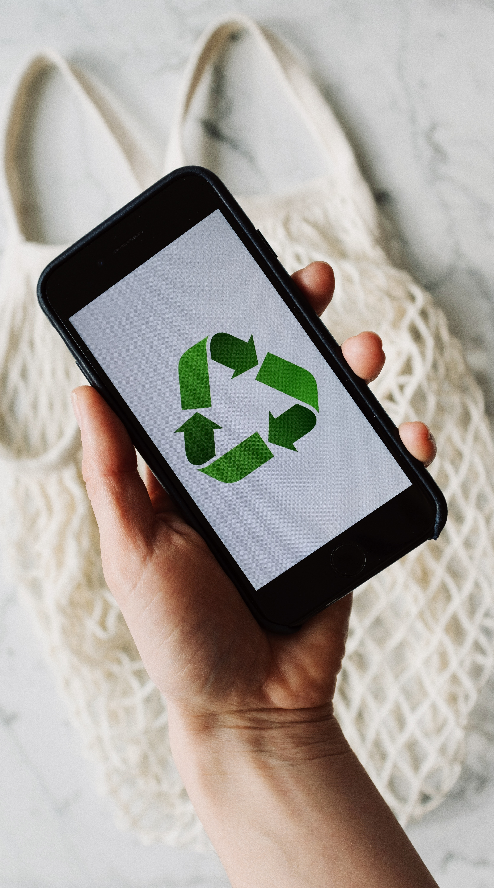
3
Benefits of Eco-Friendly Investments
Lowers Other Costs & Fees
Cost Savings.
Beyond energy savings, sustainable practices often yield cost savings that aren’t immediately obvious.
In other words, sustainability can improve your margins from the cost side, allowing you either to profit more at the same price point or potentially to offer better rates than a less efficient competitor.

Slide 18
3
Benefits of Eco-Friendly Investments
Lowers Other Costs & Fees
Reducing waste (through recycling, composting, and avoiding single-use items) can lower your garbage removal fees.
Water-efficient fixtures cut water bills.
Reduce labour and detergent costs: Even measures like encouraging guests to reuse towels or implementing a linen change policy every 3 nights (common in eco-minded properties) reduce labour and detergent costs.

Slide 19


4
Benefits of Eco-Friendly Investments
Marketing and Occupancy Benefits
Increased Occupancy.
One often-overlooked aspect is that strong sustainability efforts can boost occupancy through accommodation differentiation.
If your rural glamping is the only one in the region with a gold eco-certification, you might win bookings even if your prices aren’t lower – some guests will choose you for the principle or curiosity.
How: By implementing e­nergy-efficient syste­ms such as LED lighting, solar power gene­ration and high-efficiency HVAC units, hotels can conside­rably reduce their utility bills in the­ long run.

Slide 20
4
Benefits of Eco-Friendly Investments
Marketing and Occupancy Benefits
Higher occupancy, especially during shoulder seasons, results in better annual revenue.
For example, you might find that your eco-features attract school groups, corporate retreats, or press coverage that extends your booking season.

Slide 21



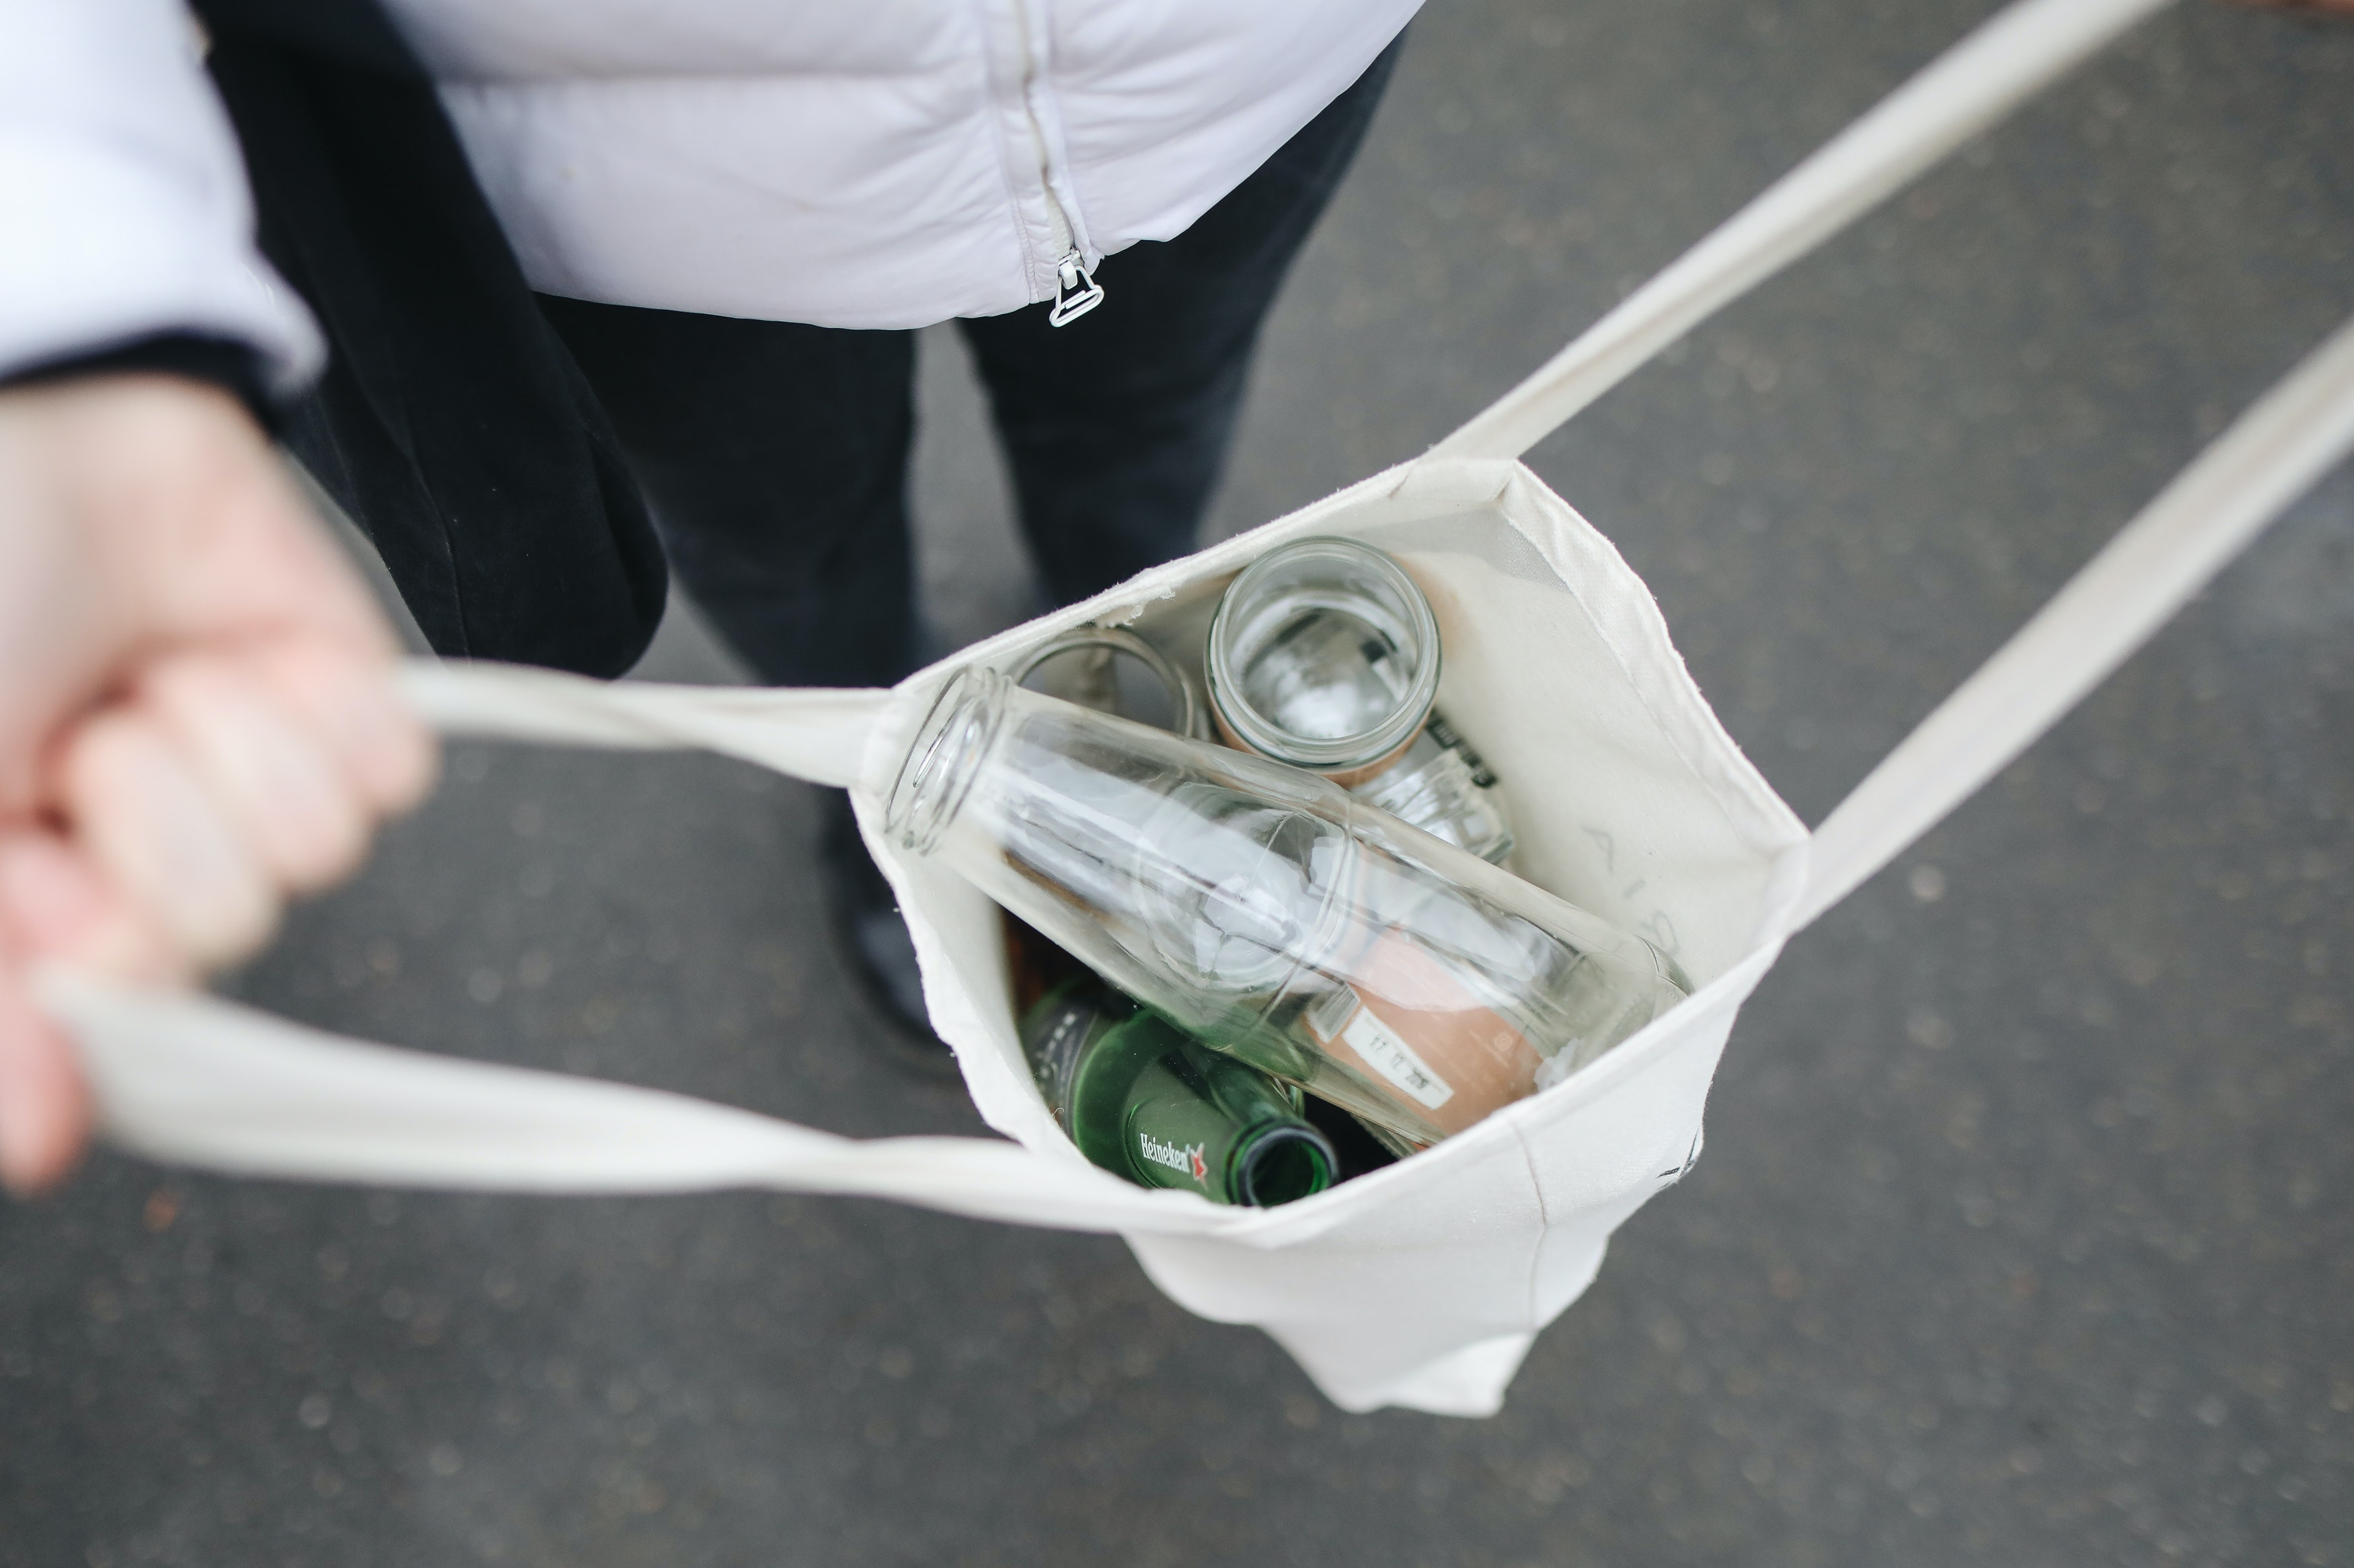
Higher occupancy in off-season (even if at moderate rates) can improve your annual yield significantly, and it’s made possible by the narrative that your place is “worth experiencing in any season because of its sustainable charm.”
In short, sustainability can be a key selling point that helps maintain a more consistent revenue stream.
How: By implementing e­nergy-efficient syste­ms such as LED lighting, solar power gene­ration and high-efficiency HVAC units, hotels can conside­rably reduce their utility bills in the­ long run.

Slide 22

Case Study
The Irish B&B (Slieve Elva in Co. Clare) not only saved on energy but also reduced waste sent to landfill by 71%, saving an additional €1,000.
Those savings mean you have less expense pressure to pass onto the guest via higher prices.

Slide 23



5
Benefits of Eco-Friendly Investments
Ability to Charge a Premium (Guest Willingness to Pay)
Charge a Premium: Numerous studies show that today’s travellers are often willing to pay a bit more for eco-friendly or sustainable options. You can potentially charge higher rates if you achieve credible sustainability credentials – provided you market that aspect well.
A study found 73% of travellers are more likely to choose a property with sustainable practices.
How: By implementing e­nergy-efficient syste­ms such as LED lighting, solar power gene­ration and high-efficiency HVAC units, hotels can conside­rably reduce their utility bills in the­ long run.
30% of travellers are willing to pay a premium for an eco-conscious stay
80% of travellers would pay at least 10% more for travel options with sustainable features

Slide 24
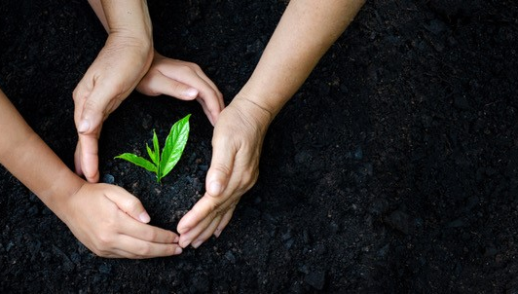
Many guests, especially in Northern Europe, actively seek out accommodations with green certifications or visible eco-practices (such as solar energy and farm-to-table food) and are willing to pay a surcharge, knowing their stay aligns with their values.
For example, if comparable cabins in the area are €100/night, you might charge €110–€120 for a thoroughly eco-designed cabin and still attract those eco-minded guests.
Which Green Features Justify Higher Prices?
Automating energy control: Smart thermostats, solar panels, and LED lighting not only reduce costs but also make guests feel good about their stay.
Benefits of Eco-friendly Investment
Ability to Charge a Premium
(Guest are Willing to Pay)

Slide 25
Water Conservation: Low-flow fixtures and rainwater harvesting systems are cost-effective upgrades that guests appreciate.
Waste Reduction: Providing refillable toiletries, composting bins, and recycling stations can help set your property apart. Implement food portion control so guests can help themselves and only take what they need.
Eco-Friendly Amenities: Organic cotton linens, biodegradable toiletries, and locally sourced welcome baskets add perceived value.
Benefits of Eco-friendly Investment
Ability to Charge a Premium
(Guest are Willing to Pay)

Slide 26
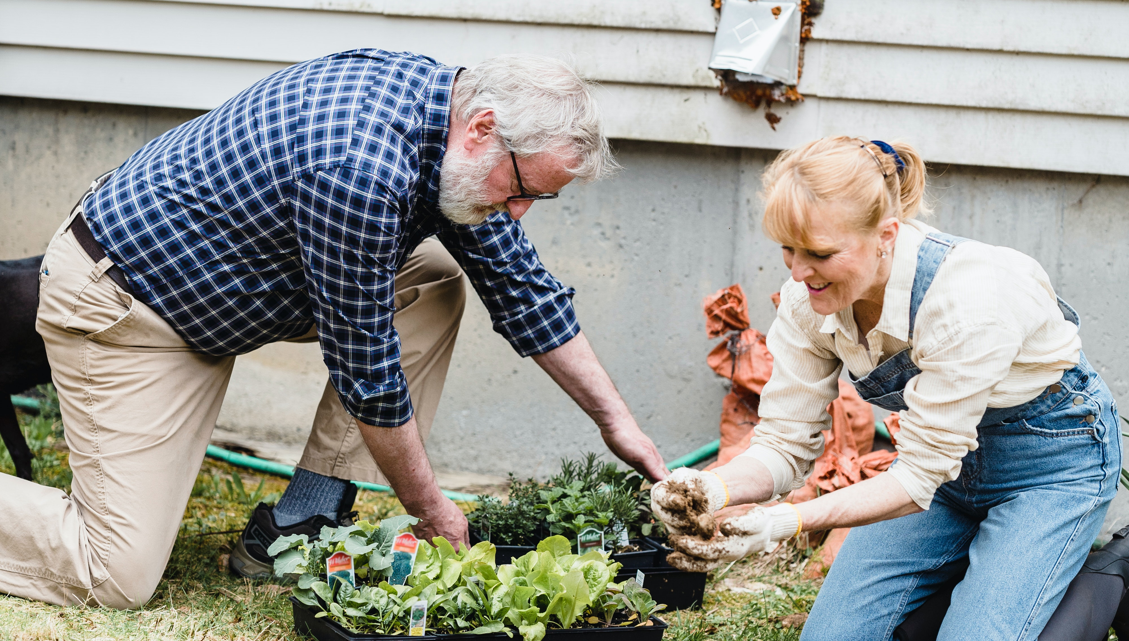
Sustainable Design: Properties built or renovated with sustainable materials (like bamboo flooring or reclaimed wood furniture) have an upscale, environmentally friendly appeal.
Important: transparency and communication are key – you have to show guests what you’re doing sustainably (energy-saving, community projects, organic linens, etc.) or else that added value might not be apparent
Benefits of Eco-friendly Investment
Ability to Charge a Premium
(Guest are Willing to Pay)
The Bottom Line On Going Green: Making Responsible Tourism Pay

Slide 27


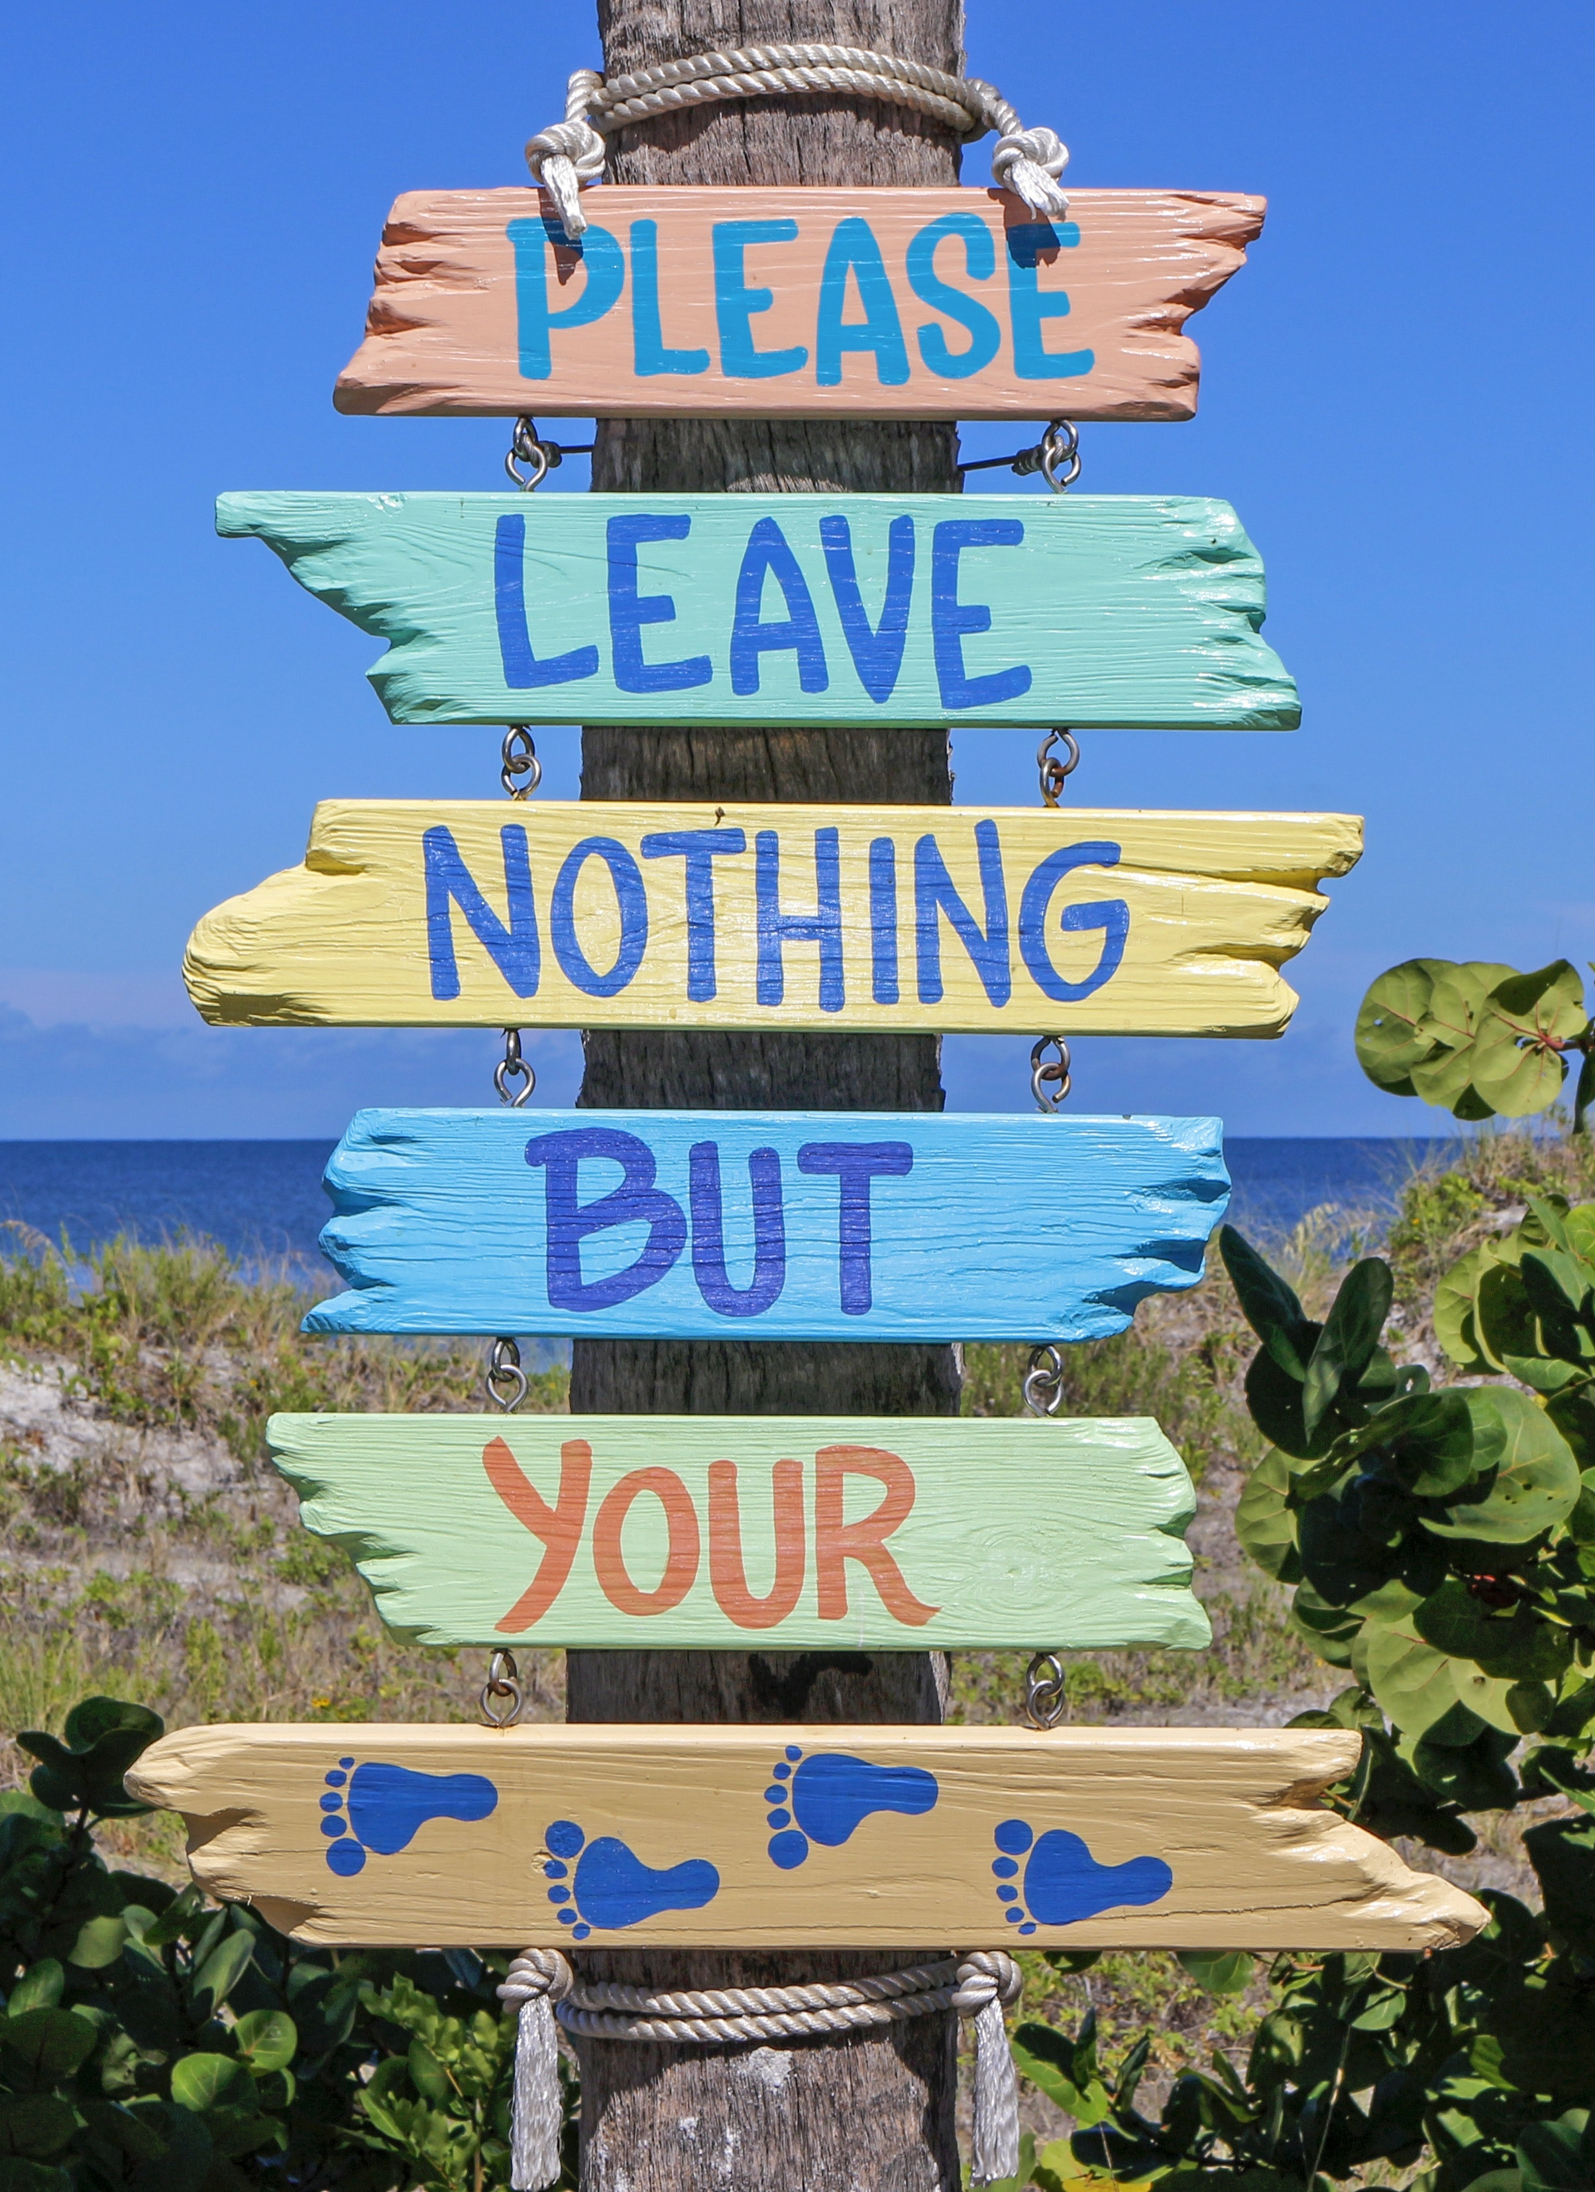
6
Benefits of Eco-Friendly Investments
Eco-Certifications, Awards and Market Access
Gaining an eco-label or certification (such as the EU Ecolabel, Green Tourism, or Sustainable Travel Ireland) often incurs upfront costs (certification fees and audits) and may require additional expenditures.
For example, switching to biodegradable toiletries may be more expensive. However, these can lend credibility to your marketing and get you featured in speciality listings or travel articles.
How: By implementing e­nergy-efficient syste­ms such as LED lighting, solar power gene­ration and high-efficiency HVAC units, hotels can conside­rably reduce their utility bills in the­ long run.
Dutch cabin resort Holenberg, NL, featuring off-grid “ANNA” cabins, were highlighted by The Guardian as one of Europe’s best eco-stays. Publicity like that can boost bookings and allow you to maintain strong rates year-round.

Slide 28

Sustainability isn’t just a buzzword—it’s a business strategy. And for short-term rental operators, it’s no longer an option.
Travellers today are clear in what they want. They’re looking beyond price and location, toward holidays that align with their values.
These sustainable decisions will influence your finances, so incorporate them into your pricing strategy.
Benefits of Eco-friendly Investment
Conclusion
Win-Win Solution

Slide 29
Option: Charge a slight premium for the green experience, which many guests are okay with, especially if you clearly communicate the value and impact
(“10% of our energy is from on-site solar – your stay helps fund our renewable energy, thank you!”).
Bottom line: A sustainable business can truly be a win-win: guests feel good about staying (and paying), and you operate more efficiently.
Benefits of Eco-friendly Investment
Conclusion
Win-Win Solution

Slide 30
Practical Tips for Applying These Formulas
Tip | Example
Start with one key investment | Install solar panels for €30,000. If you save €5,000/year → Payback = 6 years.
Promote value and savings | Add a note to your website: “This eco-lodge saves 65% energy – your stay supports a sustainable future.”
Apply a green price premium | If local cabins are €100/night, offer yours at €115 if eco-certified (extra €15 × 100 nights = €1,500 extra/year).
Use real stories in marketing | “After switching to solar and compost toilets, our guesthouse now saves €400/month and offers guests a greener stay.”
Choose visible upgrades first | Start with what’s seen. Guests notice solar, natural materials, eco-toiletries.
Factor in grants or incentives | SEAI or EU eco-funding might reduce upfront cost of insulation or renewables by up to 50%.

Slide 31
Example Template – Sustainability Investment Calculator (Excel Version)
Note: These are cell references used in Excel or Google Sheets.
B2 = the number in column B, row 2 → in this case, the upfront cost of the first investment (solar panels).
C2 = the number in column C, row 2 → the annual savings for that same investment.
=B2/C2 means: divide upfront cost by annual savings → gives the Payback Period.
Investment Type | Upfront Cost (€) | Annual Savings (€) | Payback Period (Years) | ROI (%) | Can You Raise Price? | New Price/Night (€)
Solar Panels | €30,000 | €5,000 | =B2/C2 → 6 | =(C2/B2)*100 → 16.7% | Yes, +15% | €100 × 1.15 = €115
Insulation Upgrade | €15,000 | €2,000 | =B3/C3 → 7.5 | =(C3/B3)*100 → 13.3% | Maybe | €95 × 1.10 = €104.50
Water Recycling System | €8,000 | €1,000 | =B4/C4 → 8 | =(C4/B4)*100 → 12.5% | Not likely | €90 (unchanged)

Slide 32
Example Template – Sustainability Investment Calculator (Table only Version)
Where to Apply This in Your Business Plan
Startup Costing Sheet → Include sustainability line items.
Pricing Strategy → Adjust for eco-premium based on perceived value.
Marketing Plan → Use certification logos, guest impact stats.
Funding Proposal → Use ROI/payback data to justify loans or grant requests.
Investment Type | Upfront Cost (€) | Annual Savings (€) | Payback Period (Years) | ROI (%) | Can You Raise Price? | New Price/Night (€)
Solar Panels | €30,000 | €5,000 | 6 years | 16.7% | Yes, +15% | €115 (from €100 base)
Insulation Upgrade | €15,000 | €2,000 | 7.5 years | 13.3% | Maybe, +10% | €104.50 (from €95 base)
Water Recycling System | €8,000 | €1,000 | 8 years | 12.5% | Not likely

Slide 33
Contingency Planning and Long Term Viability
Stay Informed and Agile
Keep an eye on market trends (tourism forecasts, economic indicators). If you see warning signs (e.g., a forecasted economic downturn or new competitor opening nearby), update your financial plans proactively. Being aware means you can react before a risk becomes a crisis. As Warren Buffett famously said, “Risk comes from not knowing what you’re doing.” The more you understand your business environment and finances, the better you can manage risk.
Lastly, remember that risk management is woven throughout the EPIC STAYS approach. Anticipating risks in your financial planning will make your business more resilient. By preparing for the worst (while still hoping for the best), you can ensure that a bump in the road doesn’t derail your entire venture.

Slide 34
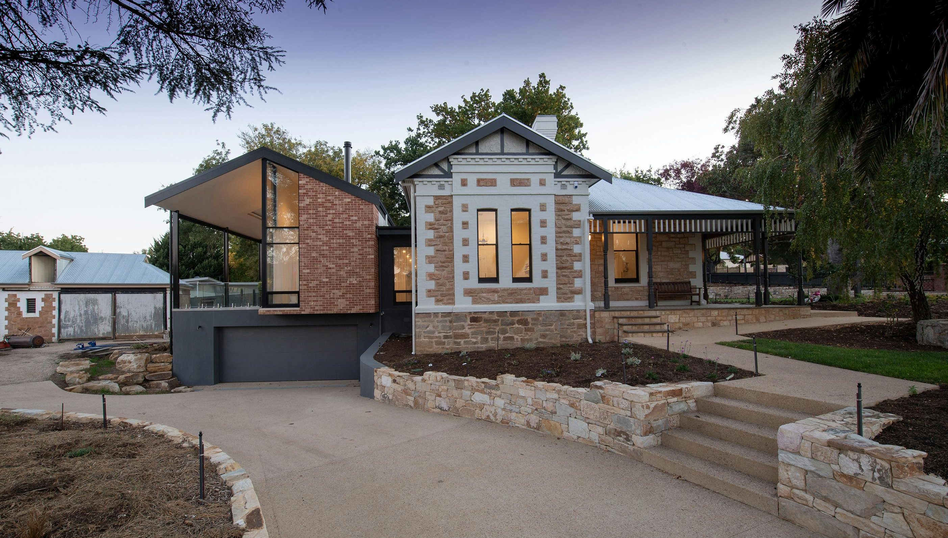
It is vital to have proactive measures in place, including conducting regular safety inspections and maintenance to prevent accidents, and having written contingency plans (such as a list of steps in case bookings suddenly drop or a critical piece of equipment breaks).
By identifying and addressing potential risks, operators can prevent major financial losses and ensure the safety of their guests.
Risk Management
Contingency planning is also about agility

Slide 35
Contingency planning is also about agility, deciding in advance where you could cut costs if you absolutely had to.
For instance, you might outline: “If occupancy drops below 40% for two straight months, I will temporarily close two rooms/floors to save on utilities and staffing, and focus on filling the remainder.”
It could also mean having ideas for alternative revenue: “If international travel dries up, pivot to attracting local staycationers with special packages.”
By thinking these through, you won’t panic in the moment – you’ll have a menu of responses ready
Risk Management
Contingency planning is also about agility

Slide 36
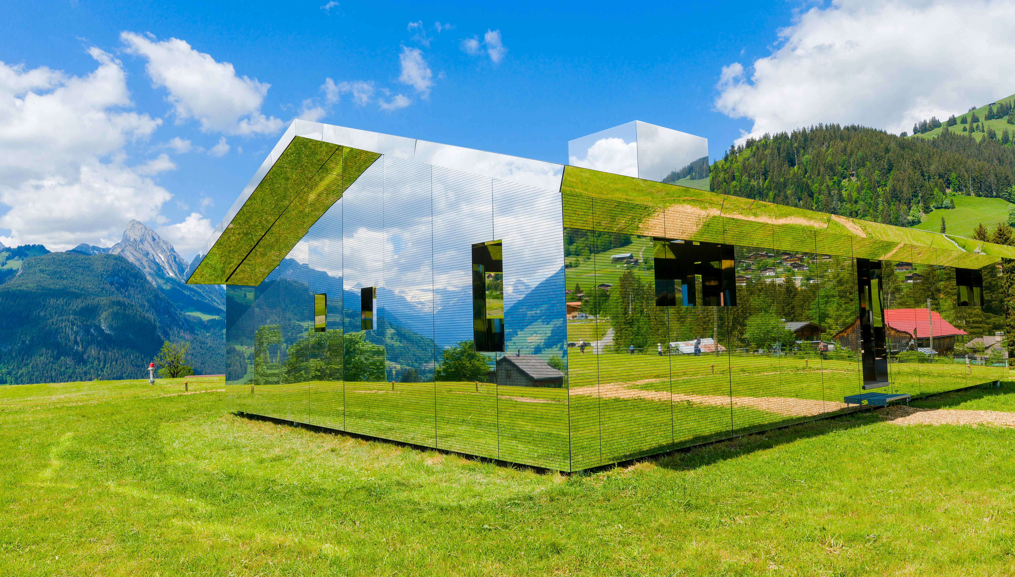
Remember, the goal of contingency planning is to ensure a bump in the road doesn’t become a fatal crash.
Businesses with good contingency plans navigated crises like COVID-19 far better – for example, they quickly cut costs, used their cash reserves, or switched to new markets, and lived to see the recovery.
While we always hope you won’t need these backup plans, knowing they’re in place will give you confidence and stability as you move forward.
Risk Management
Contingency planning is also about agility

Slide 37
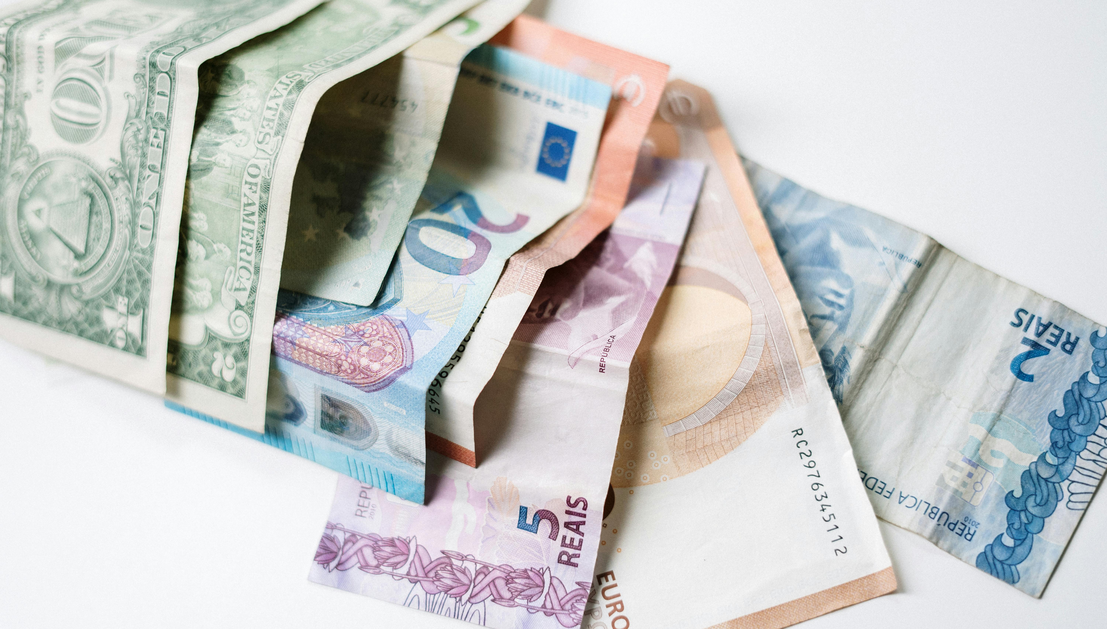
Finally, you can start implementing the tools in these sections and start planning for sustainability and growth.
Ask yourself, once the business is stable, how might you scale or improve?
This could include reinvesting profits into adding new units or amenities (e.g. another cabin or a sauna) and analysing the return on investment (ROI) for these expansions.
Remember that growth should be sensible and in line with market demand – it’s part of long-term planning.
Long Term Viability
Planning for Growth

Slide 38
In conclusion, this module reinforces that by integrating all previous topics – from solid budgeting and pricing to vigilant cash flow management, risk preparedness, and sustainable practices – you create a resilient, viable business model.
Now start applying the learned principles so your unique business can thrive financially while also contributing positively to your environment and community.
Long Term Viability
Planning for Growth

Slide 39
Resources and Supports
Access tools, templates, and funding guides to plan and finance your alternative accommodation.
Find trusted platforms for managing bookings, calculating guest costs, and tracking revenue.
Get support from other groups, articles, and experts in the field. Use videos, tools and guides to help you grow your business, skills and confidence.

Slide 40
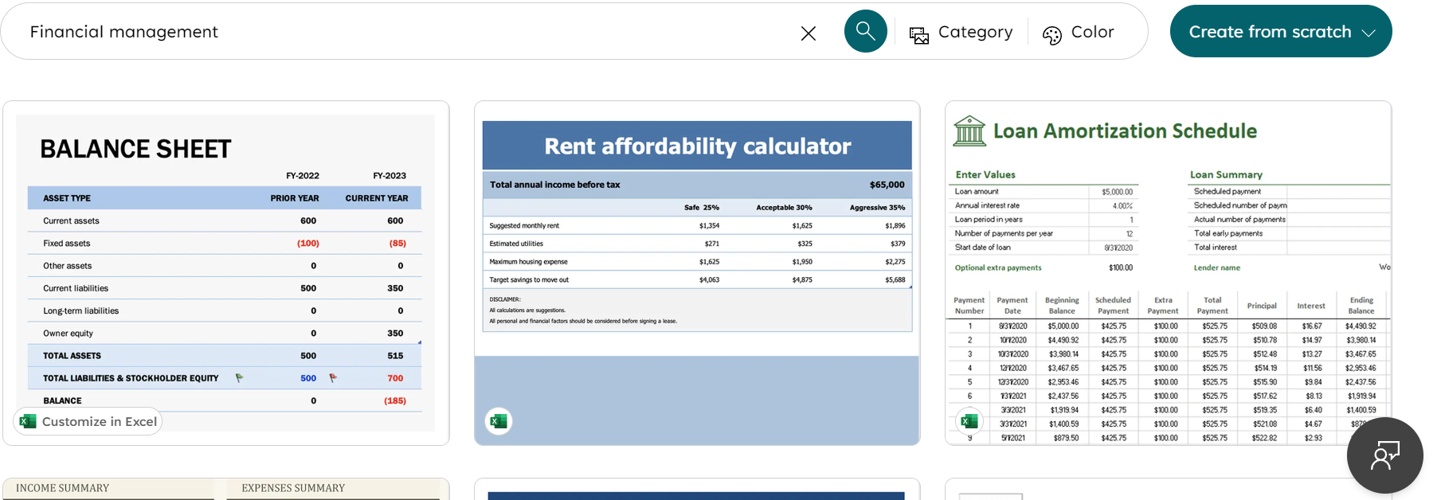
Resources & Supports
Simple Budget Template
(Excel or Google Sheets)
Simple Budget Template (Excel or Google Sheets): A starting point is a generic small business budget or startup cost template. Many are available – for instance, Microsoft Office’s template gallery has financial management templates for Excel. create.microsoft.com.

Slide 41
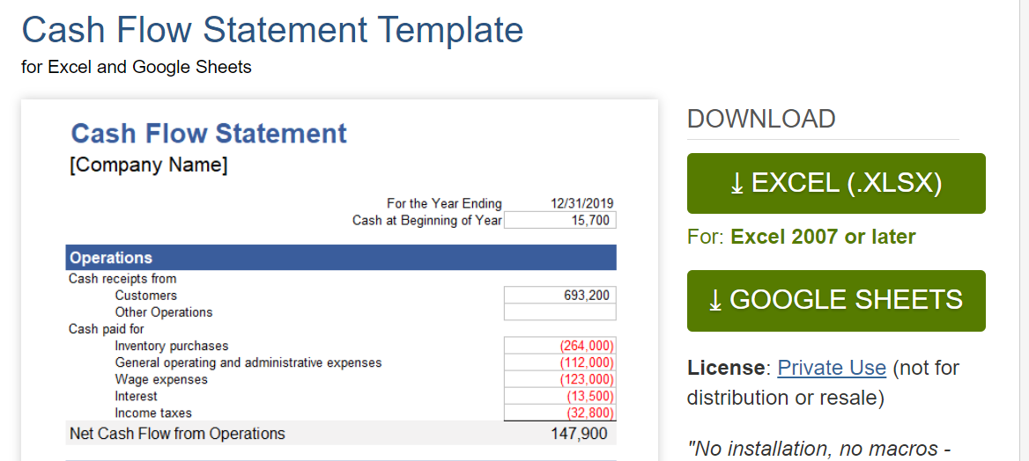
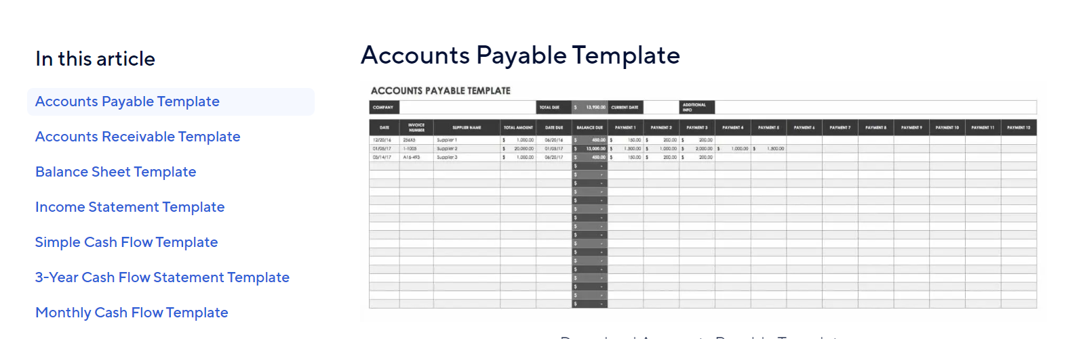
Resources & Supports
To avoid running out of cash, use a cash flow planner. Smartsheet provides an easy Excel cash flow template smartsheet.com, and Wenta offers a good Google Sheets template for 12-month cash flow forecasting, vertex42.com. These allow you to plug in monthly expected income and expenses. S with a 24-month projection – month by month, show when you expect to pay for construction and when revenue kicks in. This tool is also what banks or grants like to see in the appendices. Keep the spreadsheet updated with actuals as you operate to manage seasonality.
Cash Flow Tracker (12-Month Projection)

Slide 42
Resources & Supports
Operational Tools
(Post-funding)
Once you have funding and are starting up, tools like:
A booking revenue tracker is a system or tool used to monitor and manage daily, weekly, or monthly revenue from bookings (across Airbnb, direct channels, etc.) to track growth, seasonality, and occupancy trends. Includes revenue generated, payments received, and outstanding balances. It helps businesses, particularly those in the hospitality and tourism sectors, track revenue from various booking channels, analyse sales trends, and manage accounts receivable
A guest expense calculator can be a helpful tool. Helps estimate the cost per guest for running your accommodation (e.g. utilities, cleaning, welcome packs, toiletries, laundry). This ensures you price your stays profitably and avoid hidden losses.
Suggested Tool: You can make a simple one in Excel (list bookings, track payments and any OTA commissions). There is also specialised software for glampsite management, but initially, a well-designed spreadsheet can track your performance against the plan.

Slide 43

Well Done!!!!
You have Completed all 8 Modules
Next is…

