Slide 1

Mayo Glamping, Ireland
Module 8 (Part 6)
Making It Viable – Managing Risks and Protecting Your Business

Slide 2
Module 8 (Part 6) Overview
Learning Outcomes
Financial success isn’t just about what you earn today — it’s about preparing wisely for tomorrow. In this section, you’ll explore how to safeguard your accommodation business against risks while staying aligned with both environmental and financial sustainability.
We cover risk management and contingency planning to help you prepare for best, expected, and worst-case scenarios, and show how insurance can act as a financial safety net.
You’ll learn how to make smart long-term decisions that keep your business viable, resilient, and competitive in changing conditions.
Making It Viable – Managing Risks and Protecting Your Business
Identify key financial risks that could impact your business operations.
Develop contingency plans to prepare for emergencies, economic downturns, or climate-related disruptions.
Implement financial buffers (e.g., cash reserves) to manage unexpected challenges.

Slide 3

Module 8 Laying the Financial Foundations for a Viable Accommodation Business
05
Photo Credit:
Section
CONTENTS
Section 11
Section
Managing Risks and Protecting Your Business

Slide 4

Section 11
Managing Risks and Protecting Your Business
(Risk) How can I protect my alternative accommodation business from future risks? (Financial Health) How can I plan for long-term financial health, and make sure my business remains viable?
Objective: (Managing Risk, Environmental Sustainability and Long-Term Financial Health for Long-Term Viability) To help you assess and identify potential risks and future financial challenges that could impact your business, and what protection measures you can put in place.

Slide 5
Module 8 Laying the Financial Foundations for a Viable Accommodation Business
Financial success isn’t just about what you earn today—it’s about planning wisely for tomorrow. In the final section of this module, you’ll explore how to protect your accommodation business from future risks while staying aligned with environmental and financial sustainability goals. From emergency funds and climate resilience to strategic reinvestment, this section helps you prepare for uncertainty and make long-term decisions that ensure your business remains viable, responsible, and resilient in the years ahead.
Section 11: Managing Risks and Protecting Your Business
How can I ensure my business remains environmentally sustainable, protected and financially viable long term?
Objective: To identify financial risks, build contingency plans, invest wisely in eco-decisions and implement long-term sustainability strategies.
.

Slide 6
Managing Risks and Protecting Your Business
Helps you manage risks and prepare for the best vs the expected vs the worst-case scenarios. Risk management isn’t about fearing worst-case scenarios — it’s about building confidence. By anticipating what could go wrong, you’ll be better equipped to either prevent disruptions or bounce back faster when challenges arise. The ultimate goal is resilience. With clear contingency plans, you’ll reduce stress, make faster decisions, and maintain financial health and stability — even in turbulent times. As the saying goes, “Hope for the best, plan for the worst.” Learn prevention and mitigation tools so your business not only survives tough times but emerges stronger.
42
Risk Management & Contingency Planning
Preparing for the ‘what ifs’, worst vs expected vs best case scenarios
43
Risk and Insurance Protection
Understand types of risks that could threaten your business and the role of insurance as a financial safety net.
44
Financial Strategy and Planning for Stability
Create a financial strategy and implement prevention and mitigation measures so you can survive economic risks and be financially healthy long term.

Slide 7

42
Risk Management & Contingency Planning
If the past few years have taught business owners anything (think global events like pandemics, or even local surprises like a sudden road closure that affects a hotel), it’s that unexpected challenges can arise.
After establishing a budget, performance tracking and financial management, we must acknowledge and prepare for the risks and uncertainties in your tourism accommodation business.
This section is about being prepared for the “what-ifs.” The purpose of risk management and contingency planning is to identify potential risks to your business and plan how you’d deal with them so that a setback doesn’t turn into a business-ending crisis.
Risk Management
Preparing for the ‘what ifs’

Slide 8
42
Risk Management & Contingency Planning
In the context of an accommodation business, risks can range from low-probability disasters (such as fire, flood, or pandemic) to more likely events (such as a slow tourism season, a competitor opening next door, staff turnover, or equipment failure).
If the past few years have taught business owners anything (think global events like pandemics, or even local surprises like a sudden road closure that affects a hotel), it’s that unexpected challenges can arise.
After establishing a budget, performance tracking and financial management, we must acknowledge and prepare for the risks and uncertainties in your tourism accommodation business.
Risk Management
Preparing for the ‘what ifs’

Slide 9
42
Risk Management & Contingency Planning
This section is about being prepared for the “what-ifs.”
The purpose of risk management and contingency planning is to identify potential risks to your business and plan how you’d deal with them so that a setback doesn’t turn into a business-ending crisis.
In the context of an accommodation business, risks can range from low-probability disasters (such as fire, flood, or pandemic) to more likely events (such as a slow tourism season, a competitor opening next door, staff turnover, or equipment failure).
Risk Management
Preparing for the ‘what ifs’

Slide 10

Guiding Question: What could go wrong in my business, and how do I prepare for it so I can survive tough times?
The objective here is not to scare you, but to instill a habit of proactive thinking: by anticipating possible problems, you can often either prevent them or soften the blow.
A saying in business is “hope for the best, plan for the worst.”
This section helps you do that by creating contingency plans. In real-world terms, this could mean having financial safety nets, insurance, backup marketing strategies, or simply a plan B for various scenarios.
Risk Management
Hope for the Best & Plan for the Worst

Slide 11
Contingency planning is essentially risking management – managing risks so they don’t manage you.
This section covers identifying possible risks to your alternative accommodation venture and how to mitigate them so that your financial viability isn’t compromised.
Another contingency is insurance: ensure you have appropriate business insurance (property insurance, liability insurance, maybe business interruption insurance if available) so that incidents like theft, fire, or lawsuits don’t bankrupt you.
Risk Management
Hope for the Best & Plan for the Worst

Slide 12

Learn how running a glamping or tiny lodge business involves specific financial risks, so owners should clearly understand these risks and have strategies in place to mitigate them.
Next, we discuss different risks and key risk mitigation or prevention tools.
By identifying these, you’re not dwelling on doom and gloom, but rather making sure you’re not caught completely off-guard.
For each significant risk you identify, outline a contingency plan – what actions will you take if that scenario comes true?
Risk Management
Hope for the Best & Plan for the Worst
Contingency Planning for Retailers and Hospitality Businesses

Slide 13
Essentially, “If X happens, then we will do Y.”
Also consider preventive measures (things you can do now to reduce the chance or impact of the risk).
A critical part of contingency planning is financial safeguards. One of the simplest yet most effective safeguards is an emergency cash reserve.
Risk Management
Hope for the Best & Plan for the Worst
Contingency Planning for Retailers and Hospitality Businesses

Slide 14
Many business plans include three cases: worst, expected, and best.
It’s helpful to model a pessimistic scenario (e.g., lower occupancy and some higher costs) to see if you still break even or have a tolerable loss.
Also model an optimistic case (high occupancy, stable costs) – this isn’t to be Pollyannaish (overly optimistic), but to see the potential upside and ensure you have capacity (e.g. enough cleaning help) if things go really well.
As a beginner, focus on making the “expected” case solid, but have the worst-case scenario in your back pocket so you’re not caught off guard if tourism is slow or a rainy summer hits bookings.
Worst-Case vs Expected Case vs Best-Case Examples in the next slide!
Worst vs Expected vs Best-Case

Slide 15
In this version, you assume things don’t go as planned:
Lower-than-expected occupancy
Higher variable or unexpected costs (e.g. repairs, fuel surges)
Possible marketing delays or tourism downturns
Goal: To stress-test your model and ensure you can at least break even or withstand a manageable loss. This helps you prepare for downturns — for example, a rainy summer, local event cancellation, or rising utility costs.
Worst-Case Scenario
01
Expected Case Scenario

Slide 16
This is your baseline forecast — the version you use to budget, plan, and operate your business.
Based on realistic occupancy rates drawn from local market trends or past performance.
Includes typical running costs and seasonal variations.
Assumes stable pricing and normal guest booking behaviours.
Goal: Focus on this one, make sure your business can thrive in normal conditions.
Expected Case Scenario
02
Expected Case Scenario

Slide 17
This is the optimistic view:
Occupancy is high or full during peak months.
Costs are stable or reduced due to efficiency.
You receive additional bookings, upgrades, or group stays.
Goal: Look at the potential upside and make sure you’re ready to scale if things go better than planned — e.g., do you have enough staff, laundry capacity, or amenities if demand surges?
Best Case Scenario
03
Expected Case Scenario

Slide 18

43
Insurance
Protecting Your Assets & Reducing Risk
What types of insurance do I need to protect my business, and why is it necessary? Objective: Understand how insurance protects your business from potential threats that could cause financial loss or disrupt operations. Identify the right insurance policies that will provide a financial safety net, minimising and preventing disruption from incidents like fire, weather damage, theft, or guest injury.

Slide 19
Insurance: Risk Assessment & Strategies
Identify and Prioritise Risks
Insurance and Mitigation
Use insurance to protect against certain risks. While insurance costs money, it can save you from catastrophic losses (for example, covering damage costs from that storm). Additionally, take preventive measures – regular maintenance can help prevent unexpected expenses, and flexible cost structures (such as part-time staff or seasonal contractors) can help adjust expenses when business is slow.
First, think through what could go wrong.
List scenarios – from mild (e.g. a slow month) to severe (e.g. a natural disaster affecting tourism). Assess the likelihood of each and the potential impact if it were to happen. This helps prioritize what to prepare for.

Slide 20
Identify Risks and Implement Prevention & Mitigation Strategies
Emergency Risk
Protection is having a financial cushion (emergency fund, as noted earlier) and a plan for operating under unexpected conditions.
For example, if a storm forces you to close for a month, do you have funds or a line of credit to carry through?
Operational Risk
Protection: For operational risks, have backup solutions: if your booking software fails, have a manual process or a secondary system in place.
If a key staff member quits during peak season, maintain a relationship with a temp agency or have a cross-trained team so others can fill in.
Consider scenarios: “What if the boiler breaks in the middle of winter?” or “What if my booking system goes offline during a peak booking period?”

Slide 21
Bookings Underperform
Protection One common risk for seasonal businesses is that peak-season bookings may underperform.
For example, say you planned on 80% occupancy in summer but only achieved 60%. If you’ve identified that as a risk, you can watch early booking trends and maybe increase marketing or adjust pricing quickly when you see slow pickup, rather than realising too late.
Liability Risk Insurance
Protection: It protects you if someone has an accident or gets injured on your property, natural disasters (such as storms or floods) damage your facilities, or sudden drops in tourism occur, or even if another pandemic strikes, so that one incident doesn’t bankrupt the business.
For example, someone slips in the shower of the treehouse.

Slide 22
Property Insurance
Protection: Protection insurance covers damages to your structures (tents, cabins, etc.), crucial if you operate in hazard-prone areas (forest fire or flood zones).
Example: If a kitchen fire causes damage and closure for a month, insurance can cover repairs and lost income in that period, rather than you paying out of pocket entirely.
Market Risks
Protection: For competitive risks, such as a new rival, a contingency might involve ramping up your unique selling points (better service, local experiences) or targeted marketing to loyal customers.
Consider “What if a new unique hotel opens nearby with cheaper rates?” or “What if travel regulations change (e.g. visa rules or airline routes) and fewer guests come?”

Slide 23
External Risks
Protection like economic downturns or health crises. Assign each risk a rough likelihood and impact.
For example, a slow season being worse than expected is fairly likely at some point and has a medium impact (lost revenue), whereas a natural disaster hitting your area might be very unlikely but have a high impact.

Slide 24

44
Financial Health
Financial Strategy & Long-Term Viability
How can I plan for long-term financial health and make sure my business remains viable in changing economic conditions?
Objective: To build a sustainable Financial Strategy (plan) that ensures your accommodation can survive challenges, grow profitably, and support your personal and professional goals. To equip you with the tools to create a strong financial strategy, including cash flow forecasting, setting aside contingency funds, monitoring profitability, and planning for reinvestment. This supports long-term growth, investor confidence, and peace of mind.

Slide 25

Sustainability and Long-Term Financial Health
With risk management in place, you have built resilience into your business model.
The final step is to look at sustainability and long-term success – essentially, how to keep your venture thriving for years to come.
We transition by pointing out that managing risks and finances wisely lays the groundwork for sustainable operations, which is the focus of the concluding section.
Long Term Viability
Financial and Environmental

Slide 26
Sustainability and Long-Term Financial Health
This capstone section ties everything together and looks at the big picture of enduring success.
We discuss “sustainability” in two senses: financial sustainability (consistent profitability and ability to reinvest in your business) and environmental sustainability, which is highly relevant in alternative tourism and can also bolster financial success.
Environmental viability is discussed in Section 12.
It is essential to note that a financially sustainable business regularly earns more than it spends, adapts to change, and plans for growth.
Long Term Viability
Financial and Environmental

Slide 27

This means continuously applying what was learned, including updating budgets, refining pricing in response to market changes, managing costs efficiently, and maintaining effective risk strategies.
We must emphasise in the modern tourism market, eco-sustainability and financial viability often go hand in hand.
Adopting sustainable practices can reduce operating costs and attract more guests.
For example, installing solar panels or rainwater harvesting systems can lower utility bills over time and earn tax credits or incentives.
Long Term Viability
Eco-sustainability & Financial Go Hand in Hand

Slide 28
Likewise, eco-friendly lodgings often enjoy higher demand and guest loyalty, thereby strengthening revenue.
Studies have found that sustainable properties tend to have lower operating costs and increased guest appeal, which in turn boosts their financial performance.
We encourage owners to seek sustainability wins, such as energy efficiency (to save money), local sourcing or community initiatives (to enhance brand and potentially build community support), and obtain eco-certs that can justify premium pricing.
Long Term Viability
Eco-sustainability & Financial Go Hand in Hand

Slide 29
What is a Financial Strategy?
Your Money Management Plan!
A Financial Strategy is essentially a money-management game plan for your business goals. It answers the questions:
“Where should our money go to best achieve our objectives?”
and
“How will we fund our plans?”
This strategy will typically cover decisions about spending, saving, investing, and financing.

Slide 30
What is a Financial Strategy?
Your Money Management Plan!
This strategy will typically cover decisions about spending, saving, investing, and financing.
In practical terms, a financial strategy for your accommodation business will include things like investment decisions, financing decisions, cost management and pricing strategies.
In short, the financial strategy is your guide for decision-making. Whenever you face a financial choice, you refer to this strategy.
Example: Should you hire another staff member? Your financial strategy (based on your goals and budget) will guide whether that’s feasible now or later.
Example: Should you reinvest earnings or keep cash? The strategy clarifies priorities (maybe reinvest if growth is the goal, or save if building a safety net is the goal).

Slide 31

All businesses face financial risks. Effective financial management means identifying potential risks and planning how to deal with them.
In the alternative tourism accommodation sector, some common financial risks include:
Cash Flow Shortages: Seasonal dips or unforeseen events (like a sudden travel ban or pandemic) could dry up your bookings for a while.
This risk is particularly high in tourism – you may experience a sudden shift from full occupancy to near zero due to factors beyond your control. If you haven’t prepared, you could run out of cash.
Risk Management
Cash Flow, Unexpected Expenses & Market Fluctuations

Slide 32
Market Fluctuations: Economic conditions or market trends can affect tourism demand.
A recession might mean fewer travellers, or increased competition in your area could force prices down.
Even changes in exchange rates can impact you if you cater to international guests.
These external factors can reduce your revenue or increase costs (e.g., rising utility or supply prices).
To manage these risks, plan ahead as part of your financial strategy. The next slide shows some Risk Management Strategies:
Risk Management
Cash Flow, Unexpected Expenses & Market Fluctuations

Slide 33
Financial Strategy: Practical Terms Explained
Investment Decisions
Example: deciding to allocate €15,000 toward building a new treehouse accommodation because your goal is to expand capacity.
Financing Decisions
Example: planning to use 50% saved profits and 50% a small business loan to finance that treehouse, thereby balancing risk and cost.
Cost Management
Example: implementing energy-saving measures to cut utility expenses by 10%, helping increase net profits which can be reinvested.
Pricing Strategy
Example: setting seasonal pricing (higher in peak season, discounts in off-peak) to maximize revenue while maintaining occupancy.

Slide 34


Why Do You Need a Financial Strategy?
Without a strategy, your financial decisions might be ad-hoc and reactive. Here’s why having a clear financial strategy is important:
Guides Your Decisions
Example
  A financial strategy acts like a compass for your spending and investing choices. It helps ensure each euro is used in a way that moves the business toward its goals.
If your goal is to attract eco-tourists, your strategy might prioritise spending on sustainable infrastructure (like solar power or rainwater harvesting) rather than on something unrelated. This helps you decide whether to approve expenses that align with the plan and decline those that don’t.

Slide 35


Prepares You for the Future
Example
  With a strategy, you’re thinking ahead. You can plan for growth opportunities or big expenditures well in advance.
If you know you want to expand to a new location in two years, your financial strategy might involve saving a portion of profits or securing an investor now, so the money is available when you’re ready to expand. It also helps you anticipate potential pitfalls (e.g., needing extra funds in winter, which can be part of the strategy to maintain a minimum cash balance.
Keeps You On Track
Example
  Business environments are full of distractions and unexpected challenges. A solid strategy keeps you focused on your long-term goals even when short-term issues arise.
If a tempting opportunity arises (such as investing in something unrelated), your strategy helps you stay focused on your core goals, like improving your accommodation. It also provides a guide during setbacks (like a tourism downturn), so you can adapt without losing direction.

Slide 36

Builds Credibility
Example
  If you ever seek external funding (loans or investors), having a clear financial strategy is a big plus. It shows you’ve done your homework and manage finances deliberately.
Banks and investors are far more likely to trust and fund a business owner who can articulate their financial strategy and show that their budget and financial records align with that plan. In essence, it demonstrates professional financial management of the business.
In summary, failing to plan is planning to fail. A financial strategy is needed to ensure all parts of your business (sales, expenses, investments) are working in harmony toward what you want to achieve. It’s your financial roadmap to success.

Slide 37

Address Challenges with Strategies and Use Opportunities to Build Resilience
To build a truly sustainable and resilient tourism business, financial planning must go beyond monthly income and short-term budgeting.
The following strategies provide a roadmap for achieving long-term financial health, ensuring your accommodation can adapt to change, withstand seasonal fluctuations, and support both your personal goals and business mission.
From setting aside emergency funds and reinvesting in upgrades to tracking financial performance and diversifying income streams, each area strengthens your foundation for growth.
By addressing inflation, risk, and long-term vision, you’ll not only keep your business afloat—you’ll set it up to thrive for years to come.
Long Term Financial Health
How to Address Challenges and Build Opportunities

Slide 38

Understand Your Financial Situation Right Now – Current Problems
Before you can plan for the future, you need a clear picture of your present finances. This involves reviewing your financial records and statements to answer: Where is your money coming from and where is it going right now?
Review Financial Statements and Understand
Where You Stand Right Now
Look at your Income Statement, Balance Sheet, and Cash Flow Statement (more on these statements below) to gather key facts. How much revenue did you earn last month or last year? What are your major expenses? How much debt do you have? How much cash do you have on hand?
Example: Your income statement might show that your B&B earned €100,000 last year, with €90,000 in expenses, resulting in a €10,000 profit. The balance sheet might reveal that you have €5,000 in cash in the bank, a loan of €20,000, and assets (such as property and equipment) worth €50,000.

Slide 39

Cost Over Runs are a Common Challenge for Busineses
Cost Over Runs
A common risk is cost overruns – for example, energy prices spike, making utilities much more expensive than budgeted. Knowing this could happen, you might decide to invest in some energy-efficient appliances or have a bit extra in your emergency fund for utility bills.
Emergency Cash Reserve
Set money aside that you only use when something goes wrong. Many experts suggest having a few months’ worth of operating expenses saved if possible. Example: If you know your fixed costs are €5,000 a month, having, say, €10,000 in an emergency fund means if you suddenly have a couple of near-zero revenue months (imagine a travel ban or pandemic scenario), you can still pay rent and basic bills and survive until things recover.

Slide 40
Costs rarely stay constant – electricity prices might rise, or suppliers charge more. It’s wise to include an “inflation” scenario.
For example, what is the impact if utility costs go up 15% next year?
You can adjust those numbers in your cost table and see the profit shrink.
If a significant cost increase is likely, plan to counteract it (perhaps by raising prices a bit, improving energy efficiency, etc.).
Possible:
Cost Inflation Scenario

Slide 41
Solution = Contingency: This refers to extra budget set aside for unexpected costs or price increases. We included a contingency in startup costs.
Similar applies to annual costs, you might want a contingency line (say 5-10% of expenses) or at least be aware that your actual results may vary.
Planning a scenario with across-the-board 10% higher expenses can stress-test your business model.
Possible:
Cost Inflation Scenario

Slide 42

Understand Your Financial Situation – Identify Opportunities
Identify Strengths, Weaknesses & Opportunities
As you review, note areas of strength to leverage and weaknesses to address. Strengths could include a high profit margin on certain offerings (such as your guided tours or meal services) or a strong cash reserve. Weaknesses might be high debt or seasonal cash flow problems (e.g., every winter you dip into the red). Perhaps your occupancy is high on weekends but low on weekdays, or your utility costs are increasing faster than your revenue. These insights help shape your strategy.
Example: A strength, like a loyal customer base, might lead you to implement a referral program to boost bookings, whereas a weakness, like high debt, might lead you to prioritise using profits to pay down loans.

Slide 43
By knowing where you stand, you can set a strategy that addresses challenges and builds on opportunities. This means looking closely at:
your costs,
your revenue patterns, and
how your resources (land, staff, time) are being used — or not.
Example 1: Your cleaning costs are very high; your strategy might include finding a more cost-effective cleaning service or investing in equipment that reduces costs in the long term.
Compare different cleaning service providers
Hire seasonal staff instead of contractors
Investing in better laundry or…
Know Where You Stand
How to Address Challenges and Build Opportunities

Slide 44
…cleaning equipment (which pays off over time)
Using less but higher-quality changeover days per week
Result: You reduce ongoing costs, without sacrificing guest satisfaction.
Example 2: Idle Land or Underused Space
If part of your site is unused during peak season, that’s lost revenue potential. Your strategy could be:
Adding a few low-cost camping or tent pitches for overflow
Creating a small picnic/event space for community rentals
Partnering with local artisans for pop-up…
Know Where You Stand
How to Address Challenges and Build Opportunities

Slide 45
markets or wellness classes
Result: You turn passive land into active income, without major new investment.
Example 3: Low Off-Season Revenue
If your bookings are almost zero in January–March, but you’re still paying heating or staff costs:
Try closing completely for those months
Or offer weekend-only bookings, or retreats
Add local marketing to attract out-of-town guests for Valentine’s, wellness weekends, etc.
Result: Either cut costs or create targeted income without overextending.
Know Where You Stand
How to Address Challenges and Build Opportunities

Slide 46
Need Back Up Cash: Basic Financial Risk Strategies
Diversify Income Streams
Maintain a Cash Reserve
Where possible, don’t rely on a single source of revenue. In an accommodation business, consider offering add-on experiences (such as tours or meals) or listing your property on multiple booking platforms to reach different customer segments. If one channel or market weakens, others can help compensate. Similarly, avoid relying on a single large client or a single group of guests – diversify your customer base to spread risk.
Set aside an emergency fund or risk buffer in your budget. This is extra cash saved for those “just in case” moments.
For example, you might keep a reserve equal to 2-3 months of expenses. That way, if a risk event hits (say a sudden slow season or an unexpected repair), you have funds to bridge the gap(as budgeting for contingencies helps avoid nasty surprises).

Slide 47
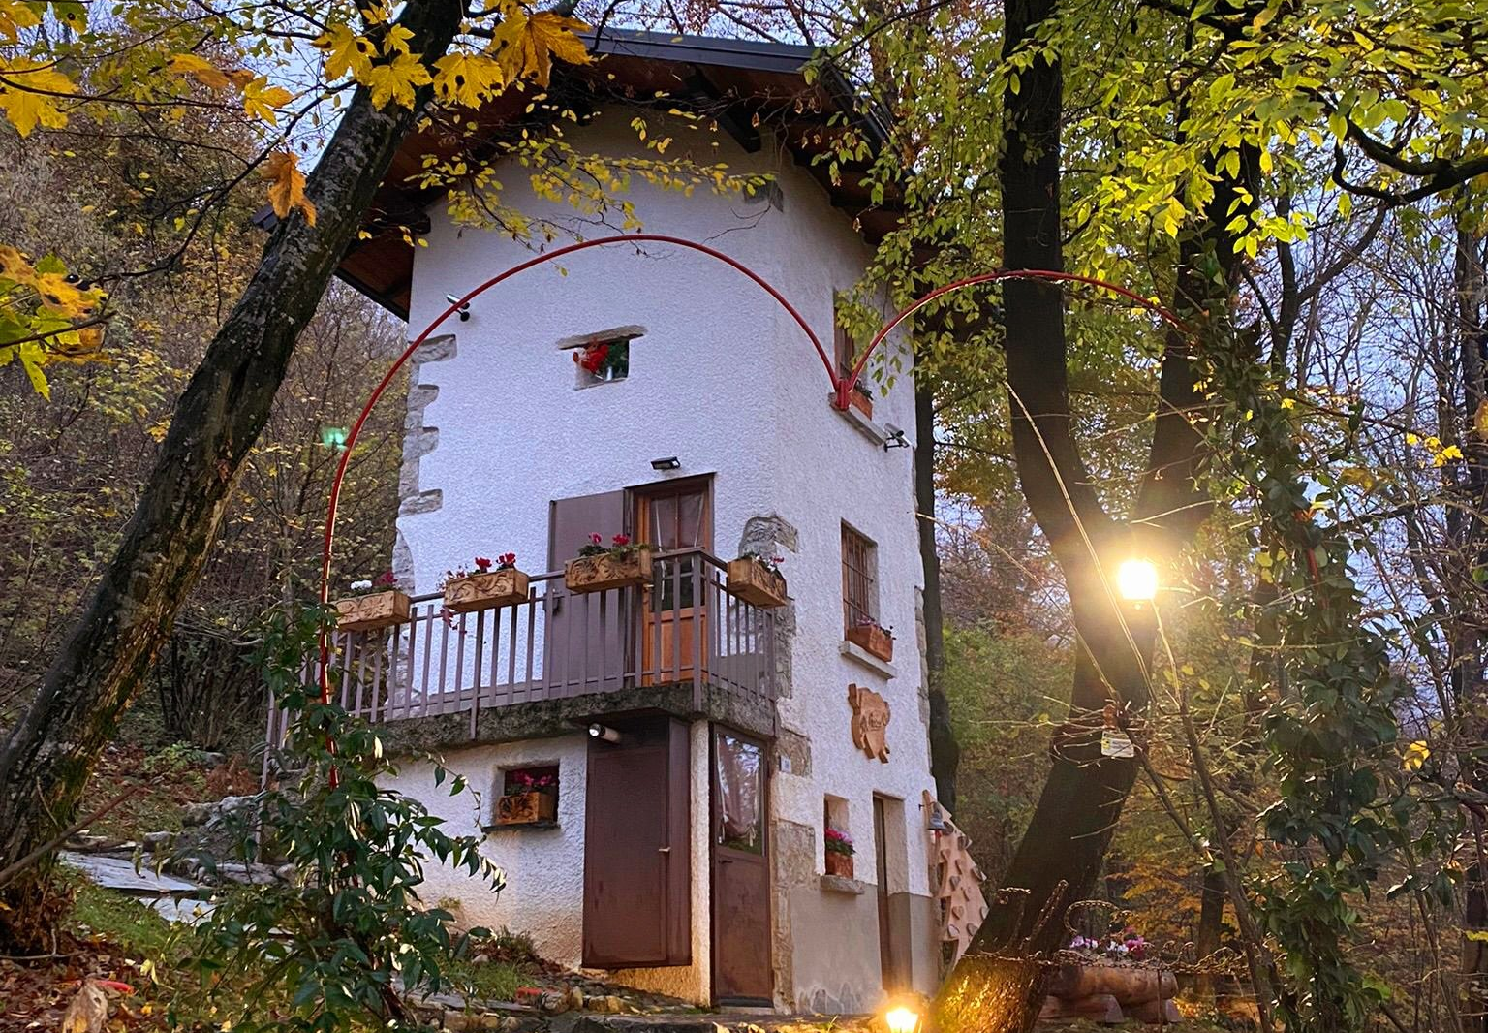
Il Roccolino Casa Vacanze, Italy
Strategies – For Financial Resilience

Slide 48
Strategies – For Financial Resilience
Strategy | Description
1. Build Cash Reserves | Every sustainable business needs a financial safety net. Cash reserves act as a cushion during off-peak seasons, unexpected cancellations, urgent repairs (like plumbing or roof leaks), or global disruptions (like a pandemic). Best practice is to save 3–6 months’ worth of operating expenses in a separate account.
2. Reinvestment Planning | Future-proofing your accommodation means regularly reinvesting part of your profits. This can include installing solar panels, upgrading interiors, adding new units, or enhancing guest experiences (e.g., sauna, local food tastings, wellness packages). Plan annual reinvestment goals based on long-term value creation.

Slide 49
Strategies – For Financial Resilience
Strategy | Description
3. Adjust for Inflation and Costs | Your operating costs (cleaning, supplies, energy, etc.) will rise over time. To stay profitable, update your pricing annually. Review your cost-per-night and ensure your profit margin stays healthy. Use market comparisons, inflation rates, and guest demand trends to guide price adjustments.
4. Monitor Financial Health | Don’t just look at monthly income —track key financial indicators like net profit margin (how much profit you keep), cash flow (what’s coming in and going out), and debt-to-income ratio (how much you owe vs. earn). Simple monthly reviews help you spot trends early and adjust accordingly.

Slide 50
Strategies – For Financial Resilience
Strategy | Description
5. Diversify Revenue Streams | Avoid relying solely on overnight stays. Add income through value-aligned extras: e.g., yoga classes, local crafts, farm tours, surf lessons, or a mini shop selling eco-products. Partner with local businesses or offer Airbnb Experiences to increase revenue and enhance guest satisfaction.
6. Risk Management | Risks like market downturns, new competitors, regulatory changes, or illness can impact your income. A solid risk plan includes insurance, flexible cancellation policies, multiple booking channels, and contingency plans for income dips (e.g., seasonal local workshops or events).

Slide 51
Strategies – For Financial Resilience
Strategy | Description
7. Long-Term Goal Mapping | Where do you want to be in 3, 5, or 10 years? Whether it's scaling your business, reducing your working hours, selling the business, or reinvesting in the community, mapping long-term goals helps shape decisions today. Break these goals into financial, lifestyle, and operational targets.

Slide 52
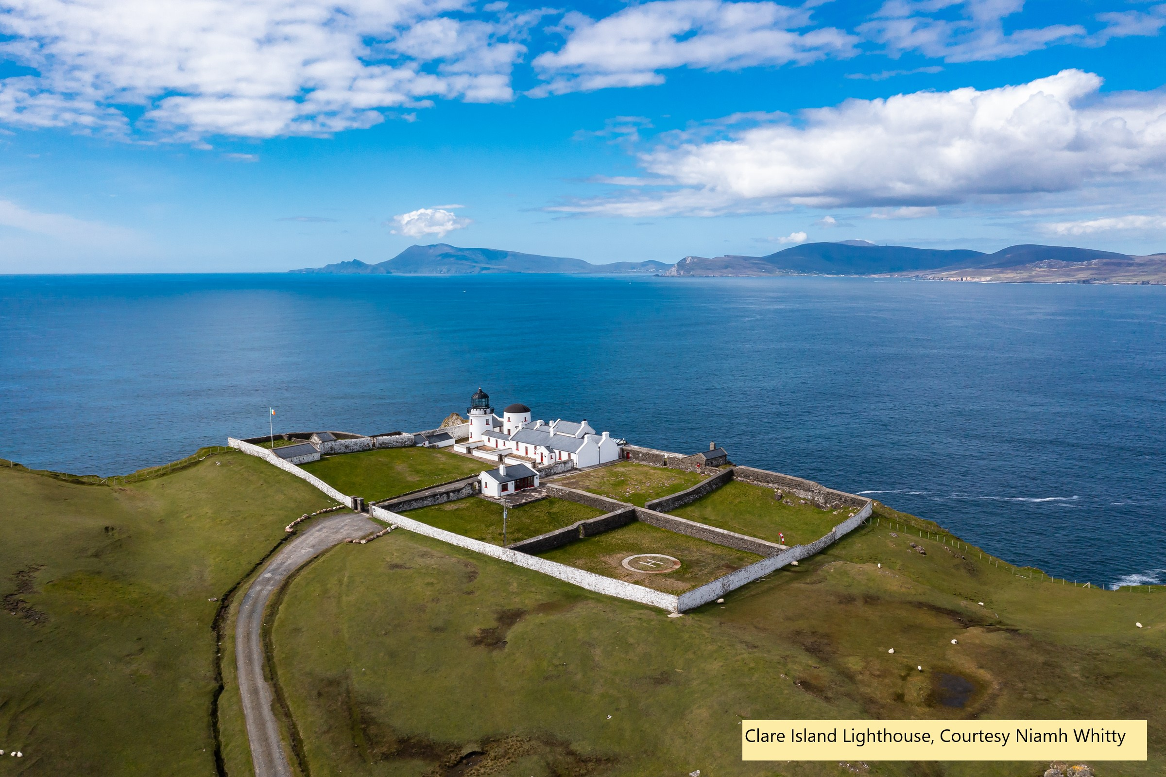
Clare Island Lighthouse, Clare Island, Mayo, Ireland
How (with examples) to
Plan for Prevention
and Resilience

Slide 53
How (with examples) to Plan for Prevention and Resilience
Strategy | Description | Strategy | Example
1. Building Cash Reserves | Why and how to build a buffer for emergencies, slow seasons, or unexpected repairs. | Set aside 10–15% of monthly revenue in a separate savings account. | If you earn €2,500/month, automatically save €250–€375/month in a business reserve account.
2. Reinvestment Planning | Allocate a portion of your profit for upgrades, renewables, or guest experience improvements. | Create an annual reinvestment plan with a percentage target (e.g. 20% of net profit). | Spend €3,000 per year upgrading to solar panels or renovating a cabin to improve guest ratings.

Slide 54
How (with examples) to Plan for Prevention and Resilience
Strategy | Description | Strategy | Example
3. Adjusting for Inflation & Costs | Update your prices annually and review costs to stay profitable. | Use cost-plus pricing and review suppliers yearly. Adjust your nightly rate annually. | Raise nightly rate from €120 to €130 if utilities, laundry, and insurance increase by 8%.
4. Monitoring Financial Health | Use financial ratios and tools to check performance (e.g., profit margin, net income trend, debt-to-income ratio). | Set a monthly “finance check-in” using Excel or a dashboard to track performance indicators. | Track that your profit margin remains at 30%. If it drops, review your variable costs and pricing.

Slide 55
How (with examples) to Plan for Prevention and Resilience
Strategy | Description | Strategy | Example
5. Diversifying Revenue Streams | Add experiences, local partnerships, or retail products to reduce reliance on bookings alone. | Offer local artisan products, eco-tours, or yoga classes through partnerships or on-site. | Partner with a local guide to offer €30/person forest walks, or sell €15 local jams in-room.
6. Risk Management | Prepare for cancellations, natural events, competitor activity, or changing regulations. | Get business interruption insurance; create a backup marketing plan and flexible pricing. | If flooding forces a temporary closure, insurance covers your missed income and cleanup costs.

Slide 56
How (with examples) to Plan for Prevention and Resilience
Strategy | Description | Strategy | Example
7. Long-Term Goal Mapping | Define your 3–5–10 year vision: lifestyle, scale, or exit plan. | Use SMART goals to plan growth milestones and regularly review progress. | 3-year goal: Add 2 glamping pods. 5-year goal: Go fully off-grid. 10-year goal: Sell or license brand.

Slide 57

Church Blönduós, Iceland
Value of Preventing and Mitigating Risks and Problems

Slide 58
Value of Preventing and Mitigating Risks and Problems
Strategy | Problem/Risk Being Addressed | What It Prevents or Mitigates
1. Building Cash Reserves | Unplanned expenses (e.g., boiler failure), seasonal dips, or emergency repairs. | Prevents business disruption, panic borrowing, or forced closures due to lack of funds.
2. Reinvestment Planning | Business stagnation, wear and tear, outdated amenities, poor guest experience. | Ensures continued guest satisfaction, improves reviews, and keeps your offer competitive.
3. Adjusting for Inflation & Costs | Rising costs, e.g., suppliers, energy, and labour costs that eat into profits if pricing isn’t updated. | Protects your profit margins and ensures long-term viability by keeping pricing aligned with real costs.
4. Monitoring Financial Health | Business drift — operating without clarity on performance, costs, or profitability. | Early warning system for cash flow problems, poor pricing decisions, or unsustainable debt.

Slide 59
Value of Preventing and Mitigating Risks and Problems
Strategy | Problem/Risk Being Addressed | What It Prevents or Mitigates
5. Diversifying Revenue Streams | Overreliance on bookings — if bookings slow, revenue collapses. | Spreads risk across multiple income sources, increasing resilience during low seasons or demand shifts.
6. Risk Management | Uncertainty — cancellations, pandemics, competitor openings, new taxes, climate impacts. | Helps absorb shocks, adapt to change, and reduce vulnerability to external disruptions.
7. Long-Term Goal Mapping | Lack of direction — no growth path, unclear purpose, no plan for scaling or exiting. | Helps you stay focused, make intentional decisions, and grow in alignment with your personal and business values.

Slide 60
Example Financial Strategy: Wild Haven Eco-Stay
Next Slide is an Example Strategy
Business Goal: To operate a sustainable, profitable eco-accommodation with strong seasonal income, reinvestment for growth, and financial buffers for risk.
This strategy focuses on balancing profit and purpose: generating steady income, protecting against unexpected costs, and reinvesting in sustainability upgrades that boost guest appeal and reduce future expenses.

Slide 61
Example Financial Strategy: Wild Haven Eco-Stay
Category | Strategy | Example
Revenue Planning | Set seasonal pricing with minimum 40% occupancy to break even | €150/night in summer, €110/night in shoulder seasons
Cash Flow Management | Track monthly cash inflow/outflow and maintain 3-month emergency fund | Use a simple spreadsheet + AirDNA insights
Profit Targets | Aim for minimum 25% profit margin by end of Year 1 | Projected: €30,000 revenue – €22,500 total costs = €7,500 profit
Cost Control | Monitor variable costs per guest and negotiate supplier rates | Cap cleaning + welcome pack at €35/night
Contingency Fund | Save 10% of net income each quarter for maintenance & slow periods | €750 set aside every 3 months in separate account
Reinvestment Plan | Reinvest 50% of Year 1 profits into improvements (solar lighting, outdoor sauna) | €3,750 allocated to upgrade amenities
Insurance Coverage | Maintain up-to-date public liability, contents, and business interruption insurance | €1,000/year budgeted from fixed costs

Slide 62

Well Done
Module 8 (Part 7)
Green Investments for Long-Term Financial Health
You have Completed… Module 8 (Part 6)
Managing Risks and Protecting Your Business
Next is…

