Slide 1
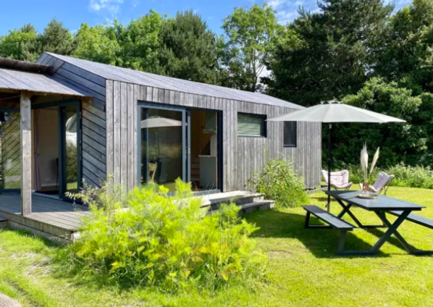
Camping ’t Weergors
Module 8 (Part 4)
Making It Viable – How Many Nights You Need to Sell to Cover Costs and Make a Profit.

Slide 2
Module 8 (Part 4) Overview
Learning Outcomes
Making it Viable - How Many Nights You Need to Sell to Cover Costs and Make a Profit.
Financial sustainability starts with knowing your numbers. These sections walk you through the essentials of break even point and how to make decisions about cost structure and occupancy.
You will learn how to work out your break-even point—the nights and occupancy needed to cover expenses and move into profit.
Together, these steps give you the clarity and confidence to price strategically, avoid losses, and plan for long-term success.
Calculate your break-even point in both number of nights and occupancy rate.
Make informed decisions based on cost structure and occupancy to increase profitability and financial confidence.

Slide 3
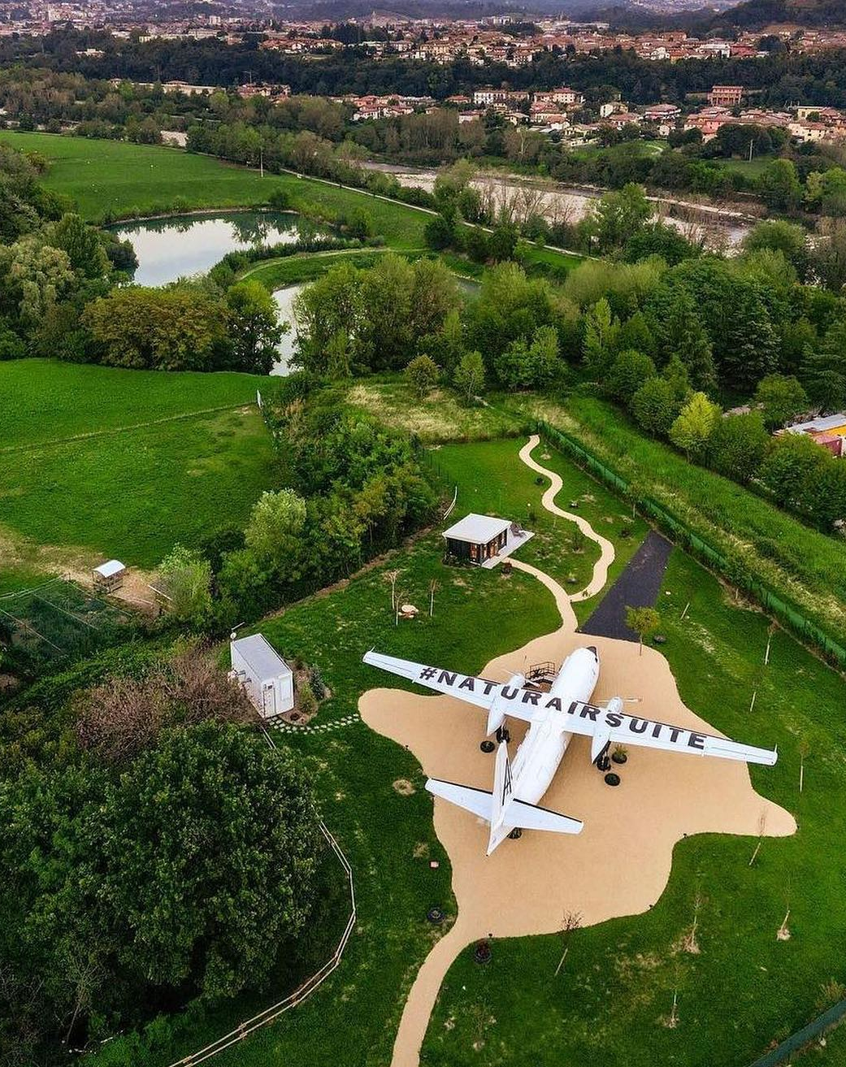
Module 8 Laying the Financial Foundations for a Viable Accommodation Business
Natur Air Suite, Italy
Photo Credit:
CONTENTS
Section 6
Find Your Break-even Point and Occupancy Rate

Slide 4
Module 8 Laying the Financial Foundations for a Viable Accommodation Business
Section 6: Find Your Break-even Point and Occupancy Rate
How many nights do I need to sell to break even, and how many to cover my costs and make a profit?
Objective: Break-Even Analysis & Occupancy Calculations
(How to make sure you don’t lose money). To calculate your break-even point in both nights and occupancy rate, providing clarity and confidence in planning.

Slide 5

Section 6
Find Your Break-even Point and Occupancy Rate
Break-Even Analysis & Occupancy Calculations
(How to make sure you don’t lose money)
To calculate your break-even point in both nights and occupancy rate, providing clarity and confidence in planning.
How many nights do I need to sell to break even, and how many to cover my costs and make a profit?

Slide 6
Financial Logic & Planning for Accommodation Businesses Planning
Section | Section | Why It Comes Here
3 | Revenue & Capacity Foundation | You start by calculating what you earn or all your income You must know what you're earning (primary and secondary income sources) and how many nights you can sell.
4 | Cost Structure | Figure out what you spend Without knowing your fixed and variable costs, you can't set prices or calculate profit.
5 | Know Your Cost Per Night | Calculate what each night must cover Helps establish your minimum charge to break even. You calculate the cost per night by dividing total costs by expected nights sold.
6 | Break-Even Analysis & Occupancy & Revenue Planning | Determine your financial survival point & forecast occupancy & revenue potential Tells you how to stop losing money. Once costs are known, calculate how many bookings are needed to break even. Ensure achievable pricing with realistic bookings targets and occupancy rate % goals.
7 | Profit & Pricing Strategies | Then choose a pricing strategy aligned with your goals With all the above in place, you can confidently set pricing and set profit targets

Slide 7
Find Your Break-even Point and Occupancy Rate
17
Occupancy Rate – Available No. of Nights
Use available nights per year to measure realistic operational potential.
Know how many nights you need to sell to cover your costs. Determine how many nights you need to sell per year to cover your operating costs—and start making a profit.
Knowing your break-even point means understanding how many nights you need to book before your business stops incurring a loss and starts generating a profit. This is a crucial step in assessing whether your accommodation model is financially viable. Breakeven calculations can be approached in different ways depending on whether you're starting from scratch or already have annual cost data. Occupancy rate calculations help turn these nights into realistic sales goals.
18
19
Calculate Actual Occupancy (Nights Booked)
Estimate how many of your available nights you’ll realistically book.
Calculate Break Even Nights
1. Break Even Nights (New Business)
Estimate the nights needed to cover fixed costs.
2. Break Even Nights (Known Annual Costs)
Use annual total costs to calculate breakeven nights.
20
21
Occupancy Rate – For Break Even Nights
Convert breakeven nights into a % of your nights sold.

Slide 8
Break-Even & Occupancy Calculations
Step 1: Occupancy Rate – Available No. of Nights
Use available nights per year to measure realistic operational potential.
Before you can calculate bookings or breakeven, you must know how many nights your property is available to sell (e.g., 365 full years, or 300 if you close in winter).
Calculate Your Capacity
Step 2: Calculate Estimated Occupancy
Estimate how many of those nights you’ll realistically book.
Use this to project expected revenue. This is your forecasted or target occupancy rate, based on market trends, past data, or seasonal patterns (e.g. 50–70%).
Calculate Projected Sales
Step 3: Break Even Nights (New Business)
Estimate the nights needed to cover fixed costs.
Use if you’re just starting out and don’t yet have complete annual data. Formula:
Fixed Costs ÷ (Price – Variable Cost per Night) = Breakeven nights.
Calculate Nights to Survive

Slide 9
Break-Even & Occupancy Calculations
Step 4: Break Even Nights (Known Annual Costs)
Use annual total costs to calculate breakeven nights.
If your business is already operational and you know your total costs (fixed and variable), this provides a more accurate breakeven point.
Total Annual Costs ÷ Net Revenue per Night = Breakeven nights.
Turn Nights into a % Target
Step 5: Occupancy Rate – For Break Even Nights
Convert breakeven nights into a % of your nights sold.
This is a calculated occupancy rate. Formula:
(Break-Even Nights ÷ Available Nights) × 100 = Occupancy Rate Needed to Break Even
Required Breakeven Occupancy

Slide 10
Break Even Analysis
Plain Terms: “Break even” means you’re not making or losing money.
It tells you the minimum business you need. For a small glampsite, breaking even might require only a relatively low occupancy (because operating costs can be low). However, don’t get complacent – a low break-even point is good, but your ultimate goal is a healthy profit above that. Use the break-even as a safety threshold when planning. (Glampitect)

Slide 11
Breakeven & Profitability Analysis
(Finding Your Break-Even Point and Beyond)
Finding Your Breakeven Point
Guiding Question: “What is my business’s break-even point (in nights or occupancy), and how many bookings or what rate do I need to achieve my profit goals?”
In real-world terms, a first-time business owner should know “the magic number” of bookings or occupancy needed to survive, and what it takes actually to make a good return.
The objective of this section is to arm you with those numbers and scenarios so you can plan realistically and set achievable targets (or adjust your plan if the targets seem out of reach).
It’s a bit of number-crunching, but it brings peace of mind by clarifying the threshold between loss and profit.
Introduction

Slide 12
Breakeven & Profitability Analysis
(Finding Your Break-Even Point and Beyond)
Finding Your Breakeven Point
This section zooms in on two critical concepts: Breakeven Point and Profitability Targets.
The breakeven point is when your total revenue equals your total costs – in other words, the business is not losing money, but not making a profit either. It’s a key milestone: reaching breakeven means your business can sustain itself.
Profitability analysis goes a step further to determine how you can go from breakeven to hitting a desired profit. The purpose here is to calculate the number of nights you need to book to break even (cover all costs) and to examine how different pricing and occupancy scenarios impact that and your profit goals.
Break Even Nights

Slide 13
Available Number of Nights
17
Taken from Section 3. Determine your available Nights per Year. Assume you operate all year, 365 nights. (You can adjust this if you're open seasonally, e.g., 300 nights, 250, etc.)
Available Nights = Total Nights in a Year – Owner Blocked Nights – Maintenance Days – Seasonal Closures
This number is essential for calculating realistic occupancy rates. It helps you project maximum revenue and understand operational limits. You'll use this figure in break-even analysis and revenue planning.
Total Nights in a Year | 365
Owner Use (e.g. holidays, personal stays) | 30
Scheduled Maintenance Days (e.g. deep clean, repairs) | 10
Off-Season Closures (e.g. closed Jan–Feb) | 45
Available Nights | 365 – 30 – 10 – 45 = 280 nights

Slide 14
Estimate Actual Occupancy
Estimate how many of your available nights you’ll realistically book
18
This is about forecasting your actual occupancy based on market trends, local demand, and your property’s appeal. It helps you project income.
Involves research and further analysis into market trends: Check similar listings on Airbnb, Booking.com, or tourism reports. Typical ranges:
Rural tourist predictions based on DMO figures: 20–40%
Popular tourist areas: 50–80%. Nearby glamping sites average 45% occupancy
Consider Seasonality: Break the year into high, mid, and low seasons. Estimate bookings per season based on demand. | High season (Jul–Aug): 70% | Mid (May–Jun, Sep): 50% | Low (rest): 20%
Factors in Your Offer & Location. If your stay has unique features (e.g., a hot tub, a sea view), you can expect above-average bookings. Unique hot tub & views may boost your occupancy to 55% annually

Slide 15
Estimate Actual Occupancy:
Estimate how many of your available nights you’ll realistically book
Example:
You have 280 available nights after blocking off dates for personal use and maintenance.
But based on your research, you think you'll only get bookings for 60% of them:
280 × 60% = 168 booked nights per year ← Your revenue estimate is based on this.
Involves research and further analysis into market trends: Check similar listings on Airbnb, Booking.com, or tourism reports. Typical ranges:

Slide 16
Breakeven Point Analysis
Find Your Break Even Point
The break-even point is a fundamental financial concept: it’s when your total revenue equals your total costs (resulting in neither profit nor loss).
Example: For a glamping business, a useful break-even metric is the occupancy level or number of nights you must rent out to cover your expenses.
How to Calculate Your Break Even
(Option A) Calculate Break Even Nights
(New Business) The Classic Break-even Question.
“How many nights do I need to book just to cover my fixed costs?”
(Option B) Calculate Break Even Nights
(If you know your total annual costs already)
“Based on what I expect to spend all year, how many nights must I book to break even?”

Slide 17
(Option A) Calculate Break Even Nights
For a Business Starting from scratch!
Option A
Option A is about how many nights you must book to cover costs — the focus is "nights needed to survive.“
Break-Even Nights = Fixed Costs ÷ Profit per Occupied Night (Price per Night – Variable Cost per Night)
This tells you how many nights you need to sell and what percentage occupancy you must achieve to cover your costs.
The next slide explains the breakdown of the formula.
Nights You Must Book to Survive!

Slide 18
A
19
(Option A) Calculate Break Even Nights
For a Business Starting from scratch!
“How many nights do I need to book just to cover my fixed costs?”
Use this if you're just starting out and want to know the minimum number of nights needed to break even. We use your fixed costs to find the break-even. In other words, what is your minimum bookings target to avoid a loss? Take your total annual fixed costs (from the income statement) and divide by your average nightly rate. This provides a rough estimate of the number of booked nights required to cover those fixed expenses. Note: We assume each night’s revenue contributes fully to fixed costs after paying any per-night variable costs – effectively using the contribution margin approach in a simple way.)
Break-even Nights FC = Fixed Costs (FC) ÷ Net Revenue per Night (Price per Night – Variable Cost (VC) per night.

Slide 19
Calculate Break-even Nights to Cover Costs
1
Calculate Annual Fixed Costs (e.g., insurance, loan payments, internet). These are the non-negotiable expenses you pay no matter how many bookings you get. €14,000/year
Annual Fixed Costs
2
Profit Per Occupied Night
Your Nightly Rate – Variable Costs (e.g. cleaning, welcome packs, utilities per guest) If you charge €150/night and it costs you €30 to host a guest, your profit per night is €120. This pays for your fixed costs.
3
Break-even
nights per year
Break-even nights per year The number of booked nights needed to cover fixed costs €14,000 fixed costs ÷ €120 profit per night = 117 nights
You need to book 117 nights just to break even.
Break-Even Nights = Fixed Costs ÷ Profit per Occupied Night (Price per Night – Variable Cost per Night)
€14,000 fixed costs ÷ €120 profit per night = 117 nights

Slide 20
Example: (Option A) Calculate Break Even Nights
Suppose your annual fixed costs are €20,000, and your average room rate is €100.
Break-Even Nights = €20,000 / €100 = 200 nights.
That means you’d need 200 paid nights over the year to generate €20,000 in revenue, which would roughly cover your €20k of fixed costs.
At 200 nights, you’re not really profiting – you’re just paying all the bills.
Any booking beyond 200 nights in this scenario would start generating profit.
This approach is handy if you’re still figuring out costs and plan to set a price – it directly tells you “I must sell X nights at this price to not lose money.”

Slide 21
Break-Even Nights = Fixed Costs ÷ (Price per Night – Variable Cost per Night)
Suppose your fixed costs (insurance, maintenance, etc., plus an allowance for your salary) are €30,000 per year.
Your average nightly rate is €100, and variable costs (cleaning, utilities, etc.) are about €20 per night occupied. Then the profit per night is €80.
If you have 4 units, the total available nights = 4 × 365 = 1,460 nights. 375 nights is about 26% occupancy annually.
Break-Even Nights = 30,000 ÷ 80 = 375 nights per year.
This means you’d need roughly 26% yearly occupancy (e.g. about 96 nights booked per pod throughout the year) to cover €30k in fixed costs.
Any occupancy above that, at those rates, would produce a profit. If you operate only 9 months a year, the break-even % of open days would be higher (because you have fewer available nights to achieve the same 375 nights).
Case Study
Option A: Example Using 4 Units

Slide 22
B
20
(Option B) Calculate Break Even Nights
If you know your total annual costs already
“Based on what I expect to spend all year, how many nights must I book to break even?
In other words if everything goes as planned cost-wise, how many nights do I need to cover all those costs? ”
Total Annual Costs (TAC) = Fixed Costs (FC) +(Variable Costs (VC) × Estimated Occupied Nights)
Use this formula if you already have a realistic number of nights you expect to book (e.g. 200 nights a year).
*Use this if you already expect a certain occupancy (e.g., 200 nights).

Slide 23
Example: (Option B) Calculate Break-Even Nights (Using Total Costs)
If you have a projection of total annual costs (fixed + variable) – for instance, from your income statement – you can divide that by your average rate to get break-even nights.
Essentially, this method asks: if everything goes as planned cost-wise, how many nights do I need to cover all those costs?
Example: Say your total annual expenses came to €19,600, and your average nightly rate is €100.
Break-Even Nights = €19,600 / €100 = 196 nights.

Slide 24
Example: (Option B) Calculate Break-Even Nights (Using Total Costs)
This is similar to Option A in result (as it should be, since total costs include fixed + variable, and variable costs per night mean the required nights might be slightly higher than Option A’s number if variable costs are significant).
If your average rate is a bit different (e.g., maybe averaging €110 because of a mix of seasons), use that.
The outcome tells you the sales volume (in nights booked) needed such that revenue equals costs – the point of no loss, no profits.
Both Option A and Option B give you a benchmark number of nights; Option B is just more precise if you have detailed cost estimates. For a quick estimate, Option A is often enough.

Slide 25
Example: (Option B) Calculate Break-Even Nights (Using Total Costs)
(Side note: The break-even formula in unit terms is essentially Fixed Costs ÷ (Price – Variable Cost per unit). By using average price and considering variable costs, you’re doing a simplified version of this. For small accommodations, variable costs per night are usually relatively low, so many owners approximate break-even in terms of nights by just using fixed costs and price.)
Break-even Nights = Total Annual Costs ÷ (Average Price per Night − Variable Cost per Night)
Example:
Total Annual Costs (TAC) = €20,000
Fixed Costs = €14,000
Variable Cost per Night = €30
Estimated Nights = 200
Average Price per Night = €150
TAC = €14,000 + (€30 × 200) = €20,000
Net Revenue per Night = €150 − €30 = €120
Break-even Nights = €11,000 ÷ €90 = 167 nights

Slide 26
Using The Break-even To Guide Decisions
If you are below break-even point
You either need to increase revenue (higher rates or more nights) or reduce costs.
Continuing the Case Study Example, if you fear that 26% occupancy might not be reached, you can see how to improve the picture.
For example, reducing fixed costs by €5,000 would lower the break-even point, while increasing the average price by €10 would raise the profit per night and reduce the number of break-even nights needed.
Tip: Use a spreadsheet to experiment with these numbers (e.g., a formula for break-even occupancy) to determine which levers (cost or price) have the most most tremendous impact.
If you fear 26% occupancy might not be reached

Slide 27
Remember that break-even doesn’t account for repaying your initial investment or loans – it’s purely on an operational basis, year-by-year.
To recoup your startup costs (such as the €256k from earlier), you’d want to generate profits over time or have sufficient cash flow to service any debt used to finance the setup.
One measure of return is ROI (Return on Investment), which calculates profit relative to the initial investment.
For example, if you invested €100k and made €10k profit in Year 1, that’s a 10% ROI for that year.
Return on Investment (ROI)
Starting a Glamping Business: The Ultimate Guide

Slide 28
High-end glamping can sometimes achieve fast ROI – one analysis showed even a relatively costly safari lodge tent could pay for itself in a few seasons if occupancy and rates are strong, while simpler structures can recoup investment in the first year.
But as a beginner, focus first on breaking even and steadily improving from there.
Return on Investment (ROI)
Starting a Glamping Business: The Ultimate Guide

Slide 29
Calculate the Occupancy Rate
21
With break-even nights (from Option A or B) and your available nights, you can find the occupancy rate required to break even. The occupancy rate is simply the percentage of available nights that are booked (occupied).
Formula: Occupancy Rate = (Booked Nights ÷ Available Nights) × 100%. In this case, use your break-even nights as the “booked nights” needed.
Example: Continuing Option B’s example: break-even 196 nights. If you have 365 nights available, the required occupancy is 196/365 = 54%.
If you had only 320 nights available (due to closures), then 196/320 = 61% occupancy is needed.
This number tells you how intensive your booking rate must be. A required 60% occupancy to break even means you need to fill a little over half of all available nights on average.
Occupancy Rate
Calculate the Occupancy Rate Needed to Break Even
Occupancy Rate Formula

Slide 30
Calculate the Occupancy Rate
Occupancy Rate
Industry context: A 50-60% occupancy rate might be very achievable in a popular area, whereas a rate of 80% or higher could be a red flag.
For instance, if your calculations showed you need 80% year-round occupancy to break even, that’s quite high for a new business – it might prompt you to reduce costs or raise prices to lower that break-even occupancy requirement.
Essentially, the breakeven occupancy is the lowest occupancy rate at which you cover all costs.
Industry Context
What is the Break Even
Occupancy Rate for Hotels?

Slide 31
Calculate the Occupancy Rate
Occupancy Rate
Knowing this percentage helps you gauge if your business plan is realistic: compare it to typical occupancy rates for similar businesses or to your own seasonal projections.
If your expected occupancy (from Revenue Sources assumptions) is lower than what the breakeven demands, you have more work to do on your plan.
Industry Context
What is the Break Even
Occupancy Rate for Hotels?

Slide 32
Calculate Occupancy Rate (to Break Even)
“What percentage of the year do I need to be booked to break even?”
This shows whether your break-even target is realistic based on market conditions. In Ireland, average glamping occupancy is 40–50%, with well-run sites reaching 60–70%.
1
First, Identify Your Key Values (see previous calculations)
Fixed Costs (FC) = €14,000 → costs that stay the same regardless of bookings.
Variable Cost per Night (VC) = €30 → costs that increase per booking.
Price per Night = €150 → what you plan to charge.
Available Nights in the Year (you choose—let’s say 365 for this example)

Slide 33
Calculate Occupancy Rate (to Break Even)
2
Calculate Net Revenue per Night
This is the amount left over after variable costs are deducted from the price you charge.
Net Revenue per Night = Price – VC
= €150 – €30 = €120
3
Calculate Break-Even Nights
Break-Even Nights = Fixed Costs ÷ Net Revenue per Night
= €14,000 ÷ €120 = 116.67 nights
So, you need to book at least 117 nights in the year to break even.

Slide 34
Calculate Occupancy Rate (to Break Even)
Occupancy Rate % = Break-even Nights ÷ Available Nights Per Year x 100
4
Calculate Occupancy Rate Needed to Break Even
Now, apply the occupancy rate formula
Occupancy Rate (%) = (Break-Even Nights ÷ Available Nights) × 100
= (117 ÷ 365) × 100 = 32.05%
Final Output
Metric | Result
Fixed Costs | €14,000
Variable Cost per Night | €30
Price per Night | €150
Net Revenue per Night | €120
Break-Even Nights | 117 nights
Occupancy Rate to Break Even | 32%

Slide 35
Break-Even & Occupancy Rate: Put it altogether in 5 Steps (*Calculate with Formula)
Step | Title | What You Do | Why It Matters
Available Nights | *Occupancy Rate – Available No. of Nights | Count how many nights per year your property can realistically operate (e.g. 365 or 300). | Defines your operational capacity and is essential for calculating realistic performance goals.
Estimate Booked Nights (Occupancy Rate) | *Calculate Occupancy Rate | Estimate the percentage of those nights you expect to book (e.g. 60–70%). | Helps you forecast revenue and understand market performance potential.
Option A Breakeven Nights (Fixed Costs only) | *Break-Even Nights (New Business - Fixed Costs only) | Use fixed costs and estimated profit per night.
Fixed Costs ÷ (Price – VC) = Nights. (For New Business) | Calculates how many booked nights you need to sell to cover fixed costs alone. Ignoring variable costs per night (because you subtract them from the price) (For New Business)
Option B Breakeven Nights (All Known Annual Costs) | *Break-Even Nights (All Known Annual Costs) | Use full annual costs.
Total Costs ÷ Net Revenue per Night = Nights. (Known Annual Costs) | This tells you how many nights you need to sell to cover your entire cost base — both fixed and variable. Gives operating businesses a more accurate break-even booking target.
Occupancy Rate to Break Even | *Occupancy Rate – For Break Even Nights | Calculate:
(Break-Even Nights ÷ Available Nights) × 100 = % | This converts your break-even nights into an occupancy rate. Tells you the minimum occupancy % rate of your total available nights must be booked to break even.

Slide 36
In Summary: Break-Even Nights From Costs to Occupancy Rate
1
Calculate Annual Fixed Costs (e.g., insurance, loan payments, internet). These are the non-negotiable expenses you pay no matter how many bookings you get. Total Annual Fixed Costs €14,000/year
Annual Fixed Costs
2
Profit Per Occupied Night
(Average nightly rate – Variable cost per night).
Your Nightly Rate – Variable Costs (e.g. cleaning, welcome packs, utilities per guest) If you charge €150/night and it costs you €30 to host a guest, your profit per night is €120. This pays for your fixed costs.
3
Break-even
nights per year
Break-even nights per year (Fixed Costs ÷ Profit per occupied night) The number of booked nights needed to cover fixed costs €14,000 fixed costs ÷ €120 profit per night = 117 break even nights
You need to book 117 nights just to break even.
4
Calculate the Occupancy Rate
Calculate profit per occupied night (Break-even nights ÷ Total available nights in a year × 100) 117 break-even nights ÷ 365 available nights = 32% occupancy rate You need to book about one in every three nights to break even.

Slide 37

Exercise: Complete Break-Even Nights, Costs & Occupancy Rate
1
Calculate Annual Fixed Costs (e.g., insurance, loan payments, internet). These are the non-negotiable expenses you pay no matter how many bookings you get. Total Annual Fixed Costs € [insert figure]/year
Annual Fixed Costs
2
Profit Per Occupied Night
(Average nightly rate – Variable cost per night).
Your Nightly Rate – Variable Costs (e.g. cleaning, welcome packs, utilities per guest) € [insert figure] /night and it costs you € [insert figure] to host a guest, your profit per night is € [insert figure]. This pays for your fixed costs.
3
Break-even
nights per year
Break-even nights per year (Fixed Costs ÷ Profit per occupied night) The number of booked nights needed to cover fixed costs € [insert figure] fixed costs ÷ € [insert figure] profit per night = [insert figure] break even nights
You need to book [insert figure] nights just to break even.
4
Calculate the Occupancy Rate
Calculate profit per occupied night (Break-even nights ÷ Total available nights in a year × 100) [insert figure] break-even nights ÷ 365 available nights = [insert figure] % occupancy rate.

Slide 38
From your total annual costs, you can calculate the minimum nightly rate you must charge to avoid operating at a loss.
For example, if your annual costs are €15,200 per year and you estimate 180 booked nights a year (roughly 50% occupancy), then your break-even price per night is:
€15,200 ÷ 180 = €84.44 → €85/night
This simple calculation ensures that your baseline rate covers all operating expenses.
Note: Actual occupancy varies seasonally, so it’s wise to add a safety margin or use a range of occupancy scenarios.
Exercise
Calculating Your Break-Even Nightly Rate

Slide 39

Case Study: Glampitect
Break-Even Calculation (5 Glamping Pods)
For 5 glamping pods at €140/night, the revenue at various occupancy levels is:
€127,750/year at 50% occupancy, €153,300 at 60%, and €178,850 at 70%
After estimating such revenue, you’d subtract your operating costs to see the profit.

Slide 40
Case Study: Glampitect
Break-Even Calculation (5 Glamping Pods)
They note typical operating costs for small sites include energy, cleaning, consumables (toiletries, firewood, etc.), maintenance, marketing, and insurance, and these are “generally pretty low” relative to revenue for glamping, meaning good profit margins if managed well.

Slide 41

Well Done
Module 8 (Part 5)
Managing Risks and Protecting Your Business
You have Completed… Module 8 (Part 4)
How Many Nights You Need to Sell to Cover Costs and Make a Profit.
Next is…

