Slide 1

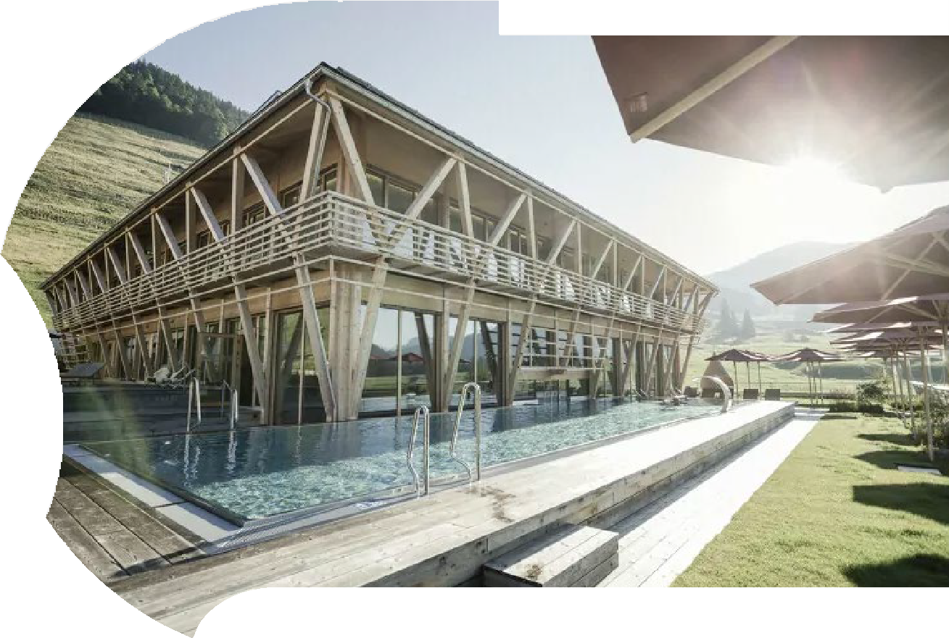


Module 6 (Part 3)
Location, Land & Logistics – Planning for a Profitable Site
Case Study Hubertus Mountain Refugio Allgäu, Germany
EPIC STAYS is licensed under CC BY-SA 4.0
Funded by the European Union. Views and opinions expressed are however those of the author(s) only and do not necessarily reflect those of the European Union or the European Education and Culture Executive Agency (EACEA). Neither the European Union nor EACEA can be held responsible for them.

Slide 2
Learning Outcomes
Module 6 (Part 3) Overview
Your location can make or break your business. This module guides you through the practical realities of planning your site—from navigating zoning and planning approvals to ensuring guests can access your accommodation safely and easily. Whether you're connecting to existing infrastructure or going off-grid, the focus is on helping you avoid costly surprises by making informed decisions early. By the end of this module, you’ll be equipped to choose the right site with confidence—balancing legal, physical, and logistical considerations to set your business up for long-term success.
Launching Smart - Location, Land & Logistics – Planning for a Profitable Site
By the end of this section, you will be able to:
Understand zoning, planning, and permitting processes relevant to alternative accommodations.
Assess land suitability based on terrain, drainage, soil, and buildability.
Calculate realistic costs and options for connecting to (or replacing) infrastructure such as power, water, waste, and internet.
Evaluate accessibility and transport considerations to ensure guest convenience and safety.
Avoid common site-related pitfalls that lead to costly rework, delays, or lost revenue.
EPIC STAYS | DESIGNING INNOVATIVE TOURISM STAYS

Slide 3
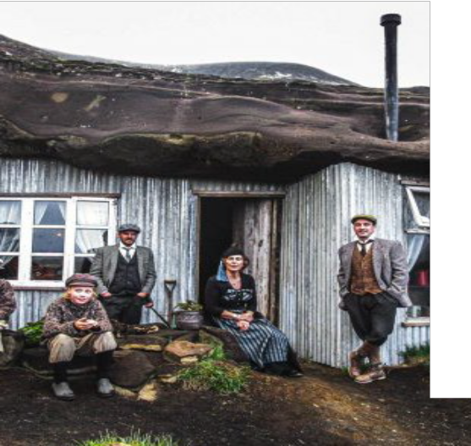
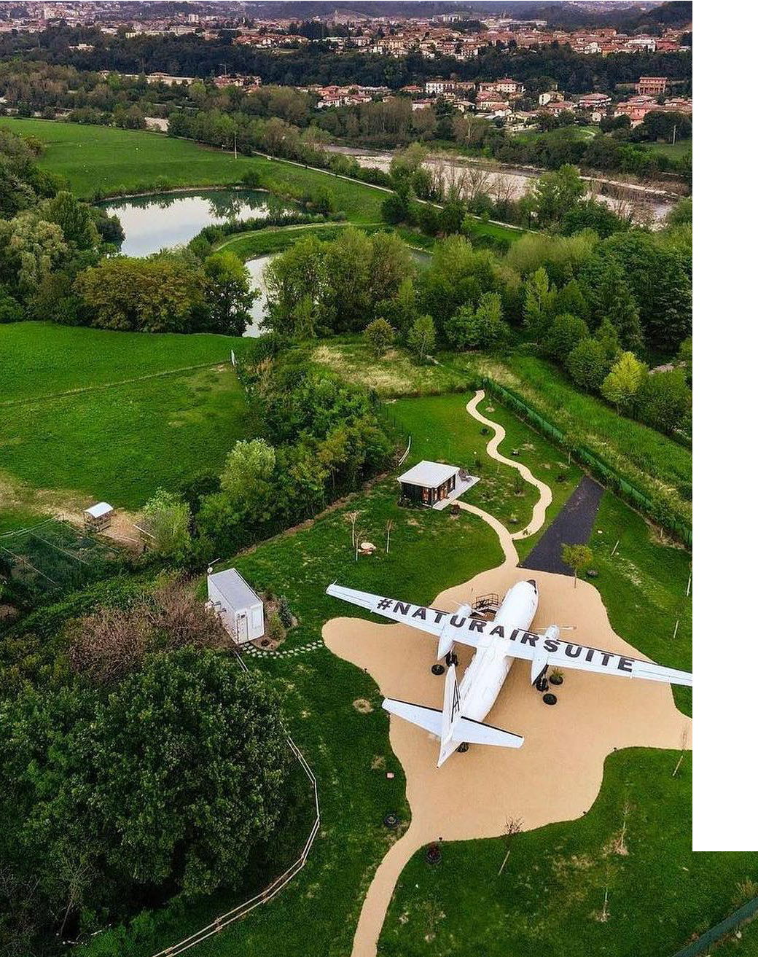
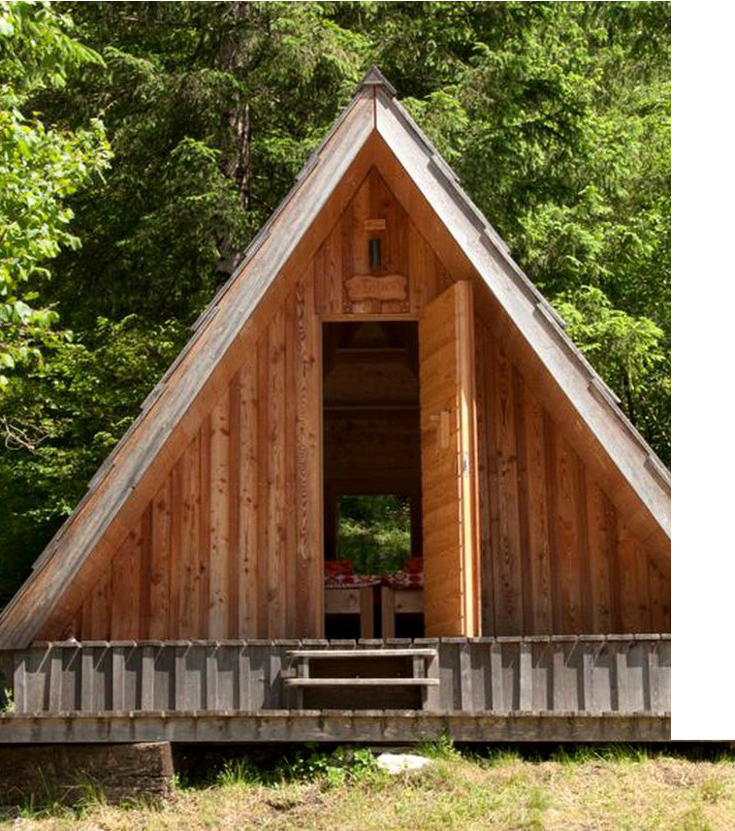
Module 6 Location, Land & Logistics – Planning for a Profitable Site
Photo Credit: Cave People, Iceland
Photo Credit: Natur Air Suite, Italy
05
Section
Plug In Without Burning Funds: Utilities & Infrastructure
Photo Credit:
CONTENTS
04
Section
06
Section
Photo Credit: A-Frame in Soča, Gorizia, Slovenia
Pick (and Permit) the Right Place: Zoning & Planning Costs
Make Sure You Get Them There: Access & Transport Costs

Slide 4
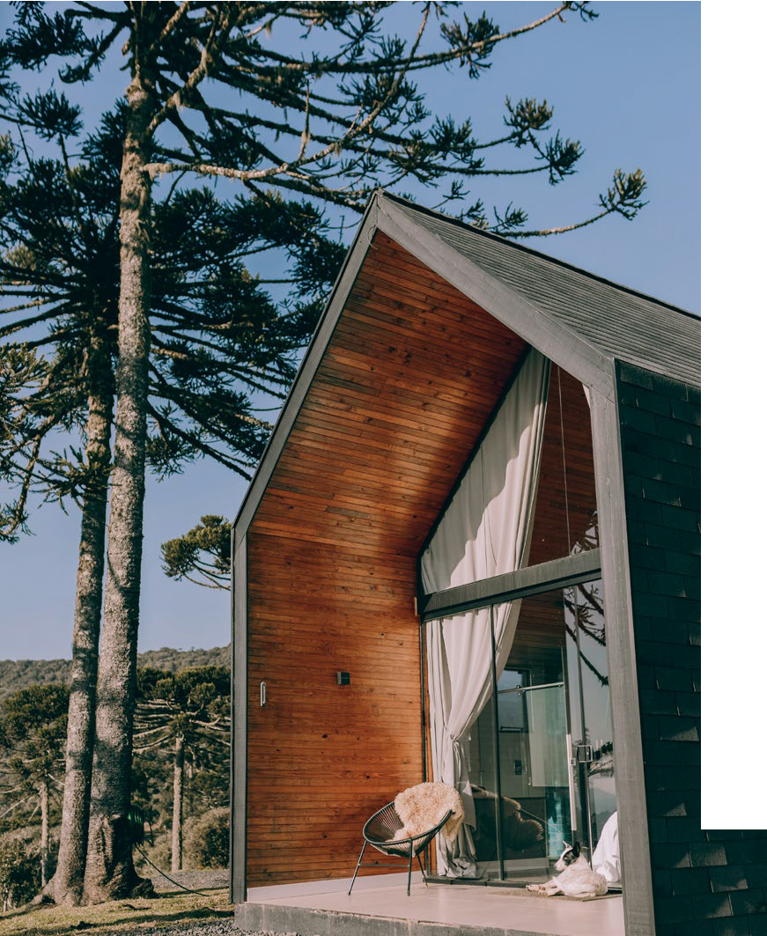
Module 6 Location, Land & Logistics – Planning for a Profitable Site
Photo Credit: Cave People, Iceland
Photo Credit:
CONTENTS
07 Section
Picking the Wrong Land Can Be Detrimental: Terrain, Drainage & Buildability
(5 Slides)

Slide 5
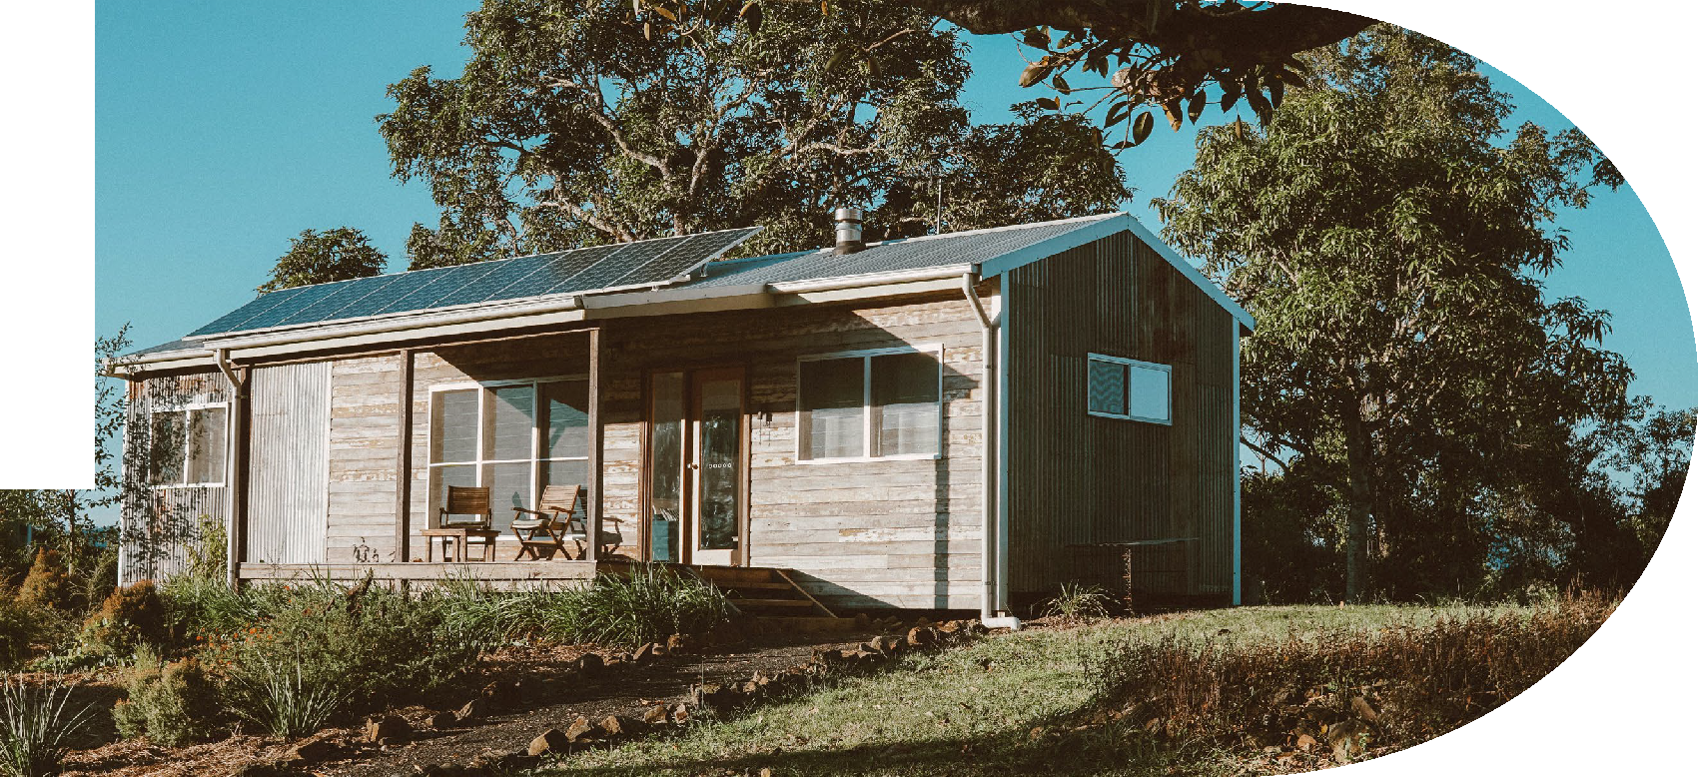
04
Pick (and Permit) the Right Place: Zoning & Planning
Costs
Before you buy land or build anything, you need to understand local zoning laws and planning permissions. This topic breaks down how regulations can impact your timeline, budget, and even your ability to open. You’ll learn what questions to ask your local authority, what documents to prepare, and how to avoid common permit pitfalls.
Planning early can save months of delay and thousands in rework or legal fees.
EPIC STAYS | DESIGNING INNOVATIVE TOURISM STAYS

Slide 6
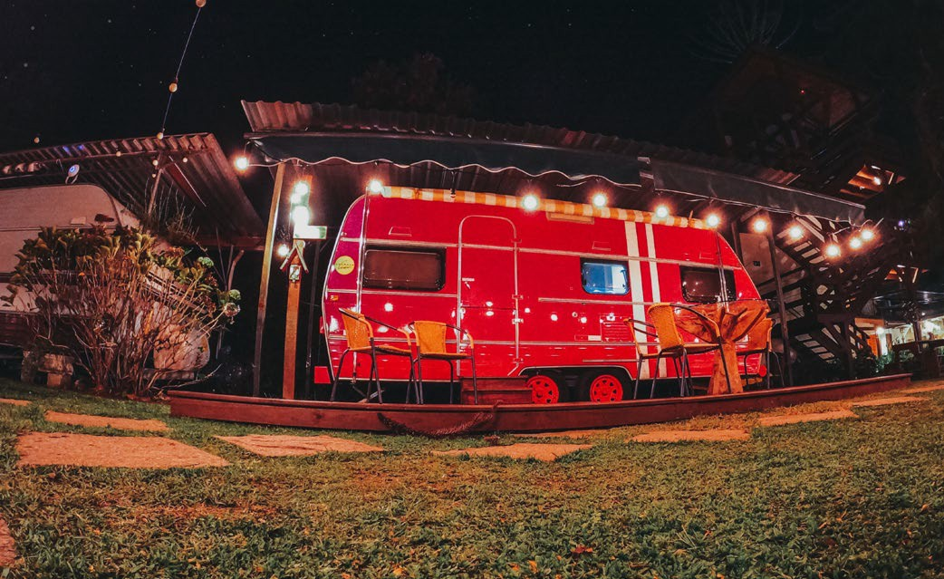
Location influences nightly rates, access to grants, and marketing power.
Are you thinking of setting up your Alternative Tourism Accommodation (ATA) locally, beside your home or dreaming about a spot near a beach or unique location?
Location Matters to Guests
Location is the Heart Of Your ATA Business!
Before you make your decision, make sure it is the right location and site – this is the heart of your ATA business.
Priority 6 (€)
Pick a practical appealing location!
EPIC STAYS | DESIGNING INNOVATIVE TOURISM STAYS
Choosing the right location and site is one of the most important early decisions when developing an alternative tourism accommodation (ATA) business.

Slide 7
The site you choose isn’t just about scenery—it’s the foundation of your business model and your bottom line.
It shapes the guest experience, operational costs, service offering, and pricing potential.
A strategically selected location can significantly reduce your start-up costs, increase guest satisfaction, and boost long-term revenue. Here’s how a smart location delivers real financial value:
Location Matters to Guests
Location is the Heart Of Your ATA Business!
Priority 6 (€)
Pick a practical appealing location!
EPIC STAYS | DESIGNING INNOVATIVE TOURISM STAYS

Slide 8
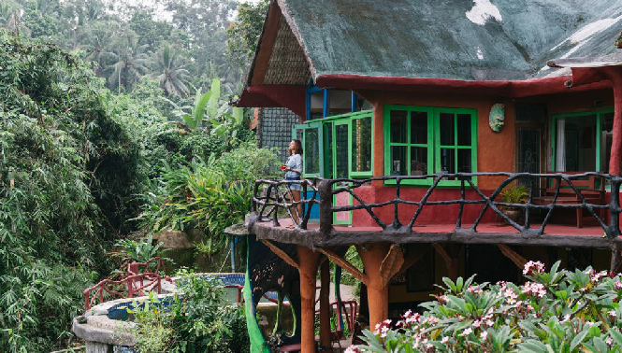

A Suitable Target Market Site Selection
Enhance the guest experience, enabling premium pricing
for scenic, tranquil, or immersive cultural stays
Reduce infrastructure costs → Cuts expenses for water,
power, sewage, and road access (savings of €10,000–
€50,000+)
Boost occupancy by being near attractions, trails, or transport links increases year-round bookings
Enable unique experiences allow you to sell add-ons like forest bathing, stargazing, or local workshops for extra income
Support sustainability goals, access to sun, wind, or local food systems, reduces running costs and attracts funding/grants
Bottom line: Choosing the right site is one of the few early decisions that can both lower your costs and raise your revenue. It's not just where you build
Location Matters to Guests
Priority: Choosing the Right Site & Balancing Costs
EPIC STAYS | DESIGNING INNOVATIVE TOURISM STAYS
Recommended Reading Survey of travellers finds 76% want more
sustainable options, 2023

Slide 9
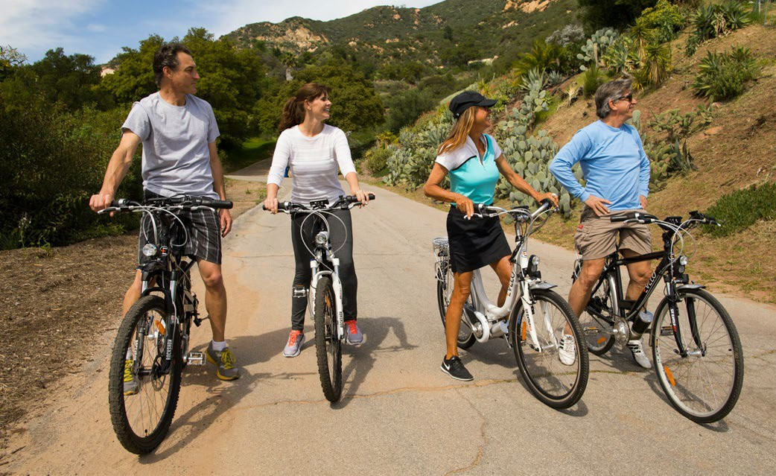
Understanding Guest Appeal and Experiences
Proximity to Activities and Themes
While remoteness is appealing, accessibility to meaningful activities is also key. Tourists want to “do something” while staying off-grid.
‘72% of travellers say their choice of accommodation is influenced by nearby activities, especially for nature- and wellness-based experiences (Booking.com 2023 Sustainable Travel Report).
This means one of your greatest assets is what’s just beyond your doorstep.
Location Sells – Choose it Like a Guest Would
Priority: Ensure Bookings By Location Proximity
EPIC STAYS | DESIGNING INNOVATIVE TOURISM STAYS

Slide 10
What locations and environments are they looking for!
They are looking for accommodations and locations that offer
outdoor adventures (kayaking, hiking, wild swimming, cycling),
wellness experiences (forest bathing, yoga, thermal springs),
food & wine experiences (farm-to-table dining, foraging, vineyards), and
art or local craftsmanship (pottery, weaving, painting retreats).
Location Sells – Choose it Like a Guest Would
Priority: Ensure Bookings By Location Proximity
EPIC STAYS | DESIGNING INNOVATIVE TOURISM STAYS

Slide 11
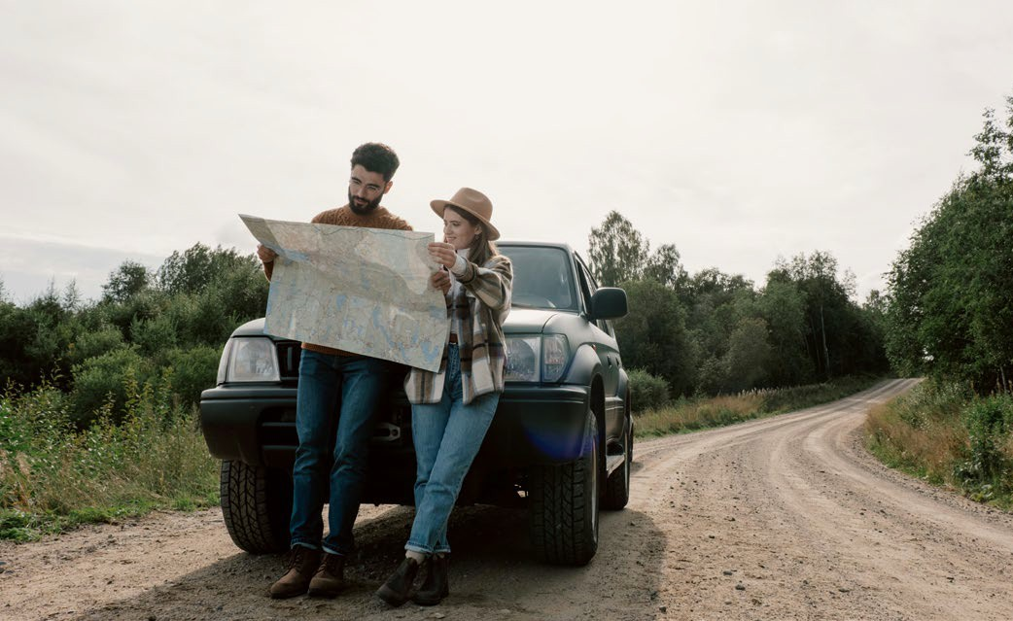
Example: In Iceland, cabins with access to geothermal pools or aurora viewing spots consistently rank among the highest for bookings and reviews — often priced at €200–€350 per night, far above the national average.
Location Sells – Choose it Like a
Guest Would
Priority: Ensure Bookings By Location Proximity
Financial Tip:
Even if you don’t offer the activity
yourself, curating local experiences and packaging them (with a mark-up or partner commission) can add €25–€100 per guest per stay — significantly improving your revenue without major capital costs.
EPIC STAYS | DESIGNING INNOVATIVE TOURISM STAYS

Slide 12
Financial Benefits of Location Proximity to Experiences
Type of Nearby Experience | Possible Setup/Partnership Cost | Financial Opportunity
Trail access, lake use, or riverside path | €0–€2,000 (landscaping, signage) | Increases guest stay length, seasonal appeal
Yoga deck / wellness retreat area | €3,000–€10,000 | Enables retreat packages (€300–€900 pp/weekend)
Partnering with vineyard or forager | Minimal cost or % commission | Upsells add-on experiences (€50–€150 pp)
Artist or artisan collaboration | Revenue share or per-event fee | Create high-margin “experience packages” for off-peak stays
Thermal spring, spa, or sauna access | €5,000–€30,000 investment | High yield on spa-themed packages; boosts low-season stays
EPIC STAYS | DESIGNING INNOVATIVE TOURISM STAYS

Slide 13
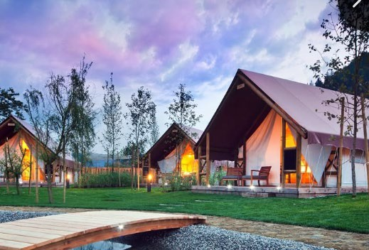
Nature-Based, Scenic, Remote Settings are Top of the List!
https://www.charmingslovenia.com/en/herbal-glamping-resort-ljubno.html
More and more travellers are ditching standard hotels in favour of immersive, nature-based experiences — like glamping pods in the woods, cabins by the lake, eco-lodges in mountain valleys, or converted farmhouses in wine country. These settings aren’t just visually stunning — they boost booking rates and price premiums.
A study by the EU Rural Tourism initiative found that 61% of European travellers who chose agritourism or eco-stays did so primarily because of the landscape and rural setting (Source: CBI/EU Market Research). That means your location choice directly affects your visibility, occupancy, and potential profit margin.
Let Your Location Do the Selling
Priority: Immersive Natural Settings Drive Higher Rates
EPIC STAYS | DESIGNING INNOVATIVE TOURISM STAYS

Slide 14
What locations and environments are they looking for!
https://www.charmingslovenia.com/en/herbal-glamping-resort-ljubno.html
They are looking to immerse themselves in forests, lakes, coastal views, mountains, or vineyards.
They want silence, cleanliness, pristine nature, privacy, wildlife, and starry skies.
They also want clean air, nature trails, or water access (hot springs, rivers, beaches). This will make you stand out and give you the wow factor.
Let Your Location Do the Selling
Priority: Immersive Natural Settings Drive Higher Rates
EPIC STAYS | DESIGNING INNOVATIVE TOURISM STAYS

Slide 15
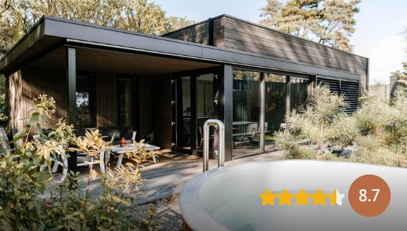
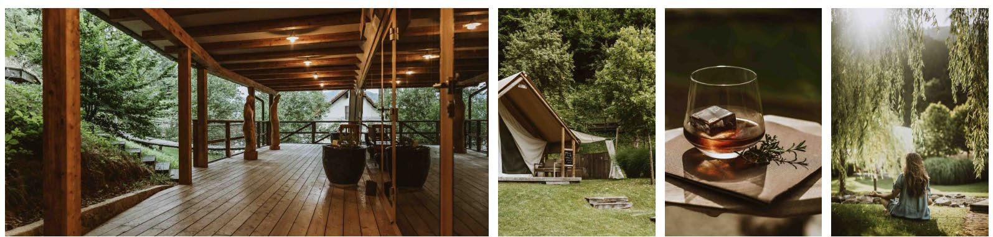
Examples:
https://www.soofretreats.com/
Herbal Glamping Ljubno, Slovenia – Nestled in the Alps near the Savinja River, it markets clean air, wild herbs, and wellness. They charge €250+ per night in high season — a price justified by the immersive setting and spa features.
Agriturismo La Ghiandaia, Tuscany, Italy – Surrounded by vineyards and olive groves, they offer farmhouse stays with cooking classes and wine tastings. The location allows them to charge €180–€250 per night, double that of nearby basic hotels.
Let Your Location Do the Selling
Priority: Immersive Natural Settings Drive Higher Rates
Soof Retreats, Netherlands – Their lodges near nature parks are fully gas-free and powered by solar, with design focused on nature immersion. Despite being low-density, they profit from eco-conscious branding and repeat Dutch urbanite clientele
EPIC STAYS | DESIGNING INNOVATIVE TOURISM STAYS

Slide 16
Financial Benefits of Scenic Settings & Natural Experiences
Feature/Setting | Added Cost | Financial Benefit | Save Costs €€€
Forest, coastal, or riverside land | May cost more per acre or need access work (€5K–€25K) | Higher room rates, 4-season appeal, wildlife-based tours | Forests allow for natural shade (less € energy for cooling)
Mountain or vineyard setting | May involve slope engineering or permits | Premium appeal, weddings, retreats, wine tourism | Elevated areas with wind/sun exposure are ideal for off-grid power solutions
Remote or off-grid location | May require solar/water investment (€10K–€30K) | Unique selling point = higher prices, longer stays | Seclusion boosts privacy (and appeal), so no need for heavy landscaping
Proximity to national parks/trails | Permit/zoning costs (€1K–€10K) | Can market as eco-adventure base, increasing stay length | Streams or rivers can enhance greywater recycling or hydro-features
Scenic “Instagrammable” views | May mean fewer units due to protected views | Fewer units = exclusivity = higher nightly yield | User Generated Content UGC – free marketing and referrals to your target markets
EPIC STAYS | DESIGNING INNOVATIVE TOURISM STAYS

Slide 17
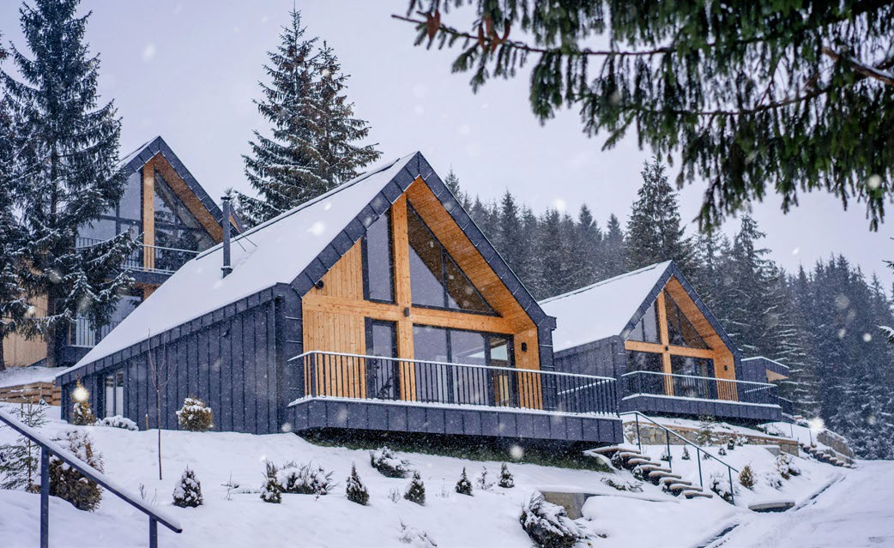
Understanding Guest Appeal and Experiences
Authenticity Through Rural or Heritage Sites
The location contributes to a sense of "place" and cultural authenticity, especially in heritage accommodations or repurposed rural buildings.
These settings aren’t just visually stunning — they
boost booking rates and price premiums.
Tourists are more likely to choose stays embedded in local history or rural tradition — particularly those over age 35 or traveling for cultural enrichment (European Travel Commission, 2022). This makes repurposed rural buildings, like old barns, mills, cottages, or even castles, highly attractive — and highly bookable.
Be the Place They Want to Stay
Priority: Cultural Authenticity Increases Value & Trust
EPIC STAYS | DESIGNING INNOVATIVE TOURISM STAYS

Slide 18
Why it works financially:
This heritage positioning
allows them to charge a €60–€100 per night premium. Also, other financial benefits are longer stays,, more five-star reviews, strong word-of-mouth and return visits
What locations and environments are they looking for!
They want to stay in and surround themselves with an authentic, unique environment, such as converted barns, stone cottages, old mills, or castles.
They want to experience and immerse themselves in traditional architecture or village communities. A bonus is the opportunity to experience connections to local cultural stories, artisanal crafts, or food traditions.
Be the Place They Want to Stay
Priority: Cultural Authenticity Increases Value & Trust
EPIC STAYS | DESIGNING INNOVATIVE TOURISM STAYS

Slide 19
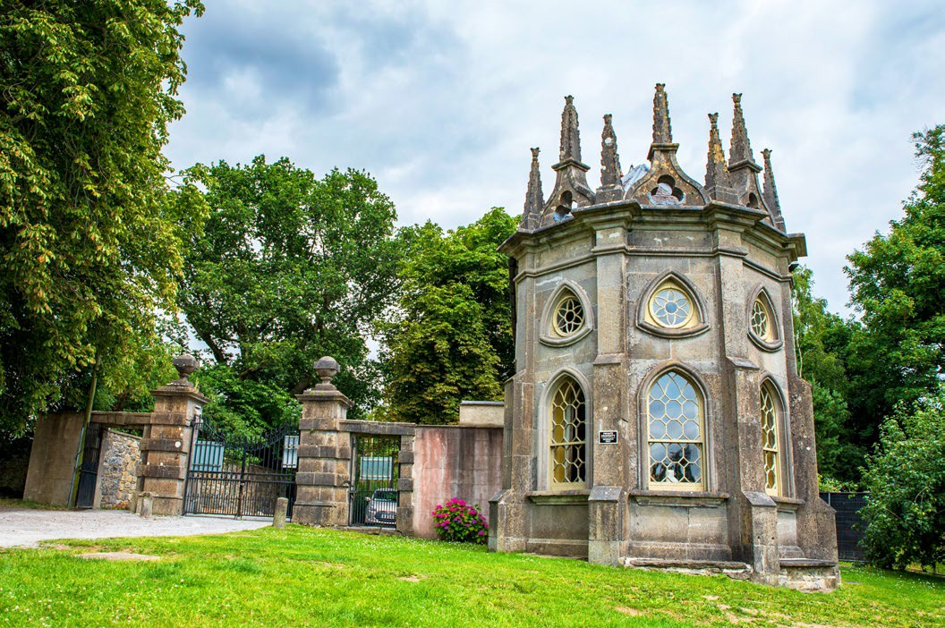
Example: Batty Langley Lodge, Ireland
https://irishlandmark.com/properties/batty-langley-lodge/
Batty Langley Lodge is a restored 18th-century Gothic-style gate lodge located at the entrance to the historic Castletown House estate.
They market charge a premium of €180–€200 per night over standard accommodation elsewhere.
Guests are happy to pay this because they are not just paying for a place to stay but for an experience of sleeping in an authentic, 18th-century Gothic lodge with preserved architectural details.
As there’s only one Batty Langley Lodge — its rarity creates perceived luxury and exclusivity.
Be the Place They Want to Stay
Priority: Cultural Authenticity Increases Value & Trust
EPIC STAYS | DESIGNING INNOVATIVE TOURISM STAYS

Slide 20
Financial Benefits of Heritage and Rural Authenticity
Feature/Investment | Potential Cost | Financial Advantage | Save Costs €€€
Renovating a barn/cottage into a stay | €25K–€100K depending on state and location | Heritage appeal = 20–50% premium on nightly rates | Up to €700 more revenue per week than a standard stay
Registering for cultural heritage support | Variable (€500– €3,000) | May unlock EU cultural tourism or rural development grants
Working with local artisans for décor | €2K–€10K for sourcing materials | Enhances storytelling = higher guest satisfaction + return rates | Justification for grant support, trust funding..
Adding interpretive content or workshops | €500–€2,000 setup | Creates add-on revenue streams (e.g., €25–€75 pp for workshops) | Low marketing spend due to strong word-of-mouth and earned media
Heritage branding or label (e.g. “Alpine Traditional Stay”) | Minimal cost if strategic | Improved SEO, niche targeting, loyalty | Increased off-season bookings due to heritage appeal
EPIC STAYS | DESIGNING INNOVATIVE TOURISM STAYS

Slide 21
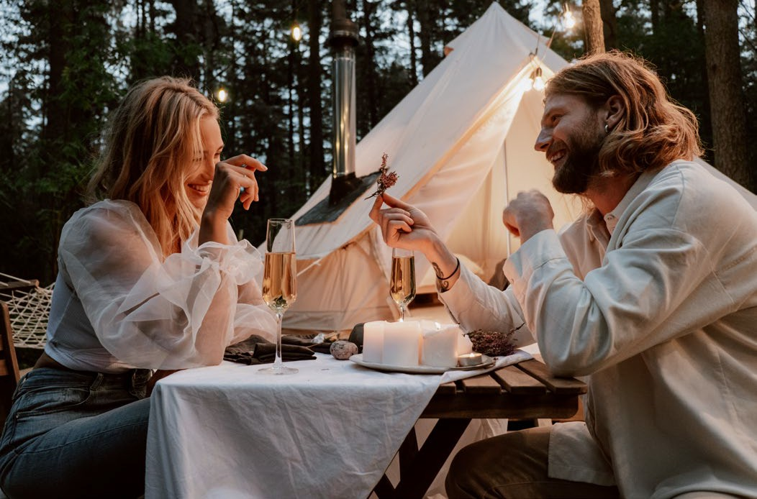

Why Location Matters in Alternative Tourism
Emotional Value and Connection with the Location
Be the Place They Want to Stay
People often book these accommodations for emotional reasons — to disconnect, heal, recharge, or celebrate.
Priority: Invest in a True Escape with Emotional Connection
A peaceful location is the #1 factor for choosing glamping-style or off-grid stays, with over 43% of respondents in 2024, according to many EU rural tourism reports (especially among Gen Z and Millennials).
EPIC STAYS | DESIGNING INNOVATIVE TOURISM STAYS
Recommended Reading
World Tourism Organization: Rural Tourism Overview (UNWTO)

Slide 22
What locations and environments influence their decision!
They want a setting that looks peaceful, magical, wild, or “Instagrammable”. They want to go to a place that will bring them calmness, joy, or romance. They want an escape — mentally, emotionally, or physically — from urban life
Be the Place They Want to Stay
Priority: Invest in a True Escape with Emotional Connection
Example: In Iceland, cabins on private land with access to geothermal pools or aurora viewing spots are top picks.
EPIC STAYS | DESIGNING INNOVATIVE TOURISM STAYS
Recommended Reading
World Tourism Organization: Rural Tourism Overview (UNWTO)

Slide 23
Guest Appeal & Financial Value Table
Appeal Driver | Example Features | Estimated Cost | Financial Benefit / ROI
Authenticity (Heritage & Rural) | Converted barns, stone cottages, old mills, castles, village homes | €25K–€100K renovation | Charge 20–50% higher nightly rates; strong off-season demand; eligibility for grants
Cultural storytelling & artisan links | Decor with local crafts, traditional furniture, family histories | €2K–€10K (materials & curation) | Adds emotional value = better reviews, higher guest satisfaction, return visits
Scenic Nature-Based Location | Forests, lakes, rivers, coastal cliffs, mountain views, vineyards | €5K–€25K (land prep, site access) | Premium rates (+30– 50%); longer stays; seasonal and retreat potential
Unique natural features | Starry sky zones, wildlife spotting, dark-sky designation | €0–€5K (signage, promotion) | Eco-brand appeal = higher value per stay, marketing advantage
EPIC STAYS | DESIGNING INNOVATIVE TOURISM STAYS

Slide 24
Appeal Driver | Example Features | Estimated Cost | Financial Benefit / ROI
Proximity to Outdoor Activities & Experiences | Hiking trails, kayaking, cycling, wild swimming, bird watching | €0–€2K (pathway, signage, insurance) | Increases average length of stay + value of stay; improves Google ranking
Wellness features | Forest bathing, yoga deck, outdoor saunas, hot tubs, thermal springs | €3K–€30K depending on feature | Spa/wellness packages (€300–€900 pp); off-season demand stabilisation
Food & wine experiences | Vineyards, foraging tours, cooking classes, farm-to-table dining | €500–€10K (partnerships or infrastructure) | Add-ons (€50–€150 pp); strong appeal for midlife and older travellers
Arts & local craftsmanship | Pottery, weaving, painting, craft retreats | €1K–€5K (space setup or collab fees) | Creates midweek or off-season income; high-margin workshops; social media appeal
“Wow Factor” experiences | Cabins with geothermal pools, aurora viewing, outdoor firepits | €5K–€35K (site-dependent) | Nightly rates €200–€350+; marketable as premium/Instagrammable stays
Experience packaging & curation | Bundled itineraries, partner-led tours or workshops | Minimal (staff/admin or % fee) | Adds €25–€100 per guest; low-cost upsell; strengthens local networks
EPIC STAYS | DESIGNING INNOVATIVE TOURISM STAYS

Slide 25
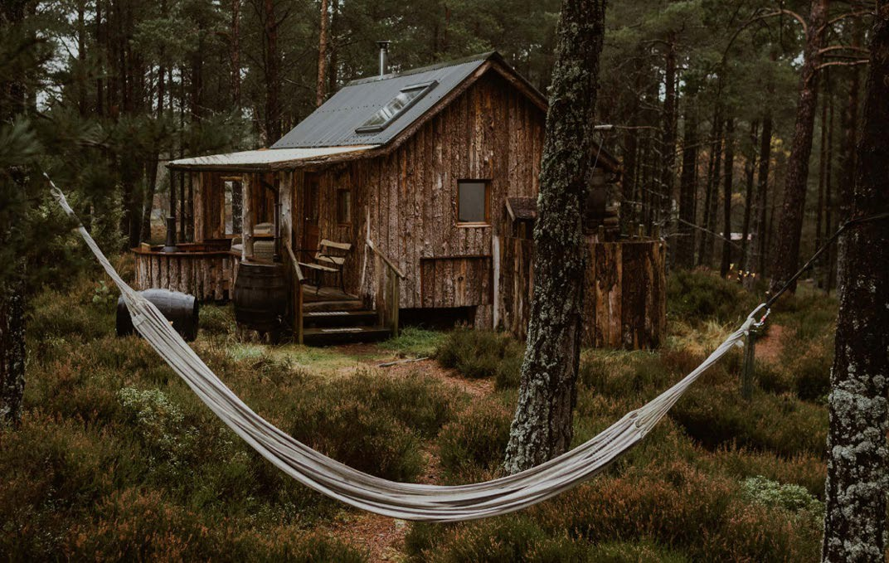
Location & Site Selection
Now that you understand guest appeal, you need to carefully assess if there are any restrictions, such as zoning and planning restrictions, accessibility, services, practicality, sustainability, and long-term viability.
The right site will enhance guest appeal, reflect your brand values, help manage costs effectively and deliver memorable experiences. These are a few to consider; we’ll explore more in the next section.
Priority: Next Site Section & Location Costings
1. Zoning and Planning Permission: Choose a site where tourism is legally permitted, this will avoid disappointments, delays and refusals. (explained in the next section). Check out GSTC Standards & Criteria.
EPIC STAYS | DESIGNING INNOVATIVE TOURISM STAYS

Slide 26
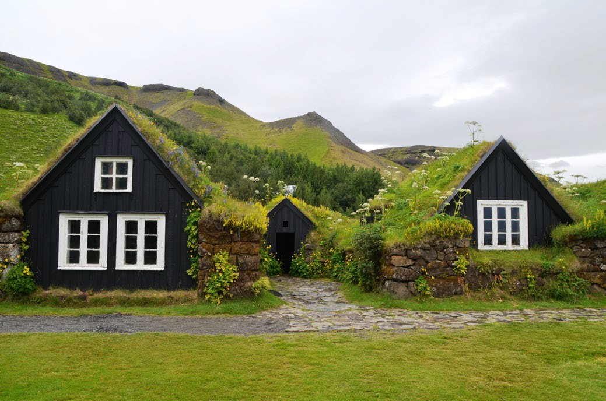
Access & Transport: Guests need reliable access by car, road or public transport. Poor access can hurt bookings and cause frustration.
Utilities & Infrastructure: Costly if not available. Consider water, power, broadband, and drainage. Think off-grid options.
Low environmental risk: Low impact on the environment and avoids ecological damage to protected areas.
Local community: Consider noise, access, and cultural fit.
Market fit: Does the location serve your target audience, e.g., wellness
Location & Site Selection
Priority: Next Site
Section & Location
EPIC STAYS | DESIGNING INNOVATIVE TOURISM STAYS

Slide 27

Securing Land Suitable for Development
Know the legal, zoning, and permit costs early to avoid delays, refusals, or expensive rework down the line.
Not all beautiful locations are legal to build on — and finding out too late can be expensive. This step is all about choosing a viable site and understanding local planning, zoning, or environmental rules and regulations that can affect or block your build. Whether it’s change-of-use fees, permit applications, consultant fees, or delays — planning costs can run from €1,000 to €10,000+, depending on the region. Being informed early avoids financial waste and ensures compliance
EPIC STAYS | DESIGNING INNOVATIVE TOURISM STAYS

Slide 28
Alternative Tourism Accommodation
Securing Land Suitable for Development
Not all rural land is suitable for alternative tourism accommodation!
Launching an alternative accommodation business involves significant capital investment, particularly in securing land suitable for development. This means that, among other things, it must be suitable for alternative tourism accommodation, planning permission can be obtained, and basic infrastructure is in place.
Key considerations that can significantly impact the cost include land acquisition (cost), planning fees (including application and associated reports), and site preparation (including roads and utilities).
EPIC STAYS | DESIGNING INNOVATIVE TOURISM STAYS
Recommended Reading
Tourism Planning: Importance, Benefits, Types & Levels, 2024
•
Sustainable Tourism: Understanding the Opportunity

Slide 29
Alternative Tourism Accommodation
Securing Land Suitable for Development
Not all rural land is suitable for alternative tourism accommodation!
Alternative accommodation planning is a part of general tourism planning but has its own planning laws; it focuses on land-use, which includes building regulations, legal compliance, community involvement, environmental impact, and guest experience.
Here is what you generally need to consider when planning an alternative tourism accommodation.
EPIC STAYS | DESIGNING INNOVATIVE TOURISM STAYS
Recommended Reading
Tourism Planning: Importance, Benefits, Types & Levels, 2024
•
Sustainable Tourism: Understanding the Opportunity

Slide 30
Planning & Zoning Components Checklist
Component | What to Consider | EPIC STAYS | DESIGNING INNOVATIVE TOURISM STAYS
Site & Location | Access, zoning, natural features, views, privacy
Type of Accommodation | Pods, cabins, converted barns, treehouses, yurts
Infrastructure and Utilities | Roads, access, electricity, water, waste, energy efficiency.
Target Market | Eco-tourists, wellness travellers, families, remote workers
Experience Design | Nature trails, farm visits, cultural workshops, wellness services
Sustainability | Compost toilets, rainwater harvesting, solar power, local sourcing
Legal & Regulatory | Planning permission, building regulations, tourism licensing
Financial Planning | Setup costs, ROI, funding sources, contingency budget
Partnerships | Local artisans, guides, farmers, wellness practitioners
Promotion | Digital presence, photography, storytelling, guest reviews
Monitoring | KPIs: occupancy rate, income, repeat bookings, community feedback

Slide 31
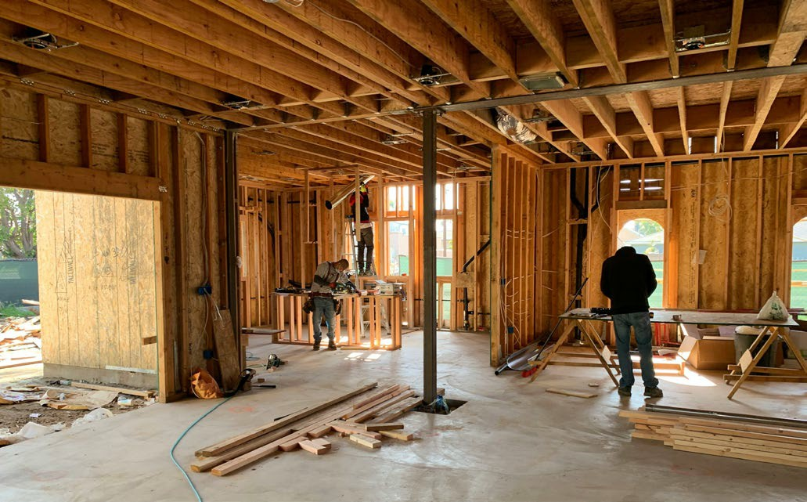
Local tourism zoning and planning are critical foundations when developing an ATA. Avoid hidden costs from zoning or refusal; compliance saves time and money.
Selecting the Right Site & Location
Go to Your Local Tourism Planning Office
Priority 7 (€)
Find out where you can legally build.
Ensure the land is properly zoned for tourist lodging and secure all required permits and planning permissions before development.
Before you can bring your alternative tourism accommodation idea to life—whether it’s a glamping pod, eco-retreat, tiny house, or heritage guesthouse—you need to carefully consider where you’ll build and what permissions are required.
EPIC STAYS | DESIGNING INNOVATIVE TOURISM STAYS

Slide 32
Selecting the Right Site & Location
Every country has unique planning, zoning, and regulatory frameworks that determine what type of accommodation can be developed, how it must be built, and whether it's allowed at all on a specific site.
Choosing the right land, understanding local zoning laws, securing planning permission, and complying with relevant regulations will not only ensure your project is legal and insurable but also save you time, money, and stress in the long run.
Go to Your Local Tourism Planning Office
EPIC STAYS | DESIGNING INNOVATIVE TOURISM STAYS
Priority 7 (€)
Find out where you can legally build.

Slide 33
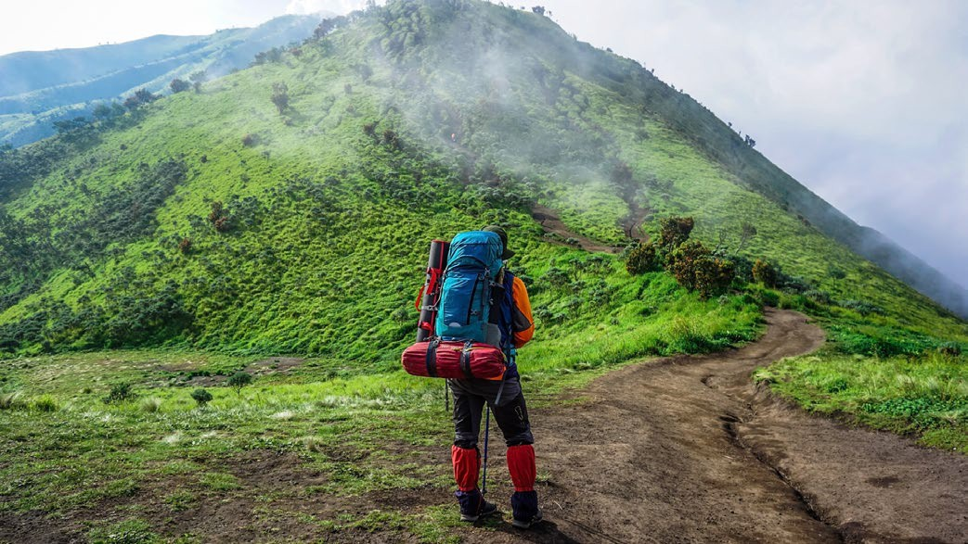
Skipping this can lead to shutdowns or fines—ensuring legal and long-term viability is crucial.
Find Where You Can Build!
You will need to first call your local Council and Tourism Planning Office to determine what you’re legally allowed to build, where you can build it, and how your project fits within the local tourism zones, environment and community planning.
Go to Your Local Tourism Planning Office
Priority 8 (€)
Understand planning and tourism regulations.
EPIC STAYS | DESIGNING INNOVATIVE TOURISM STAYS
Remember, unlike traditional accommodations, ATAs often rely on rural, natural, or heritage-rich locations—areas that may fall under strict zoning laws or be designated as protected land.

Slide 34
These regulations are designed to ensure developments are safe, environmentally sound, and aligned with broader community goals.
Securing proper permissions early avoids costly delays, fines, or forced removal, and it’s also key to securing funding, insurance, and future scalability.
Without the correct zoning, your site might prohibit tourism activities altogether, and without planning permission, even semi-permanent units like glamping pods or eco-cabins can be deemed illegal.
Find Where You Can Build!
Go to Your Local Tourism Planning Office
Priority 8 (€)
Understand planning and tourism regulations.
EPIC STAYS | DESIGNING INNOVATIVE TOURISM STAYS

Slide 35
Tourism Destination Planning:
Different to Residential and Commercial Planning
Planning an alternative accommodation business isn’t just about finding beautiful land and building on it—it’s about navigating tourism and its mix of legal, economic, environmental, and infrastructural realities.
It involves making major decisions which cannot be taken spontaneously. This is especially critical for small rural entrepreneurs, where investment risks are higher and access to land is limited or conditional.
Understanding tourism planning is essential;
"The upkeep and expansion of the tourism sector in a particular area" is indeed referred to as tourism planning. It involves developing strategies and plans to increase, develop, and stimulate tourism within a specific region, with the primary goal of generating revenue and contributing to economic growth.’
EPIC STAYS | DESIGNING INNOVATIVE TOURISM STAYS

Slide 36
Tourism Destination Planning:
Different to Residential and Commercial Planning
Look at tourism planning from a destination context first. Try to incorporate strategies and plans that will help increase, develop, and stimulate tourism in a destination.
Will it promote tourism and boost the local economy?
Will it provide a quality service to both tourists and residents?
EPIC STAYS | DESIGNING INNOVATIVE TOURISM STAYS

Slide 37
Tourism Destination Planning
Tourism Zoning Regulations
Tourism zoning regulations, particularly those related to accommodation, are designed to manage the impact of tourism development on communities and the environment.
These regulations aim to strike a balance between the needs of tourists, the well-being of residents, and the preservation of natural resources. They often include restrictions on building density, plot coverage, and noise levels, as well as requirements for parking, waste management, and emergency access.
Managing Development Density:
  Plot Coverage Limits: Regulations often limit the percentage of a plot that can be covered by buildings, ensuring that a portion is dedicated to open spaces, green areas, and landscaping.
EPIC STAYS | DESIGNING INNOVATIVE TOURISM STAYS

Slide 38
Tourism Destination Planning
Tourism Zoning Regulations
Building Height and Spacing: Zoning may specify maximum building heights and distances between structures to prevent overcrowding and minimise visual impact.
Low-Density Development: In some areas, tourism development is encouraged to be low-density, with larger plots and more spacing between buildings to reduce environmental impact and maintain scenic beauty.
Recommended Reading
  The Importance of the Tourism Accommodation Sector, 2024
  All Types of Tourism Accommodation Explained
  Ireland: Development Guidelines for Tourism Destination Towns, Failte Ireland and Over €32million in investment grants announced for regenerative tourism projects in Midlands, Failte Ireland
  Netherlands: How The Netherlands Is Charting A Sustainable Path For Travel, Tourism, And Society
  Desirable Tourism September 2019 Capitalising On Opportunities In The Living Environment
EPIC STAYS | DESIGNING INNOVATIVE TOURISM STAYS

Slide 39

Tourism Destination Planning
Tourism Zoning Regulations
Planning to Protect the Sector & Environment
  Coastal Zones: In coastal areas, tourism zoning may be particularly strict to protect sensitive ecosystems and prevent erosion.
  Green Spaces: Zoning regulations may require the preservation and creation of green spaces to enhance the beauty and ecological integrity of the area.
  Noise and Light Pollution: Regulations can limit noise levels and light pollution from tourism facilities to protect residents and wildlife.
    Iceland: The OECD Competition Assessment Review of Iceland, analyses regulatory barriers to competition in the construction and tourism sectors.
EPIC STAYS | DESIGNING INNOVATIVE TOURISM STAYS

Slide 40
Tourism Destination Planning
Tourism Zoning Regulations
Supporting Local Businesses & Communities:
  Balancing Accommodation Types: Zoning may encourage a mix of accommodation types, including hotels, resorts, bed and breakfasts, and vacation rentals, to cater to different visitor needs and budget levels.
  Supporting Local Services: Tourism zoning may require tourism developments to integrate with local businesses and amenities, such as restaurants, shops, and recreational facilities.
  Balancing Tourist and Resident Needs: Zoning can help balance the needs of tourists and residents, ensuring that STRs do not negatively impact the character of residential neighbourhoods.
    Italy: Tourism Digital Hub TDH Objectives of the strategic plan, building a bridge between the tourist and the ecosystem of the tourism offer.
    Slovenia: Slovenia Tourism Development Strategy
EPIC STAYS | DESIGNING INNOVATIVE TOURISM STAYS

Slide 41

European Overview
Regulations across Europe vary, but all countries require some form of planning, zoning, or change-of-use approval for tourism accommodations—even for temporary or mobile units like yurts, pods, or tiny cabins. These legal requirements are not just bureaucratic hurdles—they come with real financial costs that need to be factored into your start-up budget.
Country | Key Requirements
Ireland | Planning permission is required for all glamping sites, even on private land. Teagasc and local authorities provide guidance. Rural zoning and site landscaping must be factored in. EIAs for sensitive sites can add €5,000–€10,000+ Planning Costs €5,000–€10,000 Approvals: 8–12 weeks (can extend with objections)
Netherlands | Must comply with zoning regulations (“bestemmingsplan”) and obtain environmental permits. Nature permits are required if near protected areas. Regulations you must comply with include building codes, fire safety, and sanitation rules in each locale. (EIA) €2,000 – €10,000+ Planning Costs €4,000–€9,000 Approvals: 12–16 weeks (includes environmental checks)
Tourism Zoning, Planning and Regulations
EPIC STAYS | DESIGNING INNOVATIVE TOURISM STAYS

Slide 42
European Overview | Country | Key Requirements
 | Slovenia | Strong support for eco-tourism. Glamping is considered a luxury “above-standard” category, requiring alignment with strict design, environmental, and hospitality standards. Planning Costs €3,000–€7,000 Approvals: 8–14 weeks, depending on zone sensitivity
 | Italy | Varies by region. For example, Piedmont regulates "glamping" only within registered campgrounds. Agriturismo law often applies in rural areas. Local communes manage permissions. Planning Costs €3,000–€7,000 Legal/zoning consultation (if complex) €500 – €2,000 Approvals: Varies by region – 10 to 20 weeks are common
Tourism Zoning, Planning and Regulations
 | Iceland | Must apply through Umhverfisstofnun (Environment Agency) and local councils. Projects in rural or sensitive zones require impact screenings. Eco-conscious design is a must. Traffic/access studies or noise mitigation €1,000 – €3,000 Planning Costs €6,000–€12,000 Approvals: 10–16 weeks, often includes ecological review
s Bell Tent
Photo Savill
EPIC STAYS | DESIGNING INNOVATIVE TOURISM STAYS

Slide 43
Permit overview by country
How To Start, Set Up, And Build A Profitable Glamping Business
Country | Benefits | Permits & Legal Notes | Tips
Italy | Agro-tourism friendly | Permit needed per unit; zoning must allow tourist activity (often agriturismo) €3,000 – €7,000 | Use agriturismo-designated land to streamline approval
Ireland | High rural tourism demand, LEADER funding | Full planning permission required, even for tents or pods; tied to tourism use zoning. €5,000 – €10,000 | Pre-application with County Council is essential
Slovenia | Strong support for green tourism | Tourism use must be allowed in zoning plan; Natura 2000 sites are heavily restricted. €3,000 – €7,000 | Municipal planners are key allies—build early relationships
Netherlands | Tech-savvy, eco-conscious traveller base | Pods/cabins need municipal approval; gas-free builds required in most areas. €4,000 – €9,000 | Focus on sustainability and circularity to unlock subsidies
Iceland | Unique nature experience, low competition | Any land development (even temporary) needs local authority approval and environmental checks. €6,000 – €12,000 | Use low-impact structures; consider seasonal/portable units
EPIC STAYS | DESIGNING INNOVATIVE TOURISM STAYS

Slide 44
Each Country has Different Tourism Building and Planning Regulations
Each country differs in Tourism Building and Planning Regulations, but the general rule is…
Planning Authorities have a legal obligation to include objectives for accommodation in development plans, including areas for travelers and other tourism-related accommodation. Traveller Accommodation and the Local Authority Development Plan 2021
The Office of the Planning Regulator has emphasised the importance of a strong evidence base for development plans and housing strategies.
EPIC STAYS | DESIGNING INNOVATIVE TOURISM STAYS

Slide 45
Each Country has Different Tourism Building and Planning Regulations
Tourism Development Plans should also consider aspects like attracting tourists, enhancing amenities, and fostering sustainable growth
Failte Ireland provides resources and support for tourism development, including investment grants and funding schemes for project
In short, zoning and planning aren’t just bureaucratic steps—they’re essential tools to build a sustainable, compliant, and successful tourism venture.
Recommended Reading
Obtaining Special Permits for Glamping Sites Teagasc Planning Permission for Glamping
Do you need planning permission for a glamping site and what kind of permission?
EPIC STAYS | DESIGNING INNOVATIVE TOURISM STAYS

Slide 46

Off-grid solutions cost more up front—budget realistically for infrastructure or utility workarounds.
Picking the right plot is critical. Ideally, you want scenic, tranquil land (such as a forest edge, lakeshore, or hillside) to offer the "lost in nature" experience.
Selecting the Right Site & Location
Pick a Practical Site that Won’t Cost You the Earth
Priority 9 (€)
Ensure Access to Services (Electricity, Water, Internet, Roads).
At the same time, practical access is essential. Select a site with good road access and nearby utilities; otherwise, your costs will increase significantly and quickly.
EPIC STAYS | DESIGNING INNOVATIVE TOURISM STAYS

Slide 47
Example: A site with an all-weather track that can reach each unit, has access to mains electricity, water supply, and has sewage connections within a feasible distance will save you thousands. (Discussed further in this Module)
Legal Zoning and Use: Check land zoning and if tourism/agritourism is permitted.
Access to Utilities: Electricity, water (well or mains), and sewage (septic or dry toilet).
Topography and Safety: Avoid flood zones, steep slopes, and ecologically sensitive habitats.
Proximity: To local services, attractions, and emergency access.
Selecting the Right Site & Location
Pick a Practical Site that Won’t Cost You the Earth
Priority 9 (€)
Ensure Access to Services (Electricity, Water, Internet, Roads).
EPIC STAYS | DESIGNING INNOVATIVE TOURISM STAYS

Slide 48
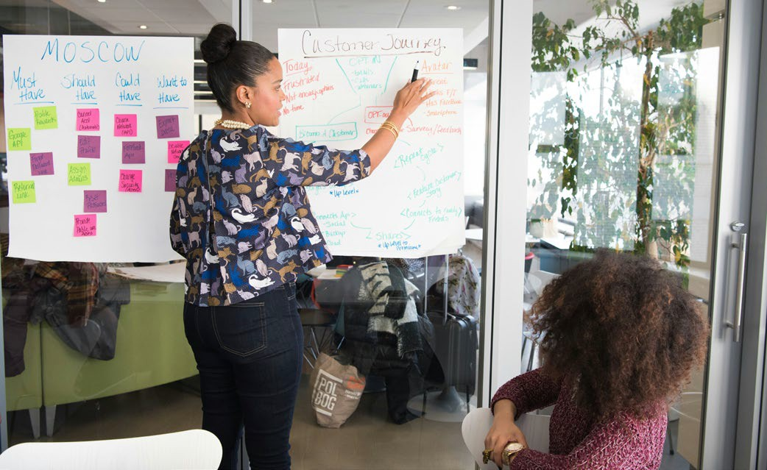
Location & Site Selection
Environmental Limits: Especially relevant in Slovenia due to Natura 2000 and landscape regulations. Note also that tourism accommodations typically require higher safety and amenity standards (such as fire safety, disabled access, and wastewater treatment) than a private home.
Pick a Practical Site that Won’t Cost You the Earth
Note: Even if you plan to lease land, vet it as thoroughly as if you were buying. You will need to conduct a feasibility study and perform the same due diligence, including checking local development plans, zoning, regulations, existing accommodations, guest demand, and planning precedents.
EPIC STAYS | DESIGNING INNOVATIVE TOURISM STAYS
Recommended Reading
Launching Your Glamping Business: Tips And Insights For A Successful Start

Slide 49
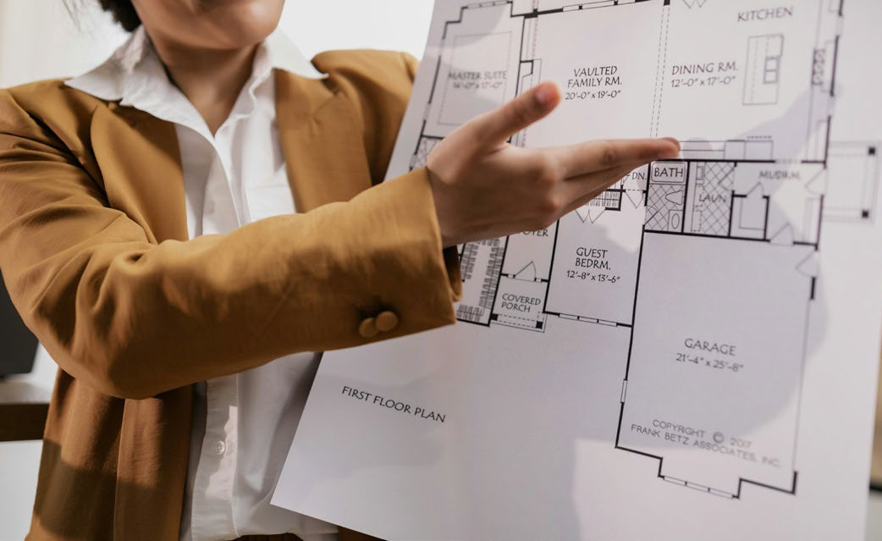



Financial Tips
Financial Tip: Research local zoning laws and planning permission early – some areas may prohibit commercial accommodations or limit structure types. See what factors to consider in the context of a hotel site selection. Choose a site where tourism is legally allowed (verify zoning regulations and local planning permissions), this will avoid disappointments, delays and refusals. Check with your local authority's development plan it will help you determine what is allowed in the area and strengthen your case. Each Planning Authority has a checklist you can download.
Financial Tip: Make sure your business is a low environmental risk i.e., has low impact on the environment and voids ecological damage to protected areas, peatlands, or sensitive biodiversity zones will save you thousands. Check European Environment Agency – Natura 2000 Viewer for protected areas near your site.
Zoning, Planning and Regulations
EPIC STAYS | DESIGNING INNOVATIVE TOURISM STAYS
Recommended Reading
All about Setting up a Glamping Tourism Accommodation

Slide 50


Financial Tips
Financial Tip: Budget for regulatory costs (e.g. application fees, environmental impact assessments) and set aside time for the approval process – incomplete paperwork or delays in permits can stall your project and lead to lost revenue. Engaging a local planning consultant can help navigate requirements and avoid costly missteps.
Financial Tip: Engage in early consultations with local planning authorities – most countries offer a pre-application meeting to flag any issues e.g., site boundaries, fire regulations, water supply, drainage and sanitation. This can save money by uncovering
deal-breakers before you invest heavily. Also, factor in the time (often 6–12 months for approval) and have contingency funds for any unexpected requirements (like extra traffic or environmental studies).
Zoning, Planning and Regulations
EPIC STAYS | DESIGNING INNOVATIVE TOURISM STAYS

Slide 51

05
Plug In Without Burning Funds: Utilities
& Infrastructure
Factor in the real costs and find savings when connecting power, water, waste, and internet — or prepare to budget for off-grid solutions.
Power, water, drainage, broadband — they don’t just appear. If your dream location is off-grid or remote, expect significant up-front costs to connect or create these systems. Off-grid solar and septic systems can cost €10,000–€30,000, depending on the site's complexity. Even on-grid properties may require groundwork, upgrades, or approvals from the provider. Accurately assessing infrastructure feasibility avoids cash flow shocks down the line.
EPIC STAYS | DESIGNING INNOVATIVE TOURISM STAYS

Slide 52
Considerations: Assess how you will provide water, power, waste management, and communications on-site.
Remote or undeveloped locations may lack town and village hookups, meaning you’ll need to drill wells, install septic systems, or generate off-grid power.
These infrastructure investments can be significant, for example:
Untilities & Infrastructure
Accurately assess infrastructure feasibility
Providing basic services – water, waste disposal, and power – is non-negotiable for guest comfort and environmental compliance. Determine how you will supply fresh water (mains connection or well), manage sewage (septic tank, biodigester, or hookup to municipal sewer), and supply electricity (grid connection vs. solar/off-grid systems).
EPIC STAYS | DESIGNING INNOVATIVE TOURISM STAYS

Slide 53
Many European jurisdictions require demonstrated solutions for sewage and graywater when approving a new accommodation.
For example, mains water supply, proper sewage (foul drainage) and electricity were deemed “essential” for a viable glamping enterprise in a Savills Ireland analysis. If the site is off-grid (as is common in parts of Slovenia’s mountains or Iceland’s highlands), plan for renewable energy and composting toilets to meet standards (and possibly obtain special permits).
Untilities & Infrastructure
Accurately assess infrastructure feasibility
EPIC STAYS | DESIGNING INNOVATIVE TOURISM STAYS
Recommended Reading
Fáilte Ireland's Climate Action Programme helps businesses reduce costs, improve efficiency, and meet sustainability goals
New VAT Rules for Small Businesses | EU VAT SME Scheme

Slide 54

Untilities & Infrastructure
Costs: Utility hookup costs depend on proximity to networks. Connecting a rural site to the electrical grid in Ireland, for instance, costs around €1,800–€2,500 for a single-phase supply (higher if a new transformer or poles are needed).
Drilling a well and installing a pump can range
€5,000–€10,000, whereas a mains water tap-in fee might be a few thousand euros.
What it really costs to get connected or stay off-grid!
A septic system or bio-treatment unit typically costs €4,000–€15,000 installed (ensure it meets local regulations). If going off-grid, solar power setups with battery storage can cost
EPIC STAYS | DESIGNING INNOVATIVE TOURISM STAYS
Netherlands VAMIL Program Investment Options for EV Charging Infrastructure. NL government supports
€10,000–€30,000, depending on capacity.
businesses achieving climate action targets.
54

Slide 55



Don’t forget internet connectivity if you promise it to guests (satellite internet in remote areas might run a few hundred to a couple thousand dollars for setup).
These upfront investments are significant: a report notes that combined infrastructure (utilities and access) for a small four-unit glamping site commonly runs €58k–
€116k (savills.ie).
Untilities & Infrastructure
What it really costs to get connected or stay off-grid!
Financial Tip: Include a healthy infrastructure budget in your financial plan. Also, build in a contingency for unexpected costs (e.g., drilling hitting deeper rock or needing a larger generator) to avoid cash flow crunches during construction.
Financial Tip: Wherever possible, use sustainable systems (solar, rainwater harvesting) that may have higher upfront costs but lower operating expenses over time.
EPIC STAYS | DESIGNING INNOVATIVE TOURISM STAYS

Slide 56






Untilities & Infrastructure
Financial Tip: Explore cost-saving options like phased utility upgrades or hybrid systems. For example, start with a smaller solar array and expand as revenue grows, or use on-demand gas water heaters instead of a complete electrical system to reduce the load.
Financial Tip: Investigate local incentive programs – some countries offer grants for renewable energy or rural water services. In the Netherlands (VAMIL program) and Ireland (Climate Action Programme), new tourism businesses can sometimes receive support for installing eco-friendly utilities or may be eligible to reclaim VAT on capital equipment.
Financial Tip: Crucially, never cut corners on waste: invest in proper sewage treatment upfront to avoid fines or environmental damage later.
Financial Tips
EPIC STAYS | DESIGNING INNOVATIVE TOURISM STAYS

Slide 57
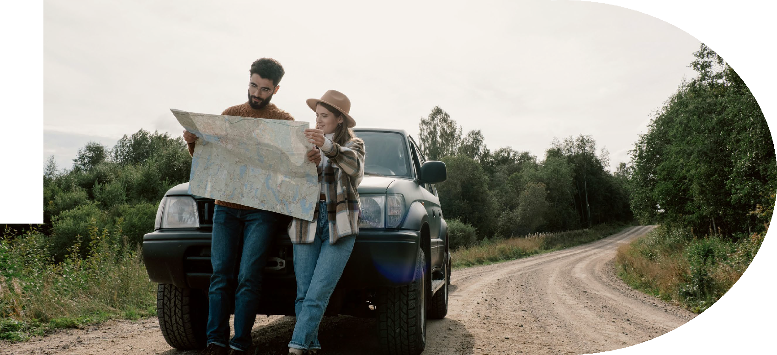
06
Make Sure You Get Them There: Access &
Transport Costs
Ensure your guests (and service vehicles) can reach you safely, affordably, and without detours — or risk losing bookings.
If guests can’t reach you easily, they won’t book. Good access includes safe roads, clear signage, adequate vehicle parking, and sometimes pathway lighting or shuttle services. Poor access = bad reviews and lower occupancy. You may need to level the land, build driveways, or apply for a right-of-way, which can cost from a few hundred euros to €20,000 or more, depending on the terrain and permissions. Ensuring access is a non-negotiable for operational success.
EPIC STAYS | DESIGNING INNOVATIVE TOURISM STAYS

Slide 58
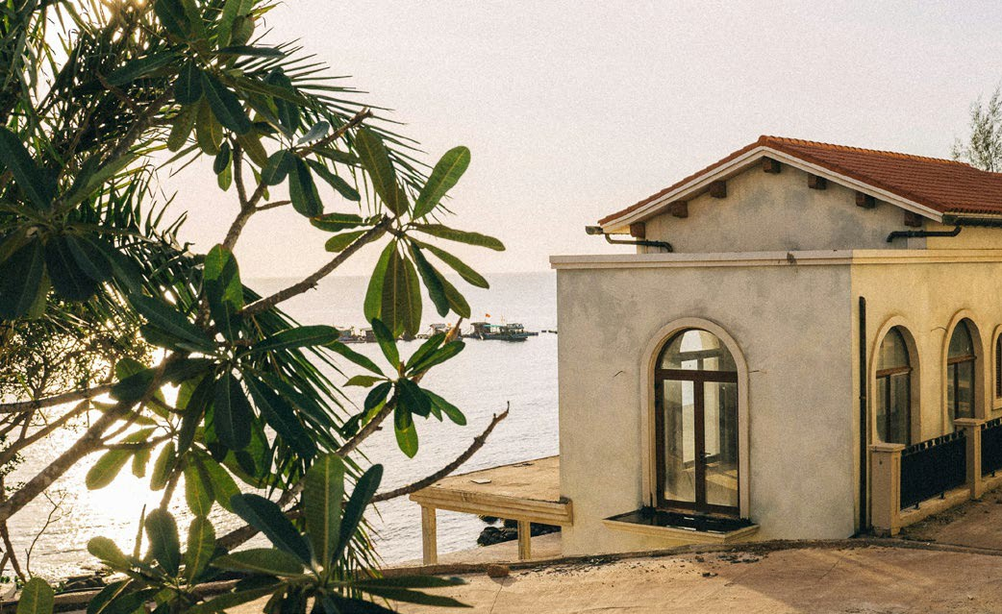
Access, Mobility & Transport
Considerations: Consider how guests (and emergency services) will reach the site. It is also vital for construction and maintenance. Many rural sites in Europe are down narrow lanes or unpaved roads – check if upgrades are needed for year-round access.
Evaluate road access, entryways, and parking. A location with good road access and clear signage enhances guest convenience, whereas a remote site may require building or upgrading private access roads. The site should be easily reachable by car with parking (or even by regular tour buses in popular areas) and have safe entry/exit points.
Ensuring smooth arrival for guests and logistics.
EPIC STAYS | DESIGNING INNOVATIVE TOURISM STAYS
Consider accessibility standards: a welcoming site provides disabled access or at least the ability to navigate with luggage.

Slide 59
Access, Mobility & Transport
In remote Iceland or mountainous Italy, winter access (snow, heavy rain) might be an issue; in the Netherlands, consider proximity to main roads or public transport for guests. Difficult or long access routes not only deter guests but also raise construction costs (bringing materials in).
Costs: Improving a site’s access can range widely.
Laying a basic gravel driveway (100m) might cost €5,000–€15,000 depending on terrain, so factor this into your budget if the site is off the beaten path. Building a small bridge or reinforcing a steep slope could cost tens of thousands.
Ensuring smooth arrival for guests and logistics.
EPIC STAYS | DESIGNING INNOVATIVE TOURISM STAYS

Slide 60
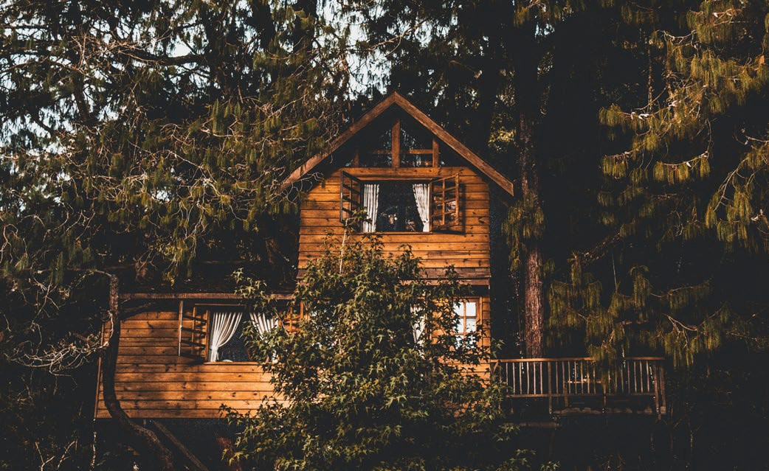
Infrastructure costs for a small glamping site (e.g. roads, paths, utilities) often total €60,000–
€120,000 for a few units, especially “depending on the availability of existing services and access.”
Access, Mobility & Transport
For example, if an existing farm road is present, costs are low; if you must cut a new road or widen a lane (common in Ireland’s countryside), expect higher expenses.
Spend Smart: The True Cost of Access & Infrastructure
Also evaluate proximity to transportation hubs or attractions – being reasonably close to airports, highways, or popular tourist sites can widen your market.
EPIC STAYS | DESIGNING INNOVATIVE TOURISM STAYS
Recommended Reading
How To Set Up A Glamping Business

Slide 61
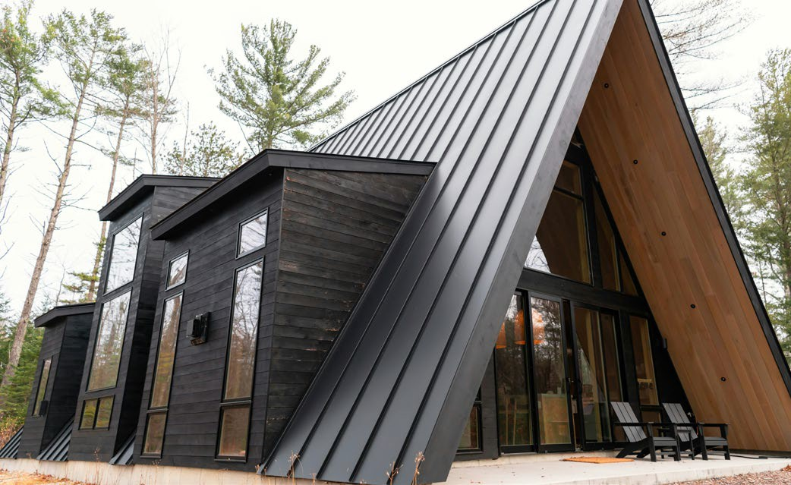

Access, Mobility & Transport
Financial Tip: Leverage existing infrastructure whenever possible. Choosing a plot that already has an access lane, or an existing farm track can save a significant amount of money. If you need new access, consult local authorities about grants or cost-sharing options. Some regions (like rural parts of Ireland or Slovenia) may have development funds to improve tourist infrastructure. Additionally, consider installing signage along main roads (at a modest cost of €200–€500) to help guests easily and safely locate the site.
Financial Tips
Financial Tip: Plan for ongoing maintenance of access routes (snow clearing, grading, signage) and consider transport solutions (like shuttle services) if the site is very remote. Investing in reliable access upfront prevents guest dissatisfaction and costly last-minute fixes later.
EPIC STAYS | DESIGNING INNOVATIVE TOURISM STAYS
Recommended Reading
Glamping Startup Cost 2 - Groundworks, Landscaping and Utilities

Slide 62
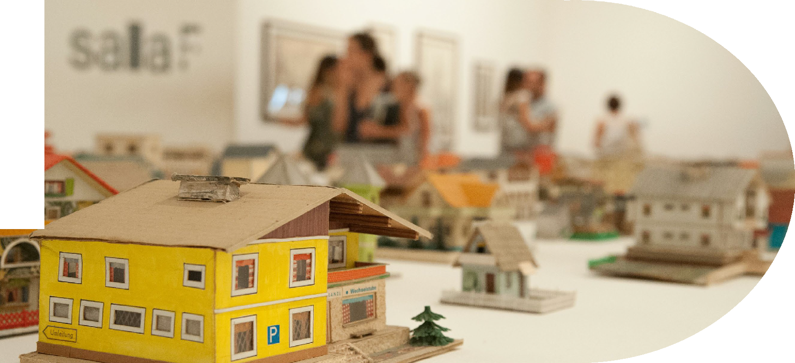
07
Picking the Wrong
Land can be Detrimental: Terrain, Drainage & Buildability
Choose build-ready land to avoid costly surprises, such as drainage issues, structural groundwork, or site regrading — always assess the slope, soil, and surface before you invest.
Topography and ground conditions have a significant impact on your build costs. Steep slopes, poor drainage, unstable soil, or flood risk can turn a dream location into a financial drain. Site surveys, geotechnical reports, or groundworks can cost between €2,000 and €15,000, depending on their complexity. Choose land that needs minimal intervention, or understand how much you’ll need to spend to make it usable before you commit.
EPIC STAYS | DESIGNING INNOVATIVE TOURISM STAYS

Slide 63
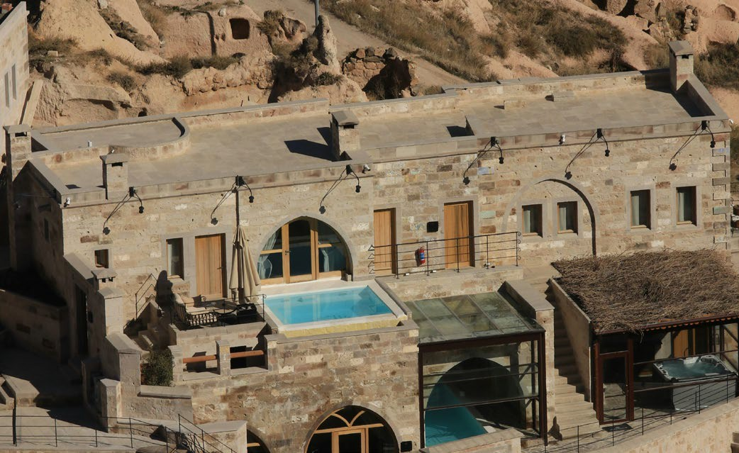
Bad land = extra costs (groundworks, regrading); good land reduces capital outlay.
The land’s natural features and shape will heavily influence development costs and guest safety/experience.
Terrain, Drainage & Buildability
Land Quality: Poor-quality land can lead to extra expenses, such as the need for extensive groundwork and regrading, while good-quality land can minimise capital expenditure.
Land Quality & Ability to Build
Priority 10 (€) Ensure the land is buildable (drainage, soil, access, slope)
Natural Features and Shape: The land's natural features and topography play a crucial role in determining development costs and ensuring guest safety and enjoyment.
EPIC STAYS | DESIGNING INNOVATIVE TOURISM STAYS

Slide 64
Terrain, Drainage & Buildability
Topography Considerations: Factors such as slope steepness, soil stability, drainage, and exposure are vital. For example, a scenic hilltop may offer beautiful views but could also be windy or require terraced platforms, while a riverside meadow might seem ideal until flooding occurs.
Land Quality & Ability to Build
Environmental Safety: In Europe, planners must assess environmental hazards. For instance, Ireland’s guidelines recommend selecting sites that are free from risks such as flooding, falling tree limbs, or loose rocks on cliffs.
Priority 10 (€) Ensure the land is buildable (drainage, soil, access, slope)
EPIC STAYS | DESIGNING INNOVATIVE TOURISM STAYS

Slide 65
Terrain, Drainage & Buildability
Soil Conditions: It's also important to examine soil conditions. Soft, boggy ground, common in areas like Ireland and Slovenia, may require reinforcement, while rocky terrain might require expensive excavation work.
Sun and Wind Exposure: Lastly, consider the effects of sun and wind. In Iceland, a valley sheltered from wind could extend your operating season, whereas in countries like Italy or Slovenia, providing shade or a cool breeze on south-facing slopes can enhance comfort for summer guests.
Land Quality & Ability to Build
Priority 10 (€) Ensure the land is buildable (drainage, soil, access, slope)
EPIC STAYS | DESIGNING INNOVATIVE TOURISM STAYS
Costs: Land preparation can be a hidden budget eater. Simple grading and clearing for a few tent platforms might be €2,000–€5,000, but extensive earthworks (cutting into a slope or building retaining walls) can easily exceed €20,000.

Slide 66

Terrain, Drainage & Buildability
If you need to elevate structures above flood level (e.g. building decks or stilts in a floodplain), each unit’s platform could add €5k–€10k. Don’t forget drainage solutions – ditching or culverts to channel runoff may cost a few thousand euros, but they are vital on sloped sites.
Budget for driveways or pathways suited to the terrain (gravel paths on flat ground are cheap; steps or boardwalks on steep or marshy ground cost more).
Recommended Tools for Assessing Typography, drainage, flood risks
Land Quality & Development Costs
EPIC STAYS | DESIGNING INNOVATIVE TOURISM STAYS
Floodinfo.ie Ireland’s highly detailed flood mapping with interactive data and predictive models — essential for rural or riverside tourism sites.
FloodMap.net assessing elevation and flood risk across Europe. Combine with Google Earth or GIS data for richer terrain analysis.
ILWIS (Integrated Land & Water Information System) an advanced tool especially valuable for complex sites or off grid builds.

Slide 67
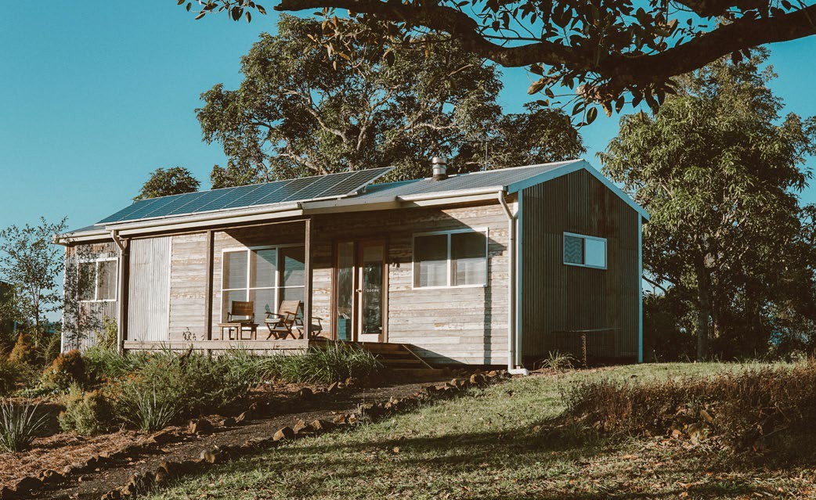
Financial Tip: Match your design to the terrain to minimize heavy engineering.
For instance, use light-weight, semi-permanent units on uneven ground (yurts or pods that sit on adjustable pedestals) instead of trying to level the entire site. This approach not only preserves the natural appeal but also cuts costs.
Financial Tip: It’s wise to conduct a soil and drainage survey (often €500–€1,500) before finalising the site layout – this can pinpoint any problem areas or extra costs early. In many European regions, local contractors have experience with the terrain (e.g. draining peatland or building on alpine slopes), so seek their input to avoid costly mistakes.
Terrain, Drainage & Buildability
Financial Tips
EPIC STAYS | DESIGNING INNOVATIVE TOURISM STAYS

Slide 68
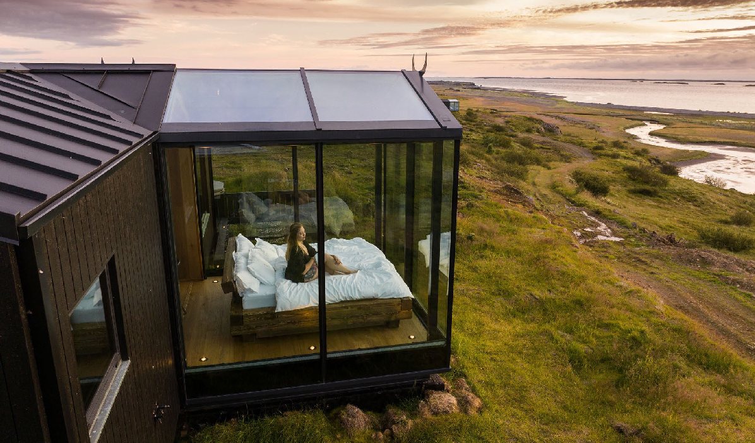
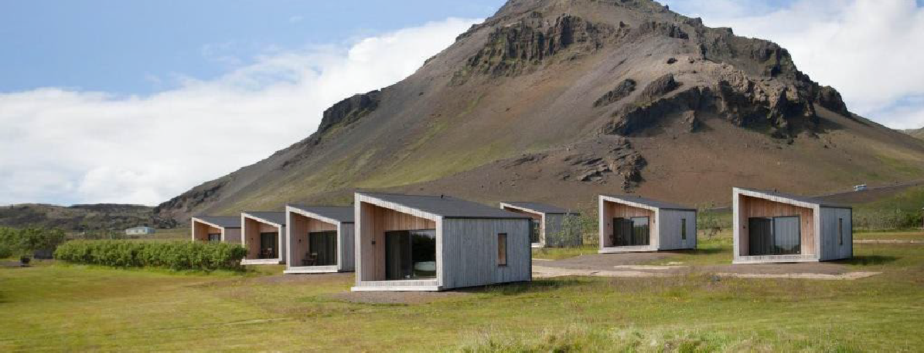
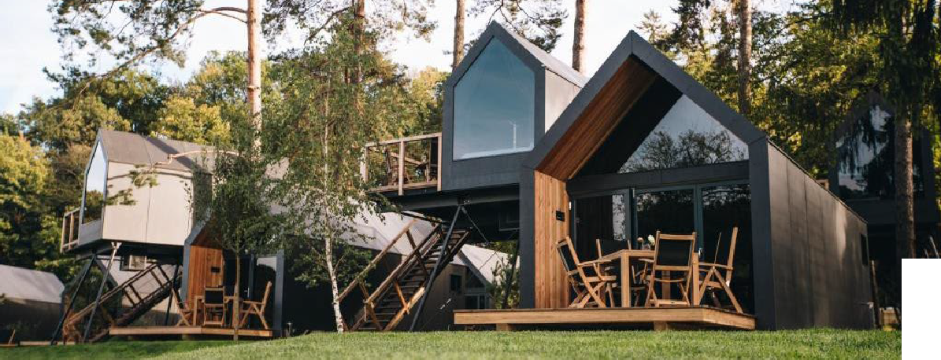
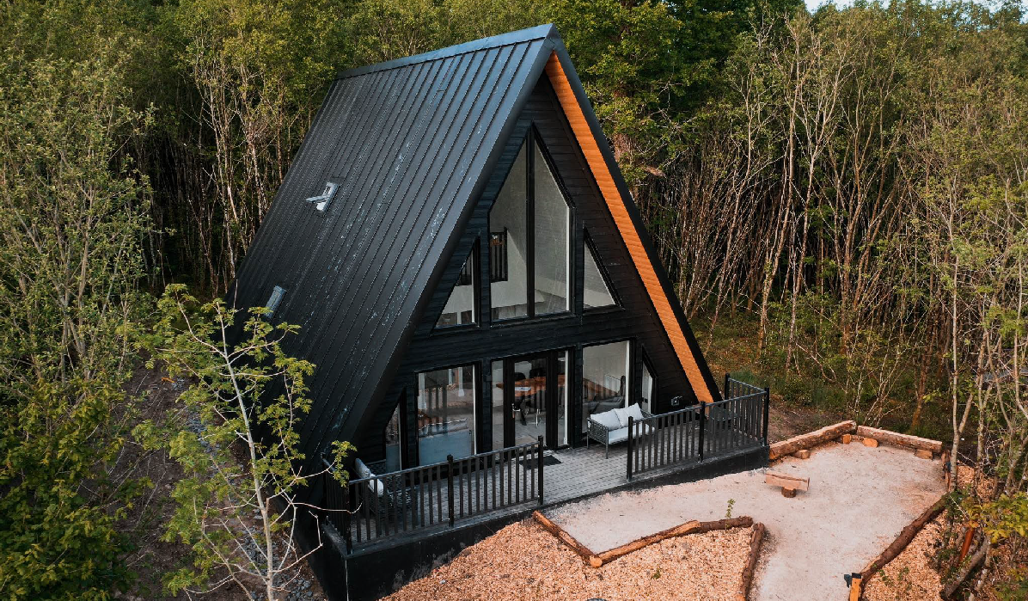
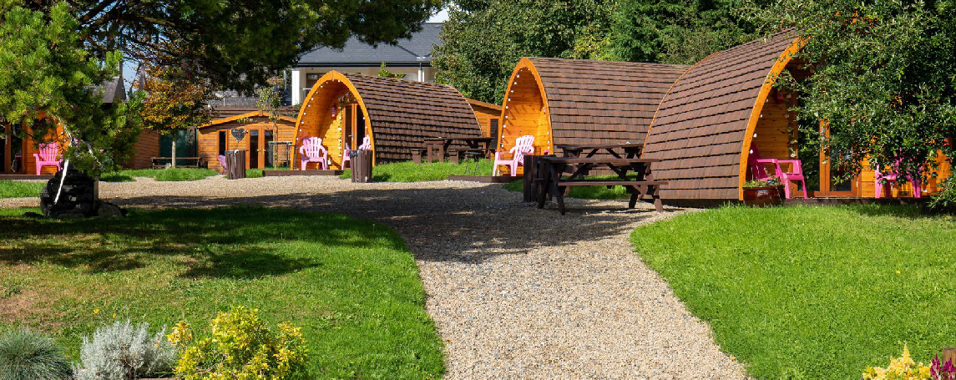
Nature & Environement
Photo Credit: European Examples see Locations on
Epic Stays Website
EPIC STAYS | DESIGNING INNOVATIVE TOURISM STAYS

Slide 69



Well Done
Module 6 (Part 4)
Sustainability, Investing in the WOW Factor & Support Tools
You have Completed… Module 6 (Part 3)
Location, Land & Logistics: Planning for a Profitable Site
Next is…
EPIC STAYS is licensed under CC BY-SA 4.0
Funded by the European Union. Views and opinions expressed are however those of the author(s) only and do not necessarily reflect those of the European Union or the European Education and Culture Executive Agency (EACEA). Neither the European Union nor EACEA can be held responsible for them.

