Slide 1
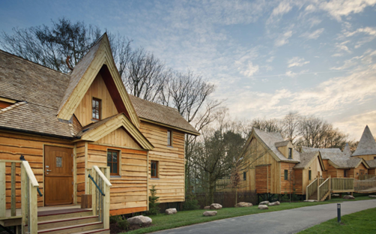
Module 7 (Part 3)
Investment Funding, Grant Applications & Pitching Your Idea
Financial Planning & Funding
www.epicstays.eu

Slide 2
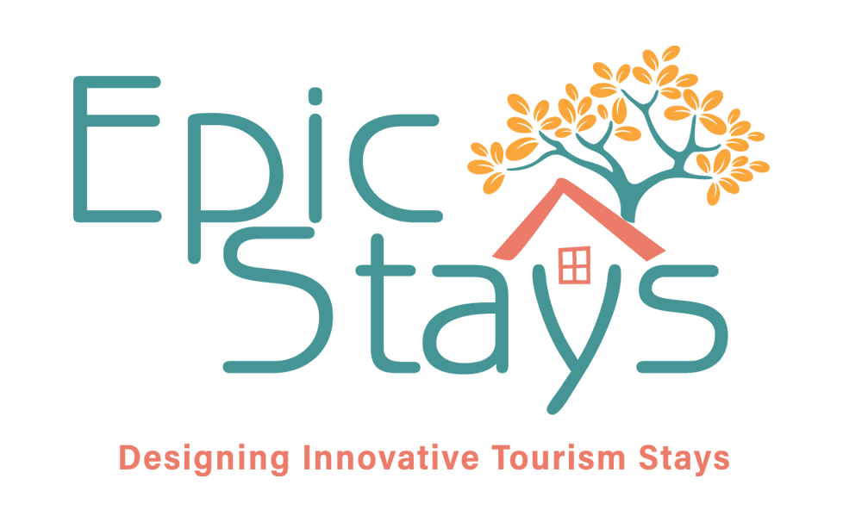
Learning Outcomes
Module 7 (Part 3) Overview
Investment Funding, Grant Applications & Pitching Your Idea
This section equips learners with the skills and confidence to secure funding for their projects by understanding what funders and investors value most. It breaks down the essentials of financial planning, and risk management, while also offering practical tools for completing grant applications and developing persuasive pitches. Learners will review sample answers to common funding questions, explore strategies for aligning proposals with investor expectations, and practice creating strong, story-led business pitches that highlight mission, market potential, and impact. By the end of the module, participants will be prepared to approach funding opportunities with clarity, credibility, and confidence.
Recognise what funders and investors look for, including sustainability, financial planning, execution capability, and risk awareness.
Confidently approach applications – Apply sample responses and phrasing techniques to craft persuasive authentic answers to grant applications.
Create compelling funding applications and business proposals that clearly communicate impact, and viability.
Design and deliver an engaging pitch deck that effectively presents financials, market opportunity, and impact in a clear, story-led format.

Slide 3
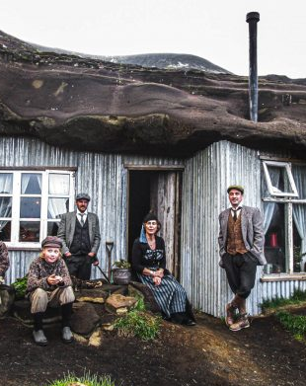
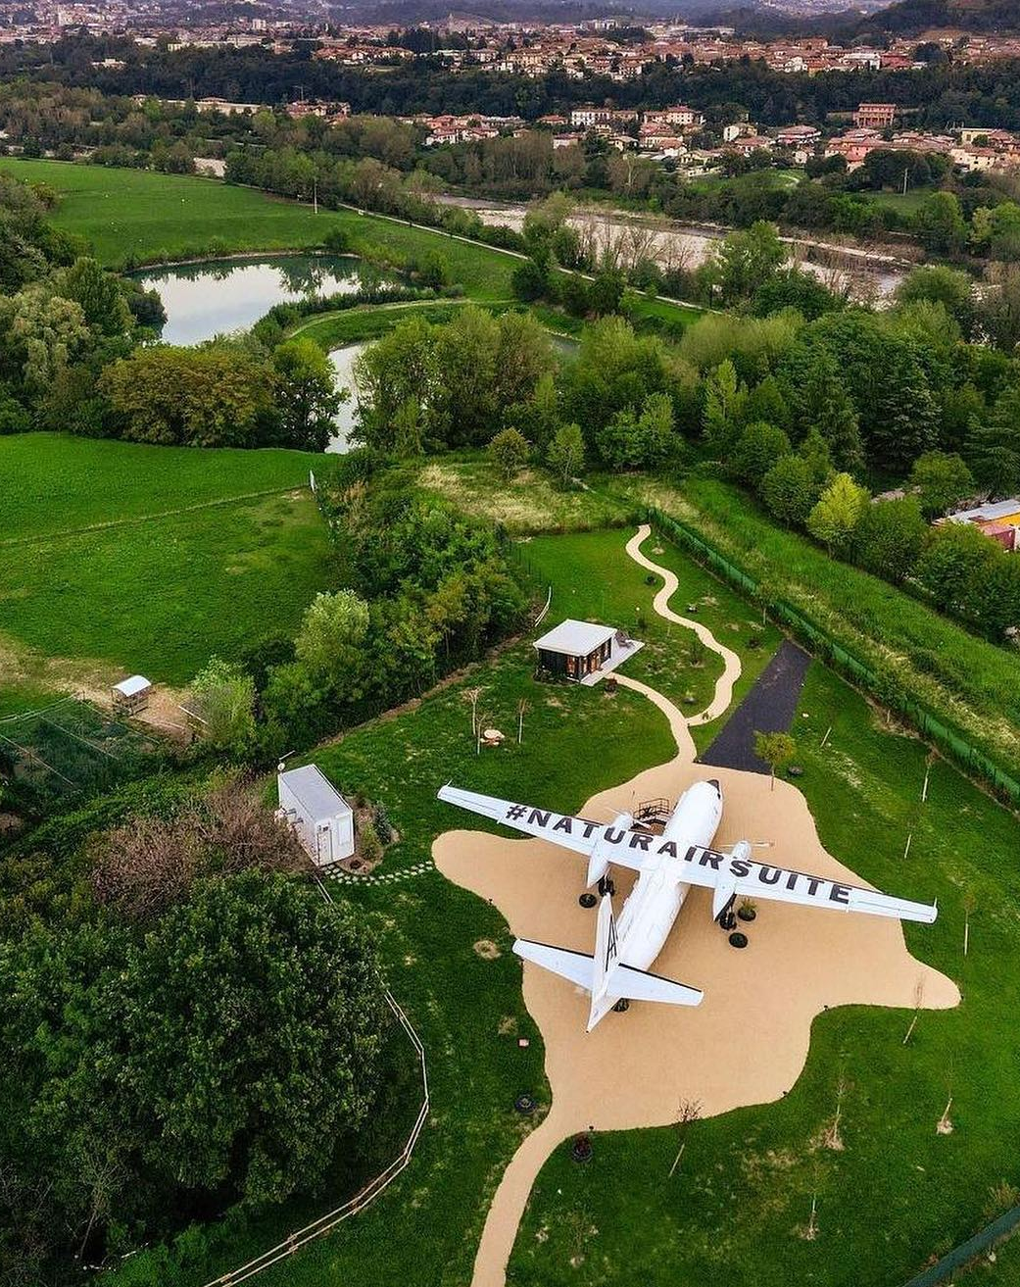
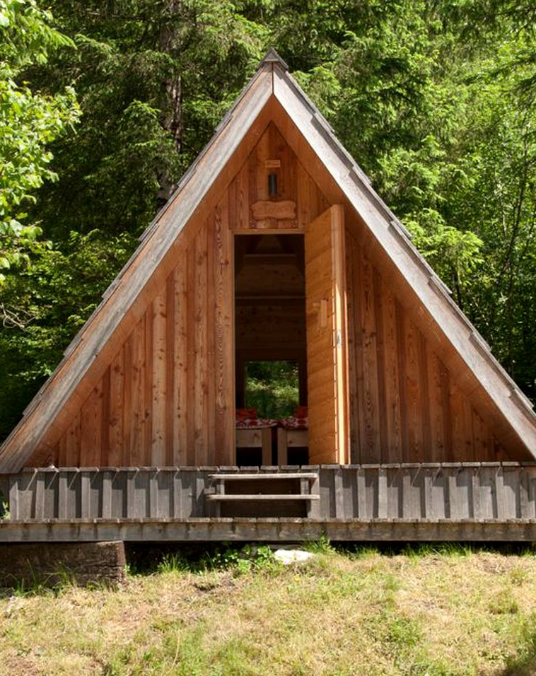
Part 3: Investment Funding, Grant Applications & Pitching Your Idea
Photo Credit: Cave People, Iceland
:
Photo Credit: Natur Air Suite, Italy
09
Section
Grant Applications with Sample Answers
(39 Slides)
Module 7
CONTENTS
08
10
Section
Section
What Funders and Investors Look For
(17 Slides)
Structuring a Basic Pitch Deck & Pitching Your Idea
(19 Slides)
Photo Credit: A-Frame in Soča, Gorizia, Slovenia

Slide 4
Module 7 Overview
Section 3: Investment Funding, Grant Applications & Pitching Your Idea
What Funders and Investors Look For: Before funding your project, grant reviewers and investors want to know it’s viable, impactful, and in line with their goals. This section examines the key factors they consider—such as financial planning, sustainability, execution capability, and risk awareness—so you can craft your proposal with confidence and clarity.
Sample Answers for Grant Application Questions: Grant applications can feel overwhelming, especially when you're unsure what funders want to hear. This section provides sample answers and phrasing ideas for common questions about impact, innovation, viability, and community value, making it easier to craft authentic and persuasive responses.
Pitching Your Business Idea: If you're preparing to pitch to investors, lenders, or grant panels, a clear and engaging pitch deck is essential. This section outlines the key slides to include—from your mission and market opportunity to financials and impact—helping you build a strong, story-led presentation that resonates.

Slide 5

08
What Funders and Investors Look For
Before funding your project, grant reviewers and investors want to ensure it’s viable, impactful, and aligned with their goals. This section examines the key factors they consider—such as financial planning, sustainability, execution capability, and risk awareness—so you can craft your proposal with confidence and clarity.

Slide 6
What Funders and Investors Look For
Understanding the funder’s perspective is crucial.
Funders—whether banks, investors, or public agencies—typically want to know:
What problem are you solving (e.g. lack of eco-accommodation in your area)
How your business will make money (realistic income and expense projections)
How you’ll make an impact (job creation, sustainability, community benefit)
That you're prepared (basic documents, like a business plan, budget, and marketing plan)
The Basics of What They want to Know!

Slide 7
This is covered under the following criteria. Generally, you should cover these bases in your pitch or application:
Viability & Profitability
Does the business seem financially viable?
Viability refers to whether your alternative accommodation business can realistically function and sustain itself over time, both financially and operationally, within its market and location. From a funding perspective, a viable project:
Fills an apparent demand (e.g. glamping, eco-stays, heritage tourism)
Has achievable financial forecasts (break-even, recurring income)
Can cover its running costs (staff, maintenance, utilities)
Meets legal, zoning, and environmental requirements
Operates in a setting with access, safety, and tourist appeal
.
What Funders and Investors Look For
Viability and Profitability

Slide 8
Example of viability: A small off-grid retreat near a national park with strong local partnerships and modest running costs is viable if tourists consistently visit the area and the business can cover expenses without heavy ongoing subsidy.
Profitability refers to a business generating income that exceeds its total costs, thereby creating a financial return on investment. In alternative accommodation, this includes:
A healthy margin after expenses (cleaning, energy, maintenance)
Seasonal pricing strategies to maximise income during peak periods
Diversified revenue streams (e.g. overnight stays, local experiences, farm tours)
Financial resilience (e.g. savings buffer, adaptable to shocks)
Funders often look for signs of profitability within 2–5 years, depending on investment size and grant type. Profitability reassures funders that the business won’t require constant external support.
What Funders and Investors Look For
Viability and Profitability

Slide 9
Profitability Example: A coastal glamping site that charges €150/night during summer and offers low-season yoga retreats may break even in year 2 and show profitability in year 3 if managed efficiently.
What each funding stream wants to see;
Investors want to see profit potential
Loan officers want to see that you can repay
Grant committees want to ensure the project will last beyond the grant.
You address this by solid financial planning and showing market demand. Demonstrate a realistic break-even and that you have a plan to reach occupancy goals:
For example, mention any advance interest you’ve gotten – “1000 people subscribed to our newsletter waiting for opening” or “tour operators expressed interest in partnering”.
What Funders and Investors Look For
Viability and Profitability

Slide 10
Experience & Execution Capability
Funders ask: Can this person/team execute the plan? Even if you’re new to tourism, demonstrating the right mindset, support, or willingness to learn builds confidence. Highlight any relevant background — hospitality, construction, project management.
Need to learn more? Explain how you’re filling the gaps, for example, perhaps you've a mentor or have completed a training course. If you lack hospitality experience, show you’re learning (mention visiting other glamping sites, attending tourism workshops).
Lack direct experience? Show evidence of learning and initiative. Mention actions like attending tourism workshops, shadowing other business owners, or completing a local enterprise course.
Tip: Confidence in execution can be boosted by small pilots – e.g. “Last summer we tested the concept by renting out one cabin on Airbnb, achieving 80% occupancy and great reviews.” This kind of proof helps funders believe in your ability to execute.
What Funders and Investors Look For
Experience and Capability

Slide 11
Innovation or Uniqueness
Funders—especially grant bodies and equity investors—are often drawn to projects that offer something new, original, or impactful. Innovation doesn’t always mean high-tech; it can be in the experience you offer.
Example: the first glamping site in your region, a stay themed around local folklore, a sustainability approach (off-grid, carbon-neutral cabins), or your business model (community-owned, women-led, or creatively combining regenerative farming with tourism).
To stand out, clearly articulate what makes your project different. Even if it’s not groundbreaking on a global scale, it may be entirely new in your region or niche market, which funders see as a strong opportunity for local impact and visibility.
What Funders and Investors Look For
Innovation & Uniqueness

Slide 12
Alignment with Their Goals
Every funding body—whether it’s a grant provider, investor, or bank—has specific goals and priorities.
For Example, an EU rural development grant may favour projects that create jobs, support youth or female entrepreneurship, promote digital innovation, or preserve cultural heritage. To increase your chances, ensure your application reflects these themes wherever applicable.
Investors, too, often focus on niche areas—such as sustainable tourism, impact-driven enterprises, or community-owned businesses. Banks are primarily concerned with risk, so they prefer applicants who can offer collateral, demonstrate repayment capacity, or access loan guarantee schemes.
To stand out, always research the funder’s language, mission, and track record. Read their guidelines carefully, and if possible, speak with past beneficiaries or programme officers to understand what really makes a proposal successful. Make sure to read the guidelines carefully and get expert advice from your local enterprise office to hit the mark.
What Funders and Investors Look For
Alignment with Their Goals

Slide 13
Social and Environmental Impact
Modern funders—and especially grant programmes—place high value on projects that generate clear environmental and social benefits. To strengthen your application, outline how your business will operate sustainably. For Example, this could include using solar energy, greywater recycling, limiting landscape disturbance, or educating guests on environmental awareness.
Also, highlight your social impact: Are you partnering with local producers, supporting community initiatives, or directing tourists toward nearby attractions? (Perhaps you’ll encourage guests to visit local artisans, or you’ll donate a portion to a community project.)? Funders love to see a multiplier effect—where your business stimulates the local economy by sourcing locally, creating jobs, or encouraging longer stays.
For Example, a strong angle for LEADER or community-based grants is more likely to support a project that benefits multiple small businesses in the area, not just your own.
What Funders and Investors Look For
Social and Environmental Impact

Slide 14
Risk Mitigation
Smart funders—whether investors, grant juries, or banks—will look at the risks involved in your project. These may include seasonality, zoning restrictions, weather vulnerability, or market uncertainty. Proactively addressing these risks in your proposal shows that you're realistic and well-prepared.
For example, you might say: “To mitigate seasonality, we’re designing at least one accommodation unit for year-round use,” or “We’ve consulted with the local planning authority and, while permitting is complex, we’ve secured letters of support from neighbouring landowners.”
Banks, in particular, may feel more confident if you mention loan security measures like personal guarantees, insurance, or participation in a guaranteed scheme.
Demonstrating that you've thought through the challenges—and planned ways to reduce or manage them—builds credibility and trust with any funder.
What Funders and Investors Look For
Risk Mitigation

Slide 15

What Funders and Investors Look For
In summary, funders are looking for a well-thought-out project led by dedicated, capable individuals—one that addresses a clear market need, demonstrates strong financial planning, and directly supports the goals of their funding programme.
Your job is to connect those dots: show them why your project matters, how it works, and why you’re the right person to bring it to life.
Final Note
Recommended Reading
Slovenian and European tenders
Non-repayable grants for tourism: all the Invitalia Open Calls for 2025
Dutch tax changes toward sustainability: an overview
Launching the Rural Tourism Fund
LEADER 2024 European funding programme focused on rural development.
Ardara Farm Diversification Project Made Possible With Leader Funding
Starting a glamping business: full guide
LEADER funding for the rich tapestry of Irish rural life
Glamping site on Bere gets funding from Leader

Slide 16

09
Sample Answers for Grant Application Questions
Grant applications can feel overwhelming, especially when you're unsure what funders want to hear. This section provides sample answers and phrasing ideas for common questions about impact, innovation, viability, and community value, making it easier to craft authentic and persuasive responses.

Slide 17
Sample Answers for Grant Application Questions
Grant Application Questions
Grant applications often come in the form of standardised questionnaires with specific questions. Here are some high-level tips to get you started:
Use clear, jargon-free language. Assume the evaluator is not intimately familiar with your area or glamping trends – explain concepts where needed (but briefly).
Be specific and realistic. Avoid overly flowery promises with no backup. If you claim “hundreds of jobs” or “100% occupancy”, it sounds dubious. It’s better to show modest, credible numbers and how you arrived at them.
Use Appendices/Evidence/ Attachments Wisely: Often, you can attach supporting documents – use this for things like sketches of your pods, letters of support from local tourism offices or community leaders, supplier quotes for cost verification, market research snippets and any preliminary booking interest from tour agencies or tourists. In the written answers, you can reference these: “(See letter of support from Mayor in Appendix)”.
Introduction

Slide 18
Match Language to Criteria: If the grant prioritises or funding objectives.
Example, innovation: If it’s an innovation grant, focus on what’s new or pilot about your project. Explicitly mention what is innovative (e.g., “first solar-powered floating cabins in Italy”). If it’s about inclusivity, consider how your site will be accessible and how you’ll engage with the community. Tailor each answer to hit the points they care about.
For example, digitalisation or green transition: an EU grant might have horizontal priorities like digitalisation or green transition – even if your project is small, you could mention using a modern online booking system (digitalisation) or eco-friendly construction (green). For example, rural development focusing on community/jobs—mirroring keywords from the call guidelines.
Grant Application Questions
Introduction

Slide 19

1
Question 1 Sample Answer
“Describe the project and what you are seeking funding for.”
Sample Answer: Mountain Sky Glamping, Slovenia
“We will establish ‘MountainSky Glamping’, a 5-unit luxury camping site on our family farm in northwestern Slovenia. Each unit will be a timber cabin on stilts with panoramic views. The project includes installing utilities, road access, and a small reception/service hut.
Our objective is to create a new tourist accommodation that attracts at least 800 visitors in the first full year, lengthening stays in our region and generating income for our family and community.”
Note: This answer clearly states what, where, how many units, and the goal, all in a few sentences.

Slide 20
2
Question 1 Sample Answer
Sample Answer: GreenGlamp, Iceland
GreenClamp Iceland is a proposed eco-friendly glamping site on a family-owned farm in West Iceland. We plan to install five insulated domes (each with solar panels and geothermal heating) to host guests year-round.
The funding will be used to prepare the site (including road, water, and septic systems), purchase and install the domes, and construct a small service cabin with a kitchen and showers.
Our project will convert currently unused farmland into a sustainable tourism enterprise, filling a gap in the local accommodation market and attracting new visitors to the region.”
“Describe the project and what you are seeking funding for.”
Note: This works because it is concise, states what the project is, what funding will be used for, and ties to broader goals.

Slide 21
Sample Answer: GreenGlamp, Iceland
“The total project cost is €150,000. We are requesting a grant of €75,000 (50%) and will co-fund €75,000. Our co-funding is secured through personal savings (€50,000) and a confirmed credit union loan (€25,000).
Major cost items include: €60k for five dome structures (supplier quote attached), €40k for site works (road, utilities – quote from contractor attached), €20k for facilities cabin and bathhouse construction, €10k for renewable energy systems, and €20k for interior furnishings, permits, marketing and contingency.
A detailed breakdown is in the business plan. We have also set aside additional personal funds to cover the first 6 months of operating expenses, ensuring the project’s viability post-construction.”
“Describe the project and what you are seeking funding for.”
Note: This next part shows you have thought through costs and funding. It’s specific and shows commitment and risk-sharing by securing other financing.

Slide 22
1
Question 2 Sample Answer
“Why is this project needed? Provide evidence of demand or need.”
Sample Answer: Mountain Sky Glamping, Slovenia
“Currently, our municipality has only two small guesthouses and no high-end nature accommodations. However, tourism data shows an upswing in demand for eco-friendly stays.
By developing MountainSky Glamping, we address this gap – providing an option that currently does not exist, thereby keeping visitors (especially higher-spending ones) in the area who might otherwise stay elsewhere or do day trips only.”
Note: If asked about the rationale or need for the project, identify a gap and how your project fills it. This kind of answer demonstrates that you understand the local context and needs.

Slide 23
“Tourism in our region has grown 25% in the last three years (source: Regional Tourism Board), but there is a shortage of innovative accommodation – visitors currently must stay in hotels 50 km away or forego overnight trips.
Our own survey of 50 tourists at the National Park indicated over 60% would be interested in an on-site glamping option.
Additionally, the local development strategy identified eco-tourism as a priority, and our project directly addresses that by creating a new sustainable stay option. Importantly, it will repurpose our unused land and buildings, giving them new life and preventing potential decay of heritage structures.”
“Describe the project and what you are seeking funding for.”
Note: Here they extend their answer by citing data and local strategy alignment, showing the project is grounded in documented needs.

Slide 24
1
Question 3 (A) Sample Answer
“What are the expected outcomes and benefits of the project?”
“The project will generate several key benefits:
Economic: creating two full-time and two part-time jobs, and bringing an estimated 1,200 additional visitor-nights to the area in the first year, benefiting local attractions and restaurants.
Environmental: The site will run on 100% renewable energy (solar and geothermal), serving as a model for low-impact tourism, and we will actively restore 1 hectare of surrounding land with native plants.
. Community: We will collaborate with local tour guides and craft producers to offer our guests authentic experiences (e.g., horse riding, craft workshops), thereby supporting other small businesses. By year 3, we aim to host environmental workshops for local schools and tourists, educating ~200 people annually about sustainable living.”
Note: This answer quantifies benefits and aligns them with grant objectives like economic development, sustainability, and community involvement.

Slide 25
2
Question 3 (B) Sample Answer
or can look like “ Highlight and explain the expected project impacts”
“The project will directly create two full-time equivalent jobs (1 family member and two part-time seasonal employees). We estimate an additional €100,000 in annual tourist spending in the area, as guests will utilise local restaurants, shops, and activity providers (based on 800 guests/year with an average daily spend of €50 outside the accommodation).
By revitalising an unused portion of our farm for tourism, the project helps diversify the rural economy and keeps our younger generation employed locally. Furthermore, we will partner with the village cooperative to offer local food baskets to guests, thus supporting local farmers.”
Note: For impact questions, use specifics and tie to grant goals. This answer quantifies jobs and spending and hits keywords like diversify rural economy, youth retention, community partnership – all things funders love to hear. Source Glamping site on Bere gets funding from Leader

Slide 26
1
Question 4 (A) Sample Answer
“Outline the project feasibility, budget and financing.”
“Outline the project feasibility, budget and financing.”Also phrased as
“How will you ensure the project’s long-term sustainability (financial or otherwise)?”
“Our financial projections show profitability from year 2 onwards. Even in a low scenario (30% occupancy), we can cover operating costs. We have a commitment from a domestic tour operator to include our glamping in their packages, which will aid initial market penetration.
Additionally, we will reinvest part of the earnings each year to maintain and upgrade facilities, ensuring long-term viability. The family’s continued farm income will also support the project in case of any initial shortfall, guaranteeing that the glamping site will be maintained and operational for the long run.”
Note: Grants often fear projects that fizzle out. They may ask how you will sustain the project beyond the grant. This is a strong response. This shows the grantors that you won’t depend on them forever and have thought through long-term running.

Slide 27
2
Question 4 (A) Sample Answer
“Outline the project feasibility, budget and financing.”
“Outline the project feasibility, budget and financing.”Also phrased as
“How will you ensure the project’s long-term sustainability (financial or otherwise)?”
“Financially, our projections (attached) show the glamping site will become self-sustaining by year 2 with an expected occupancy of 50% and annual revenue of €110k, yielding a net profit of €30k.
We have a conservative scenario planning for 30% occupancy (break-even) in case of slower uptake. We will continually reinvest a portion of the profits into maintenance and marketing to maintain quality and sustain demand.
Environmentally, we'll operate with a minimal footprint to keep operating costs low – for example, our solar panels are expected to cover 70% of our electricity needs, and we’ll implement water-saving systems to reduce utility expenses.

Slide 28
“Describe the project and what you are seeking funding for.”
We are establishing partnerships with tour operators to drive bookings during the shoulder seasons, helping to stabilise cash flow year-round. With these measures, we’re confident the project will thrive long after the grant-funded phase.”
Note: Grantors want to fund something that lasts; this answer addresses financial resilience, environmental sustainability (which also ties to cost saving), and market strategy for longevity.

Slide 29
In essence, tell stories with facts. Funders and grant evaluators read dozens—sometimes hundreds—of applications. To stand out, yours should tell a compelling, human story: a needed project, led by passionate people, grounded in realistic planning and backed by solid data.
Remember, where an investor pitch emphasises profit, a grant pitch must also demonstrate public value, such as community benefit, environmental impact, or cultural preservation. By providing concrete details and facts with authenticity and aligning your proposal with the funder’s goals, you’ll significantly increase your chances of success.
Passion + professionalism: Let your enthusiasm shine (this is your dream!) but present it in a well-structured, factual manner. The people reading should feel your commitment and trust your competence.
06
Tell a compelling story backed up with facts

Slide 30
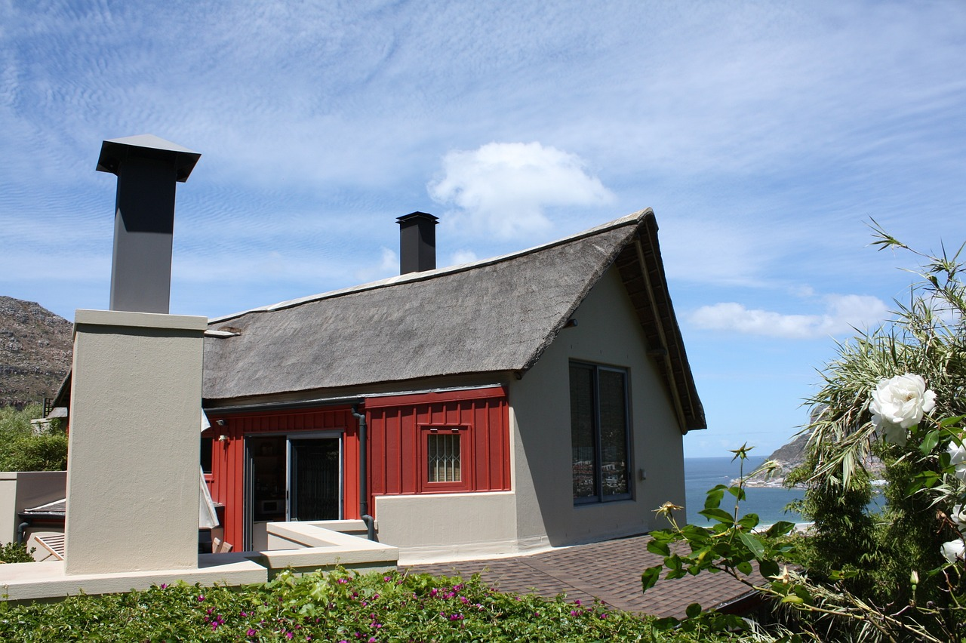
Best Practice Tips for Financial Management
Finally, once you’ve gotten funding and launched, sound financial practices will keep your venture healthy.
Running a small hospitality business means wearing many hats – one of which is financial manager.
By staying organized, informed, and being willing to adjust, you’ll navigate the financial ups and downs adeptly.
As Joanne of Little Oakhurst glamping reflects, she had to teach herself bookkeeping and budgeting, but doing it saved her thousands and was key to her success. With practice, you will gain confidence in managing the numbers and actually see the story they tell about your business. Some best practices for managing your glamping business finances

Slide 31
Best Practice Tips for Financial Management
Separate Business Finances: Register a business entity and keep a separate bank account. It’s easier to track performance and is required by many grant/loan conditions. Pay yourself a salary or draw, but keep your personal and business expenses separate.
Bookkeeping & Monitoring: Set up a simple bookkeeping system from day one (even if just a spreadsheet or using software like QuickBooks). Track all income and expense categories. This will help you analyse profitability on a per-unit or per-season basis. Regularly (at least monthly) review your cash flow and P&L (Profit & Loss statement). If you’re not financially savvy, consider hiring a part-time bookkeeper or using an accountant to review quarterly.

Slide 32
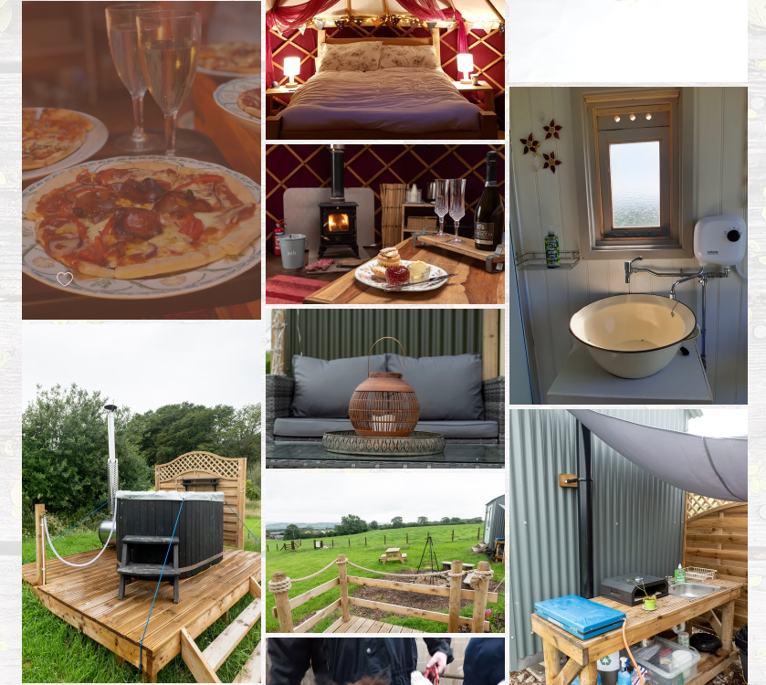

Slide 33
Budget Updates: Treat your initial budget as a living document. Update it with actual figures and re-forecast for the next 12 months on a rolling basis. If you overspent in one area, where can you cut, or how can you drive more sales to compensate? Be proactive – don’t wait until the bank account is low to react.
Yield Management: Just as hotels do, adjust your pricing to maximise revenue. For high-demand periods, ensure you’re charging premium rates (don’t sell out too cheap, too early). In the low season, consider specials or packages to at least cover fixed costs. Monitor your booking patterns – if you’re fully booked every weekend but empty midweek, consider introducing a '3rd night free' promotion for midweek. Smart pricing can significantly boost your annual revenue and smooth cash flow.
Monitor KPIs: Key Performance Indicators for your business might include Occupancy Rate, Average Daily Rate (ADR), Revenue per Available Night (RevPAR), and operating expense ratio. Track these yearly and seasonally. If occupancy is lower than expected, determine whether it’s a marketing issue, a pricing issue, or something else. If expenses are higher, identify the specific category (e.g., utilities, cleaning) and investigate why (perhaps a solar installation could reduce that, or a more efficient cleaning routine could be implemented).

Slide 34
Cost Control: In a small accommodation business, little savings add up. Install energy-efficient lighting and heating systems to reduce utility costs. Negotiate with suppliers (buy in bulk for toiletries, or partner with other B&Bs to get volume discounts). Perform preventive maintenance – a small fix now can avoid a huge repair later. During very low periods, can you shut some facilities to reduce costs (e.g. winterise and close 2 out of 5 units if demand is near zero)? Keep a close eye on variable costs per guest and try to optimise them (without sacrificing the quality of the guest experience).
Manage Debt Wisely: If you took loans, plan those repayments into your cash flow. Where possible, use extra cash to pre-pay high-interest debt, but balance this against keeping a reserve. Avoid the temptation to continuously refinance or take on new loans for expansions until you have proven steady cash flow. Growth is excellent, but over-leveraging too fast is a common pitfall.

Slide 35
Insurance: This is a protective financial measure – ensure you have appropriate insurance (property, liability, and business interruption). One accident or incident could otherwise bankrupt your project. Shop around for policies specialised for holiday accommodations.
Reinvest in Marketing: Set aside a marketing budget continually, especially in the early years. Once you’re open, financial planning isn’t only about cutting costs but also about driving revenue. A portion of your income should be reinvested in online advertising, website improvements, guest loyalty programs, or listing on new platforms. These are investments in maintaining and increasing your cash inflow.
“At this point in my business now, I’m looking back and am proud of the fact that at 53, I’ve had to teach myself how to build a website, set up social media platforms, run house-keeping, manage accounts, bookkeeping, take on the roles as maintenance, grounds keeper and baker – none of which I had ever done in my life, it’s all self-taught and doing it myself has saved me thousands.”

Slide 36

10
Pitching Your Idea & Structuring a Basic Pitch Deck
If you're preparing to pitch to investors, lenders, or grant panels, a clear and engaging pitch deck is essential. This section outlines the key slides to include—from your mission and market opportunity to financials and impact—helping you build a strong, story-led presentation that resonates with your audience.

Slide 37
Pitching and Grant Application Guidance
Securing funding often comes down to how well you can pitch your idea and demonstrate its viability and impact. Whether you’re pitching to an investor, bank, or grant committee, the fundamentals are similar. This section will cover how to structure a basic pitch deck, what funders and grant evaluators typically look for, and examples of strong answers to common questions.
Structuring a Basic Pitch Deck (Covering 10 Key Aspects)
When presenting your business (either in a written application or a slideshow for a meeting), a clear structure helps convey your vision succinctly. A classic pitch deck for a new venture contains about 10 slides covering key aspects:

Slide 38


Structuring a Basic Pitch Deck (Covering 10 Key Aspects)
Slide 1
Title Slide
Name of your project and a tagline.
For example, “Northern Lights Glamping – Luxury Eco-Pods in West Iceland.” Include your name and contact info.
Slide 2
Problem & Opportunity:
What gap in the market have you identified? Describe the problem.
Example: “Tourists driving the Ring of Kerry struggle to find unique, upscale lodging – many end up in generic hotels far from nature.” The idea is to show a need or demand for your concept.

Slide 39

Structuring a Basic Pitch Deck (Covering 10 Key Aspects)
Slide 3
Solution (Your Concept)
Introduce your accommodation concept as the solution. Use visuals – a sketch or reference image of a glamping pod or treehouse – to make it real. Explain how your solution is unique.
Example: “Our solution is a small cluster of luxury treehouses on our farm, offering immersion in nature with hotel-like comfort. This provides travelers a one-of-a-kind experience, currently unavailable in our region.”

Slide 40

Structuring a Basic Pitch Deck (Covering 10 Key Aspects)
Slide 4
Market and Market Fit
Who are your target customers and how big is the market? Provide some data:
Example: “Glamping is a growing trend – EU market grew 15% last year’ Touch Stay 2024. In our area, there are 100,000 visitors annually and surveys show increasing demand for eco-friendly stays.”
If you have a specific niche (families, couples, eco-travelers), mention that. Show that you understand the tourism market dynamics in your country (seasonality, source markets, etc.).

Slide 41

Structuring a Basic Pitch Deck (Covering 10 Key Aspects)
Slide 5
Competitive Landscape
Acknowledge what alternatives tourists currently have and why you’ll stand out. This could be a simple table comparing your offering to others (local B&Bs, campsites, hotels). Emphasise your USP (Unique Selling Proposition)
For example, maybe it’s the only floating cabins in the country, or the first themed treehouse resort, or simply the most authentic farm stay with a luxury twist. Funders want to know you have an edge.

Slide 42

Structuring a Basic Pitch Deck (Covering 10 Key Aspects)
Slide 6
Revenue Model & Pricing
Explain how you will make money. Show the expected pricing, for example, an average of €120/night, along with occupancy assumptions. Include a simple projection:
“At €120/night and 50% yearly occupancy for five units, we expect €130,000 annual revenue.”
Mention any other income streams if relevant (tours, meals, equipment rental, etc.). This slide reassures investors that the numbers can work. For a grant application, you may instead provide a budget table and a narrative explaining how the grant money will be used to generate economic activity.

Slide 43

Structuring a Basic Pitch Deck (Covering 10 Key Aspects)
Slide 7
Financials
For investors or loans, include a slide with key financial projections (3-5 year outlook), including revenue, expenses, profit, and break-even point. Highlight if/when the business becomes profitable. Also, state how much funding you seek, what form (equity, loan, or grant), and how it will be used.
For example, “Seeking €200k total: €100k for construction, €50k for pods, €50k for working capital”. For grant pitches, focus on project cost and the grant amount requested, with confirmation of your co-funding and that the project is viable long-term (grants committees want to know their money creates something sustainable, not a failed project).

Slide 44
Structuring a Basic Pitch Deck (Covering 10 Key Aspects)
Slide 8
Team
Introduce who is behind the project. In many rural startups, it might just be you and your family – that’s fine. Highlight relevant skills or experience:
For example, “I have 10 years’ experience managing our farm and guesthouse” or “My partner is a carpenter (will help build cabins) and I have marketing experience.”
If you have support from an advisor or partner (like a local tourism expert or an architect), mention them. Funders invest in people, so show you have the passion and capability to execute this plan.

Slide 45

Structuring a Basic Pitch Deck (Covering 10 Key Aspects)
Slide 9
Milestones & Action Plan
Outline what you’ve achieved so far (business plan done, land secured, planning permission submitted, etc.) and the timeline ahead.
For example, “Q1: finalise permits, Q2: begin construction, Q3: launch and start welcoming guests.”
This shows you have a concrete roadmap. For grants, detail the project implementation plan and key milestones the grant will enable.
For example, “grant by March, build by July, open by August”.

Slide 46

Structuring a Basic Pitch Deck (Covering 10 Key Aspects)
Slide 10
Impact and Vision
Especially important for grants or community-focused investors. Describe the broader impact: jobs created (even if just 1-2 to start), preserving an old barn by repurposing it, attracting tourists to a lesser-known area, supporting local suppliers (maybe you’ll source breakfast from local farms). Align this with funder priorities.
For example, LEADER loves community impact – mention if you’ll collaborate with local activity providers or if your business keeps the younger generation on the family land. Also, share the long-term vision:
“In five years, we aim to be a flagship eco-tourism site that inspires others, with potential to add spa facilities or more units, boosting the region’s profile.” End on a positive, inspiring note.

Slide 47

Keep the pitch visuals clean and images rich (a picture of a glamping dome in a beautiful setting can instantly convey the concept).
If doing a written pitch (like a grant application form), you’ll use a similar structure in text form: an executive summary, description of project, market analysis, etc., which is essentially the content of the slides in paragraphs.

Slide 48
Conclusion & Next Steps
Embarking on an alternative tourism accommodation venture is an exciting journey. With the information in this module, you should be equipped to plan your finances smartly, find the right mix of funding, and make a compelling case to backers for your unique rural retreat. Remember:
Start with a strong plan – it’s the foundation for convincing others (and yourself) that the business will work.
Be resourceful and proactive in seeking funds – cast a wide net (from EU grants to local banks to crowdfunding) and don’t get discouraged by a “no” or a tedious application; persistence pays off.
Stay prudent but positive in financial management – keep costs in check, but also invest in quality and guest experience, which ultimately drive your revenue.
Leverage your network – talk to other entrepreneurs, use local supports, and maybe even team up with others for joint funding opportunities.
As a new entrepreneur in the glamping/eco-lodge world, you are not alone – there are communities and resources out there to help you thrive. Below is a list of reference links from this module (reports, websites, tools) – use them to dive deeper into topics as needed. Good luck turning your alternative accommodation dream into a sustainable reality!

Slide 49
Resources and Supports
Access tools, templates, and funding guides to plan and finance your alternative accommodation.
Find trusted platforms for managing bookings, calculating guest costs, and tracking revenue.
Get support from other groups, articles, and experts in the field. Use videos, tools and guides to help you grow your business, skills and confidence.

Slide 50

Resources & Supports
If you’re meeting investors or want to summarise your plan visually, use a pitch deck. You can find free pitch deck templates on tools like Canva or PowerPoint. Please focus on the 10-slide structure we outlined (Problem, Solution, etc.). For a reference, consider looking up Guy Kawasaki’s 10-slide pitch template, which is popular among startups.
Guy Kawasaki's 10/20/30 rule for presentations advocates for concise and impactful delivery. It suggests that a presentation should have no more than 10 slides, last no longer than 20 minutes, and use a font size of at least 30 points. You can create a powerful pitch that captures attention, conveys your message effectively, and increases your chances of success.
While you don’t want to copy, it helps to see how others visually present occupancy projections or market stats. Practice presenting it in 5-10 minutes – even if you’re not pitching live, it will help you communicate clearly in interviews and networking situations.
Pitch Deck Outline & Sample Slides

Slide 51
Resources & Supports
TouchStay’s Glamping Business Plan Guide, available at touchstay.com, includes a checklist and example sections that can serve as inspiration.
Winning Glamping Business Plan Template
Free glamping business plan template
Beyond the checklist: craft a compelling narrative
Or check out these other free glamping business plan templates from industry leaders: Glampitect, Inspired Camping, Growthink
If you prefer a guided web tool, platforms like Upmetrics or LivePlan have business plan builders (not free, but sometimes worth it for polish). Remember, a solid business plan document is not just for you – it’s often required by grant applications and beneficial to share with banks/investors.
TouchStay’s Resources & Templates

Slide 52
Resources & Supports
You can also use the free Glamping Financial Plan Template offered by MyGlampingPlan (a paid toolkit site) or adapt a SCORE startup budget template. These templates typically include categories for one-time startup costs and ongoing expenses, which you can customise to suit your project. Fill in the costs we discussed (land, units, permits, etc.) to get your total funding need.
Glamping Financial Plan Template
A full business plan template will include market analysis and strategy in addition to financials. Lodgify offers a free glamping business plan template (downloadable after sign-up) lodgify.com, which is tailored to accommodations. It comes with sections that you can fill out step by step, including a financial model.
Business Plan & Financial Model Templates

Slide 53
Resources & Supports
Glamping Worldwide: How it has moved from a trend to a significant industry and business model
Why this year is the perfect time to start a glamping business
The 6 signs you’re heading towards glamping business success… or not!
How farmers and landowners are using glamping to successfully manage income fluctuations
How to get more bookings for your unique rental accommodation
New and very exciting pod homes and portable shelter designs that are starting to show up in the world of glamping
Unique Holiday Rentals And Glamping Business Success In 2022
Launch a Profitable Glamping Business with No Land, Buildings, or Experience!

Slide 54
Resources & Supports
How to get planning permission for your glamping site, or even if you need planning permission at all? This is especially helpful to understand if you need planning for your yurts, wooden pods, safari tents, treehouses, bell tents, shepherd huts, cabins, and wagons, or whatever business model you intend to develop – read the article and listen to the podcast here – which also gives more information about the 28-day camping rule and campsite license
Facebook Group WELCOME to one of the largest business communities for glamping businesses and unique holiday rental hosts, with Sarah Riley, an industry specialist adviser and Podcast host.

Slide 55
Well Done
Module 8 (Part 1)
Laying the Financial Foundations for a Viable Accommodation Business
You have Completed… Module 7 (Part 3)
Investment, Grant Applications & Pitching Your Idea
Next is…

