Slide 1

Module 7 (Part 2)
Find the Funds That Fit – Funding & Finance Options
Ireland
www.epicstays.eu

Slide 2
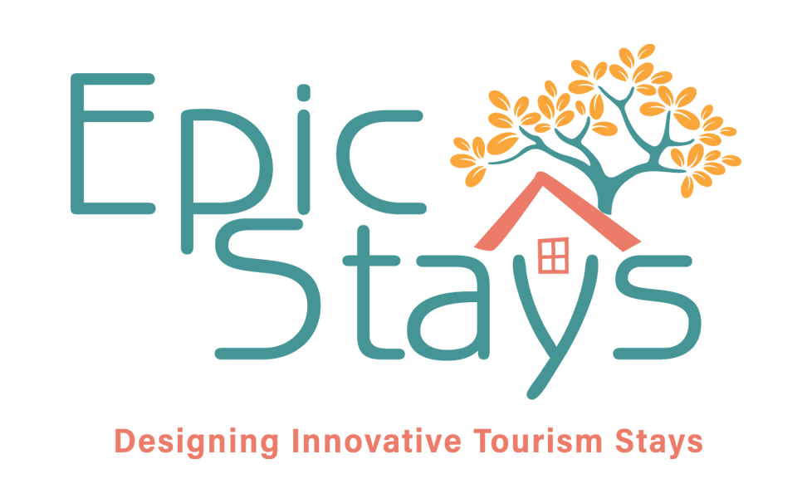
Module 7 (Part 2) Overview
Learning Outcomes
Country-Specific Funding Opportunities
Find the Funds That Fit – Funding & Finance Options. Part 2 of module explores tailored funding opportunities for alternative tourism accommodation across Ireland, Slovenia, Iceland, Italy, and the Netherlands. This section focuses on Ireland. Learn how to identify, compare, and assess funding streams that best fit your business model and goals. The focus is on aligning with key priorities such as regeneration, low-carbon growth, and community value. By the end, you’ll be able to evaluate eligibility, navigate national and EU schemes, and choose the right funding pathways for sustainable tourism success.
Explore Ireland’s mix of national, EU, and community funding, combined with professional support, creates real opportunities for sustainable, small-scale tourism accommodation.
Recognise the role of professional support in accessing and managing these funding opportunities.
Assess how small-scale tourism projects—such as cabins or glamping pods—can successfully start and scale using available funding.
Understand proven pathways for building sustainable, small-scale accommodation businesses in Ireland

Slide 3
03
Ireland’s Funding Options
For Alternative Tourism Accommodation
Ireland’s mix of national, EU, and community funding, combined with professional support, creates real opportunities for sustainable, small-scale tourism accommodation. Starting with a single cabin or glamping pod and scaling smartly is a proven path to success.

Slide 4
Introduction: Ireland’s Funding Priorities
Rural development, community benefit, energy efficiency, diversification, green sustainability, and immersive experience-driven tourism.
Ireland’s funding approach prioritises rural development, energy efficiency, and experience-driven tourism. Through programmes such as LEADER, Local Enterprise Offices, Fáilte Ireland investment schemes, and SEAI energy grants, the government aims to stimulate local job creation, support heritage and culture, and move towards climate targets in the tourism sector.
For alternative accommodation providers, aligning with these goals is key. Projects should demonstrate how they will contribute to rural vitality, whether by creating jobs, repurposing heritage buildings, or enhancing the local experience economy.
Sites that offer immersive cultural, nature-based, or wellness tourism are particularly well-supported. If your proposal includes green sustainability, such as renewable energy upgrades, building insulation, or biodiversity preservation, you’ll also be eligible for SEAI grants. To succeed in Ireland, applicants should prepare a strong business plan, connect with their Local Action Group early, and clearly show how their accommodation offering supports community benefit and environmental sustainability.

Slide 5




1
Local Enterprise Office (LEO) Grants
Objective: Local Enterprise Office (LEO) Grants: LEO in your county is the first stop to help support local small businesses and start-ups. They provide funding and mentoring support.
They offer Feasibility Study Grants to help early-stage alternative tourism providers (e.g. glamping sites, farm stays) with idea validation, feasibility research, and start-up capital. This funding can cover up to 50% of costs (maximum €15,000) for market research, prototypes, and other related expenses. Priming Grants for startups, often up to €30,000 for capital or employment costs, usually requiring matching funds.
Tip:
Always discuss with your LEO advisor – even if you don’t get a grant, LEO can provide training (e.g. Start Your Own Business courses) and mentor support.

Slide 6
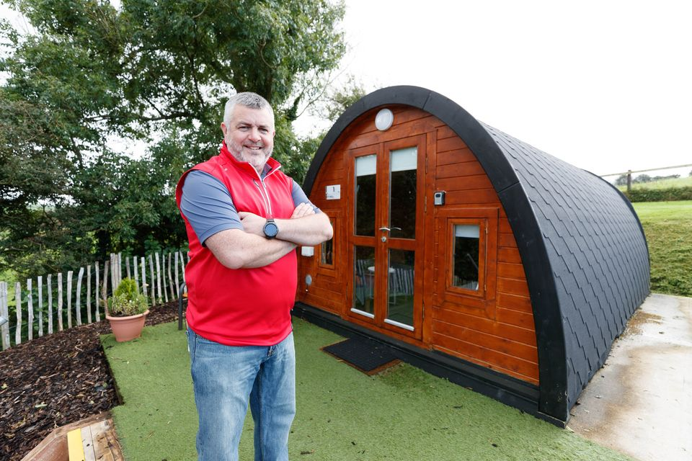

CASE STUDY Ivy Hill Glamping
Example: Ivy Hill Glamping in Co. Clare began with one pod and scaled with LEO support. Alan Vaughan, a dry-stock farmer, successfully diversified his farm by introducing glamping accommodations.
He established Ivy Hill Glamping, which has attracted both domestic and international visitors, with at least half of the bookings coming from foreign guests.
This venture has provided an additional income stream and enhanced the value of his farm, demonstrating the potential benefits of agritourism for farmers in suitable locations.
Note: LEO grants prioritise manufacturing or export-oriented businesses, but innovative tourism projects may qualify, especially if they show job creation and potential to attract overseas visitors (making it an “export” in a sense).

Slide 7
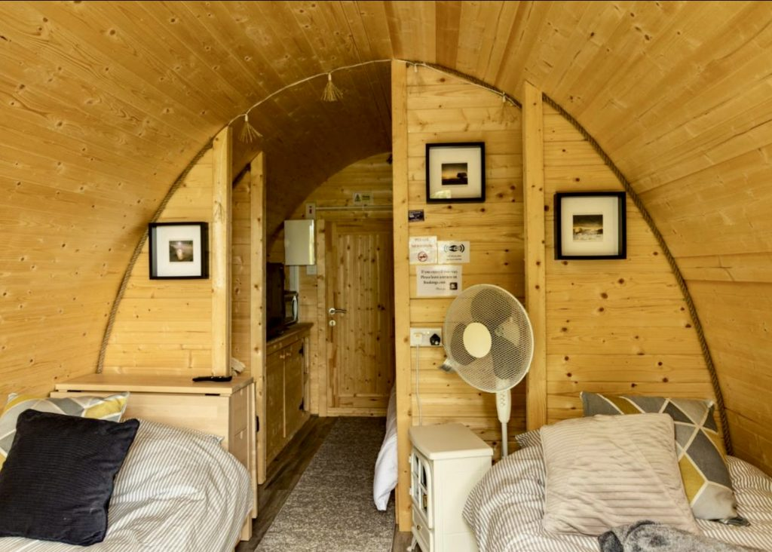
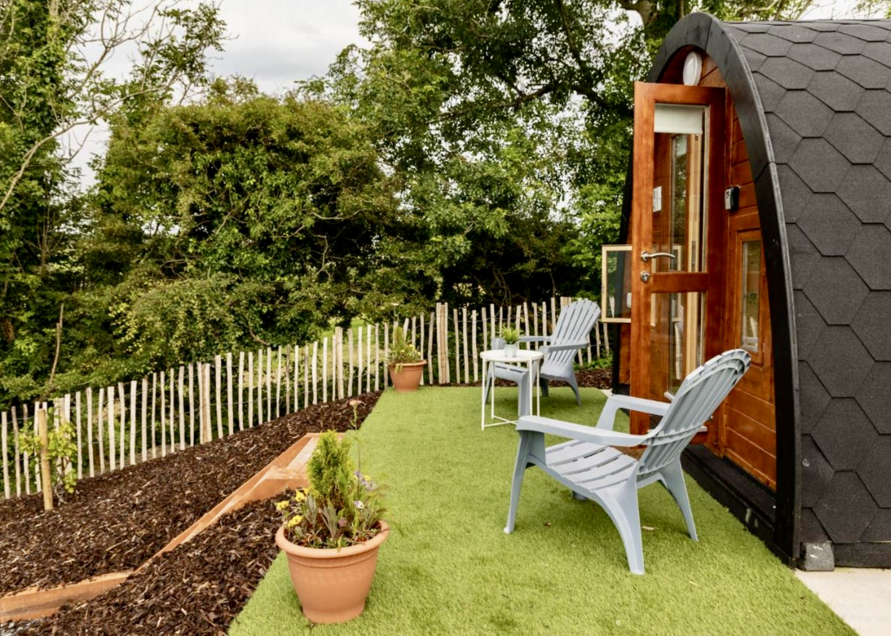
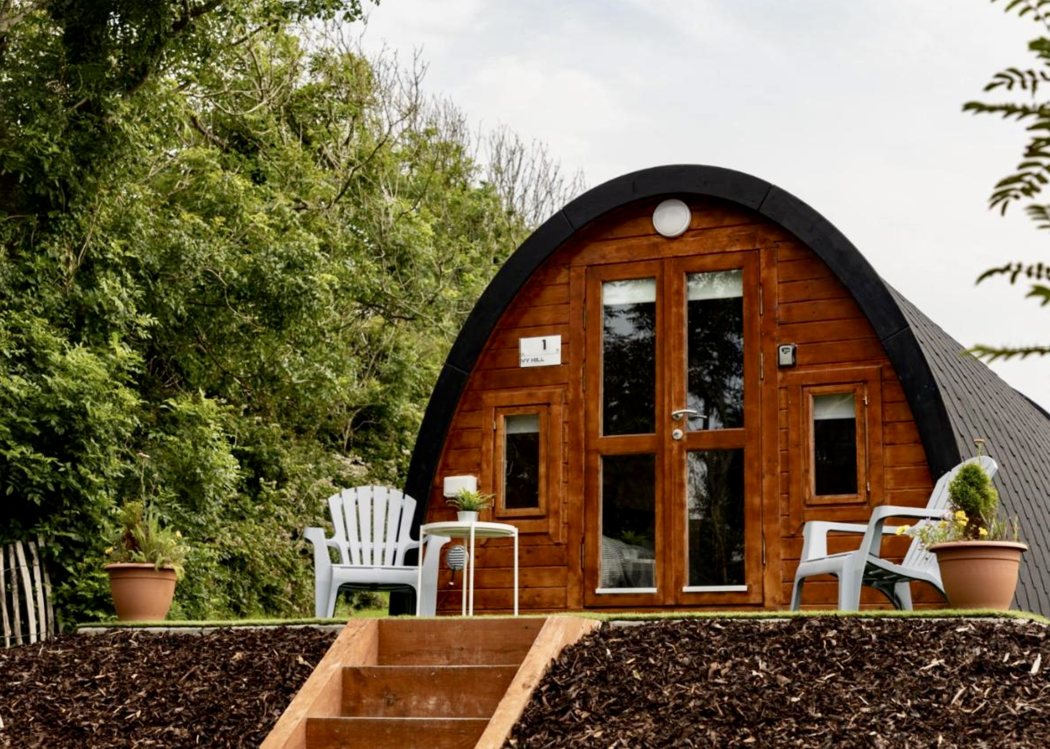
CASE STUDY Ivy Hill Glamping
For instance, the Glamping Pod One Bed 4m X 8m from Loghouse, priced at €13,630.00, offers a ready-made solution for accommodating guests.
‘Why opening one glamping pod on his farm was the best thing this Clare farmer has ever done’ Irish Independent
For those considering a similar venture, starting with a single glamping pod can be a manageable way to test the market.
For those considering a similar venture, starting with a single glamping pod can be a manageable way to test the market.
Additionally, equipping the pod with amenities like the Rhino-Pods Cubit—a compact, portable outdoor kitchen with a sink and self-powered tap—can enhance the guest experience.

Slide 8

2
Microfinance Ireland (MFI) Loans
Objective: Microfinance Ireland (MFI) Loans: Government-backed loans for small businesses and start-ups who may not qualify for bank loans.
If the bank says no, MFI can step in with a small business loan. They lend loans of €5k–€50k, interest is 6–7% to startups and micros (under 10 employees).
They enable alternative accommodation providers to finance cabins, pods, or renovations when traditional credit is unavailable. Often supported by mentoring and LEO referral
Example: Many rural tourism start-ups, especially B&Bs and glamping sites, use MFI loans when banks say no.

Slide 9


Microfinance Ireland (MFI) Loans
Benefit: The process is slightly easier than with banks and some mentoring, albeit with slightly higher interest rates.
LEO can assist with your application. Interest rates are around 6-7%. They also have business plan and cash flow templates on their site.
Recommended Reading
Microfinance Ireland Loans
Failte Ireland Funding, Ireland
LEADER Programme for Rural Development

Slide 10
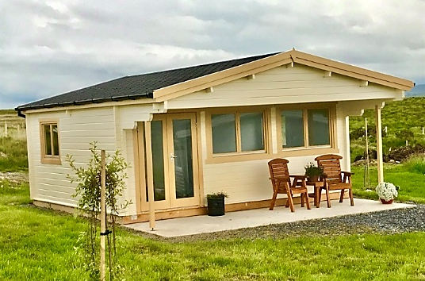

3
LEADER Rural Development Grants
Objective: LEADER Rural Development Grants: LEADER is a community-led funding stream under the EU Rural Development Programme. Managed by Local Action Groups (LAGs).
It is very important to Irish rural communities. Each Local Action Group (usually the County Development Company) issues calls under themes like rural tourism, diversification, and rural youth, among others.
A private business can typically get 50% of eligible project costs for rural tourism infrastructure, such as eco-accommodation, trails, or amenities that support visitor experiences. Usually up to a capped amount that varies, often €50k-200k.

Slide 11

LEADER Rural Development Grants
Example:
Donegal Local Development Committee (LCDC) assisted Owenea River Rest glamping cabins in Donegal, Ireland – a farm diversification project developed with a €97k LEADER grant. Grant covered 50% of the project cost, matched by the owner’s investment and labour.
Note: Requires a strong business case and community benefit. You must show how the project benefits the wider community (jobs, visitors, supporting local suppliers). Contact your Local Development Company early – they can guide you through the criteria and timing
Recommended Reading
LEADER Association for Rural Development (ELARD)

Slide 12

4
Failte Ireland
National Tourism Authority
Objective: Failte Ireland is the National tourism authority offering targeted grants to improve tourism experiences and infrastructure.
Funds sustainable accommodation and visitor experience and accommodation projects, especially in regeneration zones like the Midlands. Amounts vary; recent awards totalled €2.9 million across 17 sustainable tourism projects.
Under the Just Transition Fund, they are the intermediate body responsible to EMRA, tasked with administering up to €68 million for the Regenerative Tourism and Placemaking Scheme 2023-2026. Click here for further information.
Tip: Keep an eye on Fáilte Ireland’s announcements – sometimes they partner on EU projects or have grant calls for specific niches (e.g. adapting to COVID safety, inclusive tourism, etc.). They also offer its “mentor/clinic” services to tourism startups, which can indirectly help you refine funding applications.

Slide 13
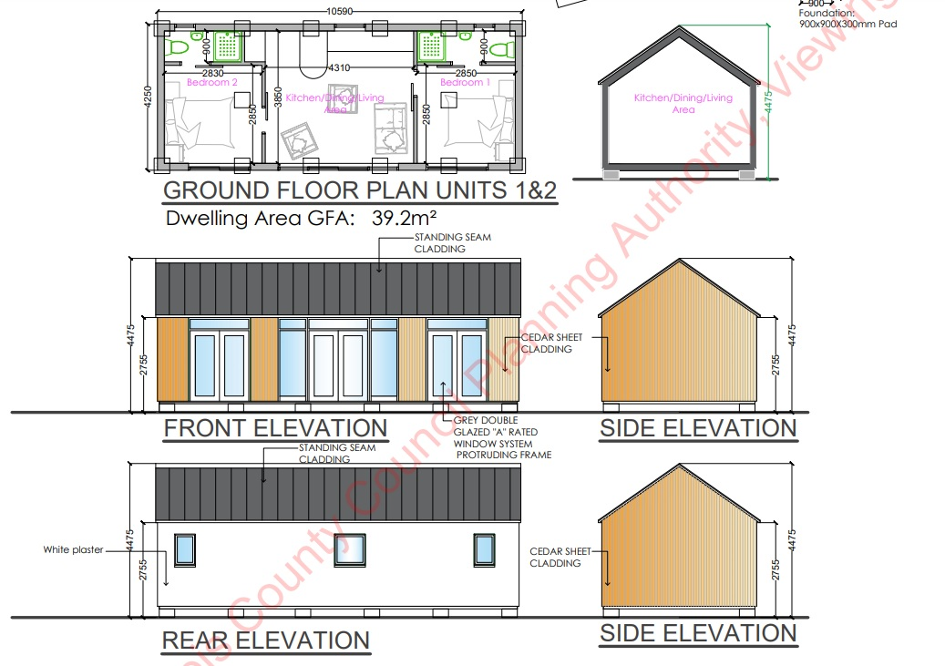
Case Study: Emo Court Glamping,
Bespoke Family Friendly Glamping on The Wild Atlantic Way
A luxury glamping site Emo Court Glamping , and a horse-drawn wagon, a glamorous camping destination in Laois have secured funding of €550,000. .
Failte Ireland Scheme: The Laois tourist destinations were among 17 tourist projects that were awarded a total of €2.9million investment under Fáilte Ireland’s Private and Community SME Scheme, which is part of the EU Just Transition Fund programme. .
Website: https://www.glampingunderthestars.ie/emo-court/

Slide 14
Case Study: Emo Court Glamping,
Bespoke Family Friendly Glamping on The Wild Atlantic Way
Outcome: Two Laois projects were selected in category two of the scheme which is aimed at the development of sustainable tourism. The largest Laois beneficiary was Emo Court Glamping, which secured a total of €300,000 for the delivery of luxury eco glamping huts, including a wheelchair accessible hut. Planning permission was granted for three standalone pod units at the Gate Lodge.
Website: https://www.glampingunderthestars.ie/emo-court/

Slide 15

Green Funding for Rural Alternative Tourism Accommodation

Slide 16
Green Funding for Rural Alternative Tourism Accommodation
Thinking of going green with your rural tourism business? Whether you're running a glamping site, eco-lodge, or farm stay, countries like Ireland, Slovenia, Iceland, the Netherlands, and Italy all offer green grants and loans to help small tourism businesses become more sustainable.
You can get funding for upgrades like solar panels, insulation, heat pumps, or even eco-certifications.
For example, Ireland’s SEAI offers grants for energy upgrades, Slovenia’s Eco Fund supports green renovations, and Italy has a €500 million fund to make tourism more sustainable. In Iceland, rural guesthouses can apply for regional development or innovation funds, while the Netherlands offers generous tax breaks and subsidies for energy-efficient improvements.
Going green isn’t just good for the planet — it also cuts your energy bills, boosts your reputation with eco-conscious guests, and future-proofs your business. And best of all? Many of these schemes are tailored for small, rural tourism accommodations just like yours.
Let’s explore what’s out there and how you can tap into these great opportunities!

Slide 17

Green Grants and Funding (Ireland)
1
LEADER Green Economy Enterprise Fund:
Ireland offers both grants and loans aimed at greening tourism.
For example, under Ireland’s new CAP-backed LEADER Programme (2023–2027), rural tourism is explicitly funded as a “Green Economy” enterprise.
LEADER (2023–27): Rural areas can get grants under LEADER for Green Economy and Rural Tourism projects.
Example: County Clare’s Castle Darcy Glamping (eco-pods) received a €200,000 LEADER grant.
Example: Waterford’s Ardmore Open Farm got €143,247 to install glamping pods.

Slide 18
Green Grants and Funding (Ireland)
2
Failte Ireland also manages major schemes: notably a Regenerative Tourism & Placemaking Fund (€68 million, 2023–26) for sustainable development in the Midlands.
GreenPlus (Enterprise Ireland) can be used for training and external consultancy to implement environmental best practices within a company.
Eligible: Hiring an external environmental service provider, creating a sustainability plan, eco-certification, training staff or installing digital monitoring.
It can cover part of the salary cost for up to 10 staff members working as part of the green team. With 50% of the eligible project costs up to a maximum of €50,000 (50% of €100,000 project).
3

Slide 19

Green Grants and Funding (Ireland)
4
SEAI & Energy Financing supports accommodation providers by providing them with grants and loans for energy upgrades and to become energy-efficient (e.g., solar panels, insulation, heating systems). Typically covers 30–50% of the total upgrade cost. Access its low-cost “green” loans via the Strategic Banking Corporation of Ireland, Growth & Sustainability Loan Scheme. This provides long-term financing for SMEs investing in climate action or energy-saving measures.
SBCI Energy Efficiency Loans: Offers low-interest loans for SME energy improvements. So, if you plan to install solar panels, high-efficiency heating, etc., explore these options – you might finance it with a mix of grant and loan on very favourable terms.
SEAI Community Energy Grant program might fund projects that have a community. Example: A glamping site partners with a local community centre to apply for a co-funded solar installation.

Slide 20
Green Grants and Funding (Ireland)
5
LeanPlus
(Enterprise Ireland) supports you in implementing new process innovations that will increase your operational effectiveness to deliver higher quality, faster and with reduced waste. 50% of the eligible project costs up to a maximum of €100,000 (€50,000 grant).
Accelerated Capital Allowance (ACA)
A 100% year-one tax deduction for energy-efficient equipment.
Eligible: Equipment on SEAI's approved list – includes solar thermal, LED lighting, efficient boilers, heat pumps.
Reduces your taxable profits, improving cash flow for small tourism businesses.
6

Slide 21

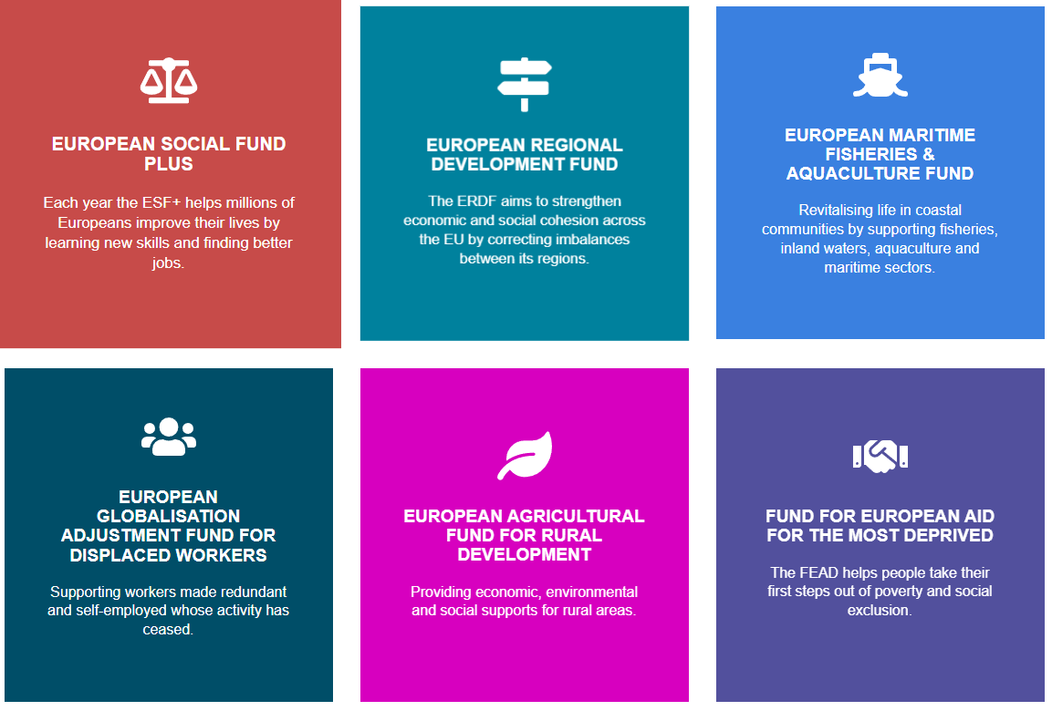
Resources & Supports
Teagasc: If you are a farmer diversifying, Teagasc (the agriculture advisory service) has resources on agritourism and often runs webinars or courses.
The Irish Self-Catering Federation (ISCF) is another body – they offer training and advice to people starting self-catering or glamping businesses. Their site (iscf.ie) can be useful for networking and best practices.
More information here To Pod or Not To Pod, Farmers Journal.
Teagasc & ISCF
Grant Application Portals: For many public grants (LEADER, etc.), the actual application might be through local offices. But also keep an eye on the EU-Funds Portal for Ireland or your local authority’s website for news on calls. For example, some County Councils offer Small Business or Community grants that you could apply for.

Slide 22

Resources & Supports
Enterprise Ireland (EI) typically doesn’t fund local services like a single glamping business unless you have a very export-oriented or innovative model (EI’s focus is larger scalable businesses). However, if you evolve into, say, a network of eco-accommodations or a tech platform for tourism, EI could become relevant.
For community-owned projects, CLÁR and Town and Village Renewal schemes sometimes fund tourism infrastructure in disadvantaged areas (usually through local councils). While not directly for private businesses, they might improve local amenities that benefit your site (trails, signage, etc.). Example: The Town and Village Renewal Scheme (TVRS) provides funding for projects that make our towns and villages more attractive and sustainable. Since the launch of the Town and Village Renewal Scheme, over €177 million has been allocated to almost 1,800 projects.

Slide 23
Well Done
Module 7 (Part 3)
Investment, Grant Applications & Pitching Your Idea
You have Completed… Module 7 (Part 2)
Find the Funds That Fit
Ireland
Next is…

