Slide 1

Module 7 (Part 2)
Find the Funds That Fit – Funding & Finance Options
Financial Planning & Funding
Italy
www.epicstays.eu

Slide 2
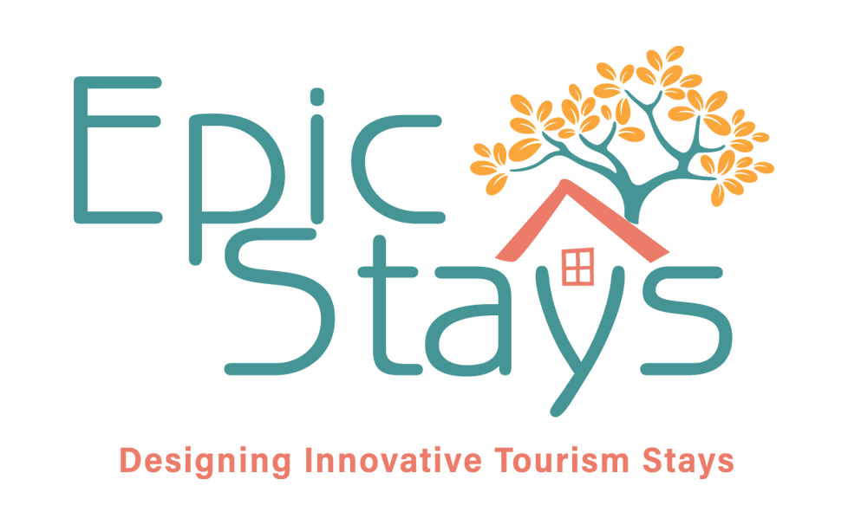
Module 7 (Part 2) Overview
Learning Outcomes
Country-Specific Funding Opportunities
Find the Funds That Fit – Funding & Finance Options. Part 2 of module explores tailored funding opportunities for alternative tourism accommodation across Ireland, Slovenia, Iceland, Italy, and the Netherlands. This section focuses on Italy. Learn how to identify, compare, and assess funding streams that best fit your business model and goals. The focus is on aligning with key priorities such as regeneration, low-carbon growth, and community value. By the end, you’ll be able to evaluate eligibility, navigate national and EU schemes, and choose the right funding pathways for sustainable tourism success.
Identify Italy’s main funding streams for alternative accommodation, including agritourism development, diversification schemes, and sustainability certification.
Recognise national and regional programmes such as RDP/EAFRD funds, Conto Termico, Ecobonus/Bonus Hotel, and eco-cert voucher initiatives.
Understand how to leverage certification (EMAS, EU Ecolabel, ISO) to unlock grants.
Assess how proposals can demonstrate climate impact mitigation and strong environmental stewardship.
Align projects with Italy’s strengths—agritourism, food and cultural heritage—to appeal to funders and policy priorities.

Slide 3
05
Italy’s Funding Options
For Alternative Tourism Accommodation
Italy offers a rich ecosystem of funding options for entrepreneurs launching eco-friendly, small-scale, or innovative tourism accommodation projects. While bureaucratic hurdles exist, those who understand the system can access powerful tools to fund sustainable and regenerative hospitality ventures.

Slide 4
Introduction: Italy’s Funding Priorities
Agritourism development, diversification, sustainability certification, energy-efficient renovation, environmental impact and local community-based rural tourism.
Italy’s funding for tourism accommodation centres on the development of agritourism, sustainability certification, and energy-efficient renovation. The government encourages farm diversification, particularly through RDP/EAFRD funds and regional programmes, enabling farmers and rural entrepreneurs to convert agricultural buildings into tourist lodging.
At the same time, national schemes like Conto Termico and Ecobonus/Bonus Hotel support renovations involving solar panels, insulation, and renewable heating systems. Italy launched a €2,000 eco-cert voucher programme to support EMAS, EU Ecolabel, and ISO standards.

Slide 5
Introduction: Italy’s Funding Priorities
To succeed in Italy, entrepreneurs should emphasise their agricultural roots, environmental impact, and connection to the local territory. Agriturismi and nature stays that promote food tourism, eco-farming, or hands-on heritage activities are especially appealing to funders.
Certification not only unlocks additional grants but also boosts credibility and bookings. Proposals should demonstrate climate impact mitigation, efficient resource utilisation, and potential for community-based tourism. Sustainability in Italy isn’t just a funding requirement—it’s also an increasing guest expectation and policy priority.

Slide 6



1
Government Not-for Profit Funding
Invitalia National Startup Incentives
Objective
Italy has a plethora of funding programs, though they can be bureaucratic. Key avenues for an Italian entrepreneur:
Invitalia Startup Incentives: Invitalia offers various startup incentives, including Smart&Start Italia and Rest in the South, which support the creation and growth of innovative and sustainable businesses, particularly in Central and Southern Italy. These incentives can include interest-free financing, non-repayable contributions, and subsidies for specific projects.
ON – Oltre Nuove Imprese a Tasso Zero: Managed by Invitalia, this flagship national program supports businesses led by women or individuals under 36 years old. It provides a mix of zero-interest loans and grants covering up to 90% of investment costs (for projects up to €3M).

Slide 7


Government Not-for Profit Funding
Invitalia National Startup Incentives
Objective
Importantly, tourism, accommodation and wellness are eligible sectors (even the purchase of real estate is allowed up to 40% of the project) for eco-glamping, off-grid cabins, and sustainable farm stays.
If you qualify (young or female-led company), this is a fantastic opportunity – essentially, almost full financing on very generous terms. Apply via www.invitalia.it
Example: You can get 75% financing (of which 50% is an interest-free loan, and 25% may be non-repayable if green/tech projects)
Buying or renovating property
Setting up glamping sites, agritourism, and accessible tourism lodgings
Recommended Reading
Non-repayable grants for tourism: all the Invitalia Open Calls for 2025

Slide 8
Government Not-for Profit Funding
Invitalia National Startup Incentives
Another Program: Smart& Start 2025
Another Invitalia program, Smart&Start 2025, offers grants/loans for “innovative startups” – mostly tech, including those with digital tourism models. Example: A unique tourism concept with a tech/platform element might qualify, such as Apps for eco-tourism booking, smart cabin tech, and digital trail guides.
Projects with expenses between € 100,000 and €1.5 million can be financed. As of 1 February 2024, there are 1,549 innovative start-ups that have been financed, with 800 million euros of investments activated, resulting in a total of 618 million euros of incentives granted.
Tip: Tourism companies that wish to take advantage of this tool must present a business plan in which the elements of innovation and new technologies are predominant (see information on Smart&Start Italia financing on the Invitalia website). You need a strong tech/digital angle; pitch your unique innovation clearly and its innovation potential.

Slide 9
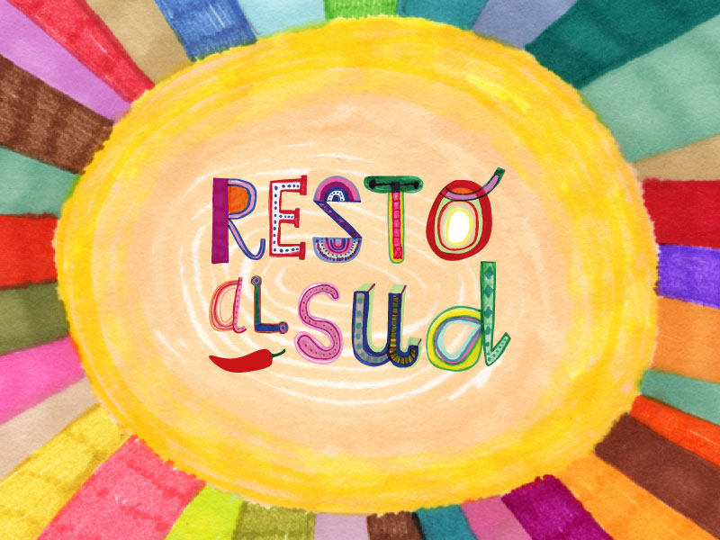

2
Resto al Sud (Stay in the South) Program
Introduction: Resto al Sud (Stay in the South) Program is a major Italian government incentive aimed at supporting young entrepreneurship and economic development in Southern Italy. v.
Many have used it to open Bed and Breakfasts, small hotels, or glamping sites. It’s a combination of a grant and a zero-interest loan. Covers up to 90% of costs (50% zero-interest loan + 40% grant). Up to €60,000 (solo) or €3 million (group projects).
Example:
Individuals can receive up to €60,000 (or up to €200,000 for multi-founder companies), comprising a 50% grant and a 50% loan.

Slide 10
Resto al Sud (Stay in the South) Program
Objective: The program offers a mix of grants and zero-interest loans for new businesses in the Southern Italy Regions (Abruzzo, Basilicata, Calabria, Campania, Molise, Puglia, Sardinia, and Sicily). For entrepreneurs residing in (or willing to relocate to) the South and looking to start a business in sectors such as tourism.
It targets young entrepreneurs 18 - 55 years old (recently expanded).
They provide non-repayable grants of around 50% funding, with the remaining 50% to be repaid over 8 years, similar to a loan (with a grace period). Many have already used it to open Bed and Breakfasts or small accommodations.
How They Can Help
Renovation and setup of alternative stays (glamping, B&Bs, farm stays)
Purchase of real estate (up to 40% of total budget)
Equipment, landscaping, marketing, digital tools, furnishings etc

Slide 11
Resto al Sud (Stay in the South) Program
Examples: Can fund land acquisition costs related to purchasing land, up to 10% of the total investment. Buying real estate, construction and facility installations: includes acquiring properties, building new structures, and installing essential systems, up to 70
Tip: Apply via www.invitalia.it with a business plan, location in the southern region, and sustainability focus e.g., eco-campsites, rural guesthouses or eco-friendly retreats
See Agricampeggio Acqua di Friso – Eco-Glamping agri camping and glamping in Calabria in the next section as an example.

Slide 12
3
Tourism Recovery & Sustainability Incentives
(PNRR/Ministry of Tourism)
Tourism Recovery & Sustainability Incentives (PNRR/Ministry of Tourism and others) Part of Italy’s EU Recovery Fund plan (PNRR). It uses these EU Recovery funds for tourism, such as tourism upgrading and green innovation, especially in rural areas.
Objective: Fondo Rotativo Turismo (FRI-TUR) is an Italian national fund managed and administered by the Ministry of Tourism (Ministero del Turismo) and Cassa Depositi e Prestiti (CDP). Fund significant investments (€500,000 to €10 million with a mix of low-interest loans and up to 35% grant.
Supports sustainable tourism and is dedicated to investing in the tourism sector, particularly in modernisation, energy efficiency, accessibility, and sustainability.

Slide 13
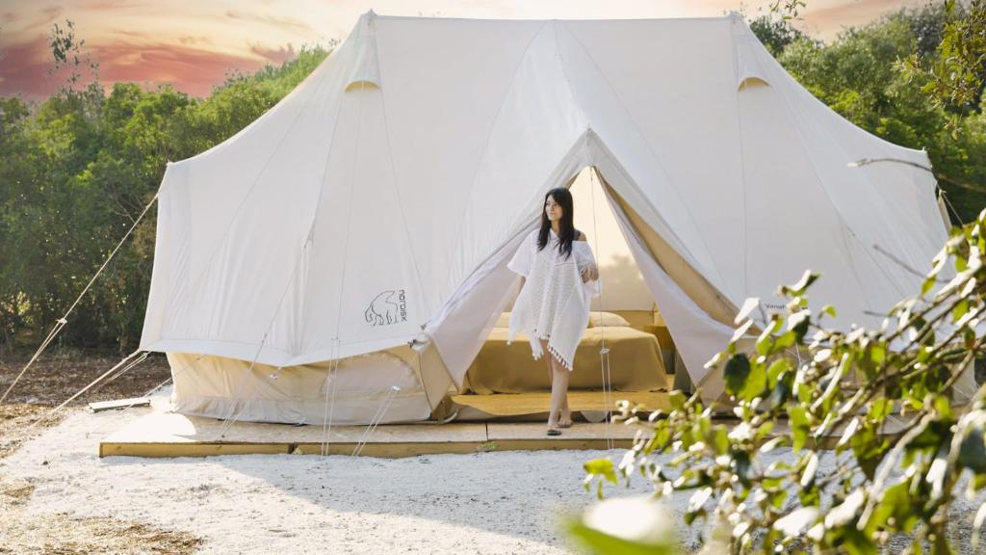
Tourism Recovery & Sustainability Incentives
(PNRR/Ministry of Tourism)
Objective: It provides loans and grants to facilitate access to credit for tourism SMEs with a 50% reserve for green investments. Ideal for:
Eco-retreats and off-grid glamping upgrading to renewable energy
Heritage buildings turned boutique stays, improving energy performance, and restoration of heritage properties
Nature-based accommodations expanding to meet accessibility and green building standards
Projects involving adaptive reuse of abandoned rural sites
Recommended Reading
Applications are made through the CDP platform: https://www.cdp.it
M1C3 Investment 4.2.5: Revolving Fund for Enterprises (FRI) to support businesses and development investments

Slide 14

Funding For:
Green upgrades to tourist facilities (e.g., Solar panels, heat pumps, insulation)
Digital innovation (e.g., Smart access, e-booking systems)
Green transition (e.g., Sustainable materials, water recycling)
Structural work (e.g., Renovation, restoration, seismic upgrades)
Accessibility (e.g., Barrier-free upgrades, sensory tools)
Circular design (e.g., Compost systems, green roofs, reused materials)
Wellness (e.g., construction of thermal pools)
Furnishings (e.g., purchase and renewal of furnishings)
Design services (e.g., purchase and renewal of furnishings)
Acquiring land and more.
This is for existing businesses and those looking to upgrade. Non-repayable contributions can cover up to 35% of total project costs, with co-financing required through CDP loans and private capital.
Note: These are more for existing businesses upgrading hotels, etc., but keep an eye on Ministry of Tourism announcements, especially if you plan eco-sustainability features

Slide 15
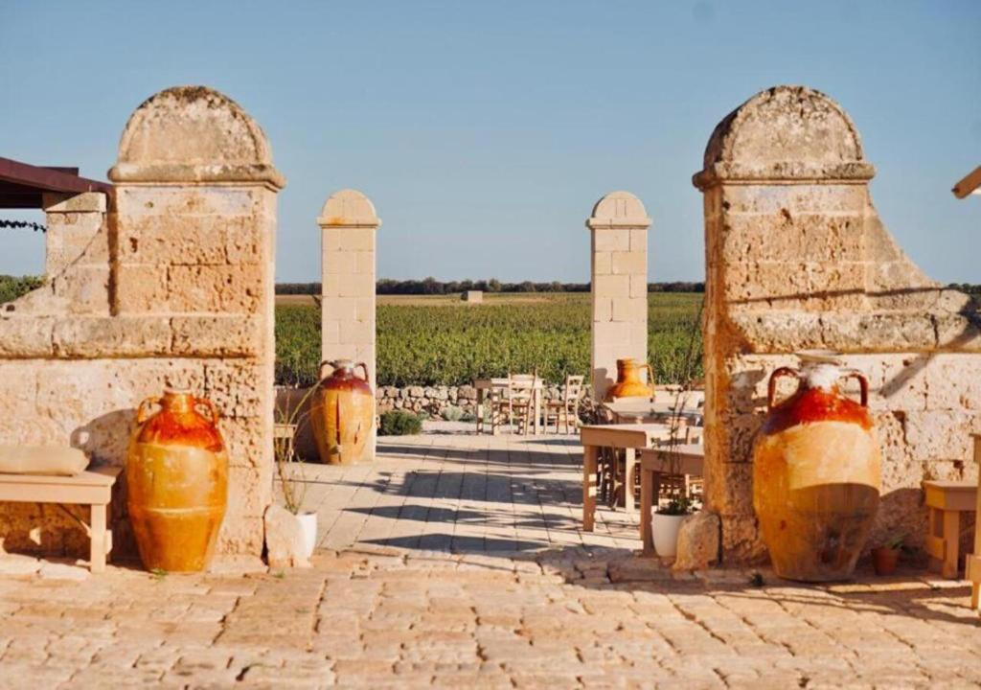

Tourism Recovery & Sustainability Incentives
(PNRR/Ministry of Tourism)
Beneficiaries: are existing hotel businesses, structures that carry out agritourism activities, open-air accommodation facilities, as well as businesses in the tourism, recreational, beach resorts, spa complexes and more.
Example: Direct contributions to expenditure (35%) for interventions (min €500,000 – max €10,000,000) of environmental requalification, environmental sustainability and digital innovation. Subsidised financing repayable in 15 years.
Tip: Outdoor accommodation facilities configured as campsites and tourist villages may adopt alternative commercial names, such as 'camping village' and 'glamping', if they meet the technical requirements defined in Regulation No. 11/22 (Annex A) in relation to campsites; furthermore, they may be given the name 'camping' or 'camping and lodge’.

Slide 16

4
GALS Gruppi di Azione Locale
(Local Action Groups)
Objective: GALS Gruppi di Azione Locale (Local Action Groups) play a key role in rural development across Italy (and Europe), especially under the EU's LEADER approach. A GAL is a local public-private partnership that brings together municipalities, businesses, NGOs, and citizens to support sustainable development in rural areas.
Funded mainly by the European Agricultural Fund for Rural Development (EAFRD) (e.g., rural innovation, tourism, agri-food)
Sometimes co-funded by regional governments with complementary national/regional funds (e.g., infrastructure, digitalisation, green transition)
Operates within a Local Development Strategy (LDS) tailored to the needs of their specific area (e.g.,
Each GAL is unique, with its own geographic focus, priority sectors, and project calls.
Recommended Reading
Rete Rural Nazionale

Slide 17

GALS Gruppi di Azione Locale
(Local Action Groups)
How They Help You: GALs are best suited for small-scale, locally rooted projects in rural areas — ideal for alternative tourism accommodations, such as farm stays, nature lodges, or community-run guesthouses.
How can they help you?
Renovating rural buildings into eco-guesthouses
Creating glamping/agricamping units
Cultural or wellness tourism trails
Community-led tourism development
Example: GAL-Funded Alternative Tourism Project - GAL Terra dei Messapi (Puglia) issued calls for Eco-tourism and agritourism startups to convert rural buildings into guesthouses, create bicycle paths, and design signage for cultural tourism. The grants covered up to 70% of eligible costs for projects aligned with their local strategy, ranging from €5,000 to €200,000.

Slide 18


How They Work:
Identify your local GAL: Use this interactive map (Italy) to find the GAL operating in your area.
Check their Local Development Strategy: Each GAL has its priorities—some focus on tourism, others on food chains, crafts, or biodiversity.
Respond to a call: They open periodic calls where you can apply for funding with a simplified application process.
Get local support: GALs often offer help with writing applications, connecting with local partners, and navigating permits.
Tip: if you are not sure where to start, go to your GAL or local Confcommercio/Confartigianato office, and they’ll orient you and help with next steps
Recommended Reading
GAL Meridaunia
Gal Calls; A Great Opportunity For Rural Areas – How they Work!

Slide 19

To Clarify GALS Administer:
LEADER – Rural Development Fund (EAFRD) - Grants for small-scale rural tourism, agritourism, and cultural heritage
Local Development Strategy (PSL) - Area-specific calls (e.g., farm stays, glamping, trails, crafts)
Note: GALs do not administer
Invitalia programs like Resto al Sud or ON - Oltre Nuove Imprese a Tasso Zero. (Supports youth/women entrepreneurs in Southern Italy)
Ministry of Tourism & CDP - Fondo Rotativo Turismo (FRI-Tur) (Large investments in sustainable tourism)
Various ministries - PNRR grants (NextGen EU) (Green & digital transformation, including tourism)
CDP - Fondo Turismo 1 (CDP Immobiliare SGR) (Real estate investment in tourism properties)
These are national-level funding schemes managed directly by Invitalia, Italy’s national agency for inward investment and economic development.

Slide 20

5
Regional Rural Development (PSR) Grants
Objective: Regional Rural Development (PSR) Grants: A significant portion of funding for rural projects is allocated through the PSR (Piano di Sviluppo Rurale) of each region, which the EAFRD finances.
They are funded through the EU’s Common Agricultural Policy (CAP) via the European Agricultural Fund for Rural Development (EAFRD). Managed by each Italian region (e.g., PSR Puglia, PSR Sicilia). Aimed at improving the economic, environmental, and social sustainability of rural areas.
PSR Funding is a key funding stream for rural innovation and tourism, and it complements GAL grants, typically being larger, regionally managed, and sector-specific. For PSR Grants, Italian regions occasionally release their own bando (calls) for tourism and agritourism, or rural bed and breakfasts (B&Bs).
Can cover 40–70% of eligible costs, with amounts varying from €10,000 to €500,000+. Must follow regional priorities (often includes eco-tourism, digitalisation, green energy)

Slide 21
Regional Rural Development (PSR) Grants
Example: Sicily announced its 2025–27 Call with contributions of up to an 80% grant for eco-tourism projects of up to € 200,000, which includes campsites and facilities.
PSR Grants Frequently Funded:
Agritourism Development (e.g., renovating farmhouses into guest lodges or glamping)
Farm Diversification (e.g., starting nature stays, workshops, rural cafés)
Sustainable Infrastructure (e.g., installing solar panels, compost toilets)
Cultural/Educational Tourism (e.g., trails, small museums, and eco-learning centres)
Small-scale Construction (e.g., New farm accommodation and wellness cabins)

Slide 22
Regional Rural Development (PSR) Grants
Note: The CSR Puglia 2023–2027 was officially adopted by the Regional Council, which includes interventions for
Renovating rural buildings into guest accommodations.
Implementing sustainable practices in tourism operations.
Enhancing the competitiveness of agritourism businesses.
Visit the Official Portal: Access detailed information, including open calls and application procedures, at psr.regione.puglia.it.
Recommended Reading
CSR 2023-2027 - Puglia Intervention SRD01.01A: Public Notice for the Submission of Support Applications

Slide 23
Regional Rural Development (PSR) Grants
Example: Farm-Based Tourism Using PSR & GAL Funding (Measure 6.4 & LEADER)
Agritourism, where rural entrepreneurs convert agricultural buildings into lodging or rural B&Bs, can receive grants of 40-50% for setting up lodging or other farm-based tourism initiatives under measures for farm diversification.
Funding can cover the renovation of rural buildings for use as guest lodgings, the installation of bathrooms/kitchens/heating systems, the creation of common areas (e.g., small cafes, shared gardens), and the development of tourist trails, educational farms, or wellness areas.
Tip: If you are or partner with a farm, look at your region’s PSR Measure 6.4 or similar. Remember, GAL (Local Action Groups) in Italy manage LEADER funds locally – go to them first if you have a small tourism initiative that will benefit rural areas. Check with your local GAL by going to your regional PSR portal (e.g., PSR Puglia, PSR Toscana) for calls. See GAL Meridaunia for example.

Slide 24
Financial Tools – Banks, Loans and Credit Guarantees
Banks & Confidi & Microcredito
6
7
Banks & Confidi (Credit Guarantee Consortia)
Italian banks may lend to tourism entrepreneurs but often require guarantees. That’s where Confidi (collective guarantee consortia) step in—they cover part of the risk, making banks more likely to approve your loan. They are available to startups, cooperatives, agritourism businesses, or community tourism projects.
Tip: You’ll need a solid business plan, a partita IVA (VAT number), and sustainability goals, and regional impact to increase your credibility
Microcredito (Micro Loans)
They are small government-backed loans (up to €50,000) for micro-businesses, with fewer guarantees required. Example: Launching a small glamping business, upgrading a rural B&B. Tip: You’ll need a solid business plan, a partita IVA (VAT number), and sustainability goals, and regional impact to increase your credibility

Slide 25
Financial Tools – Tax Credit and Relief Tools
8
9
Bonus Ristrutturazione
Tax deduction of 50% for building renovations, including repurposing rural houses, farmhouses or barns into tourism accommodation. The deduction is spread over a 10-year period. It can be transferred to third parties for immediate liquidity. It can be used by anyone renovating eligible buildings and can be claimed as tax relief over 5 years or sold to banks to obtain upfront liquidity.
Example: You’re turning a trullo into an eco-B&B. You can claim 50–65% of renovation or energy costs as tax credits.
Ecobonus
Tax deduction of 65% for energy efficiency improvements or upgrades, such as insulation, solar panels, and heat pumps. Applicable to both individuals and businesses undertaking qualifying renovations. The deduction is spread over a 10-year period. It can be transferred to third parties (e.g., banks) for immediate liquidity. There is also the Superbonus 110% which is a 110% tax credit for expenditure improving energy efficiency.

Slide 26

Financial Tools – Tax Credit and Relief Tools
10
Community Involvement Grants (Local/Municipal)
Some small towns offer token grants, free land, or tax breaks if you create tourism infrastructure.
You could even be offered use of abandoned buildings to restore in exchange for public value. Ask your Comune or Unione dei Comuni about tourism development support.
Example: Albergo Diffuso (Scattered Hotel) is a decentralised hotel model that utilises multiple restored homes in a historic village, sharing reception/services. It is suitable for municipalities, cooperatives, groups of property owners, and community-led initiatives with local reinvestment.

Slide 27
Financial Tools – Tax Credit and Relief Tools
Example: See section beginning of this section - Vivi Calascio, Abruzzo, a revitalised abandoned homes into tourist lodging, raised €1.5M via grants, cooperative loans, crowdfunding
Works well because it is eligible for regional rural development, EU funds, and municipal support. It is also great for restoring entire villages or boosting depressed rural economies

Slide 28

Combine multiple sources (regional + Invitalia + tax credit)
Build incrementally and focus on low-debt models
Prioritise sustainability and social impact in your pitch
Seek help: grant writers, GAL advisors, local Confidi, or Chamber of Commerce
Stay informed on calls by subscribing to the ministry and regional newsletters
For community initiatives, form a cooperative, engage local stakeholders, and seek local municipal support
Ensure you have a partita IVA (business VAT number) and a business plan when approaching Italian banks or credit consortia (confidi).
Navigating Italy’s bureaucracy can be challenging – consider engaging a consultant for grant applications (often their fee can be a percentage of the obtained grant). And always read the Bandi carefully for deadlines and required documentation
Final Tips

Slide 29

Green Funding for Rural Alternative Tourism Accommodation

Slide 30
Green Funding for Rural Alternative Tourism Accommodation
Thinking of going green with your rural tourism business? Whether you're running a glamping site, eco-lodge, or farm stay, countries like Ireland, Slovenia, Iceland, the Netherlands, and Italy all offer green grants and loans to help small tourism businesses become more sustainable.
You can obtain funding for upgrades such as solar panels, insulation, heat pumps, or even eco-certifications.
For example, Ireland’s SEAI offers grants for energy upgrades, Slovenia’s Eco Fund supports green renovations, and Italy has a €500 million fund to make tourism more sustainable. In Iceland, rural guesthouses can apply for regional development or innovation funds, while the Netherlands offers generous tax breaks and subsidies for energy-efficient improvements.
Going green isn’t just good for the planet — it also cuts your energy bills, boosts your reputation with eco-conscious guests, and future-proofs your business. And best of all? Many of these schemes are tailored for small, rural tourism accommodations just like yours.
Let’s explore what’s out there and how you can tap into these great opportunities!

Slide 31

Green Grants and Funding (Italy)
1
EU Rural Development Programme (RDP / EAFRD).
EU co-funded grants via Italy’s Rural Development Programme, offering support for tourism diversification, green upgrades, and sustainable agritourism.
For farm-based tourism (agriturismi) and rural micro-enterprises, converting buildings into eco-accommodation e.g., a farm converts a barn into a guesthouse with €60k
Supports the conversion of farm buildings to tourist lodgings. Installation of solar panels, heat pumps, rainwater systems or nature-based infrastructure (trails, info centers)
Example: A vineyard estate receives €60,000 in EAFRD funding to install solar panels and repurpose an unused barn into eco-guest suites with green certification. Italy’s RDP 2023–2027 Overview
EAFRD Programme (EU)

Slide 32
2
Eco-Certification Vouchers
Decreto MIPAAF (Public Notice No. 2/2023). A voucher scheme launched by Italy’s Ministry of Agriculture (MIPAAF) offering up to €2,000 per business to cover the costs of obtaining or renewing sustainability certifications, specifically for certification costs for EMAS, EU Ecolabel, ISO 14001 / ISO 21401 and environmental audits and consultancy.
For rural and urban tourism accommodations, including B&Bs, agriturismi, hotels, and campsites, this is particularly beneficial for small eco-lodges or family-run guesthouses that are obtaining or renewing sustainability certifications.
Example: A small farm stay (agriturismo) uses the €2,000 voucher to hire a consultant to help them obtain the EU Ecolabel, thereby boosting their visibility on sustainable booking platforms.
Example: A rural B&B applies for EMAS and gets partial reimbursement for consultancy and application fees.
More Info: EMAS EU Guide

Slide 33
3
Ecobonus & Bonus Hotel (Tax Credits).
A 65–75% tax credit on energy-saving building upgrades, available to hotels, B&Bs, and hospitality SMEs. 65–75% for insulation, HVAC, solar €50k project → €37.5k credit.
Eligible for thermal insulation, efficient boilers/heating, solar thermal panels and building envelope upgrades. Example: A B&B invests €50,000 in green retrofits (roof insulation, efficient HVAC). With Ecobonus, they recover up to €37,500 via tax credits. Agenzia delle Entrate – Ecobonus (IT)
Conto Termico (Thermal Account Grant). A national fund that directly reimburses 40–65% of costs for installing renewable heating and cooling systems. 40–65% for renewables (heat, solar) €8k solar system → €4.8k reimbursed. Eligible systems include heat pumps, solar thermal panels and biomass boilers. Cash reimbursement (not tax credit), usually within 2 months. Example: A rural B&B installs solar thermal panels (€8,000) and receives €4,800 back from the GSE Conto Termico scheme.
4

Slide 34
Resources & Supports
Turismo regulations in Italy can be complex (classification, health & safety, etc.). An important step is to check the regional tourism law for your region, which will outline the requirements for “open air accommodations” or other categories that your project fits. The business registration is often under ATECO code 55 (accommodations) or 56 (if providing food). The Chambers of Commerce or local CNA/Confartigianato (artisans associations) sometimes publish guides for starting B&Bs or campsites – those can serve as checklists.
Regulatory Resources
Tourism Enterprise Agencies: Italy’s national tourism board (ENIT) is more about promotion than enterprise funding. However, they have market research and can support you in marketing once you’re open (listing your business on official channels).
DMCs (Destination Management Companies) or tourist districts that occasionally get public funding to sub-grant to local projects. Network within local tourism associations (e.g., Agriturist for agritourism, or Glamping Association if one exists).
Tourism Enterprise Agencies and DMCs

Slide 35
Resources & Supports
If you go the route of a social enterprise or cooperative, Legacoop and Confcooperative (big cooperative associations) have their own financing arms that help fund cooperative startups. Additionally, the concept of Albergo Diffuso (a scattered hotel) is exemplified in Friuli Venezia Giulia, where the regional law provides funding and promotional support for Albergo Diffuso projects. If your model involves using existing village buildings as lodging, explore that concept and its associated support network.
Cooperative Funds

Slide 36
Well Done
Module 7 (Part 3)
Investment, Grant Applications & Pitching Your Idea
You have Completed… Module 7 (Part 2)
Find the Funds That Fit
Italy
Next is…

