Slide 1

Module 7 (Part 2)
Find the Funds That Fit – Funding & Finance Options
Iceland
www.epicstays.eu

Slide 2
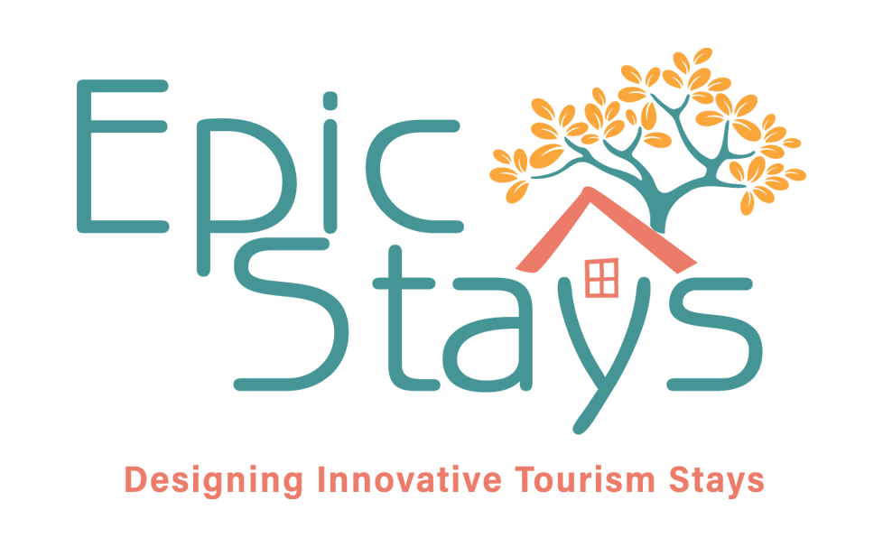
Module 7 (Part 2) Overview
Learning Outcomes
Country-Specific Funding Opportunities
Find the Funds That Fit – Funding & Finance Options. Part 2 of module explores tailored funding opportunities for alternative tourism accommodation across Ireland, Slovenia, Iceland, Italy, and the Netherlands. This section focuses on Iceland. Learn how to identify, compare, and assess funding streams that best fit your business model and goals. The focus is on aligning with key priorities such as regeneration, low-carbon growth, and community value. By the end, you’ll be able to evaluate eligibility, navigate national and EU schemes, and choose the right funding pathways for sustainable tourism success.
Identify Iceland’s main funding opportunities, including the Tourist Site Protection Fund, regional funds, rural loans, and NATA grants.
Understand the role of infrastructure and environmental funding Epic Stays projects.
Recognise how Nordic and EU-backed green loan guarantees support geothermal, eco-construction, and off-grid solutions.
Assess how to align projects with Iceland’s priorities—nature protection, dispersal of tourism, and ecological sensitivity.
Demonstrate strategies for reducing strain on natural sites.
Strengthen project proposals through collaboration with local authorities.

Slide 3
07
Iceland’s Funding Options
For Alternative Tourism Accommodation
Iceland offers a range of funding options for alternative tourism, including public infrastructure grants, regional “Uppbyggingarsjóður” funds, rural loans through Byggðastofnun, and innovation support from the Technology Development Fund. The Tourist Site Protection Fund and NATA grants also back sustainable tourism, while local municipalities and banks provide additional support. Together, these make Iceland a strong environment for launching eco-friendly glamping and rural accommodation projects.

Slide 4
Introduction: Iceland’s Funding Priorities
Green tourism, nature protection, regional dispersal of tourism, environmental infrastructure development, ecological sensitivity, site-specific sustainability.
Iceland’s green tourism funding is primarily focused on nature protection, regional dispersal of tourism, and the development of environmental infrastructure.
The main support mechanism—The Iceland Tourist Board Tourist Site Protection Fund —finances trails, waste systems, sanitation blocks, and renewable power installations near or around tourism sites. Although the fund is not limited to private businesses, it directly benefits lodges and glamping sites operating near protected landscapes.
Other support comes from Nordic and EU-backed green loan guarantees that enable rural SMEs to access affordable financing for geothermal energy systems, eco-construction, and off-grid accommodation solutions. To align with Iceland’s funding priorities, your project should be rooted in ecological sensitivity and site-specific sustainability.

Slide 5
Introduction: Iceland’s Funding Priorities
Businesses that reduce strain on natural sites—through the use of boardwalks, erosion control measures, or water-saving systems—fit well.
If you operate in a remote area, demonstrate how your accommodation helps spread tourist flows away from Reykjavík while preserving Iceland’s fragile environment.
Collaborating with local authorities, park managers, or applying for co-financed environmental upgrades will strengthen your position. Projects that demonstrate innovation, regeneration, and clear environmental benefit are best placed to secure support.

Slide 6


1
Iceland Tourist Board Tourist Site Protection Fund
(Framkvæmdasjóður ferðamannastaða)
Iceland is not an EU member, but part of the EEA – has a booming tourism sector and some supports for rural and sustainable tourism but has some supports for rural and sustainable tourism.
Objective: The Iceland Tourist Board Tourist Site Protection Fund (Framkvæmdasjóður ferðamannastaða) is a ‘tourist site’ fund or grant aimed at protecting, supporting, and developing tourist sites, infrastructure, preserving nature and cultural heritage.
Improving Access and Infrastructure: If you're operating in a rural area near a popular natural site (e.g. waterfalls, geothermal springs, hiking routes), your project may qualify for funding to:
Improve access roads or walking paths leading to or around your accommodation. Create or maintain parking areas, signage, or viewing platforms. Add safety infrastructure like railings, lighting, or trail upgrades
This improves guest experience and supports the sustainable flow of visitors.

Slide 7

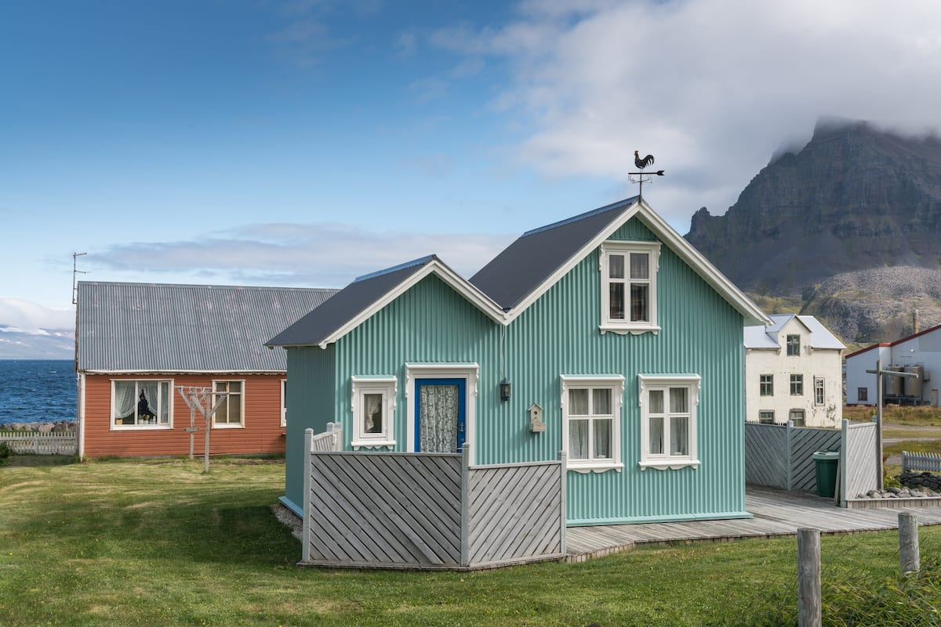
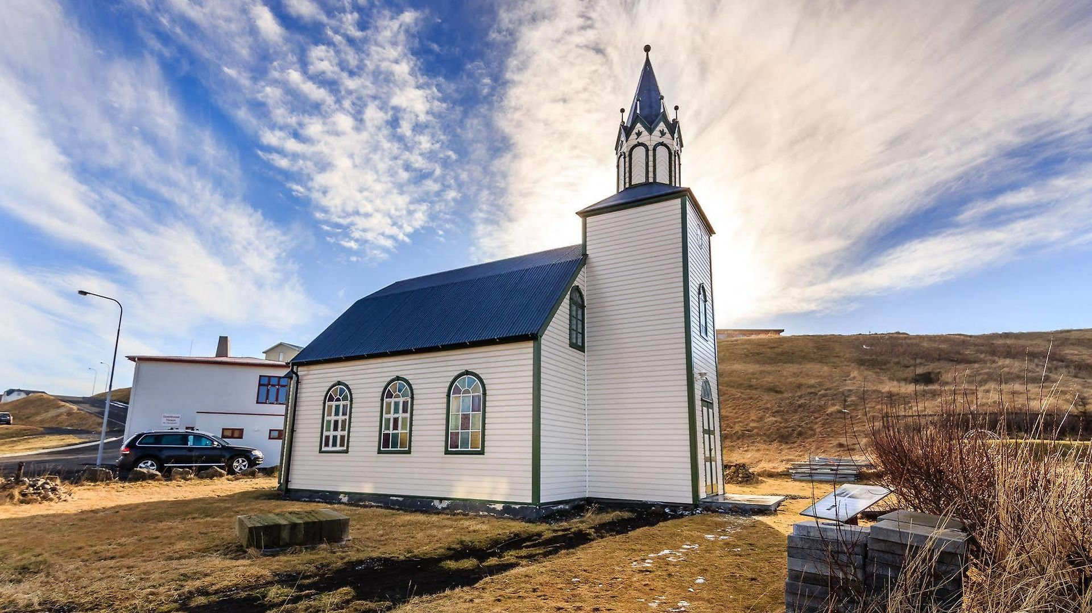
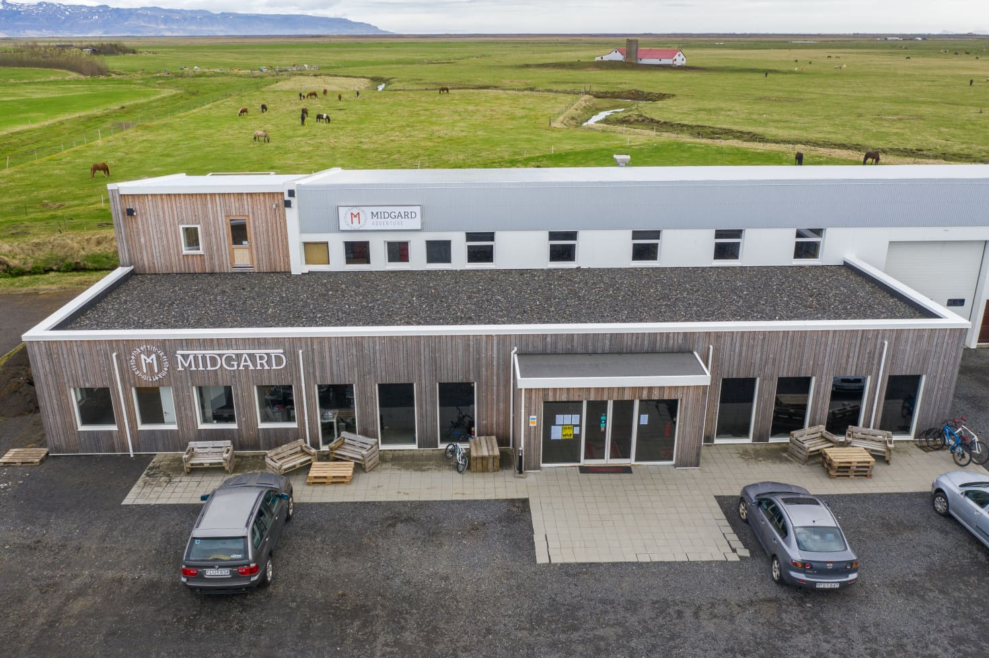
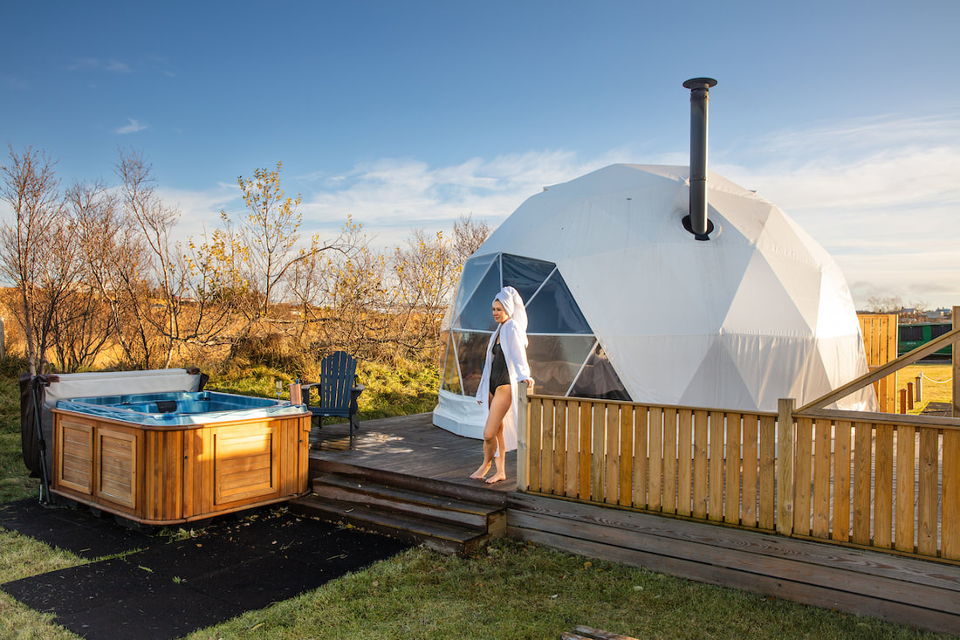
Iceland Tourist Board Tourist Site Protection Fund
(Framkvæmdasjóður ferðamannastaða)
Nature and Cultural Heritage Protection: If your glamping site, eco-cabin, or guesthouse is integrated with natural or heritage features (e.g. turf houses, lava fields, historic farm sites), the fund may support efforts to:
Restore or preserve cultural structures. Manage natural impacts (e.g., fencing off sensitive flora, soil stabilisation). Install educational signage or interpretation boards
This can be tied into your accommodation’s brand as an eco-conscious or heritage-based experience.

Slide 8
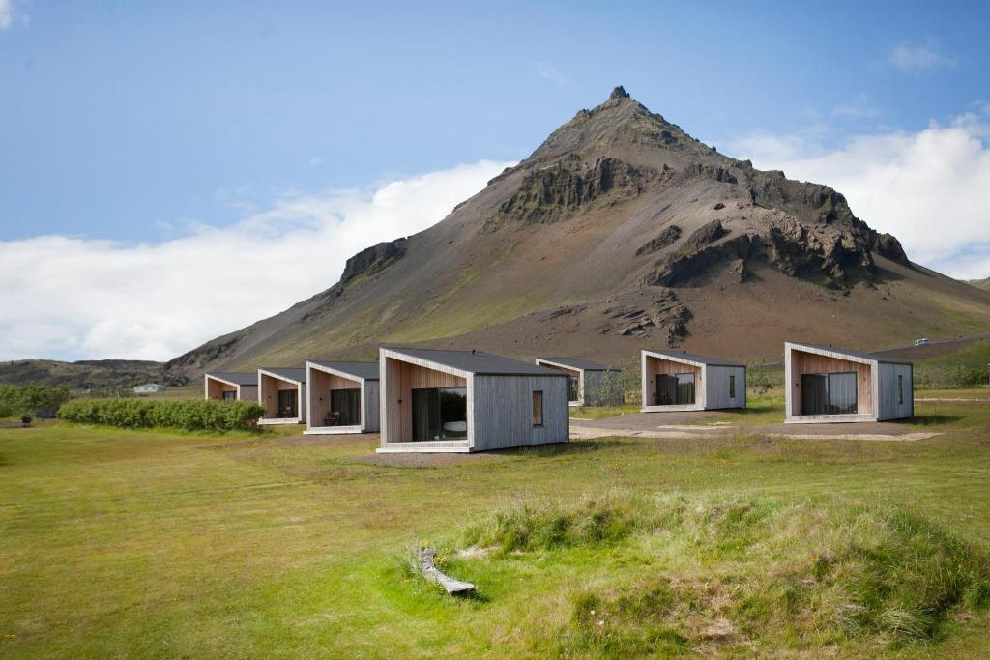
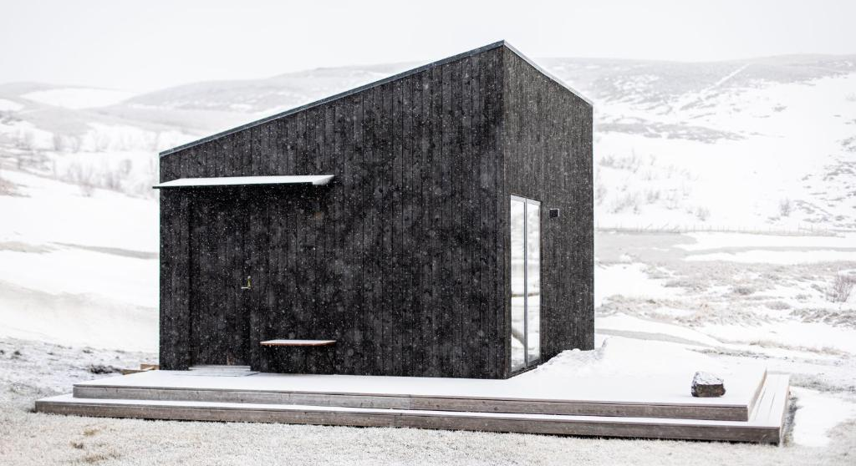
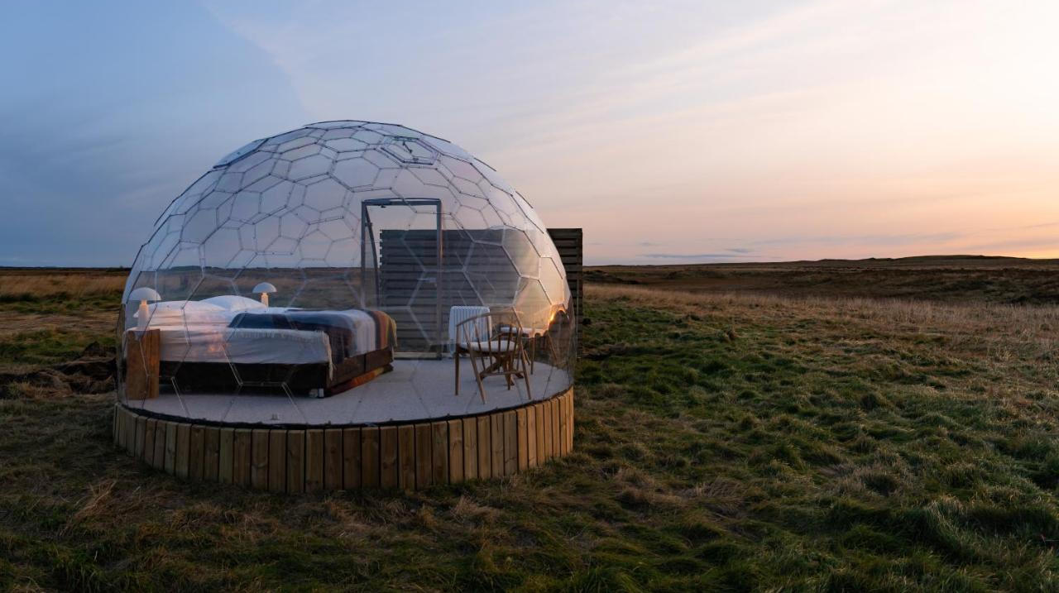
Iceland Tourist Board Tourist Site Protection Fund
(Framkvæmdasjóður ferðamannastaða)
Partnerships with Municipalities or Local Tourism Boards: While the Icelandic Tourist Board administers the fund, municipalities or landowners must supervise projects. You can:
Partner with your local municipality or a local DMO (Destination Management Organisation). Collaborate with nearby farmers, guides, or landowners to apply for a shared infrastructure upgrade. Propose your accommodation as a base for nature exploration or cultural education.

Slide 9

Iceland Tourist Board Tourist Site Protection Fund
(Framkvæmdasjóður ferðamannastaða)
This strengthens your community ties and makes your project more attractive to funders.
Private landowners can get support if the project is about protecting natural sites or infrastructure that benefits visitors.
You must show that your project benefits visitors, not just private profit.
You can be a private landowner, but you must collaborate with local authorities or submit projects aligned with tourism/public good.
Grants are not directly for building cabins or lodges, but for surrounding infrastructure that makes tourism more sustainable and safer.
Example: If your glamping requires building a sustainable walking trail to a nature spot or setting up safety measures around a nearby attraction, you might get assistance from this fund.

Slide 10

2
NATA (North Atlantic Tourism Association)
Regional Grant Program for Tourism
Objective
NATA Grants The North Atlantic Tourism Association (NATA) supports collaboration in tourism between Iceland, Greenland, and the Faroe Islands. Their grants aim to boost sustainable, innovative, and cooperative tourism projects.
In 2024, NATA was particularly interested in projects that focus on sustainability, and digitization within tourism.
Sustainability in tourism (eco-design, low-impact travel)
Digital innovation (e.g., smart booking systems, digital storytelling)
Joint marketing and destination development
Nature-based tourism infrastructure
Amounts vary to support tourism development and marketing projects. The maximum grant is DKK 100.000 (approx. €13,400) per person for travel between Iceland. Projects typically involve cross-border cooperation (Iceland + at least one other NATA country) – this amount must not exceed 50% of the project’s entire funding.

Slide 11
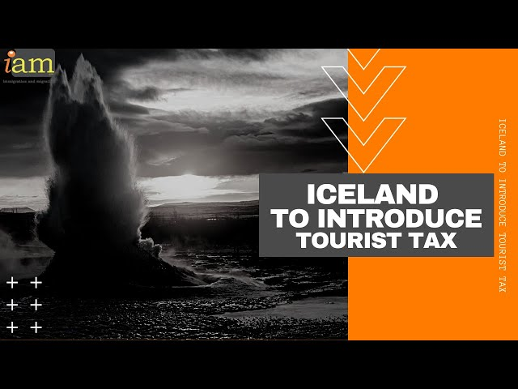


3
Iceland Tourist Tax
Publicly Administered Accommodation Overnight Tax
Objective: Tourist Tax:
Understanding the tourist tax in Iceland is essential for compliance. This is a mandatory tax that applies to all overnight stays in hotels, guesthouses, campsites, mobile homes, and even cruise ships.
The rates vary, with ISK 1,000 for cruise ships, ISK 600 per night for hotel rooms, and ISK 300 per night for campsites and alternative structures, such as glamping pods. Watch the video for more information.
How it Works:
For alternative tourism accommodation, Iceland charges a per-night Tourist Tax (Overnight Tax) on accommodations. If you’re hosting overnight guests—whether in pods, cabins, yurts, guest houses, campsites, mobile homes, lodges, even nature-based or off-grid accommodations—you must collect and report this tax.

Slide 12
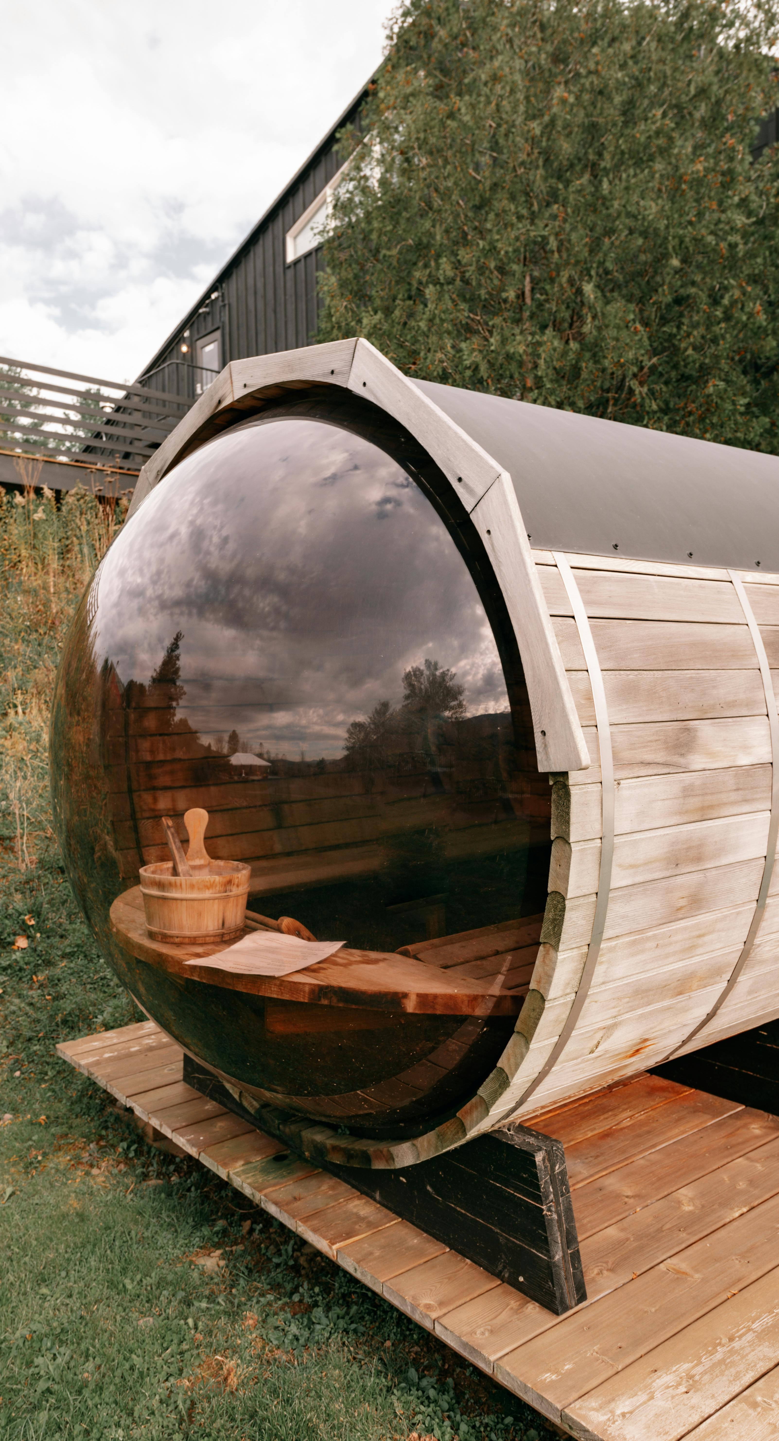
Iceland Tourist Tax
Publicly Administered Accommodation Overnight Tax
How it Works:
You need to register with the tax authority.
Collect the correct amount from guests at check-in or include it in the booking price
Submit regular reports and payments to Icelandic tax authorities

Slide 13

4
Start-up Funding: The Icelandic Regional Development Institute (Byggðastofnun)
Objective
Byggðastofnun – Regional Development Support is a state institute that provides loans and co-financing for rural SMEs, including tourism businesses.
In partnership with the Nordic Investment Bank, Byggðastofnun offers loan facilities worth approximately €12 million in total for SMEs, with tourism projects accounting for 30% of clients. Typical loans can finance equipment, site infrastructure, or building conversion. Ideal for:
Eco-lodges or farm stays in small communities
Renovating barns or turf houses into accommodations
Creating local jobs in rural areas

Slide 14
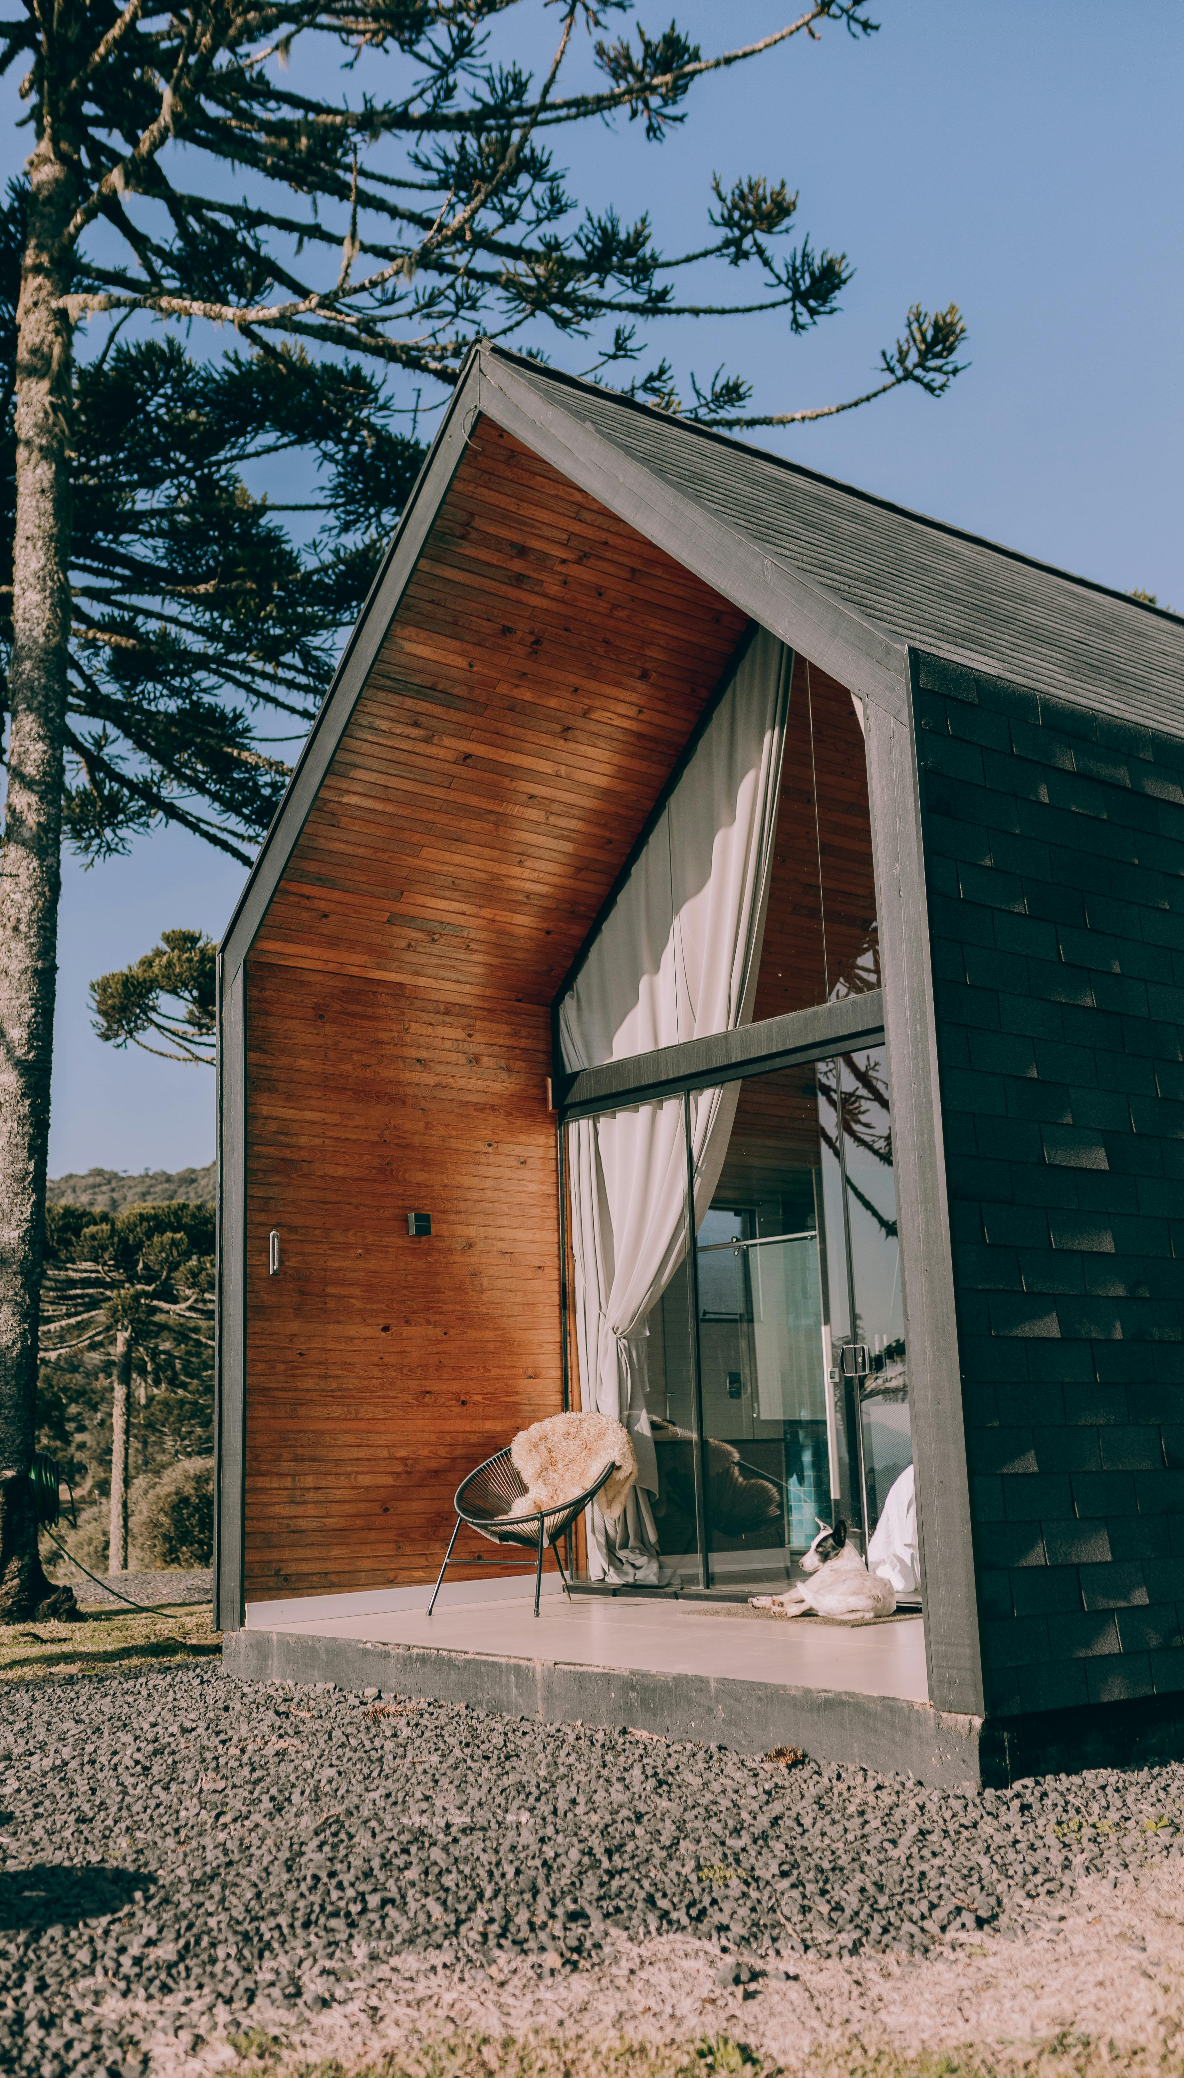
Start-up Funding: The Icelandic Regional Development Institute (Byggðastofnun)
Tip: A farm converting outbuildings into geothermal-heated cabins could secure a co-investment loan to cover 30–50% of the total project cost.
Note: In 2024, the EU-backed Byggðastofnun will lend €21 million to small rural businesses on favourable terms.
This means that a tourism startup in the Icelandic countryside could apply with lower interest and longer repayment terms to support regional growth.

Slide 15

5
National Government Grants
Regional Growth Agreements
(Uppbyggingarsjóður)
Objective: The Icelandic Regional Growth agreements provide funds to each region for projects, often including cultural, tourism development, innovation, and community and rural revitalisation initiatives. Such initiatives can get modest grants through regional authorities. Its budget is ISK 1–5 million (€6.5–32k).
Grants are usually ISK 1–5 million (approx. €6,500 to €32,000). Co-funding is often required (e.g. 50–70% covered by the applicant). Some regions offer larger amounts if the project shows a strong community or environmental impact.
Example:
This is where small-scale tourism accommodation projects—like glamping pods, heritage lodging, or eco-retreats—can apply for partial funding, especially if they:
Involve cultural elements (e.g. local stories, crafts, nature interpretation)
Create rural jobs or tourism in low-traffic areas
Include innovative or green design features (e.g. turf roofs, compost toilets)

Slide 16
National Government Grants
Regional Growth Agreements
(Uppbyggingarsjóður)
Example:
A small glamping project could consider applying for these grants (the application would be submitted through the regional council, and the criteria often include cultural/social impacts, as well as innovation). This might involve developing three off-grid cabins next to a nature trail. They could receive ISK 3.5 million (€23,000) from the Uppbyggingarsjóður Austurlands for:
Cultural signage and trail interpretation.
Compost toilet installation.
Cabin design that uses local timber and turf.
They matched the grant with a personal loan and LEADER rural development funding.
While these grants may be smaller (approximately ISK 1–5 million, equivalent to €6,000–€30,000), they are worth exploring for partial funding.

Slide 17


National Government Grants
Regional Growth Agreements
(Uppbyggingarsjóður)
Additionally: Consider innovation or green incentives: if your project has an innovative aspect (such as a new type of eco-accommodation), you may seek grants from the Technology Development Fund or similar organisations (competitive but possible).
Accommodation Projects that Qualify:
Converting a historic barn or turf house into a guest stay with cultural programming
Small-scale eco-cabin clusters that enhance year-round tourism
Glamping or wellness retreats that support local artisans or guides
Interpretation huts or overnight shelters linked to nature trails or local stories
Recommended Reading
Northeast Iceland Development Fund - Uppbyggingarsjóður grant allocation rules
The sustainable development of tourism in Iceland
The south Iceland Development fund
The south Iceland Development fund has opened applications for the autumn allocation of 2024.

Slide 18

6
Government Micro Grant
“Fræ” Seed Grant (Rannís via TDF)
Objective
“Fræ” Seed Grant (Rannís via TDF) is a micro grant for individuals or young companies to test new technology or concept—essentially a proof-of-concept fund. Amount is around EUR 10,000 (ISK 1.5 million), up to five months. Source Small Business Act
Ideal for: Piloting a tiny off-grid guest cabin with a compost toilet or testing a digital interpretive app for nature trails
Information is often available on Rannís’s startup seed grant page; search for "Fræ" or "Seed Grant Rannís". Or try the Ranní Circular Economy / Green Pilot Grants, which sometimes target tourism (e.g., plastic-free hospitality). Depends on the call, but similar to innovation grants (up to €300k).
Ideal for net-zero hut projects, recycled-material cabins, or compost-based sanitation systems. Keep an eye on their funding calls.

Slide 19
7
Commercial Banks
Landsbankinn, Arion Bank, and Íslandsbanki
Objective
The major Commercial Banks in Iceland (Landsbankinn, Arion, Íslandsbanki) have been quite involved in financing tourism ventures during the tourism boom. They primarily provide commercial lending, advisory services, and tailored financial products for the tourism and rural development sectors.
Landsbankinn: Focuses on rural and tourism SMEs, offers long-term investment loans for cabins, land, and infrastructure.
Arion Bank: Has a dedicated tourism sector lending team; involved in project finance for glamping sites, eco-hotels
Íslandsbanki: Strong on green lending and ESG (environmental, social, governance)–aligned tourism investment.
They require solid projections, but if you already own land or property, you might use that as collateral for a loan to develop cabins. Interest rates in Iceland can be high, so consider leasing arrangements as well (some companies may lease you glamping structures or equipment).

Slide 20
8
Crowd Funding & Community
Objective
Crowdfunding and Community: Iceland has a vibrant local community and also a supportive international fan base (people who love Iceland). Some projects have been crowdfunded by appealing to those groups. For instance, using platforms like Karolina Fund (an Icelandic crowdfunding site for creative projects) or even Kickstarter to invite Iceland enthusiasts worldwide to support an eco-friendly retreat in the Icelandic nature (with rewards like stays once built).
Tourism Distribution: Though smaller in scale, Iceland’s funding landscape prizes projects that help distribute tourists more evenly and do so sustainably. If your alternative accommodation is outside the heavily-travelled areas and promotes year-round tourism, emphasise that in funding applications – it aligns well with Iceland’s policy goals. Refer to the crowdfunding example on the next slide.
Recommended Reading
Landsbankinn: Growth seeking balance – economic analysis oof tourism in Iceland
Icelandic Financial Institutions
Icelandic small businesses to get €21 million European financing boost

Slide 21

Green Funding for Rural Alternative Tourism Accommodation

Slide 22
Green Funding for Rural Alternative Tourism Accommodation
Thinking of going green with your rural tourism business? Whether you're running a glamping site, eco-lodge, or farm stay, countries like Ireland, Slovenia, Iceland, the Netherlands, and Italy all offer green grants and loans to help small tourism businesses become more sustainable.
You can obtain funding for upgrades such as solar panels, insulation, heat pumps, or even eco-certifications.
For example, Ireland’s SEAI offers grants for energy upgrades, Slovenia’s Eco Fund supports green renovations, and Italy has a €500 million fund to make tourism more sustainable. In Iceland, rural guesthouses can apply for regional development or innovation funds, while the Netherlands offers generous tax breaks and subsidies for energy-efficient improvements.
Going green isn’t just good for the planet — it also cuts your energy bills, boosts your reputation with eco-conscious guests, and future-proofs your business. And best of all? Many of these schemes are tailored for small, rural tourism accommodations just like yours.
Let’s explore what’s out there and how you can tap into these great opportunities!

Slide 23

Green Grants and Funding (Iceland)
1
Tourist Site Protection Fund (Framkvæmdasjóður ferðamannastaða)
Offers grants to develop and maintain visitor infrastructure—such as trails, boardwalks, viewpoints, waste systems, and toilets—to minimise environmental impact.
For municipalities, landowners, tourism operators, glamping and lodge developers. Priority for projects that protect nature, improve safety, or distribute tourist flows.
Example: An eco-accommodation on private land installs sustainable paths and signage.

Slide 24
Example: In 2013, Hveravellir received ISK 10 million (approximately €60,000) to install geothermal power and water systems. Dozens of entries annually:
• Over 700 projects funded between 2012 and 2020 (5.5 billion ISK)
• In 2021, the fund provided 65 million ISK
COSME – Earlier Green Loan Support
Back-to-back with EIF, Pre-2020, supported green loans to 100 SMEs, including rural tourism and environmental projects, via Byggðastofnun.
NIB – Byggðastofnun Lending
NIB bilateral loan facility with Byggðastofnun (e.g., €12 million in 2015; €135 million total) supports SME investment in eco infrastructure
Nefco–EIF Guarantee for Green SMEs (Nordic-wide)
As of March 2025, a €70 million guarantee via InvestEU enables Nefco to provide preferential green loans in Iceland
2
3
4

Slide 25
Resources & Supports
Consider joining the Iceland Tourism Cluster organisations or local tourism councils (some regions have tourism committees). Networking can help you learn about any ad-hoc funding initiatives.
Business Iceland (Íslandsstofa) is focused on promoting Iceland abroad, but as a business you might tap into their marketing support (they often have co-operative marketing programs where small businesses can participate in trade shows under a national umbrella).
The Iceland Tourism Cluster Initiative
& Business Iceland
Permits and Planning: The Icelandic Tourist Board (Ferðamálastofa) is the primary agency responsible for planning and managing tourism in Iceland.
It is tasked with various responsibilities, including issuing licenses for travel agencies and tour operators, monitoring their activities, and developing Destination Management Plans (DMPs) for different regions.
The Iceland Planning for Tourism Agency

Slide 26
Resources & Supports
Each Icelandic municipality has a cultural or business development fund (often small). Also, the Icelandic Tourist Board sometimes issues development grants for specific tourism themes (e.g. to improve accessibility or innovation in tourism). Keep an eye on announcements from the Ministry of Culture and Business (which oversees tourism) government.is.
Icelandic Tourist Board

Slide 27
Well Done
Module 7 (Part 3)
Investment, Grant Applications & Pitching Your Idea
You have Completed… Module 7 (Part 2)
Find the Funds That Fit
Iceland
Next is…

