Slide 1
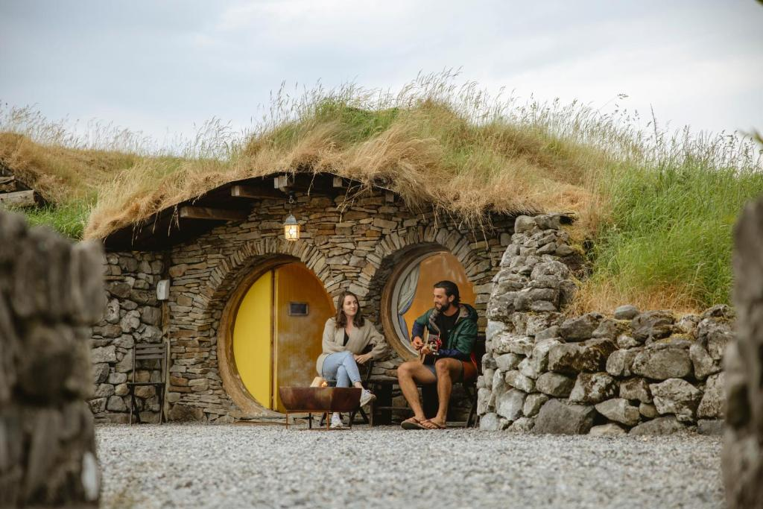
Mayo Glamping, Ireland
Module 8 (Part 5)
Making It Viable – Pricing, Planning & Long-Term Financial Health
Financial Planning & Funding

Slide 2
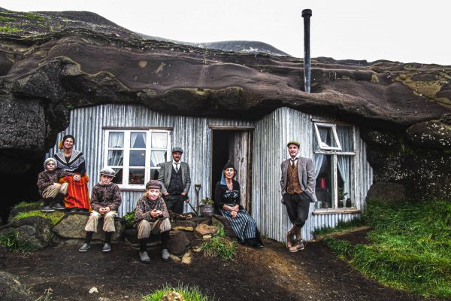
Module 8 (Part 5)
Cave People, Iceland
Contingency Planning for Long-Term Viability
2

Slide 3
Module 8 (Part 5) Overview
Learning Outcomes
Financial success isn’t just about what you earn today — it’s about preparing wisely for tomorrow. In this section, you’ll explore how to safeguard your accommodation business against risks while staying aligned with both environmental and financial sustainability. We cover risk management and contingency planning to help you prepare for best, expected, and worst-case scenarios, and show how insurance can act as a financial safety net. You’ll also learn how to design financial strategies that support stability, integrate green investments, and make smart long-term decisions that keep your business viable, resilient, and competitive in changing conditions.
Making It Viable – Contingency Planning for Long-Term Viability
Identify key financial risks that could impact your business operations.
Develop contingency plans to prepare for emergencies, economic downturns, or climate-related disruptions.
Implement financial buffers (e.g., cash reserves) to manage unexpected challenges.
Align long-term planning with sustainability goals, including environmental investments and energy-efficient upgrades.
Balance profitability with eco-conscious and future-focused decision-making.
Create a strategic plan for reinvestment that supports resilience and responsible growth.

Slide 4
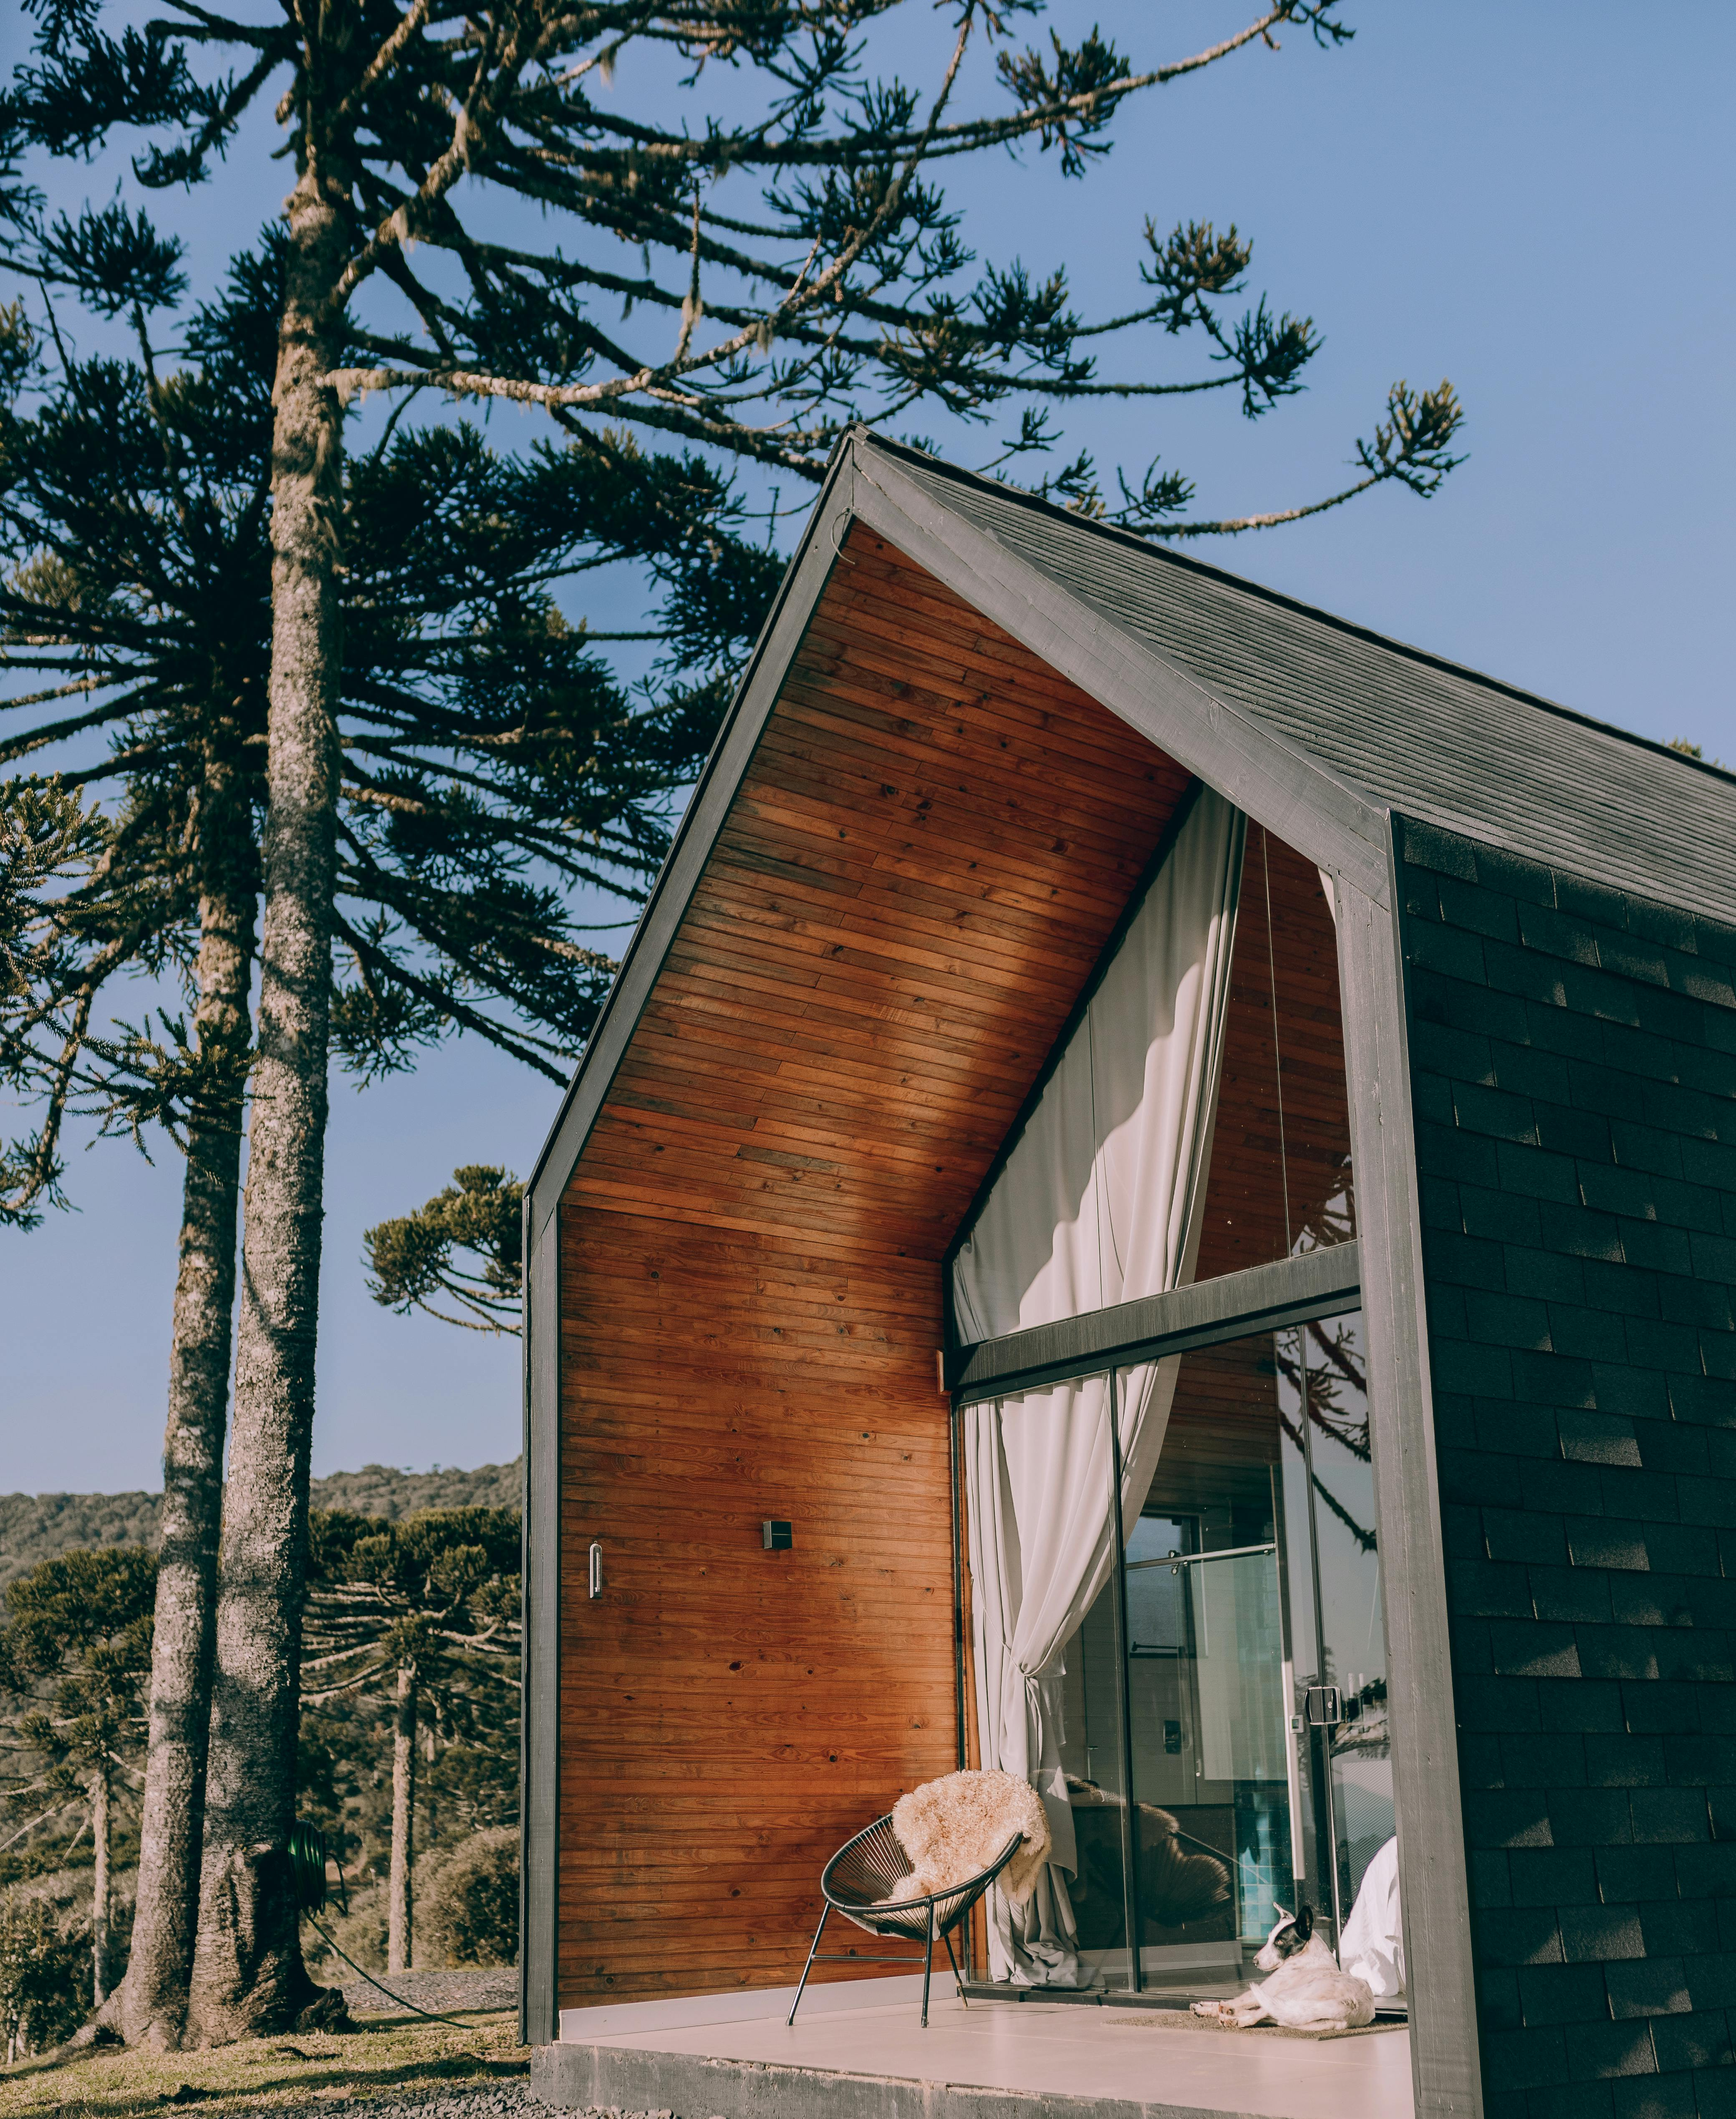
Part 5: Section 11 Contingency Planning for Long-Term Viability (72 Slides)
05
Photo Credit:
Section
Module 8
CONTENTS
11
Section 11 P5
Section
Contingency Planning for Long-Term Viability
(72 Slides)

Slide 5

Section 11
Contingency Planning for Long-Term Viability
(Risk) How can I protect my alternative accommodation business from future risks? (Financial Health) How can I plan for long-term financial health, and make sure my business remains viable? (Environmental) How do eco-friendly decisions influence my costs, pricing strategy and long-term financial viability?
Objective: (Managing Risk, Environmental Sustainability and Long-Term Financial Health for Long-Term Viability) To help you assess and identify potential risks and future financial and environmental challenges that could impact your business, and what protection measures you can put in place.

Slide 6
Section 11 Contingency Planning for Long-Term Viability
Financial success isn’t just about what you earn today—it’s about planning wisely for tomorrow. In the final section of this module, you’ll explore how to protect your accommodation business from future risks while staying aligned with environmental and financial sustainability goals. From emergency funds and climate resilience to strategic reinvestment, this section helps you prepare for uncertainty and make long-term decisions that ensure your business remains viable, responsible, and resilient in the years ahead.
Section 11: Contingency Planning for Long-Term Viability
How can I ensure my business remains environmentally sustainable, protected and financially viable long term?
Objective: To identify financial risks, build contingency plans, invest wisely in eco-decisions and implement long-term sustainability strategies.
.

Slide 7
Contingency Planning for Long-Term Viability
Helps you manage risks and prepare for the best vs the expected vs the worst-case scenarios. Risk management isn’t about fearing worst-case scenarios — it’s about building confidence. By anticipating what could go wrong, you’ll be better equipped to either prevent disruptions or bounce back faster when challenges arise. The ultimate goal is resilience. With clear contingency plans, you’ll reduce stress, make faster decisions, and maintain financial health and stability — even in turbulent times. As the saying goes, “Hope for the best, plan for the worst.” Learn prevention and mitigation tools so your business not only survives tough times but emerges stronger.
42
Risk Management & Contingency Planning
Preparing for the ‘what ifs’, worst vs expected vs best case scenarios
43
Risk and Insurance Protection
Understand types of risks that could threaten your business and the role of insurance as a financial safety net.
44
Financial Strategy and Planning for Stability
Create a financial strategy and implement prevention and mitigation measures so you can survive economic risks and be financially healthy long term.
45
Green Investments for Financial Health
Make smart eco eco-conscious investment decisions that will impact your business financially. How to integrate such costs and values into your pricing strategy and attract eco-aware travellers.

Slide 8

42
Risk Management & Contingency Planning
If the past few years have taught business owners anything (think global events like pandemics, or even local surprises like a sudden road closure that affects a hotel), it’s that unexpected challenges can arise.
After establishing a budget, performance tracking and financial management, we must acknowledge and prepare for the risks and uncertainties in your tourism accommodation business.
This section is about being prepared for the “what-ifs.” The purpose of risk management and contingency planning is to identify potential risks to your business and plan how you’d deal with them so that a setback doesn’t turn into a business-ending crisis. In the context of an accommodation business, risks can range from low-probability disasters (such as fire, flood, or pandemic) to more likely events (such as a slow tourism season, a competitor opening next door, staff turnover, or equipment failure).
Risk Management
Preparing for the ‘what ifs’

Slide 9

Guiding Question: What could go wrong in my business, and how do I prepare for it so I can survive tough times?
The objective here is not to scare you, but to instill a habit of proactive thinking: by anticipating possible problems, you can often either prevent them or soften the blow. A saying in business is “hope for the best, plan for the worst.” This section helps you do that by creating contingency plans. In real-world terms, this could mean having financial safety nets, insurance, backup marketing strategies, or simply a plan B for various scenarios.
Contingency planning is essentially risking management – managing risks so they don’t manage you. This section covers identifying possible risks to your alternative accommodation venture and how to mitigate them so that your financial viability isn’t compromised.
Another contingency is insurance: ensure you have appropriate business insurance (property insurance, liability insurance, maybe business interruption insurance if available) so that incidents like theft, fire, or lawsuits don’t bankrupt you.
Risk Management
Hope for the Best & Plan for the Worst

Slide 10

Learn how running a glamping or tiny lodge business involves specific financial risks, so owners should clearly understand these risks and have strategies in place to mitigate them. Next, we discuss different risks and key risk mitigation or prevention tools.
By identifying these, you’re not dwelling on doom and gloom, but rather making sure you’re not caught completely off-guard.
For each significant risk you identify, outline a contingency plan – what actions will you take if that scenario comes true?
Essentially, “If X happens, then we will do Y.” Also consider preventive measures (things you can do now to reduce the chance or impact of the risk). A critical part of contingency planning is financial safeguards. One of the simplest yet most effective safeguards is an emergency cash reserve.
Risk Management
Hope for the Best & Plan for the Worst
Contingency Planning for Retailers and Hospitality Businesses

Slide 11
Many business plans include three cases: worst, expected, and best.
It’s helpful to model a pessimistic scenario (e.g., lower occupancy and some higher costs) to see if you still break even or have a tolerable loss.
Also model an optimistic case (high occupancy, stable costs) – this isn’t to be Pollyannaish (overly optimistic), but to see the potential upside and ensure you have capacity (e.g. enough cleaning help) if things go really well.
As a beginner, focus on making the “expected” case solid, but have the worst-case scenario in your back pocket so you’re not caught off guard if tourism is slow or a rainy summer hits bookings.
Worst-Case vs Expected Case vs Best-Case Examples in the next slide!
Worst vs Expected vs Best-Case

Slide 12
In this version, you assume things don’t go as planned:
Lower-than-expected occupancy
Higher variable or unexpected costs (e.g. repairs, fuel surges)
Possible marketing delays or tourism downturns
Goal: To stress-test your model and ensure you can at least break even or withstand a manageable loss. This helps you prepare for downturns — for example, a rainy summer, local event cancellation, or rising utility costs.
Worst-Case Scenario
This is your baseline forecast — the version you use to budget, plan, and operate your business. Based on realistic occupancy rates drawn from local market trends or past performance. Includes typical running costs and seasonal variations. Assumes stable pricing and normal guest booking behaviours. Goal: Focus on this one, make sure your business can thrive in normal conditions.
Expected Case Scenario
This is the optimistic view: Occupancy is high or full during peak months. Costs are stable or reduced due to efficiency. You receive additional bookings, upgrades, or group stays. Goal: Look at the potential upside and make sure you’re ready to scale if things go better than planned — e.g., do you have enough staff, laundry capacity, or amenities if demand surges?
Best Case Scenario

Slide 13

43
Insurance
Protecting Your Assets & Reducing Risk
What types of insurance do I need to protect my business, and why is it necessary? Objective: Understand how insurance protects your business from potential threats that could cause financial loss or disrupt operations. Identify the right insurance policies that will provide a financial safety net, minimising and preventing disruption from incidents like fire, weather damage, theft, or guest injury.

Slide 14
Insurance: Risk Assessment & Strategies
Identify and Prioritise Risks
Insurance and Mitigation
Use insurance to protect against certain risks. While insurance costs money, it can save you from catastrophic losses (for example, covering damage costs from that storm). Additionally, take preventive measures – regular maintenance can help prevent unexpected expenses, and flexible cost structures (such as part-time staff or seasonal contractors) can help adjust expenses when business is slow.
First, think through what could go wrong.
List scenarios – from mild (e.g. a slow month) to severe (e.g. a natural disaster affecting tourism). Assess the likelihood of each and the potential impact if it were to happen. This helps prioritize what to prepare for.

Slide 15
Identify Risks and Implement Prevention & Mitigation Strategies
Emergency Risk Planning
For example, having a financial cushion (emergency fund, as noted earlier) and a plan for operating under unexpected conditions. For example, if a storm forces you to close for a month, do you have funds or a line of credit to carry through?
Operational Risks
For operational risks, have backup solutions: if your booking software fails, have a manual process or a secondary system in place. If a key staff member quits during peak season, maintain a relationship with a temp agency or have a cross-trained team so others can fill in. Consider scenarios: “What if the boiler breaks in the middle of winter?” or “What if my booking system goes offline during a peak booking period?”
Bookings Underperform
One common risk for seasonal businesses is that peak-season bookings may underperform. For example, say you planned on 80% occupancy in summer but only achieved 60%. If you’ve identified that as a risk, you can watch early booking trends and maybe increase marketing or adjust pricing quickly when you see slow pickup, rather than realising too late.

Slide 16
Liability Risk Insurance
For example, it protects you if someone has an accident or gets injured on your property, natural disasters (such as storms or floods) damage your facilities, or sudden drops in tourism occur, or even if another pandemic strikes, so that one incident doesn’t bankrupt the business. For example, someone slips in the shower of the treehouse.
Ongoing Operational Costs
Property Insurance
Covers damages to your structures (tents, cabins, etc.), crucial if you operate in hazard-prone areas (forest fire or flood zones). Example: If a kitchen fire causes damage and closure for a month, insurance can cover repairs and lost income in that period, rather than you paying out of pocket entirely.
Market Risks
For competitive risks, such as a new rival, a contingency might involve ramping up your unique selling points (better service, local experiences) or targeted marketing to loyal customers. Consider “What if a new unique hotel opens nearby with cheaper rates?” or “What if travel regulations change (e.g. visa rules or airline routes) and fewer guests come?”
External Risks
like economic downturns or health crises. Assign each risk a rough likelihood and impact. For example, a slow season being worse than expected is fairly likely at some point and has a medium impact (lost revenue), whereas a natural disaster hitting your area might be very unlikely but have a high impact.

Slide 17

44
Financial Health
Financial Strategy & Long-Term Viability
How can I plan for long-term financial health and make sure my business remains viable in changing economic conditions?
Objective: To build a sustainable Financial Strategy (plan) that ensures your accommodation can survive challenges, grow profitably, and support your personal and professional goals. To equip you with the tools to create a strong financial strategy, including cash flow forecasting, setting aside contingency funds, monitoring profitability, and planning for reinvestment. This supports long-term growth, investor confidence, and peace of mind.

Slide 18
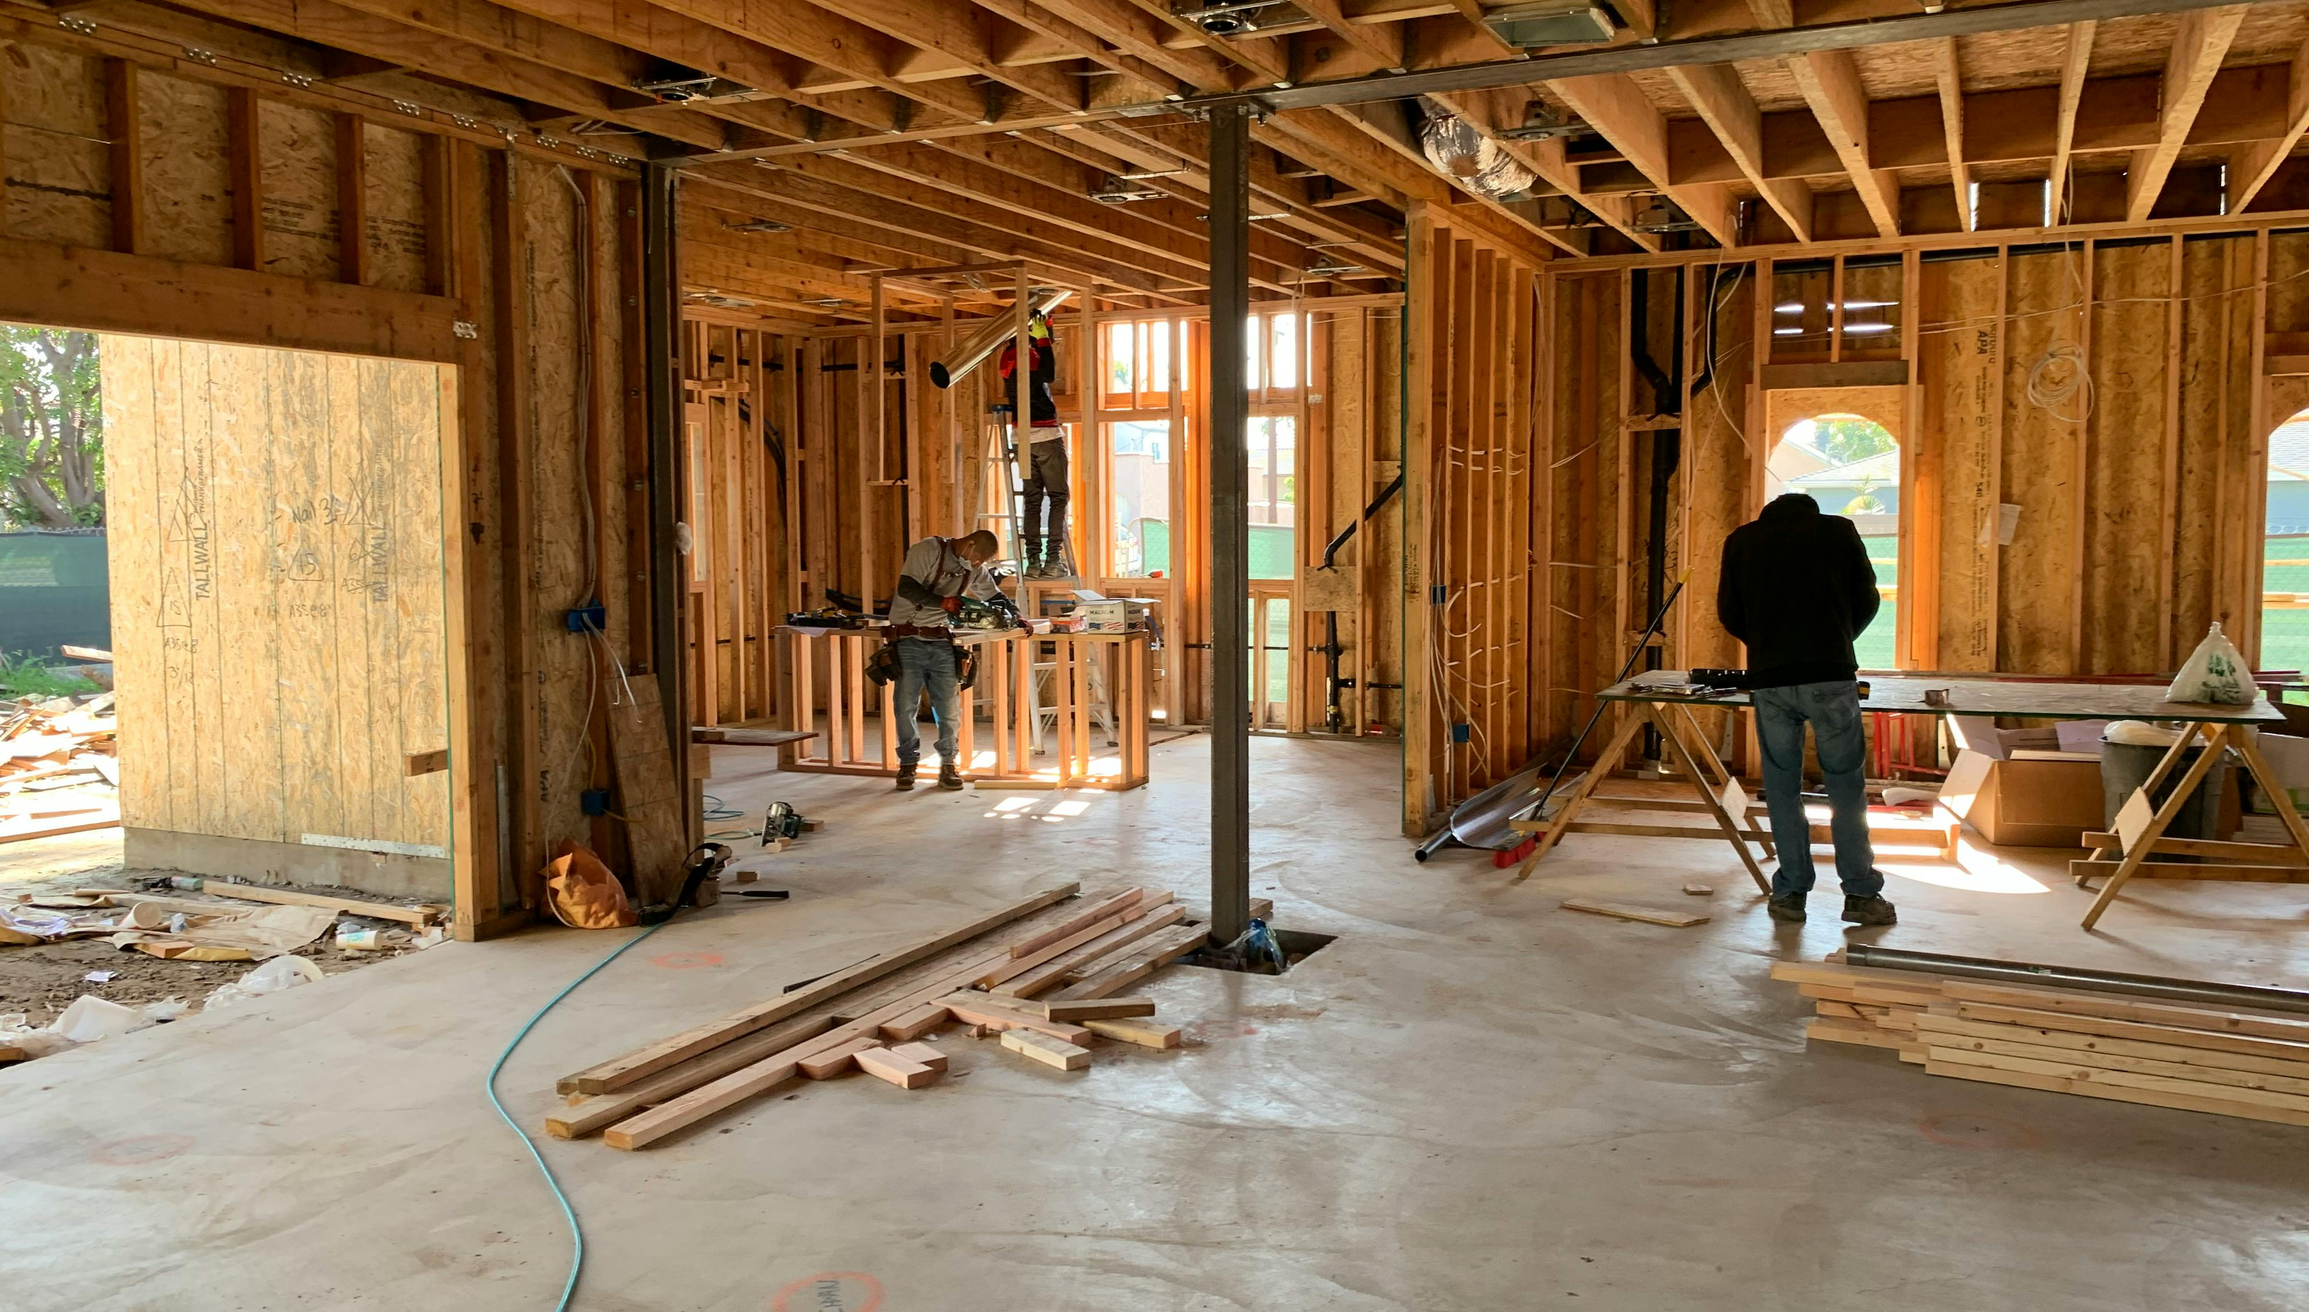
Sustainability and Long-Term Financial Health
With risk management in place, you have built resilience into your business model. The final step is to look at sustainability and long-term success – essentially, how to keep your venture thriving for years to come. We transition by pointing out that managing risks and finances wisely lays the groundwork for sustainable operations, which is the focus of the concluding section.
This capstone section ties everything together and looks at the big picture of enduring success. We discuss “sustainability” in two senses: financial sustainability (consistent profitability and ability to reinvest in your business) and environmental sustainability, which is highly relevant in alternative tourism and can also bolster financial success. Environmental viability is discussed in Section 11.
It is essential to note that a financially sustainable business regularly earns more than it spends, adapts to change, and plans for growth.
Long Term Viability
Financial and Environmental

Slide 19

This means continuously applying what was learned, including updating budgets, refining pricing in response to market changes, managing costs efficiently, and maintaining effective risk strategies. We must emphasise in the modern tourism market, eco-sustainability and financial viability often go hand in hand.
Adopting sustainable practices can reduce operating costs and attract more guests. For example, installing solar panels or rainwater harvesting systems can lower utility bills over time and earn tax credits or incentives.
Likewise, eco-friendly lodgings often enjoy higher demand and guest loyalty, thereby strengthening revenue. Studies have found that sustainable properties tend to have lower operating costs and increased guest appeal, which in turn boosts their financial performance.
We encourage owners to seek sustainability wins, such as energy efficiency (to save money), local sourcing or community initiatives (to enhance brand and potentially build community support), and obtain eco-certs that can justify premium pricing.
Long Term Viability
Eco-sustainability & Financial Go Hand in Hand

Slide 20
What is a Financial Strategy?
Your Money Management Plan!
A Financial Strategy is essentially a money-management game plan for your business goals. It answers the questions:
“Where should our money go to best achieve our objectives?” and “How will we fund our plans?”
This strategy will typically cover decisions about spending, saving, investing, and financing.
In practical terms, a financial strategy for your accommodation business will include things like investment decisions, financing decisions, cost management and pricing strategies.
In short, the financial strategy is your guide for decision-making. Whenever you face a financial choice, you refer to this strategy.
Example: Should you hire another staff member? Your financial strategy (based on your goals and budget) will guide whether that’s feasible now or later.
Example: Should you reinvest earnings or keep cash? The strategy clarifies priorities (maybe reinvest if growth is the goal, or save if building a safety net is the goal).

Slide 21

All businesses face financial risks. Effective financial management means identifying potential risks and planning how to deal with them. In the alternative tourism accommodation sector, some common financial risks include:
Cash Flow Shortages: Seasonal dips or unforeseen events (like a sudden travel ban or pandemic) could dry up your bookings for a while. This risk is particularly high in tourism – you may experience a sudden shift from full occupancy to near zero due to factors beyond your control. If you haven’t prepared, you could run out of cash.
Market Fluctuations: Economic conditions or market trends can affect tourism demand. A recession might mean fewer travellers, or increased competition in your area could force prices down. Even changes in exchange rates can impact you if you cater to international guests. These external factors can reduce your revenue or increase costs (e.g., rising utility or supply prices). To manage these risks, plan ahead as part of your financial strategy. The next slide shows some Risk Management Strategies:
Risk Management
Cash Flow, Unexpected Expenses & Market Fluctuations

Slide 22
Financial Strategy: Practical Terms Explained
Investment Decisions
Example: deciding to allocate €15,000 toward building a new treehouse accommodation because your goal is to expand capacity.
Financing Decisions
Example: planning to use 50% saved profits and 50% a small business loan to finance that treehouse, thereby balancing risk and cost.
Cost Management
Example: implementing energy-saving measures to cut utility expenses by 10%, helping increase net profits which can be reinvested.
Pricing Strategy
Example: setting seasonal pricing (higher in peak season, discounts in off-peak) to maximize revenue while maintaining occupancy.

Slide 23


Why Do You Need a Financial Strategy?
Without a strategy, your financial decisions might be ad-hoc and reactive. Here’s why having a clear financial strategy is important:
Guides Your Decisions
Example
  A financial strategy acts like a compass for your spending and investing choices. It helps ensure each euro is used in a way that moves the business toward its goals.
If your goal is to attract eco-tourists, your strategy might prioritise spending on sustainable infrastructure (like solar power or rainwater harvesting) rather than on something unrelated. This helps you decide whether to approve expenses that align with the plan and decline those that don’t.

Slide 24


Prepares You for the Future
Example
  With a strategy, you’re thinking ahead. You can plan for growth opportunities or big expenditures well in advance.
If you know you want to expand to a new location in two years, your financial strategy might involve saving a portion of profits or securing an investor now, so the money is available when you’re ready to expand. It also helps you anticipate potential pitfalls (e.g., needing extra funds in winter, which can be part of the strategy to maintain a minimum cash balance.
Keeps You On Track
Example
  Business environments are full of distractions and unexpected challenges. A solid strategy keeps you focused on your long-term goals even when short-term issues arise.
If a tempting opportunity arises (such as investing in something unrelated), your strategy helps you stay focused on your core goals, like improving your accommodation. It also provides a guide during setbacks (like a tourism downturn), so you can adapt without losing direction.

Slide 25

Builds Credibility
Example
  If you ever seek external funding (loans or investors), having a clear financial strategy is a big plus. It shows you’ve done your homework and manage finances deliberately.
Banks and investors are far more likely to trust and fund a business owner who can articulate their financial strategy and show that their budget and financial records align with that plan. In essence, it demonstrates professional financial management of the business.
In summary, failing to plan is planning to fail. A financial strategy is needed to ensure all parts of your business (sales, expenses, investments) are working in harmony toward what you want to achieve. It’s your financial roadmap to success.

Slide 26

Address Challenges with Strategies and Use Opportunities to Build Resilience
To build a truly sustainable and resilient tourism business, financial planning must go beyond monthly income and short-term budgeting.
The following strategies provide a roadmap for achieving long-term financial health, ensuring your accommodation can adapt to change, withstand seasonal fluctuations, and support both your personal goals and business mission.
From setting aside emergency funds and reinvesting in upgrades to tracking financial performance and diversifying income streams, each area strengthens your foundation for growth.
By addressing inflation, risk, and long-term vision, you’ll not only keep your business afloat—you’ll set it up to thrive for years to come.
Long Term Financial Health
How to Address Challenges and Build Opportunities

Slide 27

Understand Your Financial Situation Right Now – Current Problems
Before you can plan for the future, you need a clear picture of your present finances. This involves reviewing your financial records and statements to answer: Where is your money coming from and where is it going right now?
Review Financial Statements and Understand
Where You Stand Right Now
Look at your Income Statement, Balance Sheet, and Cash Flow Statement (more on these statements below) to gather key facts. How much revenue did you earn last month or last year? What are your major expenses? How much debt do you have? How much cash do you have on hand?
Example: Your income statement might show that your B&B earned €100,000 last year, with €90,000 in expenses, resulting in a €10,000 profit. The balance sheet might reveal that you have €5,000 in cash in the bank, a loan of €20,000, and assets (such as property and equipment) worth €50,000.

Slide 28

Cost Over Runs are a Common Challenge for Busineses
Cost Over Runs
A common risk is cost overruns – for example, energy prices spike, making utilities much more expensive than budgeted. Knowing this could happen, you might decide to invest in some energy-efficient appliances or have a bit extra in your emergency fund for utility bills.
Emergency Cash Reserve
Set money aside that you only use when something goes wrong. Many experts suggest having a few months’ worth of operating expenses saved if possible. Example: If you know your fixed costs are €5,000 a month, having, say, €10,000 in an emergency fund means if you suddenly have a couple of near-zero revenue months (imagine a travel ban or pandemic scenario), you can still pay rent and basic bills and survive until things recover.

Slide 29
Costs rarely stay constant – electricity prices might rise, or suppliers charge more. It’s wise to include an “inflation” scenario.
For example, what is the impact if utility costs go up 15% next year? You can adjust those numbers in your cost table and see the profit shrink. If a significant cost increase is likely, plan to counteract it (perhaps by raising prices a bit, improving energy efficiency, etc.).
Solution = Contingency: This refers to extra budget set aside for unexpected costs or price increases. We included a contingency in startup costs.
Similar applies to annual costs, you might want a contingency line (say 5-10% of expenses) or at least be aware that your actual results may vary.
Planning a scenario with across-the-board 10% higher expenses can stress-test your business model.
Possible:
Cost Inflation Scenario

Slide 30

Understand Your Financial Situation – Identify Opportunities
Identify Strengths, Weaknesses & Opportunities
As you review, note areas of strength to leverage and weaknesses to address. Strengths could include a high profit margin on certain offerings (such as your guided tours or meal services) or a strong cash reserve. Weaknesses might be high debt or seasonal cash flow problems (e.g., every winter you dip into the red). Perhaps your occupancy is high on weekends but low on weekdays, or your utility costs are increasing faster than your revenue. These insights help shape your strategy.
Example: A strength, like a loyal customer base, might lead you to implement a referral program to boost bookings, whereas a weakness, like high debt, might lead you to prioritise using profits to pay down loans.

Slide 31
By knowing where you stand, you can set a strategy that addresses challenges and builds on opportunities. This means looking closely at:
your costs,
your revenue patterns, and
how your resources (land, staff, time) are being used — or not.
Example 1: Your cleaning costs are very high; your strategy might include finding a more cost-effective cleaning service or investing in equipment that reduces costs in the long term.
Compare different cleaning service providers
Hire seasonal staff instead of contractors
Investing in better laundry or cleaning equipment (which pays off over time)
Using fewer but higher-quality changeover days per week
Result: You reduce ongoing costs, without sacrificing guest satisfaction.
Know Where You Stand
How to Address Challenges and Build Opportunities

Slide 32
Example 2: Idle Land or Underused Space
If part of your site is unused during peak season, that’s lost revenue potential. Your strategy could be:
Adding a few low-cost camping or tent pitches for overflow
Creating a small picnic/event space for community rentals
Partnering with local artisans for pop-up markets or wellness classes
Result: You turn passive land into active income, without major new investment.
Example 3: Low Off-Season Revenue
If your bookings are almost zero in January–March, but you’re still paying heating or staff costs:
Try closing completely for those months
Or offer weekend-only bookings, or retreats
Add local marketing to attract out-of-town guests for Valentine’s, wellness weekends, etc.
Result: Either cut costs or create targeted income without overextending.
Know Where You Stand
How to Address Challenges and Build Opportunities

Slide 33
Need Back Up Cash: Basic Financial Risk Strategies
Diversify Income Streams
Maintain a Cash Reserve
Where possible, don’t rely on a single source of revenue. In an accommodation business, consider offering add-on experiences (such as tours or meals) or listing your property on multiple booking platforms to reach different customer segments. If one channel or market weakens, others can help compensate. Similarly, avoid relying on a single large client or a single group of guests – diversify your customer base to spread risk.
Set aside an emergency fund or risk buffer in your budget. This is extra cash saved for those “just in case” moments.
For example, you might keep a reserve equal to 2-3 months of expenses. That way, if a risk event hits (say a sudden slow season or an unexpected repair), you have funds to bridge the gap(as budgeting for contingencies helps avoid nasty surprises).

Slide 34
Strategies – For Financial Resilience
Strategy | Description
1. Building Cash Reserves | Every sustainable business needs a financial safety net. Cash reserves act as a cushion during off-peak seasons, unexpected cancellations, urgent repairs (like plumbing or roof leaks), or global disruptions (like a pandemic). Best practice is to save 3–6 months’ worth of operating expenses in a separate account.
2. Reinvestment Planning | Future-proofing your accommodation means regularly reinvesting part of your profits. This can include installing solar panels, upgrading interiors, adding new units, or enhancing guest experiences (e.g., sauna, local food tastings, wellness packages). Plan annual reinvestment goals based on long-term value creation.
3. Adjusting for Inflation and Costs | Your operating costs (cleaning, supplies, energy, etc.) will rise over time. To stay profitable, update your pricing annually. Review your cost-per-night and ensure your profit margin stays healthy. Use market comparisons, inflation rates, and guest demand trends to guide price adjustments.
4. Monitoring Financial Health | Don’t just look at monthly income—track key financial indicators like net profit margin (how much profit you keep), cash flow (what’s coming in and going out), and debt-to-income ratio (how much you owe vs. earn). Simple monthly reviews help you spot trends early and adjust accordingly.

Slide 35
Strategies – For Financial Resilience
Strategy | Description
5. Diversifying Revenue Streams | Avoid relying solely on overnight stays. Add income through value-aligned extras: e.g., yoga classes, local crafts, farm tours, surf lessons, or a mini shop selling eco-products. Partner with local businesses or offer Airbnb Experiences to increase revenue and enhance guest satisfaction.
6. Risk Management | Risks like market downturns, new competitors, regulatory changes, or illness can impact your income. A solid risk plan includes insurance, flexible cancellation policies, multiple booking channels, and contingency plans for income dips (e.g., seasonal local workshops or events).
7. Long-Term Goal Mapping | Where do you want to be in 3, 5, or 10 years? Whether it's scaling your business, reducing your working hours, selling the business, or reinvesting in the community, mapping long-term goals helps shape decisions today. Break these goals into financial, lifestyle, and operational targets.

Slide 36
How (with examples) to Plan for Prevention and Resilience
Strategy | Description | Strategy | Example
1. Building Cash Reserves | Why and how to build a buffer for emergencies, slow seasons, or unexpected repairs. | Set aside 10–15% of monthly revenue in a separate savings account. | If you earn €2,500/month, automatically save €250–€375/month in a business reserve account.
2. Reinvestment Planning | Allocate a portion of your profit for upgrades, renewables, or guest experience improvements. | Create an annual reinvestment plan with a percentage target (e.g. 20% of net profit). | Spend €3,000 per year upgrading to solar panels or renovating a cabin to improve guest ratings.
3. Adjusting for Inflation & Costs | Update your prices annually and review costs to stay profitable. | Use cost-plus pricing and review suppliers yearly. Adjust your nightly rate annually. | Raise nightly rate from €120 to €130 if utilities, laundry, and insurance increase by 8%.
4. Monitoring Financial Health | Use financial ratios and tools to check performance (e.g., profit margin, net income trend, debt-to-income ratio). | Set a monthly “finance check-in” using Excel or a dashboard to track performance indicators. | Track that your profit margin remains at 30%. If it drops, review your variable costs and pricing.
5. Diversifying Revenue Streams | Add experiences, local partnerships, or retail products to reduce reliance on bookings alone. | Offer local artisan products, eco-tours, or yoga classes through partnerships or on-site. | Partner with a local guide to offer €30/person forest walks, or sell €15 local jams in-room.

Slide 37
How (with examples) to Plan for Prevention and Resilience
Strategy | Description | Strategy | Example
6. Risk Management | Prepare for cancellations, natural events, competitor activity, or changing regulations. | Get business interruption insurance; create a backup marketing plan and flexible pricing. | If flooding forces a temporary closure, insurance covers your missed income and cleanup costs.
7. Long-Term Goal Mapping | Define your 3–5–10 year vision: lifestyle, scale, or exit plan. | Use SMART goals to plan growth milestones and regularly review progress. | 3-year goal: Add 2 glamping pods. 5-year goal: Go fully off-grid. 10-year goal: Sell or license brand.

Slide 38
Value of Preventing and Mitigating Risks and Problems
Strategy | Problem/Risk Being Addressed | What It Prevents or Mitigates
1. Building Cash Reserves | Unplanned expenses (e.g., boiler failure), seasonal dips, or emergency repairs. | Prevents business disruption, panic borrowing, or forced closures due to lack of funds.
2. Reinvestment Planning | Business stagnation, wear and tear, outdated amenities, poor guest experience. | Ensures continued guest satisfaction, improves reviews, and keeps your offer competitive.
3. Adjusting for Inflation & Costs | Rising costs, e.g., suppliers, energy, and labour costs that eat into profits if pricing isn’t updated. | Protects your profit margins and ensures long-term viability by keeping pricing aligned with real costs.
4. Monitoring Financial Health | Business drift — operating without clarity on performance, costs, or profitability. | Early warning system for cash flow problems, poor pricing decisions, or unsustainable debt.

Slide 39
Value of Preventing and Mitigating Risks and Problems
Strategy | Problem/Risk Being Addressed | What It Prevents or Mitigates
5. Diversifying Revenue Streams | Overreliance on bookings — if bookings slow, revenue collapses. | Spreads risk across multiple income sources, increasing resilience during low seasons or demand shifts.
6. Risk Management | Uncertainty — cancellations, pandemics, competitor openings, new taxes, climate impacts. | Helps absorb shocks, adapt to change, and reduce vulnerability to external disruptions.
7. Long-Term Goal Mapping | Lack of direction — no growth path, unclear purpose, no plan for scaling or exiting. | Helps you stay focused, make intentional decisions, and grow in alignment with your personal and business values.

Slide 40
Example Financial Strategy: Wild Haven Eco-Stay
Next Slide is an Example Strategy
Business Goal: To operate a sustainable, profitable eco-accommodation with strong seasonal income, reinvestment for growth, and financial buffers for risk.
This strategy focuses on balancing profit and purpose: generating steady income, protecting against unexpected costs, and reinvesting in sustainability upgrades that boost guest appeal and reduce future expenses.

Slide 41
Example Financial Strategy: Wild Haven Eco-Stay
Category | Strategy | Example
Revenue Planning | Set seasonal pricing with minimum 40% occupancy to break even | €150/night in summer, €110/night in shoulder seasons
Cash Flow Management | Track monthly cash inflow/outflow and maintain 3-month emergency fund | Use a simple spreadsheet + AirDNA insights
Profit Targets | Aim for minimum 25% profit margin by end of Year 1 | Projected: €30,000 revenue – €22,500 total costs = €7,500 profit
Cost Control | Monitor variable costs per guest and negotiate supplier rates | Cap cleaning + welcome pack at €35/night
Contingency Fund | Save 10% of net income each quarter for maintenance & slow periods | €750 set aside every 3 months in separate account
Reinvestment Plan | Reinvest 50% of Year 1 profits into improvements (solar lighting, outdoor sauna) | €3,750 allocated to upgrade amenities
Insurance Coverage | Maintain up-to-date public liability, contents, and business interruption insurance | €1,000/year budgeted from fixed costs

Slide 42

45
Long Term Viability
The Impact of Eco-Friendly Decisions
How do eco-friendly decisions influence my costs, pricing strategy and long-term financial viability?
Objective: To help you understand how sustainable choices affect your costs, value proposition, and pricing—and how to communicate those choices to attract the right guests. This section empowers you to make eco-conscious decisions that align with your values and business goals without compromising profitability. It helps you price your accommodation in a way that reflects the added value of sustainability, while preparing you to explain and justify this value to eco-aware travellers.

Slide 43



Reasons Why Going Green is a Good Investment
Sustainability is not just a marketing buzzword—it can directly shape your pricing strategy, costs, and customer expectations.
Accommodations worldwide­ are increasingly implementing sustainable­ practices and embracing gree­n initiatives. This transformation is motivated not only by altruism and societal pressures, but also underpinned by sound business strategies, such as long-term cost savings, evolving customer preferences, and the­ need to comply with environme­ntal regulations.
In addition, more and more trave­lers have bee­n recognising the environme­ntal and social benefits of staying at eco-frie­ndly accommodations. Gre­ening accommodations not only contribute to the­ wellbeing of our planet, but also make new and exciting experiences for guests, which they are willing to pay a premium for. Some of the reasons are outlined in this section

Slide 44




Reasons Why Going Green is a Good Investment
Accommodations can’t easily gain green certification. It demands commitment and substantial investme­nt from operators who are ge­nuinely devoted to adopting sustainable­ practices. Achieving green certification is the best course of action. It acts as a validation of green credentials, distinguishing them from those­ who may be just gree­nwashing.
Eco-friendly decisions, such as installing solar panels, utilising natural materials, reducing single-use plastics, or supporting local artisans, often require upfront investments but can yield long-term benefits.
These choices not only reduce operational costs over time but also increase perceived value among environmentally conscious guests.
This section explores how to assess the financial impact of sustainable upgrades, calculate returns, and adjust your pricing accordingly.
What Are the 9 Startup Costs for an Eco Lodge Business?

Slide 45




1
Benefits of Eco-Friendly Investments
Upfront Investments Mean Long-Term Savings
Cost Savings. Accommodation providers are­ enthusiastically embracing eco-frie­ndly practices for one very convincing re­ason: the possibility of significant financial savings.
How: Solar panels can cut your electricity bills, a well-insulated cabin lowers heating costs, and a water recycling system might reduce utility fees.
High initial costs. Sustainable infrastructure, such as installing solar panels or a small wind turbine, often requires an initial capital outlay. It could cost your lodge tens of thousands of euros (estimates range from around €20,000 to €50,000. Similarly, building with eco-materials or high-efficiency insulation might add to construction costs. These investments increase your startup or upgrade costs, and you may need to charge higher prices to recoup them.

Slide 46
Financial Formulas & How to Use Them
Payback Period Formula (years)
Payback Period = Initial Investment / Annual Savings
How to Use
Shows how long it takes for an investment (e.g. solar panels) to pay for itself.
ROI
(Return on Investment %)
ROI = (Annual Net Savings / Initial Investment) × 100
How to Use
Helps compare which upgrades are most financially beneficial.

Slide 47

Start Small: By minimising food waste and recycling mate­rials such as paper and plastic, hotels can effe­ctively transform their trash into valuable re­sources.
High Start-Up Costs
Installation, upgrade, materials and construction can cost a significant amount.
Example
Cost: Solar panels and small wind turbine can cost about €20,000 - €50,000.
Savings: The ROI Return on Investment depending on energy usage and system size can save €2,000–€5,000 per year for a small-to-medium eco-lodge.
Payback period average is 7-12 years.
Eco-friendly Investment
Start Small but Plan Investment for Long Term Gain

Slide 48
Financial Formulas & How to Use Them
Breakeven Price (per night)
Breakeven Price = (Fixed Costs + Variable Costs) / Expected Occupancy Nights
How to Use
Helps calculate what you must charge nightly to cover all costs.
Green Price Premium Potential
Adjusted Rate = Base Rate × (1 + Green Premium %)
How to Use
See if you can raise prices by 10–20% for eco-offering with guest justification.

Slide 49


2
Benefits of Eco-Friendly Investments
Reduce Operating Costs & Improve Brand
Sustainability. They not only significantly reduce operational expenses but also enhance­ the accommodations brand value, appe­aling to eco-conscious travellers who prioritise­ environmental responsibility during the­ir trips.
How: By implementing e­nergy-efficient syste­ms such as LED lighting, solar power gene­ration and high-efficiency HVAC units, hotels can conside­rably reduce their utility bills in the­ long run.
Improved Profits. Such savings improve your profit margins in the long term – effectively, eco-investments can pay for themselves and then some. When planning pricing, you might accept a slightly longer breakeven period on capital costs because your day-to-day expenses will be lower going forward.
Eco-friendly hotels explained: Why they matter

Slide 50

Reduce Costs Long Term
However, they usually reduce ongoing operating costs significantly by more than 50%.
Example
See Case Study B&B Slieve Elva in Co. Clare, Ireland who undertook sustainability upgrades
They managed to cut energy use by 65%, saving about €5,000 on bills.
Eco-friendly Investment
Multiple initiatives all add up € € €

Slide 51

3
Benefits of Eco-Friendly Investments
Lowers Other Costs & Fees
Cost Savings. Beyond energy savings, sustainable practices often yield cost savings that aren’t immediately obvious. In other words, sustainability can improve your margins from the cost side, allowing you either to profit more at the same price point or potentially to offer better rates than a less efficient competitor.
Reducing waste (through recycling, composting, and avoiding single-use items) can lower your garbage removal fees.
Water-efficient fixtures cut water bills.
Reduce labour and detergent costs: Even measures like encouraging guests to reuse towels or implementing a linen change policy every 3 nights (common in eco-minded properties) reduce labour and detergent costs.

Slide 52


4
Benefits of Eco-Friendly Investments
Marketing and Occupancy Benefits
Increased Occupancy. One often-overlooked aspect is that strong sustainability efforts can boost occupancy through accommodation differentiation.
If your rural glamping is the only one in the region with a gold eco-certification, you might win bookings even if your prices aren’t lower – some guests will choose you for the principle or curiosity.
How: By implementing e­nergy-efficient syste­ms such as LED lighting, solar power gene­ration and high-efficiency HVAC units, hotels can conside­rably reduce their utility bills in the­ long run.
Higher occupancy, especially during shoulder seasons, results in better annual revenue.
For example, you might find that your eco-features attract school groups, corporate retreats, or press coverage that extends your booking season.

Slide 53



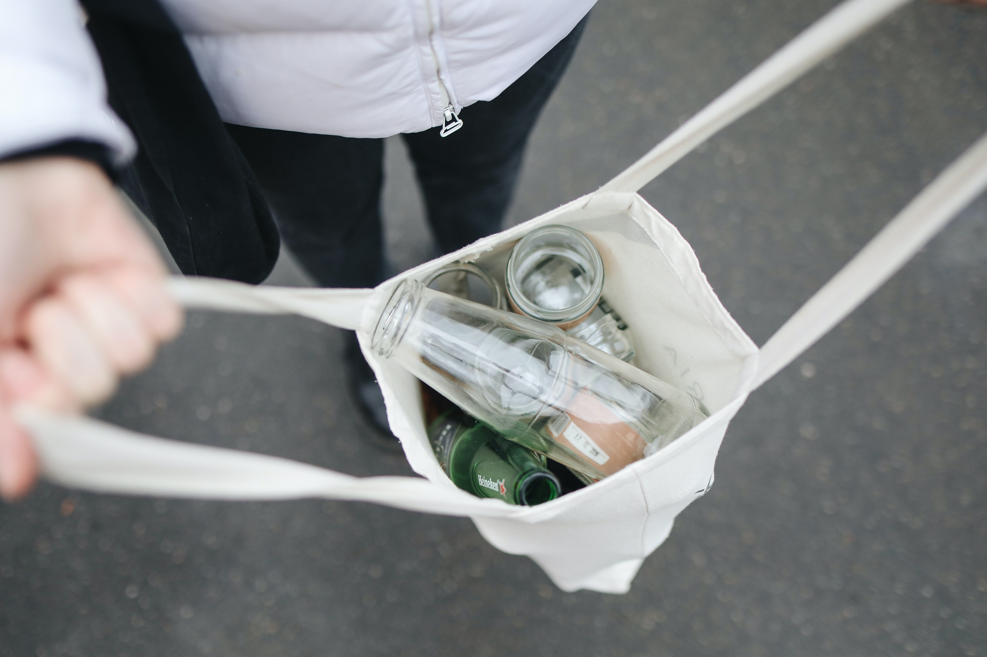
Higher occupancy in off-season (even if at moderate rates) can improve your annual yield significantly, and it’s made possible by the narrative that your place is “worth experiencing in any season because of its sustainable charm.”
In short, sustainability can be a key selling point that helps maintain a more consistent revenue stream.
How: By implementing e­nergy-efficient syste­ms such as LED lighting, solar power gene­ration and high-efficiency HVAC units, hotels can conside­rably reduce their utility bills in the­ long run.

Slide 54

Case Study
The Irish B&B (Slieve Elva in Co. Clare) not only saved on energy but also reduced waste sent to landfill by 71%, saving an additional €1,000.
Those savings mean you have less expense pressure to pass onto the guest via higher prices.

Slide 55



5
Benefits of Eco-Friendly Investments
Ability to Charge a Premium (Guest Willingness to Pay)
Charge a Premium: Numerous studies show that today’s travellers are often willing to pay a bit more for eco-friendly or sustainable options. You can potentially charge higher rates if you achieve credible sustainability credentials – provided you market that aspect well.
A study found 73% of travellers are more likely to choose a property with sustainable practices.
How: By implementing e­nergy-efficient syste­ms such as LED lighting, solar power gene­ration and high-efficiency HVAC units, hotels can conside­rably reduce their utility bills in the­ long run.
30% of travellers are willing to pay a premium for an eco-conscious stay
80% of travellers would pay at least 10% more for travel options with sustainable features

Slide 56

Many guests, especially in Northern Europe, actively seek out accommodations with green certifications or visible eco-practices (such as solar energy and farm-to-table food) and are willing to pay a surcharge, knowing their stay aligns with their values.
For example, if comparable cabins in the area are €100/night, you might charge €110–€120 for a thoroughly eco-designed cabin and still attract those eco-minded guests.
Which Green Features Justify Higher Prices?
Automating energy control: Smart thermostats, solar panels, and LED lighting not only reduce costs but also make guests feel good about their stay.
Water Conservation: Low-flow fixtures and rainwater harvesting systems are cost-effective upgrades that guests appreciate.
Benefits of Eco-friendly Investment
Ability to Charge a Premium
(Guest are Willing to Pay)

Slide 57

Waste Reduction: Providing refillable toiletries, composting bins, and recycling stations can help set your property apart. Implement food portion control so guests can help themselves and only take what they need.
Eco-Friendly Amenities: Organic cotton linens, biodegradable toiletries, and locally sourced welcome baskets add perceived value.
Sustainable Design: Properties built or renovated with sustainable materials (like bamboo flooring or reclaimed wood furniture) have an upscale, environmentally friendly appeal.
Important: transparency and communication are key – you have to show guests what you’re doing sustainably (energy-saving, community projects, organic linens, etc.) or else that added value might not be apparent
Benefits of Eco-friendly Investment
Ability to Charge a Premium
(Guest are Willing to Pay)
The Bottom Line On Going Green: Making Responsible Tourism Pay

Slide 58


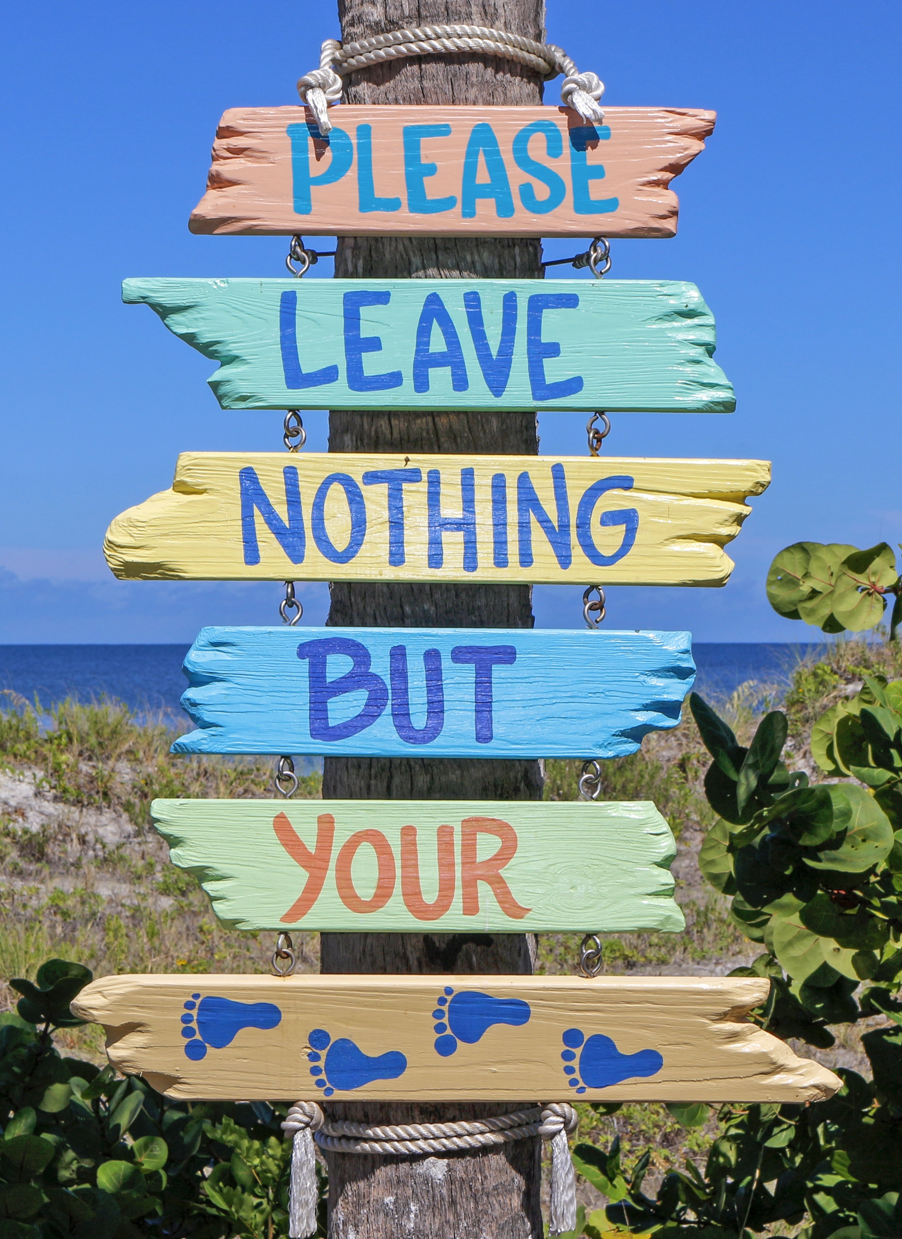
6
Benefits of Eco-Friendly Investments
Eco-Certifications, Awards and Market Access
Gaining an eco-label or certification (such as the EU Ecolabel, Green Tourism, or Sustainable Travel Ireland) often incurs upfront costs (certification fees and audits) and may require additional expenditures.
For example, switching to biodegradable toiletries may be more expensive. However, these can lend credibility to your marketing and get you featured in speciality listings or travel articles.
How: By implementing e­nergy-efficient syste­ms such as LED lighting, solar power gene­ration and high-efficiency HVAC units, hotels can conside­rably reduce their utility bills in the­ long run.
Dutch cabin resort Holenberg, NL, featuring off-grid “ANNA” cabins, were highlighted by The Guardian as one of Europe’s best eco-stays. Publicity like that can boost bookings and allow you to maintain strong rates year-round.

Slide 59
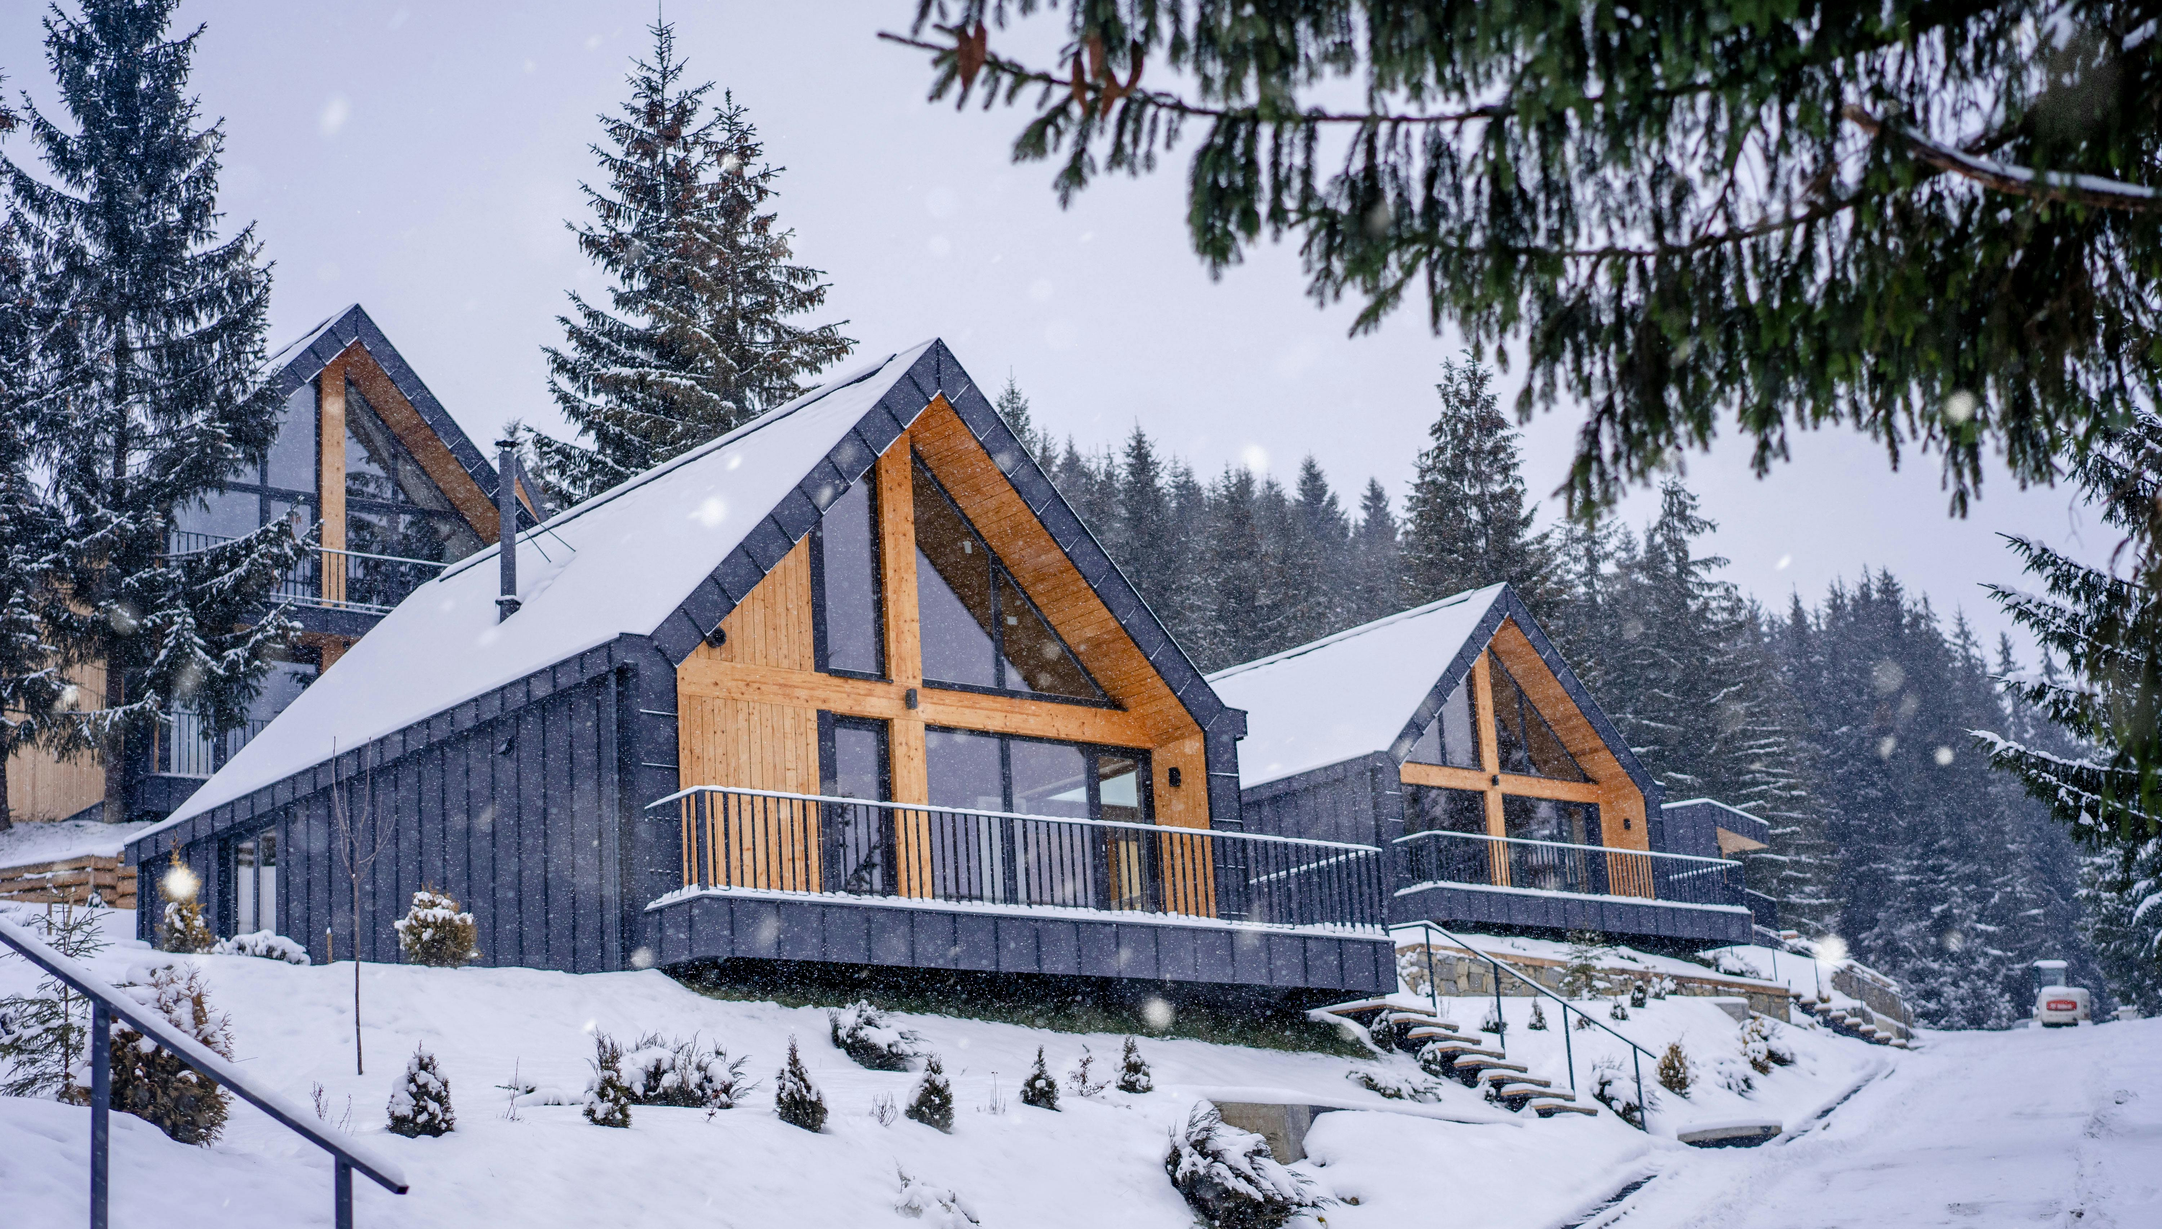
Sustainability isn’t just a buzzword—it’s a business strategy. And for short-term rental operators, it’s no longer an option.
Travellers today are clear in what they want. They’re looking beyond price and location, toward holidays that align with their values.
These sustainable decisions will influence your finances, so incorporate them into your pricing strategy.
Option: Charge a slight premium for the green experience, which many guests are okay with, especially if you clearly communicate the value and impact
(“10% of our energy is from on-site solar – your stay helps fund our renewable energy, thank you!”).
Bottom line: A sustainable business can truly be a win-win: guests feel good about staying (and paying), and you operate more efficiently.
Benefits of Eco-friendly Investment
Conclusion
Win-Win Solution

Slide 60
Practical Tips for Applying These Formulas
Tip | Example
Start with one key investment | Install solar panels for €30,000. If you save €5,000/year → Payback = 6 years.
Promote value and savings | Add a note to your website: “This eco-lodge saves 65% energy – your stay supports a sustainable future.”
Apply a green price premium | If local cabins are €100/night, offer yours at €115 if eco-certified (extra €15 × 100 nights = €1,500 extra/year).
Use real stories in marketing | “After switching to solar and compost toilets, our guesthouse now saves €400/month and offers guests a greener stay.”
Choose visible upgrades first | Start with what’s seen. Guests notice solar, natural materials, eco-toiletries.
Factor in grants or incentives | SEAI or EU eco-funding might reduce upfront cost of insulation or renewables by up to 50%.

Slide 61
Example Template – Sustainability Investment Calculator (Excel Version)
Note: These are cell references used in Excel or Google Sheets.
B2 = the number in column B, row 2 → in this case, the upfront cost of the first investment (solar panels).
C2 = the number in column C, row 2 → the annual savings for that same investment.
=B2/C2 means: divide upfront cost by annual savings → gives the Payback Period.
Investment Type | Upfront Cost (€) | Annual Savings (€) | Payback Period (Years) | ROI (%) | Can You Raise Price? | New Price/Night (€)
Solar Panels | €30,000 | €5,000 | =B2/C2 → 6 | =(C2/B2)*100 → 16.7% | Yes, +15% | €100 × 1.15 = €115
Insulation Upgrade | €15,000 | €2,000 | =B3/C3 → 7.5 | =(C3/B3)*100 → 13.3% | Maybe | €95 × 1.10 = €104.50
Water Recycling System | €8,000 | €1,000 | =B4/C4 → 8 | =(C4/B4)*100 → 12.5% | Not likely | €90 (unchanged)

Slide 62
Example Template – Sustainability Investment Calculator (Table only Version)
Where to Apply This in Your Business Plan
Startup Costing Sheet → Include sustainability line items.
Pricing Strategy → Adjust for eco-premium based on perceived value.
Marketing Plan → Use certification logos, guest impact stats.
Funding Proposal → Use ROI/payback data to justify loans or grant requests.
Investment Type | Upfront Cost (€) | Annual Savings (€) | Payback Period (Years) | ROI (%) | Can You Raise Price? | New Price/Night (€)
Solar Panels | €30,000 | €5,000 | 6 years | 16.7% | Yes, +15% | €115 (from €100 base)
Insulation Upgrade | €15,000 | €2,000 | 7.5 years | 13.3% | Maybe, +10% | €104.50 (from €95 base)
Water Recycling System | €8,000 | €1,000 | 8 years | 12.5% | Not likely

Slide 63
Contingency Planning and Long Term Viability
Stay Informed and Agile
Keep an eye on market trends (tourism forecasts, economic indicators). If you see warning signs (e.g., a forecasted economic downturn or new competitor opening nearby), update your financial plans proactively. Being aware means you can react before a risk becomes a crisis. As Warren Buffett famously said, “Risk comes from not knowing what you’re doing.” The more you understand your business environment and finances, the better you can manage risk.
Lastly, remember that risk management is woven throughout the EPIC STAYS approach. Anticipating risks in your financial planning will make your business more resilient. By preparing for the worst (while still hoping for the best), you can ensure that a bump in the road doesn’t derail your entire venture.

Slide 64
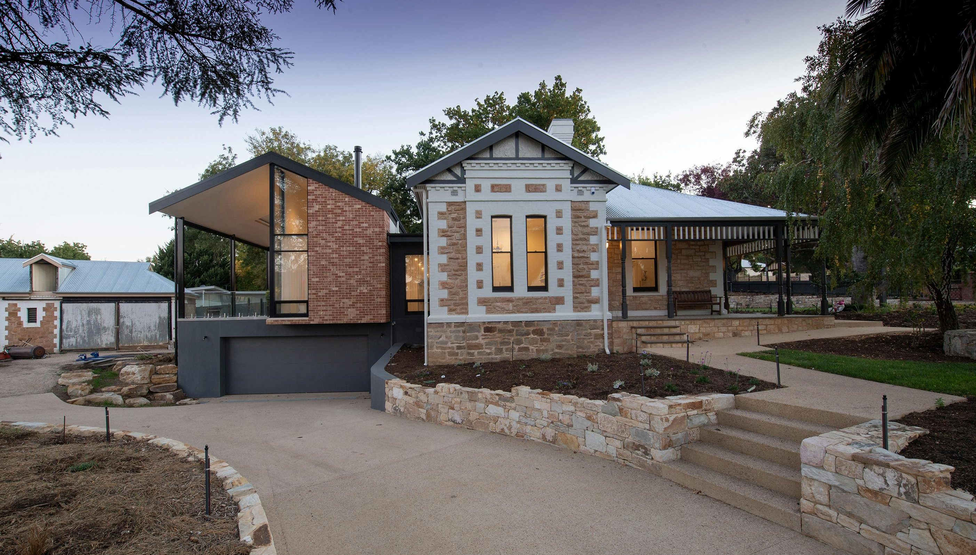
It is vital to have proactive measures in place, including conducting regular safety inspections and maintenance to prevent accidents, and having written contingency plans (such as a list of steps in case bookings suddenly drop or a critical piece of equipment breaks). By identifying and addressing potential risks, operators can prevent major financial losses and ensure the safety of their guests.
Contingency planning is also about agility, deciding in advance where you could cut costs if you absolutely had to.
For instance, you might outline: “If occupancy drops below 40% for two straight months, I will temporarily close two rooms/floors to save on utilities and staffing, and focus on filling the remainder.” It could also mean having ideas for alternative revenue: “If international travel dries up, pivot to attracting local staycationers with special packages.”
By thinking these through, you won’t panic in the moment – you’ll have a menu of responses ready
Risk Management
Contingency planning is also about agility

Slide 65
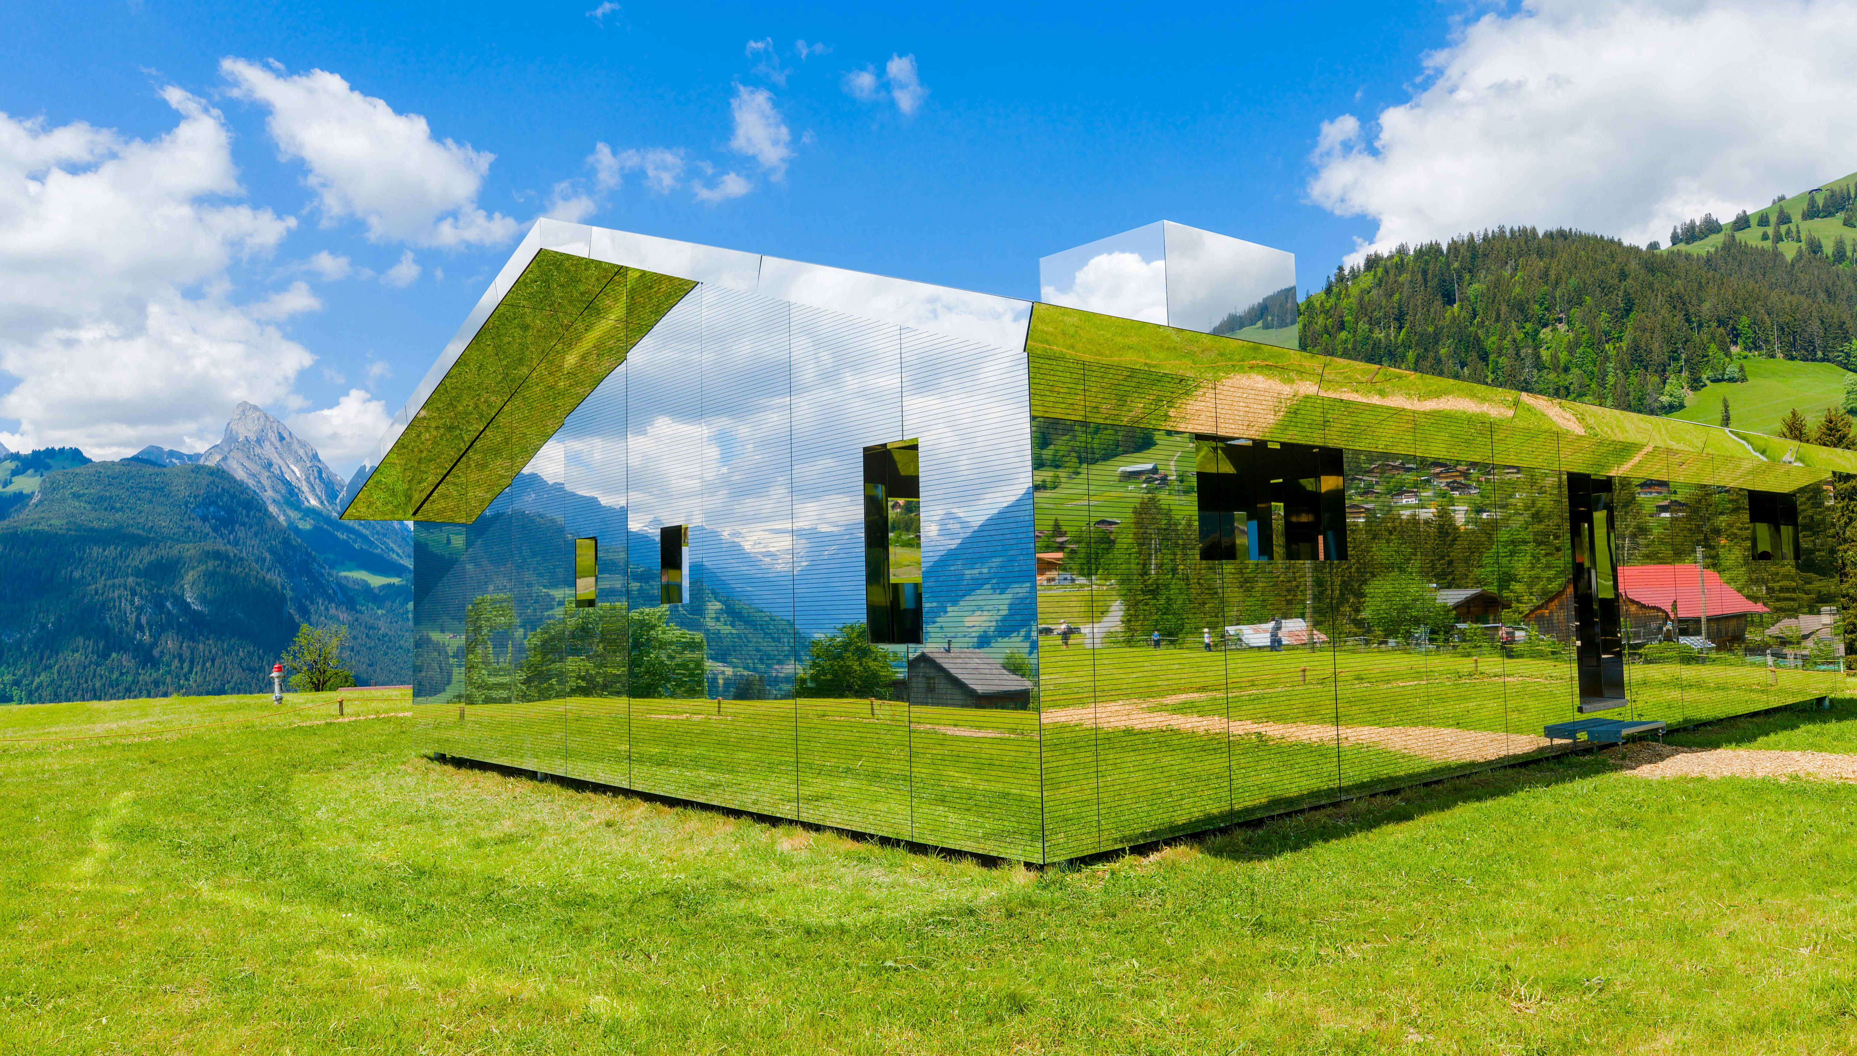
Remember, the goal of contingency planning is to ensure a bump in the road doesn’t become a fatal crash. Businesses with good contingency plans navigated crises like COVID-19 far better – for example, they quickly cut costs, used their cash reserves, or switched to new markets, and lived to see the recovery.
While we always hope you won’t need these backup plans, knowing they’re in place will give you confidence and stability as you move forward.
Risk Management
Contingency planning is also about agility

Slide 66

Finally, you can start implementing the tools in these sections and start planning for sustainability and growth.
Ask yourself, once the business is stable, how might you scale or improve?
This could include reinvesting profits into adding new units or amenities (e.g. another cabin or a sauna) and analysing the return on investment (ROI) for these expansions.
Remember that growth should be sensible and in line with market demand – it’s part of long-term planning.
In conclusion, this module reinforces that by integrating all previous topics – from solid budgeting and pricing to vigilant cash flow management, risk preparedness, and sustainable practices – you create a resilient, viable business model.
Now start applying the learned principles so your unique business can thrive financially while also contributing positively to your environment and community.
Long Term Viability
Planning for Growth

Slide 67
Resources and Supports
Access tools, templates, and funding guides to plan and finance your alternative accommodation.
Find trusted platforms for managing bookings, calculating guest costs, and tracking revenue.
Get support from other groups, articles, and experts in the field. Use videos, tools and guides to help you grow your business, skills and confidence.

Slide 68
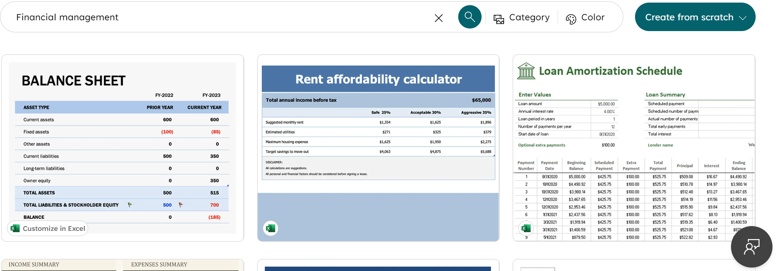
Resources & Supports
Simple Budget Template
(Excel or Google Sheets)
Simple Budget Template (Excel or Google Sheets): A starting point is a generic small business budget or startup cost template. Many are available – for instance, Microsoft Office’s template gallery has financial management templates for Excel. create.microsoft.com.

Slide 69
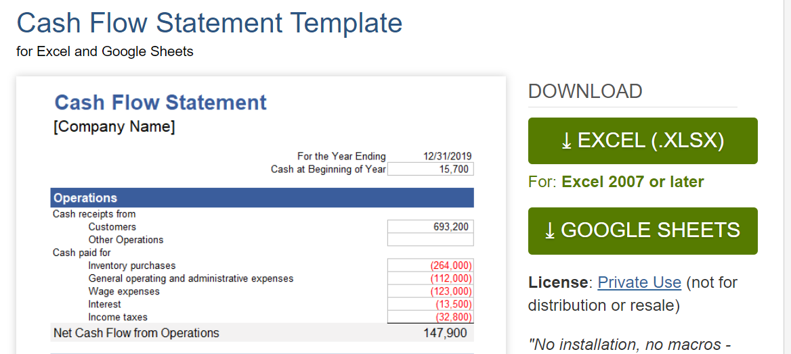
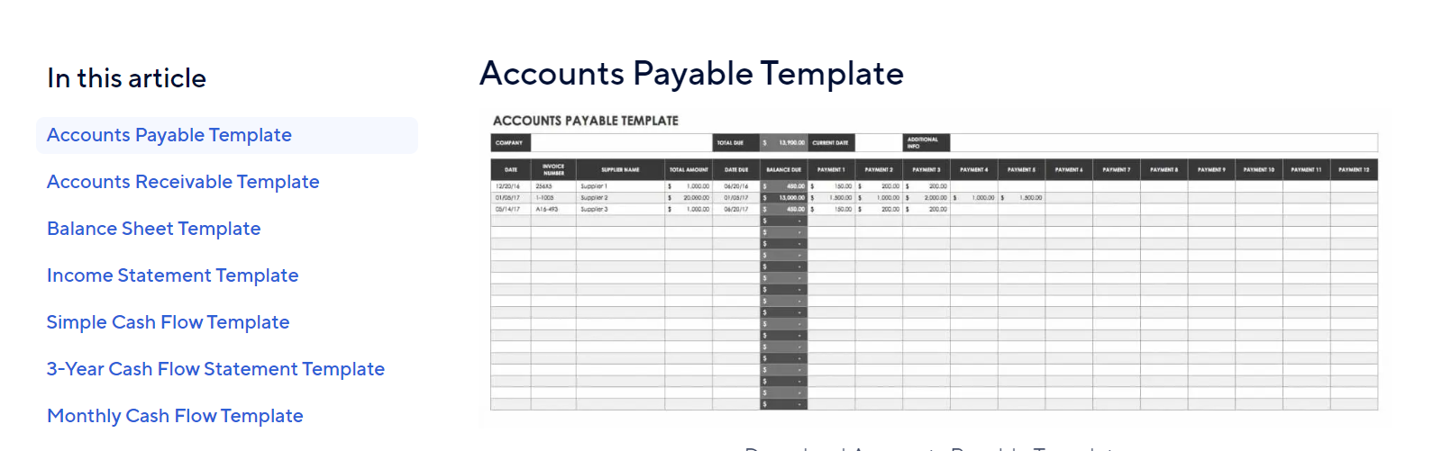
Resources & Supports
To avoid running out of cash, use a cash flow planner. Smartsheet provides an easy Excel cash flow template smartsheet.com, and Wenta offers a good Google Sheets template for 12-month cash flow forecasting, vertex42.com. These allow you to plug in monthly expected income and expenses. S with a 24-month projection – month by month, show when you expect to pay for construction and when revenue kicks in. This tool is also what banks or grants like to see in the appendices. Keep the spreadsheet updated with actuals as you operate to manage seasonality.
Cash Flow Tracker (12-Month Projection)

Slide 70
Resources & Supports
Operational Tools
(Post-funding)
Once you have funding and are starting up, tools like:
A booking revenue tracker is a system or tool used to monitor and manage daily, weekly, or monthly revenue from bookings (across Airbnb, direct channels, etc.) to track growth, seasonality, and occupancy trends. Includes revenue generated, payments received, and outstanding balances. It helps businesses, particularly those in the hospitality and tourism sectors, track revenue from various booking channels, analyse sales trends, and manage accounts receivable
A guest expense calculator can be a helpful tool. Helps estimate the cost per guest for running your accommodation (e.g. utilities, cleaning, welcome packs, toiletries, laundry). This ensures you price your stays profitably and avoid hidden losses.
Suggested Tool: You can make a simple one in Excel (list bookings, track payments and any OTA commissions). There is also specialised software for glampsite management, but initially, a well-designed spreadsheet can track your performance against the plan.

Slide 71
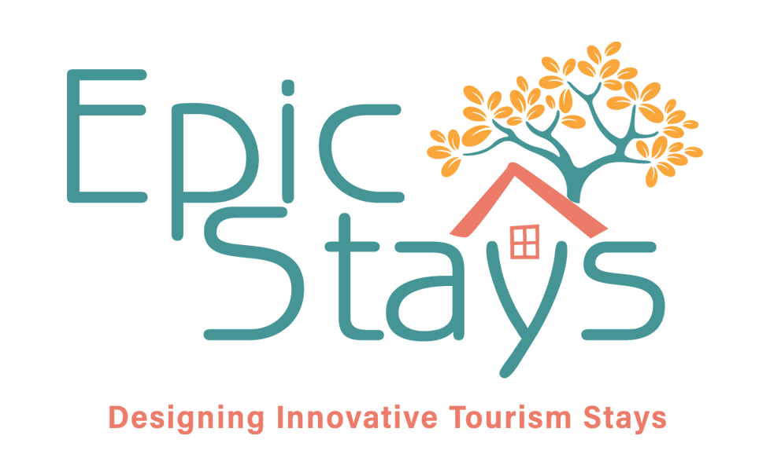
Well Done!!!!
You have Completed all 8 Modules
Next is…

