Slide 1
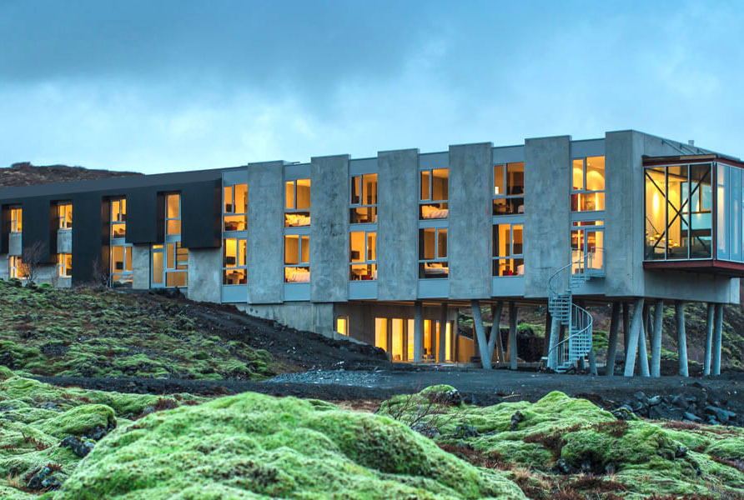
Sci Fi Ion Hotel, Iceland
Module 8 (Part 4)
Making It Viable – Pricing, Planning & Long-Term Financial Health
Financial Planning & Funding

Slide 2
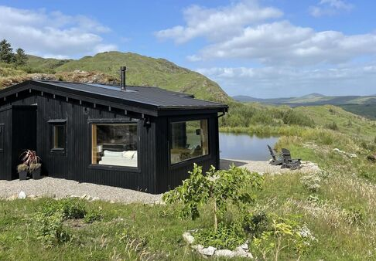
Module 8 (Part 4)
The Hidden Haven, Cork, Ireland
Boosting Revenue Through Add-Ons and Financial Oversight
2

Slide 3
Learning Outcomes
Module 8 (Part 4) Overview
Making It Viable – Boosting Revenue Through Add-Ons and Financial Oversight
Profitability goes beyond setting the right nightly rate. It’s about maximising income through upsells, premium experiences, and seasonal strategies while monitoring your financial health. These sections show you how to increase revenue through add-ons, adjust prices to meet guest demand, and track your financial performance with confidence. You’ll learn to create flexible offers that boost average booking value, compare projected versus actual revenue, and forecast outcomes to make smarter decisions. Together, these skills ensure your business stays adaptable, sustainable, and profitable in the long term.
Identify upselling opportunities and add-on services that guests value and are willing to pay for.
Create tiered pricing options to appeal to different guest segments and increase per-booking revenue.
Implement add-on strategies that align with your business brand and capacity.
Track and evaluate your financial performance using key income indicators.
Forecast revenue based on seasonal trends, pricing, and occupancy projections.
Make informed adjustments to improve financial outcomes and long-term profitability.

Slide 4
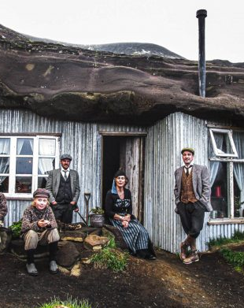
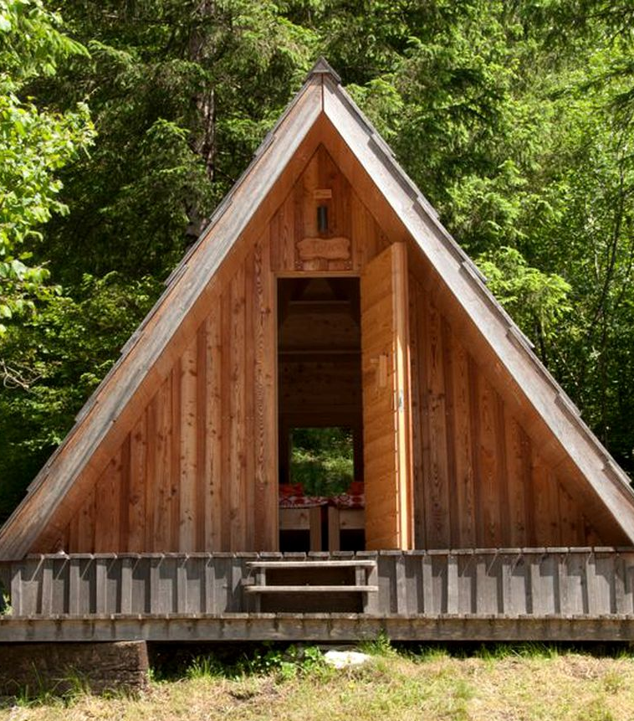
Part 4: Sections 9 – 10 Boosting Revenue Through Add-Ons and Financial Oversight
Photo Credit: Cave People, Iceland
Photo Credit:
10
Section 10 P15
Financial Planning, Tracking, and Forecasting Revenue
(57 Slides)
Module 8
CONTENTS
09
10
Section 9 P7
Upselling and Tiered Options
(7 Slides)
Resources
(20 Slides)
Photo Credit: A-Frame in Soča, Gorizia, Slovenia

Slide 5
Section 9 – 10 Boosting Revenue Through Add-Ons and Financial Oversight
Profitability isn’t just about your nightly rate—it’s also about how you maximise income through creative offers and keep a close eye on financial performance. These final sections demonstrate how to enhance earnings through upsells, premium experiences, and flexible pricing tiers that cater to guest needs and increase your average booking value. Learn how to track your revenue consistently, compare projected vs. actual performance, and forecast financial outcomes. Together, these skills allow you to adapt, improve, and grow your business with confidence.
Section 9: Upselling and Tiered Options
How can I earn more by offering add-ons or different price levels? What additional services could I offer that guests would be willing to pay for?
Objective: To create extra income opportunities through optional extras and premium upgrades.

Slide 6
Section 9 – 10 Boosting Revenue Through Add-Ons and Financial Oversight
Section 10: Financial Planning, Tracking, and Forecasting Revenue
How can I track my business’s financial performance? Am I earning enough, and what do I need to adjust financially to perform better?
Objective: Understand how your pricing and bookings affect total income. Track actual and expected revenue and evaluate your financial performance over time.
.

Slide 7

Section 9
Upselling and Tiered Options
How can I earn more by offering add-ons or different price levels? What additional services could I offer that guests would be willing to pay for?Objective: To create extra income opportunities through optional extras and premium upgrades.

Slide 8
Upselling and Tiered Options
Helps you offer more to guests while boosting your earnings. Shows you how to serve a wider range of customers and maximise earnings per stay.
Once your core pricing is in place, you can increase revenue per booking by offering upsells and tiered packages. These might include early check-in, breakfast, guided tours, or premium amenities. Whether you run a basic cabin or a luxury lodge, tiered pricing allows you to cater to different guest types and spending levels. This section shows how to design attractive add-ons and tiers to boost income without needing more bookings.
35
Tiered Pricing & Add-On Options: Basic
Simple add-ons like late checkout or breakfast.
36
Tiered Pricing & Add-On Options: Advanced
Packages like wellness retreats or themed experiences.
37
Tiered Pricing & Add-On Options:
Luxury Stay
Premium offerings for high-paying guests.
38
Tiered Pricing & Add-On Options:
Budget Stay
Value-focused upsells for price-conscious travellers.

Slide 9
Tiered Pricing & Add-On (Upselling) Options
Price Change Scenario Modelling
Not every guest wants the same experience, and not every night holds the same value. That’s where tiered pricing and add-ons come in. By offering flexible rate tiers and optional extras, you can increase revenue, better meet guest expectations, and tailor your offering to suit different budgets, occasions, and seasons.
The purpose of the Tiered Pricing & Add-On Options Table is to help you design a layered pricing strategy that boosts income beyond the base rate. It allows you to account for different guest types (e.g. , families, pet owners), peak dates (e.g., holidays or weekends), and upsell opportunities (e.g., welcome hampers, early check-in), ensuring your accommodation business remains competitive, customisable, and profitable.
Tiered Pricing & Add-On Options

Slide 10
35
Tiered Pricing & Add-On (Upselling) Options: Basic
Package / Add-On | Price (€) | Notes
Basic Stay (Night only) | €142 | Standard accommodation
Premium Stay (w/ breakfast & firewood) | €170 | Added services for convenience
Romantic Package | €200 | Decor, wine, breakfast
Extra Guest (per night) | €25 | Additional fee for 3rd or 4th person
Pet Stay | €15 | Cleaning and pet-friendly setup
Early Check-In / Late Check-Out | €20 | Optional fee for flexible timing
Note:
Offer value-based upgrades to increase revenue without raising base price for all.

Slide 11
36
Tiered Pricing & Add-On (Upselling) Options: Advanced (Part 1)
Option Type | Description | Example Price (€) | Notes
Standard Rate | Base rate for 2 adults | €140/night | Includes basic amenities (bed, bathroom, towels)
Extra Guest Fee | Charge for 3rd or 4th guest | €25/guest/night | Set maximum occupancy clearly
Weekend Premium | Higher rate for Fri–Sat stays | +€20/night | Stacked on base or seasonal rate
Holiday / Event Rate | Special pricing during festivals or peak holidays | +€40/night | Applies to Christmas, Easter, local events
Pet Fee | Flat rate for bringing pets | €30/stay | Include pet policy and cleaning fee
Early Check-in / Late Checkout | Optional add-on time slot | €15–€25 | Based on availability; improves guest satisfaction
Firewood or BBQ Pack | Add-on for outdoor cooking or heat | €10–€15 | Useful for glamping or rural stays

Slide 12
Tiered Pricing & Add-On (Upselling) Options: Advanced (Part 2)
Option Type | Description | Example Price (€) | Notes
Welcome Hamper | Basket with local produce/snacks | €20–€35 | Great for upselling and showcasing local businesses
Spa or Hot Tub Use | Premium access to spa amenities | €25–€50 | If shared, include time slots or private use fees
Cleaning Fee | One-time fixed charge per booking | €30–€50 | Helps offset staff costs; disclose clearly online
Option Type | Description | Example Price (€) | Notes
Standard Rate | Base rate for 2 adults | €140/night | Includes basic amenities (bed, bathroom, towels)

Slide 13
Tiered Pricing & Add-On (Upselling) Options: Luxury Stay
37
Luxury Table: Ideal for boutique villas, eco-luxury glamping, or high-end short-term rentals
Option Type | Description | Price (€) | Estimated Cost (€) | Profit Margin (€)
Extra Guest Fee | Charge for 3rd or 4th guest | €40 | €5 (utilities) | €35
Weekend Premium | Higher rate for Fri–Sat stays | €50 | €0 | €50
Holiday/Event Surcharge | Applies to festivals & holidays | €75 | €0 | €75
Pet Fee | Flat rate per pet, covers cleaning & prep | €50 | €15 (cleaning) | €35
Early Check-in/Late Checkout | Extended access | €30 | €5 (labour) | €25
Firewood or BBQ Pack | Premium pack with extras | €25 | €10 (materials) | €15
Welcome Hamper | Local produce/snacks | €50 | €20 (cost of goods) | €30
Hot Tub/Spa Access | Private use or premium booking | €60 | €10 (energy/clean) | €50
Private Chef Dinner | Full-service gourmet experience | €180 | €120 (chef, food) | €60

Slide 14
38
Tiered Pricing & Add-On (Upselling) Options: Budget Stay
Budget Table: Great for hostels, micro-cabins, budget-friendly pods, or shared accommodation
Option Type | Description | Price (€) | Estimated Cost (€) | Profit Margin (€)
Extra Guest Fee | For basic shared stays | €15 | €5 | €10
Weekend Premium | Slight weekend bump | €20 | €0 | €20
Holiday/Event Surcharge | Light markup for busy dates | €30 | €0 | €30
Pet Fee | Basic cleaning fee | €20 | €10 | €10
Early Check-in/Late Checkout | Flexible timing | €10 | €2 | €8
Firewood Bundle | Basic firewood pack | €8 | €4 | €4
Snack Basket | Simple refreshments | €15 | €7 | €8
Shared BBQ Access | Per-use fee | €5 | €1 | €4
Linen/Towel Rental | Optional for budget setups | €12 | €4 | €8

Slide 15

Section 10
Financial Planning Tracking and Forecasting Revenue
How can I track my business’s financial performance and know if I’m doing well or need to improve?. Am I earning enough, and what do I need to adjust financially to perform better?
Objective: Understand how your pricing and bookings affect total income. Track actual and expected revenue and evaluate your financial performance over time.

Slide 16
Tracking and Forecasting Revenue
Helps you budget, forecast earnings, track performance, and adjust as needed.
Financial success isn’t just about setting the right price—it’s also about understanding how much you’ll earn across the year and how your income compares to your expenses. You will need to define your financial goals, create a budget, track performance and understand your financial statements. For example, a basic income statement shows whether you’re making a profit or a loss. Seasonal revenue forecasting lets you predict income based on real seasonal trends, helping with cash flow planning and decision-making throughout the year.
39
Budget Control & Evaluation Planning
Track and compare spending to stay on budget. Evaluate financial performance by comparing planned vs. actual results..
40
Performance Tracking & Cash Flow Monitoring
Monitor key metrics and compare actual results to the budget. Identify trends, gaps, or opportunities in real time to make informed decisions and stay financially healthy.
41
Financial Statements Review and Adjust
Summarise and analyse your business’s actual income, expenses, assets, and liabilities over time. Use formal reports to assess profitability, cash flow, and long-term sustainability.

Slide 17
Business Financial Performance Cycle
3. Performance Tracking
(Monitoring)
4. Financial Statements
(Analyse & Adjust)
1. Set Financial Goals
2. Budgeting (Planning)
Define what success looks like: profit targets, prices, savings goals, reinvestment plans.
“I want to earn €20,000 profit this year from my glamping site.”
Create a budget.
Estimate income and expenses based on your goals, past data, and expected bookings.
‘What do I expect to earn/spend?’
Track Performance Regularly. Measure actual income & costs monthly. Compared to the budget.
‘Am I on track with my plan?’
Use your financial statements to assess your business’s true financial health and adjust accordingly.
‘What actually happened financially, and how can I improve?’
Note: Section 3: Understanding Your Costs, KPIs and Profit Margin & Section 6 Pricing Strategies and Calculation.

Slide 18
Financial Planning Tracking, and Forecasting
What will my financial plan look like to guide my business to break even, profitability, and future growth?
Financial Planning
Now that you understand pricing, forecasting, and tracking performance, it’s time to tie everything together into a financial strategy.
Think of this as your master plan for how your business will achieve long-term financial success.
The purpose of a financial strategy is to set goals (profit targets, growth plans), plan how to reach them, and outline what to do if things don’t go exactly as expected.
In context, this is the section where you, as a new owner, step back and ask: “How will all these numbers work together to make my business viable and sustainable?” The objective is to ensure you have a clear roadmap, from covering your basic costs to making a profit, and eventually expanding or improving the business.
Introduction

Slide 19
Financial Planning Tracking, and Forecasting
A solid financial strategy will cover knowing your break-even point, budgeting for all your expenses, and planning for investments or loans.
It acts as a reality check: if your strategy shows you won’t be profitable with current assumptions, you can adjust before you find yourself in trouble. Essentially, this is where all the earlier sections inform your big-picture plan.
In the previous sections, you calculated all your costs, predicted revenue, net revenue, prices using a selected pricing strategy, addressed seasonality, identified a realistic profit and applied your profit margin.
Now we will apply all your calculations to your financial management, including how to manage budgeting, performance tracking, reviewing financial statements, adjusting your plans and strategies to respond to any challenges or opportunities, and repeating and improving.
Financial Planning
Introduction

Slide 20

39
Budget Control (Evaluation & Planning)
Am I sticking to my budget—and what adjustments do I need to make?
Objective: Track and compare spending to stay on budget. Evaluate financial performance by comparing planned vs. actual results.

Slide 21
Business Financial Performance Cycle - Budgeting
3. Performance Tracking
(Monitoring)
4. Financial Statements
(Analyse & Adjust)
1. Set Financial Goals
2. Budgeting (Planning)
Define what success looks like: profit targets, prices, savings goals, reinvestment plans.
“I want to earn €20,000 profit this year from my glamping site.”
Create a budget.
Estimate income and expenses based on your goals, past data, and expected bookings.
‘What do I expect to earn/spend?’
Track Performance Regularly. Measure actual income & costs monthly. Compare to budget.
‘Am I on track with my plan?’
Use your financial statements to assess your business’s true financial health and adjust accordingly.
‘What actually happened financially and how can I improve?’
Note: Section 3: Understanding Your Costs, KPIs and Profit Margin & Section 6 Pricing Strategies and Calculation.

Slide 22
Understanding Your Business in Numbers!
Budgeting
Budgeting is the foundation of financial planning – it quantifies your business plan in numbers.
After understanding the importance of financial management, you now learn how to create a budget that outlines expected income and expenses for your venture.
You have already learned how to identify your profit margin and all revenue streams (e.g., nightly rentals, add-on services) and list all costs (from upfront setup to ongoing expenses, such as maintenance, utilities, supplies, and marketing).
You have also learned the difference between fixed and variable costs and how to estimate them realistically for various accommodation types (a cabin might have heating costs, a boat house might have mooring fees, etc.).
The Foundation of Financial Planning

Slide 23
A good budget enables you to allocate resources wisely and accurately predict whether you’ll make a profit or loss in a given period.
This section emphasises monitoring: once operations start, compare your actual income and costs to the budget regularly and adjust as needed. This ensures you catch problems early (for instance, if utility costs are higher than planned, or revenue is lower in certain months).
By the end of this section, you will be able to build a basic budget and understand your break-even point (the minimum occupancy or rate needed to cover costs).
To tie it all together, it’s helpful to see a simplified Income Statement for your glamping business. An income statement (also called Profit & Loss or P&L) summarises your revenue, expenses, and profit for a period (typically per year).
With a clear budget in hand, you will be ready to review and adjust your accommodation prices required to make sure you cover those costs and achieve a profit.
Budgeting
Predict in Advance if You’ll Make a Profit or Loss

Slide 24
With your break-even in mind and revenue forecast from earlier, you should create a budget – basically a plan for your spending and saving.
List all your expected expenses for a period (monthly or yearly): not just the obvious ones like rent and salaries, but also maintenance, supplies, marketing, taxes, and so on.
The goal is to see how your expected income vs. expenses play out. If your forecasted revenue barely covers (or is less than) your planned expenses, you must adjust – either by finding ways to increase revenue or cutting some costs.
Look at where you can control costs: maybe negotiate better rates with laundry services, use energy-efficient lighting to cut electricity bills, or adjust staffing schedules to avoid overstaffing in slow times. Effective cost control (while maintaining service quality) directly boosts your bottom line.
Budgeting & Cost Control
Income, Expenses & Saving

Slide 25


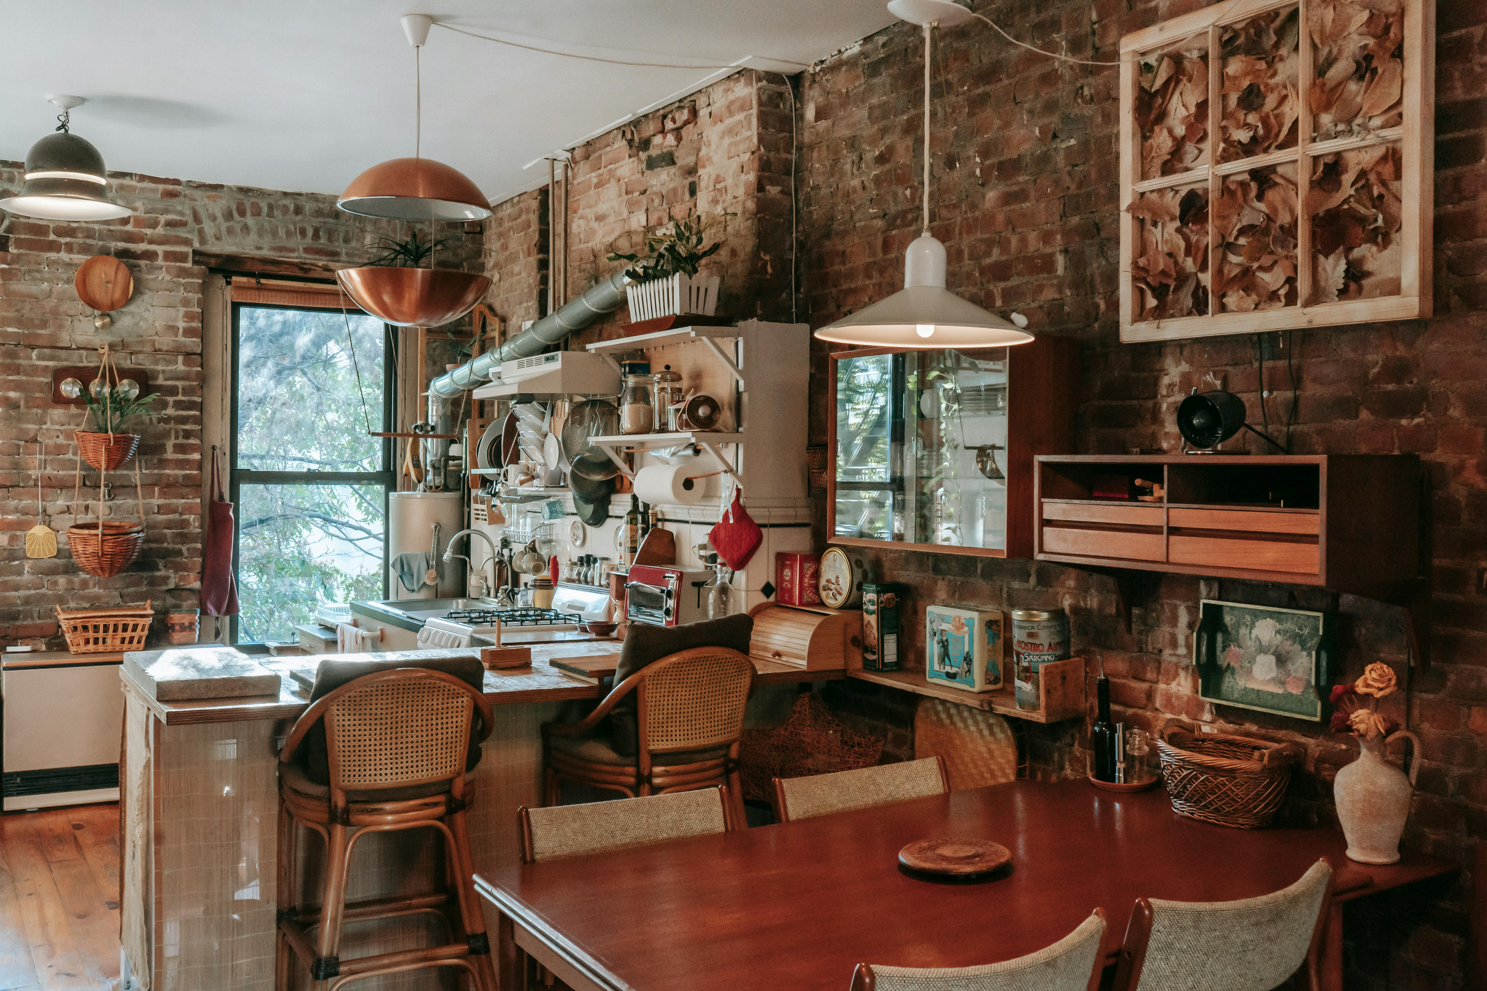
Be Budget Prepared for Timely Spending
How it Works
Example
Budgeting also involves timing: ensure that in high-revenue months you allocate money to cover bills in low-revenue months.
You might budget €2,000 for marketing for the year, more of it spent just before high season.
Or budget a bit extra for utilities in winter if heating costs rise.
Crucially, don’t forget to budget for contingencies – set aside an emergency fund for unexpected costs.
For instance, you might reserve, say, 5% of monthly revenue into a separate savings pot whenever you’re above break-even, so if a surprise repair or a bad month hits, you have a cushion.
Budget: Winning Tips and Best Practices for 2025

Slide 26




Budgeting: (Planning) Financial Roadmap
What do I expect to earn/spend?
Set Financial Goals
→ Define what success looks like: profit targets, savings goals, reinvestment plans.
(Example: “I want to earn €20,000 profit this year from my glamping site.”)
Creating a budget: estimate your income (e.g. from bookings) and expenses (e.g. utilities, cleaning, marketing).
1. Revenue (Income) Forecast
Estimate the money you expect to earn (e.g., bookings, add ons, grants, other income)
2. Operating Costs (Recurring Monthly/Annual Expenses) Costs to run your business day-to-day. (e.g., utilities, marketing, cleaning, wages)
Counters disinformation from foreign sources
3. Fixed Costs (Do not change with occupancy) Costs that stay the same whether you're booked or not. (e.g., taxes, loan repayments, insurance)
4. Variable Costs (Change with occupancy) These rise or fall based on how many guests you have. (e.g., breakfast, laundry, cleaning, heating)

Slide 27


Budgeting: (Planning) Basic Income Statement (Profit/Loss)
What do I expect to earn/spend?
5. Profit Target
The money you'd like to earn after covering all expenses. This helps set pricing and goals. For example, “I want to make €20,000 profit this
Budget is a Financial Roadmap
This gives you a financial roadmap for the period ahead (usually monthly, quarterly, or yearly).
Tip: It's forward-looking and based on your goals.
6. One-Off or Capital Costs
Big purchases or investments — not regular expenses. (e.g., land or property purchase, renovations, landscaping, furniture, septic tank, hot tub or sauna etc)
7. Contingency Fund
Contingency fund (10–15%) for unexpected costs. Cash reserve for seasonal low periods.

Slide 28
Budget and Variance Analysis Table
Next Section: Step-by-Step Instructions
Use realistic occupancy rates and prices.
Multiply nights per month × nightly rate × number of units.
Add income from extras (e.g. meals, bike rentals).
Estimate Income
List Fixed Costs
Add expenses that do not depend on how many guests stay: insurance, land rental, software, etc.
Estimate Variable Costs
Based on occupancy. Higher guests = higher laundry, utilities, supplies, and firewood.
Check the Profit/Loss
If profit is too low, you’ll know you need to either increase income (more bookings, raise price, add services) or reduce costs, or rework your offering. You’ll also use this budget to find your break-even point (covered in the next section).

Slide 29
Example Budget and Variance Analysis Table (Part 1)
(1-Unit Glamping Site for 12 Months)
This table lists typical monthly expenses (property lease, utilities, cleaning, insurance, marketing, etc.) and anticipated revenues (nightly fees, add-ons) for a glamping site. Start creating your budget and see how expense and income projections balance out.
Category | Monthly (€) | Annual (€) | Explanation
INCOME
Nightly Rental Income | €2,800 | €33,600 | E.g. 20 booked nights/month x €140/night x 4 pods
Add-On Services (e.g. firewood, breakfasts) | €200 | €2,400 | Estimate based on average upsells per guest
Total Income | €3,000 | €36,000 | = Nightly Income + Add-Ons
FIXED COSTS |  |  | Costs that do not change with occupancy
Property Lease / Land Use Fee | €500 | €6,000 | Monthly land rental or lease
Insurance | €75 | €900 | Business/property/liability insurance
Internet & Subscriptions | €50 | €600 | Includes WiFi, booking platform fees
Total Fixed Costs | €625 | €7,500 | = Sum of all fixed monthly costs x 12

Slide 30
Example Budget and Variance Analysis Table (Part 2)
(1-Unit Glamping Site for 12 Months)
Category | Monthly (€) | Annual (€) | Explanation
VARIABLE COSTS |  |  | Change depending on guest occupancy
Utilities (heating, water, electric) | €150 | €1,800 | Higher in winter – average out
Cleaning & Laundry | €200 | €2,400 | Based on number of changeovers
Consumables (toiletries, firewood, etc.) | €100 | €1,200 | Guest use dependent
Marketing & Promotion | €125 | €1,500 | Social media ads, website, promo materials
Repairs & Maintenance | €100 | €1,200 | Ongoing upkeep
Total Variable Costs | €675 | €8,100 | = Sum of all variable costs
TOTAL EXPENSES | €1,300 | €15,600 | = Fixed Costs + Variable Costs
NET PROFIT (BEFORE TAX) | €1,700 | €20,400 | = Total Income – Total Expenses

Slide 31
Compare Budget to Actual Spend (Part 3)
Category | Monthly Budget (€) | Actual (€) | Variance (€) | Notes
Utilities | €150 | €170 | –€20 | Cold month, higher heating
Cleaning | €200 | €180 | +€20 | Fewer bookings
As a Forecasting Tool
Use this table to project your monthly and annual financial health:
Enter Actual Spend – What you actually spent (from bank statements, invoices).
Calculate Variance – Subtract actual from budget to see differences.
Interpret: Positive = you saved money or Negative = investigate the reason for the overspend.
Check: Are you profitable each month? Are your costs manageable compared to income? Do you have room for unexpected costs?
Consider the efficiency of all costs and expenses: If marketing is under budget, consider reinvesting in better ads. If maintenance is over, check if it's a one-off or recurring. If supplies always go over, negotiate with suppliers or buy in bulk.

Slide 32
Plan for Loans and Return on Investments (ROIs)
How it Works
Example
If you require an initial investment (for example, renovating a property or buying furniture), will it come from your savings, a bank loan, or maybe an investor?
Any loan means you’ll have debt to repay, so include those repayments in your budget and make sure the business can support them.
If you take a €20,000 small business loan at a certain interest, your monthly repayment might be around €400 – include that in your fixed costs and thus in your break-even calculation (you’ll need slightly more nights to break even).
Ensure you have a clear plan for return on investment: “I’ll spend €10,000 on building an extra guest room, which should bring in an extra €5,000 per year in revenue, paying back in 2 years.”
If the math doesn’t make sense, reconsider the expense.
Budget: Winning Tips and Best Practices for 2025

Slide 33

Plan How You Will Handle Profits
How it Works
Example
Also, plan how you’ll handle profits: a prudent strategy is to reinvest a portion of profits back into the business – for facility improvements, new services, or marketing – to fuel long-term growth.
You might decide that each year, 50% of net profits will be reinvested (new furniture, upgraded website, etc.), and 50% you keep as owner income or further savings.
By planning this out, you avoid the common pitfall of owners simply pocketing all earnings and then struggling to pay for a new hot water system or a roof repair.
Budget: Winning Tips and Best Practices for 2025

Slide 34

Set Your Financial Goals
How it Works
Example
Having a financial strategy also means setting some financial goals: These goals give you targets to strive for and measure against. They should be realistic based on your earlier forecasting and break-even analysis.
Say, “I want to achieve €100,000 in annual revenue with a 15% profit margin by year 2” or “I aim to save €10,000 from profits by year-end as a reserve.” All in all, developing a financial strategy is about being intentional with your money, knowing how much you need, planning how you’ll use it, and ensuring every euro has a purpose in driving your business forward.
Budget: Winning Tips and Best Practices for 2025

Slide 35
Think about how you will finance your business needs and growth.
As a new entrepreneur, you might have limited capital, so part of your strategy is deciding where to get funds for various needs and how to use profits.
Your budget, performance and financial strategy isn’t static – revisit it every few months. As you get actual data from running your business, update your break-even with real numbers, adjust your budget, and refine goals. This way, your strategy stays aligned with reality and keeps guiding you toward better financial decisions.
In summary, your budget is the financial expression of your strategy – it ensures your plan is feasible given your revenue expectations, and it highlights how much room you have to manoeuvre. Regularly comparing your actual spending to your budget is a key part of performance tracking, allowing you to refine your strategy as you go.
Budgeting & Cost Control
Future Funding and Investment Planning

Slide 36
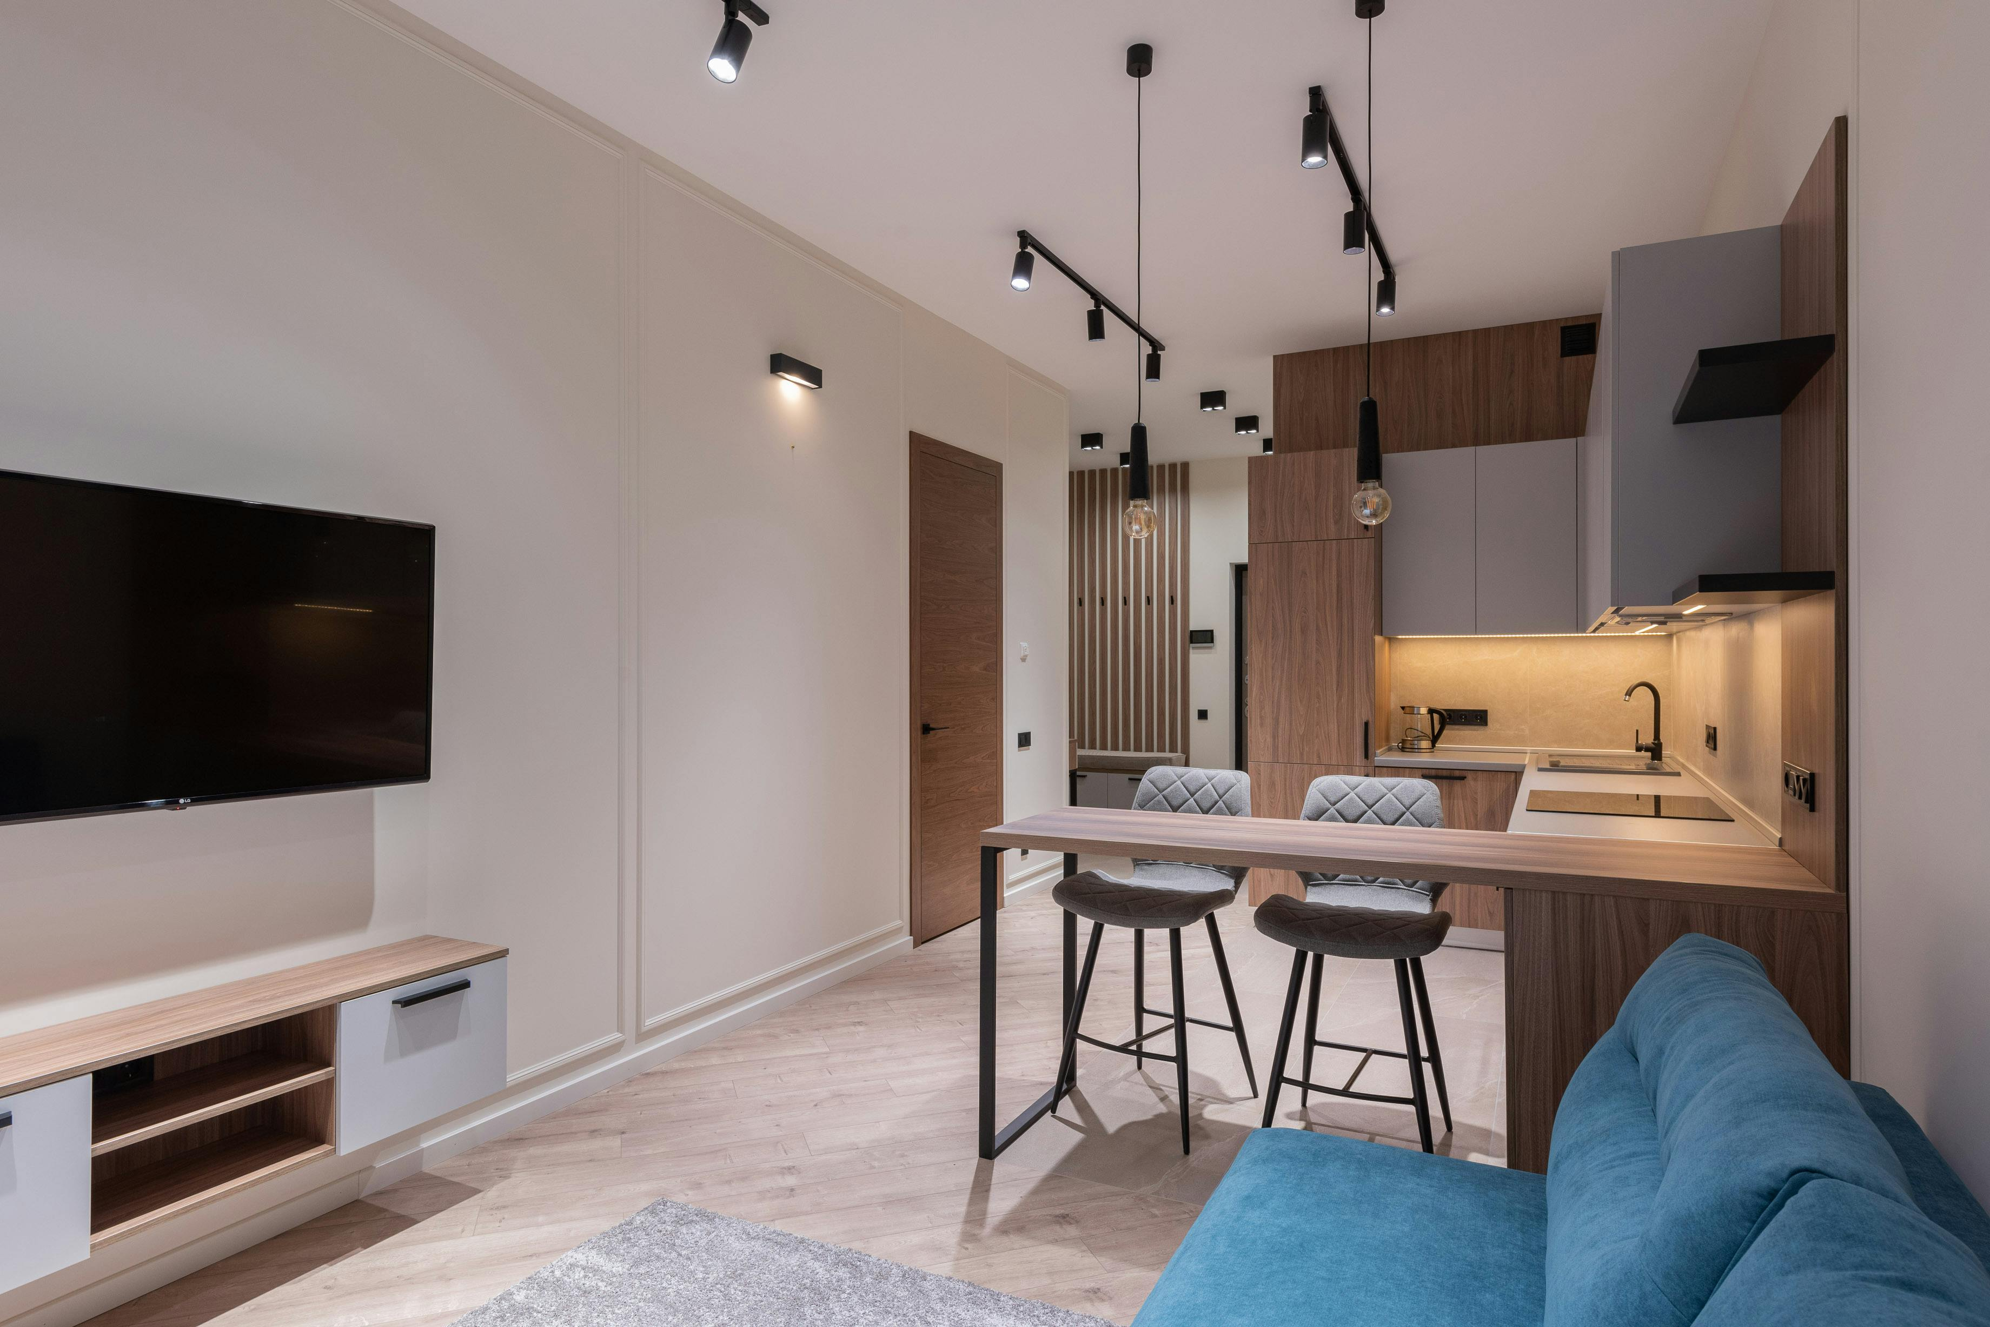
40
Performance Tracking & Cash Flow (Monitoring)
Am I staying on track financially — and how can I respond if I’m not?
Objective: Monitor key metrics and compare actual results to the budget. Identify trends, gaps, or opportunities in real time so you can make informed decisions and stay financially healthy.

Slide 37
Business Financial Performance Cycle Performance Tracking
3. Performance Tracking
(Monitoring)
4. Financial Statements
(Analyse & Adjust)
1. Set Financial Goals
2. Budgeting (Planning)
Define what success looks like: profit targets, prices, savings goals, reinvestment plans.
“I want to earn €20,000 profit this year from my glamping site.”
Create a budget.
Estimate income and expenses based on your goals, past data, and expected bookings.
‘What do I expect to earn/spend?’
Track Performance Regularly. Measure actual income & costs monthly. Compare to budget.
‘Am I on track with my plan?’
Use your financial statements to assess your business’s true financial health and adjust accordingly.
‘What actually happened financially and how can I improve?’
Note: Section 3: Understanding Your Costs, KPIs and Profit Margin & Section 6 Pricing Strategies and Calculation.

Slide 38





Performance Tracking (Monitor Progress)
Am I on track with my plan?’
Budget vs. Actual Report
How does your real income/expenses compare to your budget? (e.g., we earned €3000 less than forecasted)
As the year or season progresses, you track your actual performance compared to the budget.
This includes monitoring and measuring your occupancy, income/revenue, costs, and profit and comparing them to your budget. Helps you spot issues early and adjust (e.g. offer discounts if bookings are low).
Tip: Do this on a monthly basis. A monthly breakdown of income versus expenses allows for easier and more manageable tracking.
Key Performance Indicators (KPIs). Track your selected KPIs to determine your business health over time (e.g., Occupancy %, RevPAR, profit margin)
Occupancy and Revenue Tracking
Daily/weekly booking trends (e.g., % of nights booked, average rate)
Cash Flow Monitoring. Ensures you can meet expenses. “Do I have enough to pay staff this month?”
Break-Even Analysis. Know when you start making profit. (e.g., “I need 32% occupancy to break even.”)

Slide 39

Key Metrics for Accommodation Financials
Ensure that you include previously learned Key Performance Indicators (KPIs) and incorporate these important metrics for accommodations into your financial management, such as profit margin, occupancy rate, average daily rate (ADR), and revenue per available room.
These KPIs help you gauge how well you’re utilising your capacity and how efficient your revenue generation is.
Tracking these metrics monthly and yearly can reveal trends (e.g., a dip in occupancy each November).
All types of stays should do this kind of review – whether you run one tiny home or a whole glamping site, the practice of checking your financial health is vital.
By maintaining simple records and reviewing your statements, you can make data-driven decisions (like adjusting pricing or cutting unnecessary costs) to stay on track.
Performance Tracking
Key Performance Indicators (KPIs)

Slide 40
Key Performance Indicators (KPIs) (Quick Recap)
Here is a quick review of common accommodation KPIs (explained in detail in previous sections), including
Profit margin (what percentage of revenue is profit)
Occupancy Rate (what percentage of your rooms are filled over a period)
Average Daily Rate (ADR) – basically the average income per rented room per night, and
Revenue per Available Room (RevPAR) – which combines occupancy and rate to tell you the average revenue per room whether occupied or not.
You might also track your breakeven, profit margin (what percentage of revenue you keep as profit) or customer metrics like average length of stay. Monitoring these indicators over time helps you spot trends and identify areas to improve.
Once you know how to monitor KPIs and financial results, you’re better equipped to think about potential risks that could derail those results.

Slide 41
Key Performance Indicators (KPIs)
Example: Key Performance Indicators (KPIs) Usage
Suppose you have 10 rooms and in April you filled 300 room-nights out of a possible 300 room-nights (10 rooms × 30 days). That’s an Occupancy Rate of about 100% – fantastic!
If your total room revenue in April was €24,000, then your Average Daily Rate (ADR) is €80 (€24,000 ÷ 300 room-nights) and your RevPAR is €80 as well (since RevPAR = Occupancy Rate × ADR; at 100% occupancy, it equals ADR).
Now, if in May occupancy drops to 50% (150 room-nights) and you kept the same prices, your ADR might still be €80, but RevPAR would fall to €40 (because only half the rooms were filled on average).
By tracking these KPIs monthly, you might notice, say, your occupancy is consistently low on weekdays, telling you that you need to market mid-week stays or adjust pricing.
Or maybe your ADR is lower than similar farm guest houses in your area, indicating you could potentially charge more.
In short, KPIs act like a “health check-up” for your business performance beyond just the basic profit numbers.

Slide 42

Cash Flow Monitoring and Management
After addressing seasonal planning and budgeting, we now delve into cash flow, which is about the movement of money in and out of your business over time.
Even a profitable business can fail if it runs out of cash to pay immediate bills, so this section is crucial.
Learn the difference between profit (what you earn on paper after expenses) and cash flow (actual cash available at any given time).
You will be shown how to create a cash flow forecast, mapping month-by-month expected cash inflows (e.g. guest payments, deposits) and outflows (rent, salaries, utilities, loan payments, etc.).
This builds on the budget but adds a timeline element, highlighting, for example, that summer months may generate excess cash while winter months see cash deficits. Managing cash flow involves:
Cash Flow Management
Introduction

Slide 43


The Importance of Cash Flow Management
Cash flow is the lifeblood of any business, especially in the hospitality and tourism sector, where income can be seasonal.
Managing cash flow means actively monitoring and controlling the cash that comes in and goes out so you always have enough on hand to meet your obligations. Here’s why it’s crucial:
Prepare for Surprises
Example
  Good cash flow management helps buffer against unexpected expenses or downturns.
  Note: Cash flow is not the same as profit, and a company can be making money on paper but run into trouble if cash is tied up or timing of payments is off.
In the tourism accommodation context, this could be anything from a sudden repair (e.g. a pipe burst in your guesthouse that needs urgent fixing) to an economic downturn or travel restrictions that reduce bookings. With a cash cushion, you can handle these surprises without jeopardizing your business. Without it, even a profitable business can face a crisis

Slide 44

Maintain Operations
Example
  Positive cash flow (more cash in than out) ensures you can pay your bills, suppliers, and employees on time.
You need enough monthly cash from guest stays to pay for cleaning services, utilities, and any mortgages or rent on your properties.
If clients pay late or bookings drop unexpectedly, without cash reserves, you might struggle to cover these basics.
Invest in Growth
Example
  When you manage cash flow well, you generate surplus cash that can be reinvested in the business. If you don’t manage cash, you might miss out on growth opportunities because you’re always scrambling to cover expenses.
For instance, consistent positive cash flow might allow you to add a new eco-cabin or upgrade facilities (like installing solar panels to reduce long-term costs).

Slide 45

Managing Cash Flow Involves
Monitoring the movement of money in and out of your business over time
Forecasting and Monitoring
Project and track your cash flow for each month, updating it regularly. This helps identify potential cash shortfalls in advance.
Example
Your forecast might show that March will be tight financially; knowing this in advance lets you prepare (such as arranging a short-term credit or trimming expenses).
Maintaining Reserves
You reinforce the idea of an emergency fund or reserve. Setting aside a portion of peak-season profits as cash reserves can help cover unexpected costs or slow months
Example
Many successful small accommodations keep a few months’ worth of operating costs in savings for peace of mind.

Slide 46
Managing Cash Flow Involves
Monitoring the movement of money in and out of your business over time
Optimising Payment Terms
Tips like encouraging guests to pay deposits upfront (bringing cash in sooner) or negotiating later payment with suppliers can improve cash timing
Example
if you can pay your annual insurance in installments rather than a lump sum, it might ease a cash crunch.
Monitoring Cash Versus Budget
Look at your bank balance and upcoming bills regularly, not just end-of-year profit
Example
Simple cash flow charts can help visualise when you have surpluses or deficits, so you can take action (like moving surplus to a savings account or cutting costs) in time.

Slide 47
Cash Flow Planner
The Cash Flow Planner is a key budgeting tool; it is a forward-looking tool to forecast future cash in/out to stay solvent.
“Will I have enough cash to cover bills next month?”
A cash flow planner is one of the most essential budgeting tools for any accommodation business. While your budget helps you estimate overall income and expenses for the year, the cash flow planner breaks it down month by month, allowing you to see when money will come in and when it will need to be spent. It helps you plan for cash availability on a month-by-month basis. Ensures you don’t run out of cash even if profitable on paper and is often used to manage seasonal fluctuations. This is especially important in seasonal businesses like glamping or B&Bs, where cash inflow may vary significantly throughout the year, but bills such as insurance, loan repayments, or utilities still need to be paid monthly. The next slide shows you what a typical Cash Flow Planner looks like.
Cash Flow Management
Cash Flow Planner Tool

Slide 48
Cash Flow Planner Table (Sample)
Here is your Cash Flow Planner Table, showing monthly income, expenses, and how your ending cash balance changes across the year. This helps identify seasonal cash surpluses or shortfalls so you can plan ahead with confidence. Starting Balance: €2,000 .This table helps you forecast monthly cash availability based on expected income and expenses, and adjust for seasonal highs/lows.
Month | Income (€) | Expenses (€) | Ending Balance (€)
January | 3,000 | 2,800 | 2,200
February | 2,500 | 3,200 | 1,500
March | 3,000 | 2,900 | 1,600
April | 3,500 | 3,000 | 2,100
May | 5,000 | 3,200 | 3,900
June | 7,000 | 3,300 | 7,600
July | 8,000 | 3,400 | 12,200
August | 7,500 | 3,300 | 16,400
September | 4,000 | 3,100 | 17,300
October | 3,500 | 2,900 | 17,900
November | 3,000 | 2,800 | 18,100
December | 2,500 | 2,700 | 17,900

Slide 49
Cash Flow Planner Table (Detailed)
Month | Guest Income (€) | Add-on Sales (€) | Total Income (€) | Fixed Costs (€) | Variable Costs (€) | Loan Repayment (€) | Other Costs (€) | Net Cash Flow (€) | Cumulative Cash (€)
January | 1,000 | 100 | 1,100 | 1,000 | 200 | 300 | 100 | -500 | 2,000
February | 1,200 | 150 | 1,350 | 1,000 | 250 | 300 | 100 | -300 | 1,700
March | 2,500 | 300 | 2,800 | 1,000 | 500 | 300 | 200 | 800 | 2,500
April | 4,000 | 400 | 4,400 | 1,000 | 800 | 300 | 300 | 2,000 | 4,500
May | 5,000 | 600 | 5,600 | 1,000 | 1,000 | 300 | 400 | 2,900 | 7,400
June | 6,000 | 800 | 6,800 | 1,000 | 1,200 | 300 | 300 | 4,000 | 11,400
July | 7,000 | 900 | 7,900 | 1,000 | 1,400 | 300 | 400 | 4,800 | 16,200
August | 6,500 | 800 | 7,300 | 1,000 | 1,300 | 300 | 300 | 4,400 | 20,600
September | 4,000 | 400 | 4,400 | 1,000 | 900 | 300 | 300 | 1,900 | 22,500
October | 2,500 | 300 | 2,800 | 1,000 | 500 | 300 | 200 | 800 | 23,300
November | 1,500 | 200 | 1,700 | 1,000 | 300 | 300 | 100 | 0 | 23,300
December | 1,800 | 250 | 2,050 | 1,000 | 350 | 300 | 100 | 300 | 23,600
How to use this: You can see the quiet months in advance and plan accordingly. You can also avoid cash shortages. Guest Income: Estimate based on expected bookings × price per night. Fixed Costs: Stay constant (insurance, internet, salaries). Variable Costs: Depend on bookings (cleaning, laundry, welcome packs). Other Costs: Ad hoc (maintenance, marketing campaigns) and Cumulative Cash: Tracks total cash on hand month to month

Slide 50
Budget vs. Actual Report: Performance Tracking
The next slide provides a sample Budget vs. Actual Report (monthly). Here is how you use it for your performance tracking
Occupancy % = Nights booked ÷ Nights available × 100
Break-Even Point is reached when actual revenue covers your fixed and variable costs (you can calculate this from your break-even analysis)
Use this table monthly to:
Compare planned vs actual booking trends
Spot high/low seasons
Adjust marketing, pricing, or offers based on performance
Break-Even Example: If your break-even revenue per month is €2,000, then:
✅ March, April, and May exceeded break-even
❌ January and February fell short — consider off-season incentives
Performance Tracking
Budget vs. Actual Report

Slide 51
Sample Budget vs. Actual Report: Performance Tracking (Monthly)
Month | Nights Available | Budgeted Occupancy % | Actual Occupancy % | Budgeted Revenue (€) | Actual Revenue (€) | Average Rate (€) | Break-Even Point Reached? | Notes
January | 31 | 40% | 32% | €1,740 | €1,344 | €135 | ❌ No | Lower demand than expected
February | 28 | 50% | 46% | €1,890 | €1,750 | €135 | ❌ Almost | Offer midweek deals
March | 31 | 55% | 58% | €2,300 | €2,430 | €135 | ✅ Yes | Weekend packages helped
April | 30 | 60% | 62% | €2,430 | €2,514 | €135 | ✅ Yes | High Easter bookings
May | 31 | 70% | 75% | €2,940 | €3,150 | €140 | ✅ Yes | Full weekends

Slide 52
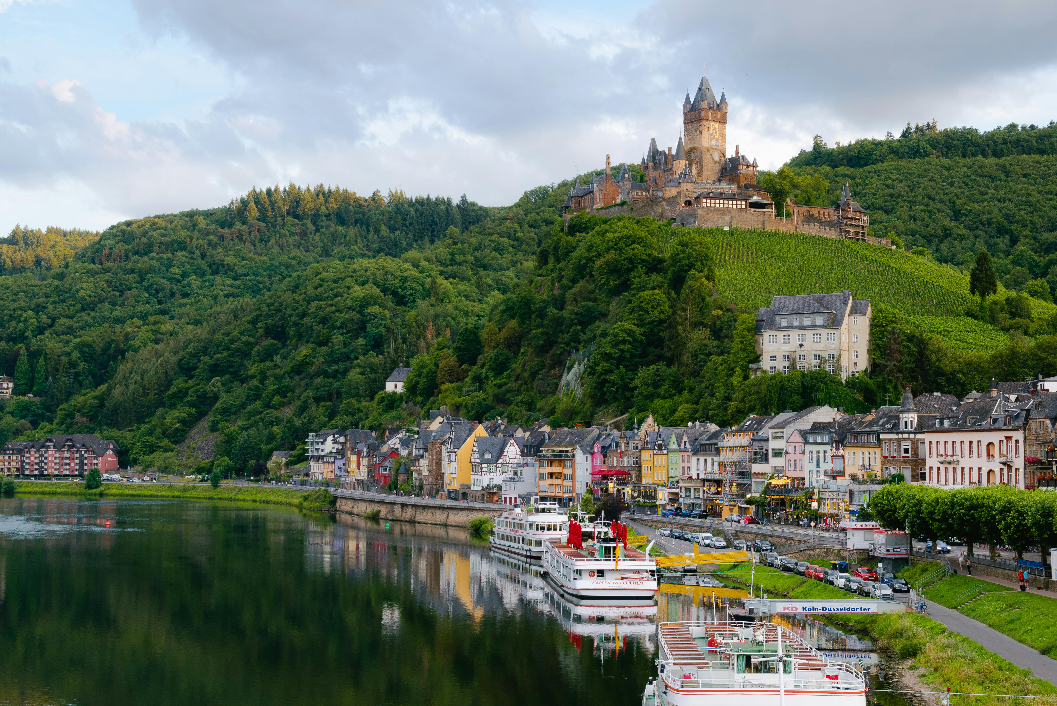
41
Financial Statements (Review & Adjust)
What’s the true financial health of my business — and what does the data tell me?
Objective: Summarise and analyse your business’s actual income, expenses, assets, and liabilities over time. Use formal reports to assess profitability, cash flow, and long-term sustainability.

Slide 53
Business Financial Performance Cycle – Financial Statements
3. Performance Tracking
(Monitoring)
4. Financial Statements
(Analyse & Adjust)
1. Set Financial Goals
2. Budgeting (Planning)
Define what success looks like: profit targets, prices, savings goals, reinvestment plans.
“I want to earn €20,000 profit this year from my glamping site.”
Create a budget.
Estimate income and expenses based on your goals, past data, and expected bookings.
‘What do I expect to earn/spend?’
Track Performance Regularly. Measure actual income & costs monthly. Compare to budget.
‘Am I on track with my plan?’
Use your financial statements to assess your business’s true financial health and adjust accordingly.
‘What actually happened financially and how can I improve?’
Note: Section 3: Understanding Your Costs, KPIs and Profit Margin & Section 6 Pricing Strategies and Calculation.

Slide 54

You have successfully set in place your budgeting and pricing and have your cash flow under control. Owners need to track their financial performance to ensure long-term viability. This is where you analyse and review the results of your financial management. The logical next step is learning how to read financial statements and track performance indicators.
This section is crucial to understand if your business is truly “viable”. If your financial plans are working, you must review statements like profit-and-loss regularly, which is the topic of this section. This section is about keeping score of your business’s financial health. Just as you might check a scoreboard to see how a game is going, financial statements and budgeting show you how your accommodation business is doing in terms of money – they tell you if you’re winning (profit) or losing (loss) and why. The purpose of regularly reviewing your budget and financial statements is to track performance, identify any warning signs early, and make informed decisions based on real data rather than gut feelings.
Financial Management
Financial Performance and Adjusting

Slide 55

In context, even small guesthouse owners need to understand their numbers; it’s not just something for big hotel chains or accountants. The objective here is to create and review your key financial statements (like your Income Statement and Cash Flow Management) and other performance metrics, explaining what each one does and how they help you manage your business better.
For example, your statements might highlight vulnerability (such as very thin profit margins or reliance on one season).
This naturally leads into risk management – the next section – where we discuss protecting your business against setbacks and ensuring those financial statements remain healthy.
By the end of this section, you’ll know how to read the financial “story” of your business and use it to steer toward success.
Financial Management

Slide 56

Financial Statements & Performance Tracking
This section introduces the basic financial statements, with a focus on the Profit and Loss Statement (also known as the Income Statement) and how to use it.
Learn how a Profit & Loss Statement summarises your revenues and expenses over a period and shows whether you earned a profit or incurred a loss.
Reading a P&L regularly (say, monthly or quarterly) lets you see if your plans are working – e.g., are your expenses in line with your budget? Are you earning enough revenue at your current pricing and occupancy levels?
By analysing this statement, you can identify areas needing improvement or cost cutting, and spot what’s performing well (maybe your food & beverage add-on sales are great, but utility costs are rising).
Performance Tracking
Introduction

Slide 57

Financial Statements (Review Results)
‘What actually happened financially and how can I improve?’
You prepare financial statements to see what really happened. Create an income statement, cash flow, and balance sheet to assess your business’s true financial health.
At the end of the period (monthly, quarterly, annually), you produce financial statements. Summarise your results, compile reports, and reflect.
Adjust Strategy or Forecasts (React & Improve) → Based on performance, make decisions, e.g, change pricing, cut costs, launch promotions or revise budget for next season.
Income Statement (Profit & Loss)
Profitability over time. Revenue – Expenses = Profit/Loss. (e.g., total revenue from bookings, direct costs, operating expenses, depreciation and taxes) Net Profit or Loss (final bottom line)
Cash Flow Statement
Money in and out of the business. Operating, Financing, and Investing cash flow. Inflows (e.g., grants/payments) Outflows (e.g., utilities, wages)
Balance Sheet
Snapshot of financial position. Assets (e.g., cash, equipment, property), Liabilities (e.g., loans, bills) and Equity (e.g., investments)
Assets = Liabilities + Owner’s Equity

Slide 58
Income Statement (Profit & Loss Statement)
The income statement is a summary of your revenues, expenses, and profit over a period of time (usually monthly, quarterly, or annually). It answers the question “Did my business make money or lose money over this period?” by subtracting all your expenses from all your income. This statement helps you see where you’re earning money and where you’re spending it, which is crucial for figuring out how to increase profits.
Example: Income Statement Usage
Imagine your bell tents income statement for the month of June shows €10,000 in total revenue (from room bookings and maybe some tour bookings you sold), and €7,500 in total expenses (including utilities, cleaning supplies, staff wages, breakfast food, etc).
The bottom line would be a profit of €2,500 for June (since €10,000 − €7,500 = €2,500).
If the next month the profit drops or turns into a loss, you can compare income statements to investigate – maybe revenue fell or certain costs spiked. This way, the income statement keeps you informed about your profitability and helps pinpoint areas to improve (like cutting unnecessary costs or boosting marketing if revenue is low).

Slide 59
Terms Explained: Basic Income Statement (Profit/Loss)
An income statement basically asks: “After paying all the bills, how much money did the business make (or lose)?”
For a newcomer, the goal is to ensure this is a positive number and understand why. By laying out all income and all expenses clearly, you can see where your money is going and identify if any cost seems too high relative to revenue.
Income Statement
This is the total money from rentals (in this case €60.25k for the year, as calculated from occupancy × rate).
If you have secondary income (e.g. selling farm produce to guests or activity add-ons), that would be additional revenue.
Revenue
We’ve split into variable and fixed as defined earlier.
You might also see them grouped together; here total operating expenses are €19.4k for the year.
Expenses

Slide 60
Terms Explained: Basic Income Statement (Profit/Loss)
The remainder after all expenses – about €40.8k in this scenario. This profit would be used to pay any taxes, loan interest, or the owner’s personal income, and reinvested in the business as needed.
Notice the profit margin here is quite high (68% of revenue).
Small glamping businesses can have high margins because, once the initial investment is made, running costs are relatively low, especially if the owner handles most tasks themselves.
Note: However, keep in mind that this profit may need to cover expenses not explicitly listed (such as saving for future pod replacements or servicing a bank loan).
Revenue
Net Profit
Expenses

Slide 61
Basic Income Statement Example (Profit/Loss)
To tie it all together, it’s helpful to see a simplified Income Statement for your glamping business.
An income statement (also called Profit & Loss or P&L) summarises your revenue, expenses, and profit for a period (typically per year).
Using the earlier projections for our 4-pod example, here is a basic Year 1 income statement:
Income Statement (Year 1) | Amount (€)
Total Revenue (from guests) | €60,250
Variable Costs (cleaning, guest supplies) | €8,400
Fixed Costs (utilities, insurance, maintenance, marketing, etc.) | €11,000
Total Expenses (Variable + Fixed) | €19,400
Net Profit (before tax) | €40,850

Slide 62
Detailed Income Statement Example (Profit/Loss)
The next slide demonstrates a detailed, copyable Projected Income Statement (Profit & Loss Forecast)
It outlines potential revenue, costs, and profit for a rural glamping accommodation business.
It includes forecasts for three seasons: low season, high season, and an average year.
You can adjust the values in an Excel spreadsheet to suit your accommodation type, country, and business model.
It includes all key financial elements—occupancy, fixed/variable costs, revenue, and profit—with formula placeholders, so you can adapt this in Excel or Word.

Slide 63
Category | Low Season | High Season | Average Year | Notes / Formula
Occupancy Rate | 30% | 80% | 55% | Estimated booked nights / total available nights
Average Nightly Rate | €100 | €140 | €120 | Rate per night per unit
Revenue | €900 | €3,360 | €2,160 | Revenue = Nights Booked x Nightly Rate
Fixed Costs | €500 | €500 | €500 | Insurance, licenses, loan payments Total FC =SUM (Fixed Costs)
Variable Costs | €200 | €480 | €340 | Utilities, supplies, cleaning (based on occupancy) Total VC = Nights Booked x SUM (Variable Costs per Night)
Marketing & Booking Fees | €100 | €250 | €175 | Booking platform fees, local advertising
Maintenance | €80 | €120 | €100 | Repairs, replacements
Total Expenses/Costs | €880 | €1,350 | €1,115 | Sum of fixed, variable, marketing & maintenance Total Costs = Total Fixed + Variable Costs
Profit (Loss) | €20 | €2,010 | €1,045 | Profit= Revenue – Total Expenses/Costs

Slide 64

Tip – Use The Template in Excel or Word
The template can be copied into Excel or Word.
The numbers should be linked to your detailed revenue and cost calculations
For example, have your spreadsheet sum up the revenue from the occupancy forecast, and sum up the costs from your budget, then the profit formula = Revenue - Expenses.
By updating the underlying assumptions (occupancy, rates, costs), the income statement will change accordingly.
This is a powerful way to do “what-if” analysis – you can instantly see how a change (say, 10% increase in utility costs or 5% lower occupancy) affects your bottom line.

Slide 65

Creating a Cash Flow Statement
A Cash Flow Statement is a tool to help you understand the movement of cash in and out of your business
It is used throughout the year (checked monthly or quarterly) to prevent cash shortages and support ongoing operations, risk management, and funding applications.
It will monitor if you have enough cash to pay bills (even if you're profitable). Whether you're spending too much at certain times (e.g., winter low season) and how much cash you need to keep in reserve
Instructions
Record all cash inflows (e.g. guest payments, loans, grants)
Record all cash outflows (e.g. supplier payments, wages, loan repayments)
Break it into three categories: Operating, Investing, and Financing activities
Ensure your ending balance stays positive
Cash Flow Statement
Guiding the Movement of Cash In and Out of Your Business

Slide 66
Cash Flow Statement
Making a profit is great, but cash flow is what keeps the lights on day to day. The cash flow statement tracks all the cash coming into your business and all the cash going out during a period, showing you how your cash balance changes over time.
It’s possible to be profitable on paper and still run out of cash, for instance, if your money is tied up in something like a property upgrade or unpaid bookings. This statement is divided into sections for operating activities (everyday business cash inflows and outflows), investing activities (money spent on equipment or improvements), and financing activities (loans, owner contributions, etc.).
Example: Cash Flow Statement Usage
Your cash flow statement for the quarter might show €25,000 cash received from guests and other income, but perhaps you paid out €30,000 during the same time (covering bills, buying new furniture, paying down a loan, etc.).
That results in a -€5,000 cash flow for the quarter, meaning €5,000 more left your bank than came in. (Continued on next slide)

Slide 67

Cash Flow Statement
Example: Cash Flow Statement Usage (Continued)
Even if your income statement showed a profit (maybe you bought furniture with cash you had saved), the cash flow statement alerts you that your cash reserves actually shrank.
This insight is crucial: if you see a trend of negative cash flow, you know you need to either secure additional funds or adjust operations (for example, by cutting costs or increasing sales) to ensure you don’t literally run out of money.

Slide 68
Cash Flow Statement
“Where did my money go last quarter?”
The Cash Flow Statement is a backwards-looking statement (part of financial reporting). What cash actually came in and went out (can differ from profit). It is not the same as the Cash Flow Planner.
Feature | Cash Planner | Cash Flow Statement
What it is | A forward-looking tool (part of budgeting) | A backward-looking statement (part of financial reporting)
Purpose | To forecast future cash in/out to stay solvent | To show actual cash in/out over a past period
When used | During budgeting & planning | During financial statement preparation
Example | “Will I have enough cash to cover bills next month?” | “Where did my money go last quarter?”

Slide 69
Cash Flow Statement: Monthly
Cash Flow Category | Monthly (€) | Annual (€) | Notes and Example
Operating Inflows |  |  | Income
Guest Revenue | 2,800 | 33,600 | 20 nights x €140
Operating Outflows |  |  | Expenses and Costs
Utilities | 150 | 1,800
Cleaning & Maintenance | 200 | 2,400
Consumables & Supplies | 100 | 1,200
Marketing | 125 | 1,500
Operating Cash Flow | 2,225 | 26,700 | Revenue - Expenses
Financing Inflows
Loan Received | 0 | 0 | Startup funding only
Financing Outflows
Loan Repayments | 300 | 3,600
Investing Activities
Equipment Purchase | 0 | 0
Net Cash Flow | 1,925 | 23,100

Slide 70
Cash Flow Statement: Actual Cash Movement Year-Round Summaries
Month | Cash In (€) | Cash Out (€) | Net Cash Flow (€)
Jan | 1500 | 1200 | 300
Feb | 1600 | 1300 | 300
Mar | 1800 | 1400 | 400
Apr | 2200 | 1700 | 500
May | 3000 | 2000 | 1000
Jun | 4000 | 2300 | 1700
Jul | 5000 | 2500 | 2500
Aug | 5200 | 2600 | 2600
Sep | 3500 | 2200 | 1300
Oct | 2700 | 2000 | 700
Total | 31,500 | 20,200 | 11,300
Formula Opening Cash Balance + Net Cash Inflows – Cash Outflows = Closing Cash Balance

Slide 71

Cash Flow Statement: Monthly
This categorical table is for year-round summaries.
Helps explain where your money is coming from and going.
Use this table in investor pitch decks, grant applications, and monthly performance summaries.
Great for budgeting and strategic planning, because it ties income to categories like loans, operating costs, and investments.
Cash Flow Management
How to Use Both Tools
Cash Flow Statement: Year-Round
This is a timeline version showing actual or expected performance and cash reserves month by month.
Useful for cash flow planning, especially for seasonal businesses, e.g., marketing pushes or maintenance
Helps identify peak revenue months (e.g. Jul-Aug) and low seasons (e.g. Jan-Feb) and adjust prices accordingly
You can compare this to your categorical cash flow to identify where you’re overspending or underperforming.

Slide 72
Many Businesses Fail Due to Cash Flow Problems
….even when sales are strong!
Remember, many businesses fail due to cash flow problems even if their sales are strong. It’s often said that “Revenue is vanity, profit is sanity, but cash is reality.” In practice, this means you should keep a close eye on when money enters and leaves your account.
For example, if your accommodation gets a large group booking that will pay on arrival next month, you cannot use that money today – it’s not in your cash yet. Ensure you have enough current cash to operate until that payment actually arrives.
By monitoring cash flow weekly or monthly, you can spot potential shortfalls early. If you see a projected cash shortfall (maybe in off-season), you can act in advance – perhaps by cutting non-essential expenses, negotiating better payment terms with suppliers, or arranging a line of credit with the bank.
Avoiding a cash crisis is always easier than fixing one, so proactive cash flow management is key to financial stability.
How Many Businesses Fail Due to Cash Flow Problems

Slide 73

Well Done
Module 8 (Part 5)
Section 11: Contingency Planning for Long-Term Viability
You have Completed… Module 8 (Part 4)
Sections 9 – 10: Boosting Revenue Through Add-Ons and Financial Oversight
Next is…

