Slide 1
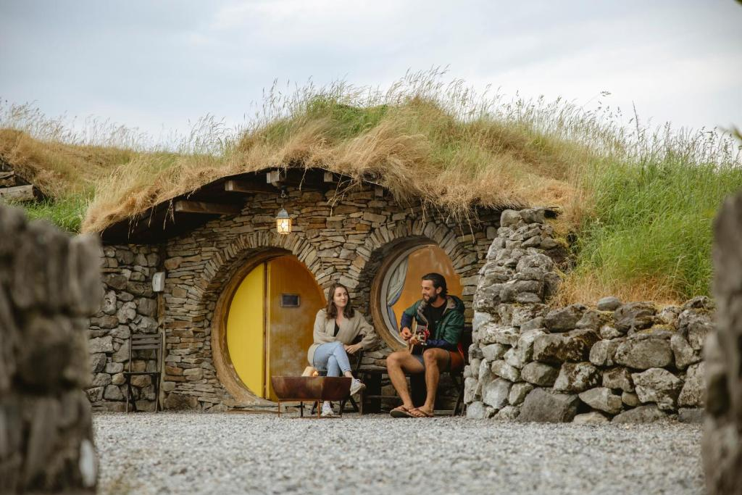
Mayo Glamping, Ireland
Module 8 (Part 3)
Making It Viable – Pricing, Planning & Long-Term Financial Health
Financial Planning & Funding

Slide 2
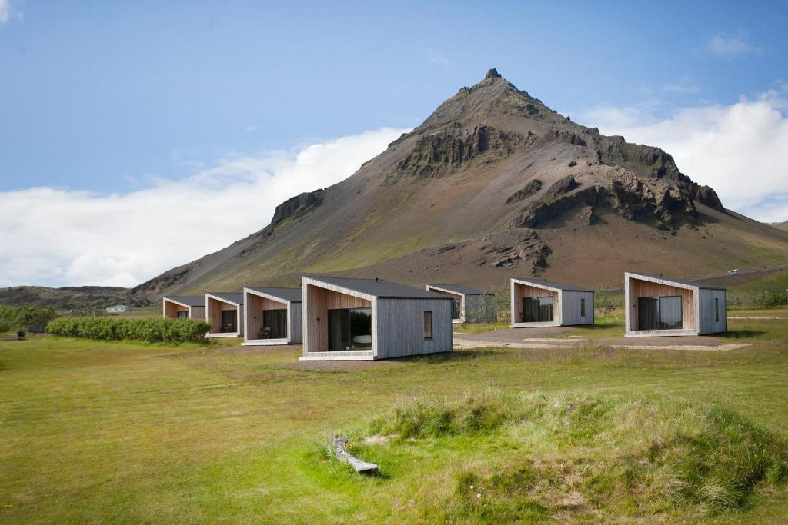
Module 8 (Part 3)
Arnarstapi Cottages, Iceland
Pricing for Profit, Value, and Seasonality
2

Slide 3
Module 8 (Part 3)Overview
Learning Outcomes
After calculating your costs and break-even point, the next step is setting prices that ensure profitability. These sections guide you through creating a pricing strategy that is both competitive and sustainable, how to balance guest expectations, operational realities, and long-term growth. You’ll explore profit-focused pricing models and learn how to adapt them to your business. Alongside this, you’ll develop seasonal strategies to adjust prices during high and low demand periods, helping you optimise bookings, maximise revenue, and maintain financial stability throughout the year. Together, these approaches give you the clarity and flexibility needed to make smarter decisions and grow a resilient, profitable accommodation.
Making it Viable - Pricing for Profit, Value, and Seasonality
Develop a pricing strategy that ensures profitability and reflects your unique brand values.
Understand different pricing models (e.g., cost-plus, value-based, dynamic) and how to apply them effectively.
Analyse your market, guest expectations, and business goals to set competitive rates.
Adjust your pricing throughout the year to reflect seasonal changes in demand.
Maximise revenue during high-demand periods while staying competitive during slower seasons.
Align your pricing with long-term sustainability, guest satisfaction, and financial goals.

Slide 4
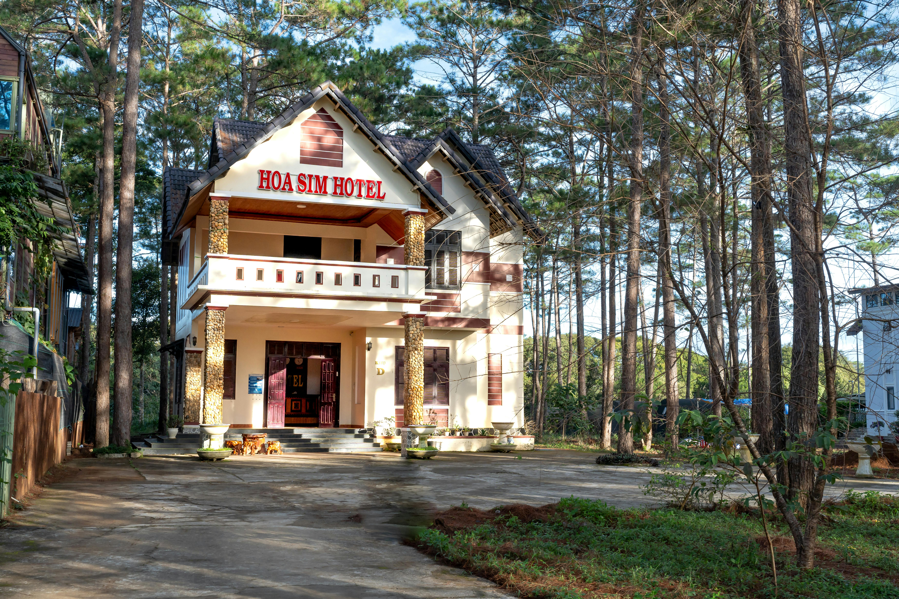
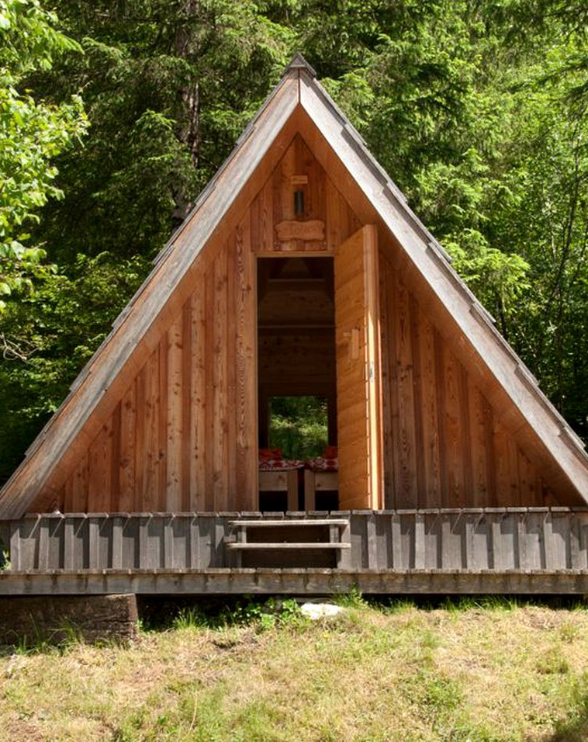
Part 3: Sections 7 – 8 Pricing for Profit, Value, and Seasonality
Photo Credit: Cave People, Iceland
Photo Credit:
Photo Credit:
08
Section 8 P36
Applying Seasonal Strategies
(45 Slides)
Module 8
CONTENTS
07
10
Section 7 P6
Profit & Pricing Strategies
(29 Slides)
Resources
(20 Slides)
Photo Credit: A-Frame in Soča, Gorizia, Slovenia

Slide 5
Section 7 – 8 Pricing for Profit, Value, and Seasonality
Once you’ve calculated your costs and break-even point, the next step is to set prices that not only cover your expenses but also generate a profit, reflect the value you offer, and align with your brand. In these sections, explore how to develop a pricing strategy that is both sustainable and competitive, while also accounting for fluctuations in demand across different seasons. From value-based pricing to seasonal adjustments, learn to optimise revenue, increase bookings, and make strategic decisions that support long-term success.
Section 7: Profit & Pricing Strategies
How should you set prices to reflect value, profit, and sustainability? What pricing model will ensure your business is sustainable and profitable?
Objective: Profit & Pricing Strategies (Making a Profit). To develop a tailored pricing strategy that ensures profitability and reflects your brand values.
Section 8: Applying Seasonal Strategies
How can I change or adjust my prices throughout the year to increase bookings and boost profits?
Objective: Adjust your prices to match seasonal demand and maximise revenue.
Choose and apply the pricing strategy that best aligns with your business goals
and guest expectations.

Slide 6

Section 7
Profit & Pricing Strategies
Profit & Pricing Strategies (Making a Profit)
To develop a tailored pricing strategy that ensures profitability and reflects your brand values.
How should you set prices to reflect value, profit, and sustainability? What pricing model will ensure your business is sustainable and profitable?

Slide 7
Financial Logic & Planning for Accommodation Businesses Planning
Section | Section | Why It Comes Here
3 | Revenue & Capacity Foundation | You start by calculating what you earn or all your income You must know what you're earning (primary and secondary income sources) and how many nights you can sell.
4 | Cost Structure | Figure out what you spend Without knowing your fixed and variable costs, you can't set prices or calculate profit.
5 | Know Your Cost Per Night | Calculate what each night must cover Helps establish your minimum charge to break even. You calculate the cost per night by dividing total costs by expected nights sold.
6 | Break-Even Analysis & Occupancy & Revenue Planning | Determine your financial survival point & forecast occupancy & revenue potential. Tells you how to stop losing money. Once costs are known, calculate how many bookings are needed to break even. Ensure achievable pricing with realistic bookings targets and occupancy rate % goals.
7 | Profit & Pricing Strategies | Then choose a pricing strategy aligned with your goals With all the above in place, you can confidently set pricing and set profit targets

Slide 8
Profit & Prixing Strategies
To choose a pricing model that reflects your business goals, values, and cost structure, ensuring not only sustainability but also long-term profit.
Once you’ve covered your break-even point, it’s time to decide how you want to earn profit. You can use:
A cost-plus strategy (add a margin on top of costs),
A value-based strategy (price based on guest perception), or
A break-even strategy (ideal for the low season or starting out).
Your profit margin should reflect your goals, lifestyle, and the value your guests receive. This section brings together everything you’ve calculated so far to guide real-world pricing.
22
Determine Your Net Profit (or Loss)
Determine if you have made a profit or loss (Revenue – Total Costs = Profit (or Loss)
23
Breakeven & Profitability
Move beyond breakeven to set profit goals.
24
Identify Your Profit Margin
Choose your desired income per booking.
25
Choose Your Pricing Strategy
Decide which pricing model fits your goals.
26
1. Break-even Pricing Strategy
A method to help you focus on covering costs first.
27
2. Cost-plus Pricing Strategy
Add a profit margin to your known costs.
28
3. Value-based Pricing Strategy
Charge based on the value guests perceive.

Slide 9
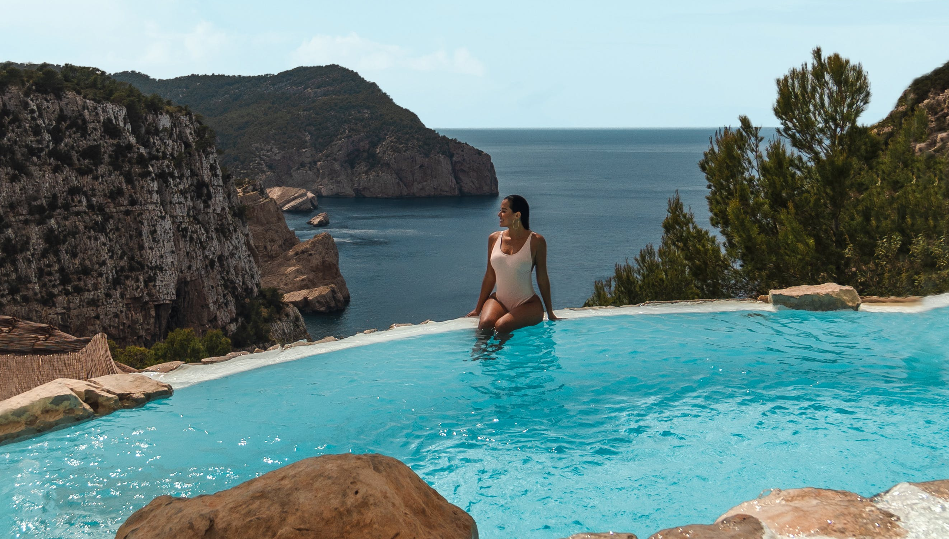
22
Calculate Your Net Profit (Or Loss)
Finally, subtract total expenses from total revenue to determine your net profit (if positive) or loss (if negative). Net profit is essentially what’s left after you pay all the bills.
Example 1: If your projected revenue is €18,240 (from Section 2’s forecast) and total expenses are €19,600,
then Net Profit = €18,240 – €19,600 = –€1,360, a net loss of €1,360.
That indicates you wouldn’t break even (you’d be in the red) with those numbers.
Profit & Pricing Strategies
Determine Your Net Profit (or Loss)
Guide to hotel financial statements

Slide 10
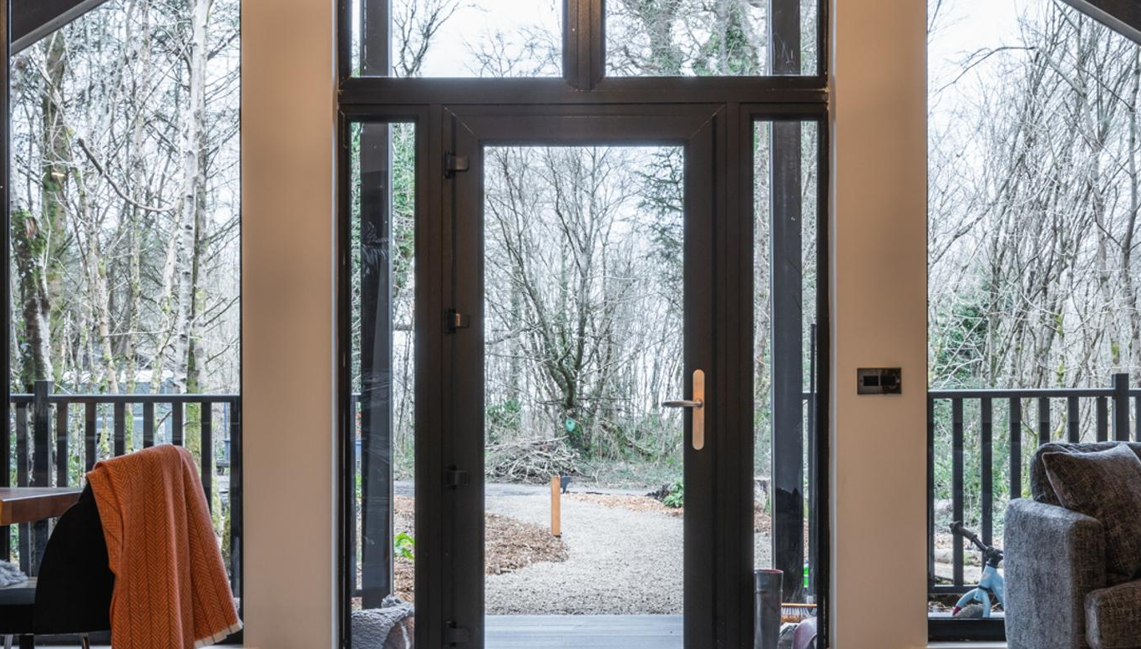
Calculate Your Net Profit (Or Loss)
Example: On the other hand, if your revenue was, say, €25,000 and expenses €19,600, then Net Profit = €5,400 – meaning you’d make €5.4k profit in the year.
This profit (or loss) figure is crucial.
A positive profit tells you the business as planned is viable (and by how much), while
A negative number is a red flag that you either need to reduce costs or find ways to increase revenue (higher rates, more bookings, or additional income streams).
Don’t be discouraged if it’s a small profit – many new businesses start with modest gains – but if it’s a loss, you now know roughly how much you’re short and can strategise accordingly (perhaps by revisiting your pricing or cutting optional expenses).
Profit & Pricing Strategies
Determine Your Net Profit (or Loss)

Slide 11
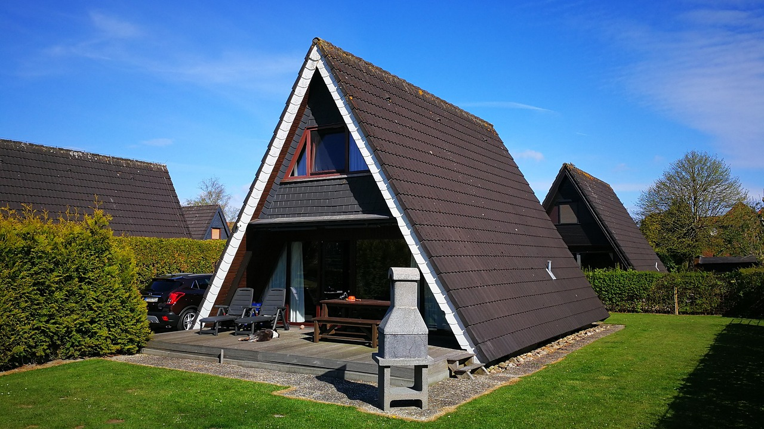
Calculate Your Net Profit (Or Loss)
Example Summary: Let’s say our example B&B ended up with €18,240 in revenue and €19,600 in expenses, resulting in a loss. To fix this, one could try to either
reduce costs (maybe trim unnecessary expenses or find cheaper providers) or
Increase revenue – perhaps by upping high-season rates a bit or aiming for higher occupancy with better marketing.
On the flip side, if the plan shows a healthy profit, you might still double-check if assumptions are realistic (e.g., is 80% occupancy in summer achievable?) and keep some buffer for unexpected costs
The goal is a realistic profit projection that satisfies you (and any stakeholders) that the business is worth pursuing.
Profit & Pricing Strategies
Determine Your Net Profit (or Loss)

Slide 12
23
Calculate Break-Even and Profitability
shows when you stop losing money
“What do I need to break even and to make a profit?
Break-even is the point where your income from bookings exactly covers your total costs — no profit, but no loss.
Profitability begins when you earn more than your break-even point — meaning every extra night booked after that contributes directly to your profit.
First Identify Your Costs, Prices and Revenue (see previous formulas)
Fixed Costs (FC) = €14,000 → costs that stay the same regardless of bookings.
Variable Cost per Night (VC) = €30 → costs that increase per booking.
Price per Night = €150 → what you plan to charge.
Net Revenue per Night = €150 – €30 = €120

Slide 13
Calculate Break-Even Point
“What percentage of the year do I need to be booked to break even?”
Find Your Break-Even Point (Formula)
Break-Even Nights = Fixed Costs ÷ Price Per Night - Variable Cost Per Night
Fixed Costs (FC) = €14,000 Variable Cost per Night (VC) = €30
Price per Night = €150 Net Revenue per Night = €150 – €30 = €120
Break-Even Nights = €14,000 ÷ €120 = 117 nights
117 nights × €120 net revenue = €14,040
You’ve covered all fixed and variable costs.
So, you need to book 117 nights per year just to cover your fixed costs.
Before this point, you're not losing money — but you're not making any profit yet.

Slide 14
Calculate Profit Based on Increased Bookings
“What percentage of the year do I need to be booked to break even?”
Find Your Profit (Formula)
Profit=(Price per Night−Variable Cost per Night) × Nights Booked−Fixed Costs
Or in simple terms
Profit=Net Revenue per Night × Nights Booked−Fixed Costs
Step 1: Find Break Even Nights First
Fixed Costs (FC) = €14,000 Variable Cost per Night (VC) = €30
Price per Night = €150 Net Revenue per Night = €150 – €30 = €120
Break-Even Nights = €14,000 ÷ €120 = 117 nights
Step 2: Identify Profit Based on Increased Bookings
Profit if you change Break-even Nights 117 to 180 Nights:
€120 x 180 nights = €21,600 - Fixed Costs €14,000
€21,600 – €14,000 = €7,600 Total Profit

Slide 15
Breakeven & Profitability Calculator Table
Here is your Breakeven & Profitability Calculator Table, showing how different nightly rates affect the number of nights needed to break even—and to earn a €10,000 profit.
You can adjust these values to plan your pricing strategy and make sure your costs and income align with your business goals.
Nightly Rate (€) | Fixed Costs (€) | Variable Cost per Night (€) | Breakeven Nights | Nights for €10k Profit
100 | 18,000 | 30 | 257 | 400
110 | 18,000 | 30 | 225 | 350
120 | 18,000 | 30 | 200 | 311
130 | 18,000 | 30 | 180 | 280
140 | 18,000 | 30 | 164 | 255

Slide 16
Calculate Your Profit Margin
24
Profit Margin shows the percentage of your total revenue that you keep as profit after covering all your costs. In other words, how much money do you actually keep from your total sales after covering all your costs?
“Am I just busy — or am I making money?”
Pricing: Helps you know if your price is high enough to cover costs and leave a profit.
Improve Decisions: Tells you if you need to reduce expenses, increase bookings, or adjust services.
Check Business Health: As your profit margin grows, your business becomes more efficient and sustainable.
Profit Margin = (Profit ÷ Total Revenue) × 100
Example: Total Revenue = €150 × 180 nights = €27,000Profit = €7,600Profit Margin = (€7,600 ÷ €27,000) × 100 = 28.15%
Profit & Pricing Strategies
Calculate Profit Margin

Slide 17
Example: Calculate Your Profit Margin
Profit margin tells you how much profit you keep from every €1 earned — so you can make better financial decisions.
Scenario | Nights Booked | Price per Night | Total Revenue | Fixed Costs | Profit | Profit Margin
A – Healthy Profit | 180 | €150 | €27,000 | €14,000 | €7,600 | 28.15%
B – Low Margin | 180 | €150 | €27,000 | €14,000 | €2,000 | 7.4%
C – More Bookings | 220 | €150 | €33,000 | €14,000 | €12,400 | 37.6%
D – Lower Price | 180 | €120 | €21,600 | €14,000 | €2,200 | 10.2%
E – Break-Even | 117 | €150 | €17,550 | €14,000 | €0 | 0%

Slide 18

25
Choosing Your Pricing Strategy
Which pricing method is best for my business to ensure it is competitive and profitable, considering cost, competition, reputation, and value?
Objective: To choose and apply the pricing strategy that best aligns with your business goals and guest expectations.

Slide 19
Setting Prices and Revenue Management
Pricing
Once you know your costs from budgeting, you can decide on pricing.
This section covers how to set the right price per night for your cabins or tents, ensuring you are both competitive and profitable.
Learn the key factors that influence pricing, include; market competition, location, seasonality, the uniqueness of your stay and amenities, your target guests, and, of course, your operational costs and profit goals.
For example, a lakeside eco-lodge with premium facilities can charge more than a basic countryside yurt – but if priced too high, you may deter guests; too low and you won’t meet your profit needs.
How to set the price right each night?

Slide 20
Setting Prices and Revenue Management
Pricing
Learn strategies like cost-plus pricing (ensuring the rate covers all costs plus a margin) and value-based pricing (charging based on the experience’s value to guests).
Importantly, learn seasonal pricing and dynamic pricing: you might raise prices during peak season or weekends when demand is high, and offer discounts in low season to attract guests.
Consider offering tiered options (e.g. basic vs. luxury package) or add-ons to boost revenue.
By the end, you should be able to calculate a nightly rate that fits your budget and market expectations, and adjust it with confidence.
& Revenue Management

Slide 21
26
Choose your Pricing Strategy
There are three main options for choosing your pricing strategy: break-even, cost-plus and value-based pricing.
1. Break-even Price Strategy (Minimum Price) sets your price just high enough to cover your total costs, but without adding any profit margin. It’s a foundational tactic used to ensure your business can sustain operations without going into loss, especially in the early stages.
It might be a good option if you're starting out, during the low season, or testing market demand. You won’t make a profit at this rate — it’s about survival, visibility, or traction. It’s not sustainable in the long term, but it’s a powerful short-term tool in your pricing toolbox. Over time, your goal is to transition to cost-plus or value-based pricing as your reputation and demand grow.
Example: If it costs €50 per night to run your pod, set your floor price at €50 — the minimum you must charge to avoid a loss.
Pricing Methods
Break-Even Strategy
(Covering Costs Only, No Profit)

Slide 22
27
2. Cost-plus Strategy (Base Price) (most common)
The Cost-Plus Pricing Strategy is one of the simplest and most widely used pricing methods, especially in early-stage or small hospitality businesses. It ensures your price covers all your costs and includes a target profit margin.
You automatically add a profit margin to your cost. Cost-Plus Pricing means calculating your base cost per night (covering all expenses) and then adding a markup (profit margin) to set your minimum or regular price.
When to Use Cost-Plus:
You want consistent profit per night
You understand your cost structure clearly
You're just starting and need a safe minimum to cover yourself
You operate in a market with predictable occupancy
Pricing Methods
Cost Plus Strategy
(Cover costs and add a profit)

Slide 23
Add a Profit Margin to Your Break-Even Price
Pricing Methods
Now that you know your break-even price per night, it’s time to move to the cost-plus strategy and add a profit margin on top of your base cost to set your final nightly price.
You have to decide how much profit you want to earn per night. What determines your Profit Margin? As explained in previous sections;
Financial goals (e.g. how much income you want to earn)
Market demand (busy vs. quiet seasons)
What your competitors are charging
The uniqueness and reputation of your accommodation
Cost Plus Strategy
(Calculating the Profit Margin)
Cost-Plus Pricing = Total Cost per Night + Desired Profit Margin = Minimum Price
€100 (all fixed and variable costs) + 30% Margin = €130/night
Use €130 as your base cost-plus price for regular season pricing. This becomes your minimum target price, before adjusting for season or demand.

Slide 24

In simple terms, cost-based pricing sets your price by calculating
All costs of running multiple rooms (per day) - from cleaning and utilities to maintenance and marketing.
Divided by the total number of occupied rooms
Then adding a margin on top = Average room rate
It ensures you always cover your costs and earn a profit on each booking. Useful if you’re starting out and don’t know what customers are willing to pay or if you want to determine off-season minimum rates (when demand is low, and you don’t want to lose money on any occupied night).
Remember: Don’t assume you know what customers are willing to pay. Get data to support your decision; otherwise, you may overprice.
Pricing Methods
Cost Plus Strategy
(Cover costs and add a profit)
Recommended Reading
What is cost-based pricing in hotels?
Example: A 5-room barn guesthouse is considering a cost-based pricing strategy. Over the last year, it has calculated that its annual costs total €200,000, and that rooms were occupied an average of 200 nights of the year. It determines that a 40% profit margin is appropriate given its circumstances, so it sets its standard room rate at €280.

Slide 25
This part provides you with a Pricing Calculator Template. A simple worksheet where you can input your own figures, e.g., annual costs, desired profit, and expected nights sold to compute a base nightly rate.
The Pricing Calculator Template helps you set your nightly rate based on costs, desired profit, occupancy expectations, and seasonal variation. It includes:
Pricing Calculator
Find Your Base Nightly Rate
Formula:
Base Nightly Rate = (Annual Costs + Desired Profit) ÷ Expected Nights Booked
Term | What It Is
Annual Costs (€) | Your total operating expenses for the year (fixed + variable costs)
Desired Profit (€) | The extra income you want to earn on top of covering costs (before tax)
Expected Nights Booked | A realistic number of nights you expect to sell in a year (e.g., 50% occupancy = 182 nights for 1 unit)

Slide 26
Cost Plus Pricing Calculator Template
Input Category | Amount (€) | Explanation / Formula
Total Annual Operating Costs | €15,600 | From your budget (Fixed + Variable Costs)
Desired Annual Profit | €10,000 | Your target income before tax
Total Revenue Goal | €25,600 | = Costs + Profit
Expected Nights Booked per Year | 180 nights | Conservative occupancy (e.g. 50% of 365 for 1 unit)
Base Nightly Rate | €142.22 | = Total Revenue Goal ÷ Nights Booked (e.g. 25,600 ÷ 180)
This is the core method used in Cost-Plus Pricing:
Base Nightly Rate = (15,600 + 10,000) ÷ 180 = 25,600 ÷ 180 = €142.22
This means you need to charge at least €142.22 per night to cover your costs and earn €10,000 profit, assuming 180 nights booked per year.
When to Adjust: If you book more nights, you could lower the rate or earn more profit.
If bookings are lower than expected, consider raising the price or reducing costs. Combine this with seasonal adjustments and competitor analysis to fine-tune your final pricing.

Slide 27
3. Value-based Strategy (Guest Perceived Worth or Value) prices your accommodation based on perceived value to the customer rather than the cost to you. You set your price based on what guests are willing to pay, not just what it costs you. Use this strategy when customers are willing to pay a premium because;
You offer something unique (e.g., a treehouse with views)
It’s high season or during special events
Competitor rates are higher and justified by demand
Or because of your location, e.g., in a protected area or close to a big event.
For instance, a treehouse with panoramic views or a cabin during a popular festival weekend can command a significantly higher rate due to its unique appeal and high demand. So, if you charge €200+ during peak weekends, and guests love your views and amenities, you can charge €180–€250/night, even if it only costs you €70 to operate.
28
Pricing Methods
Value-Based Pricing
(What it is worth to our guest)
Recommended Reading
What is cost-based pricing? Example and strategy for tourism accommodations.

Slide 28
You calculate all operating costs (cleaning, electricity, staff, maintenance, insurance, etc.).
Add fixed costs (mortgage or rent, licenses, marketing).
Include a markup (e.g. 20–30%) to ensure profit.
Example
If your average cost per guest night is €80, you might set the price at €104 to ensure a 30% profit.
Cost-Based Pricing
This strategy sets prices based on the total cost to run the business plus a markup for profit
Value-Based Pricing
This strategy is based on the perceived value of your accommodation to your ideal guest, rather than just the costs.
You consider what your guests value most: tranquillity, authenticity, eco-luxury, and cultural immersion.
Benchmark against similar unique stays (Airbnb, eco-lodges, boutique hotels).
Use branding and storytelling to justify higher rates.
Example
  If your off-grid treehouse offers a unique digital detox experience, you may charge €160 per night even if the costs are just €70, because the emotional and experiential value is high.

Slide 29
Advantages of Cost-based Pricing
What are the advantages of cost-based pricing? Here are five of the most compelling.
Minimum level of profit
When you calculate and set your cost-based price, you’re guaranteed to make a minimum level of profit whenever a guest books a room.
Structure for forecasting and budgeting
The process of setting cost-based pricing can offer valuable insights into your finances and be helpful for forecasting and budgeting.
Consistency
By using costs as your guide, you can be confident that your prices will be competitive (provided you don’t go overboard with your profit margin).
l
Mitigate risks
Cost-based pricing is safe. It considers the unique circumstances of your accommodation to come up with a price that’s good for business.

Slide 30
Cost-based Pricing Vs Other Pricing Strategies
Cost-based pricing is one of several pricing strategies available to accommodation providers. Here’s how it compares to a few of the most popular.
Cost Based Pricing
Prices are set based on how much a service costs to deliver, plus a profit margin markup.
Value Based Pricing
Prices are set based on what guests believe your rooms and services are worth.
Market-based Pricing
c
Prices are set based on factors like consumer demand, economic conditions and other market forces.
c
Competition-Based Pricing
Prices are set based on what is competition relevant i.e., what local alternative tourism accommodation competitors are charging

Slide 31
Cost Based Pricing: Decide whether to set prices from your costs or from guest-perceived value. Cost-based pricing simply adds a markup to your unit costs.
By contrast, value-based pricing charges what guests believe is fair for the experience.
In practice, combine both approaches: ensure all costs are covered and then test higher rates based on the special value you offer.
Formula: If cleaning and utilities per night cost €50 and you want a 20% profit, the room rate is €50 + (€50 × 0.20) = €60.
Example: If your site offers unique amenities (e.g. luxury tents, local food, spa services), people will often pay more even if your costs are moderate.
Combine Both: Selling Price = Cost + (Cost × Markup%)
Emphasise unique features or eco-credentials so guests understand and accept higher rates. Example: A “base rate” plus seasonal multipliers (e.g. +25% in mid-season, +50% in summer) can be calculated in Excel.

Slide 32
Summary: 3 Main Pricing Strategies
Pricing Strategy | Definition | Formula | When to Use | Example
Break-Even Pricing | Covers your costs only, no profit margin included. | Total Costs ÷ Number of Nights | Starting out, low season, or testing demand | €10,000 fixed costs ÷ 100 nights = €100/night
Cost-Plus Pricing | Adds a desired profit margin to your total costs per night. | Cost per Night + Profit (€ or %) | Regular operations, ensures margin | €100 cost/night + 30% profit = €130/night
Value-Based Pricing | Based on perceived value to the guest, not just your costs. | What guests are willing to pay | High demand, luxury/unique stays, peak season | Glamping pod with sea view: Guests value at €180, even if cost is €100

Slide 33
Adjusting Your Price Throughout the Year
Smart hosts rarely stick to one price all year. Instead, they adjust based on:
Seasonality – (summer versus winter) e.g., charge more in July/August than in January
Events or Holidays – raise prices when demand spikes
Weekends vs. Weekdays – weekend rates can often be higher
Tip: Blend Pricing Methods for Best Results
To stay competitive and maximise revenue, use a mix of:
Cost-Based Pricing – Ensure you always cover your costs + margin
Value-Based Pricing – Charge more when guests see higher value (e.g. great views, unique features, peak dates)
This balance helps you avoid underpricing in high season and losing bookings in low season.
Pricing Methods
Adjusting Your Profit Margin

Slide 34
Monthly Revenue & Break-Even Forecasting Table
Context: After you've set your price (via break-even, cost-plus, or value-based strategy), you now project income, track occupancy, and test for financial viability using monthly and annual breakdowns.
When to do this exercise: Just after the pricing strategy, and before the “profit & scaling” sections.
Why It Matters: Turns abstract pricing into real-world income. What It Does: Helps you forecast bookings, revenue, and profit.
How to Use: In a spreadsheet or monthly planner for actual business use.
Use Case | Benefit
Planning a New Business | Know if your pricing and occupancy will be viable
Low-Season Strategy | Adjust to cover costs at minimum pricing
Profit Targeting | Set financial goals and calculate how to meet them
Grant/Funding Proposals | Show financial projections and break-even logic
Seasonal Adjustments | Forecast high vs. low months and adjust marketing

Slide 35
Formulas: Strategic Revenue and Profit Forecasting Pricing
Column Name | Formula | Example
Nights Occupied (per month) | Nights Occupied = Days in Month × Occupancy Rate | If April has 30 days and 40% occupancy → 30 × 0.40 = 12 nights occupied (per pod)
Monthly Revenue (per pod) | Monthly Revenue = Nights Occupied × Average Nightly Rate | 12 nights × €90 = €1,080 per pod monthly revenue
Monthly Revenue (Total) | Total Revenue = Nights Occupied × Avg Rate × Number of Pods | 12 × €90 × 5 pods = €5,400 5 pods monthly revenue
Annual Revenue (Total): | Annual Revenue = SUM of all monthly revenues | Use Excel: =SUM(B2:B13) if your monthly revenue is in column B
Profit (Optional Add-On) | Profit = Revenue – Variable Costs – Fixed Costs | Revenue: €60,000 Fixed Costs (insurance, marketing, staff base pay): €15,000 Variable Costs (per night, e.g. laundry, cleaning): €20 × total nights booked Final: €60,000 – €15,000 – (562 nights × €20) = €33,760 Net Profit
Break-Even Occupancy Rate To calculate the minimum occupancy rate you need to cover your costs | Break-Even Nights = Fixed Costs / (Nightly Rate – Variable Cost per Night) Occupancy Rate = Break-Even Nights / (Total Nights Available × No. of Pods) | €15,000 ÷ (€90 – €20) = 214 break even nights 214 ÷ (300 × 5) = 14.27% break even occupancy

Slide 36

Section 8
Applying Seasonal Strategies
How can I adjust my prices throughout the year to increase bookings and boost profits?
Objective: Adjust your prices to match seasonal demand and maximise revenue. Choose and apply the pricing strategy that best aligns with your business goals and guest expectations.

Slide 37
Applying Seasonal Pricing
Optimise earnings across busy and quiet times. Implement flexible pricing that increases revenue during high demand and maintains occupancy during slower months. Demand for accommodation changes across seasons. Charging the same price all year means you may lose income during peak periods or miss out on bookings in the low season. Seasonal pricing enables you to adjust your rates in response to demand, occupancy trends, and market competition. Create a seasonal pricing model, apply day-based adjustments (e.g., weekends vs. weekdays), and model different pricing scenarios.
29
Seasonal Pricing Strategies
Strategies to set prices across high, mid and low seasons to maximise occupancy and profit
30
Basic Seasonal Pricing Calculator Table
A simple calculator for small businesses that adjusts rates based on seasonal demand
31
Applying Seasonal and Day-Based Adjustments to Your Base Rate
Tweak base prices by day of week and time of year.
32
Strategic Revenue Management
How to sum up total annual revenue and prepare for forecasting and Cash Flow Planning
33
Strategic Seasonal Pricing Calculator
A more advanced model for flexible pricing.
34
Low-Season Survival
Cost Savings and Revenue-Boosting Tactics

Slide 38
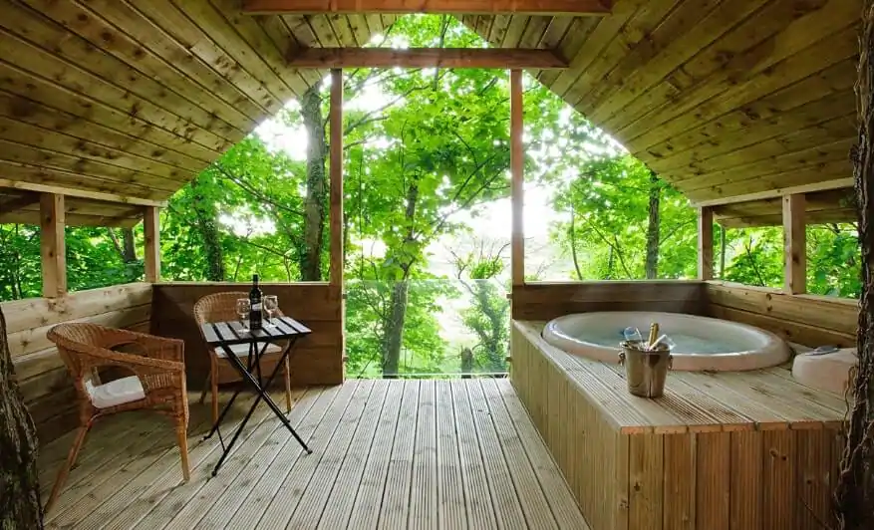
Introduction
Not all nights are created equal in the accommodation business – a room on a sunny summer weekend is far more in demand (and valuable) than the same room on a rainy off-season Tuesday. This section explores how to adjust your pricing and forecast revenue according to seasonal trends.
It will help you maximise income during high-demand periods and still attract guests during slower times by using smart pricing strategies and revenue boosting activities.
In context, most accommodation businesses face ebb and flow throughout the year (think tourist seasons, holidays, or local events). Our objective here is to create a pricing plan and provide you with practical strategies that will help you navigate these waves, charging the right prices at the right times, engaging in revenue-boosting activities, and projecting how those decisions affect your overall revenue. By doing so, you’ll ensure your business stays profitable year-round, not just during the busy spells.
Low-Season Survival
Cost Savings and Revenue-Boosting Tactics
Financial Planning Essentials For Glamping Site Operators

Slide 39
Planning for Low Seasons and Seasonality
Almost every alternative accommodation faces seasonal demand fluctuations – whether it’s weather-related (a summer glampsite in Northern Europe will be quieter in winter) or day-of-week patterns (mid-week vs. weekend).
Following pricing, this section focuses on ensuring viability during periods of low occupancy. Learn the concept of seasonal cash flow: even if your place is fully booked in peak season, you must plan so that off-peak months don’t put you in the red. Strategies here include:
Low-Season Survival
Cost Savings and Revenue-Boosting Tactics

Slide 40

Cost Savings and Revenue-Boosting Tactics
1. Seasonal Pricing (Basic)
Seasonal Pricing Adjustments: Using lower off-season rates or special promotions to maintain occupancy when demand drops. For example, offering mid-week discounts or bundled experiences (such as a winter hot tub package for a cabin stay) to entice guests during slow periods.
Discussed in more detail later.

Slide 41
“How should I adjust my room rates throughout the year to make the most of high and low seasons?”
Seasonality can greatly affect an accommodation business. During peak tourist periods, demand (and prices) can soar, while in off-peak times, you may struggle to fill rooms.
Seasonal pricing involves adjusting room rates according to the demand at different times of the year.
In high season (when demand is strong – e.g. summer or holidays), you’ll likely charge higher rates, and in low season (when tourism slows down), you might lower your prices to attract more guests.
This strategy helps you stay competitive and occupied even in quieter periods, while capitalising on peak periods when people are willing to pay more.
By structuring your rates for low, mid, and high seasons, you create a flexible pricing plan that can boost your annual revenue and occupancy.
Seasonal Pricing
Introduction
Seasonal Pricing Strategies

Slide 42
Seasonal Pricing Strategy (Flexible Rates by Season)
“How should I set my prices across different seasons to maximise occupancy and profit?”
This section helps you develop a Seasonal Pricing Strategy – essentially a plan to adjust your nightly rates for high, mid, and low seasons to maximise revenue year-round.
By the end, you’ll have a seasonal pricing “calculator” that sets smarter rates for each season, ensuring you charge higher during high-demand periods and offer attractive prices during slower months. The objective is to optimise your income throughout the year and remain competitive, while accounting for changes in occupancy and any seasonal cost differences in your operation.
Seasonal Pricing
Introduction

Slide 43
Basic Seasonal Revenue Forecast: Terms
Term | Meaning
Flat Seasonal Rates | You charge one consistent price per night for the entire season. No fluctuation within that season. Example: every night in July and August = €150.
Fixed Nightly Rate | The nightly price is predefined: Example: €80 for low season, €120 for mid, €150 for high.
Occupancy | Assumes a general percentage of bookings for the season Example: 20% for low, 40% mid, 60% high.
Rate Strategy | No dynamic pricing, discounts, surcharges, or flexibility. Pricing is set and left unchanged.
Cost Tracking | This model focuses only on revenue. It does not include business costs or show profit margins.
Projected Revenue | Based on those flat rates and occupancy estimates, you generate €21,150 annually.

Slide 44



Planning for Low, Mid and High Seasons
Strategic Pricing Questions to Model
For all scenario models watch how they affect Total Annual Profits!
29
Pricing is a strategic lever. You can model for example;
“What if we charge 10% more (or less)?” in peak season. Often, peak season is relatively inelastic (you won’t scare off all guests with a modest increase), whereas off-peak is more about generating any demand at all.
“What if we drop €15 in winter to boost occupancy?” If you drop prices in an attempt to fill more nights – check if the added bookings actually raise your total revenue.
“Can we add a premium for weekends or holidays?” If higher pricing causes only a small drop in occupancy (e.g. from 70% to 68%), you might see higher profit overall.

Slide 45





“How should I set my prices across different seasons to maximize occupancy and profit?”
Step 1 Identify Your High, Shoulder, and Low Seasons
Before setting rates, first map out the seasons for your business. Think about when demand is highest (your high or peak season), when it’s moderate (shoulder/mid-season), and when it’s lowest (off-peak/low season). Consider local travel patterns, weather conditions, and upcoming events. For example, a beachside B&B might see peak demand in summer, shoulder seasons in spring and early fall, and a low season in winter.
Example: If your B&B is located in a ski town, the winter months could be your high season (with many tourists visiting for skiing), while autumn might be considered your low season. In that case, December through February are peak months with heavy bookings, whereas October is relatively quiet.

Slide 46
Step 2 Set Your Seasonal Nightly Rates
Now assign a nightly rate for each season. The idea is to charge higher rates in high-demand periods and lower rates in low-demand periods. Use your base rate as a starting point (perhaps what you’d charge during an average season) and adjust up or down for peaks and troughs. High season can command a premium since more guests are willing to pay, while low season rates should be tempting enough to attract the few travellers around.
Example: Suppose your base rate (for mid-season) is €100 per night. You might set your high season rate at €120 (20% higher to capitalise on demand) and your low season rate at €80 (20% lower to entice bookings when demand is weak). This means that in July (peak summer), you’d charge €120/night, but in November (off-peak), maybe €80/night.

Slide 47
Step 3 Estimate Seasonal Occupancy
Setting rates goes hand-in-hand with occupancy expectations – the percentage of nights you actually book. Estimate how full you expect to be in each season. The high season is likely to have a strong occupancy rate (perhaps 80% or more), the shoulder season will be moderate, and the low season will be pretty low (possibly 30-40%). These estimates will be helpful later for forecasting revenue.
Example: If summer is your high season and you have 90 days of summer, you might expect around 80% occupancy, meaning about 72 of those 90 nights booked. In contrast, in the 90-day winter low season, you might predict only 30% occupancy (around 27 nights booked). This step involves some degree of guesswork, but utilise any available local data or industry knowledge (for instance, similar nearby properties’ occupancy trends) to inform your assumptions.

Slide 48
Step 4 Factor in Seasonal Cost Differences
Consider whether your operating costs fluctuate with the seasons and whether that should influence your pricing. Some expenses may rise in certain seasons – for example, heating costs in winter or extra staffing during peak summer – and you may want to reflect that in your pricing or at least plan for it.
Example: Your mountain lodge might spend more on heating and snow removal in winter (increasing winter operating costs). If winter is also a low season for visitors, you’ll need to budget carefully since you can’t simply charge exorbitantly more to cover these costs (higher prices could further reduce bookings in the low season). On the other hand, during the high season, you might consider hiring an extra part-time cleaner, a seasonal cost offset by your higher high-season rates. By being aware of seasonal cost swings, you can ensure your peak season profits help cover off-season bills.

Slide 49
Step 5 : Create a Basic Seasonal Pricing Table
With the above info, put together a Seasonal Pricing Table – a simple chart listing each season alongside the nightly rate you plan to charge (and perhaps the expected occupancy). This provides a clear, at-a-glance view of your pricing year.
Example: *Your table might look like:
High Season (June – Aug): €120/night (expected 80% occupancy)
Shoulder Season (Apr – May, Sept – Oct): €100/night (expected 50% occupancy)
Low Season (Nov – Mar): €80/night (expected 30% occupancy)*
This basic table is your foundation. It ensures that you’ve logically adjusted prices to meet demand. You can now test these numbers (e.g. will the high-season price seem too high to regular guests? Is the low-season price enough to cover at least your costs per stay?) and tweak as needed.

Slide 50

After establishing an initial pricing strategy, the next challenge is determining how to respond to fluctuations in demand throughout the year. You will then transition into managing those ups and downs: if you charge different rates in high and low season, how do you plan for the slower periods?
This naturally leads to the next section on planning for low seasons. Pricing is a strategic lever. You can model, for example;
If you raise your average summer rate and assume a tiny decrease in occupancy, you may see an overall increase in your yearly profit. Even modest changes can lead to significant gains if applied strategically.
Key term – Revenue Management: This is the practice of adjusting prices to maximise revenue (like hotels do with seasonal rates or last-minute deals). You don’t need complex algorithms at first; test a few scenarios with the provided calculator and use common sense to understand your customer base.
Price Change Scenario Modelling
Planning for Low, Mid and High Seasons

Slide 51
Basic Seasonal Pricing Calculator
30
Price Change Scenario Modelling
This section provides you with a Seasonal Pricing Calculator, which helps you to turn your base nightly rate into a flexible, revenue-optimised pricing plan that adjusts to high, mid, and low season occupancy trends.
The purpose of the Seasonal Pricing Calculator is to help you set smarter, more profitable prices for your accommodation business by adapting your nightly rates to seasonal demand. It also allows you to test different assumptions, such as:
Low, mid, and high season nightly rates
Occupancy estimates for each season (%)
Seasonal differences in operating costs (if any)
Let’s begin with a basic Seasonal Pricing Calculator Table showing
Then we will move on to a more Advanced Strategic Seasonal Dynamic Pricing Table in the next section.
Seasonal Pricing Calculator

Slide 52
In Sections 4 and 5, you calculated your Net Revenue Per Night and your Average Rate Per Night, also known as Base Nightly Rate or Minimum Price.
For the Season Calculator, your Average Rate Per Night will be your solid baseline. Use your total annual costs + desired profit, divided by the expected number of booked nights:
Base Nightly Rate = (Annual Costs + Desired Profit) ÷ Expected Nights Sold.
Now, with your Average Rate Per Night or base rate, apply seasonal pricing logic so you adjust for seasonal demand. The Seasonal Pricing Calculator will help you do this, e.g.,
Set higher rates in peak months (e.g. summer, holidays, festivals)
Offer discounts in off-peak months (e.g. winter weekdays)
Apply strategic rate variation without undercutting your breakeven point
This dynamic pricing strategy replaces a “one-size-fits-all” model and helps you layer in real-world seasonal demand behaviour.
Seasonal Pricing Strategy & Calculator
Adjust for Seasonal Demand

Slide 53
Basic Seasonal Revenue Forecast
Let’s begin with a basic Seasonal Pricing Calculator Table showing how nightly rates, occupancy, and season lengths affect total revenue and performance:
Model price increases in peak season
Test discounts in the low season
Forecast cash flow scenarios by adjusting rates or occupancy
Formulas used
Occupied Nights = (Occupancy Rate ÷ 100) × Nights in Season
Seasonal Revenue = Occupied Nights × Nightly Rate
Annual Revenue = Sum of all Seasonal Revenues
Average Daily Rate (ADR) = Annual Revenue ÷ Total Occupied Nights
Season | Nightly Rate (€) | Occupancy Rate (%) | Nights in Season | Occupied Nights | Seasonal Revenue (€)
Low | 80 | 20 | 90 | 18 | 1,440
Mid | 120 | 40 | 120 | 48 | 5,760
High | 150 | 60 | 155 | 93 | 13,950
Total / Avg | — | — | 365 | 159 | 21,150

Slide 54
Applying Seasonal and Day-Based Adjustments to Your Base Rate
31
Price Change Scenario Modelling
Next, using the Seasonal & Day-Based Pricing Adjustment Table, you can apply real-world adjustments based on demand to create Final Prices for each season or day type.
It shows how you adjust your flat base rate for seasonal and weekly demand fluctuations
It gives clear pricing tiers to apply across your calendar or booking system
It's ideal for communicating your strategy to partners, OTAs, or dynamic pricing tools
Seasonal & Day-Based Pricing Adjustment Table

Slide 55
Applying Seasonal and Day-Based Adjustments to Your Base Rate
Season | Base Rate (€) | Adjustment | Final Price (€) | Notes
Peak (Jul–Aug) | €142 | +20% | €170.40 | High demand: add premium
Shoulder (May–Jun, Sept) | €142 | +10% | €156.20 | Moderate demand
Off-Peak (Oct–Apr) | €142 | –15% | €120.70 | Offer discounts to attract bookings
Weekends (Fri–Sat) | €142 | +15% | €163.30 | Can stack with seasonal rate
Midweek (Sun–Thu) | €142 | 0% | €142.00 | Keep base or add deals
Note:
Apply % adjustments to base rate depending on demand.

Slide 56
2. Dynamic Pricing Strategies
Think of dynamic pricing as taking seasonal pricing to the next level. Instead of just three sets of rates (low, mid, and high season), dynamic pricing involves continuously adjusting prices based on real-time supply and demand factors.
Big hotels and airlines do this all the time – prices might go up if there are only a few rooms left or a big event is happening nearby and go down if you have plenty of availability and want to entice last-minute bookers.
For a small accommodation business, you can still apply this idea in simpler ways.
For example, if you usually charge €100 but notice that next weekend is still wide open, you might temporarily drop the rate to €90 to attract a booking or two. On the flip side, if your rooms are almost fully booked a month in advance (say there’s a festival in town), you could increase your remaining rooms to €130 because you know demand is high. Dynamic pricing can be as simple as periodically reviewing your booking calendar and tweaking rates, or as advanced as using pricing software. The goal is to maximise revenue by selling the right room at the right price at the right time.

Slide 57
Step 6 : Consider Advanced Dynamic Pricing (Optional)
For even more optimised revenue, you can explore dynamic pricing – adjusting rates within a season in response to specific demand fluctuations (like special events or last-minute booking trends). Large hotels and experienced hosts often use software to update prices daily or weekly based on occupancy and market demand. This is optional but understanding it can be useful as you grow.
Example: Using dynamic pricing, you might increase your rates an extra 15% on weekends or holidays, even during shoulder season (when demand spikes a bit), or drop prices for next week if you still have many vacant nights (to encourage last-minute bookings). If there’s a big festival in town one weekend, a dynamic approach would raise your rates for those particular nights beyond your normal seasonal rate. This advanced strategy can maximise revenue during micro-peaks and boost occupancy in slow times, but it requires active management or pricing tools. For now, knowing your seasonal base rates is the priority – you can always layer dynamic tweaks on top later.

Slide 58
Seasonal Revenue Forecast
(Projected Income by Season)
321
Seasonal Revenue Forecasting
“How much money can I expect my accommodation business to make in each season, and total for the year?”
Once your seasonal rates and occupancy assumptions are set, the next step is to forecast the revenue you’ll bring in each season and for the year overall.
You will create a Seasonal Revenue Forecast –an estimate of income from bookings in high, mid, and low seasons. The purpose is to translate your pricing, and occupancy plans into actual euros, so you can see if the numbers meet your expectations (and expenses). This forecast provides real-world context by showing how seasonality impacts your cash flow – for example, you’ll see if a busy summer’s income must carry you through a lean winter. The objective is to obtain a clear picture of monthly or seasonal cash inflows, which is crucial for budgeting and ensuring your business can stay afloat through the year’s ups and downs.
Introduction

Slide 59



“How much money can I expect my accommodation business to make in each season, and in total for the year?”
Step 1: Calculate High-Season Revenue
How it Works
Example
Start with your high season. Determine how many nights you expect to book during this period and multiply by your high-season rate. If you estimated an occupancy percentage, use it to find the number of booked nights.
If high season is 3 months long (~90 days). Example: With 80% occupancy in high season, about 72 nights (0.8 × 90) will be booked.
At a high-season rate of €120 per night, your high-season revenue would be approximately 72 × €120 = €8,640.
This is the projected income during your peak season. Jot that down.

Slide 60
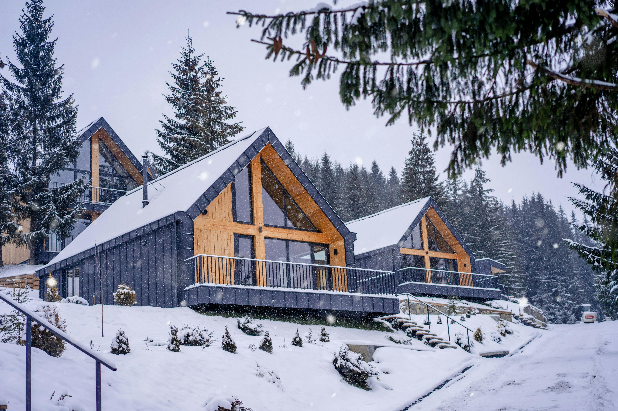
Step 2: Calculate Mid-Season Revenue
How it Works
Example
Next, do the same for your shoulder (mid) season. Figure out how many nights you’ll likely book in these moderate-demand periods and multiply by the mid-season rate.
Suppose your mid-season spans 4 months (120 days) with an expected 50% occupancy. That’s 0.5 × 120 = 60 nights booked.
At your mid-season rate of €100 per night, mid-season revenue would be about 60 × €100 = €6,000.
This is what you might earn during the spring and autumn combined, for instance.
Note: (If you have multiple shoulder seasons, you can break it down further, but for a broad estimate, combining them is fine.)

Slide 61

Step 3: Calculate Low-Season Revenue
How it Works
Example
Now project your low-season income. Low season might be the remaining part of the year (for example, the other 5 months if high is 3 months and mid is 4 months). Use your low occupancy estimate and low-season rate.
If low season covers roughly 5 months (150 days) with, say, 30% occupancy, that’s 0.3 × 150 = 45 nights booked.
At a low-season rate of €80, the low-season revenue is about 45 × €80 = €3,600.
This shows the income in the quietest period (in our example, perhaps winter). It will likely be your smallest revenue chunk, which is normal – many accommodation businesses earn the bulk of their money in a few peak months and much less in off-peak times.

Slide 62

Step 4: Sum Up Total Annual Revenue
How it Works
Example
Finally, add all up - the revenue from high, mid, and low seasons to get your total projected annual revenue.
Using the figures above: High (€8,640) + Mid (€6,000) + Low (€3,600) = €18,240 expected for the year.
This annual total gives you a benchmark for how much money you might bring in from bookings. It’s a crucial number – you’ll be comparing this against your costs in the next section to see if you’ll be profitable.
If you operate multiple rooms or units, remember to scale your revenue accordingly. For instance, if all the above calculations were for one room and you actually have 3 identical rooms to rent, your total revenue could be roughly 3 × €18,240 = €54,720 (assuming similar occupancy for each room).
Keep in mind, a forecast is an educated guess – actual results will vary, but this at least grounds your expectations in numbers rather than hope.

Slide 63

Step 5: Use the Forecast for Cash Flow Planning
How it Works
Example
Seeing when the revenue comes in is as important as how much. Your forecast likely shows that some seasons bring in more cash than others. Use this insight for budgeting.
If nearly 50% of your revenue comes in summer months, you’ll need to save some of those earnings to cover expenses in winter when revenue is sparse.
Conversely, you might plan promotions or secondary income sources for winter to boost that €3,600 low-season figure. The forecast can also highlight if you're pricing or occupancy assumptions should be adjusted. For instance, if the total annual revenue appears too low to sustain the business (relative to costs), you may consider revisiting your rates or marketing strategy to improve occupancy.
Note: Your seasonal revenue forecast is a reality check – aligning your seasonal pricing plan with expected income and preparing you to manage the seasonal cash flow swings common in the accommodation industry.

Slide 64
Strategic Seasonal Pricing Calculator
33
Price Change Scenario Modelling
The Strategic Seasonal Dynamic Pricing Table builds on your base rate and seasonal pricing strategy by introducing greater flexibility, demand-driven insights, and dynamic adjustments.
This tool enables you to refine your pricing model based on real-time demand, competitor trends, and guest behaviour, allowing you to maximise your high-demand periods and remain competitive during slower seasons. It helps you account for:
Weekday vs Weekend pricing differences
Holiday and peak event surcharges
Last-minute discounts or early booking incentives
Minimum night stay rules across seasons
Demand-based tiering (e.g., high demand = premium pricing)
Strategic Seasonal Pricing Calculator

Slide 65
Strategic Seasonal Pricing Calculator: Dynamic Rate Planning
By using this advanced model, you’re not just covering costs — you’re maximising revenue, improving occupancy, and offering pricing that reflects your property's true market value across the year.
You will be able to strategically;
Match your pricing to real-world booking patterns across different seasons
Avoid undercharging in peak periods when demand is high
Stay competitive in off-peak times by offering discounts that still protect your profitability
Test different pricing and occupancy scenarios so you can forecast annual revenue and cash flow
Make informed decisions about promotions, minimum stay policies, and pricing strategy changes
By using this tool, you create a dynamic pricing model instead of a flat rate, giving your business a competitive edge and more control over financial performance throughout the year.

Slide 66
Strategic Seasonal Pricing Calculator: Dynamic Rate Planning
Term | Meaning
Purpose | This model is built to strategically price your offering so that you not only cover your operating costs but also hit a target profit goal. It’s ideal for real business planning.
Rate Basis | Instead of picking random rates per season, you start with a calculated base rate (e.g. €125), based on your costs and profit target. Then you adjust up or down depending on demand in each season.
Occupancy | Assumes more confident booking rates than the flat model — 25% in low, 45% in mid, 65% in high season — reflecting a growth mindset or good marketing.
Rate Strategy | Rates are dynamically adjusted. For example, in high season you might add 20%, in low season subtract 15%. It’s responsive to when people are more or less likely to book.
Cost Tracking | Unlike flat models, this includes estimated operating costs per season, so you can clearly see if you’re making a profit or running at a loss.
Projected Revenue | This pricing strategy forecasts €45,630 annually — which is more than double what you’d make with a basic flat-rate model.
Profit Calculation | It clearly shows €26,430 in total annual profit, making it a complete financial tool — not just a revenue forecast.

Slide 67
Seasonal Pricing Calculator: Dynamic Rate Planning
How to Use This Template Step-by-Step
This section is a step-by-step pricing strategy guide for accommodation providers, specifically designed to help them build a profitable and competitive pricing model using the Cost-Plus Pricing Method.
Calculate your base rate using the Cost-Plus formula.
Create seasonal tiers using percentage adjustments to match demand.
Add value by designing packages or upsells that appeal to guests ‘ needs.
Test competitiveness by comparing your rates with local alternatives.
Review regularly – revise your prices if costs rise or if you reach full occupancy frequently.
The Cost-Plus Pricing Formula helps you set a base nightly rate by ensuring that your total costs are covered and that you generate a target profit.
Cost-Plus Pricing Formula:
Base Nightly Rate (€) =Annual Costs (€) + Desired Annual Profit (€) ÷ Expected Nights Booked per Year

Slide 68
Seasonal Pricing Calculator: Dynamic Rate Planning
Season | Base Rate* (€) | Seasonal Adjustment (€) | Final Nightly Rate (€) | Expected Occupancy (%) | Nights Booked | Projected Revenue (€) | Est. Cost (€) | Est. Total Profit (€)
Low Season | €125 | –€35 | €90 | 25% | 92 | €8,280 | €4,600 | €3,680
Mid Season | €125 | –€5 | €120 | 45% | 120 | €14,400 | €6,800 | €7,600
High Season | €125 | +€25 | €150 | 65% | 153 | €22,950 | €7,800 | €15,150
Total | – | – | – | – | 365 | €45,630 | €19,200 | €26,430
Definitions:
Base Rate: Your average nightly rate from cost-plus pricing (e.g. €125)
Seasonal Adjustment: Premiums or discounts applied per season
Final Nightly Rate: Actual rate you charge in that season
Projected Revenue: Final rate × nights booked
Est. Cost: Estimated seasonal expenses (can include utilities, cleaning, etc.)
Est. Profit: Revenue – Cost
*Weighted Average Daily Rate (ADR): €125

Slide 69

34
Low Season Survival
Planning for Low Seasons and Seasonality
One of the biggest challenges in rural tourism is the low season – those months when tourist demand wanes (e.g. dark winters in the north, muddy shoulder seasons, post-holiday lulls). However, with creativity, you can still generate income and keep your business in the black during these periods. Here are practical strategies to manage low-season slumps, both by cutting costs and boosting revenue:

Slide 70
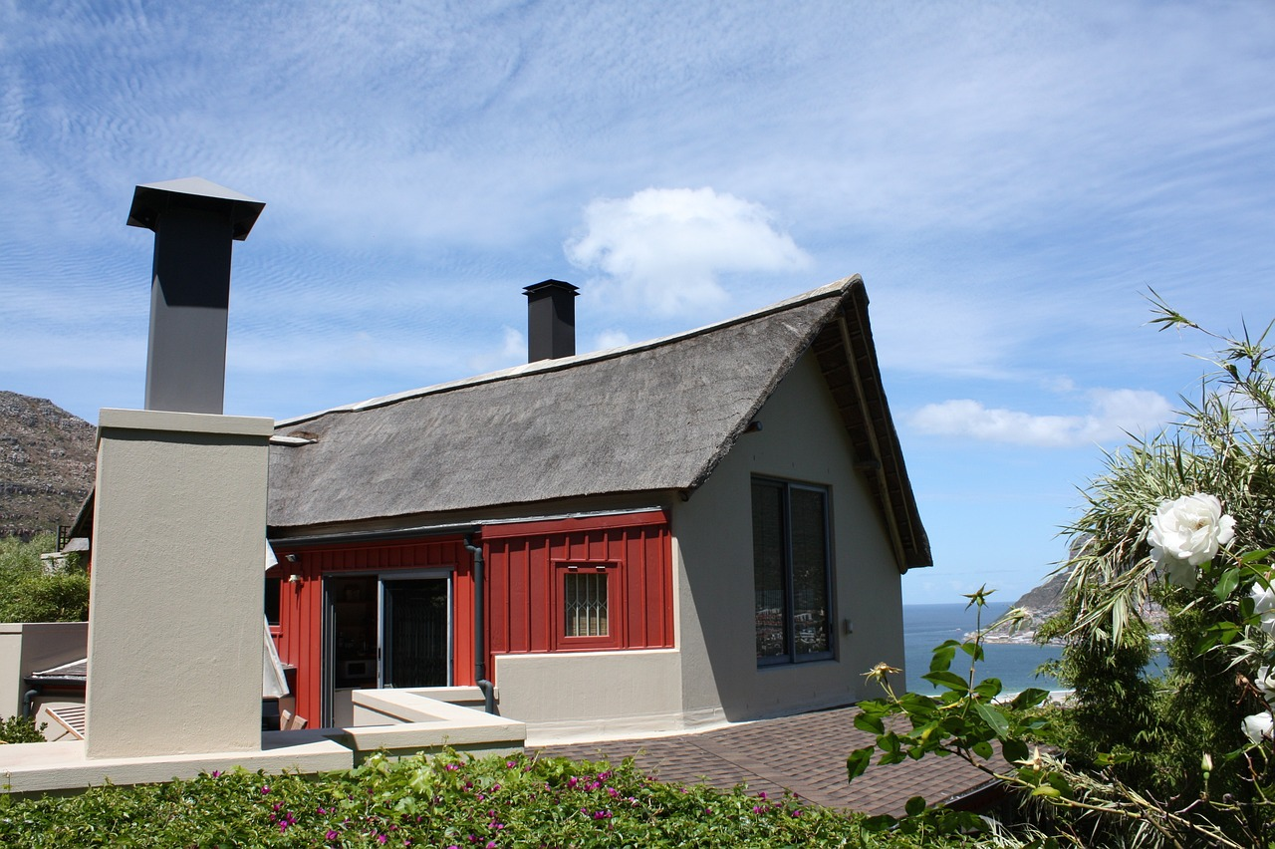
Cost Savings and Revenue-Boosting Tactics
3. Revenue Diversification
Finding other income streams during the low season. For instance, hosting events or retreats can bring in business during off-peak months – a strategy that can diversify revenue and expand your customer base. A tiny homes resort might host photography workshops or small weddings in the quieter season to utilise the space year-round. More examples are provided in this section.
Note: If regular tourists aren’t coming in droves, consider alternative uses for your facilities. Many savvy hosts “fill it with unique events and create interesting packages” to entice guests in the low season. (e.g., spa packages, business conference, yoga, writing, photography, concerts, festivals…).

Slide 71




Cost Savings and Revenue-Boosting Tactics
Host Off-Season Events and Themed Retreats
Example Offer small weddings or elopement packages amidst your scenic property (winter weddings can be magical and often cheaper for couples).
Example: You could host holiday events (Christmas or New Year’s at a cosy lodge) or partner with hobby groups (birdwatchers, painters, etc.) to organise gatherings.
Example Packaging accommodation with an experience (guided hikes, crafting lessons, etc.) adds value that can draw guests who wouldn’t otherwise travel off-season.
Example Turn your farm lodge into a venue for weekend retreats – wellness/yoga retreats, photography workshops, writing seminars – marketed to domestic travelers in off-peak months.

Slide 72

Create Special Packages with Partners
  Example: Create Special Packages with Partners’ Collaboration can stimulate low-season demand. For instance, team up with local businesses to offer bundle deals:
  a countryside “dine & stay” weekend (include a voucher for the village restaurant), or
  a “winter adventure package” with a local tour guide (e.g. include a dog-sledging or snowshoe tour in Iceland, or a truffle-hunting experience in Italy’s off-season).
Example: Spa and wellness packages are popular. If you don’t have an on-site spa, partner with one nearby. A study on low-season accommodation tactics notes that spa retreats, business conferences, team-building retreats, and food and wine events can all attract guests during periods of slow general travel. Brainstorm what makes your region attractive in the off-season (even if it’s tranquillity or seasonal beauty) and build a package around that theme.
5 Strategies to Increase Accommodation Revenue During Low Season

Slide 73

Cost Savings and Revenue-Boosting Tactics
4. Cost Management in Low Season
Controlling costs when occupancy is low – e.g. scaling back staffing, closing some units, or scheduling maintenance/upgrades during off months to turn downtime into productive time. Every euro you save in expenses during the low season directly reduces the pressure to generate revenue in those months.
Tip: Saving Peak Profits: We encourage setting aside some of the profits from the high season as a reserve to cover fixed expenses during the low season. By planning for low seasons, you avoid surprises like being unable to pay bills in the winter because summer earnings weren’t allocated properly. This proactive approach ensures a more stable income throughout the year.

Slide 74
Operational Cost-Saving Measures
  Example: On the cost side, find efficiencies when guest volume is low.
  You might close off a section of your property (to save heating/cleaning).
  Example: Negotiate seasonal pricing with suppliers (many vendors or service providers will give off-season discounts too)
  Example: Schedule renovations in the off-season (yes, it’s an expense, but doing it while you have fewer guests minimises revenue loss and can sometimes be cheaper).
  Example: Negotiate seasonal pricing with suppliers (many vendors or service providers will give off-season discounts too)
  Example: If you normally provide extensive breakfast or reception services, you could switch to a self-serve model in off-season to save staffing costs (communicate this clearly as part of a more “independent” off-season experience).

Slide 75
Cost Savings and Revenue-Boosting Tactics
5. Revenue Management and Booking Optimisation Strategies
To attract more guests and stay competitive, there are a series of guest-friendly booking strategies. These include flexible cancellation policies, reduced minimum stay requirements, and exclusive discounts and loyalty offers — all designed to make booking easier, more appealing, and more rewarding to guests.
Tip: During the low season, you have to think outside the box – suddenly, your accommodation is empty because no one wants to visit a ski field during summer. But you have a great space that could be optimised – fill it with unique events and create interesting packages.
When your revenue is down, get creative and try something new. If you want to stay ahead of competitors, you need to consistently update and improve your revenue strategy.

Slide 76
Flexible Cancellation Policies
In the low season, travellers tend to book last-minute and can be hesitant (think uncertain weather or road conditions). Adopting a more lenient cancellation policy in the off-peak can actually encourage hesitant guests to “take the leap” and book.
Example: you might switch from a strict 7-day cancellation policy in high season to a 48-hour free cancellation in low season.
Benefit: This flexibility builds trust – guests know they have an out if plans change, making them more likely to book in the first place. The trade-off is that you risk more last-minute cancellations, but since demand is low anyway, the benefit of attracting bookings often outweighs the cost.
Tip: Be sure to advertise the flexible policy in your marketing: e.g. “Free cancellation until 24hrs before arrival for winter stays!”
Choosing the Right Cancellation Policy for Your Vacation Rental

Slide 77
Reduced Minimum Stay Requirements
Similar to easing cancellation rules, consider relaxing your minimum night stay during low-demand periods. If you usually require a 2- or 3-night stay (common in peak season or weekends), dropping to 1-night stays in the off-season can capture bookings from travellers passing through or looking for a short getaway. According to rental industry experts, adjusting to even “one-night minimum stays where feasible can help attract guests” in periods of low demand.
Example: an Airbnb cabin that is normally 5 nights minimum in August might accept single-night bookings in November to fill gaps.
Benefit: Yes, one-nighters are a bit more work (more turnarounds), but an occupied one-night is better than an empty cabin.
Tip: You can also get creative: perhaps offer a “3rd night free” in the low season (effectively encouraging longer stays while still being flexible on shorter bookings).
How to Design the Optimal Minimum Stay Strategy for Your Vacation Rental

Slide 78
Special Discounts and Loyalty Offers
While you must be careful not to devalue your product, offering targeted discounts can stimulate interest during off-season periods. Consider A “locals’ rate” or repeat-guest discount for the low season to build loyalty. Some properties also offer monthly winter rentals at a flat rate to digital nomads or others, providing a steady baseline income through the quiet months.
Example: 20% off for anyone who stayed during summer if they book a winter return stay. Flash sales for specific low weekends, or value-adds
Example: free breakfast or free activity during off-peak stay are other options. Another idea is extended stay discounts in the off-season
Example:“stay 4 nights for the price of 3” or reduced weekly rates as mentioned.

Slide 79
Low-Season Accommodation Strategies
Here is a detailed table outlining the key strategies for managing seasonal cash flow in tourism businesses, with real-world pricing examples and financial learning outcomes.
Strategy | What to Do | Example Pricing or Cost Impact | Financial Learning Outcome
Host Off-Season Events & Themed Retreats | Offer niche events (yoga, writing retreats, small weddings) in your accommodation. | Charge €280/person for 2-night retreat × 10 guests = €2,800. Costs: €1,000 → Profit: €1,800 | Maximise use of property and facilities for income during low demand.
Create Special Packages with Partners | Bundle stays with local food, tours, or adventure partners. | "Wine & Stay" package: €160 B&B + €50 dinner voucher. Cross-promote with local restaurant or tour operator. | Co-marketing and package pricing increases occupancy and supports local business.
Flexible Cancellation Policies | Relax strict cancellation rules to boost confidence in booking. | Switch from 7-day to 48-hour cancellation window. Promote as “Free cancellation until 24hrs before arrival.” | Booking flexibility increases volume, even with higher cancellation risks.

Slide 80
Low-Season Accommodation Strategies
Strategy | What to Do | Example Pricing or Cost Impact | Financial Learning Outcome
Reduced Minimum Stay Requirements | Drop 2–3-night minimum stays to attract short-term or last-minute guests. | Allow 1-night stays in November. Offer “3rd night free” promo to boost midweek or longer stays. | Short stays increase total occupancy vs. empty rooms. Strategic flexibility builds resilience.
Special Discounts & Loyalty Offers | Target return guests or locals with promotions and value-adds. | 20% off for summer guests booking winter return. Flash sale: “Stay 4 nights for price of 3.” | Discounts stimulate demand if structured to protect margins and encourage repeat bookings.
Operational Cost-Saving Measures | Cut heating/cleaning in unused areas, switch to self-serve breakfast, schedule renovations. | Save €200/month by closing off a wing. Reduce staff hours. Delay non-urgent upgrades until spring. | Cost control reduces financial pressure and helps stretch seasonal profits.

Slide 81

By implementing such strategies, many rural accommodations manage to boost their off-season occupancy and income. It’s about being “positive and proactive” – rather than accepting an empty calendar, you find alternate ways to utilise your assets.
For example, one accommodation advice article noted that a property must “create new offerings… it isn’t enough to just stick with the usual” when facing the low season.
Whether it’s hosting a yoga retreat, offering a mid-week deal, or simply reducing your overhead, these approaches will help mitigate the impact of seasonality.
And remember: off-season guests, however few, should be treated just as well – impress them and they’ll spread the word (or come back in high season!).
Low season can also be a great time to gather feedback, experiment with new ideas, and strengthen community ties, all of which can pay off in the long run.
Conclusion

Slide 82

Well Done
Module 8 (Part 4)
Sections 9 – 10: Boosting Revenue Through Add-Ons and Financial Oversight
You have Completed… Module 8 (Part 3)
Sections 7 – 8: Pricing for Profit, Value, and Seasonality
Next is…

