Slide 1
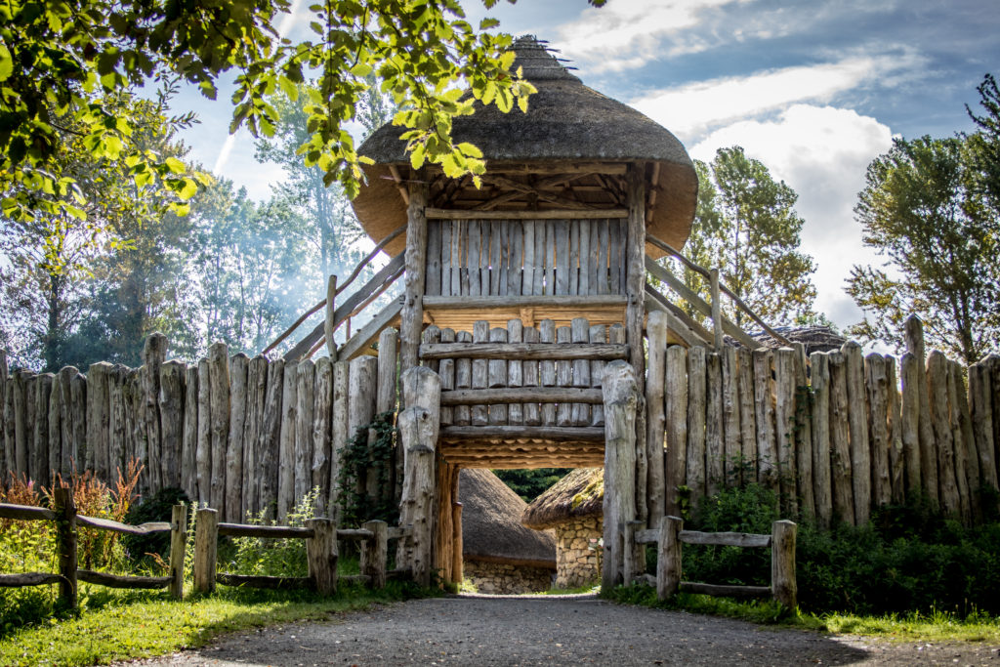
Viking House and Settlement, Wexford, Ireland
Module 8 (Part 2)
Making It Viable – Pricing, Planning & Long-Term Financial Health
Financial Planning & Funding

Slide 2
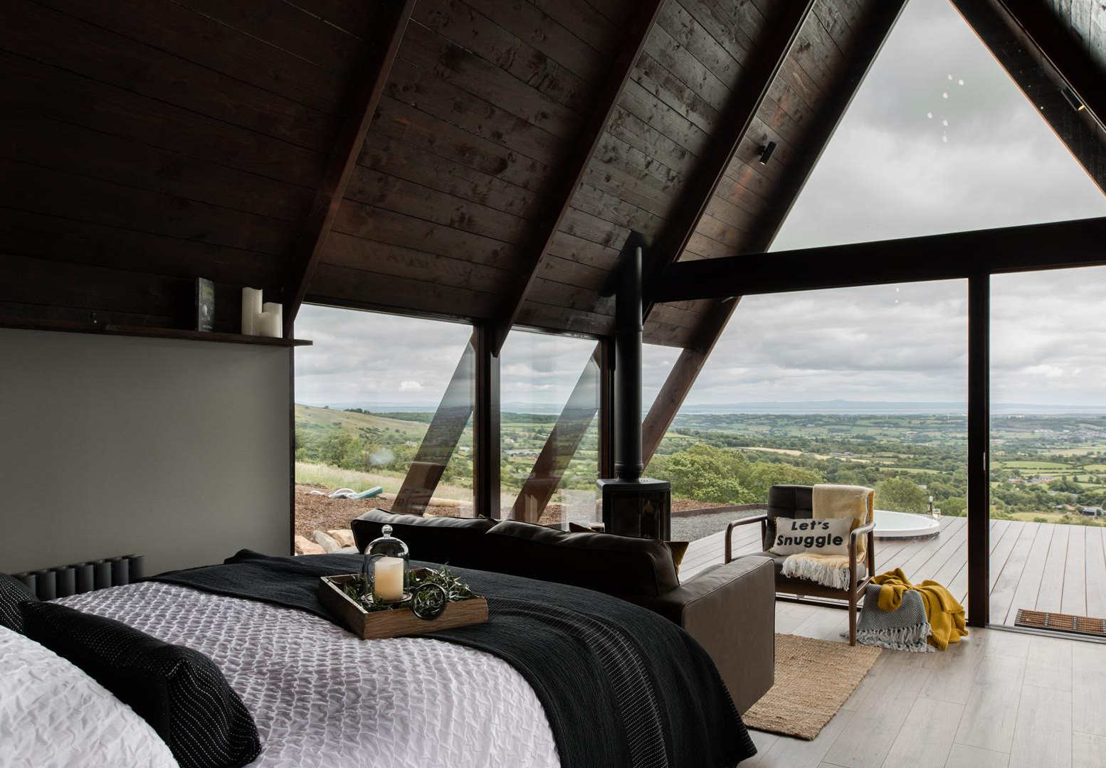
Module 8 (Part 2)
Letteran Lodges, Derry, Ireland
Understanding Your Costs, Pricing, and Break-Even Point
2

Slide 3
Module 8 (Part 2) Overview
Learning Outcomes
Making it Viable - Understanding Your Costs, Pricing, and Break-Even Point
Financial sustainability starts with knowing your numbers. These sections walk you through the essentials of cost and pricing: first, by identifying all your fixed and variable expenses so you fully understand what it takes to keep your business running, even without guests. Next, you’ll calculate your minimum nightly rate to ensure your prices are rooted in real costs. Finally, you’ll work out your break-even point—the nights and occupancy needed to cover expenses and move into profit. Together, these steps give you the clarity and confidence to price strategically, avoid losses, and plan for long-term success.
Identify and differentiate between fixed and variable costs in your business.
Understand your total cost of operation and how these affect pricing decisions.
Calculate your minimum nightly rate to ensure you're not losing money.
Apply real cost data to determine a pricing strategy that is both sustainable and aligned with your business goals.
Calculate your break-even point in both number of nights and occupancy rate.
Make informed decisions based on cost structure and occupancy to increase profitability and financial confidence.

Slide 4
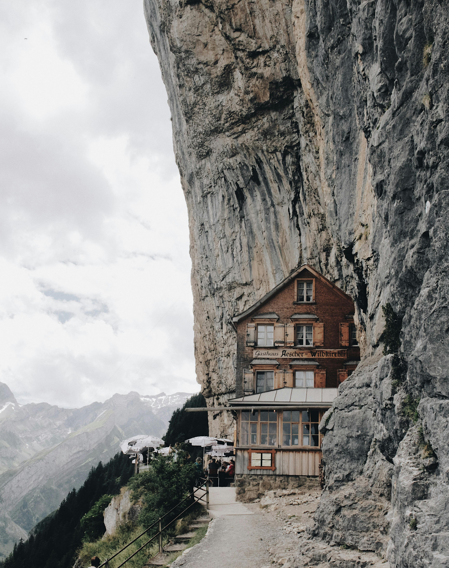
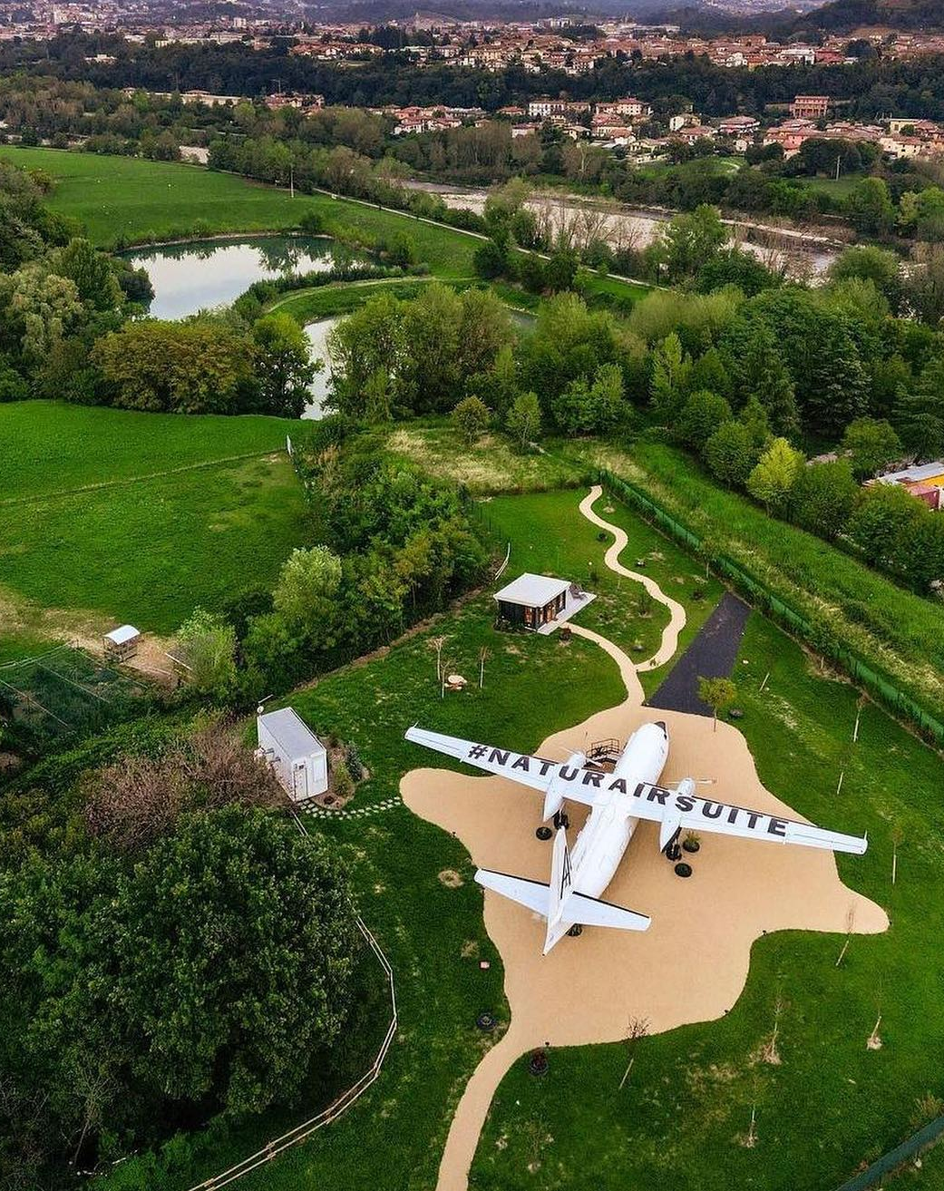
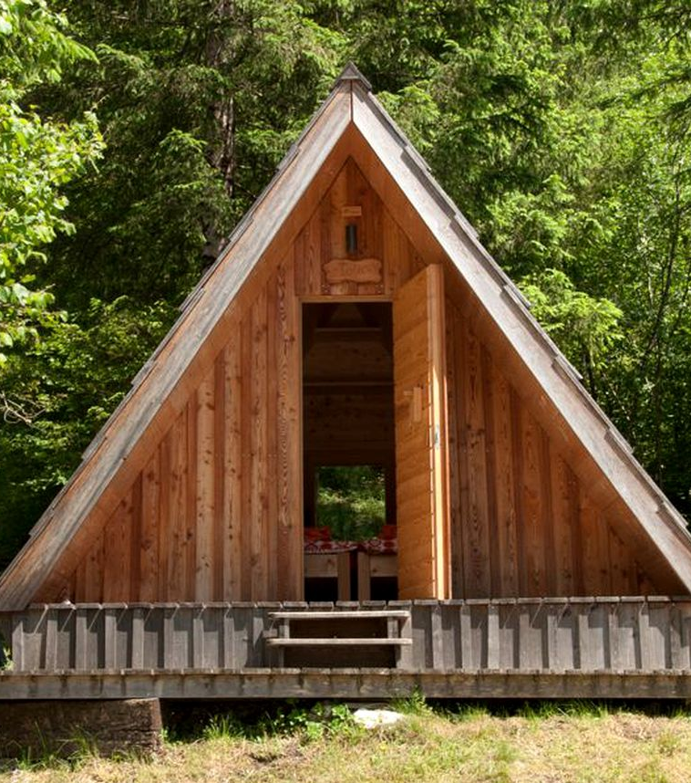
Part 2: Sections 4 – 6 Understanding Your Costs, Pricing, and Break-Even Point
05
Photo Credit: Natur Air Suite, Italy
Section 5 P24
Know Your Costs Per Night
(16 Slides)
Module 8
CONTENTS
04
06
Section 4 P7
Section 6 P44
Know Your Costs and Expenses
(16 Slides)
Find Your Break-even Point and Occupancy Rate
(32 Slides)
Photo Credit: A-Frame in Soča, Gorizia, Slovenia

Slide 5
Section 4 – 6 Understanding Your Costs, Pricing, and Break-Even Point
Knowing your numbers is essential to building a financially sustainable alternative accommodation business. These sections take you step-by-step through calculating what it costs to run your accommodation, even when no guests are present, and how to translate those costs into a minimum price per night. You’ll then use that data to calculate your break-even point—the number of nights and occupancy rate you need to reach just to cover your costs. This helps ensure your pricing isn’t just competitive, but also profitable. By understanding your full cost structure, minimum viable rate, and occupancy targets, you can make smarter, data-driven decisions for long-term success.
Section 4: Know Your Costs and Expenses
  What does it cost to run your business, even when no guests are present or even when it’s open and when it’s not?
Objective: Fixed and Variable Cost & Expenses Structure (What it costs to keep the doors open). To understand, identify, and categorise your full range of fixed and variable expenses.

Slide 6
Section 4 – 6 Understanding Your Costs, Pricing, and Break-Even Point
Section 5: Know Your Costs Per Night
What is the minimum you should charge to avoid losing money?
Objective: Know Your Costs Per Night (Figure out minimum charge)
To calculate your minimum sustainable nightly rate and ensure pricing is rooted in real costs.
Section 6: Find Your Break-even Point and Occupancy Rate
How many nights do I need to sell to break even, and how many to cover my costs and make a profit?
Objective: Break-Even Analysis & Occupancy Calculations
(How to make sure you don’t lose money). To calculate your break-even point in both nights and occupancy rate, providing clarity and confidence in planning.

Slide 7

Section 4
Know Your Costs and Expenses
Fixed and Variable Cost & Expenses Structure (What it costs to keep the doors open)
To understand, identify, and categorise your full range of fixed and variable expenses.
What does it cost to run your business, even when no guests are present or even when it’s open and when it’s not?

Slide 8
Financial Logic & Planning for Accommodation Businesses Planning
Section | Section | Why It Comes Here
3 | Revenue & Capacity Foundation | You start with calculating what you earn You must know what you're earning (primary and secondary income sources) and how many nights you can sell.
4 | Cost Structure | Figure out what you spend Without knowing your fixed and variable costs, you can't set prices or calculate profit.
5 | Know Your Cost Per Night | Calculate what each night must cover Helps establish your minimum charge to break even. You calculate the cost per night by dividing total costs by expected nights sold.
6 | Break-Even Analysis & Occupancy & Revenue Planning | Determine your financial survival point & forecast occupancy & revenue potential Tells you how to stop losing money. Once costs are known, calculate how many bookings are needed to break even. Ensure achievable pricing with realistic bookings targets and occupancy rate % goals.
7 | Profit & Pricing Strategies | Then choose a pricing strategy aligned with your goals With all the above in place, you can confidently set pricing and set profit targets

Slide 9
Know Your Costs and Expenses
To clearly define and separate fixed and variable costs so that you can create accurate pricing, budgeting, and profit projections that reflect your real-world expenses.
Understanding your costs is critical before setting prices or projecting profit. Costs are divided into fixed costs (like insurance, loan repayments, or broadband—things you pay no matter how many guests you have) and variable costs (like laundry, breakfast, and cleaning—costs that change depending on occupancy). Accurately identifying these will ensure your business is priced to survive and scale.
10
Know Your Fixed Costs (FC) (Overheads)
Identify regular, recurring expenses such as rent, salaries, insurance, and utilities.
11
Estimate Your Variable Cost per Night (VC)
Calculate costs that change depending on bookings, like laundry, cleaning, or breakfast.
12
Sample Annual Operating Costs or Variable Costs Breakdown
A list to compare and categorise your own costs.
13
Calculate Your Total Annual Costs (TAC)
Add fixed and variable costs for a full picture of what your business costs yearly.

Slide 10
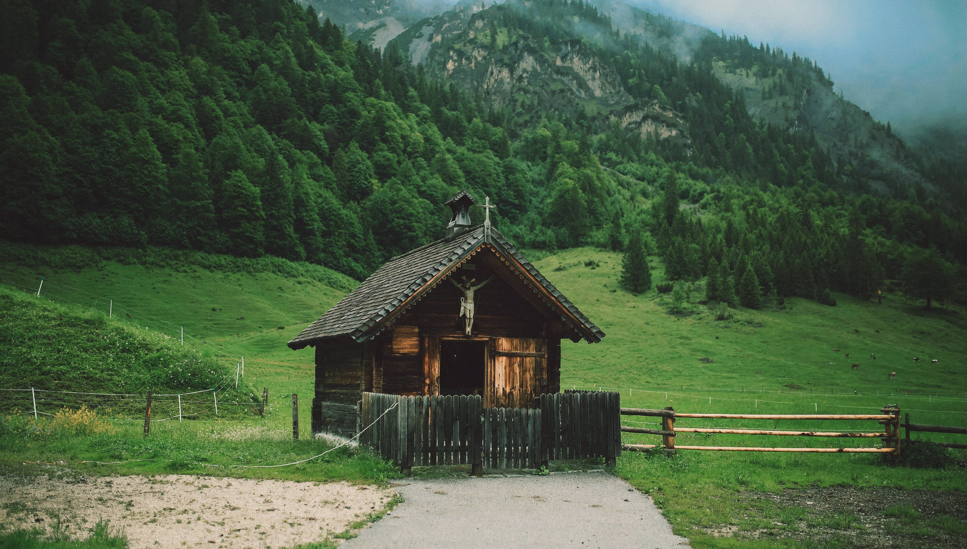
10
Calculate All Your Fixed Costs
Next, list all fixed costs – expenses that generally stay the same regardless of how many guests you have. These are often monthly or annual overheads.
Common fixed expenses in accommodation businesses include: rent or mortgage, property taxes, insurance, salaries or regular wages (if you have staff on payroll), and utilities that don’t vary much (like internet, security, etc.).
Don’t forget licenses or subscriptions, and possibly a portion of utilities that are baseline (e.g., heating to prevent pipes from freezing, even if there are no guests).
Example: Your fixed expenses might look like: Mortgage €12,000/year, Insurance €1,200/year, Property Tax €800, Utilities (base) €1,000, Marketing €1,000, and Website/Software €600 – summing up to €16,600 in fixed costs for the year.
Know All Your Costs and Expenses
Start with Your Fixed Costs

Slide 11
Know Your Fixed Costs
These costs will be incurred no matter what, so your business needs to generate at least this amount in gross profit to avoid a loss.
“What costs do I have to pay even if I get zero guests?”
These are annual costs that don’t change even at zero occupancy. Costs you pay every year no matter how many bookings you get. These are the baseline costs you need to cover before you can earn a profit.
Examples: include insurance, loan repayments, internet, marketing, licences, permits, website fees. For a small glamping site, typical fixed costs include property lease or taxes, insurance, utility base fees, maintenance and upkeep, and marketing. If you have staff on a regular salary, include that as a fixed cost. Annual insurance and maintenance for a 4-pod site might be a few thousand euros each.

Slide 12
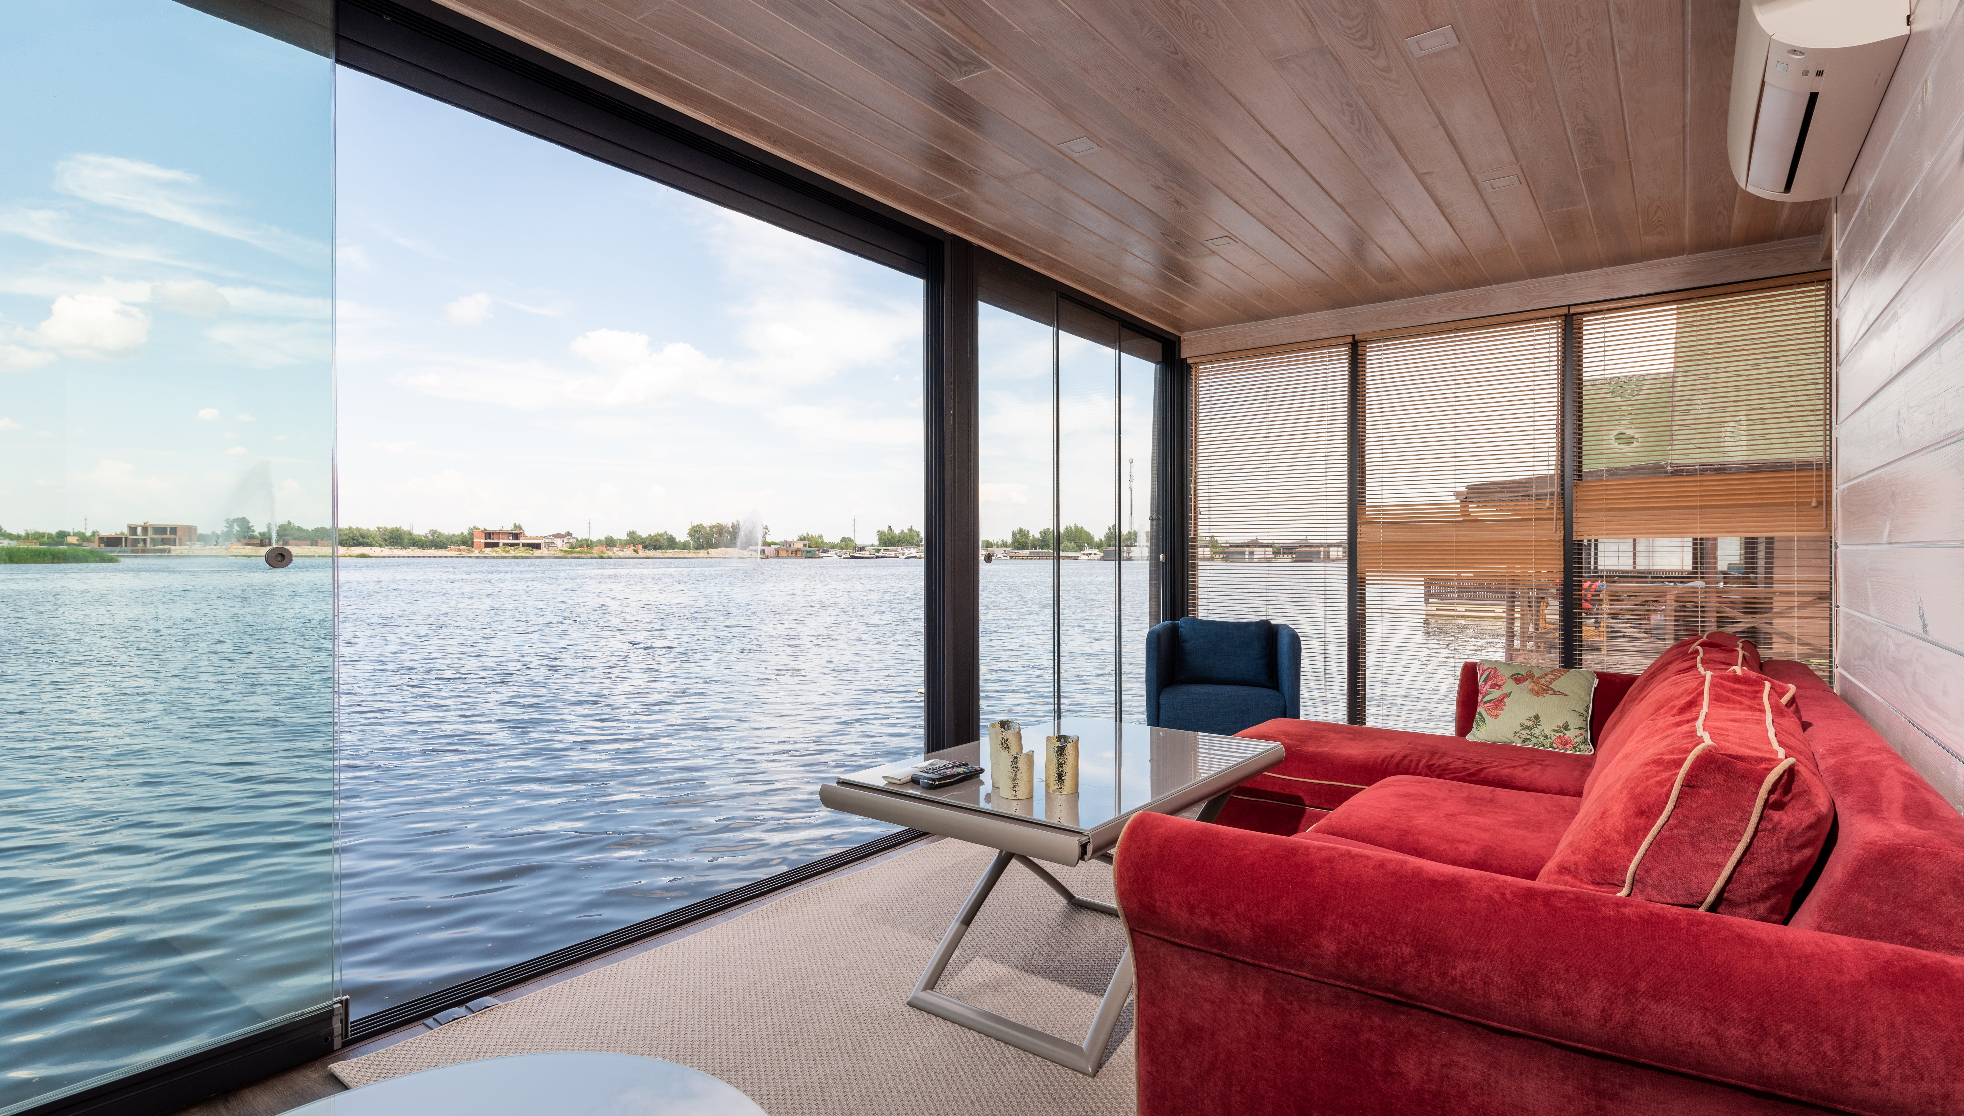
11
Calculate Your Variable Costs
Now itemise variable costs – expenses that increase with each booking or guest.
These costs depend on occupancy: the more nights booked, the higher these expenses.
Typical variable costs for an accommodation business include:
housekeeping or cleaning fees (laundry, cleaning supplies, or paying a cleaner per turnover),
breakfast or food costs per guest (if included in the stay),
utilities that vary with usage (water, electricity usage by guests),
amenities (toiletries, welcome snacks), and
booking platform commissions or credit card fees (often charged per booking).
Know All Your Costs and Expenses
Next Know Your Variable Costs

Slide 13
Calculate Your Variable Expenses
Example: You might estimate that each occupied night incurs approximately €15 of variable costs (e.g., €5 for cleaning supplies, €3 for laundry, €2 for utilities, and €5 for the booking commission).
If your forecast says 200 nights will be booked in a year, total variable costs 200 × €15 = €3,000 for the year.
Some variable costs are percentage-based (like OTA booking commissions, which may be 15% of the booking revenue); make sure to account for those as well.
Listing these costs ensures you don’t underestimate the cost of serving each guest.
Know All Your Costs and Expenses
Next Know Your Variable Costs

Slide 14
Estimate Your Variable Cost per Night (VC)
“How much does it cost me every time someone books a night?”
Costs involved each time a guest stays (e.g., cleaning, laundry, food, utilities). These factors affect the actual profit you make per night after deducting guest-related expenses. *Work out an average cost per night occupied based on these.
Examples: include laundry, cleaning, breakfast/food supplies, washing bedding after each stay, guest consumables (such as toiletries and welcome basket items), and utilities that depend on usage (like extra firewood and hot tub heating).
If you pay cleaning staff €10 per cabin turnover or pay €8 in booking platform commissions per booking, those are also variable.

Slide 15
Common Variable Costs per Night (example breakdown):
Expense Type | Cost per Night (€)
Cleaning supplies | €5
Laundry (linen/towels) | €7
Toiletries | €3
Breakfast/snacks | €6
Utilities (per night share) | €4
Booking platform fees (if % based on nightly rate) | €5 (estimate)
Total Variable Cost per Night €30
Tips for Calculating: Track a full month of bookings and the actual expenses for those stays. Divide total monthly guest-related expenses by the number of nights booked. Include any expenses that scale with each booking (excluding fixed monthly bills, such as insurance).

Slide 16
Sample Annual Operating Cost or Variable Costs Breakdown
Glamping 4 Pods (Open Year-Round)
12
Operating Cost | Annual Total (€) | Type
Utilities (electricity, water, waste) | 5,000 | Fixed (partial variable in high use)
Insurance (liability, property) | 1,200 | Fixed
Marketing & Online Listings | 1,000 | Fixed
Maintenance & Repairs | 2,000 | Fixed (allowance)
Property Taxes/Lease | 2,500 | Fixed
Cleaning & Laundry Supplies | 8,400 | Variable (€15 per occupied night)
Guest Amenities (breakfast, firewood, etc.) | 1,200 | Variable (depends on usage)
Total Operating Costs (Year) | €21,300 | (at 320 occupied nights/year)

Slide 17
Explanation of Table
Sample Annual Operating Cost or Variable Costs Breakdown
Fixed Costs stay the same regardless of how many nights are booked.
Variable Costs go up or down depending on occupancy (e.g. cleaning, amenities).
Semi-variable costs like maintenance may fluctuate with usage but are partly fixed.
Utilities often behave as a mixed cost, part fixed, part usage-based.
If you want to calculate your cost per occupied night, divide €21,300 by your expected or actual number of nights booked per year (e.g. 400 nights → €53.25 per night).
To find how many nights the €21,300 annual operating cost is based on, we need to isolate the variable costs and divide them by the cost per night for those variable items.

Slide 18
Explanation of Table
Sample Annual Operating Cost or Variable Costs Breakdown
1. Identify Variable Costs
Cleaning & Laundry Supplies: €8,400
Guest Amenities: €1,200
Total Variable Costs = €8,400 + €1,200 = €9,600
2. Assume Variable Cost per Night
You've used €30 per night previously (Cleaning + Amenities), which aligns well:
€30 × N nights = €9,600
So:
Nights = €9,600 ÷ €30 = 320 nights
Conclusion:
The total €21,300 in operating costs is likely based on 320 occupied nights per year — assuming each night costs €30 in variable expenses.

Slide 19
Explanation of Table
Sample Annual Operating Cost or Variable Costs Breakdown
Notice that energy bills, cleaning, consumables, maintenance, marketing, and insurance are all accounted for – these are common expense categories for small glamping businesses. Beginners sometimes underestimate the cost of maintenance (e.g., repairing a deck or replacing linens) – be sure to set aside funds for this.
What about my salary? If you plan to pay yourself a salary, include that in the fixed costs. Many owner-operators omit their own labour in early projections, but it’s important to at least note what a fair wage would be, so you understand the true cost of running the business.
Cost Management Tip: Track fixed costs per month (e.g. utilities, insurance, divided monthly) and variable costs per occupied night.
This helps in pricing (you’ll want your nightly rate to comfortably exceed your variable cost per night) and in understanding profit margins.
In a spreadsheet, you might use formulas like Total variable cost = Occupied nights * cost_per_night to automatically scale expenses with occupancy.

Slide 20
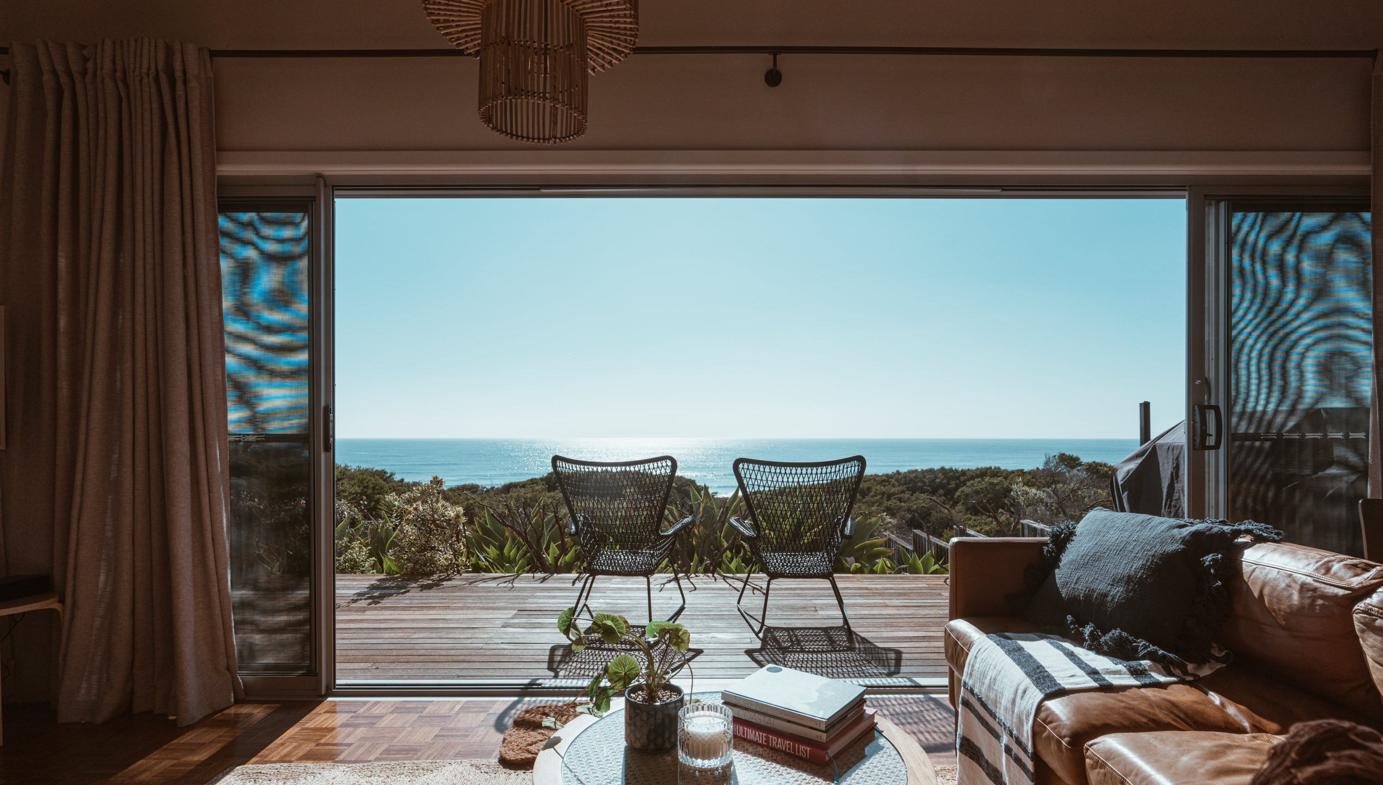
13
Calculate Total Annual Costs
Add your fixed and variable expenses to get total expected costs for the year.
Example: From previous calculations:
Fixed costs €16,600 + Variable costs €3,000 = €19,600 total expenses. This number represents the money you’ll spend to run the business for the year at the forecasted occupancy level.
It’s useful to break this down further into major categories if needed (for instance, “Operations”, “Marketing”, etc.), but the main point is to know how much it costs in total to operate for the year.
Double-check if you missed anything: maintenance or repairs, occasional fees, or an owner’s salary if you intend to pay yourself. It’s easy to overlook some expenses so think through the year in detail.
Know All Your Costs and Expenses
Calculate Your Total Annual Expenses
Break-even point

Slide 21
Calculate Your Total Annual Costs (TAC)
"How much does it really cost me to run this place for a year?"
Total Annual Costs are everything you spend in a year to run your business. This includes both Fixed Costs (unchanging): rent, insurance, and salaries, and Variable Costs (per booking): cleaning, laundry, and utilities.
Total Annual Costs (TAC) = Fixed Costs + (Variable Cost per Night × Nights Booked)
Example: Fixed Costs = €14,000, Variable Cost per Night = €30, Nights Booked = 200
TAC = €14,000 + (€30 × 200) = €14,000 + €6,000 = €20,000
"This means it costs €20,000 a year to run your business if you get 200 bookings."

Slide 22
"How many nights do I expect to be booked this year?"
This helps you estimate your total variable costs and calculate your true Total Annual Cost. You can call this a “scenario planning formula” when you're using it to explore how different numbers of nights sold (occupancy levels) affect your Total Annual Costs (TAC) and profitability.
Example: “What if I only get 150 bookings?”. “What if I increase my rates to €165?”. “What happens if cleaning costs rise?”
Fixed Costs (FC): Costs that stay the same regardless of how many nights are booked (e.g. insurance, rent, software)
Variable Costs (VC × N): Costs that change depending on how many nights are booked (e.g. cleaning, laundry, breakfast)
Total Annual Cost = Fixed Costs + (Variable Cost per Unit × Number of Units Sold/Used)
In this case, it’s: TAC = FC + (VC × N)where N = number of occupied nights

Slide 23

Experts note that basic restocking and utilities alone can eat up 20% of revenue, so your price must comfortably cover these ongoing costs. Consider making a simple table of annual costs:
Exercise
Cost Category | Annual Cost (€)
Property lease/mortgage | (e.g. €5,000)
Utilities (electric, water) | (e.g. €2,000)
Insurance & permits | (e.g. €1,200)
Cleaning & laundry | (e.g. €3,000)
Maintenance & repairs | (e.g. €2,500)
Marketing & platform fees | (e.g. €1,500)
Total Annual Costs | €15,200 (example)
Create a Table of Your Annual Costs

Slide 24

Section 5
Know Your Costs Per Night
Know Your Costs Per Night (Figure out minimum charge)
To calculate your minimum sustainable nightly rate and ensure pricing is rooted in real costs.
What does each night cost you, whether it is sold or not?
What is the minimum you should charge to avoid losing money?

Slide 25
Financial Logic & Planning for Accommodation Businesses Planning
Section | Section | Why It Comes Here
3 | Revenue & Capacity Foundation | You start by calculating what you earn or all your income You must know what you're earning (primary and secondary income sources) and how many nights you can sell.
4 | Cost Structure | Figure out what you spend Without knowing your fixed and variable costs, you can't set prices or calculate profit.
5 | Know Your Cost Per Night | Calculate what each night must cover Helps establish your minimum charge to break even. You calculate the cost per night by dividing total costs by expected nights sold.
6 | Break-Even Analysis & Occupancy & Revenue Planning | Determine your financial survival point & forecast occupancy & revenue potential Tells you how to stop losing money. Once costs are known, calculate how many bookings are needed to break even. Ensure achievable pricing with realistic bookings targets and occupancy rate % goals.
7 | Profit & Pricing Strategies | Then choose a pricing strategy aligned with your goals With all the above in place, you can confidently set pricing and set profit targets

Slide 26
Know Your Cost Per Night
To determine the minimum amount you need to charge per night to cover your full operational costs, helping you avoid underpricing and unsustainable bookings.
To calculate your cost per night, you take your total annual costs (fixed + estimated variable) and divide by the expected number of nights sold. This gives you your minimum nightly cost—what it takes just to break even per guest night. This figure should guide your base pricing so that you’re never operating at a loss without realising it.
14
Know Your Nightly Costs
Divide annual costs by expected nights sold to get your minimum nightly cost.
15
Set Average/Base or Minimum Price Per Night
Cover your costs and meet your minimum pricing goals.
16
Net Revenue per Night
What you earn from each booking after subtracting the costs of hosting a booking.

Slide 27
Your nightly cost is how much it actually costs you to host a guest for one night, including fixed annual expenses and variable costs like cleaning or breakfast. It's not what guests pay — it's what you pay to open your doors each night.
Knowing your nightly cost helps you:
Set a price that covers your expenses
Avoid undercharging
Understand your break-even point
Build a profitable pricing strategy
Without this, you’re guessing — and that can lead to losses or missed opportunities. The first and most important step is to calculate all of your costs for running your accommodation; they will form the basis of your cost-based price.
Fixed costs (e.g., insurance, loan repayments, licences)
Variable costs (e.g., cleaning, utilities per guest stay)
Then, estimate your average number of nights booked per year.
Know Your Nightly Costs
Important, so you can get your Cost Based Price
14

Slide 28
Know Your Nightly Costs
How to Calculate:
Nightly Cost = (Annual Fixed Costs ÷ Bookable Nights) + Variable Cost per Night
Step 1: Add your fixed annual costs (insurance, utilities, marketing)
Step 2: Estimate your variable costs per night (cleaning, breakfast)
Step 3: Estimate your bookable nights per year (e.g. 60% of 365 = 219)
28
Example:
Nightly Cost = (Annual Fixed Costs ÷ Bookable Nights) + Variable Cost per Night
(Annual fixed costs €12,000 ÷ 200 Bookable Nights) + Variable Cost per Night €10
= €70 per night
That’s your nightly cost — the minimum amount it costs you to host one guest night.
Tip: The simplest way is to check your total outgoings over the last year using your accounting software, then divide that total by 365 to get a daily average cost. You can then further divide that figure across the average number of occupied rooms and services you offer.
28

Slide 29
Know Your Nightly Costs
“What does it cost me to open each day, whether I get a customer or not?”
Refers to the total cost of operating your accommodation or business for a single night, whether or not a guest books. This includes both fixed costs (which stay the same no matter how many guests you have, e.g., insurance) and variable costs (which increase with each booking, e.g., cleaning and electricity). Understanding daily/nightly costs is essential to setting prices to cover expenses and generate profit.
Example: Let’s say you run a glamping pod open 200 nights per year:
Fixed Costs €10,000
Cost per Night (€/night) €50.00 (€10,000 ÷ 200 nights)
Variable Costs €20 per booking
Total Cost to Open per Night (with 1 booking): €70
So, if you charge €80 per night, your profit per night is only €10.

Slide 30
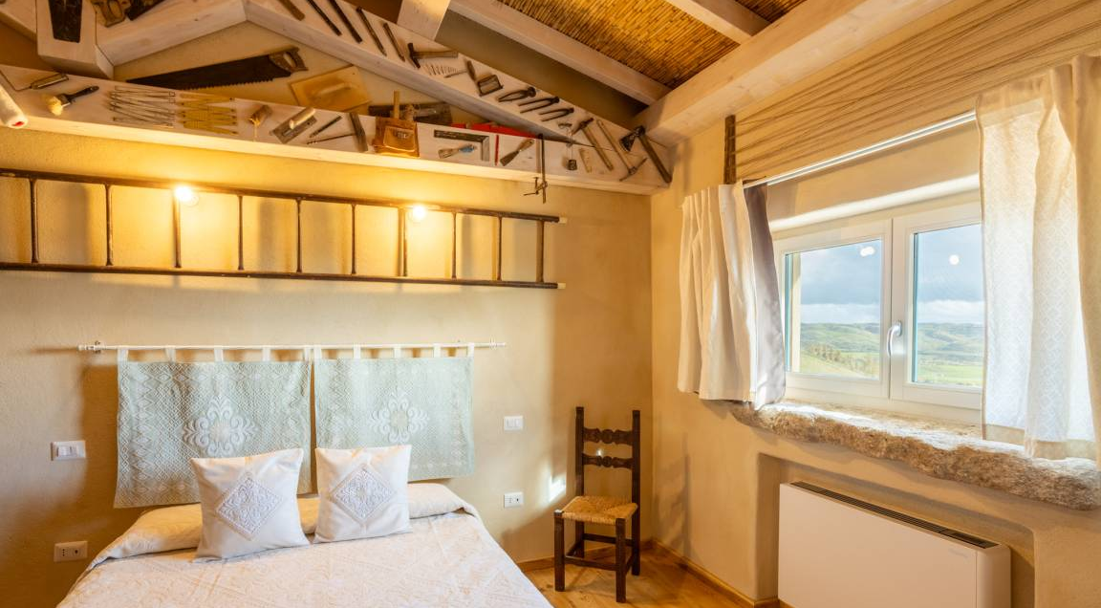
Step 1: Average/Base Price Per Night
Cover your costs and meet your minimum pricing goals
15
What price do I need to charge per night to make this business work?
Objective: Determine a sustainable average nightly rate. Find your base nightly rate or minimum price to cover all costs, reach your profit and meet your income goals.

Slide 31
Setting Your Base/Average Price per Night is critical
Your Baseline/
Average Price
Helps you calculate a nightly price that strikes a balance between affordability and profitability.
Your baseline price is the minimum nightly rate you must charge to cover all your costs and make a profit.
Your base rate reflects your financial goals while staying competitive in the local market. It's the figure that ensures your business can survive and thrive.
Your baseline price is the minimum average nightly rate you need to charge to cover all your costs and earn your target profit.
It is the foundation of your pricing strategy and serves as a reference point for adjusting prices during peak and low seasons. A well-calculated average nightly rate supports a sustainable, long-term business model. Anything below it means you're losing money.
This is your Nightly Cost (plus profit)

Slide 32
Your baseline price is not just a number — it's a strategy anchor that keeps your business sustainable and competitive.
Your Baseline/
Average Price
A well-calculated baseline rate:
Ensures you cover all your costs (fixed + variable). You will understand your lowest acceptable rate during quiet periods
Helps you reach your profit target
Avoid underpricing and running at a loss
Keeps your rate competitive and realistic so you remain attractive to your ideal guests
Set a strong foundation for seasonal or value-based pricing. You will know how many nights you need to book to break even and allow you pricing flexibility during peak and low seasons
Ensure your business is viable and profitable year-round
The Foundation of Profitability

Slide 33
Average Baseline Price - Useful For
Financial Planning
It’s the foundation for setting your pricing strategy.
Ensures your price per night will cover costs and meet income goals.
Helps plan for seasonal adjustments and occupancy forecasting.
Break-Even Analysis
Used alongside variable and fixed costs to calculate:
Break-even nightly rate
Minimum occupancy required
Cash flow forecasts
Without knowing your average price, you can't accurately determine when your business becomes profitable.
Profit Estimation
Enables you to compare expected earnings with actual costs. Set profit targets and calculate profit margin with the formula:
Profit Margin (%) = (Net Revenue per Night ÷ Average Price per Night) × 100

Slide 34
Set Your Baseline/Average Price per Night
Objective: Determine the minimum nightly rate you must charge to cover all your costs and earn a profit. This is your base price—a foundation for setting seasonal or promotional rates.
“What price do I need to charge per night to cover my costs, earn my target profit, and still attract bookings?”
This is where you determine your final price per night based on your cost calculations, market research, and profit goals. It is your baseline price – what you need to charge on average to stay booked, run a viable business, break even, while still remaining attractive to potential guests and flexible to adjust for high or low seasons. It’s not about what you'd like to earn — it's what you need to charge to run a sustainable business.
Example Values (Calculation on next page)
Let’s say you run a small eco cabin rental. Here’s how you work out your baseline price:
Total Annual Costs (fixed + variable): €20,000
Estimated Bookable Nights: 200 nights
Variable Costs per Night (cleaning, breakfast): €30
Target Profit per Night: €25

Slide 35
Calculation: Your Average Price per Night + Profit Margin
Target Average Price Per Night = (Total Annual Costs ÷ Estimated Bookable Nights) + Variable Cost per Night + Profit Margin
Category | Value
Total Annual Costs (TAC) | €20,000
Estimated Bookable Nights | 200 nights
Variable Cost per Night (VC) | €30
Desired Profit per Night | €25
Average Price Per Night = (€20,000 ÷ 200) + €30 + €25 = €155 per night
This €155 is your baseline rate – you need to charge at least this amount, on average, to cover your fixed and variable costs and hit your profit target. You might still adjust your pricing seasonally (e.g., €175 in summer or €130 midweek in winter), but this is the minimum average to remain financially sustainable. *Remember: Without this step, you risk undercharging (and losing money) or overcharging (and losing bookings) and not knowing your break-even point

Slide 36
Formula Breakdown: Your Average/Baseline Price per Night
Target Average Price Per Night = (Total Annual Costs ÷ Estimated Bookable Nights) + Variable Cost per Night + Profit Margin
Total Annual Costs = Fixed Costs (e.g. insurance, internet, loan) + (Variable Costs × Nights Booked)
Estimated Bookable Nights = Realistic number of nights you can rent (e.g. 60% of 365 = 219 nights)
Variable Cost per Night = Cleaning, breakfast, laundry, toiletries, etc.
Profit Margin = Your target earnings per night (€10–€30 is typical)
The Complete Checklist for Launching Your Own Glamping Business

Slide 37
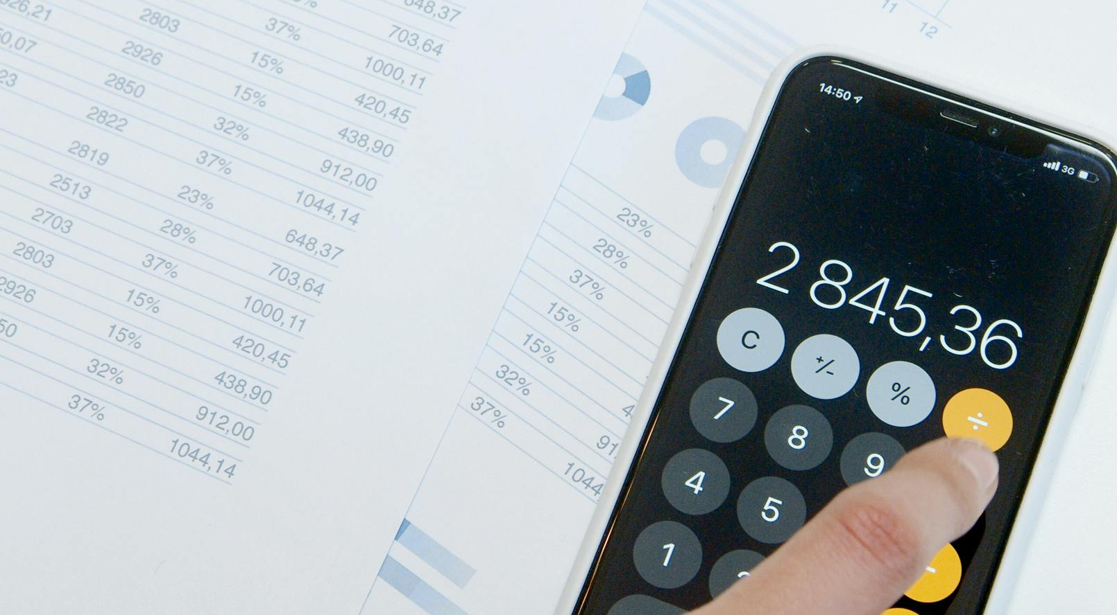
Step 2: Net Revenue Per Night
What is Your True Income Per Booking?
16
How much do I actually earn per night after costs?
Objective: Understand your net revenue per night — the actual income you keep after subtracting variable costs from your nightly rate. This helps you assess profitability, make pricing decisions, and calculate breakeven points accurately.

Slide 38
Net Revenue Per Night
Net revenue per night is what you earn from each booking after subtracting the costs of hosting that booking or guest (like cleaning, breakfast, or supplies).
It is the amount of money you actually keep as income after covering the variable costs associated with hosting a guest for one night.
It shows what each night of booking truly contributes toward:
Covering your fixed costs (like insurance, rent, marketing), and
Earning profit
What is Your True Income Per Booking?

Slide 39
It’s a key number to understand your real earnings — not just what guests pay, but what’s left after you deliver the service. Knowing your net revenue per night helps you:
See how much each booking contributes toward your overall profit
Do a break-even analysis (e.g., how many nights you need to sell to cover fixed costs)
Identify if your prices are too low or your operating costs are too high
Net Revenue Per Night
What is Your True Income Per Booking?
Formula:
Net Revenue per Night = Average Price per Night – Variable Costs per Night
Price charged per night €140 - Variable costs per night (cleaning, toiletries, breakfast) €15
→ €140 – €15 = €125 (Your net revenue per night is €125) €125 is what goes towards paying fixed costs (insurance, loan, utilities) and leaving room for profit
Tip: Once you know your net revenue per night, you can calculate your breakeven point using this formula: Break-even Nights = Annual Fixed Costs ÷ Net Revenue per Night

Slide 40
Net Revenue Price - Useful For
Financial Planning
Helps determine how much you actually earn per night after covering direct (variable) costs.
Ensures pricing covers not just costs but also desired profit margins.
Break-Even Analysis
Used to calculate how many nights you must book to cover total costs (fixed + variable).
The formula: Break-Even Nights = Fixed Costs ÷ (Net Revenue per Night)
This wouldn't be accurate without knowing the net revenue.
Profit Estimation
Knowing your Net Revenue per Night lets you:
  Forecast monthly or yearly profits
  Compare performance across seasons
  Adjust pricing or reduce costs to increase net earnings

Slide 41
Formula & Example: Your Net Revenue per Night
Net Revenue per Night = Average Price per Night – Variable Costs (VC) per Night
Net Revenue per Night = Price per Night − VC = €150 − €30 = €120
Average/Baseline Price per Night = €150
Variable Costs (cleaning, laundry, etc.) = €30
Net Revenue: €150 − €30 = €120 per night
This means you're keeping €120 from each booking after covering guest-related costs –it’s not just what the guest pays. It accounts for the costs directly tied to each booking (like cleaning, laundry, breakfast), helping you:
Understand how many nights you need to break even
Assess your true profit margin
Make more informed pricing decisions

Slide 42
Apply a True Profit Margin to Your Net Revenue Per Night
“After covering guest costs, how much do I actually earn per night?”
Net revenue per night is the amount you actually earn after subtracting your variable costs (such as cleaning, laundry, breakfast, etc.). It reflects what you truly keep per night, not just what the guest pays. This helps you to calculate how many nights you need to break even. Helps you understand your true profit margin and make informed pricing decisions
Your true profit margin is what you actually earn (net) from each booking after all your costs are deducted, not just what the guest pays.
True Profit Margin (%) = (Net Revenue per Night ÷ Average Price per Night) × 100
Example: €120 ÷ €150 × 100 = 80%
You're keeping 80% of what the guest pays, after nightly expenses are deducted.

Slide 43
Why Average Price and Net Revenue Price Are Important
Net Revenue per Night = Average Price per Night – Variable Costs per Night
Average Price Per Night = (Total Annual Costs ÷ Estimated Bookable Nights) + Variable Cost per Night + Profit Margin
Term | What it Tells You | Used For
Average Price per Night | What the guest pays | Competitor research, pricing
Net Revenue per Night | What you actually earn per booking (net) | Financial planning, break-even and profit

Slide 44

Section 6
Find Your Break-even Point and Occupancy Rate
Break-Even Analysis & Occupancy Calculations
(How to make sure you don’t lose money)
To calculate your break-even point in both nights and occupancy rate, providing clarity and confidence in planning.
How many nights do I need to sell to break even, and how many to cover my costs and make a profit?

Slide 45
Financial Logic & Planning for Accommodation Businesses Planning
Section | Section | Why It Comes Here
3 | Revenue & Capacity Foundation | You start by calculating what you earn or all your income You must know what you're earning (primary and secondary income sources) and how many nights you can sell.
4 | Cost Structure | Figure out what you spend Without knowing your fixed and variable costs, you can't set prices or calculate profit.
5 | Know Your Cost Per Night | Calculate what each night must cover Helps establish your minimum charge to break even. You calculate the cost per night by dividing total costs by expected nights sold.
6 | Break-Even Analysis & Occupancy & Revenue Planning | Determine your financial survival point & forecast occupancy & revenue potential Tells you how to stop losing money. Once costs are known, calculate how many bookings are needed to break even. Ensure achievable pricing with realistic bookings targets and occupancy rate % goals.
7 | Profit & Pricing Strategies | Then choose a pricing strategy aligned with your goals With all the above in place, you can confidently set pricing and set profit targets

Slide 46
Find Your Break-even Point and Occupancy Rate
17
Occupancy Rate – Available No. of Nights
Use available nights per year to measure realistic operational potential.
Know how many nights you need to sell to cover your costs. Determine how many nights you need to sell per year to cover your operating costs—and start making a profit.
Knowing your break-even point means understanding how many nights you need to book before your business stops incurring a loss and starts generating a profit. This is a crucial step in assessing whether your accommodation model is financially viable. Breakeven calculations can be approached in different ways depending on whether you're starting from scratch or already have annual cost data. Occupancy rate calculations help turn these nights into realistic sales goals.
18
19
Calculate Actual Occupancy (Nights Booked)
Estimate how many of your available nights you’ll realistically book.
Calculate Break Even Nights
1. Break Even Nights (New Business)
Estimate the nights needed to cover fixed costs.
2. Break Even Nights (Known Annual Costs)
Use annual total costs to calculate breakeven nights.
20
21
Occupancy Rate – For Break Even Nights
Convert breakeven nights into a % of your nights sold.

Slide 47
Break-Even & Occupancy Calculations
Step 1: Occupancy Rate – Available No. of Nights
Use available nights per year to measure realistic operational potential.
Before you can calculate bookings or breakeven, you must know how many nights your property is available to sell (e.g., 365 full years, or 300 if you close in winter).
Calculate Your Capacity
Step 2: Calculate Estimated Occupancy
Estimate how many of those nights you’ll realistically book.
Use this to project expected revenue. This is your forecasted or target occupancy rate, based on market trends, past data, or seasonal patterns (e.g. 50–70%).
Calculate Projected Sales
Step 3: Break Even Nights (New Business)
Estimate the nights needed to cover fixed costs.
Use if you’re just starting out and don’t yet have complete annual data. Formula:
Fixed Costs ÷ (Price – Variable Cost per Night) = Breakeven nights.
Calculate Nights to Survive

Slide 48
Break-Even & Occupancy Calculations
Step 4: Break Even Nights (Known Annual Costs)
Use annual total costs to calculate breakeven nights.
If your business is already operational and you know your total costs (fixed and variable), this provides a more accurate breakeven point.
Total Annual Costs ÷ Net Revenue per Night = Breakeven nights.
Turn Nights into a % Target
Step 5: Occupancy Rate – For Break Even Nights
Convert breakeven nights into a % of your nights sold.
This is a calculated occupancy rate. Formula:
(Break-Even Nights ÷ Available Nights) × 100 = Occupancy Rate Needed to Break Even
Required Breakeven Occupancy

Slide 49
Break Even Analysis
Plain Terms: “Break even” means you’re not making or losing money.
It tells you the minimum business you need. For a small glampsite, breaking even might require only a relatively low occupancy (because operating costs can be low). However, don’t get complacent – a low break-even point is good, but your ultimate goal is a healthy profit above that. Use the break-even as a safety threshold when planning. (Glampitect)

Slide 50
Breakeven & Profitability Analysis
(Finding Your Break-Even Point and Beyond)
Finding Your Breakeven Point
Guiding Question: “What is my business’s break-even point (in nights or occupancy), and how many bookings or what rate do I need to achieve my profit goals?”
In real-world terms, a first-time business owner should know “the magic number” of bookings or occupancy needed to survive, and what it takes actually to make a good return.
The objective of this section is to arm you with those numbers and scenarios so you can plan realistically and set achievable targets (or adjust your plan if the targets seem out of reach).
It’s a bit of number-crunching, but it brings peace of mind by clarifying the threshold between loss and profit.
Introduction

Slide 51
Breakeven & Profitability Analysis
(Finding Your Break-Even Point and Beyond)
Finding Your Breakeven Point
This section zooms in on two critical concepts: Breakeven Point and Profitability Targets.
The breakeven point is when your total revenue equals your total costs – in other words, the business is not losing money, but not making a profit either. It’s a key milestone: reaching breakeven means your business can sustain itself.
Profitability analysis goes a step further to determine how you can go from breakeven to hitting a desired profit. The purpose here is to calculate the number of nights you need to book to break even (cover all costs) and to examine how different pricing and occupancy scenarios impact that and your profit goals.
Break Even Nights

Slide 52
Available Number of Nights
17
Taken from Section 3. Determine your available Nights per Year. Assume you operate all year, 365 nights. (You can adjust this if you're open seasonally, e.g., 300 nights, 250, etc.)
Available Nights = Total Nights in a Year – Owner Blocked Nights – Maintenance Days – Seasonal Closures
This number is essential for calculating realistic occupancy rates. It helps you project maximum revenue and understand operational limits. You'll use this figure in break-even analysis and revenue planning.
Total Nights in a Year | 365
Owner Use (e.g. holidays, personal stays) | 30
Scheduled Maintenance Days (e.g. deep clean, repairs) | 10
Off-Season Closures (e.g. closed Jan–Feb) | 45
Available Nights | 365 – 30 – 10 – 45 = 280 nights

Slide 53
Estimate Actual Occupancy
Estimate how many of your available nights you’ll realistically book
18
This is about forecasting your actual occupancy based on market trends, local demand, and your property’s appeal. It helps you project income.
Involves research and further analysis into market trends: Check similar listings on Airbnb, Booking.com, or tourism reports. Typical ranges:
Rural tourist predictions based on DMO figures: 20–40%
Popular tourist areas: 50–80%. Nearby glamping sites average 45% occupancy
Consider Seasonality: Break the year into high, mid, and low seasons. Estimate bookings per season based on demand. | High season (Jul–Aug): 70% | Mid (May–Jun, Sep): 50% | Low (rest): 20%
Factors in Your Offer & Location. If your stay has unique features (e.g., a hot tub, a sea view), you can expect above-average bookings. Unique hot tub & views may boost your occupancy to 55% annually

Slide 54
Estimate Actual Occupancy:
Estimate how many of your available nights you’ll realistically book
Example:
You have 280 available nights after blocking off dates for personal use and maintenance.
But based on your research, you think you'll only get bookings for 60% of them:
280 × 60% = 168 booked nights per year ← Your revenue estimate is based on this.
Involves research and further analysis into market trends: Check similar listings on Airbnb, Booking.com, or tourism reports. Typical ranges:

Slide 55
Breakeven Point Analysis
Find Your Break Even Point
The break-even point is a fundamental financial concept: it’s when your total revenue equals your total costs (resulting in neither profit nor loss).
Example: For a glamping business, a useful break-even metric is the occupancy level or number of nights you must rent out to cover your expenses.
How to Calculate Your Break Even
(Option A) Calculate Break Even Nights
(New Business) The Classic Break-even Question.
“How many nights do I need to book just to cover my fixed costs?”
(Option B) Calculate Break Even Nights
(If you know your total annual costs already)
“Based on what I expect to spend all year, how many nights must I book to break even?”

Slide 56
(Option A) Calculate Break Even Nights
For a Business Starting from scratch!
Option A
Option A is about how many nights you must book to cover costs — the focus is "nights needed to survive.“
Break-Even Nights = Fixed Costs ÷ Profit per Occupied Night (Price per Night – Variable Cost per Night)
This tells you how many nights you need to sell and what percentage occupancy you must achieve to cover your costs.
The next slide explains the breakdown of the formula.
Nights You Must Book to Survive!

Slide 57
A
19
(Option A) Calculate Break Even Nights
For a Business Starting from scratch!
“How many nights do I need to book just to cover my fixed costs?”
Use this if you're just starting out and want to know the minimum number of nights needed to break even. We use your fixed costs to find the break-even. In other words, what is your minimum bookings target to avoid a loss? Take your total annual fixed costs (from the income statement) and divide by your average nightly rate. This provides a rough estimate of the number of booked nights required to cover those fixed expenses. Note: We assume each night’s revenue contributes fully to fixed costs after paying any per-night variable costs – effectively using the contribution margin approach in a simple way.)
Break-even Nights FC = Fixed Costs (FC) ÷ Net Revenue per Night (Price per Night – Variable Cost (VC) per night.

Slide 58
Calculate Break-even Nights to Cover Costs
1
Calculate Annual Fixed Costs (e.g., insurance, loan payments, internet). These are the non-negotiable expenses you pay no matter how many bookings you get. €14,000/year
Annual Fixed Costs
2
Profit Per Occupied Night
Your Nightly Rate – Variable Costs (e.g. cleaning, welcome packs, utilities per guest) If you charge €150/night and it costs you €30 to host a guest, your profit per night is €120. This pays for your fixed costs.
3
Break-even
nights per year
Break-even nights per year The number of booked nights needed to cover fixed costs €14,000 fixed costs ÷ €120 profit per night = 117 nights
You need to book 117 nights just to break even.
Break-Even Nights = Fixed Costs ÷ Profit per Occupied Night (Price per Night – Variable Cost per Night)
€14,000 fixed costs ÷ €120 profit per night = 117 nights

Slide 59
Example: (Option A) Calculate Break Even Nights
Suppose your annual fixed costs are €20,000, and your average room rate is €100.
Break-Even Nights = €20,000 / €100 = 200 nights.
That means you’d need 200 paid nights over the year to generate €20,000 in revenue, which would roughly cover your €20k of fixed costs.
At 200 nights, you’re not really profiting – you’re just paying all the bills.
Any booking beyond 200 nights in this scenario would start generating profit.
This approach is handy if you’re still figuring out costs and plan to set a price – it directly tells you “I must sell X nights at this price to not lose money.”

Slide 60
Break-Even Nights = Fixed Costs ÷ (Price per Night – Variable Cost per Night)
Suppose your fixed costs (insurance, maintenance, etc., plus an allowance for your salary) are €30,000 per year.
Your average nightly rate is €100, and variable costs (cleaning, utilities, etc.) are about €20 per night occupied. Then the profit per night is €80.
If you have 4 units, the total available nights = 4 × 365 = 1,460 nights. 375 nights is about 26% occupancy annually.
Break-Even Nights = 30,000 ÷ 80 = 375 nights per year.
This means you’d need roughly 26% yearly occupancy (e.g. about 96 nights booked per pod throughout the year) to cover €30k in fixed costs.
Any occupancy above that, at those rates, would produce a profit. If you operate only 9 months a year, the break-even % of open days would be higher (because you have fewer available nights to achieve the same 375 nights).
Case Study
Option A: Example Using 4 Units

Slide 61
B
20
(Option B) Calculate Break Even Nights
If you know your total annual costs already
“Based on what I expect to spend all year, how many nights must I book to break even?
In other words if everything goes as planned cost-wise, how many nights do I need to cover all those costs? ”
Total Annual Costs (TAC) = Fixed Costs (FC) +(Variable Costs (VC) × Estimated Occupied Nights)
Use this formula if you already have a realistic number of nights you expect to book (e.g. 200 nights a year).
*Use this if you already expect a certain occupancy (e.g., 200 nights).

Slide 62
Example: (Option B) Calculate Break-Even Nights (Using Total Costs)
If you have a projection of total annual costs (fixed + variable) – for instance, from your income statement – you can divide that by your average rate to get break-even nights.
Essentially, this method asks: if everything goes as planned cost-wise, how many nights do I need to cover all those costs?
Example: Say your total annual expenses came to €19,600, and your average nightly rate is €100.
Break-Even Nights = €19,600 / €100 = 196 nights.
This is similar to Option A in result (as it should be, since total costs include fixed + variable, and variable costs per night mean the required nights might be slightly higher than Option A’s number if variable costs are significant).
If your average rate is a bit different (e.g., maybe averaging €110 because of a mix of seasons), use that.
The outcome tells you the sales volume (in nights booked) needed such that revenue equals costs – the point of no loss, no profits.
Both Option A and Option B give you a benchmark number of nights; Option B is just more precise if you have detailed cost estimates. For a quick estimate, Option A is often enough.

Slide 63
Example: (Option B) Calculate Break-Even Nights (Using Total Costs)
(Side note: The break-even formula in unit terms is essentially Fixed Costs ÷ (Price – Variable Cost per unit). By using average price and considering variable costs, you’re doing a simplified version of this. For small accommodations, variable costs per night are usually relatively low, so many owners approximate break-even in terms of nights by just using fixed costs and price.)
Break-even Nights = Total Annual Costs ÷ (Average Price per Night − Variable Cost per Night)
Example:
Total Annual Costs (TAC) = €20,000
Fixed Costs = €14,000
Variable Cost per Night = €30
Estimated Nights = 200
Average Price per Night = €150
TAC = €14,000 + (€30 × 200) = €20,000
Net Revenue per Night = €150 − €30 = €120
Break-even Nights = €11,000 ÷ €90 = 167 nights

Slide 64
Using The Break-even To Guide Decisions
If you are below break-even point
You either need to increase revenue (higher rates or more nights) or reduce costs.
Continuing the Case Study Example, if you fear that 26% occupancy might not be reached, you can see how to improve the picture.
For example, reducing fixed costs by €5,000 would lower the break-even point, while increasing the average price by €10 would raise the profit per night and reduce the number of break-even nights needed.
Tip: Use a spreadsheet to experiment with these numbers (e.g., a formula for break-even occupancy) to determine which levers (cost or price) have the most most tremendous impact.
If you fear 26% occupancy might not be reached

Slide 65
Remember that break-even doesn’t account for repaying your initial investment or loans – it’s purely on an operational basis, year-by-year.
To recoup your startup costs (such as the €256k from earlier), you’d want to generate profits over time or have sufficient cash flow to service any debt used to finance the setup.
One measure of return is ROI (Return on Investment), which calculates profit relative to the initial investment.
For example, if you invested €100k and made €10k profit in Year 1, that’s a 10% ROI for that year.
High-end glamping can sometimes achieve fast ROI – one analysis showed even a relatively costly safari lodge tent could pay for itself in a few seasons if occupancy and rates are strong, while simpler structures can recoup investment in the first year.
But as a beginner, focus first on breaking even and steadily improving from there.
Return on Investment (ROI)
Starting a Glamping Business: The Ultimate Guide

Slide 66
Calculate the Occupancy Rate
21
With break-even nights (from Option A or B) and your available nights, you can find the occupancy rate required to break even. The occupancy rate is simply the percentage of available nights that are booked (occupied).
Formula: Occupancy Rate = (Booked Nights ÷ Available Nights) × 100%. In this case, use your break-even nights as the “booked nights” needed.
Example: Continuing Option B’s example: break-even 196 nights. If you have 365 nights available, the required occupancy is 196/365 = 54%.
If you had only 320 nights available (due to closures), then 196/320 = 61% occupancy is needed.
This number tells you how intensive your booking rate must be. A required 60% occupancy to break even means you need to fill a little over half of all available nights on average.
Occupancy Rate
Calculate the Occupancy Rate Needed to Break Even
Occupancy Rate Formula

Slide 67
Calculate the Occupancy Rate
Occupancy Rate
Industry context: A 50-60% occupancy rate might be very achievable in a popular area, whereas a rate of 80% or higher could be a red flag.
For instance, if your calculations showed you need 80% year-round occupancy to break even, that’s quite high for a new business – it might prompt you to reduce costs or raise prices to lower that break-even occupancy requirement.
Essentially, the breakeven occupancy is the lowest occupancy rate at which you cover all costs.
Knowing this percentage helps you gauge if your business plan is realistic: compare it to typical occupancy rates for similar businesses or to your own seasonal projections.
If your expected occupancy (from Revenue Sources assumptions) is lower than what the breakeven demands, you have more work to do on your plan.
Industry Context
What is the Break Even
Occupancy Rate for Hotels?

Slide 68
Calculate Occupancy Rate (to Break Even)
“What percentage of the year do I need to be booked to break even?”
This shows whether your break-even target is realistic based on market conditions. In Ireland, average glamping occupancy is 40–50%, with well-run sites reaching 60–70%.
1
First, Identify Your Key Values (see previous calculations)
Fixed Costs (FC) = €14,000 → costs that stay the same regardless of bookings.
Variable Cost per Night (VC) = €30 → costs that increase per booking.
Price per Night = €150 → what you plan to charge.
Available Nights in the Year (you choose—let’s say 365 for this example)

Slide 69
Calculate Occupancy Rate (to Break Even)
2
Calculate Net Revenue per Night
This is the amount left over after variable costs are deducted from the price you charge.
Net Revenue per Night = Price – VC
= €150 – €30 = €120
3
Calculate Break-Even Nights
Break-Even Nights = Fixed Costs ÷ Net Revenue per Night
= €14,000 ÷ €120 = 116.67 nights
So, you need to book at least 117 nights in the year to break even.

Slide 70
Calculate Occupancy Rate (to Break Even)
Occupancy Rate % = Break-even Nights ÷ Available Nights Per Year x 100
4
Calculate Occupancy Rate Needed to Break Even
Now, apply the occupancy rate formula
Occupancy Rate (%) = (Break-Even Nights ÷ Available Nights) × 100
= (117 ÷ 365) × 100 = 32.05%
Final Output
Metric | Result
Fixed Costs | €14,000
Variable Cost per Night | €30
Price per Night | €150
Net Revenue per Night | €120
Break-Even Nights | 117 nights
Occupancy Rate to Break Even | 32%

Slide 71
Break-Even & Occupancy Rate: Put it altogether in 5 Steps (*Calculate with Formula)
Step | Title | What You Do | Why It Matters
Available Nights | *Occupancy Rate – Available No. of Nights | Count how many nights per year your property can realistically operate (e.g. 365 or 300). | Defines your operational capacity and is essential for calculating realistic performance goals.
Estimate Booked Nights (Occupancy Rate) | *Calculate Occupancy Rate | Estimate the percentage of those nights you expect to book (e.g. 60–70%). | Helps you forecast revenue and understand market performance potential.
Option A Breakeven Nights (Fixed Costs only) | *Break-Even Nights (New Business - Fixed Costs only) | Use fixed costs and estimated profit per night.
Fixed Costs ÷ (Price – VC) = Nights. (For New Business) | Calculates how many booked nights you need to sell to cover fixed costs alone. Ignoring variable costs per night (because you subtract them from the price) (For New Business)
Option B Breakeven Nights (All Known Annual Costs) | *Break-Even Nights (All Known Annual Costs) | Use full annual costs.
Total Costs ÷ Net Revenue per Night = Nights. (Known Annual Costs) | This tells you how many nights you need to sell to cover your entire cost base — both fixed and variable. Gives operating businesses a more accurate break-even booking target.
Occupancy Rate to Break Even | *Occupancy Rate – For Break Even Nights | Calculate:
(Break-Even Nights ÷ Available Nights) × 100 = % | This converts your break-even nights into an occupancy rate. Tells you the minimum occupancy % rate of your total available nights must be booked to break even.

Slide 72
In Summary: Break-Even Nights From Costs to Occupancy Rate
1
Calculate Annual Fixed Costs (e.g., insurance, loan payments, internet). These are the non-negotiable expenses you pay no matter how many bookings you get. Total Annual Fixed Costs €14,000/year
Annual Fixed Costs
2
Profit Per Occupied Night
(Average nightly rate – Variable cost per night).
Your Nightly Rate – Variable Costs (e.g. cleaning, welcome packs, utilities per guest) If you charge €150/night and it costs you €30 to host a guest, your profit per night is €120. This pays for your fixed costs.
3
Break-even
nights per year
Break-even nights per year (Fixed Costs ÷ Profit per occupied night) The number of booked nights needed to cover fixed costs €14,000 fixed costs ÷ €120 profit per night = 117 break even nights
You need to book 117 nights just to break even.
4
Calculate the Occupancy Rate
Calculate profit per occupied night (Break-even nights ÷ Total available nights in a year × 100) 117 break-even nights ÷ 365 available nights = 32% occupancy rate You need to book about one in every three nights to break even.

Slide 73
Exercise: Complete Break-Even Nights, Costs & Occupancy Rate
1
Calculate Annual Fixed Costs (e.g., insurance, loan payments, internet). These are the non-negotiable expenses you pay no matter how many bookings you get. Total Annual Fixed Costs € [insert figure]/year
Annual Fixed Costs
2
Profit Per Occupied Night
(Average nightly rate – Variable cost per night).
Your Nightly Rate – Variable Costs (e.g. cleaning, welcome packs, utilities per guest) € [insert figure] /night and it costs you € [insert figure] to host a guest, your profit per night is € [insert figure]. This pays for your fixed costs.
3
Break-even
nights per year
Break-even nights per year (Fixed Costs ÷ Profit per occupied night) The number of booked nights needed to cover fixed costs € [insert figure] fixed costs ÷ € [insert figure] profit per night = [insert figure] break even nights
You need to book [insert figure] nights just to break even.
4
Calculate the Occupancy Rate
Calculate profit per occupied night (Break-even nights ÷ Total available nights in a year × 100) [insert figure] break-even nights ÷ 365 available nights = [insert figure] % occupancy rate.

Slide 74
From your total annual costs, you can calculate the minimum nightly rate you must charge to avoid operating at a loss.
For example, if your annual costs are €15,200 per year and you estimate 180 booked nights a year (roughly 50% occupancy), then your break-even price per night is:
€15,200 ÷ 180 = €84.44 → €85/night
This simple calculation ensures that your baseline rate covers all operating expenses.
Note: Actual occupancy varies seasonally, so it’s wise to add a safety margin or use a range of occupancy scenarios.
Exercise
Calculating Your Break-Even Nightly Rate

Slide 75

Case Study: Glampitect
Break-Even Calculation (5 Glamping Pods)
For 5 glamping pods at €140/night, the revenue at various occupancy levels is:
€127,750/year at 50% occupancy, €153,300 at 60%, and €178,850 at 70%
After estimating such revenue, you’d subtract your operating costs to see the profit.
They note typical operating costs for small sites include energy, cleaning, consumables (toiletries, firewood, etc.), maintenance, marketing, and insurance, and these are “generally pretty low” relative to revenue for glamping, meaning good profit margins if managed well.

Slide 76

Well Done
Module 8 (Part 3)
Sections 7 – 8: Pricing for Profit, Value, and Seasonality
You have Completed… Module 8 (Part 2)
Sections 4 – 6: Understanding Your Costs, Pricing, and Break-Even Point
Next is…

