Slide 1
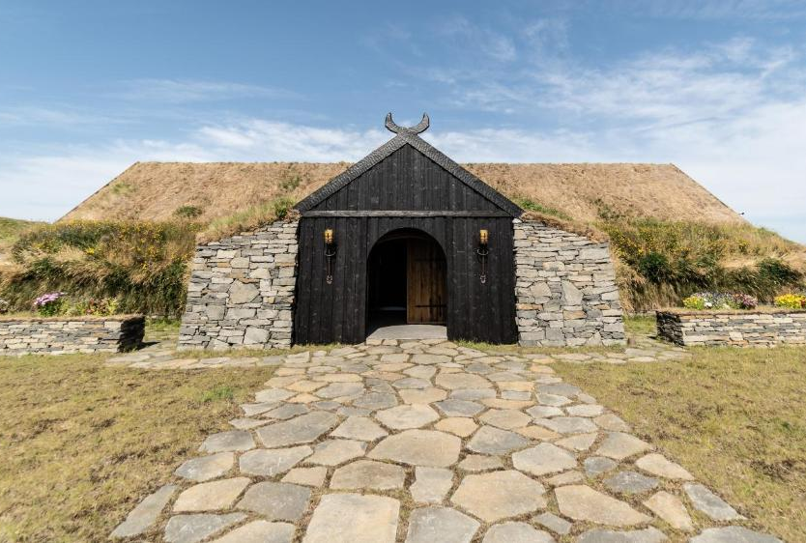
The Torfhus Retreat, Iceland
Module 7 (Part 1)
Making It Viable – Pricing, Planning & Long-Term Financial Health
Financial Planning & Funding

Slide 2
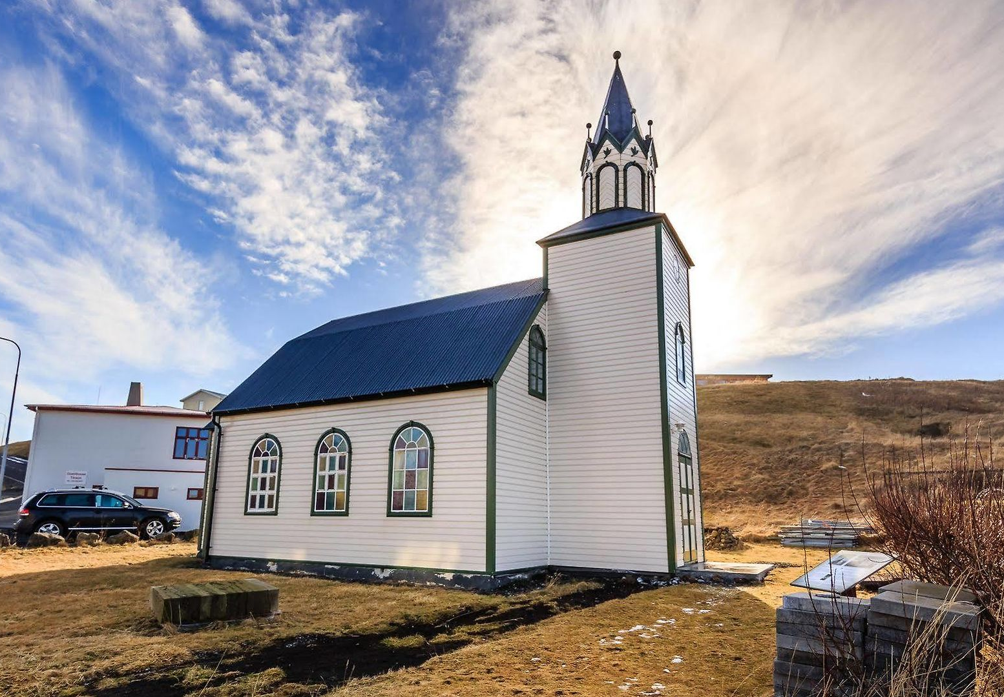
Module 7 (Part 1)
Church Blonduos, Iceland
Introduction to Private & European Funding
2

Slide 3
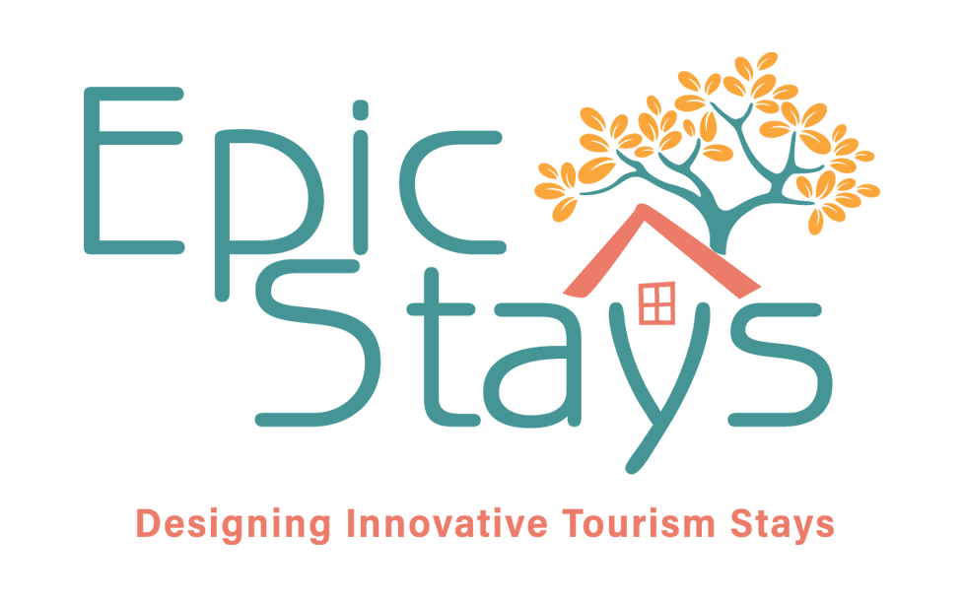
Module 7 (Part 1) Overview
Learning Outcomes
Introduction to Private & European Funding
This section will guide you through planning your finances and exploring funding options for your alternative accommodation business.
You’ll discover a range of pathways—from personal savings and public grants to ethical lenders and green investors. Discover what funders seek, including robust business plans, measurable sustainability impact, and financial viability.
Private and Blended Funding: Launching a rural tourism accommodation often requires piecing together funding from multiple sources. This section provides an overview of funding options, ranging from self-financing to blended funding.
EU Grants for Rural Sustainable Tourism & Accommodation: How the European Union provides significant funding to support rural development, green infrastructure, and tourism accommodation innovation through several key instruments.

Slide 4
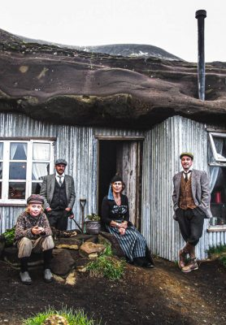
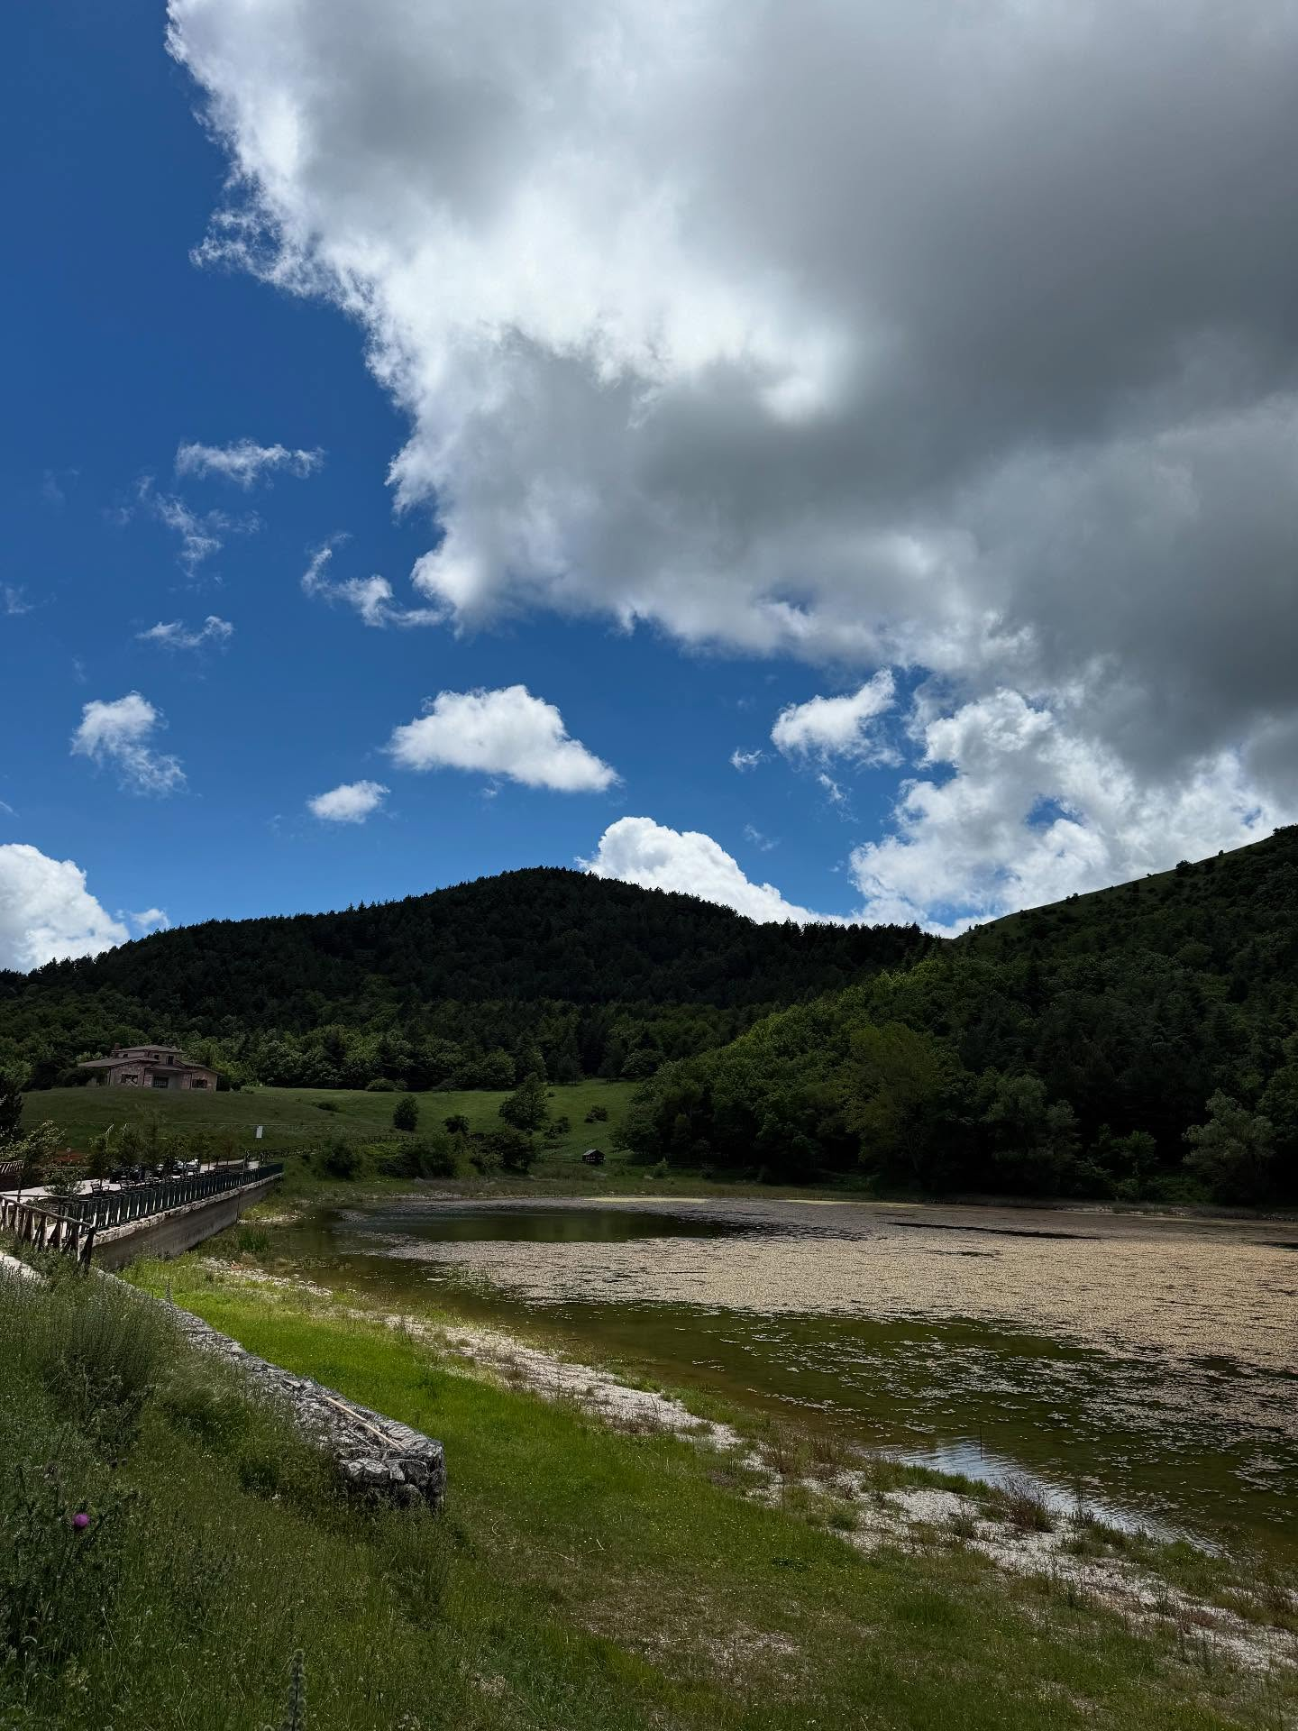
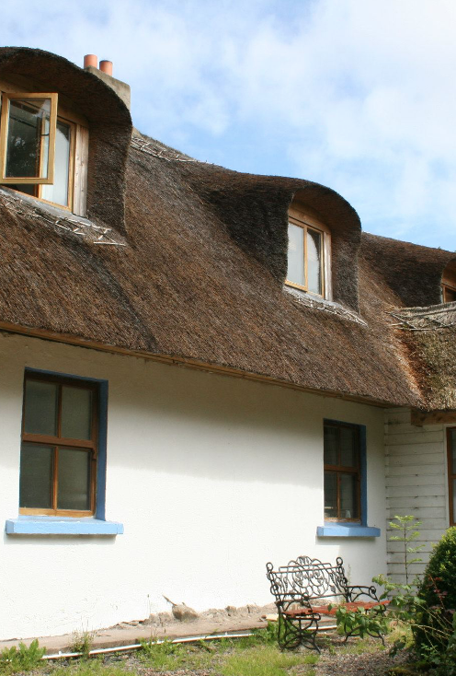
M7 Part 1
02
Photo Credit:
Page 16
Photo Credit: Daunia Avventura, Biccari
Introduction to Private & European Funding
ons of Your Business and Your Market
Section 2
EU Grants for Rural Sustainable Tourism & Accommodation (LEADER, EAFRD, ERDF)
01
03
Page 6
Page 64
Section 1
Private and Blended Funding Options
Section 3
Know What Customers Will
Pay For: Guest Appeal & Expectations
Photo Credit:
4

Slide 5

Module 7
Funding & Finance Options
Overview: This Module will guide you through planning your finances and exploring funding options for your alternative accommodation business. You’ll discover a range of pathways—from personal savings and public grants to ethical lenders and green investors. Discover what funders seek, including robust business plans, measurable sustainability impact, and financial viability. Designed to be practical and informative, this section supports aspiring entrepreneurs in launching and funding sustainable tourism accommodations. It also explores country-specific funding opportunities in Europe. By the end, you'll be equipped to choose the right funding path and approach investors or funders with clarity and purpose.
5

Slide 6

01
Private and Blended Funding

Slide 7
Common Funding Jargon, Explained Simply
Term | What it means
Grant | Free funding (no repayment) – usually comes with rules and reports
Loan | Borrowed money to repay monthly with interest
Co-financing | You must cover part of the costs (e.g. 30–50% of the budget)
Phased funding | Money paid out in stages (planning > building > delivery)
Impact Investment | Private investors who back green/social businesses
Pitch Deck | A short visual presentation of your idea for investors or grants
Funding Call | A specific opportunity to apply for a grant (has deadline + criteria)
Personal Savings | Your own money. Great for small-scale starts, but may not be enough alone
Microloans | Small loans (often €5,000–€25,000) for early-stage entrepreneurs, available through national programs (e.g. Microfinance Ireland, Slovenski Podjetniški Sklad).
Public Grants | Non-repayable funds from EU-backed schemes like LEADER (Ireland, Slovenia, Italy), PSR (Italy), or green innovation funds (Netherlands).

Slide 8
Common Funding Jargon, Explained Simply
Term | What it means
Tourism Investment Schemes | Offered by national tourism agencies like Fáilte Ireland or SPIRIT Slovenia.
Ethical or Green Investors | Individuals or funds that support social and environmentally responsible projects.
Crowdfunding | Platforms where you can raise small contributions from many supporters, often in exchange for perks or early bookings.

Slide 9

Launching innovative tourism accommodation often requires piecing together funding from multiple sources. This section gives an overview of funding options, from self-financing to blending funding :
Personal Capital: Many small-scale entrepreneurs begin with personal savings or capital as their primary source of funding. Nearly all owners invest some of their own savings. Whether it’s money you’ve saved, borrowed from friends or family, or invested from a redundancy package or pension withdrawal, personal capital gives you complete control and no debt.
Benefit: This “equity” shows skin in the game. This has the benefit of no interest or repayment burden. If you have some savings (or can gradually invest profits from an existing farm or business), it demonstrates a commitment to other funders.
1
Funding & Finance Options
Personal Capital and/or Savings
Note: For larger or riskier projects, personal funds are often combined with grants, microloans, or crowdfunding.

Slide 10
Tip Additionally, consider friends and family financing – informal loans or equity from relatives can kickstart your project (be sure to formalise agreements to avoid misunderstandings).
Pros: full ownership and control. Can cover initial deposits, site studies, or planning fees. Strengthens your equity position when applying for grants or loans. Cons: limited amounts and personal financial risk.
Credit Unions & Cooperative Banks
In some countries, local credit unions or cooperative banks support community businesses. They might be more flexible and interested in the social benefits of your project. Example: Italy’s cooperative banks or credit consortia (Confidi offer SMEs easier credit.
Funding & Finance Options
Personal Capital and/or Savings
2

Slide 11

3
Bank Loans
A traditional bank loan or mortgage on property. Banks will expect a solid business plan and collateral. e.g., property/assets, and evidence that the venture can repay its debts. Government loan guarantees may help you secure the capital you need.
Grants (Non-Repayable Funds)
Grants are competitive and come with criteria (job creation, innovation, rural development, etc.). EU rural development grants (LEADER/EAFRD), national tourism grants, or local enterprise grants fall under this category (details in the next section).
You usually need to co-fund part of the project (grants often cover 30–75% of costs, not 100%). Covered in the next section.
Funding & Finance Options
4
Credit Unions, Banks and Introduction to Grants

Slide 12


5
Equity Investment
Selling a share of your business to investors in exchange for capital.
Example: For a small glamping venture, formal equity investment is less common (investors prefer scalable startups), but you might involve a partner/investor who provides money now for a percentage of future profits. Make sure to formalise arrangements legally.
Public-Private Competitions
Occasionally, companies run contests for unique accommodation ideas
Example: Airbnb’s $10M OMG Funds for wildly unusual listing ideas worldwide.
Funding & Finance Options
Most Entrepreneurs Use a Blend of Funding Sources
6
Recommended Reading
LEADER Funding Projects for Economic Growth, Rural Infrastructure, and Climate Resilience
OECD Financing SMEs and Entrepreneurs Scoreboard: 2025 Highlights
Financing approaches for tourism SMEs and entrepreneurs

Slide 13
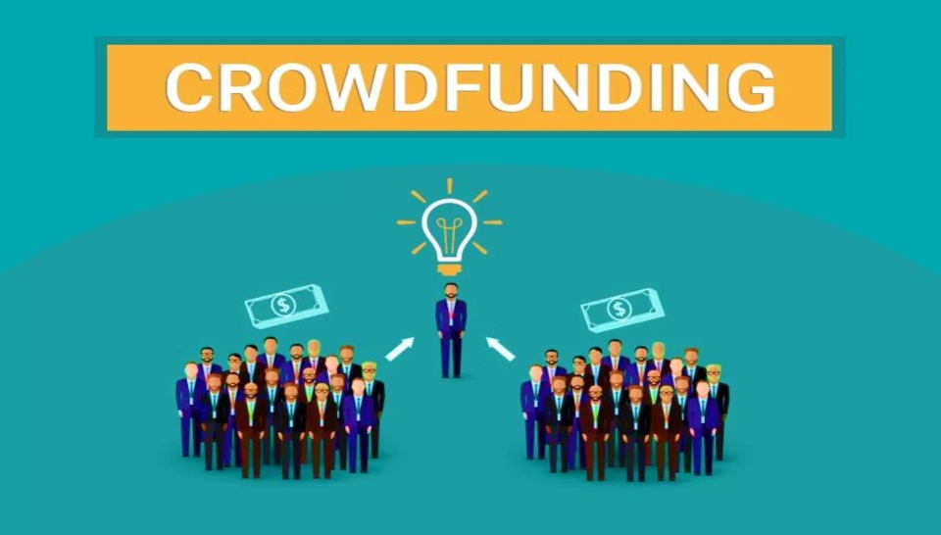
7
Crowdfunding: Raising many small contributions, typically via an online platform. This could be referred to as ‘Reward Crowdfunding’. Example: donate/pre-purchase stays – e.g. a €200 pledge for a “free weekend stay” once you open) or equity crowdfunding (selling small equity stakes). Platforms like Kickstarter, Indiegogo, or niche platforms (e.g., TravelStarter, which specifically targets tourism projects and has been used to fund eco-accommodations). Crowdfunding doubles as marketing – your backers become your first guests and ambassadors.
Example: Ecocapsule – Slovakia is a self-sustainable micro-home designed for off-grid living and eco-tourism. Launched a funding campaign on Indiegogo, a crowdfunding platform, in 2015. The goal was to raise €50,000 — they raised over €200,000 from eco-conscious backers globally.
Funding & Finance Options
Most Entrepreneurs Use a Blend of Funding Sources
*Note: TravelStarter also connects travel companies with potential backers who can invest in their projects, receiving travel-related rewards once the project's goals are reached. This platform is considered a pioneer in crowdfunding within the tourism sector.

Slide 14

8
Community Support: In rural communities, community support can be a powerful force.
A Community Cooperative Model is where local community members buy small shares to fund your ATA initiative and potentially share in profits or usage. Forming a small cooperative or community venture can be a practical approach to achieving this goal.
Cooperative finance builds local support, although managing many stakeholders can be complex.
Example: A few families might pool funds to develop a shared glamping site, or villagers buy “shares” in a tourism initiative.
Italy’s cooperative di comunità is a type of collaborative model where community-based cooperatives or residents collectively invest and manage local tourism services, resources, or businesses, especially in rural or declining areas.
Funding & Finance Options
Community Cooperative Model

Slide 15
Benefits: The model supports social, economic, and cultural regeneration by directly involving citizens in decision-making and ownership.
While this requires trust and clear agreements, it can spread both the risk and the reward locally. This is especially relevant if the project has a strong community benefit.
Tip: Talk to your neighbours and local community; sometimes locals may be willing to invest small amounts or in-kind support (like helping with construction) because it will benefit the area.
Funding & Finance Options
Community Cooperative Model

Slide 16

02
EU Grants for Rural Sustainable Tourism & Accommodation (LEADER, EAFRD, ERDF)

Slide 17
EU Grants for Rural Sustainable Tourism & Accommodation
The European Union provides significant funding to support rural development, green infrastructure, and tourism innovation through several key instruments, delivered at national level. Some of the main ones are:
LEADER / CLLD (Ireland, Slovenia, Italy): Supports local, bottom-up rural tourism initiatives through Local Action Groups. Funding is often available for eco-accommodation, farm diversification, and small-scale visitor infrastructure.
EAFRD – Rural Development Programme: Financed by the European Agricultural Fund for Rural Development, this programme supports tourism diversification, including eco-lodging, solar panels, water reuse systems, and adapting farm buildings.
ERDF – European Regional Development Fund: Supports low-carbon, innovative tourism infrastructure and digitalisation, particularly in the Netherlands, Italy, and Slovenia, through regional programs such as OPZuid or Interreg.
These grants are non-repayable, but highly competitive. Projects that demonstrate sustainability, innovation, and community value are more likely to succeed. Each country offers unique national and regional funding schemes for sustainable accommodation.

Slide 18
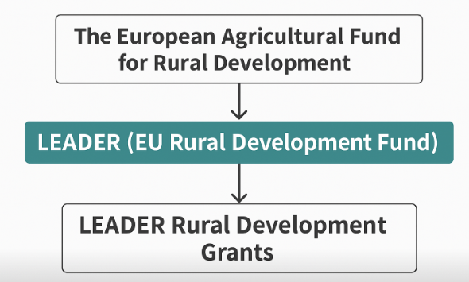
Grants (non-repayable funds) can significantly reduce your capital burden if you can obtain them. In Europe, there are multiple levels of grants – EU-funded programs, national schemes, and local/regional and rural grants.
For ATAs, the European Union offers generous support for rural development and tourism, typically administered by national/regional bodies. Here are the key EU funding streams.
Some examples on the following slides!
European Agricultural Fund for Rural Development (EAFRD)
EU Grants for Rural Tourism (LEADER, EAFRD, ERDF)
Rural Development Programme (LEADER) 2023-2027

Slide 19



1
European Agricultural Fund for Rural Development (EAFRD)
EU Grants for Rural Tourism (LEADER, EAFRD, ERDF)
Objective: EAFRD are a big EU fund that supports overall and farming development, in the context of ATA’s.
Rural tourism infrastructure (e.g., trails, signage, tourism centres)
Farming diversification (e.g., RDP measures that give farmers grants to start agritourism (converting a barn to guest rooms, building campsites on farms, etc.)
Example:
LEADER is one programme under EAFRD, but EAFRD can fund other rural tourism schemes too. A country may use EAFRD to support a national grant for agritourism.

Slide 20
2
LEADER
(EU Rural Development Fund)
EU Grants for Rural Tourism (LEADER, EAFRD, ERDF)
Objective: LEADER is a specific programme within EAFRD, designed for community-led rural development. Delivered via Local Action Groups (LAGs) in each rural region.
Also referred to as “LEADER Rural Development Grants.” This is just a practical label often used when discussing the actual grants given by LEADER. All EU countries (e.g., Iceland, Ireland, Netherlands, Slovenia, Italy) have LEADER programs.
LEADER grants typically co-fund projects that benefit rural tourism in areas like tourism accommodation, which is a common category (it can fall under rural tourism or farm diversification), eco-tourism, farm innovation or diversification, rural crafts, and trails.

Slide 21

LEADER
(EU Rural Development Fund)
Example:
In Ireland, LEADER grants can cover up to 50% of a project's cost (the maximum grant is often € 50,000 for private businesses).
Indeed, LEADER has funded glamping sites.
Example: A glamping project on Bere Island, Ireland, received € 150,000.
Recommended Reading
Introduction to LEADER Funding
European Agricultural Fund for Rural Development
EU Funding Opportunities

Slide 22
3
LEADER (CLLD)
CLLD Community-Led Local Development
CLLD stands for Community-Led Local Development
Objective: LEADER CLLD is an EU initiative specifically designed for the development of rural economies. CLLD stands for Community-Led Local Development, underpinning rural community-led development.
It is a bottom-up, locally driven EU funding initiative that funds projects based on community needs, such as creating jobs, preserving heritage, promoting inclusion, and supporting the green economy.
Funded through the European Agricultural Fund for Rural Development (EAFRD). Managed by Local Action Groups (LAGs) in rural areas. Designed to empower local communities to identify and fund projects that meet local needs. In each rural region, a Local Action Group (LAG) composed of community, private and public representatives decides on grants for local projects.

Slide 23

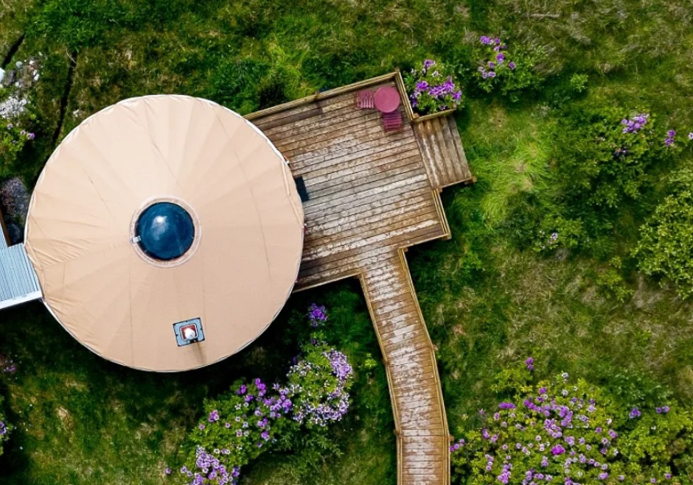
LEADER (CLLD)
CLLD Community-Led Local Development
Example:
Funds can support tourism, culture, craft, food, digitalisation, environment, and social innovation.
Usually 50-75% co-funding, depending on national rules.
Those eligible include NGOs, small businesses, municipalities, social enterprises, and individuals (with viable plans).
Case Study: Funding Opportunities Open
Tourist Accommodation Development in Donegal, Ireland (Next Slide)
Website https://dldc.org/leader-programme-2023-2027-targeted-call-for-tourist-accommodation-projects/

Slide 24



Case Study: Funding Opportunities Open
Tourist Accommodation Development in Donegal, Ireland
Donegal Local Development Company CLG (DLDC) and Donegal Local Community Development Committee (LCDC) announce funding for tourist accommodation projects under the LEADER Programme.
The Local Development Strategy (LDS), created in consultation with local communities, aims to enhance Donegal’s tourism offerings, boost rural tourism and support local tourism enterprises while promoting economic development and maintaining environmental sustainability.
Grants of up to €50,000 are available for projects under the Agricultural Diversification and Rural Tourism & Recreation sub-themes.
These grants are designed to support enterprises in developing high-quality tourist accommodations. Private applicants are eligible to receive up to 50% of their project’s cost in funding, with community applicants eligible for up to 75% of the financing.

Slide 25

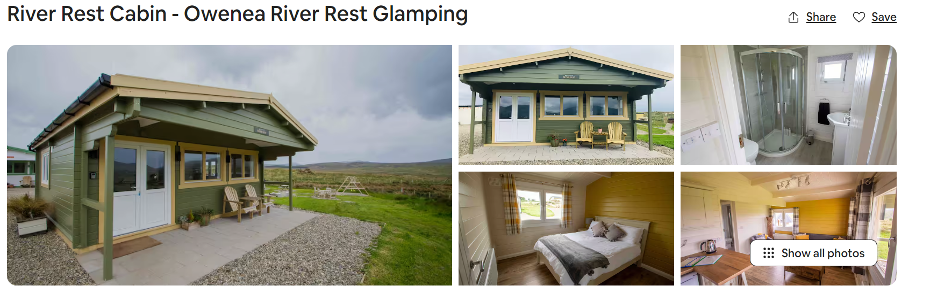
EU LEADER funded projects
Examples
In Co. Clare, Ireland, Castle Darcy Glamping a glamping pods project received a €200,000 LEADER grant.
Example: In Donegal, “Owenea River Rest” glamping cabins were awarded €97,700 via LEADER under the farm diversification scheme.

Slide 26
First Stop Your Local LEADER Office
To pursue this, contact your local LEADER LAG through the county or regional partnership – they can advise on criteria (you’ll usually need to show rural economic benefit, job creation, community impact, etc.). Find your local LEADER office or website.
Ireland
Netherlands
Slovenia
Italy
  In Ireland, the Local Development Companies are the network of all LEADER companies.
The Netherlands has LEADER in certain rural areas (like Friesland, Brabant), though competition can be stiff; you can apply via your provincial rural development agency.
Slovenia uses LEADER (CLLD) too, local groups can fund small tourism initiatives, especially if they integrate local community or heritage aspects.
Invitalia is Italy’s national agency for investment and business development. It manages several funding programs:

Slide 27
4
The EU Recovery and Resilience Facility (RRF)
Objective: This is a post-COVID economic recovery fund to support reforms and investments in digital and green transitions. Funding allocation is country-specific. In the ATA context, it funds sustainable tourism infrastructure, accessibility, and innovation. It also provides financial support for reforms and investments, including in sustainable tourism accommodation.
The EU Sustainable Tourism Strategy is a policy direction and not a fund. Still, it is designed to guide future priorities of EU tourism funding, focusing on and promoting green innovation and digital transitions in tourism, including community-based sustainable models across the EU. Funding details are integrated into future EU funding programmes, including Horizon, COSME, and Interreg. *EU Tourism Agenda for 2030.
Example: Italy has access to €772 million for sustainable tourism, improved accessibility and infrastructure and urban regeneration.

Slide 28
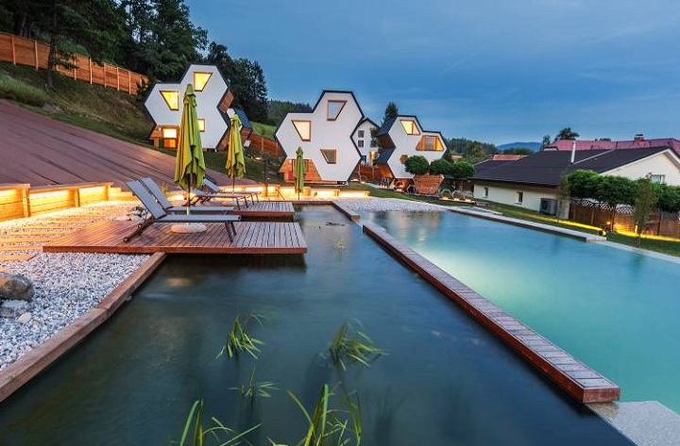
5
Regional Development Plans (RDPS)
Objective: Regional Development Plans (RDPS) are national or regional plans that outline how each EU country (or region) will use funding from the European Agricultural Fund for Rural Development (EAFRD) — including LEADER, climate action, farm diversification, sustainable tourism, green infrastructure, training and agri-environment schemes.
Example: Italy: Agritourism businesses have benefited from such measures in regional RDPs. Funds in Puglia’s RDP were allocated to farm tourism diversification.
Example: Slovenia: Through its RDP, young farmers and rural entrepreneurs could get support for innovative tourism on farms In 2021, Slovenia launched razpisi (calls) for tourism accommodation quality improvements with grants up to €1.8 million for new or renovated facilities, funded partly by EU recovery funds.

Slide 29

Regional Development Plans (RDPS)
…Contd. RDPs: Check your country’s RDP new CAP 2023–2027 programs for measures supporting rural tourism businesses. Often, these grants require the applicant to be a registered farmer or rural SME and cover 40–50% of investment costs.
Tip: If you're starting or expanding a rural tourism business, your national/regional RDP determines what types of grants are available, how much funding you can get, and from which stream (LEADER, farm diversification, tourism infrastructure, etc.).

Slide 30
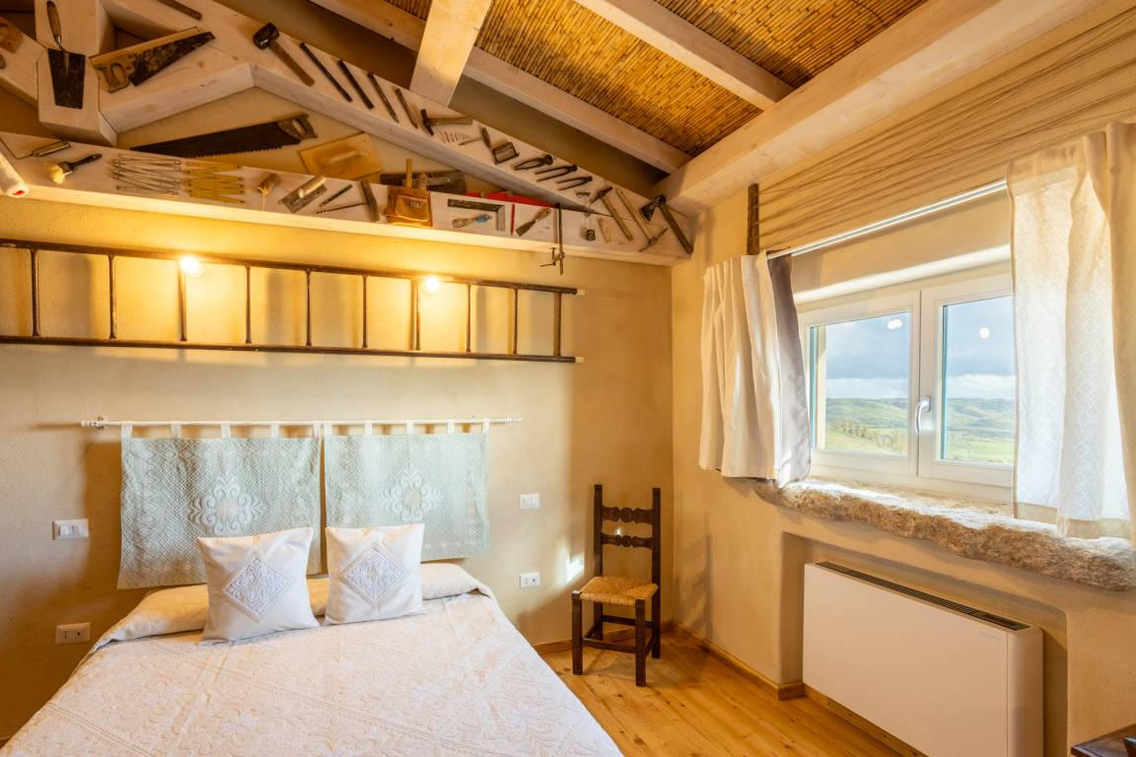
‘We will support investments in complete reconstructions or new constructions of hotels, motels, guesthouses, tourist-farms, campsites and glamping sites, and only highly environmentally sustainable investments will be eligible’.
Slovenia launched razpisi (calls) for tourism accommodation quality improvements
More information here.

Slide 31
6
EU Just Transition Fund (JTF)
Objective: The EU Just Transition Fund (JTF) serves as a vehicle for a low-carbon economy, encompassing sustainable tourism projects in a designated Just Tranisition Regions
In the context of ATA, it can vary by region.
Example: Ireland's Midlands received up to €68 million for regenerative tourism initiatives.
Alternative tourism accommodation
Grants usually cover up to 50% of eligible project costs for businesses (higher for non-profit/community projects). Funding amounts range from a few thousand euros to over € 200,000 for high-impact projects.

Slide 32
Applying for grants requires work: you’ll need to prepare proposals and often wait for calls to open. See the resources associated with this Module for support and assistance. But the effort can pay off since grants don’t need repayment.
Tip: It’s wise to align your project with grant objectives, emphasising rural development, job creation, sustainability, innovation, and cultural heritage – whichever fits the specific scheme.
Finally, note that most grants don’t cover 100% – you often need to co-finance 40-60%. So, grants usually work in combination with your own funds or loans.
Example: You might use personal savings for 50% and obtain a grant for the other 50%. This leveraging can make a project feasible.
Applying Requires Work but it Can Pay Off!
EU Grants for Rural Tourism (LEADER, EAFRD, ERDF)
Recommended Reading
Rural Policies Impact on Tourism Development in Italy: A Case Study of Agritourism
*Note: The European Agenda for Tourism 2030 emphasises the need to protect the tourism sector and, at the same time, develop a forward-looking vision to take advantage of the willingness of many Europeans to change their travel and tourism habits so as to become more sustainable and responsible.

Slide 33
Well Done
Module 7 (Part 2)
Find the Funds That Fit
You have Completed… Module 7 (Part 1)
Introduction to Private & European Funding
Next is…

