Slide 1
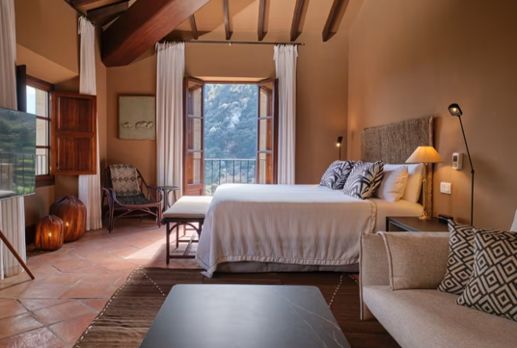
Case Study Valledemossa, Spain (Natural Sanctuary)
Module 6 (Part 3)
Setting Up & Launching Smart – Planning Your Start-Up & Capital Costs
Financial Planning & Funding

Slide 2
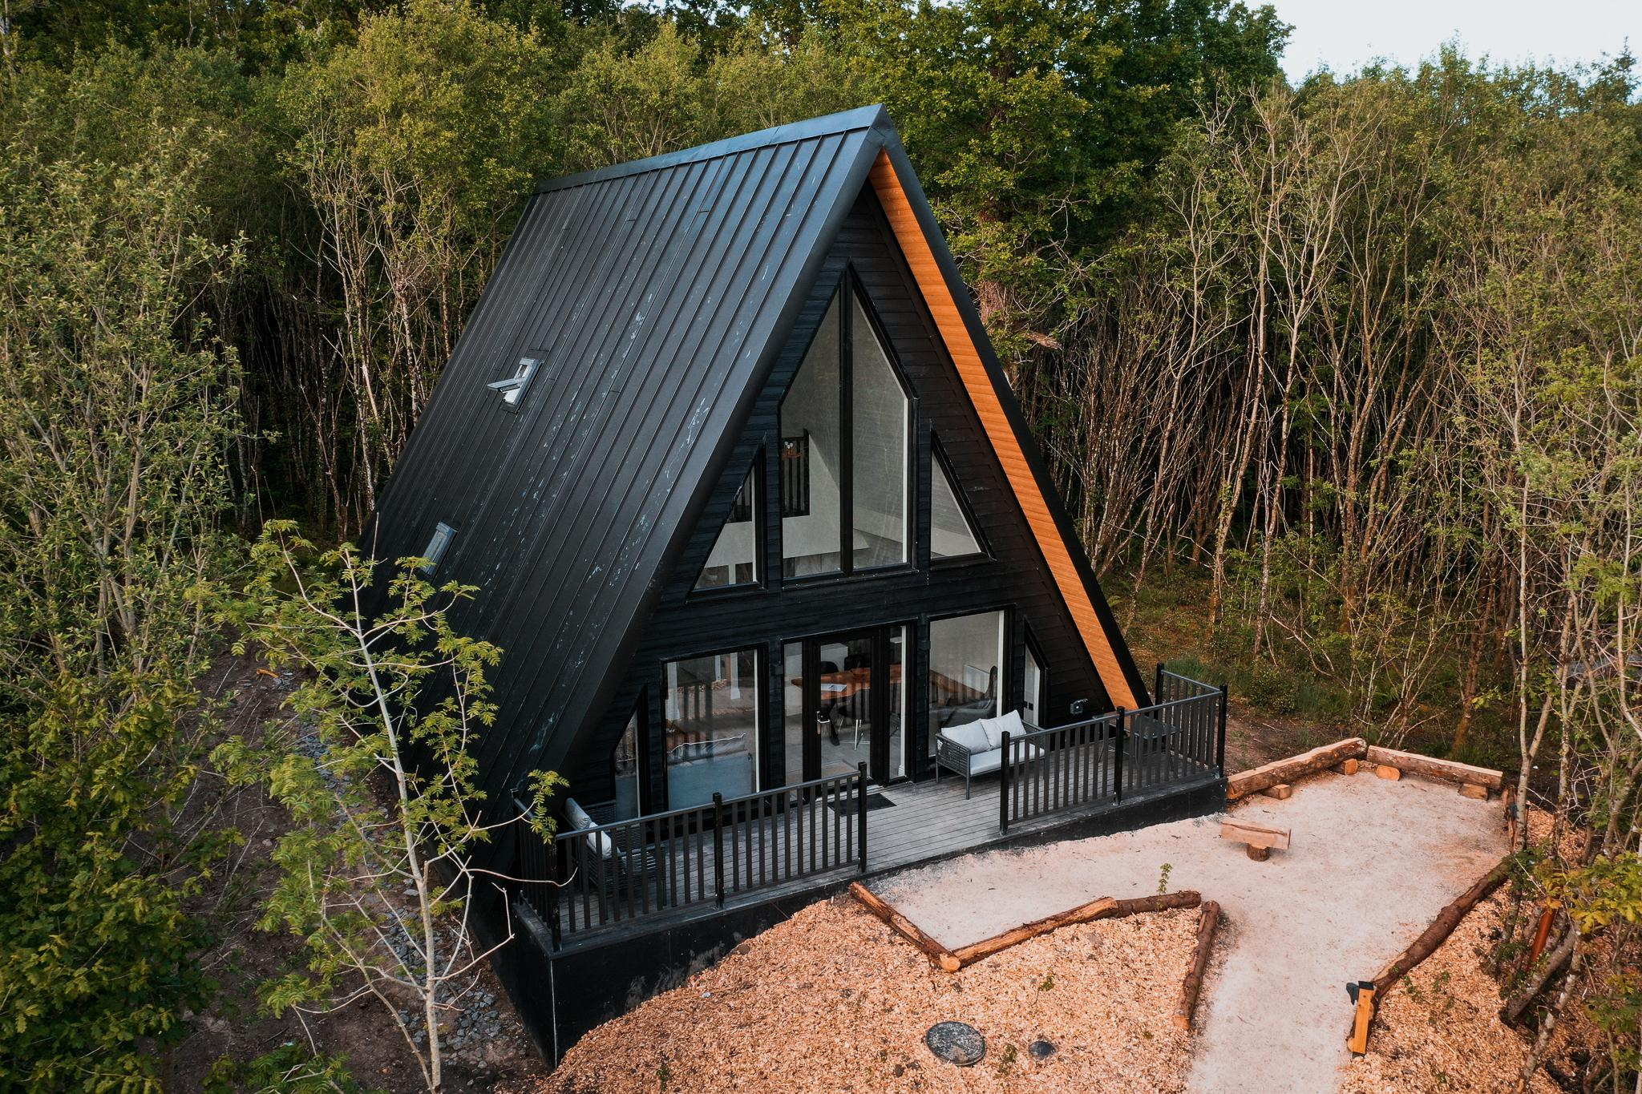
Module 6 (Part 3)
Drumheirny Woodland, Leitrim, Ireland
Sustainability, Investing in the WOW Factor
2

Slide 3
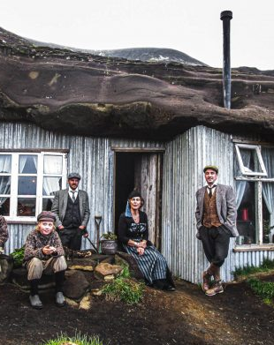
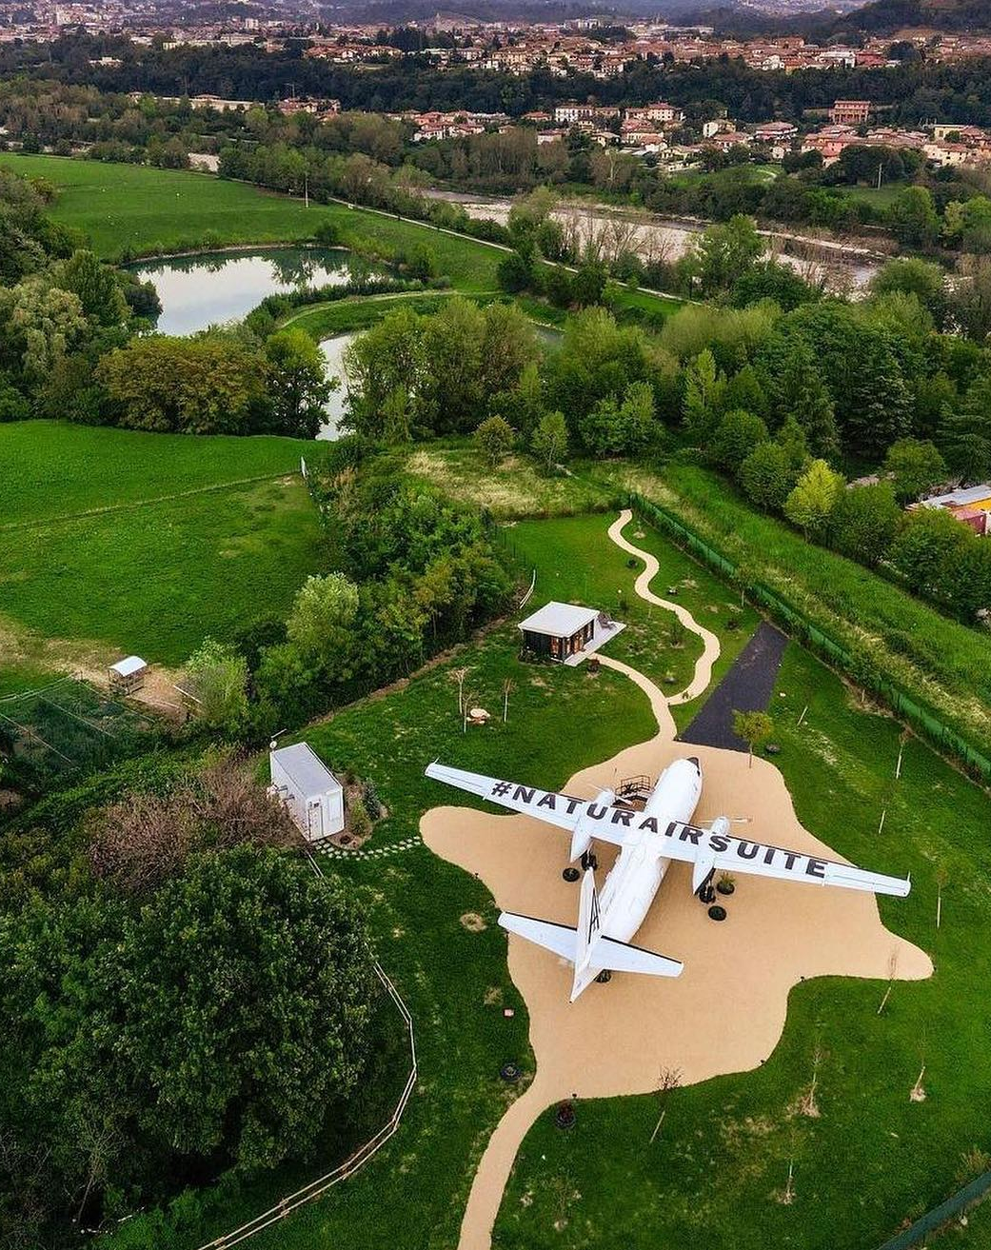
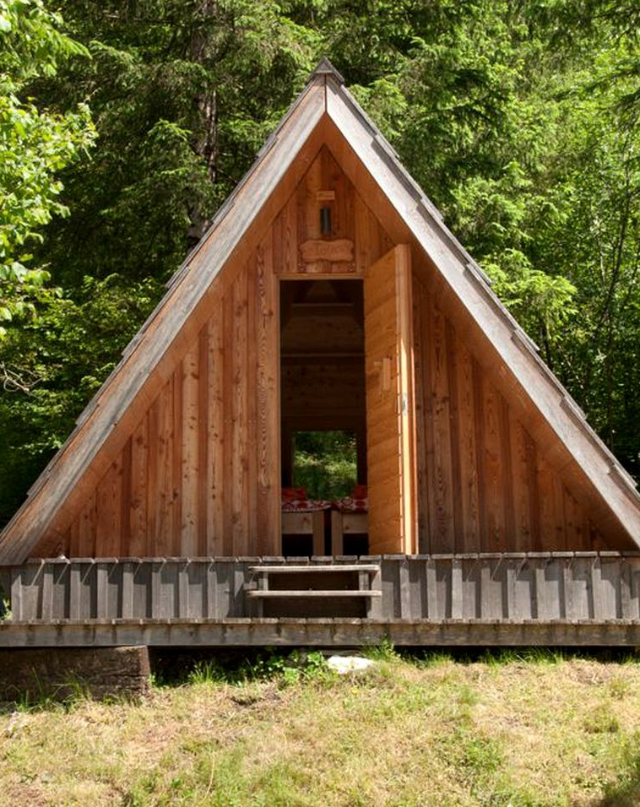
Part 3: Sustainability, Investing in the WOW Factor & Support Tools
Photo Credit: Cave People, Iceland
Photo Credit:
Photo Credit: Natur Air Suite, Italy
09
Photo Credit:
Section
Stand Out & Ensure Viability: The WOW Factor
(24 Slides)
Module 6
CONTENTS
08
10
Section
Section
Think Green, Spend Wisely: Eco & Compliance Costs
(10 Slides)
Resources
(20 Slides)
Photo Credit: A-Frame in Soča, Gorizia, Slovenia

Slide 4
Module 6 (Part 3) Overview
Learning Outcomes
Launching Smart - Sustainability, Investing in the WOW Factor
To thrive in today’s competitive tourism landscape, you need to balance eco-conscious choices with financial viability and stand out while doing it. In this section, you’ll explore how green investments can reduce long-term costs, enhance guest value, and unlock funding opportunities, such as grants or eco-financing.
You'll also learn how to build in your “WOW factor”—the memorable features that drive bookings and justify premium rates.
Finally, this section provides you with the tools and templates you need to transition from planning to action, including budgeting checklists, guest appeal worksheets, and zoning guides that clarify, enhance, and make decision-making more strategic.
Learn to weigh the short- and long-term financial impact of sustainable investments, and understand how eco-friendly choices can reduce costs or attract funding.
Identify and design “WOW factor” features that enhance guest satisfaction, justify premium pricing, and improve marketing performance.
Access and apply practical planning tools, including budgeting templates, zoning checklists, and guest appeal planners.
Make strategic, cost-conscious decisions that align with both environmental goals and long-term business viability.
Feel confident progressing from planning to implementation with the right support resources at hand.
Source: Launching Your Glamping Business: Tips And Insights For A Successful Start

Slide 5
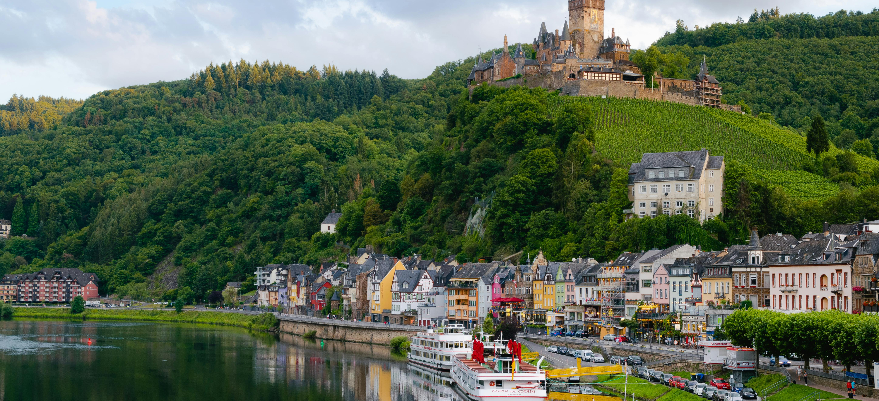
08
Think Green, Spend Wisely: Eco & Compliance Costs
Strike a balance between sustainability and financial feasibility, considering funding potential. Focus on green, sustainable investments that reduce long-term costs, add guest value, and open doors to grants or eco-financing. Building sustainably is no longer optional — it’s expected. However, going green without a plan can become expensive quickly. Utilise eco-friendly features that enhance guest value and reduce operational costs, such as solar panels, composting toilets, or low-impact landscaping. Plus, environmental design may help you qualify for green grants or low-interest funding, especially in rural EU regions. Balance ethics with return on investment for a smarter, greener build.

Slide 6
Module 6 (Part 3):
Key Learning Areas (36 Slides)
Think Green, Spend Wisely: Eco & Compliance Costs: Strike a balance between sustainability and financial feasibility, considering funding potential. Focus on green, sustainable investments that reduce long-term costs, add guest value, and open doors to grants or eco-financing.
Stand Out & Ensure Viability: The WOW Factor: Invest in memorable features that justify higher rates and marketing ROI. The goal is to make your accommodation memorable and marketable.
Resources: To put your knowledge into action, we’ve included a set of practical resources and hands-on exercises — from budgeting templates to zoning checklists and guest appeal planners — to help you make informed, cost-conscious decisions at every step of your start-up journey.

Slide 7

Enables access to green grants, preserves long-term viability, and appeals to eco-conscious guests.
Sustainable site selection and operation aren’t just ethical – they’re increasingly a market expectation and sometimes a regulatory requirement.
Aim to minimise environmental impact and integrate into the landscape. European destinations are embracing regenerative tourism, as exemplified by initiatives such as reusing historic buildings, creating eco-friendly retreats in rural areas, and installing green technology, which are highlighted in EU best practices. epicstays.eu.
Check if the site is in or near a protected area (Natura 2000 site, national park, etc.), as this will bring extra rules; for example, you may require special nature impact permits and strict wastewater treatment in such locations.
Build with climate resilience in mind too: design for energy efficiency and for more extreme weather (think heavy rain or heatwaves, depending on the region).
Think Green, Spend Wisely
Design for Sustainability, Resilience & Grant Eligibility
Priority 11 (€)
Protect the environment around you.
7
7

Slide 8
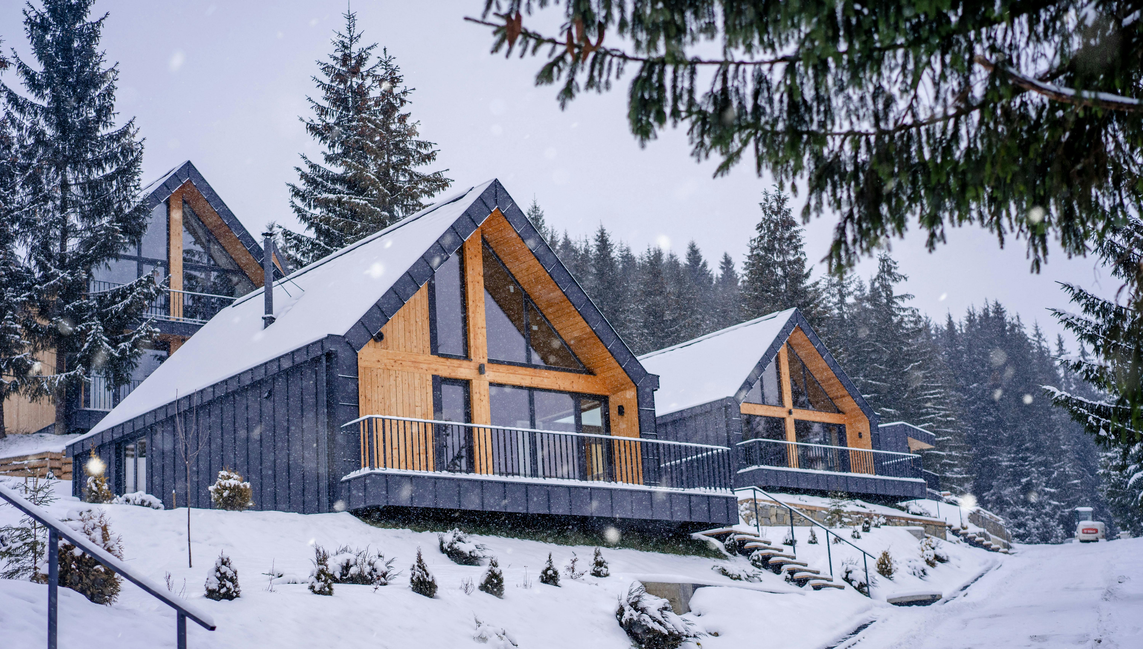

Many countries (like Ireland and Slovenia) have environmental guidelines for tourism accommodation to ensure habitat protection, waste reduction, and respect for local wildlife.
Sustainability isn’t just about nature – it also means using local materials and trades, which lowers the carbon footprint and supports the community.
Costs: Eco-friendly features often have upfront costs but long-term payoffs.
Solar panels with battery storage might be €10k–€20k as mentioned, rainwater harvesting systems €2k–€5k, and composting toilet setups around €1k–€3k each. Using sustainable materials (e.g. FSC-certified wood, green insulation) can add 10–20% to construction costs.
Green Builds Bring Bigger Returns
Remember your customer is eco-conscious.
Recommended Reading
Ireland: Environmental Guidelines for Tourism Accommodation.
Covers topics such as habitat protection, waste reduction, and energy efficiency.
Ireland: Notice Nature – Tourism Guidelines. Focus on conserving Ireland’s biodiversity, emphasizing shared responsibility among sectors, including tourism, to protect species and habitats.
8
8
8

Slide 9
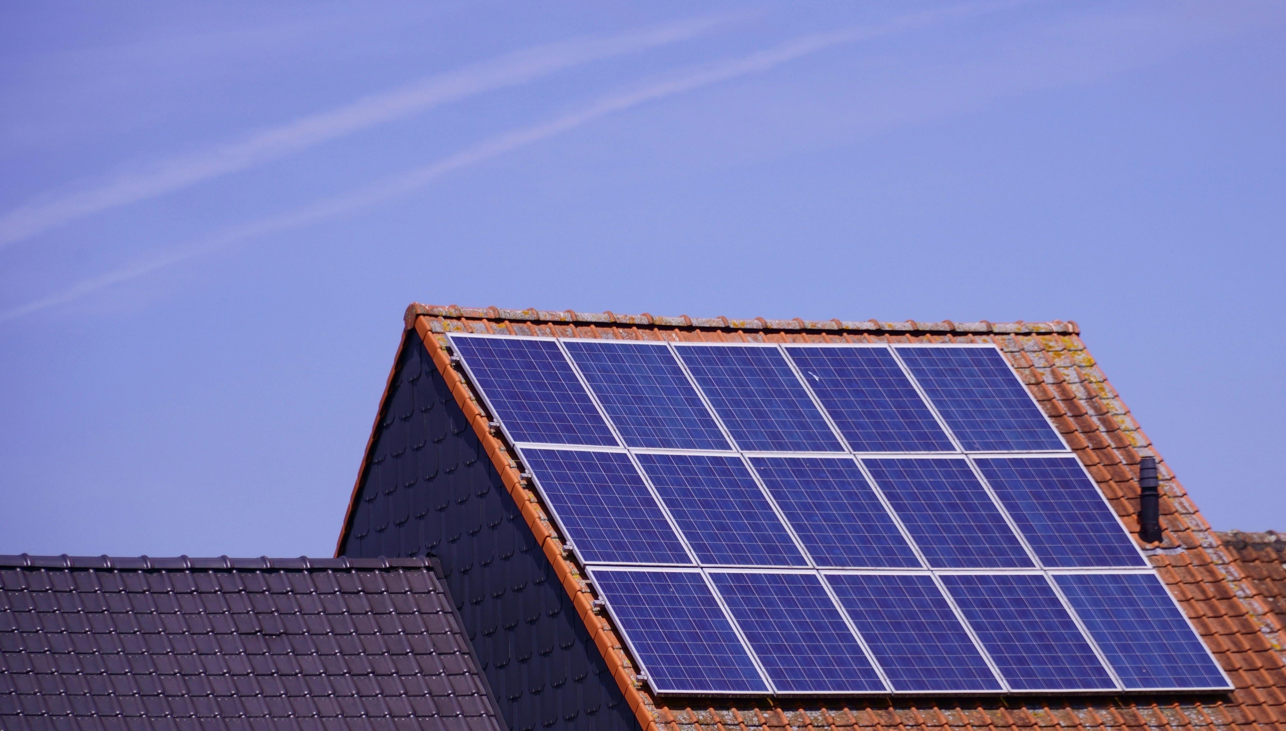
There may also be costs for environmental assessments if required (an ecology survey in Ireland or Iceland could be €1,000–€3,000).
However, operational savings and funding can offset this: solar energy cuts electricity bills, and many regions offer grants/tax incentives for green initiatives.
For instance, the EU’s LEADER programme and similar rural development funds frequently provide grants (often 30–50% of project cost) for tourism projects that embrace sustainability – farmers in Ireland have received up to €200,000 to diversify into eco-accommodation.
Eco by Design
Attract Funding & Future-Proof Your Business
Recommended Reading
Locally-Sourced Materials in Retrofitting: Provides insights into how local materials can enhance sustainability in building retrofits.
Green Scheme of Slovenian Tourism. National program certifies tourism accommodation providers committed to sustainability. They must meet international ecolabel standards and engage in practices like waste reduction and habitat preservation.
9
9
9

Slide 10

Financial Tip: Save by buying building materials locally instead of long distances (especially across borders), which adds hefty costs for fuel, freight, and logistics. This also supports local businesses and strengthens destination sustainability. Sourcing timber, stone, insulation, or straw locally helps avoid import tariffs, delays, and high fuel costs. Example: In Slovenia, using locally harvested wood for glamping pods can reduce material delivery costs up to 25%.
Financial Tip: Hiring local tradespeople cuts down on accommodation, travel expenses, and waiting time for external contractors. Local workers are familiar with the land and regulations, resulting in fewer mistakes, faster approvals, and often lower rates. Example: In rural Ireland, using local carpenters for eco-cabins has been shown to reduce build costs by 15–20%.
Think Green, Spend Wisely
Financial Tips
Recommended Reading
Top 10 Sustainable Tourism Practices in Slovenia (2024): Highlights Slovenia's initiatives, such as wildlife-friendly waste management and community engagement, promoting eco-friendly travel experiences.
Slovenia’s Commitment to Cleanliness and Sustainability. Slovenia's environmental policies, including waste management regulations and efforts to reduce carbon emissions, reinforcing its status as a green destination.
10
10
10
10

Slide 11

Financial Tip: Have fewer repair costs and better maintenance. Materials suited to the local climate (e.g., timber resistant to Irish damp or volcanic stone in Iceland) reduce long-term repair and maintenance costs. Local advantages are that repairs are faster and cheaper when parts or skills are available locally.
Financial Tip: Circular Economy savings by reusing or repurposing materials from local demolitions, salvage yards, or agriculture (e.g., stone, barn wood, wine barrels) reduce new material costs. Additionally, it benefits the local community, as many circular practices are already in place at the community level (e.g., bio-based insulation in the Netherlands, sheep's wool in Ireland).
Financial Tip: Source food locally, cuts transport costs, ensures fresher, seasonal ingredients, and enhances the guest experience with authentic regional flavours. It also supports local farmers and producers, often opening doors to collaboration, discounts, or marketing partnerships.
Think Green, Spend Wisely
Financial Tips
11
11
11
11

Slide 12
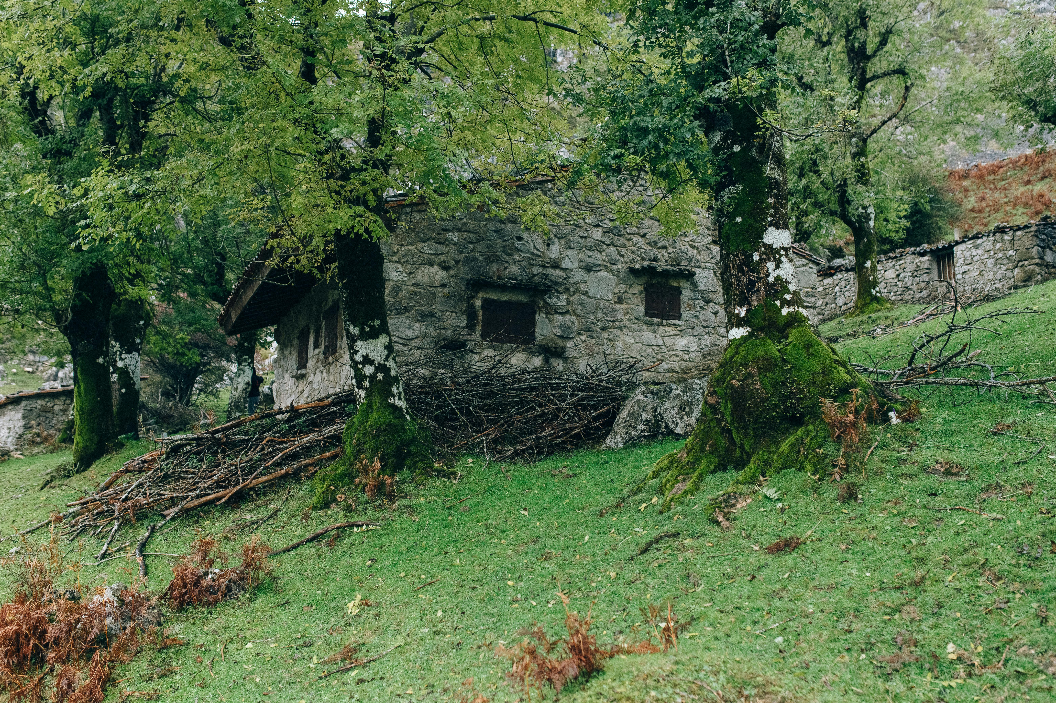
Financial Tip: Tap into green funding and expertise. Look for grants, tax credits or soft loans for sustainable tourism or energy efficiency (EU programs, national schemes, even green banks).
Financial Tip: Designing your site to high sustainability standards can also become a marketing angle – eco-conscious travellers may choose your glampsite and even pay a premium for a carbon-neutral or low-impact stay.
Financial Tip: Involve environmental experts early (even informally); for example, a local conservation group might advise how to lay out units to avoid disturbing wildlife or how to restore native plants – building goodwill and a better product in one go.
Think Green, Spend Wisely
Financial Tips
12
12
12
12

Slide 13
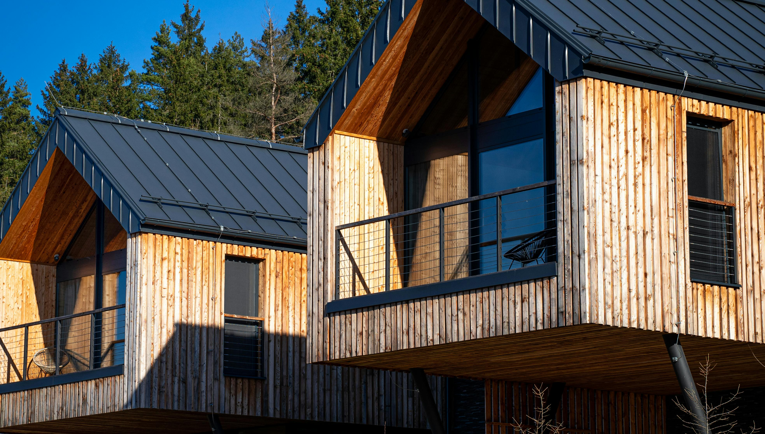
Financial Tip: Get the community behind you, promoting you and supporting you. Join local tourism associations (annual dues approximately €100–€300), sponsor a community event (€200+), or simply cover the cost of hosting an open house or coffee morning to introduce your business, and offer a discount during low periods.
Work with them on signage and maybe contribute towards road maintenance – they are also more likely to support future planning.
Financial Tips
Sustainability and Environment
13
13
13
13

Slide 14
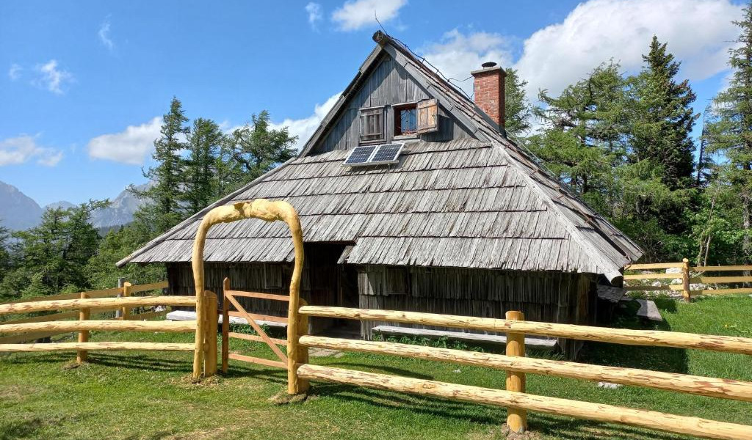
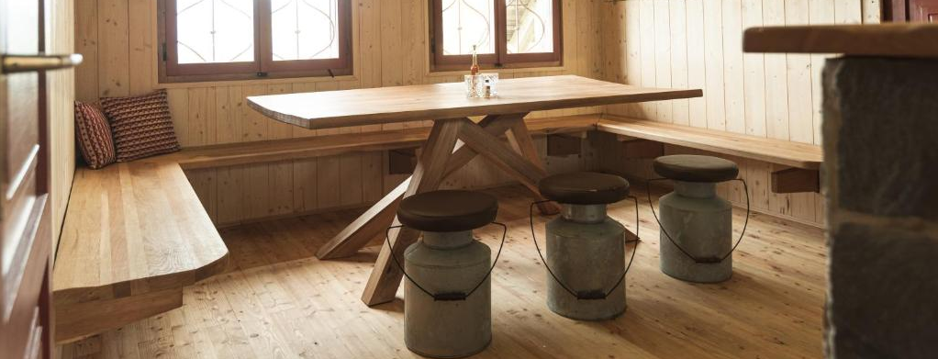
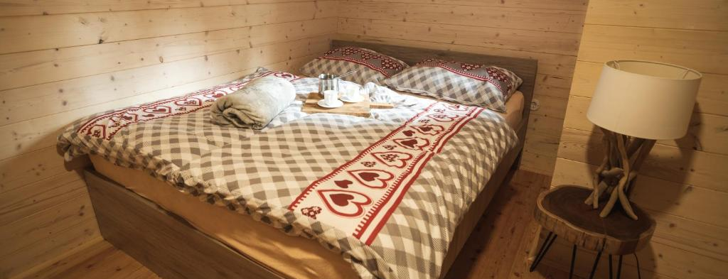

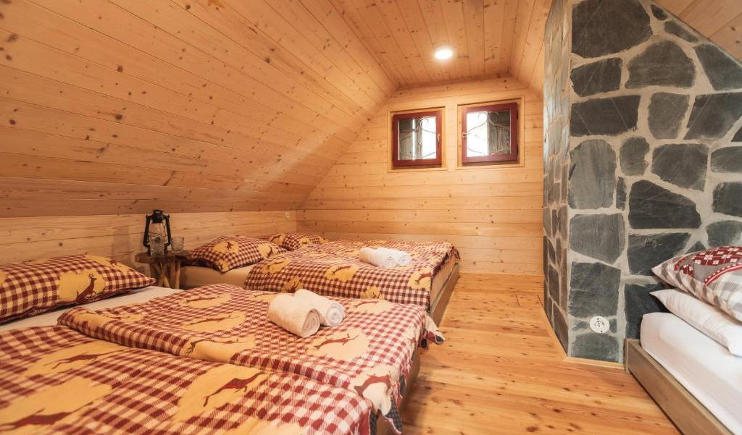
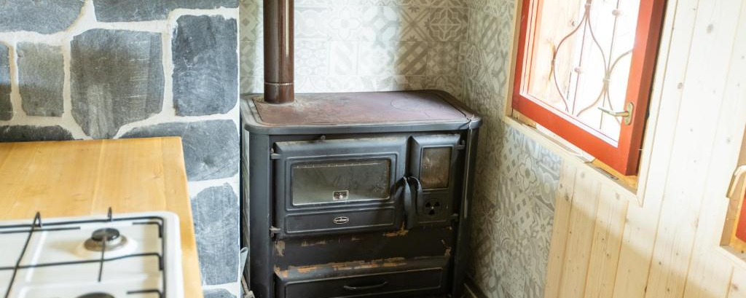
SLOVENIA
Photo Credit: Chalet Rušovc, Slovenia

Slide 15
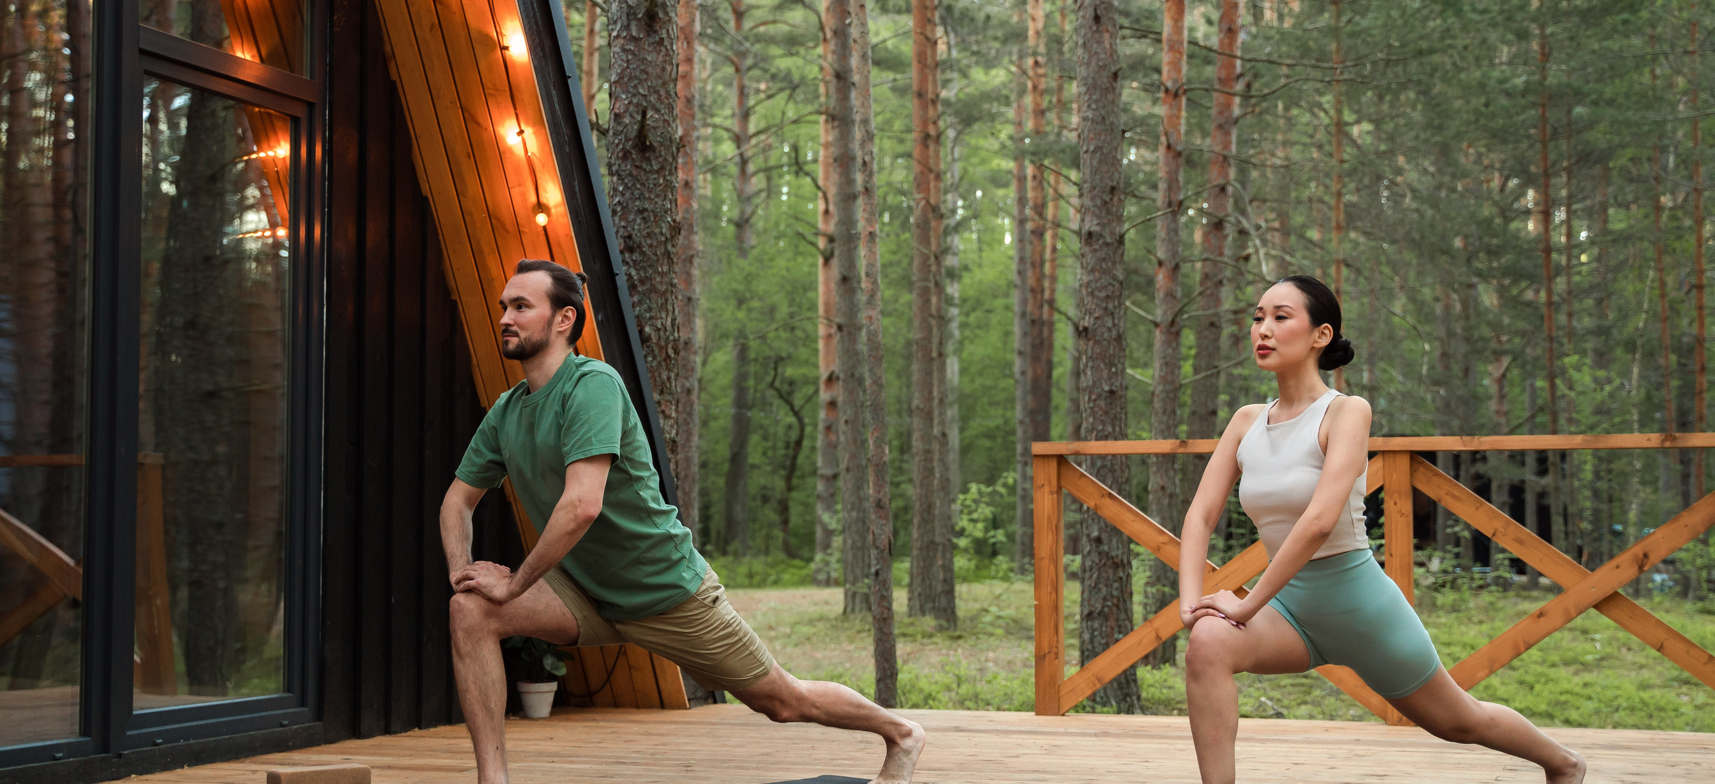
09
Stand Out & Ensure Viability: The WOW Factor
Invest in memorable features that justify higher rates and marketing ROI, the goal is to make your accommodation memorable and marketable.
The “wow factor” is what makes guests choose your place over hundreds of others. It’s also your best chance to justify premium prices and encourage organic marketing. Whether it’s a hot tub with a view, an outdoor bath, a rooftop stargazing deck, or a quirky structure like a treehouse, investing €5,000–€15,000 in a signature feature can add €50–€150 per night to your pricing. A memorable guest experience = higher earnings and repeat bookings.

Slide 16
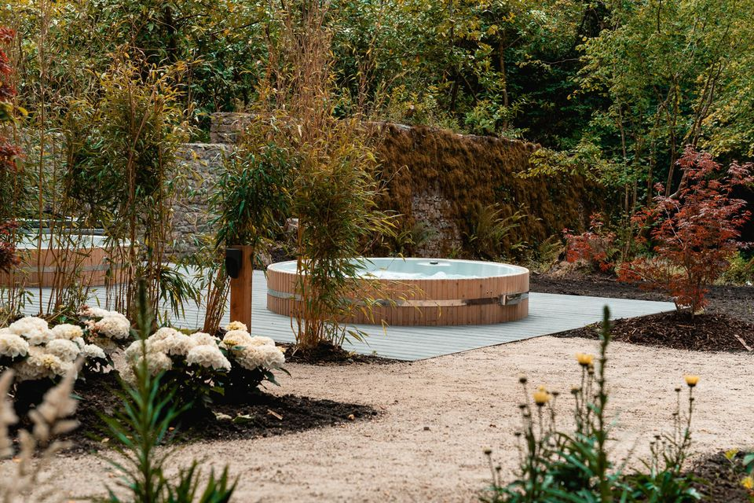
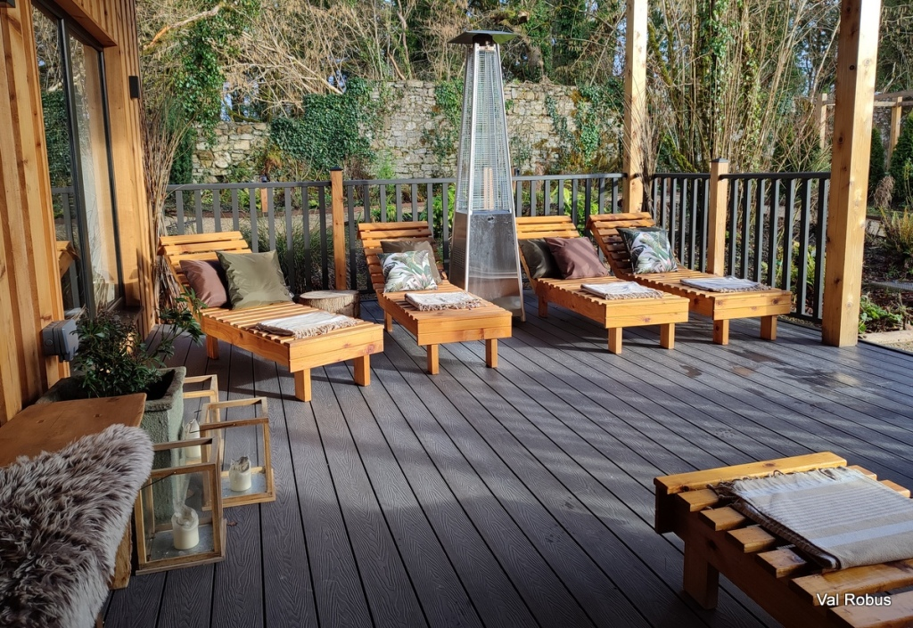
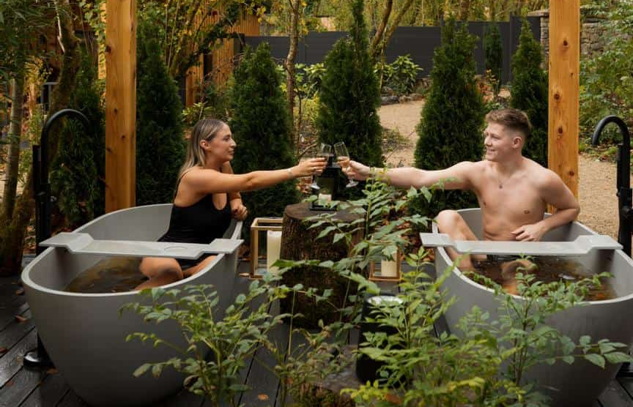
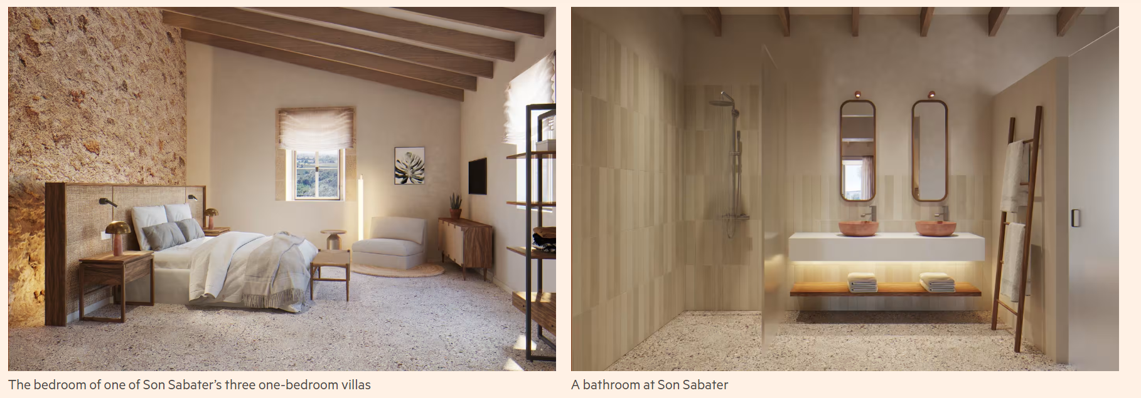
Creating the Wow Factor
Photo Credit: Fitz of Inch, Ireland

Slide 17
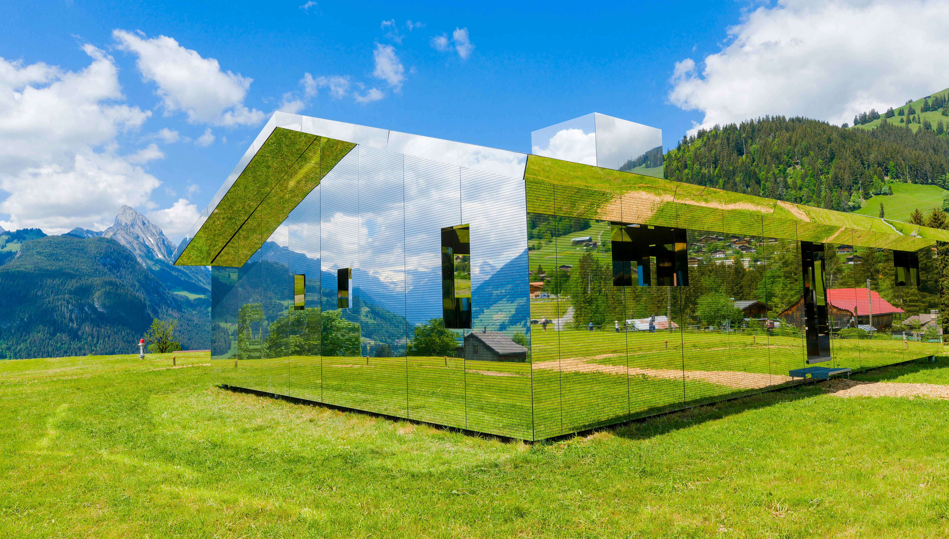
Unique features boost nightly rates by €50–€150, drive organic marketing, and attract premium guests.
The site should offer a memorable guest experience that justifies choosing your alternative accommodation over a generic hotel or tourism accommodation.
‘Accommodations must be more than just a place to sleep’
A key lesson from successful glamping businesses is to provide a “wow factor” that people will talk about. This could be an extraordinary landscape (e.g., a lakeside in Slovenia or a volcanic backdrop in Iceland) or unique structures, such as Ireland’s treehouse cabins.
This often means capitalising on unique features: stunning views, closeness to nature, privacy, or novelty.
Think about what your target market wants: stargazers might value a dark-sky location; families might want on-site nature trails. Think about what you can create on-site? How can you connect with local businesses, environments and activities?
Make Your Accommodation More than a Place to Sleep!
Priority 12 (€)
Create your WOW factor!
17
17
17

Slide 18
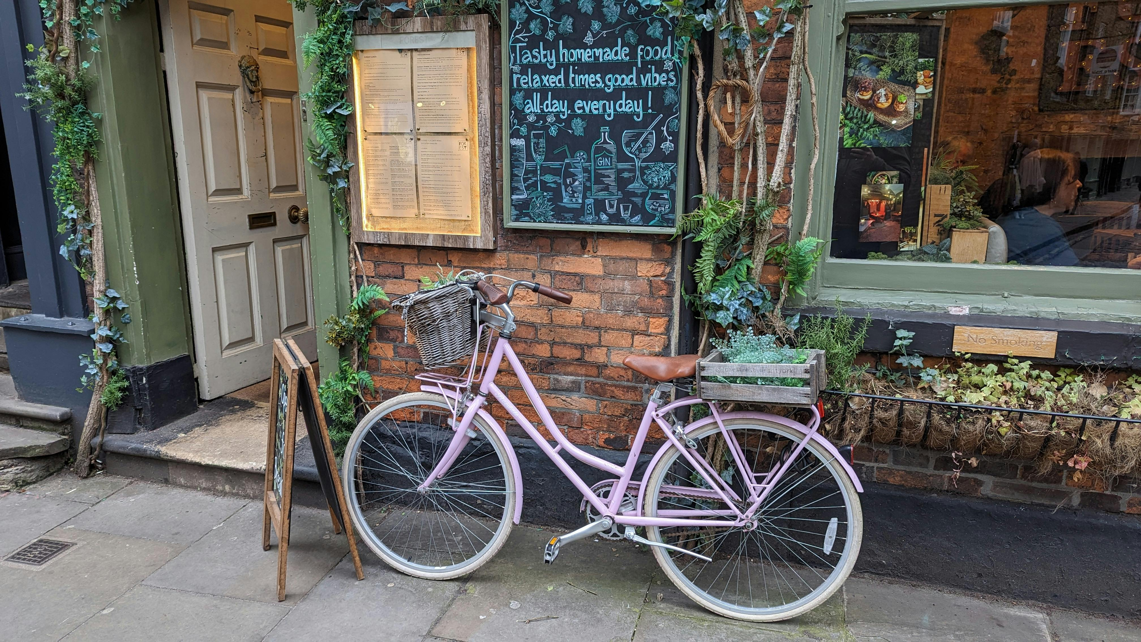
Align the site’s attributes with your theme – for example, Slovenia markets its glamping as a luxury-nature fusion, so sites there often include spa elements in forest settings. In Italy, an “albergo diffuso” (scattered hotel) might place guests in authentic village homes, emphasising culture and community over isolation.
Appeal to be accessible to all with an inclusive design. Think of people with diverse abilities and consider users’ sensory needs to communicate information effectively. Design with use efficiency, space, and comfort in mind, minimising fatigue.
Costs: Enhancing guest experience can range from minimal (leveraging natural assets) to significant investments.
Landscaping for aesthetics and privacy (planting trees, creating garden areas) could cost €3,000–€10,000.
Building viewing decks, hot tubs, or other amenities to add that wow factor easily adds €5,000+ each.
Create that WOW Factor!
Enhance Site Attributes, Theme & Inclusivity
Recommended Reading
Glamping and Lodge Accommodation Structures with WoW Factor.
EU Just Transition Webinar: Innovations in Regenerative Tourist Accommodation
18
18
18

Slide 19
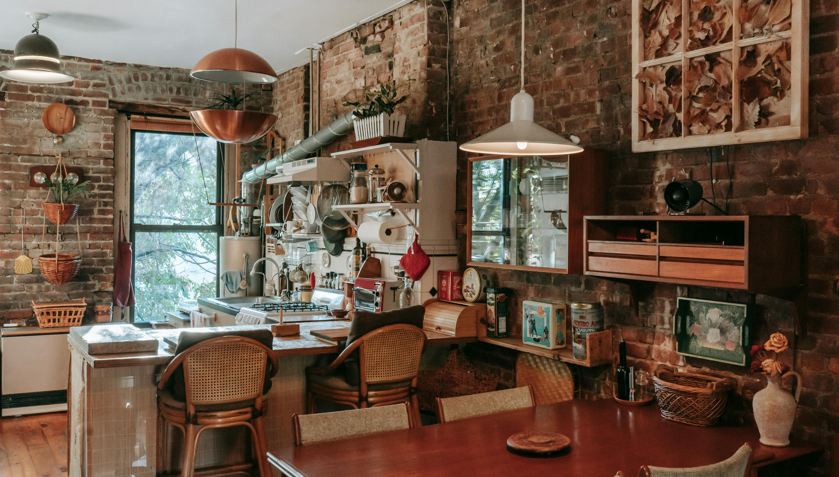
Unique accommodation structures themselves vary widely in cost: a basic furnished bell-tent might be €1,000–€3,000, whereas a bespoke treehouse or innovative eco-cabin can cost €50,000–€100,000 to construct.
These costs can pay off in rates you charge – for example, simple glamping tents might rent for around €60–€120 per night. While truly exceptional units (say a luxury geodesic dome with panoramic views or a castle tower suite) in a prime location can command €200–€400 per night.
Financial Tip: Always balance the investment with expected occupancy and pricing; an expensive setup in the wrong market won’t recoup itself.
Convenience is everything! Make it easy for people to travel and book what they want, when they want.
Create that WOW Factor!
Balance The Cost of Unique Stays with Pricing Strategies
Recommended Reading
15 Ways To Get The Wow Factor That Builds Guest Loyalty
Accessible Tourism
Inclusive Tourism Accommodation
19
19
19

Slide 20
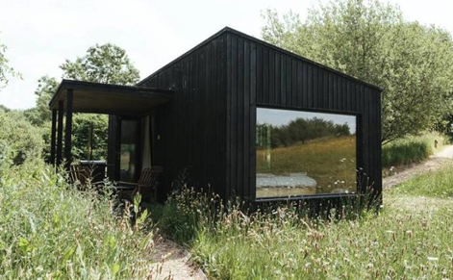
Accentuate the site’s natural and cultural strengths.
Spend thoughtfully on things that create memories – those yield the best return, as evidenced by glowing reviews and repeat visits.
If you have an amazing or panoramic view or a centuries-old olive grove, design around it rather than over it – these are free assets that boost guest satisfaction.
Small touches can elevate the experience affordably, such as fire pits for campfires, free access to a nearby hiking path, or partnerships with local adventure providers.
Also consider seasonality: offer unique experiences year-round (e.g. Northern Lights viewing from hot tubs in Iceland, or harvest-time farm dinners in Italy) to extend your season and revenue.
Phioto Credit Failte Ireland
Create that WOW Factor!
Maximise Natural and Cultural Strengths
Recommended Reading
Tourism Guide: How to Implement Environmentally Sustainable Approaches in your Business.

Slide 21
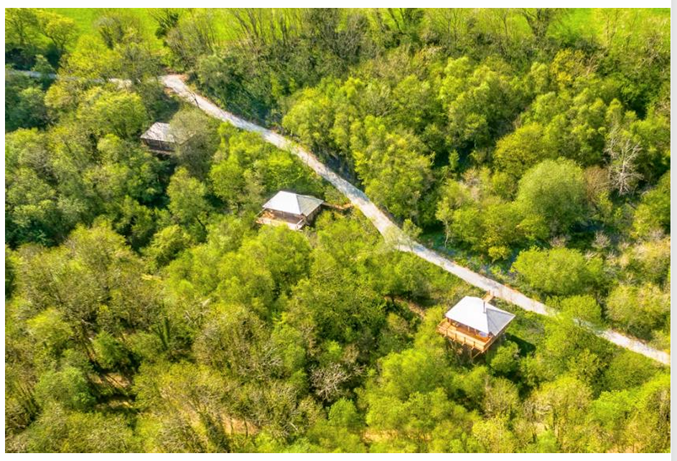
Wow Factor 1 – Going Green is a Major Shift.
Consumers are increasingly turning their attention towards how brands and businesses are conducting themselves in terms of sustainability. Protect your destination and local environment.
‘58% of guests in a recent Canopy and Stars agency survey said buying from an ethical brand is important to them’
Build in harmony with nature and the landscape for visual impact.
Use local materials (native timber, sheep’s wool and local artisan products)
Use low-carbon materials, e.g., reduce use of steel and concrete.
Design spaces that benefit nature, habitats and wildlife and work with topography. Use removable foundations and consider Biodiversity Net Gain (BNG)
Enhance the area's uniqueness by working with existing features and letting the landscape inspire your choices.
‘More than half of Irish species are in decline and 48% are in danger of extinction’
Build in Harmony with Nature
Create that WOW Factor!
Develop and Promote an Ethical Brand
Recommended Reading
Tourism Guide: Making Sure Your Business is Accessible and Inclusive.

Slide 22
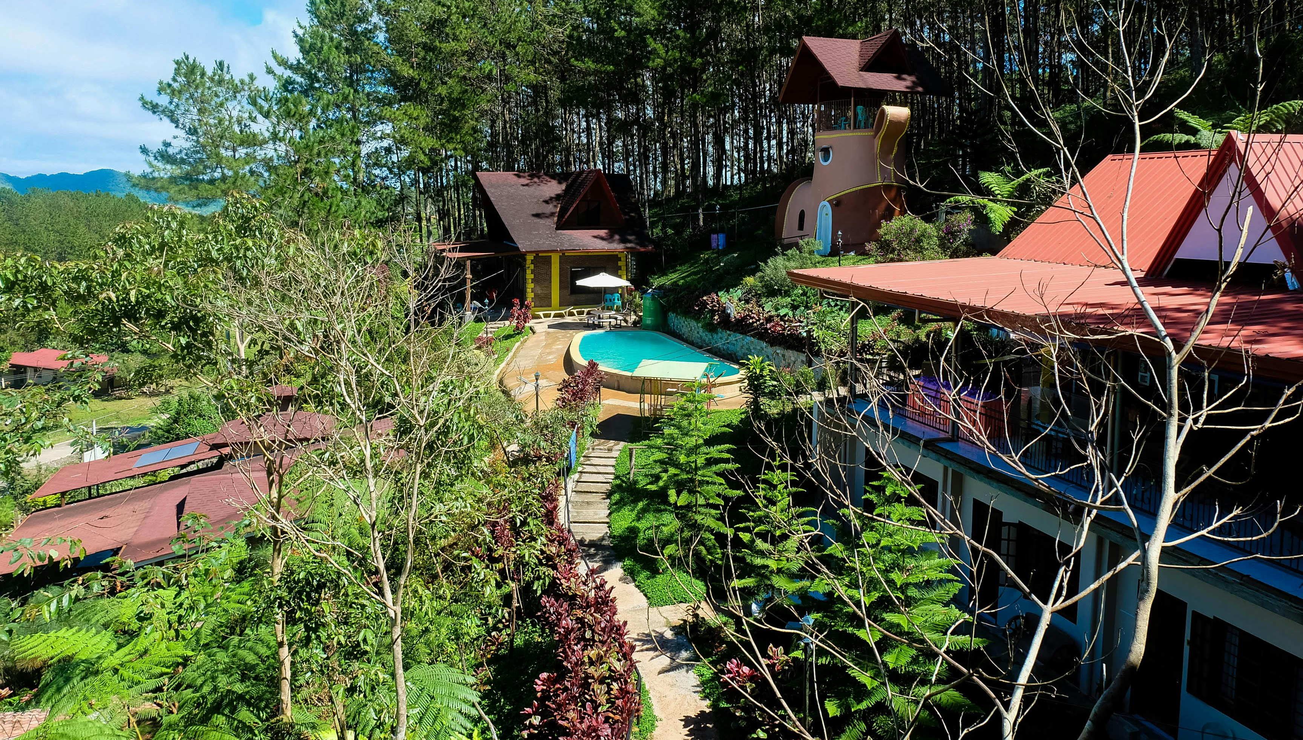
Wow Factor 1 – Going Green is a Major Shift.
‘Recent survey data from Booking and Expedia stated that 80% of consumers say travelling sustainably is important to them and 60% say they have chosen sustainable stays in the past 2 years’
Minimise your energy consumption and use renewable energy, both on- and off-grid, where possible. Utilise water harvesting and conservation systems, as well as ecological waste management systems, where feasible.
Empower visitors to make more sustainable choices by providing composting solutions and recycling bins, providing filtered water instead of plastic bottles, and providing low-impact travel tips.
Enhance and collaborate with your community by sourcing locally, partnering with local tour guides and wellness experts.
Adopting new technologies and innovations. Install smart thermostats or lighting, use QR codes for digital guides, and consider booking platforms and digital tools where possible.
Create that WOW Factor!
Ensure Green & Eco Measures
Recommended Reading
My Way Of Being One With Nature – Camping, Glamping Slovenia.
Sustainable Hotels: Traveling While Respecting the Planet Is Possible
22
22
22

Slide 23
“Wow Factor 1 – Going Green – Building & Materials” with estimated costs where applicable and financial notes to support informed budgeting for your Epic Stay.
Sustainability Action | Estimated Cost Range (€) | Financial Benefits
Build in harmony with nature | +10–20% over standard builds (site-sensitive design, minimal excavation) | Use local architects familiar with terrain and permits to reduce redesign costs. Long-term value through visual appeal and lower landscaping needs.
Use local materials (e.g. native timber, wool insulation) | Timber cladding €60–€90/m², sheep’s wool insulation €20–€30/m² | Reduces transport costs and emissions. Local supplier partnerships may offer discounts or cross-promotion opportunities.
Use low-carbon materials (avoid steel/concrete) | Timber-frame structure: €900–€1,400/m²; CLT: €1,200–€1,800/m² | May cost slightly more upfront but often speeds up construction. Eligible for green building grants (e.g. LEADER).
Design spaces that benefit nature (removable foundations, wildlife buffers) | Removable foundations (e.g. screw piles): €1,500–€3,000/unit | Lower environmental disruption and planning resistance. Reduces decommissioning costs in future.

Slide 24
Sustainability Action | Estimated Cost Range (€) | Financial Benefits
Enhance landscape features | Landscaping/nature trail: €2,000–€10,000 | Use existing trees, boulders, or terrain for ‘free’ visual assets. Increases guest satisfaction and shareability.
Inclusive design for diverse users | Accessibility adaptations: €1,000–€5,000/unit | Eligible for funding or tax deductions in many EU countries. Broadens market appeal.
Minimise energy use; use renewables | Solar panels costs involved: €10,000–€30,000; water harvesting: €2,000–€6,000, depends on size and complexity. | Saves €1,000–€3,000/yr on energy bills. Look for SEAI (Ireland) or national energy grants.
Ecological waste systems | Compost toilet costs: €250–€2,000 depending on the model; bio-treatment plant: €4,000–€10,000 | Avoids costly mains connection in rural sites. Can simplify planning in off-grid zones. Advantages of having compostable toilets.
Empower visitors to choose sustainably (signage, info packs, recycling) | €300–€1,000 | Enhances guest satisfaction and supports your eco-branding. Can increase online ratings.
Collaborate with local community | Annual engagement budget: €500–€2,000 | Reduces community resistance to planning and builds local supply chain loyalty.

Slide 25
Sustainability Action | Estimated Cost Range (€) | Financial Benefits
Adopt new tech & innovation (smart lighting, digital keys, off-grid systems) | For smart tech €2,000–€10,000 depending on scale. Smart thermostats €120–€200 or lighting €200–€800 per unit QR codes set up for digital guides approx. €50–€150 setup Booking platform fees only | Increases energy efficiency and guest convenience. Smart thermostats or lighting reduce energy bills (up to 20%) while enhancing comfort and control. See how they boost energy efficiency. QR Codes cut paper waste and printing costs. Ethical booking platform that offsets carbon emissions, help you stand out and attract ethical travellers willing to pay for ‘green’
Financial Tips
Track ROI on sustainability: High initial costs (e.g., solar or eco-design) are offset by lower operating costs (e.g., insurance, salaries, marketing, utilities) and higher occupancy. Investing in sustainable features can lead to higher occupancy rates and allow for premium pricing, enhancing long-term profitability.
Use sustainability to increase rates: Eco-accommodations in Europe can command rates 20–30% higher than those of traditional accommodations (Booking.com).
Apply for ‘Green Grants’ EU, national, or LEADER rural development grants to co-fund green investments.
Marketing Advantage: Highlighting eco-friendly initiatives can attract environmentally conscious travellers and differentiate your accommodation in the market.

Slide 26
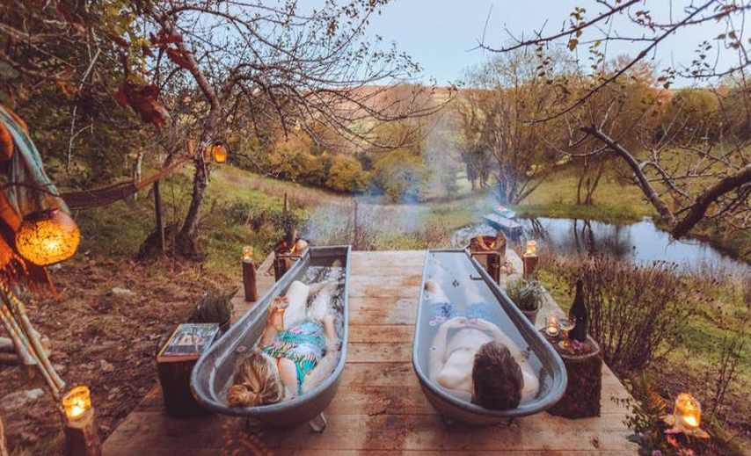
Wow Factor 2 – The Future is Wellness.
‘Wellness tourism is expected to grow more than any other wellness sector, increasing almost a quarter and reaching $1.3 trillion in value by 2025 (The Global Wellness Institute)’
‘58% of guests in a recent Canopy and Stars agency survey said buying from an ethical brand is important to them’
‘85% of leading outdoor holiday agency Canopy and Stars top performing spaces have outdoor bathing features’
‘Hot tubs have consistently ranked the highest search term in the self-catering sector YoY’
The next slide shows you how to do this and the estimated costs involved.
Photo Credit: Failte Ireland
Create that WOW Factor!
Provide a Wellness Escape & Experiences

Slide 27
“Wow Factor 2 – The Future is Wellness” with estimated costs, where applicable, and financial notes to support informed budgeting for your Epic Stay.
Action | Estimated Cost Range (€) | Financial Benefits
Install Outdoor Wellness Features (e.g. hot tubs, wood-fired tubs, outdoor showers) | €3,000–€8,000 per hot tub unit mid-range models. Running costs €744 approx. Annually. Costs to install: €85-€800. | Offer as premium add-ons (€30–€60/night) to increase revenue and justify ROI in 1–2 seasons. Use eco-friendly models (e.g. wood-fired, low-water).
Ethical Brand Storytelling (highlight sustainability, sourcing, community values) | €0–€1,500 (branding, signage, content creation) | Consumers are willing to pay more for ethical brands—make yours visible through signage, online content, and supplier transparency.
Wellness-Inspired Design (e.g. natural materials, calming colours, biophilic layout) | €1,000–€5,000 (depending on scale) | Invest once, benefit long-term. Even simple updates (e.g. linen drapes, cedar scent diffusers, local stone) elevate the wellness appeal.
Host Wellness Activities (e.g. yoga on deck, forest bathing, guided sauna rituals) | €0–€2,000 (partner-based or DIY) | Partner with local practitioners for pop-up sessions. Can increase weekday occupancy and attract wellness seekers without huge overhead.

Slide 28
“Wow Factor 2 – Wellness Experiences that WOW Guests
Wellness Experience | Why It’s a “Wow” | Cost Range (€) | Financial Tip
Wood-fired hot tubs in nature | The top searched amenity in glamping adds luxury and romance. Offer a rustic and eco-friendly bathing experience, aligning well with green travellers. | €3,500–€8,000 per unit Entry-Level Models: Approx €1,224 for a 4-person fibreglass tub with an external heater. Premium up to €4,219 for 6-person wood-fired hot tubs. | Charge premium (€30–€60/night add-on); book out mid-week stays. Baltresto offers a range of wood-fired hot tubs suitable for various budgets and capacities.
Outdoor forest or herbal saunas | Restorative, sensory-rich and Instagrammable. Enhance wellness offerings, providing guests with relaxation and health benefits. | €5,000–€12,000 Basic €1,830 for a 2.3m sauna made from spruce. Mid-range barrel, suitable for €1,530, and high-end with panoramic view and integrated hot tubs, approximately €8,000 | Use wood-fired sauna kits to reduce running costs. Factory Sale offers affordable outdoor saunas with various customisation options.

Slide 29
Wellness Experience | Why It’s a “Wow” | Cost Range (€) | Financial Tip
Guided forest bathing (Shinrin-yoku) | Forest bathing involves immersive walks in natural environments, promoting mental and physical well-being. Backed by science to reduce cortisol; minimal infrastructure needed. Outdoor yoga decks provide serene spaces for guests to practice yoga and meditation, enhancing the wellness appeal of your accommodation. | Forest Bathing: €0–€300 (training or guide hire). Some inspiration from Forest Bathing Switzerland, which offers guided experiences and training programs. Yoga Deck DIY Construction: Material costs range from €15 to €60 per square meter, depending on wood type. For example, impregnated pine costs around €15/m², while cedar is approximately €40/m². | Partner with certified guides or train staff. Utilize existing forested areas or create nature trails on your property. Choose durable, weather-resistant materials. Consider adding shade structures or pergolas for comfort and year-round usage.
Sound bath or meditation dome | Unique, immersive wellness trend; appeals to solo and group travellers | €2,000–€6,000 for setup | Host weekend retreats to drive off-season income

Slide 30
Wellness Experience | Why It’s a “Wow” | Cost Range (€) | Financial Tip
Stargazing platforms + digital detox cabins | Combines natural awe with tech-free calm | €1,000–€4,000 for platform or cabin upgrade | Attracts couples and wellness seekers at a higher nightly rate
Organic food experiences (on-site gardens, foraging walks) | Builds connection to place and healthy living | €1,500–€5,000 depending on scale | Partner with local chefs or offer DIY garden boxes
Outdoor yoga decks with nature views | Peaceful space + low infrastructure + high value | €500–€2,000 | Offer yoga kits or self-guided sessions to reduce staffing
Aromatherapy sleep rituals (e.g. pillow sprays, essential oils) | Enhances perceived care and rest quality | €5–€15 per room/per stay | Charge optional upgrade fee or include in premium rate
Cold plunge pools, ice baths or outdoor showers | Links with Nordic wellness & natural resilience. Cold plunge pools are used for hydrotherapy, aiding in muscle recovery and boosting circulation. | €500–€3,000 Basic Models €890+, single-person fiberglass tub. Mid-Range €1,270+, two-person fiberglass tubs. High-End €7,199 for stainless steel tubs with integrated water chillers. | Bundle with sauna or hot tub packages for contrast therapy.

Slide 31
“Wow Factor 2 – The Future is Wellness” with estimated costs, where applicable, and financial notes to support informed budgeting for your Epic Stay.
Action | Estimated Cost Range (€) | Financial Benefits
Create a Digital Detox Experience (e.g. no-WiFi cabins, nature journaling kits) | €200–€500 per unit | A growing trend. Market as “conscious stays.” Lower tech = lower infrastructure cost, higher perceived value.
Outdoor Relaxation Zones (e.g. hammocks, fire pits, herbal gardens) | €500–€2,500 | Can be low-cost and high-impact. Improve aesthetics and guest comfort while boosting reviews.
Financial Tips
Target Pricing: Wellness-focused accommodations can command rates 20–50% higher than those of standard accommodations.
Occupancy Boost: Outdoor bathing features (e.g. hot tubs) are a key booking trigger—often increasing occupancy by 15–25% year-round.
Grants & Funding: Some LEADER and rural tourism funds support wellness initiatives tied to nature and health.
Promote Your “Ethical Brand”: List sustainability practices clearly on your website, include locally made bath products, and highlight community partnerships.

Slide 32
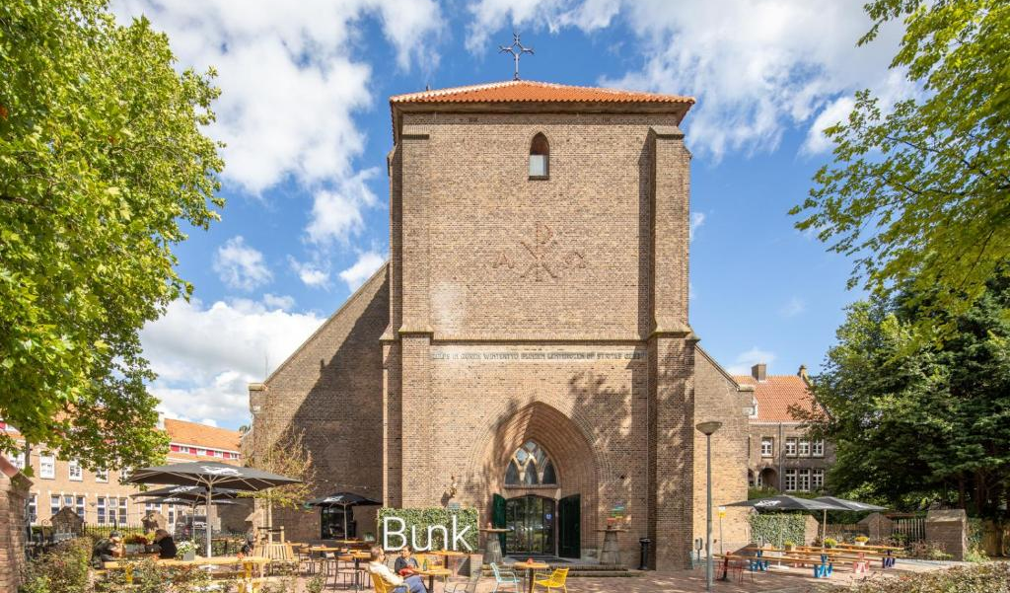
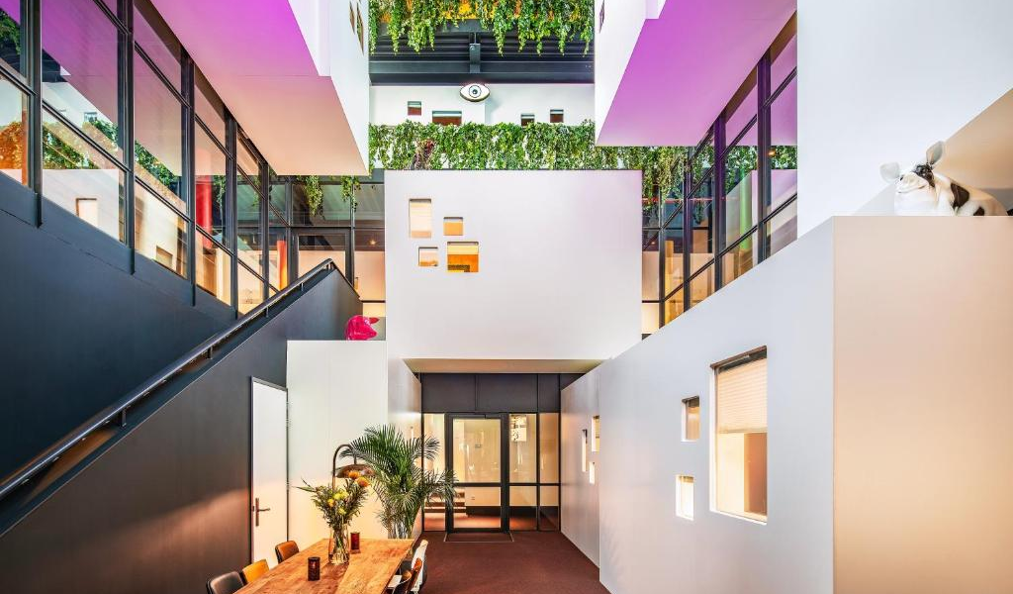

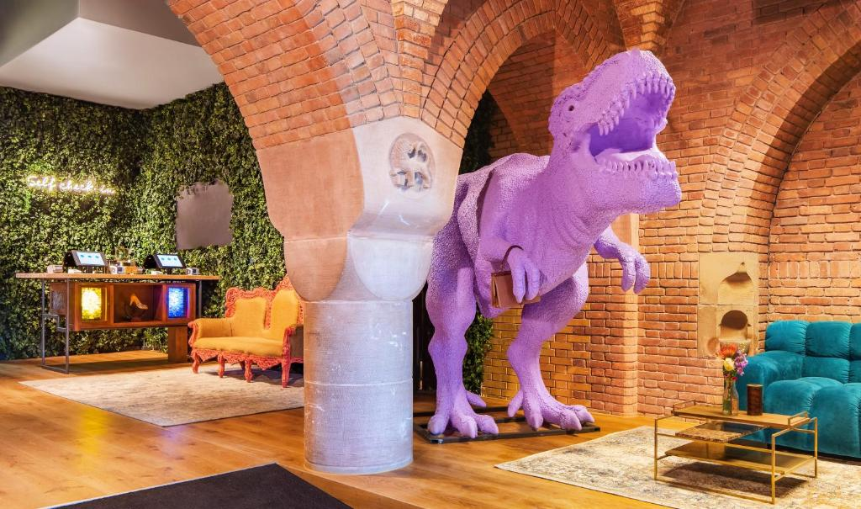
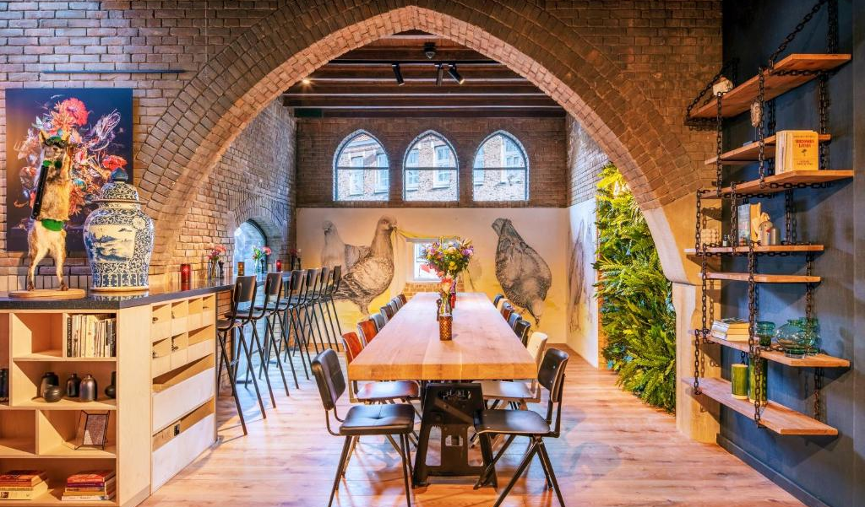
NETHERLANDS
Photo Credit: BUNK Hotel Amsterdam, Netherlands

Slide 33

Resources
Tools to Turn Planning into Profit
To put your knowledge into action, we’ve included a set of practical resources and hands-on exercises — from budgeting templates to zoning checklists and guest appeal planners — to help you make informed, cost-conscious decisions at every step of your start-up journey. Launching a successful alternative tourism accommodation isn’t just about creative design or a scenic location — it’s about building a financially viable and future-ready business. These tools are designed to help you evaluate your concept holistically, considering guest expectations, infrastructure needs, sustainability factors, and hidden costs — so you can avoid expensive missteps and unlock opportunities such as green grants, tax incentives, or eco-certifications. Don’t forget: Section 2 dives deeper into funding and finance options tailored for your alternative accommodation project.

Slide 34

Financial Tip: Start small and scale: Launch with 1–2 units and grow as income stabilises. Yurts, geodomes, safari tents, treehouses, repurposed buses or barrels
Financial Tip: Lease land before buying: Explore leasing from local farmers, forest agencies, or water boards (common in NL & IS). Start with a feasibility plan before buying land.
Financial Tip: Apply for pre-approval consultations to save months of delay.
Financial Tip: Use modular/prefab builds: Pre-approved designs can reduce planning time and construction costs.
Financial Tip: DIY landscaping: Native plantings, recycled materials, and volunteer support (e.g., community gardens) reduce costs.
Financial Tip: Phased infrastructure: Begin with composting toilets and solar lighting before upgrading to full systems.
Financial Tips
Planning and Building an ATA
34

Slide 35

Financial Tip: Second-hand or upcycled furnishings: Use local salvage or vintage shops.
Financial Tip: Join cooperatives: Group purchasing or shared marketing networks (popular in Iceland and Slovenia) lower ongoing costs.
Financial Tip: Tap into local support schemes: Ask your Local Enterprise Office, Chamber of Commerce, or tourism board about free mentoring or voucher schemes.
Financial Tip: Avoid over-designing: Keep layouts simple and efficient. Fewer paths, lower maintenance, smarter use of materials = lower capital costs.
Financial Tip: Smart Marketing: Free promotional channels: Leverage Instagram, Google Maps, Airbnb Experiences, and Booking.com to drive traffic before investing in a custom website.
Financial Tips
Planning and Building an ATA
35

Slide 36

Financial Tip: Leverage startup, green, and rural funds in parallel.
Financial Tip: Join national tourism boards and regional funding networks.
Financial Tip: Invest in storytelling: Your business should tell a local, sustainable, and inspiring story.
Financial Tips
Planning and Building an ATA
36

Slide 37

Practical Exercise: Start-Up Capital Planning for Your Alternative Accommodation
This exercise is designed to help you understand the full scope of start-up capital requirements when launching your alternative accommodation business. It provides a structured template and approach to break down the costs involved in land acquisition, construction, renovation, utilities, legal fees, marketing, and more. By completing this exercise, you'll create a grounded, realistic financial plan for your business.
Step 1:Define Your Accommodation Concept
Before diving into the financial aspects, clarify the concept of your accommodation business:
Type of Accommodation (e.g., glamping, treehouses, eco-lodges)
Location (e.g., rural, coastal, forest, near a major tourist area)
Capacity (e.g., number of units/rooms/pods)
Sustainability Focus (e.g., eco-friendly materials, renewable energy, waste management)
The next slides we have provided templates for your budgeting and financial results.

Slide 38
Step 2: Cost Categories and Breakdown
Fill out each of the following categories to estimate the total cost of starting your business. For each line item, provide a rough estimate and note why that expense is necessary.
Cost Category | Cost Category | Cost Category
Land or Property Acquisition | €______ | Cost of purchasing or leasing the land or property where the business will operate. Include broker fees or taxes.
Land Development & Preparation | €______ | Any work required to prepare the land for construction (e.g., clearing, leveling, landscaping).
Construction & Renovation | €______ | Cost to build or renovate your accommodation units. Include labor, materials, and architect fees.
Interior Fit-Out & Furnishings | €______ | Cost for interior design, furniture, bedding, appliances, lighting, and decorations.
Utility Connections & Infrastructure | €______ | Cost of connecting essential utilities like water, electricity, sewage, Wi-Fi, etc.
Legal & Permits | €______ | Fees for legal services, land permits, zoning approval, business licenses, insurance, etc.

Slide 39
Step 2: Cost Categories and Breakdown
Fill out each of the following categories to estimate the total cost of starting your business. For each line item, provide a rough estimate and note why that expense is necessary.
Cost Category | Cost Category | Cost Category
Land or Property Acquisition | €______ | Cost of purchasing or leasing the land or property where the business will operate. Include broker fees or taxes.
Land Development & Preparation | €______ | Any work required to prepare the land for construction (e.g., clearing, leveling, landscaping).
Construction & Renovation | €______ | Cost to build or renovate your accommodation units. Include labor, materials, and architect fees.
Interior Fit-Out & Furnishings | €______ | Cost for interior design, furniture, bedding, appliances, lighting, and decorations.
Utility Connections & Infrastructure | €______ | Cost of connecting essential utilities like water, electricity, sewage, Wi-Fi, etc.
Legal & Permits | €______ | Fees for legal services, land permits, zoning approval, business licenses, insurance, etc.

Slide 40
Step 2: Cost Categories and Breakdown
Fill out each of the following categories to estimate the total cost of starting your business. For each line item, provide a rough estimate and note why that expense is necessary.
Cost Category | Cost Category | Cost Category
Early-Stage Marketing & Branding | €______ | Costs for branding, website development, social media ads, flyers, and initial promotional materials.
Operational Setup (Furniture, Equipment) | €______ | Any operational supplies required for the business (e.g., kitchen equipment, cleaning supplies).
Contingency Fund | €______ | An emergency fund (usually 10-15% of total costs) to cover unforeseen expenses.
Source: xxxx

Slide 41

Checklist & Tips: Land or Property Acquisition
Checklist
Research suitable land or properties: Location is key. Consider accessibility, natural surroundings, and tourism demand.
Determine the best type of lease or purchase option: Is it more cost-effective to buy or lease the land?
Check zoning and land use regulations: Ensure the property is zoned for your type of business.
Understand land-related taxes: Know the property tax obligations and any exemptions you may qualify for.
Tips & Tricks:
Consider land with existing infrastructure: It might be more affordable to purchase land with pre-existing utilities (water, electricity).
Investigate government grants for rural land development: Look into programs offering financial support for land development in rural areas.

Slide 42
Checklist: Is Your Site Ready for Development?
Is the land zoned for tourism, glamping, or small-scale hospitality? Do you have or can you obtain planning permission?
Is the site safely accessible by guests (year-round)?
Are utilities (water, power, broadband) available or viable to install? Is the terrain suitable for your build (stable, flood-free, minimal clearance)?
Are there natural features that enhance guest experience (views, trees, trails)?
Can you install septic or eco-toilets with permission?
Have you assessed the ecological impact or conducted an Environmental Impact Assessment (EIA) if needed?
Will the local community benefit from or support your project?
Have you researched your insurance and legal obligations for the land?

Slide 43
Practical Exercise: Planning, Zoning & Commercial Site Selection
Exercise: Identify 3 real plots of land (from property websites or local listings) and analyse them using zoning, planning, and infrastructure costs.
Real Example: In Slovenia, Herbal Glamping Ljubno worked with the local municipality to secure land that already had utility access and avoided Natura 2000 restrictions, reducing planning delays.
Financial Tip: Expect €5,000–€15,000 in costs for planning permissions, environmental impact assessments (EIA), and legal consultation. Examplebelow
Useful Links: MyPlan Ireland ] Slovenia Spatial Planning ] EIA Process Slovenia – ARSO
Site Option | Zoned For Tourism?” | Utilities Nearby? | Planning Risks | Est. Planning Cost (€) | Notes
Site A | No | 500m from site | High (Natura 2000) | €12,000 | May need change of use
Site B | Yes | On-site | Low | €6,000 | Ideal for phased growth
Site C | Limited (agricultural) | Nearby mains | Medium | €8,000 | Good location, legal review

Slide 44
Practical Exercise: Factoring in Hidden Expenses (Utilities, Access, Fees)
Exercise: Build a hidden-cost forecast including infrastructure, energy systems, waste disposal, consultant fees, and tax obligations.
Real Example: In the Netherlands, small-scale site Soof Retreats spent over €100,000 on underground utility work and off-grid sanitation for a 5-unit setup due to strict environmental compliance.
Costing Tip:
Septic system: €7,000–€15,000
Access road: €10,000–€40,000 (depending on terrain)
Consultant/legal: €2,000–€5,000
EIA/Permits: €2,000–€10,000
VAT on setup costs (where applicable): 20–25%
Note: Sample Template in next slide

Slide 45
Practical Exercise: Factoring in Hidden Expenses (Utilities, Access, Fees)
Cost Item | Estimate (€) | Notes
Septic System | €9,000 | 5-unit eco site
Road Grading | €18,000 | 250m gravel track, rural slope
Planning Consultant | €3,000 | Includes application and drawings
Environmental Audit | €4,000 | Required in Natura 2000 zones
VAT (Est. 23%) | €25,000 | On all setup invoices

Slide 46

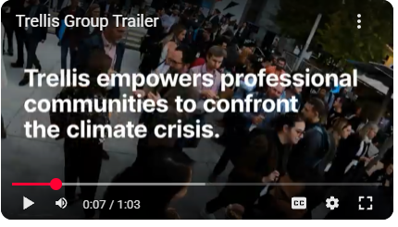
Digital Tool: Greenbiz (now Trellis)
Through peer networks that bond, events that galvanize, and industry-leading analysis, Trellis defines markets and advances opportunities at the intersection of business, technology and sustainability.
Click to Watch Video
Market Insights to Shape Financial Planning
Understand current eco-tourism trends and associated costs, green building practices, and circular economy models. Example: If there is a rising cost in eco-certified materials or solar energy installation, learners can factor this into their budgeting templates.
Spot Funding Opportunities and Trends
Discover ESG (Environmental, Social, Governance) -aligned funds, B Corp certifications, or green investment opportunities. Tip: Search the “Finance” and “Circular Economy” sections for relevant articles about funding and sustainability strategy.
Provides Useful Resources
e.g., How to Measure and Mitigate the Costs and Financial Impacts of Climate Change. Get expert insights, actionable tools and a clear framework to build climate resilience into your strategy.
https://youtu.be/F1_MnXrVdEE

Slide 47
Step 2: Cost Categories and Breakdown
Fill out each of the following categories to estimate the total cost of starting your business. For each line item, provide a rough estimate and note why that expense is necessary.
Cost Category | Cost Category | Cost Category
Land or Property Acquisition | €______ | Cost of purchasing or leasing the land or property where the business will operate. Include broker fees or taxes.
Land Development & Preparation | €______ | Any work required to prepare the land for construction (e.g., clearing, leveling, landscaping).
Construction & Renovation | €______ | Cost to build or renovate your accommodation units. Include labor, materials, and architect fees.
Interior Fit-Out & Furnishings | €______ | Cost for interior design, furniture, bedding, appliances, lighting, and decorations.
Utility Connections & Infrastructure | €______ | Cost of connecting essential utilities like water, electricity, sewage, Wi-Fi, etc.
Legal & Permits | €______ | Fees for legal services, land permits, zoning approval, business licenses, insurance, etc.

Slide 48
Step 2: Cost Categories and Breakdown
Fill out each of the following categories to estimate the total cost of starting your business. For each line item, provide a rough estimate and note why that expense is necessary.
Cost Category | Cost Category | Cost Category
Land or Property Acquisition | €______ | Cost of purchasing or leasing the land or property where the business will operate. Include broker fees or taxes.
Land Development & Preparation | €______ | Any work required to prepare the land for construction (e.g., clearing, leveling, landscaping).
Construction & Renovation | €______ | Cost to build or renovate your accommodation units. Include labor, materials, and architect fees.
Interior Fit-Out & Furnishings | €______ | Cost for interior design, furniture, bedding, appliances, lighting, and decorations.
Utility Connections & Infrastructure | €______ | Cost of connecting essential utilities like water, electricity, sewage, Wi-Fi, etc.
Legal & Permits | €______ | Fees for legal services, land permits, zoning approval, business licenses, insurance, etc.

Slide 49
Step 2: Cost Categories and Breakdown
Fill out each of the following categories to estimate the total cost of starting your business. For each line item, provide a rough estimate and note why that expense is necessary.
Cost Category | Cost Category | Cost Category
Early-Stage Marketing & Branding | €______ | Costs for branding, website development, social media ads, flyers, and initial promotional materials.
Operational Setup (Furniture, Equipment) | €______ | Any operational supplies required for the business (e.g., kitchen equipment, cleaning supplies).
Contingency Fund | €______ | An emergency fund (usually 10-15% of total costs) to cover unforeseen expenses.
Source: xxxx

Slide 50
Step 2: Cost Categories and Breakdown
Fill out each of the following categories to estimate the total cost of starting your business. For each line item, provide a rough estimate and note why that expense is necessary.
Cost Category | Cost Category | Cost Category
Early-Stage Marketing & Branding | €______ | Costs for branding, website development, social media ads, flyers, and initial promotional materials.
Operational Setup (Furniture, Equipment) | €______ | Any operational supplies required for the business (e.g., kitchen equipment, cleaning supplies).
Contingency Fund | €______ | An emergency fund (usually 10-15% of total costs) to cover unforeseen expenses.
Source: xxxx

Slide 51
Practical Exercise: Budgeting for the WOW factor
Exercise: List 3 guest-attracting features you’d love to offer. Research their real costs and expected impact on your nightly rate. Choose one feature to prioritise based on ROI.
Real Example: Northern Light Domes in Iceland invested in custom stargazing domes (€18,000/unit), enabling year-round bookings at €350+/night.
ROI Tip: A €6,000 hot tub can pay for itself in under 60 bookings if it boosts your nightly rate by €30–€40. Example below:
Feature | Cost (€) | Adds to Guest Appeal? | Est. Rate Uplift (€) | ROI Timeline | Priority (✓)
Wood-fired Sauna | €10,000 | Yes | +€40 | 6–9 months | ✓
Glass-Walled Dome | €25,000 | Yes | +€70 | 12 months
Outdoor Shower Garden | €3,500 | Medium | +€20 | 4–6 months | ✓

Slide 52
Additional Reading
Name | Description
Launching Your Glamping Business: Tips And Insights For A Successful Start | Before embarking on your glamping journey, it’s essential to understand the demands of the market and trends that are shaping it. With the insights provided in this article, you’ll be equipped with the knowledge needed to create a standout experience for your guests and set your glamping business apart from competitors. https://crrhospitality.com/blog/launching-your-glamping-business-tips-and-insights-for-a-successful-start/
Green Tourism Toolkit | Real case studies, funding ideas, and practical sustainability tips. Learn how other small accommodation providers secured funding. https://www.visitscotland.org/
Coursera: Financial Planning for Entrepreneurs | Step-by-step training in budgeting, capital requirements, and cash flow for startups. Developing practical financial skills. https://www.coursera.org/learn/financial-planning-entrepreneurs

Slide 53
Grant and Fund Support Organisations
Name | Country | Description
Regional Tourism Development Funds | Available in most European Countries | Various regions in France offer grants and financial support to promote tourism and local development. For example, the Responsible & Solidarity Tourism Fund supports projects that transform tourism to be more eco-responsible and inclusive. Businesses operating in specific regions should consult local tourism authorities for available funding opportunities.
Cultural Heritage Grants | Available in most European Countries | For projects involving the restoration or preservation of historical sites, cultural heritage grants are available. These grants often require the use of registered architects and adherence to specific guidelines to ensure the preservation of cultural assets
ECOTOURS Project Support | Available in most European Countries | The ECOTOURS Project offers financial support to Micro, Small, and Medium Enterprises (MSMEs) in France that are developing sustainable tourism products. The support is indicatively €6,650 per beneficiary, divided into three tranches, aimed at promoting eco-tourism initiatives. ​

Slide 54
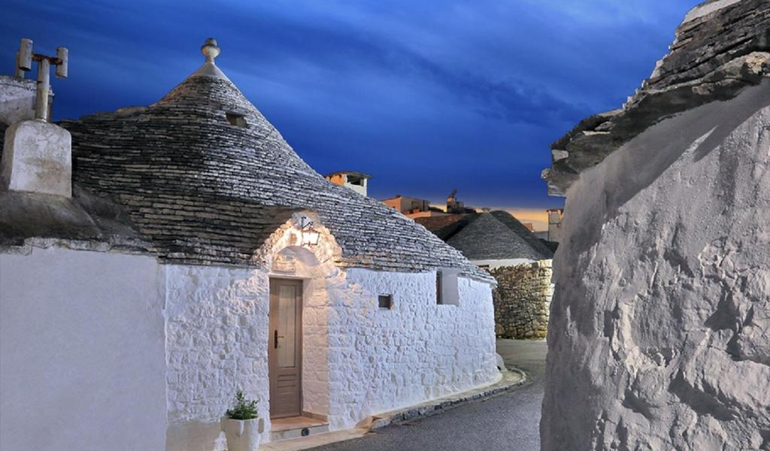
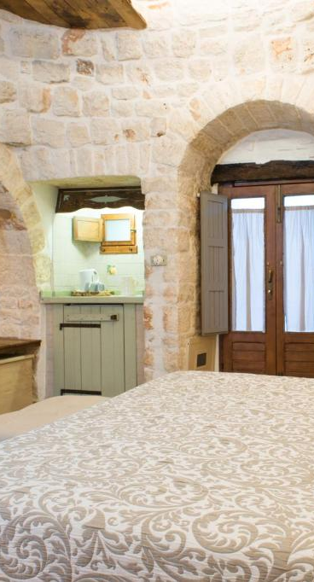
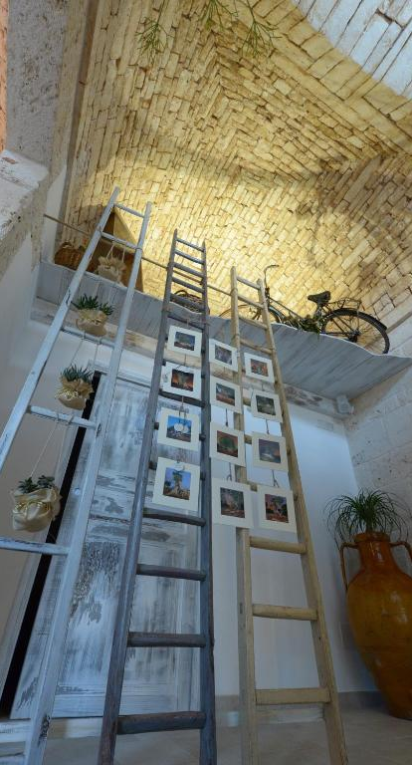
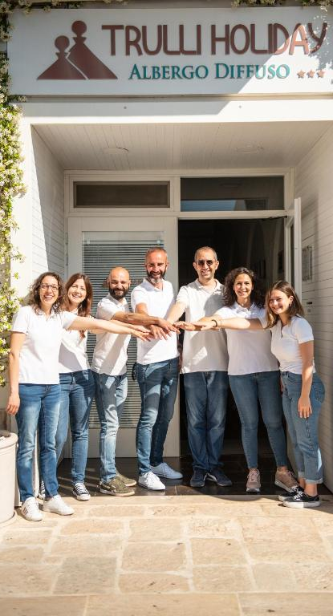

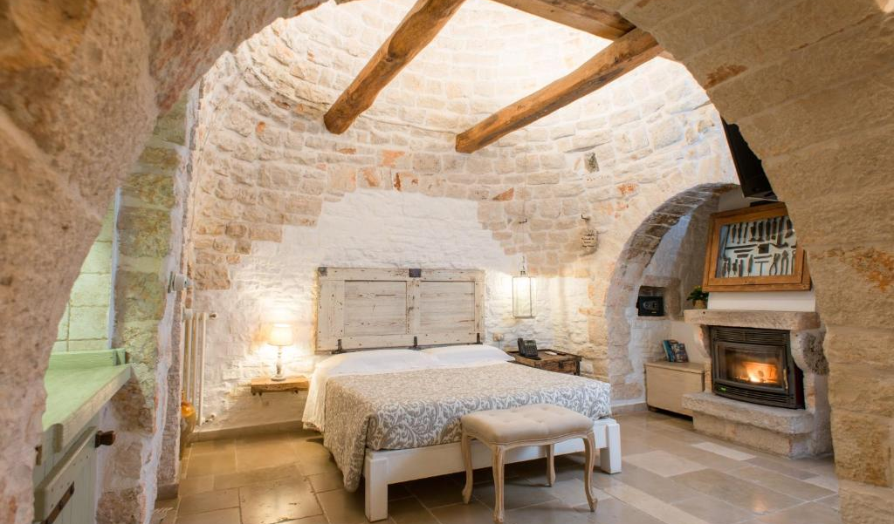
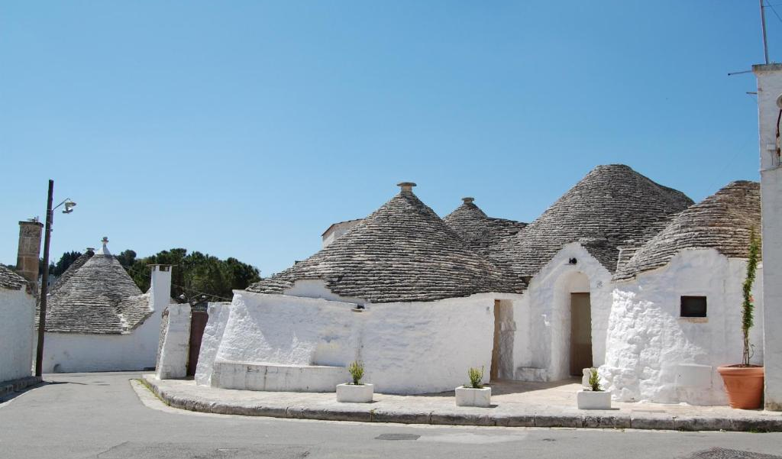
ITALY
Photo Credit: Trulli Holiday Albergo Diffuso,Italy

Slide 55

Well Done
Module 7 (Part 1)
Introduction to Private and European Funding
You have Completed… Module 6 (Part 3)
Sustainability, Investing in the WOW Factor & Support Tools
Next is…

