Slide 1
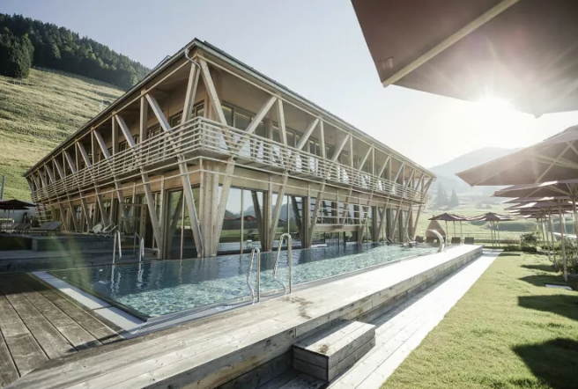
Case Study Hubertus Mountain Refugio Allgäu, Germany
Module 6 (Part 2)
Setting Up & Launching Smart – Planning Your Start-Up & Capital Costs
Financial Planning & Funding

Slide 2
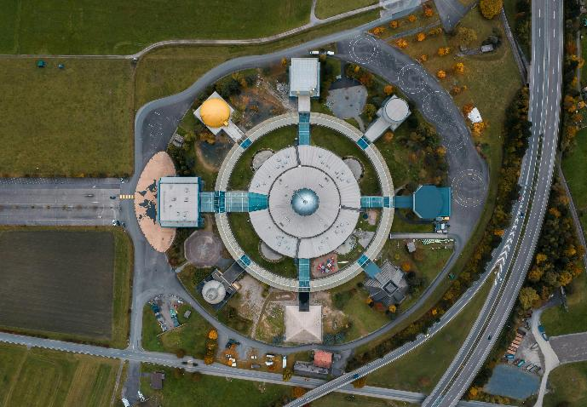
Module 6 (Part 2)
Location, Land & Logistics – Planning for a Profitable Site
2

Slide 3
Module 6 (Part 2) Overview
Learning Outcomes
Launching Smart - Location, Land & Logistics – Planning for a Profitable Site
Your location can make or break your business. This module guides you through the practical realities of planning your site—from navigating zoning and planning approvals to ensuring guests can access your accommodation safely and easily. Whether you're connecting to existing infrastructure or going off-grid, the focus is on helping you avoid costly surprises by making informed decisions early. By the end of this module, you’ll be equipped to choose the right site with confidence—balancing legal, physical, and logistical considerations to set your business up for long-term success.
By the end of this section, you will be able to:
Understand zoning, planning, and permitting processes relevant to alternative accommodations.
Assess land suitability based on terrain, drainage, soil, and buildability.
Calculate realistic costs and options for connecting to (or replacing) infrastructure such as power, water, waste, and internet.
Evaluate accessibility and transport considerations to ensure guest convenience and safety.
Avoid common site-related pitfalls that lead to costly rework, delays, or lost revenue.

Slide 4
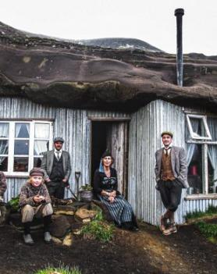
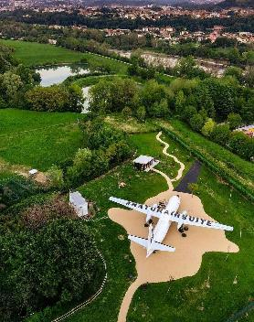
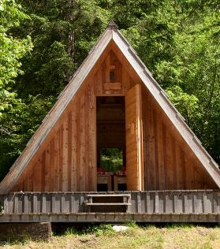
Part 2: Location, Land & Logistics: Planning for a Profitable Site
Photo Credit: Cave People, Iceland
Photo Credit:
Photo Credit: Natur Air Suite, Italy
05
Photo Credit:
Section
Plug In Without Burning Funds: Utilities & Infrastructure
(4 Slides)
Module 6
CONTENTS
YOU ARE HERE
04
06
Section
Section
Pick (and Permit) the Right Place: Zoning & Planning Costs
(46 Slides)
Make Sure You Get Them There: Access & Transport Costs
(3 Slides)
Photo Credit: A-Frame in Soča, Gorizia, Slovenia

Slide 5
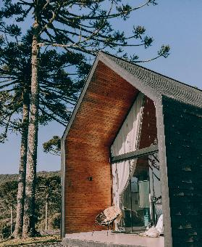
Part 2: Location, Land & Logistics: Planning for a Profitable Site
Photo Credit: Cave People, Iceland
Photo Credit:
Photo Credit:
05
Section
Module 6
CONTENTS
07
Section
Section
Picking the Wrong Land Can Be Detrimental: Terrain, Drainage & Buildability
(5 Slides)

Slide 6
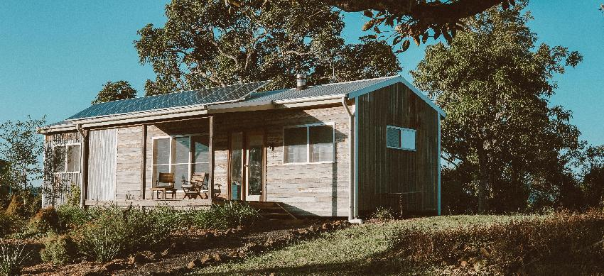
04
Pick (and Permit) the Right Place: Zoning & Planning Costs
Before you buy land or build anything, you need to understand local zoning laws and planning permissions. This topic breaks down how regulations can impact your timeline, budget, and even your ability to open. You’ll learn what questions to ask your local authority, what documents to prepare, and how to avoid common permit pitfalls. Planning early can save months of delay and thousands in rework or legal fees.

Slide 7
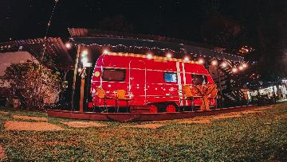
Location influences nightly rates, access to grants, and marketing power.
Are you thinking of setting up your Alternative Tourism Accommodation (ATA) locally, beside your home or dreaming about a spot near a beach or unique location?
Before you make your decision, make sure it is the right location and site – this is the heart of your ATA business.
Choosing the right location and site is one of the most important early decisions when developing an alternative tourism accommodation (ATA) business.
The site you choose isn’t just about scenery—it’s the foundation of your business model and your bottom line. It shapes the guest experience, operational costs, service offering, and pricing potential. A strategically selected location can significantly reduce your start-up costs, increase guest satisfaction, and boost long-term revenue. Here’s how a smart location delivers real financial value:
Location Matters to Guests
Location is the Heart Of Your ATA Business!
Priority 6 (€)
Pick a practical appealing location!

Slide 8
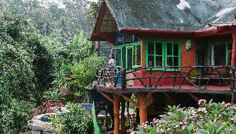

A Suitable Target Market Site Selection
Enhance the guest experience, enabling premium pricing for scenic, tranquil, or immersive cultural stays
Reduce infrastructure costs → Cuts expenses for water, power, sewage, and road access (savings of €10,000–€50,000+)
Boost occupancy by being near attractions, trails, or transport links increases year-round bookings
Enable unique experiences allow you to sell add-ons like forest bathing, stargazing, or local workshops for extra income
Support sustainability goals, access to sun, wind, or local food systems, reduces running costs and attracts funding/grants
Bottom line: Choosing the right site is one of the few early decisions that can both lower your costs and raise your revenue. It's not just where you build—it's how you build a business around it.attracts funding/grants
Location Matters to Guests
Priority: Choosing the Right Site & Balancing Costs
Recommended Reading
Survey of travellers finds 76% want more sustainable options, 2023

Slide 9
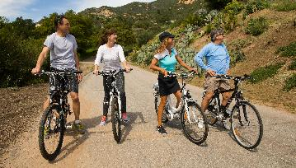
Understanding Guest Appeal and Experiences
Proximity to Activities and Themes
While remoteness is appealing, accessibility to meaningful activities is also key. Tourists want to “do something” while staying off-grid.
‘72% of travellers say their choice of accommodation is influenced by nearby activities, especially for nature- and wellness-based experiences (Booking.com 2023 Sustainable Travel Report).
This means one of your greatest assets is what’s just beyond your doorstep.
What locations and environments are they looking for!
They are looking for accommodations and locations that offer outdoor adventures (kayaking, hiking, wild swimming, cycling), wellness experiences (forest bathing, yoga, thermal springs), food & wine experiences (farm-to-table dining, foraging, vineyards), and art or local craftsmanship (pottery, weaving, painting retreats).
Location Sells – Choose it Like a Guest Would
Priority: Ensure Bookings By Location Proximity

Slide 10
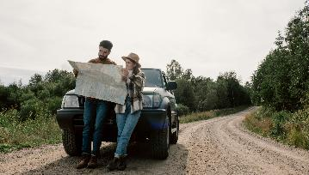
Example: In Iceland, cabins with access to geothermal pools or aurora viewing spots consistently rank among the highest for bookings and reviews — often priced at €200–€350 per night, far above the national average.
Financial Tip: Even if you don’t offer the activity yourself, curating local experiences and packaging them (with a mark-up or partner commission) can add €25–€100 per guest per stay — significantly improving your revenue without major capital costs.
Location Sells – Choose it Like a Guest Would
Priority: Ensure Bookings By Location Proximity

Slide 11
Financial Benefits of Location Proximity to Experiences
Type of Nearby Experience | Possible Setup/Partnership Cost | Financial Opportunity
Trail access, lake use, or riverside path | €0–€2,000 (landscaping, signage) | Increases guest stay length, seasonal appeal
Yoga deck / wellness retreat area | €3,000–€10,000 | Enables retreat packages (€300–€900 pp/weekend)
Partnering with vineyard or forager | Minimal cost or % commission | Upsells add-on experiences (€50–€150 pp)
Artist or artisan collaboration | Revenue share or per-event fee | Create high-margin “experience packages” for off-peak stays
Thermal spring, spa, or sauna access | €5,000–€30,000 investment | High yield on spa-themed packages; boosts low-season stays

Slide 12
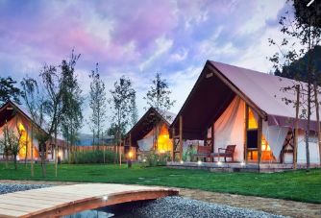
Nature-Based, Scenic, Remote Settings are Top of the List!
More and more travellers are ditching standard hotels in favour of immersive, nature-based experiences — like glamping pods in the woods, cabins by the lake, eco-lodges in mountain valleys, or converted farmhouses in wine country. These settings aren’t just visually stunning — they boost booking rates and price premiums.
A study by the EU Rural Tourism initiative found that 61% of European travellers who chose agritourism or eco-stays did so primarily because of the landscape and rural setting (Source: CBI/EU Market Research). That means your location choice directly affects your visibility, occupancy, and potential profit margin.
What locations and environments are they looking for!
They are looking to immerse themselves in forests, lakes, coastal views, mountains, or vineyards. They want silence, cleanliness, pristine nature, privacy, wildlife, and starry skies. They also want clean air, nature trails, or water access (hot springs, rivers, beaches). This will make you stand out and give you the wow factor.
https://www.charmingslovenia.com/en/herbal-glamping-resort-ljubno.html
Let Your Location Do the Selling
Priority: Immersive Natural Settings Drive Higher Rates

Slide 13
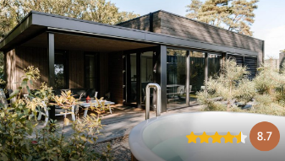
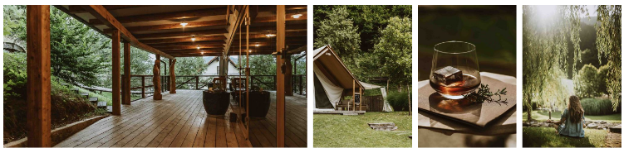
Examples:
Herbal Glamping Ljubno, Slovenia – Nestled in the Alps near the Savinja River, it markets clean air, wild herbs, and wellness. They charge €250+ per night in high season — a price justified by the immersive setting and spa features.
Agriturismo La Ghiandaia, Tuscany, Italy – Surrounded by vineyards and olive groves, they offer farmhouse stays with cooking classes and wine tastings. The location allows them to charge €180–€250 per night, double that of nearby basic hotels.
Soof Retreats, Netherlands – Their lodges near nature parks are fully gas-free and powered by solar, with design focused on nature immersion. Despite being low-density, they profit from eco-conscious branding and repeat Dutch urbanite clientele
https://www.soofretreats.com/
Let Your Location Do the Selling
Priority: Immersive Natural Settings Drive Higher Rates

Slide 14
Financial Benefits of Scenic Settings & Natural Experiences
Feature/Setting | Added Cost | Financial Benefit | Save Costs €€€
Forest, coastal, or riverside land | May cost more per acre or need access work (€5K–€25K) | Higher room rates, 4-season appeal, wildlife-based tours | Forests allow for natural shade (less € energy for cooling)
Mountain or vineyard setting | May involve slope engineering or permits | Premium appeal, weddings, retreats, wine tourism | Elevated areas with wind/sun exposure are ideal for off-grid power solutions
Remote or off-grid location | May require solar/water investment (€10K–€30K) | Unique selling point = higher prices, longer stays | Seclusion boosts privacy (and appeal), so no need for heavy landscaping
Proximity to national parks/trails | Permit/zoning costs (€1K–€10K) | Can market as eco-adventure base, increasing stay length | Streams or rivers can enhance greywater recycling or hydro-features
Scenic “Instagrammable” views | May mean fewer units due to protected views | Fewer units = exclusivity = higher nightly yield | User Generated Content UGC – free marketing and referrals to your target markets

Slide 15
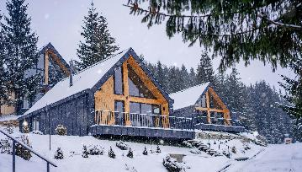
Understanding Guest Appeal and Experiences
Authenticity Through Rural or Heritage Sites
The location contributes to a sense of "place" and cultural authenticity, especially in heritage accommodations or repurposed rural buildings. These settings aren’t just visually stunning — they boost booking rates and price premiums.
Tourists are more likely to choose stays embedded in local history or rural tradition — particularly those over age 35 or traveling for cultural enrichment (European Travel Commission, 2022). This makes repurposed rural buildings, like old barns, mills, cottages, or even castles, highly attractive — and highly bookable.
Why it works financially: This heritage positioning allows them to charge a €60–€100 per night premium. Also, other financial benefits are longer stays,, more five-star reviews, strong word-of-mouth and return visits
Be the Place They Want to Stay
Priority: Cultural Authenticity Increases Value & Trust

Slide 16
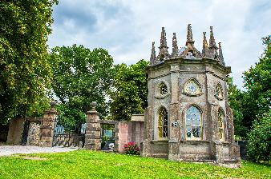
What locations and environments are they looking for!
They want to stay in and surround themselves with an authentic, unique environment, such as converted barns, stone cottages, old mills, or castles. They want to experience and immerse themselves in traditional architecture or village communities. A bonus is the opportunity to experience connections to local cultural stories, artisanal crafts, or food traditions.
Example: Batty Langley Lodge, Ireland – Batty Langley Lodge is a restored 18th-century Gothic-style gate lodge located at the entrance to the historic Castletown House estate. They market charge a premium of €180–€200 per night over standard accommodation elsewhere.
Guests are happy to pay this because they are not just paying for a place to stay but for an experience of sleeping in an authentic, 18th-century Gothic lodge with preserved architectural details. As there’s only one Batty Langley Lodge — its rarity creates perceived luxury and exclusivity.
https://irishlandmark.com/properties/batty-langley-lodge/
Be the Place They Want to Stay
Priority: Cultural Authenticity Increases Value & Trust

Slide 17
Financial Benefits of Heritage and Rural Authenticity
Feature/Investment | Potential Cost | Financial Advantage | Save Costs €€€
Renovating a barn/cottage into a stay | €25K–€100K depending on state and location | Heritage appeal = 20–50% premium on nightly rates | Up to €700 more revenue per week than a standard stay
Registering for cultural heritage support | Variable (€500–€3,000) | May unlock EU cultural tourism or rural development grants
Working with local artisans for décor | €2K–€10K for sourcing materials | Enhances storytelling = higher guest satisfaction + return rates | Justification for grant support, trust funding..
Adding interpretive content or workshops | €500–€2,000 setup | Creates add-on revenue streams (e.g., €25–€75 pp for workshops) | Low marketing spend due to strong word-of-mouth and earned media
Heritage branding or label (e.g. “Alpine Traditional Stay”) | Minimal cost if strategic | Improved SEO, niche targeting, loyalty | Increased off-season bookings due to heritage appeal

Slide 18
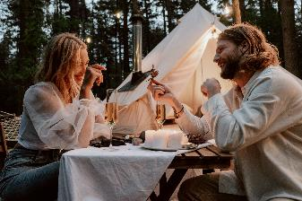

Why Location Matters in Alternative Tourism
Emotional Value and Connection with the Location
People often book these accommodations for emotional reasons — to disconnect, heal, recharge, or celebrate.
A peaceful location is the #1 factor for choosing glamping-style or off-grid stays, with over 43% of respondents in 2024, according to many EU rural tourism reports (especially among Gen Z and Millennials).
What locations and environments influence their decision!
They want a setting that looks peaceful, magical, wild, or “Instagrammable”. They want to go to a place that will bring them calmness, joy, or romance. They want an escape — mentally, emotionally, or physically — from urban life
Example: In Iceland, cabins on private land with access to geothermal pools or aurora viewing spots are top picks.
Be the Place They Want to Stay
Priority: Invest in a True Escape with Emotional Connection
Recommended Reading
World Tourism Organization: Rural Tourism Overview (UNWTO)

Slide 19
Guest Appeal & Financial Value Table
Appeal Driver | Example Features | Estimated Cost | Financial Benefit / ROI
Authenticity (Heritage & Rural) | Converted barns, stone cottages, old mills, castles, village homes | €25K–€100K renovation | Charge 20–50% higher nightly rates; strong off-season demand; eligibility for grants
Cultural storytelling & artisan links | Decor with local crafts, traditional furniture, family histories | €2K–€10K (materials & curation) | Adds emotional value = better reviews, higher guest satisfaction, return visits
Scenic Nature-Based Location | Forests, lakes, rivers, coastal cliffs, mountain views, vineyards | €5K–€25K (land prep, site access) | Premium rates (+30–50%); longer stays; seasonal and retreat potential
Unique natural features | Starry sky zones, wildlife spotting, dark-sky designation | €0–€5K (signage, promotion) | Eco-brand appeal = higher value per stay, marketing advantage

Slide 20
Appeal Driver | Example Features | Estimated Cost | Financial Benefit / ROI
Proximity to Outdoor Activities & Experiences | Hiking trails, kayaking, cycling, wild swimming, bird watching | €0–€2K (pathway, signage, insurance) | Increases average length of stay + value of stay; improves Google ranking
Wellness features | Forest bathing, yoga deck, outdoor saunas, hot tubs, thermal springs | €3K–€30K depending on feature | Spa/wellness packages (€300–€900 pp); off-season demand stabilisation
Food & wine experiences | Vineyards, foraging tours, cooking classes, farm-to-table dining | €500–€10K (partnerships or infrastructure) | Add-ons (€50–€150 pp); strong appeal for midlife and older travellers
Arts & local craftsmanship | Pottery, weaving, painting, craft retreats | €1K–€5K (space setup or collab fees) | Creates midweek or off-season income; high-margin workshops; social media appeal
“Wow Factor” experiences | Cabins with geothermal pools, aurora viewing, outdoor firepits | €5K–€35K (site-dependent) | Nightly rates €200–€350+; marketable as premium/Instagrammable stays
Experience packaging & curation | Bundled itineraries, partner-led tours or workshops | Minimal (staff/admin or % fee) | Adds €25–€100 per guest; low-cost upsell; strengthens local networks

Slide 21
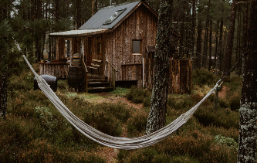
Now that you understand guest appeal, you need to carefully assess if there are any restrictions, such as zoning and planning restrictions, accessibility, services, practicality, sustainability, and long-term viability.
The right site will enhance guest appeal, reflect your brand values, help manage costs effectively and deliver memorable experiences. These are a few to consider; we’ll explore more in the next section.
Zoning and Planning Permission: Choose a site where tourism is legally permitted, this will avoid disappointments, delays and refusals. (explained in the next section). Check out GSTC Standards & Criteria.
Access & Transport: Guests need reliable access by car, road or public transport. Poor access can hurt bookings and cause frustration.
Location & Site Selection
Priority: Next Site Section & Location Costings

Slide 22
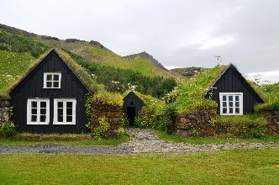
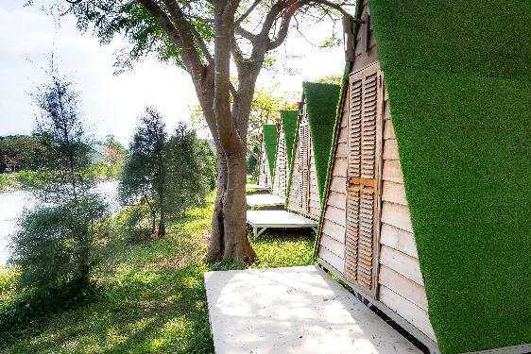
Utilities & Infrastructure: Costly if not available. Consider water, power, broadband, and drainage. Think off-grid options.
Low environmental risk: Low impact on the environment and avoids ecological damage to protected areas.
Local community: Consider noise, access, and cultural fit.
Market fit: Does the location serve your target audience, e.g., wellness, adventure or families?
Location & Site Selection
Priority: Next Site Section & Location

Slide 23
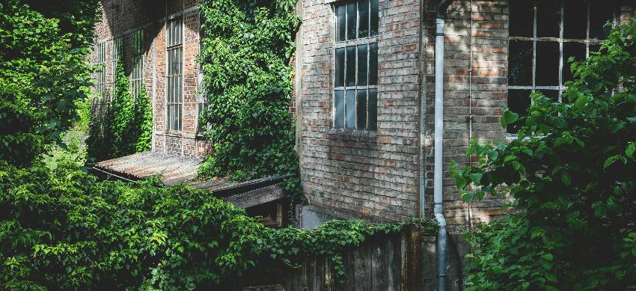
Securing Land Suitable for Development
Know the legal, zoning, and permit costs early to avoid delays, refusals, or expensive rework down the line.
Not all beautiful locations are legal to build on — and finding out too late can be expensive. This step is all about choosing a viable site and understanding local planning, zoning, or environmental rules and regulations that can affect or block your build. Whether it’s change-of-use fees, permit applications, consultant fees, or delays — planning costs can run from €1,000 to €10,000+, depending on the region. Being informed early avoids financial waste and ensures compliance

Slide 24
Alternative Tourism Accommodation
Securing Land Suitable for Development
Not all rural land is suitable for alternative tourism accommodation!
Launching an alternative accommodation business involves significant capital investment, particularly in securing land suitable for development. This means that, among other things, it must be suitable for alternative tourism accommodation, planning permission can be obtained, and basic infrastructure is in place. Key considerations that can significantly impact the cost include land acquisition (cost), planning fees (including application and associated reports), and site preparation (including roads and utilities).
Alternative accommodation planning is a part of general tourism planning but has its own planning laws; it focuses on land-use, which includes building regulations, legal compliance, community involvement, environmental impact, and guest experience. Here is what you generally need to consider when planning an alternative tourism accommodation.
Recommended Reading
Tourism Planning: Importance, Benefits, Types & Levels, 2024
Sustainable Tourism: Understanding the Opportunity
24

Slide 25
Planning & Zoning Components Checklist
Component | What to Consider
Site & Location | Access, zoning, natural features, views, privacy
Type of Accommodation | Pods, cabins, converted barns, treehouses, yurts
Infrastructure and Utilities | Roads, access, electricity, water, waste, energy efficiency.
Target Market | Eco-tourists, wellness travellers, families, remote workers
Experience Design | Nature trails, farm visits, cultural workshops, wellness services
Sustainability | Compost toilets, rainwater harvesting, solar power, local sourcing
Legal & Regulatory | Planning permission, building regulations, tourism licensing
Financial Planning | Setup costs, ROI, funding sources, contingency budget
Partnerships | Local artisans, guides, farmers, wellness practitioners
Promotion | Digital presence, photography, storytelling, guest reviews
Monitoring | KPIs: occupancy rate, income, repeat bookings, community feedback

Slide 26
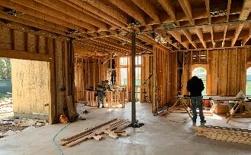
Local tourism zoning and planning are critical foundations when developing an ATA. Avoid hidden costs from zoning or refusal; compliance saves time and money.
Ensure the land is properly zoned for tourist lodging and secure all required permits and planning permissions before development.
Before you can bring your alternative tourism accommodation idea to life—whether it’s a glamping pod, eco-retreat, tiny house, or heritage guesthouse—you need to carefully consider where you’ll build and what permissions are required.
Every country has unique planning, zoning, and regulatory frameworks that determine what type of accommodation can be developed, how it must be built, and whether it's allowed at all on a specific site.
Choosing the right land, understanding local zoning laws, securing planning permission, and complying with relevant regulations will not only ensure your project is legal and insurable but also save you time, money, and stress in the long run.
Selecting the Right Site & Location
Go to Your Local Tourism Planning Office
Priority 7 (€)
Find out where you can legally build.

Slide 27
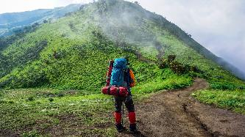
Skipping this can lead to shutdowns or fines—ensuring legal and long-term viability is crucial.
You will need to first call your local Council and Tourism Planning Office to determine what you’re legally allowed to build, where you can build it, and how your project fits within the local tourism zones, environment and community planning.
Remember, unlike traditional accommodations, ATAs often rely on rural, natural, or heritage-rich locations—areas that may fall under strict zoning laws or be designated as protected land.
These regulations are designed to ensure developments are safe, environmentally sound, and aligned with broader community goals. Securing proper permissions early avoids costly delays, fines, or forced removal, and it’s also key to securing funding, insurance, and future scalability. Without the correct zoning, your site might prohibit tourism activities altogether, and without planning permission, even semi-permanent units like glamping pods or eco-cabins can be deemed illegal.
Find Where You Can Build!
Go to Your Local Tourism Planning Office
Priority 8 (€)
Understand planning and tourism regulations.

Slide 28
Tourism Destination Planning:
Different to Residential and Commercial Planning
Planning an alternative accommodation business isn’t just about finding beautiful land and building on it—it’s about navigating tourism and its mix of legal, economic, environmental, and infrastructural realities. It involves making major decisions which cannot be taken spontaneously. This is especially critical for small rural entrepreneurs, where investment risks are higher and access to land is limited or conditional.
Understanding tourism planning is essential; "The upkeep and expansion of the tourism sector in a particular area" is indeed referred to as tourism planning. It involves developing strategies and plans to increase, develop, and stimulate tourism within a specific region, with the primary goal of generating revenue and contributing to economic growth.’
Look at tourism planning from a destination context first. Try to incorporate strategies and plans that will help increase, develop, and stimulate tourism in a destination.
Will it promote tourism and boost the local economy?
Will it provide a quality service to both tourists and residents?
28

Slide 29
Tourism Destination Planning
Tourism Zoning Regulations
Tourism zoning regulations, particularly those related to accommodation, are designed to manage the impact of tourism development on communities and the environment. These regulations aim to strike a balance between the needs of tourists, the well-being of residents, and the preservation of natural resources. They often include restrictions on building density, plot coverage, and noise levels, as well as requirements for parking, waste management, and emergency access.
1. Managing Development Density:
Plot Coverage Limits: Regulations often limit the percentage of a plot that can be covered by buildings, ensuring that a portion is dedicated to open spaces, green areas, and landscaping.
Building Height and Spacing: Zoning may specify maximum building heights and distances between structures to prevent overcrowding and minimise visual impact.
Low-Density Development: In some areas, tourism development is encouraged to be low-density, with larger plots and more spacing between buildings to reduce environmental impact and maintain scenic beauty.
29

Slide 30
Tourism Destination Planning
Tourism Zoning Regulations
Planning to Protect the Sector & Environment
Coastal Zones: In coastal areas, tourism zoning may be particularly strict to protect sensitive ecosystems and prevent erosion.
Green Spaces: Zoning regulations may require the preservation and creation of green spaces to enhance the beauty and ecological integrity of the area.
Noise and Light Pollution: Regulations can limit noise levels and light pollution from tourism facilities to protect residents and wildlife.
Recommended Reading
The Importance of the Tourism Accommodation Sector, 2024
All Types of Tourism Accommodation Explained
Ireland: Development Guidelines for Tourism Destination Towns, Failte Ireland and Over €32million in investment grants announced for regenerative tourism projects in Midlands, Failte Ireland
Netherlands: How The Netherlands Is Charting A Sustainable Path For Travel, Tourism, And Society
Desirable Tourism September 2019 Capitalising On Opportunities In The Living Environment
30

Slide 31
Tourism Destination Planning
Tourism Zoning Regulations
Supporting Local Businesses & Communities:
Balancing Accommodation Types: Zoning may encourage a mix of accommodation types, including hotels, resorts, bed and breakfasts, and vacation rentals, to cater to different visitor needs and budget levels.
Supporting Local Services: Tourism zoning may require tourism developments to integrate with local businesses and amenities, such as restaurants, shops, and recreational facilities.
Balancing Tourist and Resident Needs: Zoning can help balance the needs of tourists and residents, ensuring that STRs do not negatively impact the character of residential neighbourhoods.
Iceland: The OECD Competition Assessment Review of Iceland, analyses regulatory barriers to competition in the construction and tourism sectors.
Italy: Tourism Digital Hub TDH Objectives of the strategic plan, building a bridge between the tourist and the ecosystem of the tourism offer.
Slovenia: Slovenia Tourism Development Strategy
31

Slide 32

Regulations across Europe vary, but all countries require some form of planning, zoning, or change-of-use approval for tourism accommodations—even for temporary or mobile units like yurts, pods, or tiny cabins. These legal requirements are not just bureaucratic hurdles—they come with real financial costs that need to be factored into your start-up budget.
European Overview
Country | Key Requirements
Ireland | Planning permission is required for all glamping sites, even on private land. Teagasc and local authorities provide guidance. Rural zoning and site landscaping must be factored in. EIAs for sensitive sites can add €5,000–€10,000+ Planning Costs €5,000–€10,000 Approvals: 8–12 weeks (can extend with objections)
Netherlands | Must comply with zoning regulations (“bestemmingsplan”) and obtain environmental permits. Nature permits are required if near protected areas. Regulations you must comply with include building codes, fire safety, and sanitation rules in each locale. (EIA) €2,000 – €10,000+ Planning Costs €4,000–€9,000 Approvals: 12–16 weeks (includes environmental checks)
Tourism Zoning, Planning and Regulations
32

Slide 33
Country | Key Requirements
Slovenia | Strong support for eco-tourism. Glamping is considered a luxury “above-standard” category, requiring alignment with strict design, environmental, and hospitality standards. Planning Costs €3,000–€7,000 Approvals: 8–14 weeks, depending on zone sensitivity
Italy | Varies by region. For example, Piedmont regulates "glamping" only within registered campgrounds. Agriturismo law often applies in rural areas. Local communes manage permissions. Planning Costs €3,000–€7,000 Legal/zoning consultation (if complex) €500 – €2,000 Approvals: Varies by region – 10 to 20 weeks are common
Iceland | Must apply through Umhverfisstofnun (Environment Agency) and local councils. Projects in rural or sensitive zones require impact screenings. Eco-conscious design is a must. Traffic/access studies or noise mitigation €1,000 – €3,000 Planning Costs €6,000–€12,000 Approvals: 10–16 weeks, often includes ecological review
Photo Savills Bell Tent
European Overview
Tourism Zoning, Planning and Regulations
33

Slide 34
Permit overview by country
How To Start, Set Up, And Build A Profitable Glamping Business
Country | Benefits | Permits & Legal Notes | Tips
Italy | Agro-tourism friendly | Permit needed per unit; zoning must allow tourist activity (often agriturismo) €3,000 – €7,000 | Use agriturismo-designated land to streamline approval
Ireland | High rural tourism demand, LEADER funding | Full planning permission required, even for tents or pods; tied to tourism use zoning. €5,000 – €10,000 | Pre-application with County Council is essential
Slovenia | Strong support for green tourism | Tourism use must be allowed in zoning plan; Natura 2000 sites are heavily restricted. €3,000 – €7,000 | Municipal planners are key allies—build early relationships
Netherlands | Tech-savvy, eco-conscious traveller base | Pods/cabins need municipal approval; gas-free builds required in most areas. €4,000 – €9,000 | Focus on sustainability and circularity to unlock subsidies
Iceland | Unique nature experience, low competition | Any land development (even temporary) needs local authority approval and environmental checks. €6,000 – €12,000 | Use low-impact structures; consider seasonal/portable units

Slide 35
Each Country has Different Tourism Building and Planning Regulations
Each country differs in Tourism Building and Planning Regulations, but the general rule is…
Planning Authorities have a legal obligation to include objectives for accommodation in development plans, including areas for travelers and other tourism-related accommodation. Traveller Accommodation and the Local Authority Development Plan 2021
The Office of the Planning Regulator has emphasised the importance of a strong evidence base for development plans and housing strategies.
Tourism Development Plans should also consider aspects like attracting tourists, enhancing amenities, and fostering sustainable growth
Failte Ireland provides resources and support for tourism development, including investment grants and funding schemes for project
In short, zoning and planning aren’t just bureaucratic steps—they’re essential tools to build a sustainable, compliant, and successful tourism venture.
Recommended Reading
Obtaining Special Permits for Glamping Sites
Teagasc Planning Permission for Glamping
Do you need planning permission for a glamping site and what kind of permission?
35
35

Slide 36

Off-grid solutions cost more up front—budget realistically for infrastructure or utility workarounds.
Picking the right plot is critical. Ideally, you want scenic, tranquil land (such as a forest edge, lakeshore, or hillside) to offer the "lost in nature" experience.
At the same time, practical access is essential. Select a site with good road access and nearby utilities; otherwise, your costs will increase significantly and quickly.
Example: A site with an all-weather track that can reach each unit, has access to mains electricity, water supply, and has sewage connections within a feasible distance will save you thousands. (Discussed further in this Module)
Legal Zoning and Use: Check land zoning and if tourism/agritourism is permitted.
Access to Utilities: Electricity, water (well or mains), and sewage (septic or dry toilet).
Selecting the Right Site & Location
Pick a Practical Site that Won’t Cost You the Earth
Priority 9 (€)
Ensure Access to Services (Electricity, Water, Internet, Roads).

Slide 37

Topography and Safety: Avoid flood zones, steep slopes, and ecologically sensitive habitats.
Proximity: To local services, attractions, and emergency access.
Environmental Limits: Especially relevant in Slovenia due to Natura 2000 and landscape regulations. Note also that tourism accommodations typically require higher safety and amenity standards (such as fire safety, disabled access, and wastewater treatment) than a private home.
Note: Even if you plan to lease land, vet it as thoroughly as if you were buying. You will need to conduct a feasibility study and perform the same due diligence, including checking local development plans, zoning, regulations, existing accommodations, guest demand, and planning precedents.
Location & Site Selection
Pick a Practical Site that Won’t Cost You the Earth
Recommended Reading
Launching Your Glamping Business: Tips And Insights For A Successful Start

Slide 38
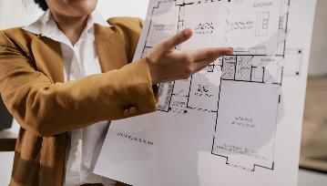
Financial Tip: Research local zoning laws and planning permission early – some areas may prohibit commercial accommodations or limit structure types. See what factors to consider in the context of a hotel site selection. Choose a site where tourism is legally allowed (verify zoning regulations and local planning permissions), this will avoid disappointments, delays and refusals. Check with your local authority's development plan it will help you determine what is allowed in the area and strengthen your case. Each Planning Authority has a checklist you can download.
Financial Tip: Make sure your business is a low environmental risk i.e., has low impact on the environment and voids ecological damage to protected areas, peatlands, or sensitive biodiversity zones will save you thousands. Check European Environment Agency – Natura 2000 Viewer for protected areas near your site.
Financial Tips
Zoning, Planning and Regulations
Recommended Reading
All about Setting up a Glamping Tourism Accommodation
38

Slide 39

Financial Tip: Budget for regulatory costs (e.g. application fees, environmental impact assessments) and set aside time for the approval process – incomplete paperwork or delays in permits can stall your project and lead to lost revenue. Engaging a local planning consultant can help navigate requirements and avoid costly missteps.
Financial Tip: Engage in early consultations with local planning authorities – most countries offer a pre-application meeting to flag any issues e.g., site boundaries, fire regulations, water supply, drainage and sanitation. This can save money by uncovering deal-breakers before you invest heavily. Also, factor in the time (often 6–12 months for approval) and have contingency funds for any unexpected requirements (like extra traffic or environmental studies).
Financial Tips
Zoning, Planning and Regulations
39

Slide 40

05
Plug In Without Burning Funds: Utilities & Infrastructure
Factor in the real costs and find savings when connecting power, water, waste, and internet — or prepare to budget for off-grid solutions.
Power, water, drainage, broadband — they don’t just appear. If your dream location is off-grid or remote, expect significant up-front costs to connect or create these systems. Off-grid solar and septic systems can cost €10,000–€30,000, depending on the site's complexity. Even on-grid properties may require groundwork, upgrades, or approvals from the provider. Accurately assessing infrastructure feasibility avoids cash flow shocks down the line.

Slide 41
Considerations: Assess how you will provide water, power, waste management, and communications on-site. Remote or undeveloped locations may lack town and village hookups, meaning you’ll need to drill wells, install septic systems, or generate off-grid power. These infrastructure investments can be significant, for example:
Providing basic services – water, waste disposal, and power – is non-negotiable for guest comfort and environmental compliance. Determine how you will supply fresh water (mains connection or well), manage sewage (septic tank, biodigester, or hookup to municipal sewer), and supply electricity (grid connection vs. solar/off-grid systems). Many European jurisdictions require demonstrated solutions for sewage and graywater when approving a new accommodation.
Untilities & Infrastructure
Accurately assess infrastructure feasibility
Recommended Reading
Fáilte Ireland's Climate Action Programme helps businesses reduce costs, improve efficiency, and meet sustainability goals
New VAT Rules for Small Businesses | EU VAT SME Scheme
41

Slide 42
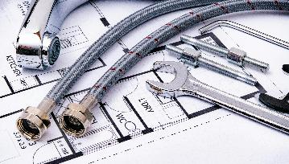
For example, mains water supply, proper sewage (foul drainage) and electricity were deemed “essential” for a viable glamping enterprise in a Savills Ireland analysis. If the site is off-grid (as is common in parts of Slovenia’s mountains or Iceland’s highlands), plan for renewable energy and composting toilets to meet standards (and possibly obtain special permits).
Costs: Utility hookup costs depend on proximity to networks. Connecting a rural site to the electrical grid in Ireland, for instance, costs around €1,800–€2,500 for a single-phase supply (higher if a new transformer or poles are needed).
Drilling a well and installing a pump can range €5,000–€10,000, whereas a mains water tap-in fee might be a few thousand euros.
A septic system or bio-treatment unit typically costs €4,000–€15,000 installed (ensure it meets local regulations). If going off-grid, solar power setups with battery storage can cost €10,000–€30,000, depending on capacity.
Untilities & Infrastructure
What it really costs to get connected or stay off-grid!
Netherlands VAMIL Program Investment Options for EV Charging Infrastructure. NL government supports businesses achieving climate action targets.
42

Slide 43

Don’t forget internet connectivity if you promise it to guests (satellite internet in remote areas might run a few hundred to a couple thousand dollars for setup).
These upfront investments are significant: a report notes that combined infrastructure (utilities and access) for a small four-unit glamping site commonly runs €58k–€116k (savills.ie).
Financial Tip: Include a healthy infrastructure budget in your financial plan. Also, build in a contingency for unexpected costs (e.g., drilling hitting deeper rock or needing a larger generator) to avoid cash flow crunches during construction.
Financial Tip: Wherever possible, use sustainable systems (solar, rainwater harvesting) that may have higher upfront costs but lower operating expenses over time.
Untilities & Infrastructure
What it really costs to get connected or stay off-grid!
43

Slide 44

Financial Tip: Explore cost-saving options like phased utility upgrades or hybrid systems. For example, start with a smaller solar array and expand as revenue grows, or use on-demand gas water heaters instead of a complete electrical system to reduce the load.
Financial Tip: Investigate local incentive programs – some countries offer grants for renewable energy or rural water services. In the Netherlands (VAMIL program) and Ireland (Climate Action Programme), new tourism businesses can sometimes receive support for installing eco-friendly utilities or may be eligible to reclaim VAT on capital equipment.
Financial Tip: Crucially, never cut corners on waste: invest in proper sewage treatment upfront to avoid fines or environmental damage later.
Untilities & Infrastructure
Financial Tips
44

Slide 45
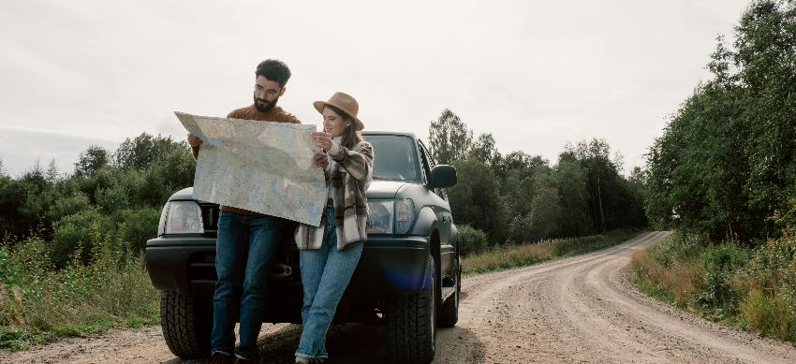
06
Make Sure You Get Them There: Access & Transport Costs
Ensure your guests (and service vehicles) can reach you safely, affordably, and without detours — or risk losing bookings.
If guests can’t reach you easily, they won’t book. Good access includes safe roads, clear signage, adequate vehicle parking, and sometimes pathway lighting or shuttle services. Poor access = bad reviews and lower occupancy. You may need to level the land, build driveways, or apply for a right-of-way, which can cost from a few hundred euros to €20,000 or more, depending on the terrain and permissions. Ensuring access is a non-negotiable for operational success.

Slide 46
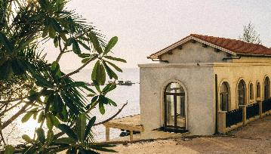
Considerations: Consider how guests (and emergency services) will reach the site. It is also vital for construction and maintenance. Many rural sites in Europe are down narrow lanes or unpaved roads – check if upgrades are needed for year-round access.
Evaluate road access, entryways, and parking. A location with good road access and clear signage enhances guest convenience, whereas a remote site may require building or upgrading private access roads. The site should be easily reachable by car with parking (or even by regular tour buses in popular areas) and have safe entry/exit points.
Consider accessibility standards: a welcoming site provides disabled access or at least the ability to navigate with luggage. In remote Iceland or mountainous Italy, winter access (snow, heavy rain) might be an issue; in the Netherlands, consider proximity to main roads or public transport for guests. Difficult or long access routes not only deter guests but also raise construction costs (bringing materials in).
Access, Mobility & Transport
Ensuring smooth arrival for guests and logistics.
46

Slide 47
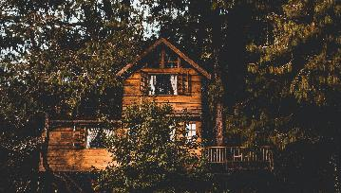
Costs: Improving a site’s access can range widely.
Laying a basic gravel driveway (100m) might cost €5,000–€15,000 depending on terrain, so factor this into your budget if the site is off the beaten path. Building a small bridge or reinforcing a steep slope could cost tens of thousands.
Infrastructure costs for a small glamping site (e.g. roads, paths, utilities) often total €60,000–€120,000 for a few units, especially “depending on the availability of existing services and access.”
For example, if an existing farm road is present, costs are low; if you must cut a new road or widen a lane (common in Ireland’s countryside), expect higher expenses.
Also evaluate proximity to transportation hubs or attractions – being reasonably close to airports, highways, or popular tourist sites can widen your market.
Access, Mobility & Transport
Spend Smart: The True Cost of Access & Infrastructure
Recommended Reading
How To Set Up A Glamping Business
47

Slide 48
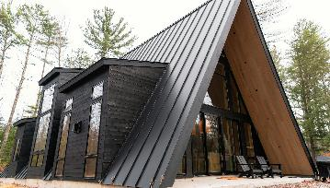
Financial Tip: Leverage existing infrastructure whenever possible. Choosing a plot that already has an access lane, or an existing farm track can save a significant amount of money. If you need new access, consult local authorities about grants or cost-sharing options. Some regions (like rural parts of Ireland or Slovenia) may have development funds to improve tourist infrastructure. Additionally, consider installing signage along main roads (at a modest cost of €200–€500) to help guests easily and safely locate the site.
Financial Tip: Plan for ongoing maintenance of access routes (snow clearing, grading, signage) and consider transport solutions (like shuttle services) if the site is very remote. Investing in reliable access upfront prevents guest dissatisfaction and costly last-minute fixes later.
Access, Mobility & Transport
Financial Tips
Recommended Reading
Glamping Startup Cost 2 - Groundworks, Landscaping and Utilities
48

Slide 49
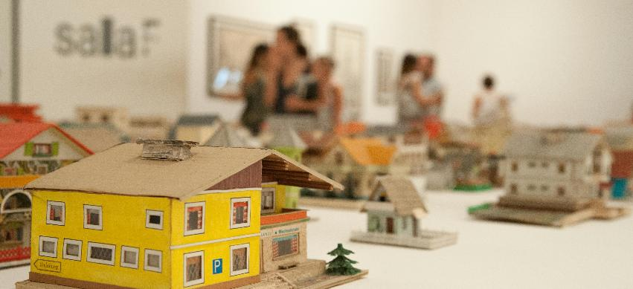
07
Picking the Wrong Land can be Detrimental: Terrain, Drainage & Buildability
Choose build-ready land to avoid costly surprises, such as drainage issues, structural groundwork, or site regrading — always assess the slope, soil, and surface before you invest.
Topography and ground conditions have a significant impact on your build costs. Steep slopes, poor drainage, unstable soil, or flood risk can turn a dream location into a financial drain. Site surveys, geotechnical reports, or groundworks can cost between €2,000 and €15,000, depending on their complexity. Choose land that needs minimal intervention, or understand how much you’ll need to spend to make it usable before you commit.

Slide 50
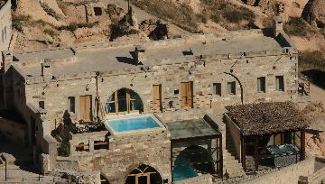
Bad land = extra costs (groundworks, regrading); good land reduces capital outlay.
The land’s natural features and shape will heavily influence development costs and guest safety/experience.
Land Quality: Poor-quality land can lead to extra expenses, such as the need for extensive groundwork and regrading, while good-quality land can minimise capital expenditure. –
Natural Features and Shape: The land's natural features and topography play a crucial role in determining development costs and ensuring guest safety and enjoyment.
Topography Considerations: Factors such as slope steepness, soil stability, drainage, and exposure are vital. For example, a scenic hilltop may offer beautiful views but could also be windy or require terraced platforms, while a riverside meadow might seem ideal until flooding occurs.
Terrain, Drainage & Buildability
Land Quality & Ability to Build
Priority 10 (€)
Ensure the land is buildable (drainage, soil, access, slope)
50

Slide 51
Environmental Safety: In Europe, planners must assess environmental hazards. For instance, Ireland’s guidelines recommend selecting sites that are free from risks such as flooding, falling tree limbs, or loose rocks on cliffs.
Soil Conditions: It's also important to examine soil conditions. Soft, boggy ground, which is common in areas like Ireland and Slovenia, may require reinforcement, while rocky terrain might necessitate expensive excavation work.
Sun and Wind Exposure: Lastly, consider the effects of sun and wind. In Iceland, a valley sheltered from wind could extend your operating season, whereas in countries like Italy or Slovenia, providing shade or a cool breeze on south-facing slopes can enhance comfort for summer guests.
Terrain, Drainage & Buildability
Land Quality & Ability to Build
Priority 10 (€)
Ensure the land is buildable (drainage, soil, access, slope)
51

Slide 52

Costs: Land preparation can be a hidden budget eater. Simple grading and clearing for a few tent platforms might be €2,000–€5,000, but extensive earthworks (cutting into a slope or building retaining walls) can easily exceed €20,000.
If you need to elevate structures above flood level (e.g. building decks or stilts in a floodplain), each unit’s platform could add €5k–€10k. Don’t forget drainage solutions – ditching or culverts to channel runoff may cost a few thousand euros, but they are vital on sloped sites.
Budget for driveways or pathways suited to the terrain (gravel paths on flat ground are cheap; steps or boardwalks on steep or marshy ground cost more).
Terrain, Drainage & Buildability
Land Quality & Development Costs
Recommended Tools for Assessing Typography, drainage, flood risks
Floodinfo.ie Ireland’s highly detailed flood mapping with interactive data and predictive models — essential for rural or riverside tourism sites.
FloodMap.net assessing elevation and flood risk across Europe. Combine with Google Earth or GIS data for richer terrain analysis.
ILWIS (Integrated Land & Water Information System) an advanced tool especially valuable for complex sites or off grid builds.
52
52

Slide 53
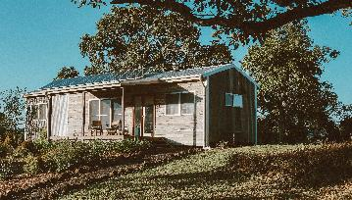
Financial Tip: Match your design to the terrain to minimize heavy engineering.
For instance, use light-weight, semi-permanent units on uneven ground (yurts or pods that sit on adjustable pedestals) instead of trying to level the entire site. This approach not only preserves the natural appeal but also cuts costs.
Financial Tip: It’s wise to conduct a soil and drainage survey (often €500–€1,500) before finalising the site layout – this can pinpoint any problem areas or extra costs early. In many European regions, local contractors have experience with the terrain (e.g. draining peatland or building on alpine slopes), so seek their input to avoid costly mistakes.
Terrain, Drainage & Buildability
Financial Tips
53

Slide 54
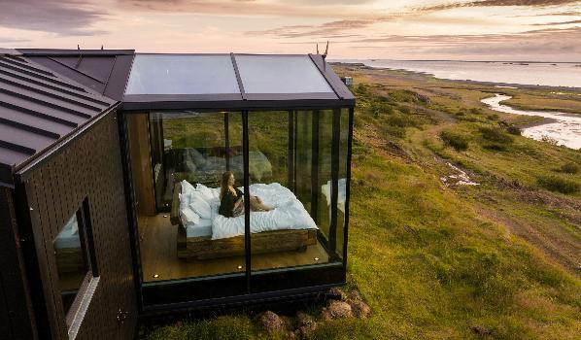
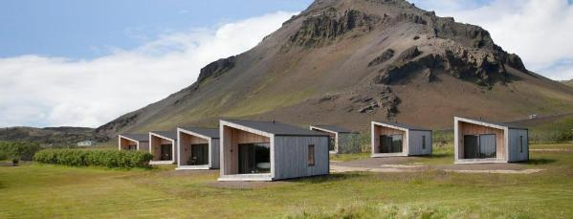
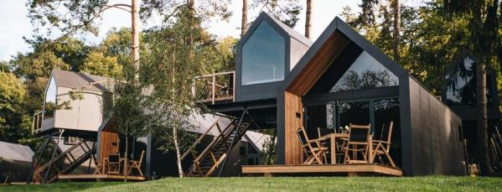
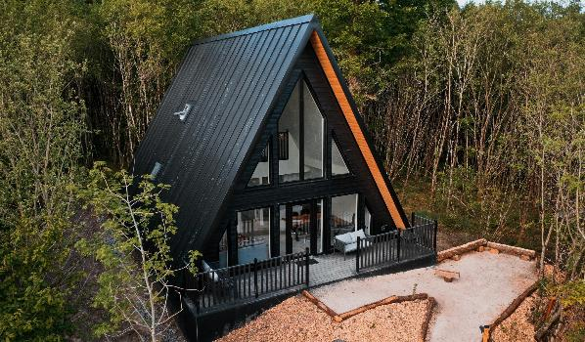
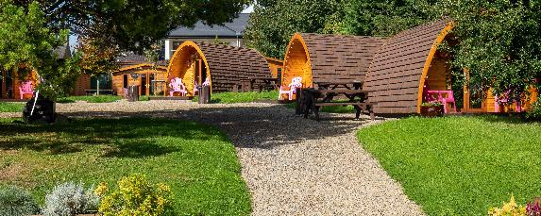
Nature & Environement
Photo Credit: European Examples see Locations on Epic Stays Website

Slide 55

Well Done
Module 6 (Part 3)
Sustainability, Investing in the WOW Factor & Support Tools
You have Completed… Module 6 (Part 2)
Location, Land & Logistics: Planning for a Profitable Site
Next is…

