Slide 1
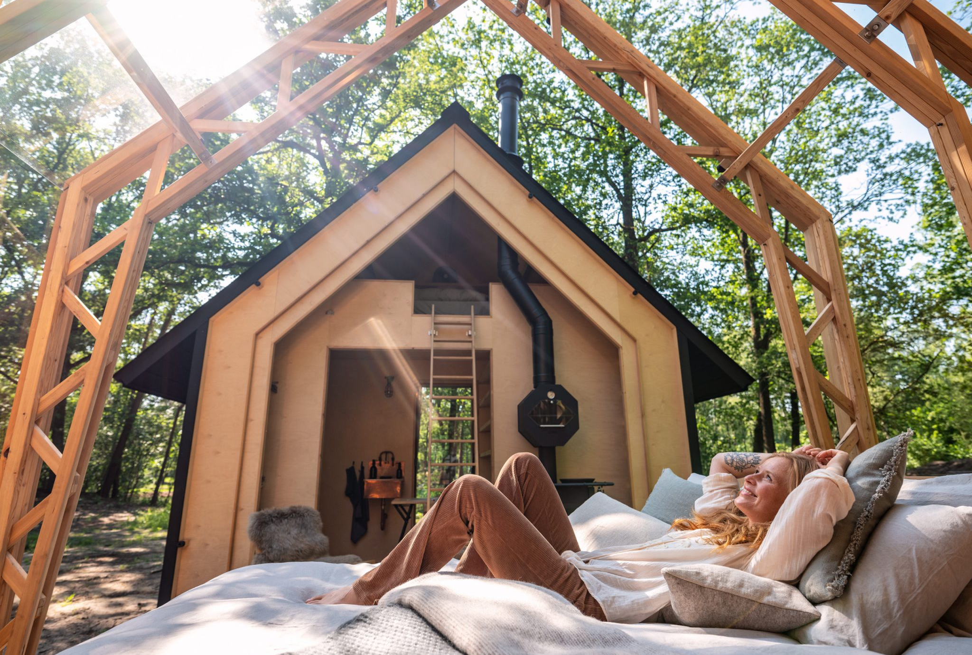
Holenberg, Netherlands
Module 6 (Part 1)
Setting Up & Launching Smart – Planning Your Start-Up & Capital Costs
Financial Planning & Funding

Slide 2
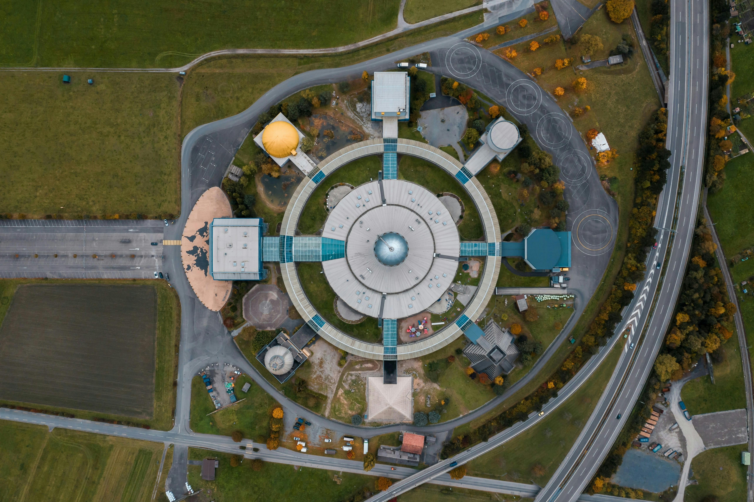
Module 6 (Part 1)
Laying the Financial Foundations of Your Business and Your Market
2

Slide 3
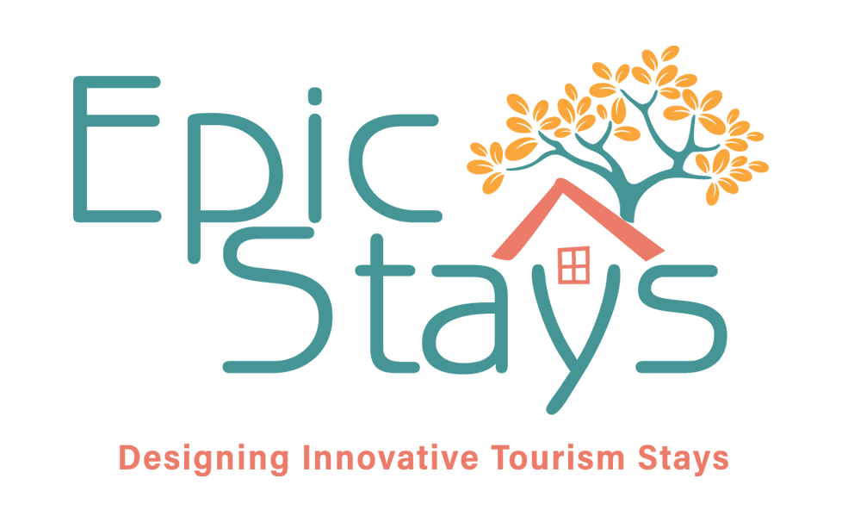
Module 6 (Part 1) Overview
Learning Outcomes
Getting Started – Laying the Financial Foundations of Your Business and Your Market
Part 1
Before laying foundations in the ground, you need to build strong foundations in your business model. This part introduces you to the world of alternative tourism accommodation and helps you make essential early decisions—what type of stay you want to offer, how much you can afford to invest, and who your ideal guests are.
Whether you’re dreaming of a forest glamping pod or a restored heritage barn, success starts by understanding the unique expectations of your target market and aligning your offer with what people are willing to pay for. You’ll also explore how to budget, scale wisely, and choose a business model that keeps your operations financially and environmentally sustainable from day one.
Identify different types of alternative tourism accommodation and understand what sets them apart from traditional models.
Define your financial limits, startup budget, and preferred business model (e.g., sole trader, partnership, limited company).
Evaluate how guest expectations and willingness to pay influence pricing, design, and experience planning.
Match your offer to the right target audience and position your accommodation for success in a competitive, values-driven market.
Source: Launching Your Glamping Business: Tips And Insights For A Successful Start

Slide 4
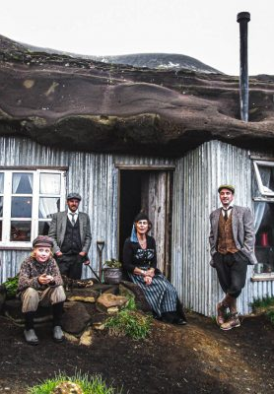
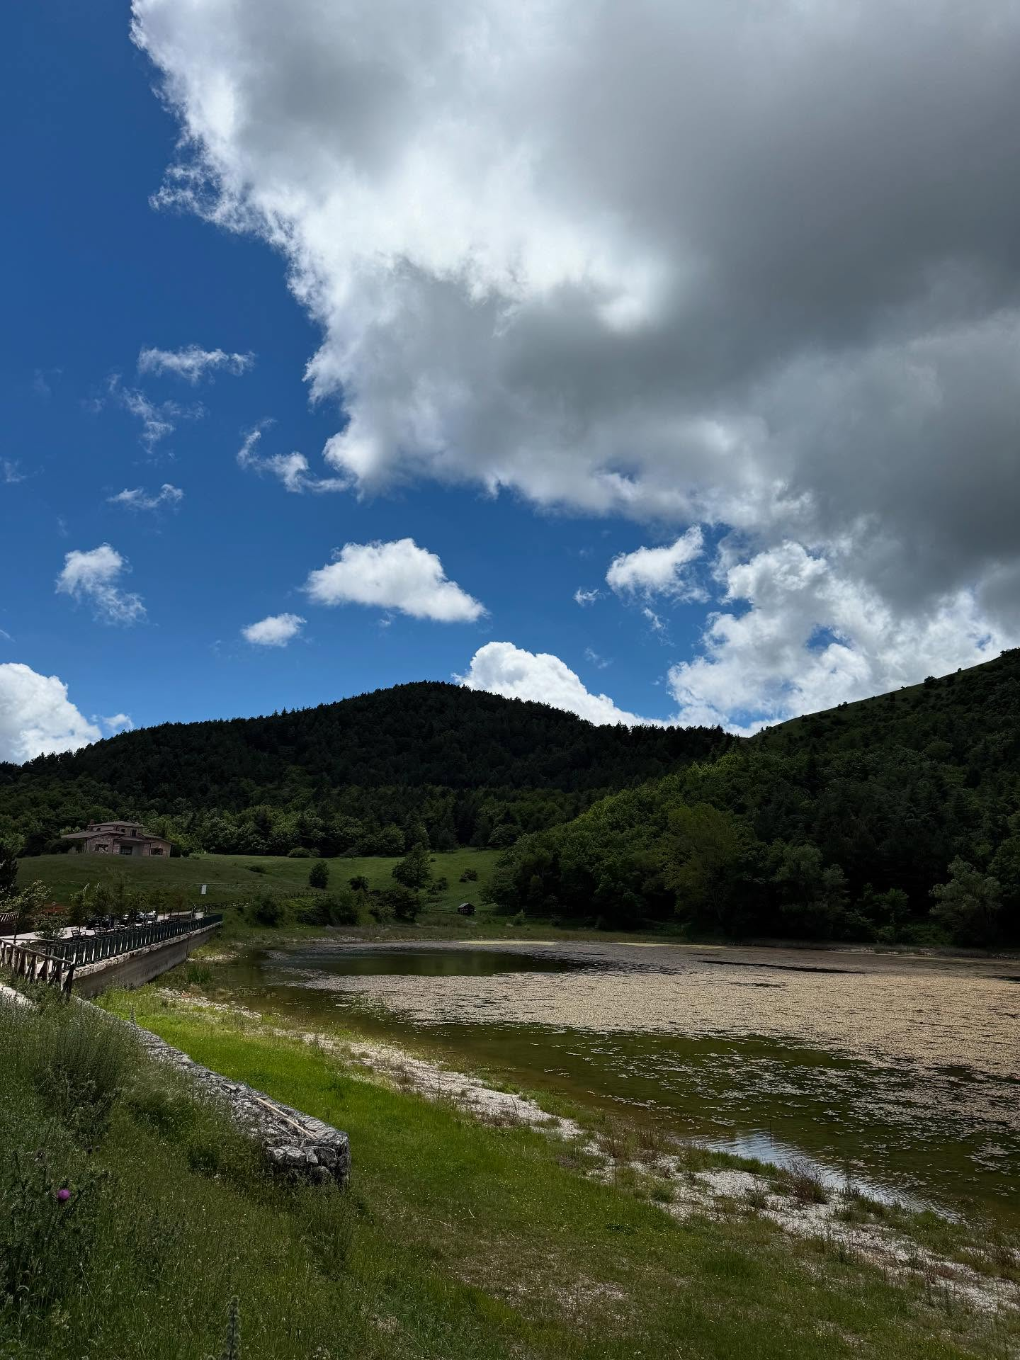
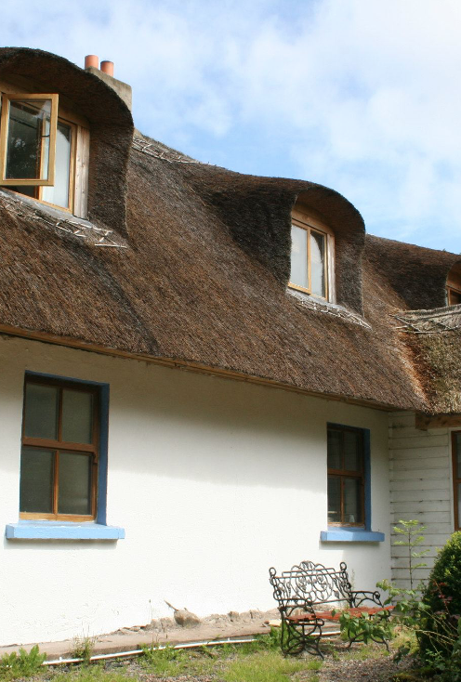
Part 1
02
Photo Credit:
Page 25
Photo Credit: Daunia Avventura, Biccari
Getting Started – The Financial Foundations of Your Business and Your Market
Section 2
Start Smart: Budget, Scale & Business Models
01
03
Page 11
Page 63
Section 1
Introduction to Alternative Tourism Accommodation
Section 3
Know What Customers Will
Pay For: Guest Appeal & Expectations
Photo Credit:
4

Slide 5

Module 6
Setting Up & Launching Smart
Overview:
Alternative tourism accommodation—like eco-lodges, glamping pods, and heritage stays—is booming as travellers increasingly seek authentic, sustainable experiences
This module introduces what sets these accommodations apart from traditional tourism models and explores key business, financial, and site planning principles for launching your own. You’ll gain the foundational knowledge needed to shape a successful, purpose-driven business that aligns with both market trends and your personal values.
5

Slide 6
Module 6 (Part 1): Key Learning Areas
01
Introduction to Alternative Tourism Accommodation
Such as eco-lodges, glamping pods, and heritage stays—is growing fast due to rising demand for authentic, sustainable travel experiences. This section explores what sets it apart from traditional tourism, defines key concepts, and outlines the primary financial and planning considerations for launching your site

Slide 7
Module 6 (Part 1): Key Learning Areas
02
Start Smart: Budget, Scale & Business Models:
Decide and define your financial limits, your start-up phase, and how you’ll operate to stay financially sustainable.

Slide 8
Module 6 (Part 1): Key Learning Areas
03
Know What Customers Will Pay For: Guest Appeal & Expectations:
Understand who your guests are and what they’ll pay extra for, so you can align your offer with demand and maximise revenue

Slide 9

01
Introduction Alternative Tourism Accommodation
Alternative tourism accommodations—such as eco-lodges, glamping pods, and heritage stays—offer unique, locally grounded experiences that reflect today’s demand for authenticity, unique experiences, and sustainability. Unlike traditional hotels, these spaces enable hosts to share their values and connect visitors with culture, community, and the natural world. The market is projected to grow from €216.5 billion in 2024 to over €715 billion by 2032 (Fortune Business Insights 2025 - 2032). The alternative tourism accommodation sector plays a vital role in diversifying tourism, supporting local economies, and promoting passionate, purpose-led entrepreneurship.
9

Slide 10
Introduction - Alternative Tourism Accommodation
Alternative Tourism Accommodation is Reshaping the Travel Landscape
Alternative tourism accommodation is reshaping the travel landscape. No longer are tourists content with generic, one-size-fits-all experiences. Today’s visitors are actively seeking meaningful stays that reflect local culture, prioritise sustainability, and offer something unique. The shift in tourism accommodation to alternative tourism accommodation aligns with global tourism trends that emphasise authenticity, environmental responsibility, and immersive local engagement – trends recognised by the UNWTO, the European
Travel Commission, and national tourism bodies across Europe.
Alternative accommodation businesses are crucial to the tourism industry, providing guests with a safe, comfortable and unique place to stay. They are usually seeking accommodation that is completely different from where they live or have previously experienced.
10

Slide 11
Introduction - Start-Up & Capital Costs – What It Really Takes to Launch
Embarking on an alternative tourism accommodation business, whether glamping pods, renovated farmhouses, or eco units, it’s exciting, but success depends on more than vision.
Understanding the real financial investment behind the scenes is essential. This section helps you break down the capital, planning, and infrastructure costs needed to turn your concept into a viable, long-term business.
You’ll explore core start-up costs such as tourism planning versus alternative tourism accommodation planning, land acquisition, renovation, construction, and furnishing, alongside often-overlooked essentials like planning permissions, utility connections, solar panels, waste systems, signage, insurance, and accessibility upgrades. Without this level of clarity, even strong ideas risk falling short due to hidden costs or unrealistic budgeting.
11

Slide 12
Introduction - Start-Up & Capital Costs – What It Really Takes to Launch
Embarking on an alternative tourism accommodation business, whether glamping pods, renovated farmhouses, or eco units, it’s exciting, but success depends on more than vision.
By the end of this section, you’ll be equipped to develop a detailed, realistic start-up budget, avoid common pitfalls, and make informed financial decisions that lay the foundation for long-term sustainability. Whether you’re starting from scratch or adapting an existing site, this knowledge is key to building confidence and securing the future of your alternative accommodation business.
12

Slide 13

Definitions -Alternative Tourism Accommodation
Defining Alternative
Tourism
Defining Tourism Accommodation
Alternative tourism encompasses various forms of travel that prioritise sustainability, social responsibility, and cultural immersion. It often includes ecotourism, community-based tourism, and adventure travel, focusing on minimising environmental impact and supporting local communities.
Accommodation in tourism is one of the most significant industry sub-sectors, encompassing various businesses that provide tourists with a place to stay. This typically refers to temporary accommodations, such as overnight lodgings.
Within the tourism industry, accommodation enables people to visit other locations and access shelter. Accommodation businesses are also often able to provide entertainment and other services.
Recommended Reading
Accommodation in Tourism: All Types of Accommodation Explained
13

Slide 14
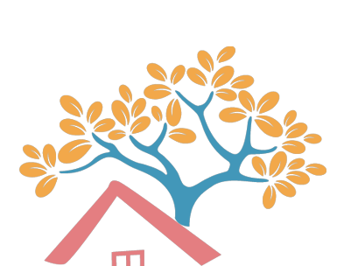
Introduction - Start-Up & Capital Costs – What It Really Takes to Launch
Defining Alternative Tourism Accommodation
They may include:
Glamping (luxury camping)
Eco-lodges
Farm stays or agritourism
Repurposed heritage buildings
Tiny homes or cabins
Community-run guesthouses or homestays
Alternative tourism accommodation refers to lodging options that differ from conventional hotels and resorts.
These accommodations emphasise sustainability, cultural authenticity, and unique guest experiences, often located in natural, rural, or community-based settings.
14

Slide 15
Introduction - Start-Up & Capital Costs – What It Really Takes to Launch
Defining Alternative Tourism Accommodation
They may include:
Glamping (luxury camping)
Eco-lodges
Farm stays or agritourism
Repurposed heritage buildings
Tiny homes or cabins
Community-run guesthouses or homestays
These models are closely aligned with the values of responsible travel, appealing to visitors who seek meaningful, low-impact experiences that directly support local people and the environment.
They often offer immersive stays and experiences shaped by local heritage, landscapes, and traditions, matching a growing demand for deeper, more ethical travel.
15

Slide 16
Alternative Tourism Accommodation Planning
Different to Typical Tourism Accommodation
Unlike traditional residential housing or commercial tourism accommodation, e.g., hotel constructions, alternative tourism accommodation (ATA) typically involves:
Low-impact or seasonal guest structures (e.g. pods, yurts, shepherd huts).
Location in rural, scenic or heritage-sensitive zones.
Operations that enhance nature, wellbeing, and local community benefits
Are a form of sustainable tourism that boosts local economies by creating jobs, supporting local producers and artisans, and attracting visitors. It helps revitalise rural areas and improve infrastructure, like trails, town centres, and dining options, that also benefit residents, e.g., Hubertus Mountain Refugio Allgäu, Germany
Business models that often align with eco-tourism, regenerative tourism, or slow travel.
16

Slide 17

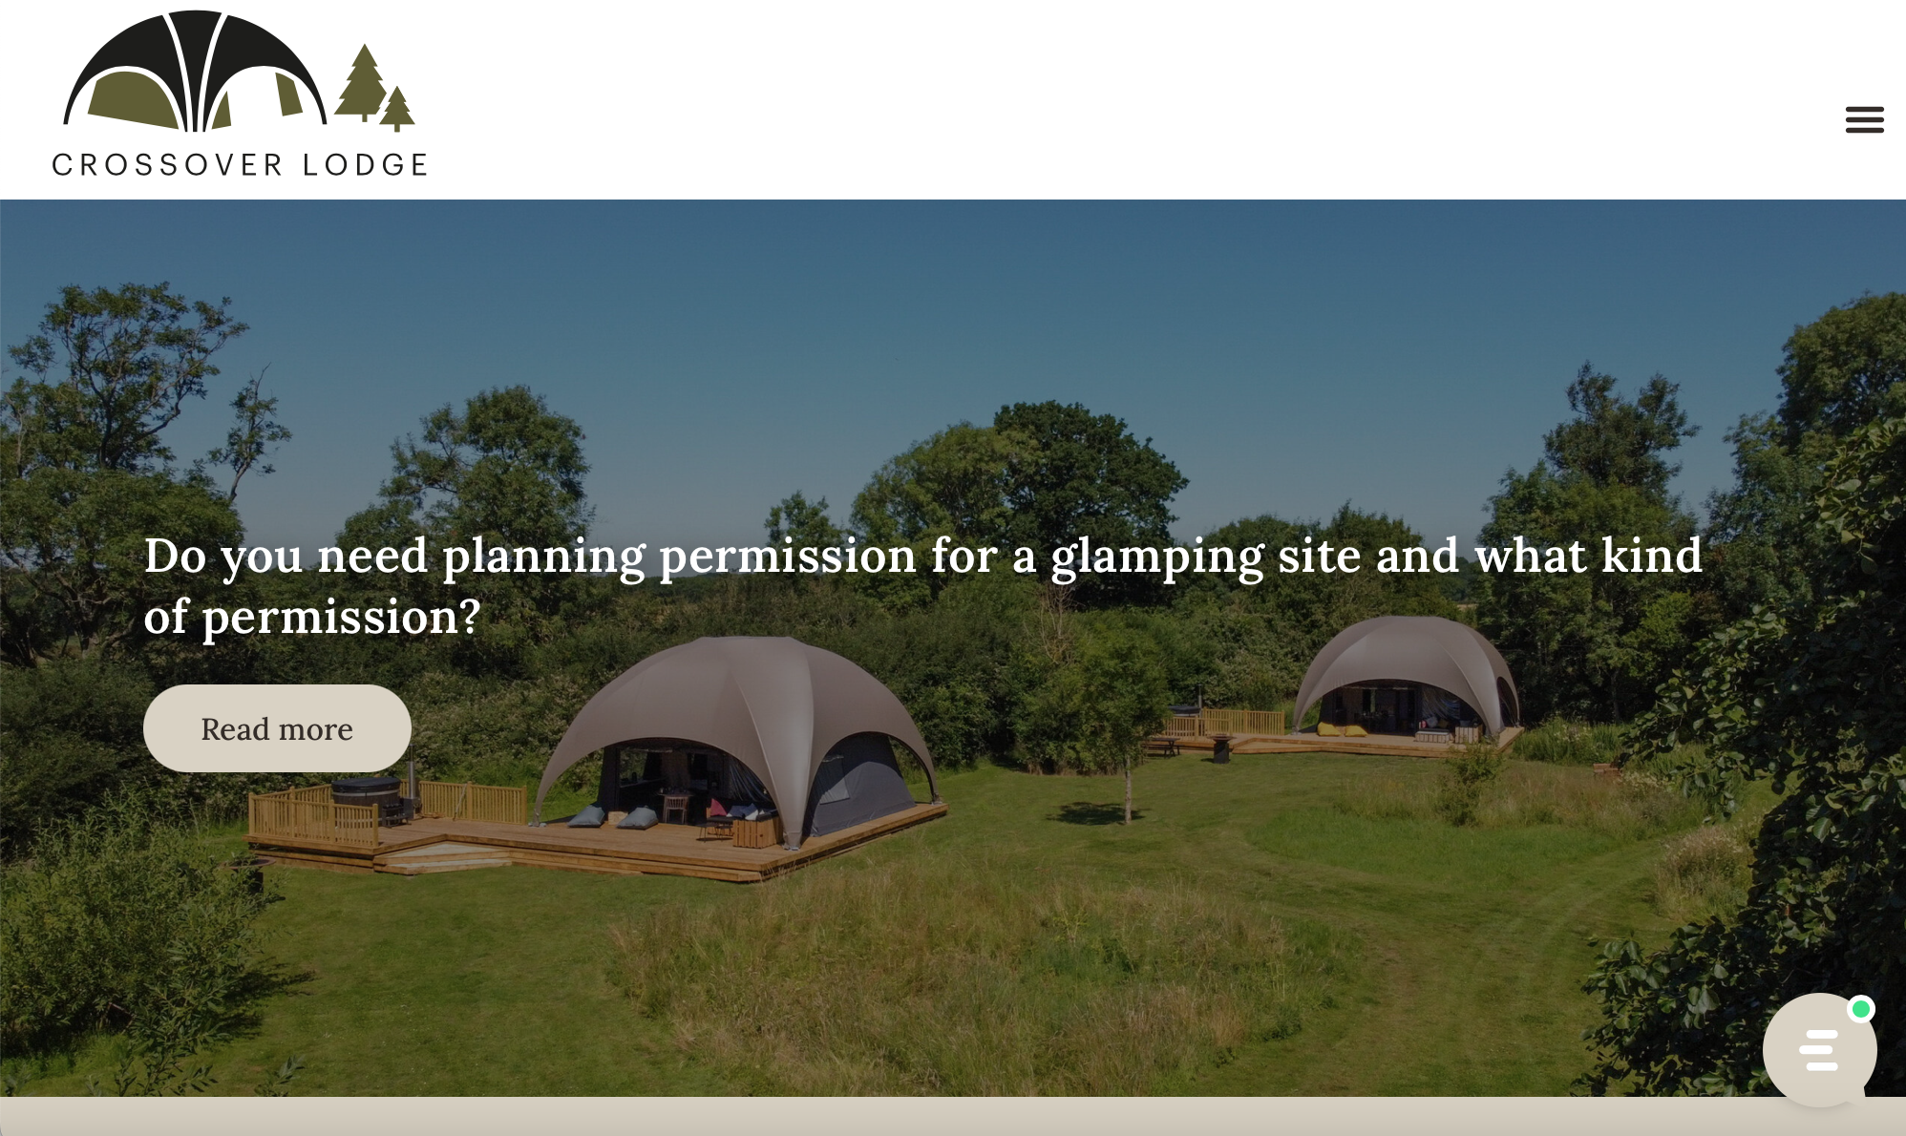
‘Glamping is more than just pitching a fancy tent. It’s about crafting experiences, connecting with nature, and creating a space people can’t wait to return to.
Crossover Lodge’
Click to Visit
17

Slide 18
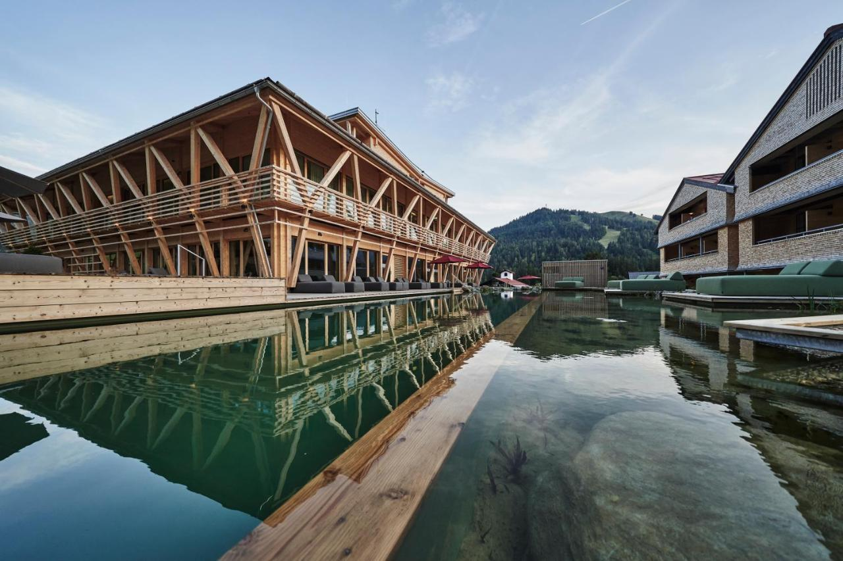
Revitalising Local Economy & Increasing Destination Attractiveness
Case Study
Hubertus Mountain Refugio Allgäu, Germany
Hubertus Mountain Refugio Allgäu, Germany, has not only contributed to the attractiveness of the region for tourists but also revitalised the rural economy. More than 70% of the employees live within two kilometres of the hotel. The presence of the hotel supports the local economy and contributes to the vitality of the village. The town lives mainly from tourism.
It is of existential importance to the community of Balderschwang. The family-run HUBERTUS extends its experiences to the local economy, offering guests the opportunity to experience the Allgäu village, nature, whether hiking, mountaineering, or winter sports.
Click to Visit
18

Slide 19
Overview and Key Cost Considerations in Setting up
Define Your Business Model: Decide if you’ll be owner-operated, a farmstay/agriturismo, seasonal pop-up, or an eco-retreat. Your model affects your costs, e.g., site selection, investment size, legal needs, and your marketing strategy.
Understand You’re Building a Commercial Tourism Business: Don’t assume this is “just camping” or part-time use—authorities treat it as commercial development.
Check Zoning & Suitability (what land you can build on): Legal compliance, the land and ATA must align with zoning laws for hospitality use, tourism zoning, building control, and tourism-use designation. Buying agricultural land without proper rezoning can significantly delay, increase the cost, or block development.
Alternative Tourism Accommodation
19

Slide 20
Overview and Key Cost Considerations in Setting up
Planning Permission & Development Restrictions (what you're allowed to build): Obtaining planning permission is a crucial step before any development can begin. Investigate local zoning laws, rural tourism strategies, Natura 2000 protections, and development plans before purchase or lease.
Selecting the land: Securing land suitable for tourism development can be a significant upfront investment. This includes the purchase price of the land, potential costs associated with rezoning (if the land is not already zoned for tourism or mixed use), and the cost of site preparation.
  Does it fit the needs and expectations of your target market, e.g., the wellness, eco-tourist or romantic couple?
Alternative Tourism Accommodation
20

Slide 21
Overview and Key Cost Considerations in Setting up
Infrastructure & Site Readiness (how guests will reach you and what utilities are available): Even if land is affordable, bringing it up to the required standards for accommodation can be expensive. Basic infrastructure, such as access roads, power, water, and sewage connections, may be necessary, and these costs can sometimes exceed the initial land purchase price. Remote and rural land often lacks such infrastructural services
Financial Planning is pointless without a budget. Capture every cost and create a realistic budget to help you determine whether your plan is viable and where you might need funding or grants. For example, when securing suitable land, the cost will vary depending on the type of land, location, and other costs such as legal fees, design fees, and construction costs.
Alternative Tourism Accommodation
21

Slide 22
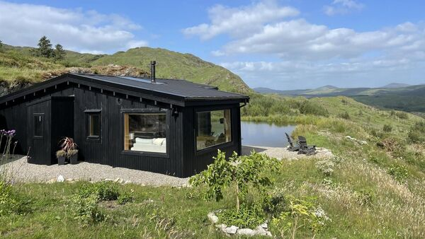
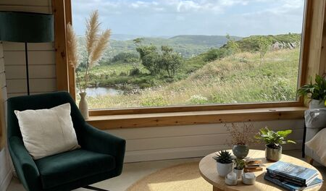

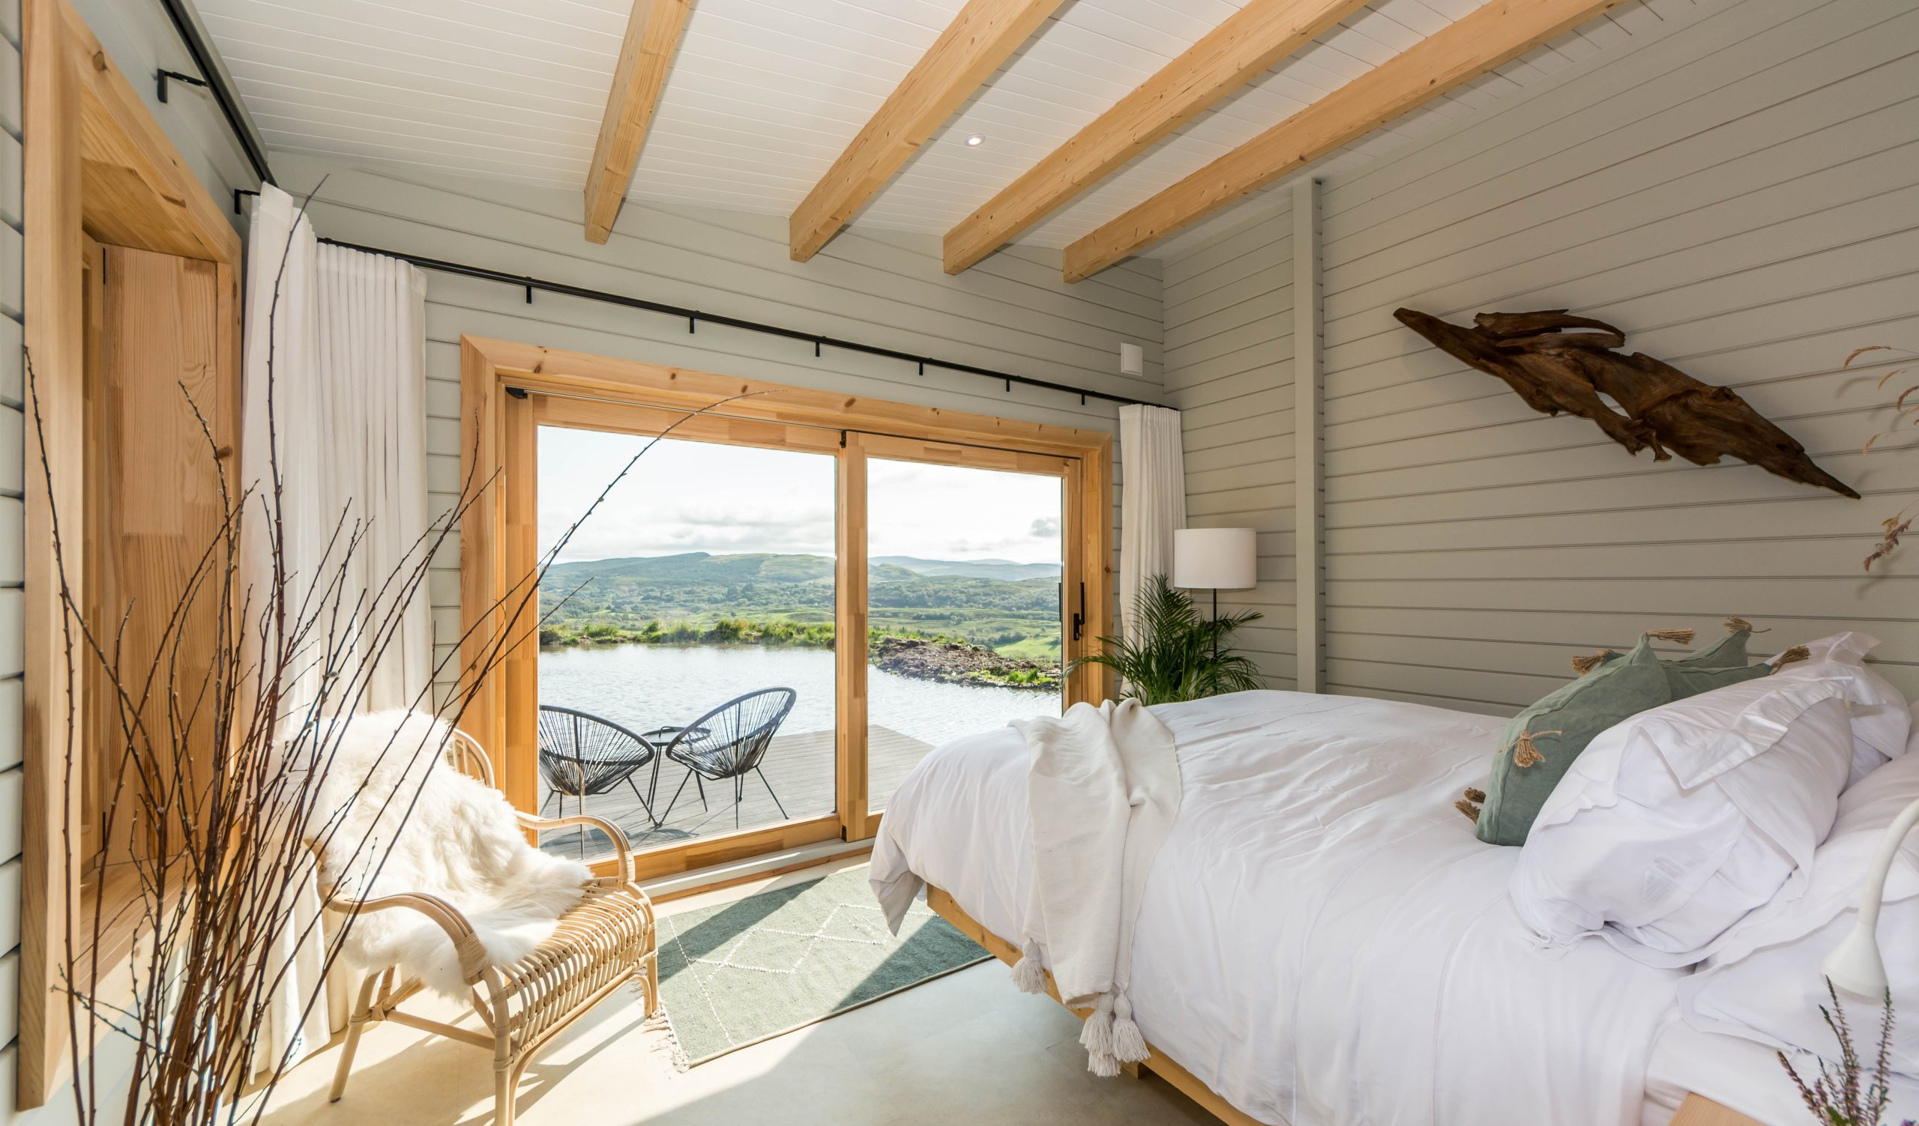
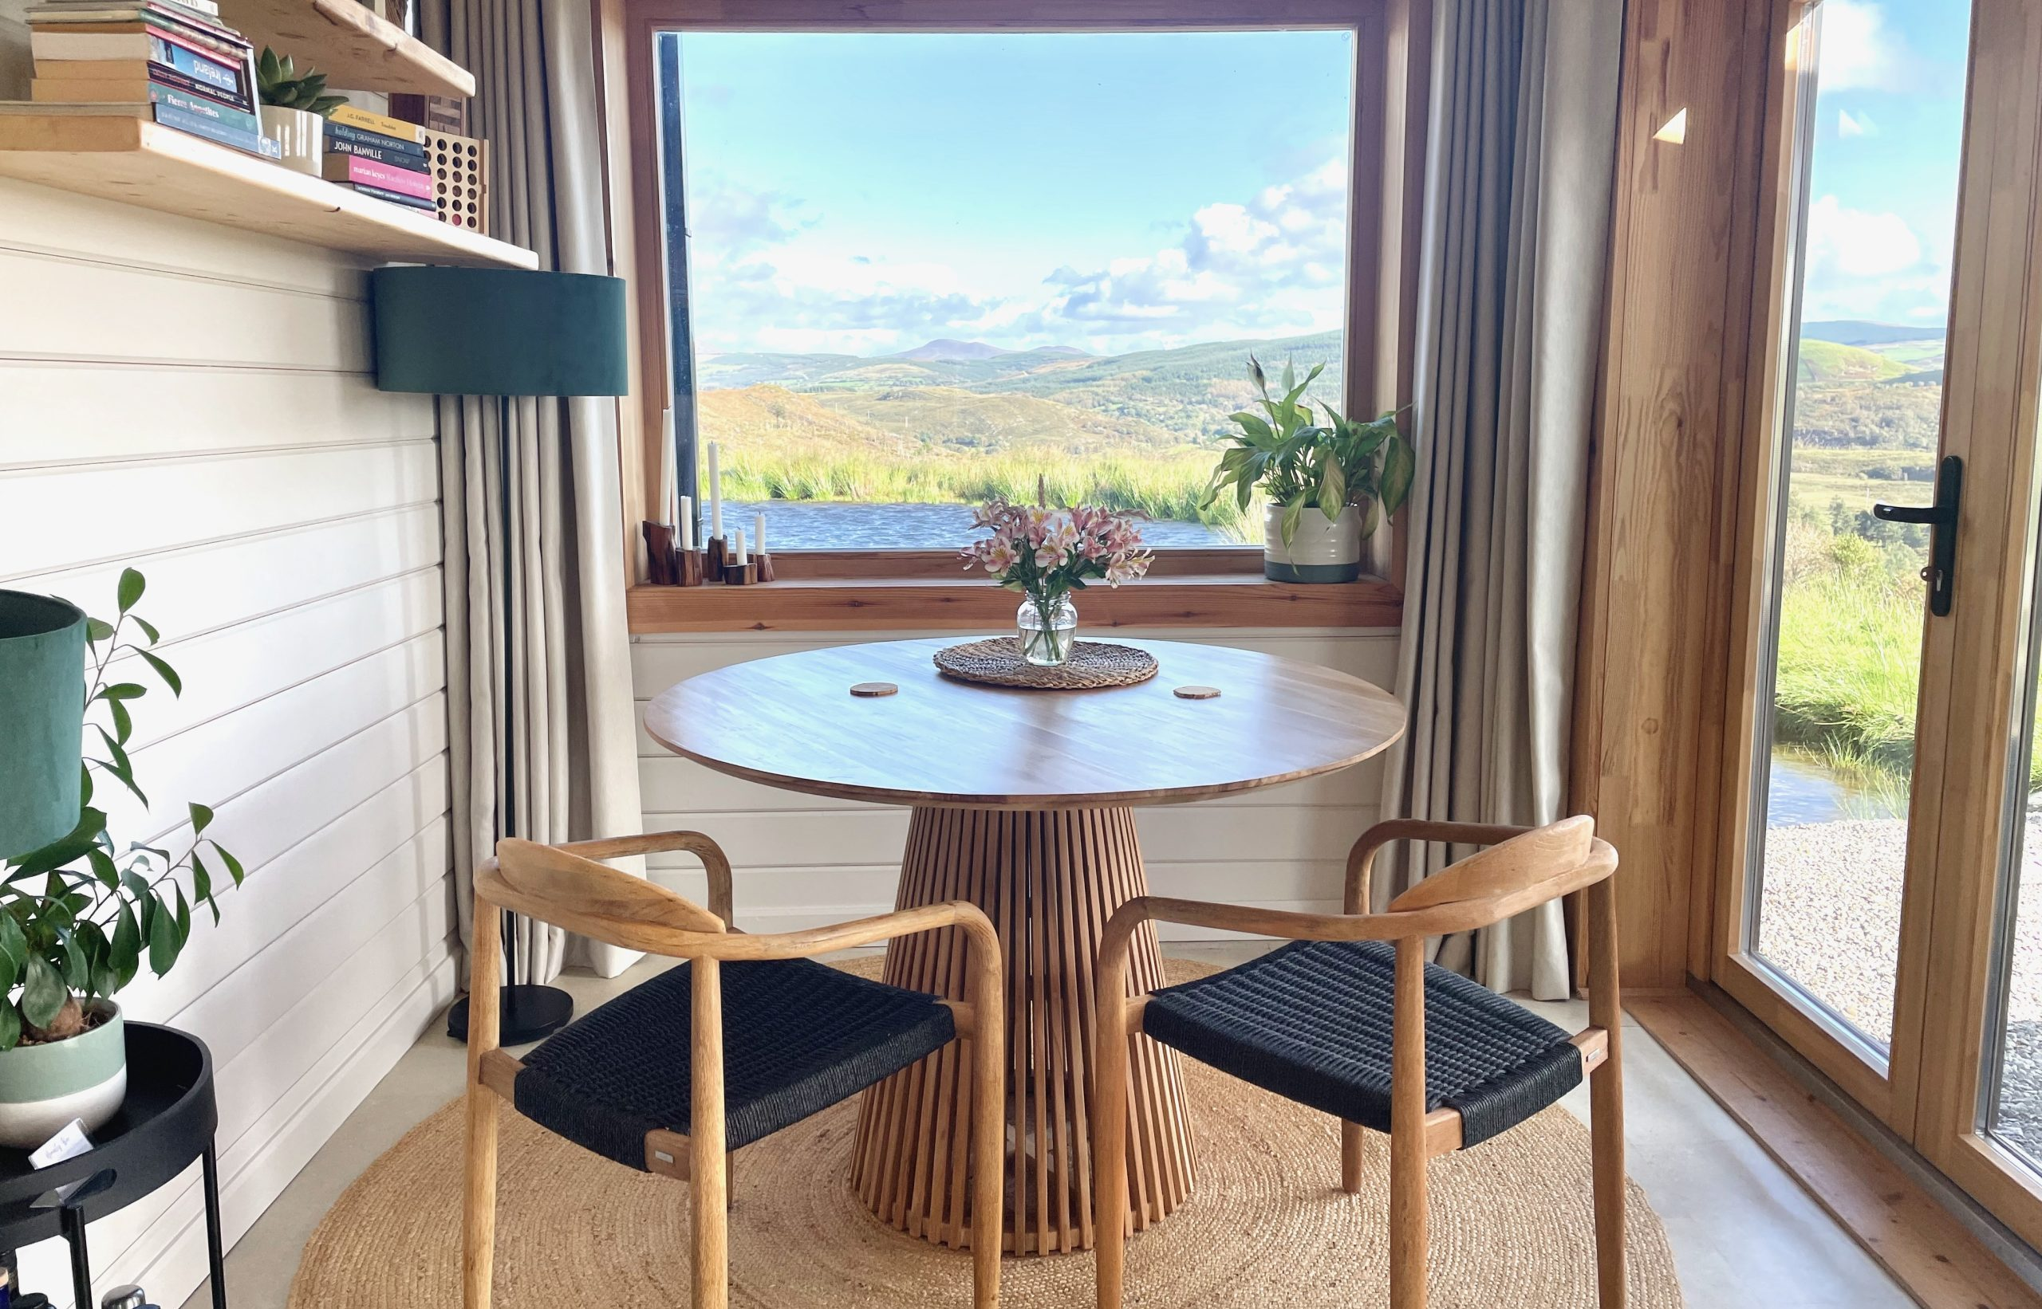
IRELAND
Photo Credit: The Hidden Haven, Cork, Ireland
22

Slide 23

02
Start Smart: Budget, Scale & Business Model
Decide and define your financial limits, your start-up phase, and how you’ll operate to stay financially sustainable.
Before anything else, you need to understand how much you can afford to spend, how big you want to start, and what kind of business you’re building. Will you operate full-time or seasonally? One unit or ten? Every choice influences your budget, cash flow, and ability to grow. A clear financial plan allows you to estimate start-up costs, ongoing expenses, and when you can expect a return. Starting small and scaling gradually is often the smartest way to test the market while keeping costs manageable.
23

Slide 24
Lean, High Return on Investment
Epic Stays Alternative Tourism Accommodations (ATA) are more than just a trend and about meaningful experiences—they’re a proven, scalable, and future-proof investment.
A Fast-growing Market Seeking Niche Accommodations
and Unique Experiences.
These models tap into the fast-growing market of conscious travellers who are willing to spend more on stays that align with their values.
As travel behaviours shift toward sustainability and authenticity, conscious consumers are actively seeking out accommodations that reflect their values.
In fact, according to Booking.com’s 2024 Sustainable Travel Report, 76% of global travellers say they want to travel more sustainably, and over 60% are willing to pay more for eco-certified stays.
Viable Business
24

Slide 25
Lean, High Return on Investment
Offers a Lean, High-impact Path To Entrepreneurship
From eco-lodges to boutique guesthouses, ATAs offer a high return on investment by combining low setup costs (e.g., repurposed structures) with low overhead and modular infrastructure tourism landscape, (like pods), flexible phasing (start with 1–2 units and expand), along with strong pricing power and year-round niche appeal based on a strong demand for immersive experiences, Epic Stays models can deliver impressive margins.
Viable Business
MODULE 1: Introduction to Alternative Tourism Accommodation covers business models in more detail
25

Slide 26
Built On Sustainable Tourism Principles
Example Yearly Returns: Sites that focus on quality over quantity—offering 5 to 10 units—can generate €40,000 to € 120,000 or more per year, depending on location, seasonality, and added services such as local food, wellness, or outdoor activities.
Built on Sustainable Tourism Principles: By blending profit with purpose, aligning your business with sustainable tourism principles opens up multiple revenue streams.
Example Revenue Streams: Including grants (e.g. LEADER or EU Green Transition funds), partnerships with local suppliers, and premium packages for wellness, slow travel, or cultural retreats.
They blend purpose with profit, and flexibility with future-readiness, making them one of the most viable rural business models in today’s evolving tourism market.
Viable Business
26

Slide 27
Long Term Viability & Profitability
The Financial Ripple Effect of a Well-Loved Stay
What’s more, businesses that operate under the Epic Stays model tend to enjoy lower marketing costs due to strong word-of-mouth, positive online reviews, and community-based branding.
According to HostPapa these businesses also build customer trust more quickly—resulting in repeat bookings, longer average stays, and higher occupancy rates. These are all key performance indicators that drive long-term profitability in the alternative tourism sector.
Viable Business
Bottom line is sustainable tourism isn’t a cost—it’s a growth strategy.
Recommended Reading
Things to consider when evaluating potential glamping locations
27

Slide 28
You Must have a Passion for the Business!
You need to have a passion for this business, as it requires a lot of dedication and effort to apply and set up an ATA, and keep it running smoothly. Therefore, you really have to love what you do.
Having a passion for alternative tourism accommodation can be a powerful motivator for creating a successful, meaningful and impactful business venture.
By focusing on sustainable, eco-friendly, and community-focused tourism, you can contribute to a more responsible and enriching travel experience for guests while benefiting the local environment and economy, according to the Global Sustainable Tourism Council (GSTC) and Failte Ireland.
Passion!
28

Slide 29
You Must have a Passion for the Business!
Allows entrepreneurs to express their passion, mission and values through place-based design combined with service and hospitality.
It is essential to remember that this is a service industry, and you will need to interact with your customers regularly. Therefore, ensure that this is something you are comfortable doing. Your genuine enthusiasm for responsible travel and environmental stewardship can inspire both your team and your guests, according to Tourism Notes.
Passion!
29

Slide 30
What Is Your Budget? How to Decide It
Your budget sets the foundation. Knowing your budget prevents over-investment and helps you prioritise your spending.
Before choosing a location or designing a glamping pod, it's essential to determine what you can realistically afford. Your budget is the foundation for everything—it shapes your business model, influences your planning and zoning decisions, and defines the guest experience you can offer. Why it matters:
It determines your accommodation type (e.g., tents vs. cabins)
Influences your pace of development (e.g., phased vs. complete build)
It sets expectations with funders, investors, and planners
Your Budget
30

Slide 31
Priority 1 (€)
Figure out your Budget!
What Is Your Budget? How to Decide It
Your Budget
How to Set Your Budget:
Define your financial ceiling – What can you invest now without external help?
Estimate key categories – Land, planning, construction, infrastructure, furnishings, website, and operations
Choose your scale – Starting with 1–2 units lets you test your concept; planning for 5–10 requires more capital but builds growth.
Factor in operational costs – Cleaning, insurance, booking fees, maintenance, utilities, and seasonal staffing
Add contingency – Always include a 10–20% buffer for unexpected costs
31

Slide 32
Some Financial Tips on Setting Up a Solid Budget
Create a budget that aligns with your life stage, risk tolerance, and long-term goals. A lean startup approach (with fewer units and simpler facilities) lets you prove demand and grow sustainably without overextending financially.
Consider revenue timelines - most sites won’t break even for 18–36 months. Planning is pointless without a budget. Create a budget that covers land, permits, units, infrastructure, hidden costs, and working capital for a period of 1–2 years.
Planning is pointless without a budget. Capture every cost—from land purchase and pod installation to insurance, signage, booking software, and cleaning supplies. A realistic budget will help you determine whether your plan is viable and identify areas where you may need funding or grants.
Explore local grants or rural development subsidies (e.g. LEADER funding in Ireland, Rural Development Programme in Slovenia) (Covered in Module 7)
Your Budget
32

Slide 33
ATA Start-Up Cost Checklist (Estimated Ranges) Excl VAT
Cost Item | Estimated Cost Range (€)
Land acquisition | €5,000–€120,000
Planning application | €1,000–€10,000+
Insurance and liability cover (annual) | €500–€2,000
Pod/yurt/cabin unit costs (per unit) | €10,000–€80,000
Infrastructure (roads, sewage, power) | €50,000–€120,000
Transport costs (unit delivery) | €2,000–€5,000
Planning consultant fees | €1,500–€4,000
Legal/surveyor fees | €1,500–€3,000
Insurance, marketing, and setup | €5,000–€10,000
Marketing and booking software (annual) | €600–€1,200
Website and brand development | €1,000–€5,000
Professional/legal/consultancy fees | €2,000–€7,000
Your Budget
Total Estimated Range (excluding VAT):
Minimum: €81,100 Maximum: €387,200+
33

Slide 34
What is Your Budget: Estimated Basic Cost Breakdown
What is your Budget?
(If your budget is tight, there are funding options, or you can phase out and plan your development) - How many units do you want to build: 1, 5, 10, or more than 10? (You need to factor in scale and site space.)
Are you Going Basic or Luxury Level?
(Obviously less expensive for basic but more potential yield with the luxury level, this comes with more investment though). Also, bear in mind that startup costs vary widely by country and scale. To illustrate, consider three scenarios. The table in the next slide does not include utilities, electricity, waste, insurance, contingency, or other add-on expenses. Explained in more detail in the following slides.
Your Budget
34

Slide 35
What is Your Budget: Estimated Basic Cost Breakdown
Expense | Single Unit | 5 Units | 10 Units
Land (approx) | €5,000–€10,000 | €20,000–€30,000 | €45,000–€60,000
Planning / Permits | €1,000–€3,000 | €5,000 | €10,000+
Infrastructure | €20,000 | €100,000 | €200,000
Units (avg cost) | €12,000–€25,000 | €125,000 | €250,000
Furnishings & Fit-out | €3,000 | €15,000 | €30,000
Total (approx) | €41,000–€55,000 | €165,000–€195,000 | €540,000–€580,000
Your Budget
35

Slide 36
Priority 2 (€)
Decide on your business model
Understanding the Costs Behind Different Business Models
What is Your Business Model: The Cost Considerations
Business Models
Your Model (e.g., Seasonal, Full-time, Retreat-based) Influences Fixed Vs. Variable Costs And ROI.
Understanding your business model early helps guide every future decision. Will you run a glamping site, farmstay, eco-retreat, or mobile pop-up?
Each has different infrastructure, seasonality, staffing, and guest expectations. It also affects funding opportunities and the regulations that apply.
36

Slide 37
Understanding the Costs Behind Different Business Models
What is Your Business Model: Cost Considerations
Standard Business Models And Their Cost Considerations:
Owner-operated glamping site: Direct management means complete control but requires time investment. Moderate startup (€60,000–€150,000 for 3–5 units).
Farmstay / Agriturismo: Combine accommodation with farming. Common in Italy and Slovenia. May require agritourism certification. Eligible for rural development funding. Moderate to high investment depending on site upgrades
Seasonal rental of pods/yurts: Lower initial costs (starting €10,000/unit), but you’ll still need toilets, decks, and insurance. Seasonal limits apply unless winterised.
Eco-retreat or wellness camp: Premium market with high standards. Needs licensed practitioners and communal space. High investment (often €150,000–€500,000 for 5–10 units and retreat facilities).
Business Models
37

Slide 38
Understanding the Costs Behind Different Business Models
What is Your Business Model: Cost Considerations
Financial Tip: Begin lean but designed for scale.
Example: Install infrastructure for 10 units or start with 2–3 units. This future-proofs your site and saves long-term costs. Understanding your business model early helps guide every future decision.
Will you run a glamping site, farmstay, eco-retreat, or mobile pop-up? Each has different infrastructure, seasonality, staffing, and guest expectations. It also affects funding opportunities and the regulations that apply.
Financial Tip: Budget ranges vary widely.
Seasonal yurts or safari tents start from €10,000–€20,000 total setup, while permanent eco-lodges and wellness camps can exceed €200,000. Start simple, scale gradually.
Business Models
38

Slide 39
It’s a ‘Commercial Tourism Business’.
That Means Extra Costs
Understand You’re Building a Commercial Tourism Business
Starting a glamping site, eco-cabin retreat, or similar alternative accommodation can be an exciting rural business opportunity. However, it’s not the same as building a private home or placing a temporary tent in your field. You’re running a tourism business, so different planning rules apply.
It’s a Commercial Activity – Not Just Camping!
Even if you're placing "temporary" structures like pods, yurts, or bell tents, you’re offering paid short-term stays. This is classed as a commercial change of land use. That means you typically need full planning permission, even if you’re on your own land.
.
Business Models
39

Slide 40
It’s a ‘Commercial Tourism Business’.
That Means Extra Costs
How this Affects You Financially:
Because your ATA is considered a commercial tourism business, your financial planning needs to reflect commercial standards - not personal or residential assumptions.
.
Business Models
40

Slide 41
Additional Commercial Business Costs
Example Additional Costs: Planning permission and consultancy fees
(typically, €5,000–€15,000).
Commercial insurance and business rates, are higher than for private land or homes.
Compliance costs (e.g. health & safety, fire regulations, water testing). Marketing and operations costs (booking platforms, guest services, maintenance).
You're not just hosting guests—you're launching a regulated, revenue-generating business. Treat it as such, and you'll build something that’s both compliant and financially sustainable.
Business Models
41

Slide 42
Additional Commercial Business Costs
Financial Tip: Always treat any form of guest accommodation as a business from a planning perspective, no matter how temporary the structure may seem.
Financial Tip: Even if you start small (1–2 units), you must budget for full site planning, as most planning authorities require a long-term development plan to approve your application
Example: In Ireland, the Agriculture Dept. advises that converting farmland to glamping definitely needs permission (even if pods are technically temporary).
Business Models
42

Slide 43
Failure to Comply Can Be Costly
Don’t Assume Exemptions Apply:It’s a common myth that because tents or pods are movable or seasonal, they don’t require planning approval. In most European countries, you still need permission. This is because you’re creating infrastructure and generating footfall.
Key Rule: If you're welcoming paying guests, it likely counts as a material change of use.
Financial Tip: Failing to comply can be costly, resulting in fines, legal action, or forced closure. But getting this right from the beginning gives your business credibility, access to funding, and community support.
In short, don’t assume tents or pods are exempt – always verify local zoning.
Business Models
43

Slide 44
Priority 3 (€)
Decide: Fixed or Temporary Structure?
Fixed Versus Temporary Units
Financial Costs & Considerations
This Impacts Planning Permission, Taxes, and Upfront Capital,
And Long-term Flexibility.
ATAs come in various forms, each with different levels of investment, planning requirements, and return potential. They typically fall into two broad categories:
Permanent Structures – Built with foundations or connected to permanent utilities, usually for year-round operation, always require full planning.
Temporary or Semi-Permanent Units – Often modular or movable, designed for seasonal use or low-impact installations. It may still require planning.
44

Slide 45
Financial Costs & Considerations
Choosing Between Permanent and Temporary Options Affects Planning And Budgeting.
Temporary units (tents, yurts) may save on structural regulations but still need decks/platforms and limit off-season revenue.
They involve varying and additional costs, fees, and charges, with varying ROI (Return On Investment) and nightly returns.
The type and level of luxury you invest in will depend on your target market and the price point you want to charge.
Fixed Versus Temporary Units
45

Slide 46
Financial Costs & Considerations
Example: Permanent huts or pods may cost more upfront, but they can host guests year-round and often command higher rates. Many businesses mix types (e.g. a few cabins + some tents).
Rural lodgings come in many styles, each with different costs, permanence and planning impact. Here are some examples in this section.
Initial Investment:
Permanent structures require more capital upfront (foundations, plumbing, planning).
Temporary units allow a lower-cost market entry and phased growth (test 1–2 units first).
Fixed Versus Temporary Units
46

Slide 47
Financial Costs & Considerations
Planning & Legal Costs: Don’t assume “temporary” means exempt—many countries still require full planning, zoning compliance, or land-use change.
Budget €3,000–€15,000 for consultants, site plans, and permissions, even for small setups.
Running Costs:
Permanent builds: higher utilities, insurance, and regulatory compliance.
Temporary units: lower utility use but may need seasonal dismantling, replacement, or upgrades.
Fixed Versus Temporary Units
47

Slide 48
Financial Costs & Considerations
Funding & Grants: Most EU rural grants (LEADER, EAFRD) require proof of planning approval.
Eco-design and low-impact builds can unlock green tourism subsidies.
Return on Investment (ROI): Average nightly rates range from €90–€200/night depending on unit and location.
High occupancy + value-added services (breakfasts, workshops, nature tours) accelerate payback.
Fixed Versus Temporary Units
48

Slide 49
Priority 4 (€)
Choose the type of ATA you’ll invest In
Financial Costs & Considerations
Types of ATAs
Lodges, Pods, Yurts, and Cabins All Vary In Cost, Lifespan, And Revenue Potential.
Bell/Safari) (Temporary): low-cost, seasonal (sheds/bell tents €1,000; large safari tents €20,000).
Yurts & Tipis (Semi-Permanent): round glamping tents on decks (€9,000–€14,000 each for 16–35m² models).
Glamping Pods/Cabins (Permanent or Fixed Structures): wood/metal huts (start €27,000 each; 1‐bed cabin €80,000).
Shepherd’s Huts (Permanent or Fixed Structures): small wooden wheeled huts (€35,000–50,000).
Treehouses/Micro-lodges (Permanent or Fixed Structures): premium multi-room units (> €100,000).
49

Slide 50
Concept and Accommodation Types
This slides explain the above in more detail and approximate costings, prices and ROI you can expect according to a number of popular alternative tourism accommodations
Types of ATAs
Accommodation Type | Pros | Cons
Safari Tents | Spacious, family-friendly | Less insulated
Glamping Domes | Futuristic design, well-insulated, suitable for all audiences | Can get hot
Tiny Houses | Fully equipped, usable year-round | Smaller
Treehouses | Unique, immersive in nature | Not always accessible
Yurts | Cozy, atmospheric | Thin walls = less privacy
How To Start, Set Up, And Build A Profitable Glamping Business
50

Slide 51
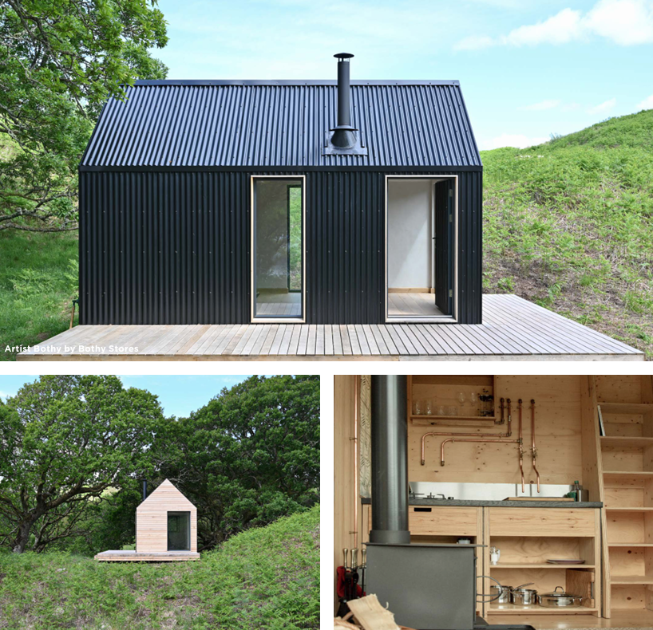
Cabins
Information provided by www.savills.ie
Cabins are growing in popularity as travelers looks to reconnect with nature and escape their busy lifestyles.
Cabins can be basic through to high-end, bespoke designs.
Cabins with en-suite facilities are most popular.
With the right location, these can provide significant ROI (Return on Investment) and allow for year-round use.
Typical Unit Cost €30,000-50,000
Typical Nightly Rental €100-200
51

Slide 52
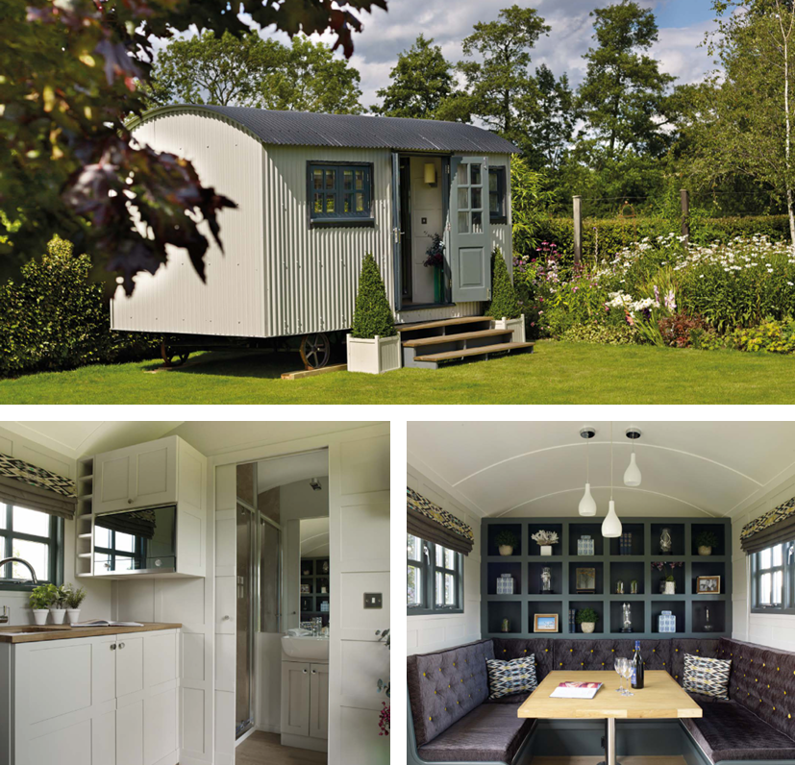
Shepard Huts
Information provided by www.savills.ie
Shepherd huts are becoming increasingly popular and have had good national press recently.
ROI is good, depending on the specification, location, and rental levels.
They are more commonly used for year-round accommodation, with growing evidence of use in gardens as an office space or ‘den’.
Typical Unit Cost €18,000-50,000
Typical Nightly Rental €75-125
52

Slide 53
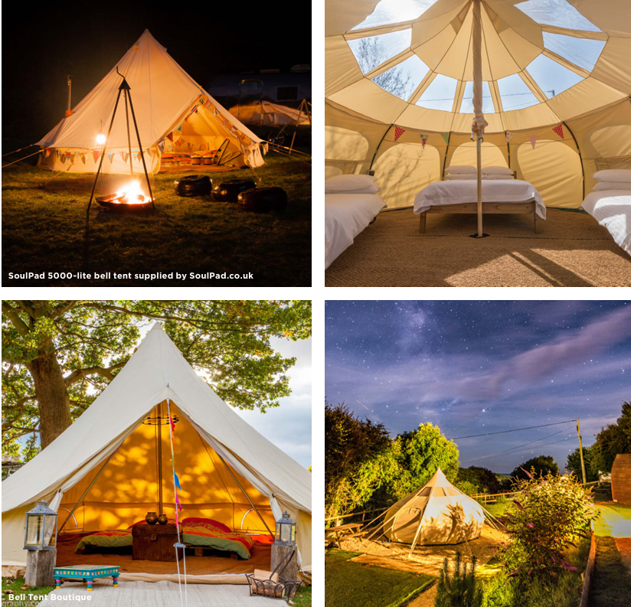
Bell Tents
Information provided by www.savills.ie
A basic tent structure is usually provided as a ‘pop-up’ or height-of-summer season facility.
They provide basic facilities, although some higher-level bell tents do have furnishings to a high standard.
It is possible to provide these structures under 28-day camping rights. Check your country’s rights.
Typical Unit Cost €500-2000
Typical Nightly Rental €50-100
53

Slide 54
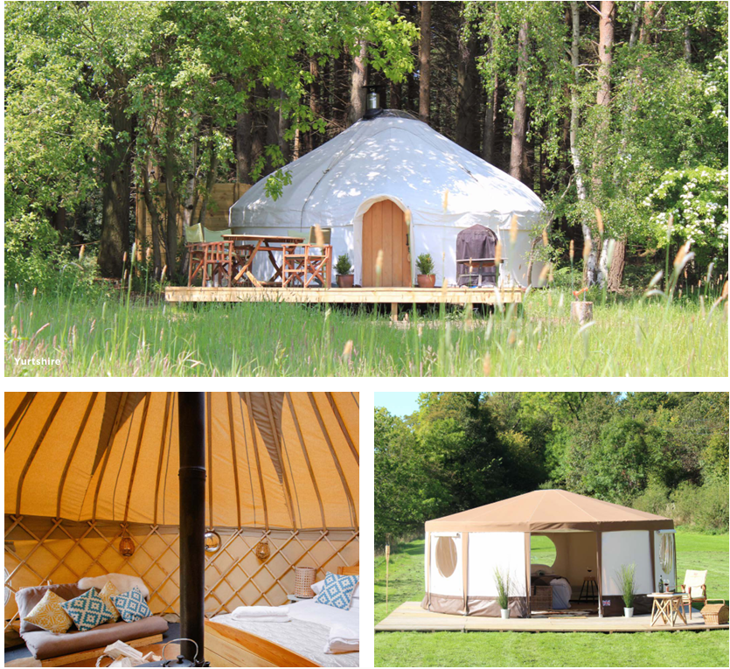
Yurts
Information provided by www.savills.ie
A more robust structure than a bell tent, yurts are most suitable for high season use.
ROI is stronger depending on specification and location.
The onus is on the landowner to provide high-quality internal furnishings, including heating.
Very popular with groups of families on existing holiday parks and holiday cottage complexes
Typical Unit Cost €3,500-10,000
Typical Nightly Rental €50-150
54

Slide 55
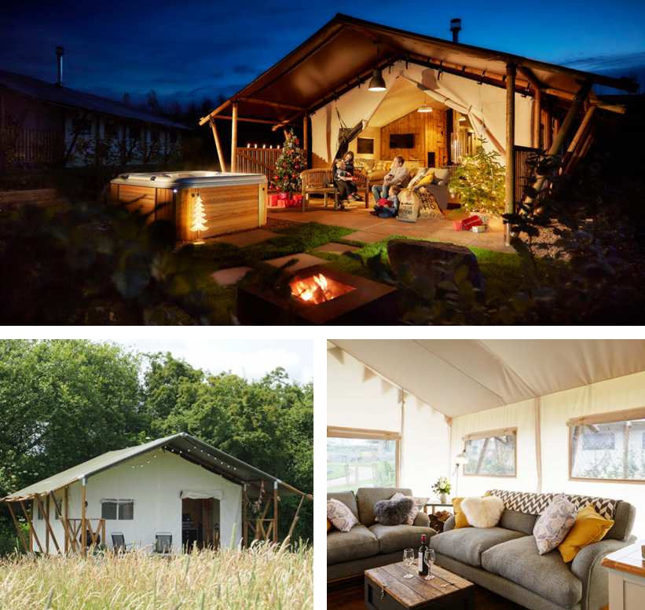
Safari Tents
Information provided by www.savills.ie
Safari tents are more of a permanent structure and require a reinforced hard-standing base.
They can utilise more external space, and the land-owner is usually responsible for internal furnishings, thereby dictating the standard of accommodation on offer.
Mainly for warmer season use.
Can deliver high occupancy rates for short breaks when the weather suddenly improves.
Popular with families.
Typical Unit Cost €7,500-50,000
Typical Nightly Rental €125-175
55

Slide 56
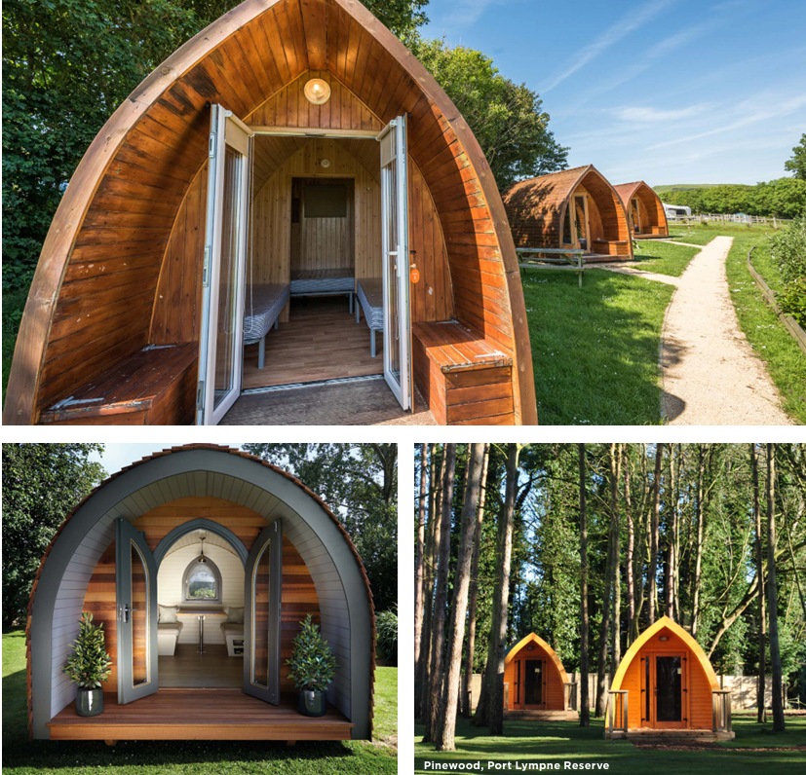
Camping Pods
Information provided by www.savills.ie
Very popular on many ‘touring unit’ holiday sites as an alternative form of accommodation to complement touring caravans and tents.
Land-owners in the right locations boast of a ROI (Return on Investment) typically being at 2-3 years.
Entry-level pods can be very basic, and as with the majority of glamping products, camping pods usually require separate washroom facilities
Typical Unit Cost €6,000-15,000
Typical Nightly Rental €50-100
56

Slide 57
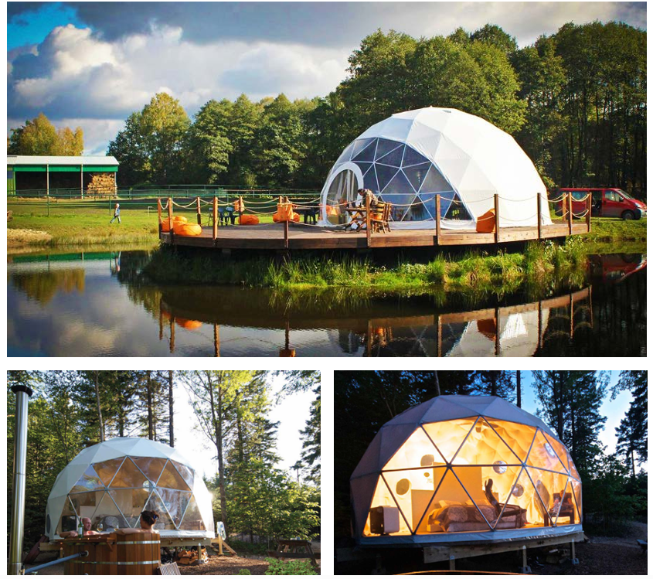
Geodesic Domes
Information provided by www.savills.ie
Simple facility to construct and can be suitable for year-round use, depending on specification.
The external appearance and evening light spill can cause issues with obtaining planning permission, although manufacturers are beginning to offer a variety of more muted external colours.
Good ROI in the right location. Ideal for summer stargazing breaks.
Typical Unit Cost €6,000-15,000
Typical Nightly Rental €95-150
57

Slide 58
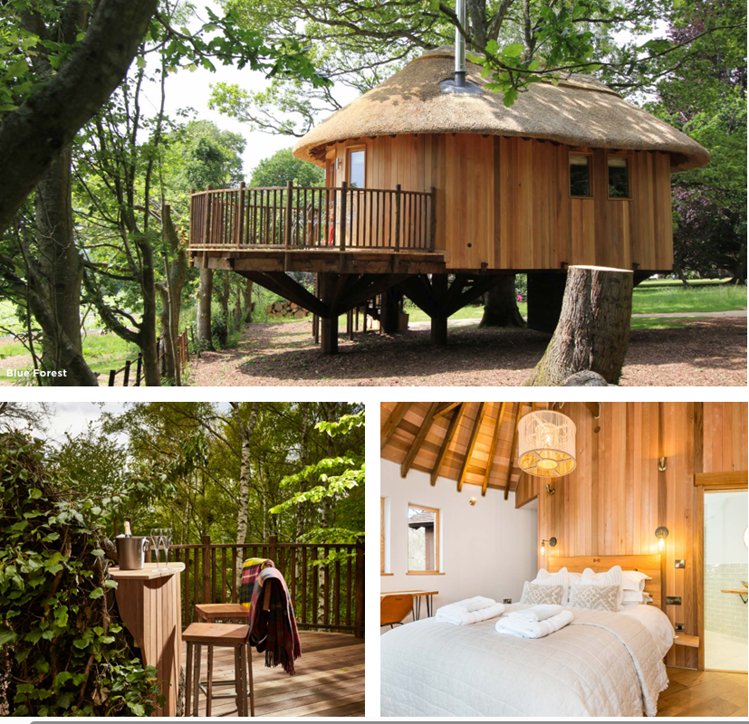
Tree Houses
Information provided by www.savills.ie
Treehouses allow for imaginative, innovative designs that can be used throughout the year.
Average occupancy and nightly rates are both high for unique designs.
Very popular with couples looking for a romantic, picturesque experience
Typical Unit Cost €50,000-120,000
Typical Nightly Rental €125-250
58

Slide 59
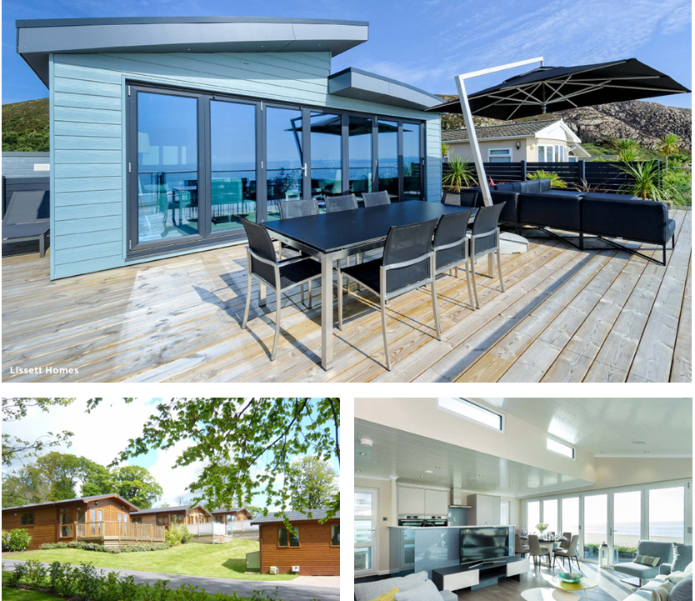
Lodges
Information provided by www.savills.ie
Lodges are popular on high quality holiday parks (existing and new) and arrive on site pre-constructed and fully furnished.
They typically sleep 4-6 people and meet the legal definition of a ‘caravan’.
In the right location they can command very high ROI.
The lodges are typically sold on 25 year licence agreements, thus enabling redevelopment and additional future sales.
Typical Unit Cost €60,000-120,000
Typical Nightly Rental €200-450
59

Slide 60
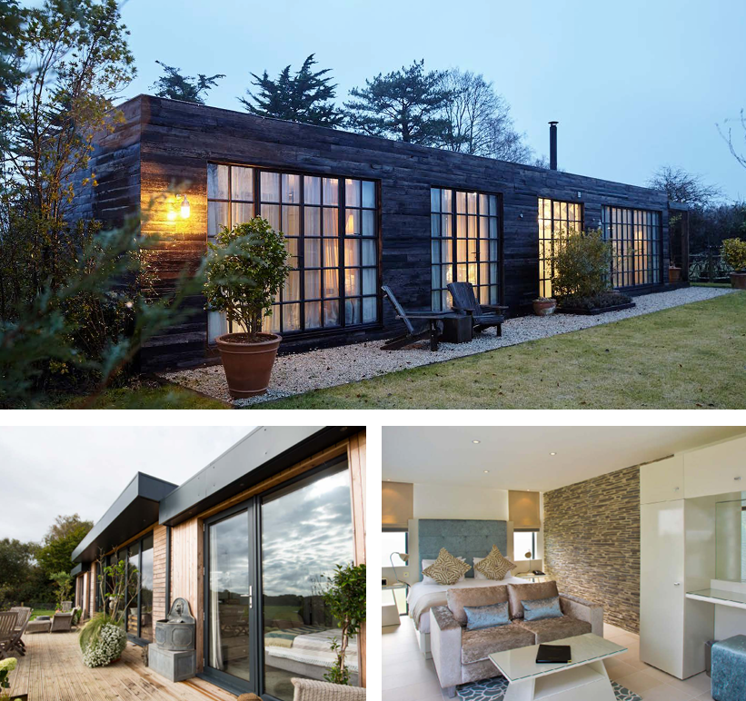
Modular Cottages
Information provided by www.savills.ie
Modular holiday accommodation (and indeed modular housing) is increasing in demand due to the short on-site construction process and the factory-led design and build.
A cost-effective alternative to traditional new build holiday cottages.
Modular apartments are now commonplace as bespoke garden room accommodation at resort locations or destinations.
Typical Unit Cost €80,000-100,000
Typical Nightly Rental €125-350
60

Slide 61
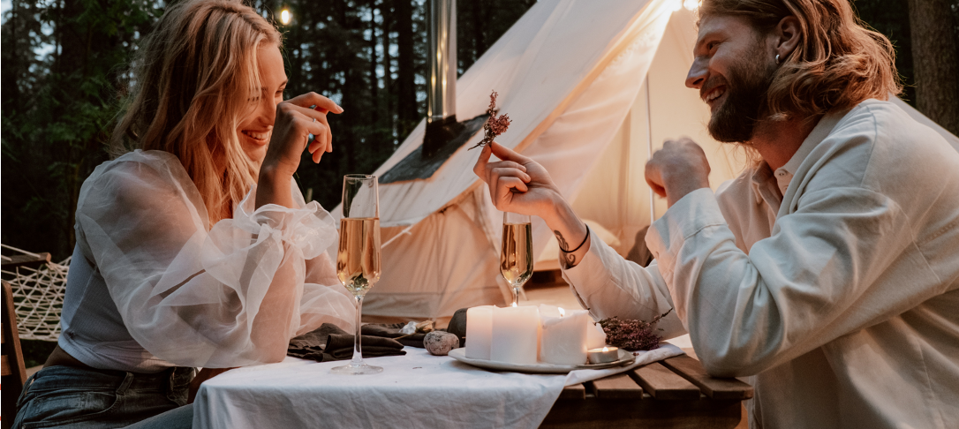
03
Know What Customers Will Pay For: Guest Appeal & Expectations
Understand who your guests are and what they’ll pay extra for, so you can align your offer with demand and maximise revenue.
Your guests will drive your revenue, so understanding what they value and are willing to pay for is essential. Whether it’s privacy, eco-features, cultural storytelling, or wellness add-ons, appeal directly translates to booking rates and pricing power. Skipping this step leads to costly misalignment between what you offer and what guests want. Researching your audience helps you make profitable design and service decisions from the start.
61

Slide 62
Priority 5 (€)
Understand your target market’s needs and motivations.
The ATA Value
Understanding Key Visitor Motivations!
Avoids costly misalignment; knowing who you serve = better marketing and higher bookings.
Recent data underscores the growing trend of alternative tourism accommodation. The global alternative accommodation market was valued at approximately €216.5 billion in 2024 and is projected to reach €715 billion by 2032, exhibiting a compound annual growth rate (CAGR) of 16.19%.
This surge is driven by travellers seeking personalised and flexible lodging options that traditional accommodations often lack.
62

Slide 63
Understanding Key Visitor Motivations!
Moreover, sustainability has become a pivotal factor in accommodation choices.
A 2023 report by the World Tourism Organisation (UNWTO) revealed that 73% of global tourists prefer to stay in establishments that implement sustainable practices.
This preference is reflected in the growth of the ecotourism market, which is expected to reach €245.41 billion by 2025, representing a 13.1% increase from the previous year.
The ATA Value
Recommended Reading
Cost vs Conscience: Booking.com Delves into the Dilemma Dividing Sustainable Travel
63

Slide 64
2025 The Year of Memorable & Purposeful Travel
01
The convergence of wellness, sustainability, and personalisation is shaping 2025 as a turning point for tourism—and it’s not just a cultural shift, it’s an economic one. As travellers move away from crowded destinations and toward unique, values-driven stays, the demand for alternative accommodations in rural and off-grid areas is rapidly increasing. This shift presents new commercial opportunities for those who are ready to offer immersive, low-impact, high-value experiences.
Growing Trend
Hotels are so last year, why everyone is choosing castles, caves, cranes…2025
64

Slide 65
2025 The Year of Memorable & Purposeful Travel
01
Brands with Purpose and Value:
For tourism, 2025 marked not just an evolution but a transformation toward more mindful, meaningful, and impactful travel. Tourists are no longer seeking just relaxation—they’re looking for transformational experiences. In response, travellers are showing a strong willingness to pay premium rates for stays that reflect authenticity, environmental care, and personal enrichment. Purpose-led brands that align with expectations are seeing higher occupancy, stronger brand loyalty, and greater margins per booking.
Unique, Memorable Stays:
From treehouses to converted farm buildings and nature-based glamping, non-traditional accommodations are booming. According to industry projections, global spending on unique stays is forecasted to reach $924 billion by 2034.
Growing Trend
65

Slide 66
Sustainable and Regenerative Travel
02
Sustainability
Sustainability has become a baseline expectation in tourism, with an increasing number of guests favouring eco-conscious brands. From luxury resorts to rural farmstays, accommodations are recognising the economic value of investing in sustainability, including carbon-neutral operations, waste reduction, and regenerative agriculture.
All properties (including luxury)
see the value and are now investing in initiatives that give back to local communities, restore natural landscapes, and preserve biodiversity. Hotels and accommodations that support carbon neutrality, reduce waste, and engage in regenerative agriculture are finding greater appeal among conscious travellers.
Growing Tend
66

Slide 67
Sustainable and Regenerative Travel
02
Eco-friendly Accommodation:
A significant number of travellers are prioritising eco-friendly accommodations.
According to Booking.com's 2023 Sustainable Travel Report, 76% of global travellers intend to embrace sustainable travel plans in the upcoming year. However, 49% perceive sustainable travel options as too expensive, highlighting a gap between interest and affordability, but still expect sustainability.
In Italy, research indicates that eco-certifications and environmental policies have a positive influence on tourists' destination and accommodation choices, suggesting that sustainability credentials can serve as a competitive advantage.
Growing Tend
67

Slide 68
Wellness, Reconnection and Nature-Centric Experiences
03
Wellness tourism
Wellness tourism is on the rise, with travellers seeking accommodations that offer health-oriented experiences. The global wellness tourism industry was valued at $850.55 billion in 2021 and is projected to grow significantly.
Alternative accommodations often provide access to nature, tranquillity, and wellness activities, aligning with the desires of wellness-focused travellers.
Modern luxury and travel
often now mean proximity to nature and meaningful interactions with the environment. Hotels are creating immersive, nature-based experiences that encourage guests to disconnect from technology and reconnect with the world around them.
Growing Tend
68

Slide 69
Wellness, Reconnection and Nature-Centric Experiences
03
Growing Tend
Activities
Activities like forest bathing, eco-tours, and wellness hikes are popular among those seeking a tranquil retreat away from urban chaos.
These experiences promote well-being by leveraging the natural healing properties of serene environments, offering a profound sense of calm and revitalisation. This is covered in greater detail later in this Module.
69

Slide 70
Cultural Immersion, Authenticity & Local Experiences
04
Growing Tend
Travellers are increasingly drawn to destinations offering culturally enriching experiences, as they seek deeper connections with local traditions and communities.
Cultural Immersion & Local Experiences:
In response, hotels and accommodations are enhancing their offerings with culturally immersive activities that range from traditional culinary workshops to artisan crafts and local storytelling. This trend not only enriches the guest experience but also supports cultural preservation and celebrates the unique heritage of each destination, adding an extra layer of authenticity to luxury travel.
70

Slide 71
Cultural Immersion, Authenticity & Local Experiences
04
European tourists:
European tourists are increasingly motivated by authentic and immersive experiences. They seek to avoid the negative impacts of travel and desire assurance that their expenditures directly benefit the communities they visit.
Platforms:
Platforms like Fairbnb and Ecobnb cater to this demand by offering accommodations that support local communities and adhere to sustainable practices.
Growing Tend
Recommended Reading
The European market potential for community-based tourism 2023
The Guardian: A break from the accommodation mega-sites
71

Slide 72
Positive Impact on the Local Community and Economy
05
Alternative tourism and accommodation play a vital role in enhancing local communities by generating employment, supporting independent and local businesses, and preserving cultural heritage.
By collaborating with local artisans, farmers, and guides, your business can directly contribute to the area’s economic resilience and social well-being, while also building long-term sustainability, viability and authenticity into your operations.
Growing Tend
Recommended Reading
The Ecotourism Business Handbook.
The Power of Balanced Tourism Growth: Fueling Sustainable Development
2025: A Pivotal Year for Transformation in Hospitality and Wellness
72

Slide 73
Positive Impact on the Local Community and Economy
05
Growing Tend
To contribute meaningfully to local economic development, your business should embrace the principles of balanced tourism growth. This involves actively supporting local entrepreneurship, small and medium-sized enterprises (SMEs), and job creation within the community.
When tourism-generated revenue is reinvested in local infrastructure, community initiatives, and the preservation of cultural heritage sites, it ensures that the benefits of tourism are shared equitably and sustainably.
73

Slide 74
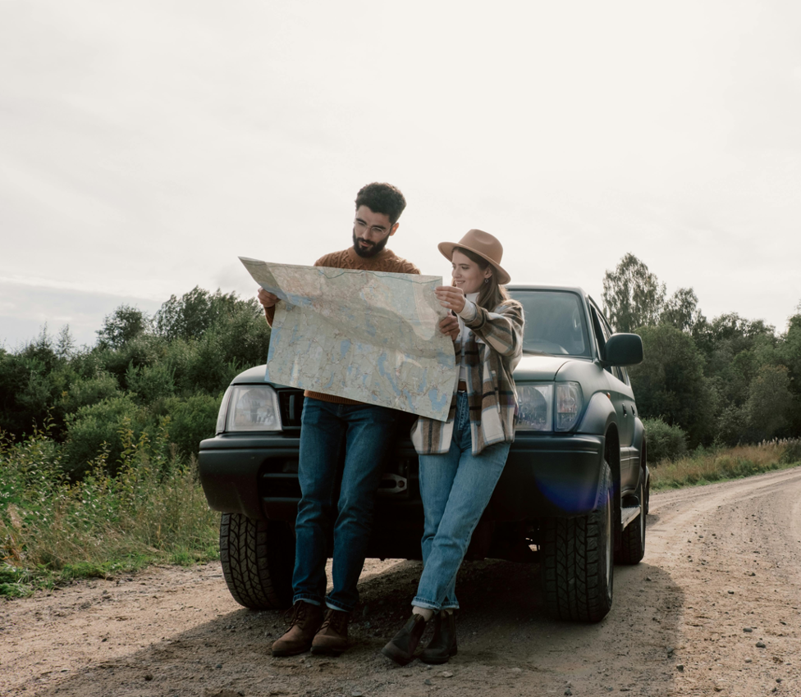
Planning Your Alternative Tourism Accommodation
Incorporating Guest Appeal and Expectations
It is vital you include your visitor in all decision-making when setting up an ATA. This section is an important first step," — emphasises the importance of visitor-centred planning in the development of Alternative Tourism Accommodation (ATA).
See the next slide for why this is a crucial first step
74

Slide 75
Incorporating Guest Appeal and Expectations
Here's Why This Is A Crucial First Step:
Builds Purpose-Driven Design:
Involving your future guests ensures your accommodation reflects their needs, values, and expectations — whether it’s sustainability, accessibility, authenticity, or comfort. This helps shape a concept that has actual demand.
Improves Guest Satisfaction:
When visitors are considered from the outset, you avoid costly mistakes later (e.g., building in an area that’s hard to access, or missing desired features like nature immersion, wellness options, or communal space).
Strengthens Your Value Proposition:
An alternative accommodation tourism offering rooted in visitor insights is more likely to stand out. Alternative tourists tend to seek unique experiences, meaningful local engagement, and environmental responsibility. By including them in early decisions, you create a more aligned and desirable product.
75

Slide 76
Incorporating Guest Appeal and Expectations
Here's Why This Is A Crucial First Step:
Encourages Word-of-Mouth & Loyalty:
Encourages Word-of-Mouth & Loyalty: Visitors who feel your space was created with them in mind are more likely to become advocates, return guests, or supporters on social media and review platforms.
When making any business decision, you must first put yourself in their shoes
Example: When making decisions in planning, building, and launching, consider every detail and whether it will enhance or affect their experience, e.g., how they will feel engaging in the types of experiences you provide (glamping, wellness treatments, engaging in immediate environment), layout of space (privacy, accessibility) to environmental considerations (type of building and waste systems)
76

Slide 77
Planning Your Alternative Tourism Accommodation
Understanding Key Visitor Motivations When Choosing an ATA
We have established that it is vital to include your visitor in all decision-making when setting up an ATA. This section covers and emphasises the importance of visitor-centred planning in the development of Alternative Tourism Accommodation (ATA).
First, let’s look at visitor key motivations, preferences and expectations when choosing an ATA. Tourists across Europe are increasingly opting for Alternative Tourism Accommodations, such as eco-lodges, agritourism farms, glamping sites, and heritage stays over conventional hotels.
Why?
This shift is driven by a desire for sustainability, authenticity, wellness, and immersive experiences. We will next examine the key visitor motivations and trends driving this industry, supported by recent data and studies.
Recommended Reading
Failte Ireland Eco-tourism Handbook
Eco-certification: Promoting sustainable tourism through eco-friendly practices in hotels
77

Slide 78
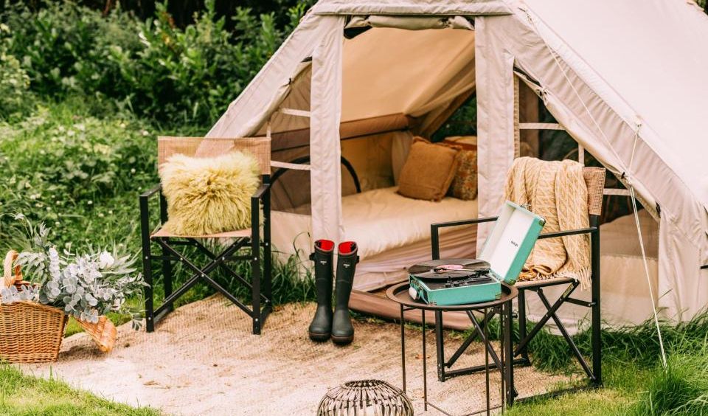
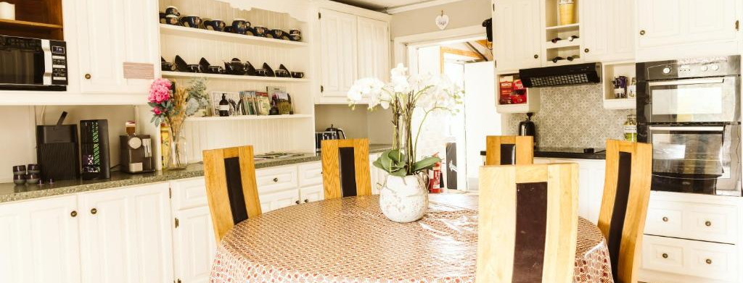
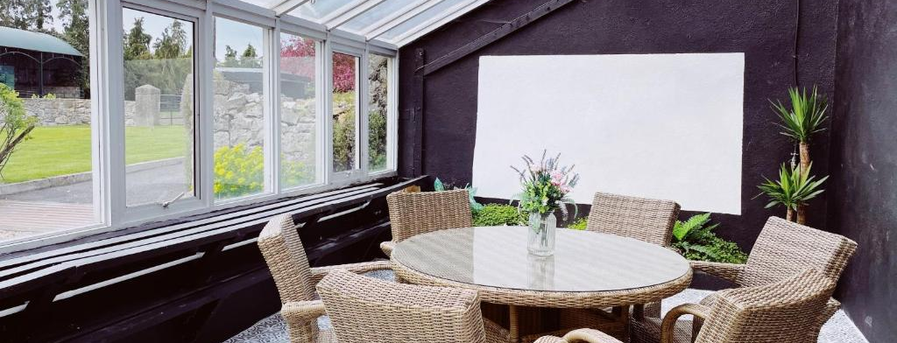
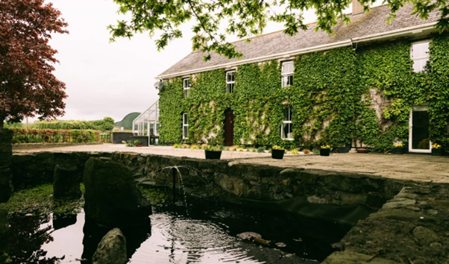
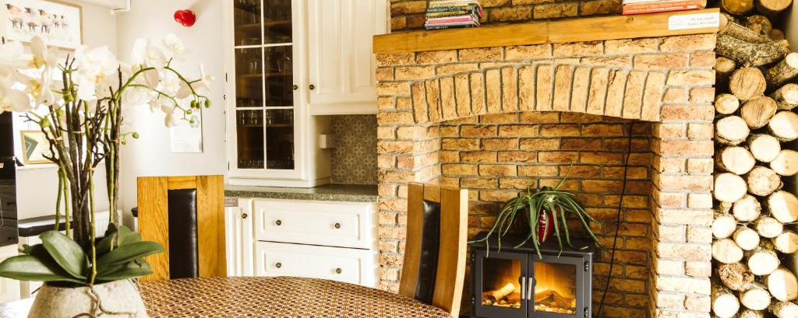
Nature & Environement
Photo Credit: Fitz of Inch, Ireland
78

Slide 79
Well Done
Module 6 (Part 2)
Location, Planning,
Land & Logistics
You have Completed… Module 6 (Part 1)
Getting Started - Foundations of Your Business and Market
Next is…

