Slide 1
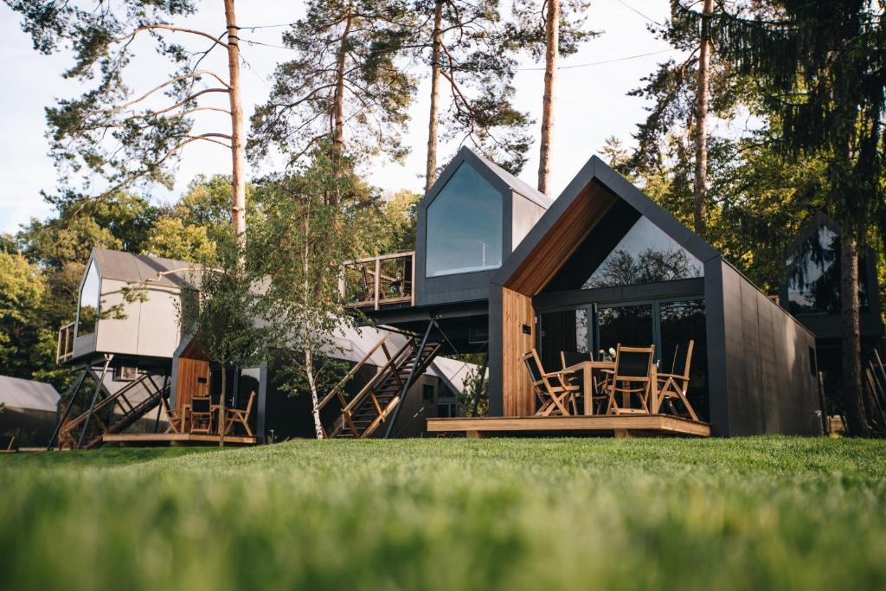

Photo Credit: Luxury Glamping Chocolate Village, Slovenia
Module 3 (Part 2)
Designing Sustainable & Place-Based Accommodation
www.epicstays.eu

Slide 2
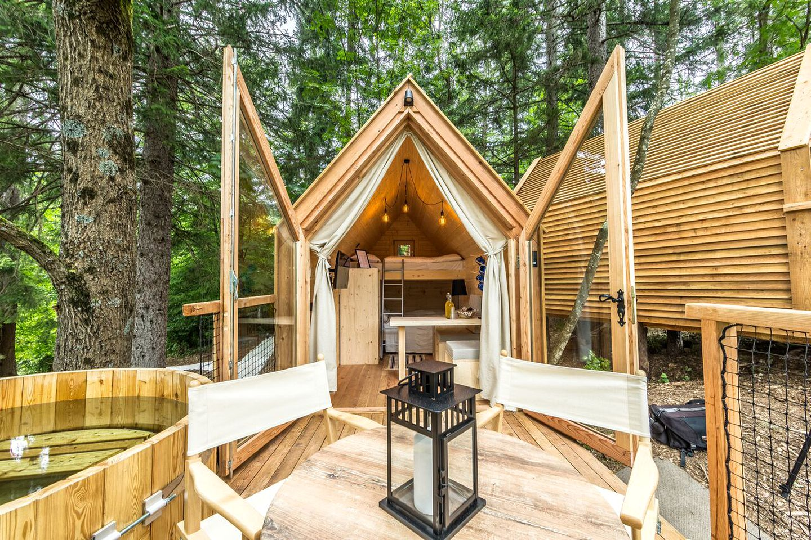
Module 3 (Part 2)
Photo Credit:
Tree house in Bled, Upper Carniola, Slovenia
Section 2
Better Building Choices Materials, Layout & Flexibility

Slide 3
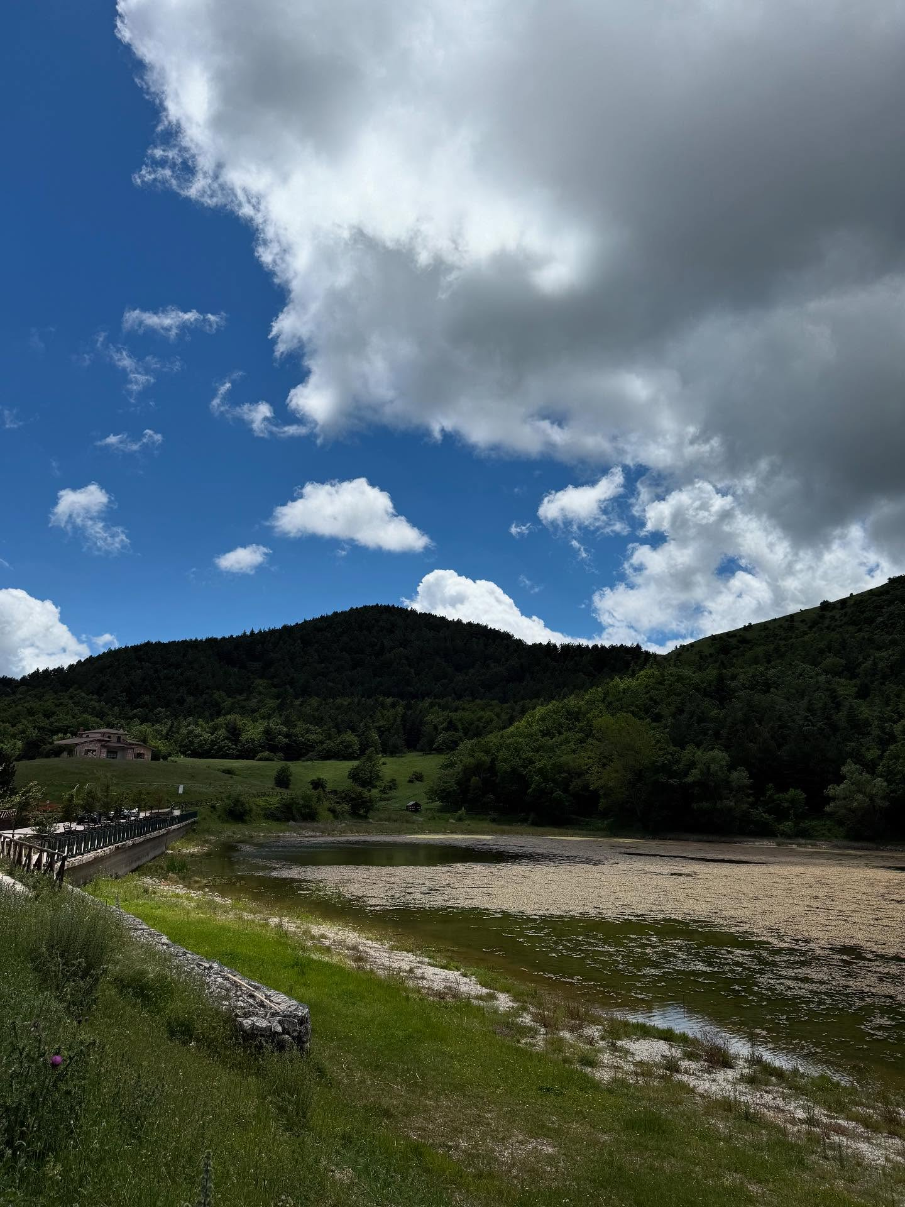
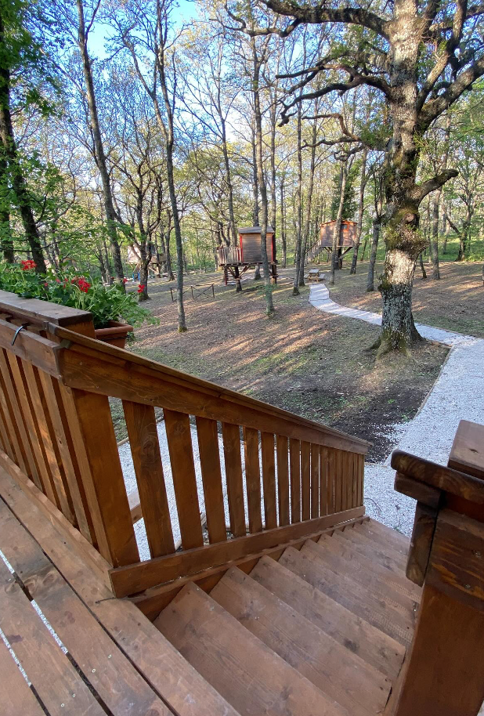
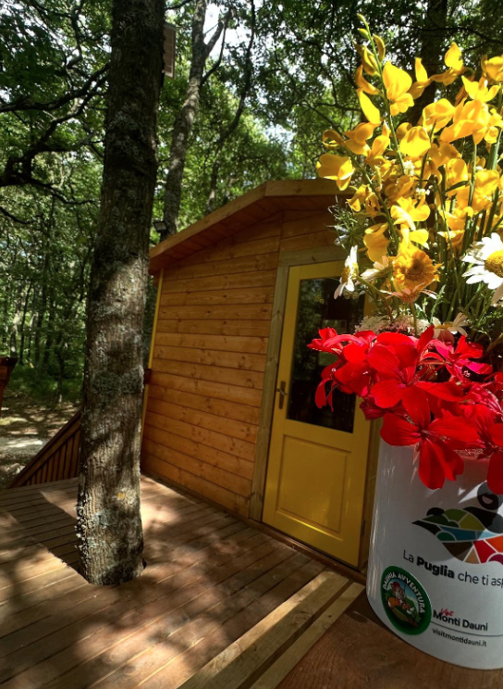
02
Photo Credit: Daunia Avventura, Biccari
Page 5
Photo Credit: Daunia Avventura, Biccari
Better Building Choices
Materials, Layout & Flexibility
CONTENTS
01
03
Page 4
Page 30
Module 3
Overview & Learning Objectives
Additional Resources including reading materials, videos, tools and exercises.
Photo Credit: Daunia Avventura, Biccari

Slide 4
Module 3 Overview
Learning Objectives
Module 3 shows how alternative accommodation can be both sustainable and deeply connected to local identity. Discover how thoughtful design, material selection, and landscape integration not only support the environment but also empower communities and preserve culture. Learn how building choices can create unique, memorable tourism experiences- especially in rural or overlooked areas.
It covers 3 Key Sections:
Smart Starts: Adapting Buildings & Using Pre-Built Units
Better Building Choices - Materials, Layout & Flexibility
Right-Sized Stays That Make a Local Impact
02
Better Building Choices — Materials, Layout & Flexibility
Go on a learning journey of understanding eco-conscious material choices and spatial design that supports both privacy and community, and multifunctional layouts adaptable to seasonal changes and evolving business models.
Learn how to choose sustainable materials and smart layout with suitable design, maximum comfort and efficiency.
Explore in particular bioclimatic layouts that use passive energy, support indoor-outdoor living, and adapt to rural settings.

Slide 5
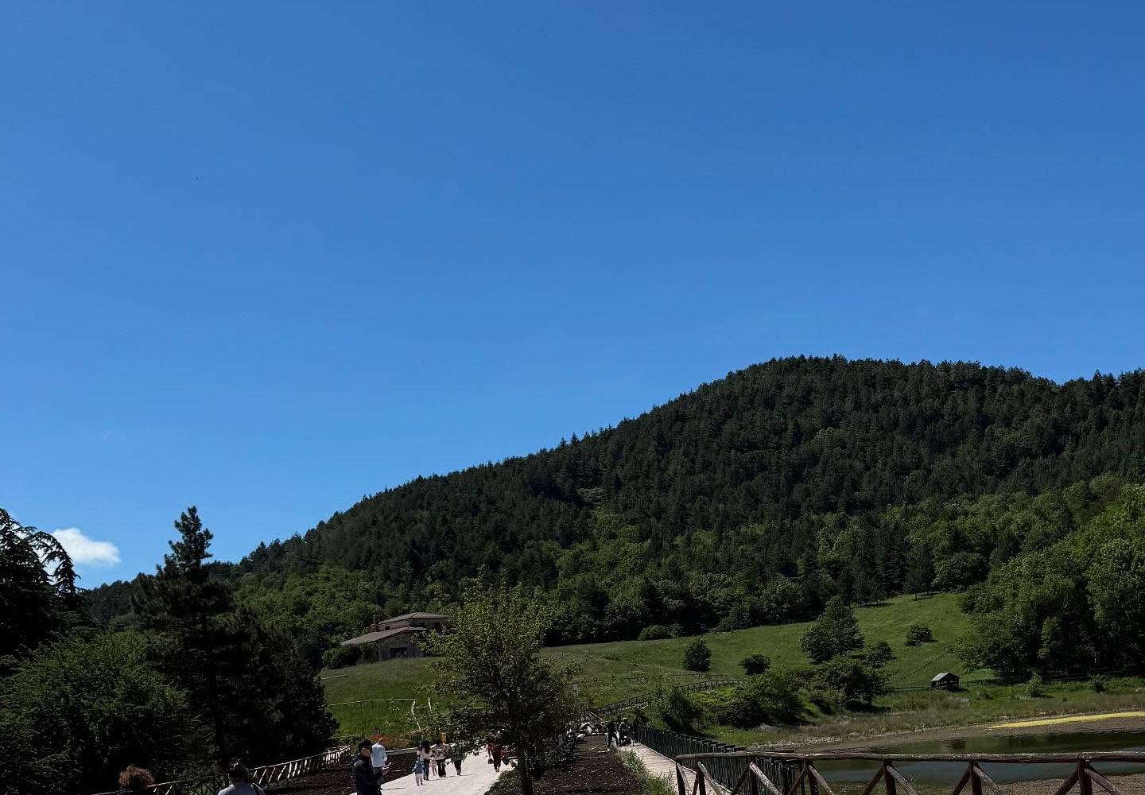
Section 2
Photo Credit: Daunia Avventura, Biccari
Better Building Choices Materials, Layout & Flexibility

Slide 6
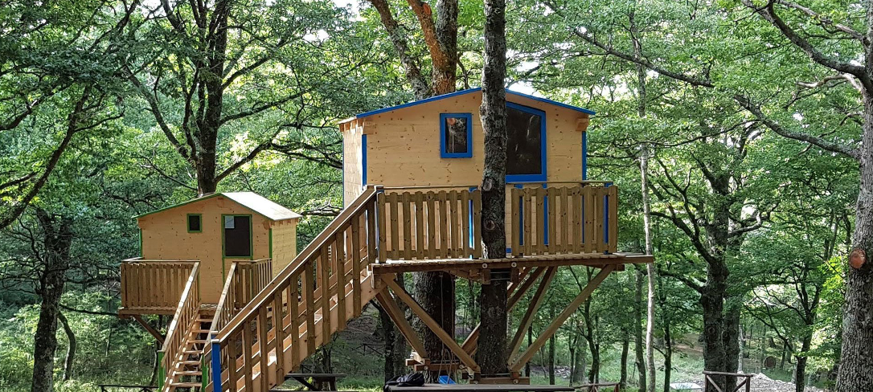
Photo Credit: : Meridaunia
Section 2
Better Building Choices - Materials, Layout & Flexibility
Overview:
This section focuses on how smart material and design choices can make alternative accommodation both sustainable and meaningful.
Using local, recycled, or eco-friendly materials reduces environmental impact while supporting local economies and cultural heritage. A flexible, climate-responsive layout ensures comfort for guests and efficient use of resources. Whether converting existing spaces or building new ones, the goal is to create accommodations that blend with the landscape, serve the community, and offer unique, authentic experiences.
6

Slide 7
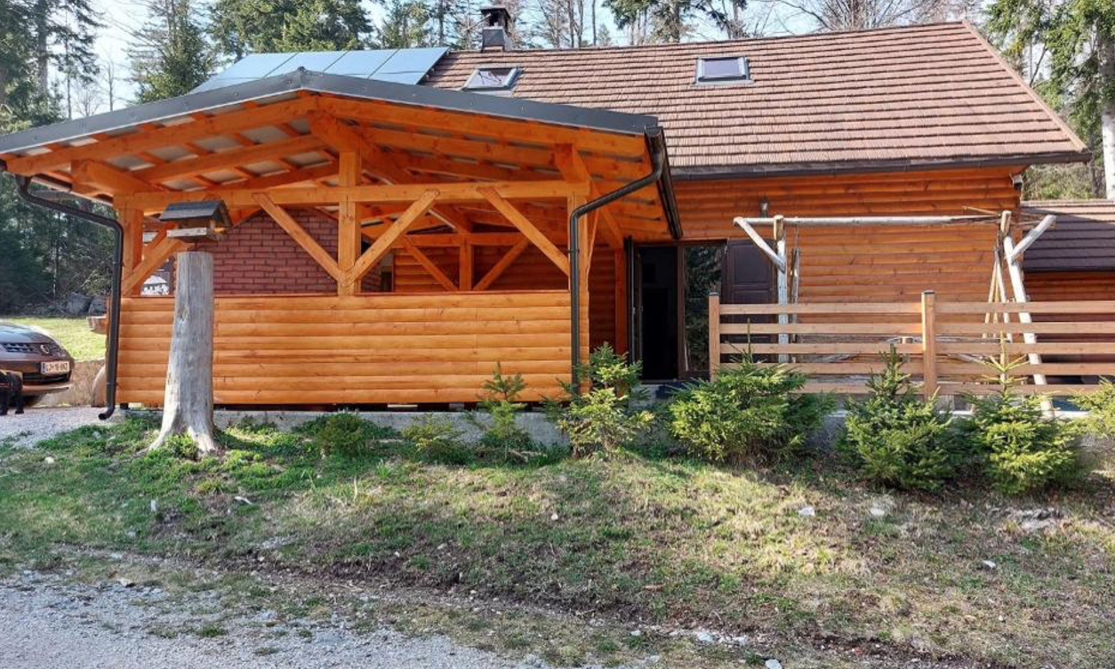
Introduction - Better Building Choices - Materials, Layout & Flexibility
Holiday Home Polsak, Slovenia
When designing alternative accommodation, the materials you choose and the way you design the space are not just technical decisions - they are statements about your values and your connection to place. This section explores how to make conscious building choices that prioritize sustainability, cultural sensitivity, and guest comfort.
Source: UNWTO (2021). Tourism and Rural Development.
World Tourism Organization.
https://www.unwto.org/tourism-and-rural-development
7

Slide 8
Introduction - Better Building Choices - Materials, Layout & Flexibility
By selecting local, recycled, or low-impact materials, you reduce your environmental footprint while supporting regional crafts and industries. Choosing the right layout goes beyond aesthetics: it means creating spaces that are flexible, efficient, and adaptable to different uses and seasons. Bioclimatic design, passive energy use, and multi-functional spaces can enhance both guest experience and resource efficiency.
In this section, you’ll learn how to balance ecological responsibility with hospitality excellence, ensuring that your accommodation respects the environment while providing comfort and authenticity. Whether you are adapting a historic building, designing a small eco-lodge, or constructing modular units, better building choices lead to accommodations that are memorable, meaningful, and sustainable.
Source: UNWTO (2021). Tourism and Rural Development.
World Tourism Organization.
https://www.unwto.org/tourism-and-rural-development
8

Slide 9
Section 1: 4 Key Learning Areas
01
Choosing Sustainable and
Local Materials:
Understand how to select building materials that are eco-friendly, locally sourced, or recycled. Learn why this matters for reducing carbon footprints, supporting local economies, and creating authentic guest experiences that reflect regional identity.

Slide 10
Section 1: 4 Key Learning Areas
02
Designing for Passive Energy Efficiency:
Explore how to use bioclimatic design principles - like natural ventilation, passive heating and cooling, and solar orientation - to reduce energy use while maximizing guest comfort. Learn how layout choices can make accommodation both comfortable and environmentally responsible.

Slide 11
Section 1: 4 Key Learning Areas
03
Creating Flexible and
Multi-Functional Spaces:
Learn how to design spaces that adapt to different uses, seasons, or guest types. Understand the importance of flexible layouts, shared spaces, and indoor-outdoor flow to enhance both guest experience and operational efficiency

Slide 12
Section 1: 4 Key Learning Areas
04
Building for Long-Term Sustainability and
Community Benefit:
Discover how thoughtful building design can support not only environmental sustainability but also local social and economic resilience. Learn how construction choices can align with circular economy principles, reduce waste, and leave a positive legacy in the community.

Slide 13
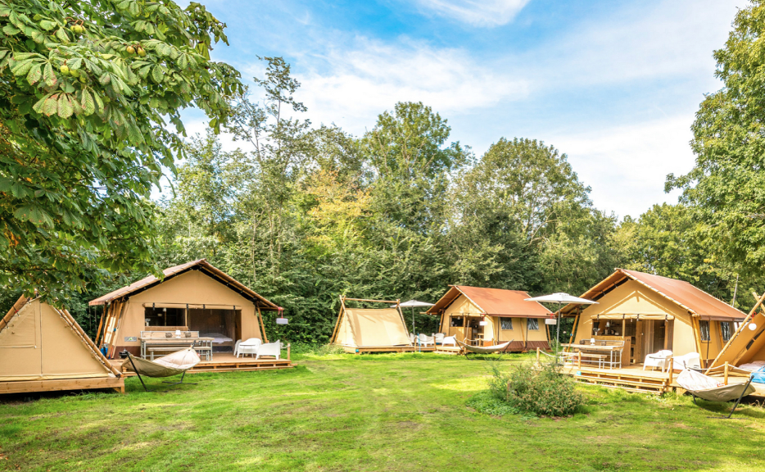
01
Choosing Sustainable and Local Materials
Key Learning Area
Selecting the right building materials is one of the most important decisions in developing alternative tourism accommodation - especially in rural or sensitive environments.
Using eco-friendly, locally sourced, or recycled materials reduces the environmental footprint of construction by minimizing transportation emissions, lowering resource extraction, and avoiding harmful production processes.
Photo credit:
Vrij Haven Camping, Netherlands
13

Slide 14
01
Choosing Sustainable and Local Materials
Key Learning Area
Choosing materials from local suppliers not only helps cut carbon emissions but also stimulates local economies, creating jobs and sustaining traditional craftsmanship. Moreover, using materials that reflect the identity of the region - like local stone, reclaimed wood, or traditional ceramics- adds a sense of place to the guest experience.
When visitors see and touch authentic, regionally inspired materials, their stay becomes more meaningful and immersive. This approach helps accommodation providers balance environmental responsibility with cultural authenticity, building unique spaces that resonate with modern travelers who value sustainability and connection to the local community.
14

Slide 15
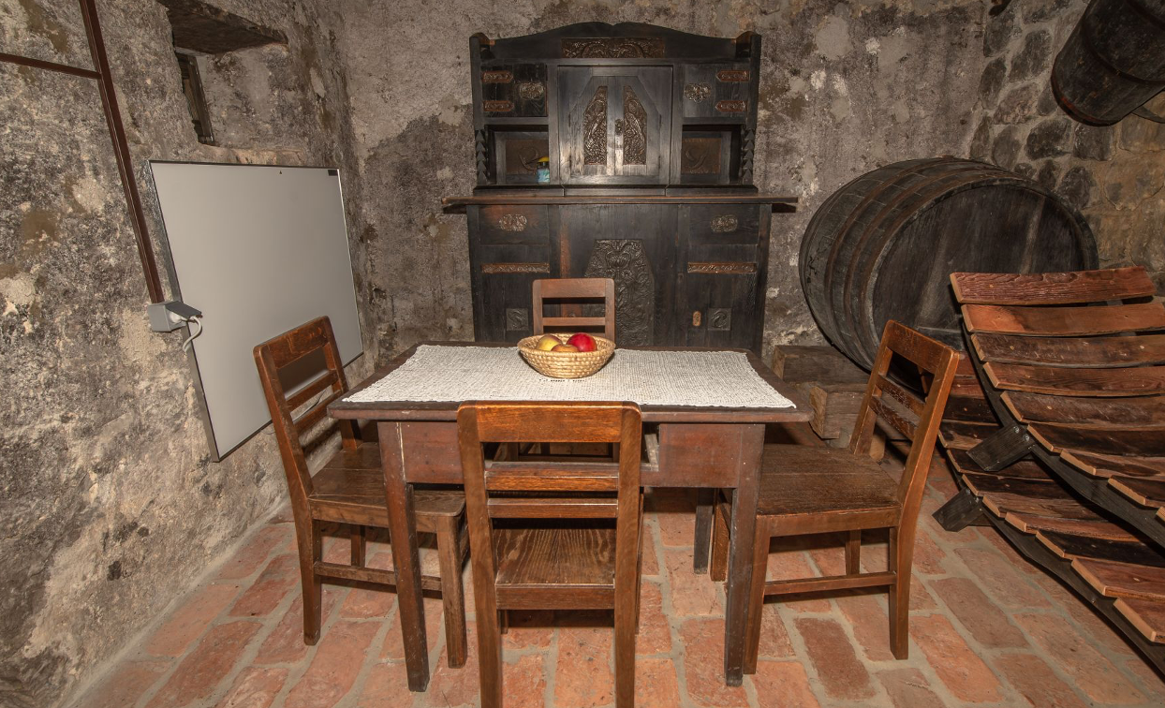
Core Contents
Photo credit:
Vineyard Cottage Skatlar, Slovenia
Environmental Benefits of Sustainable Materials
Learn how choosing eco-friendly materials - such as reclaimed wood, natural stone, bamboo, cork, or recycled composites - can reduce energy use, minimize waste, and lower your carbon footprint. Understand life-cycle assessments and how materials impact the environment from sourcing to disposal
15

Slide 16
Core Contents
Supporting Local
Supply Chains
Enhancing Guest Experience through Authentic Design
Explore how working with local artisans, suppliers, and construction professionals fosters regional economic development. Using locally sourced materials reduces transport emissions, supports local businesses, and preserves traditional building techniques that contribute to a sense of place.
Discover how material choices shape the look, feel, and emotional impact of a space. Local and natural materials create authentic, story-rich environments that guests remember and share, reinforcing the value of cultural immersion in tourism experiences.
16

Slide 17
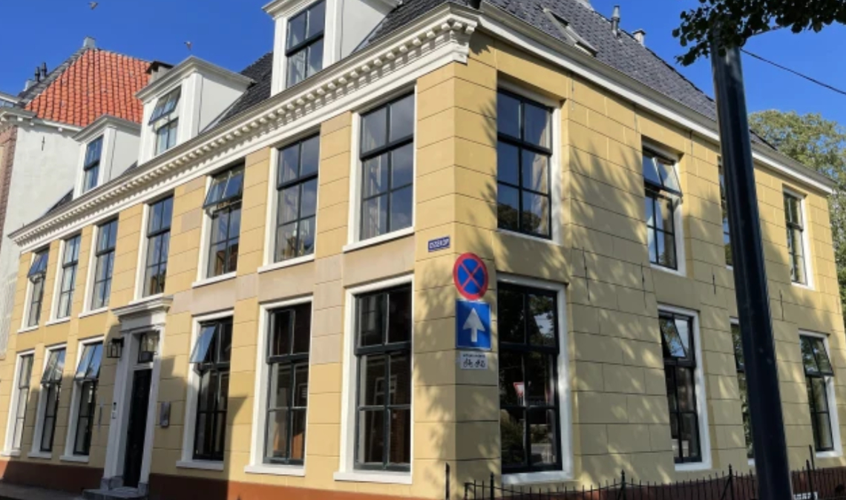
Core Contents
Balancing Cost, Sustainability, and Durability
Photo credit:
De Old Signorie BB, Netherlands
Understand how to evaluate materials not just for price, but for long-term performance, maintenance needs, and sustainability credentials. Learn how to balance aesthetics with function, ensuring that materials are durable, energy-efficient, and suitable for the local climate and context.
17

Slide 18
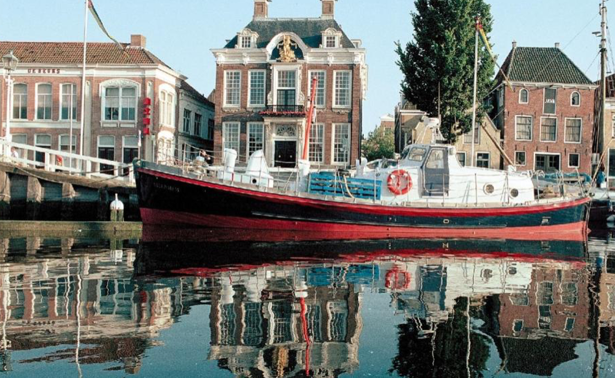
02
Designing for Passive Energy Efficiency
Key Learning Area
Designing for Passive Energy Efficiency means creating spaces that naturally regulate temperature and airflow, minimizing the need for artificial heating, cooling, or lighting. By applying bioclimatic design principles, you can align your building’s layout with the natural environment to reduce energy use while maintaining guest comfort.
Photo credit:
Reddingsboot Harlingen Boat, Netherlands
18

Slide 19
02
Designing for Passive Energy Efficiency
Key Learning Area
This involves thoughtful decisions about building orientation - such as positioning windows to capture sunlight in colder months and providing shade in warmer ones. It also includes integrating natural ventilation, using thermal mass materials like stone or concrete to retain heat, and designing overhangs or green roofs to control temperature variations.
For rural or alternative accommodations, where utility connections might be limited or costly, passive energy strategies offer an affordable, eco-friendly solution that enhances both sustainability and guest satisfaction.
19

Slide 20
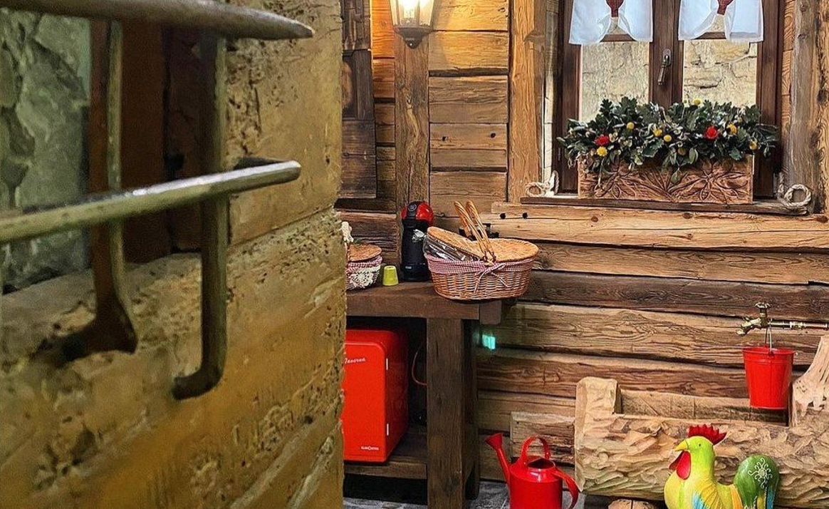
Core Contents
Photo credit:
Urban Picnic, Italy
Bioclimatic Design Principles
Discover how to design accommodations that naturally stay cool in summer and warm in winter by using smart layout, solar orientation, cross-ventilation, and shading techniques. This reduces reliance on artificial heating and cooling systems, cuts energy costs, and provides guests with a comfortable, climate-sensitive stay.
20

Slide 21
Core Contents
Smart Orientation and Layout
Thermal Mass and Insulation
Master the art of positioning windows, doors, and walls to maximize natural light, encourage effective airflow, and support passive temperature control. Strategic layout decisions like these not only elevate guest comfort but also minimize reliance on mechanical heating and cooling, making your accommodation more energy-efficient and environmentally responsible..
Learn practical strategies to promote natural airflow, including the use of cross-ventilation designs, operable windows, and open-air spaces that encourage passive cooling. These solutions reduce reliance on mechanical systems, lower energy costs, and create a healthier, more comfortable environment for guests.
21

Slide 22
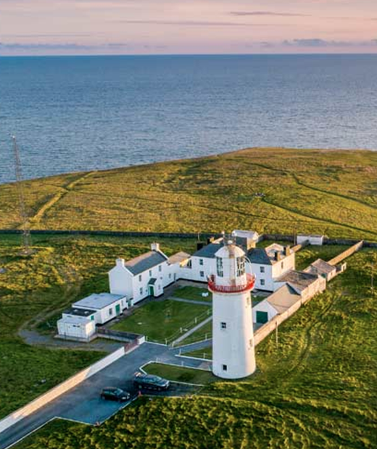
Core Contents
Natural Ventilation Techniques
Learn practical strategies to promote natural airflow, including the use of cross-ventilation designs, operable windows, and open-air spaces that encourage passive cooling. These solutions reduce reliance on mechanical systems, lower energy costs, and create a healthier, more comfortable environment for guests.
Photo credit: LoopHead Lighthouse.ie
22

Slide 23
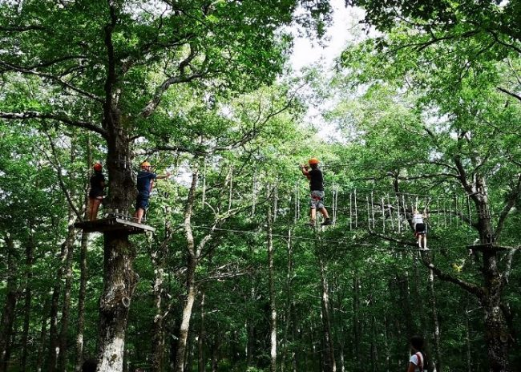
Core Contents
Green Integration Features
Incorporate elements such as green roofs, shaded terraces, and living walls to naturally regulate temperature while enriching both the biodiversity of the site and the guest experience. These features not only improve thermal comfort but also create visually appealing spaces that connect visitors with the surrounding environment.
Photo Credit: Daunia Avventura, Biccari

Slide 24


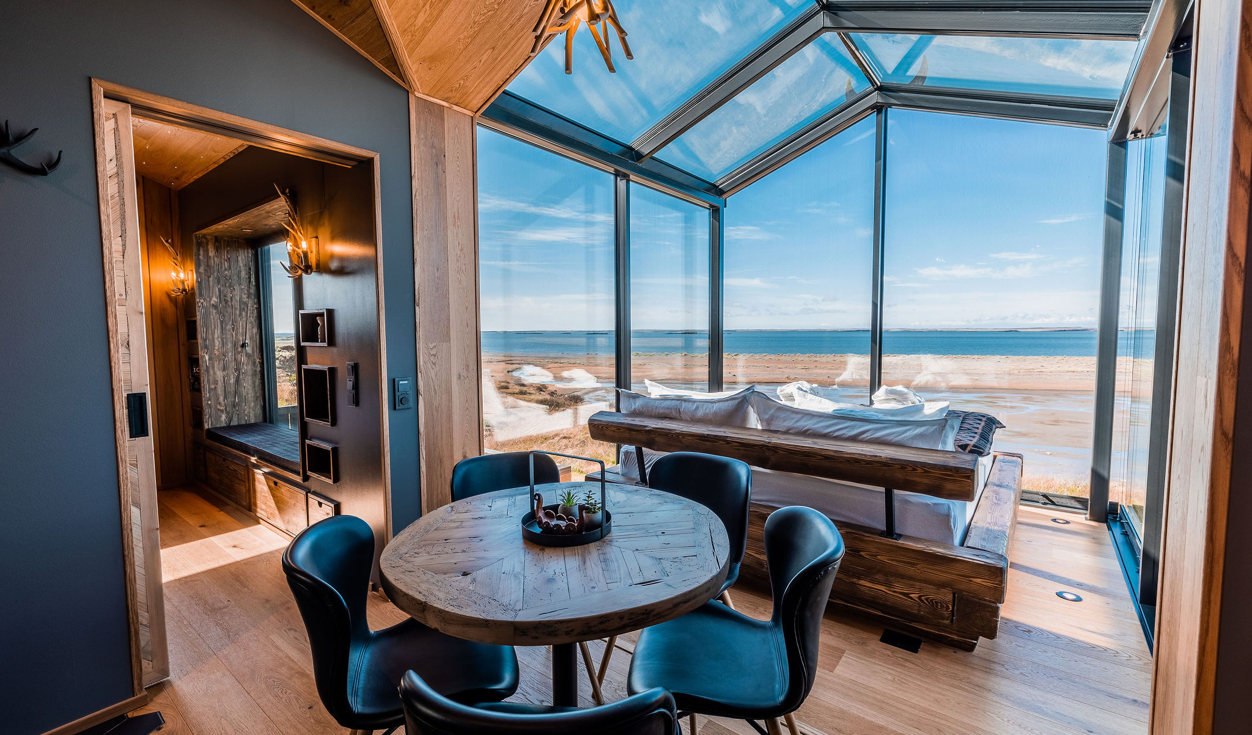
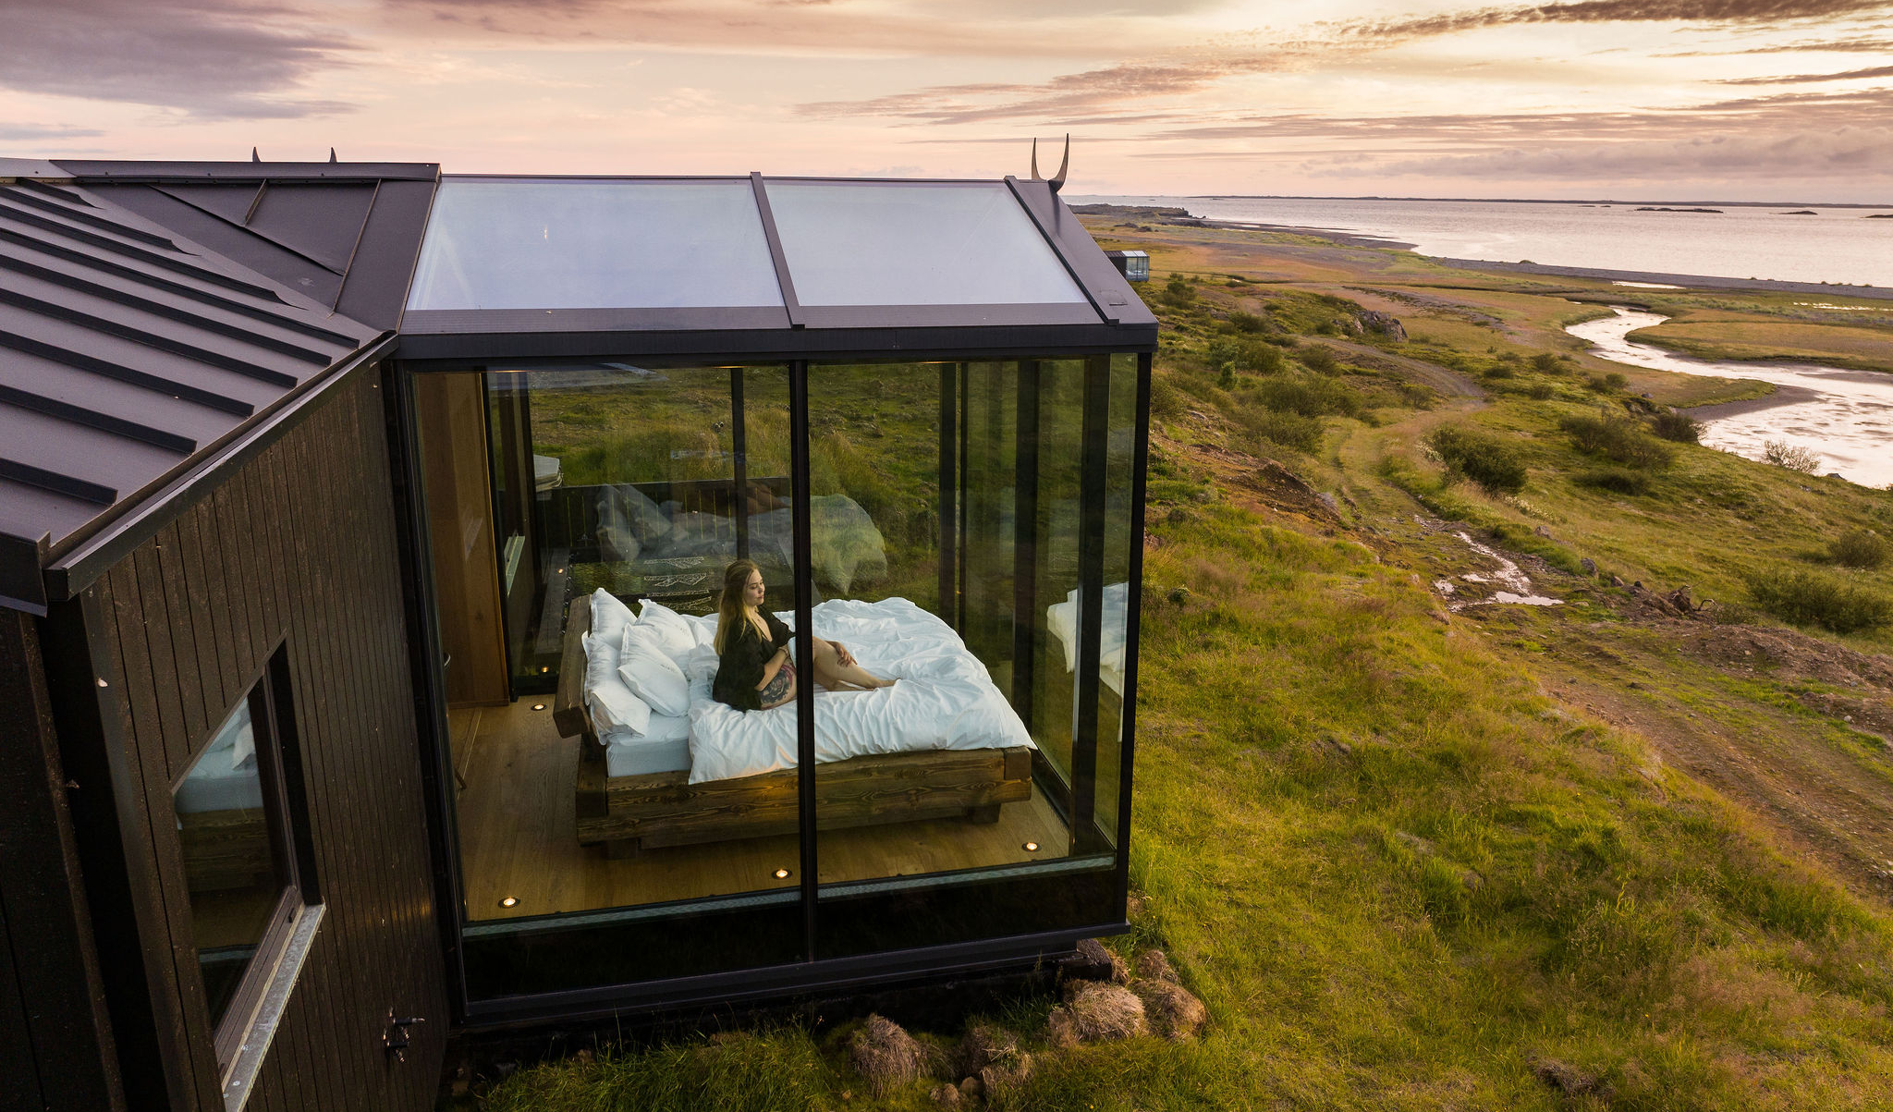
ICELAND
Photo Credit: Panoramic Glass Lodge, Iceland
24

Slide 25
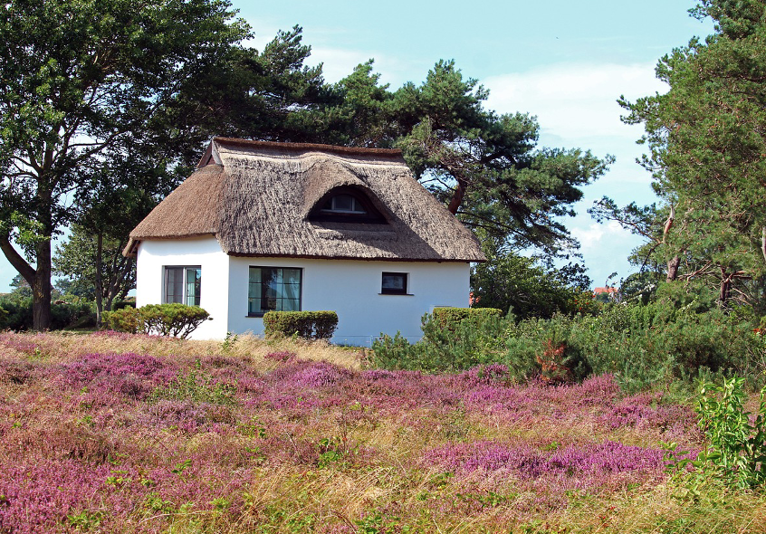
03
Creating Flexible and Multi-Functional Spaces
Key Learning Area
Creating Flexible and Multi-Functional Spaces means designing accommodation that can adapt to changing needs over time. In rural and alternative tourism contexts, this approach allows buildings to serve multiple purposes - such as transforming a dining area into a workshop space or a guest room into a co-working nook.
Photo Crdit: Hiddensee
25

Slide 26
03
Creating Flexible and Multi-Functional Spaces
Key Learning Area
By designing rooms that are modular, reconfigurable, or open to different uses, small-scale tourism businesses can optimize space, reduce operational costs, and extend the usability of their property across seasons.
This flexibility also supports resilience, allowing owners to pivot their services in response to market changes, guest expectations, or community needs. For guests, multi-functional spaces create richer, more engaging experiences, fostering interaction and connection in settings that feel both personal and versatile.
26

Slide 27
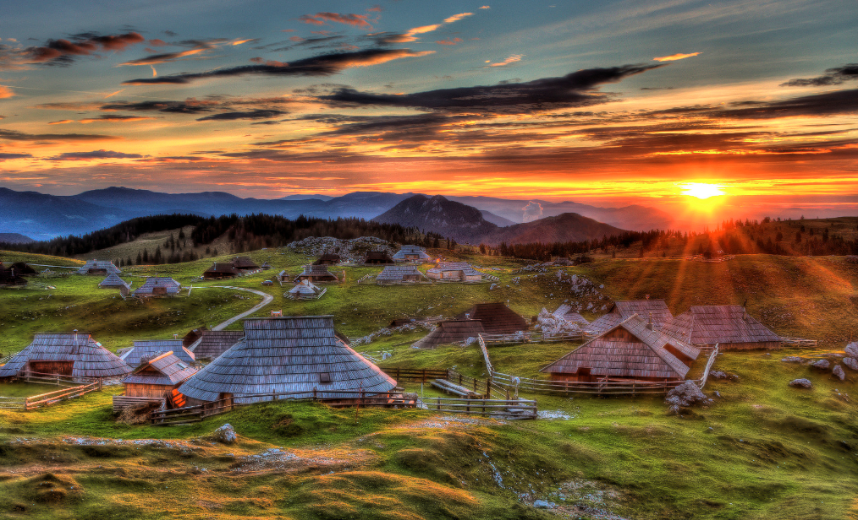
Core Contents
Photo Credit: Velika Planina, Slovenia
Designing for Adaptability
Learn how to create versatile spaces that can serve different functions throughout the day or year, such as combining guest relaxation areas with community event spaces.
27

Slide 28
Core Contents
Modular Furniture and Smart Interiors
Seamless Indoor-Outdoor Integration
Explore the use of foldable, stackable, or movable furniture to quickly shift room layouts while keeping the design cohesive and guest-friendly.
Understand how to extend accommodation spaces into outdoor areas, using terraces, patios, and gardens to offer more flexible, nature-connected experiences.
28

Slide 29
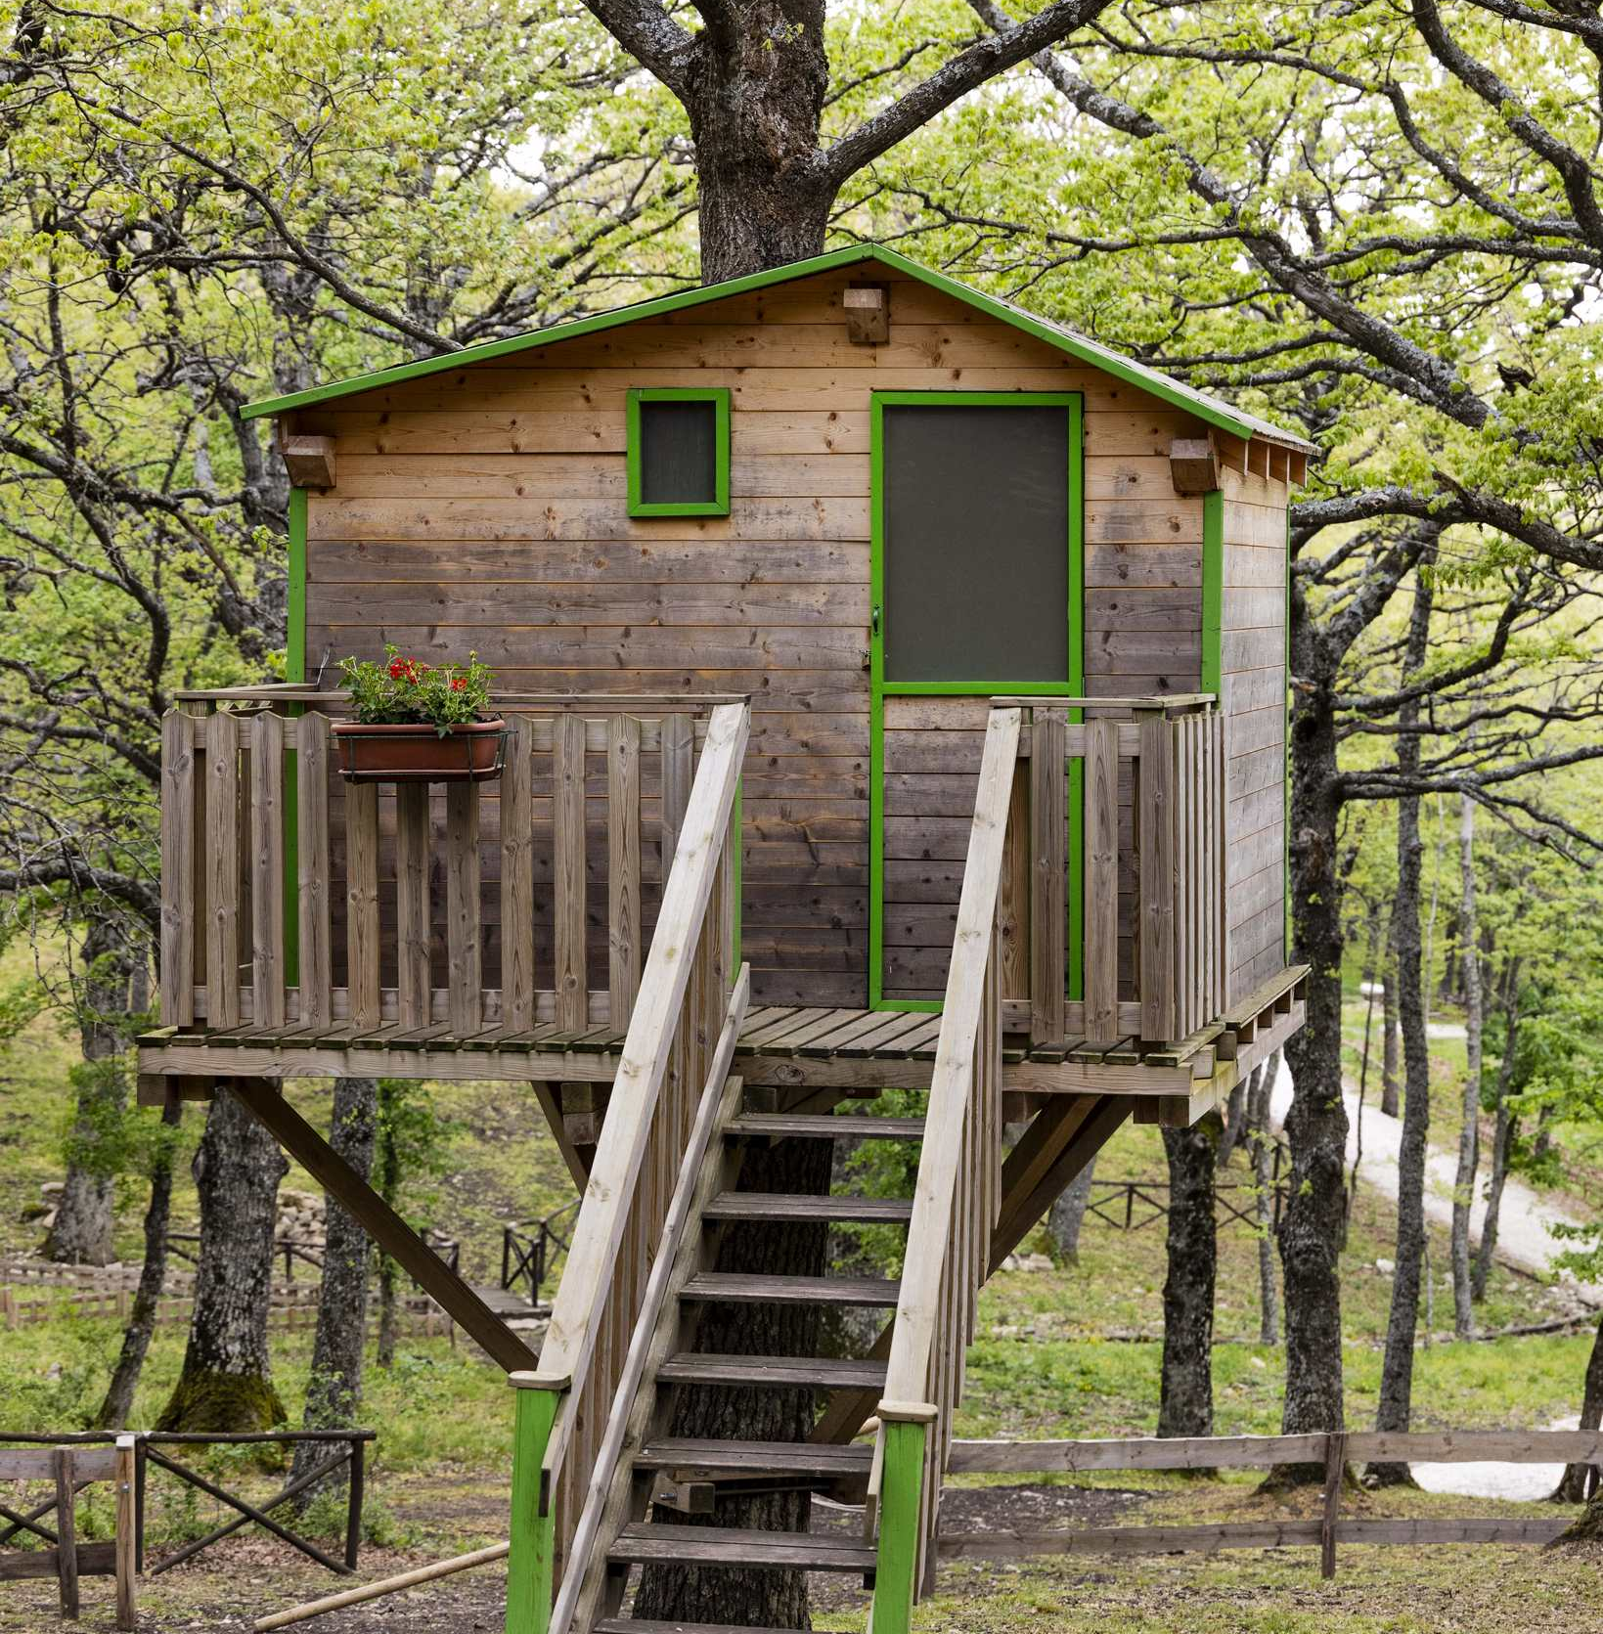
Core Contents
Supporting Local Community Use
Explore how well-designed multi-functional spaces can serve both tourists and local residents - hosting guest experiences by day and community events by night - creating meaningful connections and supporting local social and economic life.
Photo Credit: Meridaunia

Slide 30
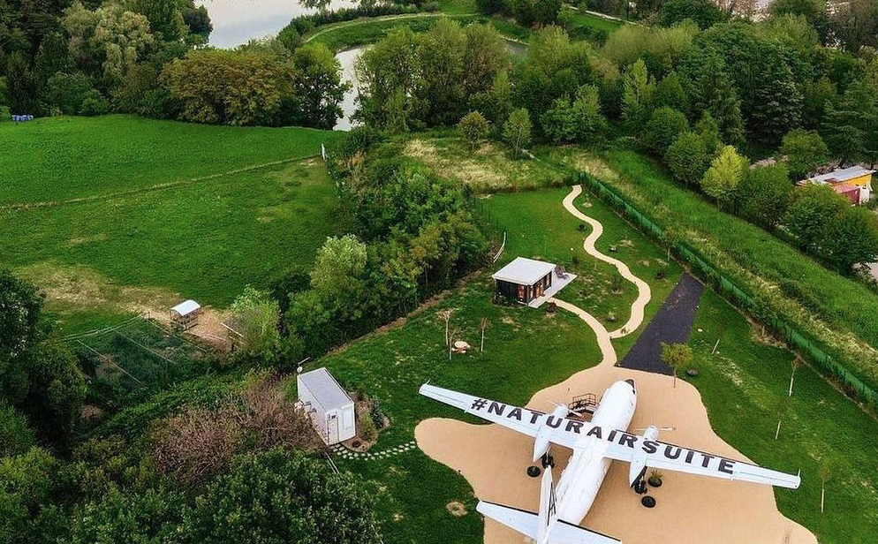
Building for Long-Term Sustainability and Community Benefit
04
Key Learning Area
Building for long-term sustainability and community benefit means going beyond short-term tourism profits to create accommodations that contribute lasting value to local environments and societies.
This approach considers the entire lifecycle of a building- from construction to daily operation and eventual renovation or repurposing. It involves selecting durable materials that age gracefully and require minimal maintenance, reducing the need for constant repairs or replacements. It also prioritizes partnerships with local artisans, builders, and suppliers, keeping economic benefits within the community.
Photo credit:
Natur Air Suite, Italy
30

Slide 31
04
Building for Long-Term Sustainability and Community Benefit
Key Learning Area
Sustainable building practices may include incorporating renewable energy sources, using water-saving systems, and designing spaces that minimize resource use without sacrificing comfort. Additionally, structures should be planned in harmony with the local landscape, avoiding overdevelopment and protecting natural habitats. By focusing on long-term sustainability, accommodation providers can ensure their business remains viable for decades, while creating opportunities for local employment, cultural preservation, and social cohesion. This strategy helps build resilience in rural or underrepresented regions, turning tourism into a tool for regenerative growth rather than extraction
31

Slide 32
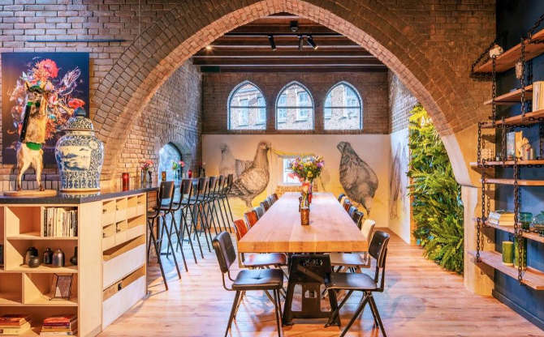
Core Contents
Photo credit:
BUNK Hotel AmsterPhoto Creditdam, Netherlands
Lifecycle Thinking in Construction and Operation
Building sustainably requires shifting from short-term development to lifecycle thinking. This involves considering the environmental, social, and economic impacts of a building from construction through decades of use.
Choosing durable, locally sourced, and low-maintenance materials - such as natural stone or reclaimed wood - reduces environmental impact while ensuring long-term resilience.
32

Slide 33
Core Contents
Lifecycle Thinking in Construction and Operation
Lifecycle thinking also includes the operational phase. Integrating renewable energy, water-saving systems, and energy-efficient technologies helps minimize the building’s footprint while cutting ongoing costs. These solutions are not only eco-friendly but also boost financial sustainability.
Finally, designing for adaptability - like creating spaces that can evolve with changing tourism trends - protects your investment and prevents infrastructure from becoming obsolete. This long-term vision ensures that accommodation remains relevant, useful, and beneficial to both visitors and the local community.
33

Slide 34
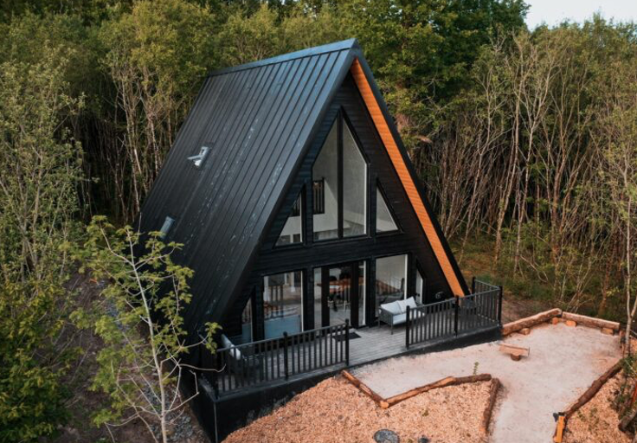
Core Contents
Photo Credit:
Drumhierny, Woodland, Leitrim, Ireland
Community-Centered Design and Local Economic Integration
Long-term sustainability is not just about buildings - it’s about people and place. Community-centered design means creating accommodation that aligns with the needs, values, and cultural identity of the local population. This could involve using traditional architectural styles, working with local artisans, or incorporating cultural narratives into the guest experience. By doing so, you preserve intangible heritage and give guests an authentic, place-based encounter.
34

Slide 35
Core Contents
Community-Centered Design and Local Economic Integration
Beyond aesthetics, local economic integration is crucial. Sustainable tourism businesses can prioritize hiring local staff, sourcing supplies from local producers, and collaborating with community enterprises such as guides, craftspeople, or farmers. For example, breakfast menus can feature locally grown products, or guest packages might include tours led by local storytellers or artisans. This model ensures that tourism revenue circulates within the community, creating shared prosperity rather than external profit extraction.
By fostering partnerships with local stakeholders and respecting the cultural and environmental limits of the destination, accommodation providers contribute to community resilience. They help prevent over-tourism, gentrification, or loss of local character—turning tourism into a tool for empowerment and sustainable regional development.
35

Slide 36

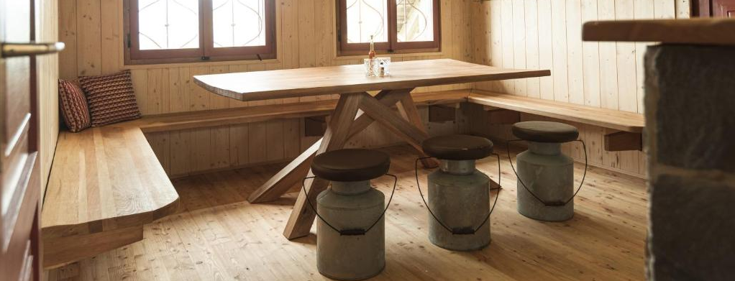
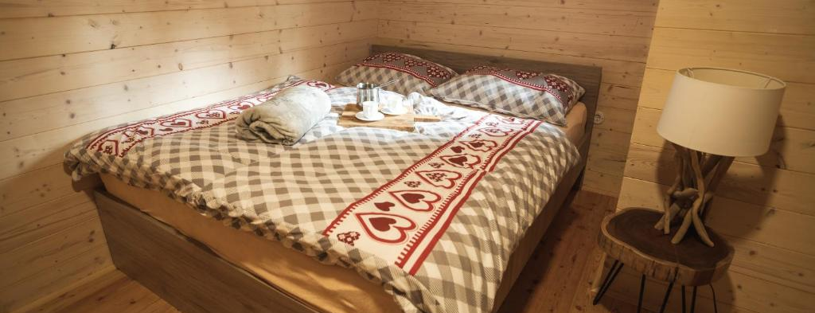

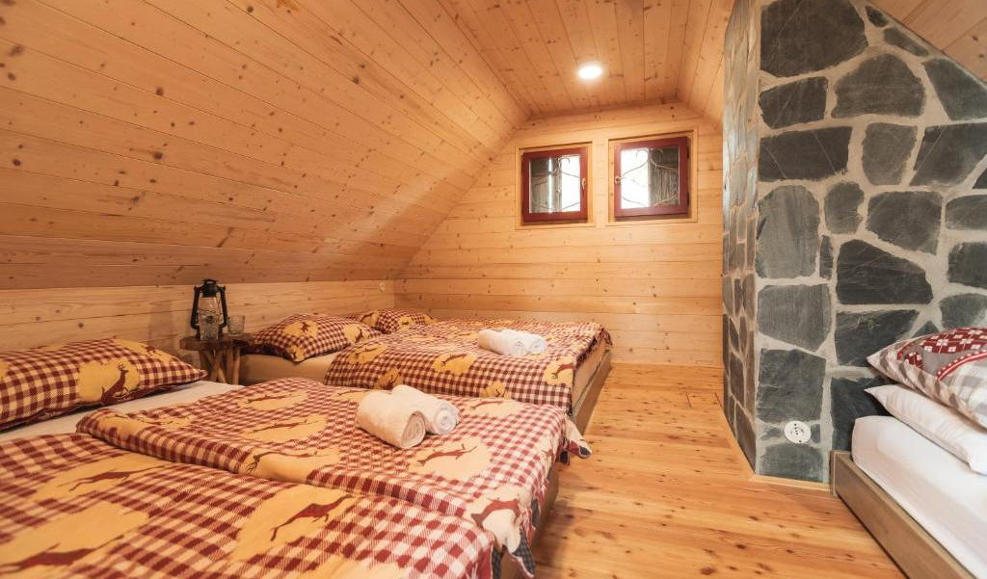
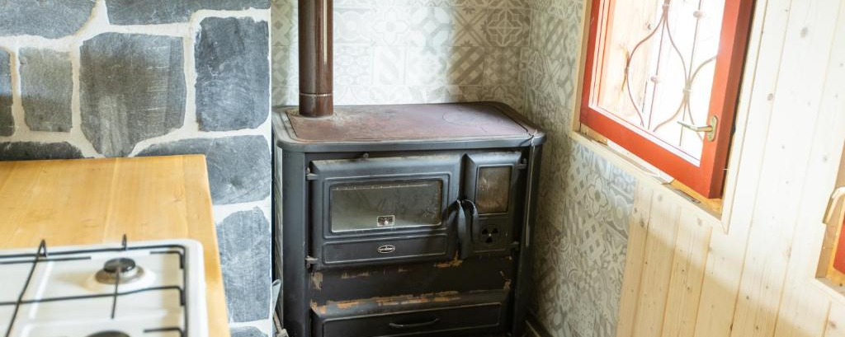
SLOVENIA
Photo Credit: Chalet Rušovc, Slovenia
36

Slide 37
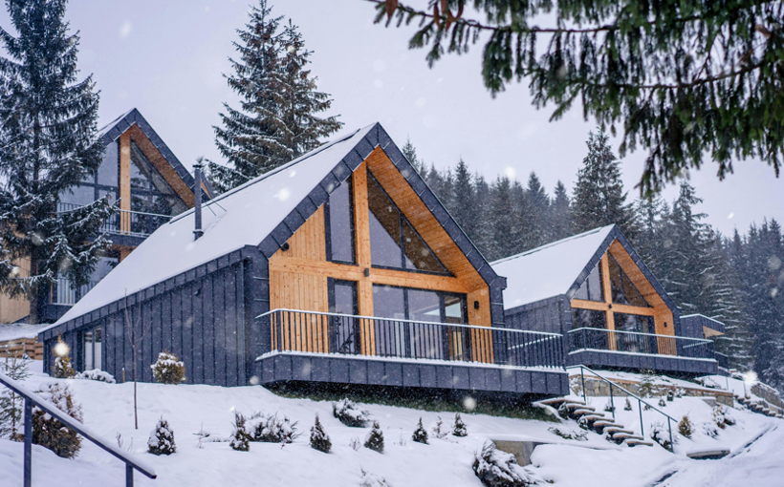
Assessing and Repurposing Existing Buildings
04
Key Learning Area
Choosing eco-friendly, locally sourced, and recycled materials reduces environmental impact while fostering a sense of place. Using materials like local stone, reclaimed wood, or natural earth not only cuts transportation emissions but also creates accommodations that reflect the culture and traditions of the region. This authenticity enhances the guest experience while supporting local economies and artisanal trades.
Source: United Nations Environment Programme (UNEP). (2021).
Building Materials and the Climate: Constructing a New Future. UNEP.
Link: https://www.unep.org/resources/report/building-materials-and
-climate-constructing-new-future
37

Slide 38
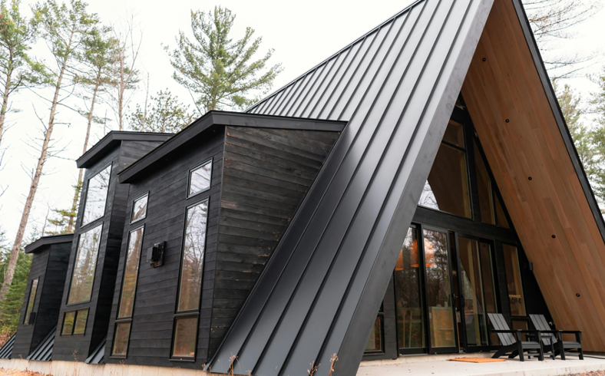
04
Assessing and Repurposing Existing Buildings
Key Learning Area
Incorporating passive design elements - such as optimal building orientation, natural ventilation, and thermal mass materials - significantly reduces energy consumption for heating and cooling. Smart layouts, shading techniques, and bioclimatic planning help maintain indoor comfort while minimizing reliance on mechanical systems, lowering long-term costs and environmental impact.
Source: International Energy Agency (IEA) & United
Nations Environment Programme (UNEP). (2013).
Technology Roadmap: Energy Efficient Building Envelopes."
Link: https://www.iea.org/reports/technology-roadmap-energy-efficient
-building-envelopes
38

Slide 39
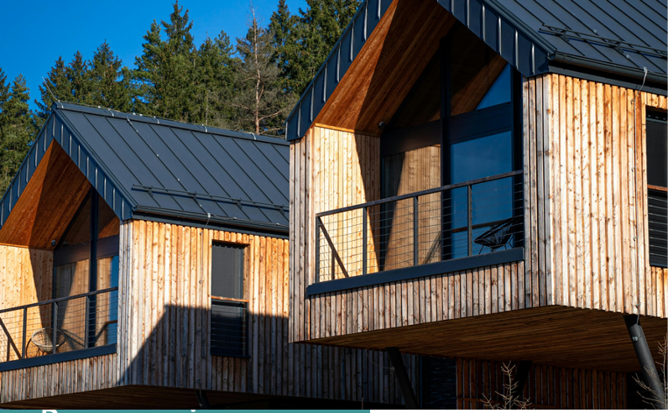
04
Assessing and Repurposing Existing Buildings
Key Learning Area
Creating multi-functional spaces allows accommodation providers to adapt to evolving guest needs and local opportunities. By designing spaces that can host both tourism-related activities and community events, accommodation becomes a hub for local interaction, enhancing social value and economic resilience. This flexibility also protects the business from market changes by offering diverse use cases.
Source: UNWTO (World Tourism Organization). (2020).
"Tourism and Rural Development."
Link: https://www.e-unwto.org/doi/book/10.18111/9789284422173
39

Slide 40
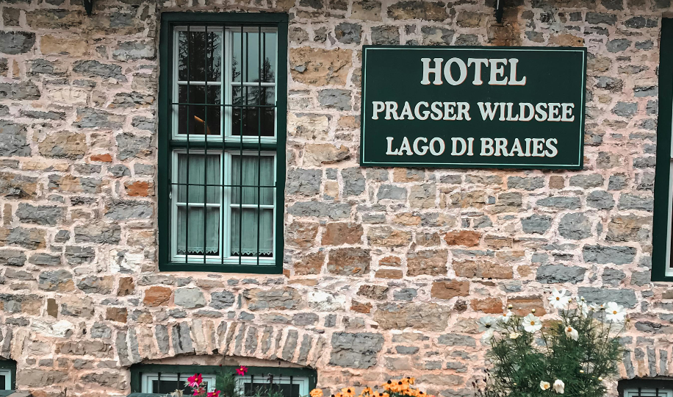
04
Assessing and Repurposing Existing Buildings
Key Learning Area
Building for long-term sustainability involves more than green construction—it requires considering the full lifecycle of the building. Durable materials, renewable energy systems, and water conservation technologies reduce operational costs over time. Planning for future adaptability ensures the accommodation remains relevant as tourism trends evolve, safeguarding both the investment and the community’s cultural and environmental assets.
Source: TOWARDS A CIRCULAR ECONOMY IN THE BUILT ENVIRONMENT
Link: https://build360.ie/wp-content/uploads/2023/07/Circular-Buildings- Coalition-Report.pdf
40

Slide 41
How to Build a Net Zero Hotel
Click to Watch Video
Name:
Hotel Svart, Norway
Description:
This video by Tomorrow’s Build explores the
innovative design of Hotel Svart in Norway,
one of the world’s first energy-positive hotels.
The video explains how the project integrates local materials, passive energy strategies, and flexible architectural solutions to minimise environmental impact while offering high-end guest experiences. It provides insights into the construction methods and sustainability practices that make the hotel a model for net-zero hospitality development.
Photo Credit: Meridaunia

Slide 42
How to Build a Net Zero Hotel
Click to Watch Video
Apply to Topic 1:
This video supports Section 2: Better Building Choices - Materials, Layout & Flexibility. It demonstrates how strategic design choices - such as passive solar orientation, eco-friendly material use, and modular construction - can create accommodation that is both luxurious and environmentally responsible.
Photo Credit: Meridaunia

Slide 43
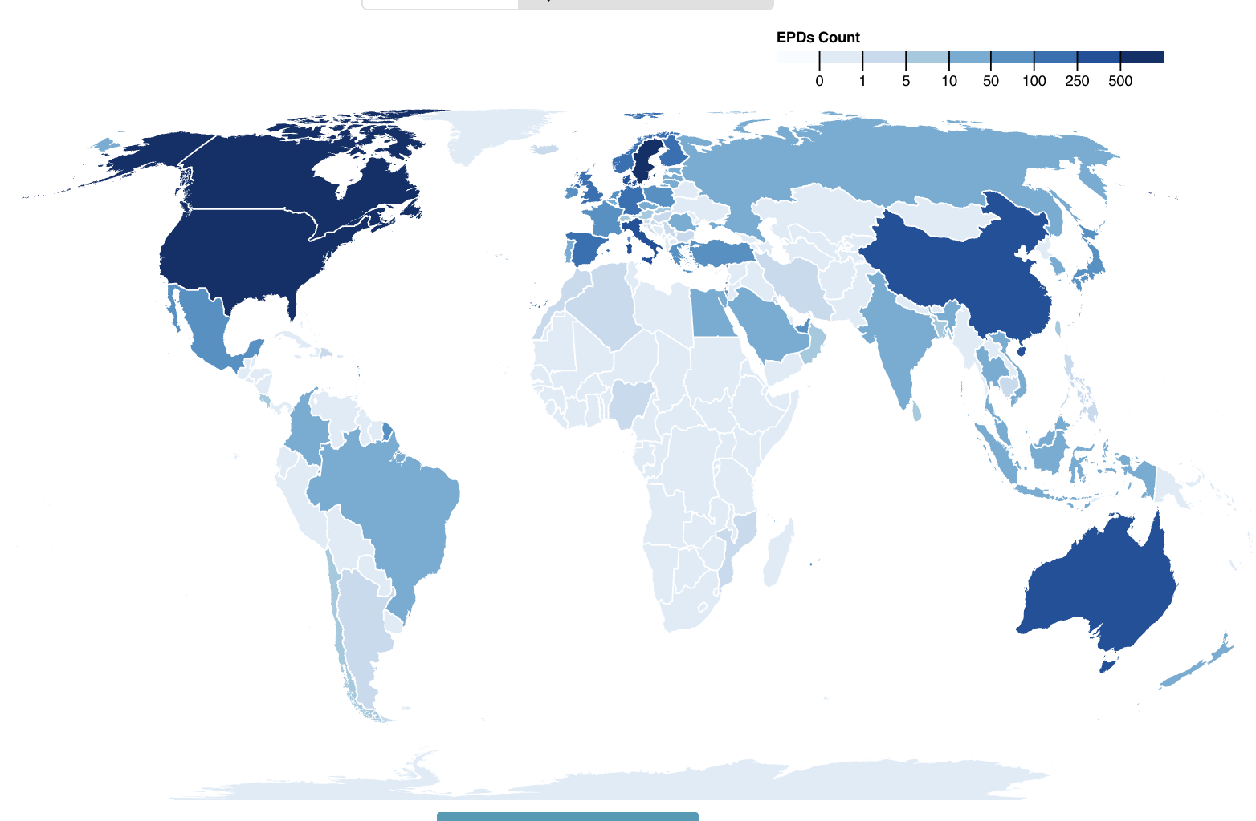
Digital Tool: EC3 (Embodied Carbon in Construction Calculator)
Click to Download the tools
EC3 is a free digital platform developed by Building Transparency that helps designers, builders, and accommodation developers estimate and reduce the embodied carbon in construction materials.
It provides real-time data on the environmental impact of materials such as concrete, steel, wood, and insulation, allowing users to make informed choices about low-carbon alternatives during the design and procurement phases

Slide 44
Digital Tool: EC3 (Embodied Carbon in Construction Calculator)
Click to Download the tools
EC3 is highly relevant for selecting sustainable building materials and planning for eco-friendly construction.
Users can compare suppliers, assess the carbon footprint of different options, and prioritise local and recycled materials - supporting both environmental goals and authentic, place-based design

Slide 45
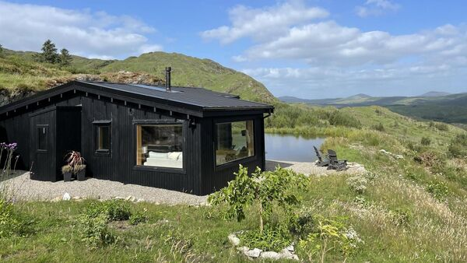
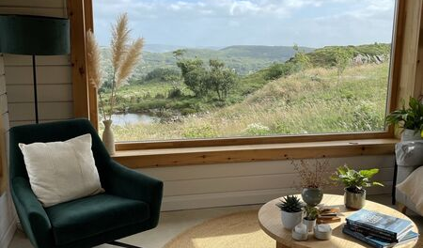

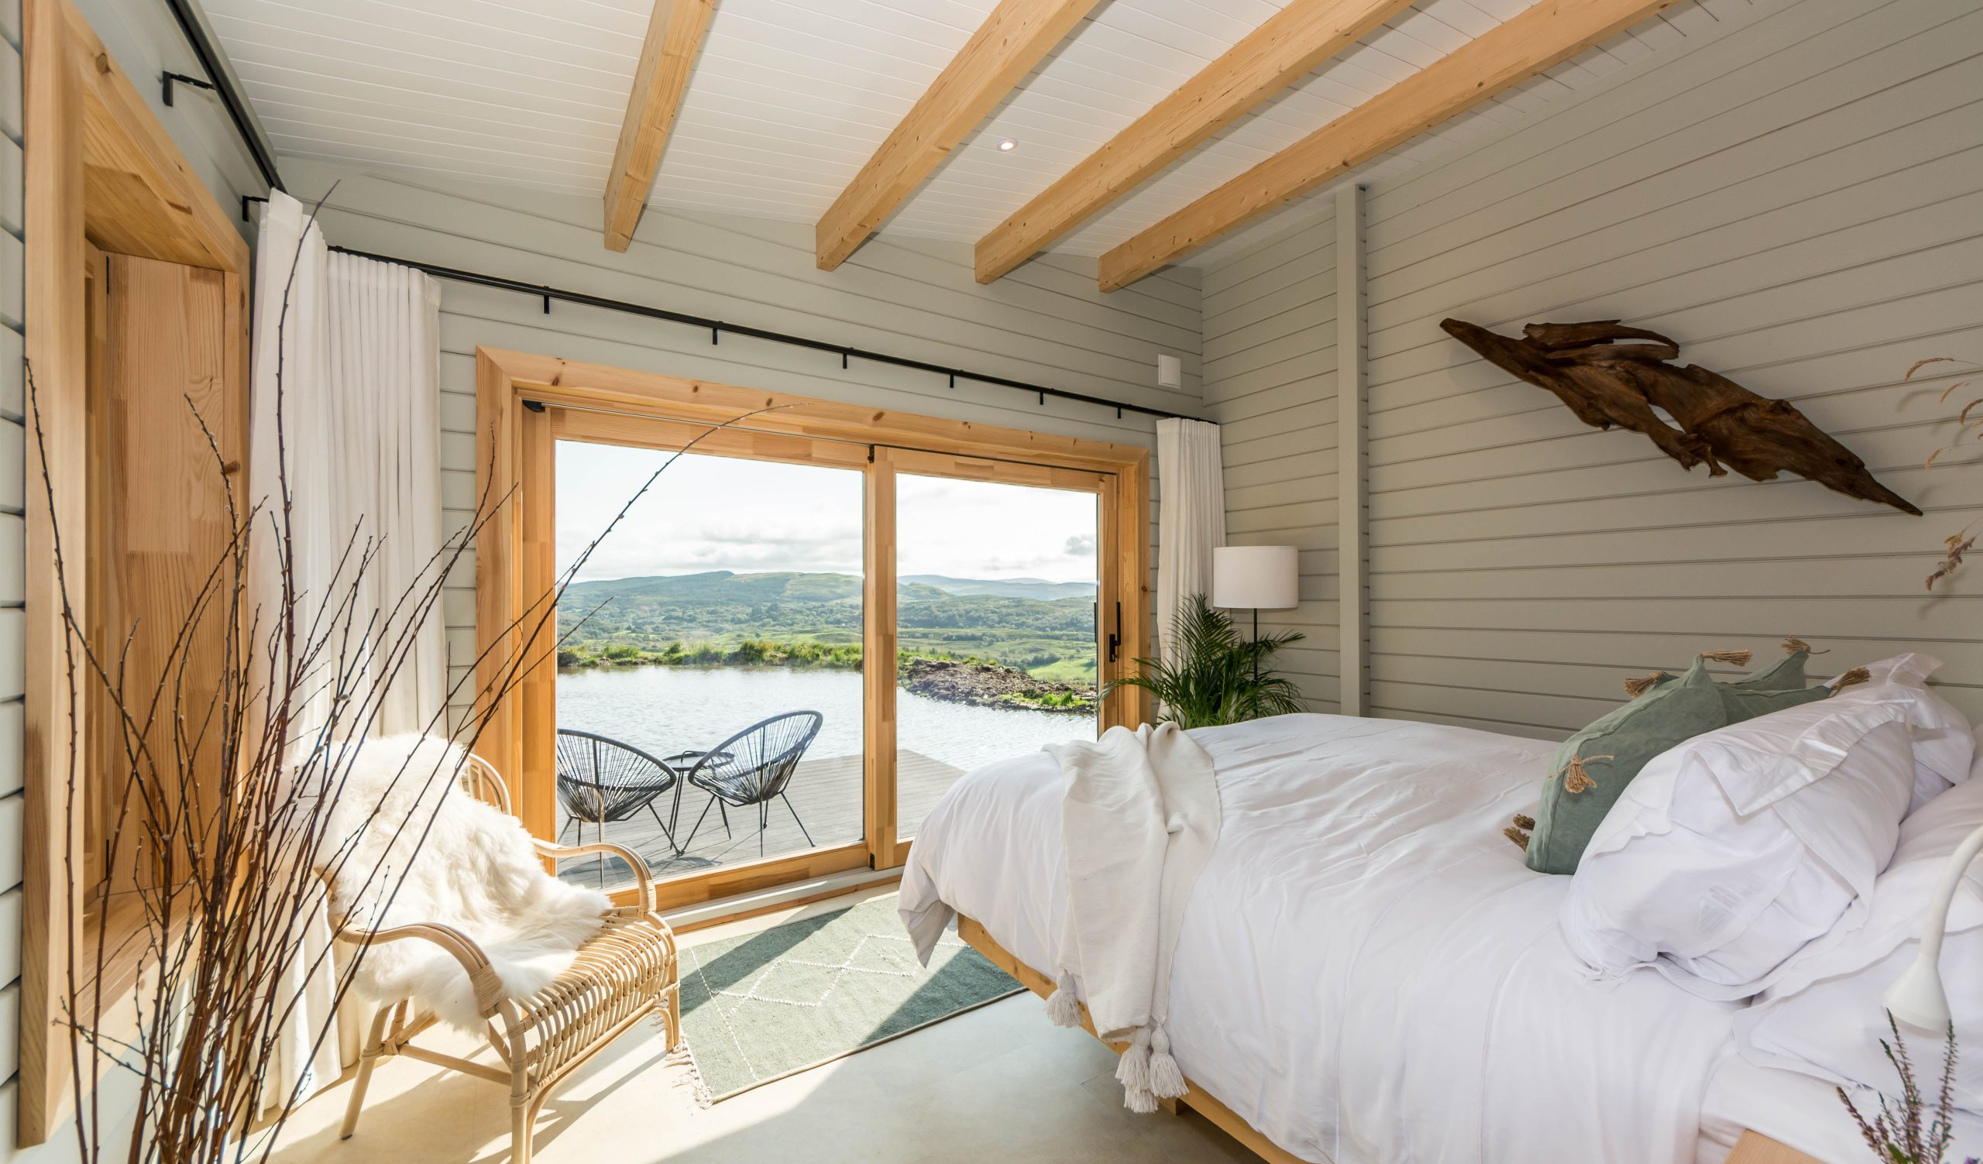
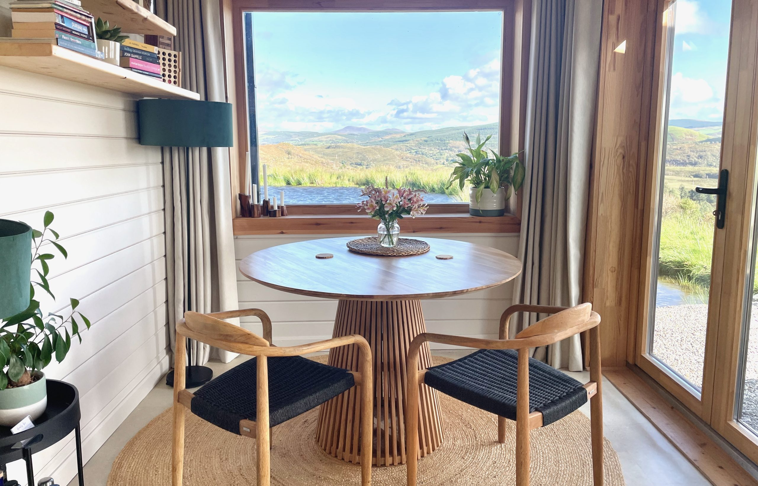
IRELAND
Photo Credit: The Hidden Haven, Cork, Ireland
45

Slide 46

Practical Exercise: Design a Sustainable Guest Unit Concept
Objective:
Apply the principles of eco-friendly building, passive design, and flexible space planning to create a concept for a small, sustainable accommodation unit.
Steps:
Choose Materials:
Select two local or recycled materials and explain why they are suitable for your chosen region (climate, heritage, sustainability).
Plan for Passive Comfort:
Sketch or describe how you would position windows, doors, and shading to maximize natural light and airflow while reducing energy needs.
46

Slide 47
Practical Exercise: Mapping Adaptive Reuse Potential in Your Community
Steps:
Include Multi-Use Space:
Identify one area that serves both guests and community use (e.g., shared kitchen doubling as a workshop space).
Reflect on Sustainability:
Write 3–4 sentences explaining how your design minimizes environmental impact and supports local culture.
This quick exercise helps you think practically about how material choices, layout, and flexibility contribute to sustainable tourism accommodation
47

Slide 48
Additional Reading
Name | Description
Routledge Handbook of Sustainable Hotel and Tourism Management Miguel Angel Gardetti & Ana Laura Torres | This handbook offers insights into sustainable building practices for tourism, including eco-materials, energy efficiency, and bioclimatic architecture. It highlights case studies of hotels and accommodations integrating green design worldwide. https://www.perlego.com/book/1556035/sustainability-in-hospitality-how-innovative-hotels-are-transforming-the-industry-pdf
Bioclimatic Architecture Guidelines European Environmental Agency | Practical guide on using local climate and natural resources for building design. Focuses on orientation, materials, ventilation, and energy efficiency. https://smart-cities marketplace.ec.europa.eu/sites/default/files/pimes_guide_for_bioclimatic_design.pdf
48

Slide 49
Additional Reading
Name | Description
Slow Tourism and Sustainable Spaces of Hospitality Simone Fullagar, Kevin Markwell | Explores how small-scale accommodations can design for sustainability, guest well-being, and cultural connection, emphasizing space design and community benefit. https://www.academia.edu/1616206/Fullagar_S_Markwell_K_and_Wilson_E_eds_2012_Slow_Tourism_Experiences_and_Mobilities_Channel_View_Bristol_Chapter_One_
49

Slide 50
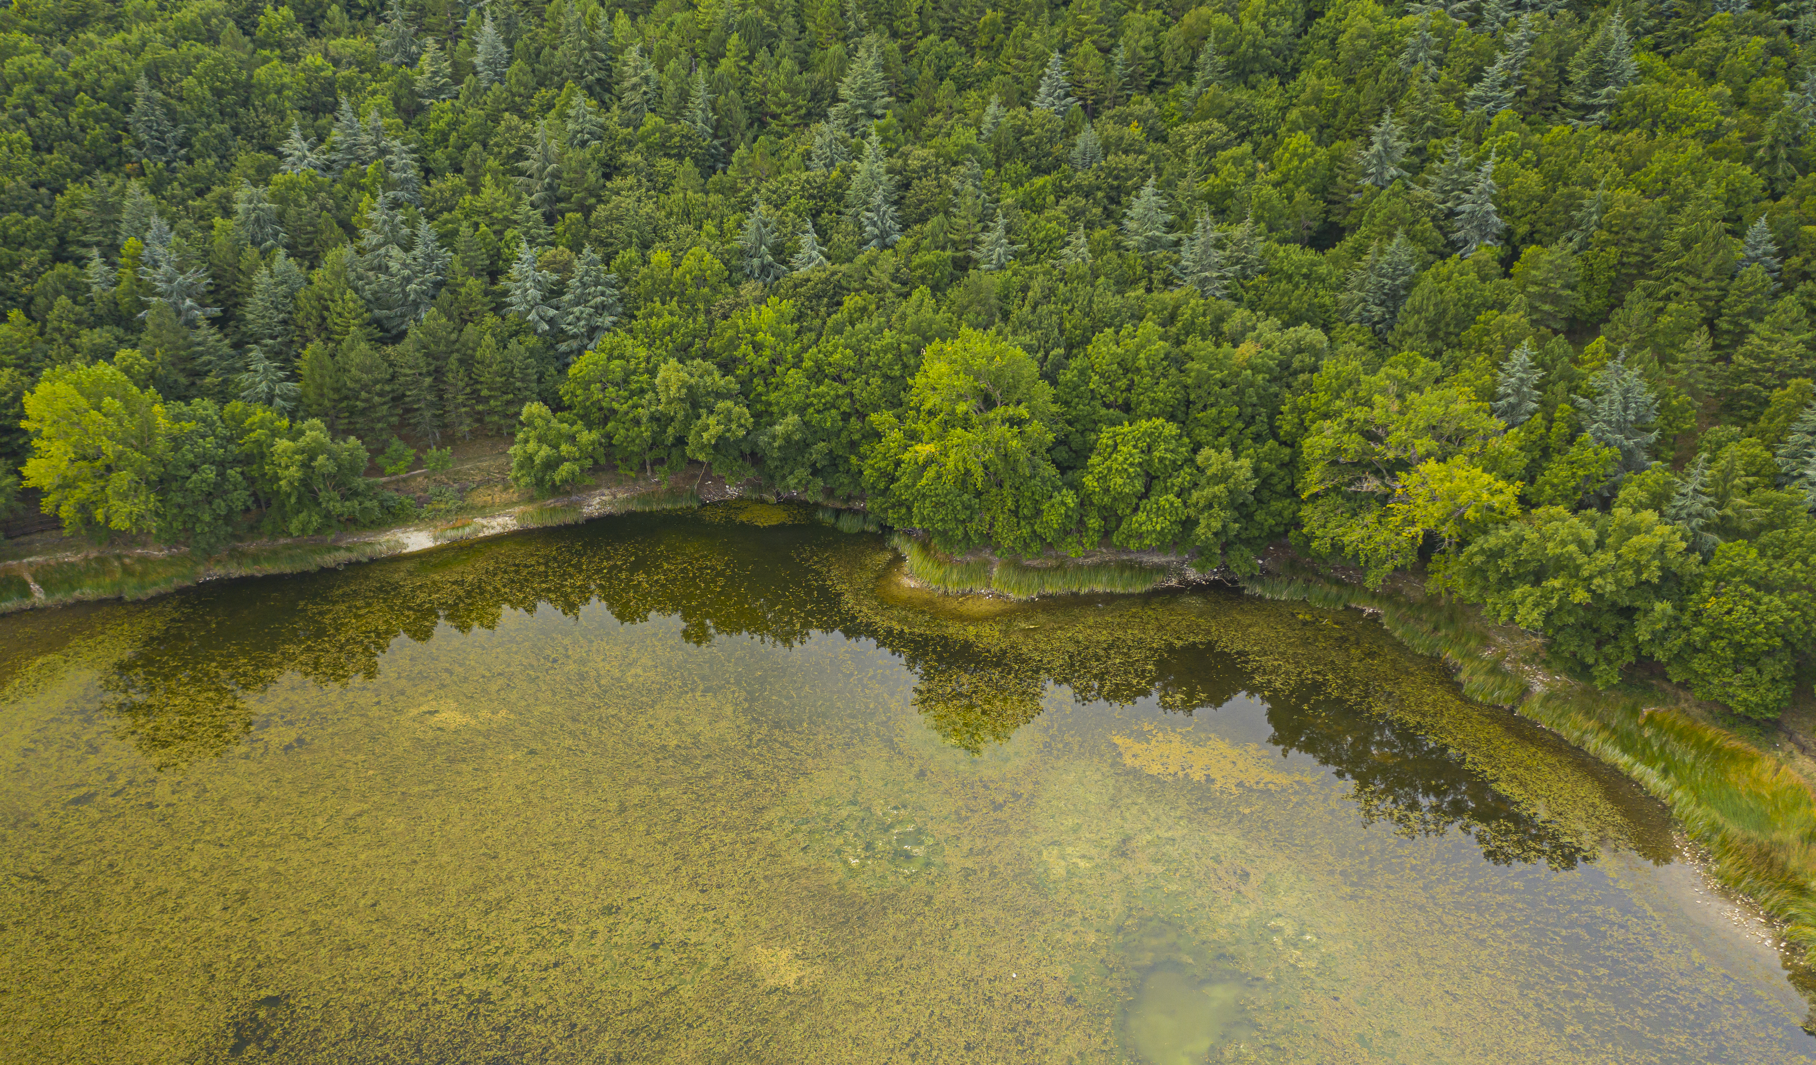
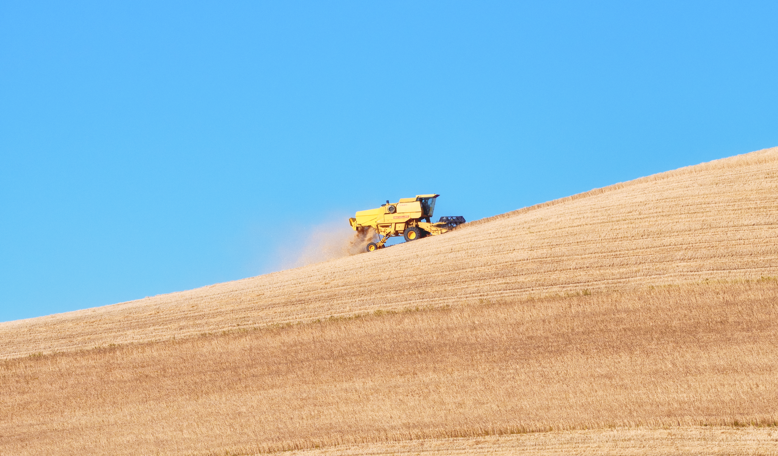
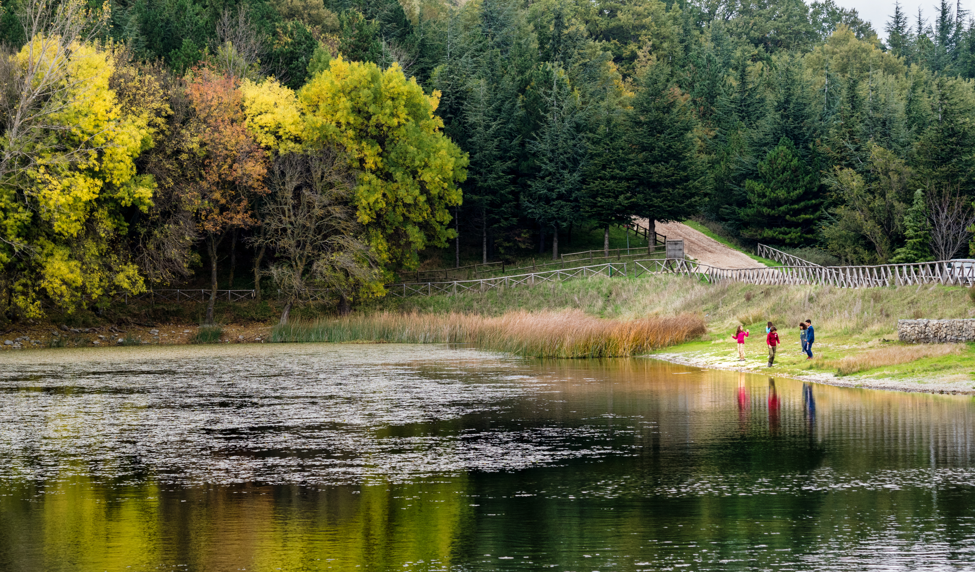
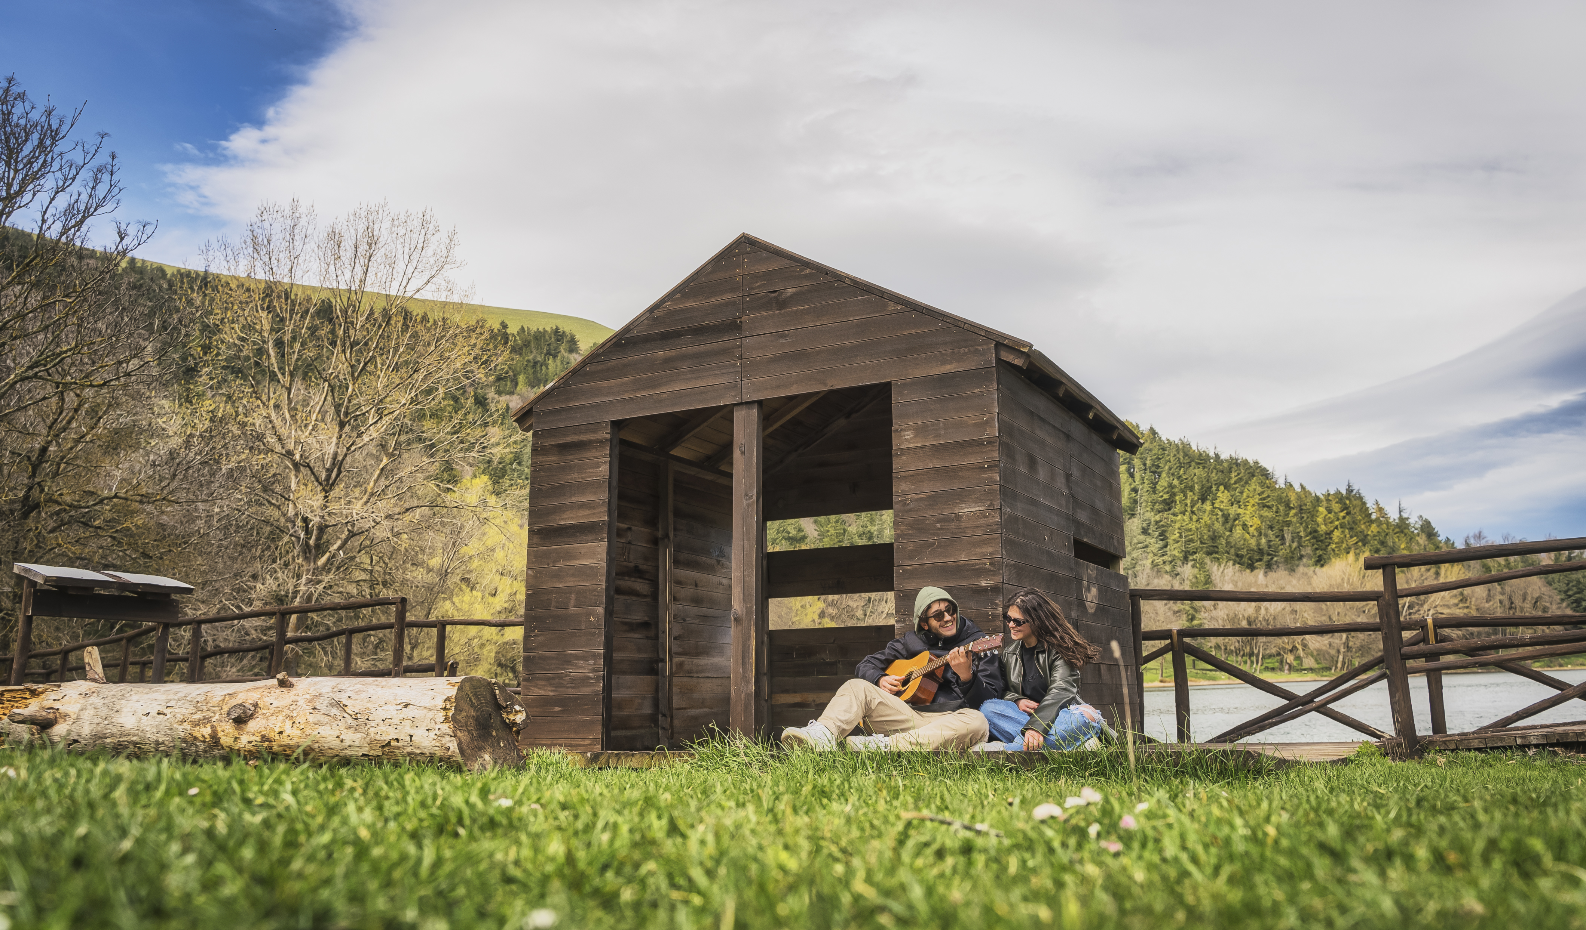
50

Slide 51
Well Done
Module 3 (Part 3)
Section 3: Right-Sized Stays That Make a Local Impact
You have Completed… Module 3 (Part 2)
Section 2: Better Building Choices — Materials, Layout & Flexibility
Next is…

